Slide 1
Solving it in 2 runs

Slide 2
Homework 4
Solving the exercise in two separate runs:
Run 1

Slide 3
Run 1

Slide 4
…SIMFLOR_2017 \ STANDSSIM \ GLOBULUS
Inputs generated using the interface
…SIMFLOR_2017 \ STANDSSIM
Input generated using the interface
Run 1
Please note that the content of these files is updated at each simulation run
Thus
If you wish to keep them you have to same them under different names
…SIMFLOR_2017 \ STANDSSIM \OUTPUT
simulation run OUTPUT

Slide 5
…SIMFLOR_2017 \ EXAMPLES
Default inputs
Run 1
… (?)
FMA inputs – up to you to decide where you save them

Slide 6
Run 2
Please note that if you wish to change FMA during the simulation you have both FMA files ready
Make sure
These are imported in the same step

Slide 7
Please note that an id is added to the name of each file (41 and 42) indicating the order by which the files were selected into the silviculture window in the first tab
Thus
Make sure you select the right file for each prescription cycle
Run 2

Slide 8
Run 2

Slide 9
Run 1
… SIMFLOR_2017 \ STANDSSIM \ ini_STANDSSIM.csv
… SIMFLOR_2017 \ STANDSSIM \ GLOBULUS \ input_stand.csv
… SIMFLOR_2017 \ STANDSSIM \ GLOBULUS \ input_clima.csv
… SIMFLOR_2017 \ STANDSSIM \ GLOBULUS \ input_presc.csv

Slide 10
Run 2
… SIMFLOR_2017 \ STANDSSIM \ ini_STANDSSIM.csv
… SIMFLOR_2017 \ STANDSSIM \ GLOBULUS \ input_stand.csv
… SIMFLOR_2017 \ STANDSSIM \ GLOBULUS \ input_clima.csv
… SIMFLOR_2017 \ STANDSSIM \ GLOBULUS \ input_presc.csv

Slide 11
Solving it in a single run

Slide 12
Solving the exercise in a single run:
… SIMFLOR_2017 \ STANDSSIM \ ini_STANDSSIM.csv
… SIMFLOR_2017 \ STANDSSIM \ GLOBULUS \ input_stand.csv
… SIMFLOR_2017 \ STANDSSIM \ GLOBULUS \ input_clima.csv
… SIMFLOR_2017 \ STANDSSIM \ GLOBULUS \ input_presc.csv

Slide 13
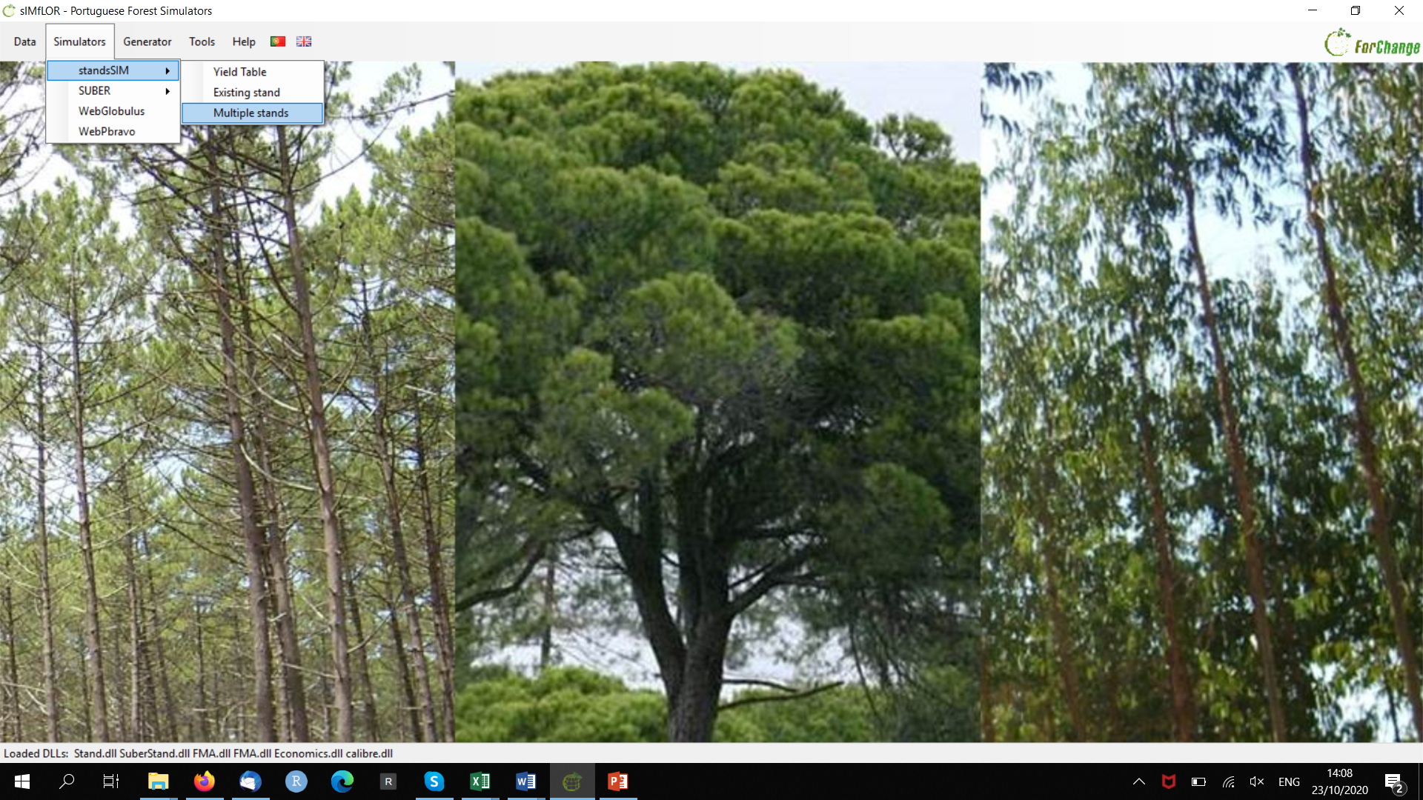
Please note that graphs are not available for “Multiple Stands”’ runs

Slide 14
NPV is used in investment planning to analyze the profitability of a projected investment. You can think of it as today’s value of the expected cash-flow minus today’s values of invested cash ​
Sum of the net present values (NPV) by the end of the 60yrs:
A NPV>0 indicates that the projected earnings generated by an investment (in present €) exceeds the anticipated costs (also in present €).
Where:
Rt = (expenses-revenue) in each simulation yr
t = simulation yr
i = discount rate
n = planning horizon (60)
1 plantation + 5 coppices (1 FMA)
2x (1 plantation + 2 coppices) (2 FMAs)
It is assumed that:
NPV>0 will be a profitable investment NPV<0 will result in a net loss.
This concept dictates that only investments with positive NPV values should be considered. However, most forestry investments have a NPV<0
Sum of the volume harvested after 6 rotations of 10 yrs were completed

Slide 15
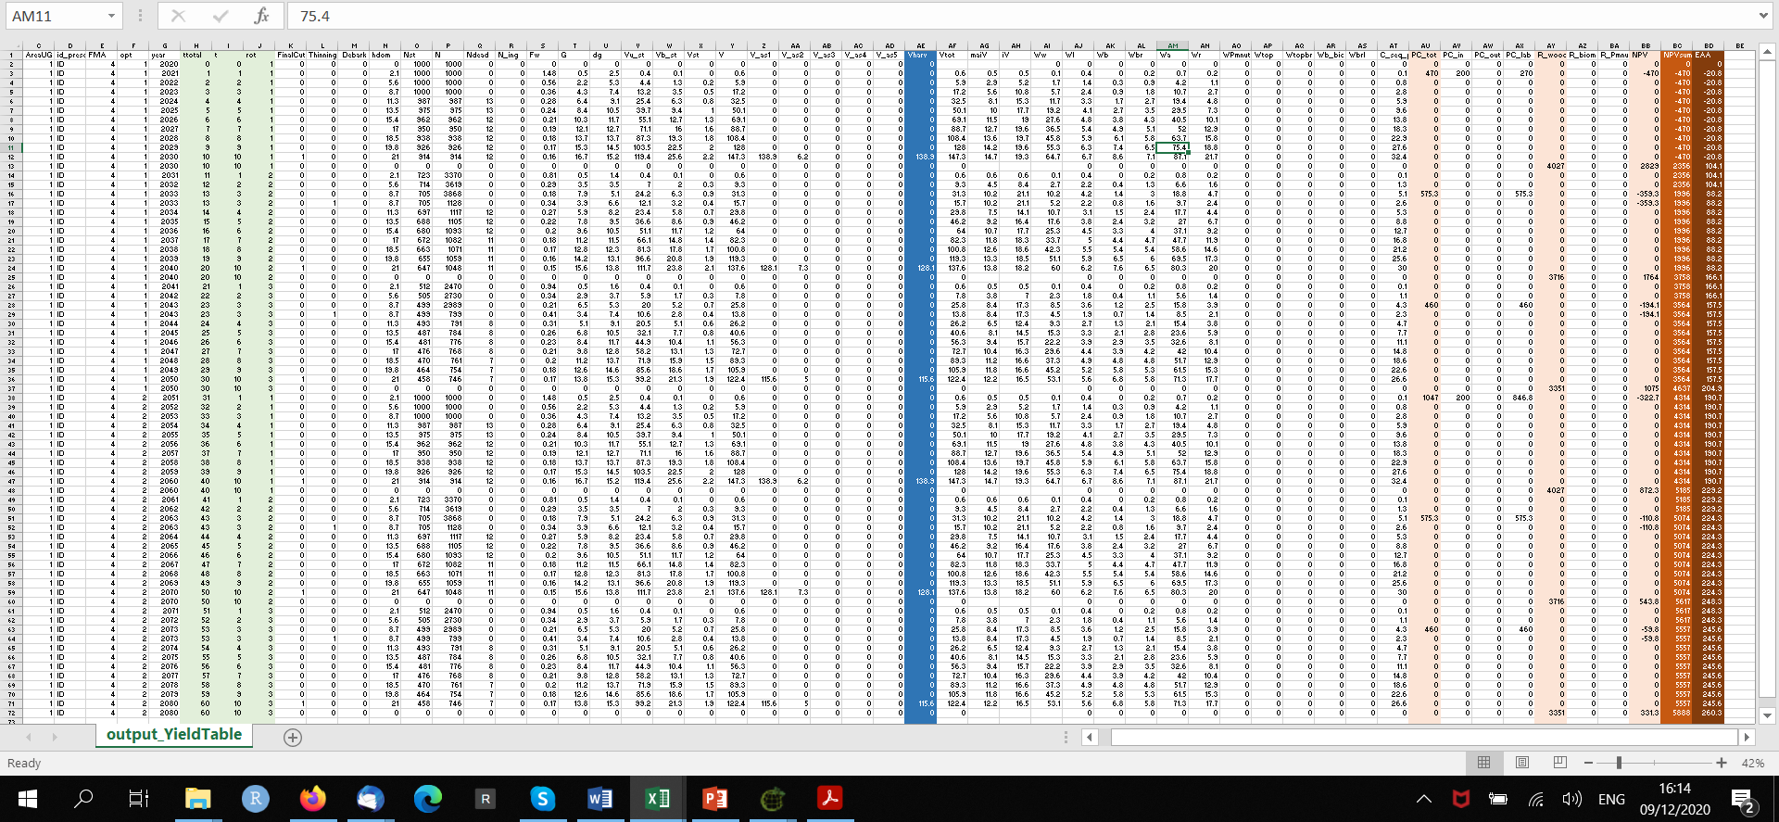
The information summarized in the black window can also be found in the output_yield table.csv, where for each year of simulation, age and rotations, you can find the volume harvested by the end of each rotation and the expenses and revenues obtained each year, that are used to calculate NPV and EAA (see explanation on the last slide) Final values are the ones resulting from the sum by the end of the simulation period.

Slide 16
The information summarized in the black window can also be found in the output_yield table.csv, where for each year of simulation, age and rotations, you can find the volume harvested by the end of each rotation and the expenses and revenues obtained each year, that are used to calculate NPV and EAA (see explanation on the next slide) Final values are the ones resulting from the sum by the end of the simulation period.
production costs for yr 1, 1st cycle (plantation)
Looking at the production costs for each plantation you could have easily detected if the stump destruction cost was being accounted for, or not.
(most of you missed it and failed to simulate it because you imported both FMAs in separate steps
production costs for yr 1, 4th cycle (replantation)

Slide 17
In this exercise you were asked to compare 2 investment options that had the same duration (60yrs).
However when the investments under comparison have different time-spans NPV is not applicable and we can use EAA instead
$$NPV=\sum_{t=1}^{n}{\frac{\left(E_{t}−R_{t}\right)}{{\left(1+i\right)}^{t}}}$$
$$EAA=\frac{\left(i_{}NPV\right)}{\left(1−{\left(1+i\right)}^{−n}\right)}$$
consider two projects:
One has a 30-year term and an NPV of 500€.
The other has a 60 term and an NPV of 800€.
Both projects are discounted at a 6 percent rate.
The EAA of each project is:
EAA Project one = (0.06 x 500€) / (1 - (1 + 0.06)⁻³⁰ ) = 36.3€
EAA Project two = (0.06 x 800€) / (1 - (1 + 0.06)⁻⁶⁰ ) = 49.5€
Where:
EAA = equivalent annuity cash-flow
NPV = net present value
i = interest rate per period
n = number of periods

