Slide 1
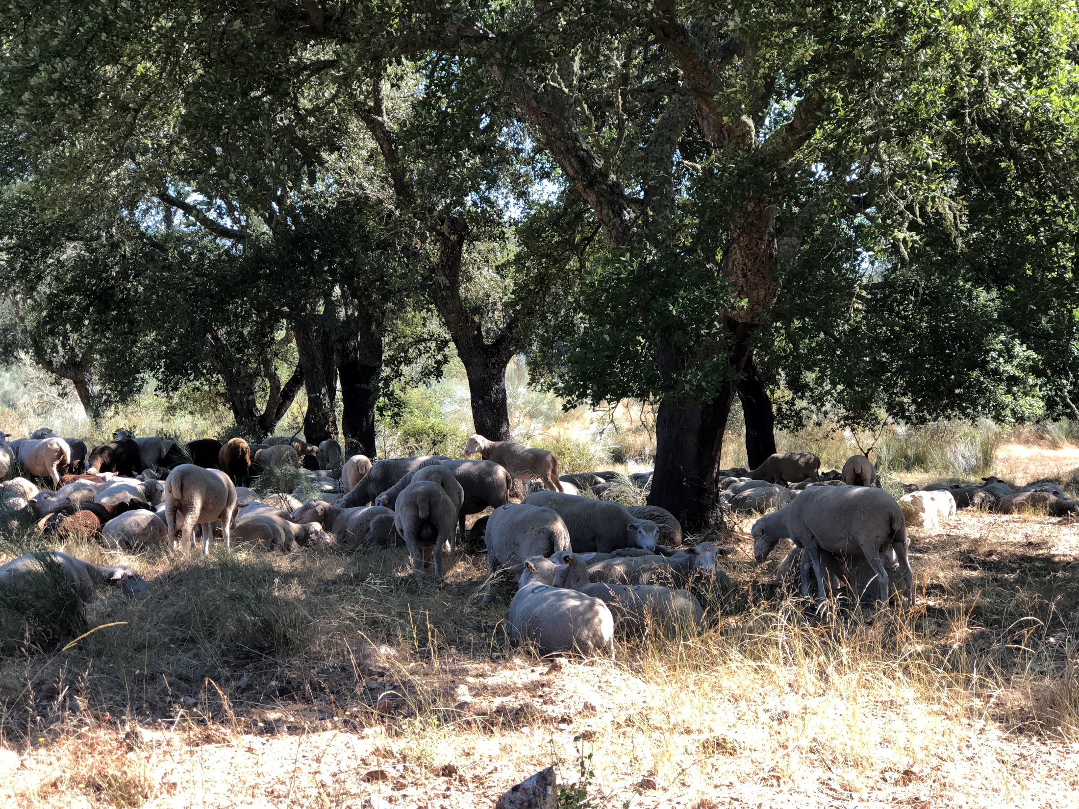
Statistics applied to Forest Modeling with the support of R

Slide 2
Instaling the R and the RStudio

Slide 3
Installing the R
If you already have the R software installed in your computer, please skip to the “installation of R studio” or to “starting R”
Go to the R website www.r-project.org and download the software at the CRAN (Comprehensive R Archive Network) mirrors link

Slide 4
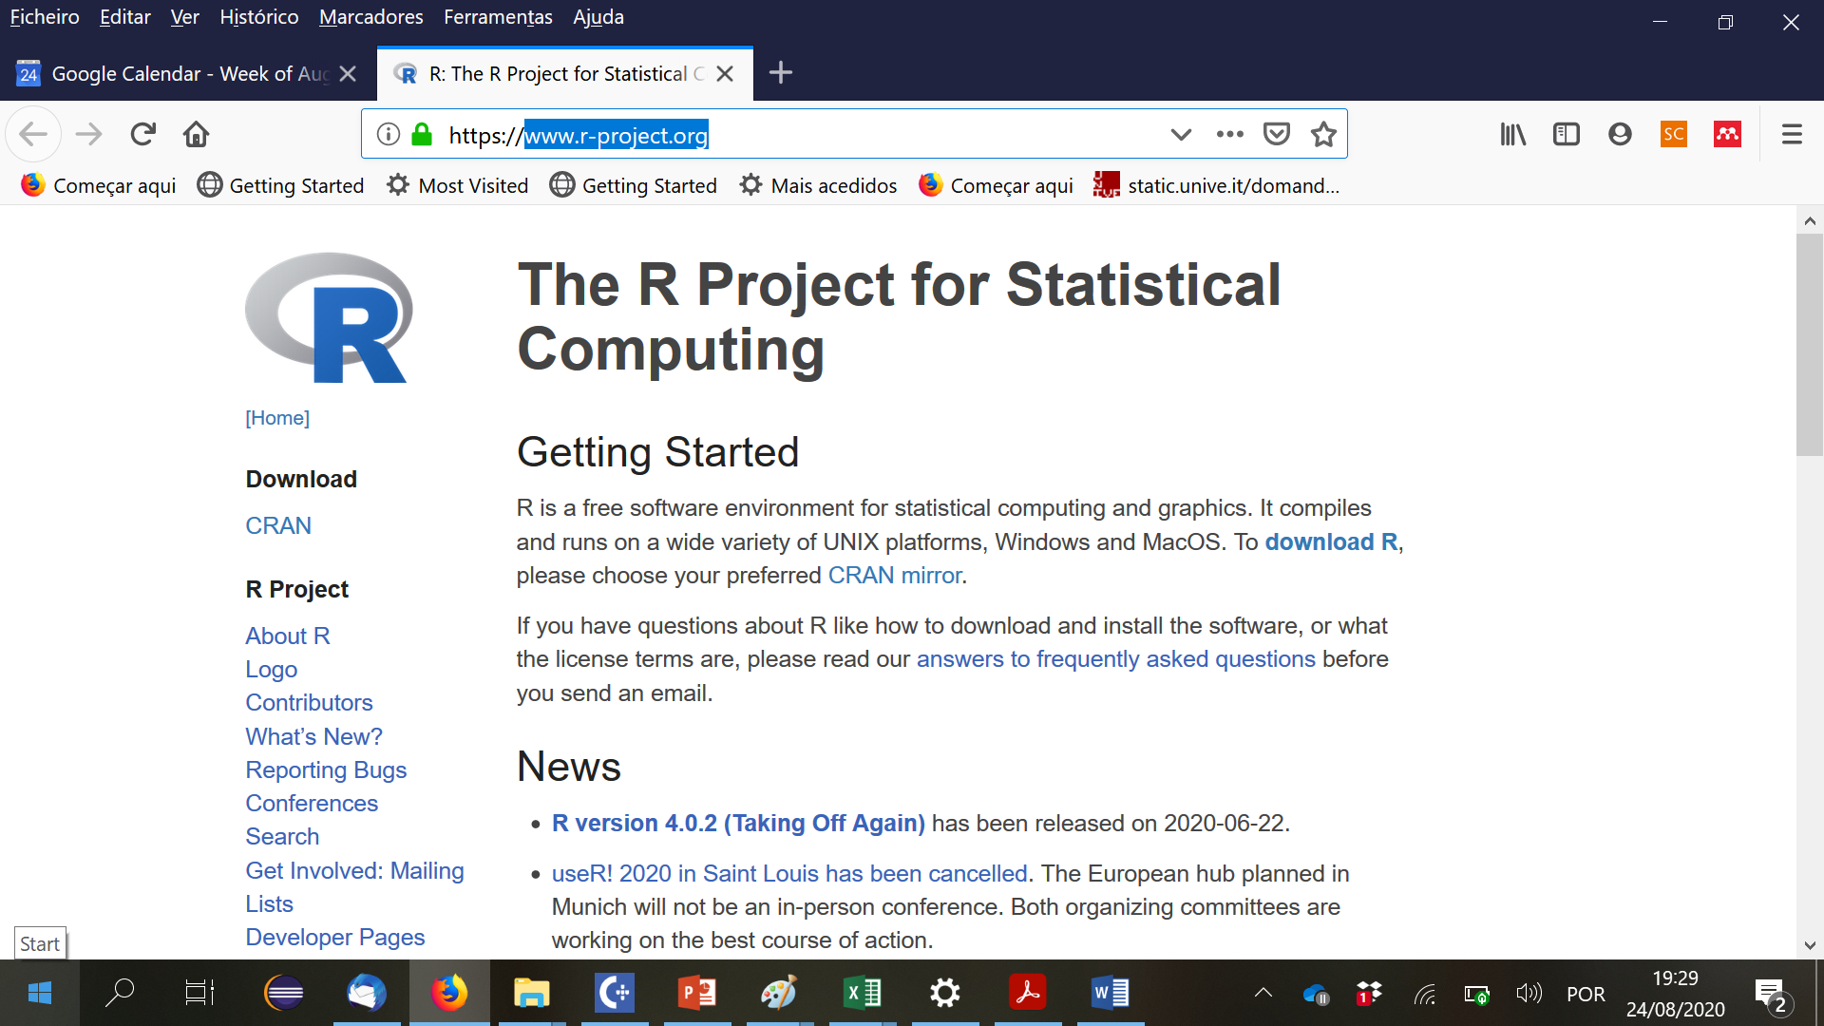

Slide 5
Installing the R
If you already have the R software installed in your computer, please skip this slide
Go to the R website www.r-project.org and download the software at the CRAN (Comprehensive R Archive Network) mirrors link
When you click on the CRAN link, you will be shown a list of network servers all over the planet. Just select one and follow the instructions for installation
Note that you can find several support material in the R website, just explore it when needed

Slide 6
Installing the RStudio
RStudio is an integrated development environment (IDE) for R
It includes a console, syntax-highlighting editor that supports direct code execution, as well as tools for plotting, history, debugging and workspace management
Download and install RStudio at
  https://www.rstudio.com/products/rstudio/download/
Scroll down to “Installers for Supported Platforms” near the bottom of the page
Click on the download link corresponding to your computer’s operating system

Slide 7
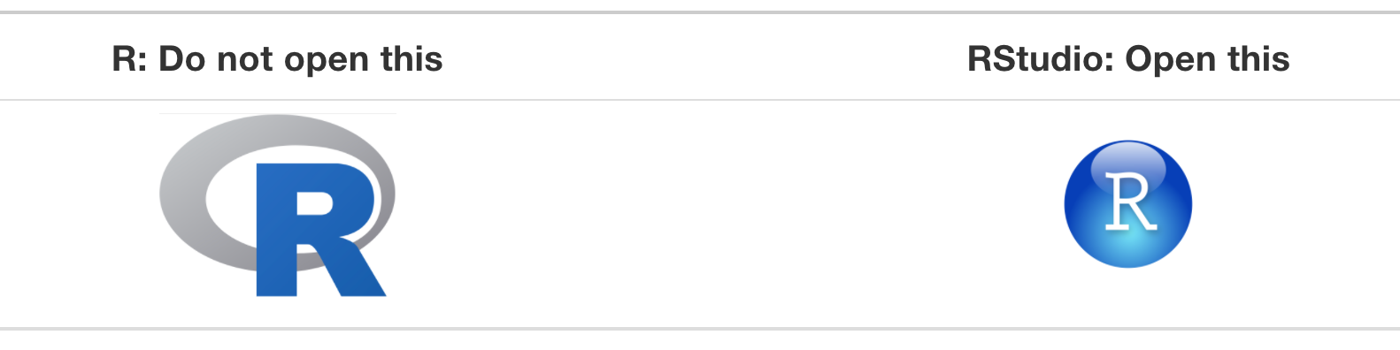
Starting R
Icons R versus RStudio on your computer

Slide 8
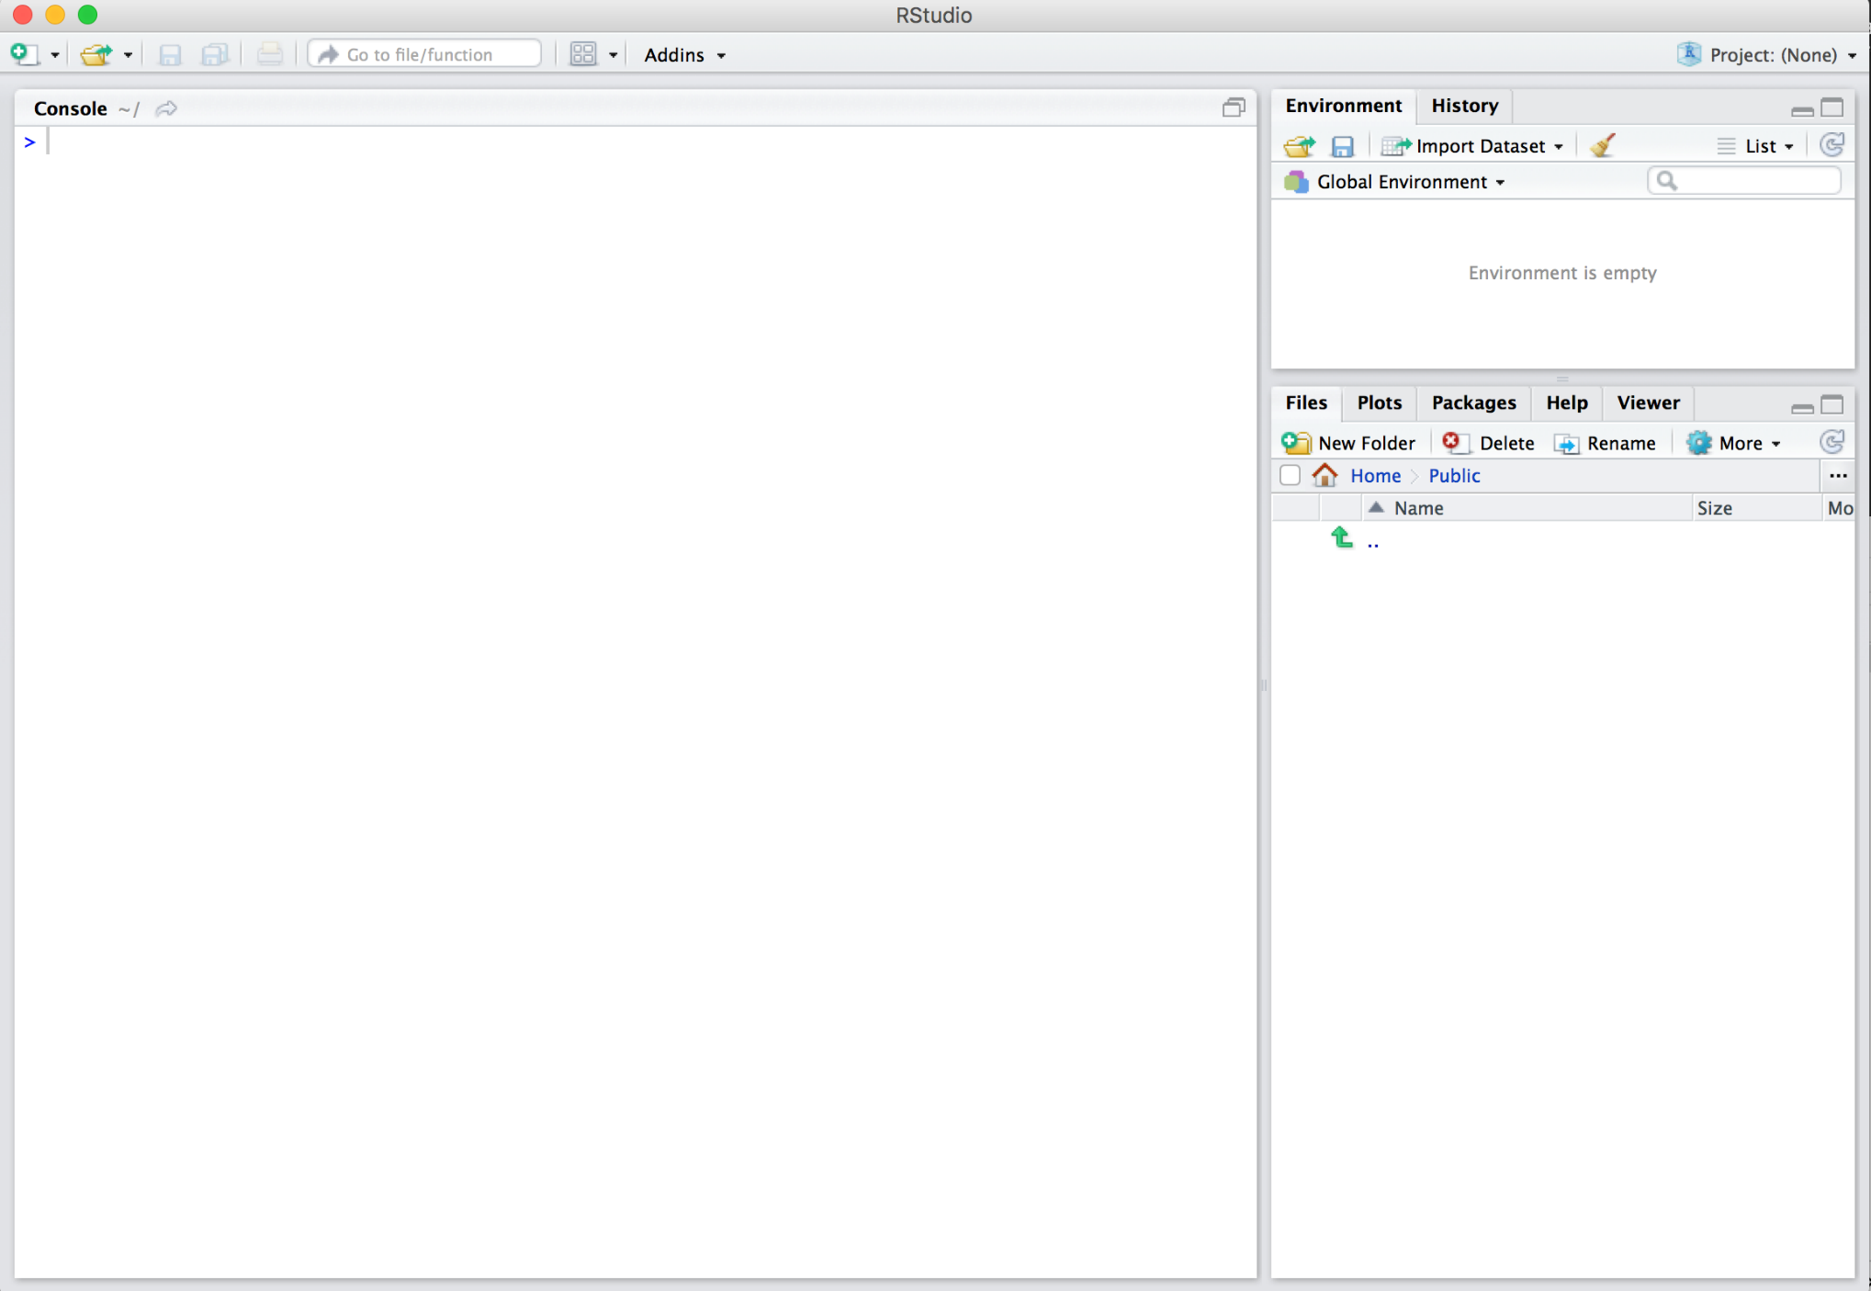
Rstudio interface to R - you should see something similar to this
Environment
Console
Files & more

Slide 9
Using R
You can use R in two ways:
  by typing the instructions in the console, one after the other, in the R command (after >)
  by writing a list of commands in a file and use it any time you need (a script)
  This is the way we are going to use R
The best way to learn R is to start to solve “problems” with the help of someone that is familiar with it
In the Rstudio interface, you can use the Help that is very powerful

Slide 10
Rstudio interface to R - you should see something similar to this
Environment
Console
Files & more

Slide 11
The Forest Models data files
Our R learning will be based on a series of exercises that use the following data files:
  Ec_GrowthData.xlsx – data from several permanent plots and trials
  Sb_SiteIndex&SiteData – data on site index (dominant height and age) and environmental variables in cork oak plots

Slide 12
Changing the current workspace
The workspace is the current R working environment where the data files and the R user-defined objects (vectors, matrices, data frames, lists, functions) are located
Functions related to the workspace
  getwd() # show the current workspace
  setwd() # changes the workspace to another folder
    setwd ("C:\\Users\\magatome\\Dropbox\\2_Ensino\\2Ciclo-ModelacaoRecursosFlorestais\\Aulas_R\\DataFiles")
  (note the \\ instead of \)

Slide 13
Reading data files with R
To read an entire data frame (set of vectors with the same length) directly, the external file will normally have a special form:
  The first line of the file should have a name for each variable in the data frame
  Each additional line of the file has as its first item a row label and the values for each variable
The Forest Models data files are already in the format required to be read as a data.frame
Data in EXCEL are read using the R function read.xlxs()

Slide 14
Saving R data files
We may want to save a (or more than one) R datafile that “took a long time to prepare”:
  save(data1,data2,file=“data.Rdata”)
Later on, in another script, you can load these data:
  load(“data.Rdata”)

Slide 15
Write R data files into EXCEL
write.xlsx (X, filename, sheetName=“Name”,
  col.names=TRUE, row.names=TRUE,
  append=FALSE)
  where X is the R data file

Slide 16
Functions related to objects
List all objects that are active
  ls()
Eliminate objects that won’t be needed anymore
  rm(object1,object2)
Describe an object
  str(object)

Slide 17
Special symbols
R objects can contain special symbols:
  NA (missing value)
  NaN (Not a Number)
  NULL (undefined value)
  Inf and –Inf (infinit)

Slide 18
The %>% operator
You can use the %>% operator with standard R functions — and even your own functions — too
The rules are simple: the object on the left hand side is passed as the first argument to the function on the right hand side
  euca <- euca_all %>%
  select(c("ID_plot","ID_rot","t","hdom","N","G"))
  is equivalent to
  euca <- select(euca_all, c("ID_plot","ID_rot","t","hdom","N","G"))

Slide 19
Example how the R functions are presented
Function apply
apply(X, MARGIN, FUN)
  x: an array or matrix
  MARGIN:
    MARGIN=1: the manipulation is performed on rows
    MARGIN=2: the manipulation is performed on columns
    MARGIN=c(1,2): the manipulation is performed on rows and columns
  FUN: tells which function to apply. Built functions like mean, median, sum, min, max and even user-defined functions can be applied
  (https://www.guru99.com/r-apply-sapply-tapply.html#1)

Slide 20
Several R functions for vectors
  mean(X) → average of the values of vector X
  sum(X) → sum values of vector X
  prod(X) → makes the product of values in vector X
  round(X, digits=k) → round numbers in vector X
  floor(X) → rounds to the integer immediately before
  ceiling(X) → rounds to the integer immediately after
  sample(X) → shuffles the values of vector X in a random order
  sample(X,size=k,replace=FALSE) → random sample k

Slide 21
Printing results in the console
See the links:
  https://www.gastonsanchez.com/r4strings/formatting.html

Slide 22
R functions to generate numbers from a fdp (distribution)
These functions require the library(“stats”)
  set.seed(1) # provides a seed to start the series of numbers
  rnorm(n= , mean=, sd=) normal distribution
  rpoison(n=, lambda=) Poison
  runif(n=,min=, max=) uniform distribution

Slide 23
Interesting links
problems with attach() and detach() functions
  https://www.r-bloggers.com/2011/05/to-attach-or-not-attach-that-is-the-question/
merging data sets by columns with diferent names
  https://www.r-bloggers.com/2012/12/joining-2-r-data-sets-with-different-column-names/
R for Data Science (a lot of topics presented in a nice way):
  https://r4ds.had.co.nz/workflow-scripts.html

Slide 24
Commenting multiple lines in scripts
There are two ways to add multiple single-line comments in R Studio:
  Select the multiple lines which you want to comment using the cursor and then use the key combination “control + shift + C” to comment or uncomment the selected lines.
  The other way is to use the GUI, select the lines which you want to comment by using the cursor and click on “Code” in menu, a pop-up window pops out in which we need to select “Comment/Uncomment Lines” which appropriately comments or uncomment the lines which you have selected.
  (https://www.geeksforgeeks.org/comments-in-r/)

Slide 25
Let´s now test how R works by following the “try and see” script “PlayWith_Ec_GrowthData”

Slide 26
Multiple linear regression

Slide 27
Continuous and categorical variables
Continuous variables are those that can take all real values within an interval
Categorical variables can just take a limited number of possible values, many times they refer to categories, such as soil type, colour, etc
For linear regression, the categorial variables have to be recoded as dummy variables (variables that can only take the values 0 or 1, depending on their value)
Generally, for a categorical variable with k categories, we need (k-1) dummy variables

Slide 28
Continuous and categorical variables
Suppose that you have a variable TreeStatus with two possible values: Dead or Alive. We need one dummy variable (X) to define the TreeStatus variable:
    X= 1 if the tree is alive; X=0 if the tree is dead
For a variable Region with 3 possible values – North, Centre, South – we need two dummies:
    X1=1 if Region=North; X1=0 otherwise
    X2=1 if Region=Centre; x2=0 otherwise
Region | X1 | X2
North | 1 | 0
Centre | 0 | 1
South | 0 | 0

Slide 29
The problem of multicollinearity
In a linear regression with one variable
y=a+bX
b – change in Y when X changes 1 unit
y1= a + b X1
y2 = a+b X2
(y2-Y1) = b (X2-X1)
b=(Y2-Y1)/(X2-X1)
y1= a + b1 X1 + b2 Z1
y2= a + b1 X2 + b2 Z2

Slide 30
The problem of multicollinearity
In a linear regression with one variable
y=a+bX
b – change in Y when X changes 1 unit
y1= a + b X1
y2 = a+b X2
(y2-Y1) = b (X2-X1)
b=(Y2-Y1)/(X2-X1)
y1= a + b1 X1 + b2 Z1
y2= a + b1 X2 + b2 Z2

Slide 31
y1= a + b1 X1 + b2 Z1
y2= a + b1 X2 + b2 Z2
(y2-y1) = b1(X2-X1) + b2(Z2-Z1)
b1=((y2-Y1)-b2(Z2-Z1)/(X2-X1)

Slide 32

Linear regression with dummy variables
The linear regression is
  $Y=a+b D$, where a and b are the parameters
if D is a dummy variable, then
  if D=1 then $Y=a+b$
  if D=0 then $Y=a$

Slide 33
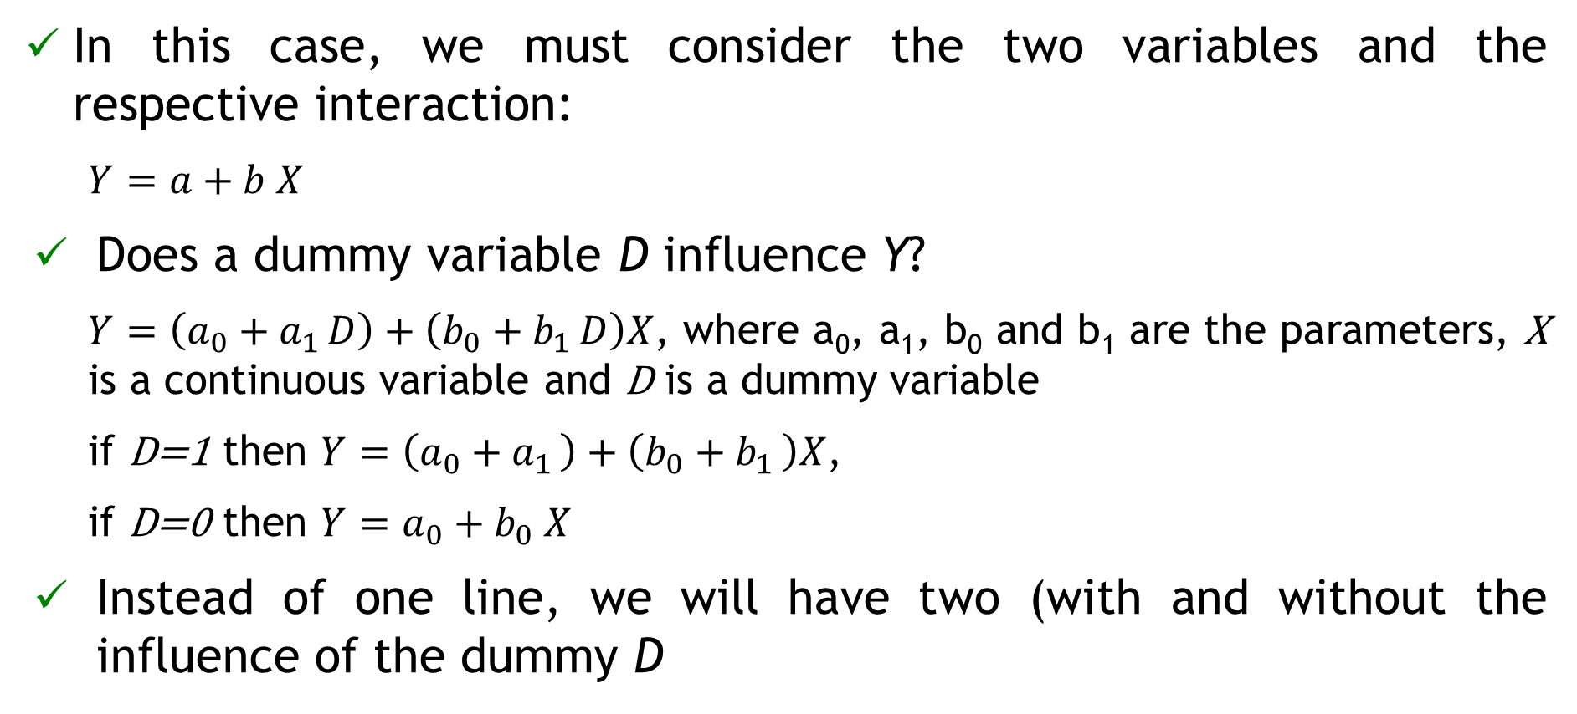
Linear regression with continuous and dummy variables
In this case, we must consider the two variables and the respective interaction:
  $Y=a+b X$
Does a dummy variable D influence Y?
  $Y=\left(a_{0}+a_{1 }D\right)+\left(b_{0}+b_{1 }D\right)X$, where a₀, a₁, b₀ and b₁ are the parameters, X is a continuous variable and D is a dummy variable
  if D=1 then $Y=\left(a_{0}+a_{1 }\right)+\left(b_{0}+b_{1 }\right)X$,
  if D=0 then $Y=a_{0}+b_{0} X$
Instead of one line, we will have two (with and without the influence of the dummy D

Slide 34
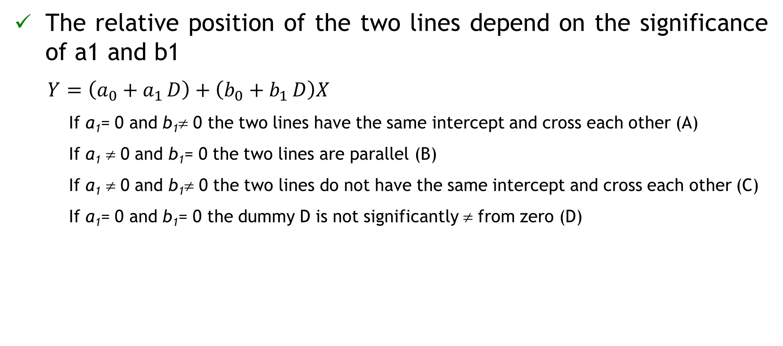
Linear regression with continuous and dummy variables
The relative position of the two lines depend on the significance of a1 and b1
  $Y=\left(a_{0}+a_{1 }D\right)+\left(b_{0}+b_{1 }D\right)X$
    If a₁= 0 and b₁≠ 0 the two lines have the same intercept and cross each other (A)
    If a₁ ≠ 0 and b₁= 0 the two lines are parallel (B)
    If a₁ ≠ 0 and b₁≠ 0 the two lines do not have the same intercept and cross each other (C)
    If a₁= 0 and b₁= 0 the dummy D is not significantly ≠ from zero (D)

Slide 35
Modelling S from environmental variables
File “S_SiteIndex&SiteData.xlsx”
I - Sdata0 <- merge Property, Climate, by Cod_Meteo
II - Sdata1 <- merge StandVariables, Sdata0, by Cod_Property
n=79
III - Sdata <- merge Sdata1 Soil_twi, by Cod_Plot
n=79
n=26
n=15

Slide 36
Algorithms for selection of variables
What shall we do when there is the need to select a subset of variables in order to have a good model?
Two types of algorithms:
  stepwise algorithms, such as step(), stepAIC(), ols_best_backward()
  all possible regressions algorithms, such as ols_best_all_possible(), ols_best_subset(), regsubsets(), leaps()
“Good” websites:
  https://cran.r-project.org/web/packages/olsrr/vignettes/variable_selection.html
  https://rdrr.io/cran/leaps/man/regsubsets.html

Slide 37
Stepwise algorithms
Three methods:
  Forward selection, starts with no predictors in the model, iteratively adds the most predictors that predicts the most according to a certain criteria, and stops when there is no improvement
  Backward selection (or backward elimination), which with all predictors in the model (full model), iteratively removes the predictors with smaller contribution according to a certain criteria, and stops when the next model will be worse according to the criteria
  Stepwise selection (or sequential replacement), which is a combination of forward and backward selections. Starts with no predictors, then sequentially add the most contributive predictors (like forward selection). After adding each new variable, remove any variables that no longer provide an improvement in the model fit (like backward selection)

Slide 38
Stepwise algorithms
Interesting links :
  https://olsrr.rsquaredacademy.com/articles/variable_selection.html
  https://cran.r-project.org/web/packages/olsrr/vignettes/variable_selection.html
  http://www.sthda.com/english/articles/37-model-selection-essentials-in-r/154-stepwise-regression-essentials-in-r/#loading-required-r-packages
  https://www.rdocumentation.org/packages/leaps/versions/2.1-1/topics/regsubsets

Slide 39
Model comparison selection
What defines a good multilinear model? How do we check model quality?
Property | Checked by
Good fit | R², adjusted R², AIC
The parameters associated with each one of the variables are significantly different from zero (all variables are significant) | t-tests
Multicolinearity is not present | Variance inflation factores (VIF) < 10
Regression assumptions can be verified | Homocedasticity - plot residuals vs predicted values Residuals follow the normal distribution - QQplots
Has a good prediction ability | Evaluated by validation with an independent data set Or Evaluated with PRESS residuals Or Evaluated with resampling methods

Slide 40
Bias and precision
Accuracy, bias and precision:
Accuracy
bias + precision
Accurate model is unbiased and has high precision
average of res_press ≅ 0
+
low average |res_press|
Precise
low average |res_press|
Not precise
high average |res_press|
unbiased
average res_press ≅ 0
biased
average res_press ≠ 0

Slide 41
Nonlinear regression

Slide 42
Nonlinear regression
A nonlinear model is a model that is nonlinear on the parameters, which means that for instance
  there are parameters as powers or included in functions that are powers
  there are multiplication of parameters
Note that
  Many of the methods from linear regression transfer directly or with small modifications to the nonlinear case
  Methods of estimation and inference in NLMs are linear methods applied to a linear approximaion to the NLM

Slide 43
Function plot() for objects of nlsResiduals type
nlsResiduals(nls) # nls – object of class ‘nls’
plot(x, which = 0,…) # x - object of class ‘nlsResiduals’
  which is an integer:
    0 = 4 graphs of residuals (types 1, 2, 4 and 6)
    1 = non-transformed residuals against fitted values
    2 = standardized residuals against fitted values
    3 = sqrt of absolute value of standardized residuals against fitted values
    4 = auto-correlation residuals (i+1th residual against ith residual)
    5 = histogram of the residuals
    6 = qq-plot of the residuals
    http://finzi.psych.upenn.edu/library/nlstools/html/nlsResiduals.html

Slide 44
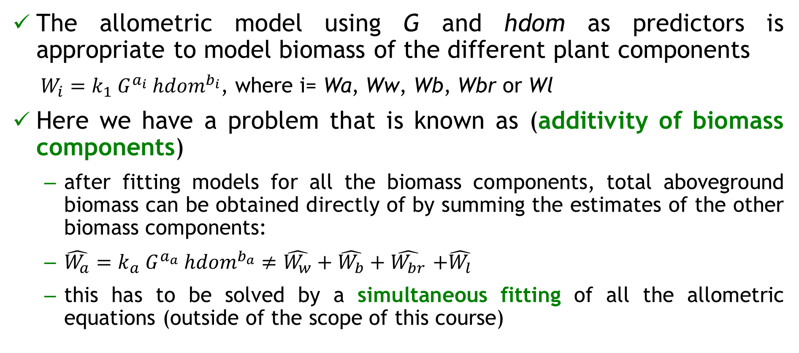
Allometric models for biomass components
The allometric model using G and hdom as predictors is appropriate to model biomass of the different plant components
  $W_{i}=k_{1}{ G}^{a_{i}} {hdom}^{b_{i}}$, where i= Wa, Ww, Wb, Wbr or Wl
Here we have a problem that is known as (additivity of biomass components)
  after fitting models for all the biomass components, total aboveground biomass can be obtained directly of by summing the estimates of the other biomass components:
  $\hat{W_{a}}=k_{a} G^{a_{a}} {hdom}^{b_{a}}≠\hat{W_{w}}+\hat{W_{b}}+\hat{W_{br}}$ $+\hat{W_{l}}$
  this has to be solved by a simultaneous fitting of all the allometric equations (outside of the scope of this course)

