Slide 1
Monte Carlo Simulation
Forestry Applications
Applied Operations Research
18 May 2022
Susana Barreiro
e-mail: smb@isa.ulisboa.pt

Slide 2
1
Monte Carlo Simulation
Forestry Applications
What is Monte Carlo? Basic Principles
2
Random Numbers
3
Sample Sizes
4
Distributions
5
Monte Carlo Simulation Examples
6
Monte Carlo Simulation Exercises

Slide 3
1
What is Monte Carlo? Basic Principles
2
Random Numbers
3
Sample Sizes
4
Distributions
5
Monte Carlo Simulation Examples
6
Monte Carlo Simulation Exercises

Slide 4
History
Stanisław Ulam Polish-American scientist in the fields of mathematics and nuclear physics (worked for the Manhattan project – thermonuclear weapons)
While playing solitaire during his recovery from surgery (game which he kept losing) he wondered how many games he had to play to get a win.
So he thought about playing hundreds of games to estimate statistically the probability of a successful outcome and the availability of computers made such statistical methods very practical.
(mechanical simulation of random diffusion of neutrons)
Ulam had an uncle who went often to Monte Carlo casino to gamble so he and his colleagues named the technique “MONTE CARLO”

Slide 5
Monte Carlo simulation: method of estimating the value of an unknown quantity using the principles of inferential statistics
Monte Carlo simulation is a computerized mathematical technique that allows to model the probability of different outcomes in a process that cannot be easily predicted due to the intervention of random variables
Monte Carlo simulation depends on a sequence of random numbers which is generated during the simulation
Population: set of examples
Sample: a proper subset of the population
Key fact: a random sample tends to exhibit the same properties as the population from which it is drawn

Slide 6
Often, the physical processes we are interested (the system) are complex
To study a certain process, we may require the use of a model (simplified representation of the system)
- fundamental tools in different fields: science, engineering, business, etc.
- abstraction of reality therefore always has limits of credibility
When we apply the model to mimic the system’s behavior, we say we run simulations

Slide 7
Monte Carlo simulation: technique that combines distributions with random number generation
Any variable has a probability distribution for its occurrence
Random numbers can be generated in different ways
Best way to relate random number to a variable is to use cumulative probability distribution
(probability density functions – pdf)

Slide 8
Let us take the following as an example:
Suppose you’re approached by a forestry nursery and you’re asked to predict the expected demand for their frost resistant Eucalyptus clone for the next 10 weeks
Any ideas?

Slide 9
Suppose the nursery had been monitoring the weekly demand for clone packs during Spring months and they know the probabilities
Relative frequencies
(probability)
If the distribution is known , WHY do we use random numbers to simulate it?
Nr packs ordered | probability
0 | 0.05
1 | 0.1
2 | 0.15
3 | 0.3
4 | 0.25
5 | 0.15
BECAUSE, although the probability is known (the relative frequency of each demand level), the order of occurrence is not
It is the order of occurrence (which is assumed random) which we want to simulate

Slide 10
Assume that the demand/week is given by:
Relative frequencies
(probability)
If the distribution is known , WHY do we use random numbers to simulate it?
BECAUSE, although the probability is known (the relative frequency of each demand level), the order of occurrence is not
0.3
0.2
0.2
0.15
0.05
0.1
It is the order of occurrence (which is assumed random) which we want to simulate
Sample: a proper subset of the population

Slide 11
Assume that the demand/week is given by:
Relative frequencies
(probability)
1
Cumulative frequencies
(probability)
0.85
0.65
0.3
0.35
0.2
0.2
0.15
0.1
0.15
0.05
0.05
Current approach:
P(X≤3)=0.4 ⬄The probability of having 3 or less packs ordered in a week is 0.4

Slide 12
Assume that the demand/week is given by:
Relative frequencies
(probability)
1
Cumulative frequencies
(probability)
0.85
0.65
0.3
0.35
0.2
0.2
0.15
0.1
0.15
0.05
0.05
Monte Carlo approach:
draw random number P(X) = 0.73
This will say the nr of clone packs to be ordered = 4

Slide 13
Assume that the demand/week is given by:
Cumulative frequencies
(probability)
Demand (x) | Cumulative frequencies | Interval for random numbers
0 | 0.05 | 0 – 4
1 | 0.15 | 5 – 14
2 | 0.35 | 15 – 34
3 | 0.65 | 35 – 64
4 | 0.85 | 65 – 84
5 | 1 | 85 – 99
1
0.85
0.65
0.35
0.15
0.05

Slide 14
Assume that the demand/day is given by:
Simulate the demand for 10 days
Demand (x) | Cumulative frequencies | Interval for random numbers
0 | 0.05 | 0 – 4
1 | 0.15 | 5 – 14
2 | 0.35 | 15 – 34
3 | 0.65 | 35 – 64
4 | 0.85 | 65 – 84
5 | 1 | 85 – 100
week | Random number | demand
1 | 14 | 1
2
3
4
5
6
7
8
9
10

Slide 15
Assume that the demand/day is given by:
Simulate the demand for 10 days
Demand (x) | Cumulative frequencies | Interval for random numbers
0 | 0.05 | 0 – 4
1 | 0.15 | 5 – 14
2 | 0.35 | 15 – 34
3 | 0.65 | 35 – 64
4 | 0.85 | 65 – 84
5 | 1 | 85 – 100
week | Random number | demand
1 | 14 | 1
2 | 74 | 4
3
4
5
6
7
8
9
10

Slide 16
Assume that the demand/day is given by:
Simulate the demand for 10 days
Demand (x) | Cumulative frequencies | Interval for random numbers
0 | 0.05 | 0 – 4
1 | 0.15 | 5 – 14
2 | 0.35 | 15 – 34
3 | 0.65 | 35 – 64
4 | 0.85 | 65 – 84
5 | 1 | 85 – 100
weeks | Random number | demand
1 | 14 | 1
2 | 74 | 4
3 | 24 | 2
4 | 87 | 5
5 | 7 | 1
6 | 45 | 3
7 | 26 | 2
8 | 66 | 4
9 | 26 | 2
10 | 94 | 5

Slide 17
Assume that the demand/day is given by:
Relative frequencies
(probability)
If 10000 random numbers were drawn it would be expected that the number of observations per class would be:
Demand (x) | frequencies | observations
0 | 0.05 | 500
1 | 0.1 | 1000
2 | 0.2 | 2000
3 | 0.3 | 3000
4 | 0.2 | 2000
5 | 0.15 | 1500
0.3
0.2
0.2
0.15
0.05
0.1

Slide 18
Some Advantages of Simulation
Often simulation is the only type of model possible for complex systems (e.g assess the impact of a certain silvicultural practices, fire)
Process of building simulators can clarify the understanding of real systems and sometimes can be more useful than the implementation of the results itself
Allows for sensitivity analysis and optimization of real system without need to operate real system (e.g no need to burn all stands to infer about fire behavior or its economic impacts)
Can maintain better control over experimental conditions than real system

Slide 19
Some Disadvantages of Simulation
May be very expensive and time consuming to build simulation/simulator
Easy to misuse simulation by “stretching” it beyond the limits of credibility
- when using commercial simulation packages due to ease of use and lack of familiarity with underlying assumptions and restrictions
- Slick graphics, animation, tables, etc. may tempt user to assign unwarranted credibility to output
Monte Carlo simulation usually requires several (perhaps many) runs at given input values, whereas analytical solutions provide exact values

Slide 20
Assume that the demand/week is given by:
Simulate the demand for 10 weeks
Demand (x) | Cumulative frequencies | Interval for random numbers
0 | 0.05 | 0 – 4
1 | 0.15 | 5 – 14
2 | 0.35 | 15 – 34
3 | 0.65 | 35 – 64
4 | 0.85 | 65 – 84
5 | 1 | 85 – 100
week | Random number | demand
1 | 14 | 1
2 | 74 | 4
3 | 24 | 2
4 | 87 | 5
5 | 7 | 1
6 | 45 | 3
7 | 26 | 2
8 | 66 | 4
9 | 26 | 2
10 | 94 | 5
The average number of packs sold/week = 2.9 ~3
How confident are you in this?

Slide 21
1
What is Monte Carlo? Basic Principles
2
Random Numbers
3
Sample Sizes
4
Distributions
5
Monte Carlo Simulation Examples
6
Monte Carlo Simulation Exercises

Slide 22
Random numbers are used to obtain random observations from a probability distribution. How are they generated?
Manually – laborious and not practical
Random Tables – random physical process but difficult to implement in a computer
Computers – generate pseudo random numbers (pseudo because they’re obtained with a deterministic mathematical process EXCEL RAND(), RANDBETWEEN(min, max)

Slide 23
We have different types of random numbers: true random numbers and pseudorandom numbers. How are they generated?
pseudorandom – look random but have an algorithm behind that we can not depict at a first look. Admit the following algorithm:
=left ( (“seed” x 25 + 156), 2)
Seed=23 Draw 5 nrs: (73, 18, 46, 11, 28)
Seed=28 Draw 5 nrs: (85, 21, 53, 13, 33)
True – generated out of the observation of some environmental variable that humans can not easily determine/control. Most commonly used is the time (e.g. when you press a certain key in your keyboard). For example:
left ( (“hour” x 25 + “minutes” x 156) /”seconds”, 2)
=left(1234,2)
=12
=left(253,2)
=25
If you wish to have the same outcome, in each run you must fix the seed!
This way, every new run produces a new set of numbers.

Slide 24
StandsSIM.md
Running the simulator for maritime pine when performing thinning the simulator selects the trees to be thinned based on a pseudorandom number with fixed seed
If the seed was not fixed, for every new run (despite providing the same inputs) you would get a different set of thinned trees
StandsSIM.sd
The simulator can be run deterministically or stochastically which has implications on the stands selected to be burnt and or harvested
Deterministically - pseudorandom number with fixed seed
Stochastically – the user selects this type of run the stochastic id is set to 1
left ( (“fixed seed” x 25 + 156), 2) + id x (f (time)

Slide 25
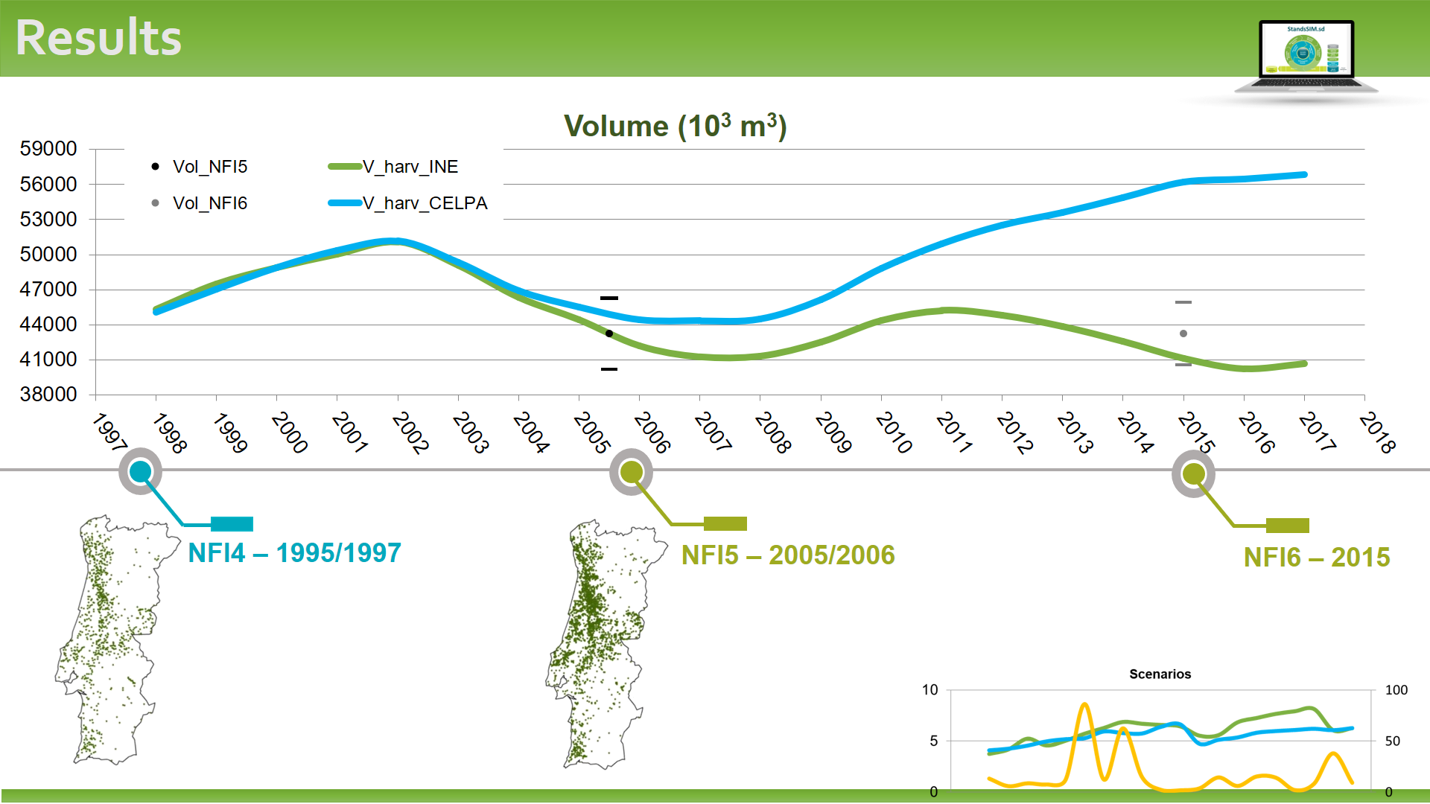
StandsSIM.sd
The simulator was run deterministically (fixed seed pseudorandom number)
Would you expect a different behavior for the curves if I had chosen to run 100 times under the stochastic mode?
Deterministic – system with “no randomness” involved producing always the same outcome
Stochastic - system with random probability distribution or pattern that may be analyzed statistically but may not be predicted precisely. You run a certain number of times (and average the results). The number of time you run the simulator - Sample size

Slide 26
1
What is Monte Carlo? Basic Principles
2
Random Numbers
3
Sample Sizes
4
Distributions
5
Monte Carlo Simulation Examples
6
Monte Carlo Simulation Exercises

Slide 27
Determining sample size (number of simulation runs) is important and relies on 2 parameters: mean and standard deviation. However, the process is rather cyclic and based on assumptions:
Standard deviation of the population. If not known , we have to use an estimate (but the calculus requires sample size)
Population mean has a normal distribution
A large sample will be taken
Etc...
Normal deviate for a confidence interval of 1-alfa, but should be replaced by t _{alfa/2,n-1} (also requires sample size)
Difference between sample mean and real mean (requires sample size to be known so that simulations can be run and the sample mean calculated)

Slide 28
Therefore, other options are commonly used:
Option 1
Choose a big sample size and then establish confidence intervals
Option 2
Compute the average value after each trial so it approaches a limit and stop simulating when the difference between population mean and sample mean reaches an acceptable value
Option 3
Make several pilot simulation runs to have an idea of the mean and standard deviation and then use it to calculate the sample size

Slide 29
1
What is Monte Carlo? Basic Principles
2
Random Numbers
3
Sample Sizes
4
Distributions
5
Monte Carlo Simulation Examples
6
Monte Carlo Simulation Exercises

Slide 30
Where do we obtain the probability distribution for one variable?
Empirical distributions
Theoretical distributions
(Poisson, Normal, Exponential, Weibull)
(Historic) Observed Data
Estimates

Slide 31
Empirical distributions
Rely on a considerable amount of real (historic) data for a given variable
Forest inventory data on stand age for eucalyptus
Require classes to be defined
Age classes with amplitude 4 (e.g using IF clause in EXCEL)
Counting observations/class
Histogram or pivot table
1)
2)
3)
4)
5)
6)
stand | age
1 | 3
2 | 16
3 | 8
4 | 12
5 | 11
6 | 9

Slide 32
Empirical distributions
Rely on a considerable amount of real (historic) data for a given variable
Forest inventory data on stand age for eucalyptus
Require classes to be defined
Age classes with amplitude 4 (e.g using IF clause in EXCEL)
Counting observations/class
Histogram or pivot table
1)
2)
3)
4)
5)
6)
stand | age
1 | 3
2 | 16
3 | 8
4 | 12
5 | 11
6 | 9

Slide 33
Empirical distributions
Rely on a considerable amount of real (historic) data for a given variable
Forest inventory data on stand age for eucalyptus
Require classes to be defined
Age classes with amplitude 4
Counting observations/class
Histogram or pivot table
class | freq
0 -3 | 1
4 - 7 | 0
8 - 11 | 3
12 - 15 | 1
>=16 | 1
 | 6
stand | age | class
1 | 3 | 0 -3
2 | 16 | >=16
3 | 8 | 8 - 11
4 | 12 | 12 - 15
5 | 11 | 8 - 11
6 | 9 | 8 - 11
3
1
0
1
1

Slide 34
Empirical distributions
Rely on a considerable amount of real (historic) data for a given variable
Forest inventory data on stand age for eucalyptus
Require classes to be defined
Age classes with amplitude 4
Counting observations/class
Histogram or pivot table
class | freq | pdf
0 -3 | 1 | (1/6) 0.16
4 - 7 | 0 | 0
8 - 11 | 3 | (3/6) 0.5
12 - 15 | 1 | (1/6) 0.16
>=16 | 1 | (1/6) 0.16
 | 6 | 1
stand | age | class
1 | 3 | 0 -3
2 | 16 | >=16
3 | 8 | 8 - 11
4 | 12 | 12 - 15
5 | 11 | 8 - 11
6 | 9 | 8 - 11
0.5
0.16
0
0.16
0.16

Slide 35
Empirical distributions
Rely on a considerable amount of real (historic) data for a given variable
Forest inventory data on stand age for eucalyptus
Require classes to be defined
Age classes with amplitude 4
Counting observations/class
Histogram or pivot table
class | freq | pdf | cpdf
0 -3 | 1 | (1/6) 0.16 | 0.16
4 - 7 | 0 | 0 | 0.16
8 - 11 | 3 | (3/6) 0.5 | 0.66
12 - 15 | 1 | (1/6) 0.16 | 0.82
>=16 | 1 | (1/6) 0.16 | 1
 | 6 | 1
1
0.82
0.66
0.5
0.16
0
0.16
0.16
0.16
0.16

Slide 36
1
What is Monte Carlo? Basic Principles
2
Random Numbers
3
Sample Sizes
4
Distributions
5
Monte Carlo Simulation Examples
6
Monte Carlo Simulation Exercises

Slide 37
In general, Monte Carlo Simulation is roughly composed of five steps:
Set up probability distribution that will be considered in the simulation
Build cumulative probability distribution
Establish an interval of random numbers for each variable
Generate random numbers
Simulate trials

Slide 38
Example 1 – Simulating with a distribution provided (empirical)
Example 2 – Setting a distribution based on know distributions of other variables (independent variables)
Example 3 – Simulating using dependent variables

Slide 39
Example 1 - Simulate a 10 weeks’ demands based on the distribution below assuming the following random numbers: 14, 74, 24, 87, 7, 45, 26, 66, 26, 94 (previously presented)
Set up probability distributions that will be considered in the simulation
0.3
0.2
0.2
0.15
0.05
0.1

Slide 40
Example 1 - Simulate a 10 days demand based on the distribution below assuming the following random numbers: 14, 74, 24, 87, 7, 45, 26, 66, 26, 94 (previously presented)
1
Set up probability distributions that will be considered in the simulation
Build cumulative probability distributions
0.85
0.65
Demand (x) | Cumulative frequencies
0 | 0.05
1 | 0.15
2 | 0.35
3 | 0.65
4 | 0.85
5 | 1
0.35
0.15
0.05

Slide 41
Example 1 - Simulate a 10 days demand based on the distribution below assuming the following random numbers: 14, 74, 24, 87, 7, 45, 26, 66, 26, 94 (previously presented)
Set up probability distributions that will be considered in the simulation
Build cumulative probability distributions
Establish an interval of random numbers for each variable
Demand (x) | Cumulative frequencies | interval
0 | 0.05 | 0 – 4
1 | 0.15 | 5 – 14
2 | 0.35 | 15 – 34
3 | 0.65 | 35 – 64
4 | 0.85 | 65 – 84
5 | 1 | 85 – 99

Slide 42
Example 1 - Simulate a 10 days demand based on the distribution below assuming the following random numbers: 14, 74, 24, 87, 7, 45, 26, 66, 26, 94 (previously presented)
day | Random number
1 | 14
2 | 74
3 | 24
4 | 87
5 | 7
6 | 45
7 | 26
8 | 66
9 | 26
10 | 94
Set up probability distributions that will be considered in the simulation
Build cumulative probability distributions
Establish an interval of random numbers for each variable
Generate random numbers

Slide 43
Example 1 - Simulate a 10 days demand based on the distribution below assuming the following random numbers: 14, 74, 24, 87, 7, 45, 26, 66, 26, 94 (previously presented)
Demand | interval
0 | 0 – 4
1 | 5 – 14
2 | 15 – 34
3 | 35 – 64
4 | 65 – 84
5 | 85 – 1
day | Random number | demand
1 | 14 | 1
2 | 74 | 4
3 | 24 | 2
4 | 87 | 5
5 | 7 | 1
6 | 45 | 3
7 | 26 | 2
8 | 66 | 4
9 | 26 | 2
10 | 94 | 5
Set up probability distributions that will be considered in the simulation
Build cumulative probability distributions
Establish an interval of random numbers for each variable
Generate random numbers
Simulate trials

Slide 44
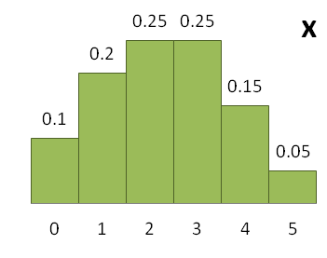
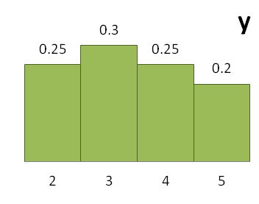
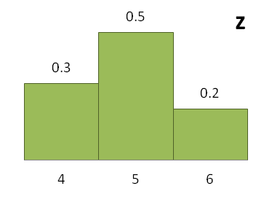
Example 2 - Assume the effectiveness function for a system is W = 5x + 2y + z, where the variables x, y and z are independent and described by the probabilities below. Run 18 trials
Set up probability distributions that will be considered in the simulation

Slide 45
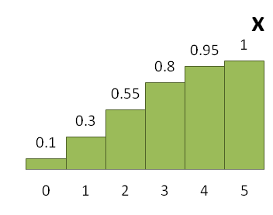
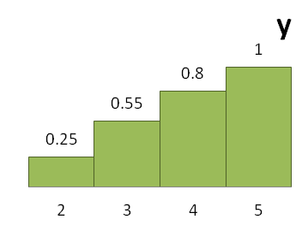
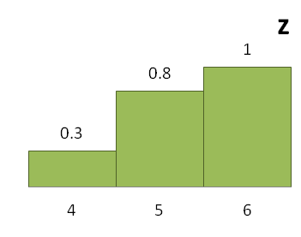
Example 2 - Assume the effectiveness function for a system is W = 5x + 2y + z, where the variables x, y and z are independent and described by the probabilities below. Run 18 trials
Set up probability distributions that will be considered in the simulation
Build cumulative probability distributions

Slide 46
Example 2 - Assume the effectiveness function for a system is W = 5x + 2y + z, where the variables x, y and z are independent and described by the probabilities below. Run 18 trials
x | distribution | cumulative distribution | aux | lower lim | upper lim | interval
0 | 0.1 | 0.1 | 10 | 0 | 9 | 0 - 9
1 | 0.2 | 0.3 | 30 | 10 | 29 | 10 - 29
2 | 0.25 | 0.55 | 55 | 30 | 54 | 30 - 54
3 | 0.25 | 0.8 | 80 | 55 | 79 | 55 - 79
4 | 0.15 | 0.95 | 95 | 80 | 94 | 80 - 94
5 | 0.05 | 1 | 100 | 95 | 99 | 95 - 99
y | distribution | cumulative distribution | aux | lower lim | upper lim | interval
2 | 0.25 | 0.25 | 25 | 0 | 24 | 0 - 24
3 | 0.3 | 0.55 | 55 | 25 | 54 | 25 - 54
4 | 0.25 | 0.8 | 80 | 55 | 79 | 55 - 79
5 | 0.2 | 1 | 100 | 80 | 99 | 80 - 99
z | distribution | cumulative distribution | aux | lower lim | upper lim | interval
4 | 0.3 | 0.3 | 30 | 0 | 29 | 0 - 29
5 | 0.5 | 0.8 | 80 | 30 | 79 | 30 - 79
6 | 0.2 | 1 | 100 | 80 | 99 | 80 - 99
Set up probability distributions that will be considered in the simulation
Build cumulative probability distributions
Establish an interval of random numbers for each variable

Slide 47
Example 2 - Assume the effectiveness function for a system is W = 5x + 2y + z, where the variables x, y and z are independent and described by the probabilities below. Run 18 trials
trial nr | rand_x | rand_y | rand_z
1 | 43 | 22 | 1
2 | 74 | 9 | 8
3 | 84 | 10 | 82
4 | 42 | 38 | 65
5 | 83 | 16 | 34
6 | 25 | 1 | 27
7 | 21 | 67 | 62
8 | 25 | 38 | 58
9 | 83 | 65 | 42
10 | 76 | 25 | 32
11 | 74 | 27 | 63
12 | 68 | 73 | 55
13 | 3 | 7 | 96
14 | 60 | 53 | 29
15 | 35 | 34 | 31
16 | 56 | 25 | 17
17 | 71 | 83 | 83
18 | 15 | 72 | 49
Set up probability distributions that will be considered in the simulation
Build cumulative probability distributions
Establish an interval of random numbers for each variable
Generate random numbers

Slide 48
Example 2 - Assume the effectiveness function for a system is W = 5x + 2y + z, where the variables x, y and z are independent and described by the probabilities below. Run 18 trials
trial nr | rand_x | rand_y | rand_z | x | y | z | w
1 | 43 | 22 | 1 | 2 | 2 | 4 | 18
2 | 74 | 9 | 8 | 3 | 2 | 4 | 23
3 | 84 | 10 | 82 | 4 | 2 | 6 | 30
4 | 42 | 38 | 65 | 2 | 3 | 5 | 21
5 | 83 | 16 | 34 | 4 | 2 | 5 | 29
6 | 25 | 1 | 27 | 1 | 2 | 4 | 13
7 | 21 | 67 | 62 | 1 | 4 | 5 | 18
8 | 25 | 38 | 58 | 1 | 3 | 5 | 16
9 | 83 | 65 | 42 | 4 | 4 | 5 | 33
10 | 76 | 25 | 32 | 3 | 3 | 5 | 26
11 | 74 | 27 | 63 | 3 | 3 | 5 | 26
12 | 68 | 73 | 55 | 3 | 4 | 5 | 28
13 | 3 | 7 | 96 | 0 | 2 | 6 | 10
14 | 60 | 53 | 29 | 3 | 3 | 4 | 25
15 | 35 | 34 | 31 | 2 | 3 | 5 | 21
16 | 56 | 25 | 17 | 3 | 3 | 4 | 25
17 | 71 | 83 | 83 | 3 | 5 | 6 | 31
18 | 15 | 72 | 49 | 1 | 4 | 5 | 18
Set up probability distributions that will be considered in the simulation
Build cumulative probability distributions
Establish an interval of random numbers for each variable
Generate random numbers
Simulate trials

Slide 49
Example 2 - Assume the effectiveness function for a system is W = 5x + 2y + z, where the variables x, y and z are independent and described by the probabilities below. Run 18 trials
trial nr | w
1 | 18
2 | 23
3 | 30
4 | 21
5 | 29
6 | 13
7 | 18
8 | 16
9 | 33
10 | 26
11 | 26
12 | 28
13 | 10
14 | 25
15 | 21
16 | 25
17 | 31
18 | 18
Set up probability distributions that will be considered in the simulation
Build cumulative probability distributions
Establish an interval of random numbers for each variable
Generate random numbers
Simulate trials
Set probability distribution for w

Slide 50
Example 2 - Assume the effectiveness function for a system is W = 5x + 2y + z, where the variables x, y and z are independent and described by the probabilities below. Run 18 trials
trial nr | w | class
1 | 18 | 15 – 24 (20)
2 | 23 | 15 – 24 (20)
3 | 30 | 25 – 34 (30)
4 | 21 | 15 – 24 (20)
5 | 29 | 15 – 24 (20)
6 | 13 | 5 – 14 (10)
7 | 18 | 15 – 24 (20)
8 | 16 | 15 – 24 (20)
9 | 33 | 25 – 34 (30)
10 | 26 | 25 – 34 (30)
11 | 26 | 25 – 34 (30)
12 | 28 | 25 – 34 (30)
13 | 10 | 5 – 14 (10)
14 | 25 | 25 – 34 (30)
15 | 21 | 15 – 24 (20)
16 | 25 | 25 – 34 (30)
17 | 31 | 25 – 34 (30)
18 | 18 | 15 – 24 (20)
Set up probability distributions that will be considered in the simulation
Build cumulative probability distributions
Establish an interval of random numbers for each variable
Generate random numbers
Simulate trials
Set probability distribution for w
Define classes for w with amplitude of 10
Count observations per class with pivot table
class | freq | prob
5 – 14 (10) | 2 | (2/18) 0.11
15 – 24 (20) | 8 | (8/18) 0.44
25 – 34 (30) | 8 | (8/18) 0.44
35 – 44 (40) | 0 | 0
 | 18
0.44
0.44
0.11
10 20 30 40

Slide 51
Example 3
The gross income/year = selling price/unit (S) x sales/year(D).
In general, as the selling price decreases, sales increase (dependent variables). Calculate the gross income assuming:
the distributions bellow
the random number for sales (D) = 73 and
the random number for selling price (S) = 22
Set up probability distributions
Build cumulative probability distributions
€/unit
Units/year

Slide 52
Example 3 – The gross income/year = sales/year (D) x selling price/unit (S). In general, as the selling price decreases, sales increase (dependent variables). Calculate the gross income assuming:
D1 | distribution | cumulative distribution | interval
180 | 0.3 | 0.3 | 0 - 29
190 | 0.5 | 0.8 | 30 - 79
200 | 0.2 | 1 | 80 - 99
D1.5 | distribution | cumulative distribution | interval
150 | 0.25 | 0.25 | 0 – 24
160 | 0.4 | 0.65 | 25 - 64
170 | 0.25 | 0.9 | 65 - 89
180 | 0.1 | 1 | 90 - 99
D2 | distribution | cumulative distribution | interval
130 | 0.3 | 0.3 | 0 - 29
140 | 0.6 | 0.9 | 30 - 89
150 | 0.1 | 1 | 90 - 99
D2.5 | distribution | cumulative distribution | interval
110 | 0.25 | 0.25 | 0 - 24
120 | 0.5 | 0.75 | 25 - 74
130 | 0.25 | 1 | 75 - 99
the distributions bellow
the random number for sales (D) = 73
the random number for selling price (S) =22
Establish an interval and simulate
S | distribution | cumulative distribution | interval
1 | 0.1 | 0.1 | 0 - 9
1.5 | 0.3 | 0.4 | 10 - 39
2 | 0.4 | 0.8 | 40 - 79
2.5 | 0.2 | 1 | 80 - 99
gross income/year = 170 x 1.5 = 255 €

