Slide 1
Stand density measures

Slide 2
Stocking and stand density
Although stocking and stand density are terms that are often applied interchangeably in forestry use, the two terms are not synonymous
  Stand density denotes a quantitative measurement of the stand
  Stocking:
    Stocking refers to the adequacy of a given stand density to meet some management objective (Bickford et al. 1957)
    Stands may be referred to as understocked, fully stocked, or overstocked
    A stand that is “overstocked” for one management objective could be “understocked” for another

Slide 3
Quantifying stand density
Stand density is a quantitative term describing the degree of stem crowding within a stocked area
It can be expressed in absolute or relative terms
  Absolute measures of density are determined directly from a given stand without reference to any other stand
  Relative density is based on a selected standard density, usually the “fully stocked” stand or the open-grown trees (the extremes)

Slide 4
Quantifying stand density
Absolute measures of stand density
  Basal area
  Number of trees per ha
Relative measures of stand density
  Stand density index
  Crown competition factor
Other stand density measures
  Relative spacing
  Spacing factor
  Percent crown cover

Slide 5
Stand density index (SDI)
SDI evaluates stand density by comparing it with the maximum density for a stand with the same quadratic mean dbh (dg) – limiting situation or self-thinning line
For any given dg there is a limit to the number of trees per unit that can be carried
Reineke (1933) noted that for a variety of species the slope of the limiting line was approximately -1.6 on the log-log scale

Slide 6
Stand density index (SDI)
Maritime pine data - PORTUGAL

Slide 7
Stand density index (SDI)
Maritime pine data - PORTUGAL

Slide 8
Stand density index (SDI)
SDI is based on the comparison of the number of trees in the stand and the maximum number of trees it could sustain according to the self-thinning line
SDI assumes that an understocked stand is located in a logN-logdg line parallel to the self-thinning line but with a smaller intercept

Slide 9
Stand density index (SDI)

Slide 10
Stand density index (SDI)
The intercept for a stand can be obtained as
The index is “normalized” by using the dg=25 as a basis for comparison

Slide 11
Stand density index (SDI)
The expression for SDI in a particular stand is then obtained:

Slide 12
Stand density index (SDI)

Slide 13
Crown competition factor (CCF)
CCF reflects the relationship between the area available for the average tree of the stand and the maximum area that the tree could use if it was growing in open space (open-grown tree)
The computation of CCF requires the study of the relationship between crown width of an open-grown tree (cw_{og}) and its dbh (d_{og}), usualy linear:

Slide 14
Crown competition factor (CCF)
The crown of an open grown tree ocupies the area ca_{og}:
CCF is then computed as the sum og the caog values for all the trees in the stand, expressed as a percentage of the plot area:

Slide 15
Relative spacing (Rs)
RS is a stand density measure that relates the mean distance between trees with the dominant height
It is based on the assumption that the stand density must decrease as the stand developes (the dominant height increases)

Slide 16
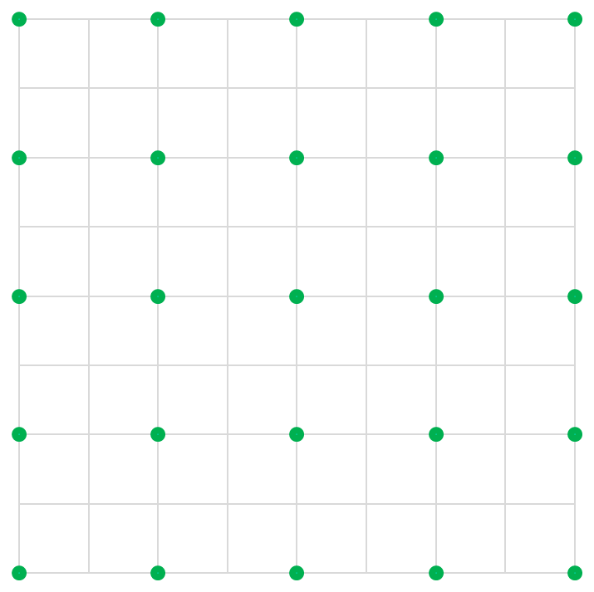
Relative spacing (Rs)- the Wilson factor (Fw)
Assuming that the trees are regularly spaced, the area available per tree is:

Slide 17
Relative spacing (Rs)- the Wilson factor (Fw)
Assuming that the trees are regularly spaced, the area available per tree is:
The relative spacing can be written in the form usuually known as wilson factor

Slide 18
Spacing factor (Sf)
Sf is a stand density measure that relates the average distance between trees to the crown width of the average tree:
If a regularly spaced stand is assumed, Sf comes as:

Slide 19
Crown cover(Cc)
Crown cover (Cc) is a stand density measure that computes the percentage of area covered with crowns :

Slide 20
The end!!

