Slide 1
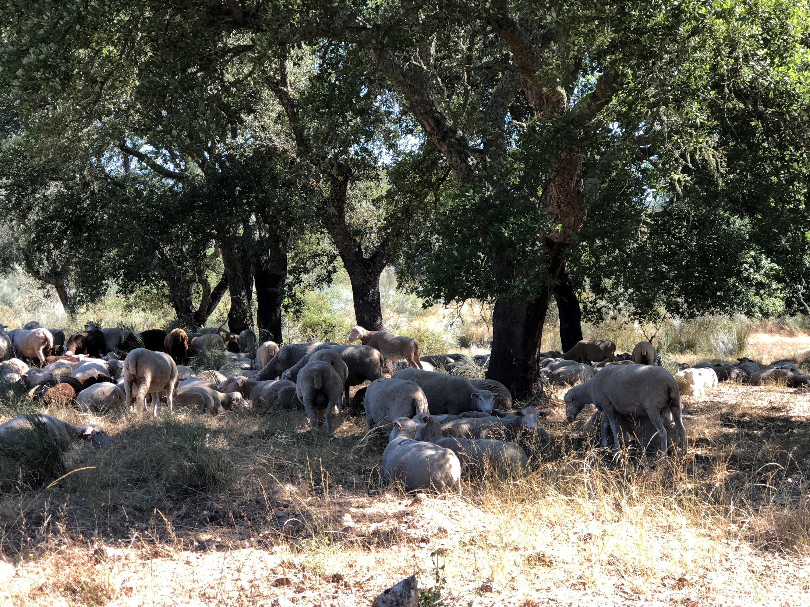
Overview of forest models and simulators as a support to sustainable forest management in a global change context

Slide 2
Why do we need forest growth models?
To support the increasingly complex forest management…

Slide 3
Forestry and forest management

Slide 4
Forestry
Forestry is the science, art, business, and practice of conserving and managing forests and forest lands in a way that
  provide a sustained supply of forest products
  maintain the forest health and vitality
  provide any other forest values desired by the forest owners
(adapted from Ford-Robertson, 1971)

Slide 5
Forestry
Forestry is the science, art, business, and practice of conserving and managing forests and forest lands in a way that
  maintain their health and vitality
  provide a sustained supply of ecosystem services desired by the forest owners and the society in general
  are resilient to the increasing occurrence of hazards
  are adaptable to climate change
(modified from Ford-Robertson, 1971)

Slide 6
  Forestry implies decisions about the relationship between the man and the forest, in particular about the way man modifies the forest in order to achieve the desired objectives
  FOREST MANAGEMENT

Slide 7
Forest management decisions are not easy…
Every forest activity, undertaken at any point in time has impacts on its future health and vitality and on the ecosystem services provided over time
There is no optimum sequence of silvicultural operations, they depend on the objective for each stand and landscape (there are no “recipes”)
Objectives may change over time (and have changed during the last decades…)
Many times there is the need to take into account rules established at a higher level (e.g. forest policy) in the day to day management

Slide 8
Forest management decisions
The need to evaluate, on the long term, the impact of alternative management options under a changing environment
FOREST GROWTH MODELS

Slide 9
Evolution of Forestry
Stage of development
Result
Preforestry – exploitation
Administrative forestry
  (timber oriented)
Ecologically-based forestry
  (considering the ecosystem as a whole)
Social and ecologically-based forestry
  (emphasis on all ecosystem services)
Resource depletion
Failure to achieve conservation and sustainability goals
Sustained production of timber achieved by an ecology based management
Ecologically based forestry that sustains a wide range of forest conditions and values desired by society
(adapted from Kimmins, 1997)

Slide 10
Primary and secondary forests, planted forests
Forests can be classified according to the level of human intervention they undergo:
  Primary forests: untouched
  Secondary forests: recovering from human disturbances, either naturally or by afforestation and/or reforestation activities
  Planted forests: at maturity are predominantly composed of trees established through planting and/or deliberate seeding
  Plantation forests: intensively managed, at maturity composed of one or two species, one age class, regular tree spacing

Slide 11
Forest management goals
1950’s
Timber
1950’s | 1960’s
Timber | Timber
 | Mutiple resources
1950’s | 1960’s | 1970’s
Timber | Timber | Timber
 | Mutiple resources | Mutiple resources
 |  | Biomass
1950’s | 1960’s | 1970’s | 1980’s
Timber | Timber | Timber | Timber
 | Mutiple resources | Mutiple resources | Mutiple resources
 |  | Biomass | Biomass
 |  |  | Global warming C sequestration
1950’s | 1960’s | 1970’s | 1980’s | 1990’s
Timber | Timber | Timber | Timber | Timber
 | Mutiple resources | Mutiple resources | Mutiple resources | Mutiple resources
 |  | Biomass | Biomass | Biomass
 |  |  | Global warming C sequestration | Global warming C sequestration
 |  |  |  | Ecosystem services (biodiversity) NWFPs
1950’s | 1960’s | 1970’s | 1980’s | 1990’s | 2000’s
Timber | Timber | Timber | Timber | Timber | Timber
 | Mutiple resources | Mutiple resources | Mutiple resources | Mutiple resources | Mutiple resources
 |  | Biomass | Biomass | Biomass | Biomass
 |  |  | Global warming C sequestration | Global warming C sequestration | Global warming C sequestration
 |  |  |  | Ecosystem services (biodiversity) NWFPs | Ecosystem services (biodiversity) NWFPs
 |  |  |  |  | Relationship with other land uses
1950’s | 1960’s | 1970’s | 1980’s | 1990’s | 2000’s | 2010’s
Timber | Timber | Timber | Timber | Timber | Timber | Timber
 | Mutiple resources | Mutiple resources | Mutiple resources | Mutiple resources | Mutiple resources | Mutiple resources
 |  | Biomass | Biomass | Biomass | Biomass | Biomass
 |  |  | Global warming C sequestration | Global warming C sequestration | Global warming C sequestration | Global warming C sequestration
 |  |  |  | Ecosystem services (biodiversity) NWFPs | Ecosystem services (biodiversity) NWFPs | Ecosystem services (biodiversity) NWFPs
 |  |  |  |  | Relationship with other land uses | Relationship with other land uses
 |  |  |  |  |  | Bioeconomy
(adapted from Lund & Smith, 1997)

Slide 12
Evolution of forestry and forest management
The evolution of forestry made the interaction between man and the forest – forest management – more and more difficult
Forest management is nowadays not an easy task...
In 2000 multifunctional sustainable forest management (MCPFC) was in the order of the day:
  Pan-European (and other) criteria and indicators / certification schemes came to the agenda

Slide 13
Evolution of forestry and forest management
The evolution of forestry made the interaction between man and the forest – forest management – more and more difficult
Forest management is nowadays not an easy task...
In 2000 multifunctional sustainable forest management (MCPFC) was in the order of the day:
  Pan-European criteria and indicators / certification
The importance of ecosystem services became relevant

Slide 14
Evolution of forestry and forest management
The evolution of forestry made the interaction between man and the forest – forest management – more and more difficult
Forest management is nowadays not an easy task...
In 2000 multifunctional sustainable forest management (MCPFC) was in the order of the day:
  Pan-European (and other) criteria and indicators / certification schemes came to the agenda
The importance of ecosystem services became relevant
Now we are in a context of an integrated bioeconomy

Slide 15
Ecosystem services
Ecosystem services are the benefices that nature provides to man and that are essential for man survival, being associated with the quality of life and welfare of society:
  Forests provide wood, food, medicinal substances and fibers, purify water, regulate climate and produce genetic resources
  Protection against natural disasters, erosion control, pollination, fertilization of soil by animal feces, decomposition of animals and plants by microorganisms
  Fluvial systems offer fresh water, energy and recreation
  The wet coastal areas filter residues, mitigate floods and serve as a nursery for commercial fishing

Slide 16
Ecosystem services
Provisioning Products produced by the ecosystems Food Fresh water Material for energy production Wood and Fiber Biochemical and genetic resources Non-wood products | Regulating Benefices resulting from the regulation of ecosystem processes Climate control Purification of water and air Regulation of the water cycle Erosion control Control of floods Control of pests and diseases | Cultural Non-material benefices provided by ecosystems Recreation Science and education Aestethical Spiritual
Supporting Services needed for the production of all the other services  cycle of nutrients  soil formation  primary production  Polinization and seed dispersal

Slide 17
Ecosystem services from different intensities of management
Adapted from Baral et al. 2016

Slide 18
Trade-offs in forest management at stand level

Slide 19
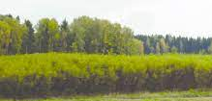
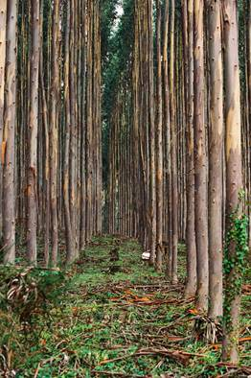
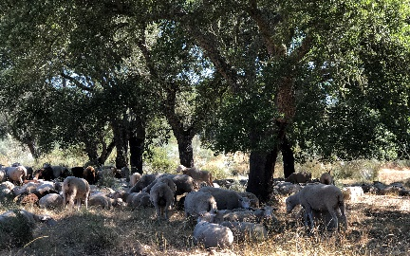
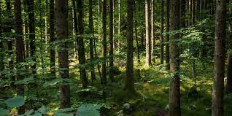
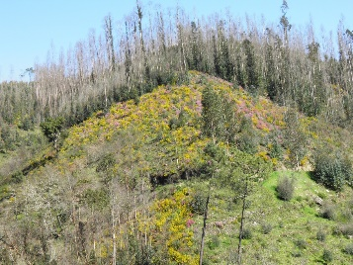
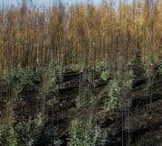
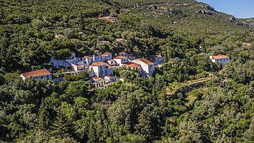
Dendro-biomass production
Forest management at stand level
Even-aged forestry
Combined objective forestry
Close-to-nature forestry
poorly managed forests
Nature conservation
Closer to Nature

Slide 20
Dendro-biomass production
Forest management at stand level
Even-aged forestry
Combined objective forestry
Provisioning ecossystem services
Close-to-nature forestry
poorly managed forests
Nature conservation
Regulation, cultural and support ecossystem services

Slide 21



Dendro-biomass production
Forest management at stand level
Even-aged forestry
Combined objective forestry
Income for landowners
Provisioning ecossystem services
Close-to-nature forestry
poorly managed forests
Nature conservation
Regulation, cultural and support ecossystem services

Slide 22

Dendro-biomass production
Forest management at stand level
Even-aged forestry
Combined objective forestry
Income for landowners
Provisioning ecossystem services
Close-to-nature forestry
poorly managed forests
Nature conservation
Regulation, cultural and support ecossystem services
Need of technical support for forest management and management costs

Slide 23

Dendro-biomass production
Forest management at stand level
Even-aged forestry
Combined objective forestry
Income for landowners
Provisioning ecossystem services
Close-to-nature forestry
poorly managed forests
Nature conservation
Regulation, cultural and support ecossystem services
Need of technical support for forest management and management costs
Valorization by the society, namely urban society

Slide 24
Implications of bioeconomy to forest management?
Before 2100 the Bioeconomy will have to double its output of raw material while halving its environmental impact (White paper on “The European bioeconomy in 2030”)
There is a recognized need to increase biomass availability – not only in amount but also in tree components (use of the whole tree)
Of course the achievement of these goals has strong implications on forest management (at all spatial levels)!

Slide 25
Implications of bioeconomy to forest management?
Increased biomass needs
Harvest in natural and semi-natural forests?
Harvest in planted forests
REDUCE THE INPUTS OF FOSSIL ENERGY
Increase planted area
Increase productivity of existing forests
LAND USE CONFLICTS
Tree breeding
Intensification of silviculture
Precision silviculture?
SUSTAINABILITY BIODIVERSITY HAS TO BE MAINTAINED
IS THERE ENOUGH KNOWLEDGE?
RESEARCH
COMPETITION FOR WATER

Slide 26
Implications of bioeconomy to forest management?
The bioeconomy context increased the complexity of forest management
The objective is to produce more reducing, if possible, the environmental impacts of biomass production
The overall energy balance has to be positive and without using fossil fuels
This is not easy and brings a series of conflicts!

Slide 27
Avoid reductions of C stock in forests (pests and diseases, wild fire, pollution)
Increase resilience of tree species to climate change
Adapt demand to the levels of possible harvest
Impact of whole tree harvest in soil fertility
Fullfill energy needs withou using fossil fuels
New forest management approaches as short rotation, uneven mixed-species forests
Efficiency of water and nutrients use
Innovation
Tree breeding, including use of GMO’s
Manage land use conflicts
Certification
Maintain / increase ecosystem services
Maintain biodiversity
SOLVING THIS PUZZLE IS THE CHALLENGE OF
TODAY’S FOREST MANAGERS!!
(adapted from Leal, 2014)

Slide 28
Actions that may help to solve the puzzle:
Forestry is a science, therefore the new challenges brought by bioeconomy need to be based on research:
  Interdisciplinary research
  Including forest managers & other actors along the forest products chains may help the transfer of knowledge to practice
Forestry is a business, therefore changes in forest management need to be profitable to forest owners:
  Forest owners must get part of the “gains” due to bioeconomy
  Importance of the valorization and payment of ecosystem services

Slide 29
Actions that may help to solve the puzzle:
Forests are to be maintained in good condition, therefore sustainability has to be guaranteed:
  Importance of monitoring systems - certification
Appropriate policy measures that promote the interest of forest owners and society in general by a green economy are also needed
Forest models and simulators may support these actions

Slide 30
Components of forest models and simulators

Slide 31
Forest model (Cost Action FP0603 terminology)
A dynamic representation of the forest and its behaviour (at whatever level of complexity)
The forest is defined by the values of a set of state variables (N, hdom, G, V, W, Wshrubs, soil characteristics, etc)
The model is able to simulate the evolution of forests over time (evolution of state variables) and its responses to changes in the driving variables
The model is based a set of (sub-)models or modules that together determine the behaviour of the forest

Slide 32
State variables (Cost Action FP0603 terminology)
Set of variables (stand and/or tree variables or some ecosystem pools) that characterize the forest at a given moment and whose evolution in time is the result (output) of the model:
  Principal variables if they are part of the growth modules
  Derived variables if they are indirectly computed from the values of the principal variables
Model module
  Set of equations and/or procedures that led to the prediction of the future value of a state variable

Slide 33
State variables (Cost Action FP0603 terminology)
Depending on the type of model, the same state variable can be principal in one model but derived in another one. For instance:
  Dominant height is usually a principal variable in empirical models, namely for even-aged pure stands, but it is usually derived in process-based models
  Basal area is a principal variable in whole stand empirical models but it is derived in individual tree models where the “equivalent” principal variable are the diameters of each individual tree
  Principal variables in process based models are mainly the biomass pools (ate stand or tree level) and not the “traditional” stand variables

Slide 34

Forest model
Outputs
Inputs
Outputs
Inputs

Slide 35
Forest model
The real growth model
It is dynamic
Simulates growth of a set of state variables - the principal variables
Growth Module
Outputs
Inputs
Outputs
Inputs

Slide 36
Forest model
Controls growth by a set of silvicultural operations
Management
Module
Growth Module
Outputs
Inputs
Outputs
Inputs

Slide 37
Forest model
Estimates other variables from the principal ones
The output module is static
Management
Module
Output / calculation
Module
Growth Module
Outputs
Outputs
Inputs
Inputs

Slide 38
Forest model
Completes the data from forest inventory
Initializes new stands
Management
Module
Output / calculation
Module
Growth Module
Initialization
Module
Outputs
Outputs
Inputs
Inputs

Slide 39
Forest model
Management
Module
Output / calculation
Module
Growth Module
Static
Growth of derived variables indirectly estimated from the principal variables
Dynamic
Predicts growth of the principal variables
Initialization
Module
Outputs
Outputs
Inputs
Inputs

Slide 40
Driving variables (Cost Action FP0603 terminology)
Variables that are not part of the forest model (some are part of the forest ecosystem) but influence its behaviour:
  Environmental variables (e.g. climate, soil)
  Human induced variables (e.g. silvicultural operations)
  Risks (e.g. fire, pests and diseases, storms)
The separation between state and driving variables is sometimes not straighforward

Slide 41
Forest simulator (Cost Action FP0603 terminology)
Computer tool that, based on a set of forest models, makes long term predictions of the status of a forest under a certain scenario of management, climate, risks, forest policy
Forest simulators usually predict, at each point in time, wood and non-wood products from the forest
It is desirable that they predict a large range of ecosystem services
They may be developed for different spatial levels

Slide 42
Forest management decisions at different spatial scales:
stand
  homogeneous forest area
management unit
  set of stands with a common
  management plan
watershed, landscape
region (e.g. PROF)
country
continent
Foresters and forest owners (private and other)
Decide on:
Land use
Tree species
Forest mgt approaches
Industry and society requirements
Politicians and public administrators
Decide on:
Forest policy - legislation
Incentives and subsidies

Slide 43
Forest model
Management
Module
Output / calculation
Module
Growth Module
Initialization
Module
Outputs
Outputs
Inputs
Inputs

Slide 44
Stand simulator
Management
Module
Output / calculation
Module
Economics
Module
Growth Module
Initialization
Module
Outputs
Outputs
Inputs
Inputs

Slide 45
Management unit and large scale simulators
Demand
Module
Management
Module
Output / calculation
Module
Economics
Module
Growth Module
Initialization
Module
Outputs
Outputs
Inputs
Inputs

Slide 46
Management unit and large scale simulators
Demand
Module
Land Use Changes
Module
Management
Module
Output / calculation
Module
Economics
Module
Growth Module
Initialization
Module
Outputs
Outputs
Inputs
Inputs

Slide 47
Management unit and large scale simulators
Demand
Module
Land Use Changes
Module
Management
Module
Output / calculation
Module
Disturbances
Module
Economics
Module
Growth Module
Initialization
Module
Outputs
Outputs
Inputs
Inputs

Slide 48
Management unit and large scale simulators
Management unit simulators or regional simulators must include several drivers
Demand
Module
Land Use Changes
Module
Management
Module
Calculation and Assortments
Module
Disturbances
Module
Economics
Module
Growth Module
Sample text
Climate
change
Initialization
Module
Outputs
Inputs

Slide 49
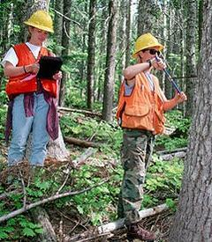
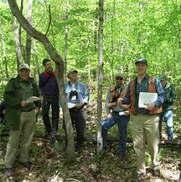
Management unit (MU)
Characterisation of each stand in the MU (values of state variables) at time t
Forest inventory
Initialization module
or/and
t+1
Prediction of wood & non-wood products and ecosystem services
Forest simulator computer program
(includes a set of forest growth models)
Forest evolution of each stand in the MU under a certain management approach (FMA)
Status of the forest (state variables) over time
Forest simulator

Slide 50
Decision support system (Cost Action FP0603 terminology)
Simulator that includes optimization algorithms that point out for a solution – selection of a forest management approach for each stand:
  Multi-criteria decision models
  Artificial neural networks
  Knowledge based systems

Slide 51


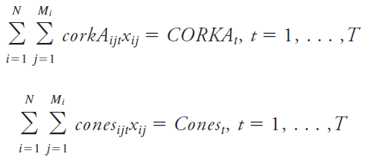
Forest inventory
Characterisation of each stand in the MU (values of state variables) at time t
Models and methods to select management options that may sustain conditions and outcomes of interest
(multiple criteria)
Forest simulator computer program
(includes a set of forest growth models)
Forest simulator applied several times to each stand
Optimization and other OR techniques
Simulation of several forest management alternatives (MA) for each stand
Prediction of wood & non-wood products and ecosystem services for each combination of FMA
Decision support system

Slide 52
Evolution of forest growth models and respective typology

Slide 53
Forestry and forest management evolution

Increased knowledge about ecosystems functioning

Technology development

Climate change

Change in society requirements from forests
EVOLUTION OF FOREST GROWTH MODELS

Slide 54
Forest growth models
Classification according to the growth module
(to be used in practice all models need a static module)
Empirical growth and yield models
Semi-empirical models
(LUE)
Process based models
3PG
YieldSAFE
---

Slide 55
Statistical FGMs (empirical G&Y)
Developed using statistical techniques and calibrated for large data-sets
The site index (hdom at a given base-age) is often used as a proxy for environmental conditions
Growth is usually modeled with the so-called growth functions
Adequately describe growth for a range of silvicultural practices and site conditions
Some are able to predict wood quality properties
Exist for all of the most important forest types in Europe and most of them have been extensively validated
Do not allow for the simulation of forest growth under a changing environment or subject to novel silvicultural practices

Slide 56
The G&Y model GLOBULUS (empirical)

Slide 57
Process-based ecophysiological models
Developed to understand forest behaviour from a description of plant-soil and carbon-nutrient-water interactions
Allow the simulation of forest growth under a changing environment or subject to novel silvicultural practices
The principal variables are biomass pools per tree component (leaves, branches, roots, wood)
A specific problem with this type of model is the need for detailed input, demanding data which are rarely available at regional or lower levels
Do not give all the output needed for forest management (but it can be easily added)

Slide 58


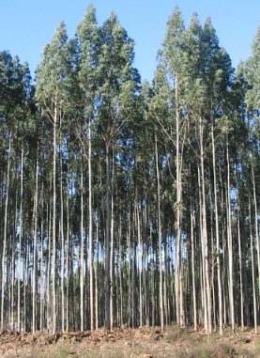
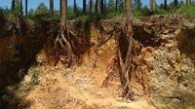
solar radiation
Transpiration
frost
Interception
Leaf area
Light intercepted
VPD
tempe rature
Age
Light use efficiency
modifiers
leaves
litter
Gross primary production
Respiration
Net primary production
Soil evaporation
woody biomass
VPD
Tree size
NPP allocation
Mortality estimation
roots
Update the biomass compartments
Soil fertility
Soil water
Soil water balance
Root turnover
Excess water

Slide 59
Growth modifiers in 3PG
Each environmental factor is represented by a growth modifier or function of the factor that varies between 0 (total limitation) and 1 (no limitation)
Factor | Modifier | Parameters
Vapor pressure deficit | f_{VPD}(D) | k_{D}
Soil water | f_{SW}(θ) | θ_{max} , c_{θ} , n_{θ}
Temperature | f_{T}(T_{av}) | T_{min} , T_{opt} , T_{max}
Frost | f_{F}(d_{f}) | k_{F}
Site nutrition | f_{N}(FR) | f_{N0}
Stand age | f_{age}(t) | n_{age} , r_{age}

Slide 60
An example: temperature growth modifier f_{T}(T)
where
T = mean monthly daily temperature
T_{min} = minimum temperature for growth
T_{opt} = optimum temperature for growth
T_{max} = maximum temperature for growth
Tmin= | 6
Topt= | 16
Tmax= | 40

Slide 61
Forest growth models
Classification according to the unit of simulation
(growth module)
Stand models
Stand models with simulation of the diameter distribution
Individual tree models

Slide 62
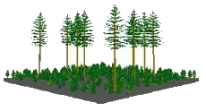
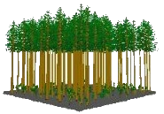
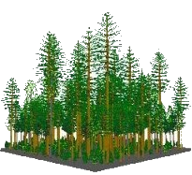

Stand Model with Diameter Distribution
Individual Tree Model
Stand Model
Principal variables: stand variables (all)
Competition: stand density measures
Principal variables: stand variables (including the variables needed to simulate diameter distribution)
Volume and biomass computed from the dd
Competition: stand density measures
Principal variables: tree variables (except hdom)
Competition (inter-tree): - competition indices - light interception modules
T | N | hdom | G | … | V
1 | N₁ |  |  | … | V₁
2 | N₂ |  |  | … | V₂
... | … |  |  | … | …
k | N_{k} |  |  | … | V_{k}
simulate more complex structures (uneven-aged, mixed-stands)
have more extrapolation ability

Slide 63
Current forest models and sustainable forest management needs

Slide 64
Requirements from forest models - moving
FROM
TO
Stand models
Empirical models
Stand simulators
Simple structure forests
Focusing just trees
Simple output, mainly traditional stand variables and volume harvested
Individual tree models
Process based models
Management unit simulators
Complex forests (uneven and mixed)
Focusing other ecosystem components (e.g shrubs, soils)
Diversified outpus, including social, economic and ecological indicators, including ecosystem services
Life is not easy for growth modelers!!

Slide 65
Examples of sustainability indicators
Economic
  Production costs (from inside and outside FWC)
  Labor costs
  Gross value added
  Total production
Social
  Wages and salaries (by gender and expertise)
  Employment
  Recreational value of forests

Slide 66
Examples of sustainability indicators
Environmental
  Forest resources (standing volume, harvested volume & biomass)
  GHG balance (carbon stock, carbon sequestration & carbon in products)
  Forest area (by age classes, afforestation, deforestation, burnt area…)
  Water use
  Water quality
  Erosion

Slide 67
Present models need improvement
There is the need for more detailed, versatile forest growth models that
  can work using readily available forest inventory data as input
  are able to give good predictions under climate change
  take into account the genetics of the plant material
  provide information on the effect of different silvicultural alternatives not only on tree growth but also on other forest products and services (indicators of MSFM)
  provide reliable information on stand structure and wood quality
  account for the possible occurrence of several damages

Slide 68
Present models need improvement
Current models:
  Do not include risk assessment such as storm damage, fire, pests and diseases
  Concentrate output on the development of trees (do not give output on the impact of forests and forest management on soils and water use, biodiversity, recreational and amenity values, etc)
  Do not simulate wood quality
  Do not simulate the impact of genetic improvement
There are models covering some of these aspects but generally these aspects are not covered

Slide 69
Present models need improvement
  Scientifically there is the need to improve the knowledge of the forest ecosystems to be able to predict stand growth and forest development under changing environmental and managerial conditions
  For forestry practice
    there is the need to improve output quality regarding the level of detail as well as the accuracy of predictions
    for instance good information on stand structure is essential to assess wood quality or to evaluate harvesting procedures and costs

Slide 70
The need to use landscape forest simulators
For instance modelling fire impacts includes several steps
  Predicting the probability of occurrence
  Once it occurs, predict the “propagation of the risk”
  Predict the impact (tree death, decrease in productivity, etc)
It can only be done at landscape/larger spatial scales and requires that the model includes new variables (such as height of shrubs, shrub biomass, height to the base of the crown, crown bulk density)
The integration of models into management unit / large scale forest simulators is a requirement of modern forest management

Slide 71
Forest simulators at different spatial scales

Slide 72
Stand simulators

Slide 73
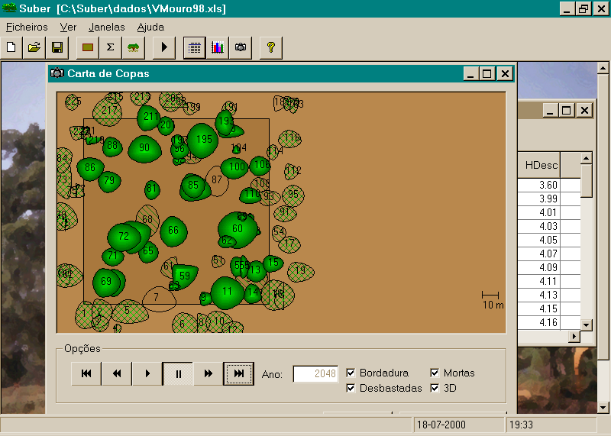
Stand characteristics
Evolution of stand development
FMAs and prescriptions
Scenarios

Slide 74
Example with the SUBER model
11 years old plantation in Portugal (Chamusca)
A forest inventory took place

Slide 75
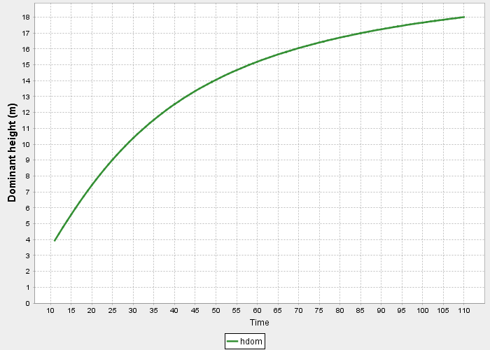
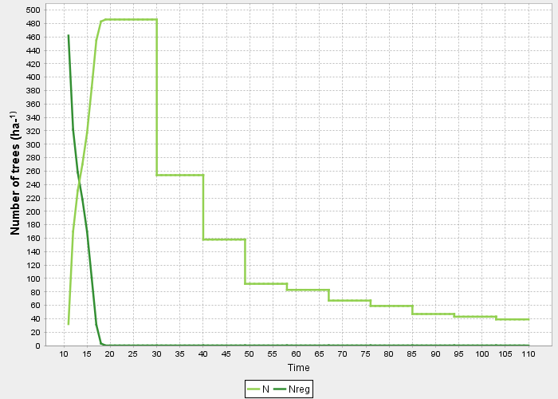
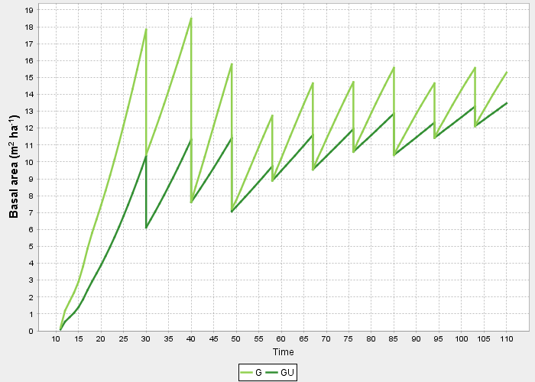
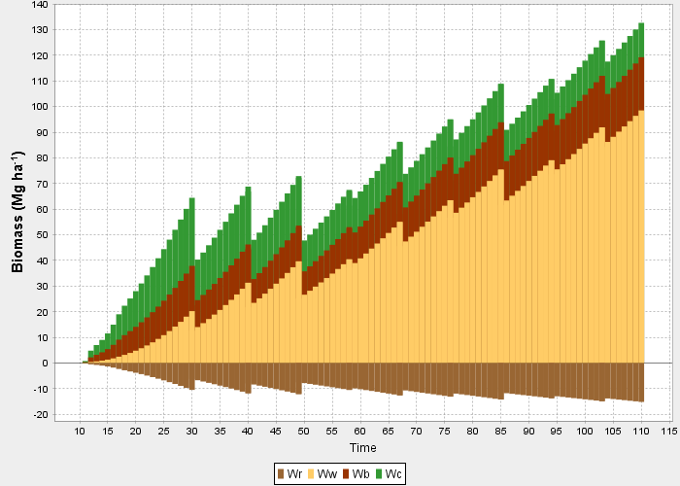
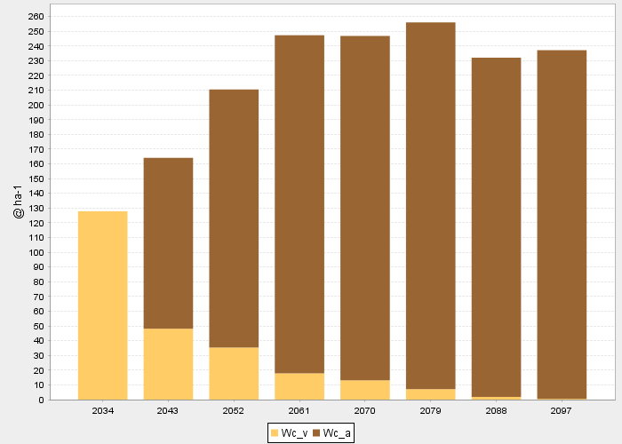
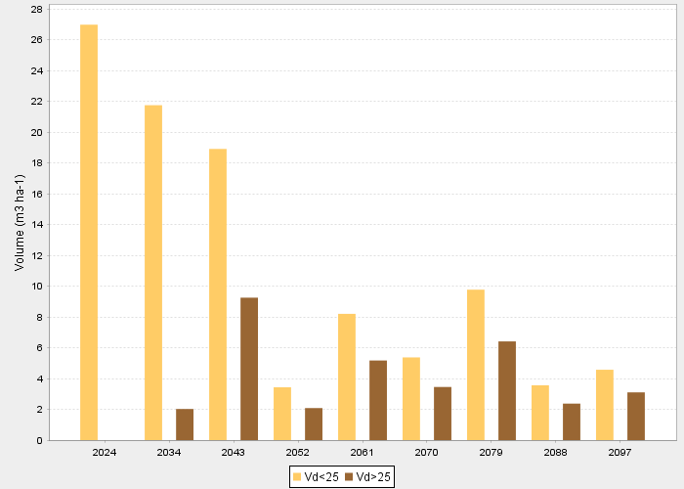
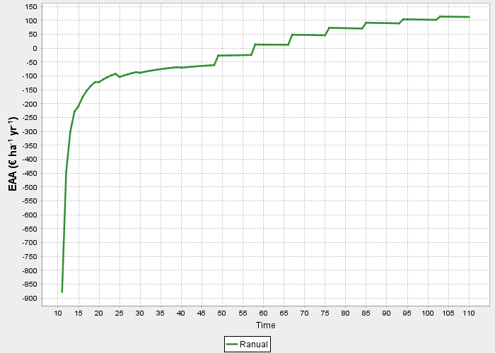
Example with the SUBER model

Slide 76
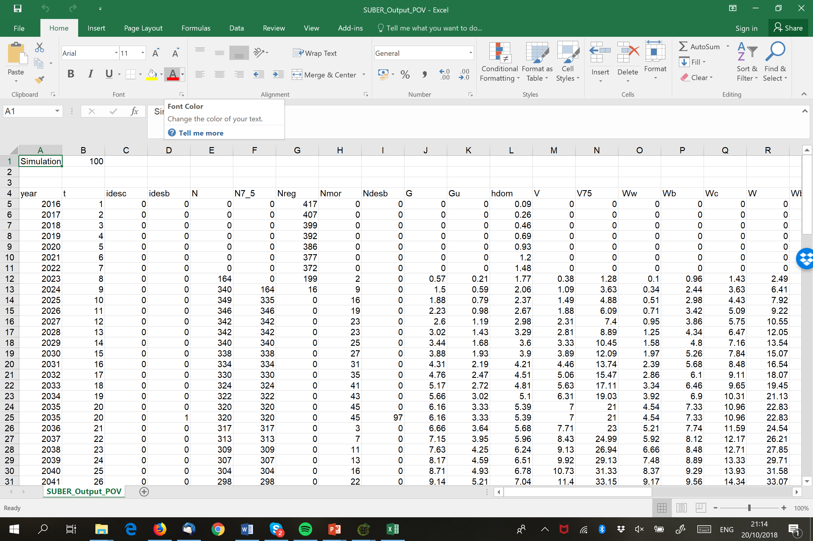
Example with the SUBER model

Slide 77
Landscape simulator

Slide 78
Landscape simulator
Forest simulator focused on the simulation of all the stands included in a certain well defined region in which the stands are spatially described in a GIS
The simulation is made on a stand by stand basis but outputs for the whole landscape are also provided, namely sustainability indicators
It allows for the testing of the effect of spatial restrictions such as maximum or minimum harvested areas or maximization of edges of each stand according to a pre-established scenario

Slide 79
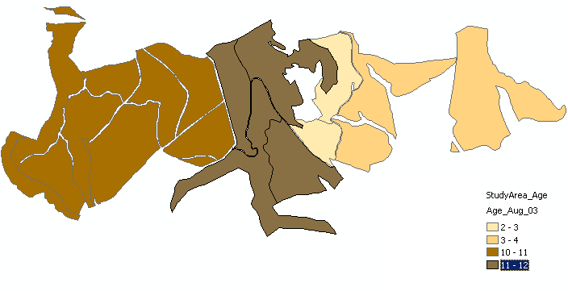
Age class

Slide 80
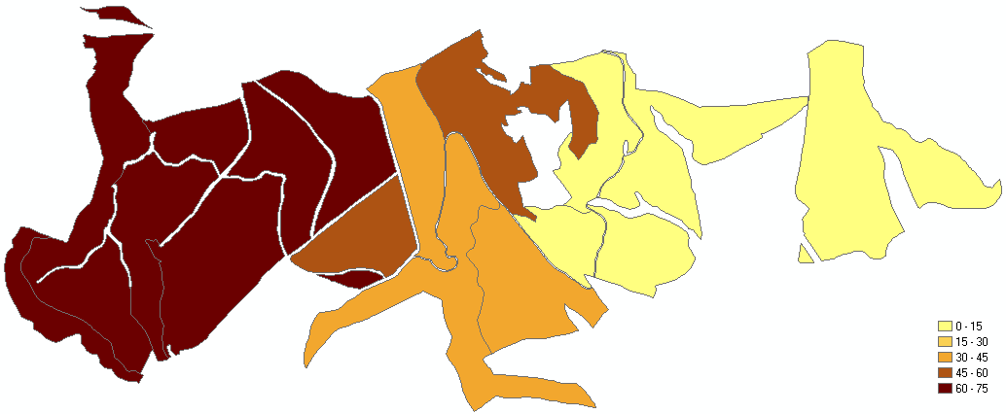
C stock -Year 0

Slide 81
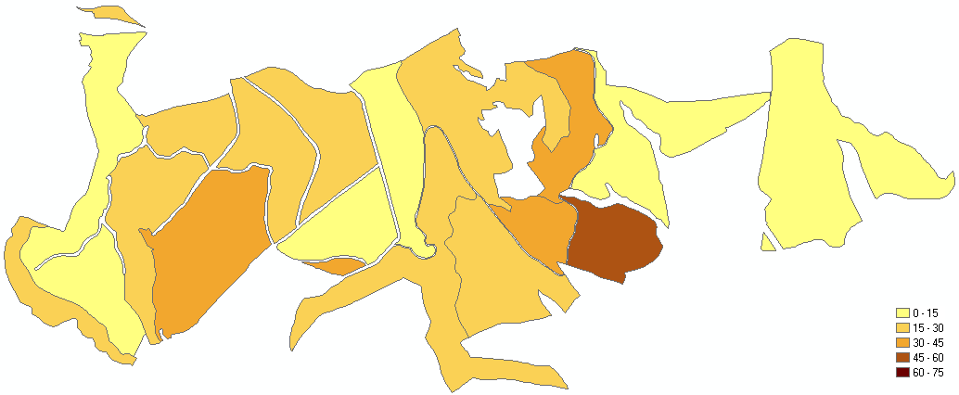
C stock -Year 10
Age class

Slide 82
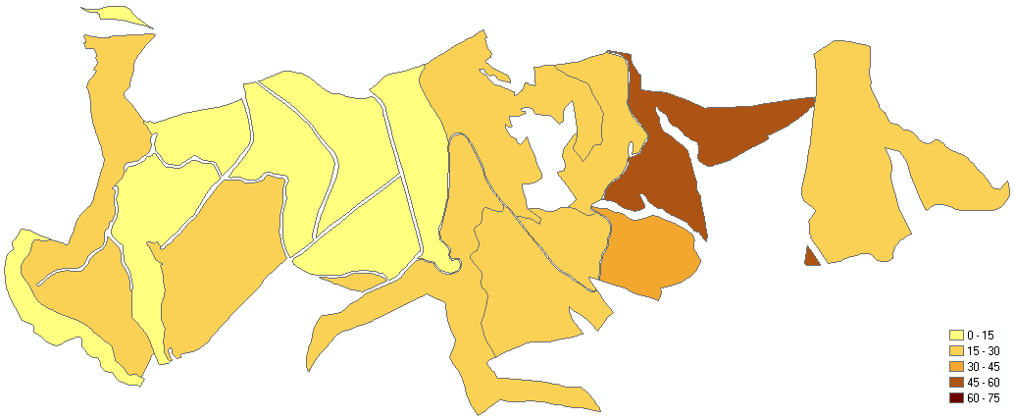
C stock -Year 20
Age class

Slide 83
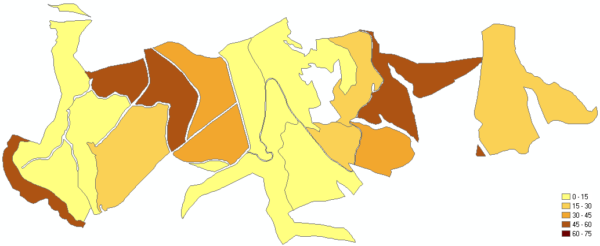
C stock -Year 30
Age class

Slide 84
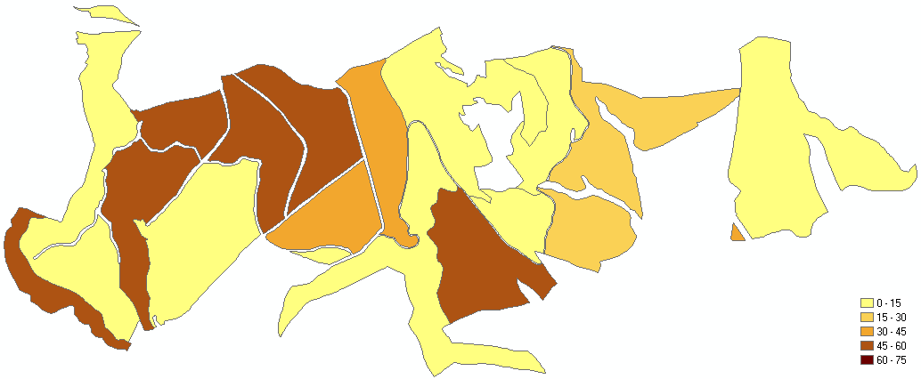
C stock -Year 40
Age class

Slide 85
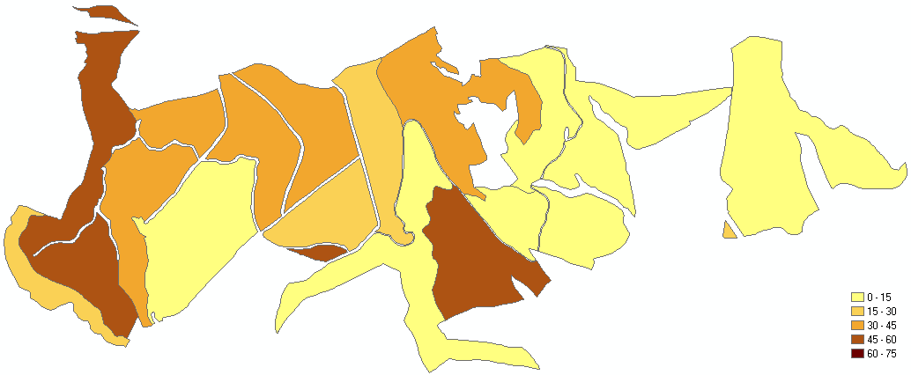
C stock -Year 50
janecopeco*90
Age class

Slide 86
Global indicators of sustainability / ES
Here we can compute, for each year, a large set of indicators of sustainability / ecosystem services
  Carbon stock and carbon sequestration
  Diversity indicators (e.g. Shannon-Winner for age classe, forest types, etc)
  Wages and employment
  % of areas dedicated to recreation
  Burned area
  Area with health problems
  ----

Slide 87
Evolution of C stocks

Slide 88
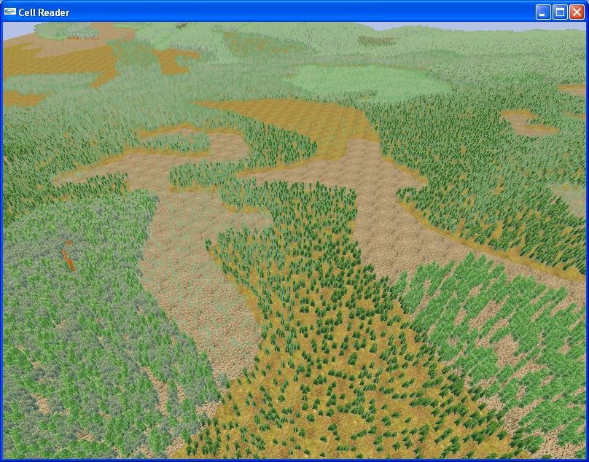
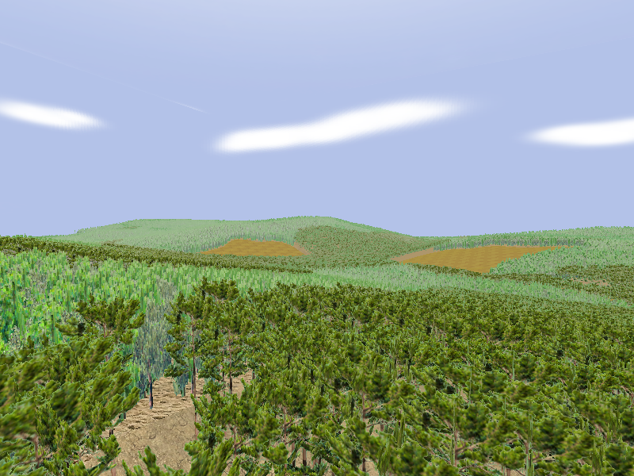
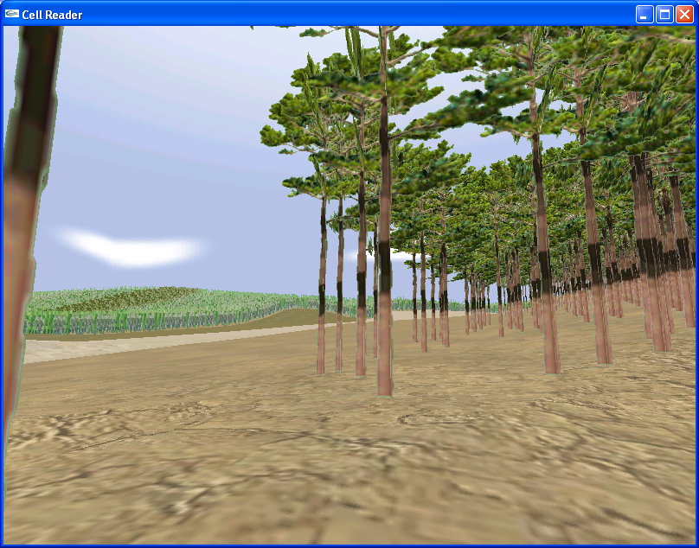
Real-time 3D visualization of the landscape

Slide 89
Regional simulators

Slide 90
Regional simulators
Start with NFI information to characterize the forest resources in a region (e.g. NUT, country, Europe)
use forest growth models to predict long-term development of forest resources in the region
take into account the influence of a certain number of external variables – the drivers
compute the subset of sustainability indicators that directly relate to forest resources

Slide 91
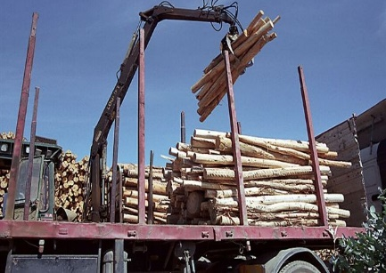

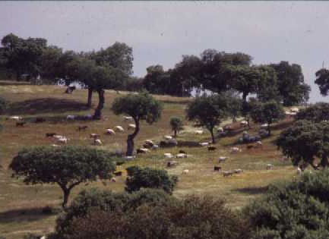
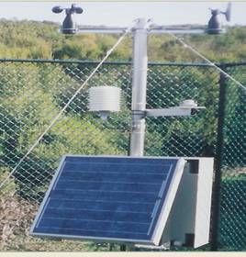
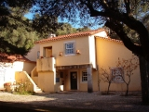
Wood consumption
Hazards
Apply forest growth models to update forest resources
Modify forest resources according to drivers
NFI data
Forest resources
Year t
Forest resources
Year t+1
Sustainability indicators
Forest management approaches
Change of FMA
Land use changes
Climate scenarios

Slide 92
Example of standsSIM.sd
Drivers:
  Annual wood harvest
  Area burned per year
  % of burned area that is harvested for industrial use
  Minimum age that allows industrial use after fire
  Minimum age for final harvest
  New areas planted every year
  % of area abandoned every year
  Climatic scenarios

Slide 93
Implementation of 3PG in standsSIM-sd
For climate change impacts standsSIM-sd use of the 3PGout+ model
The input needed for the 3PG-based growth models is not available from the Portuguese NFI:
  Soil texture, Fertility rating, Maximum available soil water
How to solve the problem?
  Persuade the Portuguese Forest Authority to improve soil characterization in NFI (long term strategy)
  Obtain the soil type from soil maps and estimate the 3PG input from that (short term strategy)
A problem really not solved!

Slide 94
Drivers
Wood demand
  CELPA statistics (consumption-import) till 2013 and maintenance of the 2013 value till 2037
    Between 8 and 35% of the wood consumption has been imported in the period 2007-2013
Forest fires
  Area burned based on historical series, considering two scenarios:
    Business as usuall
    Increased fires due to climate change

Slide 95
Drivers (cont)
Changes in forest management
  After harvesting, uneven-aged stands are converted to even-aged
  Just two FMAs, no options: UEAF and EAF
Land use changes to/from other uses
  Annual area of afforestation based on our “expert judgement” (till 2014: 800 ha; 2015-2019: 1600 ha; 2020-2026: 1200 ha; nothing after 2027)
  No defforestation was considered

Slide 96
Drivers (cont)
Climate scenarios
  Scenario A1B
  Model HadRM (25 km) that has been found to be the most appropriate for Portugal
  Selection of the “metereological station” closest to each NFI plot and simulations made with averages for two periods:
    2001 – 2030
    2061 – 2090

Slide 97
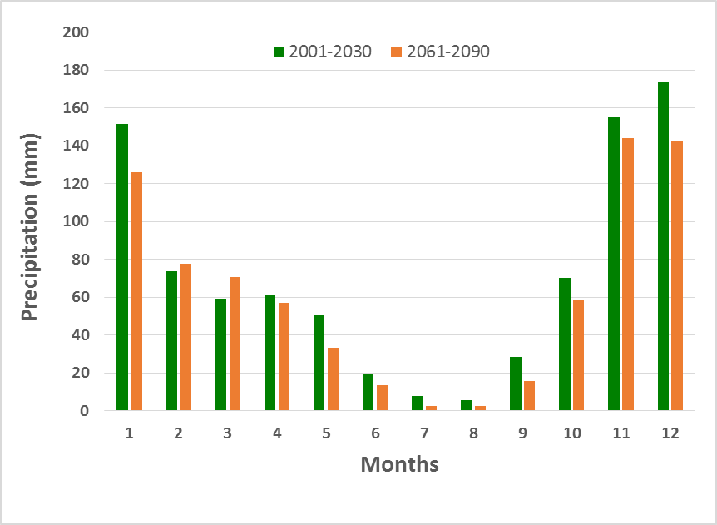
Precipitation in the two climate scenarios

Slide 98
Scenarios
A scenario is made up by the annual values for the drivers
Other user options:
  minimum age for harvest (8 years)
  minimum age allowing industrial use after fire (5 years)
  % burned area harvested for industrial use (50%)
  Minimum fire recurrence (5 years)

Slide 99
Fire and harvesting modules
All these modules work at “stand” level:
  A probability of occurrence of the event is estimated for each stand
  The event occurs or not by comparision with a random number
  In case the event occurs the simulator takes a specific action depending on the event

Slide 100
How does the simulator work?

Slide 101
Implementation of the drivers
Wood demand
Fire module

Slide 102
Implementation of the drivers
Wood demand
Thinning module
Fire module

Slide 103
Implementation of the drivers
Wood demand
Final cut module
Thinning module
Fire module

Slide 104
Implementation of the drivers
Wood demand
Clearcut module
Thinning module
Fire module

Slide 105
Actions taken for a clearcut (as an example):
The merchantable volume is added to the harvested volume
abandoned
replanted
replanted with another species
regenerated by coppice
Initialization module of the growth model initiates the new stand

Slide 106
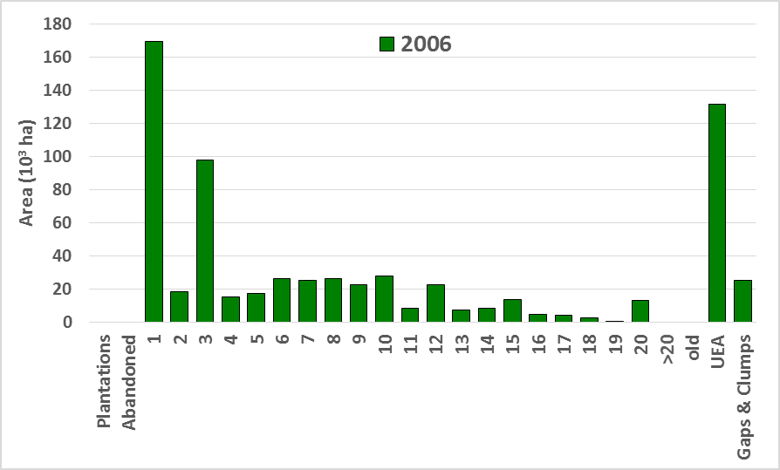
Data used as input: NFI 2005-2006
Area of eucalyptus stands (pure): 663353 ha
Number of plots: 1624
Standing volume: 40.50 (10⁶ m³) (official is 43.22)

Slide 111
New plantations start to be harvested

Slide 112
Some conclusions can be drawn from this study:
Portuguese eucalyptus forest is in danger of becoming unsustainable
The impact of climate change will emphasize this tendency
Wood import and plantations can help to meet wood demand without puting the forest at risk
Regional simulators, such as standsSIM-sd, are usefull tools to analyze forest sustainability as well as to find the best solutions to maintain it

Slide 113
Final comments

Slide 114
Good decisions on forest management?
Depend on good decision support systems that include:
  Forest inventory
  Forest models (give answers to what if? questions)
  Definition of the forest management approaches to test
  Evaluation of the results using optimization and other OR techniques
Where must the research efforts be put?

Slide 115
Forest inventory
Characterisation of each stand in the MU (values of state variables) at time t
Models and methods to select management options that may sustain conditions and outcomes of interest
(multiple criteria)
Forest simulator computer program
(includes a set of forest growth models)
Forest simulator applied several times to each stand
Optimization and other OR techniques
Simulation of several forest management alternatives (MA) for each stand
Prediction of wood & non-wood products and ecosystem services for each combination of FMA
Decision support system

Slide 116
Questions?

