Slide 1

StandsSIM-md & sIMfLOR
The Portuguese management driven forest simulator and the forest simulators platform
Susana Barreiro, Margarida Tomé
Instituto Superior de Agronomia
Universidade de Lisboa

Slide 2
Outline
Tree species in Portugal
sIMfLOR platform and its forest simulators
Important concepts
  Planning horizon
  Forest management approaches (FMA)
  Management prescriptions
  Scenarios
StandsSIM.md structure and inputs
StandsSIM.md generating and understanding input files
Running StandsSIM.md in sIMfLOR
  Generating and importing inputs
  Running StandsSIM

Slide 3
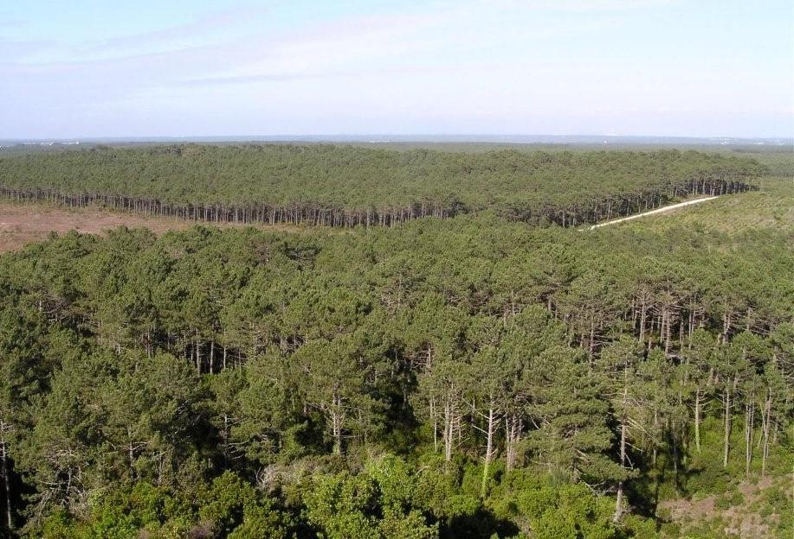
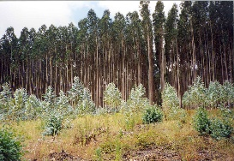
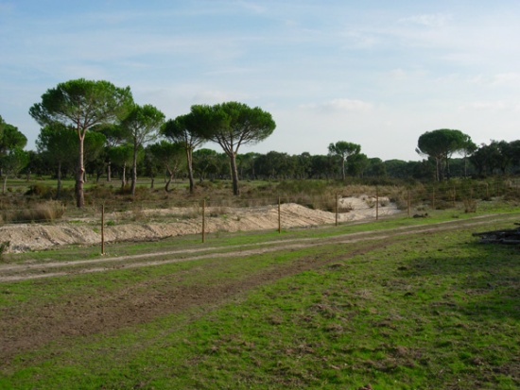
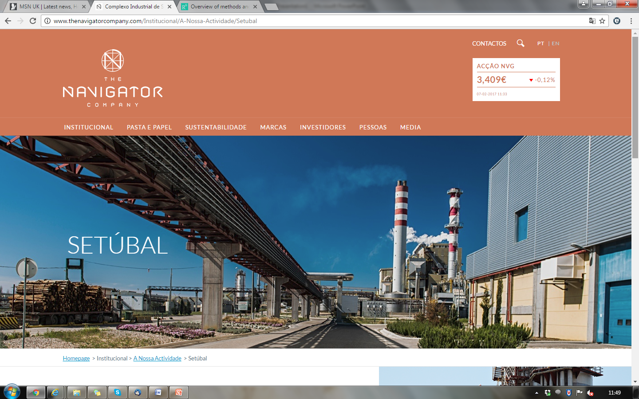
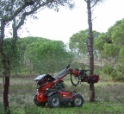
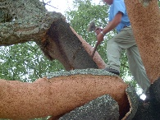
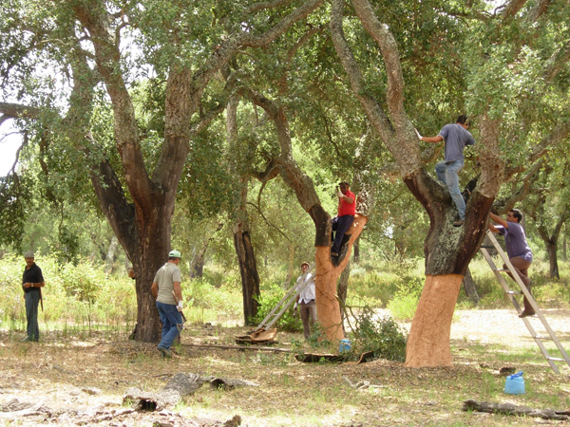
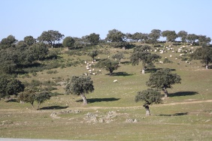
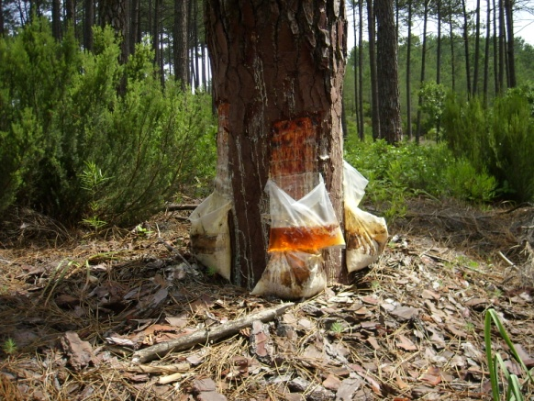
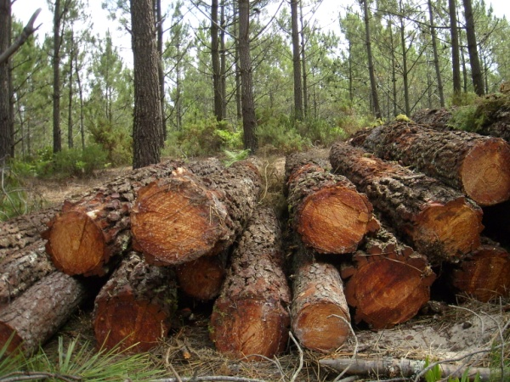
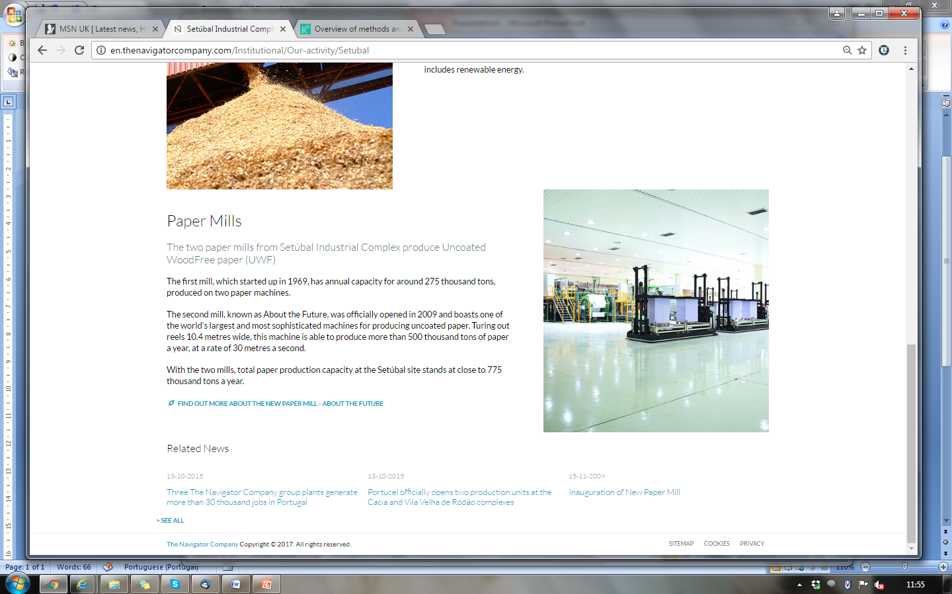
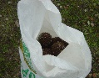
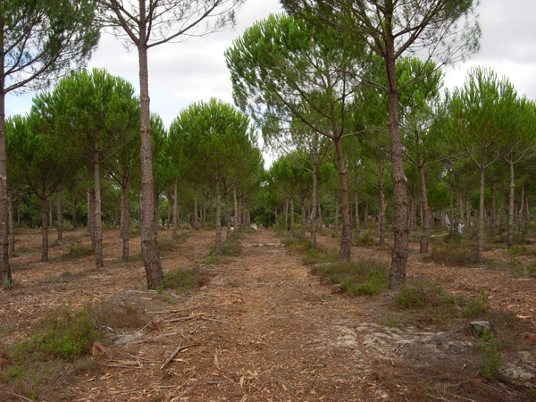
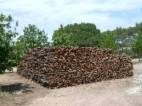
Forest Tree Species in Portugal
Maritime pine
22%
Eucalyptus
26%
Stone pine
6%
Cork oak
22%
Holm oak
11%
Traditional wood production species
Non-Traditional wood production species
Wood (and resin)
Pulp
Cork:
forbidden to harvest
thinning allowed
Agroforestry :
forbidden to harvest
thinning allowed
Pine nuts

Slide 4
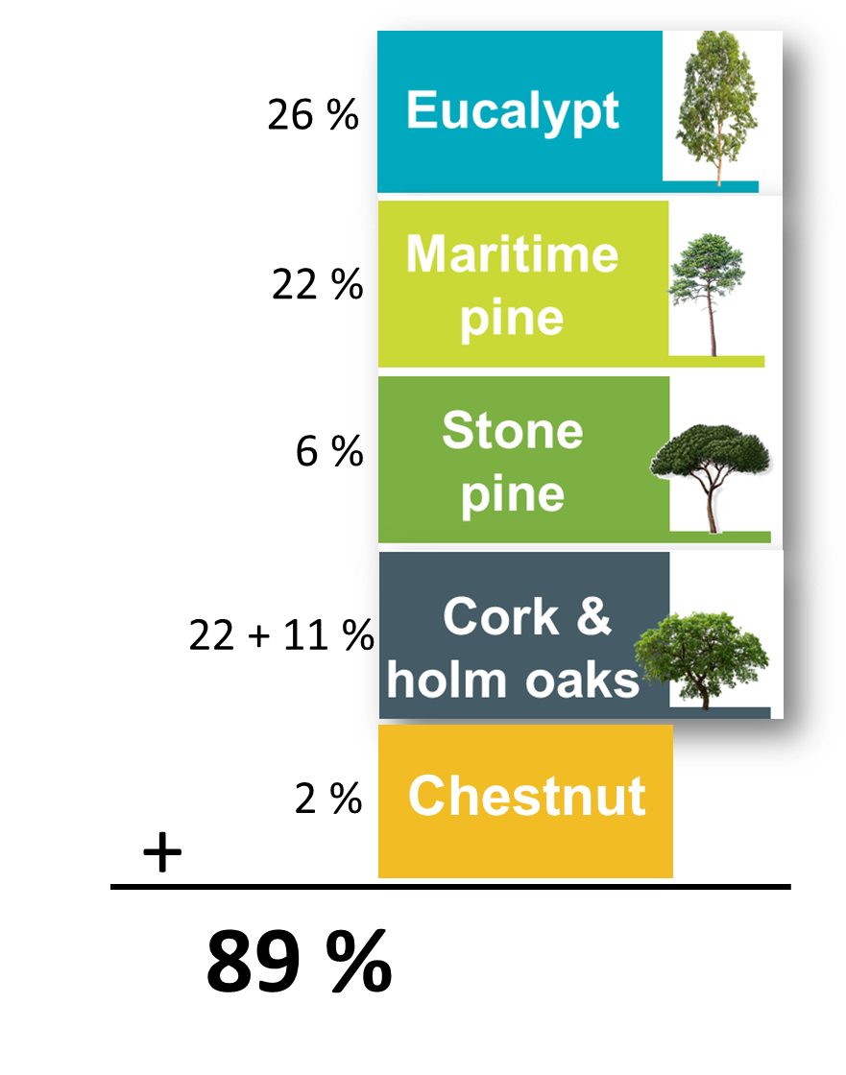
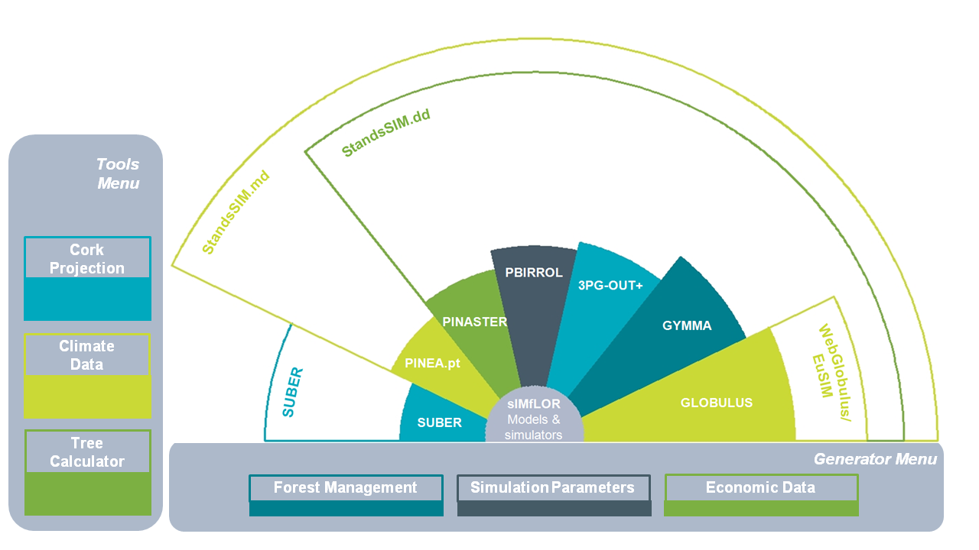
sIMfLOR platform and its forest simulators

Slide 5
Important concepts
Planning horizon:
  Number of years to simulate, projection/prediction period
Forest management approach (FMA):
  Implementation of a silvicultural systems, expressed by a sequence of silvicultural operations during a rotation
Prescription:
  Sequence of FMAs and transition between FMAs that are applied to a stand during the projection period/planning horizon
Scenario:
  Conditions present during the projection period (climate, forest policy measures, management alternatives, etc)

Slide 6
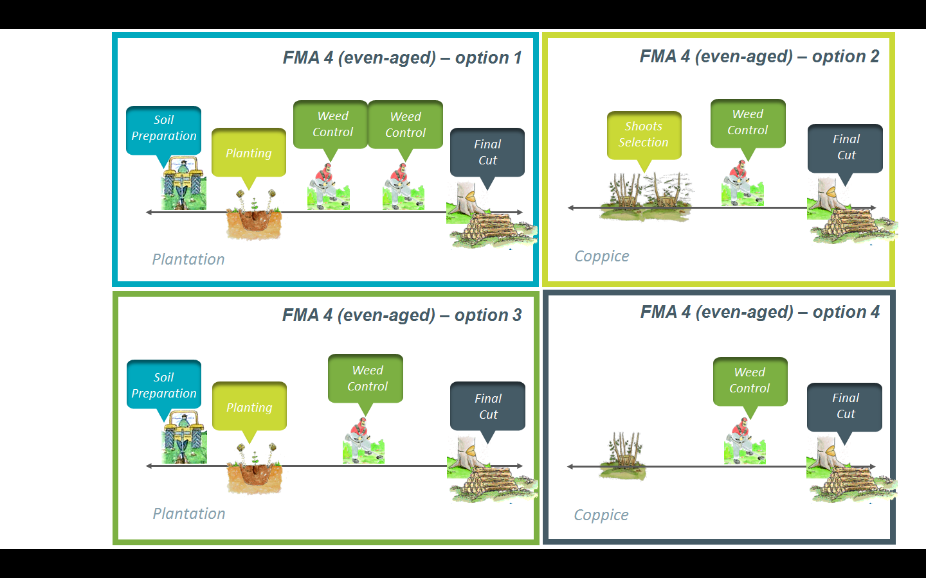
Forest management approach (FMA):
Describes silvicultural operations from stand regeneration up to final cut
Must be defined up to the maximum harvest age (even-aged stands) or for the rotation period (uneven-aged stands)
Several options can be considered under each FMA type, where options differ in terms of sets of operations considered and/or their distribution over time

Slide 7
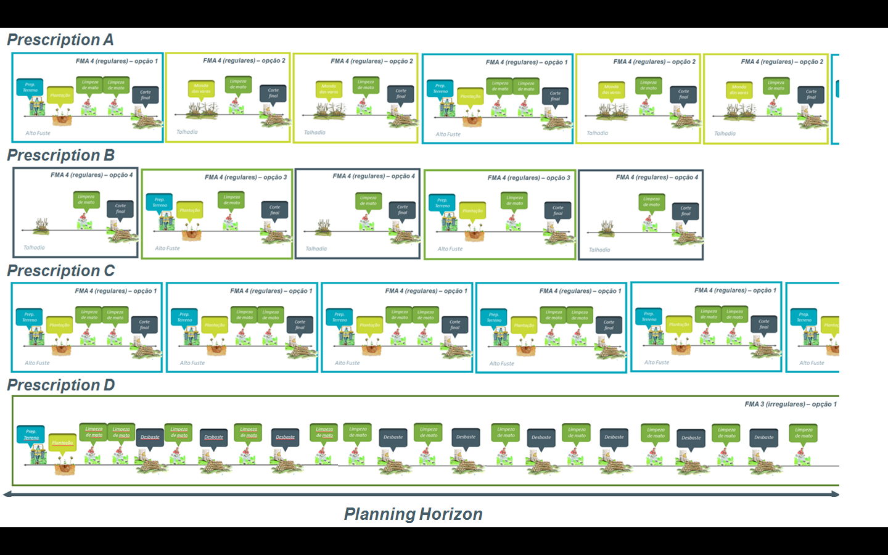
Prescription:
The set of cycles from regeneration until final cut can be built of:
Sequence of different FMAs/options (Prescriptions A & B)
Sequence of the same FMA/option (Prescription C)

Slide 8
Prescription:
can have a single cycle if the FMA is defined for a number of years greater than the planning horizon (Prescription D)
Incomplete prescriptions will stop the stand from being simulated
(Prescription B)

Slide 9
Prescription:
Defining the number of prescription cycles to cover the planning horizon when simulating a yield table is straightforward
However, when your existing stand is older, the FMA file for the first cycle starts being read at the age of the stand (e.g 7 years). As a result, the number of years simulated under the 1st cycle is smaller, often leading to incomplete prescriptions
A simple way to solve it is guaranteeing we add one or two extra cycles to the prescription

Slide 10


Scenario:
+
-
a)
S1:
S2:
++
--
b)
S1:
S2:
S3:
S4:

Slide 11
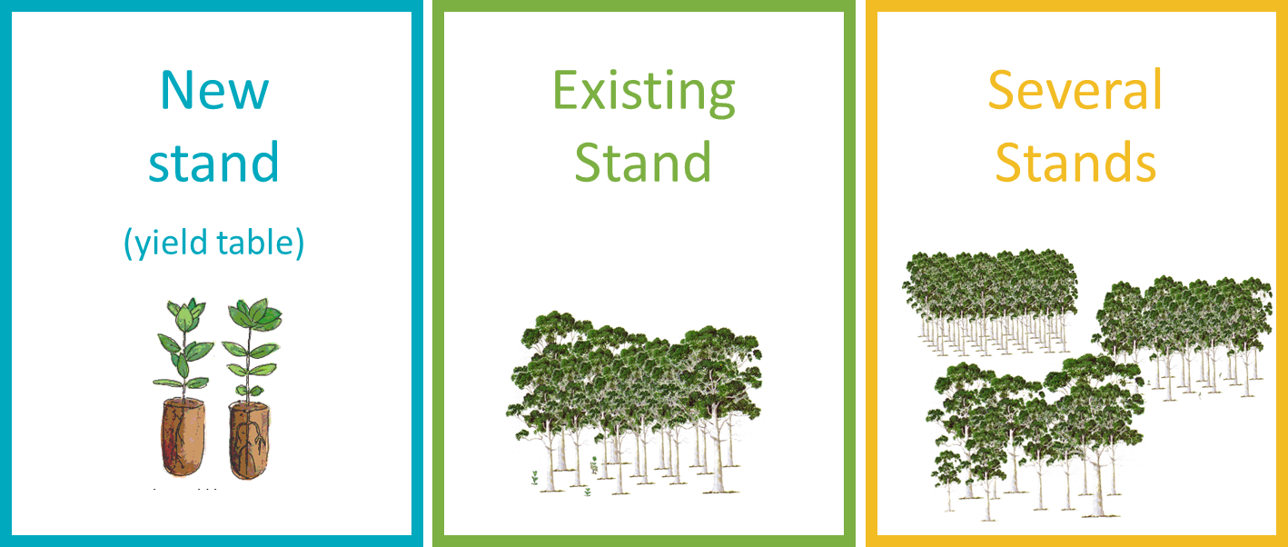
StandsSIM-md structure and inputs
Other inputs & simulation parameters
Forest Resources
t
Planning horizon
Forest Resources
t+1
Growth models
Forest managment (FMA)
Even- and uneven-aged
Prescriptions
One or a set per stand
GLOBULUS
GYMMA
3PG-OUT+
PINASTER
PBIRROL
PINEA
Castanea.pt
Other drivers:
Land Use changes (afforestation)
Climate
StandsSIM.md
Annual outputs

Slide 12
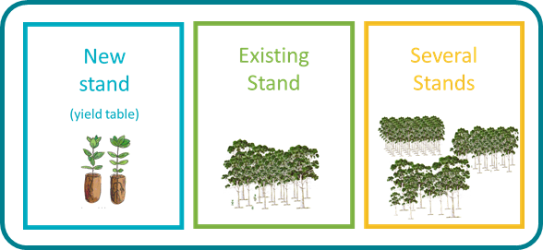
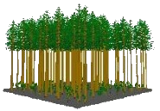
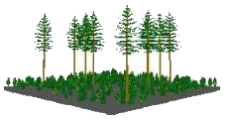
StandsSIM-md structure and inputs
Other inputs & simulation parameters
ini_standsSIM.csv
Assortment_ec.csv
Forest Resources
t
Planning horizon
Forest Resources
t+1
Growth models
Consumables.csv
Forest managment (FMA)
Even- and uneven-aged
Prescriptions
One or a set per stand
inv_sps.csv
Operations.csv
GLOBULUS
GYMMA
3PG-OUT+
PINASTER
PBIRROL
PINEA
Castanea.pt
FMA_##_Ec_*.csv
prescription_Ec_*.csv
Other drivers:
Land Use changes (afforestation)
Climate
AvgClimate.csv
inv_sps.csv
inv_sps_arv*.csv
StandsSIM.md
Annual outputs

Slide 13
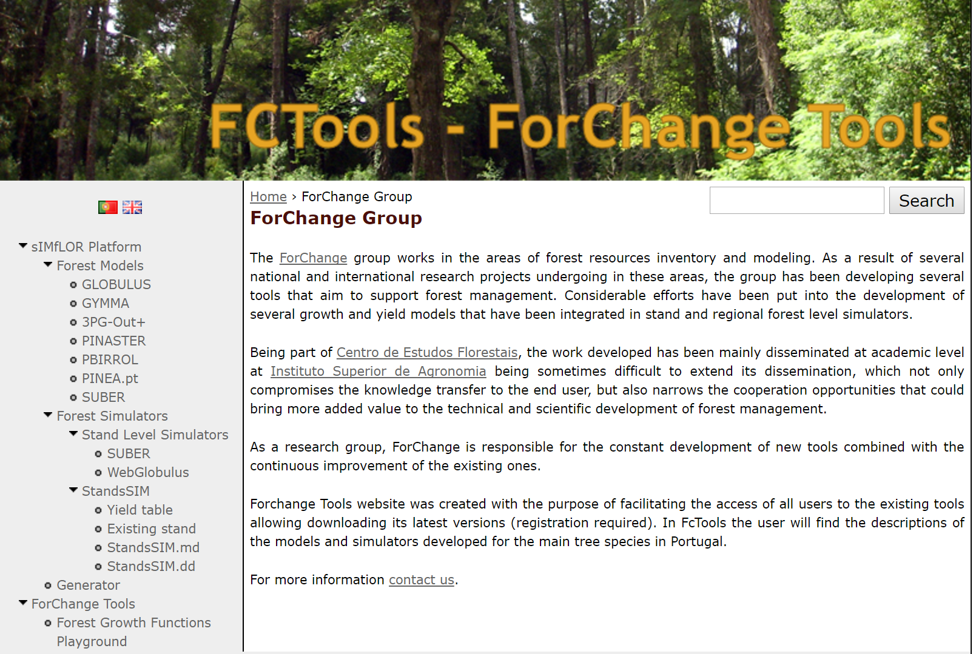
sIMfLOR platform and FCTools
http://www.isa.ulisboa.pt/cef/forchange/fctools/en/home

Slide 14
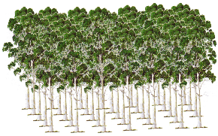
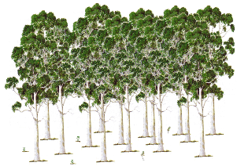
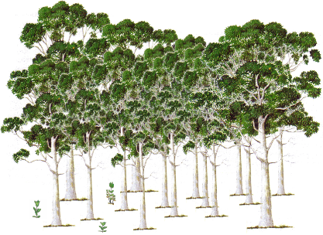
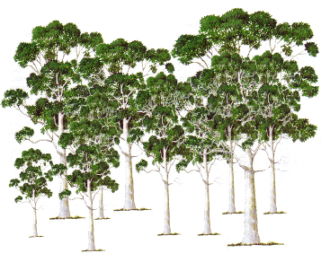
sIMfLOR platform and its forest simulators
StandsSIM.md
Required inputs
Forest characterization
New stand
(yield table)
Existing Stand
Several Stands

Slide 15
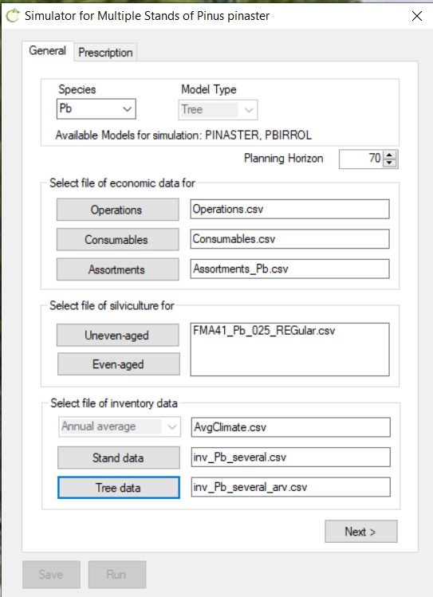
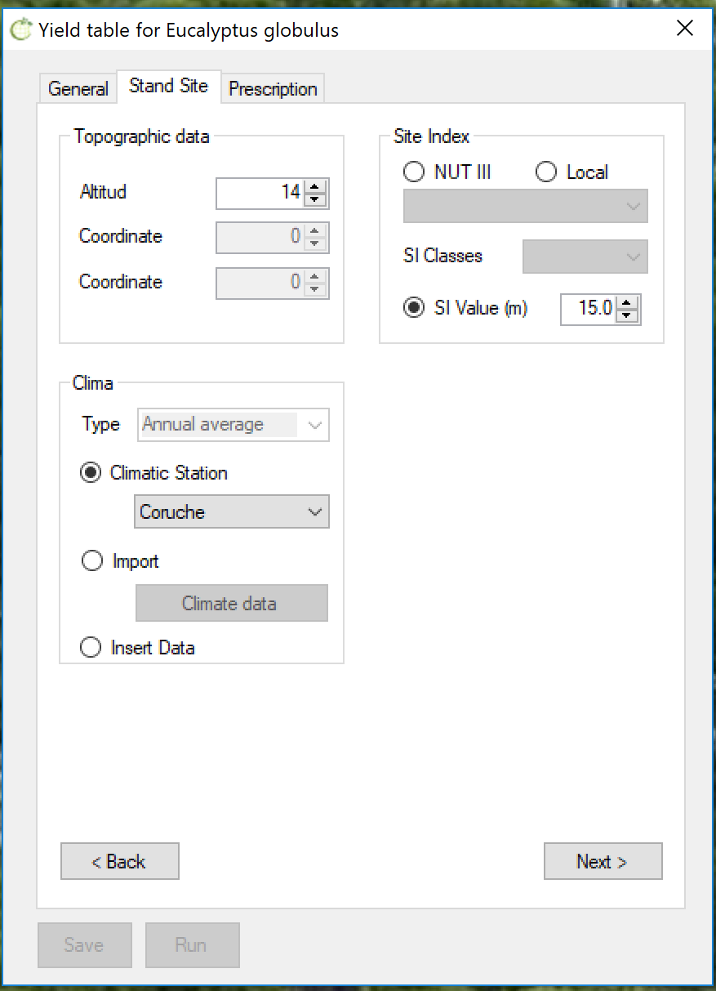

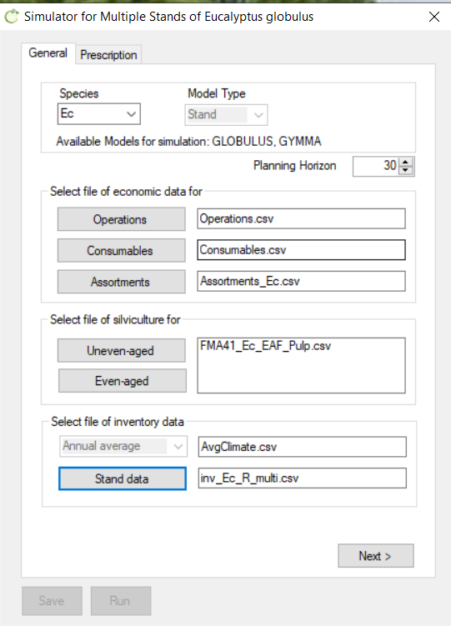
sIMfLOR platform and its forest simulators
StandsSIM.md
Required inputs
Forest characterization
New stand
(yield table)
Existing Stand
Several Stands

Slide 16
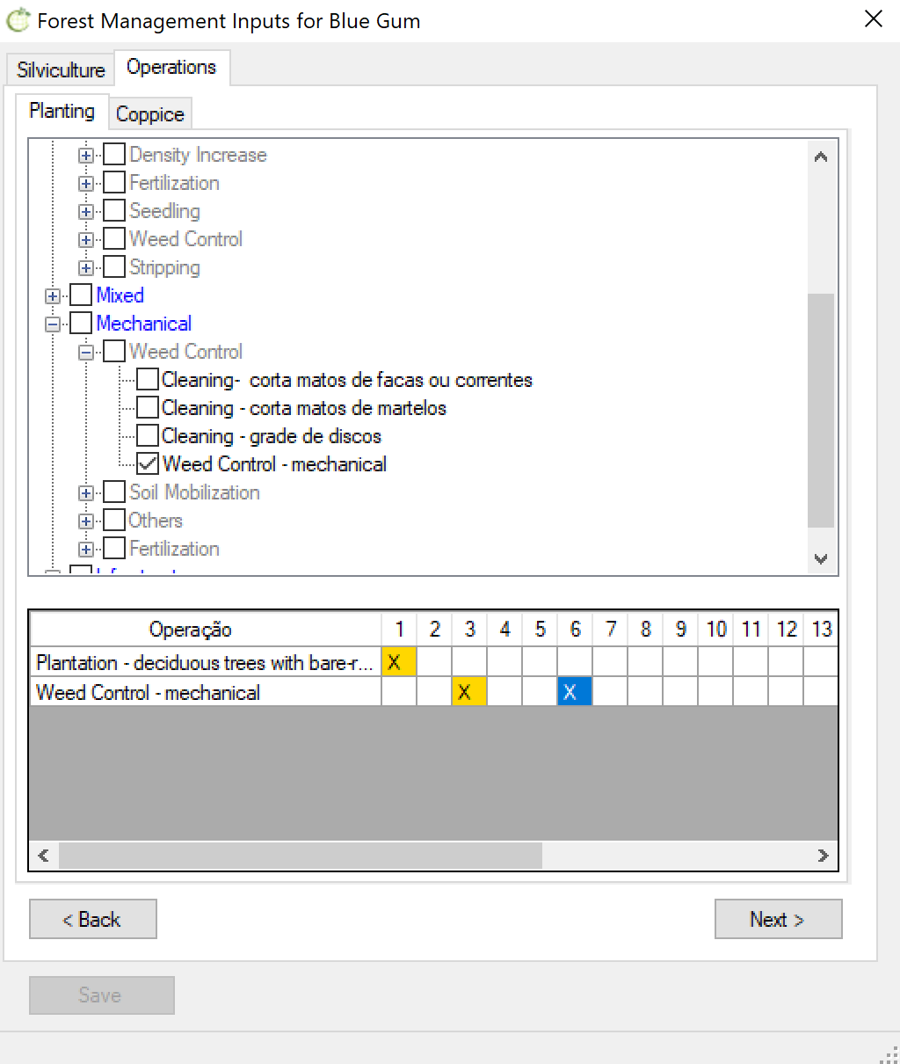
sIMfLOR platform and its forest simulators
StandsSIM.md
Required inputs
Forest characterization
Forest Management Approaches (FMA)

Slide 17
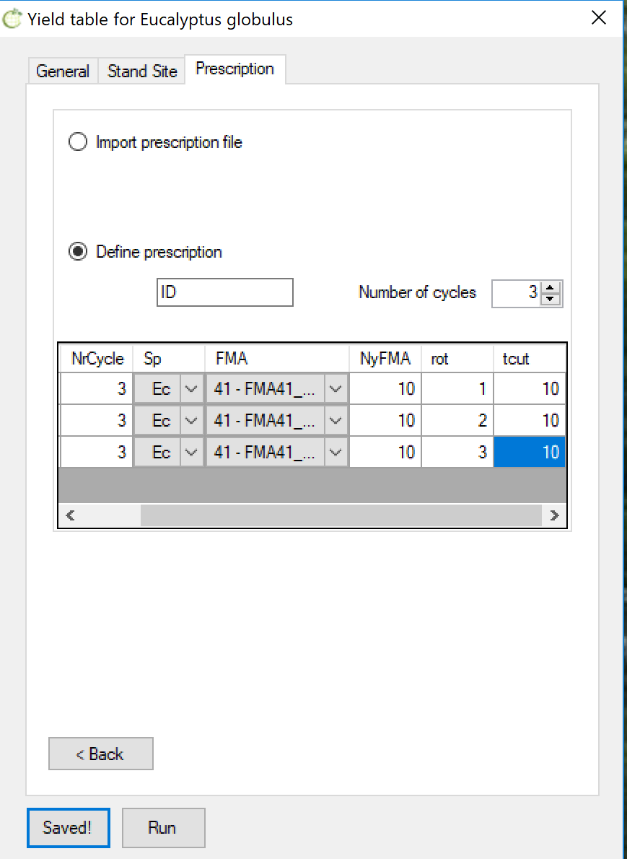
sIMfLOR platform and its forest simulators
StandsSIM.md
Required inputs
Forest characterization
Forest Management Approaches (FMA)
Prescriptions
Uneven-aged FMAs
NyFMA is the number of years during which we want the FMA to be applied
Even-aged FMAs
tcut is the harvest age which corresponds to the number of years during which we want the FMA to be applied

Slide 18
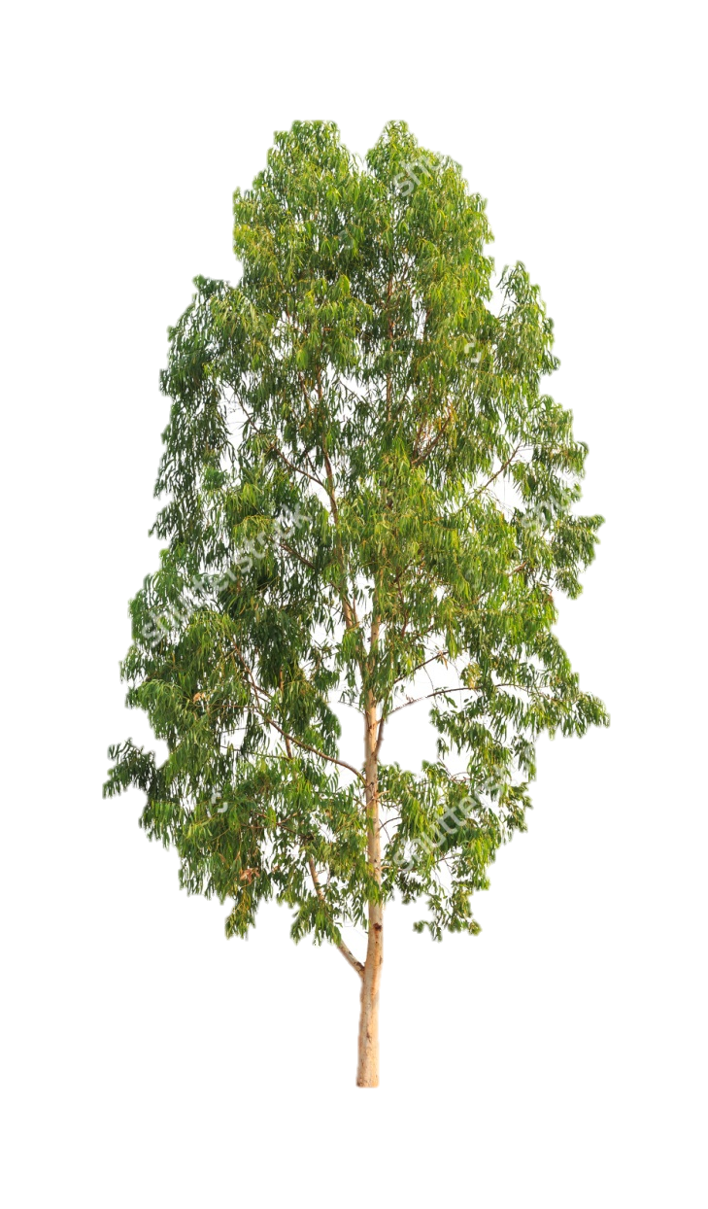


Running StandsSIM.md in sIMfLOR
Go to FCTools:
http://www.isa.ulisboa.pt/cef/forchange/fctools/en/home
Register &
Download sIMfLOR platform
Regional settings of your computer in English
Maritime pine
Stone pine
Eucalypt

Slide 19
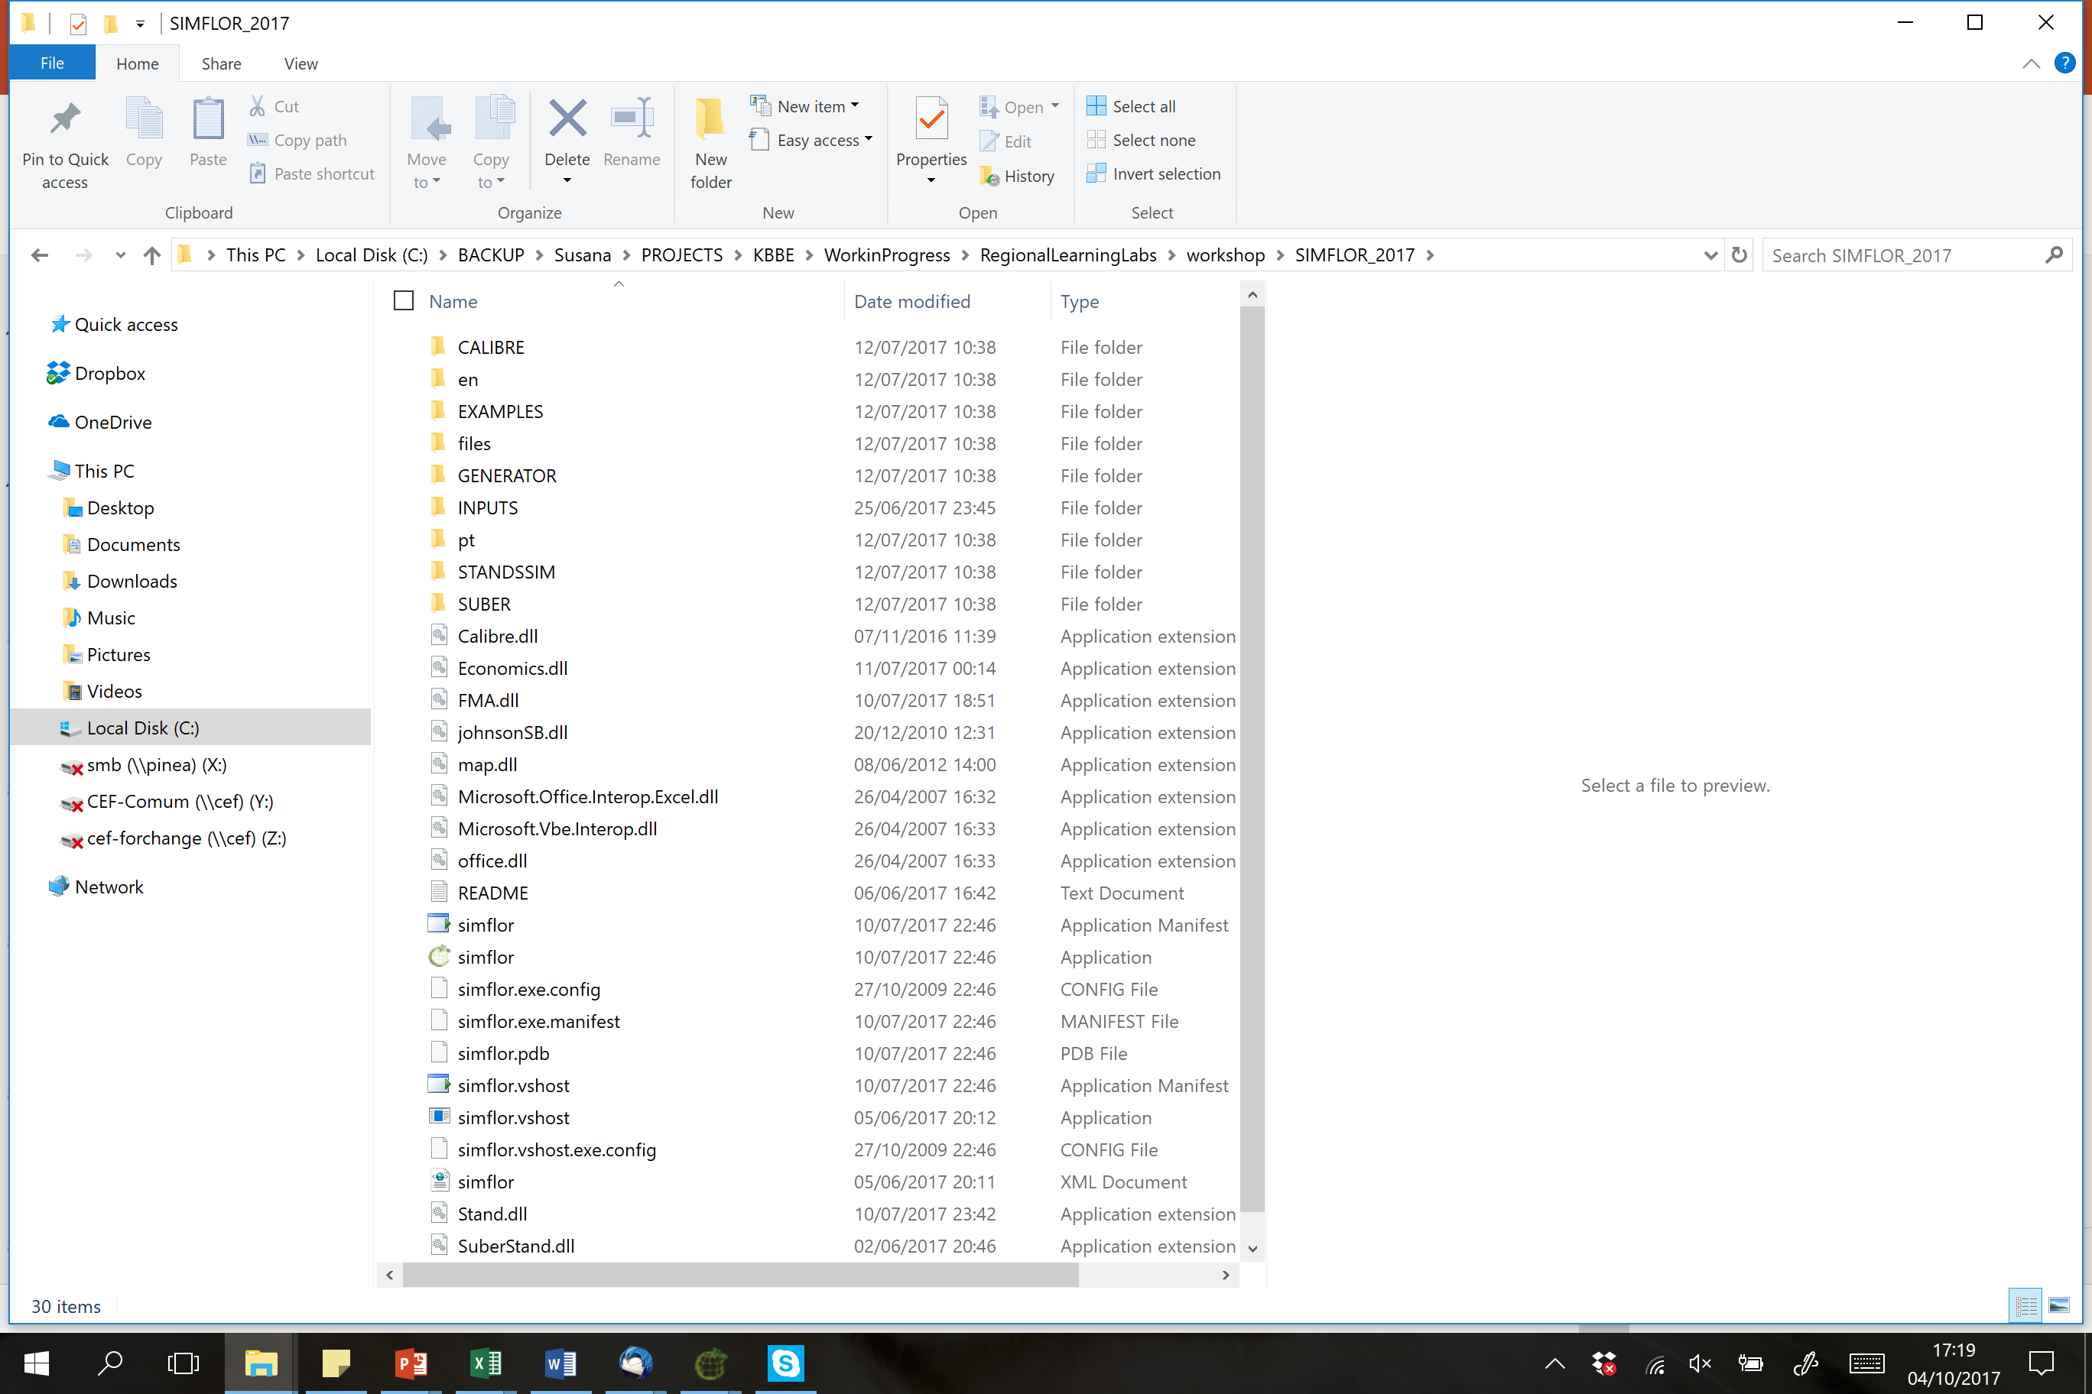
You have successfully downloaded sIMfLOR
\...\ SIMFLOR_2017

Slide 20
You have successfully downloaded sIMfLOR
\...\ SIMFLOR_2017

Slide 21
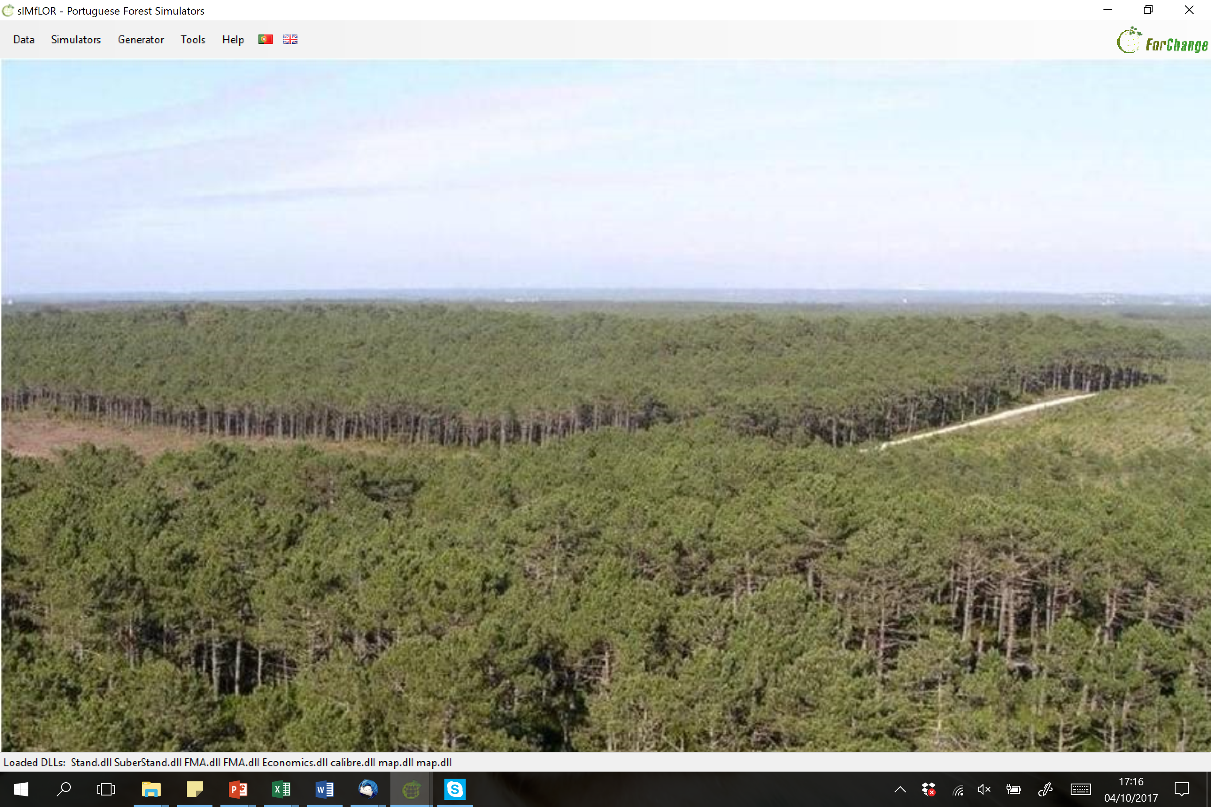
You have successfully downloaded sIMfLOR

Slide 22
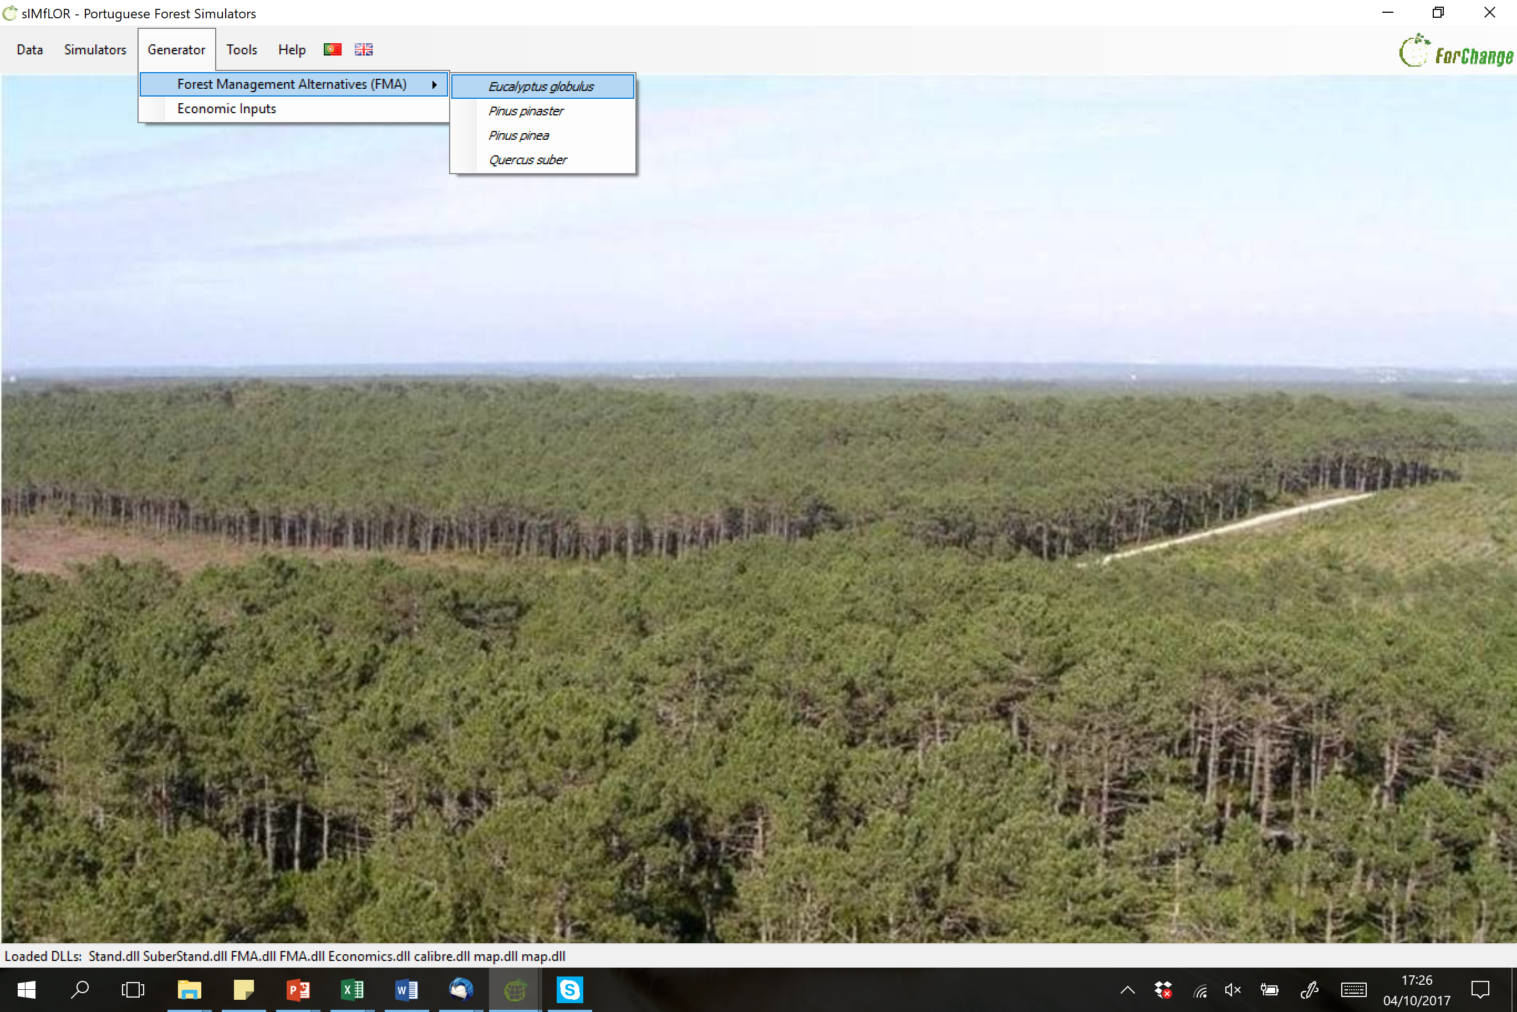
Let’s define an FMA

Slide 23
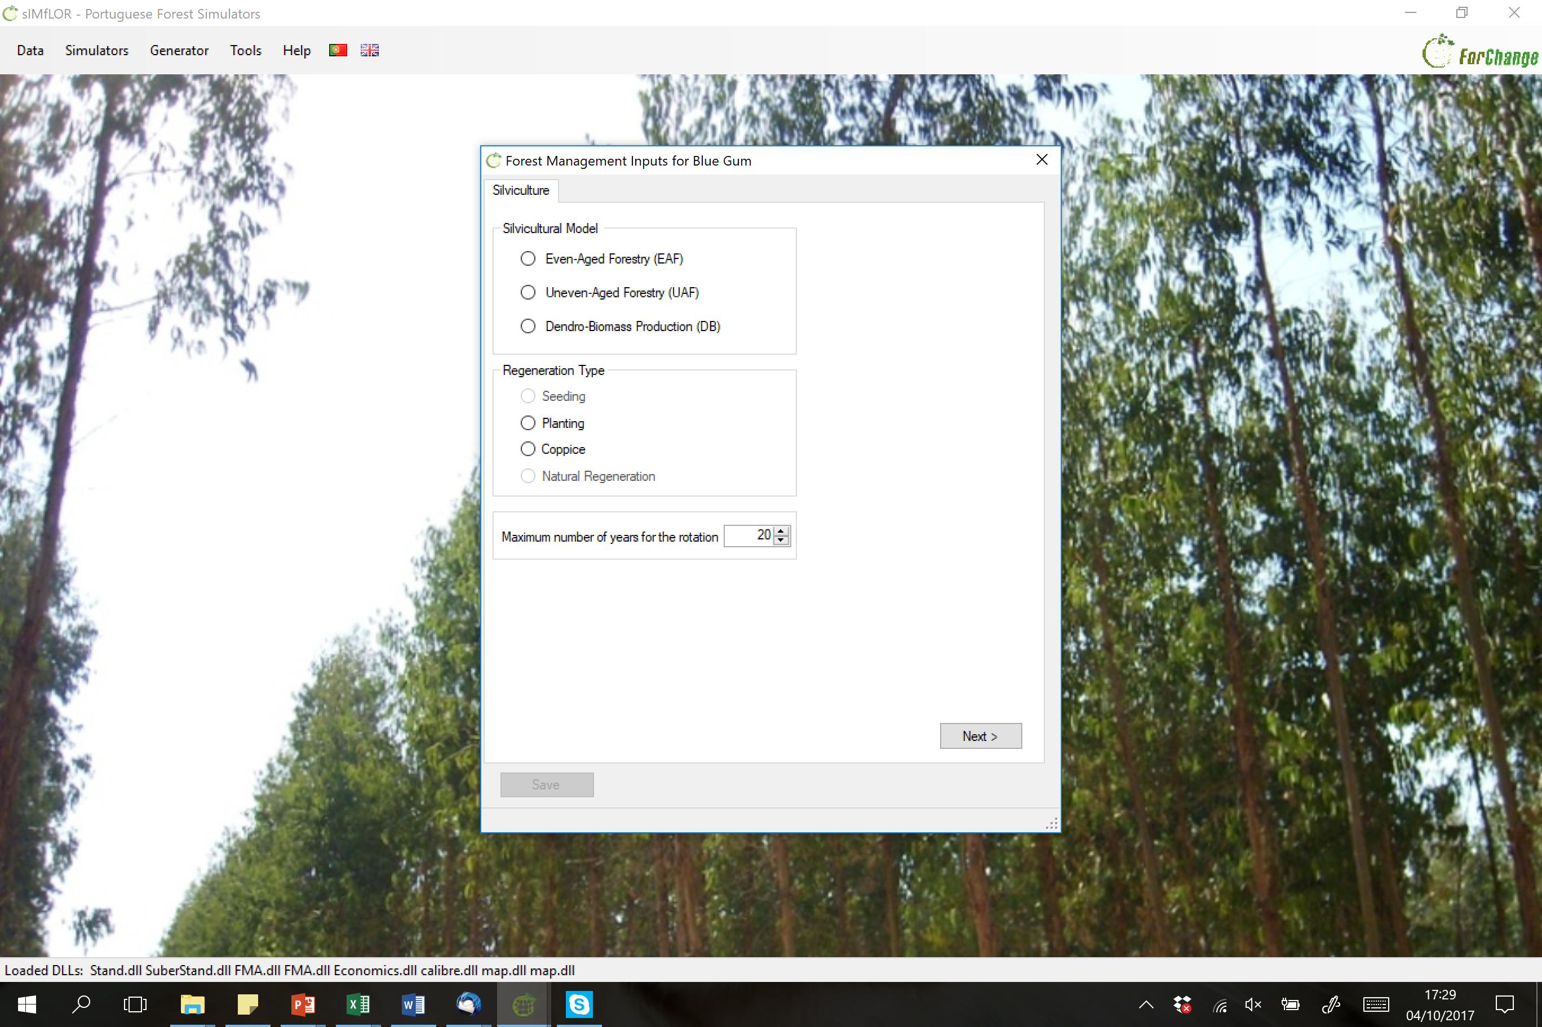
Let’s define an FMA

Slide 24
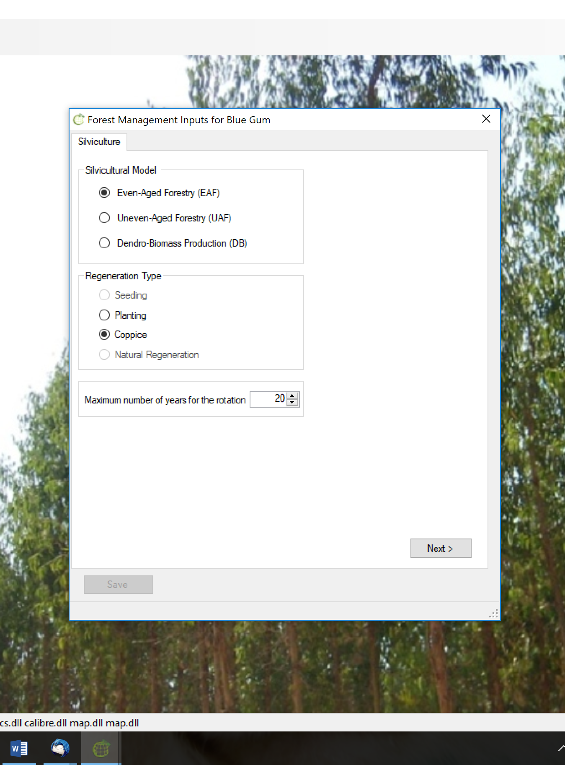
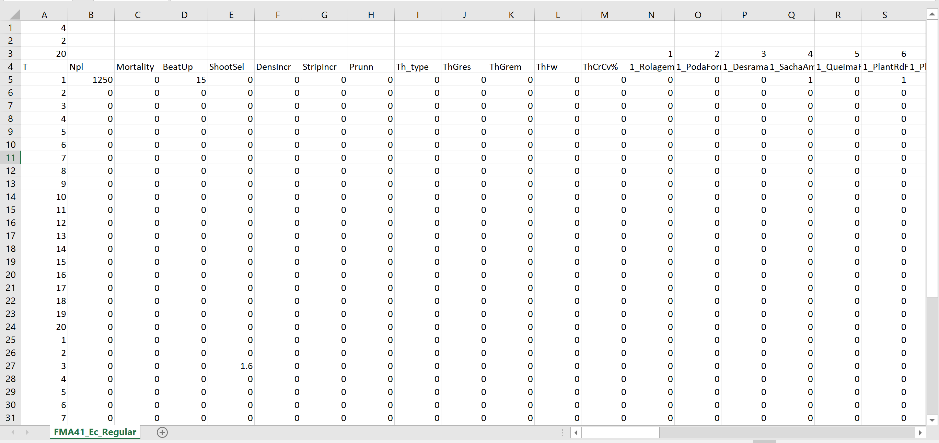
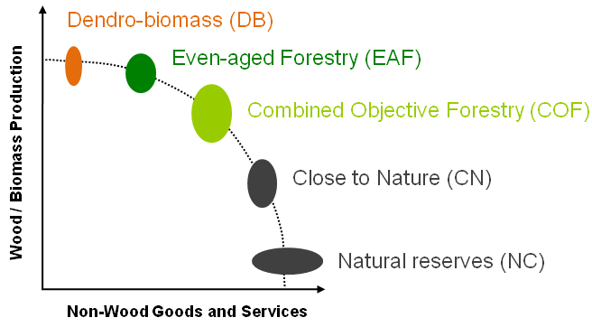
FMA file
FMA
Planting and Coppice
Maximum rotation age
FMA5
FMA4
FMA3

Slide 25
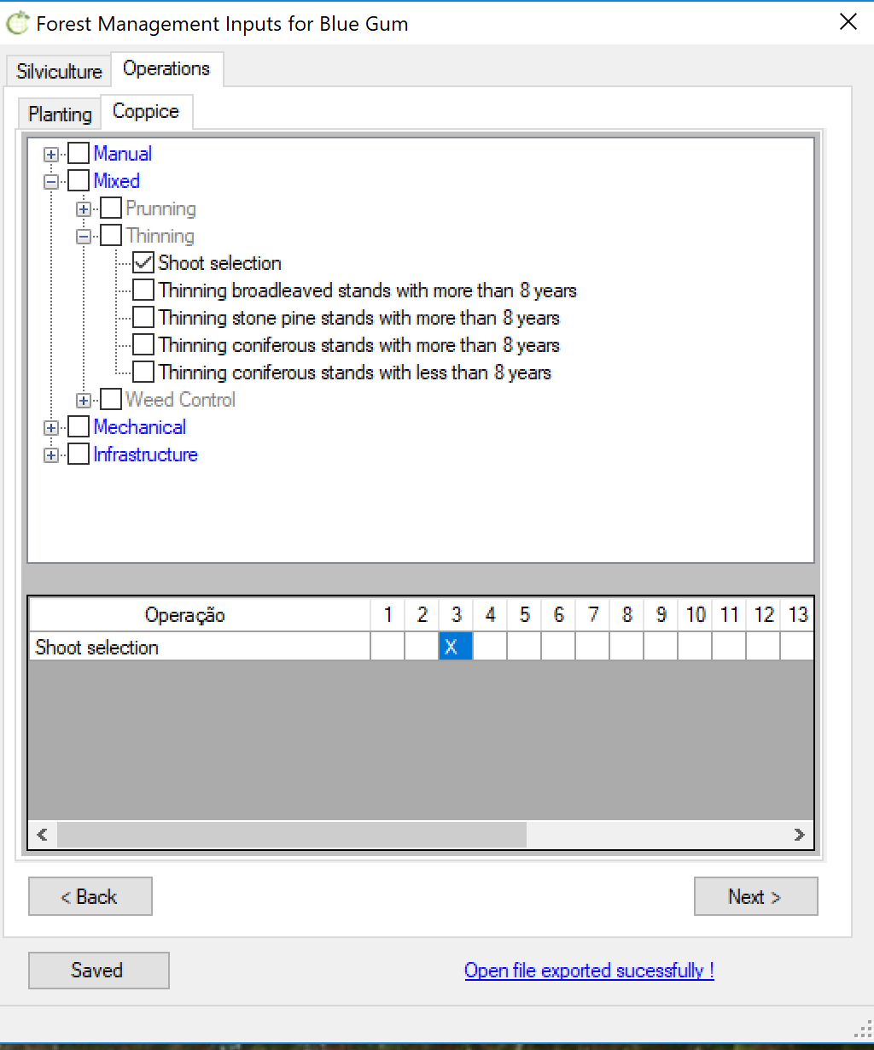
FMA file
Silvicultural operations: matrix (0,1)

Slide 26
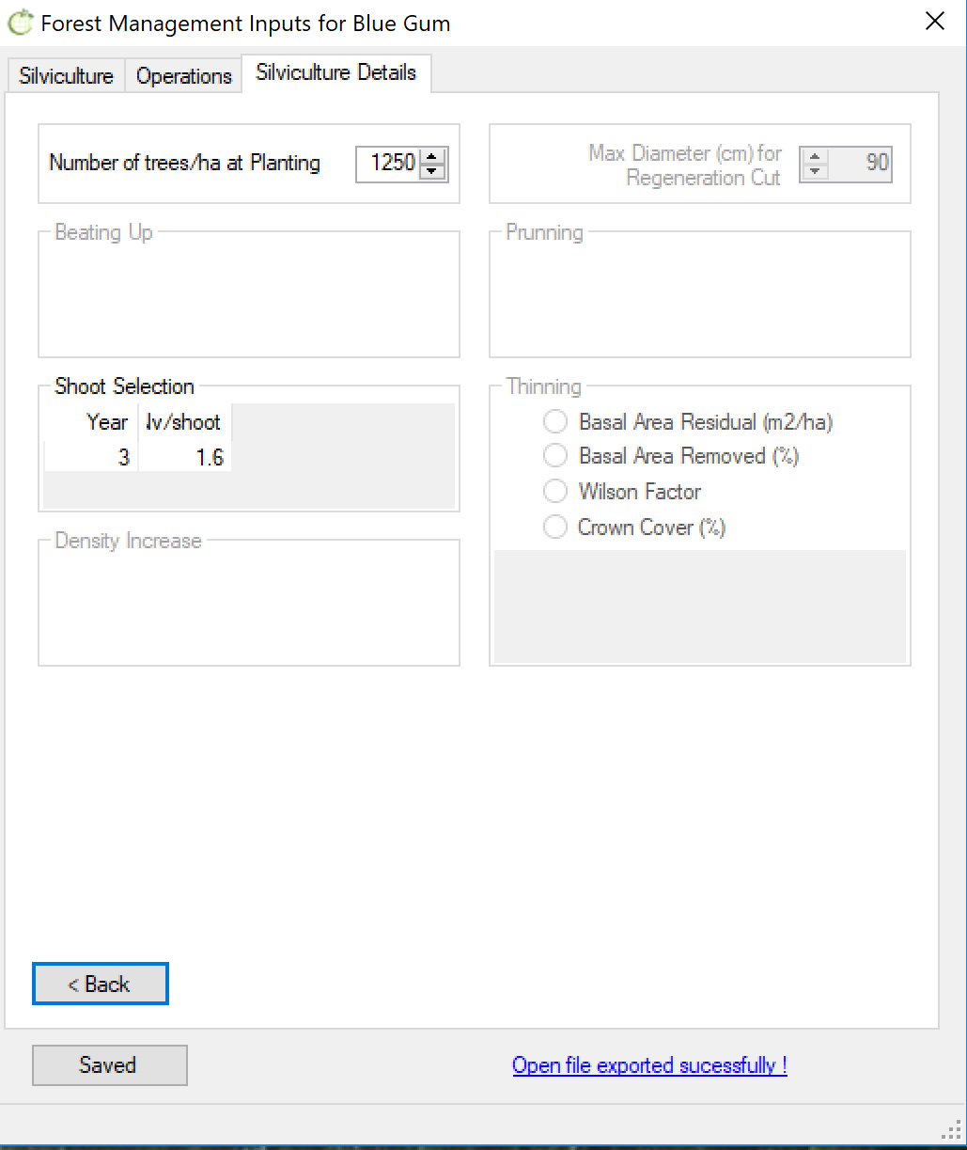
FMA file
Silvicultural operations’ details
FMA_##_Ec_*.csv

Slide 27
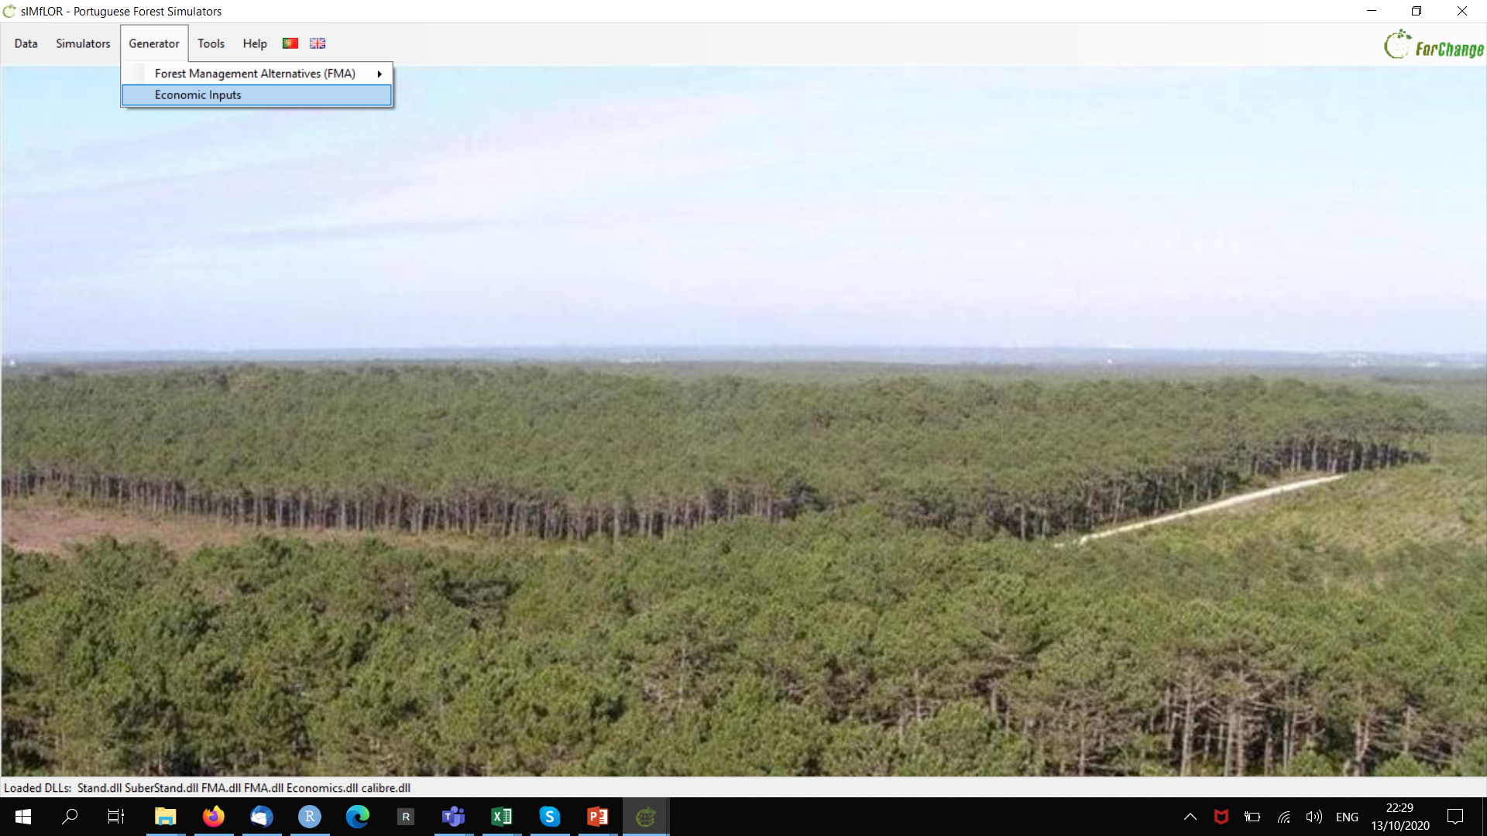
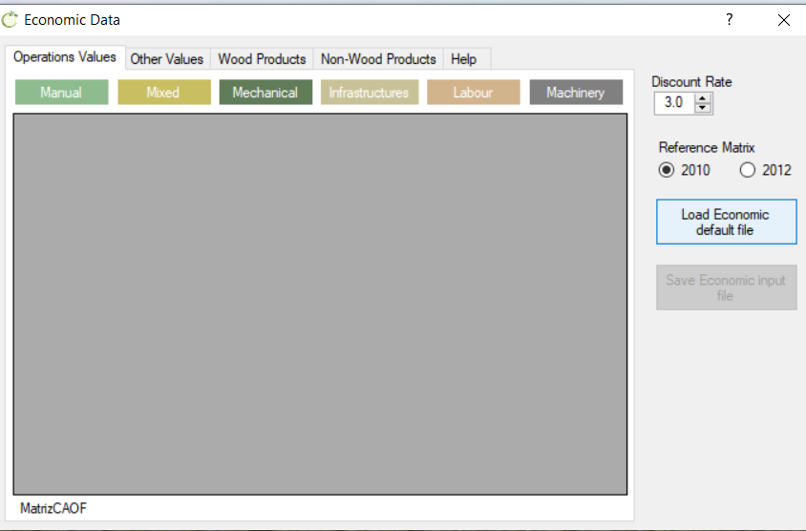
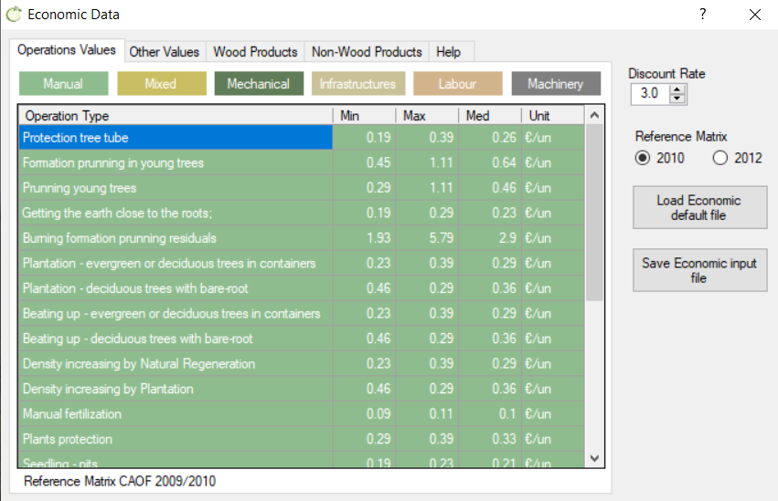
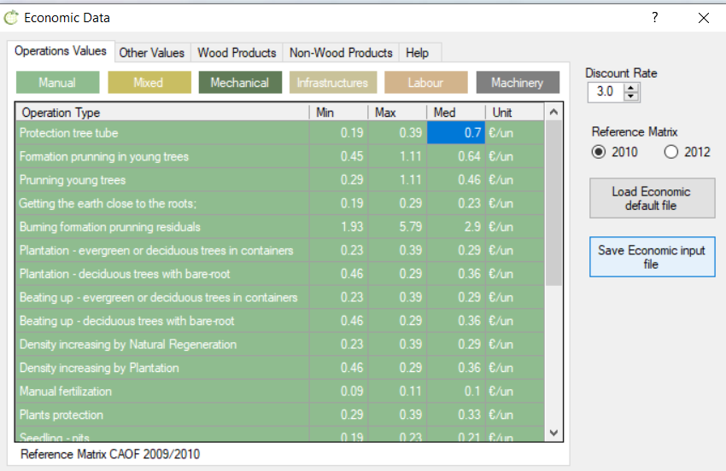
Let’s look at the economic costs

Slide 28
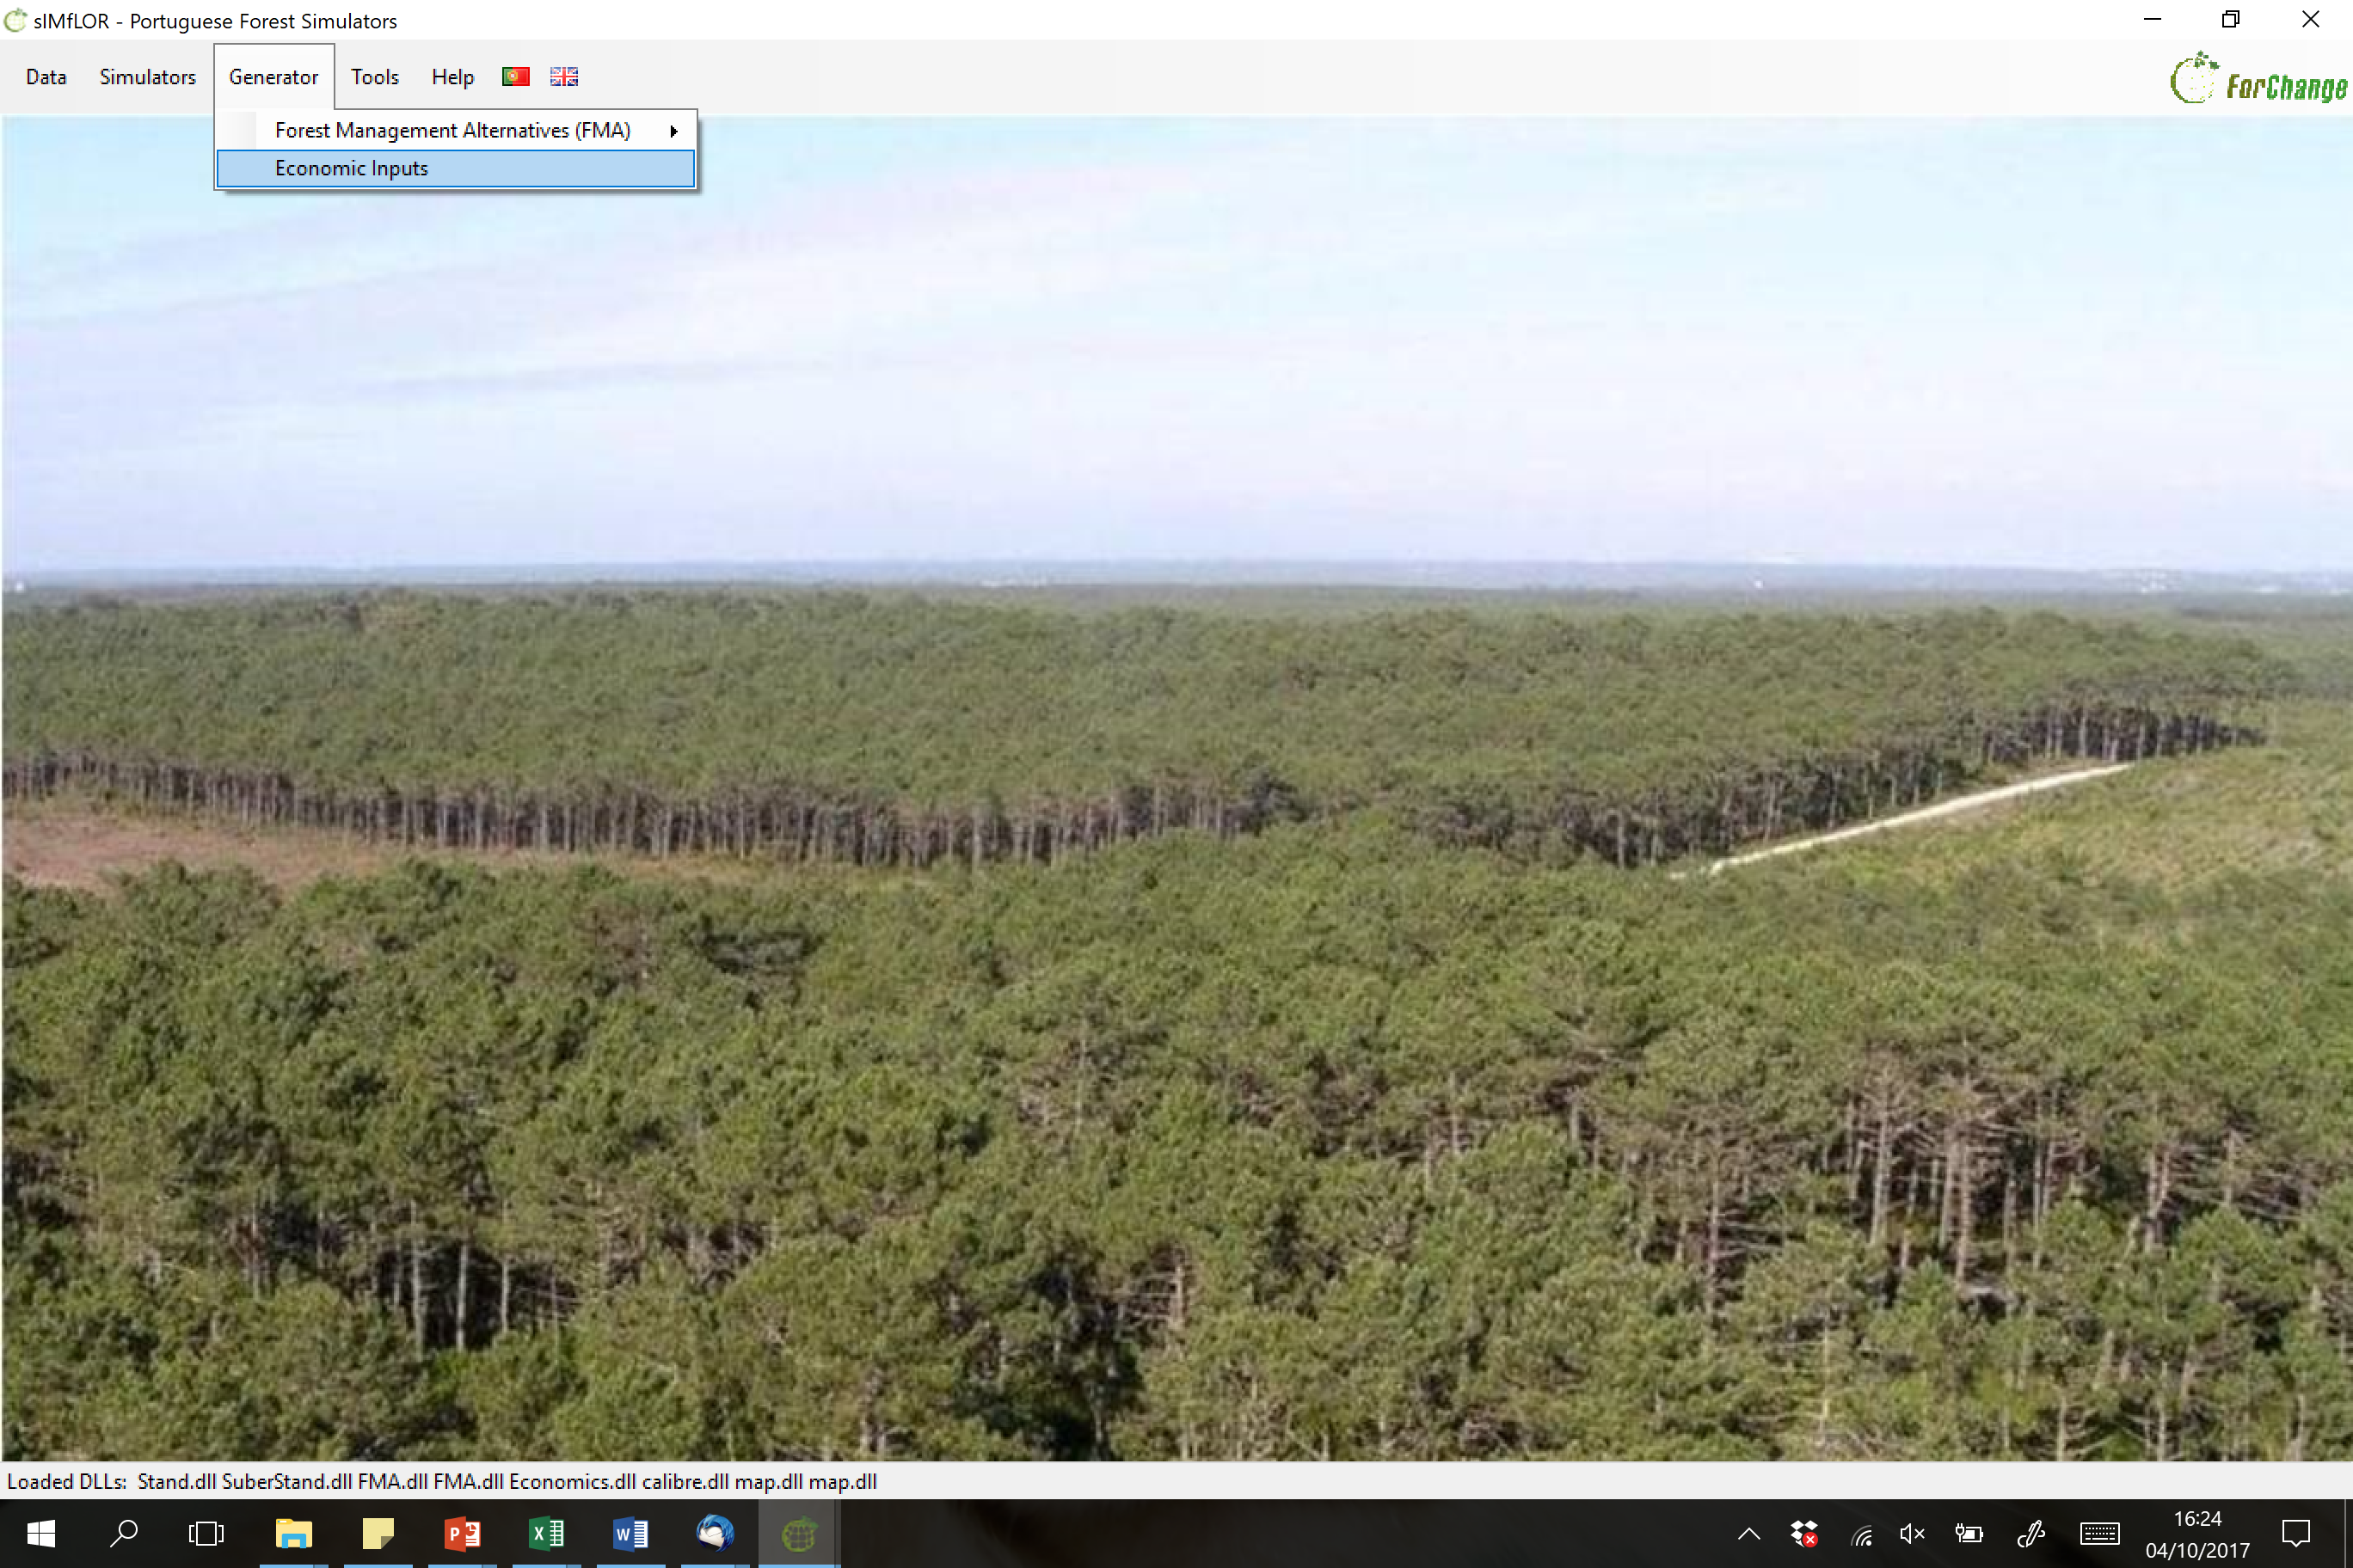
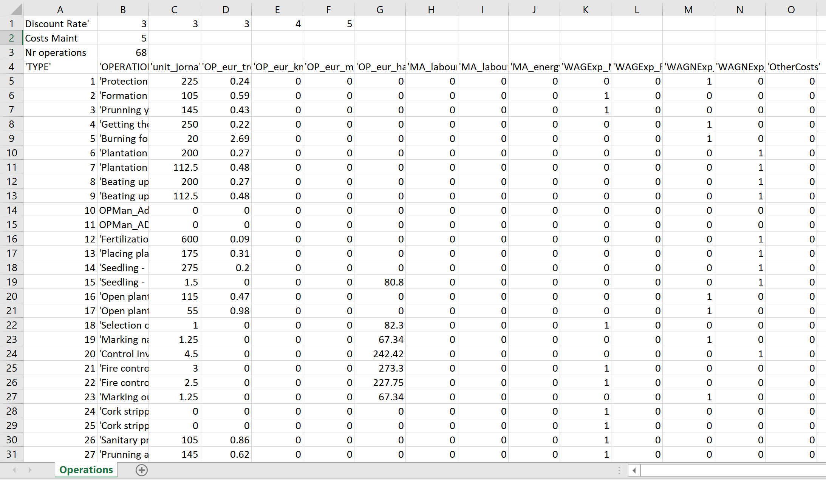
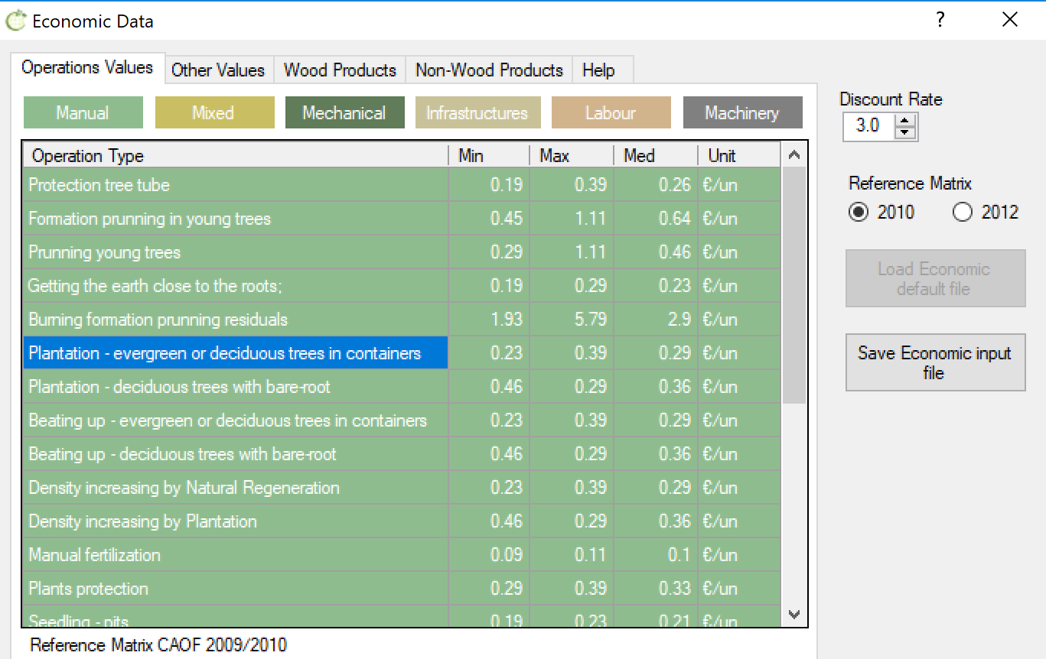
Operations/economics file
Number of additional discount rates to be tested
Additional discount rates to be tested
Maintenance costs (€ yr)

Slide 29

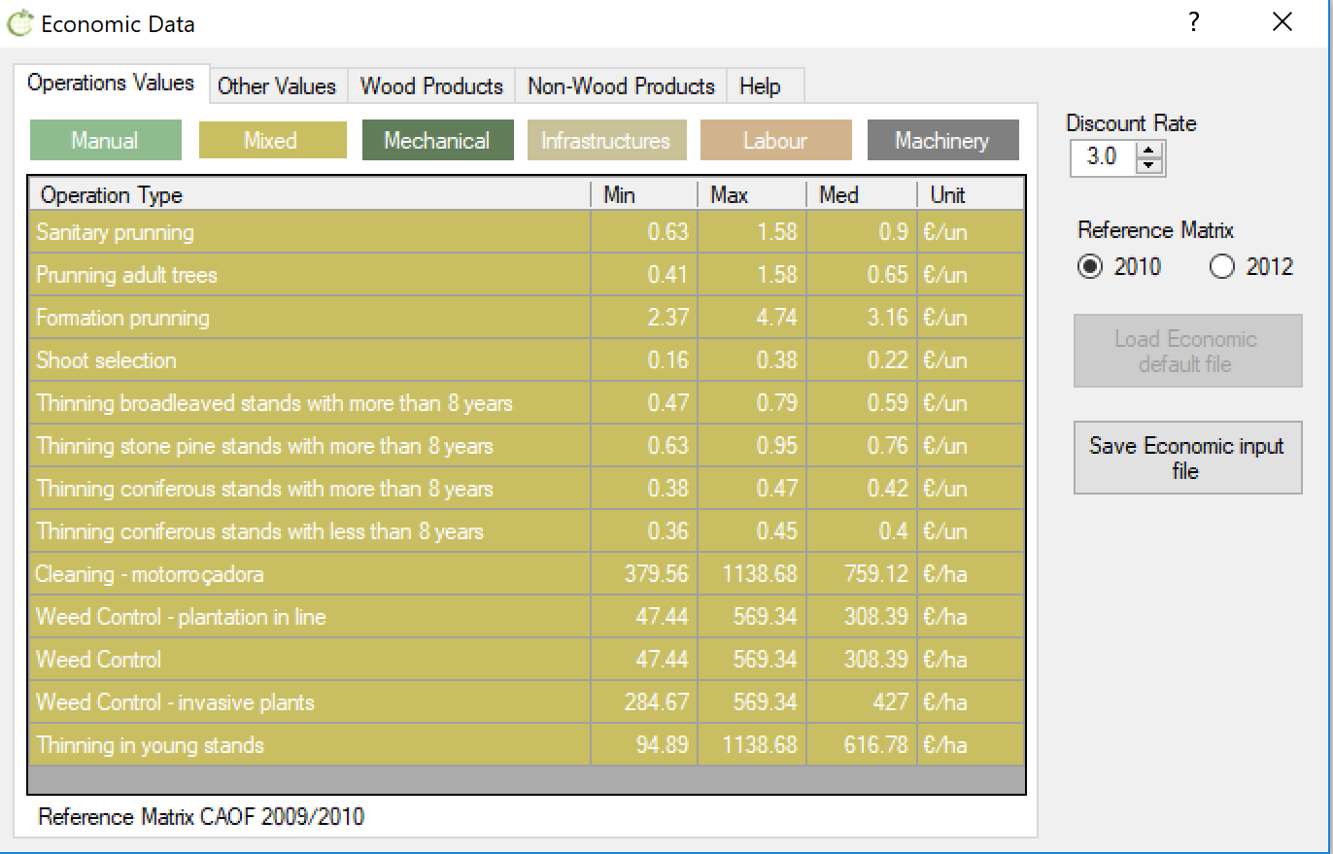


Consumables file

Slide 30



Assortments file
Assortment_ec.csv
Consumables.csv
Operations.csv

Slide 31




Prescriptions file
One plantation followed by 2 coppices

Slide 32



Prescriptions file
3 consecutive plantations

Slide 33

All the default files can be found at:
\...\ SIMFLOR_2017 \ EXAMPLES
- Eucalyptus globulus (Eucalyptus)
- Pinus pinaster (maritime pine)
- Pinus pinea (stone pine)
- Quercus suber (cork oak)

Slide 34

All the default files can be found at:
\...\ SIMFLOR_2017 \ EXAMPLES \ EC
- Forest Management Approaches
- Forest characterization (inventory)
- Forest prescriptions

Slide 35

All the default files can be found at:
\...\ SIMFLOR_2017 \ EXAMPLES \ EC \ FMA
Uneven-aged management
Even-aged management

Slide 36
The FMA files produced in the “Generator” are directed to:
\...\ SIMFLOR_2017
User decides the name and folder to save it
The prescription files produced in the “Generator” saved at:
\...\ SIMFLOR_2017 \STANDSSIM \ GLOBULUS \ input_prescr.csv

Slide 37

The “operations” files produced in the “Generator” are directed to:
User decides the name and folder to save files (e.g. input_economics.csv)
\...\ SIMFLOR_2017 \ INPUTS
- operation costs
- consumables
- assortments

Slide 38

Thank you!
Help us being useful and give us your feedback

