Slide 1
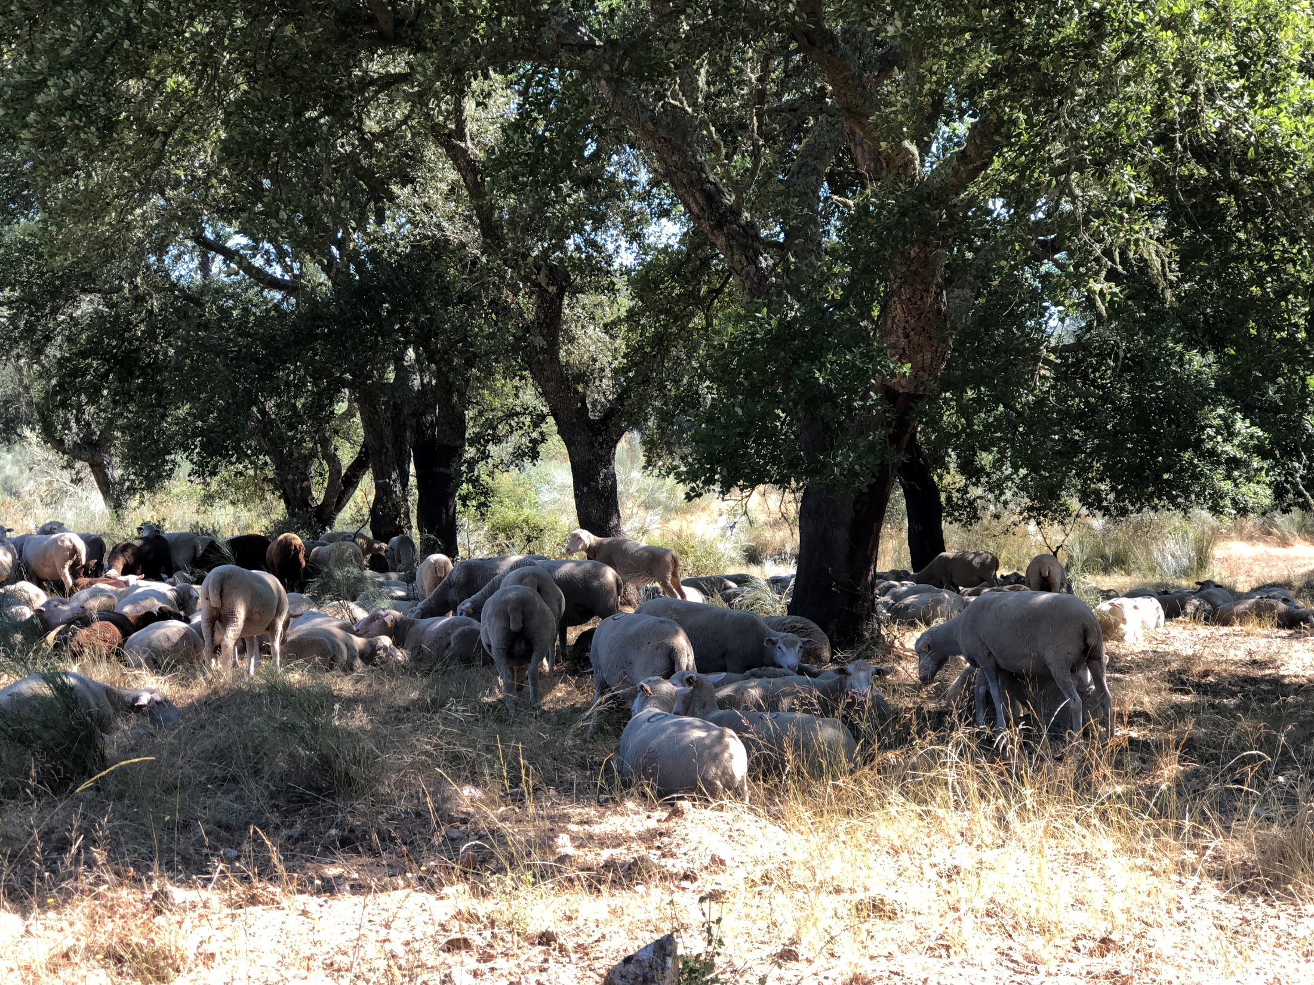
Methods to study the evolution of tree and stand variables over time
Margarida Tomé, Susana Barreiro
Instituto Superior de Agronomia
Universidade de Lisboa

Slide 2
Where do we get the data for growth studies?

Slide 3
Where do we get the data for growth studies?
Permanent and Interval plots
Temporary plots
Experimental trials
Continuous forest inventory data
Stem analysis
  Partial – analysis of increment cores at dbh level
  Total – analysis of several tree discs along the stem

Slide 4
Where do we get the data for growth studies?
In permanent and interval plots
  Plots established with the objective of measuring growth in stands managed according to “current” practices
    Permanent plots follow the stand during a long period, eventually the whole life of the stand

Slide 5
Permanent plots
Permanent plot with three successive measurements (white trees are removed during thinning). Graphical representation of data series of three permanent plots
Adapted from Gadow and Hui 1999

Slide 6
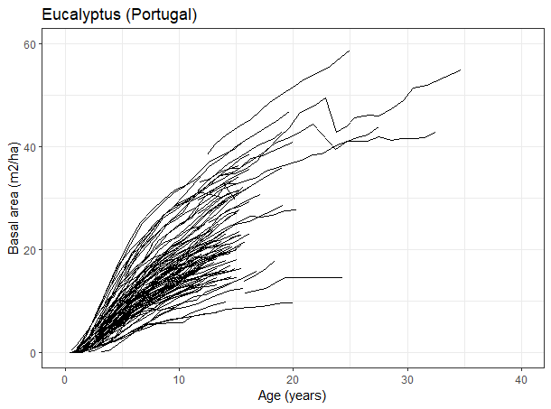
Examples of permanent plot data
G - eucalyptus
Permanent plots

Slide 7
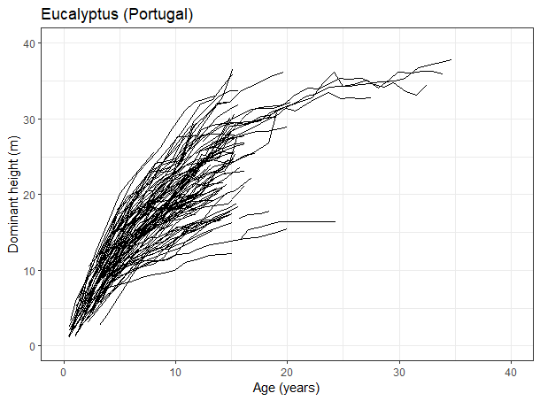
Permanent plots
Examples of permanent plot data
h_{dom} - eucalyptus

Slide 8
Where do we get the data for growth studies?
In permanent and interval plots
  Plots established with the objective of measuring growth in stands managed according to “current” practices
    Permanent plots follow the stand during a long period, eventually the whole life of the stand
    Interval plots follow the stand during a limited interval, but they are remeasured at least once

Slide 9
Interval plots
Three interval plots measured twice (white trees removed in thinning operations). Graphical representation: interval data for obtaining rates of change of observed state variables
Adapted from Gadow and Hui 1999

Slide 10
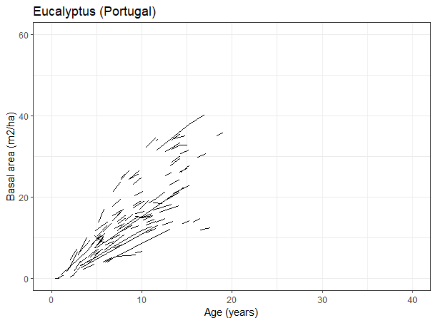
Examples of permanent plot data
G - eucalyptus
Interval plots

Slide 11
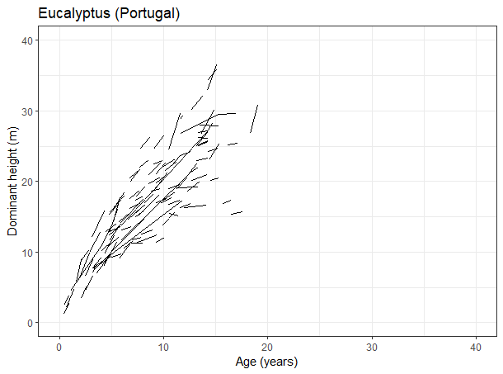
Interval plots
Examples of permanent plot data
h_{dom} - eucalyptus

Slide 12
Where do we get the data for growth studies?
In permanent and interval plots
  Plots established with the objective of measuring growth in stands managed according to “current” practices
    Permanent plots follow the stand during a long period, eventually the whole life of the stand
    Interval plots follow the stand during a limited interval, but they are remeasured at least once
In temporary plots
  Plots that are measured just at one point in time

Slide 13
Temporary plots
Three temporary plots of varying age (white trees removed in thinning operations). Graphical representation: independent height-age data obtained from temporary plots
Adapted from Gadow and Hui 1999

Slide 14
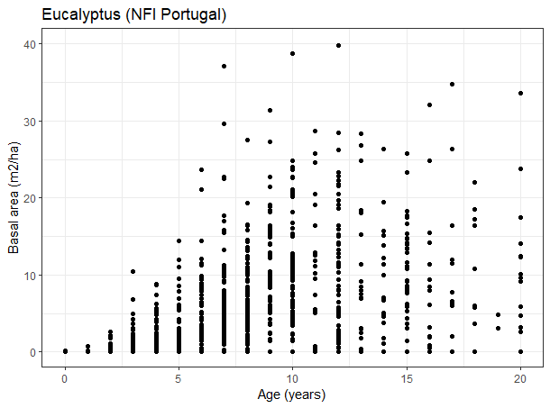
Examples of permanent plot data
G - eucalyptus
Temporary plots

Slide 15
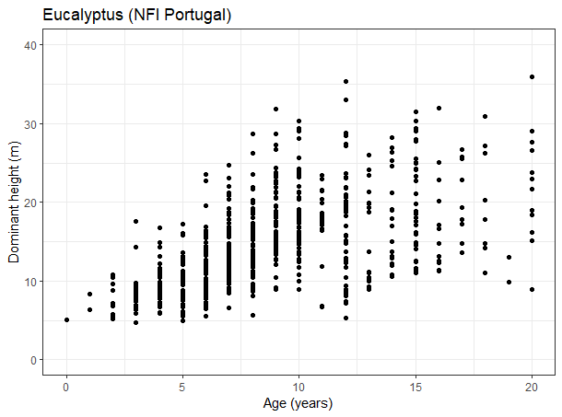
Temporary plots
Examples of permanent plot data
h_{dom} - eucalyptus

Slide 16
Where do we get the data for growth studies?
In designed silviculture and genetic trials
  Trials purposively established to study the impact of silvicultural treatments and/or genetic material on tree and stand growth

Slide 17
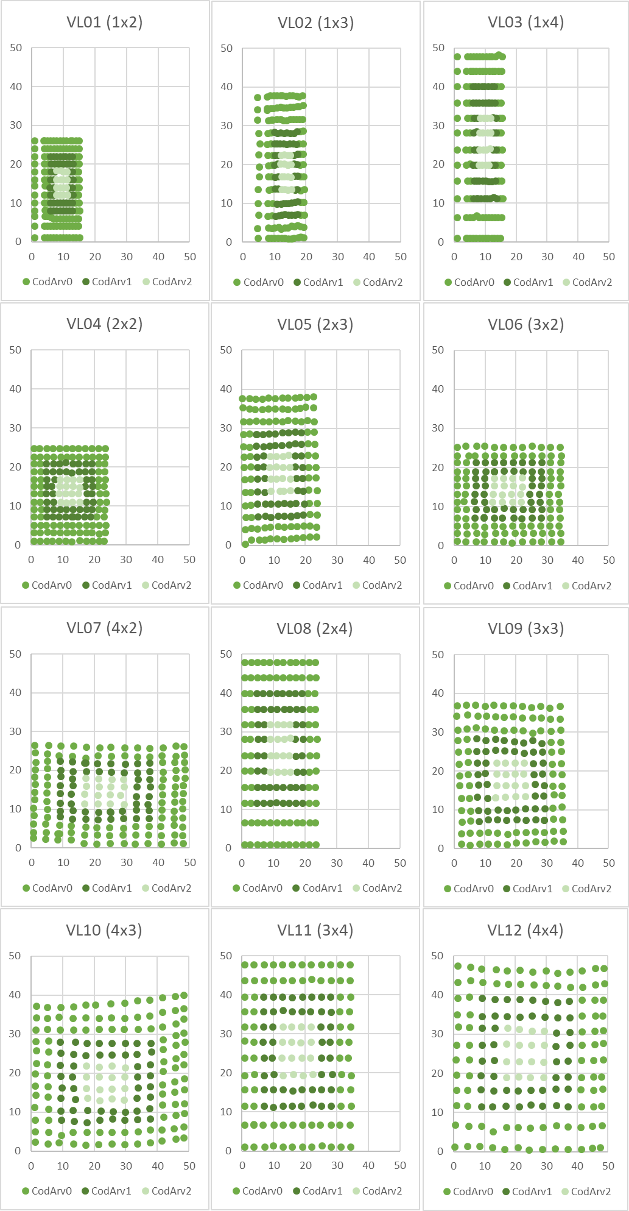
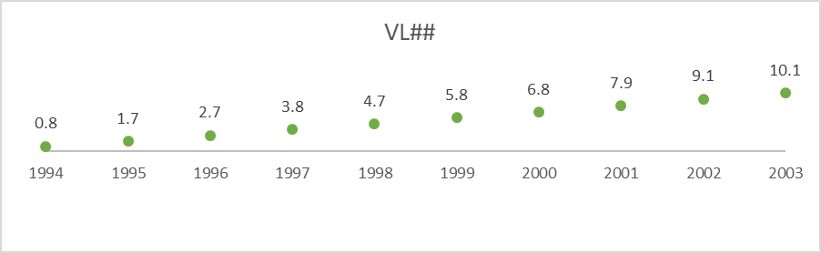
Experimental trials
Trials are set to study one specific silvicultural practice or a combination of two (even if in practice several treatments are applied simultaneously)
E.g. Spacing trial: (1x2, 1x3, 1x4, 2x2, 2x3, 3x2, 4x2, 2x4, 3x3, 4x3, 3x4, 4x4) * 3Blocks
Trials usually present a design with repetitions of the given treatment
Measurements over time covering the entire 1st rotation

Slide 18
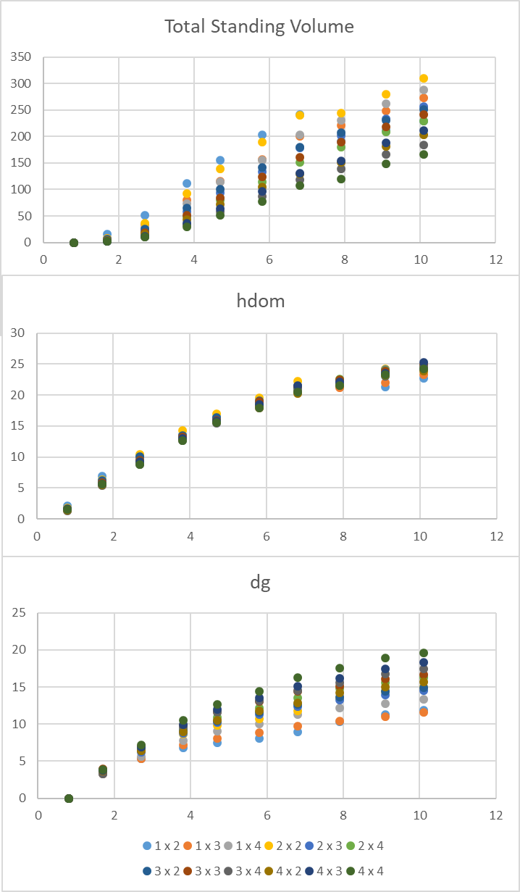
Experimental trials
Trials are set to study one specific silvicultural practice or a combination of two (even if in practice several treatments are applied simultaneously)
E.g. Spacing trial: (1x2, 1x3, 1x4, 2x2, 2x3, 3x2, 4x2, 2x4, 3x3, 4x3, 3x4, 4x4) * 3Blocks
Trials usually present a design with repetitions of the given treatment
Measurements over time covering the entire 1st rotation

Slide 19
ANALYSIS OF MEASURED RESULTS
PERMANENT PLOTS
FIELD TRIALS
Data for construction and validation
Better understanding of physiological processes
Indication for the need to obtain new data
Ideas for new experiments
ANALYSIS OF SIMULATED RESULTS using FOREST GROWTH MODELS
Better understanding of physiological processes
EXPERIMENTS UNDERTAKEN IN LABORATORY

Slide 20
Where do we get the data for growth studies?
In designed silviculture and genetic trials
  Trials purposively established to study the impact of silvicultural treatments and/or genetic material on tree and stand growth
From continuous forest inventory data
From stem analysis

Slide 21
Stem analysis
Stem analysis is the study of tree growth from the analysis and measurement of the growth rings
It is restricted to the species whose wood exhibits clear growth rings and to the regions with a climate that implies a clear stop on growth
Two types of stem analysis:
  Partial – analysis of increment cores at dbh level
  Total – analysis of several tree discs along the stem

Slide 22
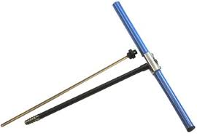
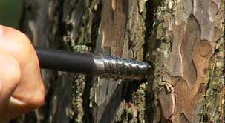
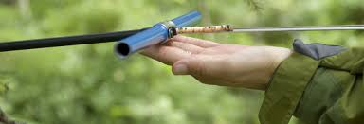
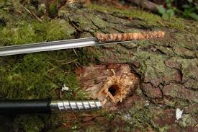

Partial stem analysis
Stand table projection
It is usually used for short term projections of forest inventory data:
  During the forest inventory an increment core is taken in some “sample” trees
  Diameter growth of wood in the last k years (usually 5 years) is measured in the increment bore from each tree and converted to diameter growth
  Estimate the diameter growth (idj) of the average tree of each diameter class (j)
(Hagloff images)

Slide 23
Partial stem analysis
Stand table projection
It includes several steps (and assumes you have just completed your forest inventory):
  Start by computing the stand table (number of trees per diameter class) from forest inventory data
  Estimate mortality in each diameter class and compute the future number of trees
  Compute the growth index or ratio between id_{j} and the width of the class – this index allows the computation of the number of trees that stay in the class and the ones that move 1 or 2 classes
    A GI=0.76 means that 76% of the trees move 1 class and none move 2 classes
    A GI=1.10 means that 90% of the trees move 1 class and 10% move 2 classes
Where id_{j} is the increment in diameter

Slide 24
Partial stem analysis
Stand table projection
Computation of growth index:
  Assumes that trees inside a dbh class have an uniform distribution
  Estimate the diameter increment in k years of each dbh class (i_{d})
  All trees inside a dbh class [d₁; d₂[ with d>d₂-i_{d}, after k years will be in the next class

Slide 25
Partial stem analysis
Stand table projection
Tree movement:
  Note that now the trees are not equally distributed but this assumption will hold for the next period projection
i_{d1}
i_{d2}
i_{d3}
Period 1
 | class d1 |  |  |  | class d2 |  |  |  | class d3
Period 2
 | class d1 |  |  |  | class d2 |  |  |  | class d3

Slide 26
Partial stem analysis
Stand table projection
=3.80/5cm
=102-24.48
=102*(1-0.76)
=100+4
Future number of trees alive in each class
Increment in diameter for the period

Slide 27
Partial stem analysis
Stand table projection
We should also take into account the ingrowth
  trees that achieve the lower limit of the first diameter class and must be added to the stand

Slide 28
Partial stem analysis
Stand table projection
=24+100

Slide 29
Partial stem analysis
Stand table project
To estimate volume (or biomass) increment:
  Estimate the height of the average tree in each dimater class using a height-diameter curve
  Estimate the respective volume with a volume equation
  Estimate the volume in each point in time using the stand tables
  Obtain the volume (biomass) growth by difference

Slide 30
Partial stem analysis
Stand table projection
=0.0070*124

Slide 31
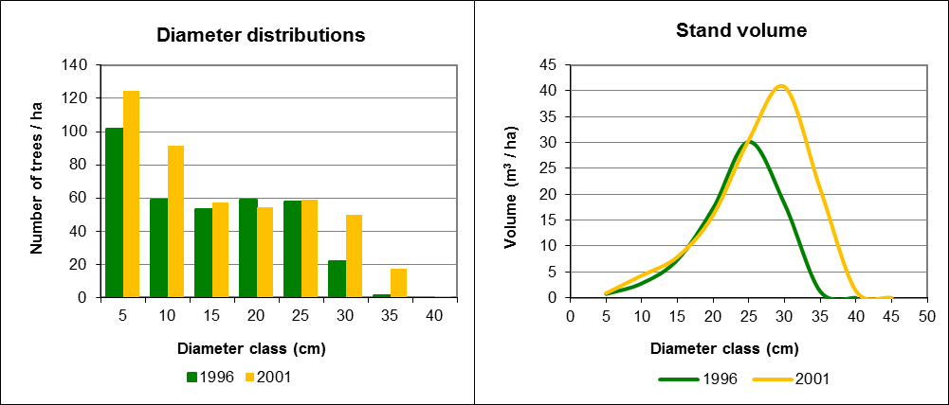
Partial stem analysis
Stand table projection
i_{V}=45m³/ha

Slide 32

Total stem analysis
...
h₁
h₂
h₃
h₄
h_{n}

Slide 33
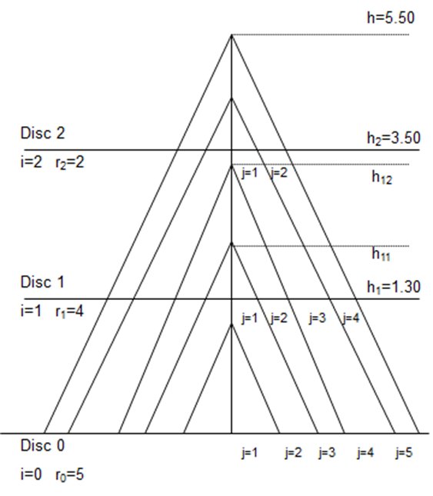
Stem analysis - example
height | N rings | age
0 | 5 | 0
1.30 | 4 | 1+ ...
3.50 | 2 | 3+ ...
5.50 | 0 | 5
Tree is 5 years old
Between Disc 1 and Disc 2, the correction is needed to estimate the heights at the end of the years: h₁₁ and h₁₂
The method most used for this correction is the Carmean method

Slide 34
Stem analysis
Carmean’s correction
Carmen’s method is based on two assumptions:
  Constant annual increment in height between two discs
  Each disc occurs at the mid-point between two whorls
The application of the method to the whorls between two discs implies:
  Computing the annual increment i_{h}=(h₂-h₁)/(nrg₁-nrg₂), where h_{i} and nrg_{i} are the height and the number of rings of disc_{i}
  Computing the height of the first whorl as: h_{i1}=h_{i}+i_{h}/2
  Computing the height of the remaining whorls as: h_{ij} = h_{i}+i_{h}/2+(j-1)*i_{h} = h_{i(j-1)}+i_{h}

Slide 35
Stem analysis
Carmean’s correction
Let’s compute h11 and h12:
Annual height growth between discs:
i_{h}=(h₂-h₁)/(nrg₁-nrg₂)
  i_{h}=(h₂-h₁)/(4 - 2)=(3.50 - 1.30)/2= 1.1

Slide 36
Stem analysis
Carmean’s correction
Let’s compute h11 and h12:
Annual height growth:
i_{h}=(h₂-h₁)/(nrg₁-nrg₂)
  i_{h}=(h₂-h₁)/(4 - 2)=(3.50 - 1.30)/2= 1.1
  h_{i1}=h_{i}+i_{h}/2
h₁₁= 1.30 + 1.1/2= 1.85
h_{ij} = h_{i}+i_{h}/2+(j-1)*i_{h} = h_{i(j-1)}+i_{h}
h₁₂= h₁₁ + i_{h} = 1.85 + 1.1 = 2.95
“1.1”
“1.1”/2
Where nrg₁ and nrg2 are the number of rings in the discs collected at heights 1 and 2 respectively.

Slide 37
Stem analysis
Carmean’s correction
It is possible to obtain a general formula for the height of any whorl h_{ij}:
is the annual growth between discs i and i+1

Slide 38
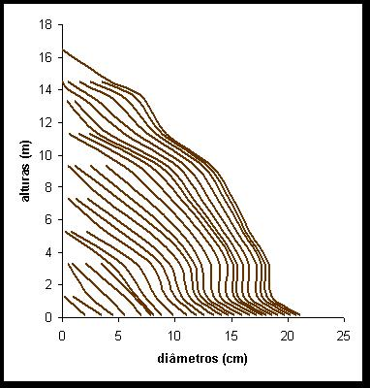
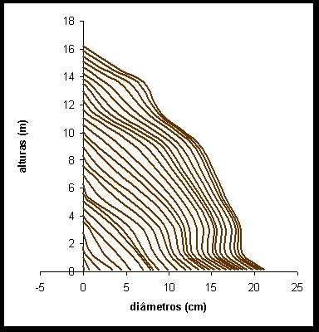
Stem analysis
Carmean’s correction
Heights (m)
Heights (m)
Diameters (cm)
Diameters (cm)

