Slide 1
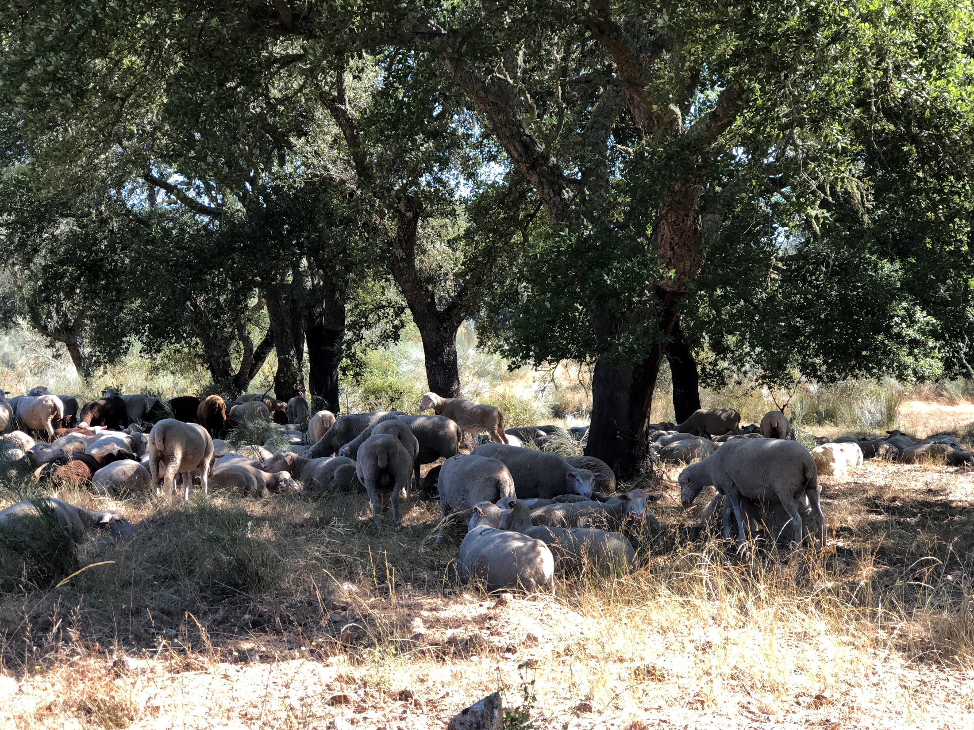
Allometric equations
Margarida Tomé, Susana Barreiro
Instituto Superior de Agronomia
Universidade de Lisboa

Slide 2
Allometric relationships/equations
Allometric equations describe proportional relative growth rates in different parts of an “organism”

Slide 3

Forest growth model / stand simulator
Management
Module
Output / calculation
Module
Economics
Module
Growth Module
Allometric equations
(static)
Initialization
Module
Outputs
Outputs
Inputs
Inputs

Slide 4
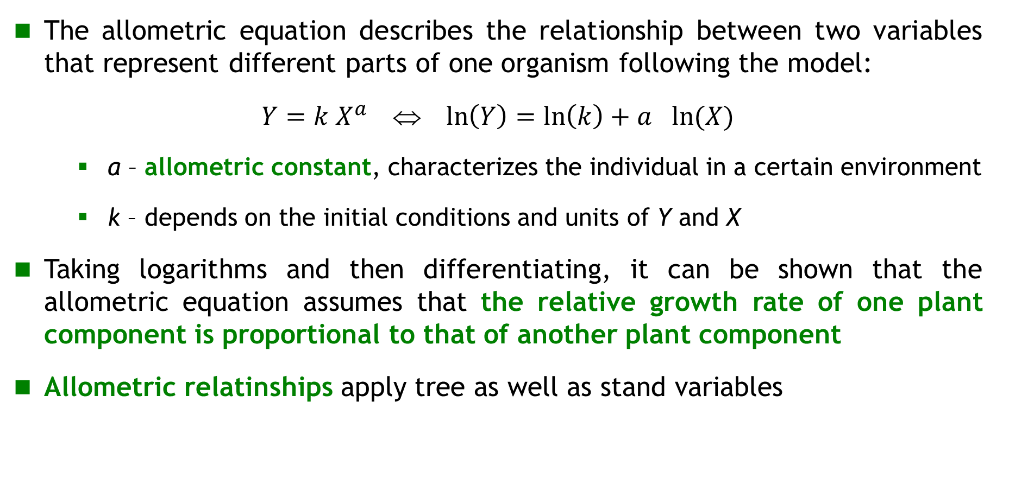
Allometric relationships
The allometric equation describes the relationship between two variables that represent different parts of one organism following the model:
$Y=k X^{a}$ ⇔ $\ln\left(Y\right)=\ln\left(k\right)+a_{}ln⁡(X)$
    a – allometric constant, characterizes the individual in a certain environment
    k – depends on the initial conditions and units of Y and X
Taking logarithms and then differentiating, it can be shown that the allometric equation assumes that the relative growth rate of one plant component is proportional to that of another plant component
Allometric relatinships apply tree as well as stand variables
Notes:
este

Slide 5
Allometric relationships
The parameter a – allometric constant - is the coefficient of proportionality between the relative growth rates of the two variables
When applying to tree or stand variables a can, therefore, provide information on the partitioning of assimilates between plant/stand parts
Notes:
este

Slide 6

Allometric relationships
The multiple allometric relationship is established between one variable (Y) and other variables (X,Z) (more than one):
$$Y=k X^{a}Z^{b}$$
The existence of allometric relationships between tree variables (or stand variables) is very important for growth and yield modelling of trees and stands
It is one of the biologic hypothesis that can be used in the formulation of models
Notes:
este

Slide 7
Allometric relationships to estimate tree biomass
some details about data from destructive sampling for tree biomass determination

Slide 8
Total biomass and biomass per tree component
Biomass is defined as “dry weight” (after drying in an oven until it reaches constant weight)
It is important to take into account the biomass of the different components of the tree:
  Stem, separated into wood and bark (ww and wb)
  Crown, separated into branches, leaves, flowers and fruits (wbr, wl, wfl and wfr)
  Roots, separated into main root, thick roots and thin roots (wr)
  The total biomass of the tree is the sum of all components of the tree
    For most purposes, some components are not taken into account (e.g. flowers and fruits for the Kyoto protocol)
    wa = ww+wb+wbr+wl+wr
  Total tree aboveground biomass does not include roots (wa=ww+wb+wbr+wl)

Slide 9
Why is biomass estimation so important?
Sustainable forest management has increased the need for reliable allometric equations to estimate tree and shrub biomass
  Biomass evaluation is the basis to estimate carbon stocks and carbon sequestration as well as nutrientes cycles
  Non-wood forest products (Woody and non-Woody) are mostly comercialized as weight:
    Wood for energy (or even for other pruposes)
    Cork, the most important NWFP for mediterranean regions, is comercialized by weight
    The same is true for stone pine nuts
  Predicting fuel loads is important to anticipate potential fire behavior

Slide 10
Tree biomass – direct evaluation?
Assessment of tree biomass involves felling the tree, including extracting the root, and separating all components of the tree
In the field just fresh weight can be obtained; therefore, direct assessment is not possible…
The tree biomass estimate is made by separating and weighting (fresh weight) each tree component:
  Determination of moisture content in a sample (by drying the sample in an oven until constant weight)
  Wood and bark biomass can be obtained from an estimate (based on samples) of the volume and density of wood and/or bark
  Among other possible methods…

Slide 11
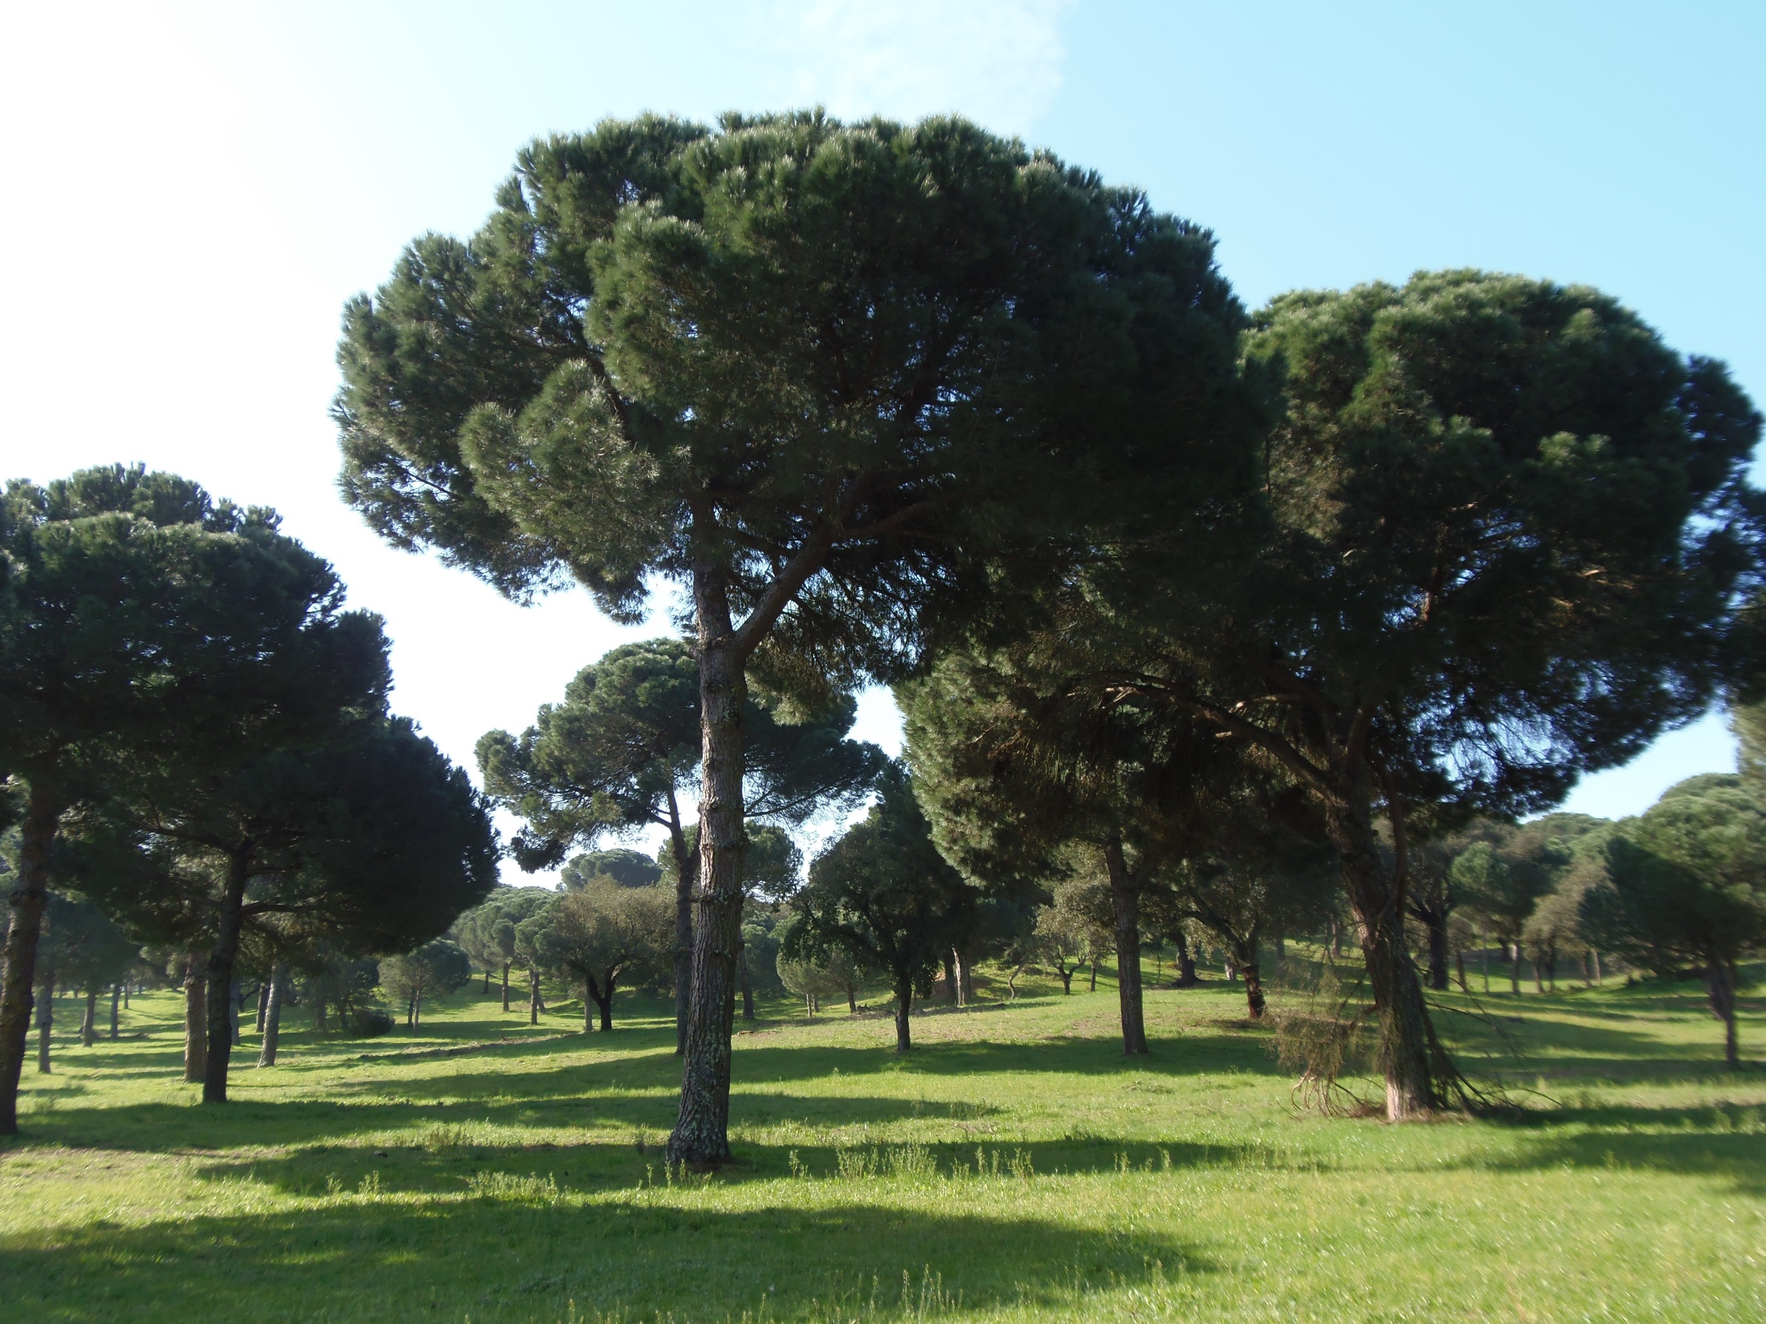

Slide 12
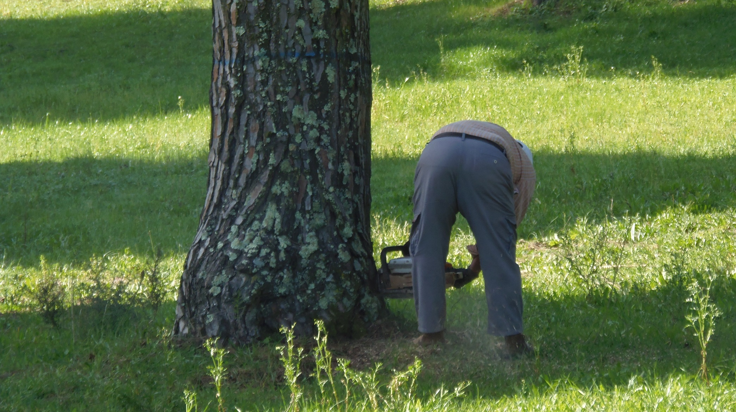

Slide 13
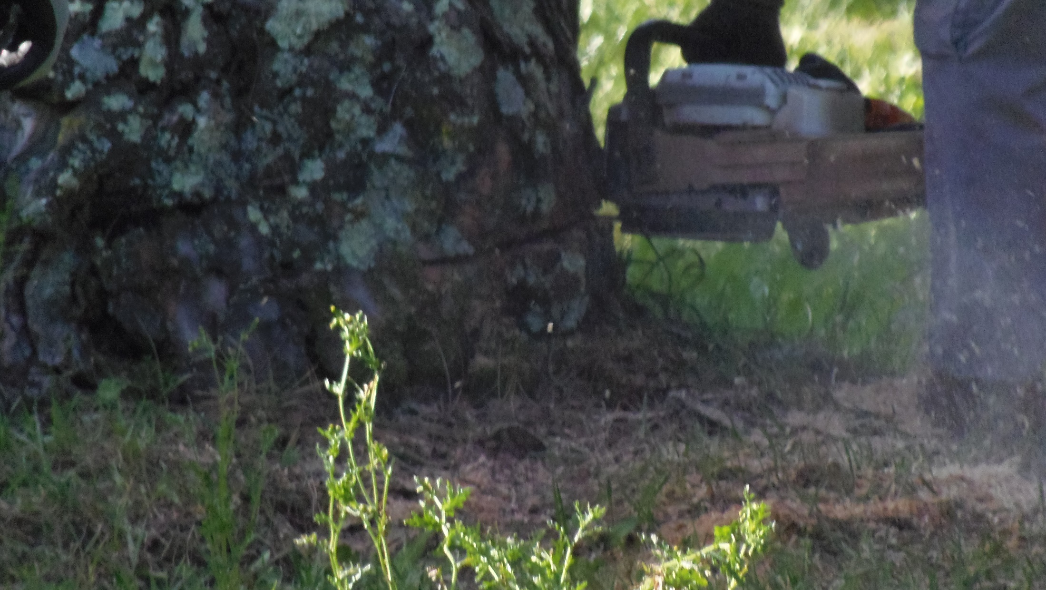

Slide 14
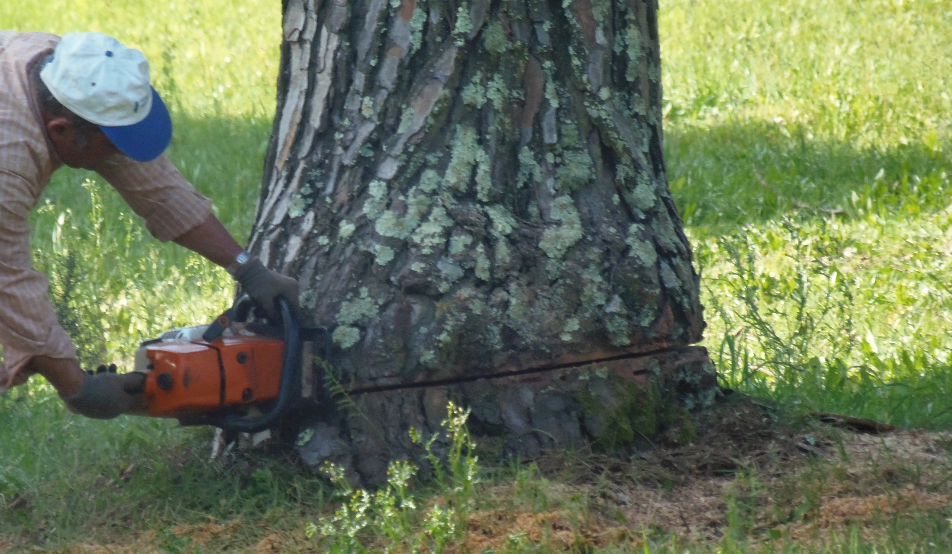

Slide 15
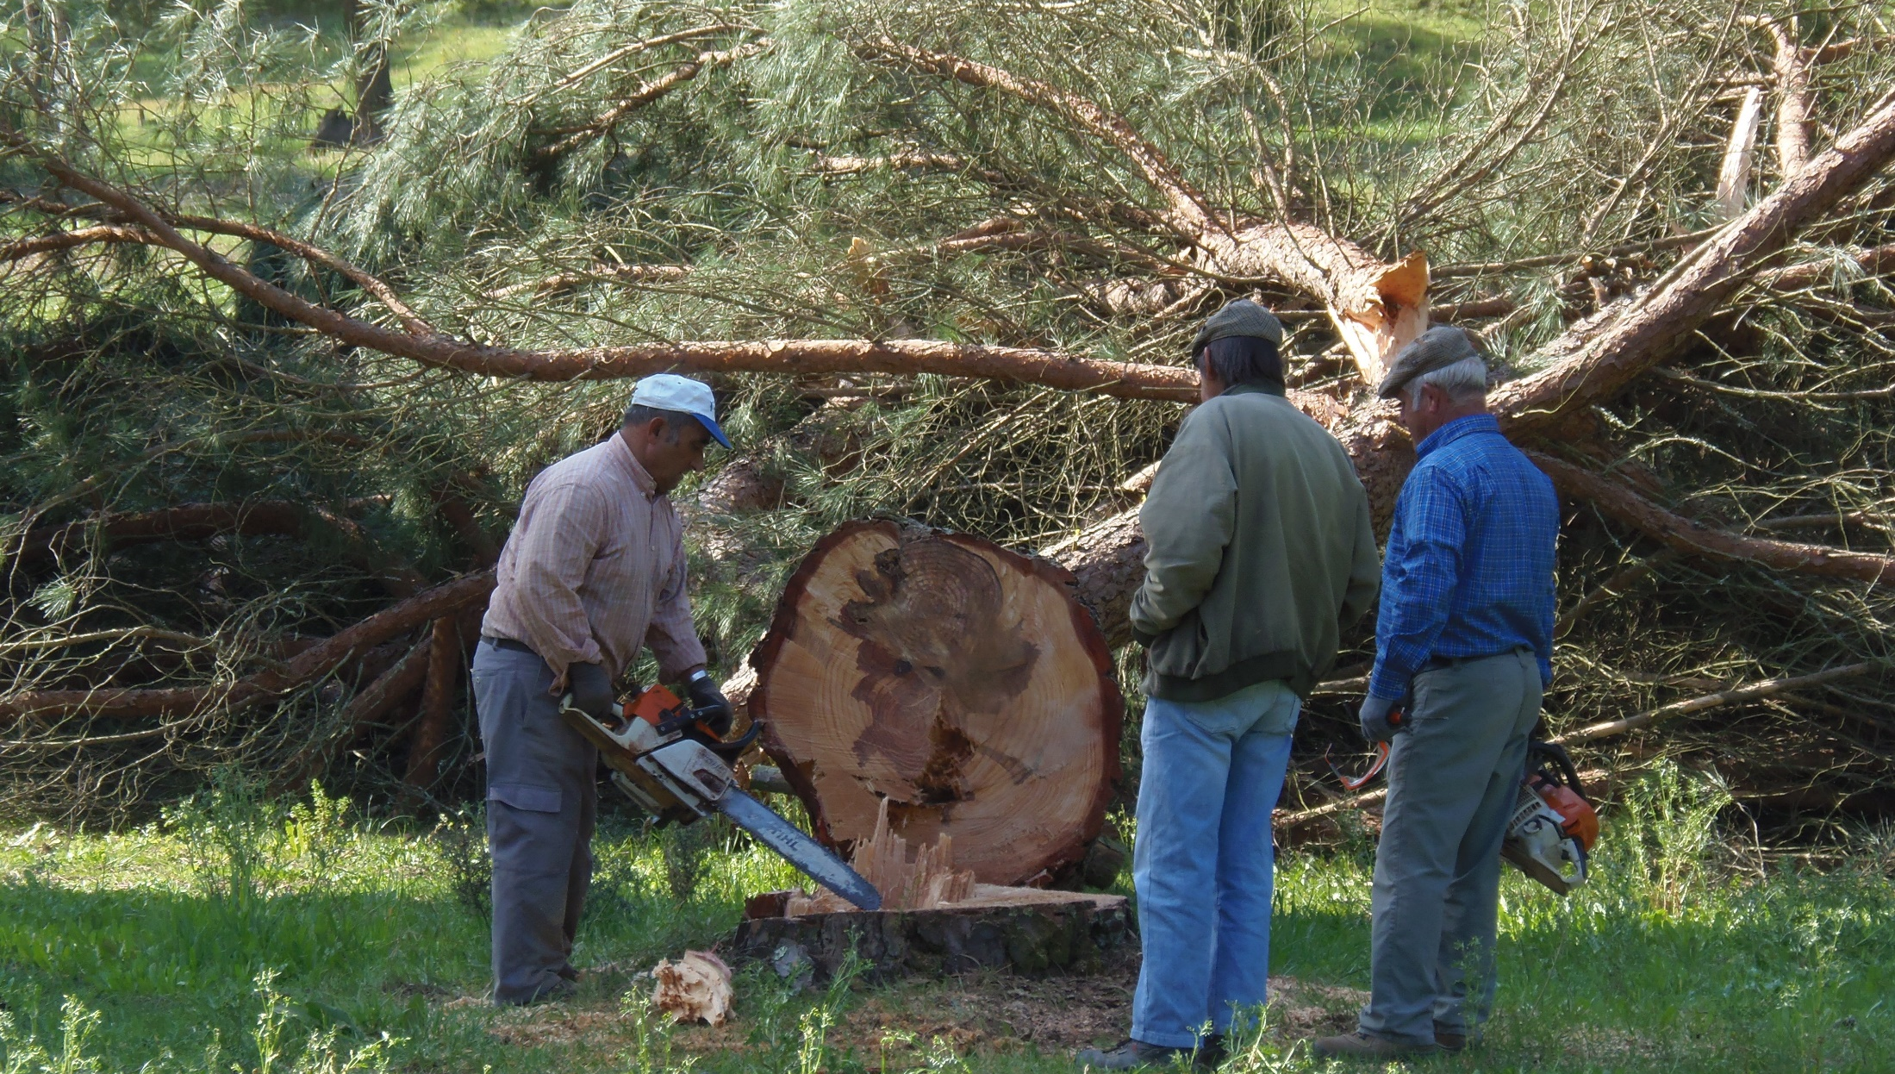

Slide 16
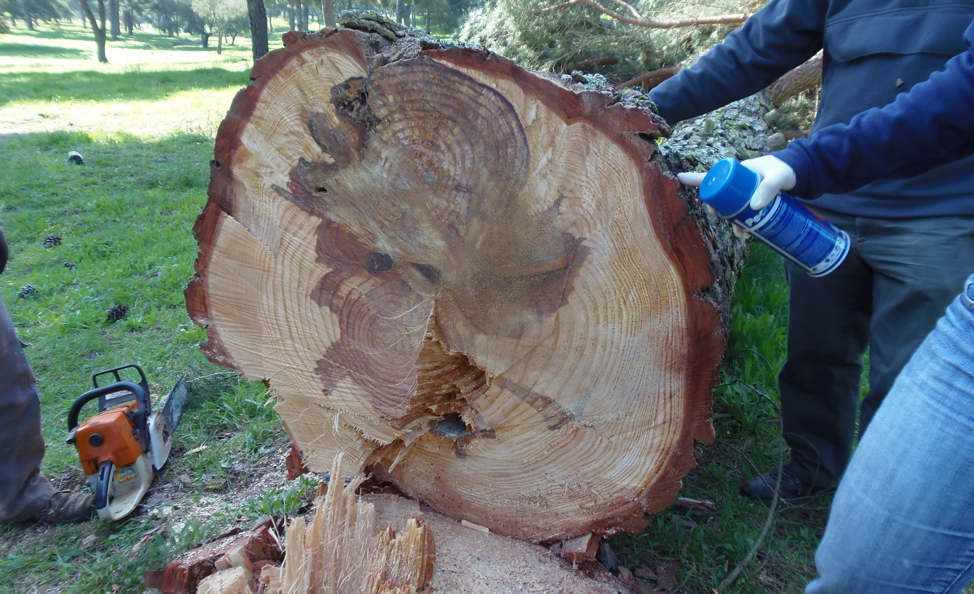

Slide 17
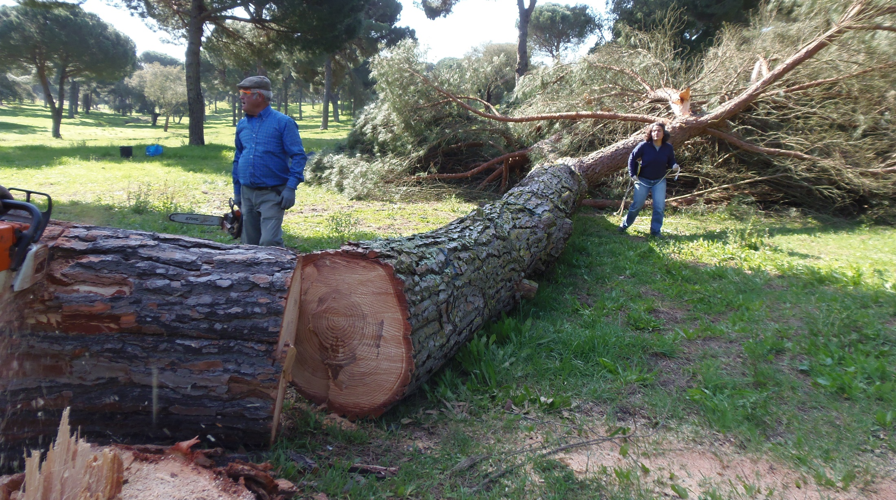

Slide 18
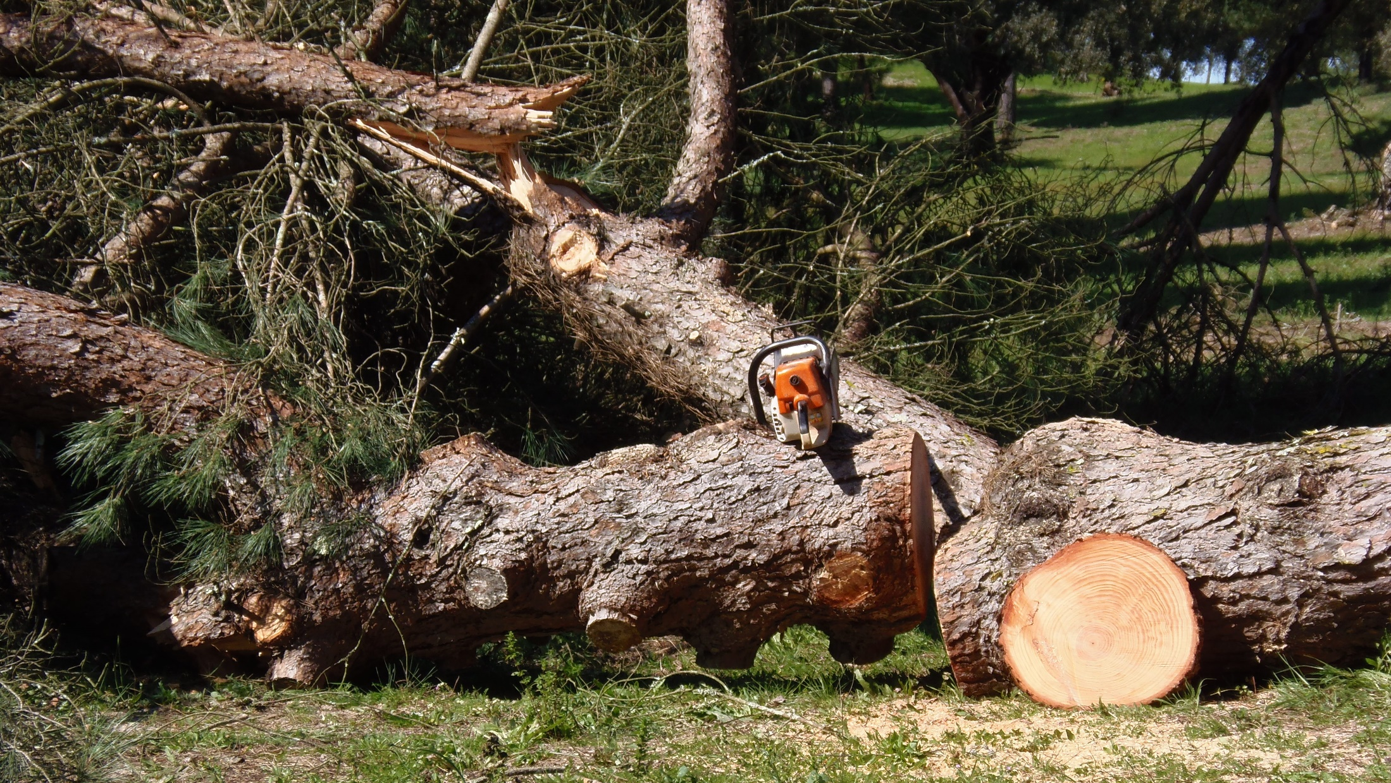

Slide 19
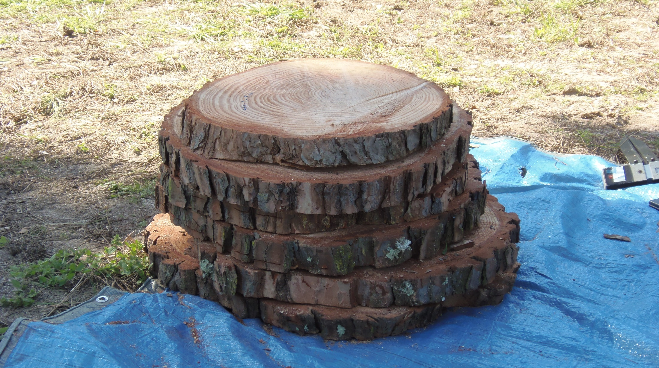

Slide 20
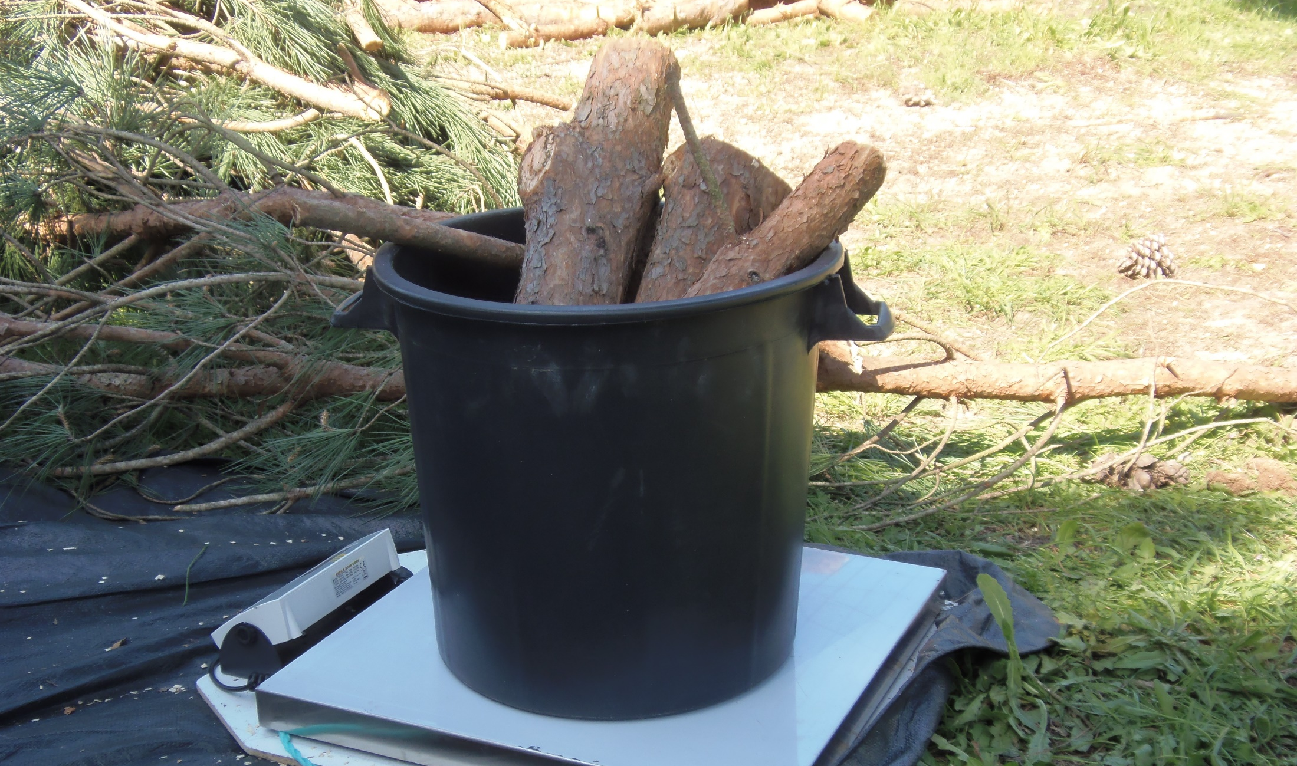

Slide 21
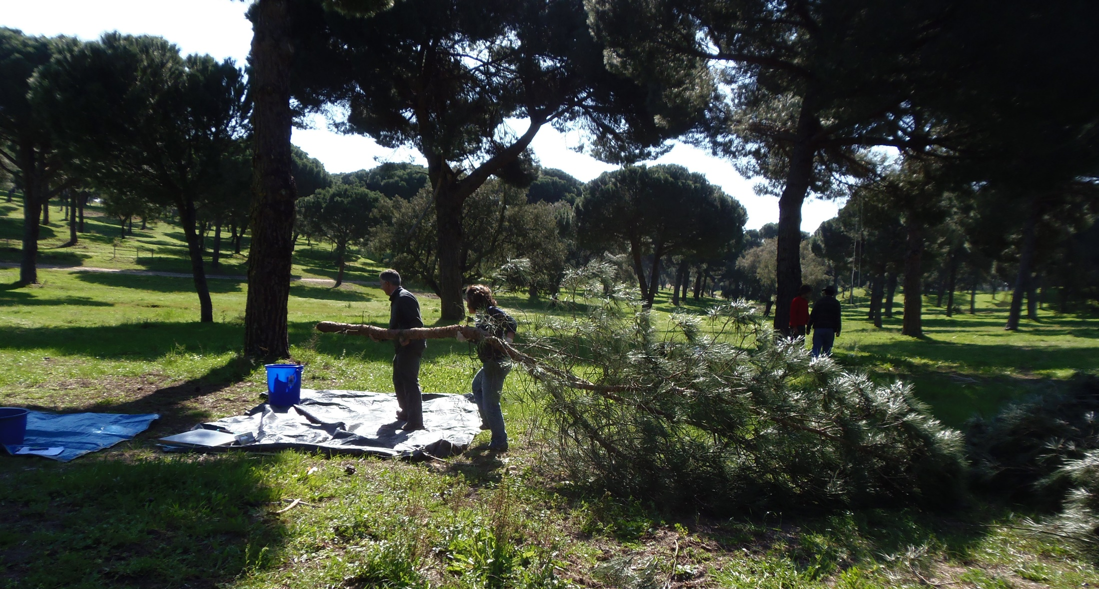

Slide 22
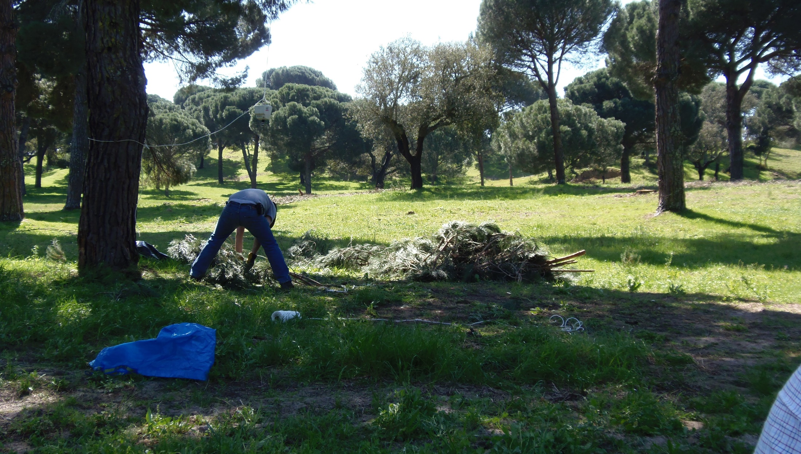

Slide 23
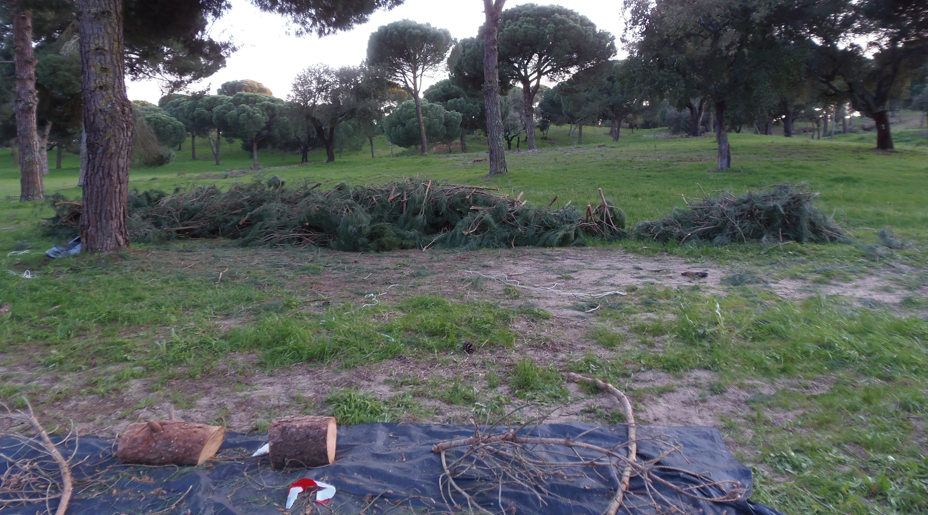

Slide 24
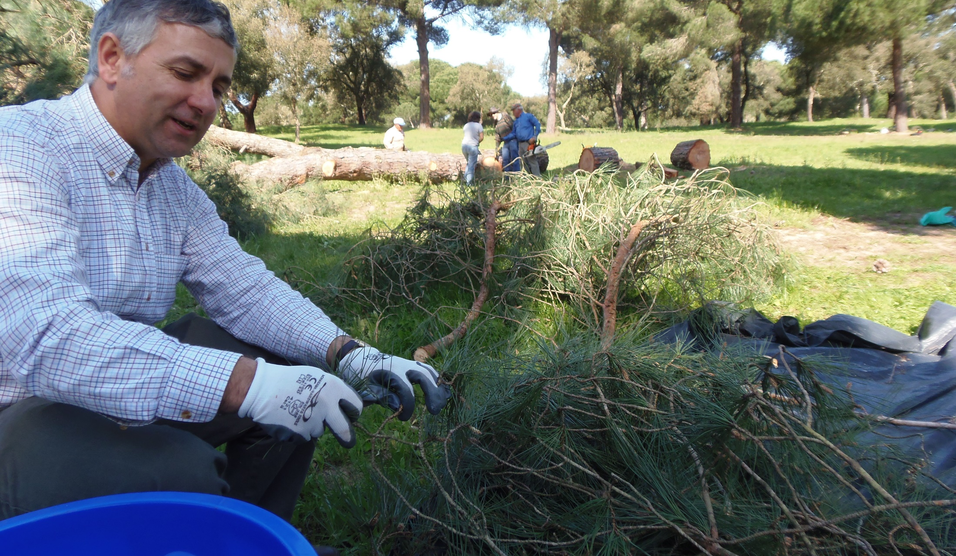

Slide 25
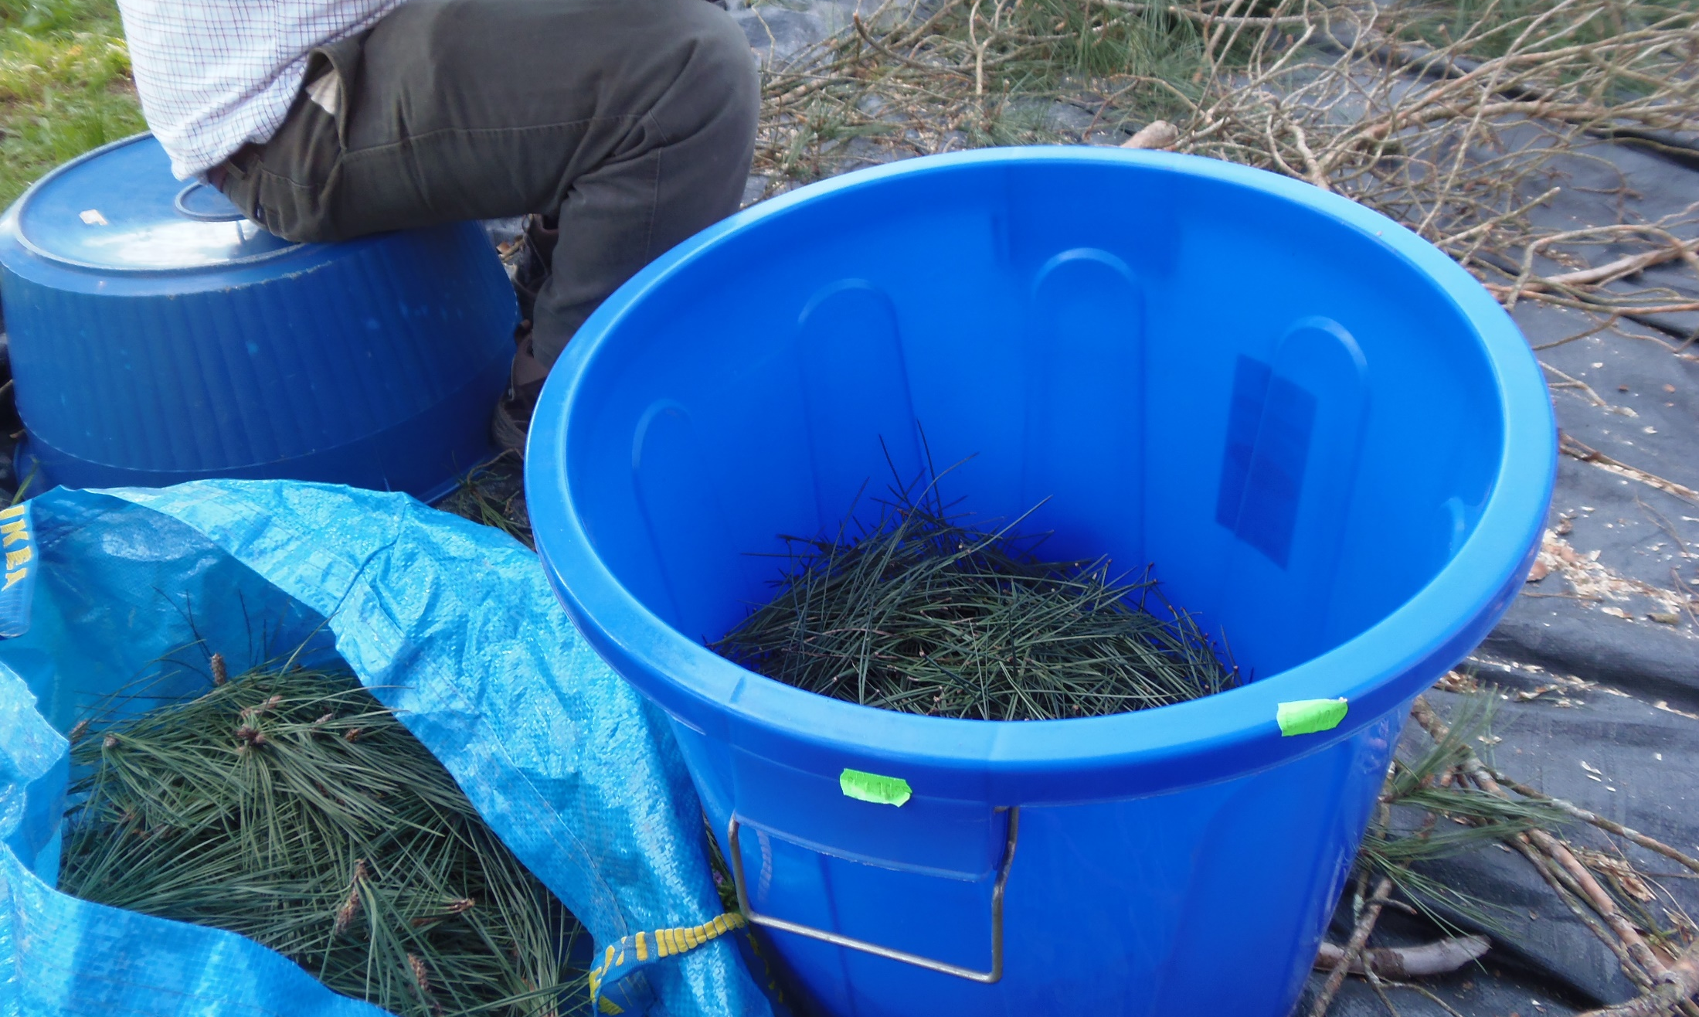

Slide 26
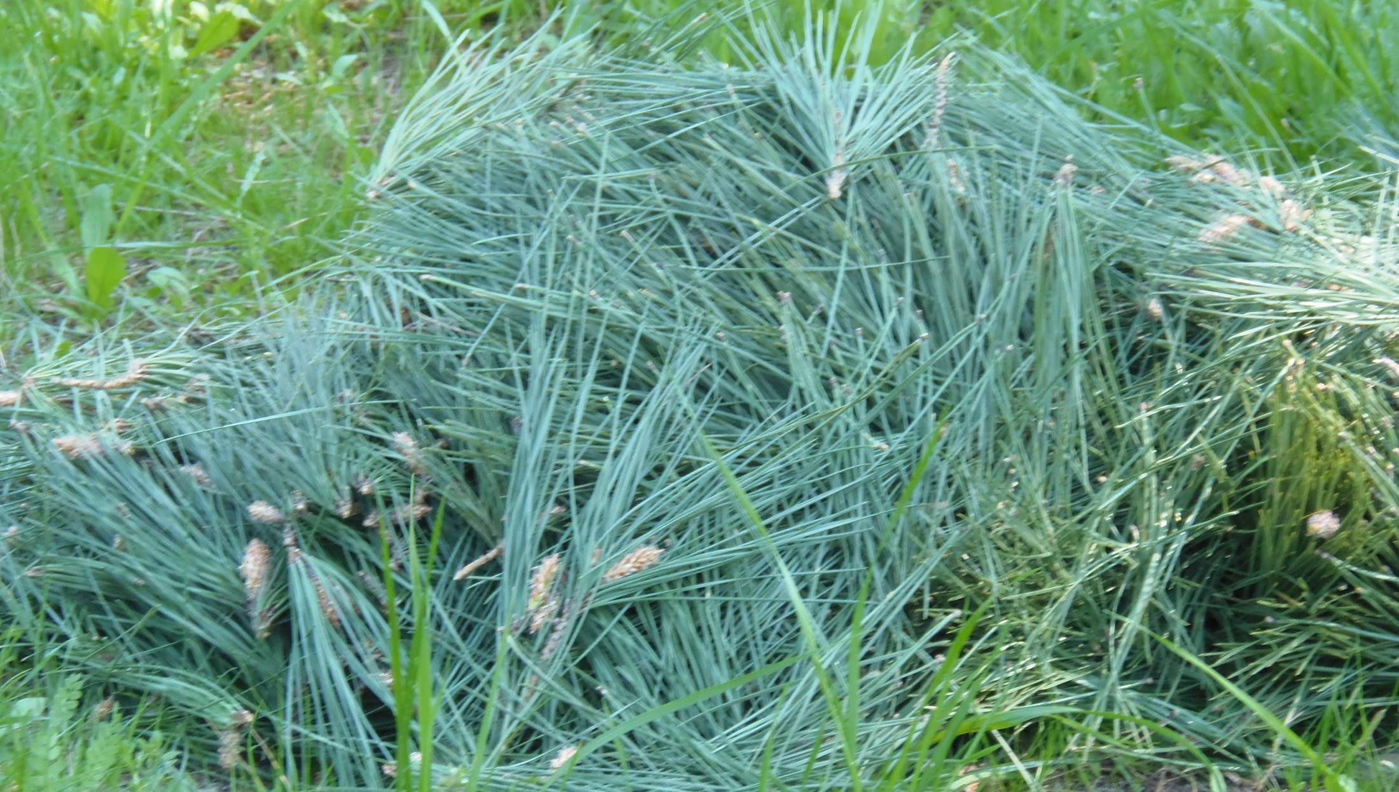

Slide 27
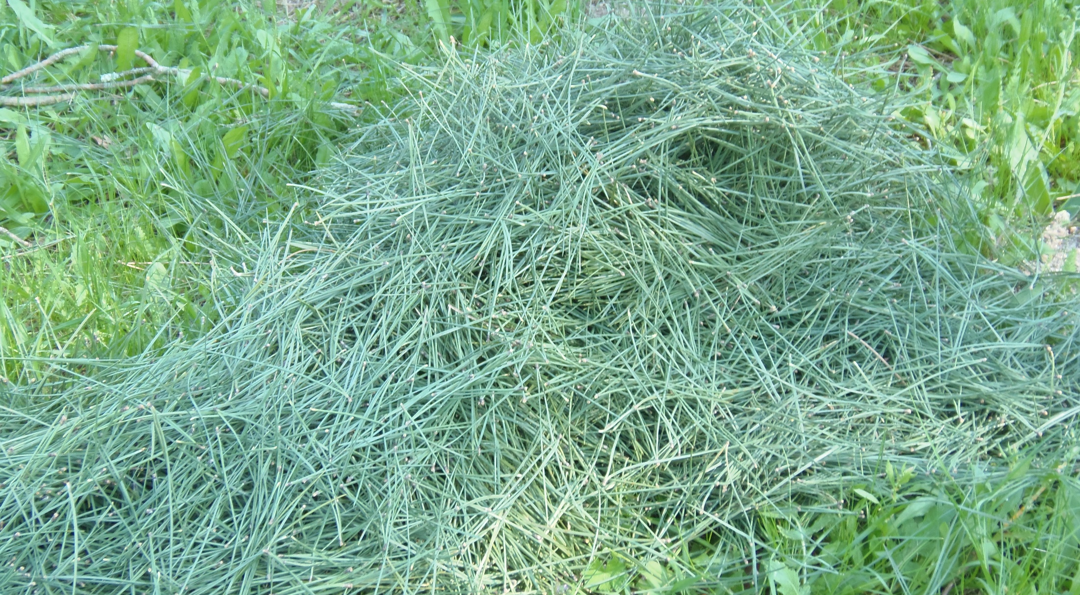

Slide 28
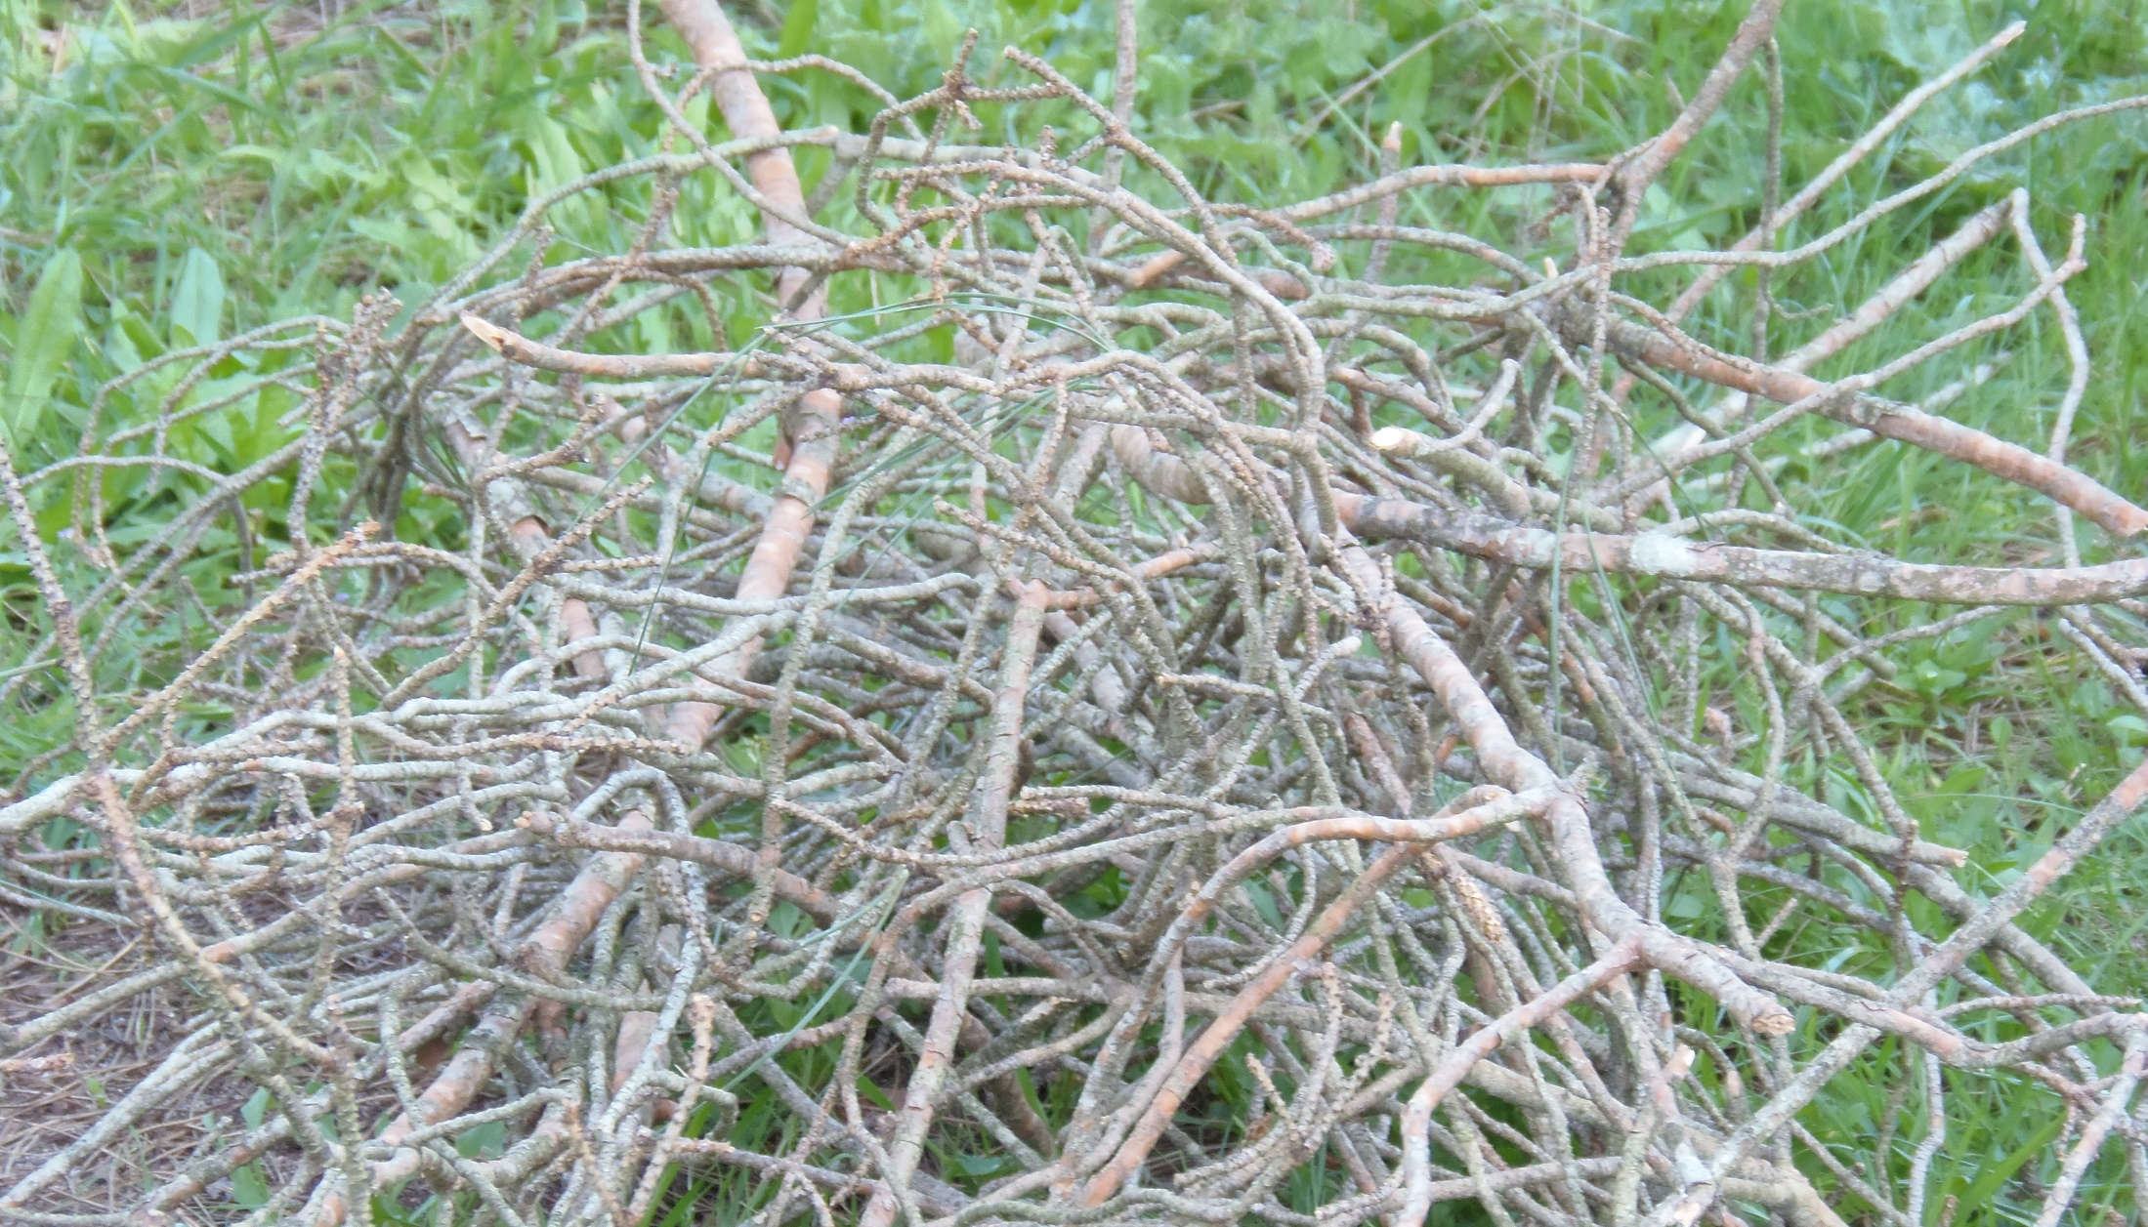

Slide 29
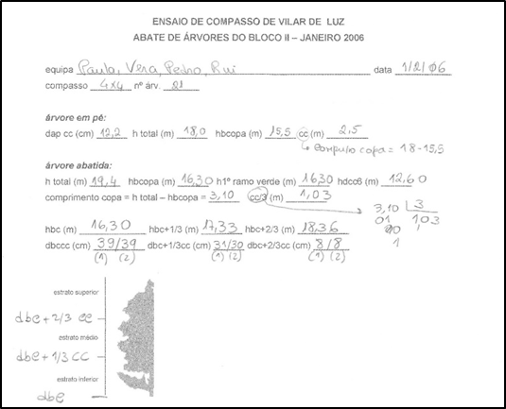
Example of data for tree biomass determination
These data refere to an eucalyptus tree harvested in a plot with spacing 4X4 m

Slide 30
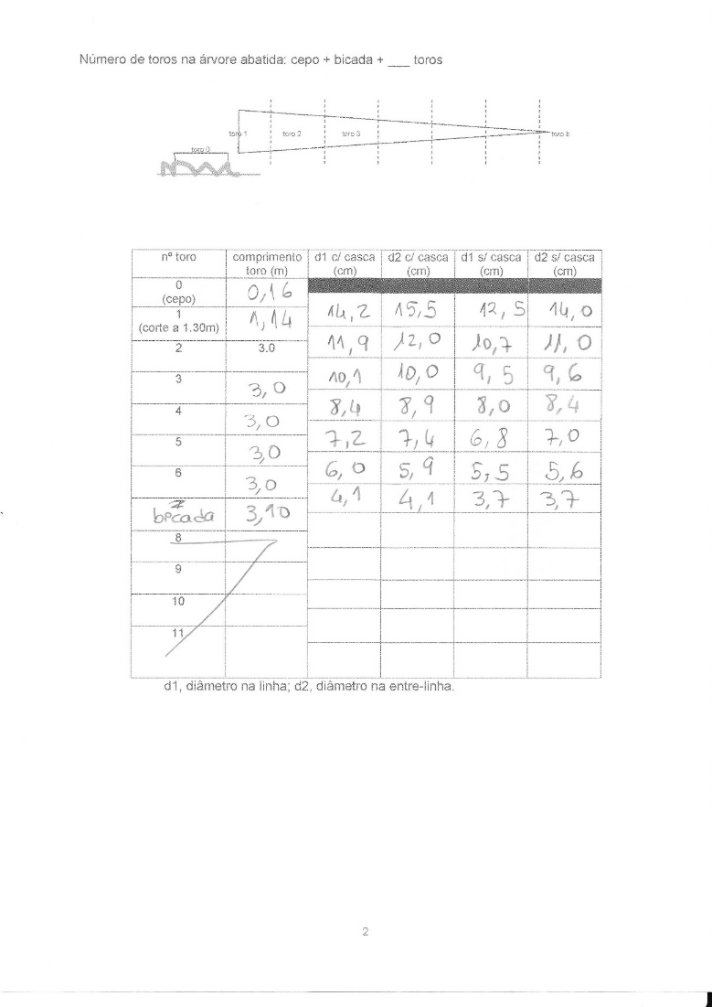
Exemplo de dados para a determinação da biomassa da árvore

Slide 31
