Slide 1
Susana Barreiro & Margarida Tomé, 2025
PINASTER
Individual Tree Model

Slide 2
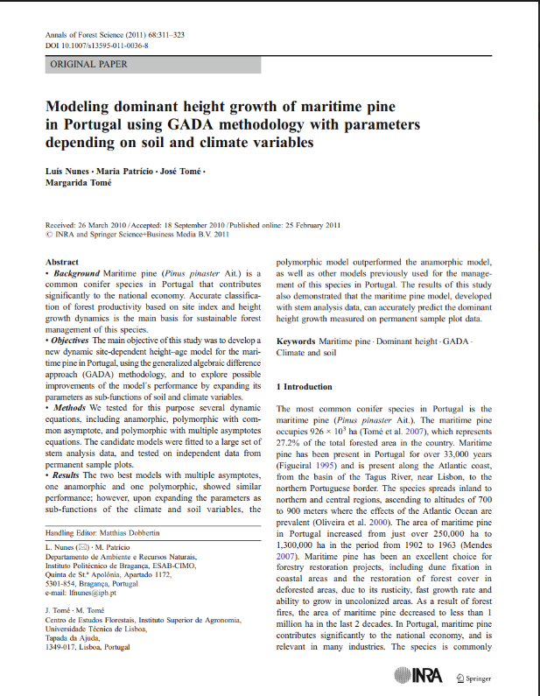
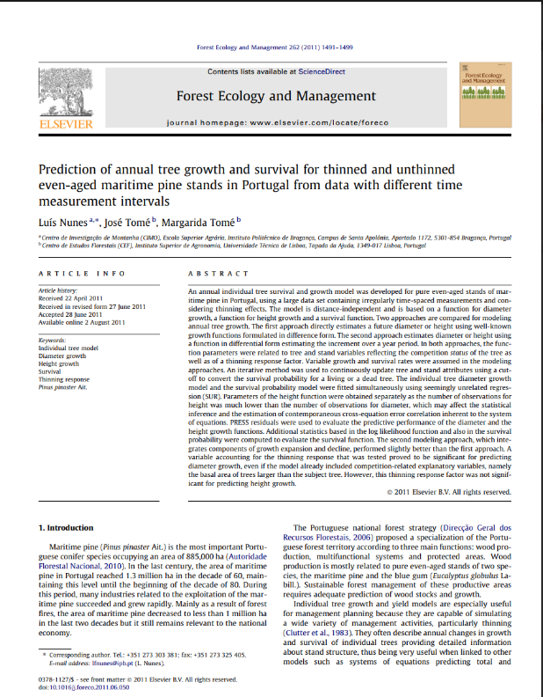
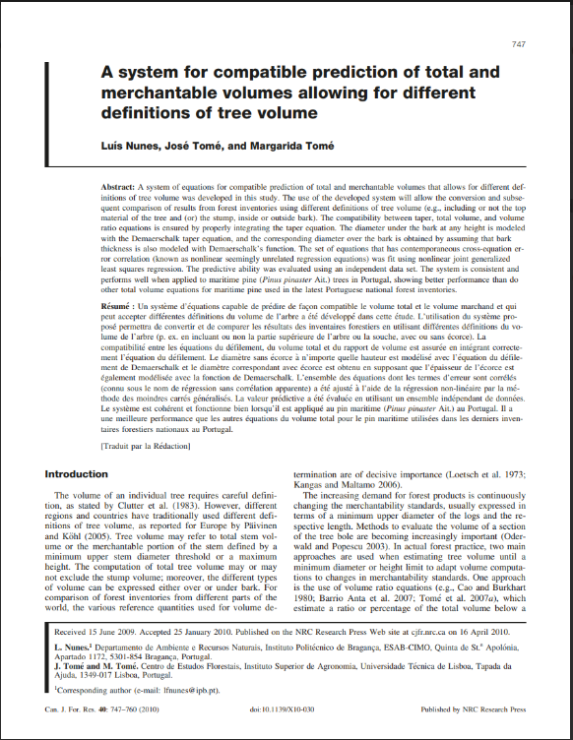
PINASTER individual tree model
´most of the model components were developed by a colleague from Instituto Politécnico de Bragança, North of Portugal, under his PhD and published in 3 separate papers
But not all its equations were integrated in StandsSIM.md simulator

Slide 3
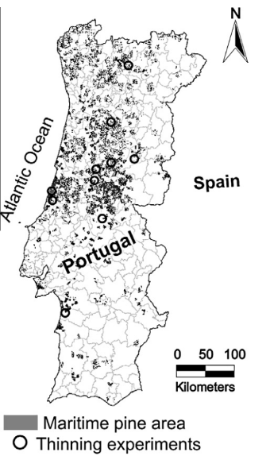
PINASTER individual tree model
Growth module (principal variables)
Thinning experiments in a total of 145 permanent sample plots covering different treatments concerning from low to heavy thinning, including no thinning, and also situations of increasing and decreasing thinning intensity. All thinnings were from below.
The diameter growth model includes:
  A variable accounting for the thinning response;
  competition-related variable = the basal area of trees larger than the subject tree.
Thinning response was not significant for predicting height growth.
The individual tree diameter growth model and the survival probability model were fitted simultaneously using seemingly unrelated regression (SUR). Parameters of the height function were obtained separately as the number of observations for height was much lower than the number of observations for diameter

Slide 4
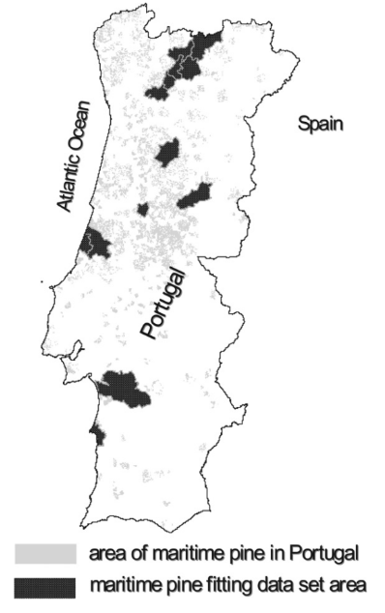
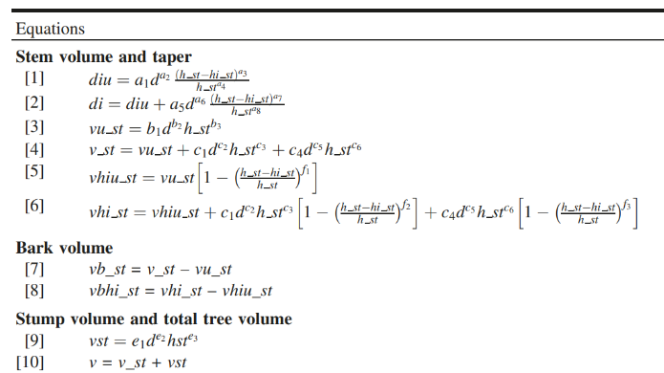
PINASTER individual tree model
Calculus module (derived variables)
Merchantability standards are usually expressed in terms of a min. upper diameter of the logs and its respective length
estimate a ratio or percentage of the total volume below a limiting top diameter or height
Total tree volume is partitioned into above-stump volume and stump volume. The above-stump volume is subdivided into stem
volume (under and over bark) and bark volume
fit using nonlinear joint generalized

Slide 5
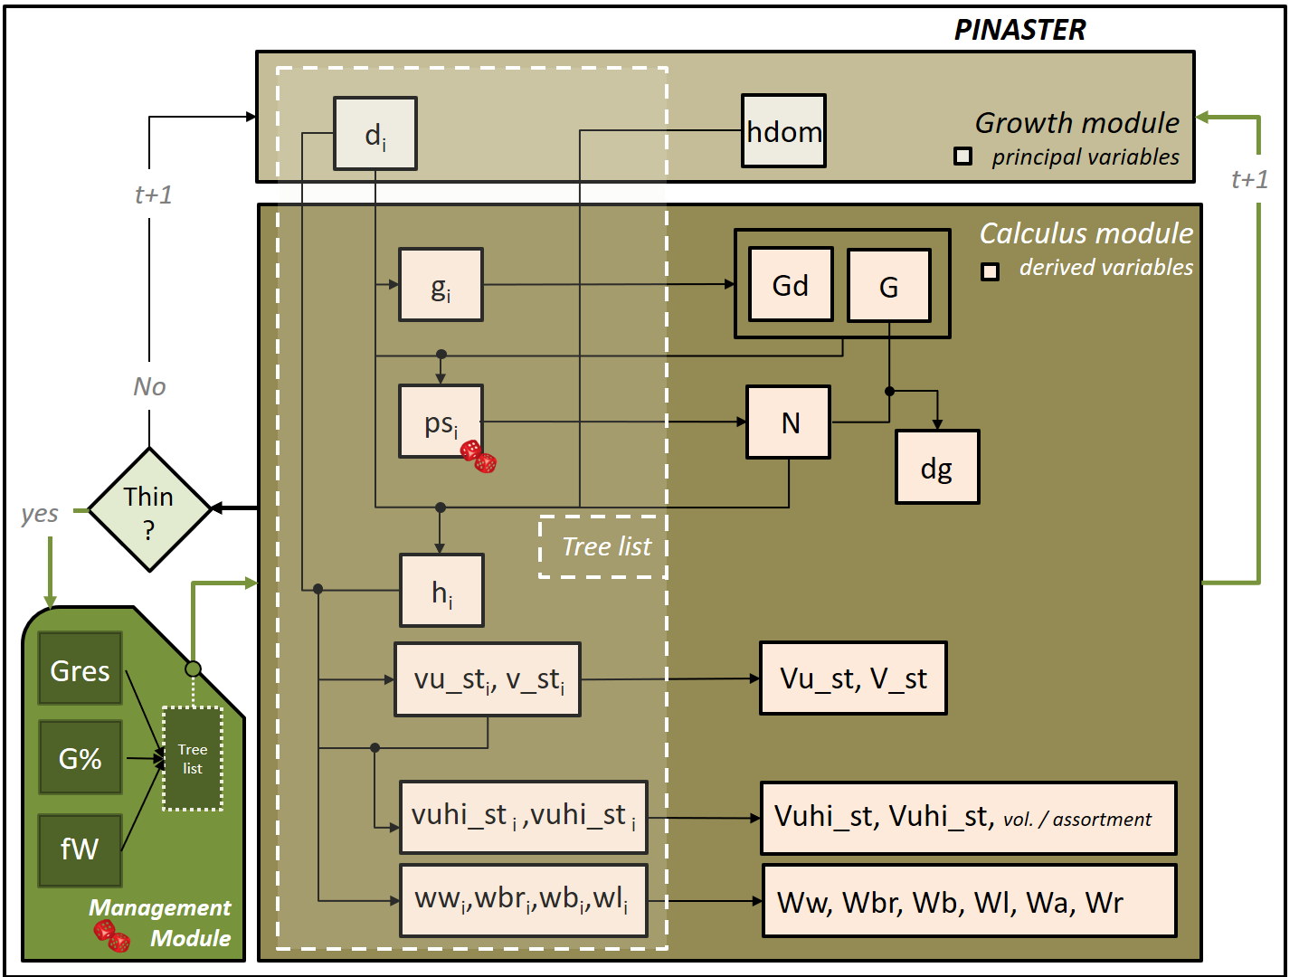
PINASTER individual tree model
Implementation of the model in StandsSIM.md
Growth Module:
Site index curves (Tomé et al. 2001)
Diameter growth (Nunes et al. 2011)
Calculus module:
Tree survival (Nunes et al. 2011)
Height-diameter curves (Tomé et al. 2007)
Self-thinning (Tomé 2001)
System of equations for total standing - volumes and volume by assortments (Nunes et al. 2010)
Total biomass and biomass by tree components (Faias 2009)

Slide 6
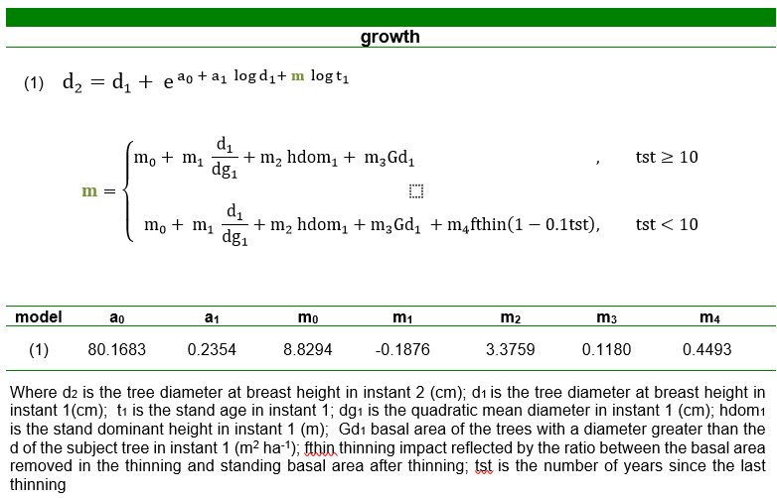
PINASTER individual tree model
Growth module (principal variables)
The diameter growth model includes:
  A variable accounting for the thinning response;
  competition-related variable = the basal area of trees larger than the subject tree.

Slide 7
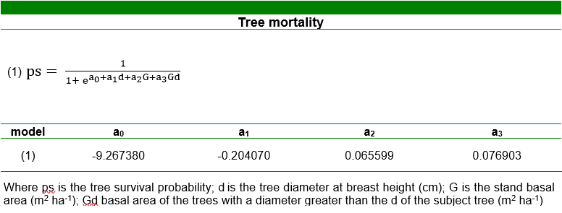
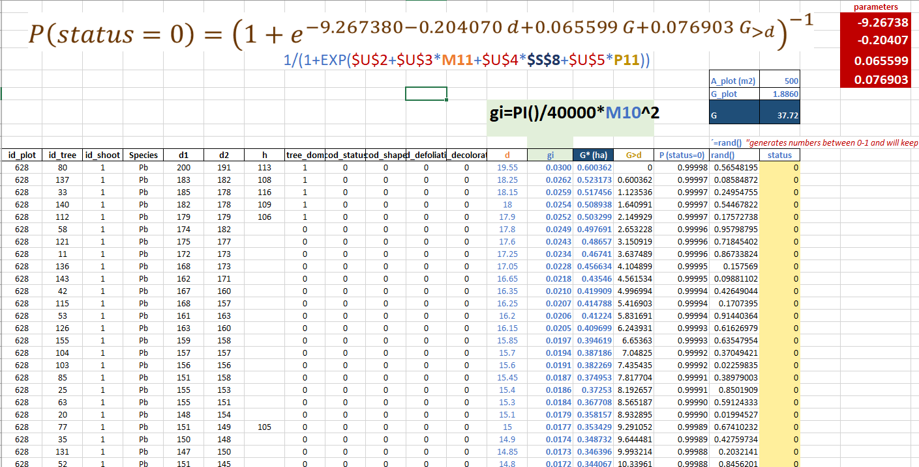

PINASTER individual tree model
Calculus module (derived variables)
The survival probability and the diameter growth equations were simultaneously fitted

Slide 8
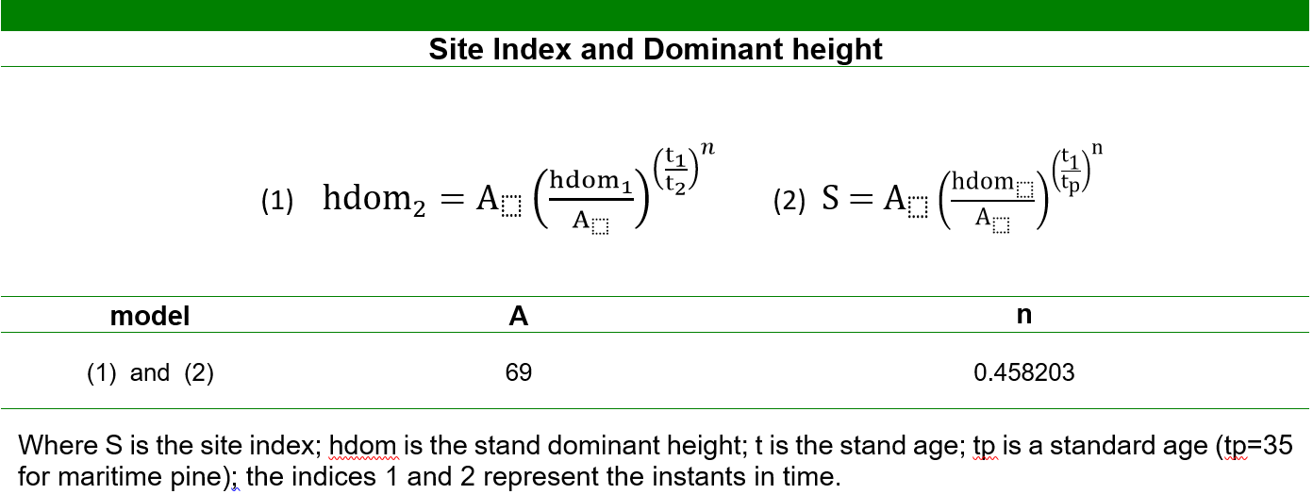
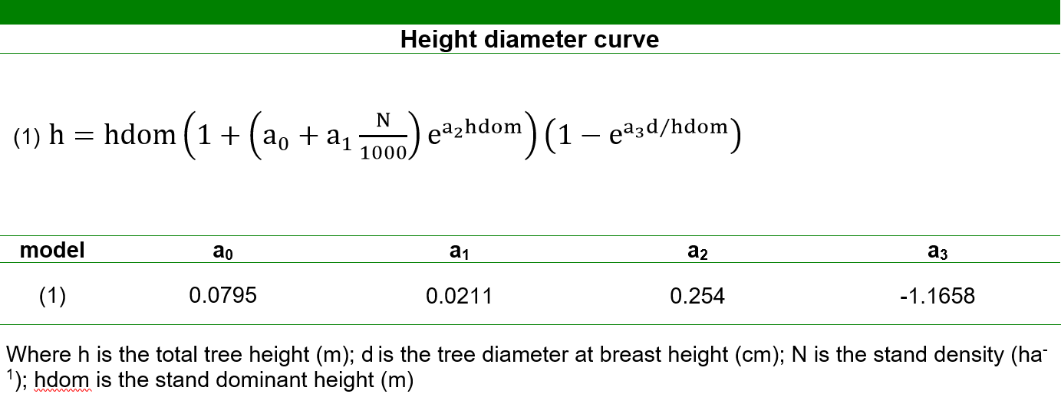
PINASTER individual tree model
Growth and Calculus modules
The dominant height growth and the tree height growth models were not compatible
CONSEQUENCE: if implemented in the simulator applying one or the other could originate different height values for the same instant in time; SOLUTION: using an alternative set of equations Tomé et al. 2001, Tomé et al. 2007 avoiding using both the height growth and hdom growth at the same time

Slide 9
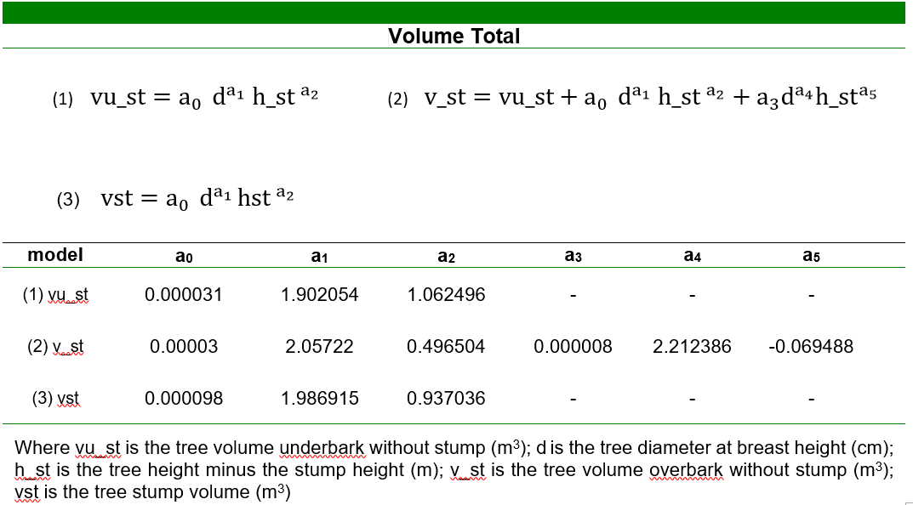
PINASTER individual tree model
Calculus module (derived variables)
Total tree volume is partitioned into above-stump volume and stump
volume. The above-stump volume is subdivided into stem volume (under and over bark) and bark volume, which is obtained by the difference of the two stem volumes.
vb
v_st -vu_st
vu_st
v_st
vst

Slide 10
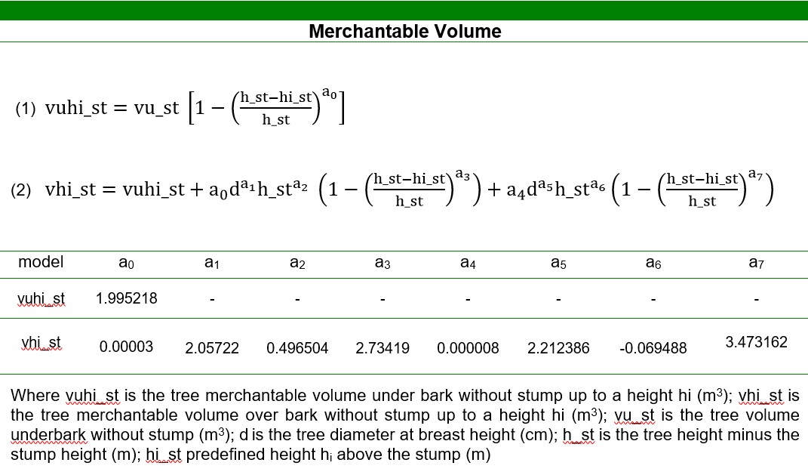
PINASTER individual tree model
Calculus module (derived variables)
Merchantable tree volume: compatible total volume equations (vu_st and v_st) and volume ratio equations (vuhi_st and vhi_st) were obtained using total or partial tree height above stump

Slide 11
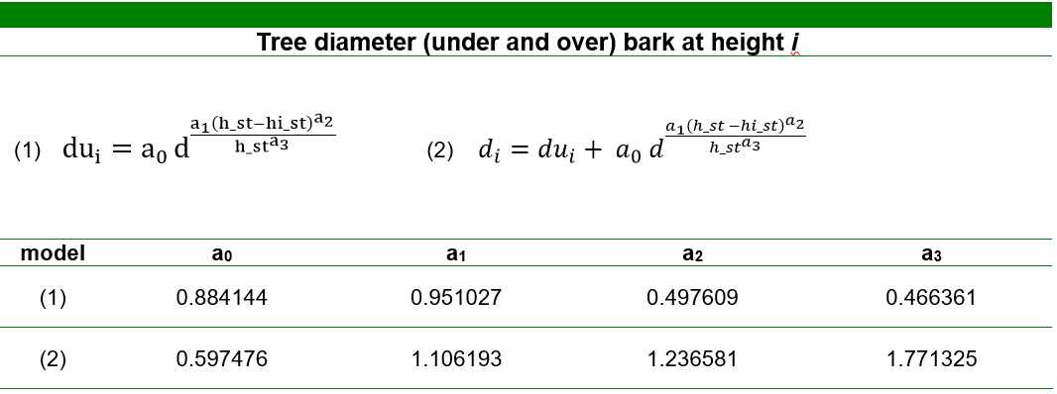
PINASTER individual tree model
Calculus module (derived variables)
Tree volume by assortment: compatible equations to estimate diameter under and over bark at a given heigh

Slide 12
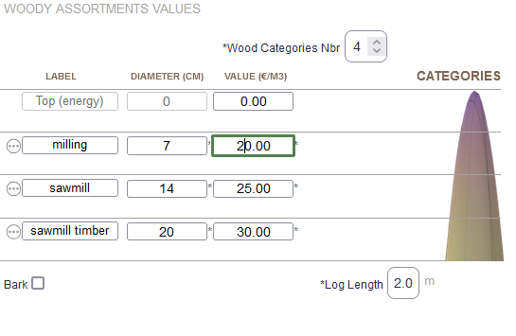
PINASTER individual tree model
Calculus module (derived variables)
Merchantable tree volume: compatible total volume equations (vu_st and v_st) and volume ratio equations (vhiu_st and vhi_st) were obtained using total or partial tree height above stump

Slide 13
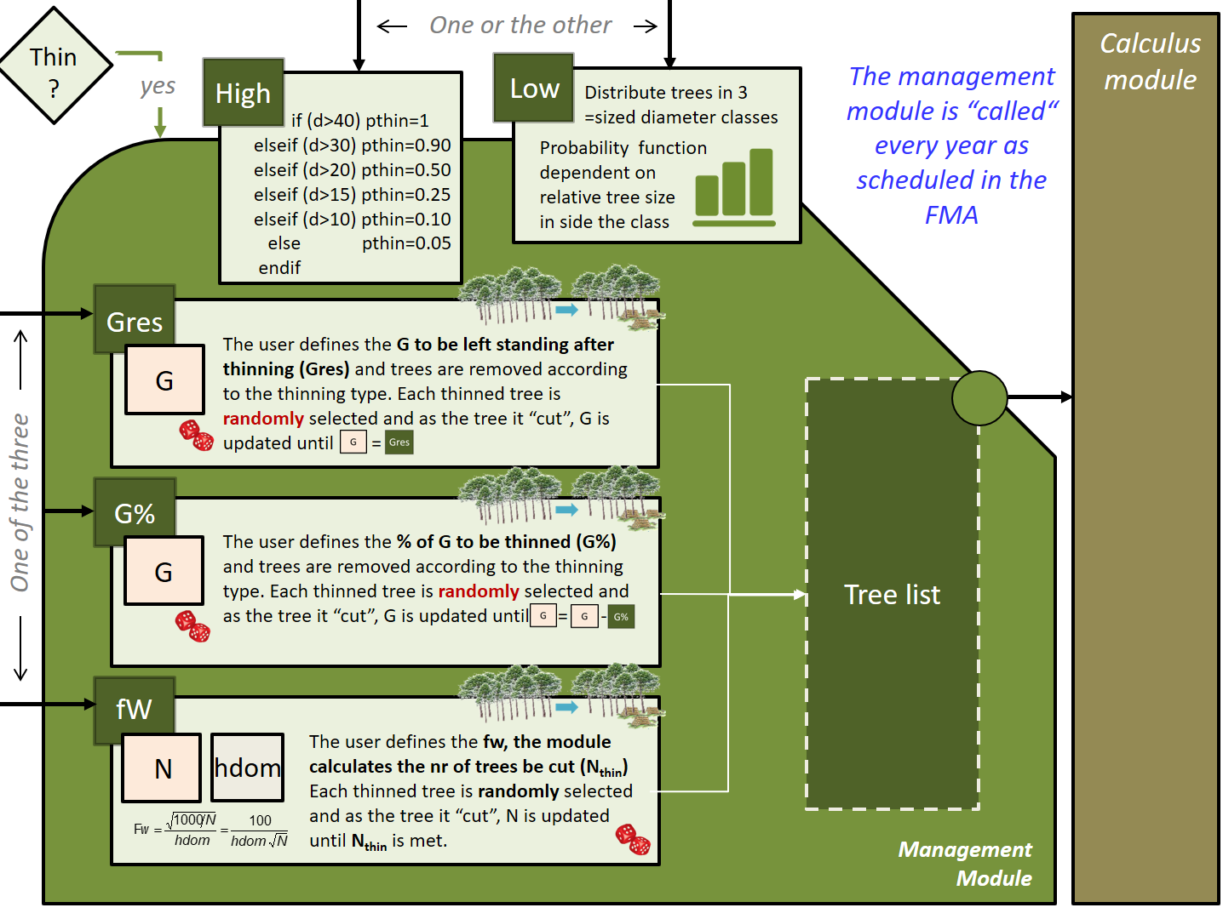
PINASTER individual tree model
The management module
Growth Module:
Site index curves (Tomé et al. 2001)
Diameter growth (Nunes et al. 2011)
Calculus module:
Tree survival (Nunes et al. 2011)
Height-diameter curves (Tomé et al. 2007)
Self-thinning (Tomé 2001)
System of equations for total standing - volumes and volume by assortments (Nunes et al. 2010)
Total biomass and biomass by tree components (Faias 2009)

Slide 14
The End!!

