Slide 1
Individual Tree Models
Margarida Tomé & Susana Barreiro, last revised 2025

Slide 2
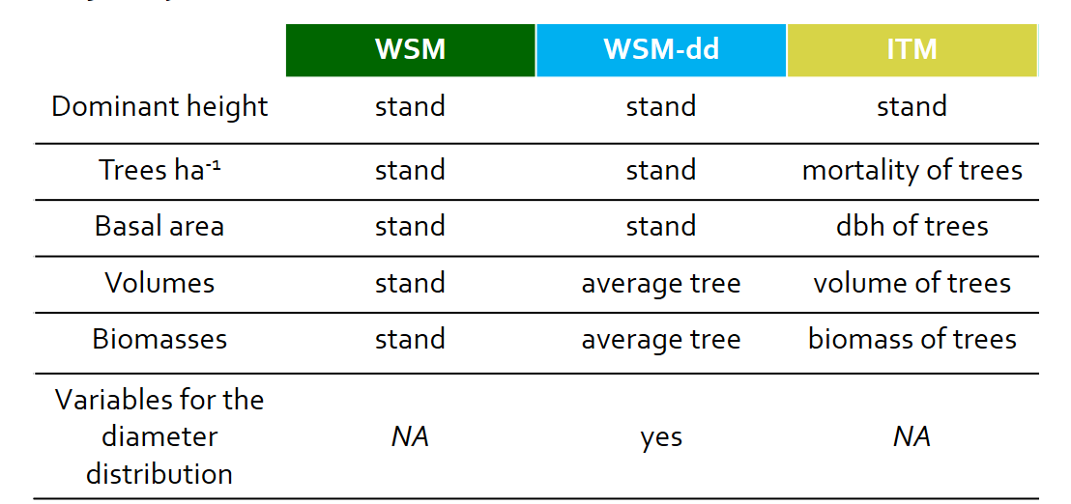
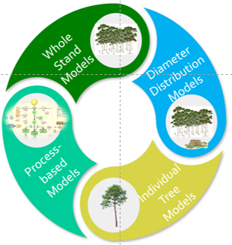
Individual tree models

Slide 3
Individual tree models
Are systems of equations to simulate stand dynamics by incrementing each tree during a growth period in relation to its growing conditions.
provide detailed information about stand development and structure, including the distribution of stand volume by size classes
have inherent flexibility allowing modeling:
combinations of species mixtures and stand structures
management regimes
regeneration methods
Tree growth
Regeneration
Ingrowth
Mortality

Slide 4
Individual tree models types
No tree locations known
Also called distance-independent, position-independent, location-independent, non-spatially-explicit
Usually consist of:
Diameter growth equation
Height growth equation (or h-d relationship to estimate h from d)
Mortality (stochastically generated or predicted as a function of growth rate and/or tree characteristics)
Growth predicted as a function of tree size and stand (t and N) and site variables (S)
Tree locations known
Also called distance-dependent, position-dependent, location-dependent, spatially-explicit
Usually consist of:
Initialization: trees inputted or generated (including their coordinates)
Growth predicted as a function of tree size, site quality (S) and a measure of competition from neighbouring trees (generally a function of size of the subject tree and (size , distance) to competitors
Survival controlled stochastically as a function of competition and/or tree attributes

Slide 5
Individual tree models growth and calculus modules

Slide 6
Individual tree models – state variables
The most common principal variables
Dominant height (stand level variable)
Diameter at breast height
Tree height may also be a principal variable
Derived variables
Tree: total height and height to the base of the crown, tree volume, tree biomass (total and per component), sometimes crown width
Stand: all variables except dominant height

Slide 7
Calculus of stand variables – example for stand volume
Start with a list of all trees at time t₁ (at least tree diameter/or height):
Growth module (GM) – prediction of:
tree mortality
tree diameter growth for each tree
tree height growth for each tree (eventually)
Calculus module (CM)- estimation of:
tree height with a height-diameter curve (if not predicted in the GM)
tree volume with a volume equation
Calculus of plot volume by summing up the volume of every tree in the plot
Expansion to the ha, using the respective expansion factor= 10000/plot area (many models use 1 ha plots therefore this step is not needed)

Slide 8
Modeling individual tree dbh growth
What factors/variables influence tree dbh growth?
site quality
micro-environment conditions (mainly soil)
tree age
tree size
stand density
influence of local neighbours
genetics

Slide 9
Modeling individual tree growth
What factors/variables influence growth?
Past growing conditions and genetic potential to grow account for actual characteristics of the tree, such as size and vigor, which are usually introduced in a tree growth model by initial tree size and age
Other factors influencing tree growth may be separated into the following three components:
General environment of competition, which is usually taken into account using stand density
Micro-environmental and genetic influences, represented by a ratio of some dimension of the tree to the mean or maximum value of this dimension in the stand
Influence of local neighbors

Slide 10
Modeling individual tree growth
The influence of local neighbors -> competition indices
The effect of local neighbors may be expressed by some mathematical formulation - commonly referred to as a “competition index” - representing how much each tree is affected by its neighbors
I Distance-independent or non spatially-explicit indices
simple formulations expressing the hierarchical position of the tree within the stand or plot (d)
II Distance-dependent or spatially explicit-indices
to more complex indices that express the size of, distance to, and number of local neighbors

Slide 11
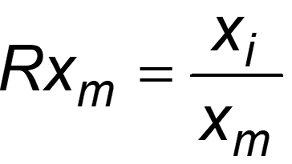
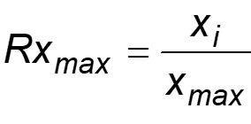
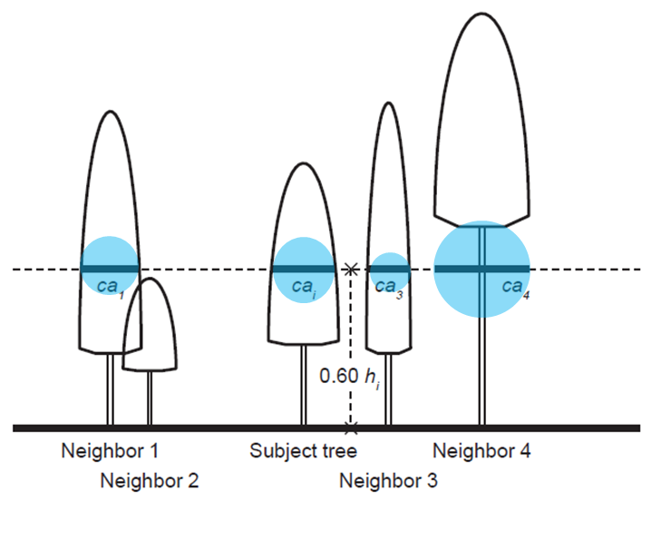
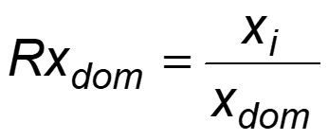
Modeling individual tree growth
The influence of local neighbors -> Distance-independent indices
The competitive influence of a neighboring tree should be:
a decreasing function of the distance between the neighbor and the subject tree
an increasing function of the neighbor’s size
Measures based on trees larger than the subject tree
Basal area of the trees larger than the subject tree (G_{>di} )
Modified version of the previous that combines it with relative spacing (R_{s})
Crown competition factor of trees larger than the subject tree
Relative dimensions
Area proportional to relative tree basal area
Measures based crown variables evaluated at a certain % of crown length/tree height
Crown cover computed at h_{p}
Crown ratio

Slide 12
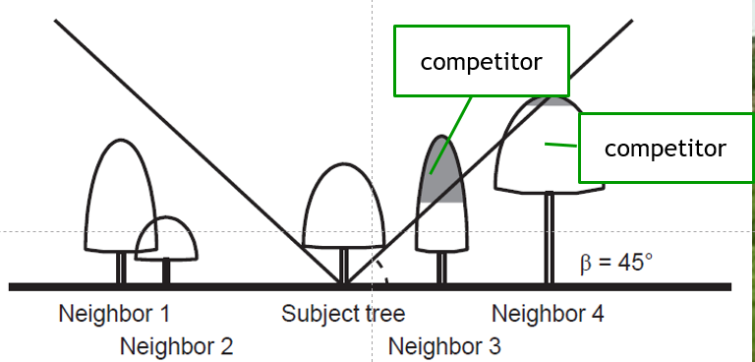
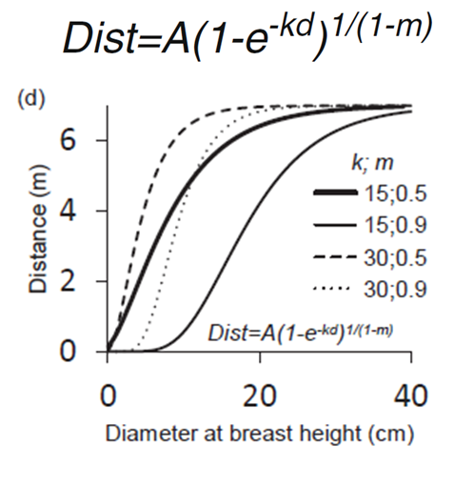
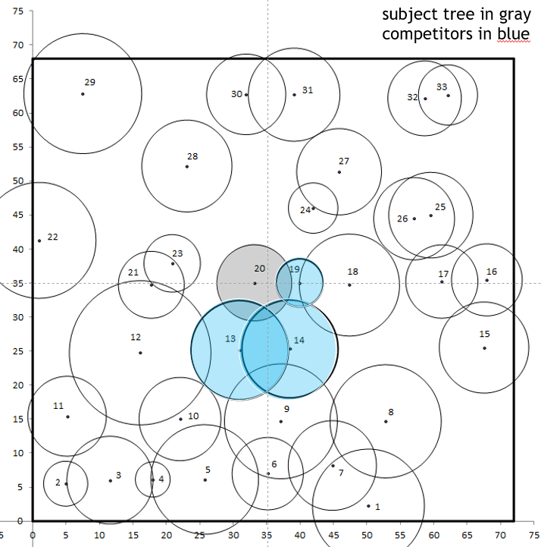
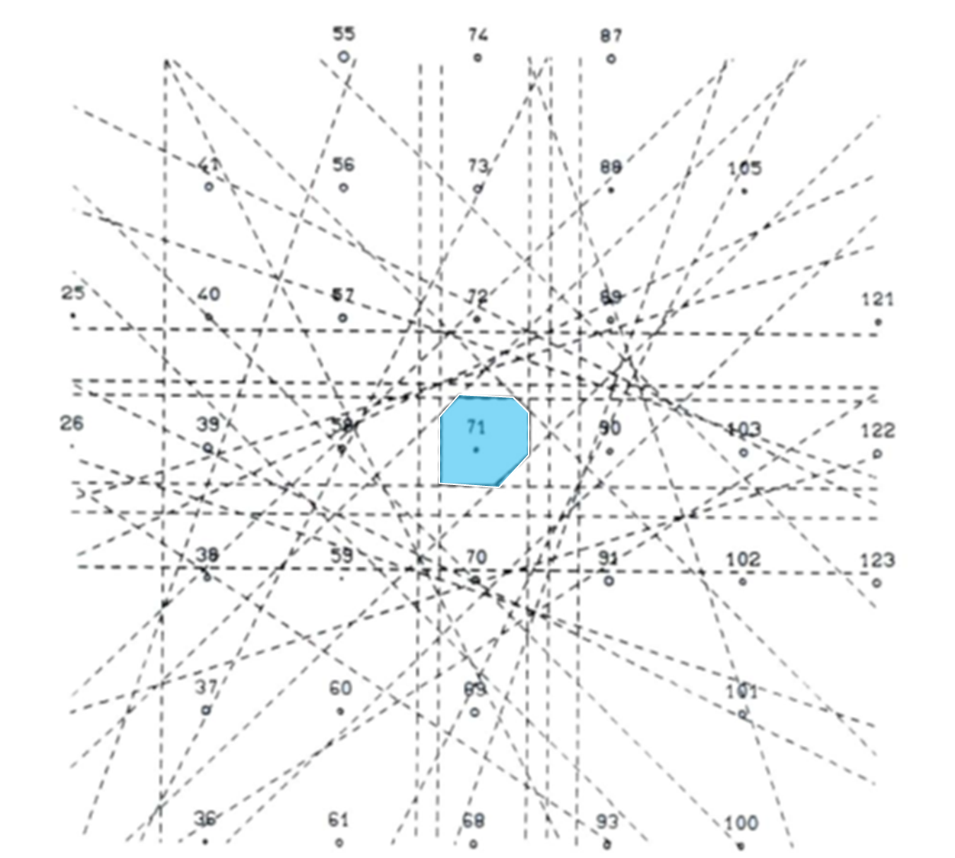
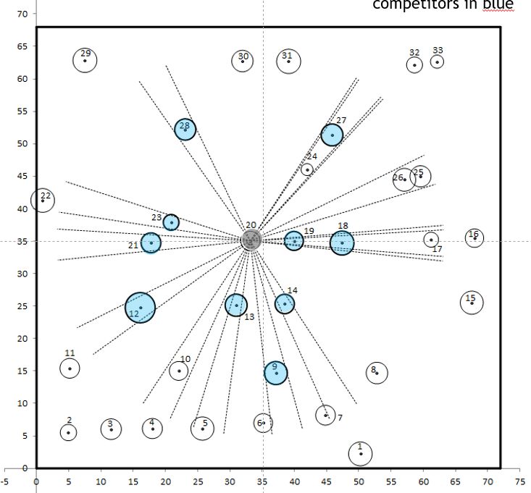
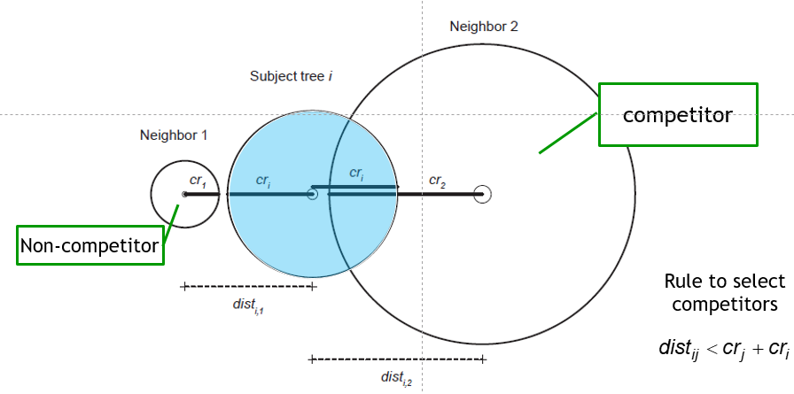
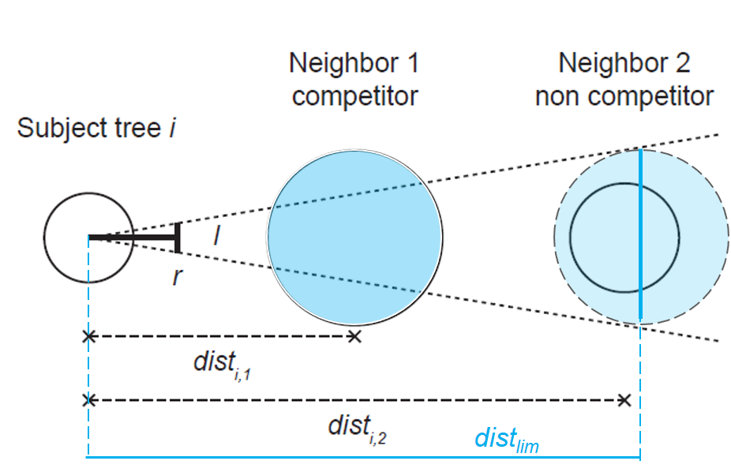
Modeling individual tree growth
The influence of local neighbors -> Distance-dependent indices
Formulation of the competition index
Point density indices and Area overlap indices
Growing space and area potentially available
Indices based on the size and distance of neighbors within a search radius
Indices based on horizontal or vertical angles centered at the subject tree
Size and distance of the neighbors within a radius
Limiting competition distance, f=(tree size)
Bitterlich method / Angle count
Overlap of areas of influence
Area potentially available (APA)
area of a polygon defined by the bisectors to the inter-tree lines

Slide 13
Modeling individual tree growth
The influence of local neighbors
Competition processes have been defined according to two basic models: symmetric/asymmetric and one-sided/two-sided competition
In two-sided competition, resources are shared by all the trees while in one-sided competition larger trees are not affected by smaller neighbors.
Resources may be shared:
equally,
proportionally to size or
using some intermediate sharing rule
When there is perfect sharing relative to size, competition is symmetric

Slide 14
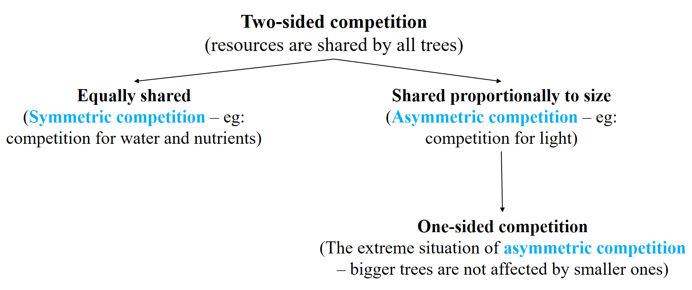
Modeling individual tree growth
The influence of local neighbors and the formulation of competition indices
All the distance-independent competition indices that are based on the trees larger than the subject tree implicitly assume asymmetric competition
For more details read chapter 9, Modelling forest trees and stands (Burkhart and Tomé, 2012)

Slide 15
Modeling individual tree dbh growth
Several methods have been used to model tree dbh growth, which may be classified as:
Method I - Linear or nonlinear regression models using i_{d} or i_{g} as dependent variable
Method II - Difference equations (d_{t2} or g_{t2} as dependent variable)
Method III - Growth potential x modifier type models
Dependent variable is usually i_{d} or i_{g}
Let´s look at each one of the methods

Slide 16
Modeling individual tree dbh growth
Method I - Linear regression models example
Site information
Stand density
Tree dimension
Distance-independent competition index

Slide 17
Modeling individual tree dbh growth
Method II - Difference equations exemple
Dbh growth model for dominant cork oak trees without age explicit (200 is an asymptote)
Site index
Tree dimension

Slide 18
Modeling individual tree dbh growth
Method II - Potential X modifier type models
These models are based on the assumption that individual tree growth may be modeled as:
i_{d}= i_{d} potential X modifier
The i_{d} potential represents the growth of a tree of the same size that grows without limitations
The modifier is a function that takes values between 0 and 1, defining growth restrictions (usually competition but other factors may also be taken into account)

Slide 19
Modeling individual tree dbh growth
Method III - Potential X modifier type models
There are different concepts of potential growth that have been used:
Maximum growth that a tree of the same species and size/age may attain under “optimum conditions” in terms of water and nutrients
Maximum observed growth for a tree of the same species and size in “normal” conditions
Maximum growth of the trees in the same plot (growth of the dominant trees)

Slide 20
Modeling individual tree dbh growth
Method III - Potential X modifier type models
GLOB-tree model - potential growth
Tree dimension
Site índex (in the asymptote)
ipot_{d} = ddom_{t2}-ddom_{t1}

Slide 21
Modeling individual tree dbh growth
Method III - Potential X modifier type models
GLOB-tree model – modifier
Stand density
Unilateral distance dependent CI
Distance independent CI
distance dependent CI

Slide 22
Height estimation - example
GLOB-tree model – h-d curve:
Young stands (t<4 years):
Adult stands (t>4 years):

Slide 23
Crown variables - example
GLOB-tree model – crown ratio:
Stand density
Tree age
Tree dimension

Slide 24
Predicting tree mortality - example
GLOB-tree model – tree mortality:
P (tree survives)
Stand density
Distance independent CI
Tree dimension

