Slide 1
Individual tree models competition indices

Slide 2
Factors affecting tree growth
Growth of individual trees on particular sites is influenced by a number of factors such as age, size, micro-environment, genetic characteristics, and competitive status
Past growing conditions and genetic potential to grow account for actual characteristics of the tree, such as size and vigor, which are usually introduced in a tree growth model by initial tree size and age

Slide 3
Factors affecting tree growth
Other factors influencing tree growth may be separated into the following three components:
  General environment of competition, which is usually taken into account using stand density
  Micro-environmental and genetic influences, represented by a ratio of some dimension of the tree to the mean or maximum value of this dimension in the stand
  Influence of local neighbors

Slide 4
Competition indices
The effect of local neighbors may be expressed by some mathematical formulation - commonly referred to as a “competition index” - representing how much each tree is affected by its neighbors
Functions used to quantify competition range from
  simple formulations expressing the hierarchical position of the tree within the stand or plot (distance-independent or non-spatially explicit indices)
  to more complex indices that express the size of, distance to, and number of local neighbors (distance-dependent or spatially explicit indices)

Slide 5
Distance independent competition indices
Distance-independent indices are simple functions of stand level variables and/or dimensions of the subject tree in relation to the average or maximum tree value of the stand without taking into account inter-tree distances
    Relative dimensions
    Area proportional to tree basal area
    Crown ratio
    Measures based on trees larger than the subject tree
    Measures based on crown variables evaluated at a certain percentage of tree height

Slide 6
Distance independent competition indices
Relative dimensions
  Measure the hierarchical position of the tree within the stand by comparison with the size of the average, maximum or dominant trees
    where x is a tree variable such as diameter, height or some crown variable and the subscripts m, max and dom indicate, respectively, the stand average, maximum and the average size of dominant trees

Slide 7
Distance independent competition indices
Area proportional to relative tree basal area
  Consists on dividing the plot area among the individual trees according to their dimension (for instance basal area) in relation to the dimension of the average tree of the stand

Slide 8
Distance independent competition indices
Crown ratio
  Crown ratio (crown length divided by total tree height) has also been used to express the past competition undergone by each individual tree

Slide 9
Distance independent competition indices
Measures based on trees larger than the subject tree
  Basal area of the trees greater than the subject tree (G_{>di} )
  Modified version of the previous that combines it with relative spacing (R_{s})
  Crown competition factor of trees larger than the subject tree

Slide 10
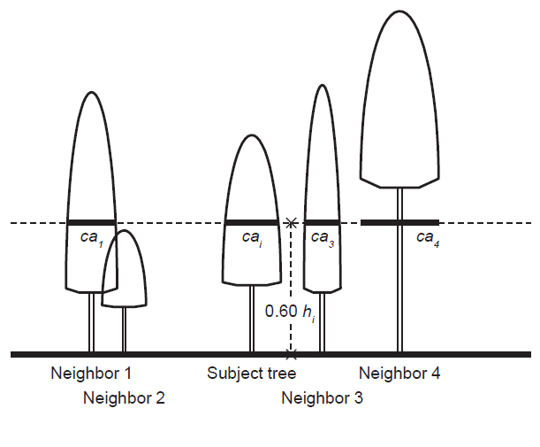
Distance independent competition indices
Measures based on crown variables evaluated at a certain percentage of crown length or tree height
Crown cover computed at h_{p}

Slide 11
Distance dependent competition indices
Distance dependent competition indices quantify the local inter-tree competition and therefore require coordinates of every tree (stem-map)

Slide 12
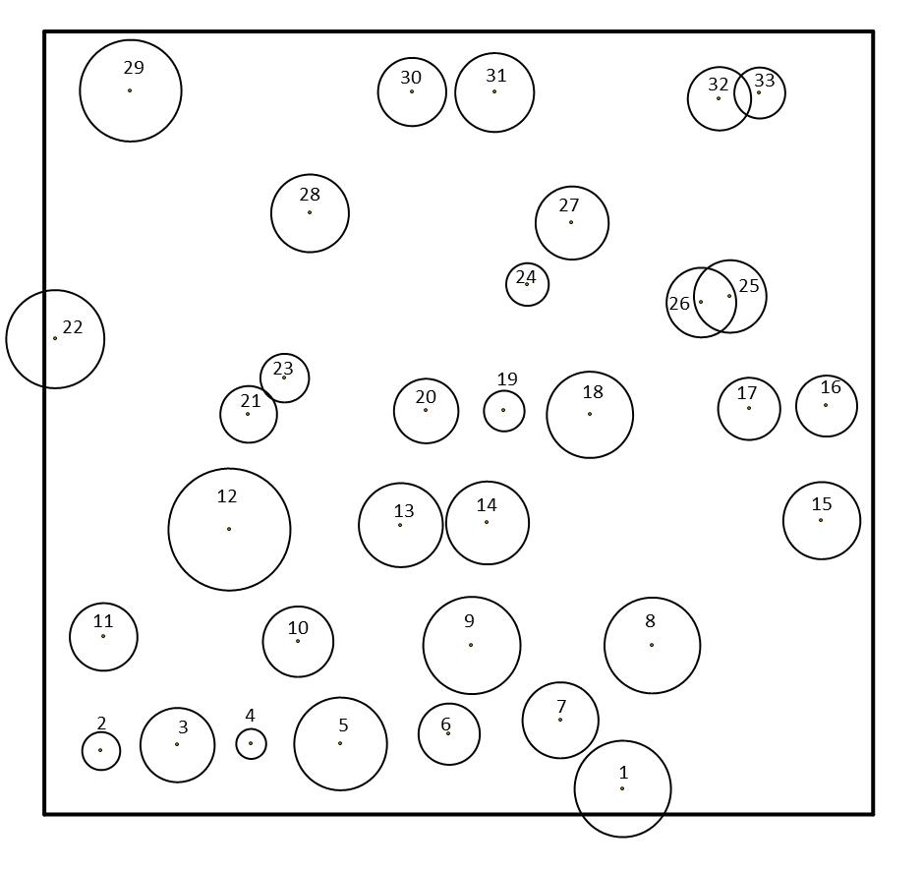

Slide 13
Distance dependent competition indices
The computation of distance-dependent measures of point density, or competition indices, involves two main steps
  selection of competitors
  computation of an index that synthetize the degree to which the subject tree has to share resources with its competitors

Slide 14
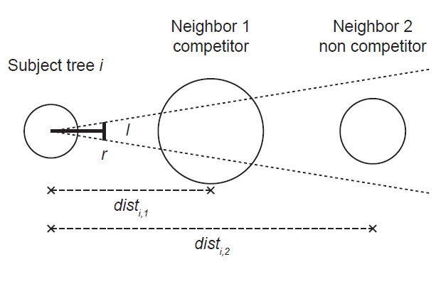
Distance dependent competition indices
- selection of competitors -
Trees selected by angle count sampling (Bitterlich’s method)
Rule to select competitors

Slide 15
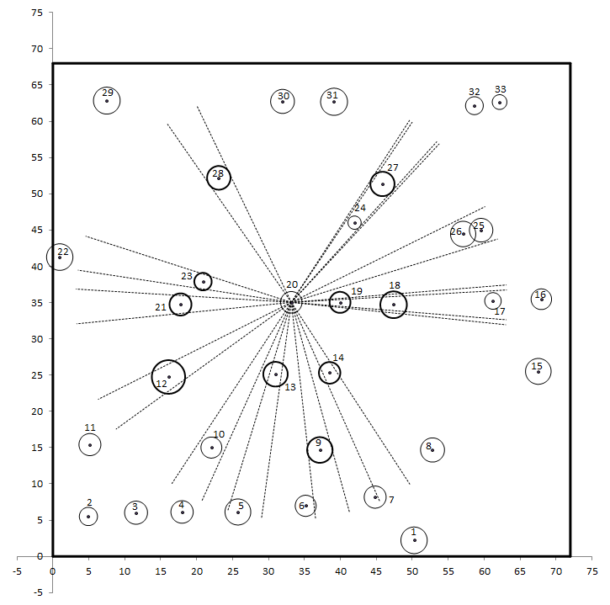
subject tree in gray
competitors in rose

Slide 16
Distance dependent competition indices
- selection of competitors -
Other methods based on a limiting competition distance, funcion of tree size
  rules based on asymptotic functions of the tree dimension

Slide 17
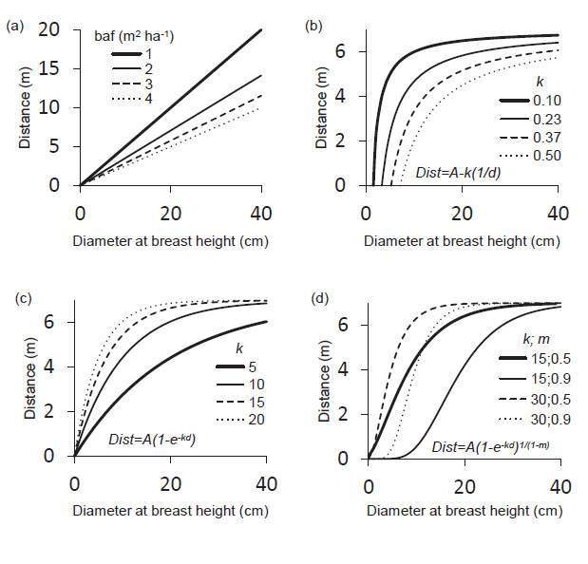

Slide 18
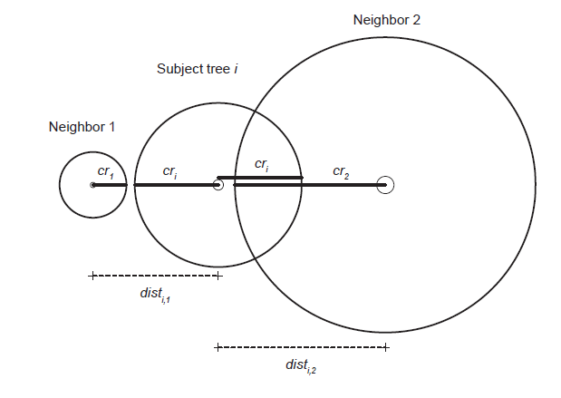
Distance dependent competition indices
- selection of competitors -
Overlap of areas of influence
competitor
Non-competitor
Rule to select competitors

Slide 19
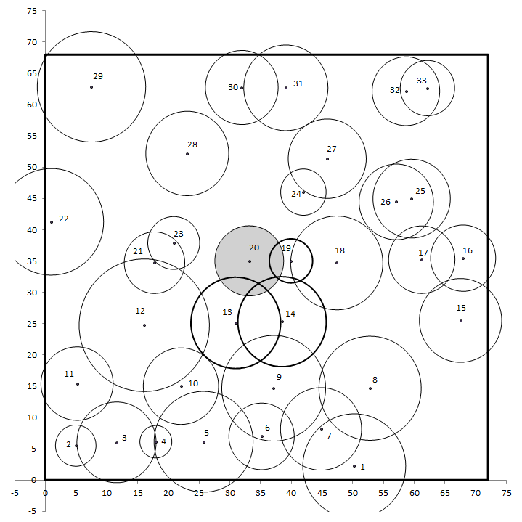
subject tree in gray
competitors in rose

Slide 20
Distance dependent competition indices
- selection of competitors -
Competition elimination angle
  The method is based on a fixed search radius to select the neighbors of a given subject tree
  Each neighbor may be an active or a passive competitor, based on a competition elimination sector defined by a specific elimination angle fixed a priori
  The nearest neighbor is first selected as a competitor and all the trees located within the angle with the vertex at the subject tree and centered at the neighbor are considered as passive competitors and discarded from the selection procedure
  The nearest neighbor outside the elimination angle is then selected and the respective passive competitors identified
  The procedure ends when all the active competitors have been identified

Slide 21
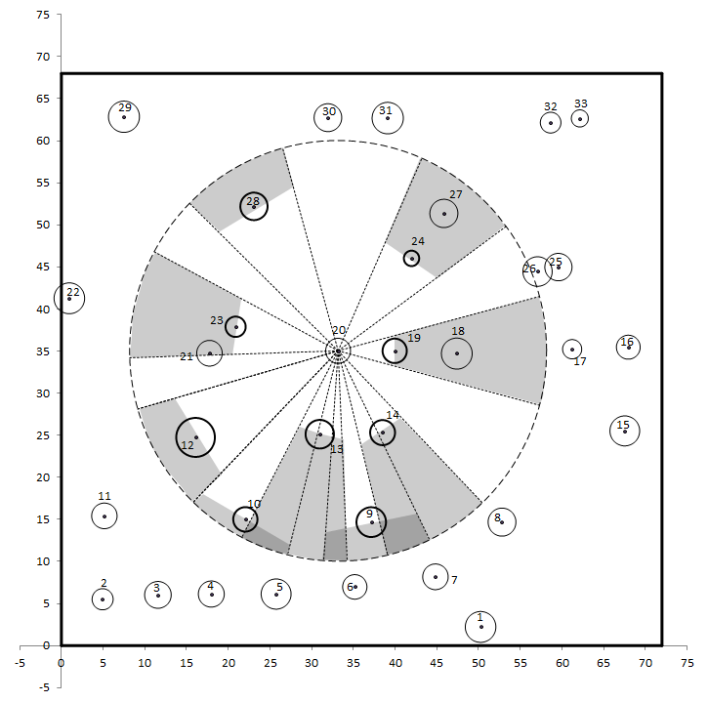
subject tree in gray
competitors in rose

Slide 22
Distance dependent competition indices
- selection of competitors -
Selection using a vertical search cone
  An upside-down search cone is set up at a certain height of the subject tree (stem base, base of the crown or some point within the crown)
  All the trees whose crowns overlap the search cone are considered as competitors

Slide 23
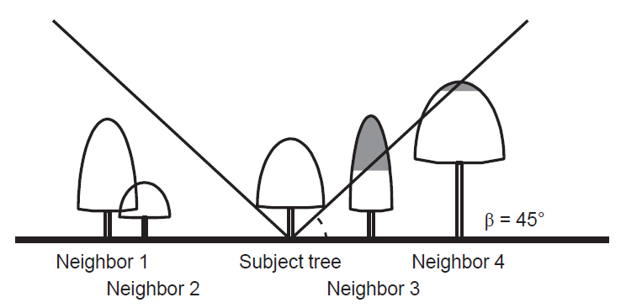
competitor
competitor
Rule to select competitors

Slide 24
Distance dependent competition indices
- formulation of the competition index -
Formulation of the competition index
  Distance-dependent competition indices include, directly or indirectly, the size of the neighbors and their distance to the subject tree
  The competitive influence of a neighboring tree should be
    a decreasing function of the distance between the neighbor and the subject tree
    an increasing function of the neighbor’s size

Slide 25
Distance dependent competition indices
- formulation of the competition index -
Formulation of the competition index
  Point density indices
  Area overlap indices
  Indices based on the size and distance of the neighbors within a search radius
  Indices based on horizontal or vertical angles centered at the subject tree
  Growing space and area potentially available
  Indices based on ecological field theory and field of neighborhood
  Indices based on the estimation of shading or light interception

Slide 26
Distance dependent competition indices
- formulation of the competition index -
Point density indices
  Adaptation of Bitterlich method for basal area determination using the centre of the subject tree as a sampling point
  There are two options for this index, excluding and including the subject tree
n – number of competitors
d_{j} – diameter of tree j
dist_{ij} – distance between trees

Slide 27
Distance dependent competition indices
- formulation of the competition index -
Area overlap indices
  The most common definitions of area of influence involve open-grown tree crown sizes or linear functions of tree dbh or crown radius
n – number of competitors
AI_{i} – area of influence of subject tree i
ao_{ij} – area overlap between trees i and j
R_{ji} – ratio between dimensions of tree j and subject tree i

Slide 28
subject tree in gray
competitors in rose

Slide 29
Distance dependent competition indices
- formulation of the competition index -
Indices based on the size and distance of the neighbors within a search radius
  The best-known indices of this type fall under the category of distance-weighted size ratio indices, known as Hegyi indices
n – number of competitors
dist_{ij} – distance between trees i and j
R_{ji} – ratio between dimensions of tree j and subject tree i

Slide 30
subject tree in gray
competitors in rose

Slide 31
Distance dependent competition indices
- formulation of the competition index -
Indices based on the size and distance of the neighbors within a search radius
  Other indices do not utilize distance as a weighting factor, they use the crown volume or crown surface area of the competitor tree above the point where a vertical angle from the base of the subject tree cuts the axis of the stem of the competitor relative to the crown volume or crown surface area of the subject tree
n – number of competitors
cvha_{j} – crown volume of tree j above the height at which the vertical angle cuts its stem axis
c_{vi} – crown volume of subject tree i
An identical index with crown surface can also be defined

Slide 32
competitor
competitor
Rule to select competitors

Slide 33
Distance dependent competition indices
- formulation of the competition index -
Indices based on horizontal or vertical angles centered at the subject tree
  The indices are based on the sum of the horizontal/vertical angles from the subject tree to all the neighbors within a fixed search radius (competitors)
n – number of competitors
α_{jk} – horizontal/vertical angle subtended by some dimension of the neighbor

Slide 34
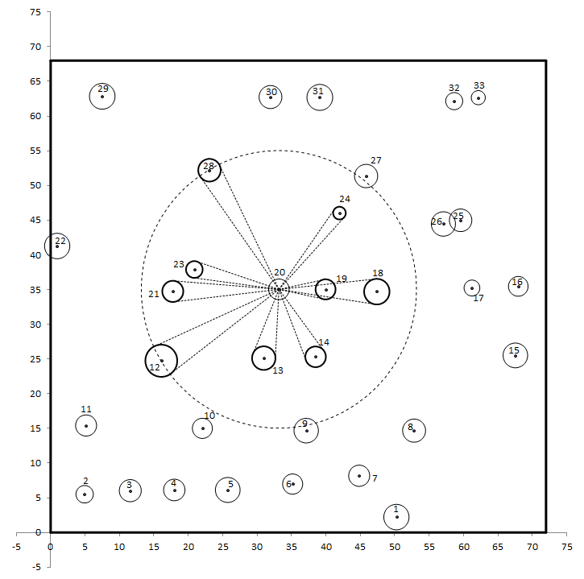
Index based on horizontal angles
subject tree in gray
competitors in rose

Slide 35
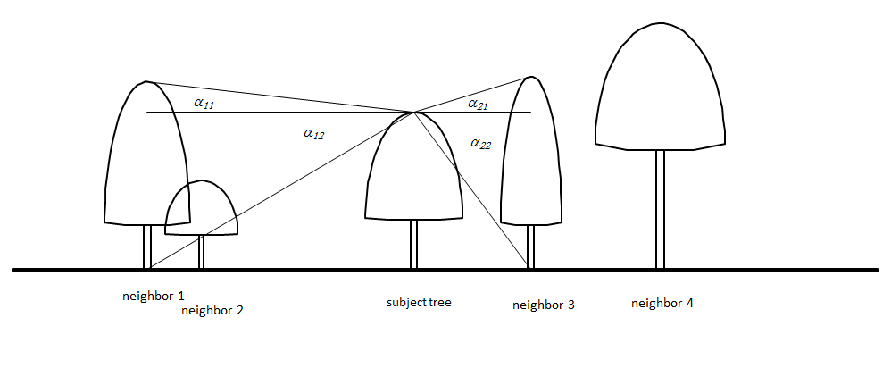
Index based on vertical angles

Slide 36
Distance dependent competition indices
- formulation of the competition index -
Indices based on horizontal or vertical angles centered at the subject tree – vertical search cone
  The sum of the angles γ between the surface line of the search cone and the line connecting the tip of the competitor tree j with the cone apex on the subject tree
  The closer and taller the competitor compared to the subject tree, the greater the angle and the competitive strength of this neighbor
  The competition measure may also include the ratio of the competitor and subject tree crown cross-sectional areas at the height of the search cone insertion and a species-specific light transmission coefficient

Slide 37
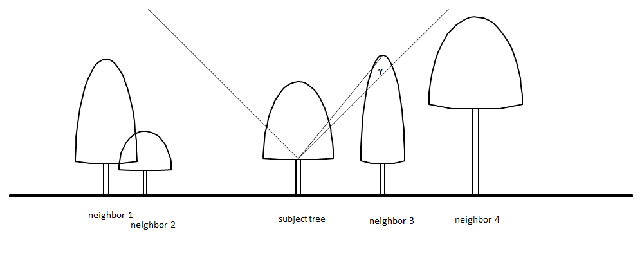
n – number of competitors
ca_{hc} - crown cross-sectional area at height of cone insertion hc
γ_{j} - angle defined by the surface line of the search cone and the line between the insertion point of the cone and the top of the competitor tree
lt_{j} - light transmission coefficient for competitor j (dependent on species)

Slide 38
Distance dependent competition indices
- formulation of the competition index -
Growing space
  The stand surrounding a central tree i is divided into as many imaginary circle segments as there are competitors
  Each circle has a radius proportional to the size of the subject tree in relation to the sum of its size and that of the corresponding competitor
  The sum of the area of these n segments, assumed to be the area available for tree growth, is used as the competition index

Slide 39
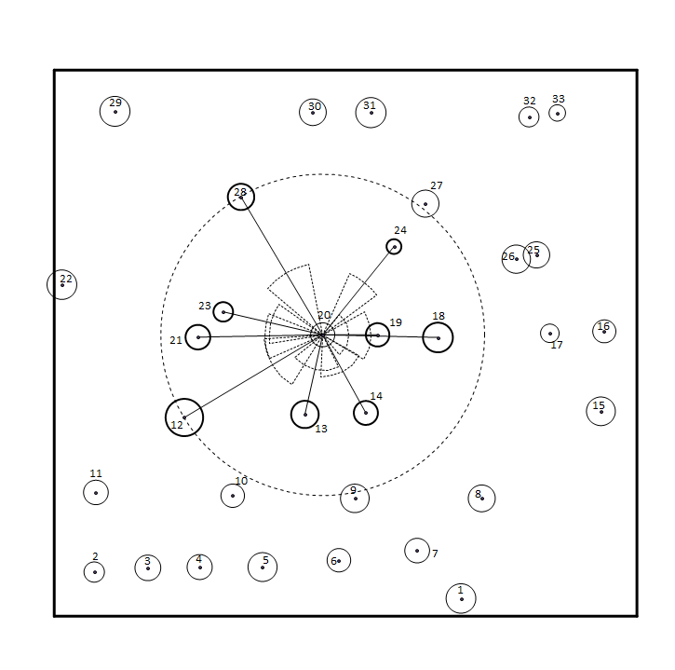
subject tree in gray
competitors in rose

Slide 40
Distance dependent competition indices
- formulation of the competition index -
Area potentially available (APA)
  The area available to each tree is calculated as the area of a polygon defined by the bisectors to the inter-tree lines
  The most used index is obtained by bisecting the inter-tree lines proportionally to the subject tree and competitor sizes
  The distance to a polygon side maybe restricted by a function of the radius of an open-grown tree of the same diameter as the subject tree to prevent polygon areas from becoming excessively large. This variant of the APA index may be useful in stands with irregular spatial patterns

Slide 41
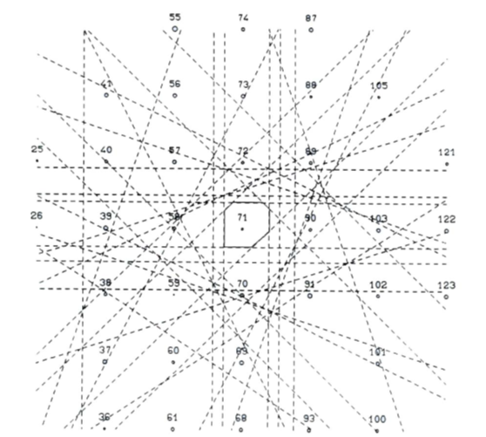

Slide 42
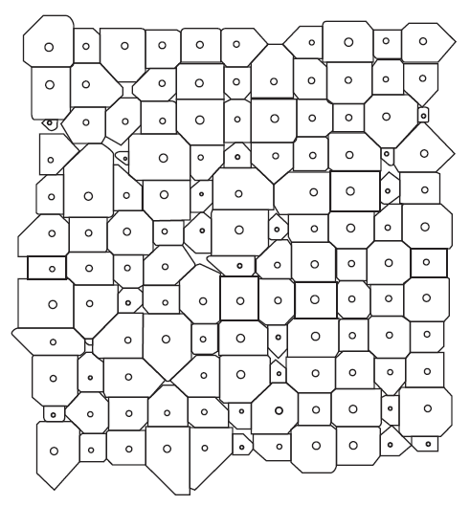

Slide 43
Distance dependent competition indices
- formulation of the competition index -
Indices based on the estimation of shading or light interception
  Indices that estimate light interception or the degree of shading from neighbors seem useful to model competition for light
  The simulation of light interception within a forest stand has been a topic of research in ecology with the objective of better understanding stand production and dynamics
  Some recent studies have used simplified models of light interception as a way to include inter-tree competition in modeling tree growth

Slide 44
Asymmetric/one-sided versions of the competition indices
Competition processes have been defined according to two basic models: symmetric/asymmetric and one-sided/two-sided competition
In two-sided competition, resources are shared by all the trees while in one-sided competition larger trees are not affected by smaller neighbors. Resources may be shared equally, proportionally to size or using some intermediate sharing rule
When there is perfect sharing relative to size, competition is symmetric

Slide 45
Asymmetric/one-sided versions of the competition indices
One-sided competition may be considered as an extreme case of asymmetric competition
Two-sided competition can be symmetric or asymmetric according to whether or not the sharing of resources is proportional to the size of the individuals
Asymmetric competition has been associated with competition for light and symmetric/two-sided competition with competition for water and nutrients

Slide 46
Asymmetric/one-sided versions of the competition indices
Depending on the respective formulation, competition indices implicitly assume an asymmetric or symmetric partitioning of resources among neighboring trees
  All the distance-independent competition indices that are based on the trees larger than the subject tree implicitly assume asymmetric competition
  In distance-dependent indices the distinction between these two models relates also to the selection of competitors

Slide 47
Asymmetric/one-sided versions of the competition indices
The formulations that reflect asymmetric competition restrict the competitors to those neighbors that are larger than the subject tree
The competitive status between each tree and its neighbors may be established taking into account their relative dimensions, neighbors larger than the subject tree place it at a competitive disadvantage, whereas those smaller put it at a competitive advantage
This leads to competition indices that are sums of positive and negative values. Dominant neighbors make a positive contribution to the index while suppressed neighbors subtract from the index

Slide 48
Asymmetric/one-sided versions of the competition indices – Hegyi type indices
dominant neighbors
suppressed neighbors
dead neighbors

Slide 49
Asymmetric/one-sided versions of the competition indices – Area overlap indices
dominant neighbors
suppressed neighbors
dead neighbors

