Slide 1
Management oriented process based models
The 3PG model as an example
Improving the Calculus Module

Slide 2
Summary
Problems with the original calculus module
Improving the calculus module
“My templates” for 3PGpjs2.7.xls
Exercises

Slide 3
Improving the calculus module “information for managers”

Slide 4
The Calculus Module of the original 3PG has some problems:
Volume estimation assumes a

Slide 5
The Calculus Module of the original 3PG has some problems
The volume estimation assumes that:
  Percentage of branches and bark can be easily estimated
  Wood density is a good “converter” of stemwood biomass into volume

Slide 6
Volume under bark prediction (original 3PG)
Woody biomass is converted into wood biomass through the ratio between branches+bark and the woody biomass (R_{Ww}) and then divided by wood density (ρ)
Wwoody=Wwood+Wbark+Wbranches
Both R_{Ww} and ρ are modeled as a function of age

Slide 7
The Calculus Module of the original 3PG has some problems
Volume estimation assumes that:
  Percentage of branches and bark can be easily estimated
  Wood density is a good “converter” of stemwood biomass into volume
Basal area estimation uses the basal area of the average tree and an allometric relationship between tree diameter and wood biomass to estimate the diameter of the average tree

Slide 8
Basal area prediction
Woody biomass of the mean tree is first predicted through division by stand density (N)
Quadratic mean diameter (dg) is then predicted through the inversion of the allometric equation for tree woody biomass prediction
Finally G is predicted by multiplying the basal area of the mean tree by stand density

Slide 9
Objective of the “new” calculus module
To improve basal area (G) and underbark volume (Vu) prediction by developing allometric equations based on existing empirical data
To develop an equation for dominant height (hdom) prediction

Slide 10
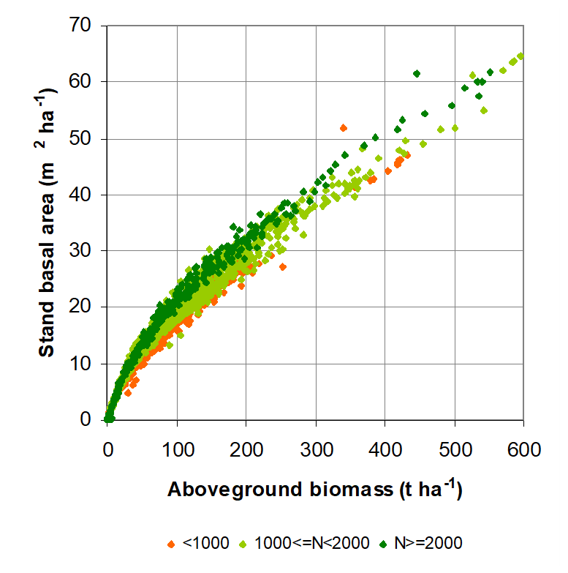
Allometric relationship for G

Slide 11
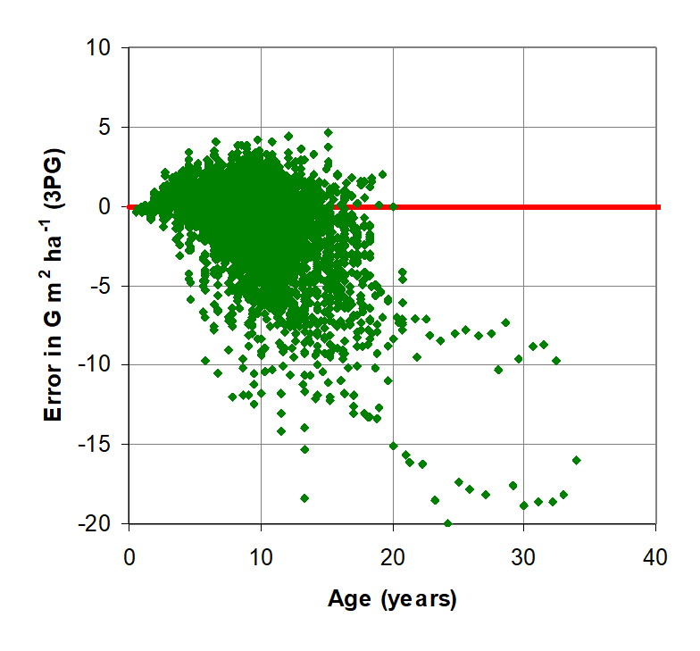
Error in G prediction (3PG)

Slide 12
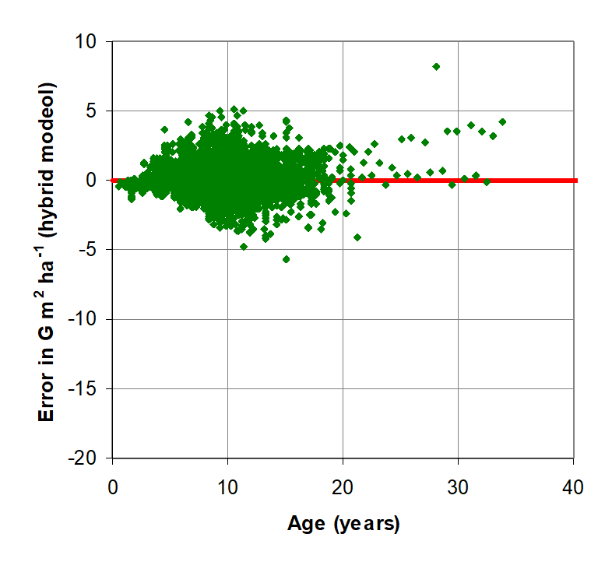
Error in G prediction (hybrid model)

Slide 13
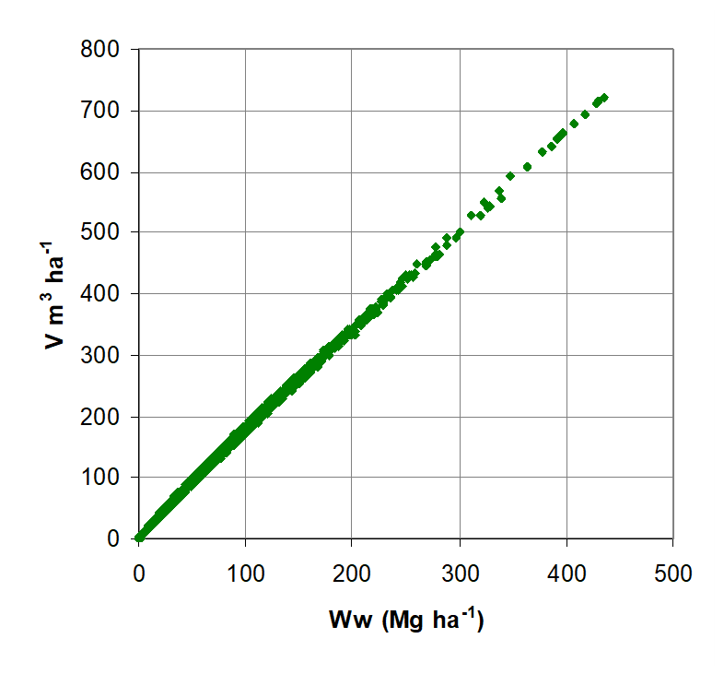
Allometric relationship for Vu

Slide 14
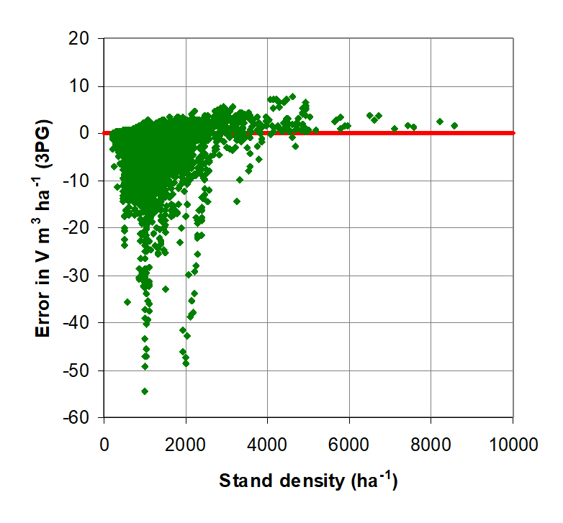
Error in Vu prediction (3PG)

Slide 15
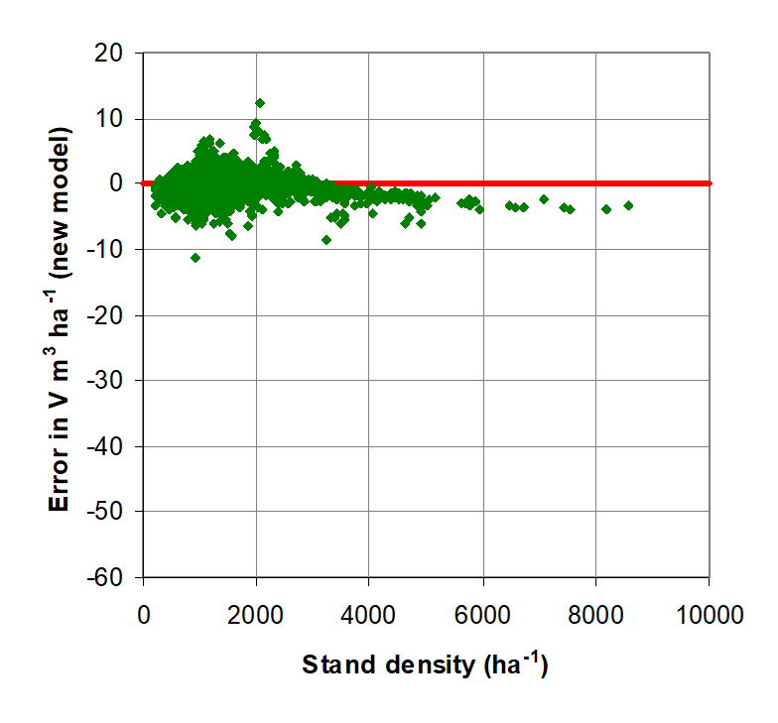
Error in Vu prediction

Slide 16
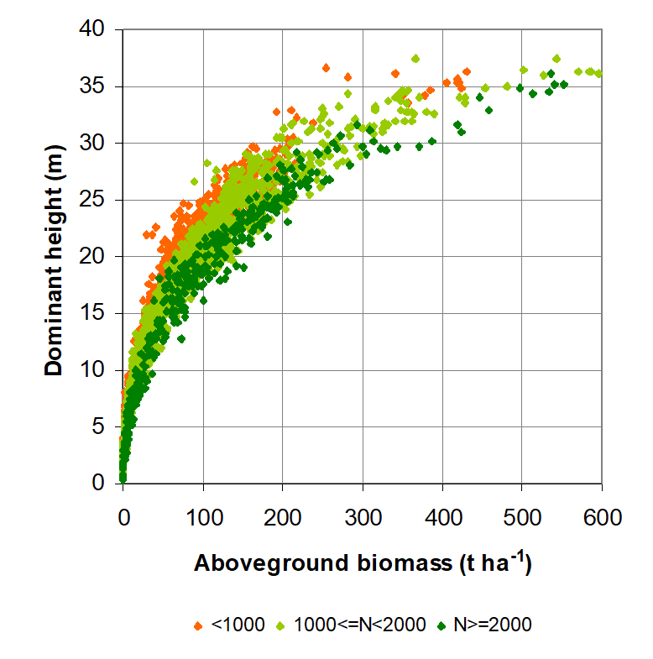
Allometric relationship for hdom

Slide 17
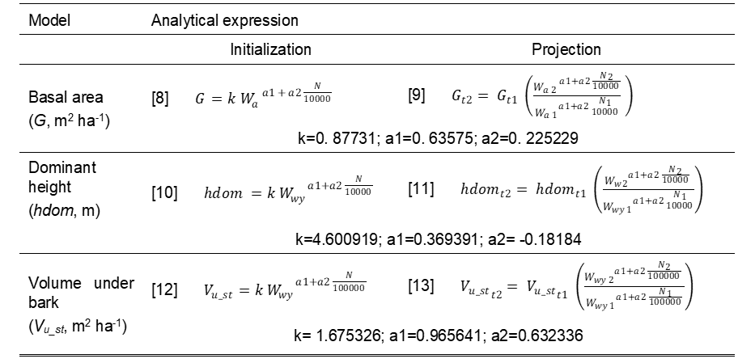
The equations of the “new” calculus module

Slide 18
The end!!!
The end!!!

