Slide 1

StandsSIM.sd
The Portuguese scenario driven forest simulator
Susana Barreiro, Margarida Tomé
Instituto Superior de Agronomia
Universidade de Lisboa

Slide 2
Outline
What motivated the development of StandsSIM.sd
StandsSIM.sd functioning
StandsSIM.sd structure and inputs
Running StandsSIM.md in sIMfLOR
Presentation of 3 case studies:
  Assessing the impact of different fire scenarios
  Assessing the impact of different afforestation levels
  Assessing the impact of climate change/fire on wood availability

Slide 3
Important concepts
Planning horizon:
  Number of years to simulate, projection/prediction period
Forest management approach (FMA):
  Implementation of a silvicultural systems, expressed by a sequence of silvicultural operations during a rotation
Scenario:
  Conditions present during the projection period (climate, forest policy measures, management alternatives, etc)

Slide 4
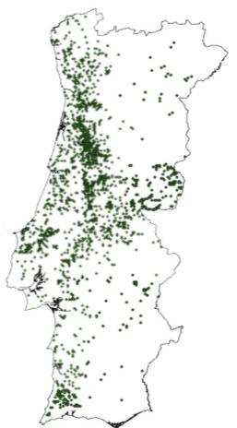
StandsSIM.sd background
StandsSIM.sd, originally called SIMPLOT, was born in 2007 with funding from the FCT
The tool continued being developed over the next few years with funding from European projects
Evolution of forest area (10³ ha) over time
(Eucalyptus)
Eucalyptus forest economically important

Slide 5
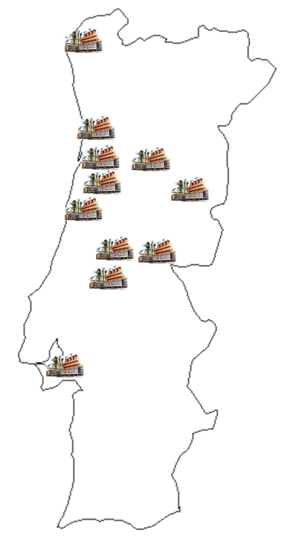
StandsSIM.sd background
StandsSIM.sd, originally called SIMPLOT, was born in 2007 with funding from the FCT
The tool continued being developed over the next few years with funding from European projects
Evolution of burnt forest area (10³ ha) over time
(Eucalyptus)
Forest Residues Biomass
1999 - 1st biomass plant operating
2013 - 19 thermoelectric plants operating

Slide 6
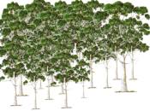
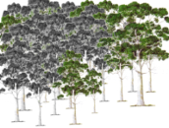
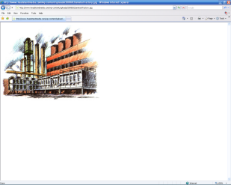



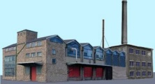

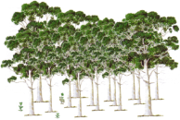

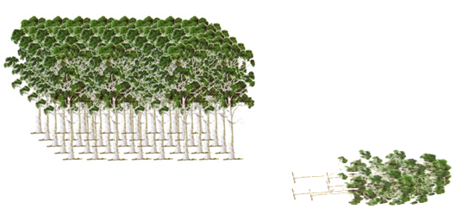
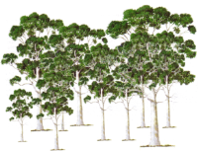

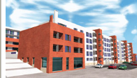
StandsSIM.sd background
There was an urgent need for a large-scale scenario simulator that could integrate the impact of several influential factors
StandsSIM.sd, originally SIMPLOT, was developed to tackle the problem of future wood availability and the analysis of conflicting interests at national level
Forest Residues Biomass
1999 - 1st biomass plant operating
Pulp versus biomass use of eucalyptus
Increasing the area of an exotic species or restraining it?
What is the true impact of severe repeated forest fires?
Biodiversity preservation against pulp management
2013 - 19 thermoelectric plants operating

Slide 7
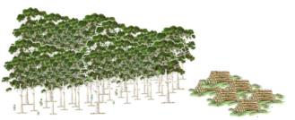
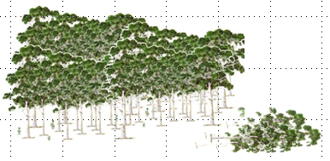
StandsSIM.sd structure and inputs
StandsSIM.sd combines forest inventory data with growth models taking into account the effect of different drivers
Wood demand, the main driver of the simulator, which has implications on the amount of harvest per year,
Biomass demand, the second main driver of the simulator, which has implications on the amount of harvests
Occurrence of hazards represented by the amount of burnt area;
Land use changes (LUC) to and from other uses (representing the afforested and the deforested areas per year);
Percentage of change between different forest management alternatives (FMAs) and/or options;
Pulp stands
Energy stands
Pulp stands
For pulp
For energy
For energy

Slide 8
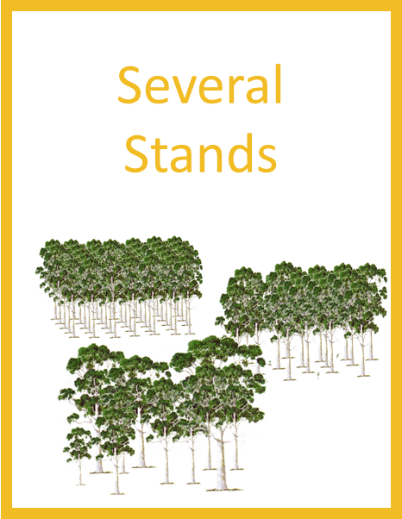
StandsSIM.sd structure and inputs
input_NFI.csv
Other inputs & simulation parameters
Planning horizon
ini_simplot.csv
Forest Resources
t
Parms_ec.csv
Forest Resources
t+1
Growth models
Scenario:
ScenarioEc_*.csv
Hazards-fire
Area to be burnt
GLOBULUS
GYMMA
GLOBEP
3PG-OUT+
Demand
(wood & biomass)
Volume harvested (pulp and energy)
Land Use Changes
Afforestation Deforestation
Forest managment (FMA)
Even- and uneven-aged
Consumables.csv
Operations.csv
FMA_51_Ec.csv
FMA_41_Ec.csv
FMA_31_Ec.csv
StandsSIM.sd
Annual outputs
“Climate files”.csv

Slide 9
Year j=1
Stand i=1,...n NFI
Simulation parameters
FMA parameters
Year j=2,...,m
Scenario
Area to be Burnt
Biomass to be Harvested
Volume to be Harvested
Area Plantation _{WPF}
% of Change _{WPF - DB}
Area Plantation _{DB}
% of Change _{DB - WPF}
Growth
Stand i=1,...,n
% of Deforestation
Fire
Stand i=1,...,n
StandsSIM.sd structure and inputs
Harvest _{DB/E}
Stand i=1,...,n
Harvest _{WPF/W}
Stand i=1,...,n
Harvest _{WPF/E}
Stand i=1,...,n
Source _{Residues}
LUC
N Stand=n-na+np
Source _{Energy}
FMA
N Stand=n-na+np
Source _{Wood}
Wood
Biomass
Year j+1

Slide 10





  All stands have = probability to burn: P_burn=0.5
  Random numbers are drawn and compared with P_burn to determine which stands will burn
  Once burnt, the stand is harvested
  %salvage wood considered
  Minimum age for salvage burnt wood for pulp
Hazards-fire
Probability Function
StandsSIM.sd structure and inputs
i+1
Did the stand burn?
Stand is harvested
_{No}
_{Yes}
_{No}
Is burnt area met ?
% Salvage wood for pulp
Biomass for energy or soil
V_fire
V_thinn
_{Yes}
EXIT

Slide 11

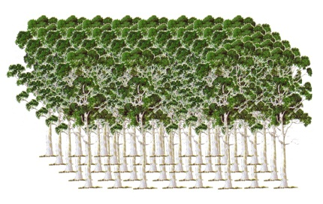
  Energy-stands:
  harvested when harvest age is reached
  Pulp-stands:
    harvested according to a user-defined probability P_harv combined with Random numbers
    have a user-defined minimum age to harvest
Demand
(wood & biomass)
Is it planted for energy ?
_{No}
Probability Function
_{Yes}
will the stand be cut ?
i+1
_{Yes}
Is biomass demand met ?
StandsSIM.sd structure and inputs
has it reached cut age ?
_{No}
Stand is harvested
_{No}
_{Yes}
_{Yes}
Is wood demand met ?
Stand is harvested
W_energy
V_pulp
Biomass for energy
Wood for pulp
_{No}
V_fire
V_thinn

Slide 12
  Afforestation:
  Random numbers are drawn to assign a S to the new stand.
  The area of each new stand corresponds to the pixel:
  AreaOfSpecies / n Plot_{Ec} (≈ 400 ha)
  Deforestation:
  Stands that have completed its 3rd rotation once harvested (due to fire or not) are candidates for being abandoned
  Random numbers used to determine which are abandoned
  Priority is given to those located in low S areas
LUC
(afforestation & deforestation)
_{yes}
Is pulp area met ?
EXIT
Max rot harvested stands
_{no}
Random number
New stand added to the input_NFI,csv
Random number
StandsSIM.sd structure and inputs
Assigned: stand_id, area, S, FMA=4
_{no}
_{yes}
Is energy area met ?
EXIT
_{yes}
Is stand abandoned?
Is deforestation met ?
_{no}
New stand added to the input_NFI,csv
_{yes}
Random number
Stand is replanted,
FMA=4
EXIT
Assigned:
stand_id, area, S, FMA=5

Slide 13
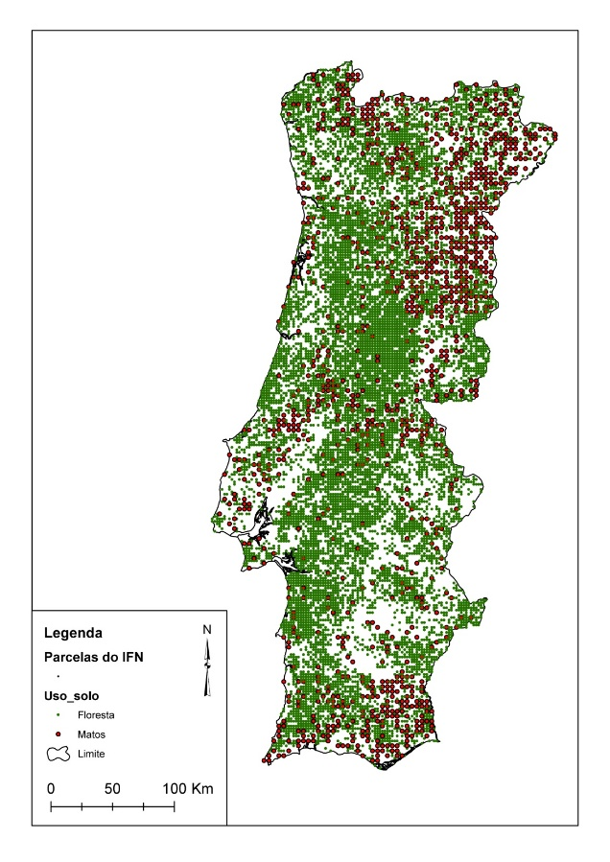

StandsSIM.sd structure and inputs
Forest Inventory
NFI based on several compatible grids:
  500 m x 500 m for photointerpretation
  2 km x 2 km for forests
  4 km x 4 km for shrubland
input_NFI.csv

Slide 14

StandsSIM.sd structure and inputs
Forest Inventory
NFI based on several compatible grids:
  500 m x 500 m for photointerpretation
  2 km x 2 km for forests
  4 km x 4 km for shrubland
The unit of simulation is a ficticious stand (“stand”) with the same characteristics of each individual plot and an area equal to AreaOfSpecies/NOfPlotsSpecies (≈ 400 ha)
Before the simulations, each “stand” can be split into how many equal parts as the user decides
Pure even- and uneven-aged stands and mixed stands
Forest operations and harvest occur in these “stands”
input_NFI.csv

Slide 15
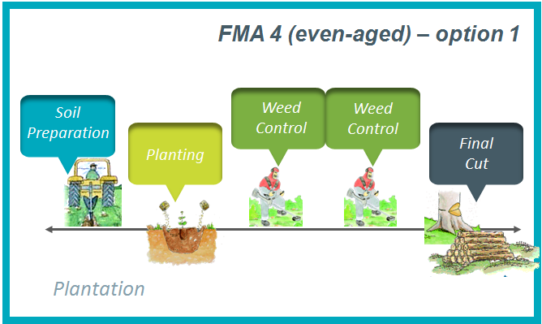
StandsSIM.sd structure and inputs
Forest Management Approaches
1 plantation + 4 coppices
Npl = 3000 trees ha⁻¹
Harvest age 4 yrs
No shoots selection
FMA_51_Ec.csv
FMA_41_Ec.csv
FMA_31_Ec.csv
Wood and biomass production
Dendro-biomass production (DB)
Even-aged forestry (EAF)
1 plantation + 2 coppices
Npl = 1250 trees ha⁻¹
Harvest age 12 yrs
Shoots selection leaving 1.6 shoots/stool
Combined objective forestry (COF)
Conversion from other FMA
Thinnigs for density reduction and stratification
Longer rotations (+/- 60)
Close to nature forestry
Natural Reserve
Non-wood forest products and services

Slide 16
StandsSIM.sd structure and inputs
Forest inventory and management objective: pulp wood
    Pure even-aged & 1250 trees ha⁻¹ & 1plantation+2coppices & cut~12
NFI data is not prepared to be used as input to run simulations
    Data-cleaning - Time-consuming
    Designing the tool to deal with situations
    Making assumptions and simplifications
input_NFI.csv
Type | Structure | Composition | Rotation | Age | Stand density
stand | even-aged | 1pure | 1 | <= 12 | > 650
burnt | uneven-aged | 2Dominant | 2 | > 12 | <= 650
harvested |  | 3dominated | 3
gap |  |  | 9
clump

Slide 17
StandsSIM.sd structure and inputs
Forest inventory and management objective: pulp wood
    Pure even-aged & 1250 trees ha⁻¹ & 1plantation+2coppices & cut~12
NFI data is not prepared to be used as input to run simulations
    Data-cleaning - Time-consuming
    Designing the tool to deal with situations
    Making assumptions and simplifications
input_NFI.csv
Type | Structure | Composition | Rotation | Age | Stand density
stand | even-aged | 1pure | 1 | <= 12 | > 650
burnt | uneven-aged | 2Dominant | 2 | > 12 | <= 650
harvested |  | 3dominated | 3
gap |  |  | 9
clump

Slide 18
StandsSIM.sd structure and inputs
Forest inventory and management objective: pulp wood
    Pure even-aged & 1250 trees ha⁻¹ & 1plantation+2coppices & cut~12
NFI data is not prepared to be used as input to run simulations
    Data-cleaning - Time-consuming
    Designing the tool to deal with situations
    Making assumptions and simplifications
input_NFI.csv
Type | Structure | Composition | Rotation | Age | Stand density
stand | even-aged | 1pure | 1 | <= 12 | > 650
burnt | uneven-aged | 2Dominant | 2 | > 12 | <= 650
harvested |  | 3dominated | 3
gap |  |  | 9
clump

Slide 19
StandsSIM.sd structure and inputs
Forest inventory and management
TYPE
  The area of gaps and clumps is assumed to remain constant throughtout simulations
STRUCTURE
  Even-aged stands for pulp (FMA_41_Ec.csv) (there were/are no FMA5 stands)
  Uneven-aged (FMA_31_Ec.csv) but once harvested are converted to even-aged
COMPOSITION:
  Mixed stands have to be “converted” to pure stands applying a correction factor to the variables (prior to the simulation run)
ROTATION:
  Stands with r=9 ( i.e. r>4 or undetermined) simulated as coppices
STAND AGE AND DENSITY:
  Old and/or understocked stands can have different harvest probabilities assigned
  When the last rotation assigned to the FMA is reached, once harvested stands can either be abandoned or replanted
  Final harvest (and fire) occur when half of the annual growth is attained

Slide 20
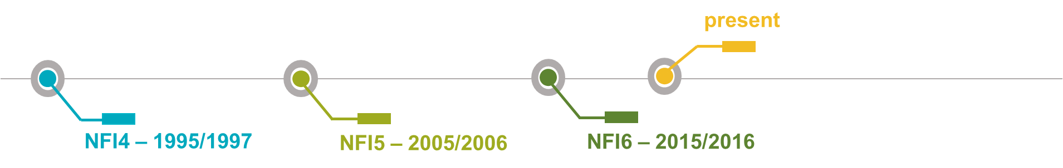
StandsSIM.sd structure and inputs
Scenario and parameters
Scenarios can be built using:
  historic data (when the planning horizon is located in the past)
  historic data + “trend data” (when the planning horizon covers both the past and future)
  “trend data” (when the planning horizon covers only the future)
Wood demand - amount of volume harvested in stands managed for pulp (m³ year⁻¹)
Biomass demand - amount of forest biomass for energy (Mg year⁻¹)
Fire – amount of forest area burnt (ha year⁻¹)
Afforestation for pulp - amount of new planted areas for pulp production (ha year⁻¹)
Afforestation for energy - amount of new planted areas for energy production (ha year⁻¹)
Deforestation - proportion of the existing total forest area in each year

Slide 21
StandsSIM.sd structure and inputs
Scenario and parameters
Planning horizon
Number of stand divisions
Fire module required parameters
Harvesting module required parameters
Forest residues removal parameters
Assortments

Slide 22
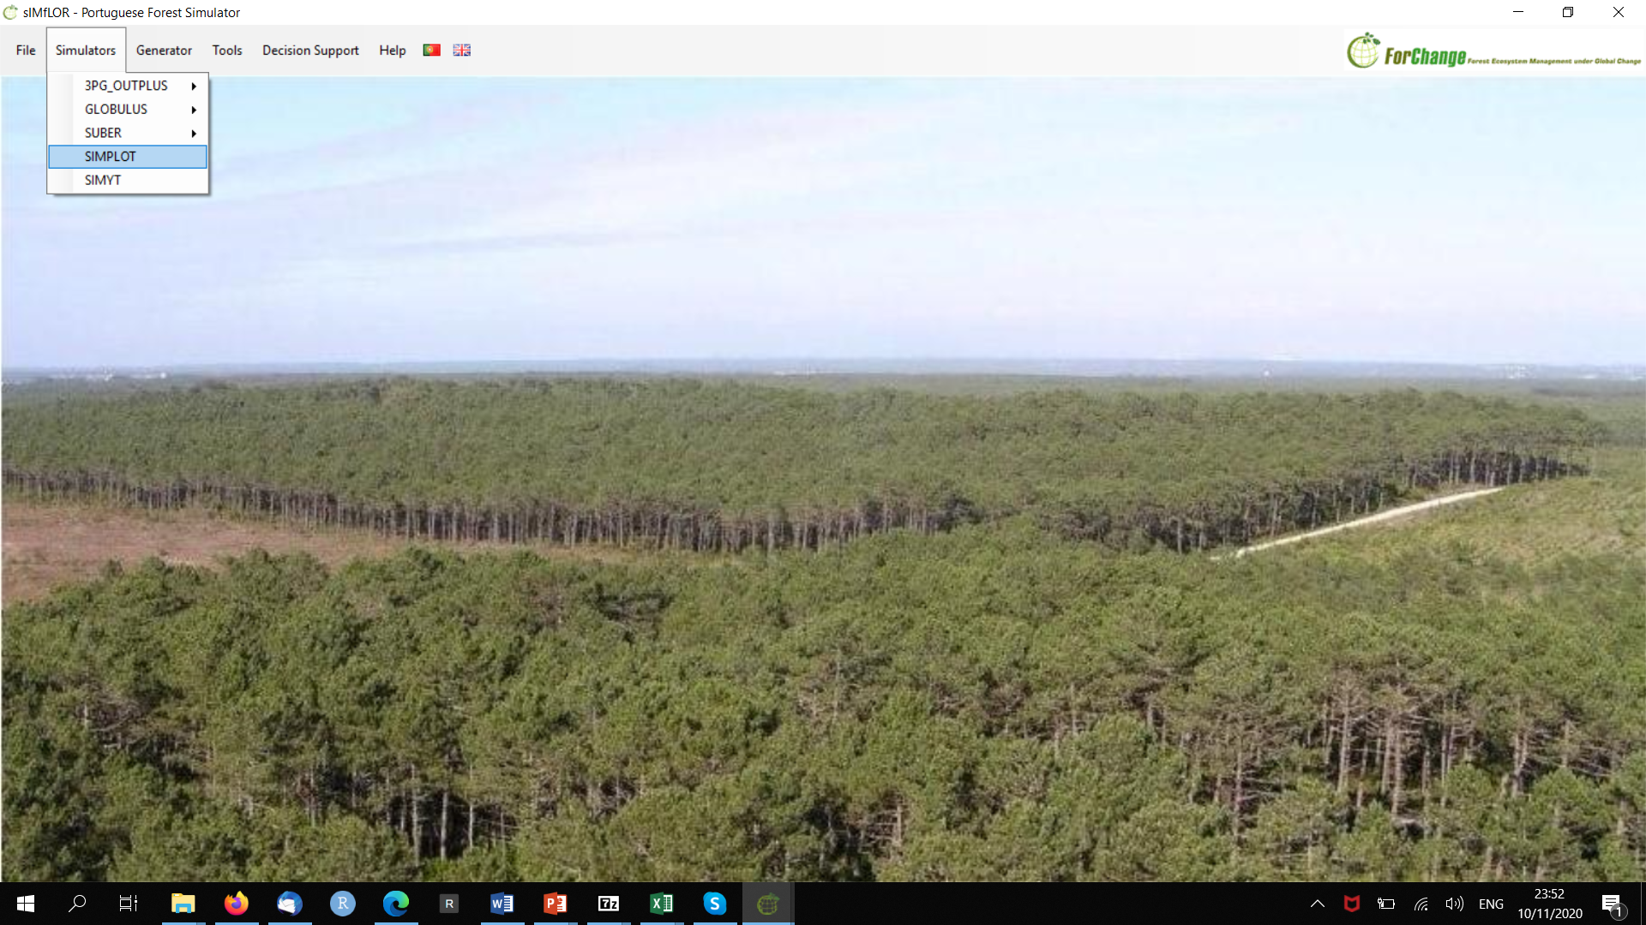
Running StandsSIM.md in sIMfLOR

Slide 23
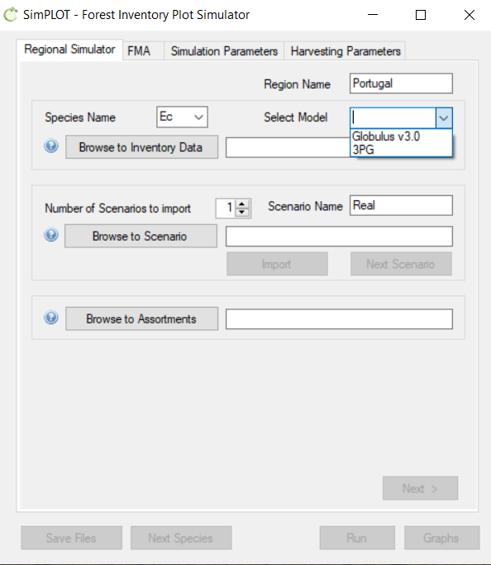
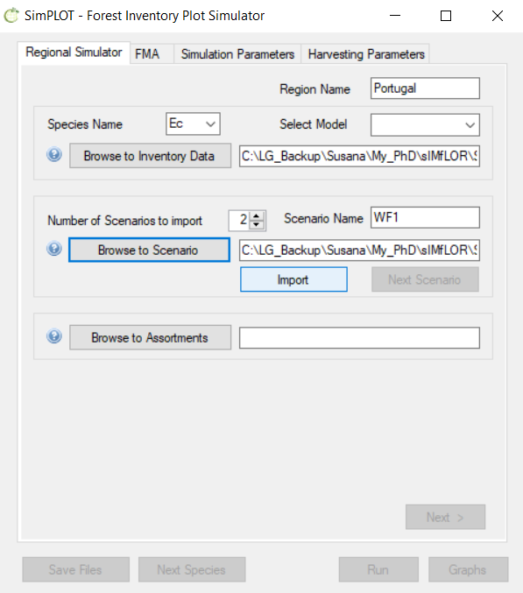
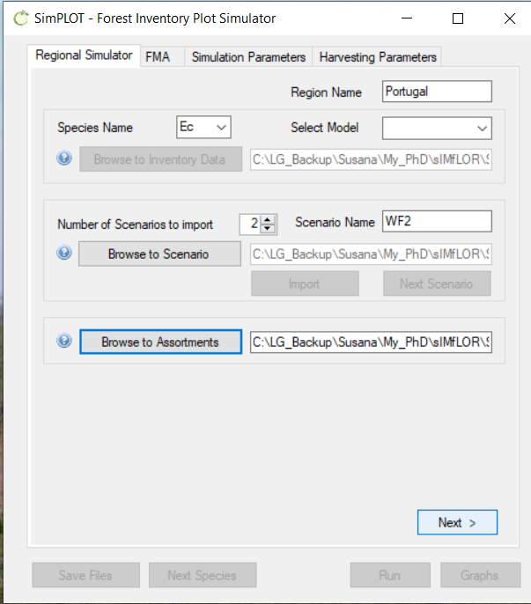
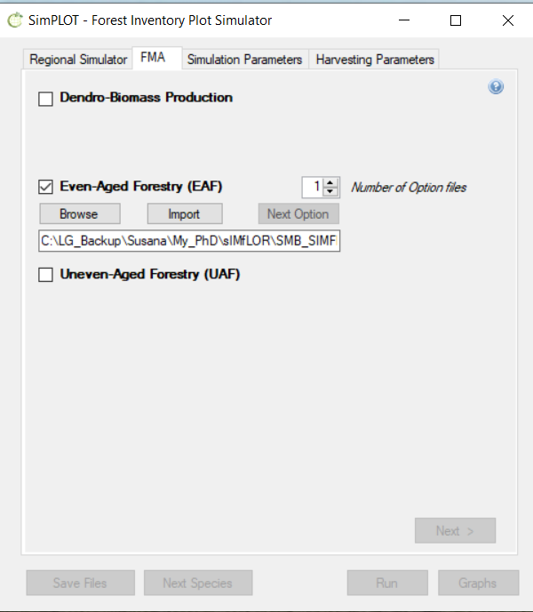
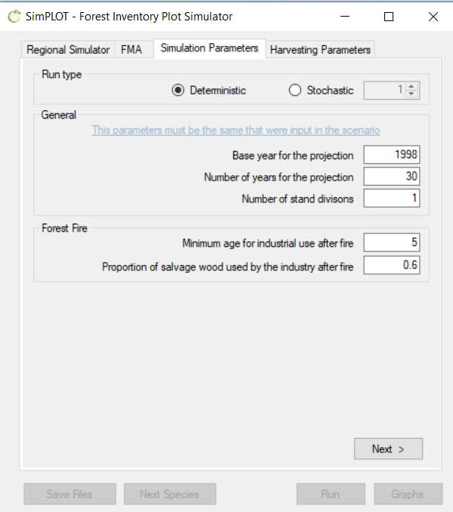
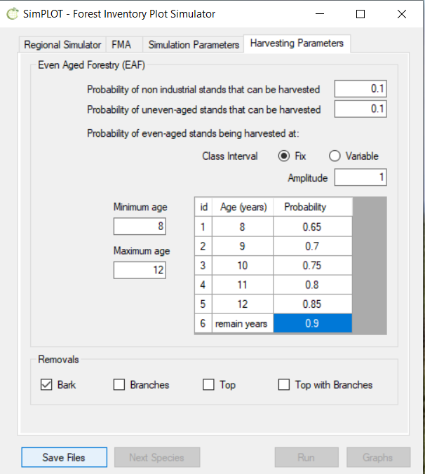
Running StandsSIM.md in sIMfLOR

Slide 24
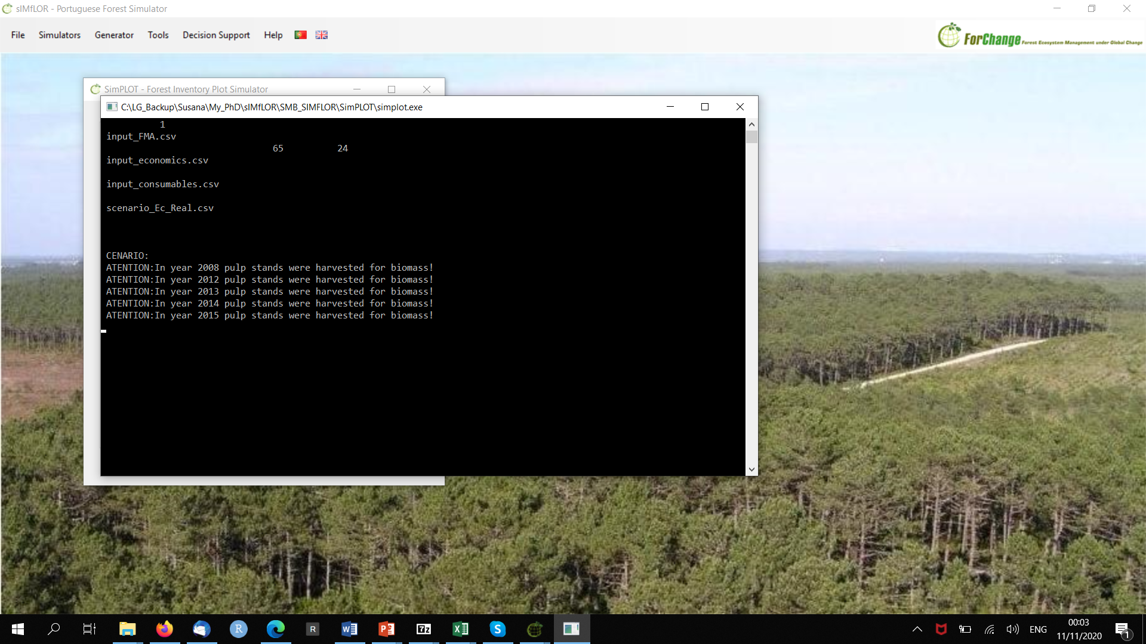
Running StandsSIM.md in sIMfLOR

Slide 25
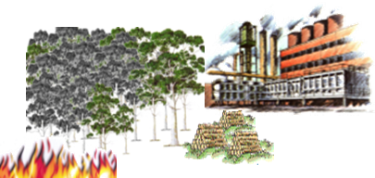
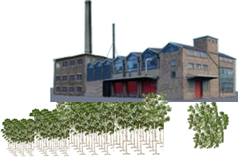
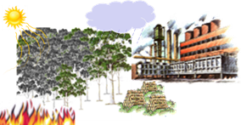
StandsSIM.sd: Presentation of 3 case studies
Assessing the impact of different fire scenarios on wood availability
Assessing the impact of different afforestation levels on wood and biomass availability
Assessing the impact of climate change/fire on wood availability

Slide 26
INPUTS: Forest + Management + Scenarios
1995 – 1997 NFI plots:
786 eucalyptus plots
‘‘fictitious’’ stand
(area corresponding to the total area of eucalyptus stands in the country divided by the number of NFI plots with eucalyptus)

Slide 27
INPUTS: Forest + Management + Scenarios
The main drivers
Wood and biomass demands:
Wood consumption by species
Until 2008:
Was found in the Portuguese statistics
2008 onward:
was considered to increase 1.2% /year
Biomass consumption estimated according to the production capacity of biomass plants

Slide 28
INPUTS: Forest + Management + Scenarios
The remaining drivers
Area to be burnt:
Until 2008 - based on statistics 2008 onward - simulated based on the analysis of historical burnt areas
3 fire scenarios were compared

Slide 29
INPUTS: Forest + Management + Scenarios
The remaining drivers
Area to be burnt:
Until 2008 - based on statistics 2008 onward - simulated based on the analysis of historical burnt areas
3 fire scenarios were compared
WF1 - No severe wildfires from 2008 onward

Slide 30
INPUTS: Forest + Management + Scenarios
The remaining drivers
Area to be burnt:
Until 2008 - based on statistics 2008 onward - simulated based on the analysis of historical burnt areas
3 fire scenarios were compared
WF1 - No severe wildfires from 2008 onward
WF2 - 2 moderate wildfires in years 2012 and 2018
3 fire scenarios were compared
WF1 - No severe wildfires from 2008 onward
WF2 - 2 moderate wildfires in years 2012 and 2018

Slide 31
INPUTS: Forest + Management + Scenarios
The remaining drivers
Area to be burnt:
Until 2008 - based on statistics 2008 onward - simulated based on the analysis of historical burnt areas
3 fire scenarios were compared
WF1 - No severe wildfires from 2008 onward
WF2 - 2 moderate wildfires in years 2012 and 2018
WF3 - 3 moderate wildfires in years 2012, 2018 and 2021
severe wildfires in years 2012, 2018 and 2021

Slide 32
INPUTS: Forest + Management + Scenarios
The remaining drivers
Forest Management and Land Use Changes (LUC):
Even-aged stands were simulated assuming even-aged forestry
      1 planted stand followed by two coppices
      Plantations with 1250 trees ha⁻¹
Uneven-aged stands after harvested become even-aged stands
Afforestation constant throughout the simulation period for FMA4 (average of new plantations from 1995 to 2000)
Deforestation proportion of the existing total forest area in each year (average value of deforestation from 1986 to 2000)

Slide 33
Results:
Harvested volume
WF1 - no wood available to met wood demand from 2018 onward

Slide 34
Results:
Harvested volume
WF1 - no wood available to met wood demand from 2019 onward
WF2 / WF3 - wood demand no longer met from 2018 onward
So, fires combined with forest overharvesting anticipate the lack of response to wood demand in JUST ONE YEAR

Slide 35
Results:
Carbon stock (Gg)
For over a decade
carbon stock depletion intensified after the consecutive severe fires

Slide 36
Results:
Carbon stock (Gg)
For over a decade
carbon stock depletion intensified after the consecutive severe fires

Slide 37
Results:
Carbon stock (Gg)
For over a decade
carbon stock depletion intensified after the consecutive severe fires
After 2012, higher carbon stock values associated to less severe fire scenarios

Slide 38
Results:
Carbon sequestered (Gg year⁻¹)
carbon sequestered responds to disturbances immediately after the event takes place

Slide 39
Results:
Carbon sequestered (Gg year⁻¹)
carbon sequestered responds to disturbances immediately after the event takes place

Slide 40
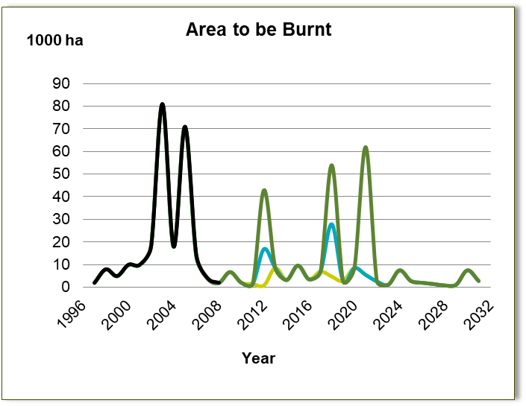
Results:
Carbon sequestered (Gg year⁻¹)
carbon sequestered responds to disturbances immediately after the event takes place
see the differences in carbon sequestered between the 3 scenarios in 2012
and how these seem to dilute right after the fires take place

Slide 41
Conclusions:
  Forest resources were already depleted when the 2003 and 2005 fires occurred
  The impact of the very large fires on carbon sequestration coincides mainly with the year of occurrence of the large fire
Only having a long-term impact in case forest becomes unsustainable
  The impact on carbon stock is much more durable
  “StandsSIM.sd is a tool for decision making, but simulation results do not necessarily need to be used in quantitative terms; but as guides in a way to explore different options and alternatives”

Slide 42
INPUTS: Forest + Management + Scenarios
1995 – 1997 NFI plots
786 eucalyptus plots
‘‘fictitious’’ stand
(area corresponding to the total area of eucalyptus stands in the country divided by the number of NFI plots with eucalyptus)
Pure even- and uneven-aged stands as well as mixed stands were used
Planning horizon: 40 years

Slide 43
INPUTS: Forest + Management + Scenarios
The main drivers
Until 2008 based on statistics
2008 onward
0.3% increase/year
(production capacity increase)
Until 2008 based on statistics
2008 onward
Historical data
(Monte Carlo Simulation)
Estimated based on the capacity of the biomass plants operating or planed to be operating in the future

Slide 44
INPUTS: Forest + Management + Scenarios
The remaining drivers
Area of new plantations
Until 2008 based on statistics
(avg planted areas from 1995 to 2000: 4833 ha)
2008 onward
Pulp stands
4833 +33% = 6444 ha
Deforestation
(abandoned areas based on the avg deforestation from 1986 to 2000)
constant proportion of forest area
Energy stands:
4833 - 33% = 1611 ha
4833 +66% = 3222 ha
0 ha

Slide 45
Results:
Wood demand can not be satisfied
The peaks in volume harvested result from fluctuations in forest area by age classes
The more we plant for energy the closer we get to meeting wood demand

Slide 46
Results:
Biomass (10³ Mg)
Biomass demand
Biomass left on the soil
Forest residues
Bioenergy plantations
Pulp plantations harvested for bioenergy
The 2003 and 2005 severe forest fires originated 2 peaks in biomass residues left on site when biomass demand was still too low

Slide 47
Results:
Biomass (10³ Mg)
Biomass demand
Biomass left on the soil
Forest residues
Bioenergy plantations
Pulp plantations harvested for bioenergy
Forest residues from pulp stands are the biggest source of biomass for energy, thus if wood demand is not meet ⬄ not enought stands to be harvested => biomass demand might not be met either
The more we plant for bioenergy, the smaller the number of stands planted for pulp that end up being harvested for bioenergy is

Slide 48
Results:
Biomass (10³ Mg)
Biomass demand
Biomass left on the soil
Forest residues
Bioenergy plantations
Pulp plantations harvested for bioenergy
As the area of bioenergy plantations increases, the harvest of pulp stands with bioenergy purposes decreases

Slide 49
Final Remarks:
Forest was unable to satisfy wood demand (even when biomass demand is disregarded)
bioenergy plantations should have to be established to secure the supply of biomass demand (avoiding wood from being used for energy)
Proposed mesures to reduce or increase imports:
  Researching the productivity of bioenergy plantations (choose alternative species)
  Using improved genetic material
  Improving sustainable forest management to increase productivity
  Privileging plantations in areas of high S

Slide 50
INPUTS: Forest + Management + Scenarios
2005 – 2007 NFI plots
  1680 (56 gaps and clumps)
‘‘fictitious’’ stand
(area corresponding to the total area of eucalyptus stands in the country divided by the number of NFI plots with eucalyptus)
Pure even- and uneven-aged stands as well as mixed stands were used
Planning horizon: 40 years

Slide 51
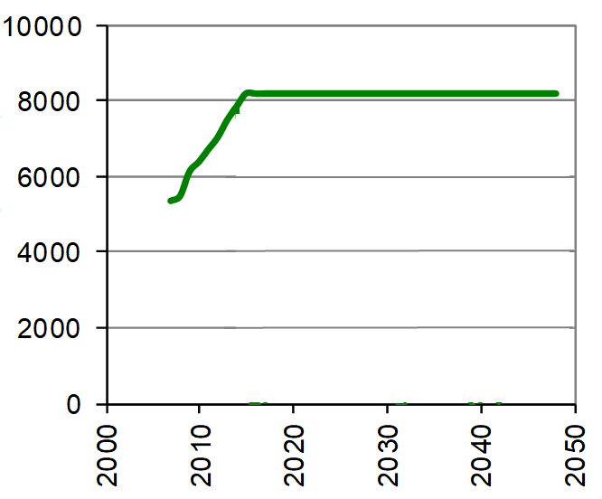
INPUTS: Forest + Management + Scenarios
The main drivers
Wood demand
  Until 2013:
  CELPA statistics (consumption-import)
  2013 onward:
  maintenance of the 2013 value
Biomass demand
disregarded
Wood imports for the period 2007-2013
Between 8 and 35% of total wood consumption
Volume to be harvested (10³ m³)

Slide 52
INPUTS: Forest + Management + Scenarios
The remaining drivers
Forest fires
  Area burned based on historical series, considering two scenarios:
    Business as usual Increased fires due to climate change

Slide 53
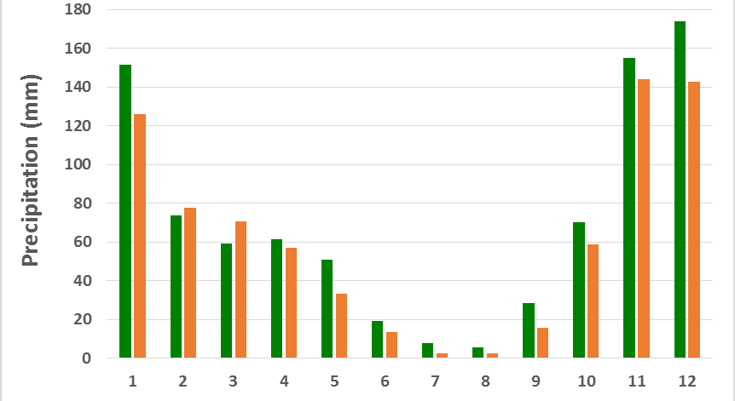
INPUTS: Forest + Management + Scenarios
The remaining drivers
Climate
  Scenario A1B
  Model HadRM (25 km) that has been found to be the most appropriate for Portugal
  Selection of the “metereological station” closest to each NFI plot and simulations made with averages for two periods:
    2001 – 2030
    2061 – 2090

Slide 54
INPUTS: Forest + Management + Scenarios
The remaining drivers
Land use changes
  Afforestation (“expert judgement”):
  untill 2014: 800 ha;
  2015-2019: 1600 ha;
  2020-2026: 1200 ha;
  after 2027: nill
  Deforestation
  disregarded
No bioenergy plantations considered

Slide 55
Results:
Assuming no wood is imported + (2001-2030) + BAU fires

Slide 56
Results:
Assuming no wood is imported + (2031-2090) + BAU fires

Slide 57
Results:
Assuming no wood is imported + (2031-2090) + Increased fires

Slide 58
Results:
Assuming no wood is imported + (2001-2030) + BAU fires

Slide 59
Results:
Assuming no wood is imported + (2001-2030) + BAU fires

Slide 60
Final Remarks:
Portuguese eucalyptus forest is in danger of becoming unsustainable
The impact of climate change will emphasize this tendency
Wood import and plantations can help to meet wood demand without puting the forest at risk
Regional simulators, such as StandsSIM.sd, are usefull tools to analyze forest sustainability as well as to find the best solutions to maintain it

Slide 61
StandsSIM.sd in sIMfLOR
StandsSIM.sd room for improvements:
Improving/completing the growth module with growth models for other tree species
Improving the simulation of mixed stands ⬄ replacing the stand level eucalyptus growth model with an individual tree growth model
Improving the simulation of uneven-aged stands ⬄ developing an algorithm for the conversion of even- to uneven-aged structures
Making the simulador geographically explicit ⬄
  Improving the fire subroutine
  Improving the harvesting subroutines
  Improving the LUC subroutines
Integrating the insect defoliation subroutine
Developing/improving the regeneration modules for most of the tree species
Improving the sIMfLOR ⬄ making it more user friendly and updating it to run the new versions of the simulators
…

