Slide 1
Multiple Objective Linear Programming
Decision Analysis and Optimization
Susana Barreiro
28 - 30 April 2021

Slide 2
Content
Single- versus multi-objective problems
Decision making and multiple objectives
Multi-objective linear programming
  Goal programming
  Classical methods - conversion to single objective problems
    - Preemptive optimization
    - Weighted sums
  True multi-objective linear programming
    - The optimality and the Pareto frontier concepts
    - Weighted sums
    - Evolutionary Multi-objective Optimization (EMO) Algorithms

Slide 3
Single- versus multi-objective problems

Slide 4
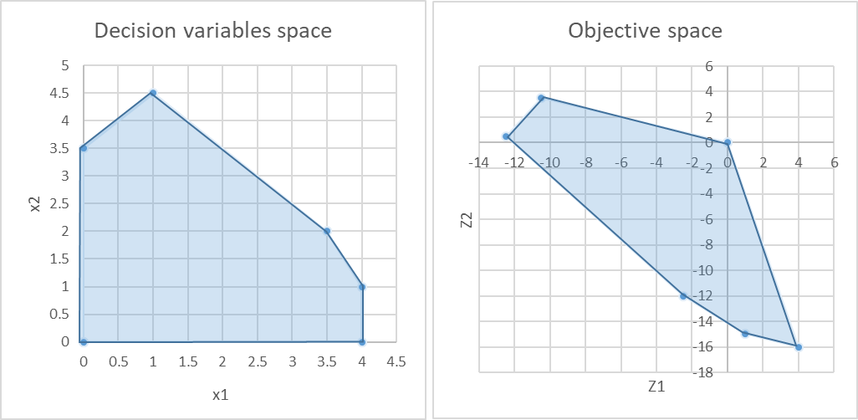
Multi-objective Linear problems
Single-objective problems
The goal is to find the (single) feasible solution that optimizes the objective function ( max Z₁ = x₁ – 3x₂ )
Even when alternative solutions exist, these provide the same objective function value
C
B
D
E
A
F

Slide 5
Multi-objective Linear problems
In many situations more than one objective is generally important
Multi-objective programming deals with:
  optimization problems with 2 or more objective functions
  problem formulation differs in the expression of the objective function(s)
  the evaluation of solutions is significantly different: instead of seeking an optimal or best overall solution, the goal is to quantify the degree of conflict (trade-off)
Several optimization techniques have been developed to capture explicitly the trade-offs that may exist between conflicting, and possibly noncommensurate, objectives

Slide 6
Multi-objective Linear problems
Multi-objective problems
we have a set of solutions reflecting different amounts of satisfaction of two different objectives (Z₁ and Z₂)
Brings us to the discussion of decision making
B
C
A
D
E
F

Slide 7
Multi-objective Linear problems
For conflicting objectives the optimality concept may be inappropriate
So, what does optimal mean in this case?
A new concept that can measure solutions against multiple, conflicting and even noncommensurate objectives is required: the non-inferiority concept
Dominance (mathematical programmers), Efficiency (statisticians and economists)
Pareto optimality (welfare economists)
A solution is non-inferior if there exists no other feasible solution with better performance with respect to any objective without having worse performance for at least one other objective

Slide 8
Multi-objective Linear problems
Multi-objective problems
we seek to find the set of solutions for which we can demonstrate that no better solution exists
This set of solutions is referred to as non-inferior or non-dominated solutions
Efficient frontier or Pareto Front
B
C
A
D
E
F

Slide 9
Multi-objective Linear problems
Multi-objective problems
Efficient frontier or Pareto Front
Classical approaches for generating the Pareto Front
  Convert to single objective problem, which delivers one efficient point in the Pareto front (one optimal solution)
  run it several times
B
C
A
D
E
F

Slide 10
Decision making and multiple objectives

Slide 11

Multiple Objective Decision Analysis
Decision Making
Takes place under multiple criteria. All the rest is: analysis, measurement and search.
Measurement and search is sufficient for finding the heaviest apple.
This is not a problem of decision making or optimization, but merely a technical challenge.
No value judgments, no trade-offs and no decisions go into single-criterion problems
Consider a basket of apples, and that weight is our single criterion. How do we proceed to find (identify, choose, select) the heaviest apple?
    We measure all apples, then we search the one with the highest weight

Slide 12


Multiple Objective Decision Analysis
Decision Making
Takes place under multiple criteria. All the rest is: analysis, measurement and search.
But this time, the function of measurement and search is not sufficient.
We have two different apples and our criteria are ‘conflicting’
Which apple do we choose?
Now, we must go beyond measurement and search and decide
Consider the same basket of apples, but now we wish to find the heaviest and the sweetest apple. Our criteria are now: weight and sweetness.
We use the same procedures of measurement and search and identify the heaviest (as before) and then the sweetest apple.

Slide 13
Multiple Objective Decision Analysis
Decision Making
Takes place under multiple criteria. But are all multiple criteria decision problems?
This particular apple would be preferred by all decision makers aiming to maximize both criteria.
Measurement and search would safely identify such an apple making it sufficient even under multiple criteria
Suppose we could look outside the basket and add an additional apple
And that this is both the heaviest and the sweetest in the basket.

Slide 14
Multiple Objective Decision Analysis
Decision Making
Thinking “outside the basket” is the key to effective Decision Making.
Decision making: is a function beyond measurement and search, aimed at managing, resolving or dissolving the conflict of trade-offs.
In this basket there are no trade-offs
we have an “ideal” apple dominating the entire basket - an obvious choice of every rational decision maker

Slide 15
Multiple Objective Decision Analysis
Decision Making Challenges
Existence of multiple conflicting objectives (e.g. car: comfort vs price; house: square footage vs price)
Difficulty in identifying good alternatives (e.g. firing one-third of your employees, reducing everyone’s pay)
Existence of intangibles ie, difficult-to-measure (e.g. consumer satisfaction, employee morale, recreation value)
Existence Long time horizons where the consequences of decisions that must be made today, will not be known for years/decades (e.g forest management and planning)
Interdisciplinary substance of decisions and/or having multiple decision makers require information from several “areas of expertise”, (e.g. forest owners, forest managers, public laws, funding schemes)
Uncertainty and risk: not being able to precisely predict the future raises questions (one can try to use historical data, expert judgments, simulations to deal with uncertainty and risk)
Being able to quantify trade-offs: expressing the value trade-offs among the multiple objectives

Slide 16
Multiple Objective Decision Analysis
Multiple Objective Decision Analysis (MODA) is an operations research technique for evaluating a decision under multiple, sometimes competing and conflicting objectives or criteria.
Multi-objective optimization leads to a set of optimal solutions (known as Pareto-optimal solutions) since no solution can be considered better than any other regarding all the objectives
MODA provides a process that systematically identifies alternatives and the decision maker’s objectives that serves as the measuring device for selecting the preferred alternative given the decision space.
Decision makers try to balance multiple objectives (e.g., cost, performance, reliability) none of which is obviously the best

Slide 17
Multiple Objective Decision Analysis
Decision Making
Its quality depends on:
  the quality of the underlying process (but not the inverse)
  the problem formulation
  the quality and nature of available decision alternatives (it is the configuration of the feasible set of available alternatives
Decision maker must choose from a set of alternative solutions
Analyst
must describe as accurate as possible the range of choices and the trade-offs among objectives

Slide 18
Multi-objective linear programming
  Goal programming
  Classical methods - conversion to single objective problems
  True multi-objective linear programming

Slide 19
Multi-objective linear problems
Multi-objective optimization problems can be formulated as:
Minimize / Maximize f_{i} (x) i = 1,…, N_{obj} – number of objective functions
Subject to:
a set of constraints (equality and inequality, sometimes with bounded var. )
To simplify the solution process, in optimization problems with a number of objective functions, additional objective functions are usually handled as constraints
HOWEVER
final solutions satisfying those constraints cannot be called optimal with respect to all the objective functions

Slide 20
Multi-objective linear problems
Goal programming
Example:
Define target levels of each objective rather than max or min the objective functions
  Suppose the goal for obj i is gi:
  obj₁ > g₁ ; obj₂ > g_{2 ; …;} obj_{n} > g_{n}
  These goals are treated as soft constraints (ie these can be violated)
  Obj = min (w₁ |obj₁ - g₁|+ w₂ |obj₂ - g₂|+ … + w_{n} |obj_{n} - g_{n}|
  Maybe we can’t satisfy all goals, but we want to capture how much we can satisfy (find the deviations). The optimal solution to this problem is not necessarily an efficient point in the original model
max Z₁ = x₁
max Z₂ = -4x₁ + x₂
x₁ > g₁
-4x₁ + x₂ > g₂
To find the deviations, which can be + or -, we use:
  y₁ = y₁⁺ - y₁⁻
  y₂ = y₂⁺ - y₂⁻
  where y_{i}⁺ ≥ 0, y_{i}⁻ ≥ 0
Y₁ = x₁ - g₁
Y₂ = -4x₁ + x₂ - g₂
x₁ - (y₁⁺ - y₁⁻) = g₁
-4x₁ + x₂ - (y₂⁺ - y₂⁻) = g₂
Set penalty weights for missing the goals. Assume 5 for falling under g₁ and 2 for falling under g₂
min Z₃ = 5 y₁⁻ + 2 y₂⁻

Slide 21
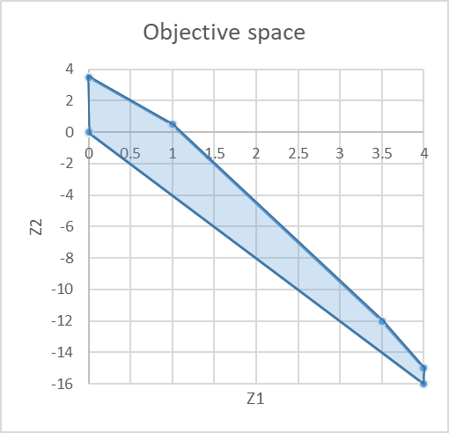
Multi-objective linear problems
Preemptive Optimization
Example:
Perform optimization by considering one objective at a time, based on priorities:
STAGE1:
  optimize the 1st objective (most important)
  obtain an optimal solution
  transform this objective into a constraint
STAGE2:
  optimize the 2nd objective (2nd most important)
  obtain an optimal solution
  …continue until all objectives have been considered
If an optimal solution is obtained at each stage => the final solution is an efficient point of the original multi-objective model
max Z₁ = x₁
max Z₂ = -4x₁ + x₂
B
C
A
D
E
F

Slide 22
Multi-objective linear problems
Preemptive Optimization
Example:
Perform optimization by considering one objective at a time, based on priorities:
STAGE1:
  Assume Z₁ is 1st priority
  obtain an optimal solution (all points along the segment)
  transform this objective into a constraint
STAGE2:
  optimize Z₂ (2nd priority)
  Add x₁ = 4 as constraint
  obtain an optimal solution: (4, -15)
  …continue until all objectives have been considered
If an optimal solution is obtained at each stage => the final solution is an efficient point of the original multi-objective model
max Z₁ = x₁
max Z₂ = -4x₁ + x₂
B
C
A
C
B
D
D
E
E
A
F
F

Slide 23
Multi-objective linear problems
Weighted Sum
Example:
Convert multiple objectives into one single objective using weights and summation:
  Determine the importance of each objective function assigning it a weight (w)
  Add up all functions:
  min Z = ( w₁ z₁ + w₂ z₂ +…+ w_{n} z_{n} )
An optimal solution to this problem is the final solution is an efficient point of the original multi-objective model
max Z₁ = x₁
max Z₂ = -4x₁ + x₂
B
C
A
D
E
F

Slide 24
Multi-objective linear problems
Weighted Sum
Example:
Convert multiple objectives into one single objective using weights and summation:
  Assume z₁ is 3 times as important as z₂ (W₁ = 3, W₂ = 1)
  Add up all functions:
  max Z₃ = ( 3x₁ - 4x₁ + x₂ )
  = ( -x₁ + x₂ )
  Optimal solution for the weighted sum 3 Z₁ + Z₂ are the points along the segment BC
max Z₁ = x₁
max Z₂ = -4x₁ + x₂
B
C
A
C
B
D
D
E
E
A
F
F

Slide 25
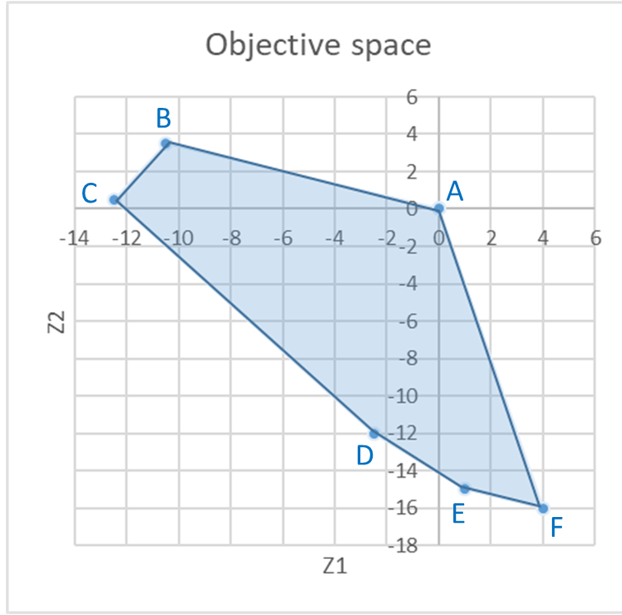
Multi-objective linear problems
Classical approaches (most common is weighted sum)
Estimate relative importance vector
w₁, w₂, …, w_{n}
Single objective optimization problem
Min Z = w₁ f₁ + w₂ f₂ + …+ w_{n} f_{n}
s.t.: constraints
Multi-objective
min f₁, f₂, …, f_{n}
s.t.: constraints
High Level info
Decision making phase
Single objective optimizer
(Simplex, solver, etc)
Optimization phase
For a 2 objectives problem Min Z = w₁ f₁ + w₂ f₂ the slope of this line (-w₁/w₂) (parameterized approach W_{i} as the parameters)
By varying the weights we can move along the objective space from one optimization to the next (generating different points along the Pareto front)
However,
    1) doesn't return an optimal solution
    2) requires the weights
    3)may lead to non-uniform Pareto optimal solutions

Slide 26
Multi-objective Linear problems
Difficulties with the most classical approaches
  The simplest options give you one solution (disregarding how many more might be)
  Need to run single optimization many times to build the Pareto front
  Expect a lot of problem knowledge (convex or not)
    - Can’t guarantee that we’ll get all the points in the convex region
    - How to assign weights? What weights to assign?
  Aggravated for complex problems (many objective functions and several variables)

Slide 27
Multi-objective linear problems
Ideal approach
Multi-objective
min f₁, f₂, …, f_{n}
s.t.: constraints
Ideal multi- objective optimizer
Multiple trade-off solutions found
High Level info
Optimization phase
Decision making phase
STEP1:
  find a set of Pareto optimal solutions
STEP2:
  choose 1 from the set of optimal solution (unlike classical methods where we first decide unaware of the solutions)
Choose 1 solution

Slide 28
Multi-objective linear problems
Evolutionary Multi-objective Methodologies
These are no single approaches, but POPULATION APPROACHES, allowing finding several solutions simultaneously and permitting a faster search
Non-Pareto techniques
  Approaches that do not incorporate directly the concept of Pareto-optimum
  Unable to reproduce certain portions of the Pareto front
  Efficient and easy to implement, but appropriate to handle only a few objectives
Pareto techniques
  Use of non-dominanted ranking and selection to move the population towards the Pareto front
  Require a ranking procedure and a technique to maintain diversity in the population

Slide 29
Multi-objective linear programming
  Goal programming

Slide 30
MOLP - Goal Programming
Single, Goal Programming & multi-objective optimization
Single-obj optim.
Goal programming
Multi-objective optim.
Manager knows his only priority (wants to minimize/maximize) a certain objective under certain constraints
Manager wants to meet certain goals and defines some reference values (thresholds) that can be met, exceeded or less than
Manager wants to optimize several objectives simultaneously but no reference values (thresholds) are defined à priori

Slide 31
MOLP - Goal Programming
Representing some goals by constraints in effect gives them priority over the goal reflected in the objective function, because the objective function is optimized within the feasible region defined by the constraints
Deciding which goal should be selected as the objective function and which ones should be reflected by constraints is often arbitrary and difficult
Goal programming attempts to overcome these limitations while using linear programming, striving toward selected objectives simultaneously, treating them all in the same manner, although perhaps giving them different weights.

Slide 32
MOLP - Goal Programming
Capacity limits we cannot change (e.g. number of seats on a flight) or we do not want to change
Linear programming
  Most LP problems have hard constraints that cannot be violated:
Goal programming
  GP problems have soft constraints that represent goals or targets we want to achieve
  Constraints are very important because they refer to the amount of resources / capacity limits we face
  First, we look at our limitations;
  Then, we think of an optimization model
Max: Z = 90 x₁ + 120 x₂
Subject to:
x₁ ≤ 40
x₂ ≤ 50
2x₁ + 3x₂ ≤ 180
and x₁ ≥ 0; x₂ ≥ 0
(ha of pine)
(ha of eucalypt)
(days of work)

Slide 33
MOLP - Goal Programming
Linear programming
  Most LP problems have hard constraints that cannot be violated:
Goal programming
  GP problems have soft constraints that represent goals or targets we want to achieve
  Suppose we look back to the Poets problem again and he says that he reconsidered and would be:
  “… willing to give an extra 250 days of work if needed… preferred having 40 and 50 ha of pine and eucalypt but he would be flexible ”
  The “days of work” would no longer be a hard constraint
Max: Z = 90 x₁ + 120 x₂
Subject to:
x₁ ≤ 40
x₂ ≤ 50
2x₁ + 3x₂ ≤ 180
and x₁ ≥ 0; x₂ ≥ 0
(ha of pine)
(ha of eucalypt)
(days of work)

Slide 34
MOLP - Goal Programming
There are three possible types of goals:
  A lower, one-sided goal sets a lower limit that we do not want to fall under (but exceeding the limit is fine).
  An upper, one-sided goal sets an upper limit that we do not want to exceed (but falling under the limit is fine).
  A two-sided goal sets a specific target that we do not want to miss on either side.

Slide 35
MOLP - Goal Programming
Goal programming problems can be categorized according to the type of mathematical programming model that it fits except for having multiple goals instead of a single objective:
  linear programming,
  integer programming,
  nonlinear programming,
  etc
In class, we ill only consider linear goal programming—those goal programming problems that fit linear programming, but I’ll refer to it just as goal programming

Slide 36
MOLP - Goal Programming
Goal programming problems can also be categorized according to how the goals compare in importance:
  nonpreemptive goal programming – if all the goals are of roughly comparable in importance
  preemptive goal programming – if there is a hierarchy of priority levels for the goals, so that the goals of primary importance receive first priority attention, those of secondary importance receive second-priority attention, and so forth (if there are more than two priority levels).

Slide 37
MOLP - Goal Programming
EXAMPLE: The OR department of the DEWRIGHT COMPANY has been assigned the task of determining which mix of products should be produced.
Management wants primary consideration given to the following three goals:
  (1) achieving a long-term profit (NPV) of at least $125 million from these products
  (2) maintaining the current employment level of 4,000 employees,
  (3) holding the capital investment to less than $55 million.

Slide 38
MOLP - Goal Programming
However, it probably will not be possible to attain all these goals simultaneously, priorities have been discussed leading to setting a penalty weight:
  5 for missing the profit goal (per $1 million under),
  2 for going over the employment goal (per 100 employees) and 4 for going under this same goal
  3 for exceeding the capital investment goal (per $1 million over)
Each new product’s contribution to profit, employment level, and capital investment level is proportional to the rate of production.

Slide 39
MOLP - Goal Programming
These contributions per unit rate of production are shown in the table along with the goals and penalty weights.
Factor | Unit contribution |  |  | Goal Unit |  |  | Penalty Weight
 | Product
 | 1 | 2 | 3
Long-term profit | 12 | 9 | 15 | ≥ | 125 | (millions of dollars) | 5
Employment level | 5 | 3 | 4 | = | 40 | (hundreds of employees) | 2(+), 4(-)
Capital investment | 5 | 7 | 8 | ≤ | 55 | (millions of dollars) | 3

Slide 40
MOLP - Goal Programming
Goal Programming Formulation: DEWRIGHT COMPANY problem includes all three possible types of goals:
  profit goal is a lower one-sided goal: 12x₁ + 9x₂ + 15x₃ ≥ 125
  employment goal is a two-sided goal: 5x₁ + 3x₂ + 4x₃ = 40
  investment goal is an upper one-sided goal: 5x₁ + 7x₂ + 8x₃ ≤ 55
Where x₁, x₂, x₃ are the decision variables representing the production rates of products 1, 2, and 3, respectively and x₁, x₂, x₃ ≥ 0

Slide 41
MOLP - Goal Programming
Linear Programming Formulation: Transform goals into soft constraints
Subject to:
  12x₁ + 9x₂ + 15x₃ ≥ 125
  5x₁ + 3x₂ + 4x₃ = 40
  5x₁ + 7x₂ + 8x₃ ≤ 55
Objective function:
The objective then is to find the values of x₁, x₂, and x₃ that:
  min Z = 5 (amount under the long-run profit goal)
  + 2 (amount over the employment level goal)
  + 4 (amount under the employment level goal)
  + 3 (amount over the capital investment goal)
Maybe we can’t satisfy all goals, but we want to capture how much we can satisfy (find the deviations)
where no penalties are incurred for being over the long-run profit goal or for being under the capital investment goal

Slide 42
MOLP - Goal Programming
Linear Programming Formulation:
To express this mathematically, we introduce some auxiliary variables y₁, y₂, and y₃, to represent the deviations defined as follows:
  y₁ = 12x₁ + 9x₂ + 15x₃ - 125 (long-term profit minus the target)
  y₂ = 5x₁ + 3x₂ + 4x₃ - 40 (employment level minus the target)
  y₃ = 5x₁ + 7x₂ + 8x₃ - 55 (capital investment minus the target)
Since each y_{i} can be either positive or negative, and replace each one by the difference of two nonnegative variables:
  y₁ = y₁⁺ - y₁⁻, where y₁⁺ ≥ 0, y₁⁻ ≥ 0
  y₂ = y₂⁺ - y₂⁻, where y₂⁺ ≥ 0, y₂⁻ ≥ 0
  y₃ = y₃⁺ - y₃⁻, where y₃⁺ ≥ 0, y₃⁻ ≥ 0
y_{i}⁺ represents the positive part of y_{i} variable (positive deviation)
y_{i}⁻ represents the negative part of y_{i} variable (negative deviation)

Slide 43
MOLP - Goal Programming
Linear Programming Formulation:
Finally, we must incorporate the above definitions of the y_{i}⁺ and y_{i}⁻ directly into the model, because the simplex method considers only the objective function and constraints that constitute the model.
Since y₁⁺ - y₁⁻ = y₁, the expression for y₁ is
12x₁ + 9x₂ + 15x₃ - 125 = y₁⁺ - y₁⁻
12x₁ + 9x₂ + 15x₃ - (y₁⁺ - y₁⁻) = 125
Now we have an equality constraint for the linear programming model.

Slide 44
MOLP - Goal Programming
Linear Programming Formulation:
Proceeding in the same way for y₂⁺ - y₂⁻ and y₃⁺ - y₃⁻, we obtain the following formulation for this goal programming problem
Subject to:
  12x₁ + 9x₂ + 15x₃ - (y₁⁺ - y₁⁻) = 125
  5x₁ + 3x₂ + 4x₃ - (y₂⁺ - y₂⁻) = 40
  5x₁ + 7x₂ + 8x₃ - (y₃⁺ - y₃⁻) = 55
  x₁ , x₂ , x₃ , y₁⁺, y₁⁻, y₂⁺, y₂⁻ , y₃⁺ , y₃⁻ ≥ 0
y₁⁺ > 0
54 -> 179
y₁⁻ > 0
25 -> 100

Slide 45
MOLP - Goal Programming
Linear Programming Formulation:
Subject to:
  12x₁ + 9x₂ + 15x₃ ≥ 125
  5x₁ + 3x₂ + 4x₃ = 40
  5x₁ + 7x₂ + 8x₃ ≤ 55
Let us build the objective function:
  Min Z = 5 y₁⁻ + 2 y₂⁺ + 4 y₂⁻ + 3 y₃⁺
Because there is no penalty for exceeding the profit goal of 125 or being under the investment goal of 55, neither y₁⁺ nor y₃⁻ should appear in this objective function representing the total penalty for deviations from the goals.
If we’re above 125, we have a positive deviation y₁⁺, but it’s according to the goal, so there is no problem. However, we don’t want to have a negative deviation, so we penalize y₁⁻
125
y₁⁺
y₁⁻

Slide 46
MOLP - Goal Programming
Linear Programming Formulation:
Subject to:
  12x₁ + 9x₂ + 15x₃ ≥ 125
  5x₁ + 3x₂ + 4x₃ = 40
  5x₁ + 7x₂ + 8x₃ ≤ 55
Let us build the objective function:
  Min Z = 5 y₁⁻ + 2 y₂⁺ + 4 y₂⁻ + 3 y₃⁺
Because there is no penalty for exceeding the profit goal of 125 or being under the investment goal of 55, neither y₁⁺ nor y₃⁻ should appear in this objective function representing the total penalty for deviations from the goals.
We don’t care if we meet exactly the goal of 40 (=40), but we don’t want to be above or below 40 (having positive or negative deviations, respectively), thus we penalize y₂⁺ both y₂⁻
40
y₂⁺
y₂⁻

Slide 47
MOLP - Goal Programming
Linear Programming Formulation:
Subject to:
  12x₁ + 9x₂ + 15x₃ ≥ 125
  5x₁ + 3x₂ + 4x₃ = 40
  5x₁ + 7x₂ + 8x₃ ≤ 55
Let us build the objective function:
  Min Z = 5 y₁⁻ + 2 y₂⁺ + 4 y₂⁻ + 3 y₃⁺
Because there is no penalty for exceeding the profit of 125 or being under the investment of 55, y₁⁺ and y₃⁻ don’t appear in the objective function representing the total penalty for deviations from the goals
We don’t care if we’re below 55, but we don’t want to be above (having positive deviation), thus we penalize y₃⁺
55
y₃⁺
y₃⁻

Slide 48
MOLP - Goal Programming
Linear Programming Formulation:
Proceeding in the same way for y₂⁺ - y₂⁻ and y₃⁺ - y₃⁻, we obtain the following formulation for this goal programming problem
Objective function:
Min Z = 5y₁⁻ + 2 y₂⁺ + 4 y₂⁻ + 3 y₃⁺
Subject to:
  12x₁ + 9x₂ + 15x₃ - (y₁⁺ - y₁⁻) = 125
  5x₁ + 3x₂ + 4x₃ - (y₂⁺ - y₂⁻) = 40
  5x₁ + 7x₂ + 8x₃ -(y₃⁺ - y₃⁻) = 55
  x₁ , x₂ , x₃ , y₁⁺, y₁⁻, y₂⁺, y₂⁻ , y₃⁺ , y₃⁻ ≥ 0

Slide 49
MOLP - Goal Programming
Summary of the steps involved in goal programming:
  Identify the decision variables
  Define the hard constraints (if any)
  Define the goals of the problem and their target values
  Define the goals and corresponding target values as soft constraints
  Include deviational variables in the soft constraints
  Determine which deviational variables represent undesirable deviations from the target
  Formulate an objective function that Min the weighted sum of undesirable deviations (or the % weighted sum of undesirable deviations)
  Identify appropriate weights for the objective function
  Solve the problem, analyze the result and if the solution is unacceptable, go back to step 8

Slide 50
MOLP - Goal Programming
Excel Solver:
Applying the simplex method to the previous GP problem results in the following solution:
x₁ = 23/5 , x₂ = 0, x₃ = 5/3
y₁⁺= 0 , y₁⁻= 0, y₂⁺= 23/5, y₂⁻= 0, y₃⁺= 0, y₃⁻ = 0
Therefore, y₁ = 0, y₂ = 23/5 , and y₃ = 0, so the first and third goals are fully satisfied, but the employment level goal of 40 is exceeded by 8 1/3 (833 employees). The resulting penalty for deviating from the goals is Z = 16 2/3.

Slide 51
MOLP - Goal Programming
Excel Solver:

Slide 52
MOLP - Goal Programming
Deviations below the goal
Excel Solver:

Slide 53
MOLP - Goal Programming
Deviations above the goal
Excel Solver:

Slide 54
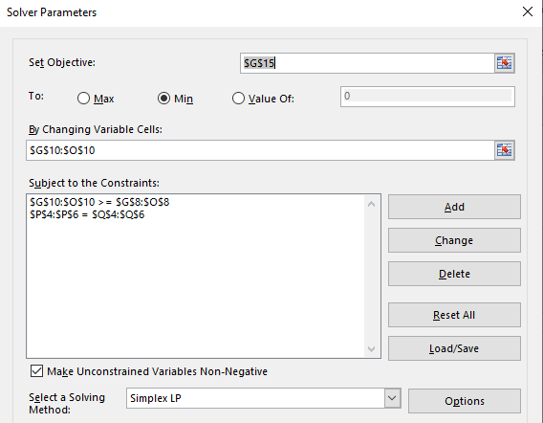
MOLP - Goal Programming
Excel Solver:

Slide 55
MOLP - Goal Programming
Excel Solver:

Slide 56
MOLP - Goal Programming
Excel Solver:

Slide 57
MOLP - Goal Programming
Excel Solver:

Slide 58
MOLP - Goal Programming
Excel Solver:

Slide 59
MOLP - Goal Programming
Excel Solver:
This means we’re 8.33 above the employment goal of 40 hundred (833 employees)

Slide 60
MOLP - Goal Programming
Excel Solver:
This means the best way to achieve the goals given these penalties is not producing product X₂

Slide 61
MOLP - Goal Programming
Final remarks on GP:
Different GP solutions should not be compared only on the basis of their objective function values (because from one iteration to the next weights are changed and these measure different things) -> look at solutions as a whole (not only to Z value)
Sometimes, one or more goals might be considered infinitely more important than other: in such case assign arbitrarily large weights to the deviations from these goals to ensure undesirable deviations from them never occur (Preemptive GP) Note that if these goals can be achieved the use of these large weights transforms them into hard constraints never to be violated

Slide 62
MOLP - Goal Programming
Final remarks on GP:
Hard constraints can be placed on a certain deviation that must never happen directly: y₅⁺ ≤ 50000
The concept of deviational variables is not exclusive to GP, thus understanding the concept might be useful in other mathematical programming situations

Slide 63
Multiple Objective Decision Analysis - Optimization
Exercise 1
  Blackstone Mining Company operates 2 coal mines Wythe and Giles. The manager is anticipating a demand increase for coal in the coming year and he wants to schedule extra shifts of workers to the mines. Each extra shift has an extra cost of 40000/month at Wythe and 32000/month at Giles.
  The extraction methods lead to the production of toxic water. Running an extra shift at Wythe leads to the production of 800 gallons and 1250 gallons at Giles.
  Despite safety guidelines are followed 0.2 life threatening accidents are expected at Wythe and 0.45
Coal production a month by a shift of workers (ton)
Increase in demand
48
28
100
Determine the number of extra shifts at each of the mines that minimizes costs, toxic waste production and life threatening accidents
Wythe
Giles

Slide 64
Multi-objective linear programming
  MOLP – minimizing weighted sum percent deviations (à prioriri approaches)

Slide 65
MOLP
An MOLP problem is an LP problem with more than one objective function
MOLP problems can be viewed as special types of GP problems where we must also determine target values for each goal or objective
We can solve 3 separate LP problems, independently optimizing each objective, to find values for t₁, t₂ and t₃. (where t is the target value of each goal)

Slide 66
MOLP
EXAMPLE: Blackstone Mining runs 2 coal mines in Southwest Virginia. Monthly production by a shift of workers at each mine is summarized as follows:
Blackstone coal production/month (tons) needs to increase 48 more tons of high-grade, 28 more tons of medium-grade, and 100 more tons of low-grade coal.
Determine the number of extra shifts at each of the mines that minimizes costs, toxic waste production and life threatening accidents
Type of Coal Wythe Mine Giles Mine
High-grade 12 tons 4 tons
Medium-grade 4 tons 4 tons
Low-grade 10 tons 20 tons
Cost per month $40,000 $32,000
Gallons of toxic water produced 800 1,250
Life-threatening accidents 0.20 0.45

Slide 67
MOLP
Decision variables:
  X₁ = number of months to schedule an extra shift at the Wythe county mine
  X₂ = number of months to schedule an extra shift at the Giles county mine
The objectives:
  Min Z₁ = 40 X₁ + 32 X₂ (Production costs)
  Min Z₂ = 800 X₁ + 1250 X₂ (Toxic water)
  Min Z₃ = 0.20 X₁ + 0.45 X₂ (Accidents)
The Constraints:
  12 X₁ + 4 X₂ ≥ 48 (High-grade coal required)
4 X₁ + 4 X₂ ≥ 28 (Medium-grade coal required)
  10 X₁ + 20 X₂ ≥ 100 (Low-grade coal required)
  X₁, X₂ ≥ 0 (Nonnegativity constraints)

Slide 68
MOLP
If the objectives had target values we could treat them like goals:
  Goal 1: The total cost of productions cost should be approximately t₁
  Goal 2: The amount of toxic water produce should be approximately t₂
  Goal 3: The number of life-threatening accidents should be approximately t₃
We can solve 3 separate LP problems, independently optimizing each objective, to find values for t₁, t₂ and t₃. (where t is the target value of each goal)
  Min Z₁ = 40 X₁ + 32 X₂
  Min Z₂ = 800 X₁ + 1250 X₂
  Min Z₃ = 0.2 X₁ + 0.45 X₂
  12 X₁ + 4 X₂ ≥ 48
  4 X₁ + 4 X₂ ≥ 28
  10 X₁ + 20 X₂ ≥ 100
  X₁, X₂ ≥ 0
  12 X₁ + 4 X₂ ≥ 48
  4 X₁ + 4 X₂ ≥ 28
  10 X₁ + 20 X₂ ≥ 100
  X₁, X₂ ≥ 0
  12 X₁ + 4 X₂ ≥ 48
  4 X₁ + 4 X₂ ≥ 28
  10 X₁ + 20 X₂ ≥ 100
  X₁, X₂ ≥ 0

Slide 69
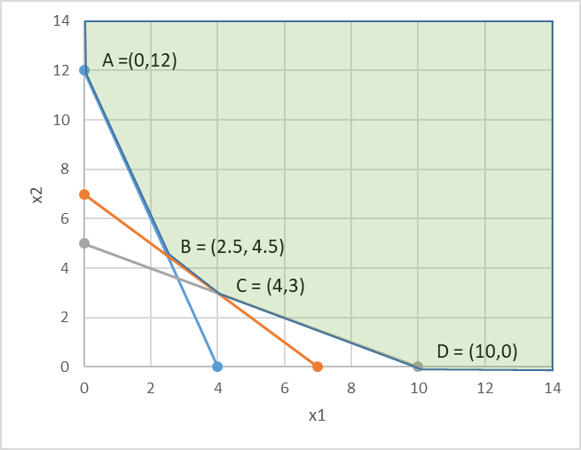
MOLP
Defining the feasible region:
Summarizing the solutions:
  12 X₁ + 4 X₂ ≥ 48
  4 X₁ + 4 X₂ ≥ 28
  10 X₁ + 20 X₂ ≥ 100
  X₁, X₂ ≥ 0
Sol. 1: min prod cost
Sol. 2: min toxic water
Sol. 3: min accidents
 | x₁ | x₂ | Z₁ | Z₂ | Z₃
A | 0 | 12 | 384 | 15000 | 5.4
B | 2.5 | 4.5 | 244 | 7625 | 2.525
C | 4 | 3 | 256 | 6950 | 2.15
D | 10 | 0 | 400 | 8000 | 2
  Min Z₁ = 40 X₁ + 32 X₂
  Min Z₂ = 800 X₁ + 1250 X₂
  Min Z₃ = 0.2 X₁ + 0.45 X₂

Slide 70
MOLP
Defining the goals and targets:
  Goal 1: The total cost of productions cost should be ~ $244
  Goal 2: The gallons of toxic water produce should be ~ 6,950
  Goal 3: The number of life-threatening accidents should be ~ 2
Defining the objective:
Minimize the sum of % deviations as follows:

Slide 71
MOLP
Solve the problem using Excel Solver considering:
    (w₁, w₂, w₃) = (1, 1, 1)
    (w₁, w₂, w₃) = (10, 1, 1)
    (w₁, w₂, w₃) = (1, 10, 1)
    (w₁, w₂, w₃) = (1, 1, 10)
to conclude that:
  All solutions are corner points of the feasible region (no matter what weights are used)
  WHY? Because this is just a linear combination of the decision variables
Note that:
For min. objectives the % deviation is: (actual - target)/target
For max objectives the % deviation is: (target - actual)/target
If a target value is zero, use the weighted deviations rather than weighted % deviations (ie no division by the target)

Slide 72
MOLP
Summary of the steps involved in MOLP (Minimize the sum of % deviations) :
  Identify the decision variables
  Identify the objectives in the problem and formulate them as usual
  Identify the constraints in the problem and formulate them as usual
  Solve the problem once for each of the objectives identified in step 2 to determine the optimal value of each objective
  Transform the objectives to goals using the optimal objective values identified in step 4 as the target values
  For each goal, create a deviation function that measures the amount by which any given solution fails to meet the goal (as an absolute value or a %)
  Assign a weight to each of the functions in step 6
  Solve the problem, analyze the result and if the solution is unacceptable, go back to step 7

Slide 73
Multi-objective linear programming
  MOLP – weighted sums (based on the Pareto front – à posteriori approach)

Slide 74
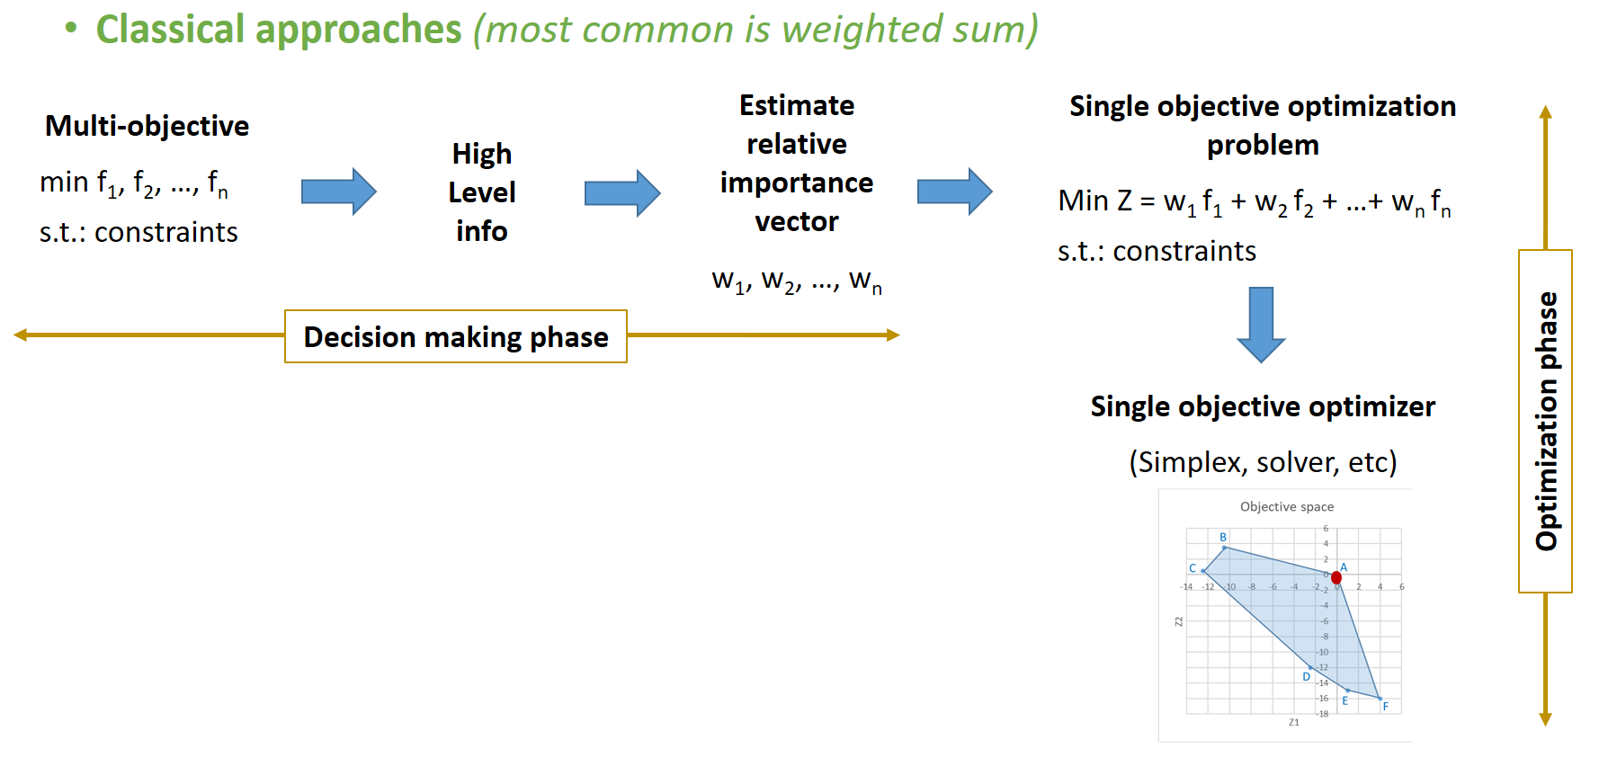
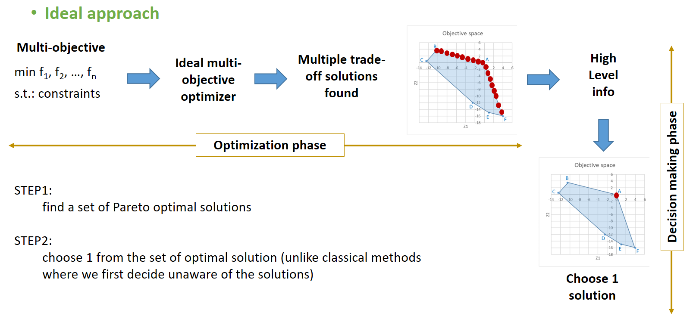
MOLP
Deciding the weights prior to optimizing
Solving LP problem -> one solution
Nondominated concept
(Pareto front)
Testing a range of combinations of weights
Solving LP problem for which weight combination to generate -> range of optimal solutions

Slide 75
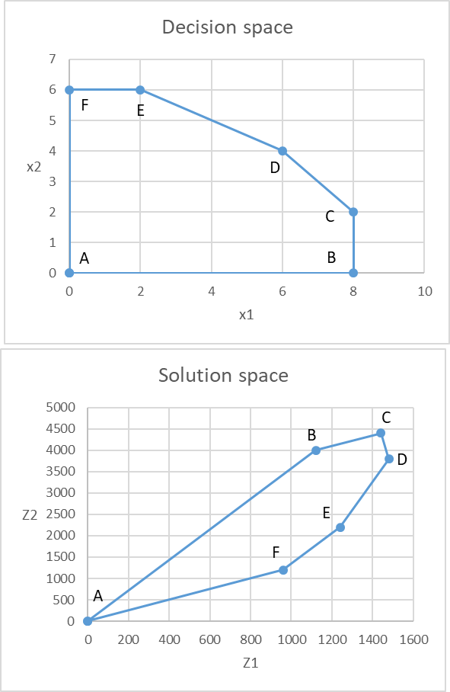
MOLP
Nondominated concept (Pareto front)
 | x1 | x2 | Max Z1 | Min Z2
A | 0 | 0 | 0 | 0
B | 8 | 0 | 1120 | 4000
C | 8 | 2 | 1440 | 4400
D | 6 | 4 | 1480 | 3800
E | 2 | 6 | 1240 | 2200
F | 0 | 6 | 960 | 1200
D is optimal for Z1
A is optimal for Z2
the optimal solution to each individual function is nondominated
- Is there any alternative that would always be preferred to B?
Yes! Both alternatives D and E perform better than B with respect to both objectives
- Is there any alternative that would always be preferred to C?
Yes! Alternative D performs better than C with respect to both objectives

Slide 76
MOLP
Nondominated concept (Pareto front)
 | x1 | x2 | Max Z1 | Min Z2
A | 0 | 0 | 0 | 0
B | 8 | 0 | 1120 | 4000
C | 8 | 2 | 1440 | 4400
D | 6 | 4 | 1480 | 3800
E | 2 | 6 | 1240 | 2200
F | 0 | 6 | 960 | 1200
B and C are dominated solutions
A, D E and F are nondominated
(Pareto front)
- Is there any alternative that would always be preferred to B?
Yes! Both alternatives D and E perform better than B with respect to both objectives
- Is there any alternative that would always be preferred to C?
Yes! Alternative D performs better than C with respect to both objectives

Slide 77
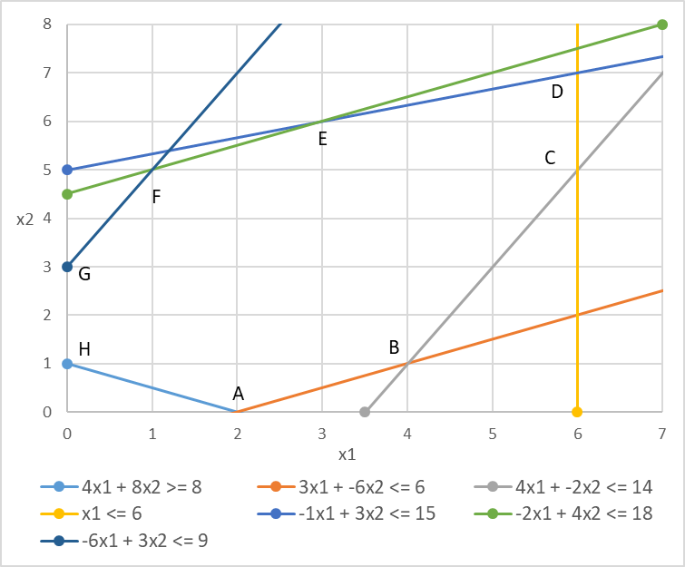
MOLP
Example
Take the following MOLP problem:
  Max Z₁ = 3 x₁ - 2 x₂
  Max Z₂ = - x₁ + 2 x₂
Subject to the following constraints:
  4 x₁ + 8 x₂ ≥ 8
  3 x₁ – 6 x₂ ≤ 6
  4 x₁ - 2 x₂ ≤ 14
  1 x₁ ≤ 6
  -1 x₁ + 3 x₂ ≤ 15
  -2 x₁ + 4 x₂ ≤ 18
  -6 x₁ + 3 x₂ ≤ 9
  x₁ , x₂ ≥ 0

Slide 78
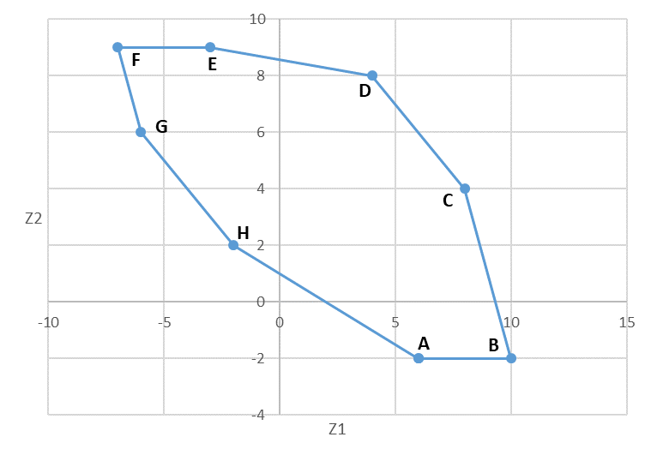
MOLP - Determining the nondominated set graphically
In which direction do I max both Z1 and Z2?
Example
There is a correspondence between the decision space (x1,x2) and the solutions space (Z1, Z2)
 | x1 | x2 | z1 | z2
A | 2 | 0 | 6 | -2
B | 4 | 1 | 10 | -2
C | 6 | 5 | 8 | 4
D | 6 | 7 | 4 | 8
E | 3 | 6 | -3 | 9
F | 1 | 5 | -7 | 9
G | 0 | 3 | -6 | 6
H | 0 | 1 | -2 | 2

Slide 79
MOLP - Determining the nondominated set graphically
Nondominated solutions (Pareto front)
Example
There is a correspondence between the decision space (x1,x2) and the solutions space (Z1, Z2)
 | x1 | x2 | z1 | z2
A | 2 | 0 | 6 | -2
B | 4 | 1 | 10 | -2
C | 6 | 5 | 8 | 4
D | 6 | 7 | 4 | 8
E | 3 | 6 | -3 | 9
F | 1 | 5 | -7 | 9
G | 0 | 3 | -6 | 6
H | 0 | 1 | -2 | 2

Slide 80
MOLP - Determining the nondominated set graphically
In which direction would I min both Z1 and Z2?
Example
There is a correspondence between the decision space (x1,x2) and the solutions space (Z1, Z2)
 | x1 | x2 | z1 | z2
A | 2 | 0 | 6 | -2
B | 4 | 1 | 10 | -2
C | 6 | 5 | 8 | 4
D | 6 | 7 | 4 | 8
E | 3 | 6 | -3 | 9
F | 1 | 5 | -7 | 9
G | 0 | 3 | -6 | 6
H | 0 | 1 | -2 | 2

Slide 81
MOLP - Determining the nondominated set graphically
In which direction would I min Z1 and max Z2?
Example
There is a correspondence between the decision space (x1,x2) and the solutions space (Z1, Z2)
 | x1 | x2 | z1 | z2
A | 2 | 0 | 6 | -2
B | 4 | 1 | 10 | -2
C | 6 | 5 | 8 | 4
D | 6 | 7 | 4 | 8
E | 3 | 6 | -3 | 9
F | 1 | 5 | -7 | 9
G | 0 | 3 | -6 | 6
H | 0 | 1 | -2 | 2

Slide 82
MOLP – Methods for generating the nondominated set
Example
Several generating techniques have been developed:
  Weighting method
  Constraint method
Both rely on the repeated solution of p LP
(oldest & most used)

Slide 83
MOLP – Weighting method for generating the nondominated set
Example
A minimization objective function can be converted to maximization by multiplying it by (-1)
Back to the previous example:
  Max Z₁ = 3 x₁ - 2 x₂
  Max Z₂ = - x₁ + 2 x₂
Solve it for Z₁ and for Z₂ independently. This is equivalent to solving:
  Max Z_{g} = w₁ Z₁ + w₂ Z₂ with w₂ = 0
  Max Z_{g} = w₁ Z₁ + w₂ Z₂ with w₁ = 0, respectively
The relative weights of these objective functions are what is important, not their specific values
It is not necessary that weights sum 1, but is common practice
The number of weights combinations increases with the increase in the number of objective functions
Several generating techniques have been developed:
  Weighting method
  Constraint method
Both rely on the repeated solution of p LP
Combine all objective functions into a single objective function by multiplying each by a weight and adding them
  Max (Z₁ , Z₂ ,…, Z_{p})
  Max Z_{g} = w₁ Z₁ + w₂ Z₂ + … + w_{n} Z_{n}
Solve Z_{g} while systematically vary the weights covering the widest range of variation possible
(oldest & most used)

Slide 84
MOLP – Weighting method for generating the nondominated set
Example
Set up a solver and apply it to each of the Z_{g}_1 ,…, Z_{g}_11
Back to the previous example:
  Max Z₁ = 3 x₁ - 2 x₂
  Max Z₂ = - x₁ + 2 x₂
Record the solution (x₁, x₂) for each of the Z_{g}_i
Find the corresponding corner point
The segment linking the corner points will correspond to the nondominated set
  Max Z_{g} = w₁ Z₁ + w₂ Z₂ + … + w_{n} Z_{n}
For a step of 0.1:
 |  | W1 | W2 | Zg
 | Zg_1 | 1 | 0 | 3x₁- 2x₂
 | Zg_2 | 0.9 | 0.1 | 2.6x₁- 1.6x₂
 | Zg_3 | 0.8 | 0.2 | 2.2x₁- 1.2x₂
 | Zg_4 | 0.7 | 0.3 | 1.8x₁- 0.8x₂
 | Zg_5 | 0.6 | 0.4 | 1.4x₁- 0.4x₂
 | Zg_6 | 0.5 | 0.5 | 1x₁
 | Zg_7 | 0.4 | 0.6 | 0.6x₁+ 0.4x₂
 | Zg_8 | 0.3 | 0.7 | 0.2x₁ +0.8x₂
 | Zg_9 | 0.2 | 0.8 | -0.2x₁+1.2x₂
 | Zg_10 | 0.1 | 0.9 | -0.6x₁+1.6x₂
 | Zg_11 | 0 | 1 | - x₁ + 2 x₂
For each set of positive weights used in Z_{g}, the resulting solution will be a nondominated solution

Slide 85
Multi-objective linear programming
  MOLP – The constraint method

Slide 86
MOLP – the constraint method for generating the nondominated set
Alternative method to weighting sum:
  Solve all the objective functions in the MOLP individually
  Identify the optimal value of each one and build the pay-off table (indicates the range of values each objective function can have on the nondominated set)
  Pick one of these objective functions (arbitrarily) to be optimized and include the remaining objective functions in the constraint set adding a RHS coefficient to each one (e.g. Z₁)
  The RHS coefficient will range between the max and min values of the function as indicated in the payoff table (e.g. Z₂ moves to the constraint set, the RHS will vary between -2 and 9)

Slide 87
MOLP – the constraint method for generating the nondominated set
Take the original MOLP problem:
  Max Z₁ = 3 x₁ - 2 x₂
  Max Z₂ = - x₁ + 2 x₂
Subject to the following constraints:
  4 x₁ + 8 x₂ ≥ 8
  3 x₁ – 6 x₂ ≤ 6
  4 x₁ - 2 x₂ ≤ 14
  1 x₁ ≤ 6
  -1 x₁ + 3 x₂ ≤ 15
  -2 x₁ + 4 x₂ ≤ 18
  -6 x₁ + 3 x₂ ≤ 9
  x₁ , x₂ ≥ 0
Take the original MOLP problem:
  Max Z₁ = 3 x₁ - 2 x₂
  Max Z₂ = - x₁ + 2 x₂
Subject to the following constraints:
  4 x₁ + 8 x₂ ≥ 8
  3 x₁ – 6 x₂ ≤ 6
  4 x₁ - 2 x₂ ≤ 14
  1 x₁ ≤ 6
  -1 x₁ + 3 x₂ ≤ 15
  -2 x₁ + 4 x₂ ≤ 18
  -6 x₁ + 3 x₂ ≤ 9
  - x₁ + 2 x₂ ≥ Lk -2 ≤ Lk ≤ 9
  x₁ , x₂ ≥ 0
Solve the problem r times (e.g r = 5):
  Max Z₁ = 3 x₁ - 2 x₂
  Max Z₂ = - x₁ + 2 x₂
Subject to the following constraints:
  4 x₁ + 8 x₂ ≥ 8
  …
  - x₁ + 2 x₂ ≥ Lk -2 ≤ Lk ≤ 9
  x₁ , x₂ ≥ 0
  L_{k} = L_{min} + ( t/(r-1) ) * (L_{max} – L_{min})
  t= 0,1,2,…(r-1)
  L₁ = -2 + ( 0/(4) ) * (9+2) = -2
  L₂ = -2 + ( 1/(4) ) * (9+2) = 0.75
  …
  L₅ = -2 + ( 4/(4) ) * (9+2) = 9

Slide 88
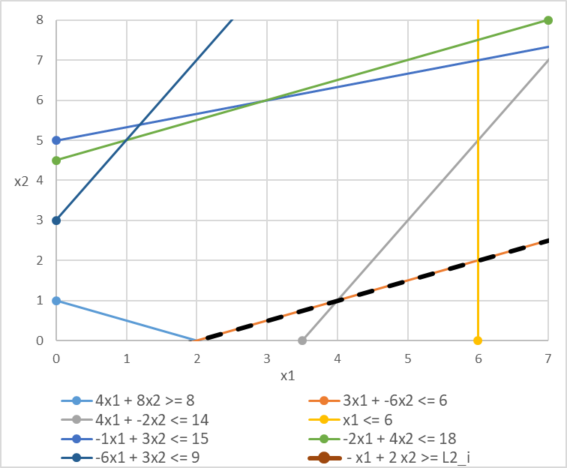
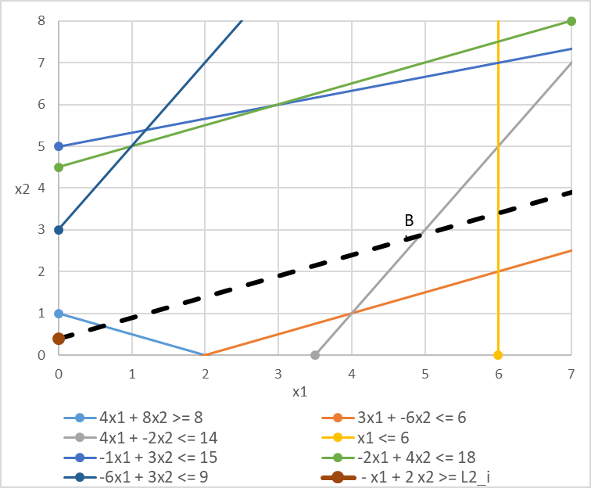
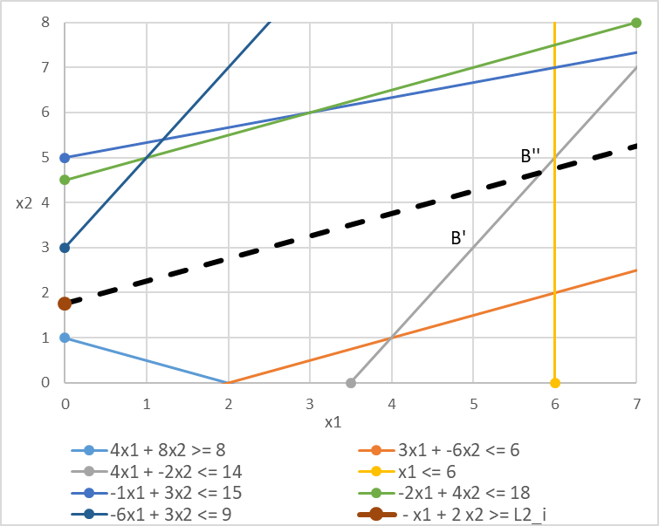
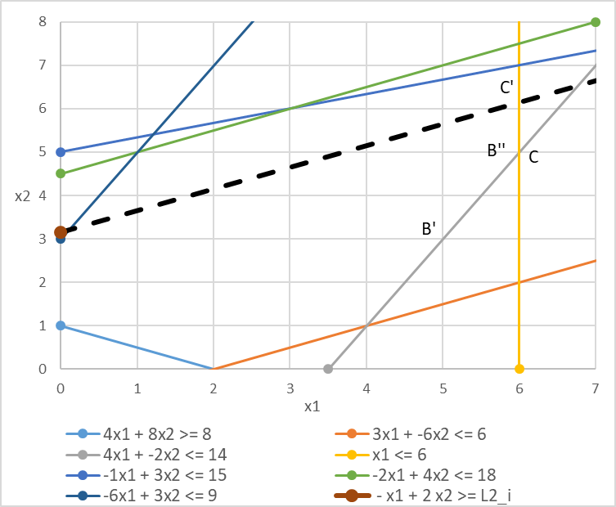
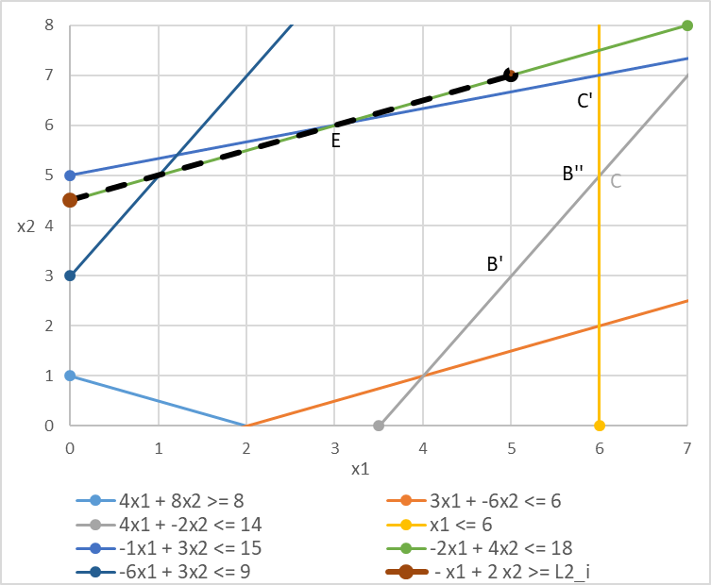
MOLP – the constraint method for generating the nondominated set
K = 1
D
K= 2
D
K= 3
D
It is a good method for screening nondominated solutions in particular regions of the objective space that are more important to the decision maker!
E
E
E
C
C
C
B’
B
K = 4
D
K = 5
D
E
Binding constraints
C
C
B
B
The method allows to determine an approximation to the nondominated set, but it misses solutions C and D. However there is more detail found between points B and C

