Slide 1
Multiple Objective Linear Programming
Decision Analysis and Optimization
Susana Barreiro
28 April 2021

Slide 2
Content
Single- versus multi-objective problems
Decision making and multiple objectives
Multi-objective linear programming
  Goal programming
  Classical methods - conversion to single objective problems
    - Preemptive optimization
    - Weighted sums
  True multi-objective linear programming
    - The optimality and the Pareto frontier concepts
    - Weighted sums
    - Evolutionary Multi-objective Optimization (EMO) Algorithms

Slide 3
Single- versus multi-objective problems

Slide 4
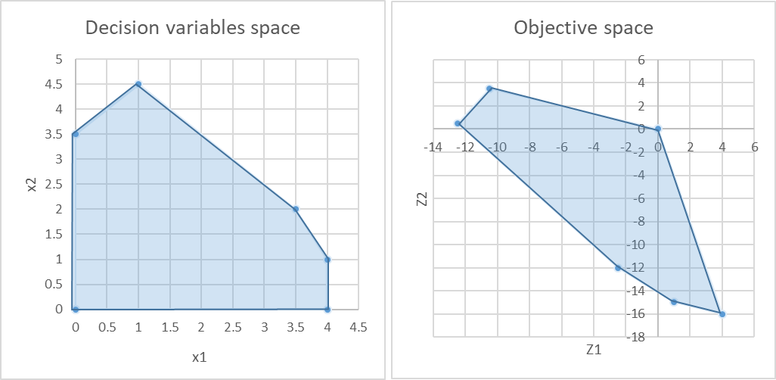
Multi-objective Linear problems
Single-objective problems
The goal is to find the (single) feasible solution that optimizes the objective function ( max Z₁ = x₁ – 3x₂ )
Even when alternative solutions exist, these provide the same objective function value
C
B
D
E
A
F

Slide 5
Multi-objective Linear problems
In many situations more than one objective is generally important
Multi-objective programming deals with:
  optimization problems with 2 or more objective functions
  problem formulation differs in the expression of the objective function(s)
  the evaluation of solutions is significantly different: instead of seeking an optimal or best overall solution, the goal is to quantify the degree of conflict (trade-off)
Several optimization techniques have been developed to capture explicitly the trade-offs that may exist between conflicting, and possibly noncommensurate, objectives

Slide 6
Multi-objective Linear problems
Multi-objective problems
we have a set of solutions reflecting different amounts of satisfaction of two different objectives (Z₁ and Z₂)
Brings us to the discussion of decision making
B
C
A
D
E
F

Slide 7
Multi-objective Linear problems
For conflicting objectives the optimality concept may be inappropriate
So, what does optimal mean in this case?
A new concept that can measure solutions against multiple, conflicting and even noncommensurate objectives is required: the non-inferiority concept
Dominance (mathematical programmers), Efficiency (statisticians and economists)
Pareto optimality (welfare economists)
A solution is non-inferior if there exists no other feasible solution with better performance with respect to any objective without having worse performance for at least one other objective

Slide 8
Multi-objective Linear problems
Multi-objective problems
we seek to find the set of solutions for which we can demonstrate that no better solution exists
This set of solutions is referred to as non-inferior or non-dominated solutions
Efficient frontier or Pareto Front
B
C
A
D
E
F

Slide 9
Multi-objective Linear problems
Multi-objective problems
Efficient frontier or Pareto Front
Classical approaches for generating the Pareto Front
  Convert to single objective problem, which delivers one efficient point in the Pareto front (one optimal solution)
  run it several times
B
C
A
D
E
F

Slide 10
Decision making and multiple objectives

Slide 11

Multiple Objective Decision Analysis
Decision Making
Takes place under multiple criteria. All the rest is: analysis, measurement and search.
Measurement and search is sufficient for finding the heaviest apple.
This is not a problem of decision making or optimization, but merely a technical challenge.
No value judgments, no trade-offs and no decisions go into single-criterion problems
Consider a basket of apples, and that weight is our single criterion. How do we proceed to find (identify, choose, select) the heaviest apple?
    We measure all apples, then we search the one with the highest weight

Slide 12


Multiple Objective Decision Analysis
Decision Making
Takes place under multiple criteria. All the rest is: analysis, measurement and search.
But this time, the function of measurement and search is not sufficient.
We have two different apples and our criteria are ‘conflicting’
Which apple do we choose?
Now, we must go beyond measurement and search and decide
Consider the same basket of apples, but now we wish to find the heaviest and the sweetest apple. Our criteria are now: weight and sweetness.
We use the same procedures of measurement and search and identify the heaviest (as before) and then the sweetest apple.

Slide 13
Multiple Objective Decision Analysis
Decision Making
Takes place under multiple criteria. But are all multiple criteria decision problems?
This particular apple would be preferred by all decision makers aiming to maximize both criteria.
Measurement and search would safely identify such an apple making it sufficient even under multiple criteria
Suppose we could look outside the basket and add an additional apple
And that this is both the heaviest and the sweetest in the basket.

Slide 14
Multiple Objective Decision Analysis
Decision Making
Thinking “outside the basket” is the key to effective Decision Making.
Decision making: is a function beyond measurement and search, aimed at managing, resolving or dissolving the conflict of trade-offs.
In this basket there are no trade-offs
we have an “ideal” apple dominating the entire basket - an obvious choice of every rational decision maker

Slide 15
Multiple Objective Decision Analysis
Decision Making Challenges
Existence of multiple conflicting objectives (e.g. car: comfort vs price; house: square footage vs price)
Difficulty in identifying good alternatives (e.g. firing one-third of your employees, reducing everyone’s pay)
Existence of intangibles ie, difficult-to-measure (e.g. consumer satisfaction, employee morale, recreation value)
Existence Long time horizons where the consequences of decisions that must be made today, will not be known for years/decades (e.g forest management and planning)
Interdisciplinary substance of decisions and/or having multiple decision makers require information from several “areas of expertise”, (e.g. forest owners, forest managers, public laws, funding schemes)
Uncertainty and risk: not being able to precisely predict the future raises questions (one can try to use historical data, expert judgments, simulations to deal with uncertainty and risk)
Being able to quantify trade-offs: expressing the value trade-offs among the multiple objectives

Slide 16
Multiple Objective Decision Analysis
Multiple Objective Decision Analysis (MODA) is an operations research technique for evaluating a decision under multiple, sometimes competing and conflicting objectives or criteria.
Multi-objective optimization leads to a set of optimal solutions (known as Pareto-optimal solutions) since no solution can be considered better than any other regarding all the objectives
MODA provides a process that systematically identifies alternatives and the decision maker’s objectives that serves as the measuring device for selecting the preferred alternative given the decision space.
Decision makers try to balance multiple objectives (e.g., cost, performance, reliability) none of which is obviously the best

Slide 17
Multiple Objective Decision Analysis
Decision Making
Its quality depends on:
  the quality of the underlying process (but not the inverse)
  the problem formulation
  the quality and nature of available decision alternatives (it is the configuration of the feasible set of available alternatives
Decision maker must choose from a set of alternative solutions
Analyst
must describe as accurate as possible the range of choices and the trade-offs among objectives

Slide 18
Multi-objective linear programming
  Goal programming
  Classical methods - conversion to single objective problems
  True multi-objective linear programming

Slide 19
Multi-objective linear problems
Multi-objective optimization problems with a number of equality and inequality constraints can be formulated as:
Minimize / Maximize f_{i} (x) i = 1,…, N_{obj} – number of objective functions
Subject to:
a set of constraints
To simplify the solution process, in optimization problems with a number of objective functions, additional objective functions are usually handled as constraints
HOWEVER, the final solutions can be satisfying those constraints they cannot be called optimal with respect to all the objective functions.

Slide 20
Multi-objective linear problems
Goal programming
Example:
Define target levels of each objective rather than max or min the objective functions
  Suppose the goal for obj i is gi:
  obj₁ > g₁ ; obj₂ > g_{2 ; …;} obj_{n} > g_{n}
  These goals are treated as soft constraints (ie these can be violated)
  Obj = min (w₁ |obj₁ - g₁|+ w₂ |obj₂ - g₂|+ … + w_{n} |obj_{n} - g_{n}|
  Maybe we can’t satisfy all goals, but we want to capture how much we can satisfy (find the deviations). The optimal solution to this problem is not necessarily an efficient point in the original model
max Z₁ = x₁
max Z₂ = -4x₁ + x₂
x₁ > g₁
-4x₁ + x₂ < g₂
To find the deviations, which can be + or -, we use:
  y₁ = y₁⁺ - y₁⁻
  y₂ = y₂⁺ - y₂⁻
  where y_{i}⁺ ≥ 0, y_{i}⁻ ≥ 0
Y₁ = x₁ - g₁
Y₂ = -4x₁ + x₂ - g₂
x₁ - (y₁⁺ - y₁⁻) = g₁
-4x₁ + x₂ - (y₂⁺ - y₂⁻) = g₂
Set penalty weights for missing the goals. Assume 5 for falling under g₁ and 2 for falling above g₂
min Z₃ = 5 y₁⁻ + 2 y₂⁺

Slide 21
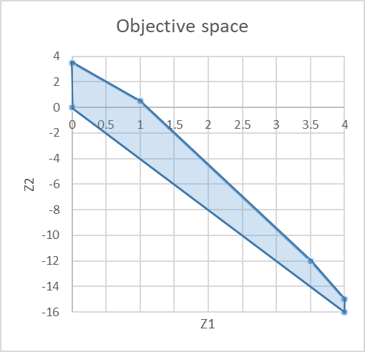
Multi-objective linear problems
Preemptive Optimization
Example:
Perform optimization by considering one objective at a time, based on priorities:
STAGE1:
  optimize the 1st objective (most important)
  obtain an optimal solution
  transform this objective into a constraint
STAGE2:
  optimize the 2nd objective (2nd most important)
  obtain an optimal solution
  …continue until all objectives have been considered
If an optimal solution is obtained at each stage => the final solution is an efficient point of the original multi-objective model
max Z₁ = x₁
max Z₂ = -4x₁ + x₂
B
C
A
D
E
F

Slide 22
Multi-objective linear problems
Preemptive Optimization
Example:
Perform optimization by considering one objective at a time, based on priorities:
STAGE1:
  Assume Z₁ is 1st priority
  obtain an optimal solution (all points along the segment)
  transform this objective into a constraint
STAGE2:
  optimize Z₂ (2nd priority)
  Add x₁ = 4 as constraint
  obtain an optimal solution: (4, -15)
  …continue until all objectives have been considered
If an optimal solution is obtained at each stage => the final solution is an efficient point of the original multi-objective model
max Z₁ = x₁
max Z₂ = -4x₁ + x₂
B
C
A
C
B
D
D
E
E
A
F
F

Slide 23
Multi-objective linear problems
Weighted Sum
Example:
Convert multiple objectives into one single objective using weights and summation:
  Determine the importance of each objective function assigning it a weight (w)
  Add up all functions:
  min Z = ( w₁ z₁ + w₂ z₂ +…+ w_{n} z_{n} )
An optimal solution to this problem is the final solution is an efficient point of the original multi-objective model
max Z₁ = x₁
max Z₂ = -4x₁ + x₂
B
C
A
D
E
F

Slide 24
Multi-objective linear problems
Weighted Sum
Example:
Convert multiple objectives into one single objective using weights and summation:
  Assume z₁ is 3 times as important as z₂ (W₁ = 3, W₂ = 1)
  Add up all functions:
  max Z₃ = ( 3x₁ - 4x₁ + x₂ )
  = ( -x₁ + x₂ )
  Optimal solution for the weighted sum 3 Z₁ + Z₂ are the points along the segment BC
max Z₁ = x₁
max Z₂ = -4x₁ + x₂
B
C
A
C
B
D
D
E
E
A
F
F

Slide 25
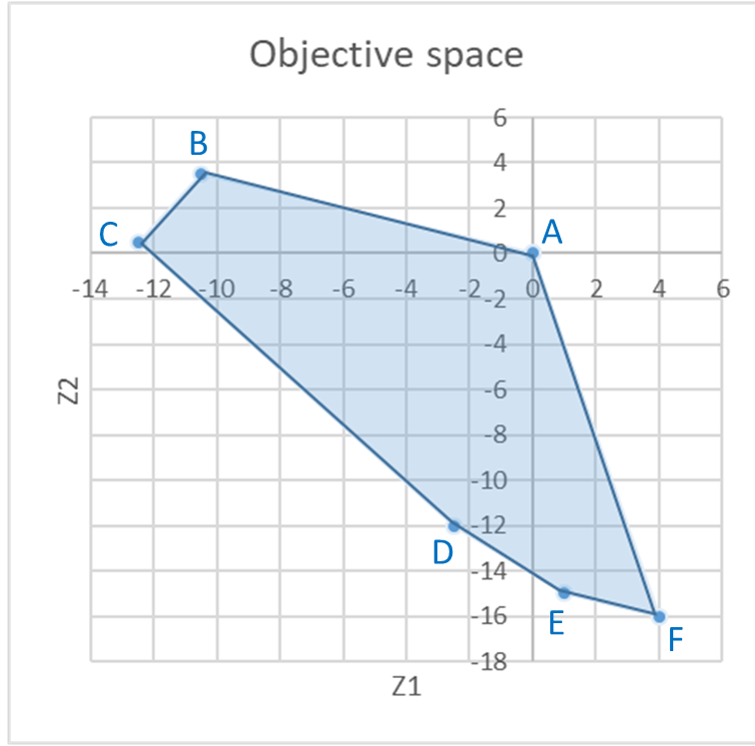
Multi-objective linear problems
Classical approaches (most common is weighted sum)
Estimate relative importance vector
w₁, w₂, …, w_{n}
Single objective optimization problem
Min Z = w₁ f₁ + w₂ f₂ + …+ w_{n} f_{n}
s.t.: constraints
Multi-objective
min f₁, f₂, …, f_{n}
s.t.: constraints
High Level info
Decision making phase
Single objective optimizer
(Simplex, solver, etc)
Optimization phase
For a 2 objectives problem Min Z = w₁ f₁ + w₂ f₂ the slope of this line (-w₁/w₂) (parameterized approach W_{i} as the parameters)
By varying the weights we can move along the objective space from one optimization to the next (generating different points along the Pareto front)
However,
    1) doesn't return an optimal solution
    2) requires the weights
    3)may lead to non-uniform Pareto optimal solutions

Slide 26
Multi-objective Linear problems
Difficulties with the most classical approaches
Need to run single optimization many times to build the Pareto front
Expect a lot of problem knowledge (convex or not)
  - Can’t guarantee that we’ll get all the points in the convex region
  - How to assign weights? What weights to assign?
Aggravated for complex problems (many objective functions and several variables)

Slide 27
Multi-objective linear problems
Ideal approach
Multi-objective
min f₁, f₂, …, f_{n}
s.t.: constraints
Ideal multi- objective optimizer
Multiple tradeoff solutions found
High Level info
Optimization phase
Decision making phase
STEP1:
  find a set of Pareto optimal solutions
STEP2:
  choose 1 from the set of optimal solution (unlike classical methods where we first decide unaware of the solutions)
Choose 1 solution

Slide 28
Multi-objective linear problems
Evolutionary Multi-objective Methodologies
These are no single approaches, but POPULATION APPROACHES, allowing finding several solutions simultaneously and permitting a faster search
Non-Pareto techniques
  Approaches that do not incorporate directly the concept of Pareto-optimum
  Unable to reproduce certain portions of the Pareto front
  Efficient and easy to implement, but appropriate to handle only a few objectives
Pareto techniques
  Use of non-dominanted ranking and selection to move the population towards the Pareto front
  Require a ranking procedure and a technique to maintain diversity in the population

Slide 29
Multi-objective linear programming
  Goal programming

Slide 30
MOLP - Goal Programming
We have assumed so far that linear programming encompasses a single overriding objective (e.g. maximizing total profit / minimizing total cost).
Most times this is not realistic since we frequently focus on a variety of objectives, e.g. forest management:
    to maintain stable profit,
    increase wood production,
    diversify ecosystem services,
    restrain the impact of pests /diseases,
    minimize erosion,
    …
Goal programming provides a way of achieving several objectives simultaneously.
representing some goals by constraints in effect gives them
priority over the goal reflected in the objective function, because the objective function is optimized within the feasible region defined by the constraints

Slide 31
MOLP - Goal Programming
Representing some goals by constraints in effect gives them priority over the goal reflected in the objective function, because the objective function is optimized within the feasible region defined by the constraints
Deciding which goal should be selected as the objective function and which ones should be reflected by constraints is often arbitrary and difficult
Goal programming attempts to overcome these limitations still while using linear programming, striving toward selected objectives simultaneously, treating them all in the same manner, although perhaps giving them different weights.

Slide 32
MOLP - Goal Programming
We have assumed so far that linear programming encompasses a single overriding objective (e.g. maximizing total profit / minimizing total cost).
Most times this is not realistic since we frequently focus on a variety of objectives, e.g. forest management:
    to maintain stable profit,
    increase wood production,
    diversify ecosystem services,
    restrain the impact of pests /diseases,
    minimize erosion,
    …
Goal programming provides a way of achieving several objectives simultaneously.

Slide 33
MOLP - Goal Programming
Capacity limits we cannot change (e.g. number of seats on a flight) or we do not want to change
Linear programming
  Most LP problems have hard constraints that cannot be violated:
Goal programming
  GP problems have soft constraints that represent goals or targets we want to achieve
  Constraints are very important because they refer to the amount of resources / capacity limits we face
  First, we look at our limitations;
  Then, we think of an optimization model
Max: Z = 90 x₁ + 120 x₂
Subject to:
x₁ ≤ 40
x₂ ≤ 50
2x₁ + 3x₂ ≤ 180
and x₁ ≥ 0; x₂ ≥ 0
(ha of pine)
(ha of eucalypt)
(days of work)

Slide 34
MOLP - Goal Programming
Linear programming
  Most LP problems have hard constraints that cannot be violated:
Goal programming
  GP problems have soft constraints that represent goals or targets we want to achieve
  Suppose we look back to the Poets problem again and he says that he reconsidered and would be:
  “… willing to give an extra 250 days of work if needed… preferred having 40 and 50 ha of pine and eucalypt but he would be flexible ”
  The “days of work” would no longer be a hard constraint
Max: Z = 90 x₁ + 120 x₂
Subject to:
x₁ ≤ 40
x₂ ≤ 50
2x₁ + 3x₂ ≤ 180
and x₁ ≥ 0; x₂ ≥ 0
(ha of pine)
(ha of eucalypt)
(days of work)

Slide 35
MOLP - Goal Programming
The basic approach of goal programming is to:
  establish a specific numeric goal for each of the objectives
  formulate an objective function for each objective
  seek a solution that minimizes the (weighted) sum of deviations of these objective functions from their respective goals

Slide 36
MOLP - Goal Programming
There are three possible types of goals:
  A lower, one-sided goal sets a lower limit that we do not want to fall under (but exceeding the limit is fine).
  An upper, one-sided goal sets an upper limit that we do not want to exceed (but falling under the limit is fine).
  A two-sided goal sets a specific target that we do not want to miss on either side.

Slide 37
MOLP - Goal Programming
Goal programming problems can be categorized according to the type of mathematical programming model that it fits except for having multiple goals instead of a single objective:
  linear programming,
  integer programming,
  nonlinear programming,
  etc
In class, we ill only consider linear goal programming—those goal programming problems that fit linear programming, but I’ll refer to it just as goal programming

Slide 38
MOLP - Goal Programming
Goal programming problems can also be categorized according to how the goals compare in importance:
  nonpreemptive goal programming – if all the goals are of roughly comparable in importance
  preemptive goal programming – if there is a hierarchy of priority levels for the goals, so that the goals of primary importance receive first priority attention, those of secondary importance receive second-priority attention, and so forth (if there are more than two priority levels).

Slide 39
MOLP - Goal Programming
The OR department of the DEWRIGHT COMPANY has been assigned the task of determining which mix of products should be produced.
Management wants primary consideration given to the following three goals:
  (1) achieving a long-run profit (NPV) of at least $125 million from these products
  (2) maintaining the current employment level of 4,000 employees,
  (3) holding the capital investment to less than $55 million.

Slide 40
MOLP - Goal Programming
However, it probably will not be possible to attain all these goals simultaneously, priorities have been discussed leading to setting a penalty weight:
  5 for missing the profit goal (per $1 million under),
  2 for going over the employment goal (per 100 employees) and 4 for going under this same goal
  3 for exceeding the capital investment goal (per $1 million over)
Each new product’s contribution to profit, employment level, and capital investment level is proportional to the rate of production.

Slide 41
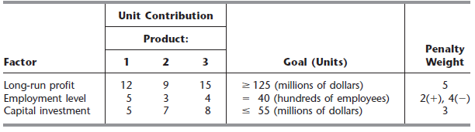
MOLP - Goal Programming
These contributions per unit rate of production are shown in the table along with the goals and penalty weights.

Slide 42
MOLP - Goal Programming
Goal Programming Formulation: The Dewright Company problem includes all three possible types of goals:
  profit goal is a lower one-sided goal: 12x₁ + 9x₂ + 15x₃ ≥ 125
  employment goal is a two-sided goal: 5x₁ + 3x₂ + 4x₃ = 40
  investment goal is an upper one-sided goal: 5x₁ + 7x₂ + 8x₃ ≤ 55
Where x₁, x₂, x₃ are the decision variables representing the production rates of products 1, 2, and 3, respectively and x₁, x₂, x₃ ≥ 0

Slide 43
MOLP - Goal Programming
Linear Programming Formulation: Transform goals into constraints
Subject to:
  12x₁ + 9x₂ + 15x₃ ≥ 125
  5x₁ + 3x₂ + 4x₃ = 40
  5x₁ + 7x₂ + 8x₃ ≤ 55
Objective function:
The objective then is to choose the values of x₁, x₂, and x₃ that minimize
  Z = 5(amount under the long-run profit goal)
  + 2(amount over the employment level goal)
  + 4(amount under the employment level goal)
  + 3(amount over the capital investment goal)
Maybe we can’t satisfy all goals, but we want to capture how much we can satisfy (find the deviations)
where no penalties are incurred for being over the long-run profit goal or for being under the capital investment goal

Slide 44
MOLP - Goal Programming
Linear Programming Formulation:
To express this mathematically, we introduce some auxiliary variables y₁, y₂, and y₃, to represent the deviations defined as follows:
  y₁ = 12x₁ + 9x₂ + 15x₃ - 125 (long-run profit minus the target)
  y₂ = 5x₁ + 3x₂ + 4x₃ - 40 (employment level minus the target)
  y₃ = 5x₁ + 7x₂ + 8x₃ - 55 (capital investment minus the target)
Since each y_{i} can be either positive or negative, and replace each one by the difference of two nonnegative variables:
  y₁ = y₁⁺ - y₁⁻, where y₁⁺ ≥ 0, y₁⁻ ≥ 0
  y₂ = y₂⁺ - y₂⁻, where y₂⁺ ≥ 0, y₂⁻ ≥ 0
  y₃ = y₃⁺ - y₃⁻, where y₃⁺ ≥ 0, y₃⁻ ≥ 0
y_{i}⁺ represents the positive part of y_{i} variable (positive deviation)
y_{i}⁻ represents the negative part of y_{i} variable (negative deviation)

Slide 45
MOLP - Goal Programming
Linear Programming Formulation:
Subject to:
  12x₁ + 9x₂ + 15x₃ ≥ 125
  5x₁ + 3x₂ + 4x₃ = 40
  5x₁ + 7x₂ + 8x₃ ≤ 55
Let us build the objective function:
  Min Z = 5y₁⁻ + 2 y₂⁺ + 4 y₂⁻ + 3 y₃⁺
Because there is no penalty for exceeding the profit goal of 125 or being under the investment goal of 55, neither y₁⁺ nor y₃⁻ should appear in this objective function representing the total penalty for deviations from the goals.
If we’re above 125, we have a positive deviation y₁⁺, but it’s according to the goal, so there is no problem. However, we don’t want to have a negative deviation, so we penalize y₁⁻
125
y₁⁺
y₁⁻

Slide 46
MOLP - Goal Programming
Linear Programming Formulation:
Subject to:
  12x₁ + 9x₂ + 15x₃ ≥ 125
  5x₁ + 3x₂ + 4x₃ = 40
  5x₁ + 7x₂ + 8x₃ ≤ 55
Let us build the objective function:
  Min Z = 5y₁⁻ + 2 y₂⁺ + 4 y₂⁻ + 3 y₃⁺
Because there is no penalty for exceeding the profit goal of 125 or being under the investment goal of 55, neither y₁⁺ nor y₃⁻ should appear in this objective function representing the total penalty for deviations from the goals.
We don’t care if we meet exactly the goal of 40 (=40), but we don’t want to be above or below 40 (having positive or negative deviations, respectively), thus we penalize y₂⁺ both y₂⁻
40
y₂⁺
y₂⁻

Slide 47
MOLP - Goal Programming
Linear Programming Formulation:
Subject to:
  12x₁ + 9x₂ + 15x₃ ≥ 125
  5x₁ + 3x₂ + 4x₃ = 40
  5x₁ + 7x₂ + 8x₃ ≤ 55
Let us build the objective function:
  Min Z = 5y₁⁻ + 2 y₂⁺ + 4 y₂⁻ + 3 y₃⁺
Because there is no penalty for exceeding the profit goal of 125 or being under the investment goal of 55, neither y₁⁺ nor y₃⁻ should appear in this objective function representing the total penalty for deviations from the goals.
We don’t care if we’re below 55, but we don’t want to be above (having positive deviation), thus we penalize y₃⁺
55
y₃⁺
y₃⁻

Slide 48
MOLP - Goal Programming
Linear Programming Formulation:
Finally, we must incorporate the above definitions of the y_{i}⁺ and y_{i}⁻ directly into the model, because the simplex method considers only the objective function and constraints that constitute the model.
Since y₁⁺ - y₁⁻ = y₁, the expression for y₁ is
12x₁ + 9x₂ + 15x₃ - 125 = y₁⁺ - y₁⁻
12x₁ + 9x₂ + 15x₃ - (y₁⁺ - y₁⁻) = 125
Now we have an equality constraint for the linear programming model.

Slide 49
MOLP - Goal Programming
Linear Programming Formulation:
Proceeding in the same way for y₂⁺ - y₂⁻ and y₃⁺ - y₃⁻, we obtain the following formulation for this goal programming problem
Objective function:
Min Z = 5y₁⁻ + 2 y₂⁺ + 4 y₂⁻ + 3 y₃⁺
Subject to:
  12x₁ + 9x₂ + 15x₃ - (y₁⁺ - y₁⁻) = 125
  5x₁ + 3x₂ + 4x₃ - (y₂⁺ - y₂⁻) = 40
  5x₁ + 7x₂ + 8x₃ -(y₃⁺ - y₃⁻) = 55
  x₁ , x₂ , x₃ , y₁⁺, y₁⁻, y₂⁺, y₂⁻ , y₃⁺ , y₃⁻ ≥ 0

Slide 50
MOLP - Goal Programming
Excel Solver:
Applying the simplex method to this formulation yields an optimal solution with:
x₁ = 23/5 , x₂ = 0, x₃ = 5/3
y₁⁺= 0 , y₁⁻= 0, y₂⁺= 23/5, y₂⁻= 0, y₃⁺= 0, y₃⁻ = 0
Therefore, y₁ = 0, y₂ = 23/5 , and y₃ = 0, so the first and third goals are fully satisfied, but the employment level goal of 40 is exceeded by 8 1/3 (833 employees). The resulting penalty for deviating from the goals is Z = 16 2/3.

Slide 51
MOLP - Goal Programming
Excel Solver:

Slide 52
MOLP - Goal Programming
Deviations below the goal
Excel Solver:

Slide 53
MOLP - Goal Programming
Deviations above the goal
Excel Solver:

Slide 54
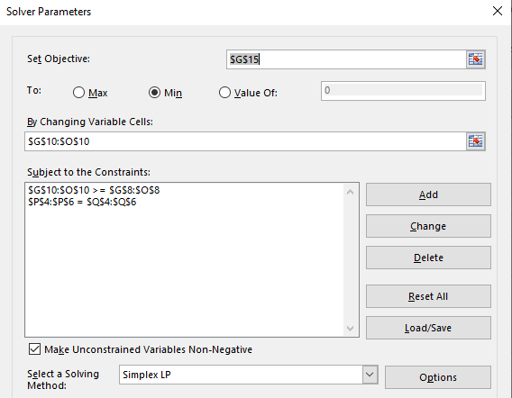
MOLP - Goal Programming
Excel Solver:

Slide 55
MOLP - Goal Programming
Excel Solver:

Slide 56
MOLP - Goal Programming
Excel Solver:

Slide 57
MOLP - Goal Programming
Excel Solver:

Slide 58
MOLP - Goal Programming
Excel Solver:

Slide 59
MOLP - Goal Programming
Excel Solver:
This means we’re 8.33 above the employment goal of 40 hundred (833 employees)

Slide 60
MOLP - Goal Programming
Excel Solver:
This means the best way to achieve the goals given these penalties is not producing product X₂

Slide 61
MOLP - Goal Programming
Exercise 1:
A project manager wants to find the quantities of 3 products. Producing 1 unit of:
  product 1 requires 40 employees, 2 tons of raw material and will bring the company a profit of 5 hundred €
  product 2 requires 30 employees, 4 tons of raw material and will bring the company a profit of 8 hundred €
  product 3 requires 20 employees, 3 tons of raw material and will bring the company a profit of 4 hundred €
The manager has 3 goals:
  The maximum number of employees that can be allocated to producing these 3 products is 100 employees
  There are 10 tons of raw material in the warehouse and he wants to consume no more no less than that
  The total profit is expected to be at least 30 hundred €
The manager suspects he might not be able to meet these 3 goals simultaneously therefore he sets some penalty weights to each of the goals:
  Each extra employee is associated to a penalty of 5
  Each ton below the goal is associated to a penalty of 8 (-) whereas each ton above the goal of 10 is associated to a penalty of 12 (+)
  If profit is less than 30 hundred €, each hundred € is associated to a penalty of 15
Formulate the problem as a linear programming problem and use excel solver (LP simplex) to find the combination of the 3 products that minimizes the penalties.

Slide 62
MOLP - Goal Programming
Exercise 2:
Reconsider the original version of the Dewright Co. After further reflection about the solution obtained by the simplex method, management now is asking some what-if questions.
(a) Management wonders what would happen if the penalty weights in the rightmost column of Table 7.5 were to be changed to 7, 4, 1, and 3, respectively. Would you expect the optimal solution to change? Why?
(b) Management is wondering what would happen if the total profit goal were to be increased to wanting at least $140 million (without any change in the original penalty weights). Solve the revised model with this change.
(c) Solve the revised model if both changes are made.

Slide 63
MOLP - Goal Programming
Exercise 2:
New penalty weights of: 7, 4, 1, and 3, respectively.
profit goal were to be increased to wanting at least $140 million

Slide 65
Multi-objective linear programming
  Difficulties with the most classical approaches

Slide 66
Multiple Objective Decision Analysis
Single objective
Multi-objective
Selecting the eucalyptus clone with the highest volume production
Might lead to having:
  - Frost sensitiveness
  - Low re-sprouting ability
  - Medium fiber quality
  - Moderate resistance to defoliation
  - Production cost
We may want to optimize with the following objectives
  - Volume production
  - Frost resistance
  - Re-sprouting ability
  - Fiber quality
  Resistance to defoliation
  Production cost

Slide 67
Multiple Objective Decision Analysis
Single objective
Multi-objective
Selecting the eucalyptus clone with the highest volume production
Might lead to having:
  - Frost sensitiveness
  - Low re-sprouting ability
  - Medium fiber quality
  - Moderate resistance to defoliation
  - High production costs
We may want to optimize with the following objectives
  - Volume production (obj. 1)
  - Frost resistance (obj. 2)
  - Re-sprouting ability (obj. 3)
  - Fiber quality (obj. 4)
  Resistance to defoliation (obj. 5)
  Production cost (obj. 6)

Slide 68
Multiple Objective Decision Analysis
Multi-objective
Each solution will have 6 objective values indicating which
This poses several difficulties but the most significant is how do we decide if a solution is better than another?
We may want to optimize with the following objectives
  - Volume production (obj. 1)
  - Frost resistance (obj. 2)
  - Re-sprouting ability (obj. 3)
  - Fiber quality (obj. 4)
  Resistance to defoliation (obj. 5)
  Production cost (obj. 6)

Slide 69
Multiple Objective Decision Analysis - Optimization
How do we carry out multi-objective optimization for more than 2 variables?
We can use evolutionary optimization algorithms
  suitable to solve multi-objective optimization problems dealing with a set of possible solutions simultaneously.
  A single run enables finding several elements of the Pareto-optimal set
  Less susceptible to the shape or continuity of the Pareto-front dealing with discontinuous or concave Pareto fronts
There are non-Pareto and Pareto techniques for multi-objective optimization using evolutionary optimization (e.g. genetic algorithm, simulated annealing, PSO methods)

Slide 70
Multiple Objective Decision Analysis - Optimization
Assume we have a set of feasible solutions and different objective functions
The Pareto-improvement concept consists in moving from one feasible solution to another so that
  At least one objective function returns a better value
  And no other objective function becomes worse
When no further Pareto-improvement can be achieved the Pareto-optimal has been reached

Slide 71
Multiple Objective Decision Analysis
Single objective
Multi-objective
obj. - volume production
obj. 1 - volume production
obj. 2 - Frost resistance
Neither solution is better than the other

Slide 72
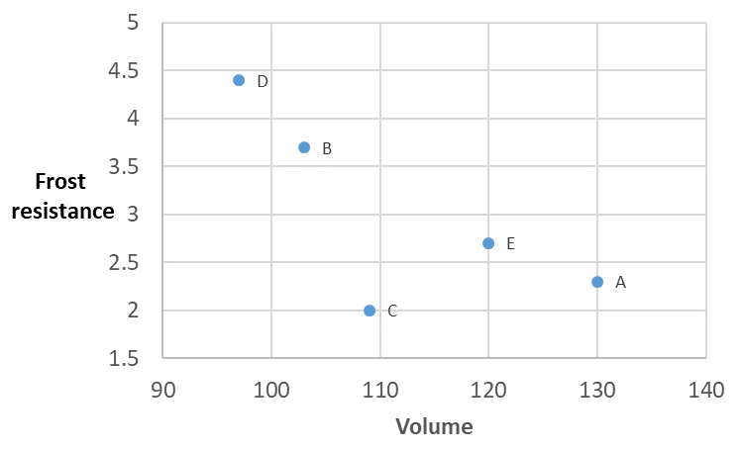
Multiple Objective Decision Analysis
Let us plot the objective space:
Multi-objective
obj. 1 - volume production
obj. 2 - Frost resistance
Neither solution is better than the other

Slide 73
Multiple Objective Decision Analysis
Let us plot the objective space:
Multi-objective
obj. 1 - volume production
obj. 2 - Frost resistance
Neither solution is better than the other

Slide 74
Multiple Objective Decision Analysis
Let us plot the objective space:
Multi-objective
obj. 1 - volume production
obj. 2 - Frost resistance
Space where all solutions are worse than solution D
Neither solution is better than the other

Slide 75
Multiple Objective Decision Analysis
Let us plot the objective space:
Multi-objective
obj. 1 - volume production
obj. 2 - Frost resistance
Space where all solutions are worse than solution B
Neither solution is better than the other

Slide 76
Multiple Objective Decision Analysis
Let us plot the objective space:
Multi-objective
obj. 1 - volume production
obj. 2 - Frost resistance
Space where all solutions are worse than solution E
We can get rid of solution C because it does not offer us anything solution E can not, thus we can say solution C is dominated by solution E
Neither solution is better than the other

Slide 77
Multiple Objective Decision Analysis
Let us plot the objective space:
Multi-objective
obj. 1 - volume production
obj. 2 - Frost resistance
Space where all solutions are worse than solution A
We can get rid of solution C because it does not offer us anything solution A can not, thus we can say solution C is dominated by solution A
Neither solution is better than the other

Slide 78
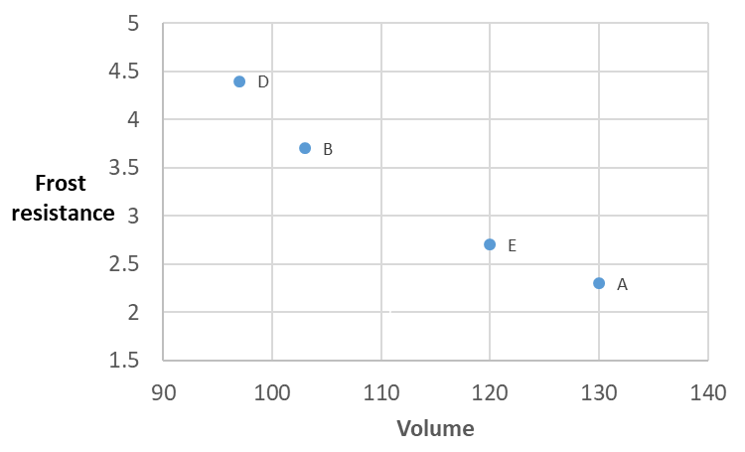
Multiple Objective Decision Analysis
Let us plot the objective space:
Multi-objective
After shading all the areas we can see that no solutions are inside the shaded area, thus all remaining solutions are non dominated
obj. 1 - volume production
obj. 2 - Frost resistance

Slide 79
Multiple Objective Decision Analysis
Let us plot the objective space:
Multi-objective
After shading all the areas we can see that no solutions are inside the shaded area, thus all remaining solutions are non dominated
obj. 1 - volume production
obj. 2 - Frost resistance
Because no solution dominates another, no solution is completely better than the other UNLESS we have some additional information about the decision makers preferences…
We may know he does not want frost resistance < 2.5
So, which of these solutions is the best?

Slide 80
Multiple Objective Decision Analysis
Let us plot the objective space:
Multi-objective
After shading all the areas we can see that no solutions are inside the shaded area, thus all remaining solutions are non dominated
Because no solution dominates another, no solution is completely better than the other UNLESS we have some additional information about the decision makers preferences…
We may know he does not want frost resistance < 2.5
There are several ways to reduce the number of solutions, but this still DOES NOT tell you which is best
So, which of these solutions is the best?

Slide 81
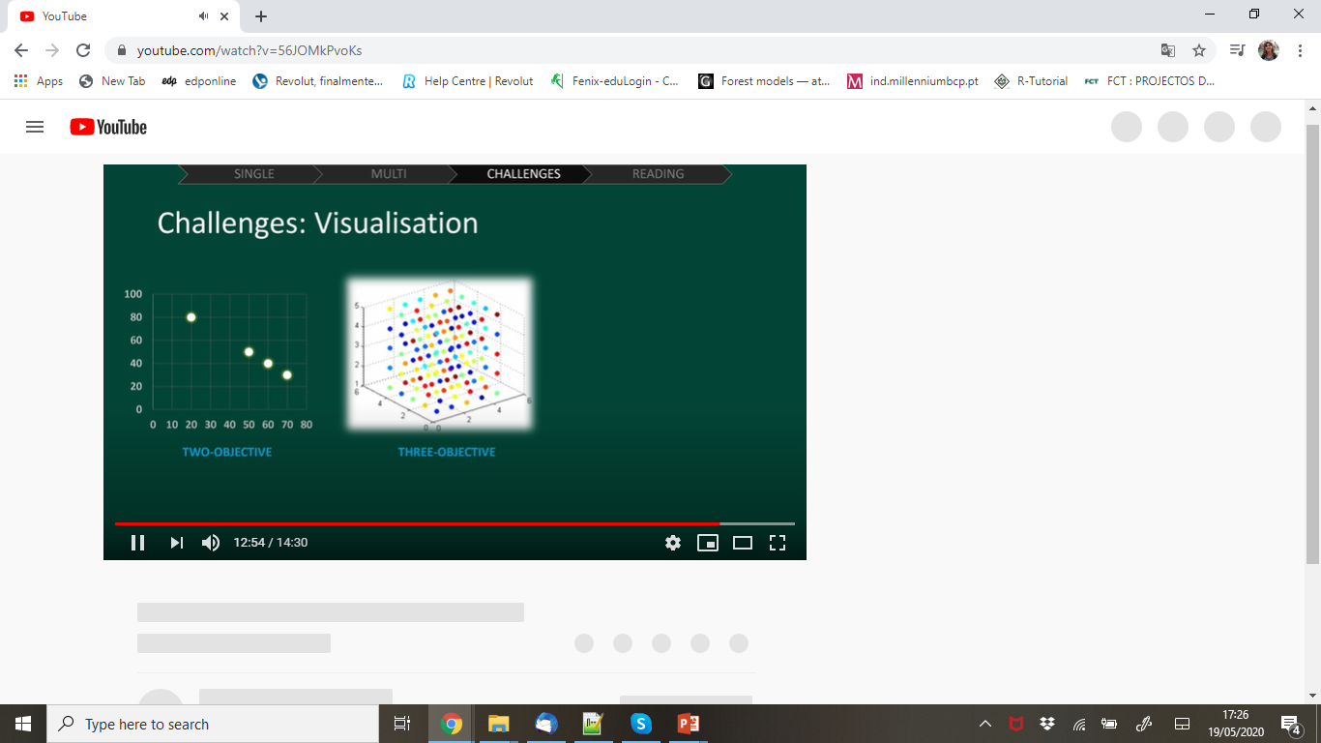
Multiple Objective Decision Analysis
Challenges: Selecting the best solution,
Visualization
Initialization
Evaluate
2D
3D
Terminate?
Selection
Variation
How we visualize the objective space is not complicated for 2 variables, but for 3 it gets difficult to see which solutions are dominated and for 4…

Slide 82
Multiple Objective Decision Analysis - Optimization
Evolutionary Optimization Algorithms
Non-Pareto techniques
  Aggregating approaches
  Vector evaluated genetic algorithm (VEGA)
  Lexicographic ordering
  Target vector approaches
Pareto techniques
  Multi-objective genetic algorithm (MOGA)
  Non-dominated sorting genetic algorithm-II (NSGA-II)
  Multi-objective particle swarm optimization (MOPSO)
  Strength Pareto evolutionary algorithm (SPEA-II)

Slide 83
Multiple Objective Decision Analysis - Optimization
Evolutionary Optimization Algorithms
Non-Pareto techniques
  Aggregating approaches
  Vector evaluated genetic algorithm (VEGA)
  Lexicographic ordering
  Target vector approaches
Pareto techniques
  Multi-objective genetic algorithm (MOGA)
  Non-dominated sorting genetic algorithm-II (NSGA-II)
  Multi-objective particle swarm optimization (MOPSO)
  Strength Pareto evolutionary algorithm (SPEA-II)

Slide 84
Multiple Objective Decision Analysis - Optimization
Non-dominated sorting genetic algorithm-II (NSGA-II)
This method was proposed by Deb et al. in 2000
Key features:
Emphasizes non-dominated sorting
Uses a diversity preserving mechanism
Performs crowding comparison
Uses elitist principle: some parents go directly to the next generation based on the above mentioned conditions

Slide 85
Multiple Objective Decision Analysis - Optimization
Non-dominated sorting genetic algorithm-II (NSGA-II)
The algorithm uses an evolutionary process including selection, genetic crossover, and genetic mutation. (In the following example we will skip this part)
The population of solutions is sorted into a hierarchy of sub-populations based on the ordering of Pareto dominance.
Similarity between members of each sub-group is evaluated on the Pareto-front
Similarity measures are used to promote a diverse front of non-dominated solutions.

Slide 86
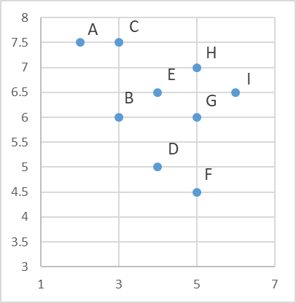
Multiple Objective Decision Analysis - Optimization
Non-dominated sorting genetic algorithm-II (NSGA-II)
non-dominated sorting
Minimize Time & Minimize Cost
A&B
A is better in terms of time, but
B is better in terms of cost
THUS, A&B are a non-dominated set

Slide 87
Multiple Objective Decision Analysis - Optimization
Non-dominated sorting genetic algorithm-II (NSGA-II)
non-dominated sorting
Minimize Time & Minimize Cost
A&B
A is better in terms of time, but
B is better in terms of cost
THUS, A&B are a non-dominated set
A&C
A is better in terms of time, but
C is equally good in terms of cost
THUS, A dominates C
… (see Excel)

Slide 88
Multiple Objective Decision Analysis - Optimization
Non-dominated sorting genetic algorithm-II (NSGA-II)
non-dominated sorting
Minimize Time & Minimize Cost
A dominates C
B dominates C, E, G, H, I
D dominates E, G, H, I
F dominates G, H, I
THUS
A, B, D, F form a non-dominated set
A, B, D, F form the Pareto-optimal front

Slide 89
Multiple Objective Decision Analysis - Optimization
Non-dominated sorting genetic algorithm-II (NSGA-II)
non-dominated sorting
The line is the Pareto-optimal front and the solutions in it are called the Pareto-optimal
Solutions along the line are non-dominated
All Pareto-optimal solutions are non-dominated

Slide 90
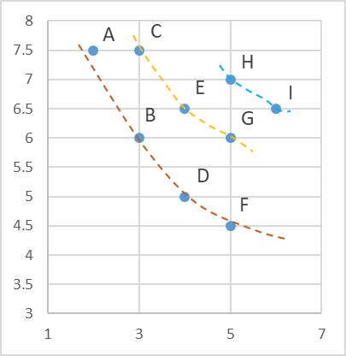
Multiple Objective Decision Analysis - Optimization
Non-dominated sorting genetic algorithm-II (NSGA-II)
non-dominated sorting
If we repeat the comparison procedure leaving A, B, D and F out we conclude C, E and G form a non-dominated set
Pareto-optimal front 2
Rank 2
Pareto-optimal front 1
Rank 1

Slide 91
Multiple Objective Decision Analysis - Optimization
Non-dominated sorting genetic algorithm-II (NSGA-II)
non-dominated sorting
Pareto-optimal front 3
Rank 3
Pareto-optimal front 2
Rank 2
Pareto-optimal front 1
Rank 1
When selecting Rank 1 has priority over 2 and 2 over 3, etc

Slide 92
Multiple Objective Decision Analysis - Optimization
Non-dominated sorting genetic algorithm-II (NSGA-II)
Population diversity and crowding
How to choose solutions in the same Pareto-optimal front ?
If we had to choose 3 out of 4, which would we choose?
We have to ensure population diversity so choosing solutions along the font will serve the purpose
A and F being at the extremes will be chosen, but we have to decide among B and D
Pareto-optimal front 1
Rank 1

Slide 93
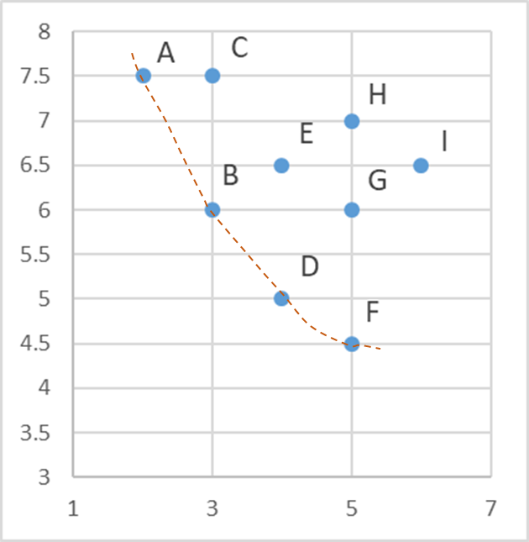

Multiple Objective Decision Analysis - Optimization
Non-dominated sorting genetic algorithm-II (NSGA-II)
Population diversity and crowd distance (CD)
Sort all the solutions in the Pareto front in ascending order for each objective ($f_{m}\left(x_{i+1}\right)>f_{m}\left(x_{i−1}\right)$) and compute CD:
CD_{im} = $\frac{\left(f_{m}\left(x_{i+1}\right)−f_{m}\left(x_{i−1}\right)\right)}{\left(f_{m}\left(x_{max}\right)−f_{m}\left(x_{min}\right)\right)}$
2) Repeat the process for each objective, the distance will result of the sum of the CD for all options/solutions
CD_{i} = $\sum_{m=1}^{M}{{CD}_{im}}$
3) Given 2 solutions, the one preferred is the one with the highest CD value
Where m is the number of objectives, I is the number of options/solutions in the Pareto-optimal front and f_{m} the values of each objective under each option
x_{i-1}
X_{i+1}
Pareto-optimal front 1

Slide 94

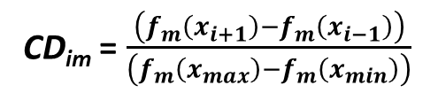
Multiple Objective Decision Analysis - Optimization
Non-dominated sorting genetic algorithm-II (NSGA-II)
Population diversity and crowd distance (CD)
decide among B and D
Let us look at the crowding distance for B
Pareto-optimal front 1
CD_{im} = $\frac{\left(f_{m}\left(x_{i+1}\right)−f_{m}\left(x_{i−1}\right)\right)}{\left(f_{m}\left(x_{max}\right)−f_{m}\left(x_{min}\right)\right)}$
CD_{B} (Cost) = ( 7.5 -5) / (7.5 -4.5) = 2.5/3 = 0.83
CD_{B} (Time) = ( 4 -2) / (6 -2) = 2/4 = 0.5
CD_{B} (Cost + Time) = 0.83 + 0.5 = 1.33
($f_{m}\left(x_{i+1}\right)>f_{m}\left(x_{i−1}\right)$)

Slide 95
Multiple Objective Decision Analysis - Optimization
Non-dominated sorting genetic algorithm-II (NSGA-II)
Population diversity and crowd distance (CD)
decide among B and D
Let us look at the crowding distance
Pareto-optimal front 1
CD_{im} = $\frac{\left(f_{m}\left(x_{i+1}\right)−f_{m}\left(x_{i−1}\right)\right)}{\left(f_{m}\left(x_{max}\right)−f_{m}\left(x_{min}\right)\right)}$
CD_{D} (Cost) = ( 6 -4.5) / (7.5 -4.5) = 1.5/3 = 0.5
CD_{D} (Time) = ( 5 -3) / (6 -2) = 2/4 = 0.5
CD_{D} (Cost + Time) = 1.00
($f_{m}\left(x_{i+1}\right)>f_{m}\left(x_{i−1}\right)$)

Slide 96
Multiple Objective Decision Analysis - Optimization
Non-dominated sorting genetic algorithm-II (NSGA-II)
Population diversity and crowd distance (CD)
decide among B and D
Let us look at the crowding distance
CD_{B} (Cost) = ( 7.5 -5) / (7.5 -4.5) = 2.5/3 = 0.83
CD_{B} (Time) = ( 4 -2) / (6 -2) = 2/4 = 0.5
CD_{B} (Cost + Time) = 0.83 + 0.5 = 1.33
CD_{D} (Cost) = ( 6 -4.5) / (7.5 -4.5) = 1.5/3 = 0.5
CD_{D} (Time) = ( 5 -3) / (6 -2) = 2/4 = 0.5
CD_{D} (Cost + Time) = 1.00
CD_{A} = CD_{F} = infinity
CD_{B} = 1.33, CD_{A} = CD_{F} = infinity
Pareto-optimal front 1

Slide 97
Multiple Objective Decision Analysis - Optimization
Non-dominated sorting genetic algorithm-II (NSGA-II)
NSGA is an extension of the Genetic Algorithm for multiple objective function optimization.
Genetic algorithms provide an alternative approach to optimization in the case of more complex problems:
  - advantages - works well for problems with chaotic or ill-defined behavior and also those problems with local maxima or minima that would, perhaps, trap a conventional search algorithm; fitting several loops simultaneously
  - disadvantages - its random nature may not always find the absolute optimum solution, but offers a greater chance of quickly finding a relatively good one.

Slide 98
Multiple Objective Decision Analysis - Optimization
Non-dominated sorting genetic algorithm-II (NSGA-II)
NSGA is an extension of the Genetic Algorithm for multiple objective function optimization.
Genetic algorithms provide an alternative approach to optimization in the case of more complex problems:
  - advantages - works well for problems with chaotic or ill-defined behavior and also those problems with local maxima or minima that would, perhaps, trap a conventional search algorithm; fitting several loops simultaneously
  - disadvantages - its random nature may not always find the absolute optimum solution, but offers a greater chance of quickly finding a relatively good one.
Requires software implementation !

Slide 99

Multiple Objective Decision Analysis - Optimization
The approach combines the use of mathematical programming and interactive decision maps techniques
(…)
The feasible goals method/interactive decision maps (FGM/IDM) technique is used to provide interactive and animated visualization of the Pareto frontier generated by the ERM
Conclusion: FGM/IDM technique may be used to develop and display the Pareto frontier in the case of problems with more than three forest management planning objectives

Slide 100
Multiple Objective Decision Analysis - Optimization
How do we carry out multi-objective optimization for more than 2 variables?
We can also use Multi Objective Linear Programming (MOLP)
Tradeoffs concept
Part of the challenge is in expressing the value trade-offs among the objectives.
These trade-offs indicate which objectives are relatively more important to the decision maker.
  Which 2 objectives does a decision maker prefer: “decrease production costs” or “increase product quality”?
      - Does he prefer them equally?
      - Is one more important?
      - How much more important is it?
Incorporating trade-offs into the decision-making process is valuable because it ensures decisions integrate the decision maker’s values

Slide 101
Multiple Objective Decision Analysis - Optimization
Multi Objective Linear Programming
Hypothetical example of trade-offs between profit and toxic waste
Take the following example:
Untreated pulp and paper mill effluents are very toxic to most aquatic life, treatment can reduce toxicity but at a cost. Increasing profit usually leads to the production of more toxic waste. Ideally the mill managers will wish to maximize profit reducing toxic waste production.
The decision maker has to decide the most desirable level of trade-offs between profit and waste
for the same level of waste, profit can be increased (C)
C
Profit
The solution indicated by point A is clearly undesirable because
B
A
for the same level of profit, waste can be reduced (B)
Toxic waste
Each point on the curve corresponds to a possible level of profit and the minimum amount of waste that must be produced to achieve it

Slide 102
Multiple Objective Decision Analysis - Optimization
Multi Objective Linear Programming
Hypothetical example of trade-offs between profit and toxic waste
Take the following example:
Untreated pulp and paper mill effluents are very toxic to most aquatic life, treatment can reduce toxicity but at a cost. Increasing profit usually leads to the production of more toxic waste. Ideally the mill managers will wish to maximize profit reducing toxic waste production.
The decision maker has to decide the most desirable level of trade-offs between profit and waste
So, points B and C are both preferable to (or dominate) point A
C
All points along the curve connecting B and C are preferable to A
Profit
B
A
A alternative is dominated if another produces a better value for at least one of the objectives without worsening the other objectives
Toxic waste
Each point on the curve corresponds to a possible level of profit and the minimum amount of waste that must be produced to achieve it

Slide 103
Multiple Objective Decision Analysis - Optimization
Multi Objective Linear Programming
Decision makers should only want to consider decision alternatives that are non-dominanted.
MOLP guarantees the decisions presented to the decision maker are non-dominanted.
MOLP can be viewed as special types of GP problems where apart of solving the problem, we must also determine target values for each goal or objective.
Thus solving these problems also requires we use the minimization and maximization objectives described in previous classes.
C
Profit
B
A
Toxic waste

Slide 104
Multiple Objective Decision Analysis - Optimization
Multi Objective Linear Programming
Some ideas to form goal function:
  Objective 1: Maximize profit (OF1)
  Objective 2: Minimize toxic waste production (OF2)
  1st Goal Form:
    Goal function = Max (OF1) and add OF2 as constraint
    Produced hazards <= Max allowable

Slide 105
Multiple Objective Decision Analysis - Optimization
Multi Objective Linear Programming
Some ideas to form goal function:
  Objective 1: Maximize profit (OF1)
  Objective 2: Minimize toxic waste production (OF2)
  2nd Goal Form:
    Goal function = Max (OF1/OF2) or Goal function = Min (OF2/OF1)

Slide 106
Multiple Objective Decision Analysis - Optimization
Multi Objective Linear Programming
Some ideas to form goal function:
  Objective 1: Maximize profit (OF1)
  Objective 2: Minimize toxic waste production (OF2)
  3rd Goal Form (weighted normalized method):
    Goal function = Min (W1 * abs (Actual OF1- Optimum OF1) / Optimum OF1) +
    W2 * abs (Actual OF2- Optimum OF2) / Optimum OF2)
Absolut values are used to avoid the existence of big positive deviation in one OF to cancel big negative deviation in the other

Slide 107
Multiple Objective Decision Analysis - Optimization
Multi Objective Linear Programming
Example:
  Objective 1: Maximize profit (OF1)
  Objective 2: Minimize toxic waste production (OF2)
  3rd Goal Form (weighted normalized method):
    Goal function = Min (W1 * abs (Actual OF1- Optimum OF1) / Optimum OF1) +
    W2 * abs (Actual OF2- Optimum OF2) / Optimum OF2)

Slide 108
Multiple Objective Decision Analysis - Optimization
Exercise 1
  Blackstone Mining Company operates 2 coal mines Wythe and Giles. The manager is anticipating a demand increase for coal in the coming year and he wants to schedule extra shifts of workers to the mines. Each extra shift has an extra cost of 40000/month at Wythe and 32000/month at Giles.
  The extraction methods lead to the production of toxic water. Running an extra shift at Wythe leads to the production of 800 gallons and 1250 gallons at Giles.
  Despite safety guidelines are followed 0.2 life threatening accidents are expected at Wythe and 0.45
Coal production a month by a shift of workers (ton)
Increase in demand
48
28
100
Determine the number of extra shifts at each of the mines that minimizes costs, toxic waste production and life threatening accidents
Wythe
Giles

