Slide 1
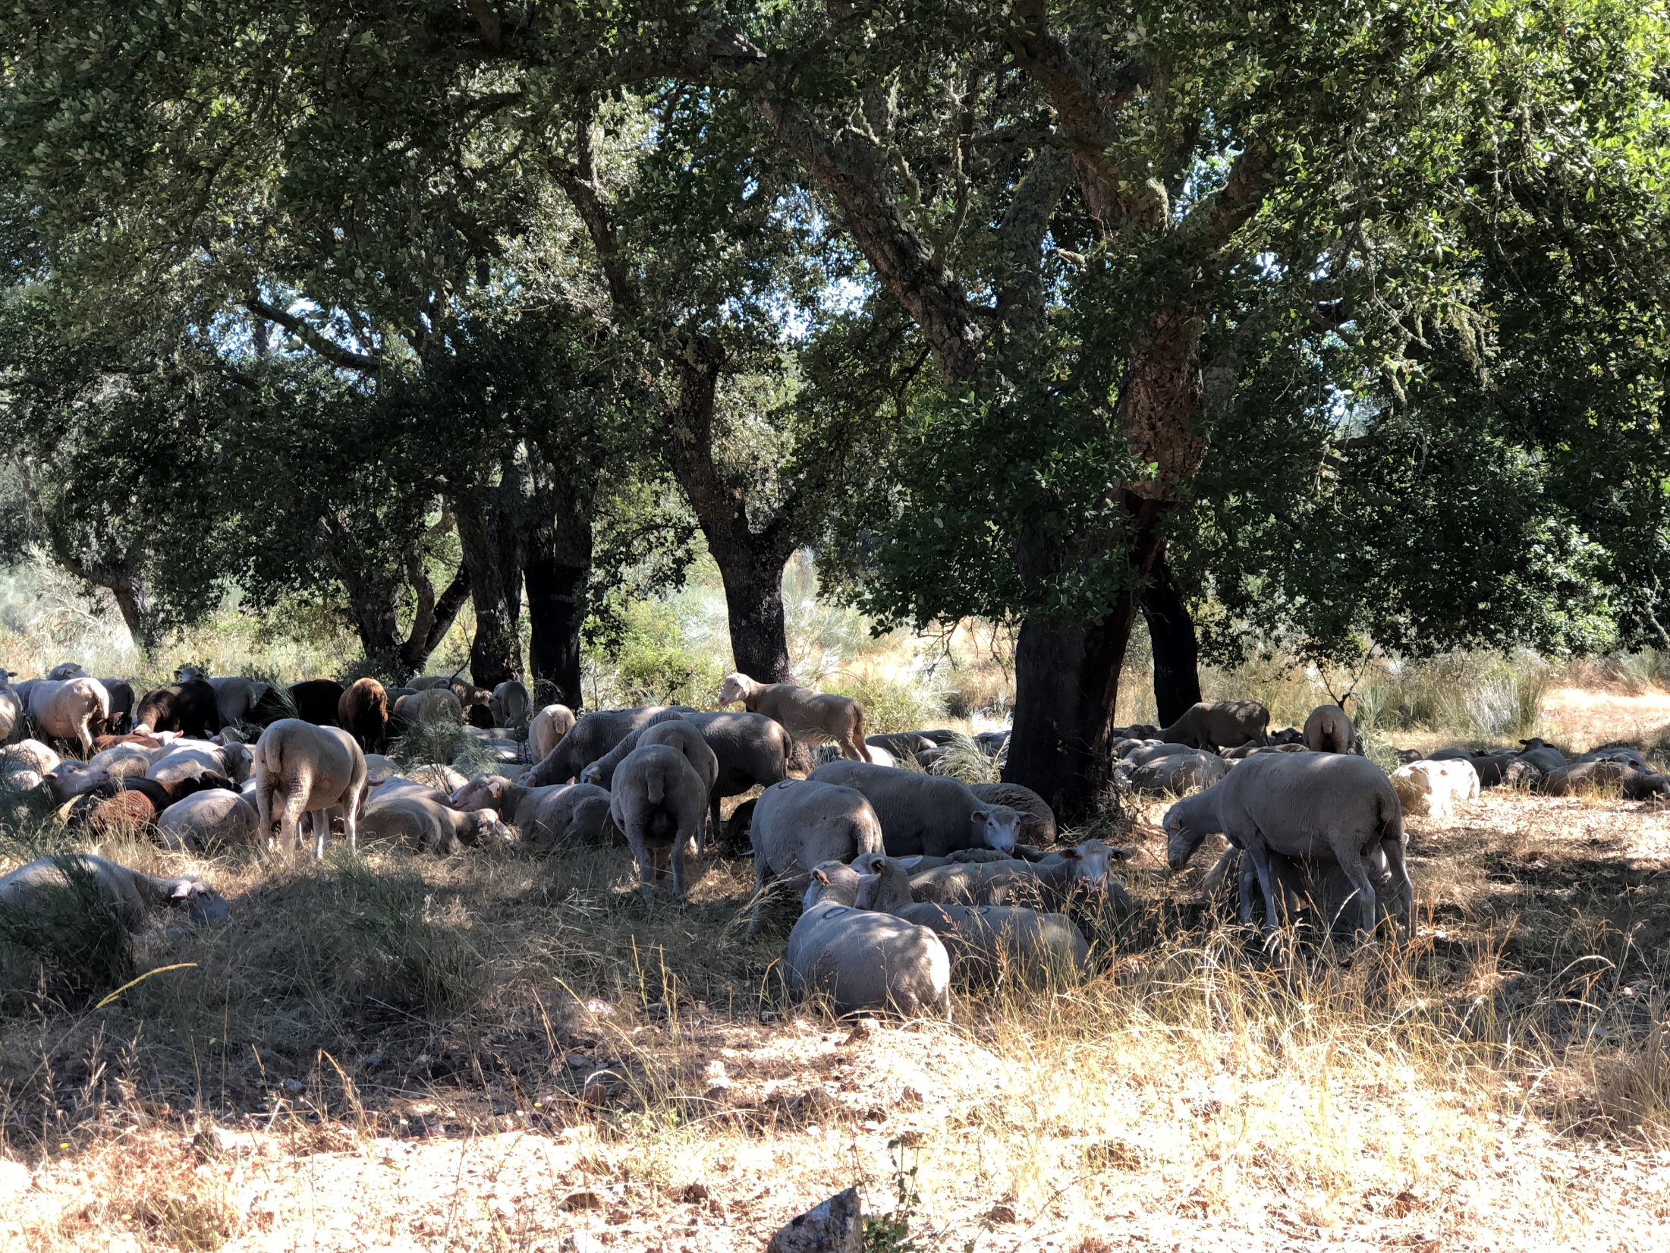
Methods to study the evolution of tree and stand variables over time
Margarida Tomé, Susana Barreiro
Instituto Superior de Agronomia
Universidade de Lisboa

Slide 2
Summary
Where do we get the data for growth studies?
  Permanent and Interval plots
  Temporary plots
  Experimental trials
  Continuous forest inventory data
  Stem analysis
    Partial – analysis of increment cores at dbh level
    Total – analysis of several tree discs along the stem

Slide 3
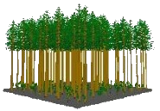
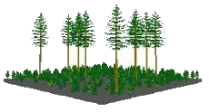
1950’s | 1960’s | 1970’s | 1980’s | 1990’s | 2000’s | 2010’s
Timber | Timber | Timber | Timber | Timber | Timber | Timber
 | Mutiple resources | Mutiple resources | Mutiple resources | Mutiple resources | Mutiple resources | Mutiple resources
 |  | Biomass | Biomass | Biomass | Biomass | Biomass
 |  |  | Global warming C sequestration | Global warming C sequestration | Global warming C sequestration | Global warming C sequestration
 |  |  |  | Ecosystem services (biodiversity) NWFPs | Ecosystem services (biodiversity) NWFPs | Ecosystem services (biodiversity) NWFPs
 |  |  |  |  | Relationship with other land uses | Relationship with other land uses
 |  |  |  |  |  | Bioeconomy
Production forestry often involved:
the establishment of pure even-aged stands
substantial investments for intensive management
Several approaches from empirical to process-based have been used
Stands are composed of trees and models of tree attributes:
stem taper,
tree volume
tree biomass
crown characteristics
central components in comprehensive growth & yield prediction systems
Trees and stands respond to silvicultural treatments & environment
branchiness
crown size

Slide 4
1950’s | 1960’s | 1970’s | 1980’s | 1990’s | 2000’s | 2010’s
Timber | Timber | Timber | Timber | Timber | Timber | Timber
 | Mutiple resources | Mutiple resources | Mutiple resources | Mutiple resources | Mutiple resources | Mutiple resources
 |  | Biomass | Biomass | Biomass | Biomass | Biomass
 |  |  | Global warming C sequestration | Global warming C sequestration | Global warming C sequestration | Global warming C sequestration
 |  |  |  | Ecosystem services (biodiversity) NWFPs | Ecosystem services (biodiversity) NWFPs | Ecosystem services (biodiversity) NWFPs
 |  |  |  |  | Relationship with other land uses | Relationship with other land uses
 |  |  |  |  |  | Bioeconomy
Production forestry often involved:
the establishment of pure even-aged stands
substantial investments for intensive management
Based on the description of observed data at tree or stand level
Several approaches from empirical to process-based have been used
Stands are composed of trees and models of tree attributes:
stem taper,
tree volume
tree biomass
crown characteristics
central components in comprehensive growth & yield prediction systems
Based on the description of processes that lead to the production of dry matter its distribution among plant parts
Trees and stands respond to silvicultural treatments & environment
branchiness
crown size

Slide 5
Where do we get the data for growth studies?

Slide 6
Where do we get the data for growth studies?
In permanent and interval plots
  Plots established with the objective of measuring growth in stands managed according to “current” practices
    Permanent plots follow the stand during a long period, eventually the whole life of the stand

Slide 7
Permanent plots
Permanent plot with three successive measurements (white trees are removed during thinning). Graphical representation of data series of three permanent plots
Adapted from Gadow and Hui 1999

Slide 8
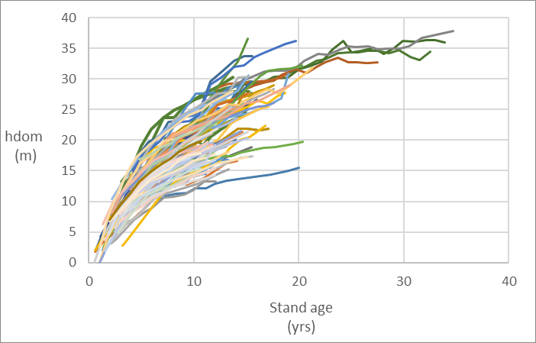
Permanent plots
Examples of permanent plot data
h_{dom} - eucalyptus

Slide 9
Where do we get the data for growth studies?
In permanent and interval plots
  Plots established with the objective of measuring growth in stands managed according to “current” practices
    Permanent plots follow the stand during a long period, eventually the whole life of the stand
    Interval plots follow the stand during a limited interval, but they are remeasured at least once

Slide 10
Interval plots
Three interval plots measured twice (white trees removed in thinning operations). Graphical representation: interval data for obtaining rates of change of observed state variables
Adapted from Gadow and Hui 1999

Slide 11
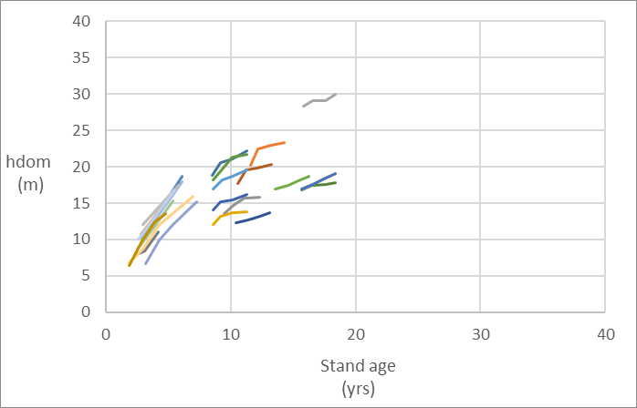
Interval plots
Examples of interval plot data
h_{dom} - eucalyptus

Slide 12
Let us take a look at a few permanent and interval plots in ForChange Eucalypt database

Slide 13
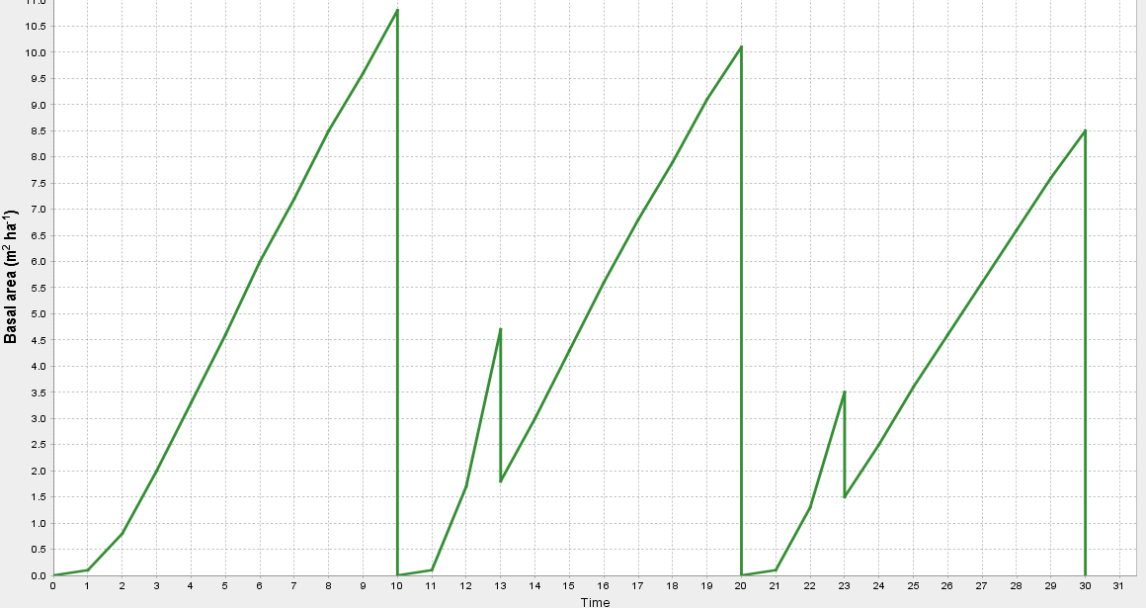
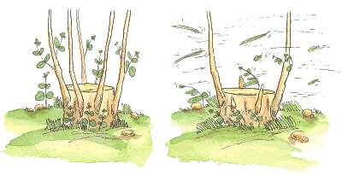
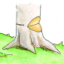
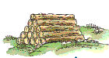
Plantation
Coppice
1st rotation
2nd rotation
3rd rotation
Terminology !
Shoots selection operation
Seedlings are planted
Stools resprout
Final harvest or clear cut
Trees are harvested
originating many shoots

Slide 14
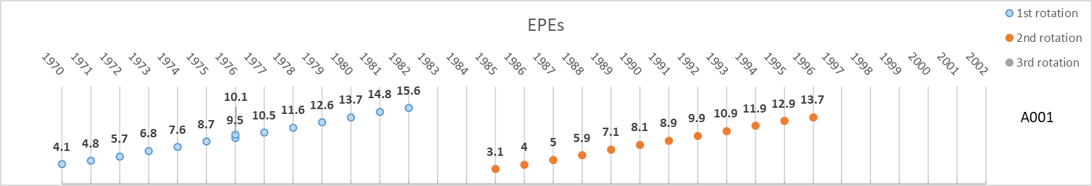
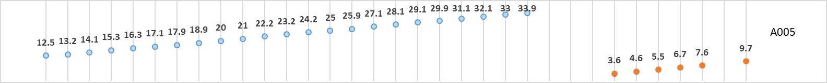
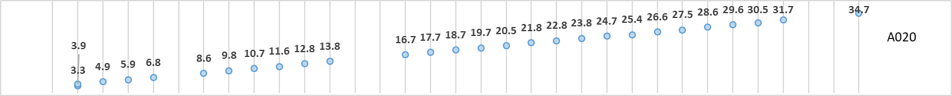

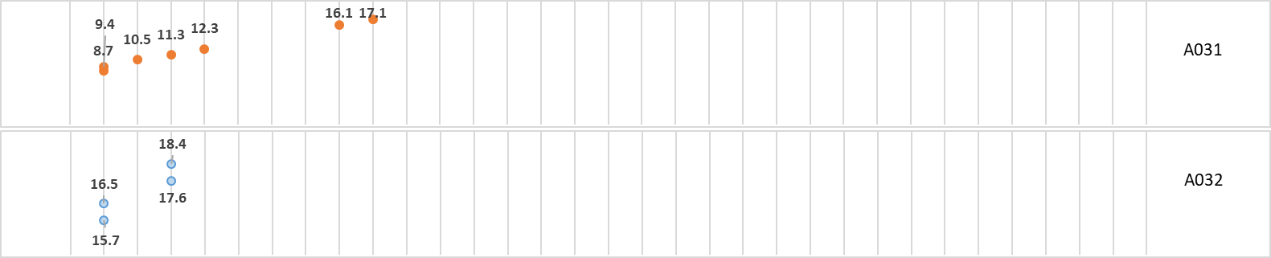
Stand age at each measurement
This is not stand height evolution!
Permanent plots
Interval plots

Slide 15
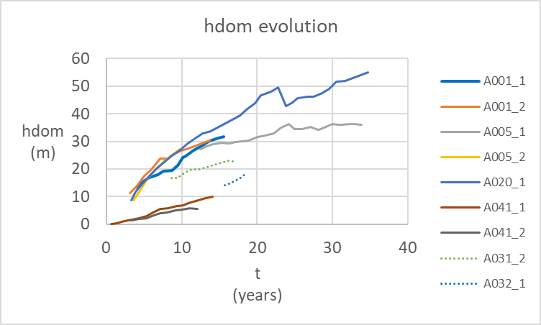
This is stand height evolution!
Permanent plots
Interval plots

Slide 16
Where do we get the data for growth studies?
In permanent and interval plots
  Plots established with the objective of measuring growth in stands managed according to “current” practices
    Permanent plots follow the stand during a long period, eventually the whole life of the stand
    Interval plots follow the stand during a limited interval, but they are remeasured at least once
In temporary plots
  Plots that are measured just at one point in time

Slide 17
Temporary plots
Three temporary plots of varying age (white trees removed in thinning operations). Graphical representation: independent height-age data obtained from temporary plots
Adapted from Gadow and Hui 1999

Slide 18
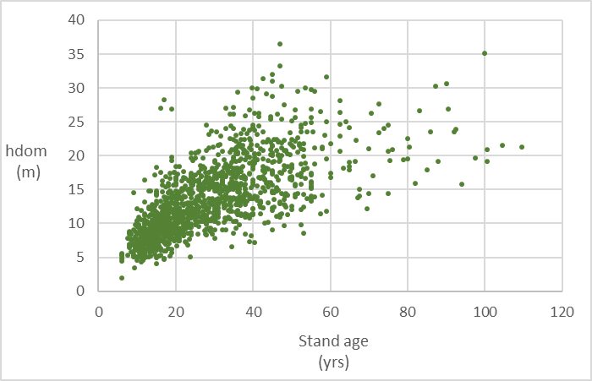
Temporary plots
Examples of temporary plot data
h_{dom} - eucalyptus

Slide 19
Where do we get the data for growth studies?
In designed silviculture and genetic trials
  Trials purposively established to study the impact of silvicultural treatments and/or genetic material on tree and stand growth

Slide 20
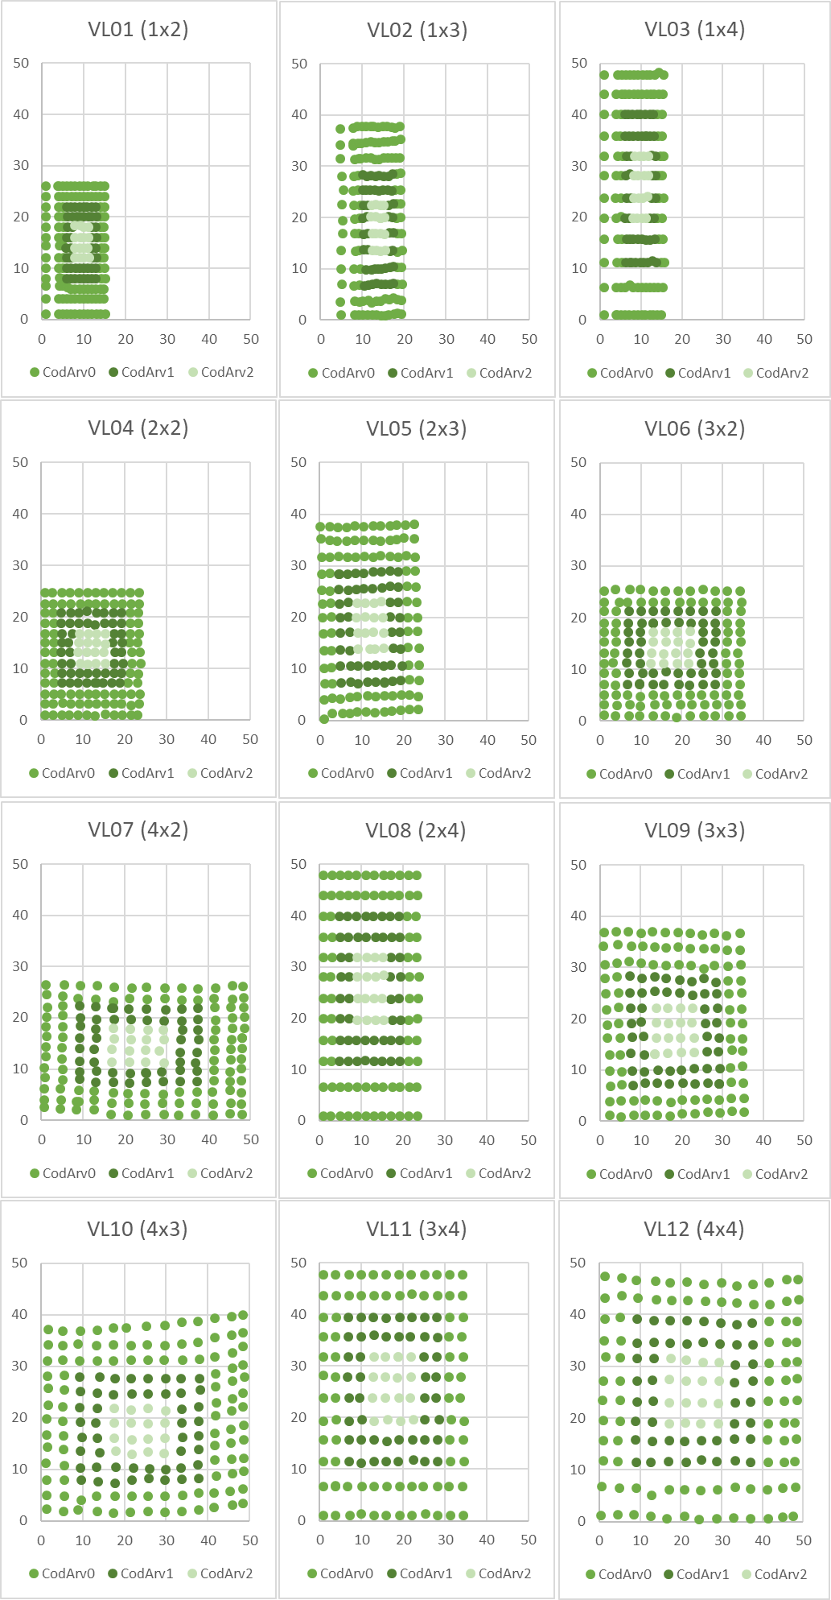
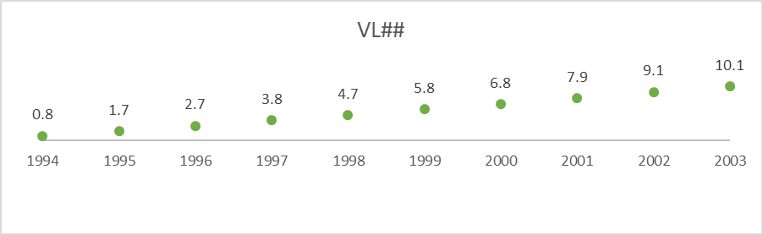
Experimental trials
Trials are set to study one specific silvicultural practice or a combination of two (even if in practice several treatments are applied simultaneously)
Trials usually present a design with repetitions of the given treatment
E.g. Spacing trial: (1x2, 1x3, 1x4, 2x2, 2x3, 3x2, 4x2, 2x4, 3x3, 4x3, 3x4, 4x4) * 3Blocks
Measurements over time covering the entire 1st rotation

Slide 21
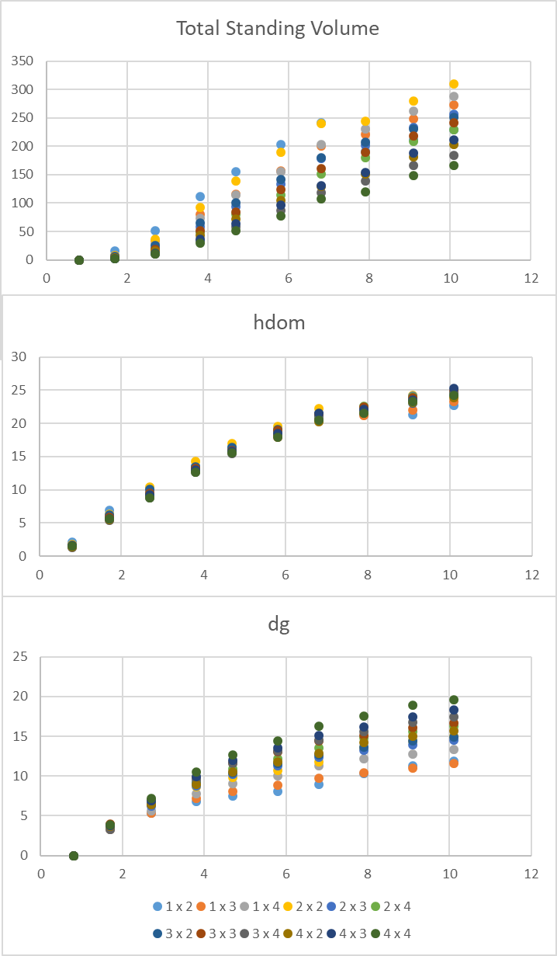
Experimental trials
Trials are set to study one specific silvicultural practice or a combination of two (even if in practice several treatments are applied simultaneously)
Trials usually present a design with repetitions of the given treatment
E.g. Spacing trial: (1x2, 1x3, 1x4, 2x2, 2x3, 3x2, 4x2, 2x4, 3x3, 4x3, 3x4, 4x4) * 3Blocks
Measurements over time covering the entire 1st rotation

Slide 22
Experimental trials
Trials are set to study one specific silvicultural practice or a combination of two (even if in practice several treatments are applied simultaneously)
Trials usually present a design with repetitions of the given treatment
E.g. Spacing trial: (1x2, 1x3, 1x4, 2x2, 2x3, 3x2, 4x2, 2x4, 3x3, 4x3, 3x4, 4x4) * 3Blocks
Comparison of some stand variables at age 10.1:
Spacing that maximizes volume

Slide 23
Experimental trials
Trials are set to study one specific silvicultural practice or a combination of two (even if in practice several treatments are applied simultaneously)
Trials usually present a design with repetitions of the given treatment
E.g. Spacing trial: (1x2, 1x3, 1x4, 2x2, 2x3, 3x2, 4x2, 2x4, 3x3, 4x3, 3x4, 4x4) * 3Blocks
Comparison of some stand variables at age 10.1:
Spacing that maximizes diameter

Slide 24
ANALYSIS OF MEASURED RESULTS
PERMANENT PLOTS
FIELD TRIALS
Data for construction and validation
Better understanding of physiological processes
Indication for the need to obtain new data
Ideas for new experiments
ANALYSIS OF SIMULATED RESULTS using FOREST GROWTH MODELS
Better understanding of physiological processes
EXPERIMENTS UNDERTAKEN IN LABORATORY

Slide 25
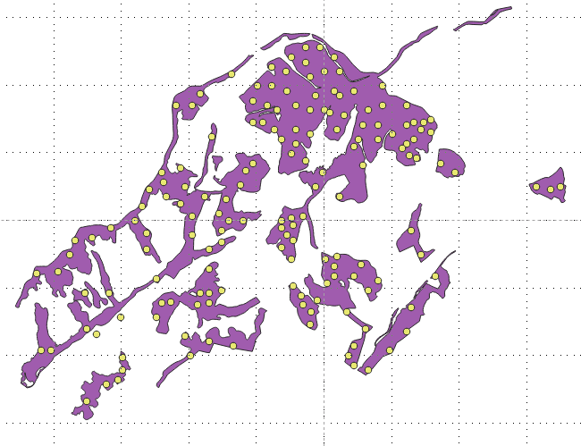
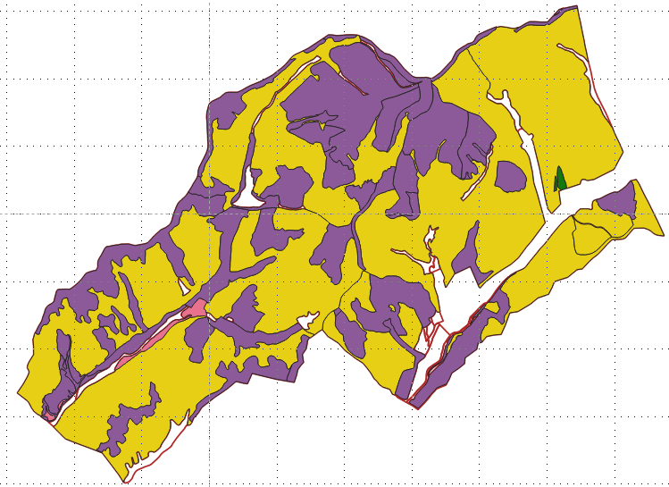
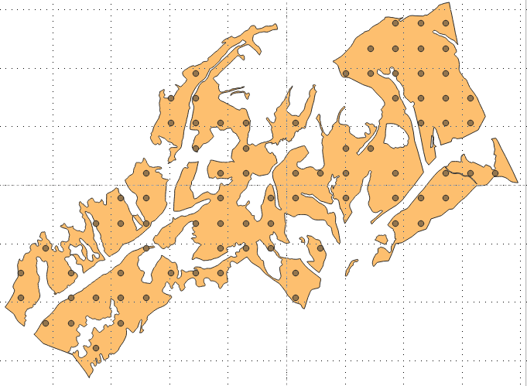
Where do we get the data for growth studies?
In designed silviculture and genetic trials
  Trials purposively established to study the impact of silvicultural treatments and/or genetic material on tree and stand growth
From continuous forest inventory data
Plots randomly distributed
Management unit with
2 different species
Plots systematically distributed

Slide 26
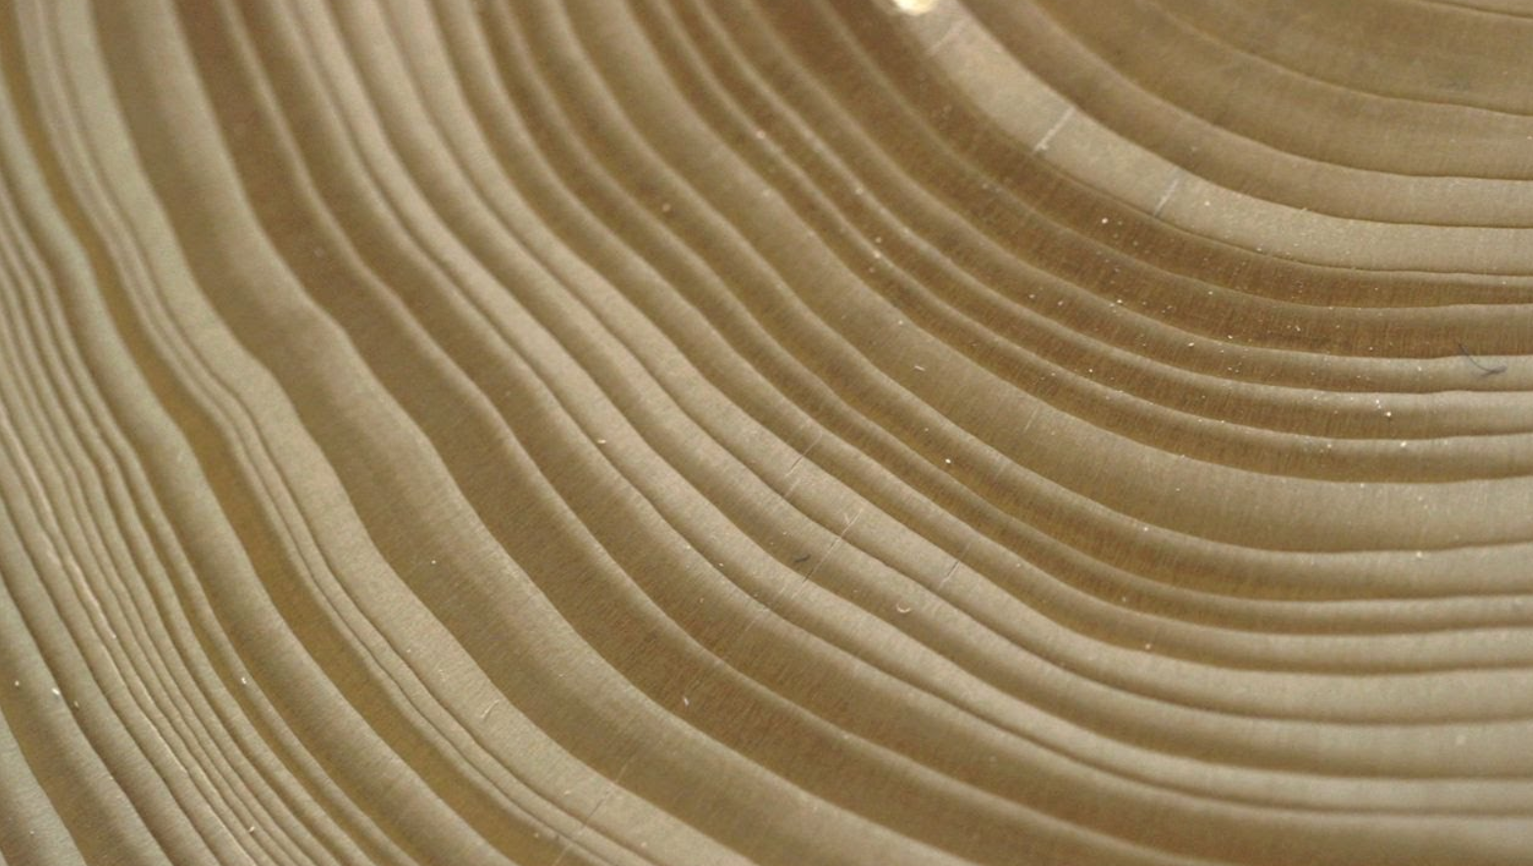
Where do we get the data for growth studies?
In designed silviculture and genetic trials
  Trials purposively established to study the impact of silvicultural treatments and/or genetic material on tree and stand growth
From continuous forest inventory data
From stem analysis
Trees growing In temperate forests add a new layer of wood (from ground level to the tip and all around the stem) pushing the bark outwards creating a new layer every year.
Looking at the cross-cut, these layers appear as rings.
Each year:
  a light ring (early wood) of new growth is created in the trunk during the spring and early summer,
  a dark thinner ring (late wood) is created in the fall, when growth is slower.

Slide 27
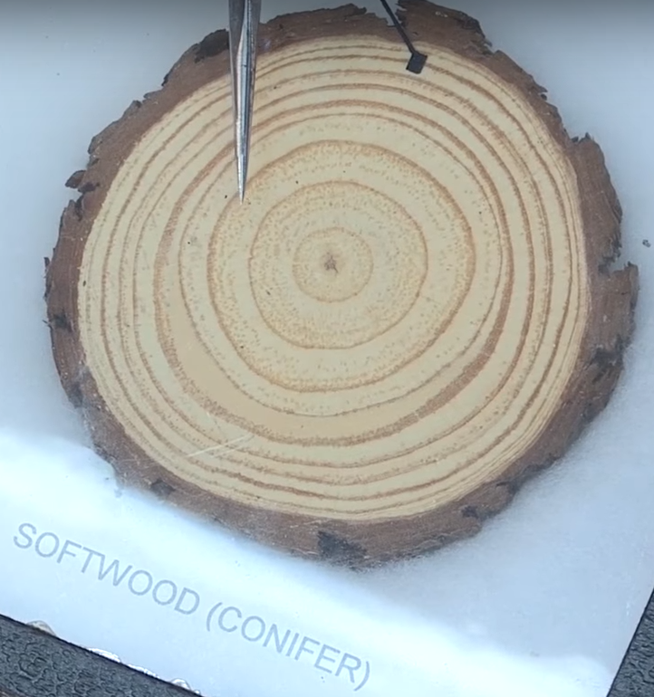
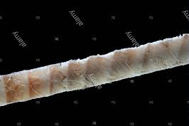
Stem analysis
Stem analysis is the study of tree growth from the analysis and measurement of the growth rings
It is restricted to the species whose wood exhibits clear growth rings and to the regions with a climate that implies a clear stop on growth
Two types of stem analysis:
  Partial – analysis of increment cores at dbh level
  Total – analysis of several tree discs along the stem

Slide 28
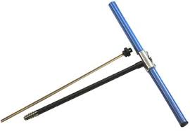
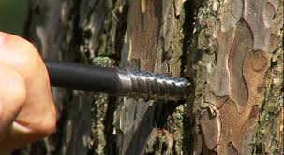
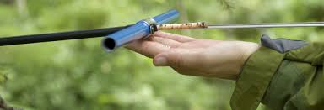
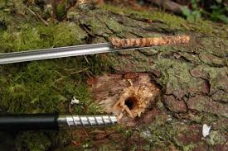

Partial stem analysis
Stand table projection
It is usually used for short-term predictions of forest inventory data:
  During the forest inventory an increment core is taken in some “sample” trees
  Diameter growth of wood in the last k years (usually 5 years) is measured in the increment core from each tree and converted to diameter growth
  The diameter growth (idj) of the average tree of each diameter class (j) is estimated
(Hagloff images)

Slide 29
Partial stem analysis
Stand table projection
It includes several steps (and assumes you have just completed your forest inventory):
  Start by computing the stand table (number of trees by diameter class) from forest inventory data
Take a core from the tree that is closest to the central diameter in each diameter class
Measure the width of the rings over the past k yrs to determine the increment in each class (id_{j})

Slide 30
Partial stem analysis
Stand table projection
It includes several steps (and assumes you have just completed your forest inventory):
  Start by computing the stand table (number of trees by diameter class) from forest inventory data
  Estimate mortality in each diameter class and compute the future number of trees
  Compute the growth index ie the ratio between id_{j} and the width of the class – this index allows the computation of the number of trees that stay in the class and the ones that move 1 or 2 classes

Slide 31
Partial stem analysis
Stand table projection
It includes several steps (and assumes you have just completed your forest inventory):
  Start by computing the stand table (number of trees by diameter class) from forest inventory data
  Estimate mortality in each diameter class and compute the future number of trees
  Compute the growth index ie the ratio between id_{j} and the width of the class – this index allows the computation of the number of trees that stay in the class and the ones that move 1 or 2 classes
    A GI=0.76 means that 76% of the trees move 1 class and none move 2 classes
    A GI=1.10 means that 90% of the trees move 1 class and 10% move 2 classes

Slide 32
Partial stem analysis
Stand table projection
Computation of growth index:
  Assumes that trees inside a dbh class have an uniform distribution
  Estimate the diameter increment in k years of each dbh class (i_{d})
  All trees inside a dbh class [d₁; d₂[ with d>d₂+i_{d}, after k years will be in the next class
12.5
17.5
15

Slide 33
Partial stem analysis
Stand table projection
=102*(1-0.76)
=100+4
=3.80/5cm
…
=3.9/5cm
=102-24.48
number of trees alive in each class
Increment in diameter for the period

Slide 34
Partial stem analysis
Stand table projection
We should also take into account the ingrowth
  trees that achieve the lower limit of the first diameter class and must be added to the stand

Slide 35
Partial stem analysis
Stand table projection
=24+100

Slide 36
Partial stem analysis
Stand table project
To estimate volume (or biomass) increment:
  Estimate the height of the average tree in each dimater class using a height-diameter curve
  Estimate the respective volume with a volume equation
  Estimate the volume in each point in time using the stand tables
  Obtain the volume (biomass) growth by difference

Slide 37
Partial stem analysis
Stand table projection
=0.0070*124

Slide 38
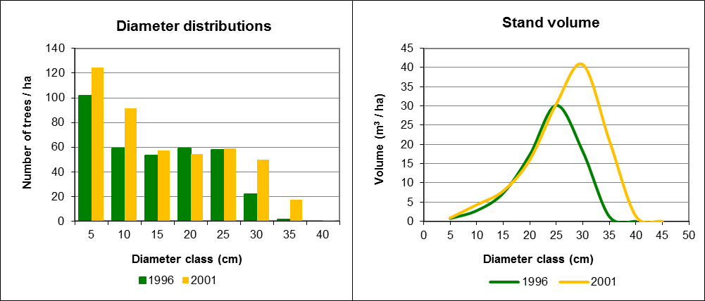
Partial stem analysis
Stand table projection
i_{V}=45m³/ha

Slide 39
Partial stem analysis
Stand table projection
Tree movement:
  Note that now the trees are not equally distributed but this assumption will hold for the next period projection
I_{d1}= 3/4 interval
I_{d2}= 2/4 interval
I_{d3}= 1/4 interval
Class d1 = 4 trees
Class d2 = 8 trees
Class d3 = 4 trees
Moves to Class d2:
3/4 interval * 4 trees
3 trees move to d2
Moves to Class d3:
I_{d2}= 2/4 interval * 8 trees
4 trees move to d3
i_{d1}
i_{d2}
i_{d3}
Period 1
 | class d1 |  |  |  | class d2 |  |  |  | class d3
Period 2
 | class d1 |  |  |  | class d2 |  |  |  | class d3

Slide 40

Total stem analysis
...
h₁
h₂
h₃
h₄
h_{n}

Slide 41
Stem analysis - example
Tree is 5 years old
h₅ = 5.5
h₄
h₃
h₂
h₁

Slide 42
Stem analysis - example
Tree is 5 years old
Between Disc 1 and Disc 2, the correction is needed to estimate the heights at the end of the years: h₁₁ and h₁₂
The method most used for this correction is the Carmean method
h₅ = 5.5
height | N rings | age
0 | 5 | 0
1.30 | 4 | 1+ ...
3.50 | 2 | 3+ ...
5.50 | 0 | 5
h₄
Disc 2
h = 3.5
h₃ = h ₁₂
h₂ = h₁₁
Disc 1
h = 1.3
h₁
Disc 0
h = 0

Slide 43
Stem analysis
Carmean’s correction
Carmen’s method is based on two assumptions:
  Constant annual increment in height between two discs
  Each disc occurs at the mid-point between two whorls
The application of the method to the whorls between two discs implies:
  Computing the annual increment i_{h}=(h₂-h₁)/(nrg₁-nrg₂), where h_{i} and nrg_{i} are the height and the number of rings of disc_{i}
  Computing the height of the first whorl as: h_{i1}=h_{i}+i_{h}/2
  Computing the height of the remaining whorls as: h_{ij} = h_{i}+i_{h}/2+(j-1)*i_{h} = h_{i(j-1)}+i_{h}

Slide 44
Stem analysis
Carmean’s correction
Let’s compute h₁₁ and h₁₂:
Annual height growth between discs:
i_{h}=(h_{D2}-h_{D1})/(nrg₁-nrg₂)
  i_{h}=(3.50 - 1.30)/(4 - 2)=(2.2)/2= 1.1
Disc 2
h = 3.5
h₁₂
“1.1”
h₁₁
Disc 1
h = 1.3
Where nrg₁ and nrg2 are the number of rings in the discs collected at heights 1 and 2 respectively.

Slide 45
Stem analysis
Carmean’s correction
Let’s compute h₁₁ and h₁₂:
Annual height growth between discs:
i_{h}=(h_{D2}-h_{D1})/(nrg₁-nrg₂)
  i_{h}=(3.50 - 1.30)/(4 - 2)=(2.2)/2= 1.1
Disc 2
h = 3.5
h₁₂
“1.1”
h₁₁
  A1: Constant annual increment in height between two discs ie 1.1
  A2: Each disc occurs at the mid-point between two whorls ie from 1.3 up to h₁₁ the increment will be 1.1/2
“1.1”/2
Disc 1
h = 1.3
h₁
  h_{i1}=h_{i}+i_{h}/2
h₁₁= 1.30 + 1.1/2= 1.85
h_{ij} = h_{i}+i_{h}/2+(j-1)*i_{h} = h_{i(j-1)}+i_{h}
h₁₂= h₁₁ + i_{h} = 1.85 + 1.1 = 2.95
Where nrg₁ and nrg2 are the number of rings in the discs collected at heights 1 and 2 respectively.

Slide 46
Stem analysis
Carmean’s correction
It is possible to obtain a general formula for the height of any whorl h_{ij}:
Disc 2
h = 3.5
h₁₂
h₁₁
is the annual growth between discs i and i+1
Disc 1
h = 1.3
h₁
Where nrg₁ and nrg2 are the number of rings in the discs collected at heights 1 and 2 respectively.

Slide 47
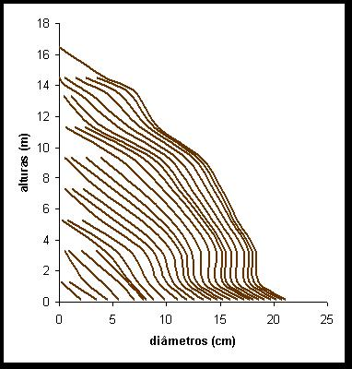
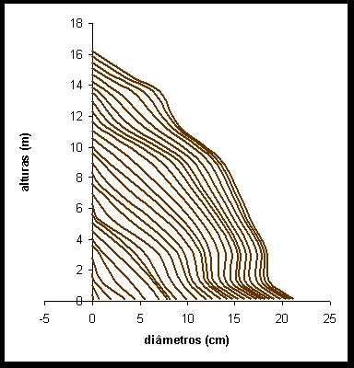
Stem analysis
Carmean’s correction
Heights (m)
Heights (m)
Diameters (cm)
Diameters (cm)

Slide 48
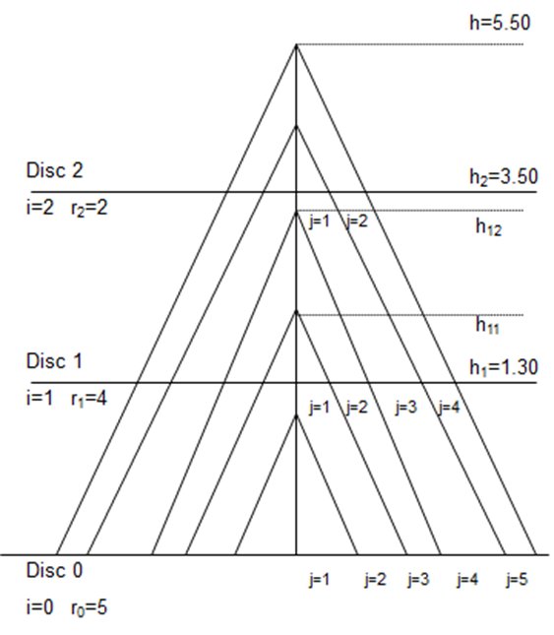
Stem analysis
Carmean’s correction
It is possible to obtain a general formula for the height of any whorl h_{ij}:
is the annual growth between discs i and i+1

