Slide 1

StandsSIM.md - GLOBULUS
The Portuguese management driven forest simulator
Susana Barreiro, Margarida Tomé
Instituto Superior de Agronomia
Universidade de Lisboa

Slide 2
Outline
The Globulus model
  Globulus 2.1 (in Excel)
  Globulus 3.0 (in Excel)
  Globulus 3.0 in StandsSIM.md
Running Globulus in StandsSIM.md in sIMfLOR
  Deep analysis of and understanding of input files

Slide 3
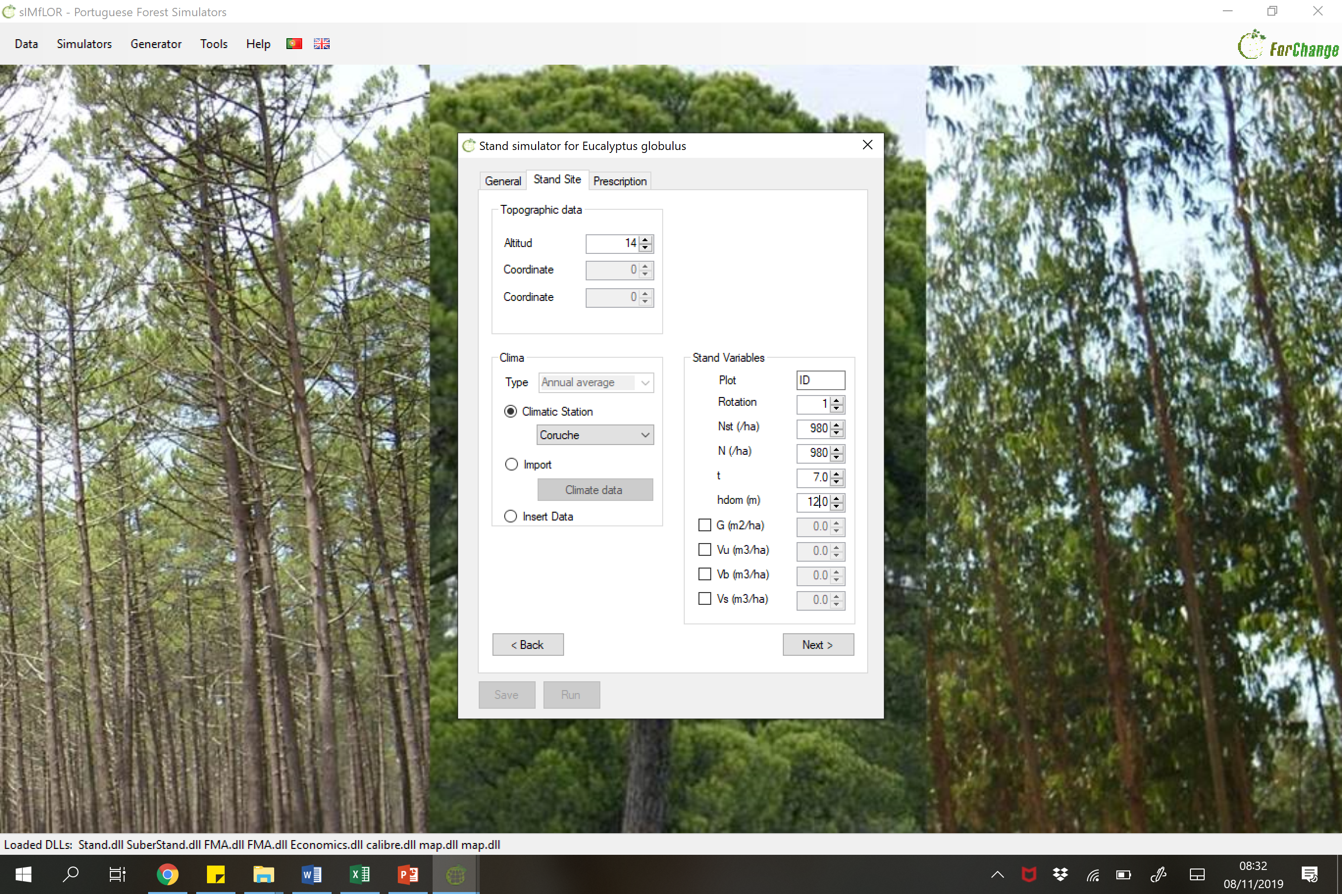
Globulus 3.0 in StandsSIM.md

Slide 4
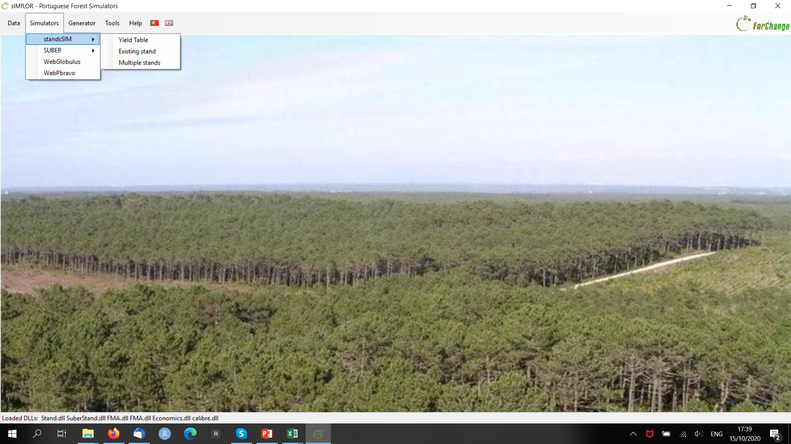
Running Globulus in StandsSIM.md in sIMfLOR

Slide 5
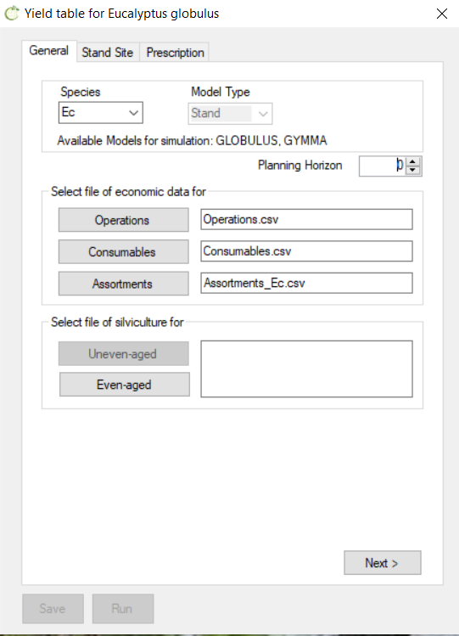
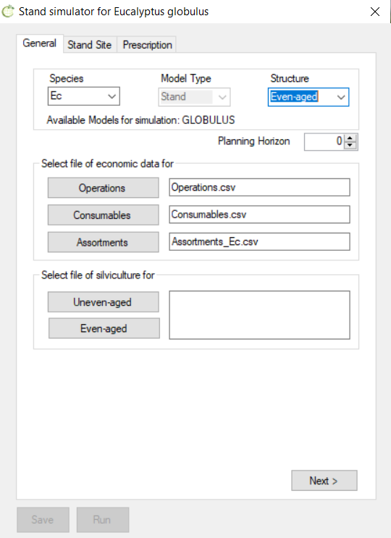

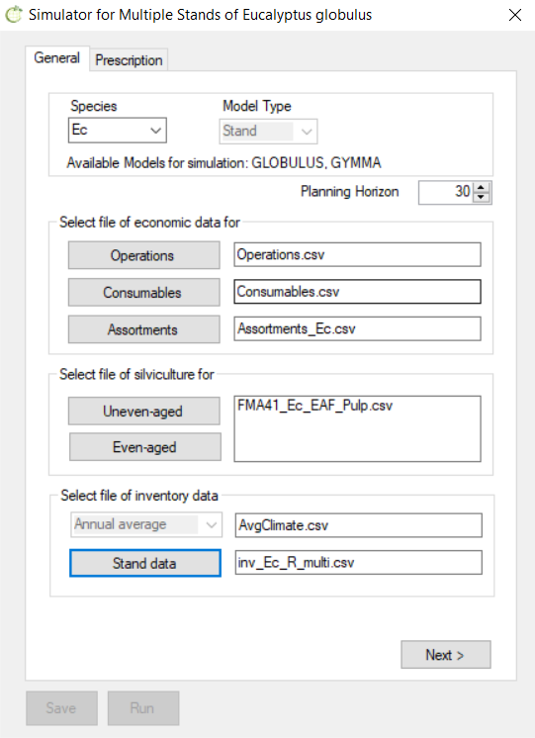
Running Globulus in StandsSIM.md in sIMfLOR
By selecting Eucalyptus as the tree species the interface will direct you to the growth model to be used:
Yield table -> Globulus 3.0
Existing stand \ even-aged -> Globulus 3.0
Existing stand \ uneven-aged -> GYMMA
Multiple stands -> Globulus 3.0 and/or GYMMA (depending on the species and stand structure inside the input file)
Plantations are always even-aged!

Slide 6
Running Globulus in StandsSIM.md in sIMfLOR
5.1.1 A forest owner owns some land and wants to know how much standing volume of eucalyptus he will obtain over the next 30 years if he made a plantation in his property.
Yield table -> Globulus 3.0 (new plantation)
Existing stand \ even-aged -> Globulus 3.0
Existing stand \ uneven-aged -> GYMMA
Multiple stands -> Globulus 3.0 and/or GYMMA (depending on the species and stand structure inside the input file)

Slide 7
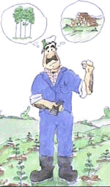
Exercise 5.1.1 a)
Build a yield table for a eucalyptus considering the following information:
Location: Coruche municipality
Altitude: 14 m (if you don’t know the altitude you can use the webGLOBULUS stand simulator to obtain it)
Site index: 15 m (base age 10 years)
Plantation spacing: 4 x 2.5 (the interface requires the number of trees per hectare)
Define a suitable forest management approach (FMA) considering a prescription composed of 3 cycles with 10 years each (one plantation followed by two coppices).

Slide 8
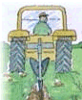
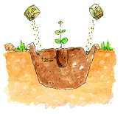
Exercise 5.1.1 a)
FMA
Mr Santos is a forest owner and he asks you to tell him how much standing volume of eucalyptus he would obtain over the next 30 years if he made a plantation in his property.
Build a yield table for a eucalyptus considering the following information:
Location: Coruche municipality
Altitude: 14 m (if you don’t know the altitude you can use the webGLOBULUS stand simulator to obtain it)
Site index: 15 m (base age 10 years)
Plantation spacing: 4 x 2.5 (the interface requires the number of trees per hectare)
Define a suitable forest management approach (FMA) considering a prescription composed of 3 cycles with 10 years each (one plantation followed by two coppices).
Planted
Coppice
Coppice

Slide 9
Exercise 5.1.1 a)
FMA
Mr Santos is a forest owner and he asks you to tell him how much standing volume of eucalyptus he would obtain over the next 30 years if he made a plantation in his property.
Build a yield table for a eucalyptus considering the following information:
Location: Coruche municipality
Altitude: 14 m (if you don’t know the altitude you can use the webGLOBULUS stand simulator to obtain it)
Site index: 15 m (base age 10 years)
Plantation spacing: 4 x 2.5 (the interface requires the number of trees per hectare)
Define a suitable forest management approach (FMA) considering a prescription composed of 3 cycles with 10 years each (one plantation followed by two coppices).
Planted
Coppice
Coppice
= 10 000 / (4 x 2.5)

Slide 10
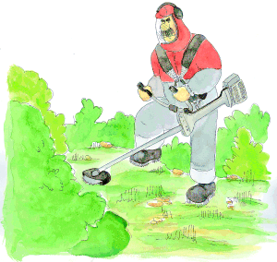
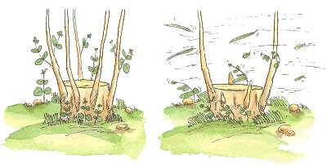
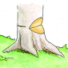
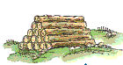
Exercise 5.1.1 a)
FMA
Mr Santos is a forest owner and he asks you to tell him how much standing volume of eucalyptus he would obtain over the next 30 years if he made a plantation in his property.
Build a yield table for a eucalyptus considering the following information:
Location: Coruche municipality
Altitude: 14 m (if you don’t know the altitude you can use the webGLOBULUS stand simulator to obtain it)
Site index: 15 m (base age 10 years)
Plantation spacing: 4 x 2.5 (the interface requires the number of trees per hectare)
Define a suitable forest management approach (FMA) considering a prescription composed of 3 cycles with 10 years each (one plantation followed by two coppices).
Weed control
Weed control
Weed control
Weed control
Shoots selection
Shoots selection
Final harvest 10 yrs
Final harvest 10 yrs
Final harvest 10 yrs
Planted
Coppice
Coppice
= 10 000 / (4 x 2.5) = 1000

Slide 11
Exercise 5.1.1 a)
Ages | Operation | Details
1 | Harrowing and ripping
1 | Planting | xxxxx plants per ha
1 | Fertilizing at planting | 32 g/plant – slow release
1 | Beating up/filling in | 15% of the plants
2, 4 | Weed control | Disk arrow
2, 4 | Fertilization | (150 kg/ha; 250 kg/ha)
10 | Final harvest
3, 5 | Fertilization | (150 kg/ha; 250 kg/ha)
3 | Shoots selection | 1.6 shoots per stool
10 | Final harvest
FMA
Mr Santos is a forest owner and he asks you to tell him how much standing volume of eucalyptus he would obtain over the next 30 years if he made a plantation in his property.
Build a yield table for a eucalyptus considering the following information:
Location: Coruche municipality
Altitude: 14 m (if you don’t know the altitude you can use the webGLOBULUS stand simulator to obtain it)
Site index: 15 m (base age 10 years)
Plantation spacing: 4 x 2.5 (the interface requires the number of trees per hectare)
Define a suitable forest management approach (FMA) considering a prescription composed of 3 cycles with 10 years each (one plantation followed by two coppices).

Slide 12
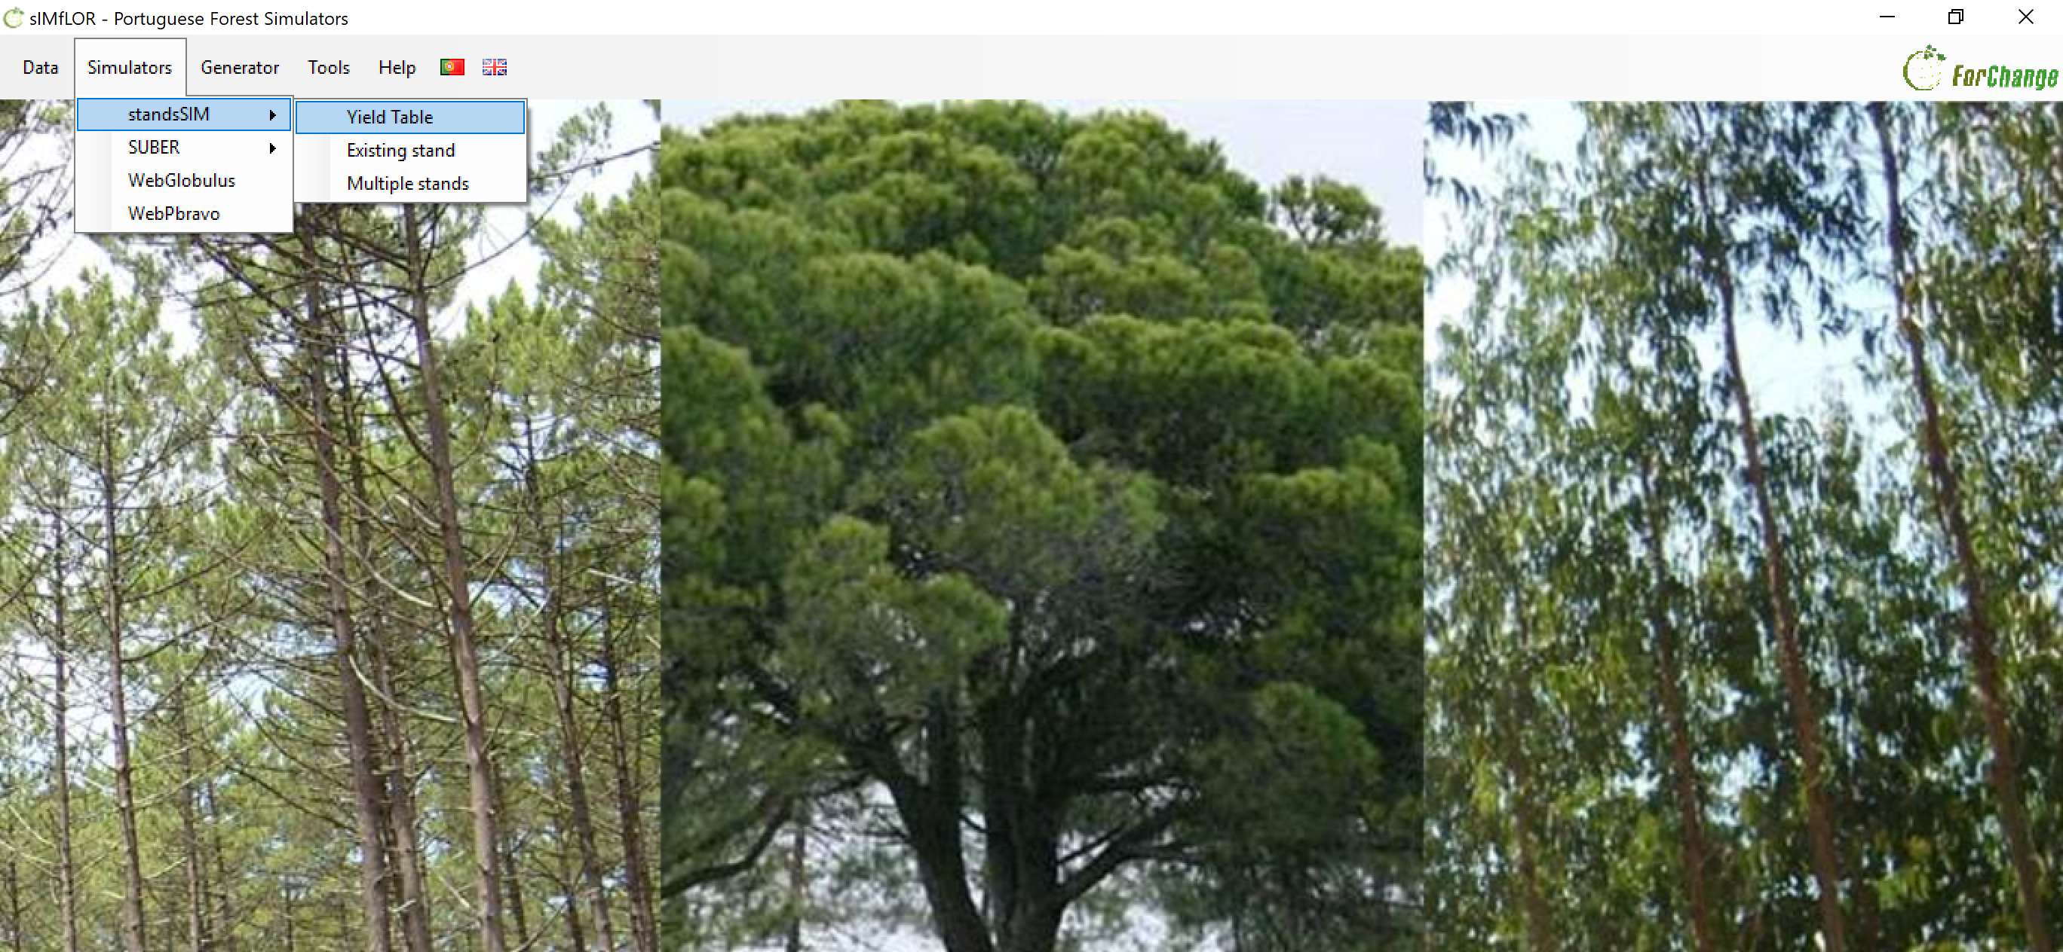
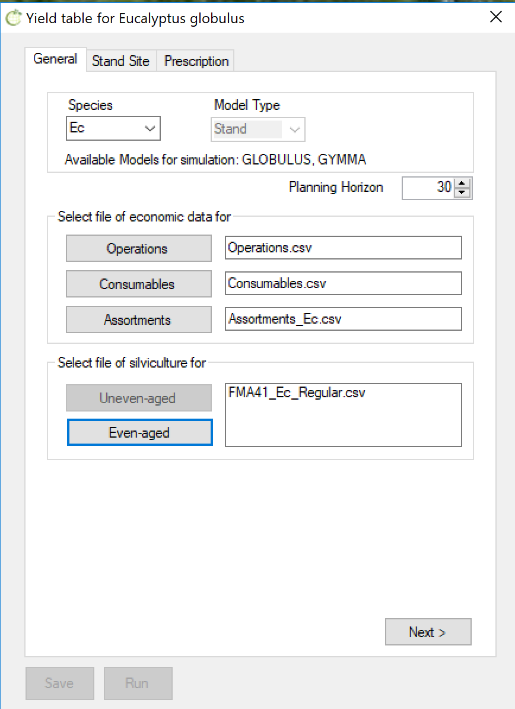

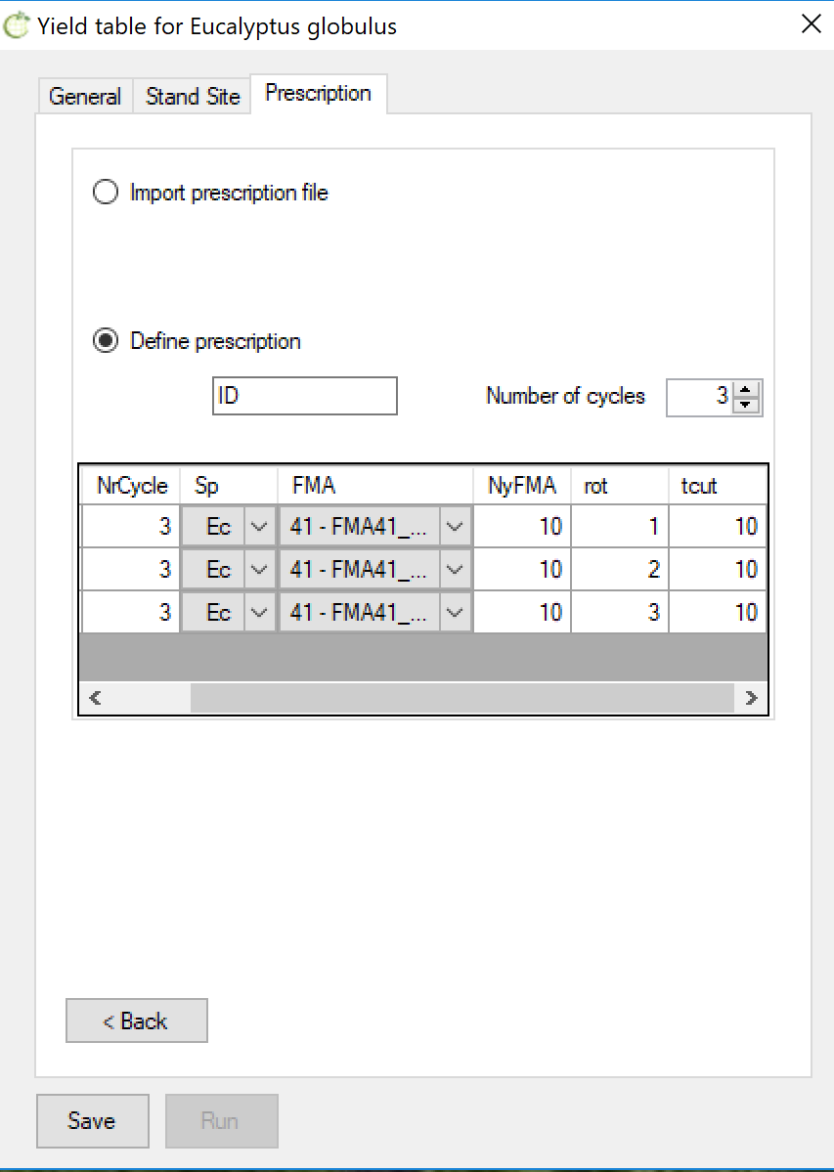
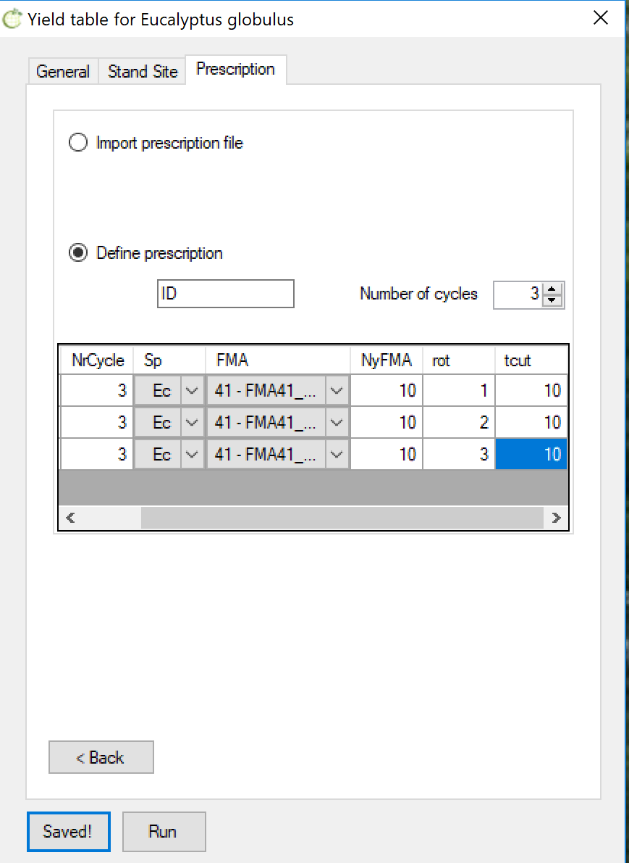
Exercise 5.1.1 a) - solution

Slide 13
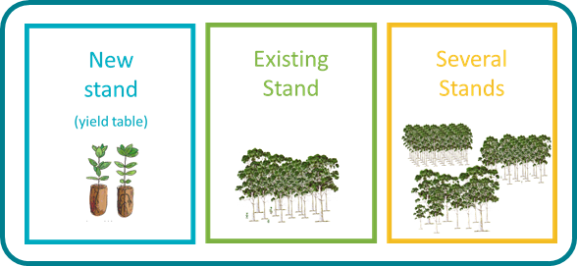
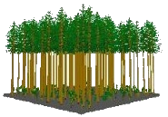
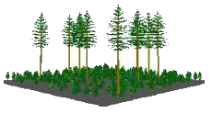
StandsSIM-md structure and inputs
INTERFACE
GENERATOR
Other inputs & simulation parameters
ini_standsSIM.csv
Assortment_ec.csv
Forest Resources
t
Planning horizon
INTERFACE
Forest Resources
t+1
Growth models
Consumables.csv
Forest managment (FMA)
Even- and uneven-aged
Prescriptions
One or a set per stand
input_stand.csv
Operations.csv
GLOBULUS
GYMMA
3PG-OUT+
PINASTER
PBIRROL
PINEA
Castanea.pt
FMA_##_Ec_*.csv
Input_prescr.csv
Other drivers:
Land Use changes (afforestation)
Climate
Input_clima.csv
input_stand.csv
inv_sps_arv*.csv
StandsSIM.md
Annual outputs
INTERFACE

Slide 14
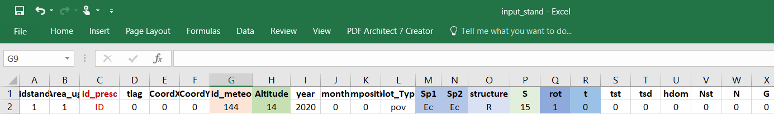
Exercise 5.1.1 a) - solution

Slide 15
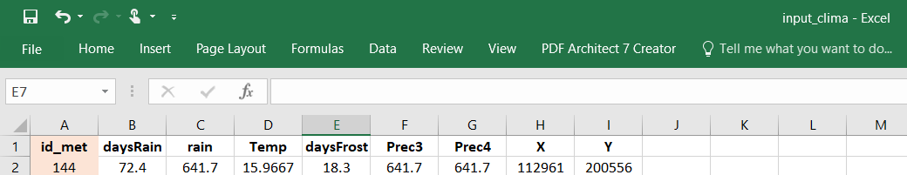
Exercise 5.1.1 a) - solution

Slide 16
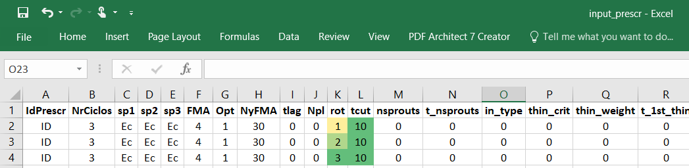
Exercise 5.1.1 a) - solution

Slide 17
…\SIMFLOR_2017\STANDSSIM\GLOBULUS\input_stand.csv
…\SIMFLOR_2017\STANDSSIM\GLOBULUS\input_clima.csv
…\SIMFLOR_2017\STANDSSIM\GLOBULUS\input_prescr.csv
…\SIMFLOR_2017\STANDSSIM\ini_standsSIM.csv
Exercise 5.1.1 a) - solution
input_stand.csv
Input_clima.csv
Input_prescr.csv
ini_standsSIM.csv

Slide 18
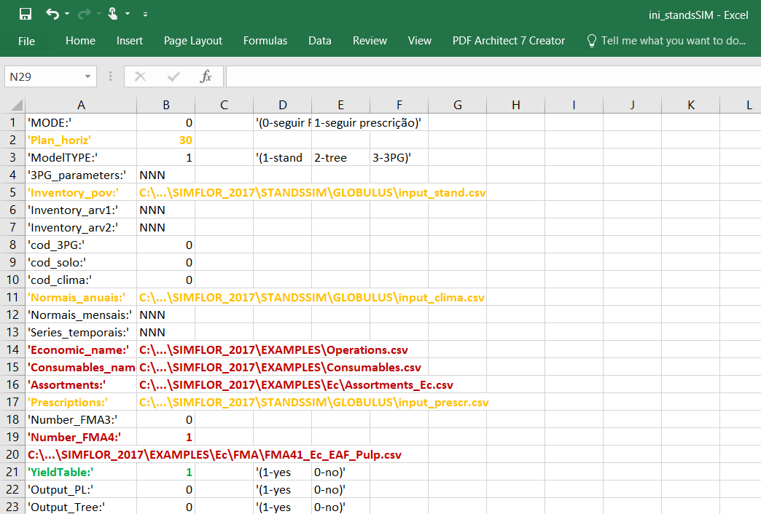
…\SIMFLOR_2017\STANDSSIM\GLOBULUS\input_stand.csv
…\SIMFLOR_2017\STANDSSIM\GLOBULUS\input_clima.csv
…\SIMFLOR_2017\STANDSSIM\GLOBULUS\input_prescr.csv
…\SIMFLOR_2017\STANDSSIM\ini_standsSIM.csv
Exercise 5.1.1 a) - solution
input_stand.csv
Input_clima.csv
Input_prescr.csv
ini_standsSIM.csv

Slide 19
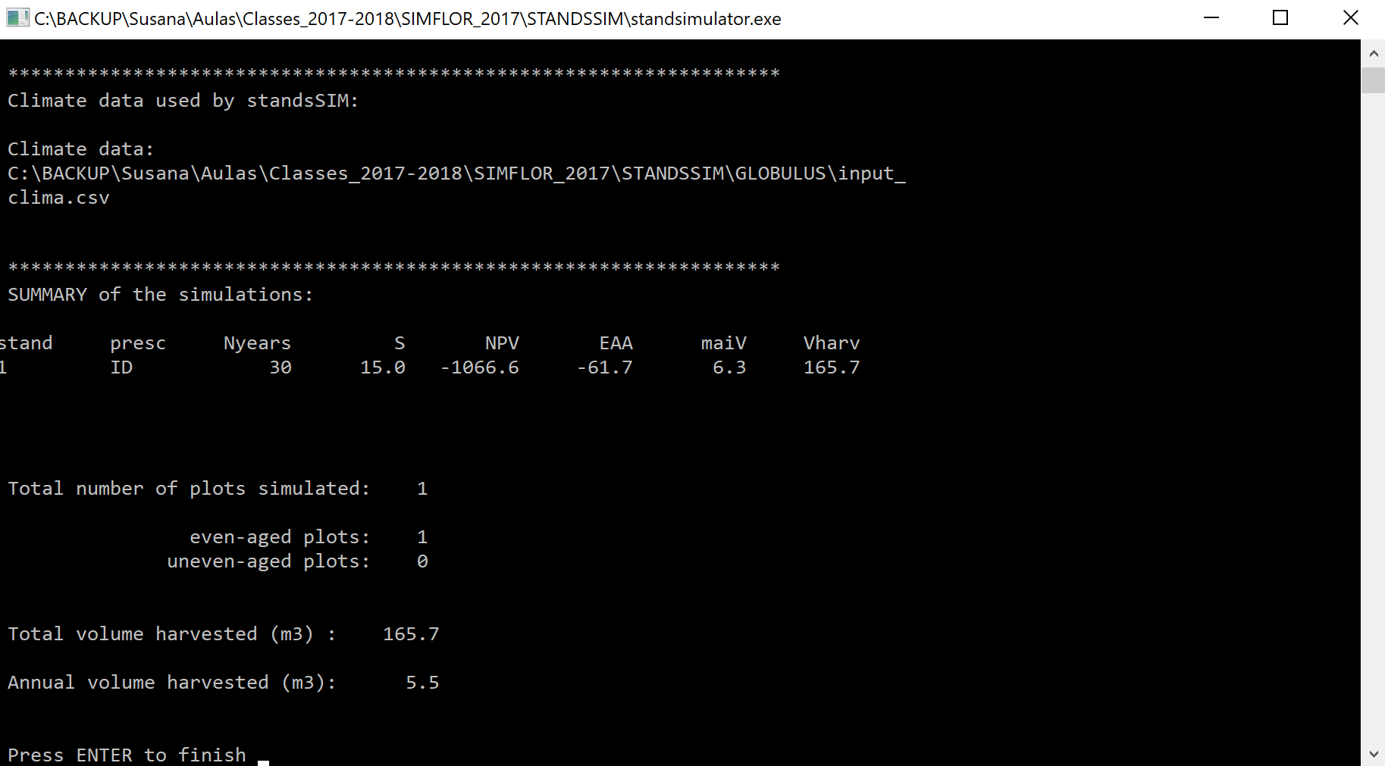
Exercise 5.1.1 a) - solution

Slide 20
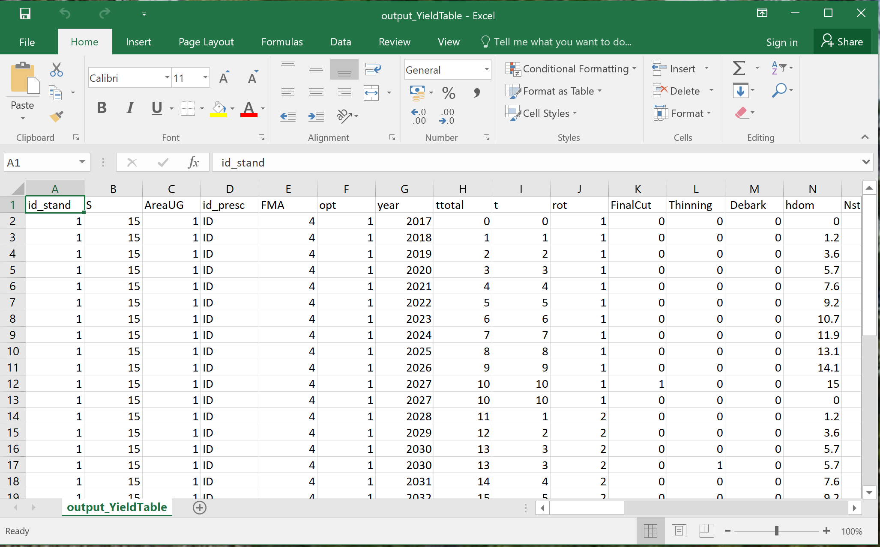
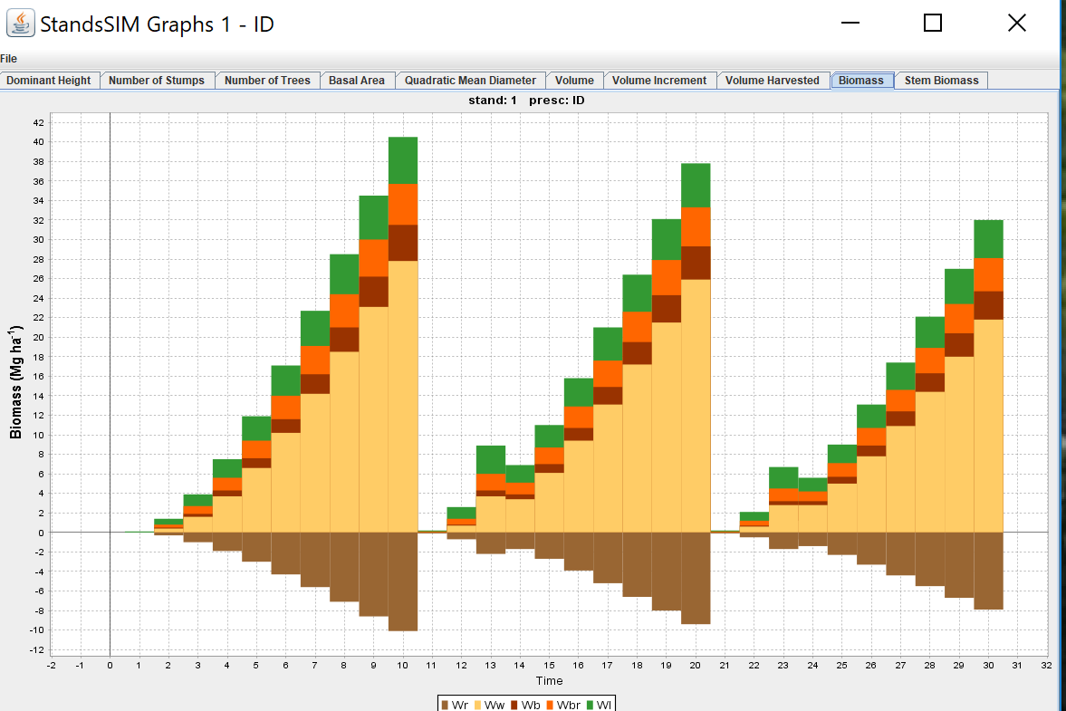
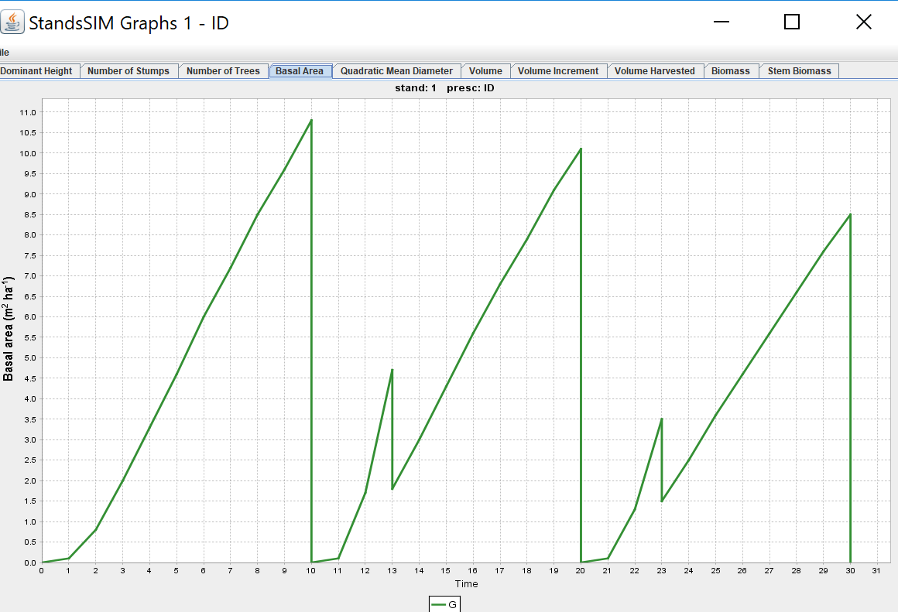

Exercise 5.1.1 a) - solution

Slide 21
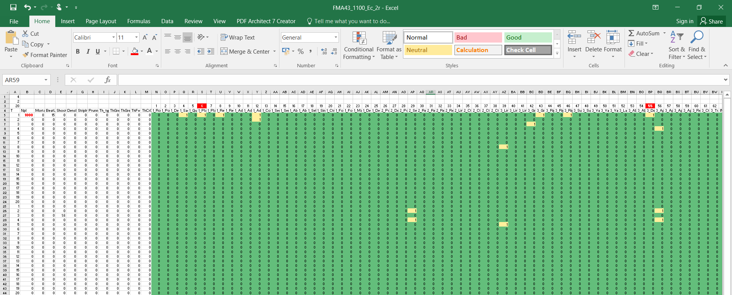
Exercise 5.1.1 a) - variants
What if the initial density was 1250?
What if he had to carry out a stump destruction?

Slide 22
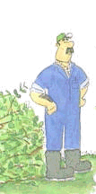
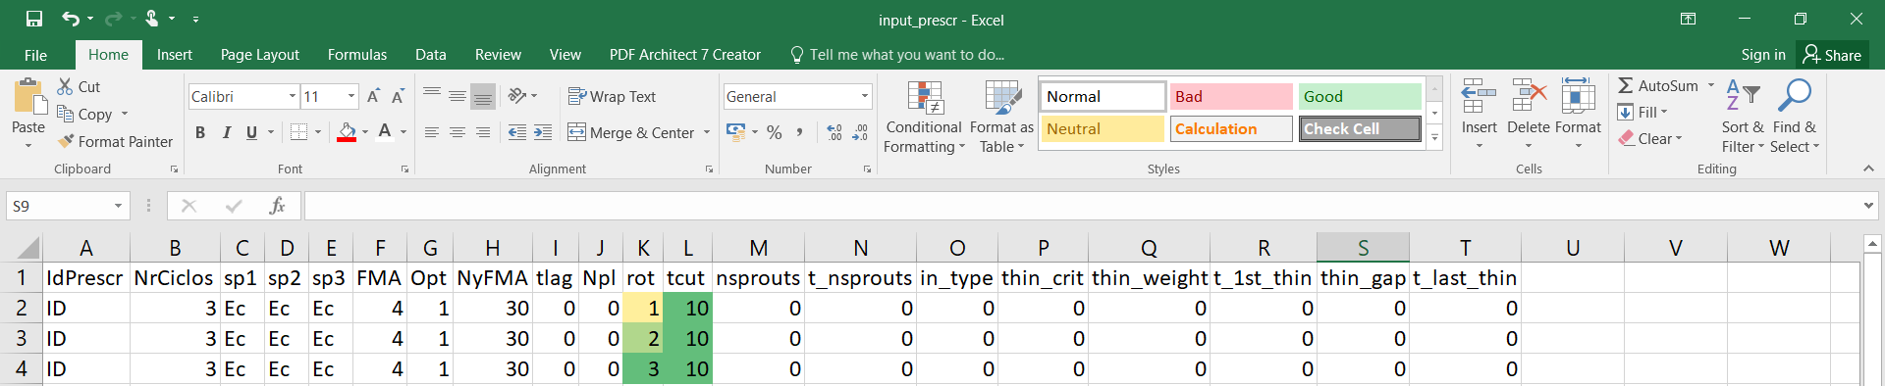
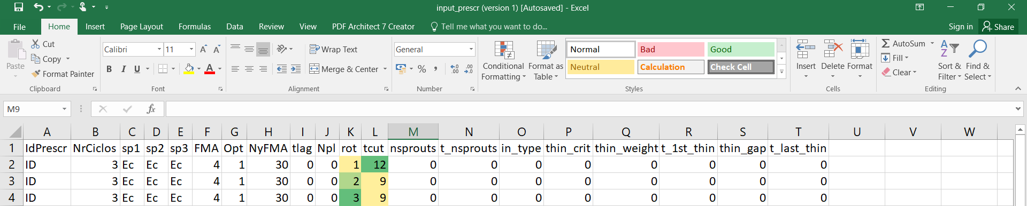
Exercise 5.1.1 b)
For a planning horizon of 30 years compare the following prescriptions:
Compare both simulations and discuss the results.
10
10
10
12
9
9

Slide 23
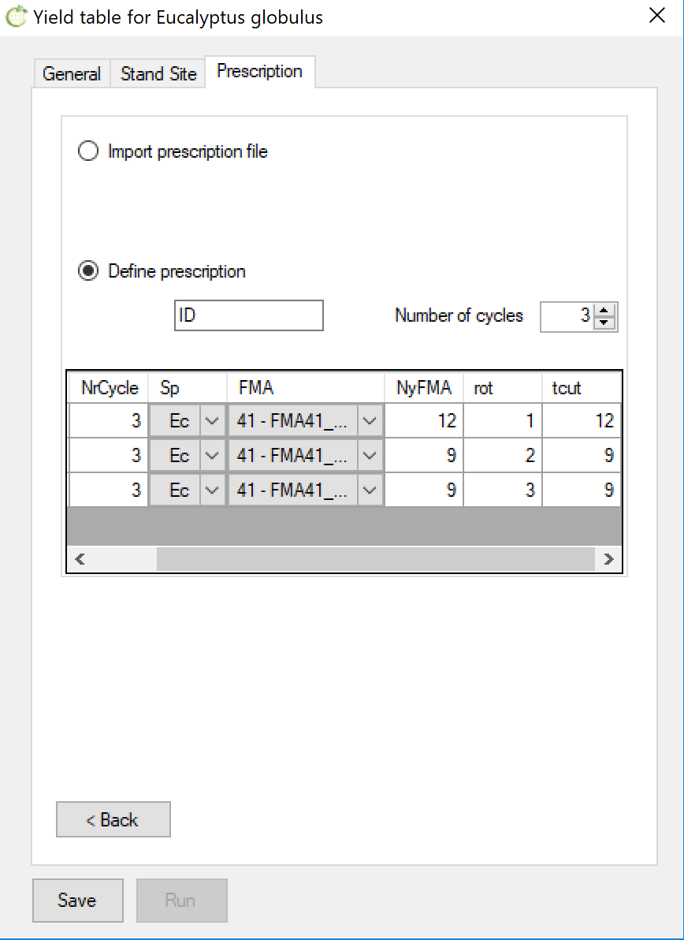
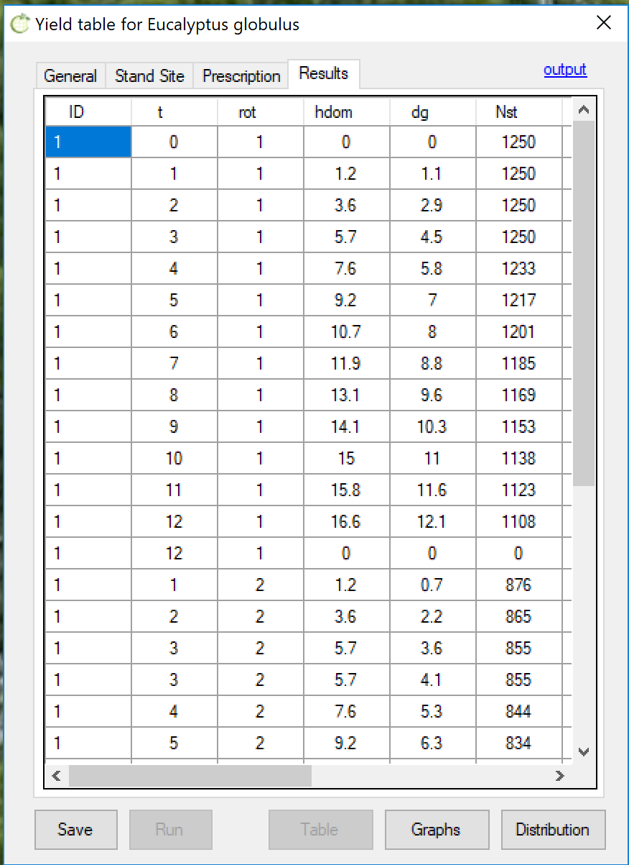
Exercise 5.1.1 b)

Slide 24
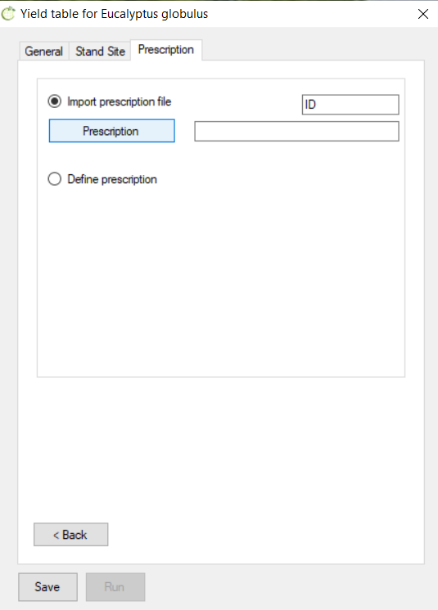
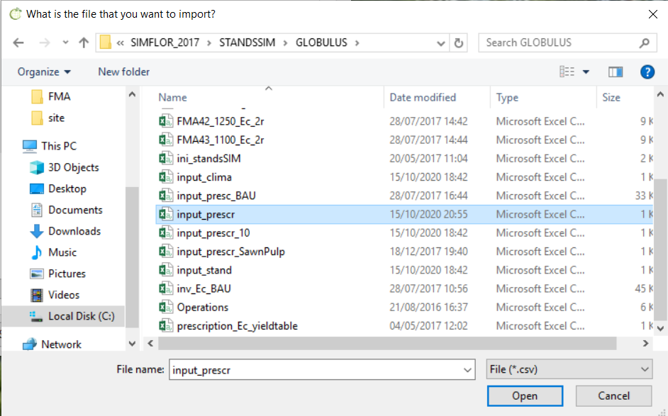
Because we are using GLOBULUS/Ec the prescription file was saved at:
…\SIMFLOR_2017\STANDSSIM\GLOBULUS\input_prescr.csv
If you go to the prescription tab and generate a new prescription with harvest ages of 12, 9, 9 as you’re being requested, you will see the simulator will update the content of the file and you’ll loose the previous prescription (harvest ages of 10, 10, 10 ).
Alternatively to using the tab to generate the cycles, now that you know the location of the file and understand its structure, you can edit the input_prescr.csv to the new harvest ages and import this new file.
Exercise 5.1.1 b)

Slide 25
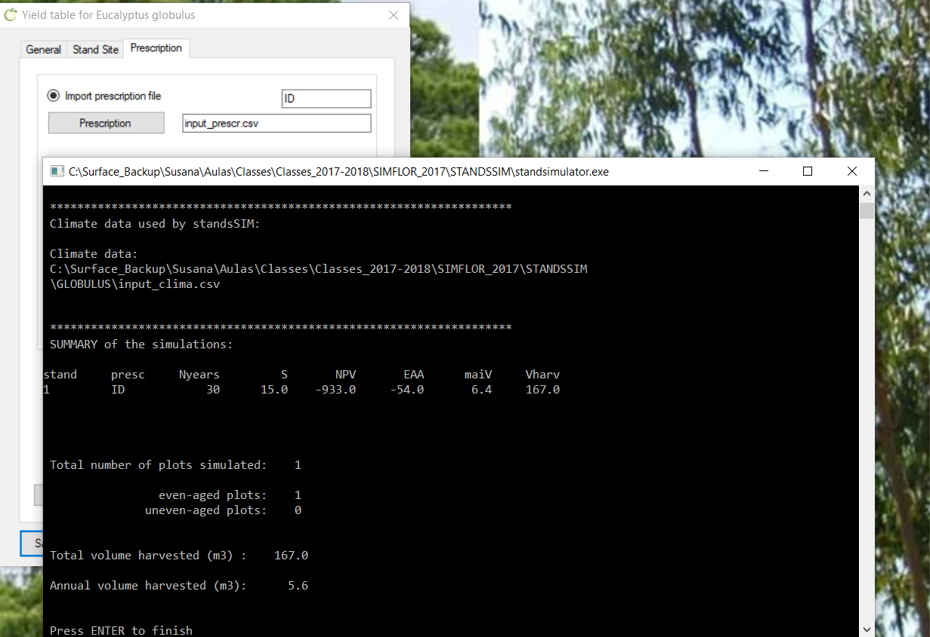
Because we are using GLOBULUS/Ec the prescription file was saved at:
…\SIMFLOR_2017\STANDSSIM\GLOBULUS\input_prescr.csv
If you go to the prescription tab and generate a new prescription with harvest ages of 12, 9, 9 as you’re being requested, you will see the simulator will update the content of the file and you’ll loose the previous prescription (harvest ages of 10, 10, 10 ).
Alternatively to using the tab to generate the cycles, now that you know the location of the file and understand its structure, you can edit the input_prescr.csv to the new harvest ages and import this new file.
Exercise 5.1.1 b)

Slide 26
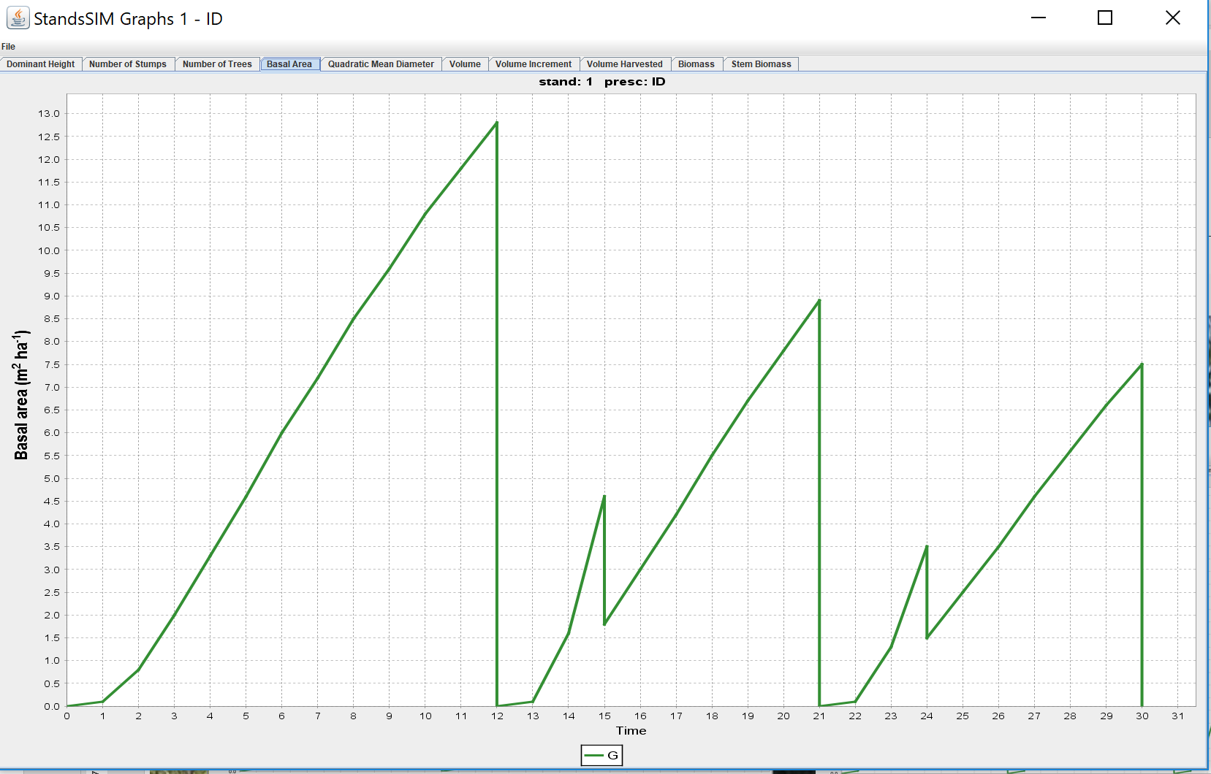
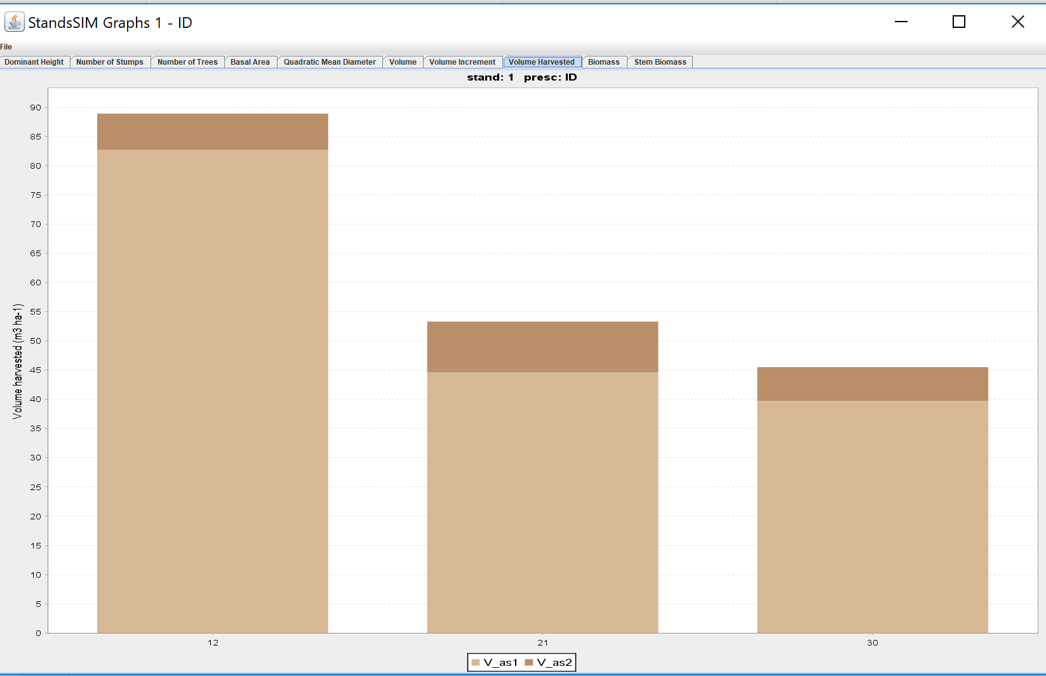
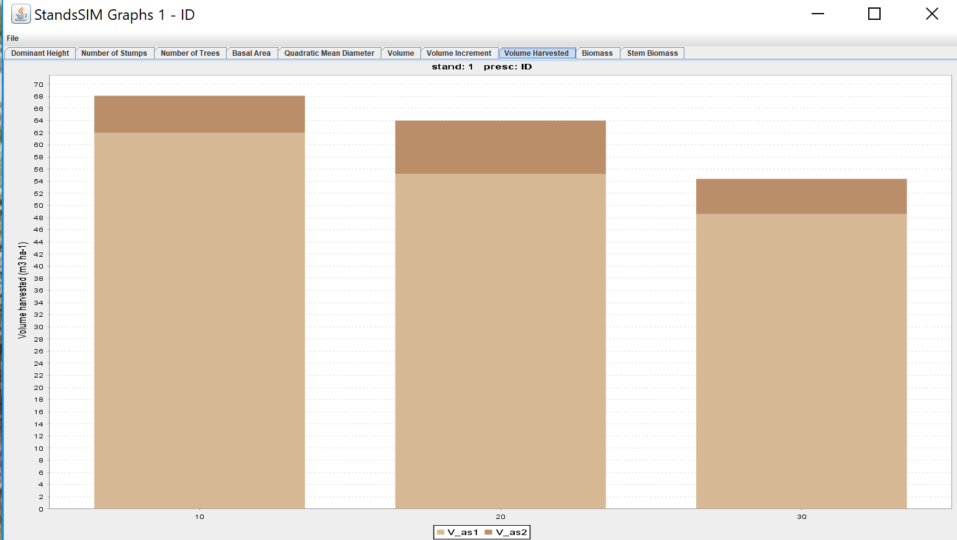
Exercise 5.1.1 b)

Slide 27
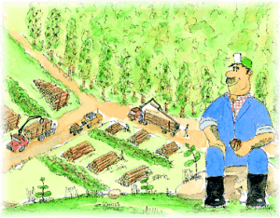
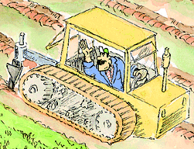
Exercise 5.1.2
For a planning horizon of 60 years compare the following prescriptions:
6 cycles for each the plantation is harvested at age 10, followed by 5 coppices always harvested at age 10
b) 6 cycles all harvested at age 10, but considering a replantation in the 4th cycle. Please note that soil preparation when replanting is different which implies the definition of 2 different FMAs.
Stump destruction

Slide 28

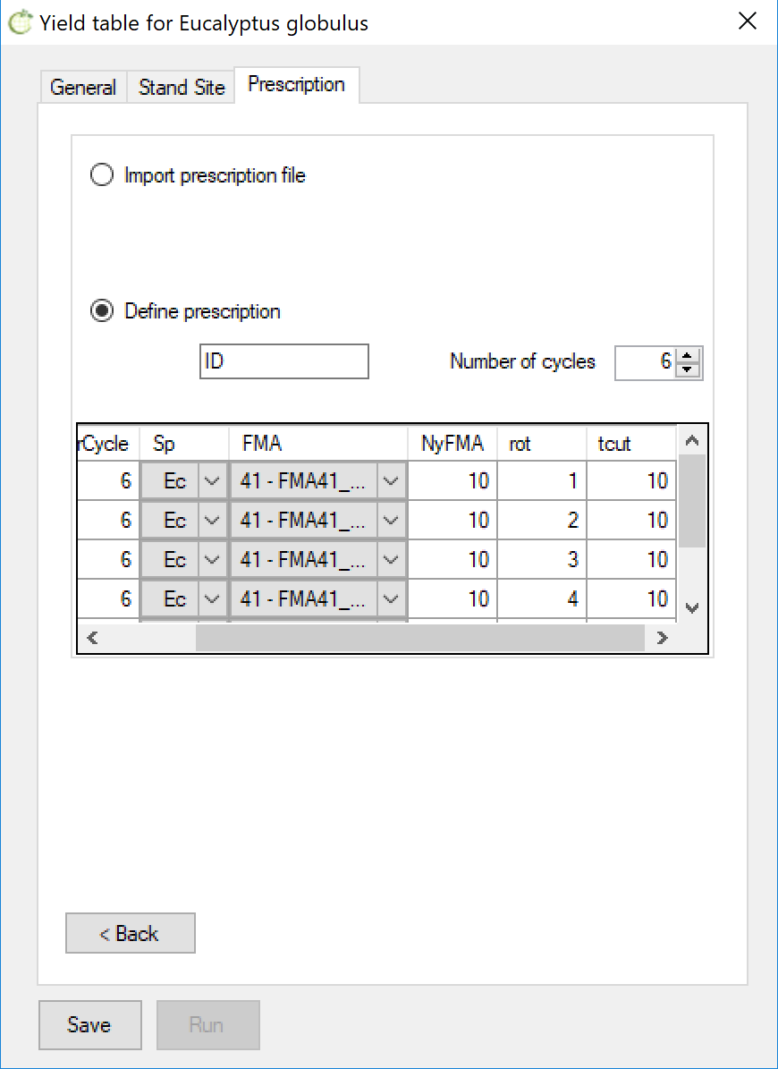
Exercise 5.1.2 – solution (option a)

Slide 29
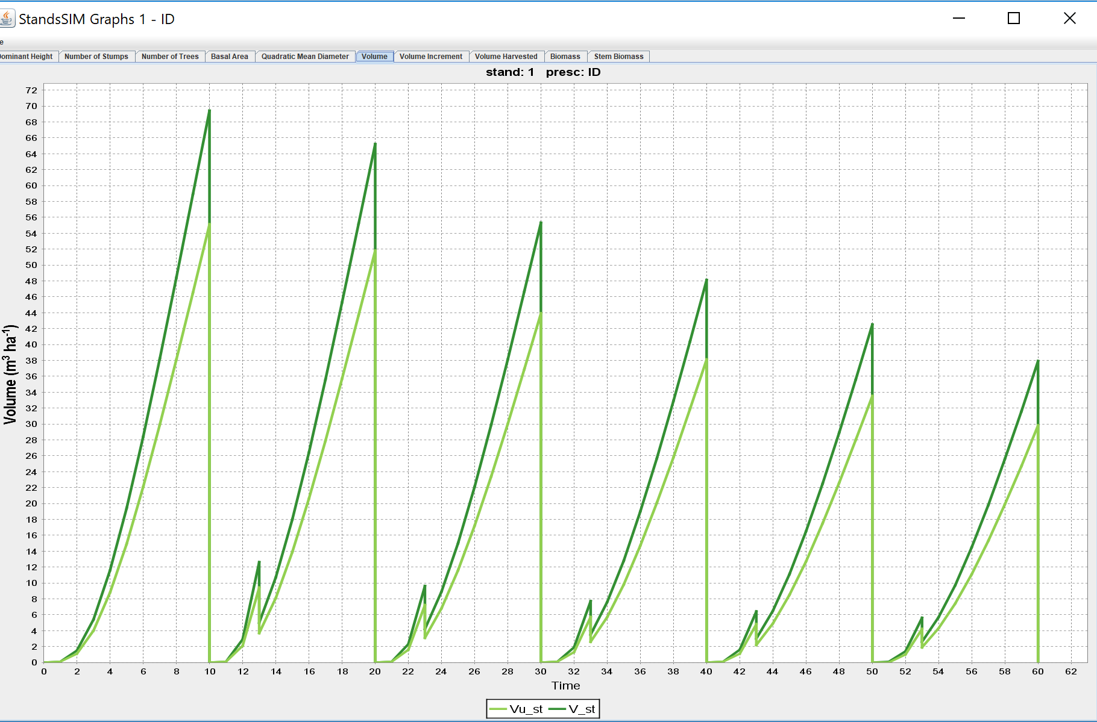
Exercise 5.1.2 – solution (option a)

Slide 30


Exercise 5.1.2 – solution (option b)

Slide 31
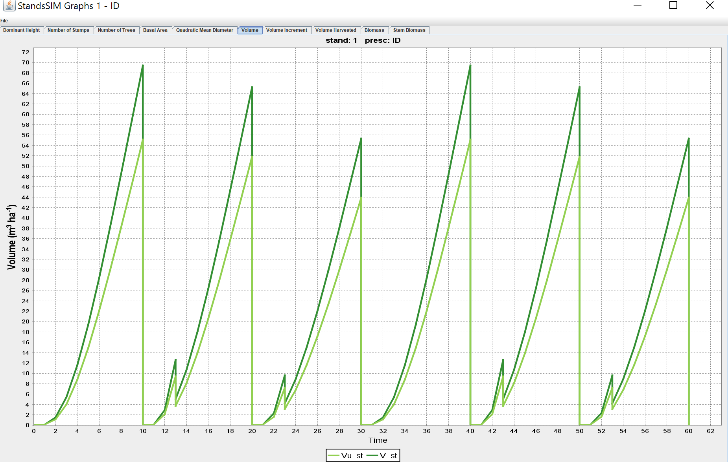
Exercise 5.1.2 – solution (option b)

Slide 32
Exercise 5.1.2 – solution (options a and b)

Slide 33

Exercise 5.1.3
Suppose that another landowner wants you to simulate his existing stand:
Location: Coruche municipality
Age: 7 years
Dominant height: 12 m
Stand density: 980 trees ha⁻¹
Altitude: 14 m (if you don’t know the altitude you can use the webGLOBULUS stand simulator to obtain it)
Define a suitable FMA and consider the same prescription as before: 3 cycles with 10 years each (one plantation followed by two coppices).
You will likely get the message: “terminated before the planning horizon – check prescriptions” because the 3 cycles only cover 23 years (3 years for the plantation and 10+10 for coppice). Therefore, in order to run the simulation, you will have to define another cycle or change the planning horizon. Having more than the required number of cycles represents no problem for StandsSIM.

Slide 34
Exercise 5.1.3
Defining the number of prescription cycles to cover the planning horizon when simulating a yield table is straightforward
However, when your existing stand is older, the FMA file for the first cycle starts being read at the age of the stand (e.g 7 years). As a result, the number of years simulated under the 1st cycle is smaller, often leading to incomplete prescriptions
A simple way to solve it is guaranteeing we add one or two extra cycles to the prescription

Slide 35
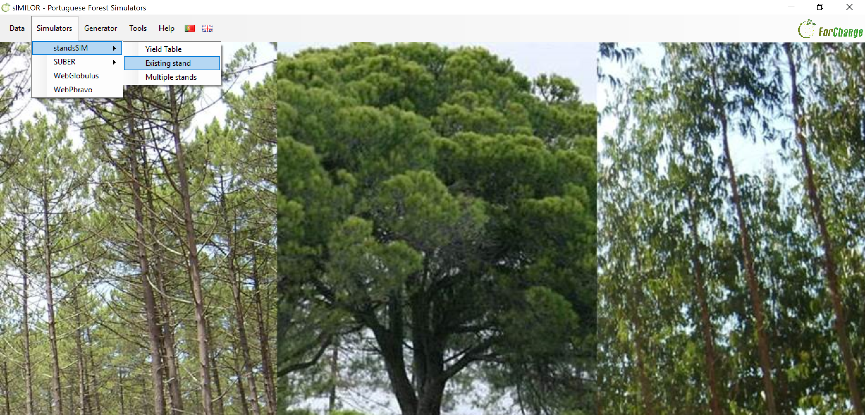
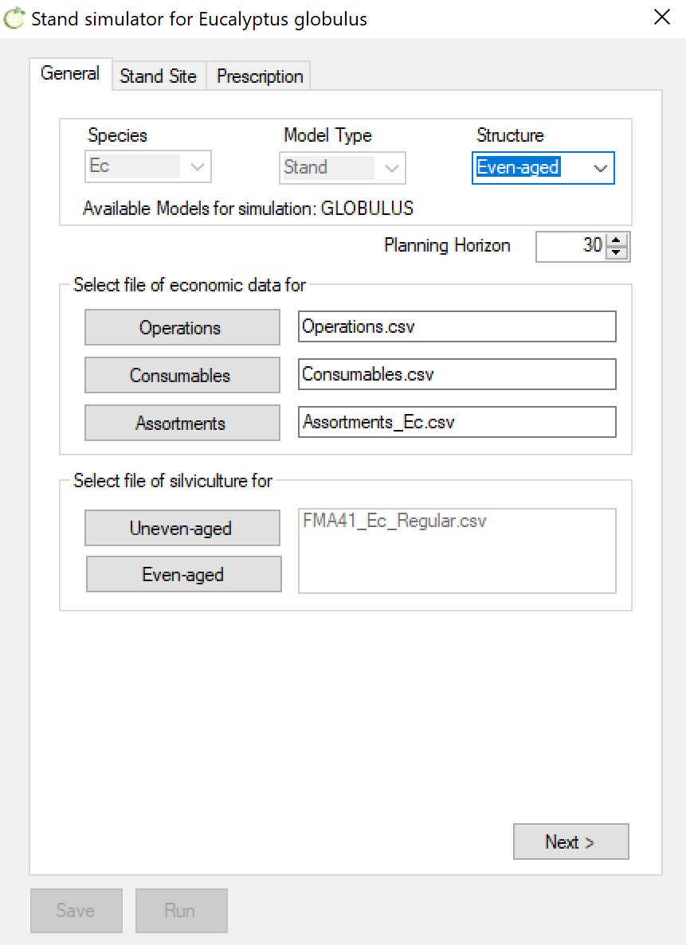

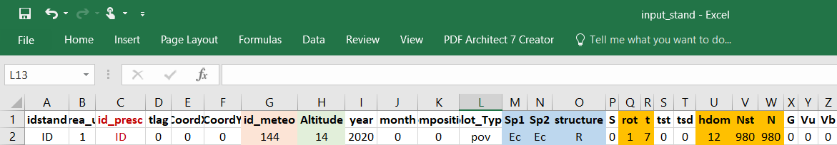
Exercise 5.1.3 - solution

Slide 36
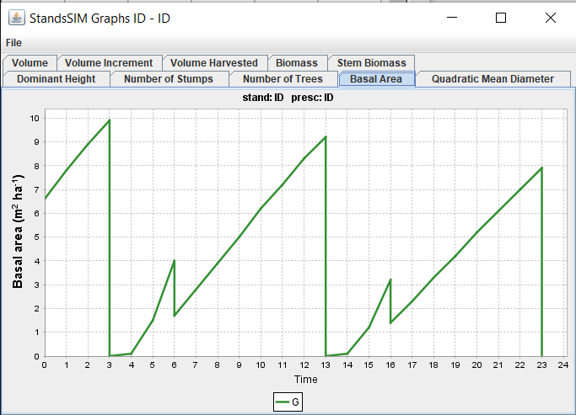
Exercise 5.1.3 - solution
Didn't reach the 30 yrs planning horizon!!!

Slide 37
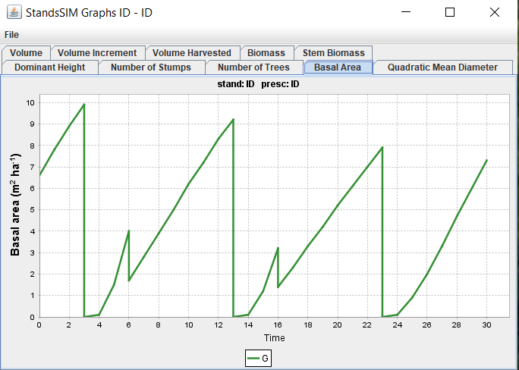
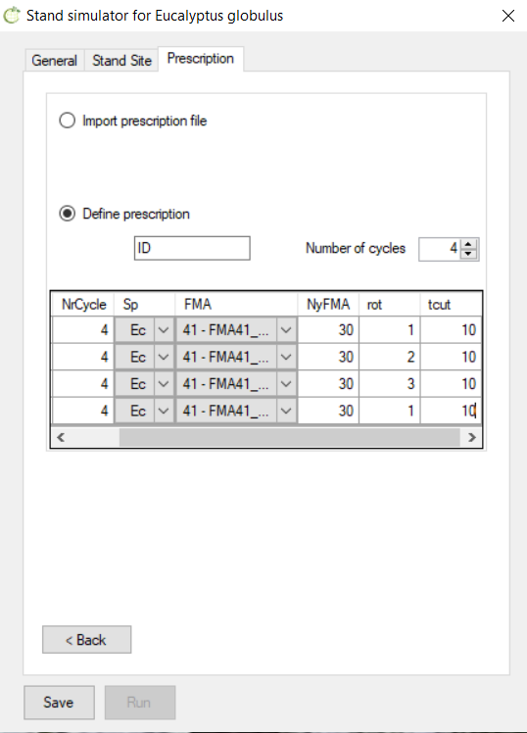
Exercise 5.1.3 - solution
Planning horizon was met!!!

Slide 38

Globulus 2.1 (in Excel)

Slide 39

Globulus 2.1 (in Excel)

Slide 40



Globulus 2.1 (in Excel)

Slide 41


Globulus 3.0 (in Excel)
Growth Module: hdom₂ = f (t₁, t₂, hdom₁, Rain)

Slide 42

Globulus 3.0 (in Excel)
Growth Module: Nst₂ = f (t₁, t₂, Nst₁, NPL, rotation)

Slide 43

Globulus 3.0 (in Excel)
Growth Module: G₂ = f (t₁, t₂, Nst₁, Nst₂, G₂, rotation, Rain, altitude)

Slide 44


Globulus 3.0 (in Excel)
Module calculus: Vdi = (Vu, Vs, dg, Altitude, S, NPL, top_diameter)

Slide 45

Globulus 3.0 (in Excel)
Module calculus: Ww = (t, hdom, G, Nst, S, rotation)

Slide 46


Globulus 3.0 (in Excel)
Module inicialization: hdom = f( t, Rain, S)

Slide 47

Globulus 3.0 (in Excel)
Module inicialization: G = f( t, Nst, Rain, Altitude, S, NPL, rotation)

Slide 48



Globulus and GYMMA - descriptions and equations

