Slide 1
16.43
Suppose we have a tree with a total height of 16.43 m

Slide 2
16.43
Suppose we have a tree with a total height of 16.43 m

Slide 3
16.43
Suppose we have a tree with a total height of 16.43 m

Slide 4
16.43
Suppose we have a tree with a total height of 16.43 m

Slide 5
16.43
Suppose we have a tree with a total height of 16.43 m

Slide 6
16.43
Suppose we have a tree with a total height of 16.43 m

Slide 7

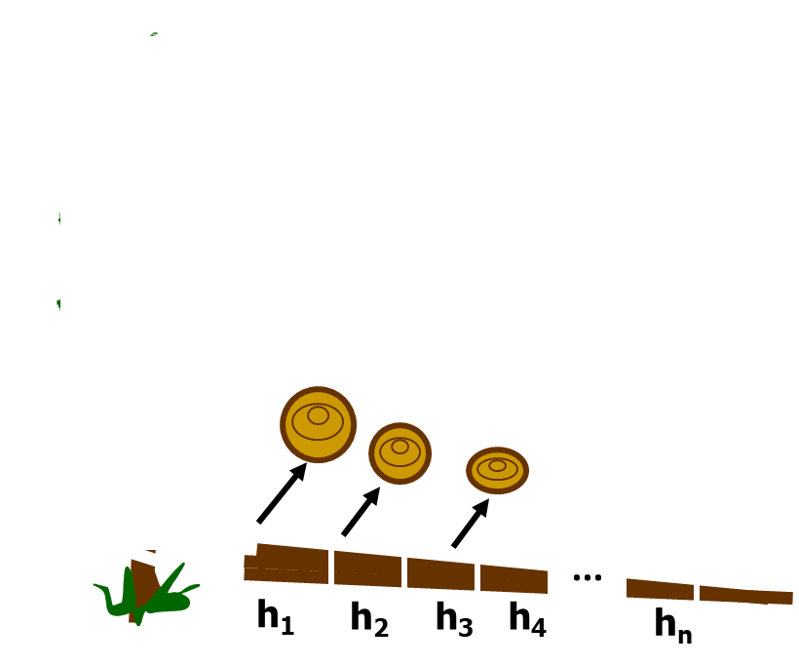
We cut this tree and sample discs at different height from the soil (m) and count the number of rings in each disc
Rings
=
29 years

Slide 8
Number of rings
16.43
height from the soil (m)
5
14.50
We cut this tree and sample discs at different height from the soil (m) and count the number of rings in each disc
6
14.00
8
13.30
11
11.30
15
9.30
18
7.30
21
5.30
Rings
=
29 years
25
3.30
27
1.30
29
0.15

Slide 9
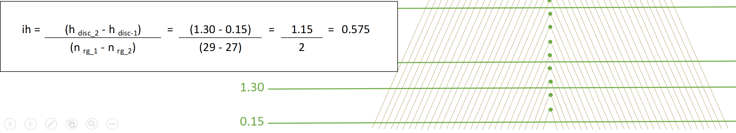
With this information we want to determine the evolution of tree height over time, however a bias in height determination for given ages results because the cut will seldom occur at the tip of a terminal leader (whorl) requiring a correction method to be applied.
Carmean’s method is based on two assumptions:
  Constant annual increment in height between two discs
  Each disc occurs at the mid-point between two whorls
Age 1 -> 0.15 + 0.575/2 = 0.4375
Age 2 -> 0.4375 + 0.575 = 1.01
27
0.575
29
0.575/2

Slide 10
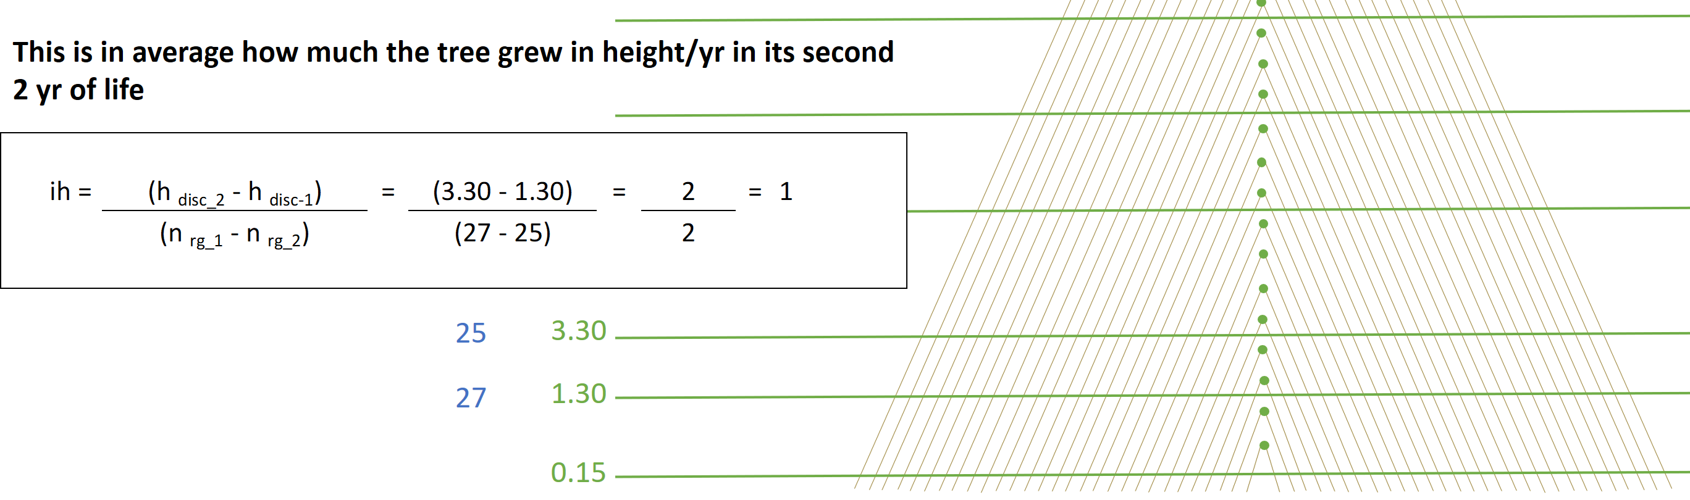
Carmean’s method is based on two assumptions:
  Constant annual increment in height between two discs
  Each disc occurs at the mid-point between two whorls
Age 1 -> 0.15 + 0.575/2 = 0.4375
Age 2 -> 0.4375 + 0.575 = 1.01
Age 3 -> 1.30 + 1 / 2 = 1.8
Age 4 -> 1.8 + 1 = 2.8
1
1/2

Slide 11
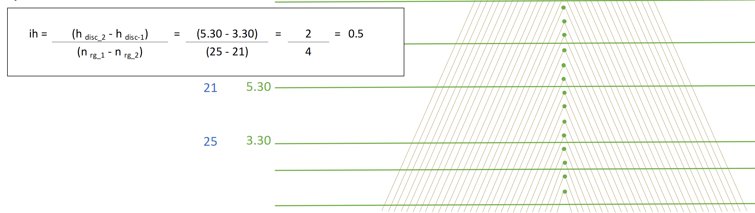
Carmean’s method is based on two assumptions:
  Constant annual increment in height between two discs
  Each disc occurs at the mid-point between two whorls
Age 1 -> 0.15 + 0.575/2 = 0.4375
Age 2 -> 0.4375 + 0.575 = 1.01
Age 3 -> 1.30 + 1 / 2 = 1.8
Age 4 -> 1.8 + 1 = 2.8
Age 5 -> 3.30 + 0.5 / 2 = 3.55
Age 6 -> 3.55 + 0.5 = 4.05
Age 7 -> 4.05 + 0.5 = 4.55
Age 8 -> 4.55 + 0.5 = 5.05
0.5
0.5
0.5
0.5/2

Slide 12
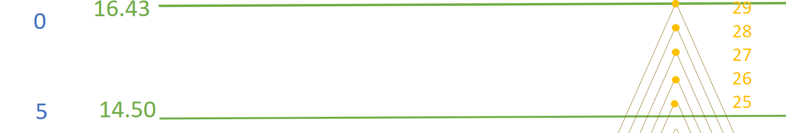
Nr of rings
height from the soil (m)
Tree age
0.386
0.386
0.386
0.386
0.386/2
Age 1 -> 0.15 + 0.575/2 = 0.4375
Age 2 -> 0.4375 + 0.575 = 1.01
Age 3 -> 1.30 + 1 / 2 = 1.8
Age 4 -> 1.8 + 1 = 2.8
Age 5 -> 3.30 + 0.5 / 2 = 3.55
Age 6 -> 3.55 + 0.5 = 4.05
Age 7 -> 4.05 + 0.5 = 4.55
Age 8 -> 4.55 + 0.5 = 5.05
…
Age 25 -> 14.50 + 0.386 /2 = 14.69
Age 26 -> 14.69 + 0.386 = 15.08
Age 27 -> 15.08 + 0.386 = 15.47
Age 28 -> 15.47 + 0.386 = 15.85
Age 29 -> 15.85 + 0.386 = 16.43

