Slide 1

StandsSIM.md
The Portuguese management driven forest simulator
Using the GENERATOR for producing FMAs
(exercises 3.1-3.11)
Susana Barreiro, Margarida Tomé
Instituto Superior de Agronomia
Universidade de Lisboa

Slide 2
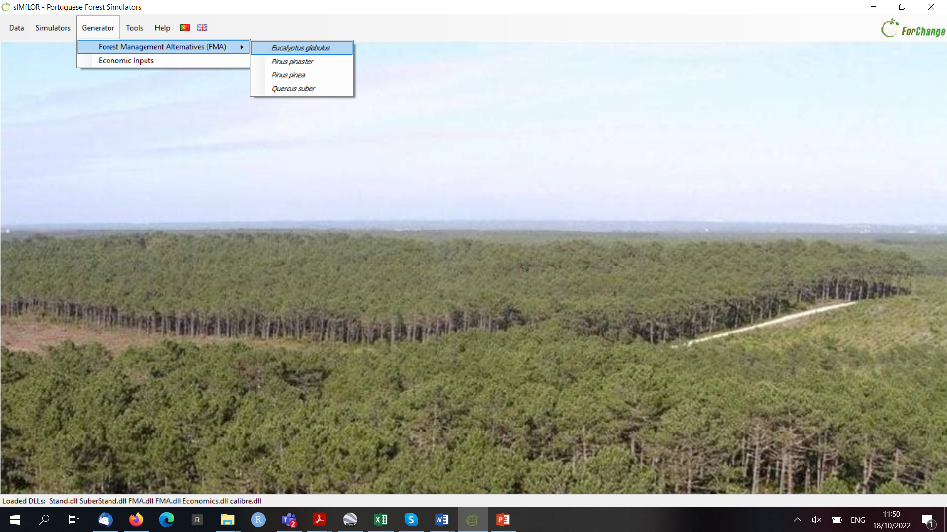
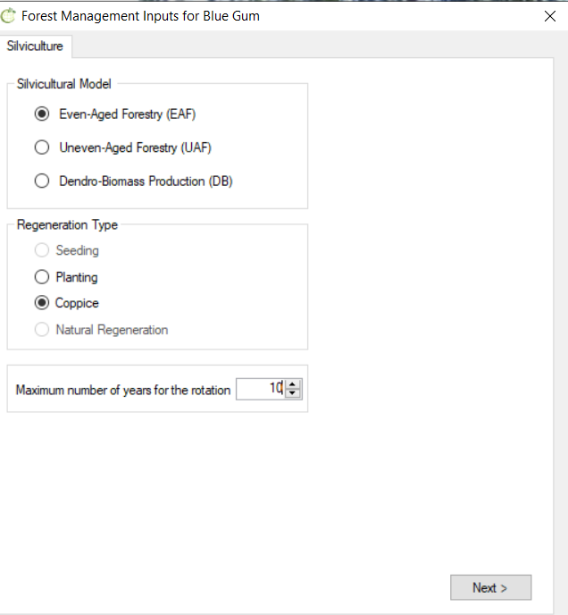
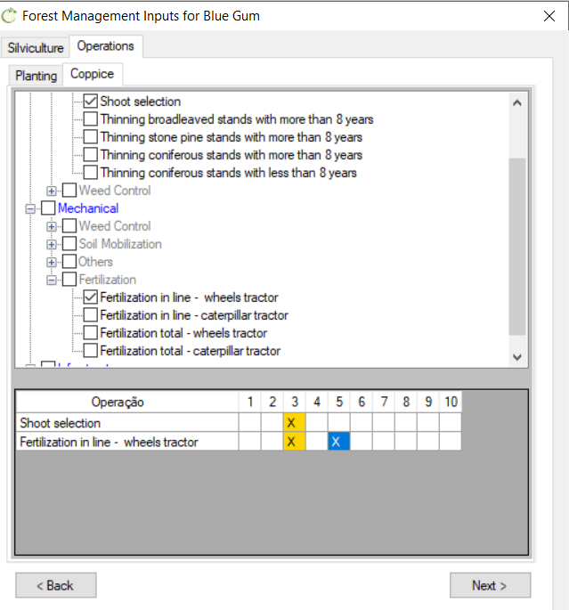
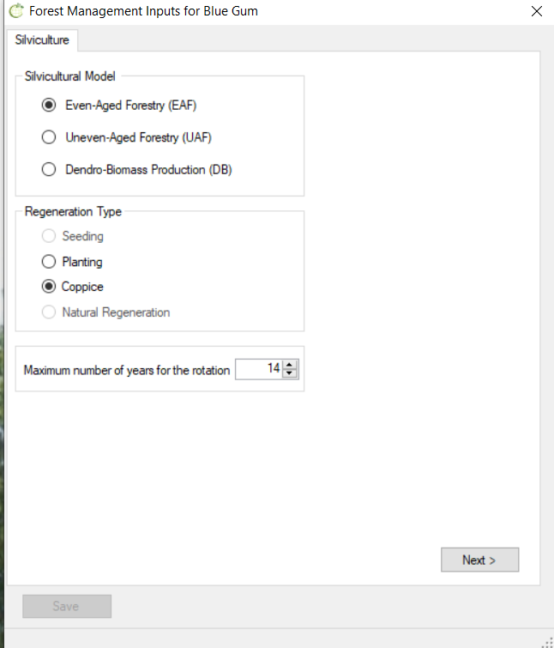
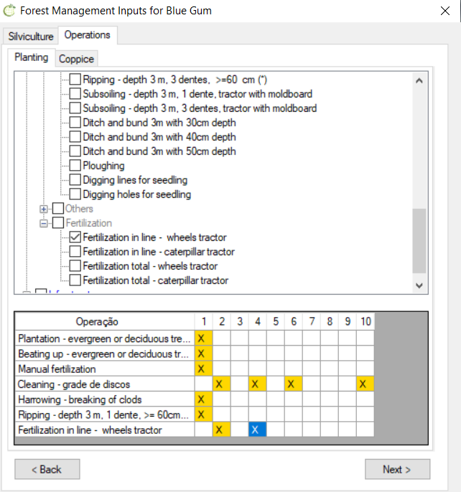
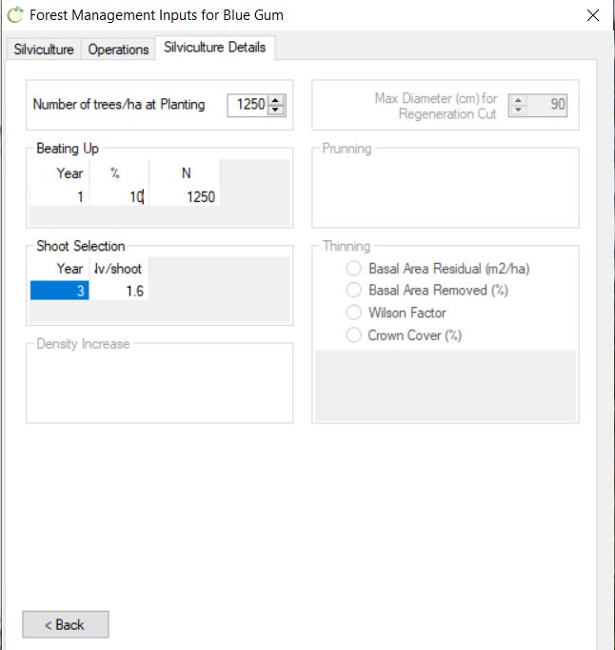
Exercise 3.1 - FMA4.1_Ec

Slide 3
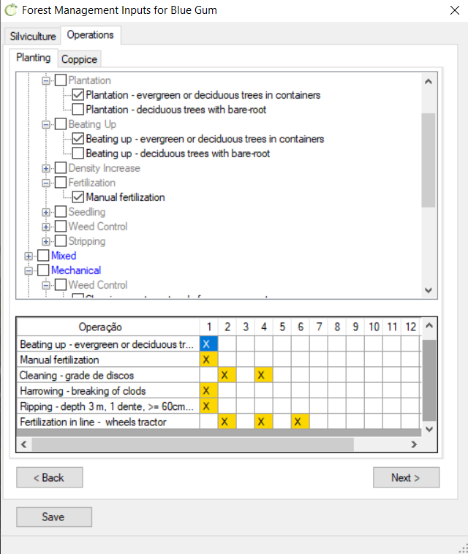
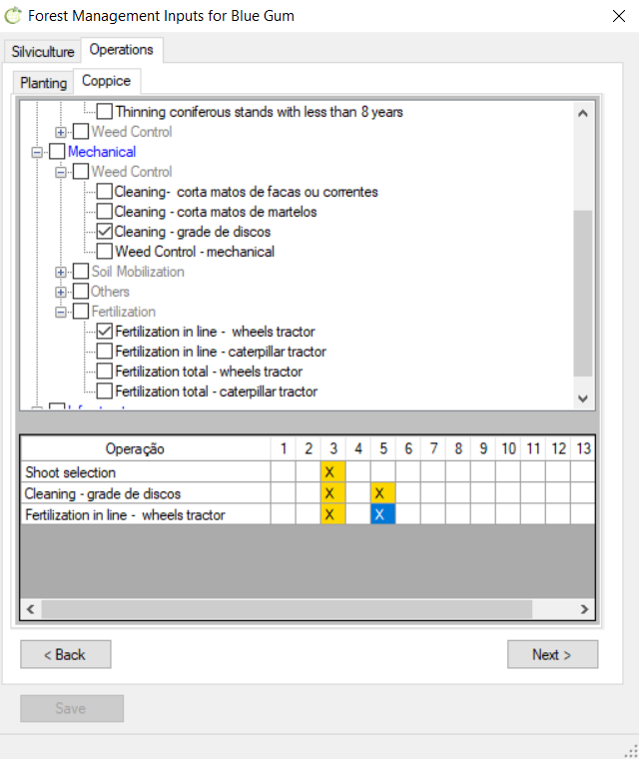
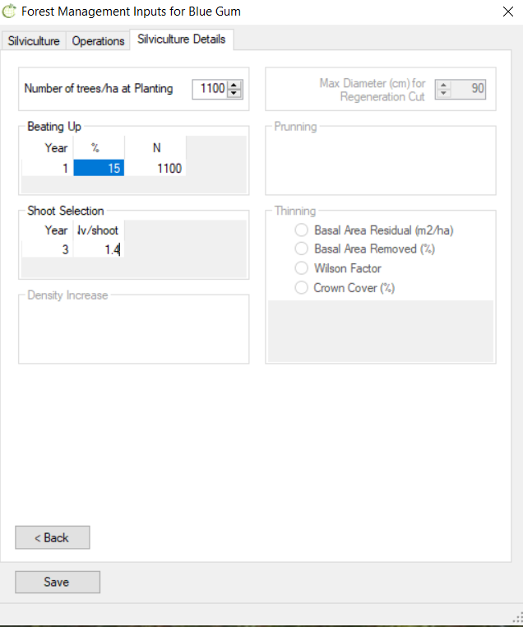
Exercise 3.2 - FMA4.2_Ec

Slide 4
  Exercise 3.3 - Could you apply FMA4.1 and FMA4.2 if you wished to simulate the growth of only 1 coppice or would you have to change something in the FMA generation process? Justify.
  Exercise 3.4 - Would you be able to use FMA4.1 and 4.2 (defined for maximum ages of 10 and 14, respectively) to simulate eucalyptus growth considering an harvest age of 12 years? Justify and describe any inconvenience you might see in that.
  Exercise 3.5 - Would you be able to apply FMA4.1 or 4.2 if you only wished to simulate consecutive plantations (without benefiting from E. globulus resprouting ability)? Justify.
  Exercise 3.6 - Describe how you would have to proceed if you were asked to generate an FMA similar to FMA4.1, but considering a stump destruction operation had to be performed before planting.
  Exercise 3.7 - Suppose a forest owner decides to manage E. globulus for sawlog production. Propose an FMA considering a rotation cycle of 40 years.

Slide 5
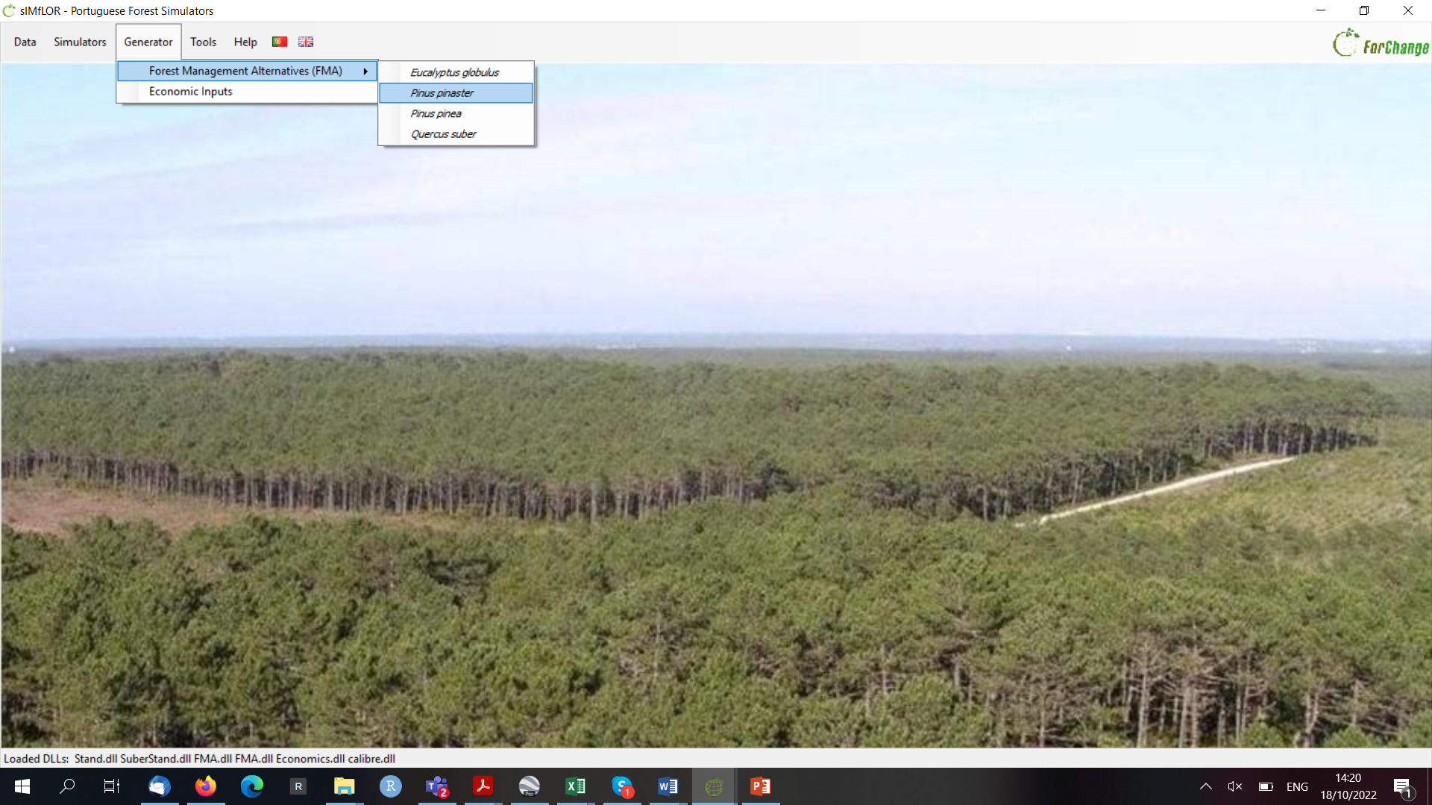
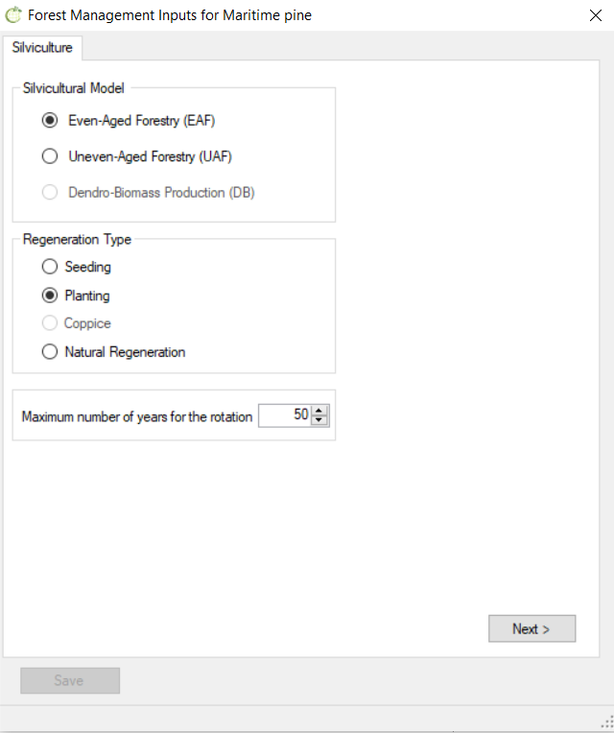
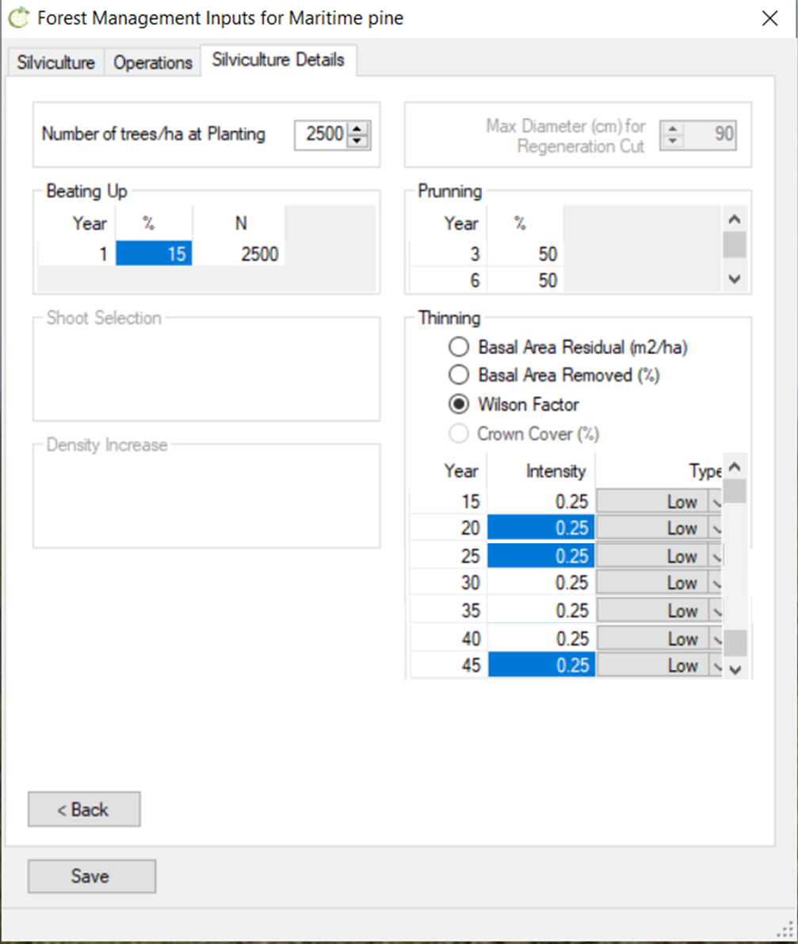
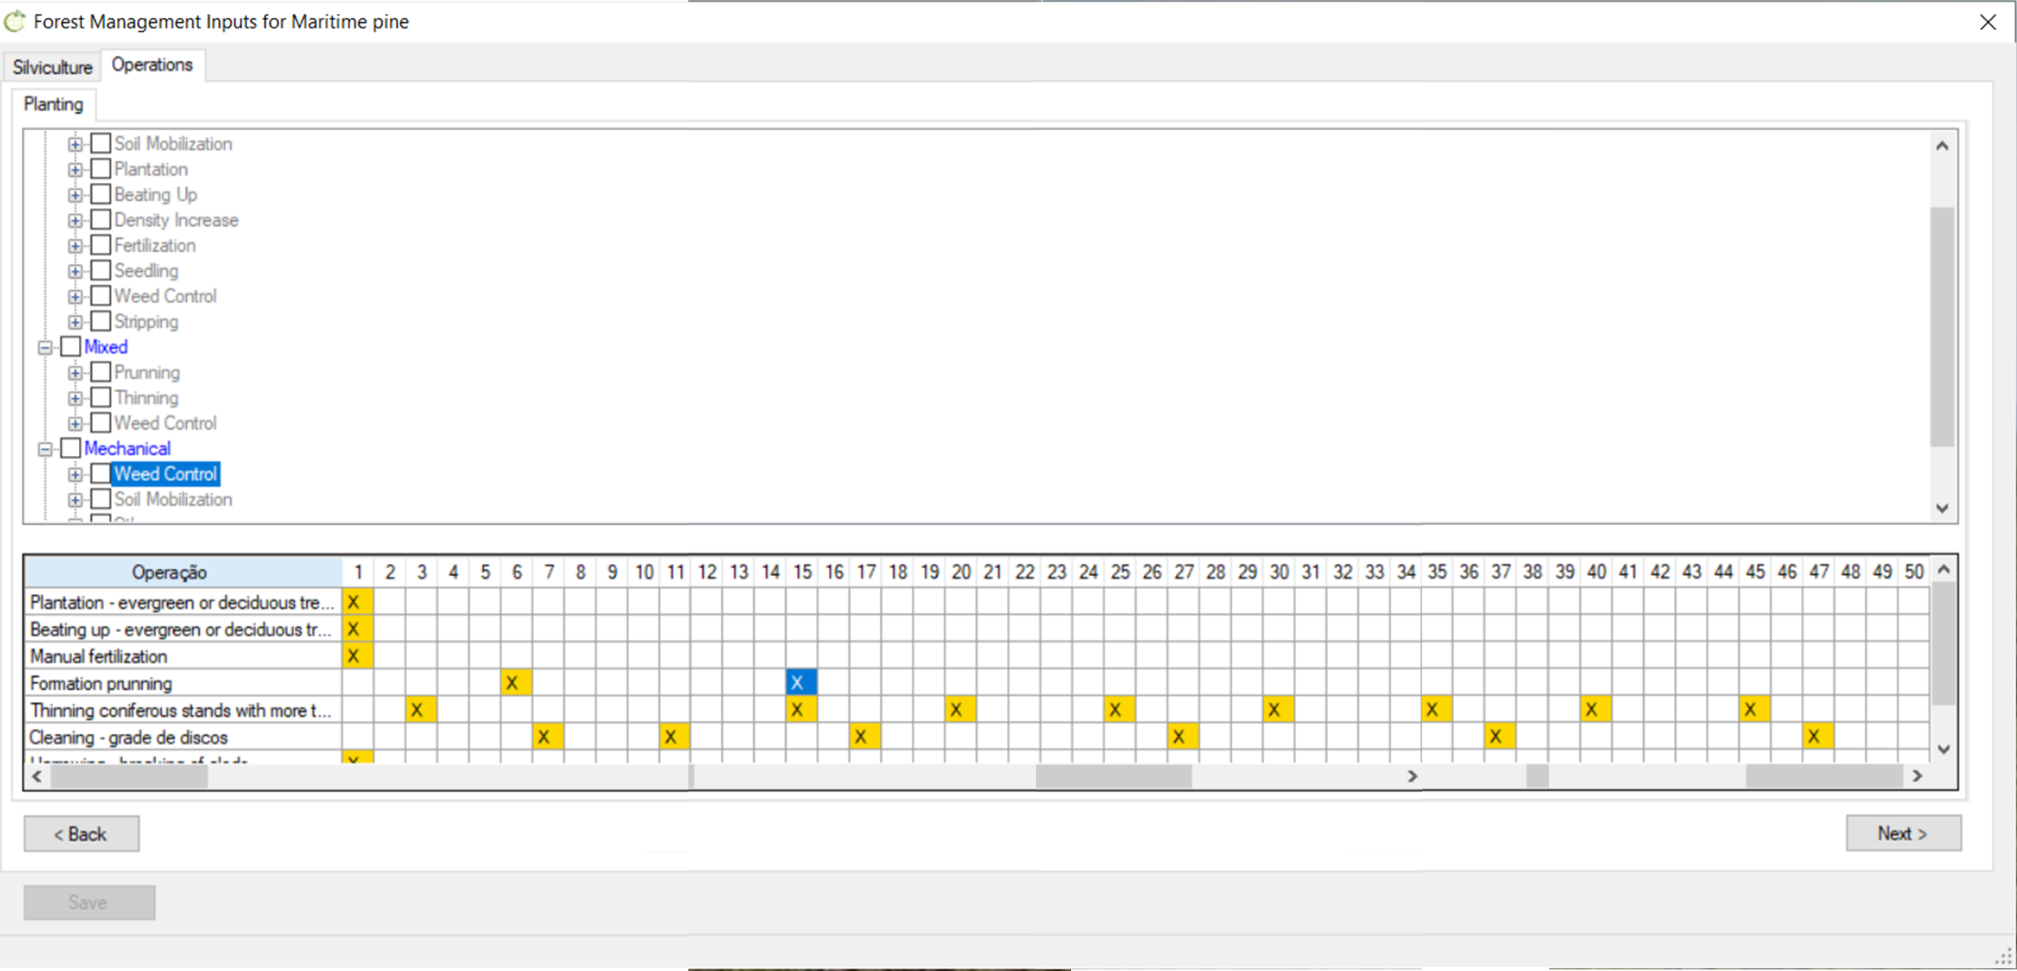
Exercise 3.8 - FMA4.1_Pb

Slide 6
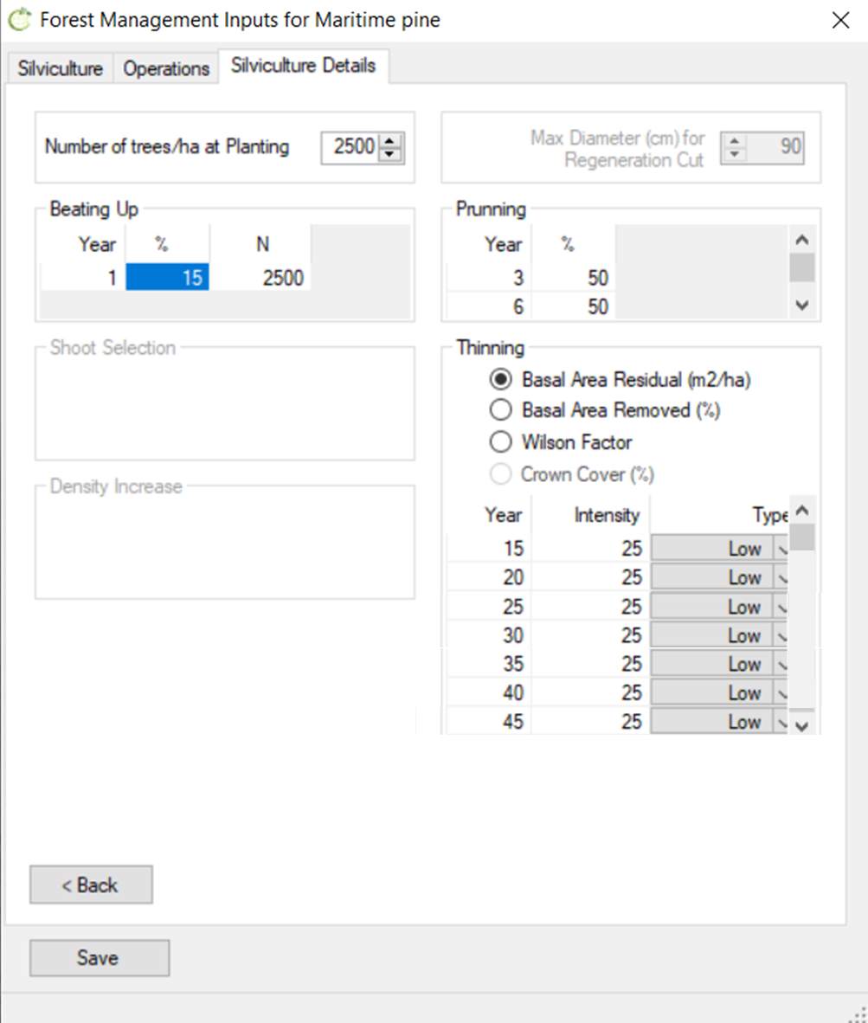
Exercise 3.9 - FMA4.2_Pb

Slide 7
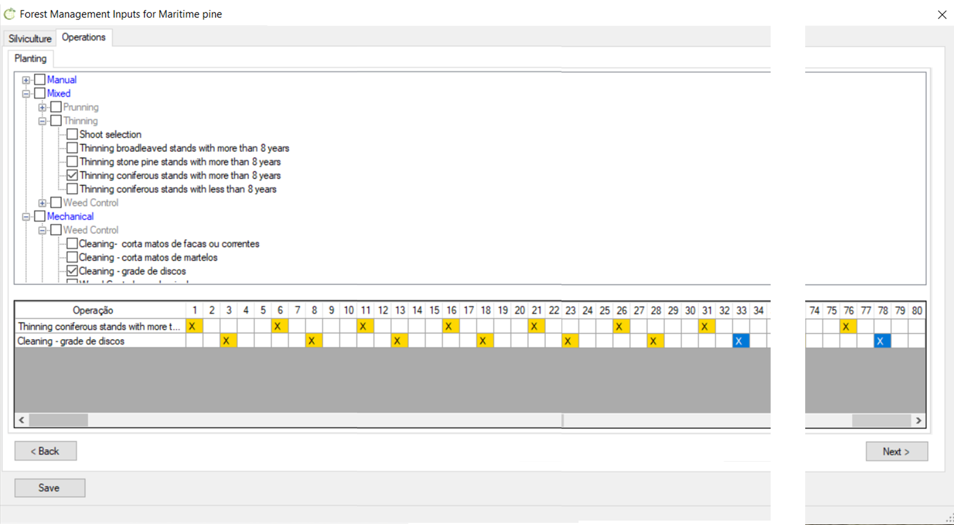
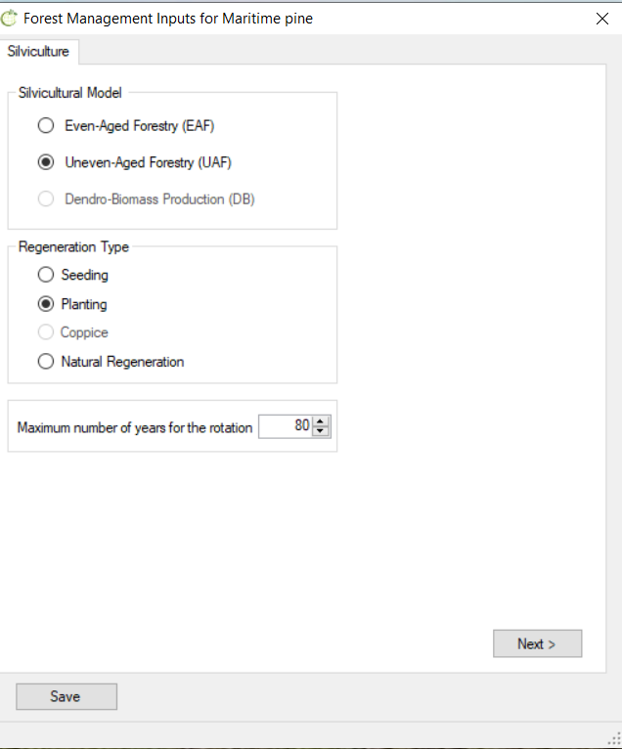
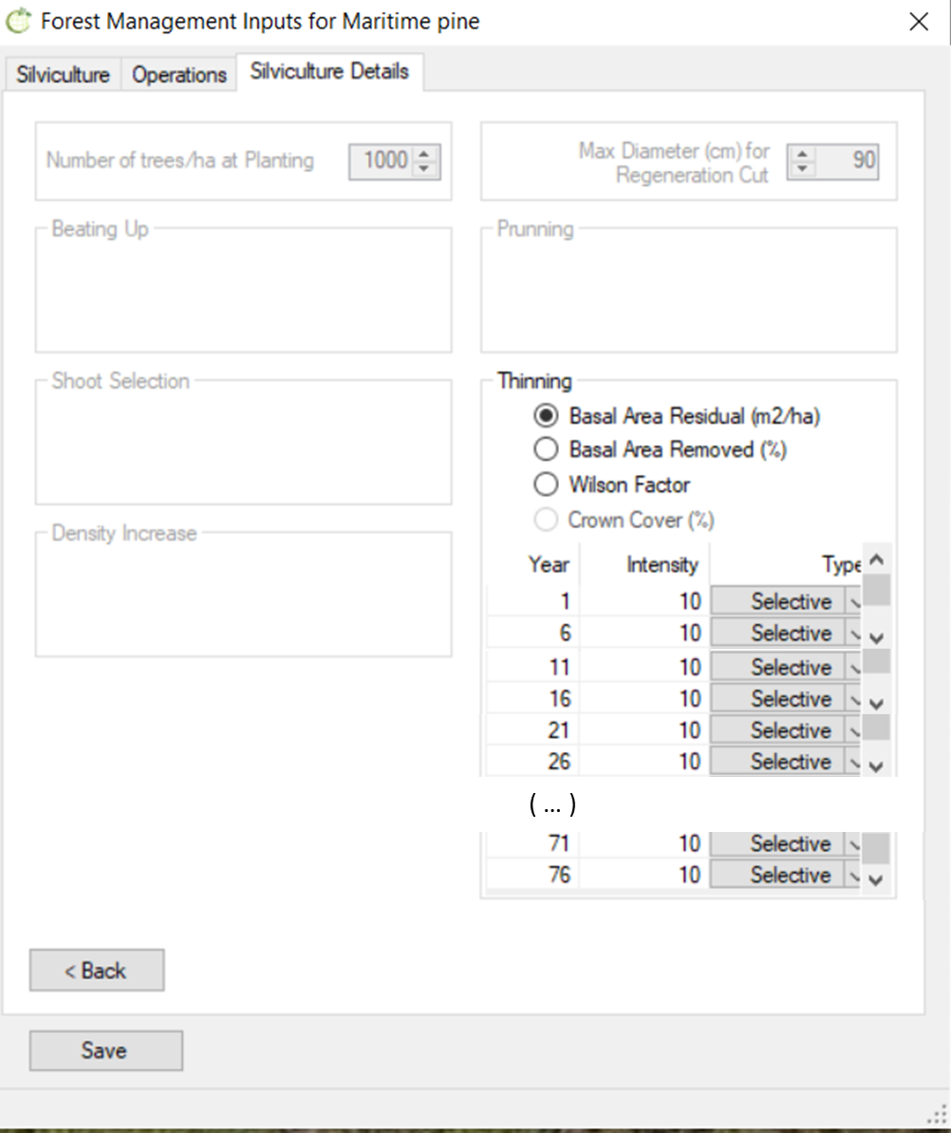
Exercise 3.10 - FMA3.1_Pb

Slide 8
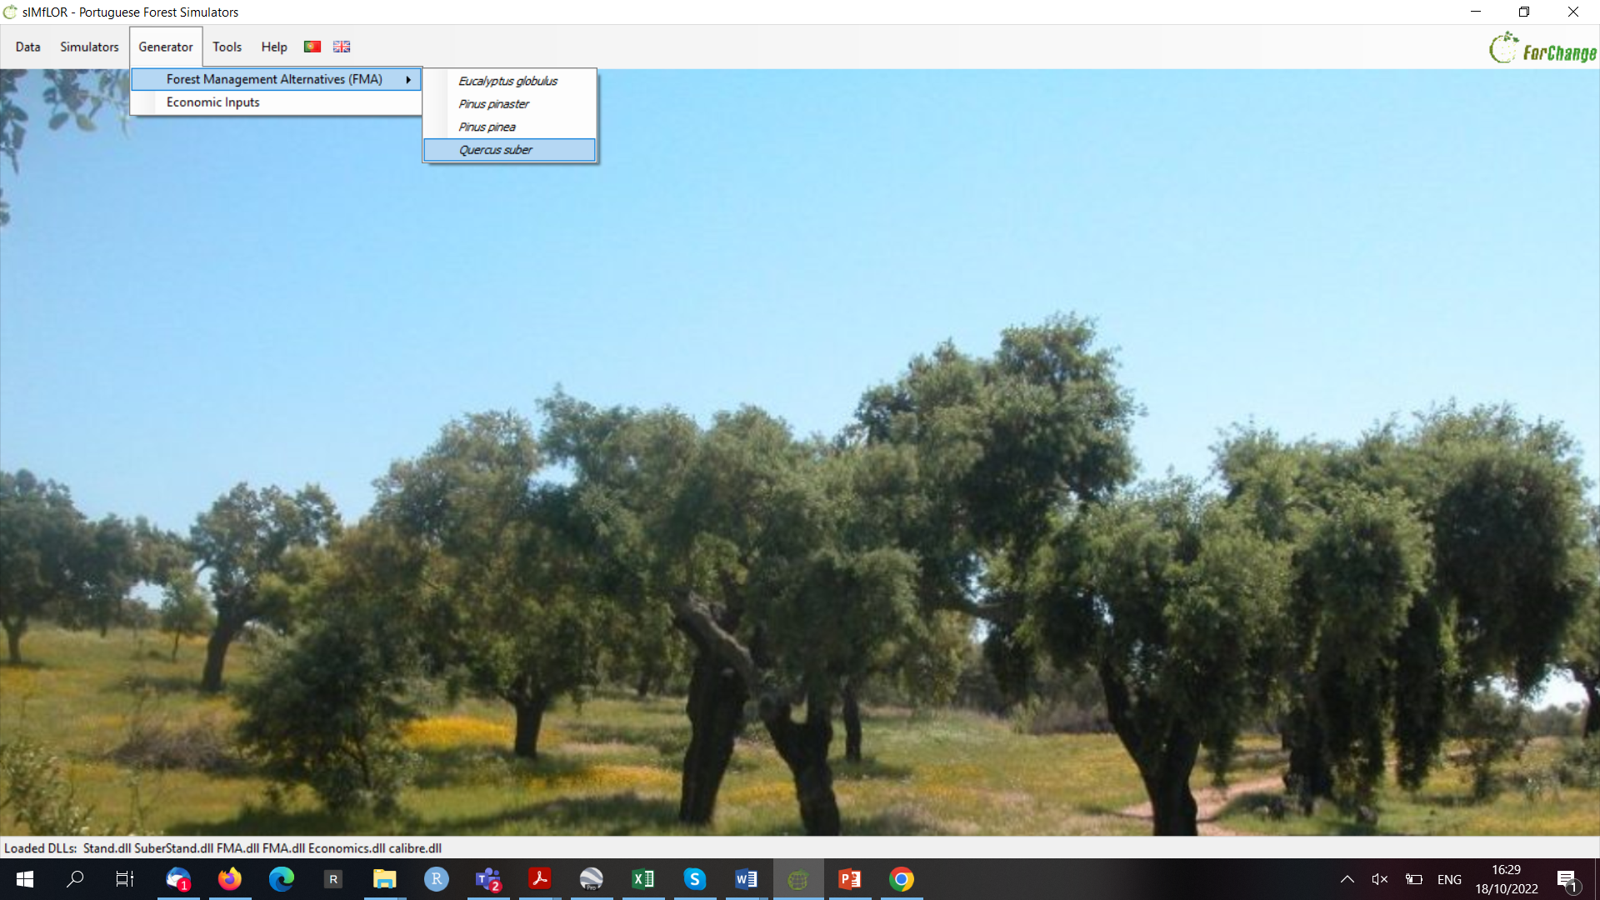
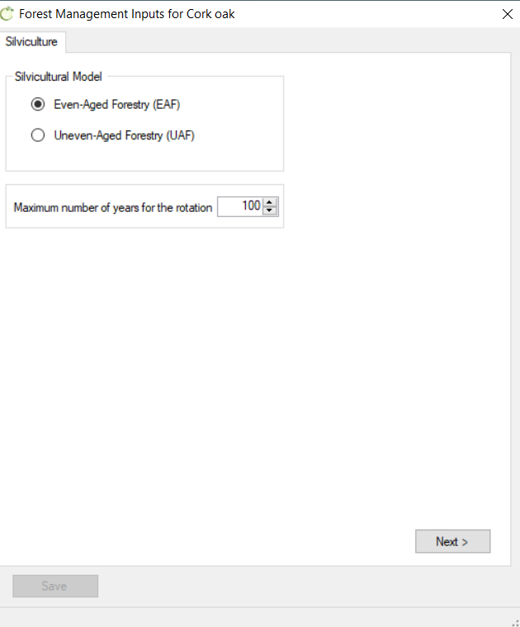
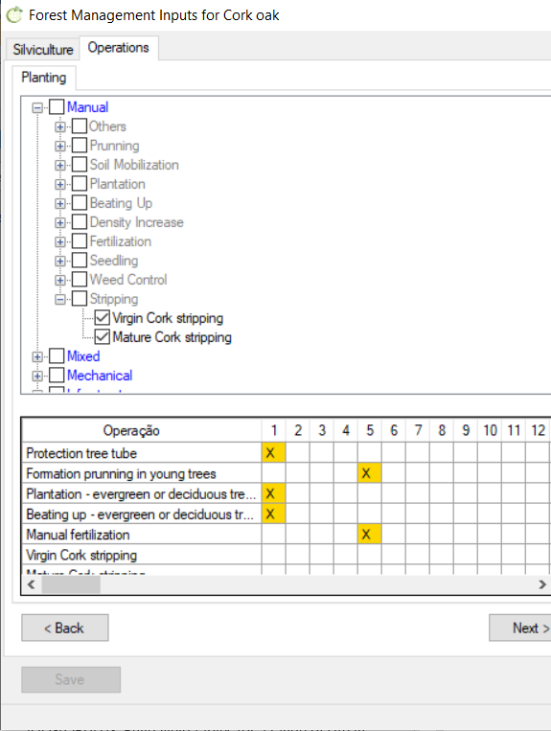
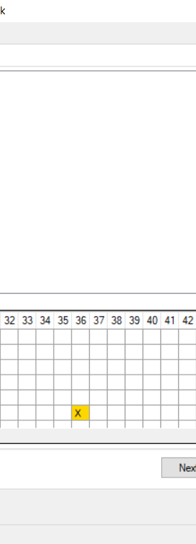
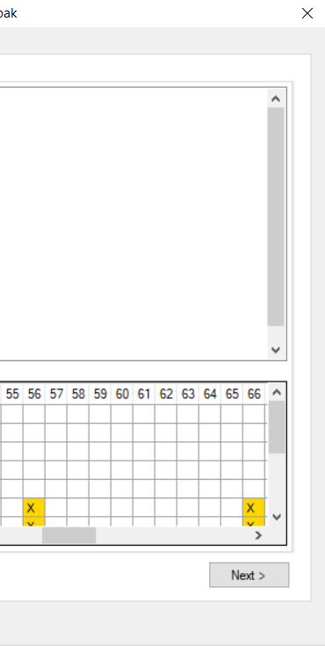
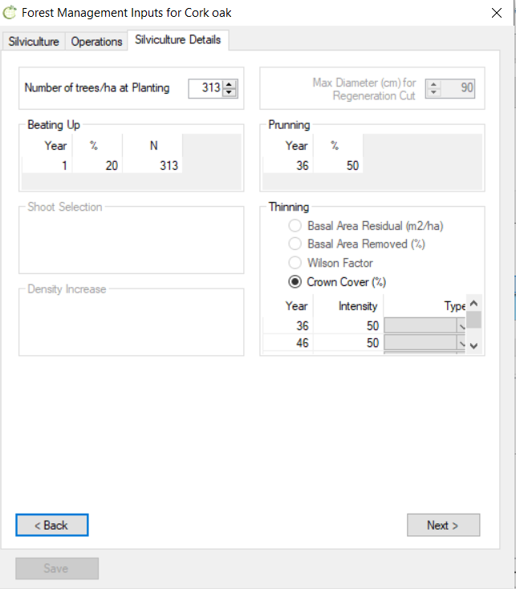
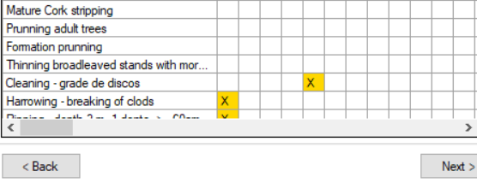
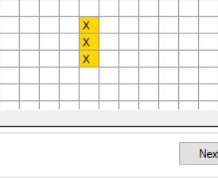
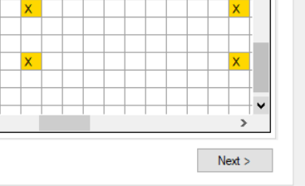
Exercise 3.11 FMA4.1_Sb
( … )
( … )

Slide 9
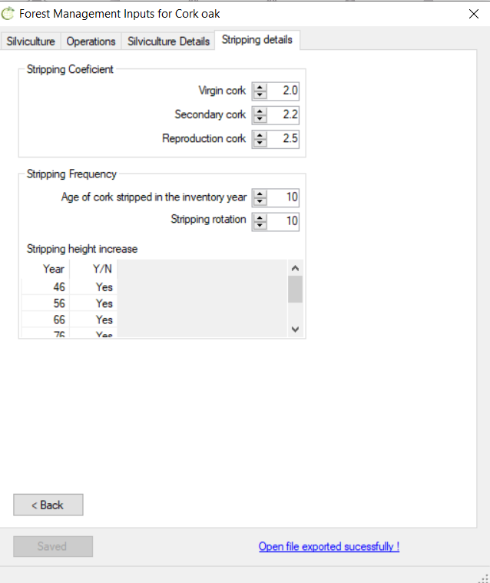
Exercise 3.11 FMA4.1_Sb
( … )
( … )

