Slide 1
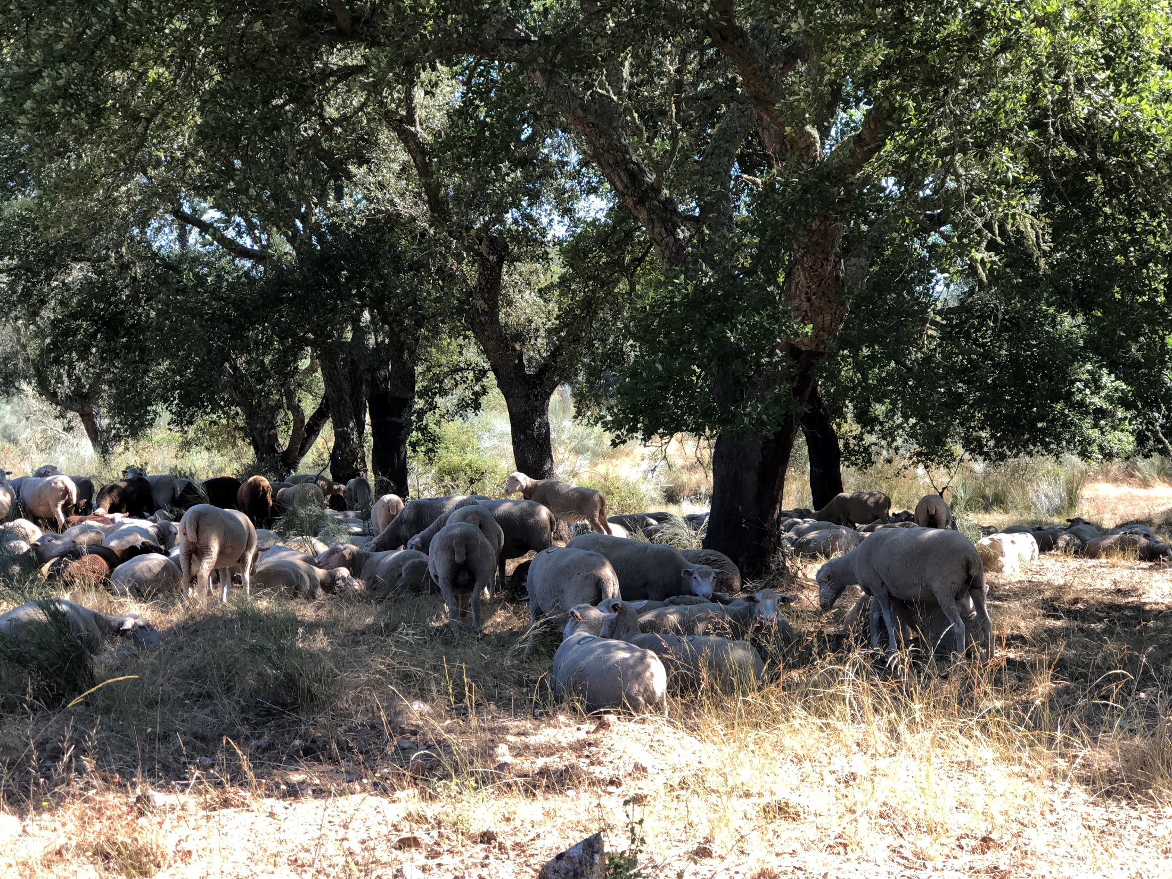
Growth Functions and Allometric equations
Margarida Tomé, Susana Barreiro
Instituto Superior de Agronomia
Universidade de Lisboa

Slide 2
Outline
Growth functions
Theoretical growth functions
  Lundqvist-Korf type functions
  Richards type functions
  Hossfeld IV function
    McDill-Amateis function
Simultaneous modeling of several individuals (trees or stands)
Formulating growth functions without age explicit
Allometric relationships/equations

Slide 3

Forest Growth model (simulator)
Growth functions
Allometric equations
Management
Module
Output / calculation
Module
Growth Module
Outputs
Outputs
Inputs
Inputs

Slide 4
Growth functions
Growth functions describe the change in size of an individual or population with time
Chapt 6

Slide 5
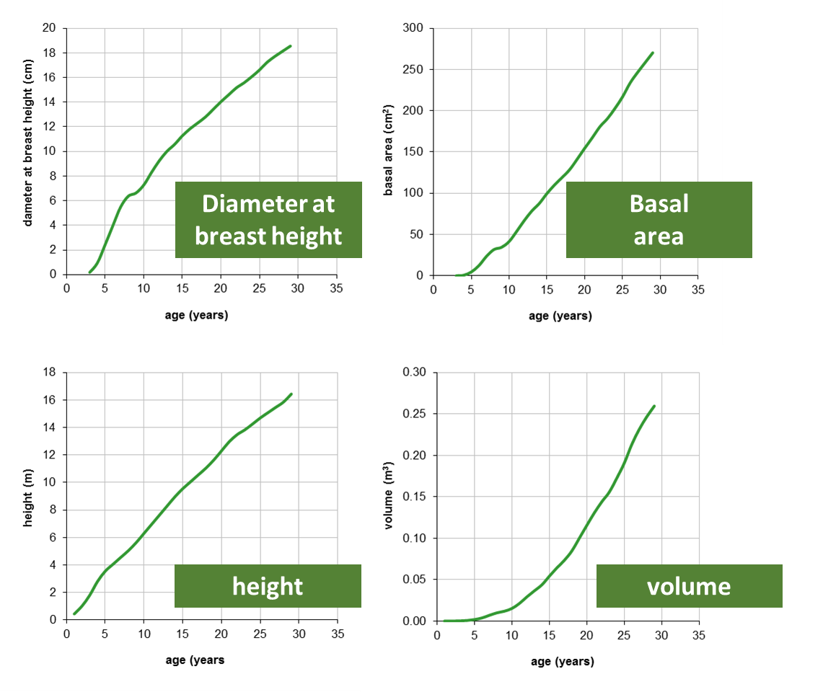
Tree growth
The growth of a tree is expressed by the modification of the different variables that characterize a tree:
  diameter at breast height,
  total height,
  height to the base of the crown,
  stem profile, total and partial volumes, etc
The shape of the growth curve is not the same for all the tree variables
When studying tree growth it is very important to define unambiguously which is the variable of interest

Slide 6
Shape of the growth curves
The evolution of all tree variables corresponds to a S-shaped curve (sigmoidal)
In a S-shaped curve there are several stages:
  Lag
  Exponential
  Senecence
  Stationary
Lag stage
Exponential / juvenile stage
Transitional senescence stage
Stationary stage
rapid initial exponential
growth
concavity upward
Tends to a plateau:
the asymptote
growth slows
concavity turns downward
Growth (size/weight of the organism)
Initial stage of establishment
Time
Notes:
este

Slide 7
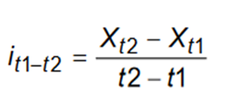
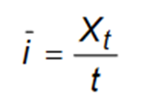
Growth and Yield relationships
Yield
total amount available at a given time, yield can be regarded as the summation of the annual increments
Growth
the increase (increment) over a given period of time
Notes:
este

Slide 8
Growth functions
The selection of functions – growth functions - appropriate to model tree and stand growth is an essencial stage in the development of growth models
  Differencial form (growth)
  Integral form (yield)
We get growth (f(t)) differentiating yield (Y)
We get yield (Y) by integrating the growth function (f(t))
Notes:
Many equations have been developed usually in the integral from

Slide 9
Growth functions
Growth functions must have a shape that is in accordance with the principles of biological growth:
  The curve is limited by yield 0 at the start (t=0 ou t=t₀) and by a maximum yield at an advanced age (existence of assymptote)
  The relative growth rate (variation of the y variable per unit of time and unit of x) presents a maximum at a very early stage, decreasing afterwards; in most cases, the maximum occurs very early so that we can use decreasing functions to model relative growth rate
  The slope of the curve increases in the initial stage and decreases after a certain point in time (existence of an inflection point)

Slide 10
Growth functions
Two types of functions have been used to model growth:
  Empirical growth functions (non-sigmoid)– the modeler will describe the behaviour of the response variable based on the data
    Relationship between the dependent variable – the one we want to model – and the regressors according to some mathematical function – e.g. linear, parabolic, without trying to identify the causes or explaining the phenomenon.
    THUS, when used for modelling => caution with extrapolations outside the data range + parameter signs, so that they present a shape ~ biological growth
  Functional or theoretical growth functions – the modeler will tend to construct models before doing experiments or analyzing the data
    Conceived in terms of the mechanism of forest growth, usually having an underlying hypothesis associated with the principles of forest growth
Notes:
The first: the model is developed to describe the behavior of the dependent variable based on the data (e.g. Table 6.1 in Margarida’s Book) don’t have all the desirable characteristics, thus careful with extrapolations and signs
The second: the model is developed before analyzing data or doing experiments just thinking of the possible mechanisms that can explain the phenomenon (e.g. Table 6.2 in Margarida’s Book)

Slide 11
Theoretical growth functions
Theoretical growth functions have commonly been developed in their growth form – either absolute or relative growth – and the respective yield form has been obtained by integration
Generally, this approach allows interpretation of the function parameters and helps to impose restrictions on the values that the parameters can take to be biologically consistent
Theoretical growth functions are grouped according to their functional form in:
  Lundqvist-Korf type
  Richards type
  Hossfeld IV type
  Other growth functions

Slide 12
Theoretical growth functions

Slide 13
Lundqvist-Korf type functions
Differential form:
  Based on the hypothesis that the relative growth rate has a linear relationship with the inverse of time^{m+1} (which means that it decreases nonlinearly with time):
  Schumacher function if m=1

Slide 14
Lundqvist-Korf type functions
Integral form:
  The A parameter is the assymptote
  The k and m parameters are growth rate and shape parameters:
    k is inversely related with the growth rate
    m influences the age at which the inflexion point occurs

Slide 15
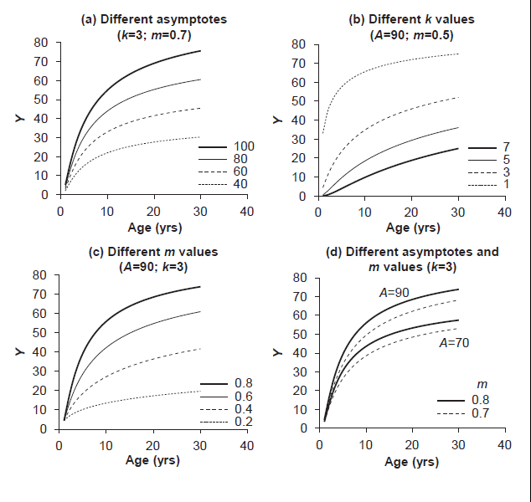
Lundqvist-Korf type functions

Slide 16
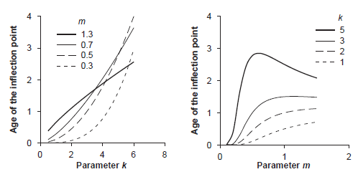
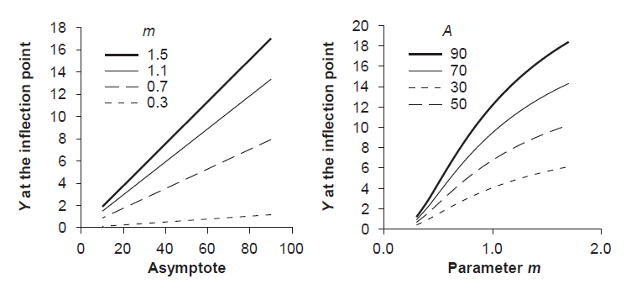
Lundqvist-Korf type functions
Location of the inflection point does not depend on the asymptote
Y does not depend on K

Slide 17
Richards type functions
Differential form:
  based on the hypothesis that the absolute growth rate of biomass (or volume) is modelled as the difference between:
    the anabolic rate (construction metabolism), proportional to the photossintethicaly active area (expressed as an allometric relationship with biomass)
    the catabolic rate (destruction metabolism), proportional to biomass
    Anabolic rate
    Catabolic rate
    Growth rate
S – photossintethically active biomass ; Y – biomass; m – alometric coefficient;
c0,c1,c2,c3 – proportionality coefficients
Notes:
Richards: Anabolic rate – catabolic rate

Slide 18
Richards type functions
The differential form of the Richards function is then:
By integration and using the initial condition y(t₀)=0, the integral form of the Richards function is obtained:
with parameters m, c, k and A where:
Notes:
Richards: absolute growth rate = anabolic rate – catabolic rate

Slide 19
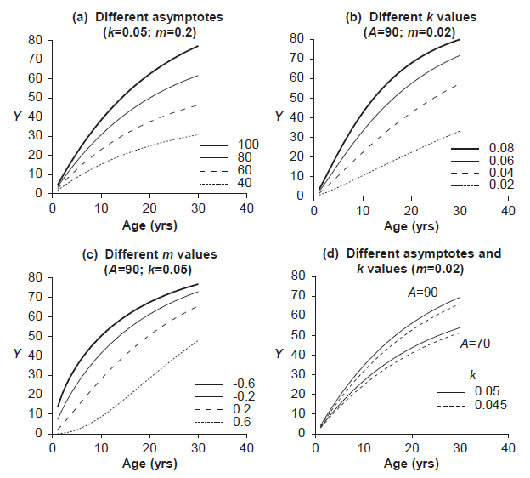
Richards function

Slide 20
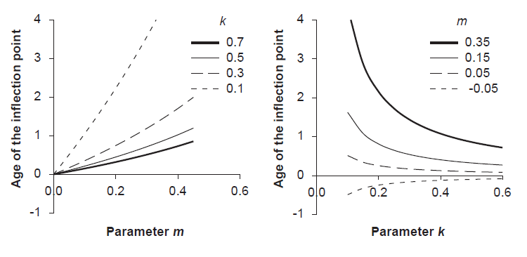
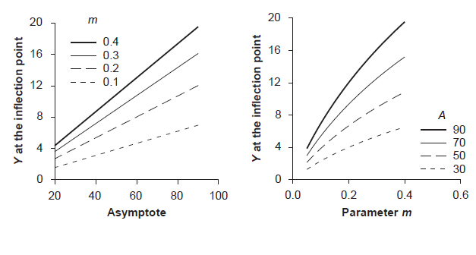
Richards function
Location of the inflection point early with higher k and lower m

Slide 21
Functions of the Richards type
Monomolecular, when the m parameter equal to 0 (no inflection point)
Logistic, when the m parameter equal to 2 (symmetric in relation to the inflection point)
Generalized logistic
  If kt is a function of t, usually a polynomial
Gompertz, when the m parameter →1
Notes:
Monomolecular: absolute growth rate decreases linearly with size (A, k = rate of decrease of the growth rate, no inflection point)
Logistic: relative growth rate = to a biotic potential K, reduced according to size (individual or population). The curve is symmetric around the inflection point
Gompertz: relative growth rate inversely related to ln( present dimension of the dependent var. /A) (decreasing exponential function of time)

Slide 22
Hossfeld IV function
The Hossfeld IV function is a sigmoid function, originally proposed in 1822 (Zeide 1993), for the description of tree growth:
The function can also be obtained from the generalized logistic by using f(X,t)=-klog(t). Consequently some authors designate it as the log-logistic growth function
Not based on any particular biological rationale

Slide 23
McDill-Amateis function
Integral form:
  where (t₀,Y₀) is the initial condition and k expresses the growth rate
  By making
  the integral form of the McDill-Amateis function coincides with the Hossfeld IV function
To guarantee compatibility of dimensions and to take into account biological properties expected for growth functions
- k relates to growth rate
- c to the initial conditions

Slide 24
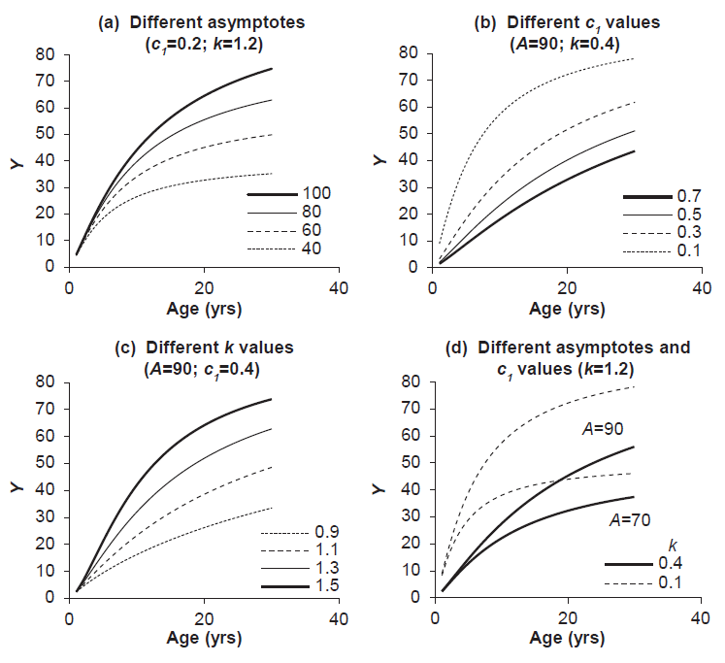
Hossfeld IV function

Slide 25
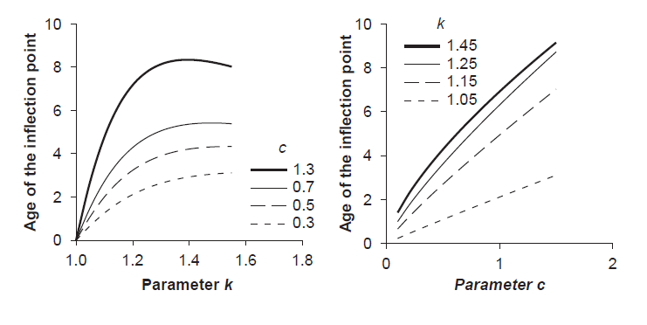
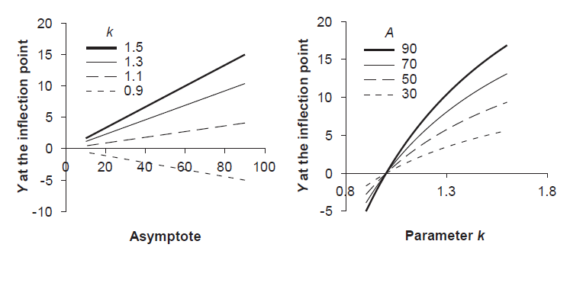
Hossfeld IV function
Location of the inflection point

Slide 26
Growth functions
Growth functions describe changes in size over time
t₁
Growth period 1
t₂
Growth period 2
t₃
Lundqvist-Korf type
Richards type
Hossfeld IV type
Notes:
When fitted to data a number of these functions will give similar results (within the range of the data used for estimating their coefficients)
HOWEVER, when extrapolated their behavior may be quite different

Slide 27
Simultaneous modeling of several individuals
(Families of growth functions)
Notes:
6ª

Slide 28
Families of growth functions
The fitting of a growth function to data from one permanent plot is straightforward
Example:
  Fitting the Lundqvist function to basal area and dominant height growth data from a permanent plot
A - asymptote
k, m – shape parameters

Slide 29
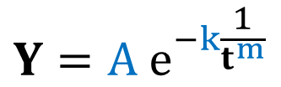
Growth functions
Basal area (G)
A = 58.46, k = 5.13, m = 0.81
Modelling efficiency = 0.995
Dominant height (hdom)
A = 48.75, k = 4.30, m = 0.75
Modelling efficiency = 0.960
$$Y=A e^{−k\frac{1}{t^{m}}}$$

Slide 30
Growth functions
Basal area (G)
A = 58.46, k = 5.13, m = 0.81
Modelling efficiency = 0.995
Dominant height (hdom)
A = 48.75, k = 4.30, m = 0.75
Modelling efficiency = 0.960
$$Y=A e^{−k\frac{1}{t^{m}}}$$

Slide 31
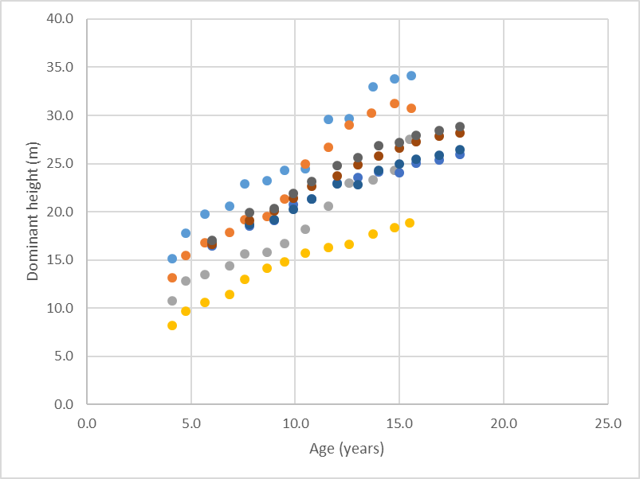
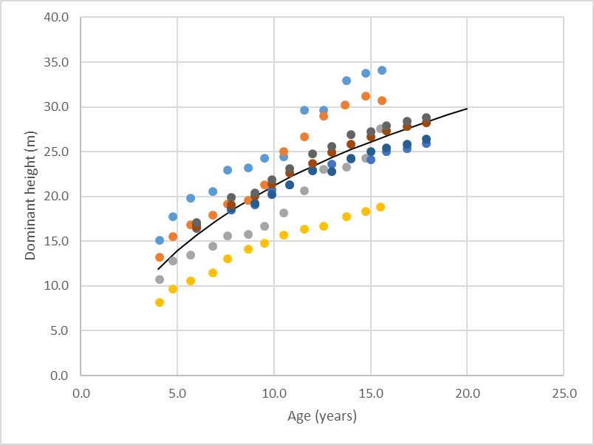
But how to model the growth of a series of plots?
This is our objective when developing FG&Y models…

Slide 32
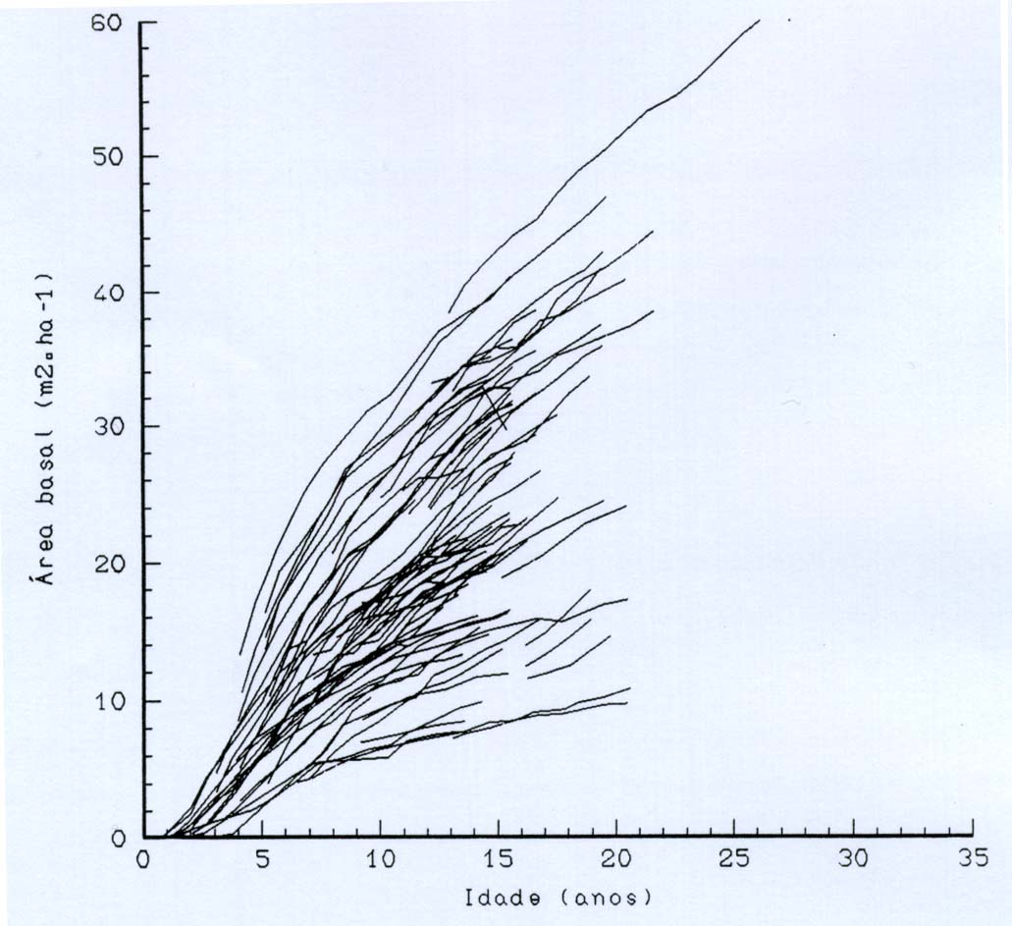
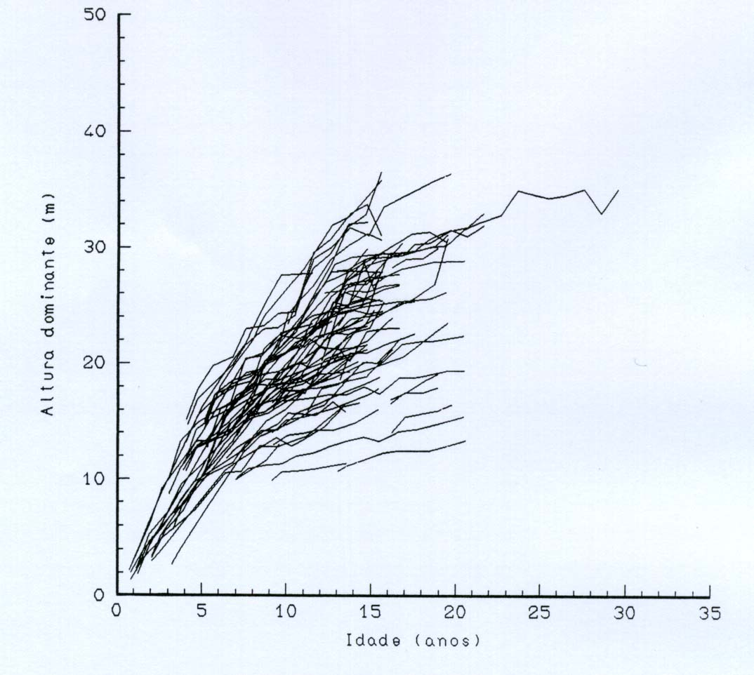
But how to model the growth of a series of plots?
This is our objective when developing FG&Y models…
These plots represent “families” of curves

Slide 33
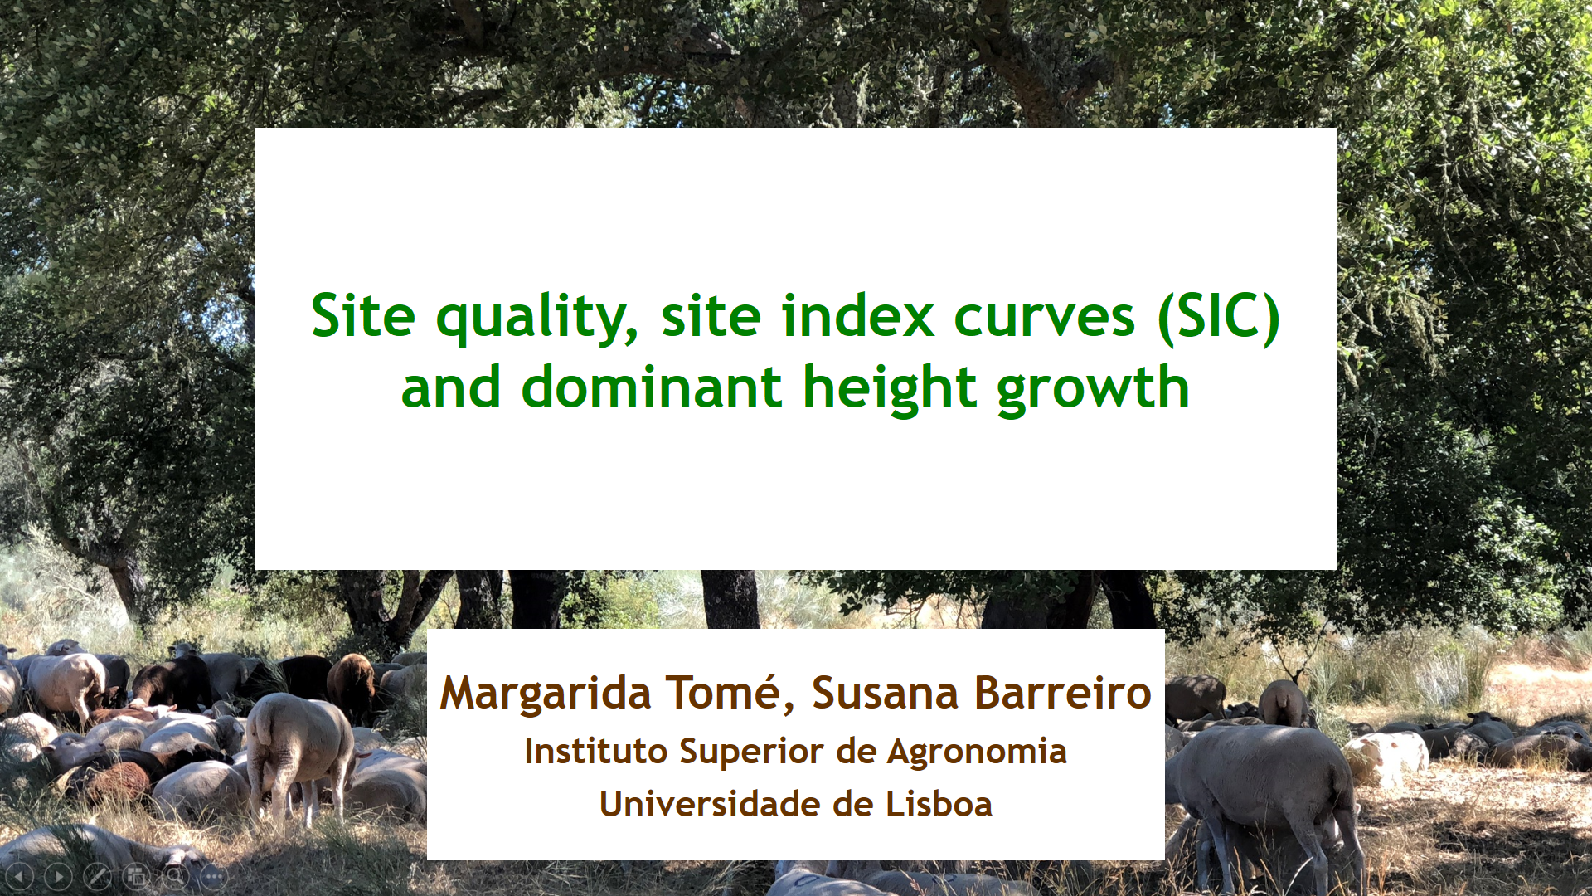

Slide 34
But how to model the growth of several plots?
There are several methods to simultaneously model the growth of several plots:
  The Guide-curve method (only for hdom)
  Expressing the parameters as a function of site and/or tree/stand variables (named “Parameter Prediction Method” when applied to hdom)
  Growth functions formulated as difference equations
    Algebraic Difference Approach (ADA)
    Generalized Algebraic Difference Approach (GADA)
  Mixed-effects models
n this course we will just focus the first three methods (information on other methods available at the end of the slides)

Slide 35
But how to model the growth of several plots?
There are several methods to simultaneously model the growth of several plots:
  The Guide-curve method (only for hdom) (chapt 7.4)
  Expressing the parameters as a function of site and/or tree/stand variables (named “Parameter Prediction Method” when applied to hdom)
  Growth functions formulated as difference equations
    Algebraic Difference Approach (ADA)
    Generalized Algebraic Difference Approach (GADA)
  Mixed-effects models
In this course we will just focus the first three methods (information on other methods available at the end of the slides)

Slide 36
But how to model the growth of several plots?
The Guide-curve Method
  The guide-curve method is the adaptation of the initial graphical methods to the regression analysis techniques
  The method is usually used with temporary plots data
  The application of the method implies the fitting of the selected growth curve to the whole data set – the guide-curve
  The curve for site index S is located at a distance from the guide-curve proportional to the distance between S and the site index of the guide-curve

Slide 37
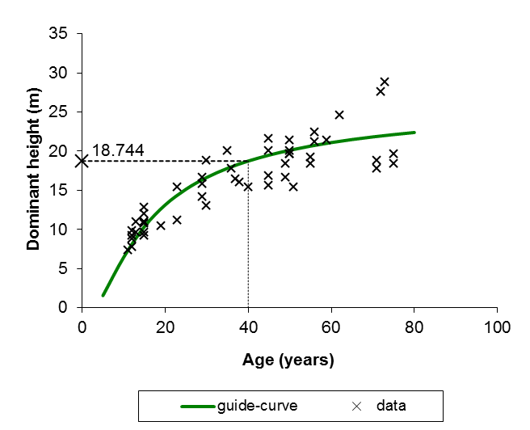
But how to model the growth of several plots?
The guide-curve Method
Oliveira (1985) fitted the following guide-curve to data from temporary plots measured in maritime pine stands in the mountain and sub-mountain regions
  Site index of the guide-curve is 18.744 m
  (base age 40 years)

Slide 38
tp = 40; t = 20
Guide-curve
hdom_{GC} _{(tp)}
hdom_{GC (t)}
hdom_{GC(tp)}
=
SIC₁
hdom_{C1 (tp)}
hdom_{C1 (t)}
hdom_{GC(t)}
SI_{GC}
hdom_{GC (t)}
hdom_{C1(tp)}
=
SI_{C1}
hdom_{C1 (t)}
hdom_{C1(t)}
  Using the guide-curve fitted by Oliveira (1985):
hdom_{C1(t)}
SI_{C1}
40
=
=
SI_{C1}
hdom_{C1(t)}
40
-
Designating dominant height at age t by hdom:
hdom_{C1(t)}
SI_{C1}
40
=

Slide 39
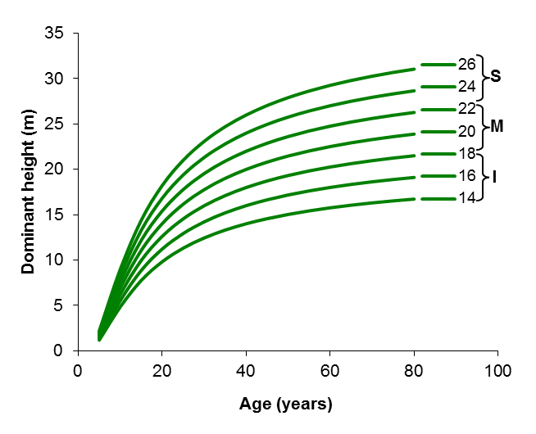
But how to model the growth of several plots?
The guide-curve Method
Obtaining the set of curves Oliveira (1985)
Applying the equation to S from 14 to 26 varying t from a young age until 80 years

Slide 40
But how to model the growth of several plots?
The guide-curve Method
Obtaining the set of curves Oliveira (1985)
Applying the equation to S from 14 to 26 varying t from a young age until 80 years

Slide 41
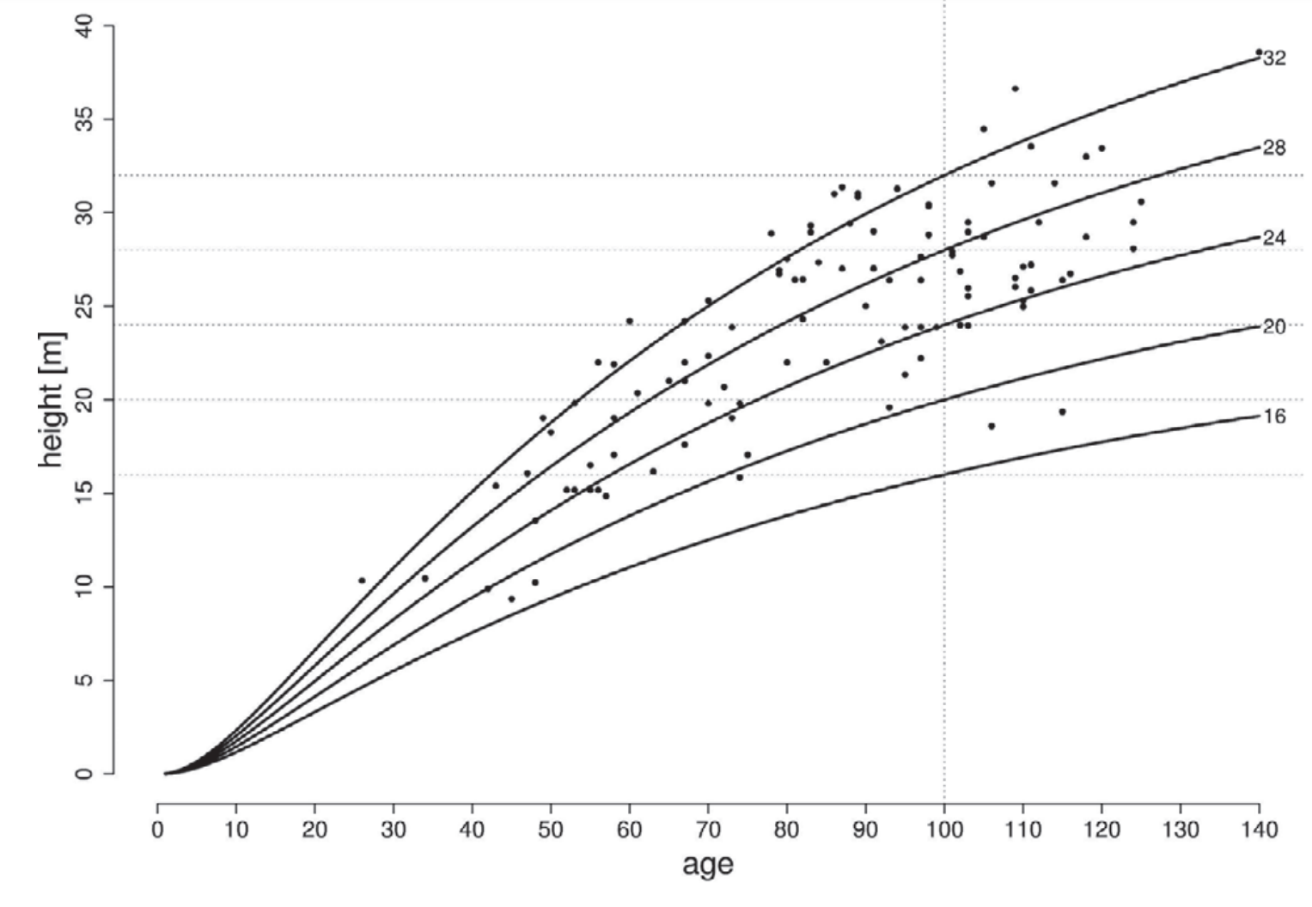
Anamorphic and polymorphic SICs
According to the relationship between the curves that represent different site indices, the site index curves can be:
  Anamorphic
    Anamorphic curves assume a common shape for all site classes.
    For many species, height growth exhibits pronounced sigmoid shapes on higher-quality sites, and “flatter” shape on lower-quality sites

Slide 42
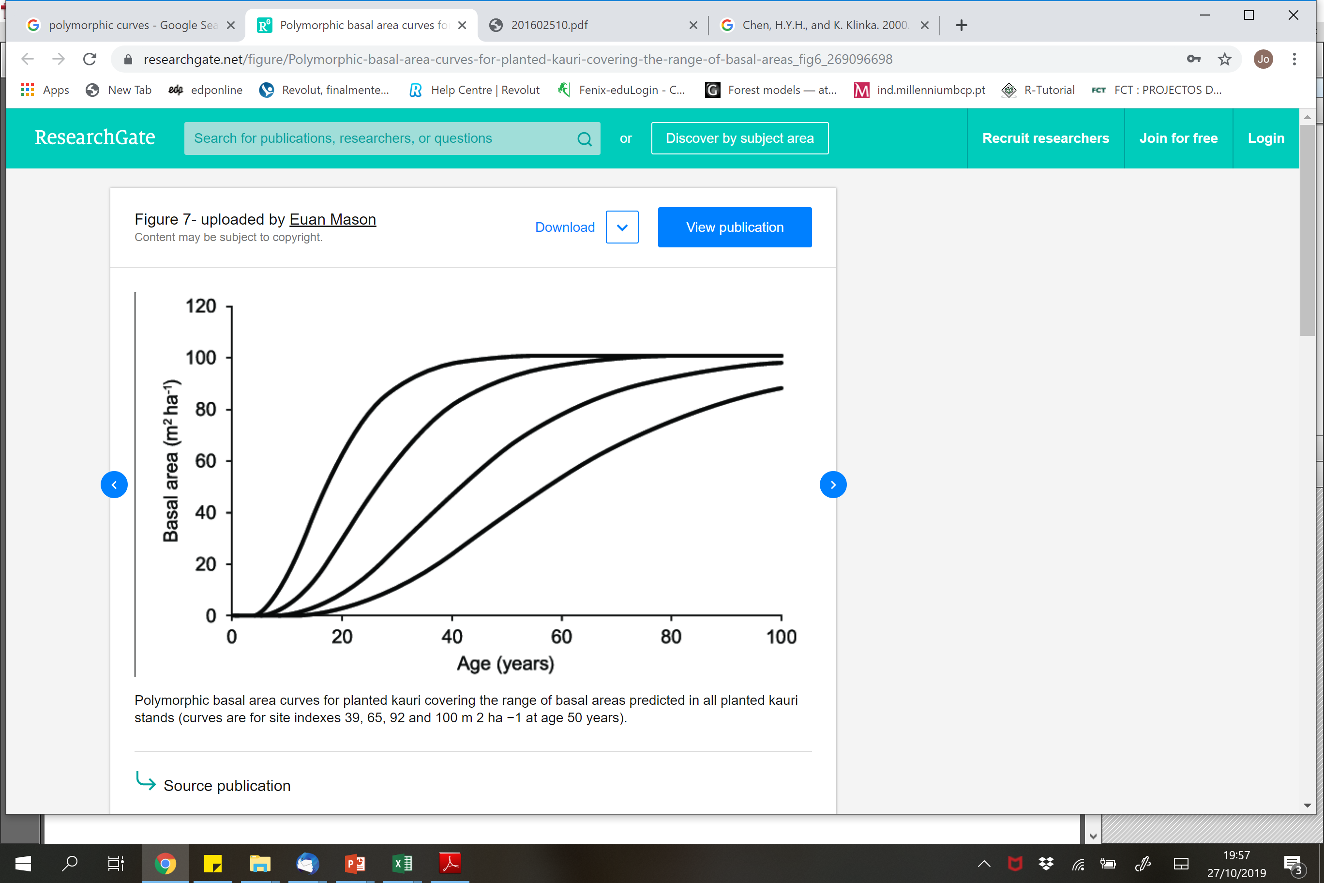
Anamorphic and polymorphic SICs
According to the relationship between the curves that represent different site indices, the site index curves can be:
  Anamorphic
  Polymorphic
    family of site index curves display differing shapes for different site-index classes
    Anamorphic curves assume that a common shape for all site classes.
    For many species, height growth exhibits pronounced sigmoid shapes on higher-quality sites, and “flatter” shape on lower-quality sites

Slide 43
But how to model the growth of several plots?
There are several methods to simultaneously model the growth of several plots:
  The Guide-curve method (only for hdom)
  Expressing the parameters as a function of site and/or tree/stand variables (named “Parameter Prediction Method” when applied to hdom) chap 7.5
  Growth functions formulated as difference equations
    Algebraic Difference Approach (ADA)
    Generalized Algebraic Difference Approach (GADA)
  Mixed-effects models
n this course we will just focus the first three methods (information on other methods available at the end of the slides)

Slide 44
But how to model the growth of several plots?
The parameter prediction method (hdom)
  This method can only be used when there is a set of long-term growth series
  Therefore it has been essentially applied with stem analysis data (or to interval/permanent plots)
  It is equivalent to modelling a family of curves by expressing the parameters as a function of stand/site variables

Slide 45
But how to model the growth of several plots?
The parameter prediction method (hdom)
  It was developed on purpose to obtain polymorphic site index curves
  It implies 4 stages:
    Calculate S for each tree/plot (interpolation) or determine S by fitting a linear or nonlinear height/age function to the data on a tree-by-tree (stem analysis data) or plot by plot (remeasurement data) basis
    Using each fitted curve to assign a site index value to each tree or plot (try error)
    Establish the relationship between the parameters obtained for each tree/plot and the respective S, (i.e. study the relationship, if linear: parameter= a0 + a1 S)
    Fit the final model with some parameter(s) expressed as a function of S

Slide 46
But how to model the growth of several plots?
The parameter prediction method (hdom)
  This method has some disadvantages:
    The curves do not pass through the point corresponding to the base age (S), but it is possible to force the model to do so
    The curves are dependent from the selected base age, they will need to be refitted it a new base age is selected

Slide 47





But how to model the growth of several plots?
Expressing parameters as a function of tree/stand variables
  Example with the Lundqvist function fit to basal area growth of eucalyptus (GLOBULUS 2.1 model):
$G=A$ $e^{−k {\left(\frac{1}{t}\right)}^{m}}$
$A=a_{0}$ $S^{2}$
$$fe=\frac{100}{S \sqrt{Npl}}$$
$k=k_{0}$ + $k_{1}S+ k_{2}\frac{Npl}{1000}+ k_{3} fe$
$m=m_{0}$ + $m_{1} ln(S)+ m_{2}\frac{N}{1000}$

Slide 48
But how to model the growth of several plots?
There are several methods to simultaneously model the growth of several plots:
  The Guide-curve method (only for hdom)
  Expressing the parameters as a function of site and/or tree/stand variables (named “Parameter Prediction Method” when applied to hdom)
  Growth functions formulated as difference equations chap 7.8
    Algebraic Difference Approach (ADA) chap 7.8.1
    Generalized Algebraic Difference Approach (GADA)
  Mixed-effects models
In this course we will just focus the first three methods (information on other methods available at the end of the slides)

Slide 49
But how to model the growth of several plots?
Growth functions formulated as difference equations
  If the data set includes at least two remeasurements from each plot, it is possible to fit growth functions in the difference equation form
  The existence of long term growth series (interval, permanent and or/stem analysis) is an advantage as in this way the data has more information about the curve shape
  There are several methods to fit difference equations (self-referencing curves) to growth data but they are out of the scope of this course

Slide 50
But how to model the growth of several plots?
Growth functions formulated as difference equations - ADA
Algebraic difference approach (ADA)
  When formulating a growth function as a difference equation, it is assumed that the curves belonging to the same “family” differ just by one parameter - the site-specific parameter
  A growth function with 3 parameters allows for 3 different formulations, usually denoted by the free/site-specific parameter
  For example for the Richards function:
    Richards-A (model with site specific asymptote)
    Richards-k (model with common asymptote)
    Richards-m (model with common asymptote)

Slide 51
But how to model the growth of several plots?
Growth functions formulated as difference equations - ADA
  Lundvqvist- A (A is site-specific and k and m as common parameters)
A specific curve of the family is defined by the value of the free parameter (the site-specific)
In practice, the free parameter is a function of an initial condition (Y₀,t₀)

Slide 52
But how to model the growth of several plots?
Growth functions formulated as difference equations - ADA
  Lundvqvist- k
By making t₂=t_{p}, we have hdom₂=S
A

Slide 53
But how to model the growth of several plots?
There are several methods to simultaneously model the growth of several plots:
Hdom/S families of curves | Type of curve | Data sources | Limitations | Advantages
The guide curve method | Anamorphic | all types but the only that can use temporary plot data | i) age at which the maximum h growth is observed is the same for all curves; iii) potentially biased if only temp. plots are used and the distribution are not representative for all classes; iv) new base age requires redrawing the curves (not the guide-curve) | i) used because it's the only method that allows developing a model based on one measurement
The parameter prediction method | Polymorphic | permanent plots or stem analysis provided that height measurements near or at base age are included | i) very demanding in terms of data; ii) estimate hdom at base age slightly differs from S; iii) new base age requires new fitting; iv) many functions cannot be solved explicitly for S given hdom and t | i) age at which the maximum h growth is observed varies with site quality
Difference equations (ADA) | Anamorphic or polymorphic | permanent/ interval or stem analysis | i) only one parameter is site-specific | i) hdom at tp = S; ii) base age invariant; iii) varying asymptotes
Difference equations (GADA) | Anamorphic or polymorphic | permanent/ interval or stem analysis | i) mathematical expression is difficult to develop | i) hdom at tb = S; ii) base age invariant; iii) varying asymptotes; iv) more than one parameter can be site specific
Chap 7.4
Chap 7.5
Chap 7.8/7.8.1

Slide 54
But how to model the growth of several plots?
There are several methods to simultaneously model the growth of several plots:
Other variables families of curves | Hdom/S families of curves | Type of curve | Data sources
(not applicable) | The guide curve method | Anamorphic | all types but the only that can use temporary plot data
Expressing parameters as a function of site and/or tree/site variables | The parameter prediction method | Polymorphic | permanent plots or stem analysis provided that height measurements near or at base age are included
Difference equations Algebraic Difference Approach (ADA) |  | Anamorphic or polymorphic | permanent/ interval or stem analysis
Difference equations Generalized Algebraic Difference Approach (GADA) |  | Anamorphic or polymorphic | permanent/ interval or stem analysis
Chap 7.4
Chap 7.5
Chap 7.8. and 7.8.1
Chap 7.8. and 7.8.2

Slide 55
But how to model the growth of several plots?
Which is the best method to model “families” of growth functions?
  There is no best method to model “families” of growth functions
  If appropriate different methods can be combined in order to obtain more flexible growth models:
    Example with the Lundqvist function fit to basal area growth of eucalyptus with k as free parameter:
    By using the same method as above we obtain:

Slide 56
But how to model the growth of several plots?
Formulating growth functions without age explicit
  In many applications age is not known (e.g. in trees that do not exhibit easy to measure growth rings or in uneven aged stands)
  For these cases it is useful to derive formulations of growth functions in which age is not explicit
  The derivation of these formulations is obtained by expressing t as a function of the variable and the parameters and substituting it in the growth function written for t+a (Tomé et al. 2006)

Slide 57
But how to model the growth of several plots?
Formulating growth functions without age explicit
  Example with the Lundqvist function:

Slide 58
But how to model the growth of several plots?
There are several methods to simultaneously model the growth of several plots:
  The Guide-curve method (only for hdom)
  Expressing the parameters as a function of site and/or tree/stand variables (named “Parameter Prediction Method” when applied to hdom)
  Growth functions formulated as difference equations
    Algebraic Difference Approach (ADA)
    Generalized Algebraic Difference Approach (GADA)
  Mixed-effects models
In this course we will just focus the first three methods (information on other methods available at the end of the slides)

Slide 59
Allometric relationships/equations
Allometric equations describe unequal growth rate in different parts of the body in comparison to the growth rate of the body

Slide 60
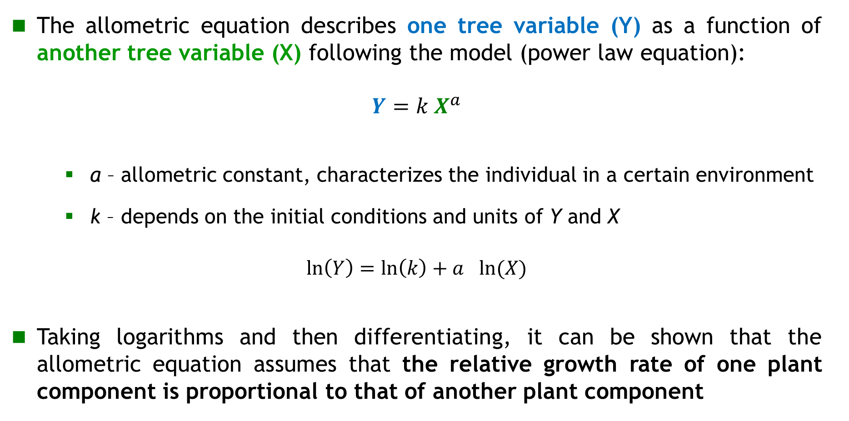
Allometric relationships
The allometric equation describes one tree variable (Y) as a function of another tree variable (X) following the model (power law equation):
$$Y=k X^{a}$$
    a – allometric constant, characterizes the individual in a certain environment
    k – depends on the initial conditions and units of Y and X
$$\ln\left(Y\right)=\ln\left(k\right)+a_{}ln⁡(X)$$
Taking logarithms and then differentiating, it can be shown that the allometric equation assumes that the relative growth rate of one plant component is proportional to that of another plant component
usually difficult to evaluate
usually easy to measure
Notes:
este

Slide 61
Allometric relationships
The parameter a – allometric constant - is the coefficient of proportionality between the relative growth rates of the two plant parts
a can, therefore, provide direct information on the partitioning of assimilates between plant parts
Notes:
este

Slide 62

Allometric relationships
The multiple allometric relationship is established between one variable (Y) and other variables (X,Z) (more than one):
$Y=k X^{a}$Z^{b}
Allometric relationships can also be established between stand variables
The existence of allometric relationships between tree variables (or stand variables) is very important for growth and yield modelling of trees and stands
It is one of the biologic hypothesis that can be used in the formulation of models
Notes:
este

Slide 63
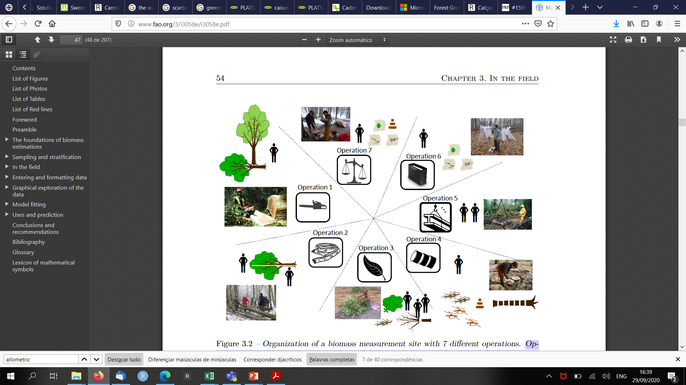
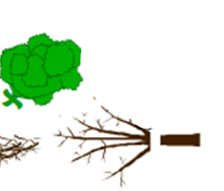
Data collection for biomass assessment and model development
operation 7: samples packing for lab weighing
operation 1: site preparation and felling of the tree
operation 6: weighing the total tree by compartment (stem, branches, leaves, roots,…)
operation 2: measurement (d/h) of felled tree and marking for cross-cutting operation
operation 3: cross-cutting for separating different tree parts (stem branches, leaves, fruit and roots)
operation 5: stripping of leaves and limbing
operation 4: cross-cutting into logs and cutting disks samples
(Adapted from Pickard et al 2012)

Slide 64
Allometric relationships
Sustainable forest management has increased the need for reliable allometric equations to estimate tree and shrub biomass.
Much effort has been placed on developing equations to estimate the weight, rather than the volume, of the commercial portion of tree stems
Increasing interest in:
  quantifying branches and foliage
  predicting fuel loads and potential fire behavior
  quantifying carbon cycles and storage
Weight estimates are more easily obtained than volume
Notes:
este

Slide 65
Using growth functions formulated as difference equations - GADA
Generalized algebraic difference approach (GADA)
  One of the problems with ADA is the fact that it originates formulations that differ just by one parameter
  With GADA it is possible to obtain formulations that have more than one site-specific parameter
  In GADA parameters are assumed to be function of an unobservable set of variables (denoted by X) that express site differences
  The equations are then solved by X, which, for a particular site, is substituted in the original equation (X₀)

Slide 66
Using growth functions formulated as difference equations - GADA
Example with the Schumacher function:
Suppose that α=X and β=γX, then
By substituting X0 into the previous expression, we get

Slide 67
Using growth functions formulated as difference equations - GADA
Another example with the Schumacher function
Suppose now that α=X and β=X, then
and
Solving for X:
Finally, substituting X0 in the previous expression

Slide 68
Using mixed-models
Mixed-models (linear and non-linear) “split” the model error according to different sources of variation, such as:
  Region
  Stand
  Plots
  …
When using a model fitted with mixed-models theory it is possible to calibrate the parameters with random components by measuring a small sample of individuals
This means that it is possible to use specific parameters for a particular tree/stand

