Slide 1
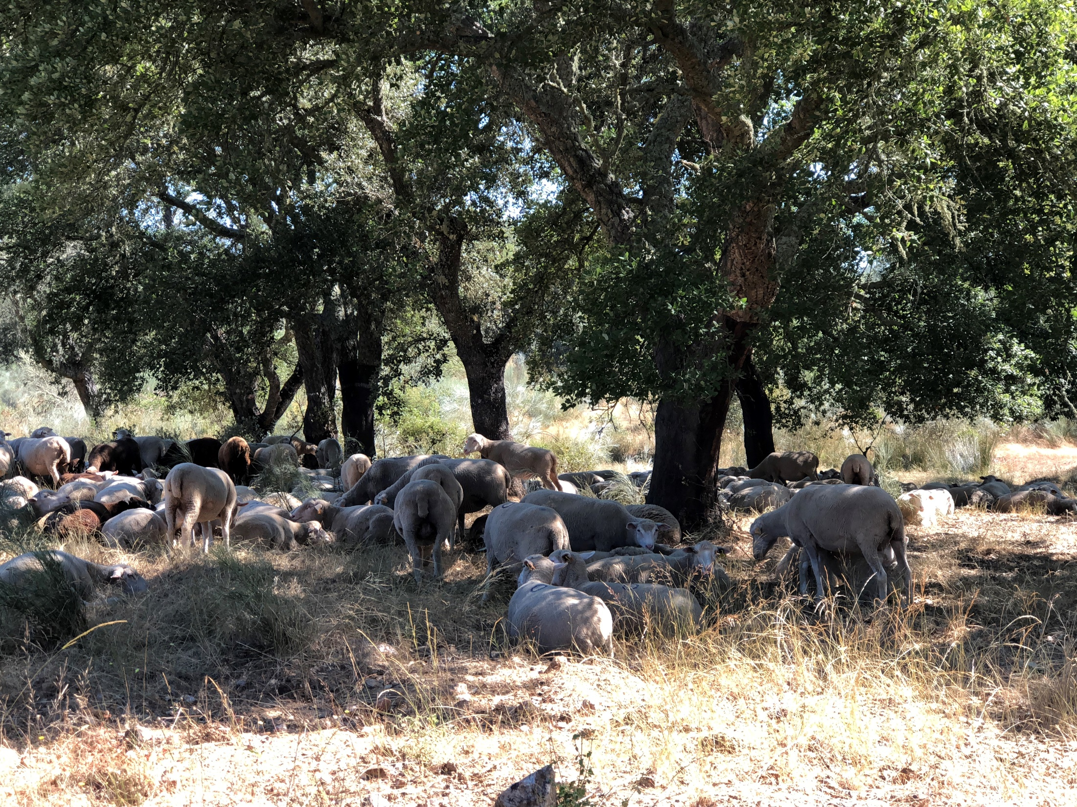
R – Reading, pre-processing and exploring data

Slide 2
Installing the R and the RStudio

Slide 3
Installing the R
If you already have the R software installed in your computer, please skip to the “installation of R studio” or to “starting R”
Go to the R website www.r-project.org and download the software at the CRAN (Comprehensive R Archive Network) mirrors link

Slide 4
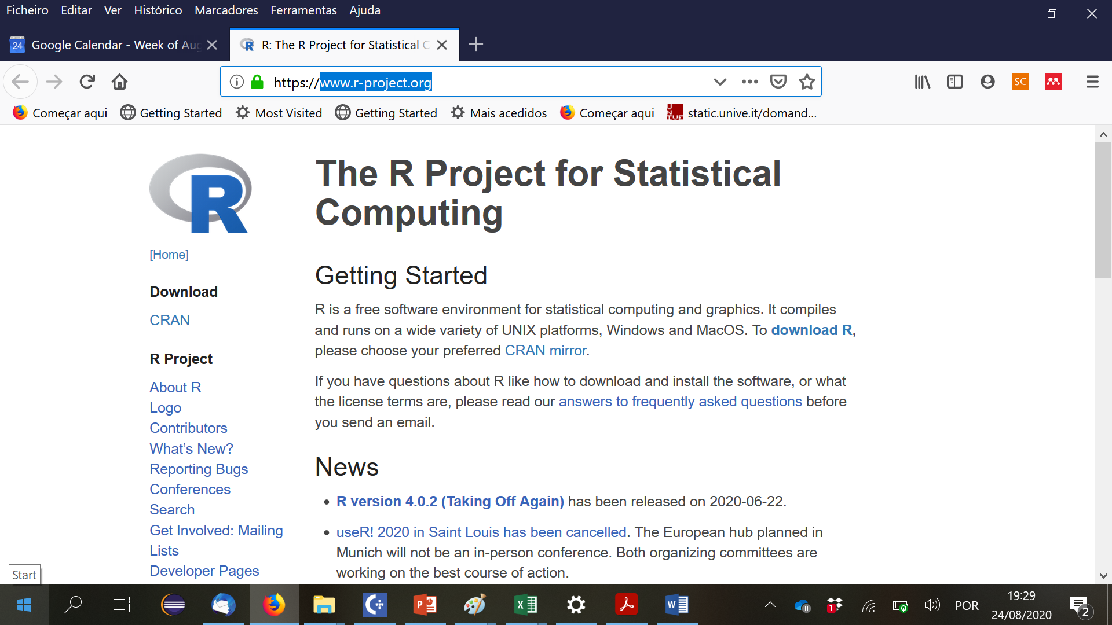

Slide 5
Installing the R
If you already have the R software installed in your computer, please skip this slide
Go to the R website www.r-project.org and download the software at the CRAN (Comprehensive R Archive Network) mirrors link
When you click on the CRAN link, you will be shown a list of network servers all over the planet. Just select one and follow the instructions for installation
Note that you can find several support material in the R website, just explore it when needed

Slide 6
Installing the RStudio
RStudio is an integrated development environment (IDE) for R
It includes a console, syntax-highlighting editor that supports direct code execution, as well as tools for plotting, history, debugging and workspace management
Download and install RStudio at
https://www.rstudio.com/products/rstudio/download/
Scroll down to “Installers for Supported Platforms” near the bottom of the page
Click on the download link corresponding to your computer’s operating system

Slide 7
Starting R
Icons R versus RStudio on your computer

Slide 8
Installing Rtools
Download the installer from CRAN:
On Windows 64-bit: rtools40v2-x86_64.exe (i386 and x64 compilers)
On Windows 32-bit: rtools40-i686.exe (i386 compilers only)
(please check you are using a recent version of Rstudio, at least 1.2.5042)
After installation is complete, you need to put the location of the Rtools make utilities on the PATH. The easiest way to do so is to give the following instruction to R in the console:
writeLines('PATH="${RTOOLS40_HOME}\\usr\\bin;${PATH}"', con = "~/.Renviron")
Now restart R and it must work
(more in: https://cran.r-project.org/bin/windows/Rtools/)

Slide 9
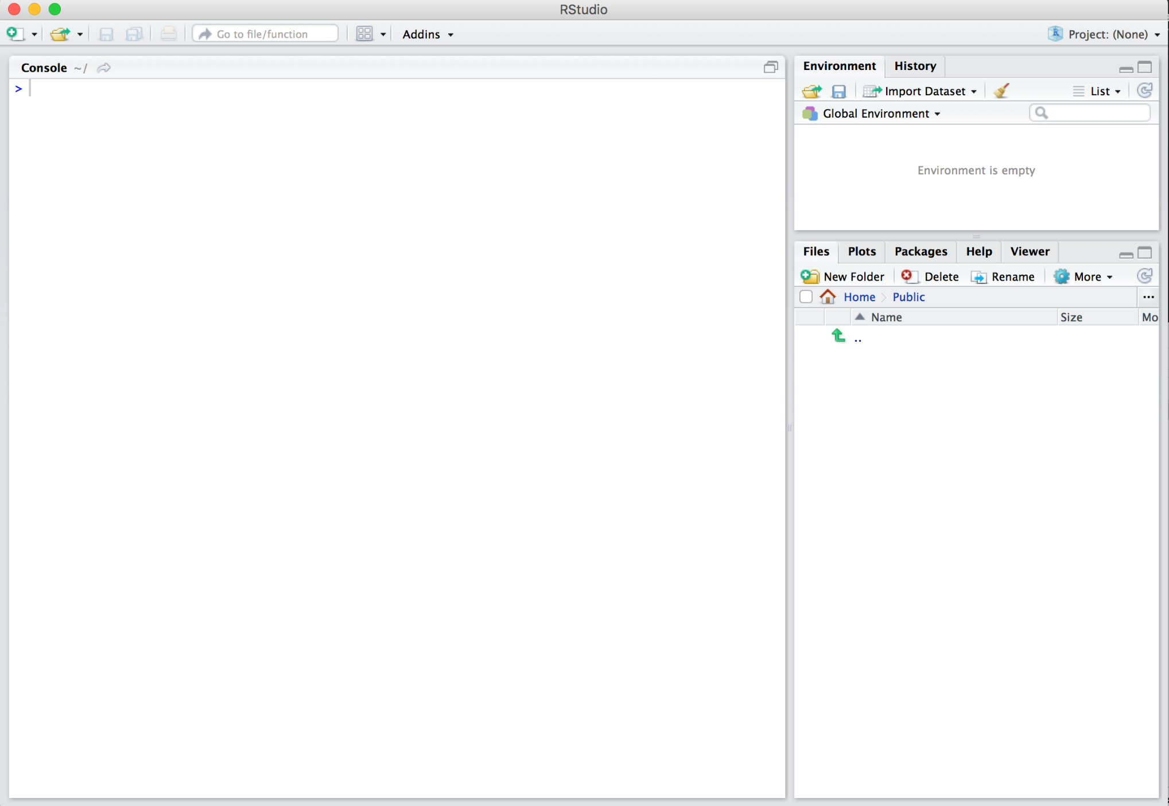
Rstudio interface to R - you should see something similar to this
Environment
Console
Files & more

Slide 10
The R studio environment

Slide 11
Using R
You can use R in two ways:
by typing the instructions in the console, one after the other, in the R command (after >)
by writing a list of commands in a file and use it any time you need (a script); this is the way we are going to use R
The best way to learn R is to start to solve “problems” with the help of someone that is familiar with it
In the Rstudio interface, you can use the Help that is very powerful

Slide 12
Rstudio interface to R - you should see something similar to this
Environment
Console
Files & more

Slide 13
The Forest Models data files
Our R learning will be based on a series of exercises that use the following data files:
IFN_TM_Arv_Pb – data of maritime pine trees (Pb) from the Portuguese National Forest Inventory (NFI)
Sb_SiteIndex&SiteData – data on site index (dominant height and age) and environmental variables in cork oak plots
Ec_StandGrowthData.xlsx – data from several permanent plots and trials established in eucalypt plantations

Slide 14
R workspace
The workspace is the current R working environment where the data files and the R user-defined objects (vectors, matrices, data frames, lists, functions) are located
Functions related to the workspace
getwd() # show the current workspace
setwd() # changes the workspace to another folder
setwd ("C:\\Users\\magatome\\Dropbox\\2_Ensino\\2Ciclo-ModelacaoRecursosFlorestais\\Aulas_R\\DataFiles")
(note the \\ instead of \; it is also possible to use / instead of \)

Slide 15
Typing R instructions in the console
You can type the instructions directly in the console. Just try with some instructions related to the workspace:
getwd()
[1] "C:/Users/magatome/OneDrive - Universidade de Lisboa/Documentos“
setwd ("C:\\Users\\magatome\\Dropbox\\2_Ensino\\2Ciclo-ModelacaoRecursosFlorestais\\Aulas_R\\DataFiles")
use the path where you placed the data files
getwd()
[1] "C:/Users/magatome/Dropbox/2_Ensino/2Ciclo-ModelacaoRecursosFlorestais/Aulas_R/DataFiles“
you will get the path where you placed the data files

Slide 16
Using R packages

Slide 17
Using R packages
R packages are collections of functions and data sets developed by the community
They increase the power of R by improving existing base R functionalities, or by adding new ones
An R package is a set of reusable R functions, the documentation that describes how to use them, and sample data
We are going to use several R packages
Interesting LINK: https://r-pkgs.org/

Slide 18
Using R packages
How to work with packages?
You install them from CRAN with install.packages("x")
You use them in R with library("x")
You just need to install a package once but you have to “call” it with the library(“x”) everytime you want to use it
You get help on them with package?x and help(package = "x")
You may create a script “InstallPackages.R” with the list of all packages that you have installed (just a suggestion…)

Slide 19
Data structures in R

Slide 20
Data structures in R
It is important to have a look at thedata structures that can be used in R:
vectors
lists
matrix
data frame (and tibble)
factors
You can explore several web sites, for instance:
https://swcarpentry.github.io/r-novice-inflammation/13-supp-data-structures/

Slide 21
Importing, exporting and saving data files

Slide 22
Reading EXCEL data files with R
To read an entire data frame (set of vectors with the same length) directly, the external file will normally have a special format:
The first line of the file should have a name for each variable in the data frame
The first item (column) is usually a row label, followed by the values for each variable (one variable per column)
Each sheet in the Forest Models data files is already in the format required to be read as a data.frame
Data in EXCEL are read using the R function read.xlxs() which requires the instalation of the “xlsx” package

Slide 23
Reading EXCEL data files with R
Start by installing the package “xlsx” – just need to do it once
Each time you need to read data in Excel files, you need to load the “xlsx” package and use the read.xlsx function:
library “xlsx”
To learn more about the read.xlsx command use the help tab in the R studio or search in the web

Slide 24
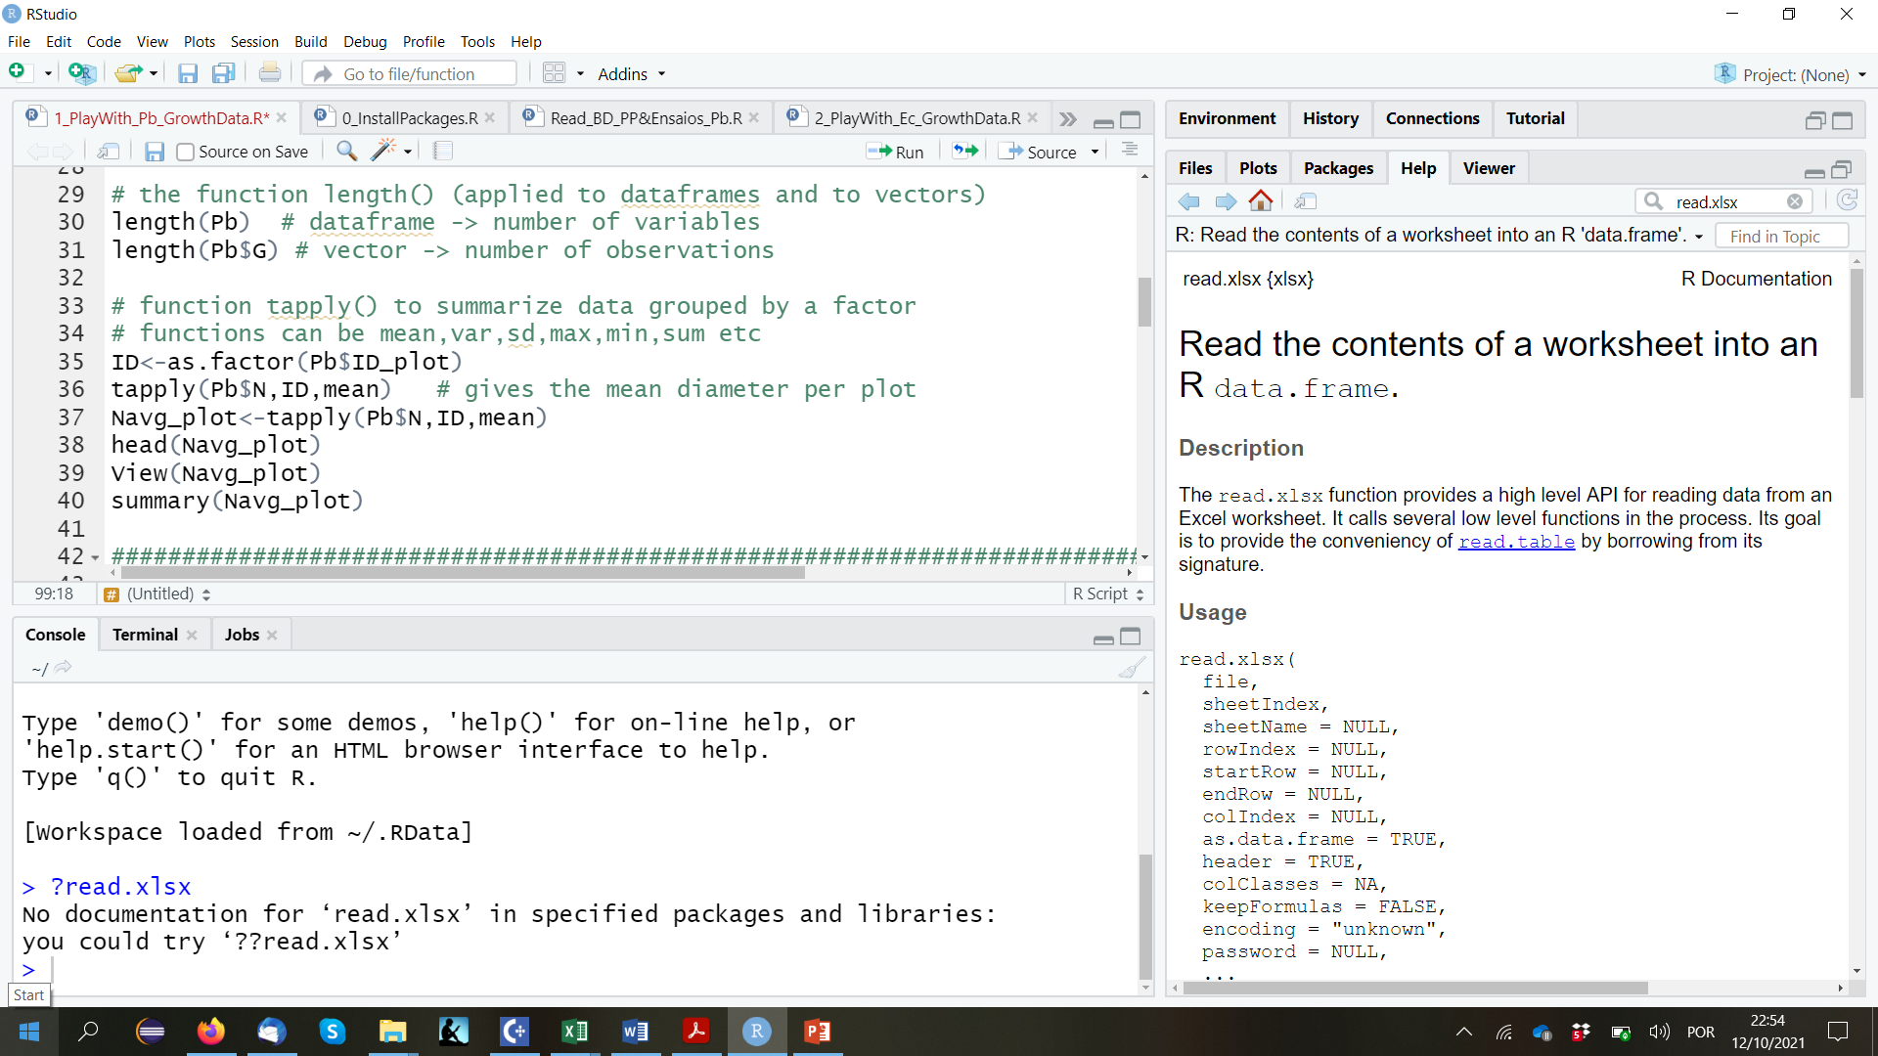
Reading EXCEL data files with R

Slide 25
Reading ACCESS tables with R
To read an ACCESS table into a data frame you need to use the “RODBC” package. After loading it, use function sqlFetch() to read an ACCESS table into a dataframe
For instance to read the table called 'TM_Biomassa' in the database BD_Pb_data.accdb located in C:/Users/magatome/BasesDeDados:
setwd ("C:/Users/magatome/BasesDeDados")
Pb_data <- odbcConnectAccess2007("BD_PB_data.accdb")
TM_biomassa <- sqlFetch(Pb_data, "TM_Biomassa")

Slide 26
Saving and loading R data files
We may want to save a (or more than one) R datafile that “took a long time to prepare”:
save(data1,data2,file=“data.Rdata”)
Later on, in another script, you can load these data:
load(“data.Rdata”) - we will have direct access to the data structures data1 and data2
To know which files are in “your” working space:
list.files()

Slide 27
Write R data files into EXCEL
write.xlsx (X, filename, sheetName=“Name”,
col.names=TRUE, row.names=TRUE,
append=FALSE)
where X is the R data file

Slide 28
Special symbols
R objects can contain special symbols:
NA (missing value)
NaN (Not a Number)
NULL (undefined value)
Inf and –Inf (infinit)

Slide 29
Functions in R

Slide 30
“Looking” at R data files
Several functions can be used to “see” data inside a R data file
View(Data) opens the R file Data
nrows(filename)
lenght (filename) provides the number of variables
lenght (filename$var) provides the number of lines
lenght (unique(filename$var1, filename$var2) provides the number of lines with different values of filename$var1 x filename$var1

Slide 31
“Looking” at R data files
Several functions can be used to “see” data inside a R data file (cont.)
str(filename) describes the structure of the R data file
summary(filename) shows a summary for each variable in the R data file
head(filename) shows the first 6 lines of the R data file
head(filename) shows the first 6 lines of the R data file
head(filename, n=k) shows the first k lines of the R data file

Slide 32
Functions of the apply family
Functions of the apply family come with the R basic package
These functions allow us to manipulate data frames, arrays, matrices, vectors.
They can be seen as a substitute to the loop
https://www.guru99.com/r-apply-sapply-tapply.html#1
https://www.analyticssteps.com/blogs/apply-family-functions-r

Slide 33
Functions of the apply family – apply()
The apply() function helps us to apply a function on rows or columns of a matrix or of a data frame
apply (X, MARGIN, FUN, …)
x: an array, matrix, data frame
MARGIN=1: the manipulation is performed on rows
MARGIN=2: the manipulation is performed on columns
MARGIN=c(1,2): the manipulation is performed on rows and columns
FUN: tells which function to apply. Built functions like mean, median, sum, min, max and even user-defined functions can be applied

Slide 34
Functions of the apply family – lapply()
The lapply() takes a list as an argument and applies a function to each element of the list by looping
lapply(X, FUN, …)
x: Specifies a list on which functions should be replicated
FUN: is a function that needs to be looped on each element of the list

Slide 35
Functions of the apply family – sapply()
The sapply() is a more generalized version of lapply(). It works the same as lapply(), the only difference is in output generalization. Where lapply() returns a list as an output every time, sapply has certain algorithms while returning the output.
If the result is a list with each element of length unity, a vector will be returned.
If the result is a list with more than one element, but each vector of the same length, a matrix will be returned.
If none of the above algorithms is applicable, a list will be returned

Slide 36
Functions of the apply family – sapply()
sapply(X, FUN, …, simplify=TRUE, USE.NAMES=TRUE)
x: Specifies a list on which functions should be replicated
FUN: is a function that needs to be looped on each element of the list
simplify - argument that specifies if we want to simplify the results or not
USE.NAME - specifies the argument names to be used or not.

Slide 37
Functions of the apply family – tapply()
The tapply() function can be applied on a subset of a vector where the vector is divided into different levels that are also known as factors
tapply(X, INDEX, FUN)
x: an object, usually a vector
INDEX: a list containing factor
FUN: tells which function to apply. Built functions like mean, median, sum, min, max and even user-defined functions can be applied
the function FUN provides values for each value of the factor

Slide 38
Functions related to objects
List all objects that are active
ls()
Eliminate objects that won’t be needed anymore
rm(object1,object2)
Describe an object
str(object)

Slide 39
The %>% operator
You can use the %>% operator with standard R functions — and even your own functions — too
The rules are simple: the object on the left hand side is passed as the first argument to the function on the right hand side
euca <- euca_all %>%
select(c("ID_plot","ID_rot","t","hdom","N","G"))
is equivalent to
euca <- select(euca_all, c("ID_plot","ID_rot","t","hdom","N","G"))

Slide 40
Several R functions for vectors
mean(X) → average of the values of vector X
sum(X) → sum values of vector X
prod(X) → makes the product of values in vector X
round(X, digits=k) → round numbers in vector X
floor(X) → rounds to the integer immediately before
ceiling(X) → rounds to the integer immediately after
trunc(X) → gives the integer obtained by truncating X
sample(X) → shuffles the values of vector X in a random order
sample(X,size=k,replace=FALSE) → random sample k

Slide 41
R functions to generate numbers from a fdp (distribution)
These functions require the library(“stats”)
set.seed(1) # provides a seed to start the series of numbers
rnorm(n= , mean=, sd=) normal distribution
rpoison(n=, lambda=) Poison
runif(n=,min=, max=) uniform distribution

Slide 42
Functions related to graphics
par(mar, mgp, las)
par(mar=c(5.1, 4.1, 4.1, 2.1), mgp=c(3, 1, 0), las=0)
mar – A numeric vector of length 4, which sets the margin sizes in the following order: bottom, left, top, and right. The default is c(5.1, 4.1, 4.1, 2.1)
mgp – A numeric vector of length 3, which sets the axis label locations relative to the edge of the inner plot window. The first value represents the location the labels (i.e. xlab and ylab in plot), the second the tick-mark labels, and third the tick marks. The default is c(3, 1, 0)
las – A numeric value indicating the orientation of the tick mark labels and any other text added to a plot after its initialization. The options are as follows: always parallel to the axis (the default, 0), always horizontal (1), always perpendicular to the axis (2), and always vertical (3)
par (“mar”), par(“mgp”), par(“las”) show the current value of the parameters

Slide 43
Functions related to graphics
par(mfrow= par(mfrow=c(2,2))
creates a 2x2 plotting matrix
par(mfrow= par(mfrow=c(1,1))
come back to the original
Notes:
Explicado

Slide 44
The ggplot2 package (e.g. https://ggplot2.tidyverse.org/)
ggplot2 is a system for declaratively creating graphics, based on The Grammar of Graphics. You provide the data, tell ggplot2 how to map variables to aesthetics, what graphical primitives to use, and it takes care of the details
In most cases, you start with ggplot(), supply the aesthetic with aes() and then add layers (like the type of graphics, the colours, etc)

Slide 45
Printing results in the console
See the links:
https://www.gastonsanchez.com/r4strings/formatting.html

Slide 46
Interesting links
problems with attach() and detach() functions
https://www.r-bloggers.com/2011/05/to-attach-or-not-attach-that-is-the-question/
merging data sets by columns with diferent names
https://www.r-bloggers.com/2012/12/joining-2-r-data-sets-with-different-column-names/
R for Data Science (a lot of topics presented in a nice way):
https://r4ds.had.co.nz/workflow-scripts.html

Slide 47
Commenting multiple lines in scripts
There are two ways to add multiple single-line comments in R Studio:
Select the multiple lines which you want to comment using the cursor and then use the key combination “control + shift + C” to comment or uncomment the selected lines.
The other way is to use the GUI, select the lines which you want to comment by using the cursor and click on “Code” in menu, a pop-up window pops out in which we need to select “Comment/Uncomment Lines” which appropriately comments or uncomment the lines which you have selected.
(https://www.geeksforgeeks.org/comments-in-r/)

Slide 48
Let´s now test how R works by following the “try and see” scripts “PlayWith_Pb_GrowthData” “Pbtrees_NFIData_LargeDataset” “PlayWith_Ec_GrowthData”

