Slide 1
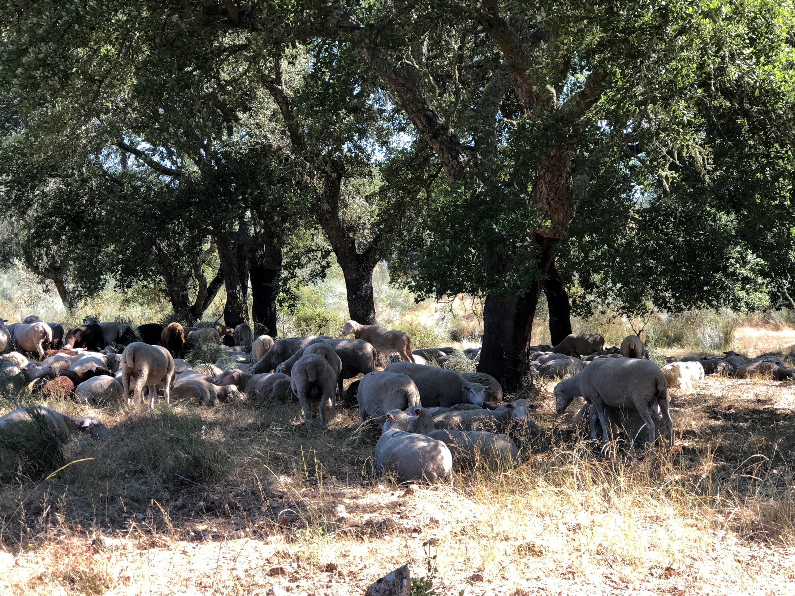
Using R for Forest Growth Modeling

Slide 2
Simple linear regression

Slide 3
Simple linear regression in R
In simple linear regression the objective is to find the equation of the straight line that better describes the relationship between two variables, the independent variable (or regressor variable), usually designed by X, and the dependent variable Y

Slide 4
Model evaluation and checking regression assumptions
What defines a good model? How do we check model quality?
How do we check the regression assumptions (that should be met if we want to make inferences regarding the model estimates or to use the model to make predictions)
Property | Checked by
Good fit | R², adjusted R²
The parameters associated with the X variable is significantly different from zero | t-test
Regression assumptions are met | Homocedasticity - plot residuals vs predicted values Residuals follow the normal distribution – Qqplots Independence of the observations
Has a good prediction ability | Evaluated by validation with an independent data set Or Evaluated with PRESS residuals Or Evaluated with resampling methods

Slide 5
Simple linear regression in R
The function lm(), part of the “stats” package included in the standard installation of R, is usually the one used to perform linear regression in R
It has several associated functions to evaluate the model and to test regression assumptions, just check all of them:
    y <- d
    mod <- lm( y ~d0)
    summary(mod)
    r2 <- summary(mod)$r.squared
    adj.r2 <- summary(mod)$adj.r.squared
    res <- resid(mod)
    yest <- fitted(mod)
    hat <- lm.influence(mod)$hat
    res_press <- res/(1-hat)
    ares_press <- abs(res_press)
    mean_rp <- mean(res_press)
    mean_arp <- mean(ares_press)
    rp_p95 <- quantile(res_press,0.95)
    rp_p05 <- quantile(res_press,0.05)
    r2p <- 1-sum(res_press**2)/(var(y)*length(y)-1)
    plot(mod,which=c(1,2,4,5))
    xmod <- c(r2,adj.r2,mean_p,mean_ap,rp_p95,rp_p05,r2p)
    print(xmod,digits=4)

Slide 6
Continuous and categorical variables
Continuous variables are those that can take all real values within an interval
Categorical variables can just take a limited number of possible values, many times they refer to categories, such as soil type, colour, etc
For linear regression, the categorial variables have to be recoded as dummy variables (variables that can only take the values 0 or 1, depending on their value)
Generally, for a categorical variable with k categories, we need (k-1) dummy variables

Slide 7
Continuous and categorical variables
Suppose that you have a variable TreeStatus with two possible values: Dead or Alive. We need one dummy variable (X) to define the TreeStatus variable:
    X= 1 if the tree is alive; X=0 if the tree is dead
For a variable Region with 3 possible values – North, Centre, South – we need two dummies:
    X1=1 if Region=North; X1=0 otherwise
    X2=1 if Region=Centre; x2=0 otherwise
Region | X1 | X2
North | 1 | 0
Centre | 0 | 1
South | 0 | 0

Slide 8
Multiple linear regression

Slide 9
The problem of multicollinearity
In a linear regression with one variable
y=a+bX
b – change in Y when X changes 1 unit
y1= a + b X1
y2 = a+b X2
(y2-Y1) = b (X2-X1)
b=(Y2-Y1)/(X2-X1)
y1= a + b1 X1 + b2 Z1
y2= a + b1 X2 + b2 Z2

Slide 10
The problem of multicollinearity
In a linear regression with one variable
y=a+bX
b – change in Y when X changes 1 unit
y1= a + b X1
y2 = a+b X2
(y2-Y1) = b (X2-X1)
b=(Y2-Y1)/(X2-X1)
y1= a + b1 X1 + b2 Z1
y2= a + b1 X2 + b2 Z2

Slide 11
y1= a + b1 X1 + b2 Z1
y2= a + b1 X2 + b2 Z2
(y2-y1) = b1(X2-X1) + b2(Z2-Z1)
b1=((y2-Y1)-b2(Z2-Z1)/(X2-X1)

Slide 12

Linear regression with dummy variables
The linear regression is
  $Y=a+b D$, where a and b are the parameters
if D is a dummy variable, then
  if D=1 then $Y=a+b$
  if D=0 then $Y=a$

Slide 13
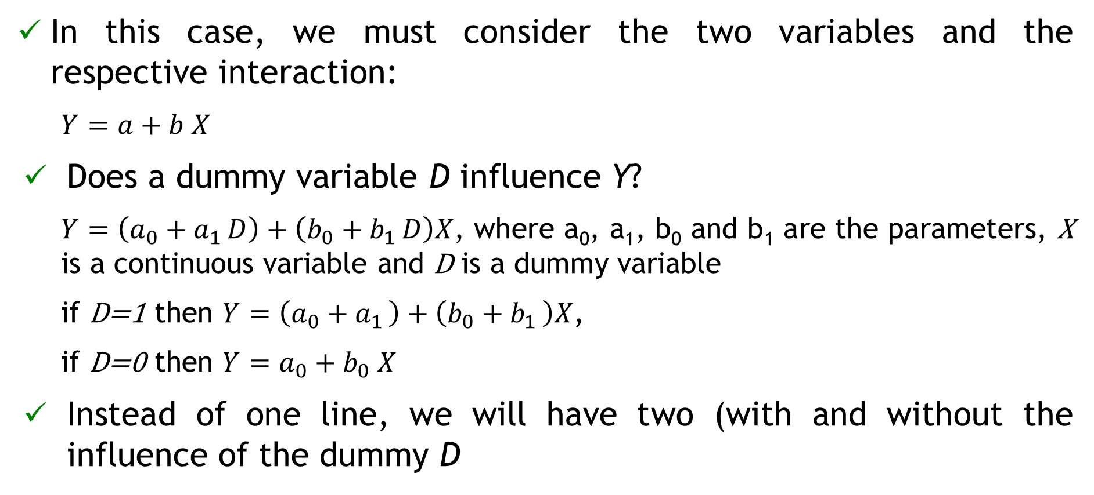
Linear regression with continuous and dummy variables
In this case, we must consider the two variables and the respective interaction:
  $Y=a+b X$
Does a dummy variable D influence Y?
  $Y=\left(a_{0}+a_{1 }D\right)+\left(b_{0}+b_{1 }D\right)X$, where a₀, a₁, b₀ and b₁ are the parameters, X is a continuous variable and D is a dummy variable
  if D=1 then $Y=\left(a_{0}+a_{1 }\right)+\left(b_{0}+b_{1 }\right)X$,
  if D=0 then $Y=a_{0}+b_{0} X$
Instead of one line, we will have two (with and without the influence of the dummy D

Slide 14
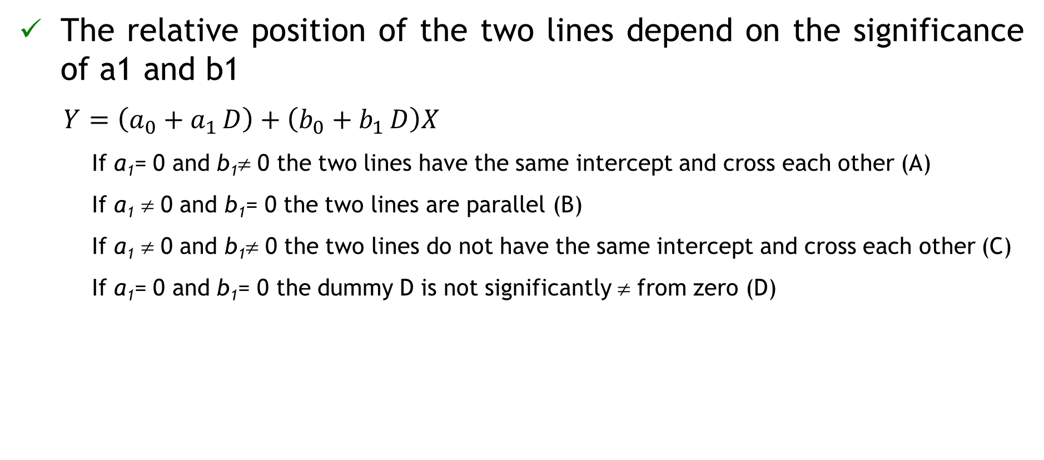
Linear regression with continuous and dummy variables
The relative position of the two lines depend on the significance of a1 and b1
  $Y=\left(a_{0}+a_{1 }D\right)+\left(b_{0}+b_{1 }D\right)X$
    If a₁= 0 and b₁≠ 0 the two lines have the same intercept and cross each other (A)
    If a₁ ≠ 0 and b₁= 0 the two lines are parallel (B)
    If a₁ ≠ 0 and b₁≠ 0 the two lines do not have the same intercept and cross each other (C)
    If a₁= 0 and b₁= 0 the dummy D is not significantly ≠ from zero (D)

Slide 15
Modelling S from environmental variables
File “S_SiteIndex&SiteData.xlsx”
I - Sdata0 <- merge Property, Climate, by Cod_Meteo
II - Sdata1 <- merge StandVariables, Sdata0, by Cod_Property
n=79
III - Sdata <- merge Sdata1 Soil_twi, by Cod_Plot
n=79
n=26
n=15

Slide 16
Algorithms for selection of variables
What shall we do when there is the need to select a subset of variables in order to have a good model?
Two types of algorithms:
  stepwise algorithms, such as step(), stepAIC(), ols_best_backward()
  all possible regressions algorithms, such as ols_best_all_possible(), ols_best_subset(), regsubsets(), leaps()
“Good” websites:
  https://cran.r-project.org/web/packages/olsrr/vignettes/variable_selection.html
  https://rdrr.io/cran/leaps/man/regsubsets.html

Slide 17
Stepwise algorithms
Three methods:
  Forward selection, starts with no predictors in the model, iteratively adds the most predictors that predicts the most according to a certain criteria, and stops when there is no improvement
  Backward selection (or backward elimination), which with all predictors in the model (full model), iteratively removes the predictors with smaller contribution according to a certain criteria, and stops when the next model will be worse according to the criteria
  Stepwise selection (or sequential replacement), which is a combination of forward and backward selections. Starts with no predictors, then sequentially add the most contributive predictors (like forward selection). After adding each new variable, remove any variables that no longer provide an improvement in the model fit (like backward selection)

Slide 18
Stepwise algorithms
Interesting links :
  https://olsrr.rsquaredacademy.com/articles/variable_selection.html
  https://cran.r-project.org/web/packages/olsrr/vignettes/variable_selection.html
  http://www.sthda.com/english/articles/37-model-selection-essentials-in-r/154-stepwise-regression-essentials-in-r/#loading-required-r-packages
  https://www.rdocumentation.org/packages/leaps/versions/2.1-1/topics/regsubsets

Slide 19
Model comparison selection
What defines a good multilinear model? How do we check model quality?
Property | Checked by
Good fit | R², adjusted R², AIC
The parameters associated with each one of the variables are significantly different from zero (all variables are significant) | t-tests
Multicolinearity is not present | Variance inflation factores (VIF) < 10
Regression assumptions can be verified | Homocedasticity - plot residuals vs predicted values Residuals follow the normal distribution - QQplots
Has a good prediction ability | Evaluated by validation with an independent data set Or Evaluated with PRESS residuals Or Evaluated with resampling methods

Slide 20
Bias and precision
Accuracy, bias and precision:
Accuracy
bias + precision
Accurate model is unbiased and has high precision
average of res_press ≅ 0
+
low average |res_press|
Precise
low average |res_press|
Not precise
high average |res_press|
unbiased
average res_press ≅ 0
biased
average res_press ≠ 0

Slide 21
Nonlinear regression

Slide 22
Nonlinear regression
A nonlinear model is a model that is nonlinear on the parameters, which means that for instance
  there are parameters as powers or included in functions that are powers
  there are multiplication of parameters
Note that
  Many of the methods from linear regression transfer directly or with small modifications to the nonlinear case
  Methods of estimation and inference in NLMs are linear methods applied to a linear approximaion to the NLM

Slide 23
Function plot() for objects of nlsResiduals type
nlsResiduals(nls) # nls – object of class ‘nls’
plot(x, which = 0,…) # x - object of class ‘nlsResiduals’
  which is an integer:
    0 = 4 graphs of residuals (types 1, 2, 4 and 6)
    1 = non-transformed residuals against fitted values
    2 = standardized residuals against fitted values
    3 = sqrt of absolute value of standardized residuals against fitted values
    4 = auto-correlation residuals (i+1th residual against ith residual)
    5 = histogram of the residuals
    6 = qq-plot of the residuals
    http://finzi.psych.upenn.edu/library/nlstools/html/nlsResiduals.html

Slide 24
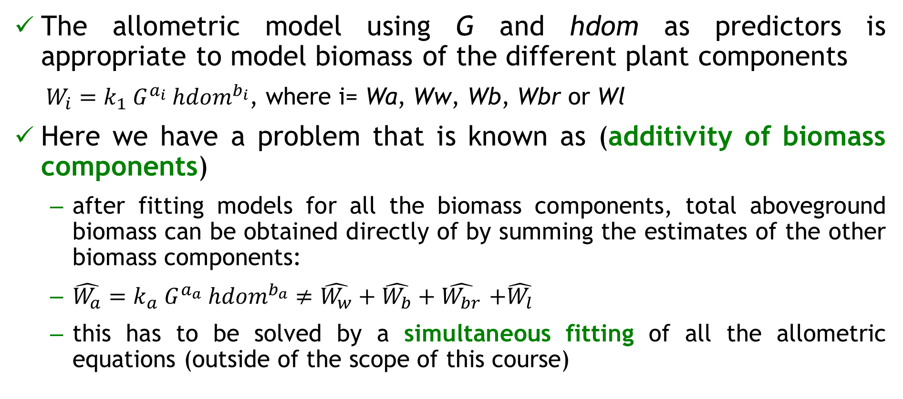
Allometric models for biomass components
The allometric model using G and hdom as predictors is appropriate to model biomass of the different plant components
  $W_{i}=k_{1}{ G}^{a_{i}} {hdom}^{b_{i}}$, where i= Wa, Ww, Wb, Wbr or Wl
Here we have a problem that is known as (additivity of biomass components)
  after fitting models for all the biomass components, total aboveground biomass can be obtained directly of by summing the estimates of the other biomass components:
  $\hat{W_{a}}=k_{a} G^{a_{a}} {hdom}^{b_{a}}≠\hat{W_{w}}+\hat{W_{b}}+\hat{W_{br}}$ $+\hat{W_{l}}$
  this has to be solved by a simultaneous fitting of all the allometric equations (outside of the scope of this course)

Slide 25
Obtaining initial values for nonlinear models that can be linearized by some math transformation
Nonlinear model: W = k G^a hdom^b
Linearized to: ln(W) = ln(k) + a ln(G) + b ln(hdom)
  Z=ln(W); k0=ln(k); X1=ln(G); X2=ln(hdom)
  The linear model is Z=k0 + a X1+b X2
  Initial values: kini=exp(ln(k)), aini=a, bini=b

