Slide 1
A day in the life of a
phytosanitary inspector
Lisbon| 8 of november2022

Slide 2
Inspections Imports/Exports
Mandatory annual Inspections for economic operators
Prospecting for harmful biotic agents
Supervision of manufacturing units

Slide 3
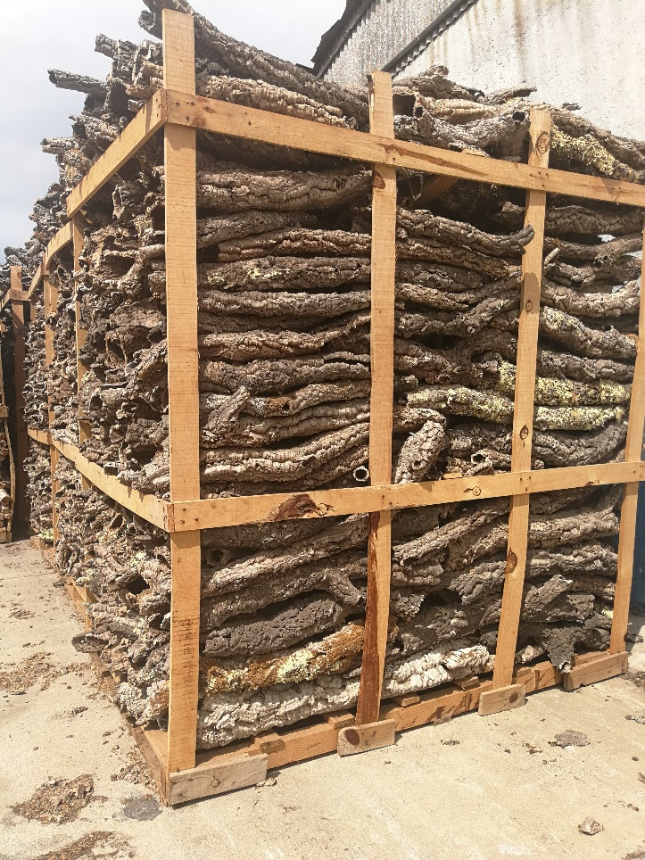
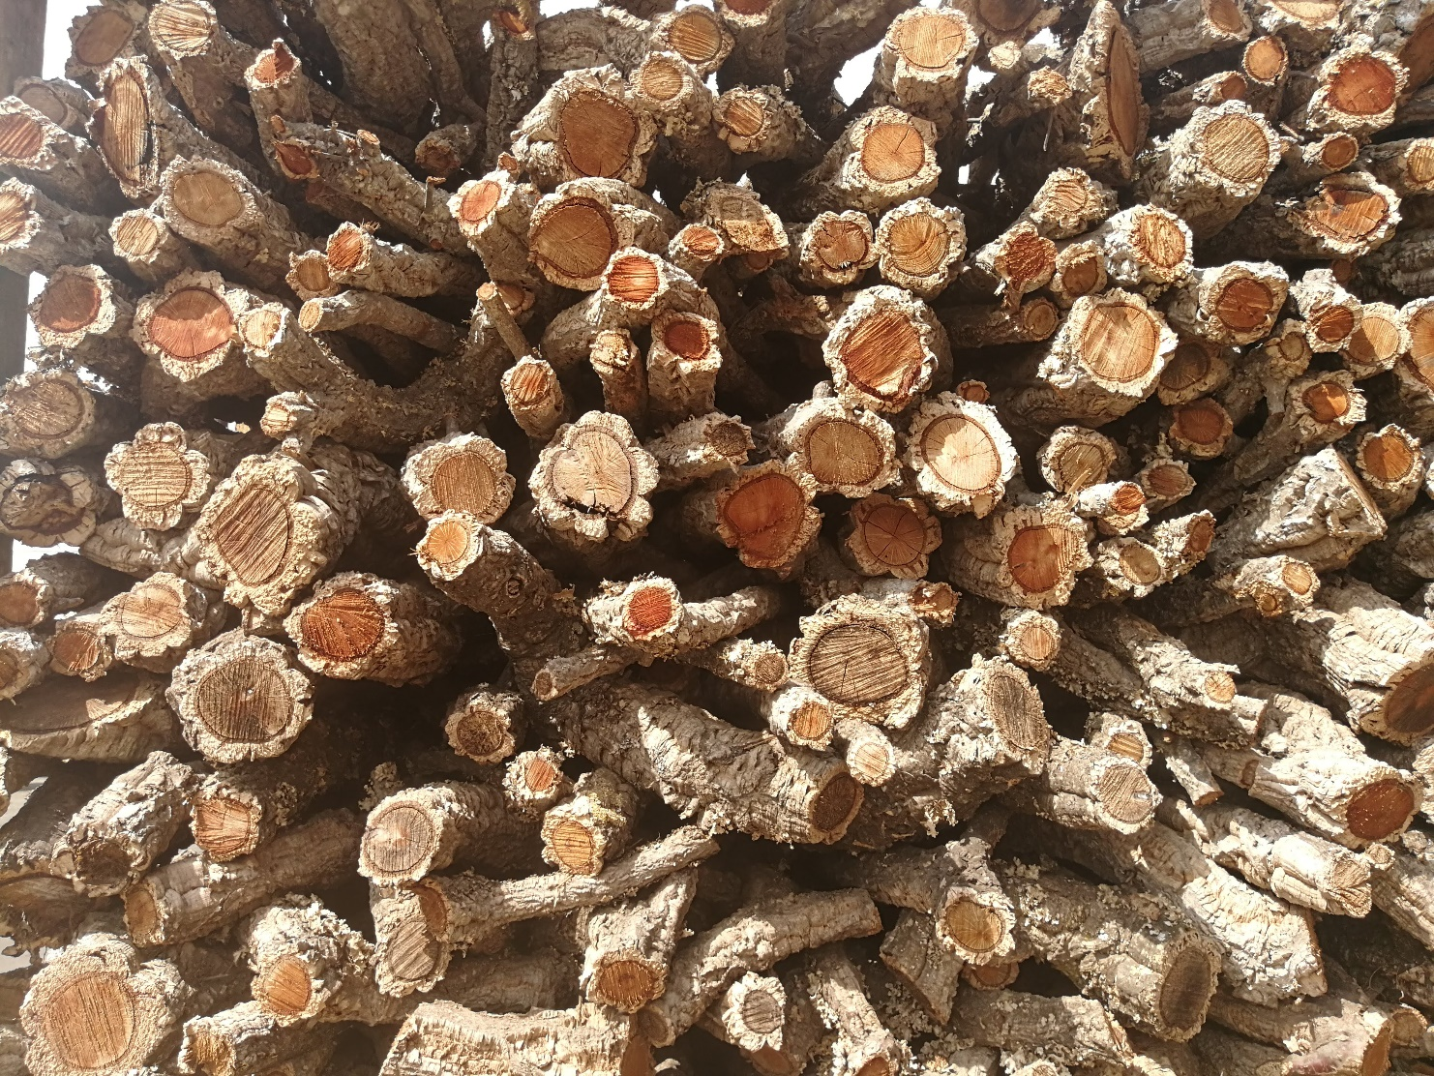
Inspections Imports/Exports

Slide 4
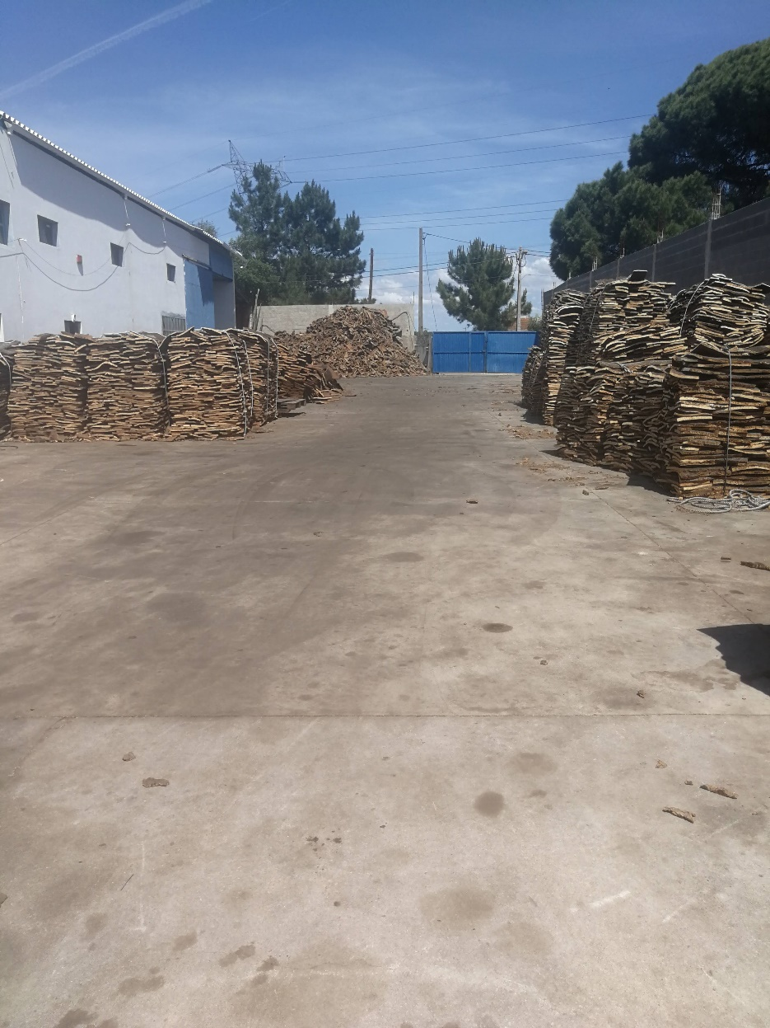
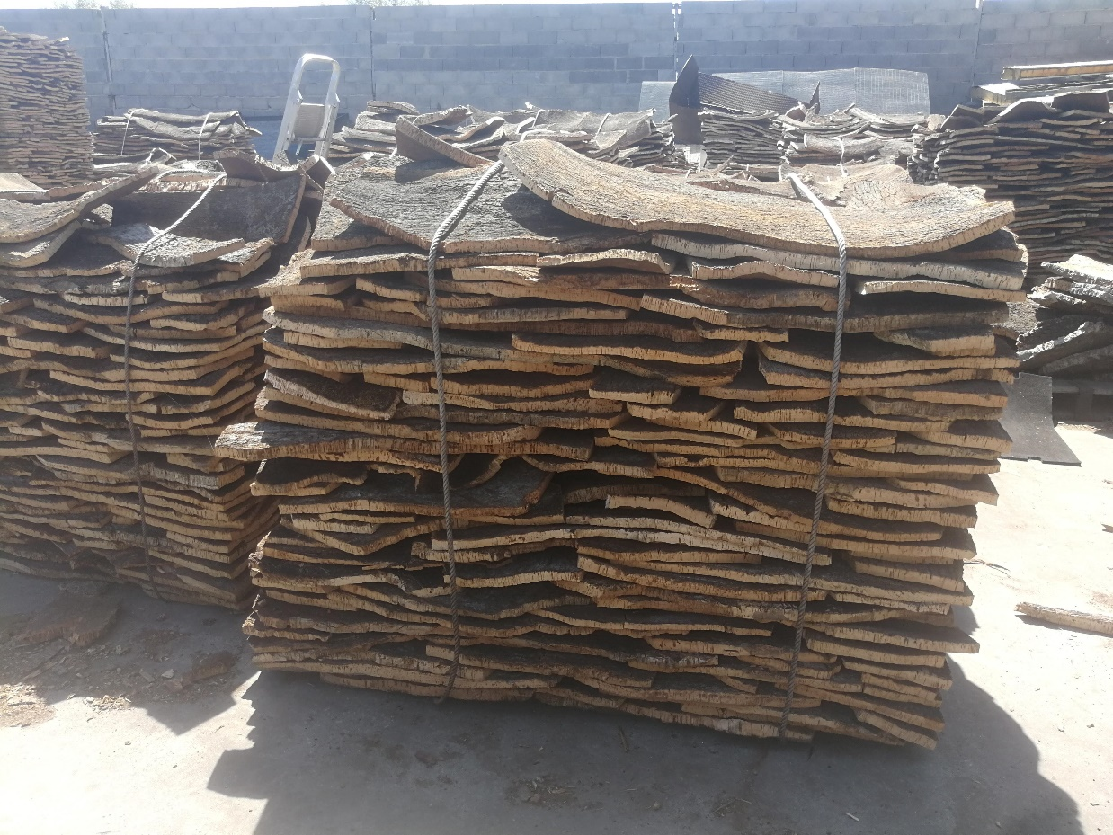
Exports of Cork, Virgin Cork, Cork Planks, Cork Stoppers

Slide 5
Imports
In the Alentejo Region we only have one port (Port of Sines).
The imports are Pine wood posts of Yellow pine from Brasil
Wood of Quercus alba from the United States
We have to check the Phytosanitary certificate
And verify that there is no sticky bark …

Slide 7
The IMSOC system is made up of several EU information systems (iRASFF, ADIS, EUROPHYT, TRACES). These systems allow EU countries to exchange information on official controls of food, animals and plants in order to prevent fraud in the food sector.

Slide 8
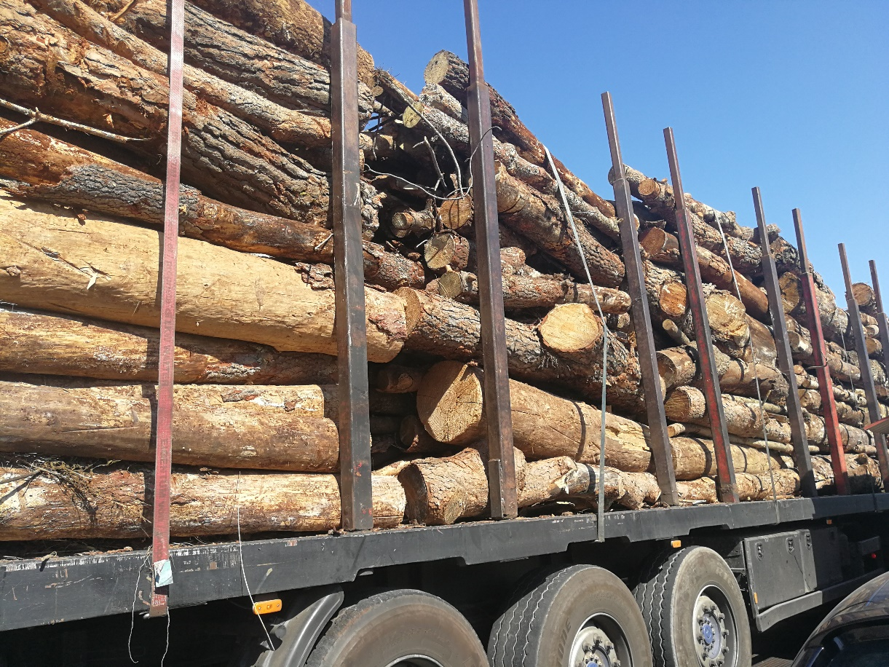
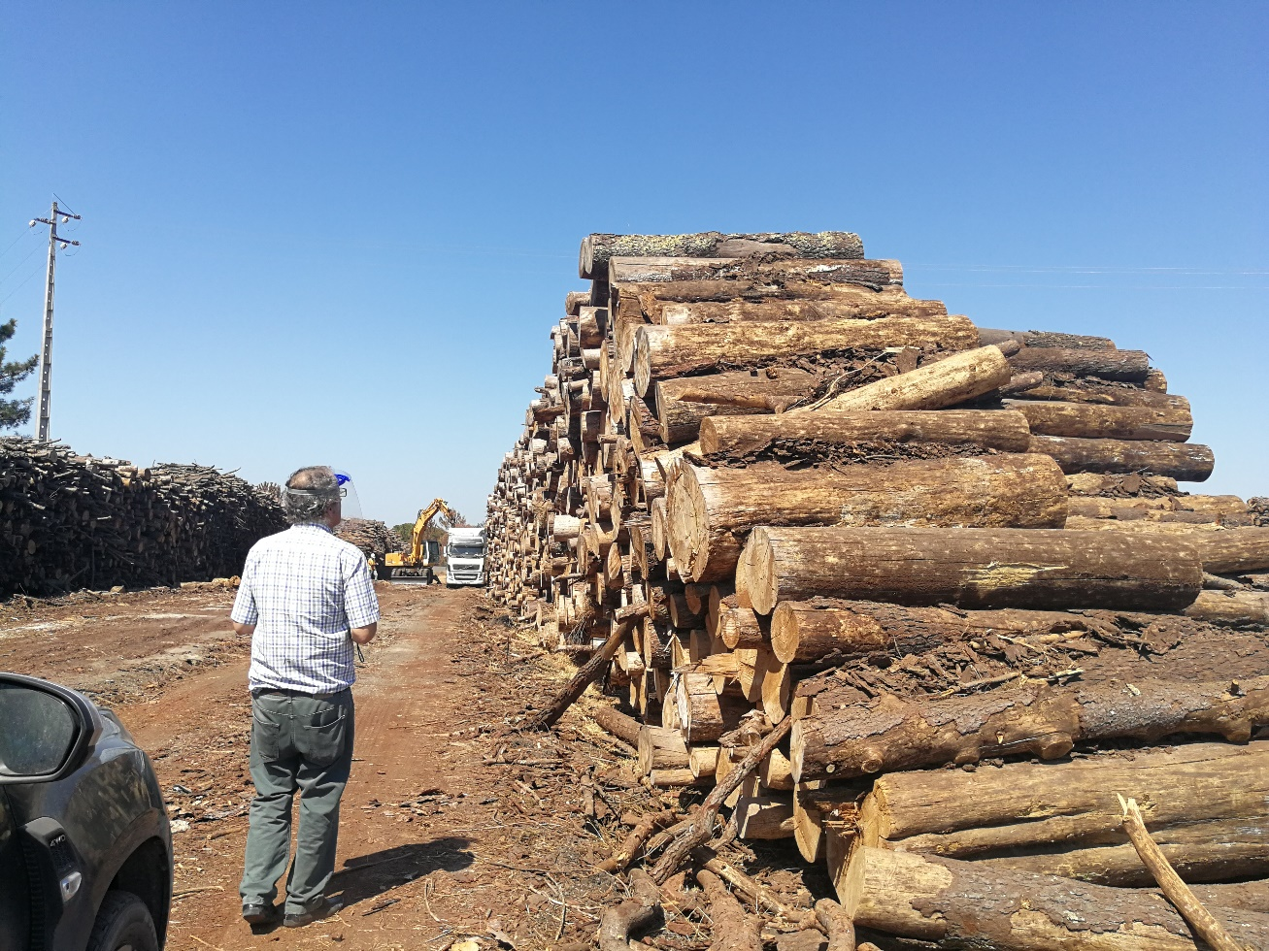
Mandatory annual inspections for economic operators

Slide 9
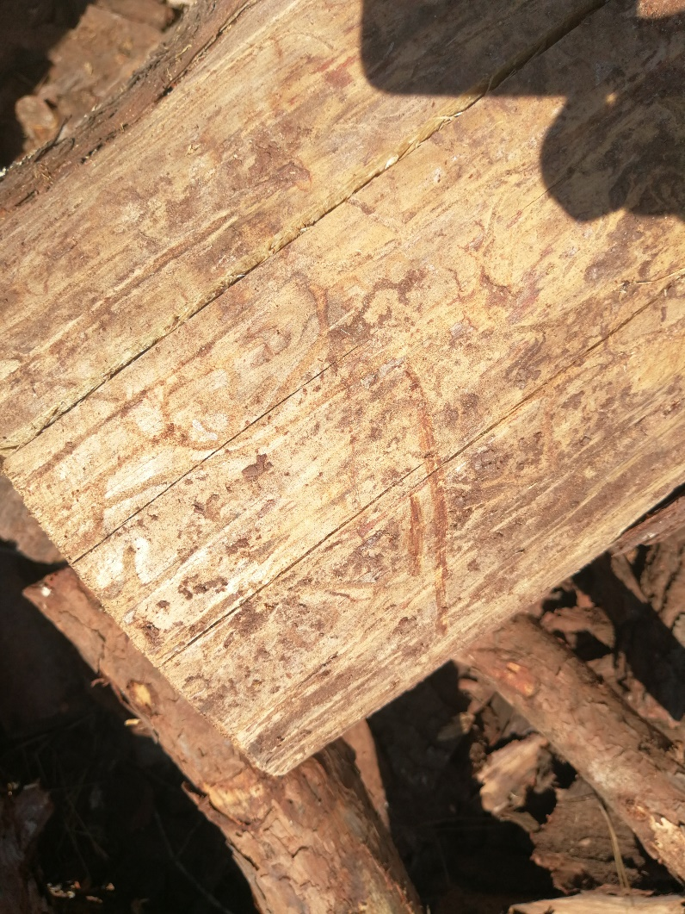
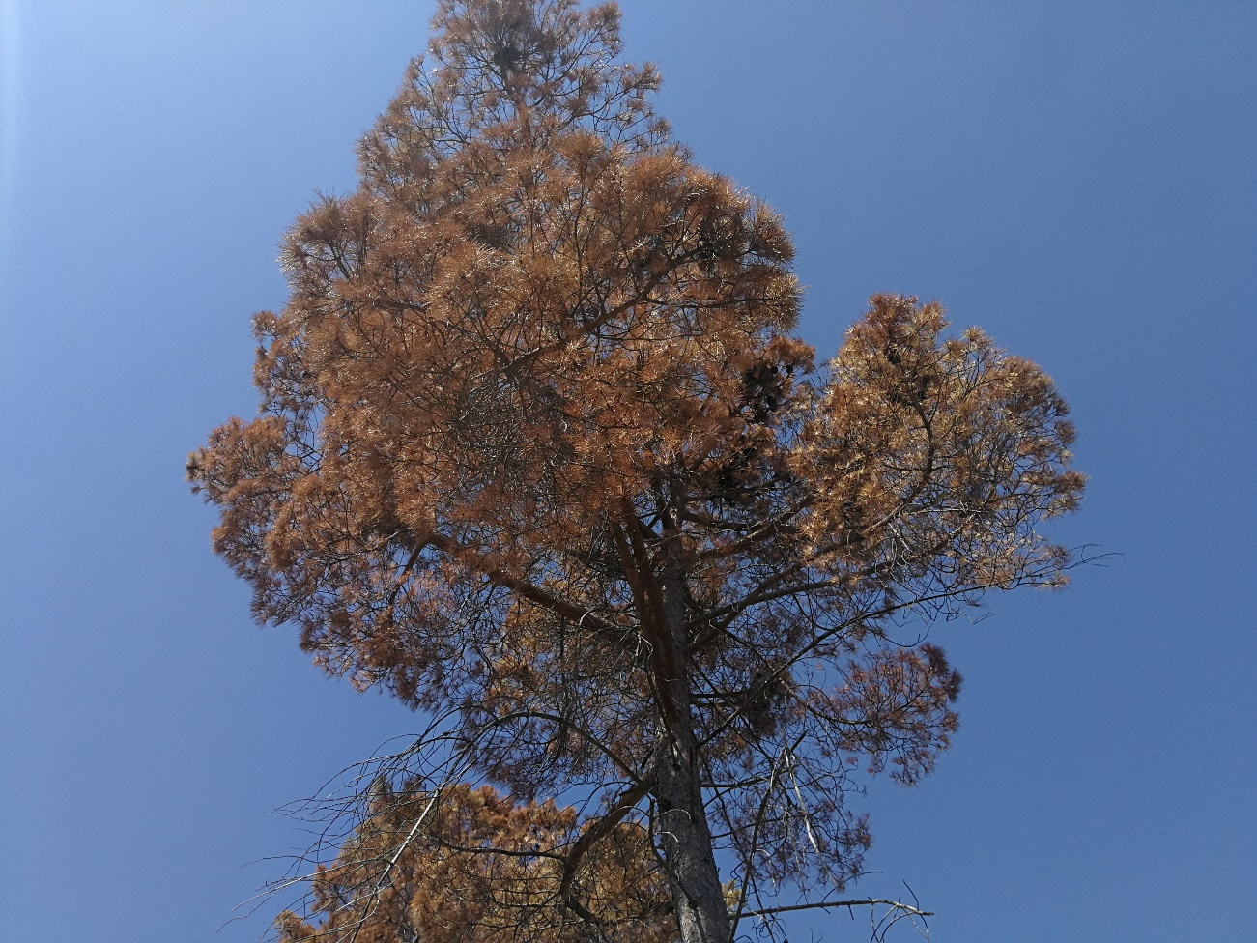
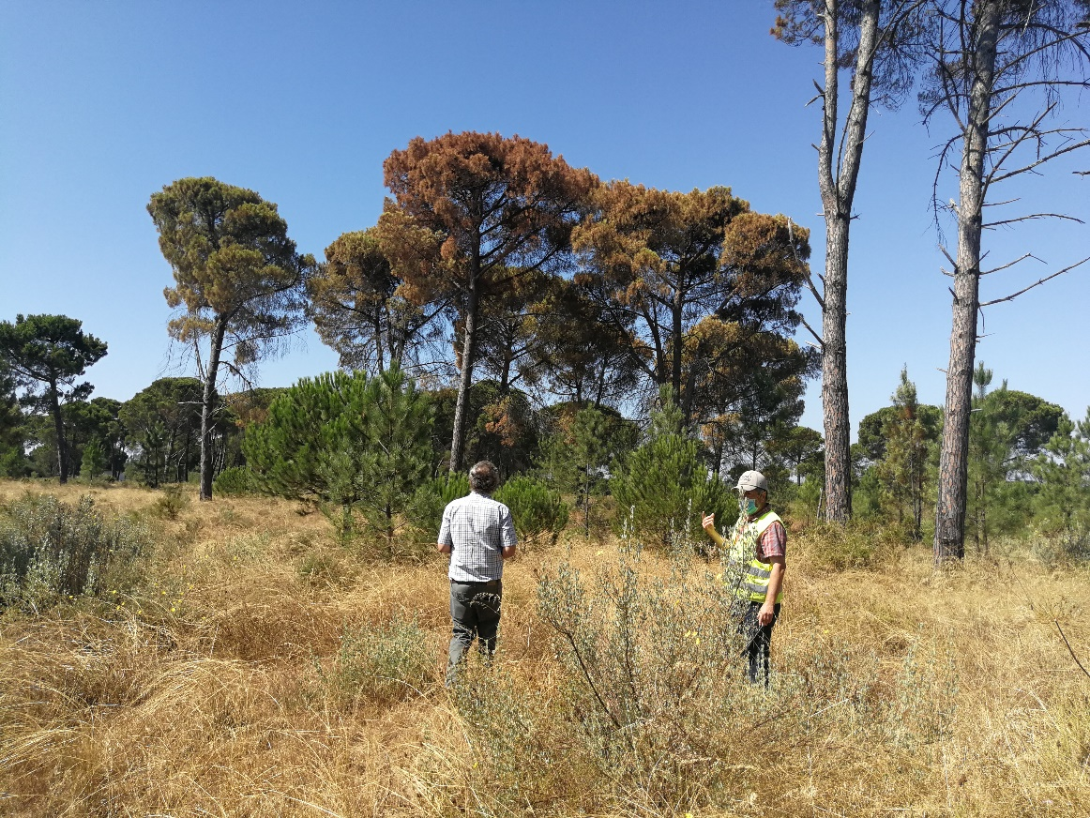

Slide 10
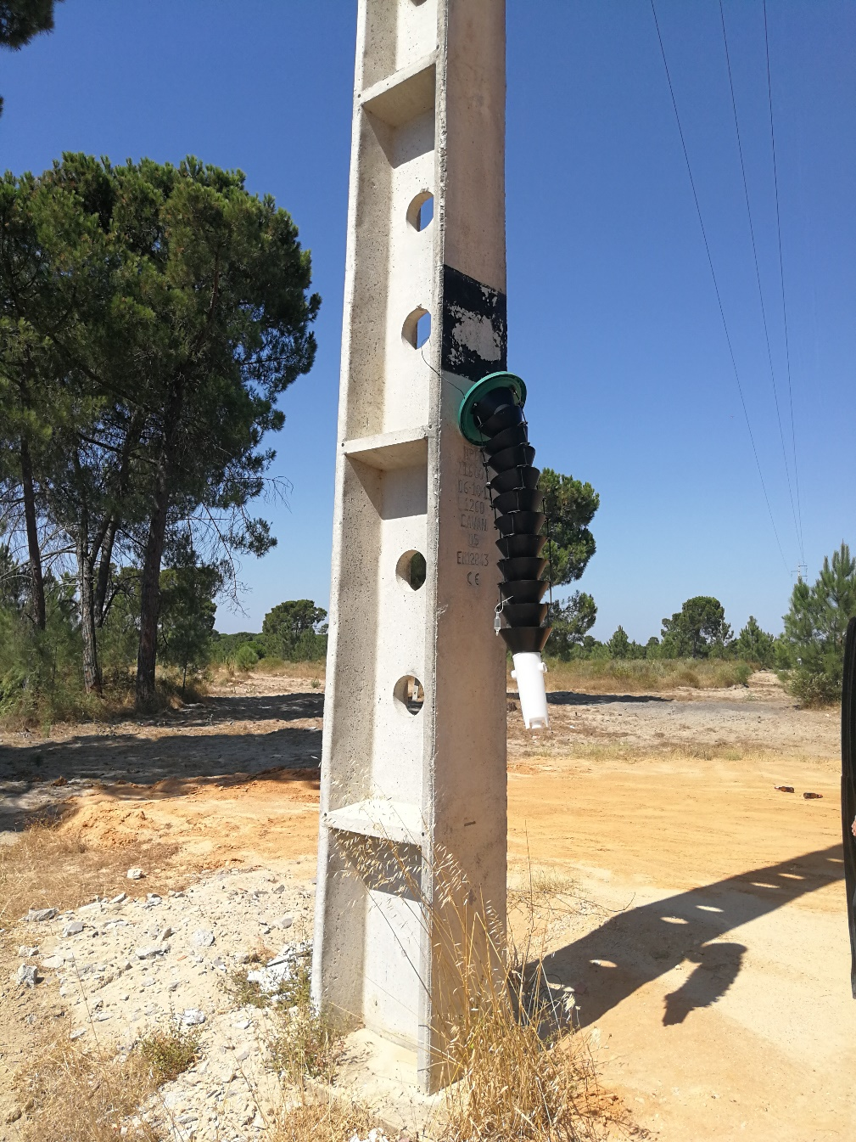
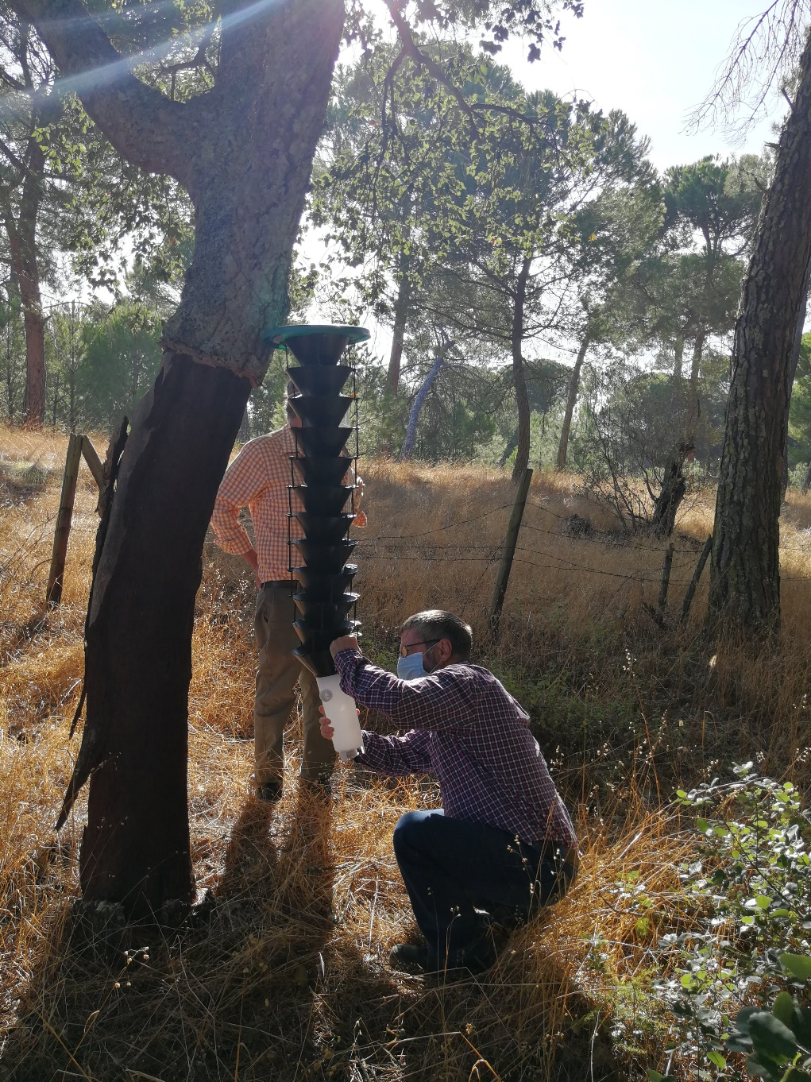

Slide 11
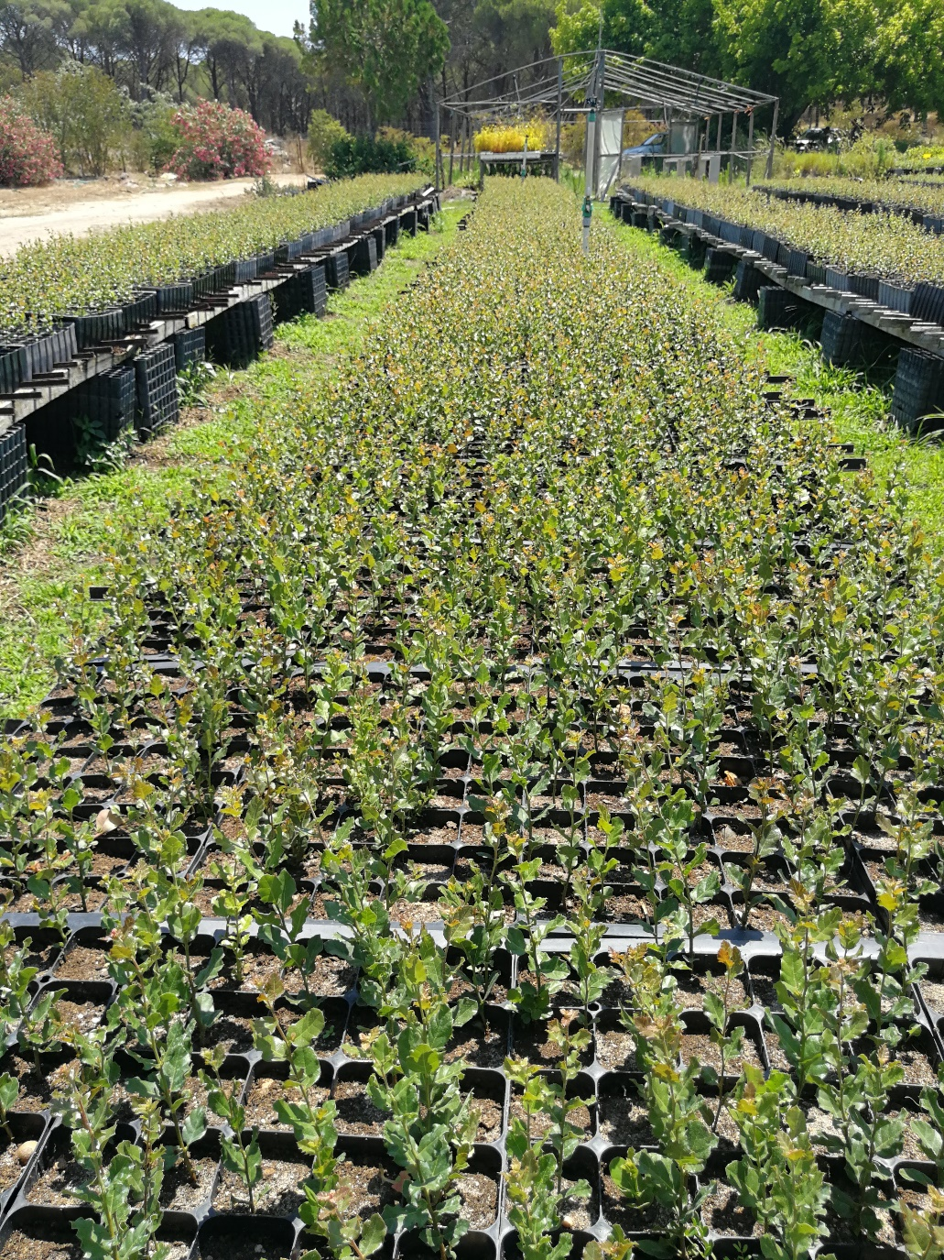
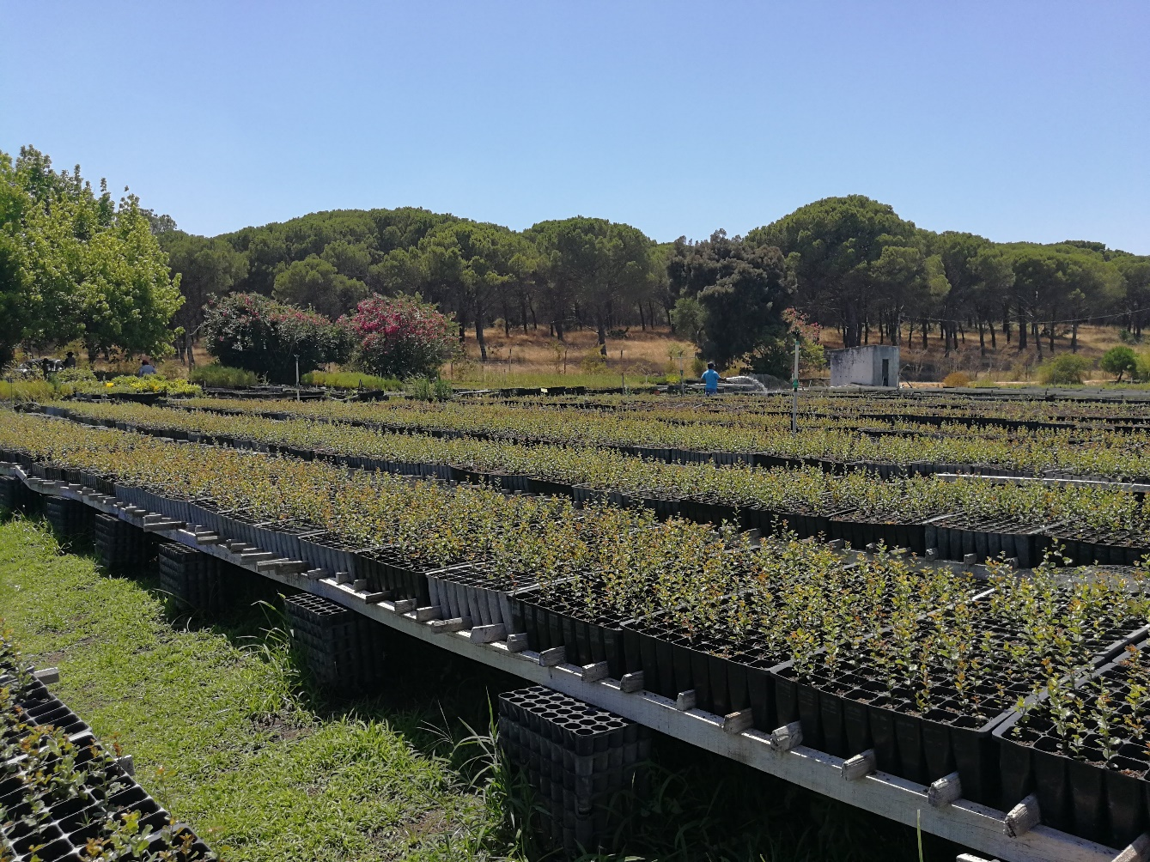
Forest Plant nurseries

Slide 12
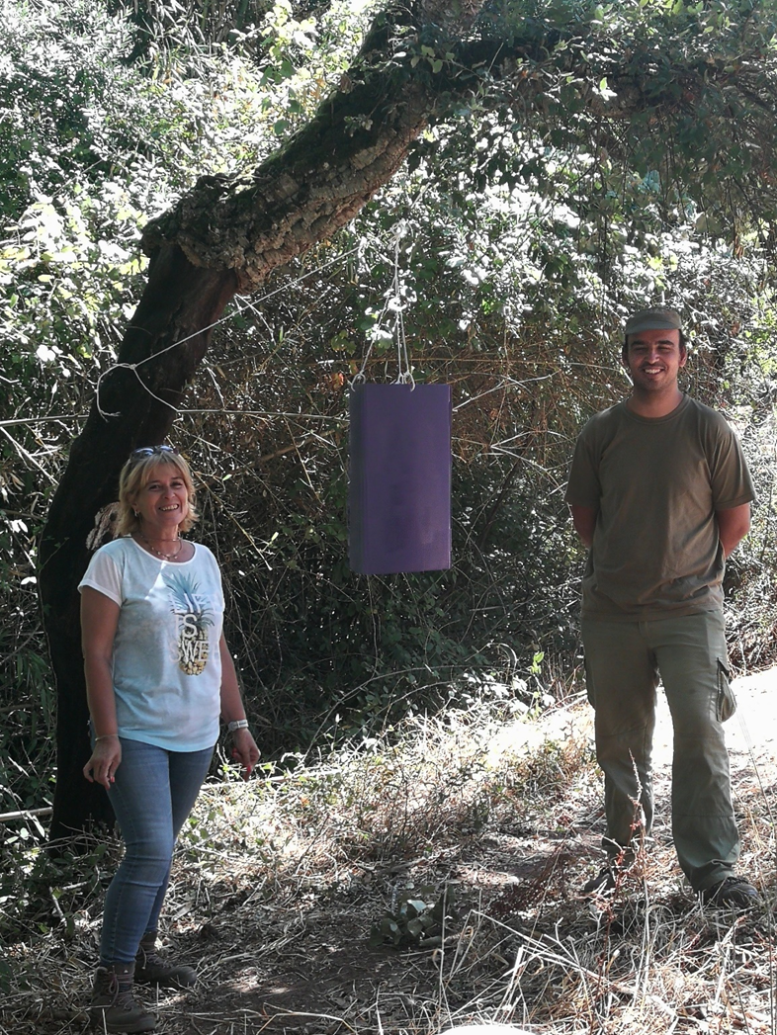
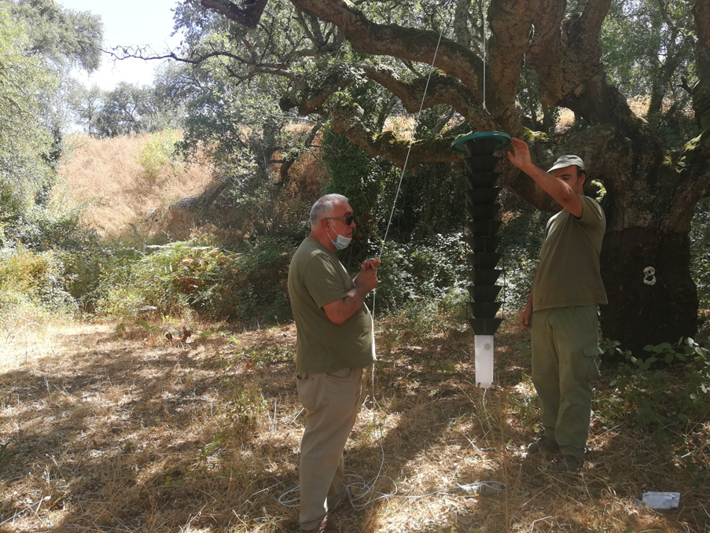
Prospecting for harmful biotic agents

Slide 13
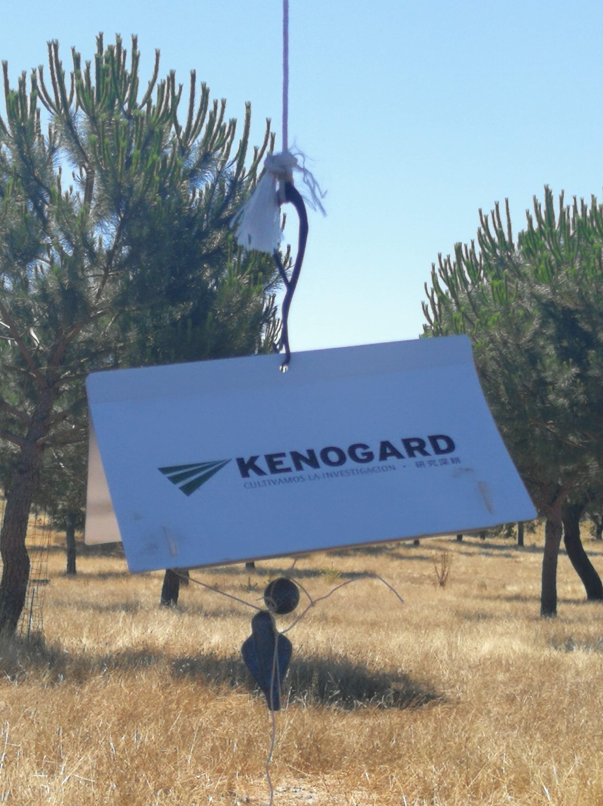

Slide 14
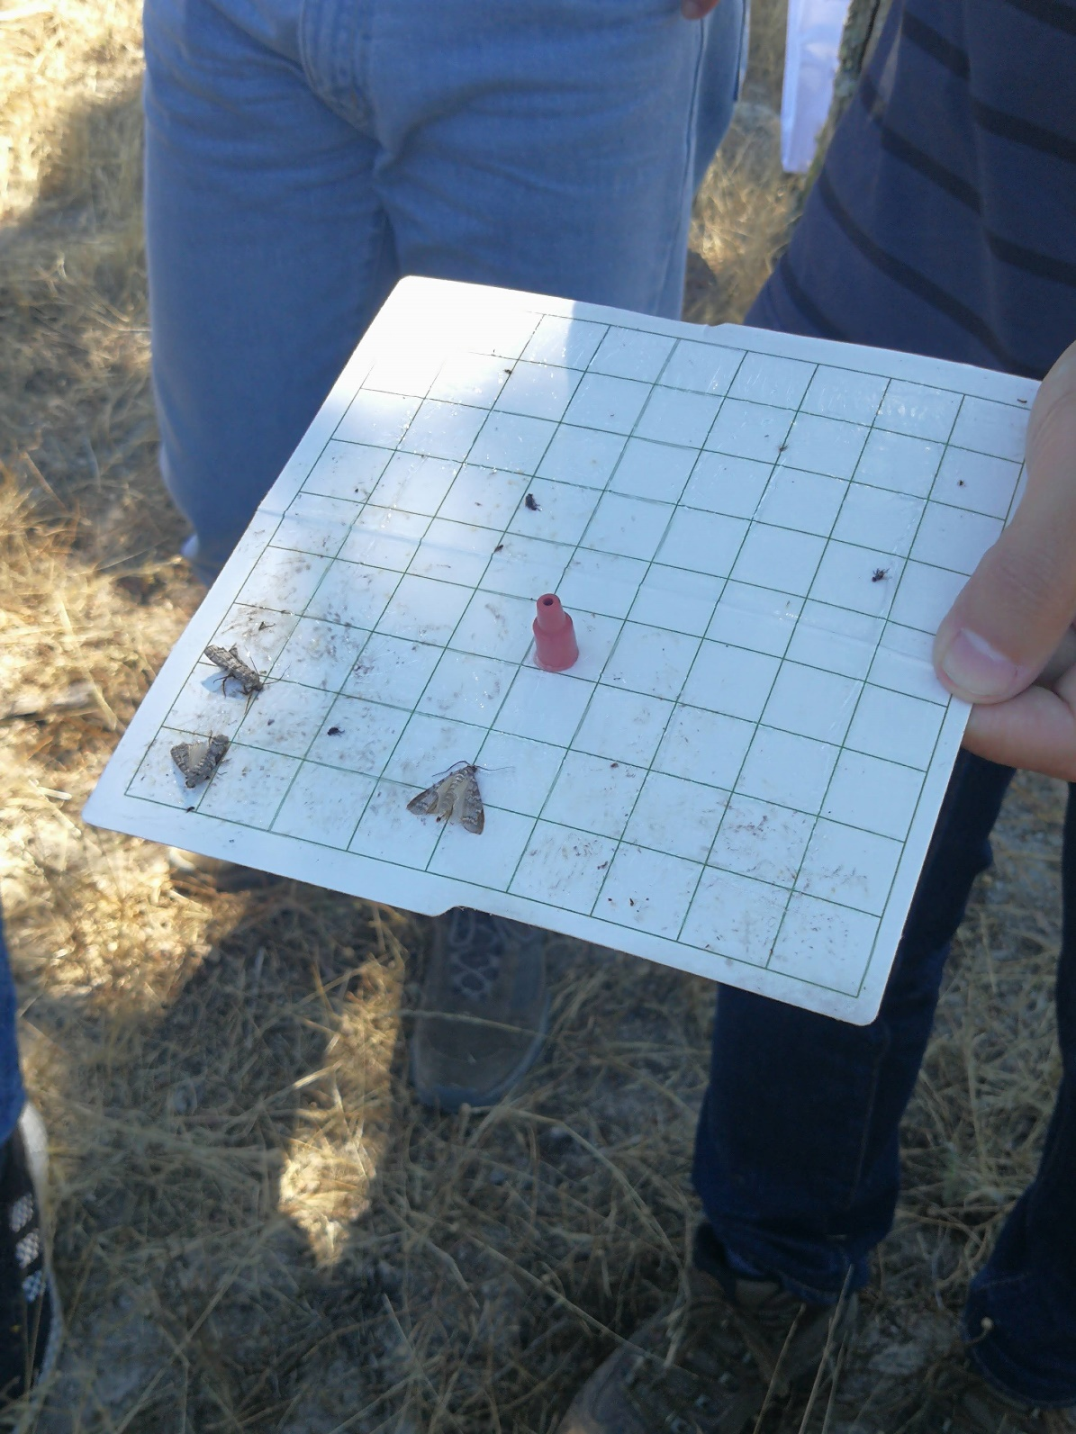

Slide 16
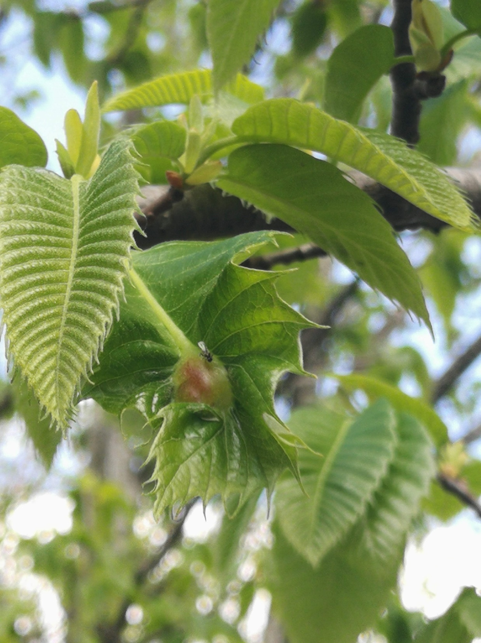

Slide 17
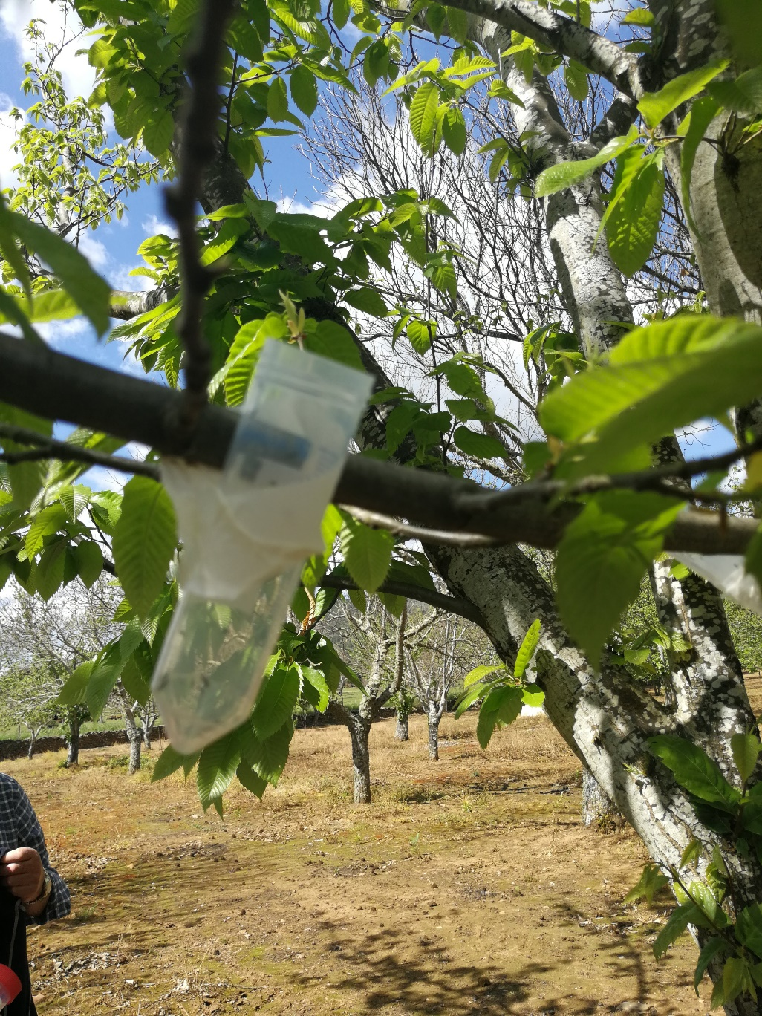

Slide 18
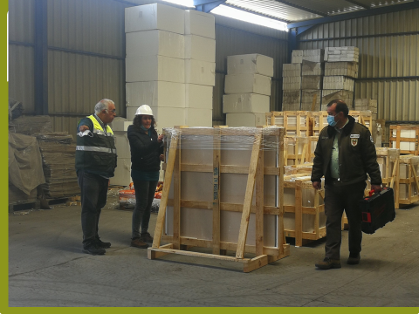
Supervision of manufacturing units

Slide 19
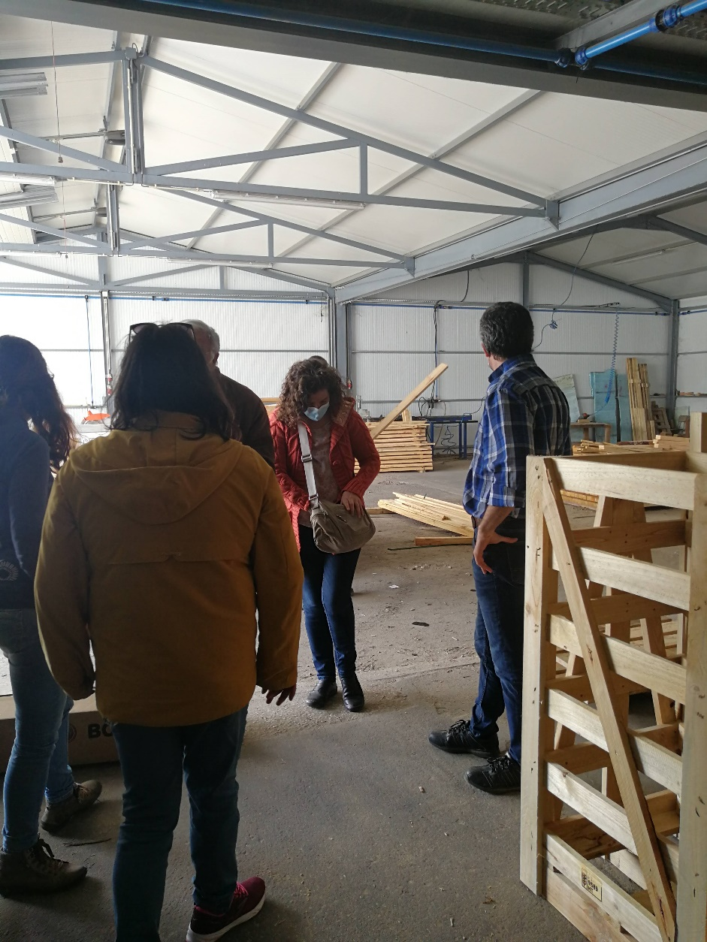

Slide 20
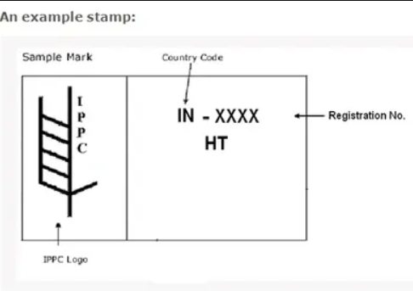
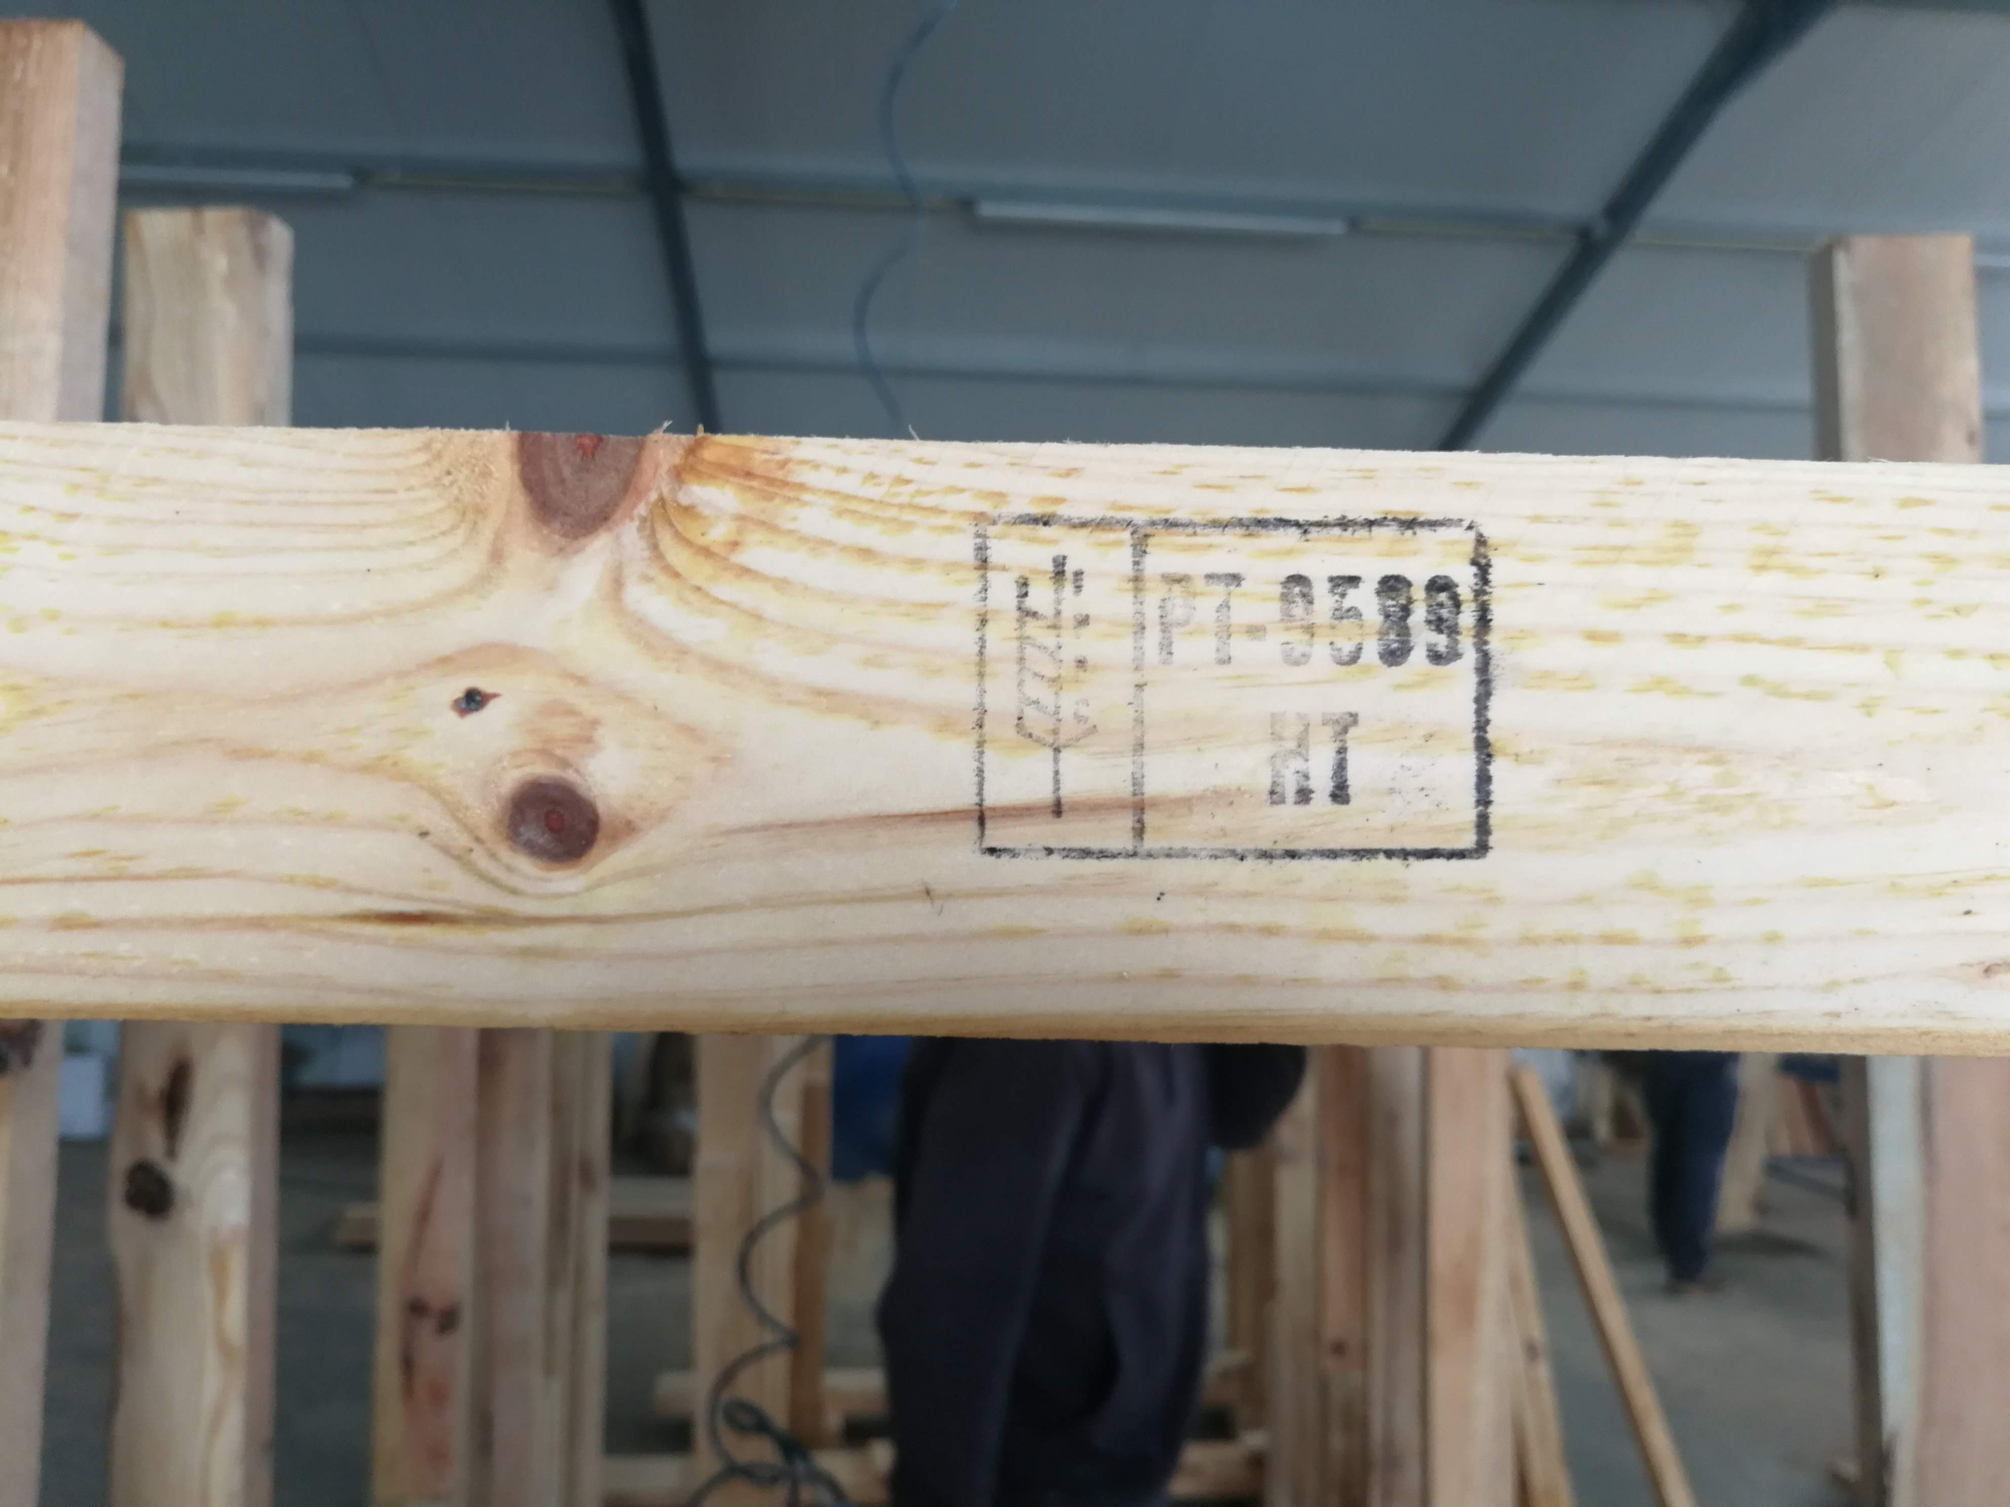

Slide 23
Prospection of Pine wood nematode
Prospetion of Harmful biotic agents
Prospetion of Fusarium
Prospetion of Xylella fastidiosa
Prospetion of Platypus cilindricus

Slide 25
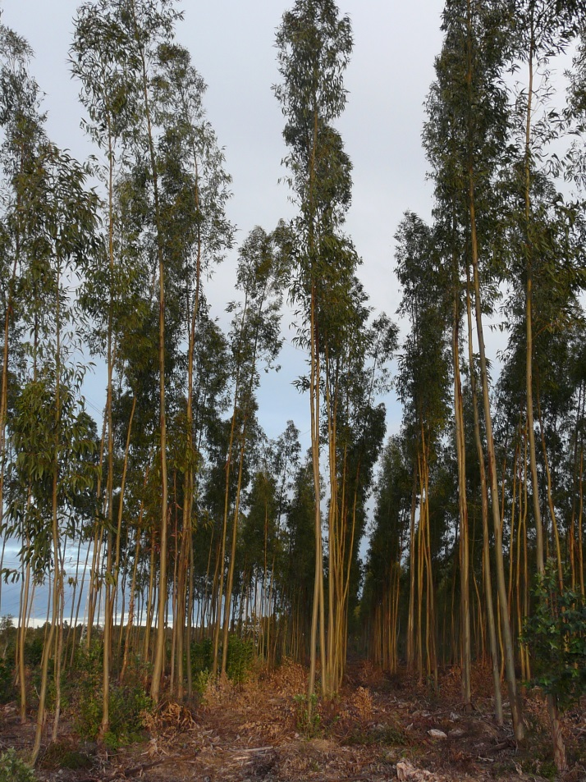
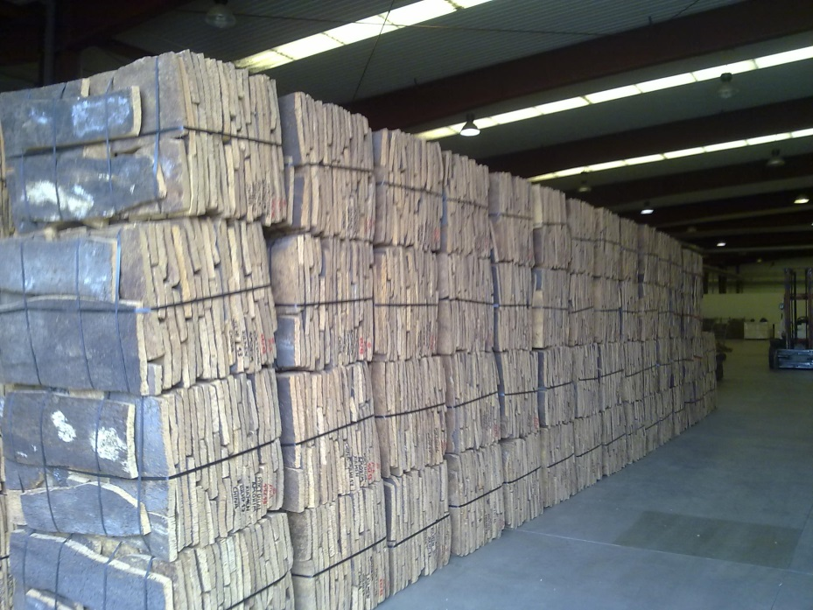
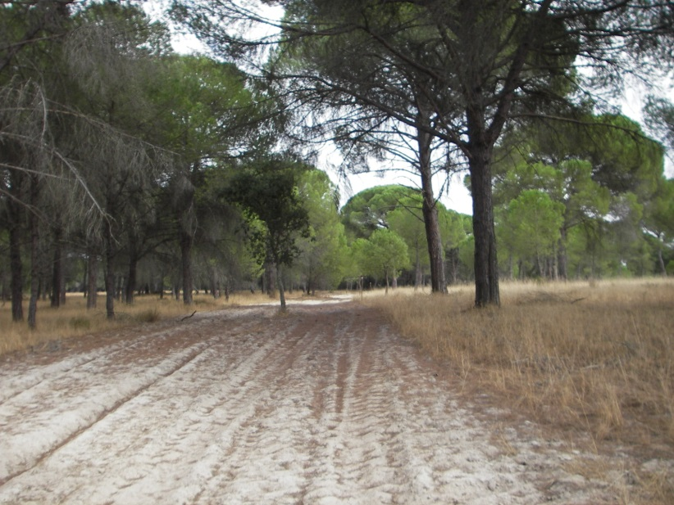
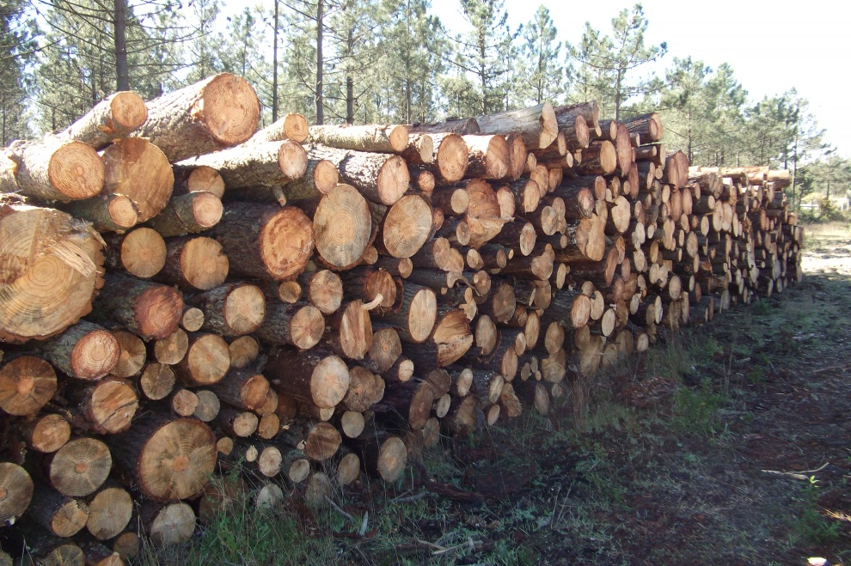
Thanks

