Slide 1
Implementing different thinning types, severities and intensities in stand and regional simulators

Slide 2
Components of a thinning model:
Intensity of thinning (interval between thinnings)
Severity of thinning (amount of “stand” removed in one thinning)
Type of thinning (thinning from below, thinning from above, selective thinning, etc) – selection of trees to be thinned
Type of thinning/tree selection is by far the most important/difficult component of the model

Slide 3
Intensity of thinning
With a fixed periodicity
Based on a threshold for a certain variable (e.g. G) – not practical, how does the user decide when he/she is going to thin?
By modelling the probability of a thinning to occur – useful to reproduce the BAU
standsSIM – the user defines a forest management approach that he/she wants to test (chronology and characteristics of silvicultural treatments)

Slide 4
Severity of thinning
By modelling the probability of a tree to be thinned, if a thinning takes place – useful to reproduce the BAU
Based on the value of a X variable after thinning (Xathin) for a certain variable (e.g. G) or by any other means (e.g. the A-value in SILVA, MOSES or BWIN or using an equilibrium curve for dbh distribution)
standsSIM – the user defines the value of a X variable (G% to be removed, Gres, Fw, %CC of the remaining stand) that allows the computation of Xthin (value of X to be thinned)

Slide 5
Type of thinning (just examples)
Different algorithms for different types of thinning; selective thinning usually needs a specific algorithm
Algorithms able to cope with several types of thinning
Algorithms can be applied to the whole stand or to groups of trees (bio-sociologic tree status, dbh classes)
Stochastic or analytical algorithms
Method used for tree selection is essential to simulate different types of thinning (depends on distance-dependent competition or tree size, stem quality, tree vitality, score of existence, probability to be selected for thinning)

Slide 6
Type of thinning (just examples)
standsSIM:
no distance-dependent competition index, trees are selected according to:
a thinning index depending on tree size and product quality
a probability function (continuous or discrete)
the user defines:
groups of trees (dbh classes) as well as the % of the total removal of X in each group;
an equilibrium curve computed so that %CC is equally distributed per d class;
equilibrium curve defined by number of trees/ha per d class
Other being implemented

Slide 7
The easiest part: just select some algorithm and write the respective computer program!
Some difficulties found
Usual forest inventory plots (e.g. 500 m²) are too small for thinning application, plot size has to be increased
In probabilistic selection, tree ranking during selection for thinning has a strong influence on the final result

Slide 8
Evaluating the results of thinning algorithms is not easy:
Comparison of stand simulation over time with real data
Example for plot SSB102 from São Salvador trial
Thinning intensity – according to real
Thinning severity – defined by residual basal area (Gres) to reproduce the real stand
Thinning type – trees selected from 3 groups (d classes of igual size) with a distribution of %Gthin equal to 98%, 2% and 0% (thinning from below); tree selection inside the group according to a probability function dependent on relative tree size

Slide 9
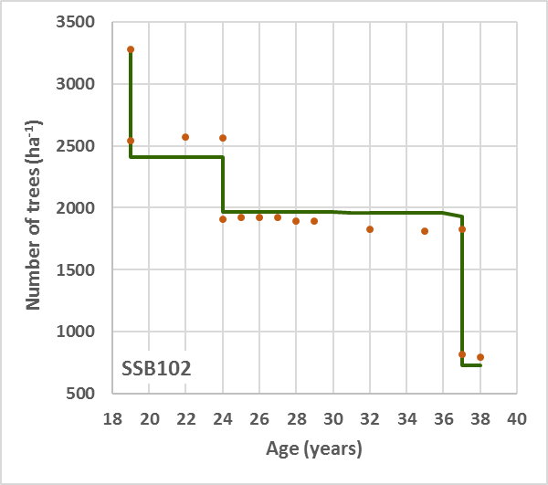
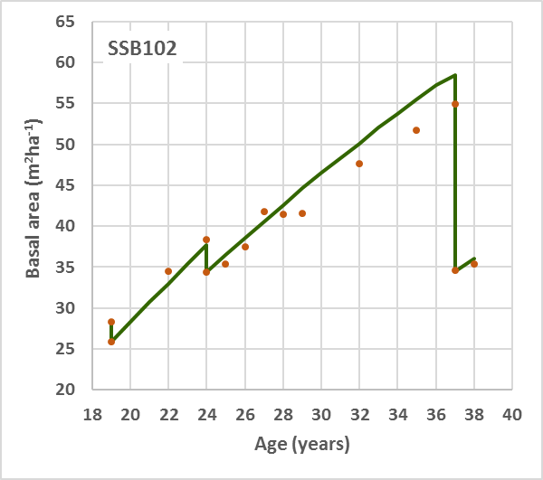
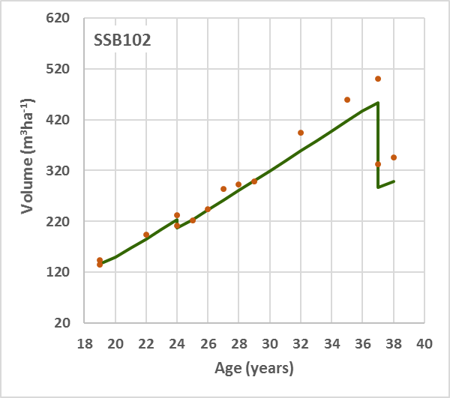
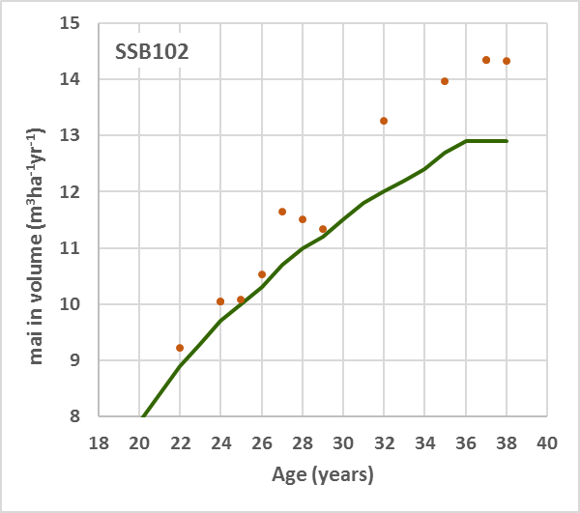
V harvested: 142.3 m³
NPV: -2718 euros
EAA: -207 euros

Slide 10
Evaluating the results of thinning algorithms is not easy:
Comparison of stand simulation over time with real data
Comparison of evolution of diameter distributions before and after thinning with data from real plots

Slide 11
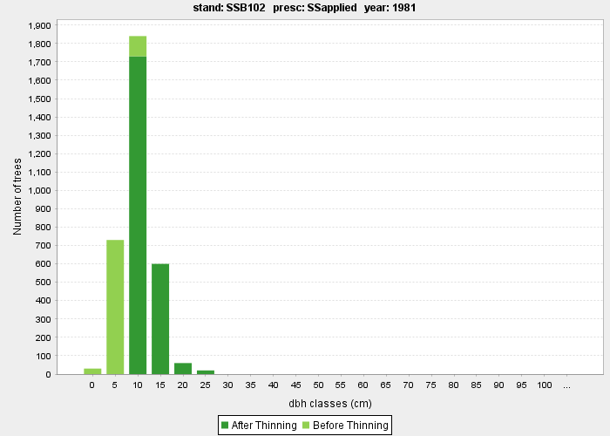
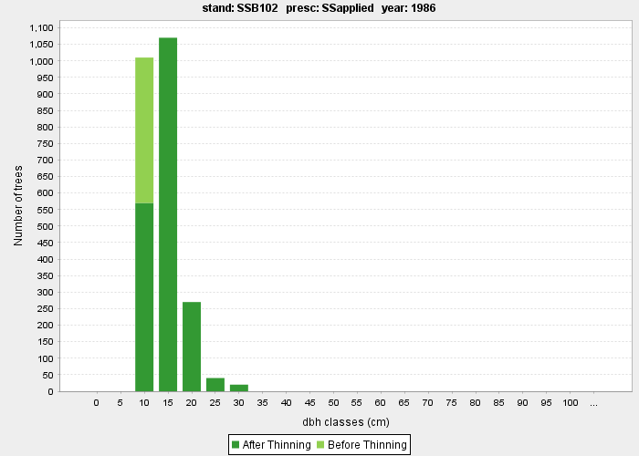
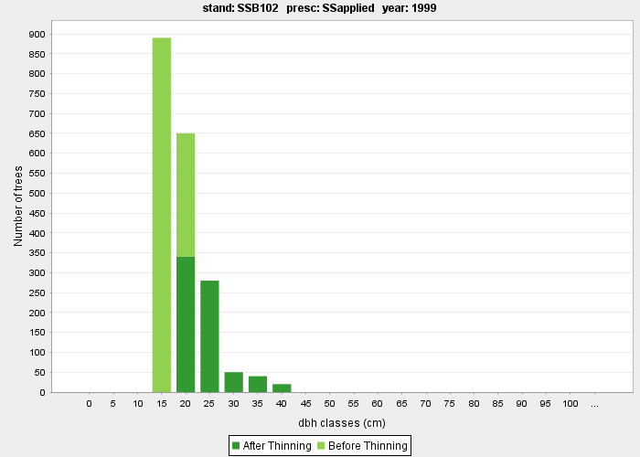
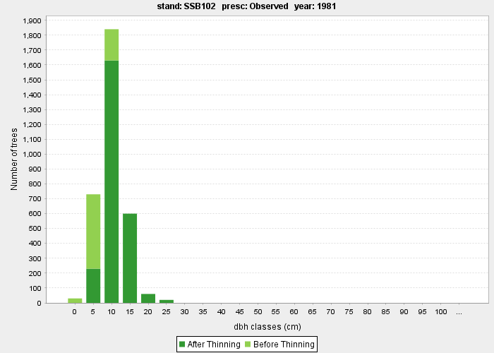
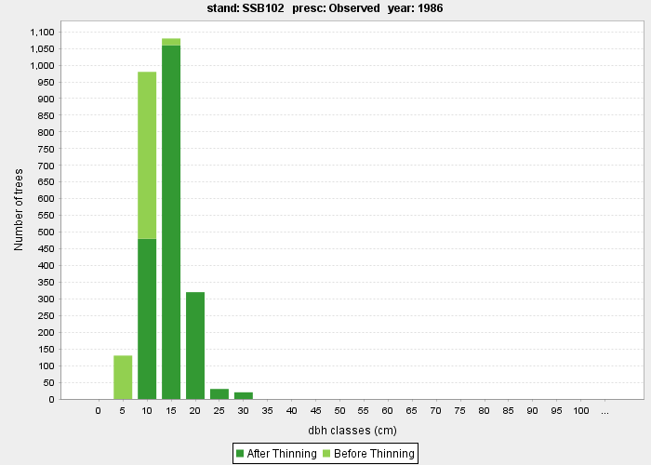
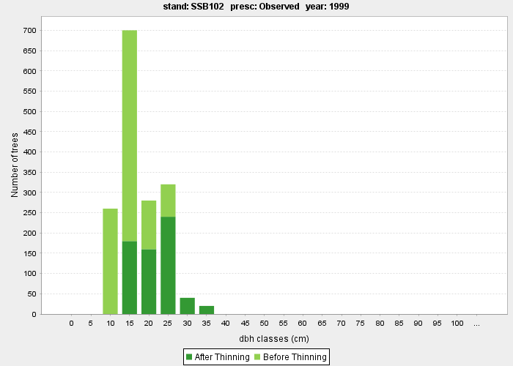
Simulated
Observed

Slide 12
Evaluating the results of thinning algorithms is not easy:
Comparison of stand simulation over time with real data
Another thinning type
Thinning intensity and severity according to real
Thinning type – trees selected from 1 group according to a discrete probability function dependent on tree size, simulating thinning from above
if (d>40) pdesb=1
elseif (d>30) pdesb=0.90
elseif (d>20) pdesb=0.50
elseif (d>15) pdesb=0.25
elseif (d>10) pdesb=0.10
else pdesb=0.05
endif

Slide 13
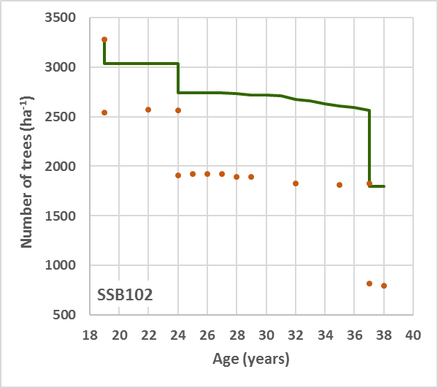
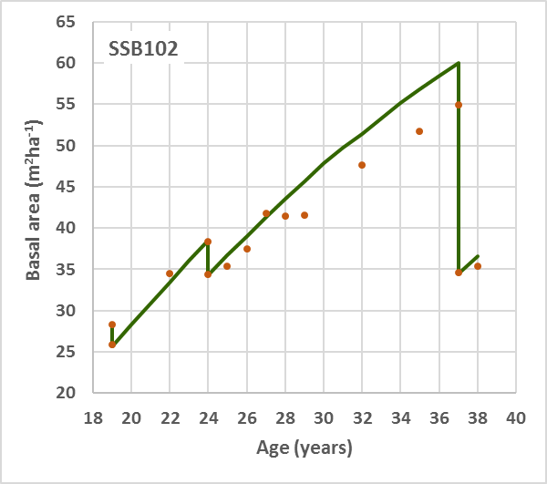
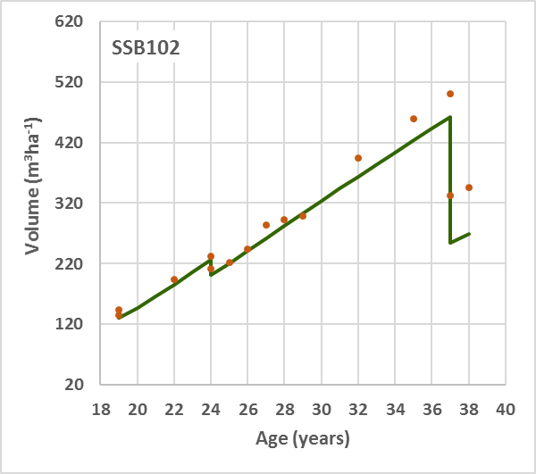
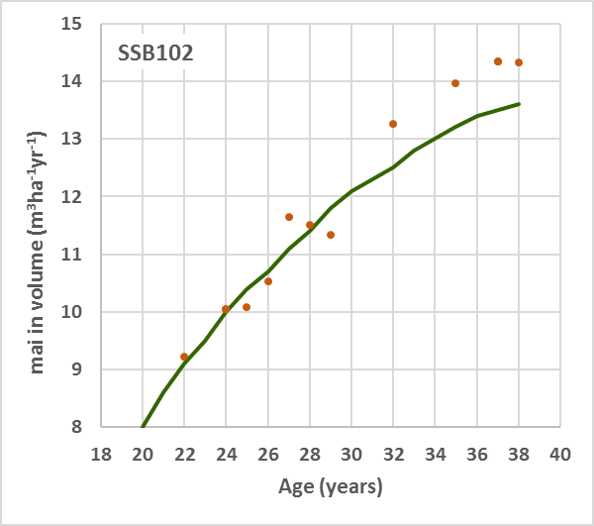
V harvested: 208.8 m³
NPV: 2535 euros
EAA: 193 euros

Slide 14
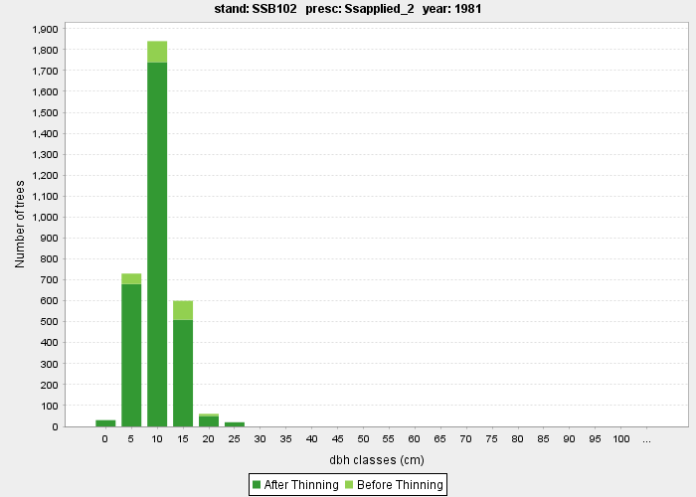
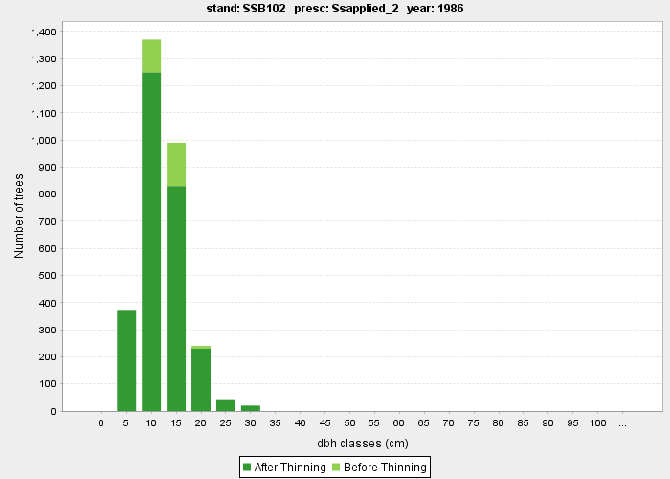
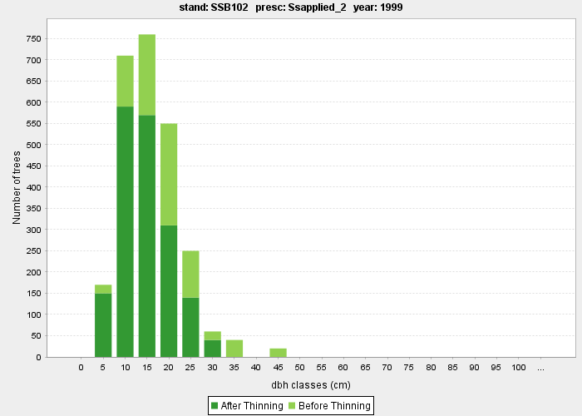
Simulated
Observed

Slide 15
Evaluating the results of thinning algorithms is not easy:
Comparison of stand simulation over time with real data
Comparison of evolution of diameter distributions before and after thinning with data from real plots
Evaluation by “experts” of the evolution of diameter distributions before and after thinning
Just for distance-independent algorithms: comparison of evolution of diameter distributions before and after thinning with data from simulations with distance-dependent thinning algorithms
Just for distance-dependent algorithms: evaluation by “experts” of the evolution of crown maps before and after thinning

Slide 16
The End!!

