Slide 1
Site quality, site index curves (SIC) and models to estimate site index

Slide 2
What is the site?
Site refers to “an area considered in terms of its environment, particularly as this determines the type and quality of the vegetation the area can carry” (Society of American Forests 1971)

Slide 3
Site quality
Site quality can be evaluted through direct and indirect methods
  Direct or geocentric methods – site is evaluated by climate and soil characteristics
  Indirect or phytocentric methods – site is evaluated by the analysis of the vegetation growing in the site
    Indicator plants (namely shrubs)
    Site index

Slide 4
Site index - definition
Site index (S) is defined as the dominant height that the stand has, had or will have at a certain age, the base age
Therefore, the simulation of dominant height growth is intimately related with the prediction of site index
The site index concept assumes that the dominant height is not affected by silvicultural treatments
The set of curves that represent dominant height growth for the range of possible site indices is know as site index curves

Slide 5
Building SIC – data that can be used
Site index curves may be built with different types of data:
  Independent data pairs (hdom, t) from temporary plots
  Successive data pairs (hdom, t) from permanent and/or interval plots
  Height growth data of individual trees reconstructed with stem analysis techniques

Slide 6
Building SIC – data that can be used
Independent data pairs (hdom,t) from temporary plots
  In order to avoid biased site index curves, it is important to guarantee that all the site index classes are equally represented in the data set
  Correlations between site index and stand age are often found (e.g. more fertile sites were first planted) and, if this is the case, the site index curves will be influenced by this relationship

Slide 7
Building SIC – data that can be used
Successive data pairs (hdom,t) from permanent and/or interval plots
  The set of remeasurements from the same plot is usualy designated by “growth series”
  This is the prefered method to develop site index curves as it allows the identification of the real growth shape
  It is important to have data that give a good representation of all the ages, covering all the growth stages, from juvenile to senescency

Slide 8
Building SIC – data that can be used
Stem analysis
  This method applies only in the temperate zones and with tree species characterized by well defined growth rings
  One has to assume that the dominant trees at the age of harvest have been the dominants during the whole life of the stand
  Tennent and Burkhart (1981) found out that the stem analysis could be restricted to 2 dominant trees with d close to ddom and the heights within the interval hdom ±5%

Slide 9
Anamorphic and polymorphic SICs
According to the relationship between the curves that represent different site indices, the site index curves can be:
  Anamorphic
  Polymorphic disjoint
  Polymorphic non-disjoint

Slide 10
Anamorphic and polymorphic SICs
Anamorphic curves
  If there exists a constant relationship among curves representing different site indices (parallell curves)
  Bruce and Schumacher (1942) describe a methodology to correct the proportion to apply at each age which is based on the coefficient of variation of hdom at that age relative to the CV of hdom at the base age
  This was a preliminary procedure to obtain polymorphic curves or a set of curves with different shape

Slide 11
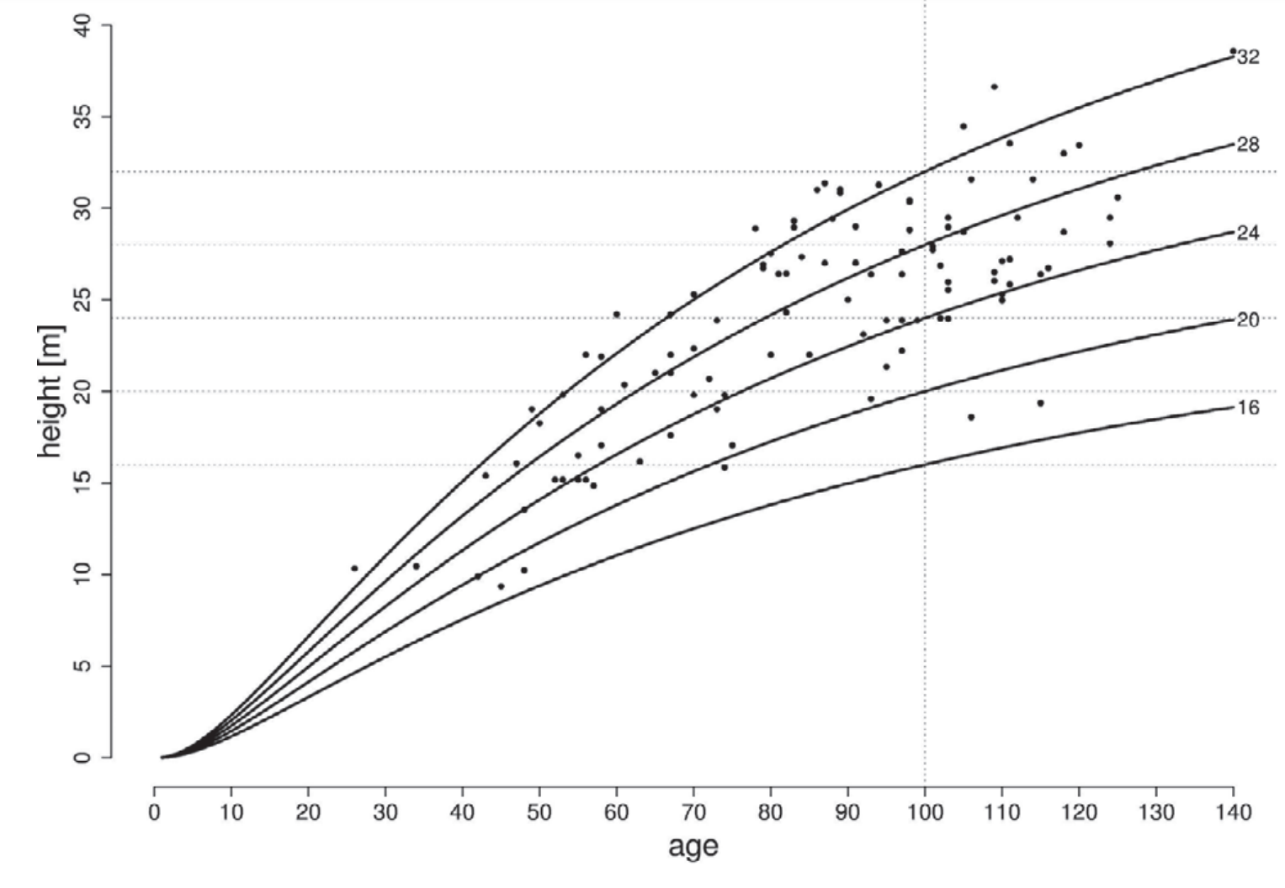
Anamorphic site index curves
Anamorphic curves assume a common shape for all site classes

Slide 12
Anamorphic and polymorphic SICs
Polymorphic curves
  If the sheaf of curves assume, in some way, that the shape of the curves is different among different site indices
  The polymorphic curves can be disjoint if the curves do not cross each other
  The non-disjoint curves there are different sheafs of curves that cross each other (for instance, a sheaf of curves for each one of several soil types)

Slide 13
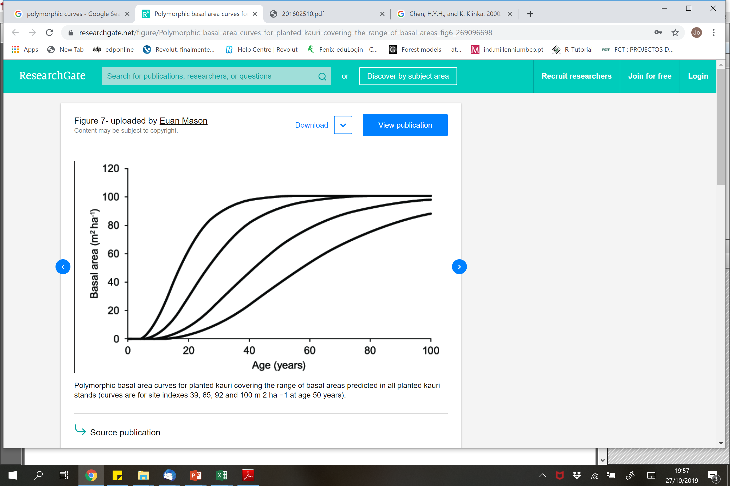
Polymorphic site index curves
For many species, height growth exhibits pronounced sigmoid shapes on higher-quality sites, and “flatter” shape on lower-quality sites

Slide 14
Methods for SICs development
The existing methods for SICs development can be grouped in the following:
  Independent fitting of SICs (old method, usually not used anymore)
  Guide-curve method (with temporary plots)
  Parameter prediction method (with long term permanente plots or stem analysis)
  Difference equations (with at least two measurements – data pairs needed)
  Mixed-models (not covered in this course)

Slide 15
Methods for SICs development
Independent fitting of SICs
  Data available for each age is grouped into 3 or 5 groups, depending on the number of curves that one wants to fit
  Fit the same growth curve to the data from each one of the groups originated by this procedure
  This method may be used for temporary plots data

Slide 16
Methods for SICs development
Guide-curve method
  The guide-curve method is the adaptation of the initial graphical methods to the regression analysis techniques
  The method is usually used with temporary plots data
  The application of the method implies the fitting of the selected growth curve to the whole data set – the guide-curve
  The curve for site index S is located at a distance from the guide-curve proportional to the distance between S and the site index of the guide-curve

Slide 17
Methods for SICs development
Guide-curve method – example (Oliveira, 1985)
  Oliveira (1985) fitted the following guide-curve to data from temporary plots measured in maritime pine stands in the mountain and sub-mountain region

Slide 18
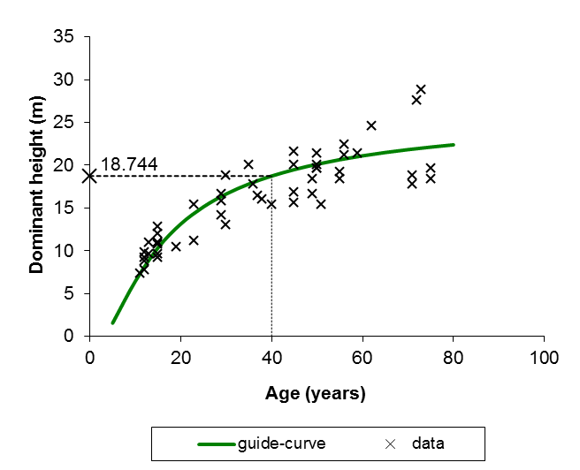
Methods for SICs development
Guide-curve – Oliveira (1985)
  Site index of the guide-curve (base age 40 years) is 18.744 m

Slide 19
Methods for SICs development
Guide-curve method – example (Oliveira, 1985)
  Oliveira (1985) fitted the following guide-curve to data from temporary plots measured in maritime pine stands in the mountain and sub-mountain region :

Slide 20
Methods for SICs development
Obtaining a curve for site index S
  Using the guide-curve fitted by Oliveira (1985):

Slide 21
Methods for SICs development
Obtaining a curve for site index S (continuation)
  Designating dominant height at age t by hdom:

Slide 22
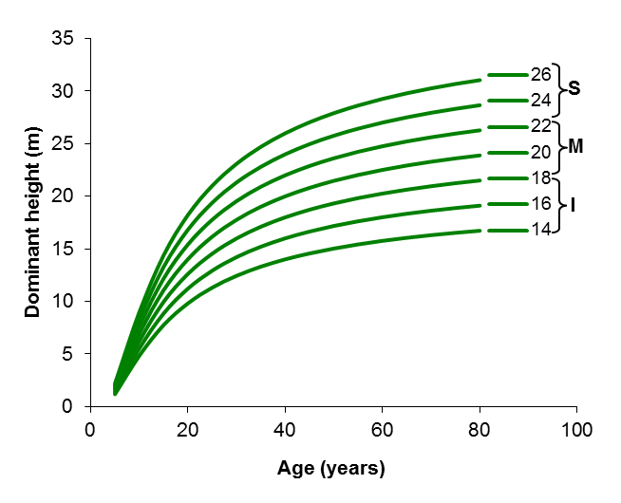
Methods for SICs development
Obtaining the sheaf of curves – Oliveira (1985)

Slide 23
Methods for SICs development
Parameter prediction method
  This method can only be used when there is a set of long term growth series
  Therefore it has been essentially applied with stem analysis data
  It is equivalent to modelling a family of curves by expressing the parameters as a function of stand/site variables

Slide 24
Methods for SICs development
Parameter prediction method
  It was developed on purpose to obtain polymorphic site index curves
  It implies 4 stages:
    Estimating S for each tree/plot
    Fitting the growth curve to the data from each tree/plot
    Establish the relationship between the parameters obtained for each tree/plot and the respective S
    Fit the final model with some parameter(s) expressed as a function of S

Slide 25
Methods for SICs development
Parameter prediction method
  This method has some disadvantages:
    The curves do not pass through the point (base age, S ). But it is possible to force the model to do so
    The curves are dependent from the selected base age, they will need to be refitted it a new base age is selected

Slide 26
Methods for SICs development
Difference equations
  If the data set includes at least two remeasurements from each plot, it is possible to fit growth functions in the difference equation form
  The existence of long term growth series is an advantage as in this way the data has more information about the curve shape
  There are several methods to fit difference equations (self-referencing curves) to growth data but they are out of the scope of this course

Slide 27
Methods for SICs development
Difference equations – example with the Lundqvist function
By making t₂=t_{p}, we have hdom₂=S

Slide 28
Site index modelling from environmental variables
It is possible to develop equations that express S as a function of the environmental factors that determine site productivity
  soil characteristics
  soil type
  geology
  topography
  climatic variables
  etc
S may also be estimated from the characteristics of understory vegetation

Slide 29
Site index modelling: maritime pine
Examples from Portugal:
  Maritime pine (Marques, 1991)
    Model 1 – topographic, edaphic and climate variables (R²=0.544)
    Model 2 – species in the understory (R²=0.144)

Slide 30
Site index modelling: Pseudotsuga menziesii
Examples from Portugal:
  Pseudotsuga menziesii (Fontes et al., 2003) – several eqs, e.g.:

Slide 31
Site index modelling: cork oak
Cork oak (Paulo et al., 2015)
  Study based on several plots established in juvenile stands (of known age) representative of cork oak forests in Portugal (contrasting soil and climate situations)
  A detailed soil characterization of each plot, including the study of the entire soil profile
  The climate was characterized by the average of the municipality in which each plot was located
  The site index curves developed for Spain – Mariola Gonzaléz – were used to estimate the site index (S) of each plot
  The relationship between S and soil and climate characteristics was then modelled

Slide 32
Site index modelling: cork oak
Detailed model
S=14.420
  + 0.468 Arenosolos + 0.150 Cambisolos - 0.492 Leptosolos + 0.233 Luvisolos - 0.596 Podzois
  - 0.602 Areias + 0.256 Arenitos + 0.817 Form.det.xisto – 1.965 Xistos + 0.074 Xistos + 0.406 Granitos
  + 0.013 Soil depth
  + 0.037 Depth of A horizon
  - 0.518 Fine texture – 0.028 Mean texture + 0.495 Coarse texture
  - 0.012 Mean evaporation (mm)
  - 0.284 Average number of days with frost
Soil type
Litology
Soil depth
Soil texture
Climate

Slide 33
Site index modelling: cork oak
Simplified model
S=16.446
  + 0.574 (7) + 1.073 (8) – 4.303 (17) – 3.364 (20) – 1.237 (22) – 0.951 (26) + 2.125 (311) + 0.115 (310)
  - 0.006 Mean evaporation (mm) (mm)
  - 0.291 Average number of days with frost
Litology
(numbers represent the codes for litology units in “Atlas do Ambiente”)

Slide 34
Site index modelling: cork oak
Simplified model
  it was possible to map site índex for cork oak
  na app was also developed for mobile phones

Slide 35
Let’s make some exercises

Slide 36
Using growth functions formulated as difference equations - GADA
Generalized algebraic difference approach (GADA)
  One of the problems with ADA is the fact that it originates formulations that differ just by one parameter
  With GADA it is possible to obtain formulations that have more than one site-specific parameter
  In GADA parameters are assumed to be function of an unobservable set of variables (denoted by X) that express site differences
  The equations are then solved by X, which, for a particular site, is substituted in the original equation (X₀)

Slide 37
Using growth functions formulated as difference equations - GADA
Example with the Schumacher function:
Suppose that α=X and β=γX, then
By substituting X0 into the previous expression, we get

Slide 38
Using growth functions formulated as difference equations - GADA
Another example with the Schumacher function
Suppose now that α=X and β=X, then
and
Solving for X:
Finally, substituting X0 in the previous expression

Slide 39
Using mixed-models
Mixed-models (linear and non-linear) “split” the model error according to different sources of variation, such as:
  Region
  Stand
  Plots
  …
When using a model fitted with mixed-models theory it is possible to calibrate the parameters with random components by measuring a small sample of individuals
This means that it is possible to use specific parameters for a particular tree/stand

