Slide 1
Monte Carlo Simulation
Forestry Applications
Applied Operations Research
2023-2024
Susana Barreiro
e-mail: smb@isa.ulisboa.pt

Slide 2
Monte Carlo methods refer to a class of methods for the simulation of systems to solve mathematical problems using random samples (collected/generated to estimate an expected value)
Systems are modelled by a set of random input variables of known probability distribution.
Simulation outputs depend on the random inputs (thus they must be random as well), but the probability distribution of the outputs is unknown
In fact, the objective of simulating the system is to determine the behaviour of the outputs

Slide 3

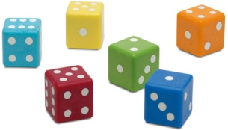


1
Monte Carlo Simulation
Forestry Applications
What is Monte Carlo? Basic Principles
2
Random Numbers
3
Sample Sizes
4
Distributions
5
Monte Carlo Simulation Examples
6
Monte Carlo Simulation Exercises

Slide 4
1
What is Monte Carlo? Basic Principles
2
Random Numbers
3
Sample Sizes
4
Distributions
5
Monte Carlo Simulation Examples
6
Monte Carlo Simulation Exercises

Slide 5
History
Stanisław Ulam Polish-American scientist in the fields of mathematics and nuclear physics (worked for the Manhatan project – thermonuclear weapons)
  While playing solitaire during his recovery from surgery (game which he kept losing) he wondered how many games he had to play to get a win.
  So he thought about playing hundreds of games to estimate statistically the probability of a successful outcome and the availability of computers made such statistical methods very practical.
  (mechanical simulation of random diffusion of neutrons)
Ulam had an uncle who went often to Monte Carlo casino to gamble so he and his colleagues named the technique “MONTE CARLO”

Slide 6
Monte Carlo simulation: method of estimating the value of an unknown quantity using the principles of inferential statistics
Monte Carlo simulation is a computerized mathematical technique that allows to model the probability of different outcomes in a process that cannot be easily predicted due to the intervention of random variables
Monte Carlo simulation depends on a sequence of random numbers which is generated during the simulation
  Population: set of examples
  Sample: a proper subset of the population
  Key fact: a random sample tends to exhibit the same properties as the population from which it is drawn

Slide 7
Often, the physical processes we are interested (the system) are complex
To study a certain process, may require the use of (a) model(s) (simplified representation of the system).
When we apply the model to mimic the system’s behavior, we say we run simulations
  - Models are fundamental tools of science, engineering, business, etc.
  - Abstraction of reality therefore always have limits of credibility

Slide 8
Monte Carlo simulation: technique that combines distributions with random number generation
Any variable has a probability distribution for its occurrence
Random numbers can be generated in different ways
Best way to relate random number to a variable is to use cumulative probability distribution
(probability density functions – pdf)

Slide 9
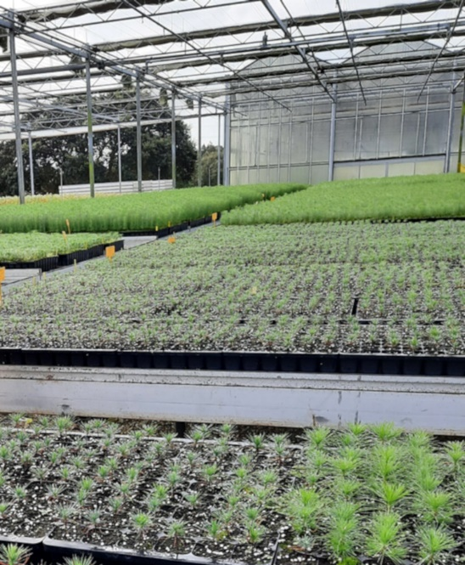
The daily demand for clone packs (80 seedlings/pack) during Spring months was studied (200 weeks) and the probabilities are the following:
Relative frequencies
(probability)
If the distribution is known , WHY do we use random numbers to simulate it?
Nr packs ordered | probability
0 | 0.05
1 | 0.1
2 | 0.15
3 | 0.3
4 | 0.25
5 | 0.15
BECAUSE, although the probability is known (the relative frequency of each demand level), the order of occurrence is not
It is the order of occurrence (which is assumed random) which we want to simulate

Slide 10
Assume that the demand/day is given by:
Relative frequencies
(probability)
If the distribution is known , WHY do we use random numbers to simulate it?
BECAUSE, although the probability is known (the relative frequency of each demand level), the order of occurrence is not
0.3
0.2
0.2
0.15
0.05
0.1
It is the order of occurrence (which is assumed random) which we want to simulate
  Sample: a proper subset of the population

Slide 11
Assume that the demand/day is given by:
Relative frequencies
(probability)
1
Cumulative frequencies
(probability)
0.85
0.65
0.3
0.35
0.2
0.2
0.15
0.1
0.15
0.05
0.05

Slide 12
Assume that the demand/day is given by:
Cumulative frequencies
(probability)
Demand (x) | Cumulative frequencies | Interval for random numbers
0 | 0.05 | 0 – 4
1 | 0.15 | 5 – 14
2 | 0.35 | 15 – 34
3 | 0.65 | 35 – 64
4 | 0.85 | 65 – 84
5 | 1 | 85 – 99
1
0.85
0.65
0.35
0.15
0.05

Slide 13
Assume that the demand/day is given by:
Simulate the demand for 10 days
Demand (x) | Cumulative frequencies | Interval for random numbers
0 | 0.05 | 0 – 4
1 | 0.15 | 5 – 14
2 | 0.35 | 15 – 34
3 | 0.65 | 35 – 64
4 | 0.85 | 65 – 84
5 | 1 | 85 – 100
day | Random number | demand
1 | 14 | 1
2
3
4
5
6
7
8
9
10

Slide 14
Assume that the demand/day is given by:
Simulate the demand for 10 days
Demand (x) | Cumulative frequencies | Interval for random numbers
0 | 0.05 | 0 – 4
1 | 0.15 | 5 – 14
2 | 0.35 | 15 – 34
3 | 0.65 | 35 – 64
4 | 0.85 | 65 – 84
5 | 1 | 85 – 100
day | Random number | demand
1 | 14 | 1
2 | 74 | 4
3
4
5
6
7
8
9
10

Slide 15
Assume that the demand/day is given by:
Simulate the demand for 10 days
Demand (x) | Cumulative frequencies | Interval for random numbers
0 | 0.05 | 0 – 4
1 | 0.15 | 5 – 14
2 | 0.35 | 15 – 34
3 | 0.65 | 35 – 64
4 | 0.85 | 65 – 84
5 | 1 | 85 – 100
day | Random number | demand
1 | 14 | 1
2 | 74 | 4
3 | 24 | 2
4 | 87 | 5
5 | 7 | 1
6 | 45 | 3
7 | 26 | 2
8 | 66 | 4
9 | 26 | 2
10 | 94 | 5

Slide 16
Assume that the demand/day is given by:
Relative frequencies
(probability)
If 10000 random numbers were drawn it would be expected that the number of observations per class would be:
Demand (x) | frequencies | observations
0 | 0.05 | 500
1 | 0.1 | 1000
2 | 0.2 | 2000
3 | 0.3 | 3000
4 | 0.2 | 2000
5 | 0.15 | 1500
0.3
0.2
0.2
0.15
0.05
0.1

Slide 17
Some Advantages of Simulation
Often simulation is the only type of model possible for complex systems (e.g assess the impact of a certain silvicultural practices, fire)
Process of building simulators can clarify the understanding of real systems and sometimes can be more useful than the implementation of the results itself
Allows for sensitivity analysis and optimization of real system without need to operate real system (e.g no need to burn all stands to infer about fire behavior or its economic impacts)
Can maintain better control over experimental conditions than real system

Slide 18
Some Disadvantages of Simulation
May be very expensive and time consuming to build simulation
Easy to misuse simulation by “stretching” it beyond the limits of credibility
  - when using commercial simulation packages due to ease of use and lack of familiarity with underlying assumptions and restrictions
  - Slick graphics, animation, tables, etc. may tempt user to assign unwarranted credibility to output
Monte Carlo simulation usually requires several (perhaps many) runs at given input values, whereas analytical solutions provide exact values

Slide 19
1
What is Monte Carlo? Basic Principles
2
Random Numbers
3
Sample Sizes
4
Distributions
5
Monte Carlo Simulation Examples
6
Monte Carlo Simulation Exercises

Slide 20




  Random numbers are used to obtain random observations from a probability distribution. How are they generated?
  Manually – laborious and not practical
  Random Tables – random physical process but difficult to implement in a computer
  Computers – generate pseudo random numbers (pseudo because they’re obtained with a deterministic mathematical process EXCEL RAND(), RANDBETWEEN(min, max)

Slide 21
  Random numbers are used to obtain random observations from a probability distribution. How are they generated?
  Computers can generate truly random values, but there would also be an important disadvantage, namely that we would lack control of the produced random numbers and the same simulation when run twice would not produce the same set of samples (problem when testing a simulation method or model)
  Thus, random number generation in computers is based on special mathematical functions or algorithms, which given one or more initial values (referred to as seeds) produces a sequence of numbers between 0 and 1.
  If the same seed is used the sequence makes simulations repeatable: the simulation is called deterministic and the nr not truly random, but called pseudo-random

Slide 22
1
What is Monte Carlo? Basic Principles
2
Random Numbers
3
Sample Sizes
4
Distributions
5
Monte Carlo Simulation Examples
6
Monte Carlo Simulation Exercises

Slide 23
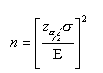
Determining sample size (number of simulation runs) is important and relies on 2 parameters: mean and standard deviation. However, the process is rather cyclic and based on assumptions:
Standard deviation of the population. If not known , we have to use an estimate (but the calculus requires sample size)
Population mean has a normal distribution
A large sample will be taken
Etc...
Normal deviate for a confidence interval of 1-alfa, but should be replaced by t _{alfa/2,n-1} (also requires sample size)
Difference between sample mean and real mean (requires sample size to be known so that simulations can be run and the sample mean calculated)

Slide 24
Therefore, other options are commonly used:
Option 1
  Choose a big sample size and then establish confidence intervals
Option 2
  Compute the average value after each trial so it approaches a limit and stop simulating when the difference between population mean and sample mean reaches an acceptable value
Option 3
  Make several pilot simulation runs to have an idea of the mean and standard deviation and then use it to calculate the sample size

Slide 25
1
What is Monte Carlo? Basic Principles
2
Random Numbers
3
Sample Sizes
4
Distributions - empirical
5
Monte Carlo Simulation Examples
6
Monte Carlo Simulation Exercises

Slide 26
  Where do we obtain the probability distribution for one variable?
Empirical distributions
Theoretical distributions
(Poisson, Normal, Exponential, Weibull)
(Historic) Observed Data
Estimates

Slide 27
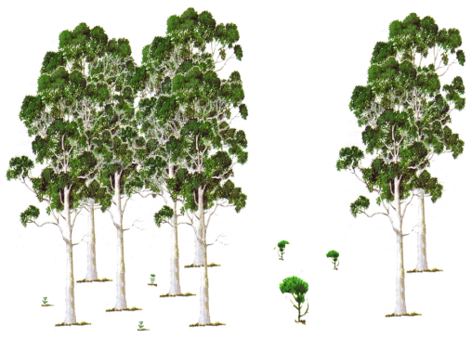

Empirical distributions
Rely on a considerable amount of real (historic) data for a given variable
  Forest inventory data on stand age for eucalyptus
Require classes to be defined
  Age classes with amplitude 4 (e.g using IF clause in EXCEL)
Counting observations/class
  Histogram or pivot table
1)
2)
3)
4)
5)
6)
stand | age
1 | 3
2 | 16
3 | 8
4 | 12
5 | 11
6 | 9

Slide 28
Empirical distributions
Rely on a considerable amount of real (historic) data for a given variable
  Forest inventory data on stand age for eucalyptus
Require classes to be defined
  Age classes with amplitude 4 (e.g using IF clause in EXCEL)
Counting observations/class
  Histogram or pivot table
1)
2)
3)
4)
5)
6)
stand | age
1 | 3
2 | 16
3 | 8
4 | 12
5 | 11
6 | 9

Slide 29
Empirical distributions
Rely on a considerable amount of real (historic) data for a given variable
  Forest inventory data on stand age for eucalyptus
Require classes to be defined
  Age classes with amplitude 4
Counting observations/class
  Histogram or pivot table
class | freq
0 -3 | 1
4 - 7 | 0
8 - 11 | 3
12 - 15 | 1
>=16 | 1
 | 6
stand | age | class
1 | 3 | 0 -3
2 | 16 | >=16
3 | 8 | 8 - 11
4 | 12 | 12 - 15
5 | 11 | 8 - 11
6 | 9 | 8 - 11
3
1
0
1
1

Slide 30
Empirical distributions
Rely on a considerable amount of real (historic) data for a given variable
  Forest inventory data on stand age for eucalyptus
Require classes to be defined
  Age classes with amplitude 4
Counting observations/class
  Histogram or pivot table
class | freq | pdf
0 -3 | 1 | (1/6) 0.16
4 - 7 | 0 | 0
8 - 11 | 3 | (3/6) 0.5
12 - 15 | 1 | (1/6) 0.16
>=16 | 1 | (1/6) 0.16
 | 6 | 1
stand | age | class
1 | 3 | 0 -3
2 | 16 | >=16
3 | 8 | 8 - 11
4 | 12 | 12 - 15
5 | 11 | 8 - 11
6 | 9 | 8 - 11
0.5
0.16
0
0.16
0.16

Slide 31
Empirical distributions
Rely on a considerable amount of real (historic) data for a given variable
  Forest inventory data on stand age for eucalyptus
Require classes to be defined
  Age classes with amplitude 4
Counting observations/class
  Histogram or pivot table
class | freq | pdf | cpdf
0 -3 | 1 | (1/6) 0.16 | 0.16
4 - 7 | 0 | 0 | 0.16
8 - 11 | 3 | (3/6) 0.5 | 0.66
12 - 15 | 1 | (1/6) 0.16 | 0.82
>=16 | 1 | (1/6) 0.16 | 1
 | 6 | 1
1
0.82
0.66
0.5
0.16
0
0.16
0.16
0.16
0.16

Slide 32
1
What is Monte Carlo? Basic Principles
2
Distributions
3
Random Numbers
4
Sample Sizes
5
Monte Carlo Simulation Examples
6
Monte Carlo Simulation Exercises

Slide 33
In general, Monte Carlo Simulation is roughly composed of five steps:
  Set up probability distribution that will be considered in the simulation
  Build cumulative probability distribution
  Establish an interval of random numbers for each variable
  Generate random numbers
  Simulate trials

Slide 34
Example 1 – Simulating with a distribution provided (empirical)
Example 2 – Setting a distribution based on know distributions of other variables (independent variables)
Example 3 – Simulating using dependent variables

Slide 35
Example 1 - Simulate a 10 days demand based on the distribution below assuming the following random numbers: 14, 74, 24, 87, 7, 45, 26, 66, 26, 94 (previously presented)
  Set up probability distributions that will be considered in the simulation
0.3
0.2
0.2
0.15
0.05
0.1

Slide 36
Example 1 - Simulate a 10 days demand based on the distribution below assuming the following random numbers: 14, 74, 24, 87, 7, 45, 26, 66, 26, 94 (previously presented)
1
  Set up probability distributions that will be considered in the simulation
  Build cumulative probability distributions
0.85
0.65
Demand (x) | Cumulative frequencies
0 | 0.05
1 | 0.15
2 | 0.35
3 | 0.65
4 | 0.85
5 | 1
0.35
0.15
0.05

Slide 37
Example 1 - Simulate a 10 days demand based on the distribution below assuming the following random numbers: 14, 74, 24, 87, 7, 45, 26, 66, 26, 94 (previously presented)
  Set up probability distributions that will be considered in the simulation
  Build cumulative probability distributions
  Establish an interval of random numbers for each variable
Demand (x) | Cumulative frequencies | interval
0 | 0.05 | 0 – 4
1 | 0.15 | 5 – 14
2 | 0.35 | 15 – 34
3 | 0.65 | 35 – 64
4 | 0.85 | 65 – 84
5 | 1 | 85 – 99

Slide 38
Example 1 - Simulate a 10 days demand based on the distribution below assuming the following random numbers: 14, 74, 24, 87, 7, 45, 26, 66, 26, 94 (previously presented)
day | Random number
1 | 14
2 | 74
3 | 24
4 | 87
5 | 7
6 | 45
7 | 26
8 | 66
9 | 26
10 | 94
  Set up probability distributions that will be considered in the simulation
  Build cumulative probability distributions
  Establish an interval of random numbers for each variable
  Generate random numbers

Slide 39
Example 1 - Simulate a 10 days demand based on the distribution below assuming the following random numbers: 14, 74, 24, 87, 7, 45, 26, 66, 26, 94 (previously presented)
Demand | interval
0 | 0 – 4
1 | 5 – 14
2 | 15 – 34
3 | 35 – 64
4 | 65 – 84
5 | 85 – 1
day | Random number | demand
1 | 14 | 1
2 | 74 | 4
3 | 24 | 2
4 | 87 | 5
5 | 7 | 1
6 | 45 | 3
7 | 26 | 2
8 | 66 | 4
9 | 26 | 2
10 | 94 | 5
  Set up probability distributions that will be considered in the simulation
  Build cumulative probability distributions
  Establish an interval of random numbers for each variable
  Generate random numbers
  Simulate trials

Slide 40
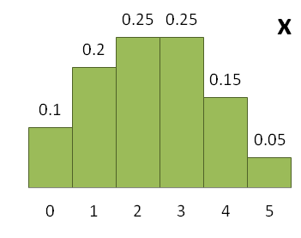
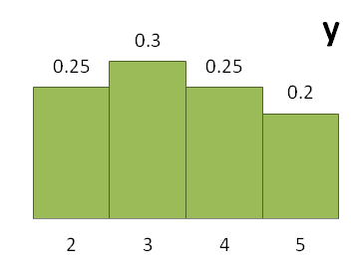
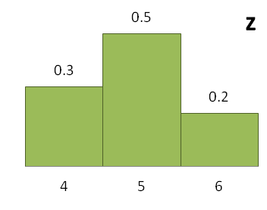
Example 2 - Assume the effectiveness function for a system is W = 5x + 2y + z, where the variables x, y and z are independent and described by the probabilities below. Run 18 trials
  Set up probability distributions that will be considered in the simulation

Slide 41
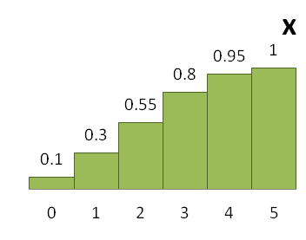
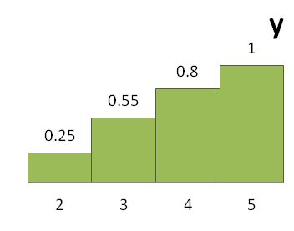
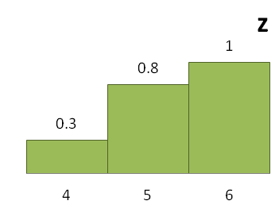
Example 2 - Assume the effectiveness function for a system is W = 5x + 2y + z, where the variables x, y and z are independent and described by the probabilities below. Run 18 trials
  Set up probability distributions that will be considered in the simulation
  Build cumulative probability distributions

Slide 42
Example 2 - Assume the effectiveness function for a system is W = 5x + 2y + z, where the variables x, y and z are independent and described by the probabilities below. Run 18 trials
x | distribution | cumulative distribution | aux | lower lim | upper lim | interval
0 | 0.1 | 0.1 | 10 | 0 | 9 | 0 - 9
1 | 0.2 | 0.3 | 30 | 10 | 29 | 10 - 29
2 | 0.25 | 0.55 | 55 | 30 | 54 | 30 - 54
3 | 0.25 | 0.8 | 80 | 55 | 79 | 55 - 79
4 | 0.15 | 0.95 | 95 | 80 | 94 | 80 - 94
5 | 0.05 | 1 | 100 | 95 | 99 | 95 - 99
y | distribution | cumulative distribution | aux | lower lim | upper lim | interval
2 | 0.25 | 0.25 | 25 | 0 | 24 | 0 - 24
3 | 0.3 | 0.55 | 55 | 25 | 54 | 25 - 54
4 | 0.25 | 0.8 | 80 | 55 | 79 | 55 - 79
5 | 0.2 | 1 | 100 | 80 | 99 | 80 - 99
z | distribution | cumulative distribution | aux | lower lim | upper lim | interval
4 | 0.3 | 0.3 | 30 | 0 | 29 | 0 - 29
5 | 0.5 | 0.8 | 80 | 30 | 79 | 30 - 79
6 | 0.2 | 1 | 100 | 80 | 99 | 80 - 99
  Set up probability distributions that will be considered in the simulation
  Build cumulative probability distributions
  Establish an interval of random numbers for each variable

Slide 43
Example 2 - Assume the effectiveness function for a system is W = 5x + 2y + z, where the variables x, y and z are independent and described by the probabilities below. Run 18 trials
trial nr | rand_x | rand_y | rand_z
1 | 43 | 22 | 1
2 | 74 | 9 | 8
3 | 84 | 10 | 82
4 | 42 | 38 | 65
5 | 83 | 16 | 34
6 | 25 | 1 | 27
7 | 21 | 67 | 62
8 | 25 | 38 | 58
9 | 83 | 65 | 42
10 | 76 | 25 | 32
11 | 74 | 27 | 63
12 | 68 | 73 | 55
13 | 3 | 7 | 96
14 | 60 | 53 | 29
15 | 35 | 34 | 31
16 | 56 | 25 | 17
17 | 71 | 83 | 83
18 | 15 | 72 | 49
  Set up probability distributions that will be considered in the simulation
  Build cumulative probability distributions
  Establish an interval of random numbers for each variable
  Generate random numbers

Slide 44
Example 2 - Assume the effectiveness function for a system is W = 5x + 2y + z, where the variables x, y and z are independent and described by the probabilities below. Run 18 trials
trial nr | rand_x | rand_y | rand_z | x | y | z | w
1 | 43 | 22 | 1 | 2 | 2 | 4 | 18
2 | 74 | 9 | 8 | 3 | 2 | 4 | 23
3 | 84 | 10 | 82 | 4 | 2 | 6 | 30
4 | 42 | 38 | 65 | 2 | 3 | 5 | 21
5 | 83 | 16 | 34 | 4 | 2 | 5 | 29
6 | 25 | 1 | 27 | 1 | 2 | 4 | 13
7 | 21 | 67 | 62 | 1 | 4 | 5 | 18
8 | 25 | 38 | 58 | 1 | 3 | 5 | 16
9 | 83 | 65 | 42 | 4 | 4 | 5 | 33
10 | 76 | 25 | 32 | 3 | 3 | 5 | 26
11 | 74 | 27 | 63 | 3 | 3 | 5 | 26
12 | 68 | 73 | 55 | 3 | 4 | 5 | 28
13 | 3 | 7 | 96 | 0 | 2 | 6 | 10
14 | 60 | 53 | 29 | 3 | 3 | 4 | 25
15 | 35 | 34 | 31 | 2 | 3 | 5 | 21
16 | 56 | 25 | 17 | 3 | 3 | 4 | 25
17 | 71 | 83 | 83 | 3 | 5 | 6 | 31
18 | 15 | 72 | 49 | 1 | 4 | 5 | 18
  Set up probability distributions that will be considered in the simulation
  Build cumulative probability distributions
  Establish an interval of random numbers for each variable
  Generate random numbers
  Simulate trials

Slide 45
Example 2 - Assume the effectiveness function for a system is W = 5x + 2y + z, where the variables x, y and z are independent and described by the probabilities below. Run 18 trials
trial nr | w
1 | 18
2 | 23
3 | 30
4 | 21
5 | 29
6 | 13
7 | 18
8 | 16
9 | 33
10 | 26
11 | 26
12 | 28
13 | 10
14 | 25
15 | 21
16 | 25
17 | 31
18 | 18
  Set up probability distributions that will be considered in the simulation
  Build cumulative probability distributions
  Establish an interval of random numbers for each variable
  Generate random numbers
  Simulate trials
  Set probability distribution for w

Slide 46
Example 2 - Assume the effectiveness function for a system is W = 5x + 2y + z, where the variables x, y and z are independent and described by the probabilities below. Run 18 trials
trial nr | w | class
1 | 18 | 15 – 24 (20)
2 | 23 | 15 – 24 (20)
3 | 30 | 25 – 34 (30)
4 | 21 | 15 – 24 (20)
5 | 29 | 15 – 24 (20)
6 | 13 | 5 – 14 (10)
7 | 18 | 15 – 24 (20)
8 | 16 | 15 – 24 (20)
9 | 33 | 25 – 34 (30)
10 | 26 | 25 – 34 (30)
11 | 26 | 25 – 34 (30)
12 | 28 | 25 – 34 (30)
13 | 10 | 5 – 14 (10)
14 | 25 | 25 – 34 (30)
15 | 21 | 15 – 24 (20)
16 | 25 | 25 – 34 (30)
17 | 31 | 25 – 34 (30)
18 | 18 | 15 – 24 (20)
  Set up probability distributions that will be considered in the simulation
  Build cumulative probability distributions
  Establish an interval of random numbers for each variable
  Generate random numbers
  Simulate trials
  Set probability distribution for w
  Define classes for w with amplitude of 10
  Count observations per class with pivot table
class | freq | prob
5 – 14 (10) | 2 | (2/18) 0.11
15 – 24 (20) | 8 | (8/18) 0.44
25 – 34 (30) | 8 | (8/18) 0.44
35 – 44 (40) | 0 | 0
 | 18
0.44
0.44
0.11
10 20 30 40

Slide 47
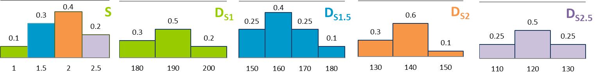
Example 3
The gross income/year = selling price/unit (S) x sales/year(D).
In general, as the selling price decreases, sales increase (dependent variables). Calculate the gross income assuming:
the distributions bellow
the random number for sales (D) = 73 and
the random number for selling price (S) = 22
  Set up probability distributions
  Build cumulative probability distributions
€/unit
Units/year

Slide 48
Example 3 – The gross income/year = sales/year (D) x selling price/unit (S). In general, as the selling price decreases, sales increase (dependent variables). Calculate the gross income assuming:
D1 | distribution | cumulative distribution | interval
180 | 0.3 | 0.3 | 0 - 29
190 | 0.5 | 0.8 | 30 - 79
200 | 0.2 | 1 | 80 - 99
D1.5 | distribution | cumulative distribution | interval
150 | 0.25 | 0.25 | 0 – 24
160 | 0.4 | 0.65 | 25 - 64
170 | 0.25 | 0.9 | 65 - 89
180 | 0.1 | 1 | 90 - 99
D2 | distribution | cumulative distribution | interval
130 | 0.3 | 0.3 | 0 - 29
140 | 0.6 | 0.9 | 30 - 89
150 | 0.1 | 1 | 90 - 99
D2.5 | distribution | cumulative distribution | interval
110 | 0.25 | 0.25 | 0 - 24
120 | 0.5 | 0.75 | 25 - 74
130 | 0.25 | 1 | 75 - 99
the distributions bellow
the random number for sales (D) = 73
the random number for selling price (S) =22
  Establish an interval and simulate
S | distribution | cumulative distribution | interval
1 | 0.1 | 0.1 | 0 - 9
1.5 | 0.3 | 0.4 | 10 - 39
2 | 0.4 | 0.8 | 40 - 79
2.5 | 0.2 | 1 | 80 - 99
gross income/year = 170 x 1.5 = 255 €

Slide 49
Example 4 – Assign site index (S) values to the NFI plots missing that information
Site index can be seen as an indication of site productivity. It is calculated based on stand age and on the average height of the dominant trees in the stand. Growth is affected by productivity, thus in order to simulate the evolution of growth for each stand (here represented by each National Forest Inventory plot) all plots need to be assigned a S value.
Suppose you need to prepare inputs to run some eucalyptus simulations using StandsSIM.md simulator.
This tool requires information about site index (S), but S estimates are not available for all NFI plots.
The data in spreadsheet Ex_4 shows that only 139 of the 348 plots have been assigned an S value.
Use plots with S to build the distribution of NFI plots by S class and using Monte Carlo simulation assign S values to the remaining plots taking into consideration that S values lower than 8 and greater than 26 are to be disregarded. Consider S classes with range=1
Even-aged stands
S = f (hdom, t, 10)
279 NFI plots:
139 plots with S
137 plots without S
Uneven-aged stands
S = f (?, ??, ???)
69 NFI plots:
Without S

Slide 50
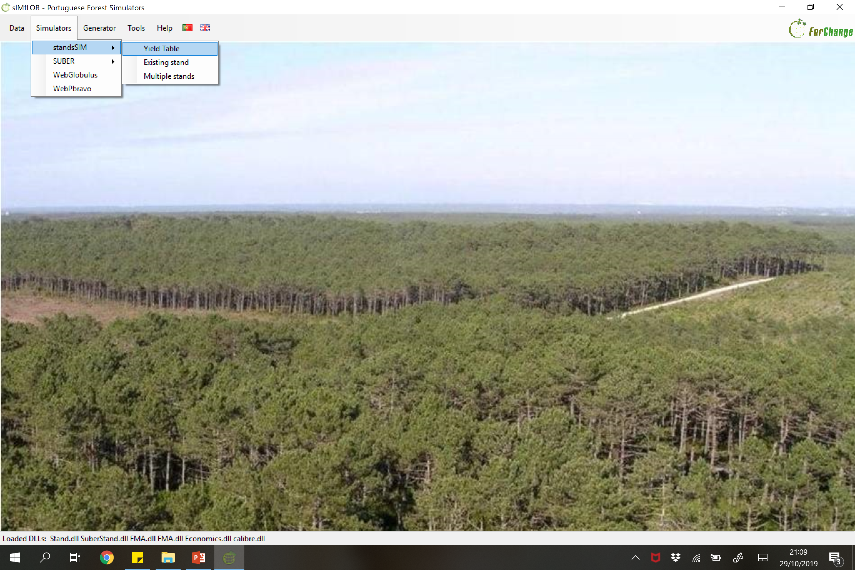
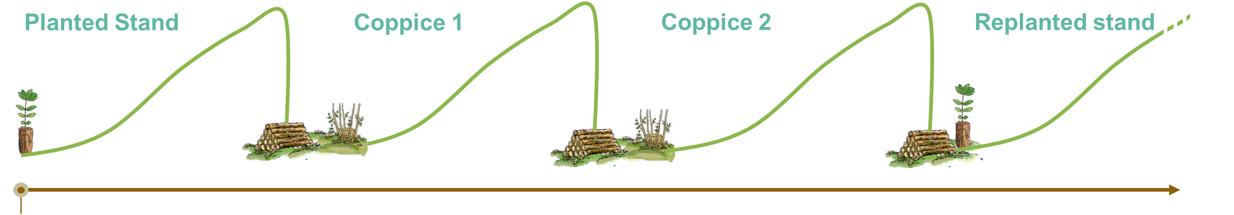
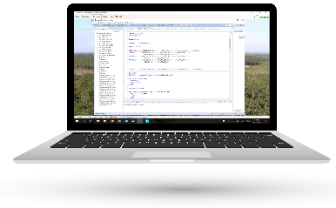
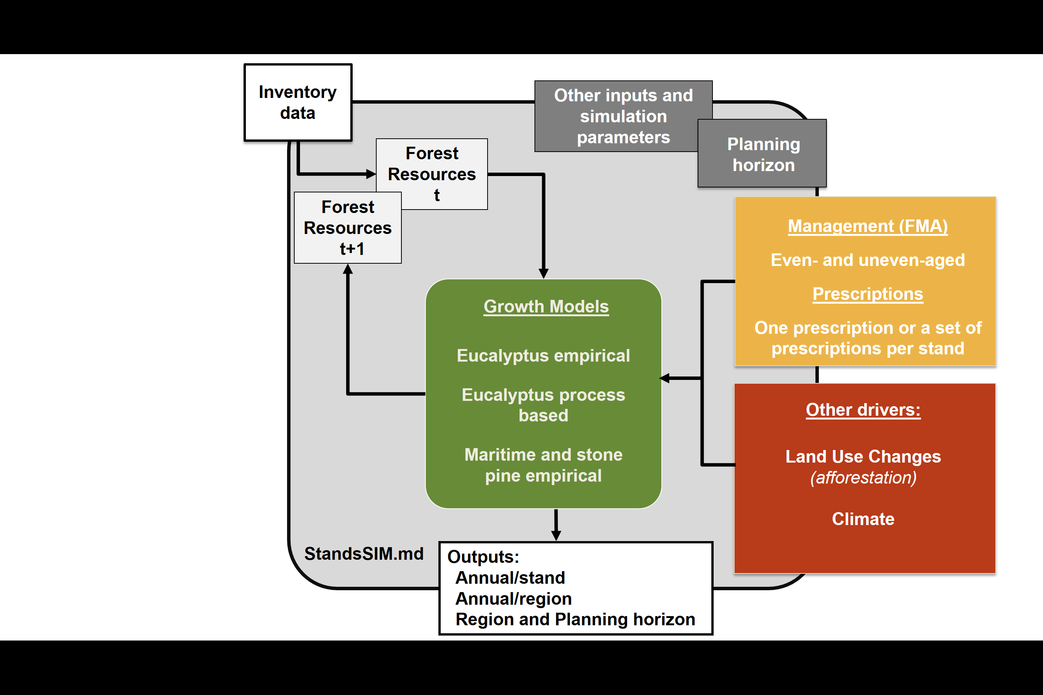
Example 4 – Assign site index (S) values to the NFI plots missing that information
Even-aged stands
S = f (hdom, t, 10)
StandsSIM.md

Slide 51
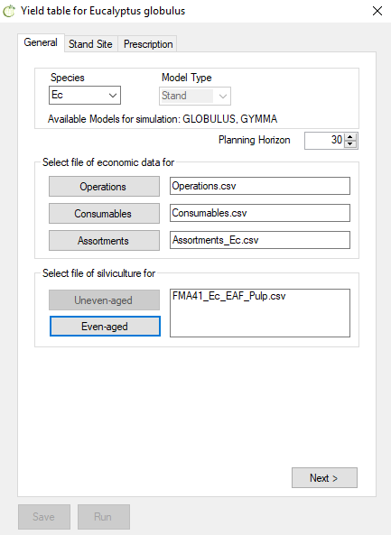
Example 4 – Assign site index (S) values to the NFI plots missing that information
Even-aged stands
S = f (hdom, t, 10)
StandsSIM.md

Slide 52
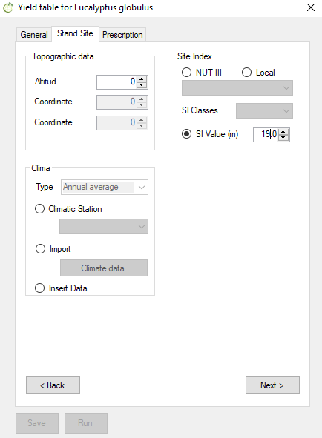
Example 4 – Assign site index (S) values to the NFI plots missing that information
Even-aged stands
S = f (hdom, t, 10)
StandsSIM.md

Slide 53
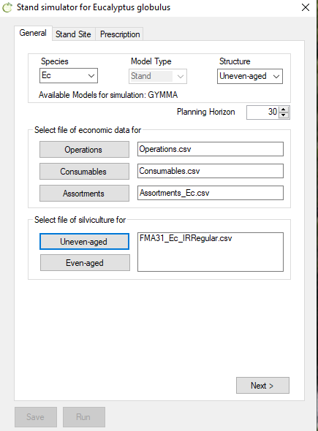
Example 4 – Assign site index (S) values to the NFI plots missing that information
Even-aged stands
S = f (hdom, t, 10)
Uneven-aged stands
S = f (?, ??, ???)
CONVERT: Uneven- to Even-aged
Hdom = ?
StandsSIM.md

Slide 54
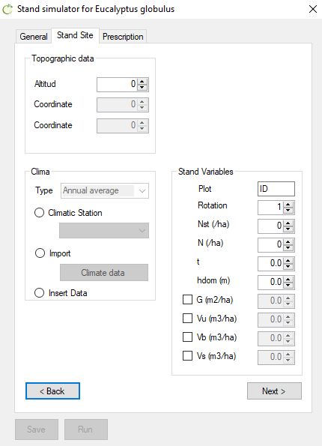
Example 4 – Assign site index (S) values to the NFI plots missing that information
Even-aged stands
S = f (hdom, t, 10)
Uneven-aged stands
S = f (?, ??, ???)
CONVERT: Uneven- to Even-aged
Hdom = ?
StandsSIM.md

Slide 55
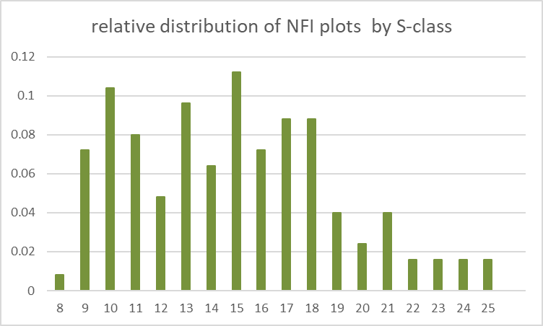
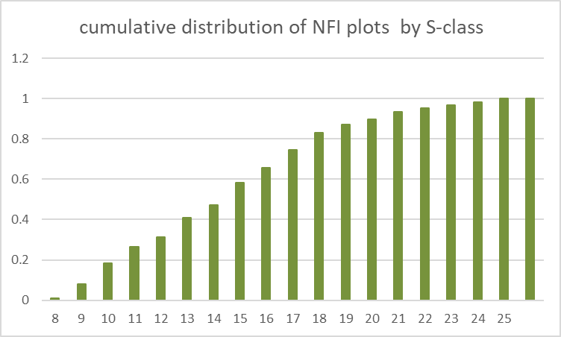
Example 4 – Assign site index (S) values to the NFI plots missing that information
Even-aged stands
S = f (hdom, t, 10)
279 NFI plots:
139 plots with S
137 plots without S
Because:
tree heights were not measured or stand age not recorded (e.g. recently harvested stands)
Uneven-aged stands
S = f (?, ??, ???)
69 NFI plots:
Without S

Slide 56
1
What is Monte Carlo? Basic Principles
2
Random Numbers
3
Sample Sizes
4
Distributions- theoretical
5
Monte Carlo Simulation Examples
6
Monte Carlo Simulation Exercises

Slide 57
  Where do we obtain the probability distribution for one variable?
Empirical distributions
Theoretical distributions
(Poisson, Normal, Exponential, Weibull)
(Historic) Observed Data
Estimates

Slide 58
Theoretical distributions – Probability distributions:
Normal
Poisson
Exponential
Weibull
often used in natural and social sciences to represent real-valued random variables whose distributions are not known
Number of events that occur in an interval of time
Time taken between 2 events occurring
Commonly used for generating diameter distributions in forest plots,

Slide 59
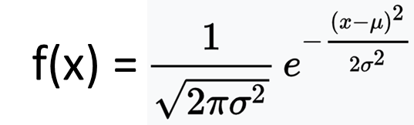
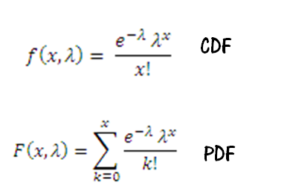
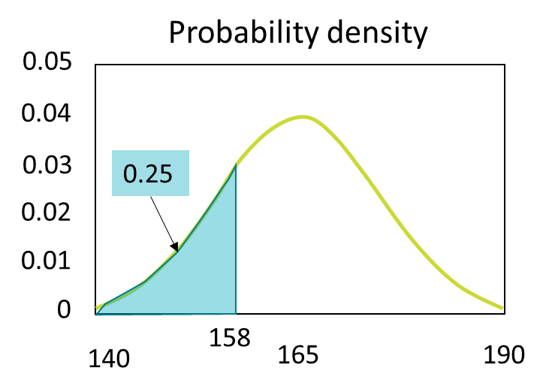
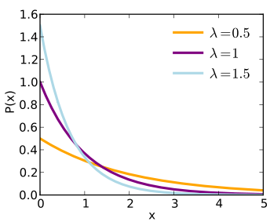
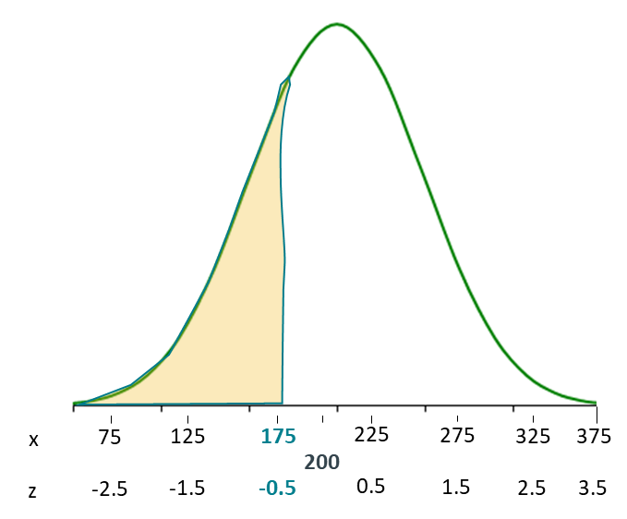
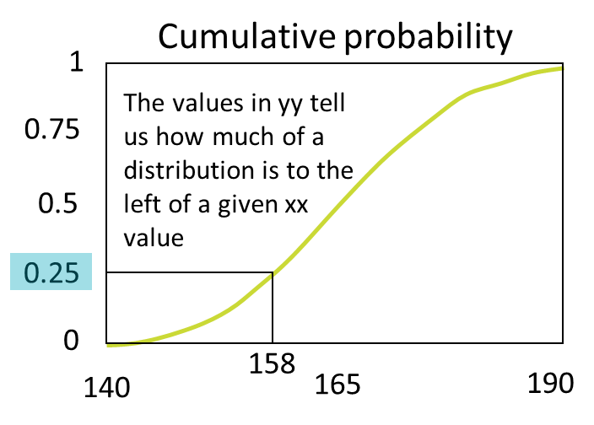
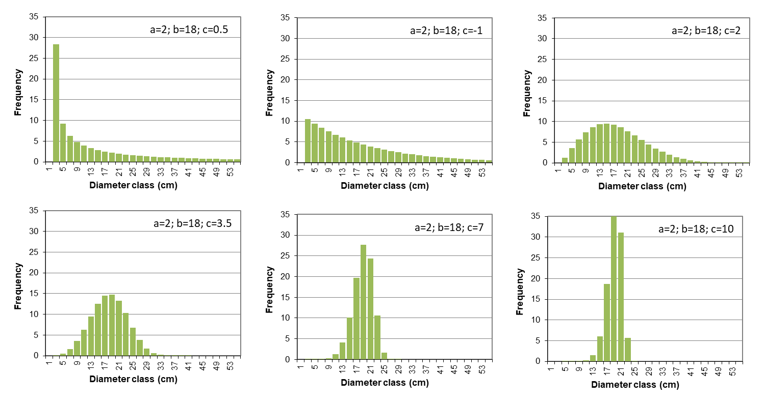
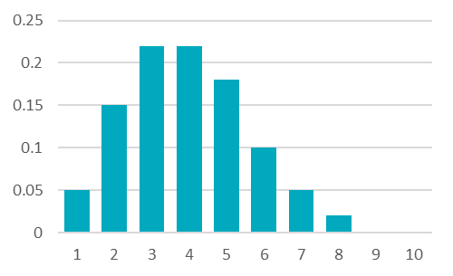
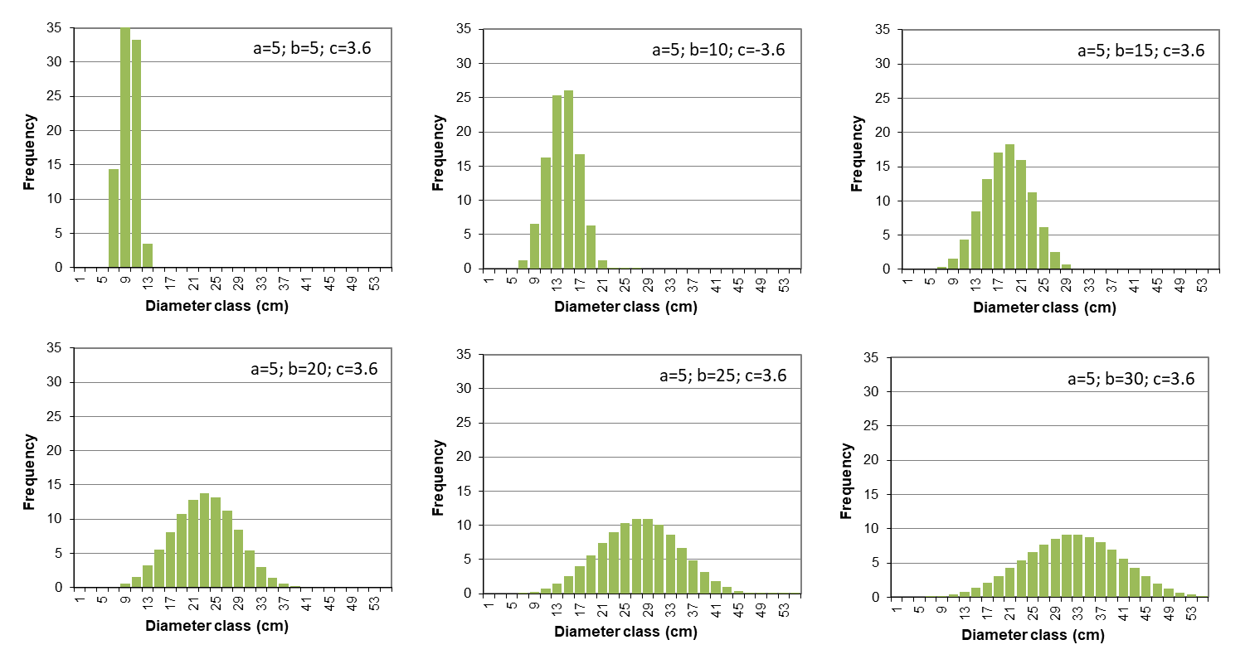

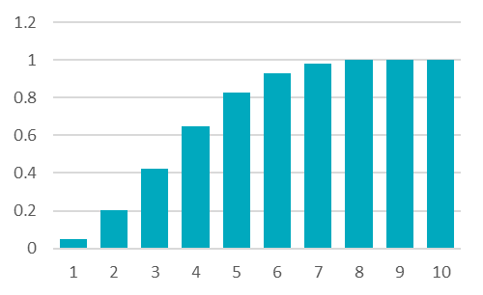
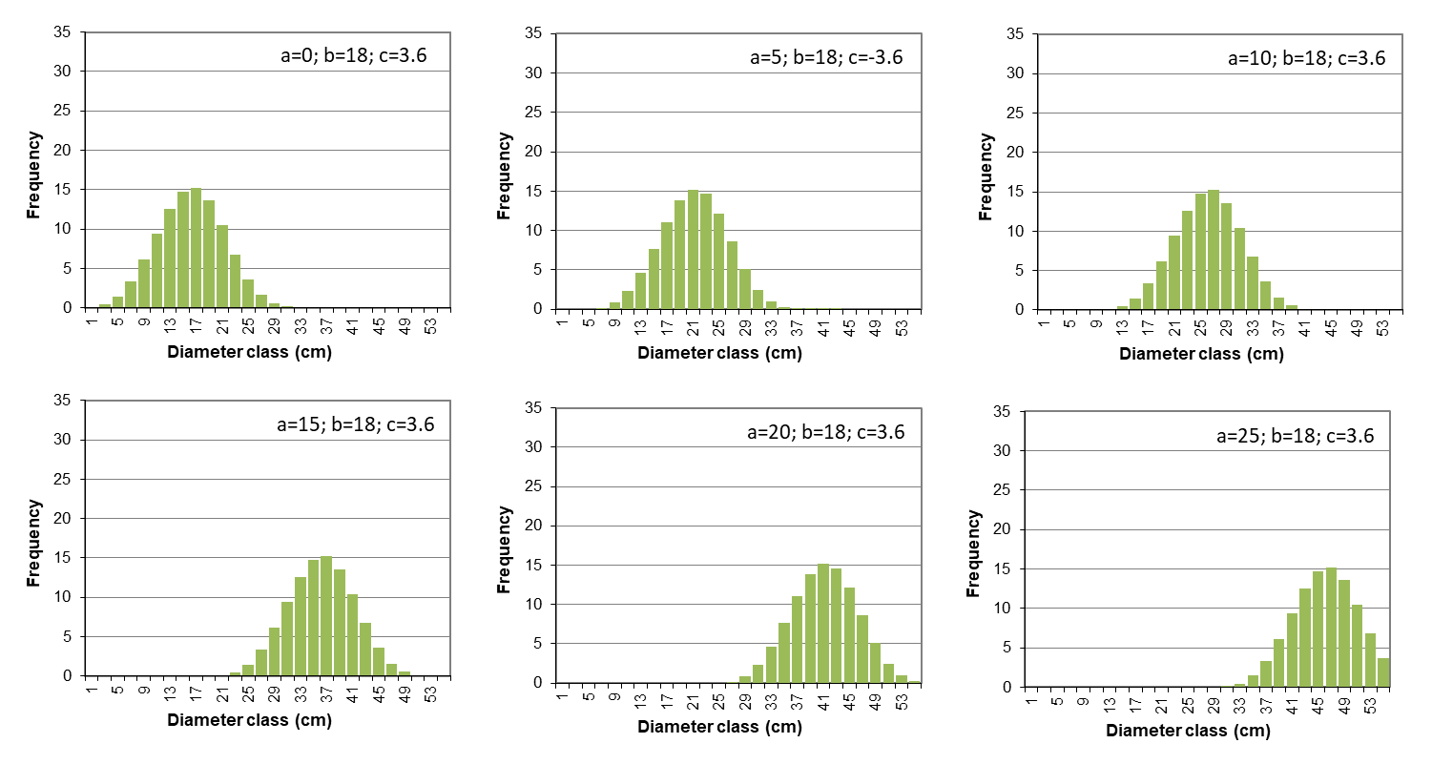

3-Weibull
location (a), scale (b), shape (c)
2-Weibull
scale (b), shape (c)
Theoretical distributions – Probability distributions:
N (μ,σ)
Z∼N (μ=0,σ=1)
Poisson
Exponential
Weibull
Normal
P (x) = λ e^{−λx}
= expon.dist ( x , λ , false)
= poisson.dist ( x , λ , false)
= expon.dist ( x , λ , true)
P (X <= x) = 1- e^{−λx}
$$f\left(x≤175\right)=f\left(\frac{x−μ}{σ}≤\frac{175−200}{50}\right)$$
= Weibull.dist ( upperlim, c, b, true)
= poisson.dist ( x , λ , true)
= Normsdist ( (upperLimit-mean)/std) )
Probability density
Probability density
Cumulative probability
Cumulative probability

Slide 60
c – shape parameter

Slide 61
a – location parameter

Slide 62
b – scale parameter

Slide 63

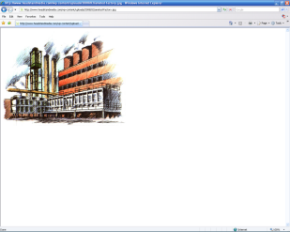


Example 4 - Demand for paper (units/week) and the lead time for paper production (weeks) are given by theoretical distributions: demand has a normal dist. (200,50) and the lead time an exponential dist (1).
  Simulate The Old Library stock assuming that:
  the initial stock (units)= 600,
  the order point (units)= 200 and the quantity ordered (units)= 600
The Old Library
The Paper Mill

Slide 64
Example 4 - Demand for paper (units/week) has a normal dist. (200; 50)
The Old Library
  Set up the probability distribution
  Build cumulative probability distribution considering a 50 units interval for demand
−∞
demand | upper xup | z=(xup-200)/50 | cummulative distribution
50 | 75 | -2.5 | 0.00621
100 | 125 | -1.5 | 0.06681
150 | 175 | -0.5 | 0.30854
200 | 225 | 0.5 | 0.69146
250 | 275 | 1.5 | 0.93319
300 | 325 | 2.5 | 0.99379
350 | 375 | 3.5 | 0.99977
400 | ¥ | ¥ | 1.00000
Excel Function gives the cumulative distribution
Normsdist (z)

Slide 65
Example 4 - Demand for paper (units/week) has a normal dist. (200; 50)
The Old Library
  Set up the probability distribution
  Build cumulative probability distribution considering a 50 units interval for demand
  Establish an interval of random numbers
−∞
demand | upper xup | z=(xup-200)/50 | cummulative distribution | aux | lower lim | upper lim | interval
50 | 75 | -2.5 | 0.00621 | 6 | 0 | 5 | 0 - 5
100 | 125 | -1.5 | 0.06681 | 67 | 6 | 66 | 6 - 66
150 | 175 | -0.5 | 0.30854 | 309 | 67 | 308 | 67 - 308
200 | 225 | 0.5 | 0.69146 | 691 | 309 | 690 | 309 - 690
250 | 275 | 1.5 | 0.93319 | 933 | 691 | 932 | 691 - 932
300 | 325 | 2.5 | 0.99379 | 994 | 933 | 993 | 933 - 993
350 | 375 | 3.5 | 0.99977 | 1000 | 994 | 999 | 994 - 999
400 | ¥ | ¥ | 1.00000 | 1000 | 1000 | 999 | 1000 - 999

Slide 66
Example 4 - Lead time for pulp production (weeks) has an exponential dist (1)
  Set up the probability distribution
  Build cumulative probability distribution considering a 1 week interval for lead time
The Paper Mill
The Exponential cumulative function
1-EXP(-xup/mean)
Lead time | upper xup | cumulative distribution
1 | 1.5 | 0.78
2 | 2.5 | 0.92
3 | 3.5 | 0.97
4 | 4.5 | 0.99
5 | 5.5 | 1.00

Slide 67
Example 4 - Lead time for pulp production (weeks) has an exponential dist (1)
  Set up the probability distribution
  Build cumulative probability distribution considering a 1 week interval for lead time
  Establish an interval of random numbers
The Paper Mill
Lead time | upper xup | cumulative distribution | aux | lower lim | upper lim | interval
1 | 1.5 | 0.78 | 78 | 0 | 77 | 0 - 77
2 | 2.5 | 0.92 | 92 | 78 | 91 | 78 - 91
3 | 3.5 | 0.97 | 97 | 92 | 96 | 92 - 96
4 | 4.5 | 0.99 | 99 | 97 | 98 | 97 - 98
5 | 5.5 | 1.00 | 100 | 99 | 99 | 99 - 99

Slide 68
  the initial stock (units)= 600, the order point (units)= 200 and the quantity ordered (units)= 600
Example 4 - Simulate the library paper stock for 16 weeks
week | r_demand | Paper demand | Stock | r_lead-time | lead-time | orders | receive
0 |  |  | 600
1 | 201 | 150 | 450 (600-150)
2 | 765 | 250 | 200 (450-250) | 52 | 1 | 600 |  | order 600 units
3 | 648 | 200 | 600 (200-200+600) |  |  |  | 600 | receive 600 units
4 | 196 | 150 | 450 (600-150)
5 | 93 | 150 | 300 (450-150)
6 | 705 | 250 | 50 (300-250) | 82 | 2 | 600 |  | order 600 units
7 | 10 | 100 | -50 (50-100)
8 | 20 | 100 | 450 (-50-100+600) |  |  |  | 600 | receive 600 units
9 | 149 | 150 | 300 (450-150)
10 | 398 | 200 | 100 (300-200) | 35 | 1 | 600 |  | order 600 units
11 | 865 | 250 | 450 (100-250+600) |  |  |  | 600 | receive 600 units
12 | 875 | 250 | 200 (450-250) | 79 | 2 | 600 |  | order 600 units
13 | 174 | 150 | 50 (200-150)
14 | 975 | 300 | 350 (50-300+600) |  |  |  | 600 | receive 600 units
15 | 269 | 150 | 200 (350-150) | 43 | 1 | 600 |  | order 600 units
16 | 361 | 200 | 600 (200-200+600) |  |  |  | 600 | receive 600 units

Slide 69
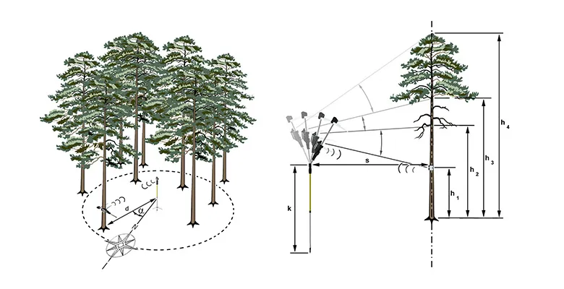


Example 5 – Forest inventory students went to the forest inventory practice week and measured all the trees in a 500 m² trial plot. By the end of the day while they were at a local restaurant waiting for dinner they calculated some stand variables such as:
After a few beers they left the restaurant leaving the field forms with the tree diameters behind…
Stand density (708 trees ha⁻¹)
Dominant height (10.5 m),
Basal area (21.8 m²ha⁻¹),
Minimum diameter (3.8 cm)
Percentile 90 diameter (27.2 cm)

Slide 70
Guilty for the loss they decided to use the 3-Weibull probability density function to simulate the diameter distribution for this stand considering:
  a = 0.9 dmin
  b = (P90-a)/(2.999573^(1/c))
  c = 3.6
…

Slide 71
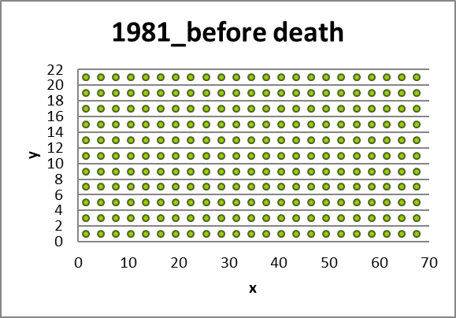
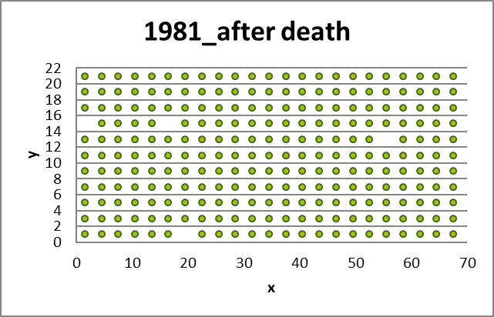
Example 5 – Simulate which trees will die in the plot using the death probability function:
Where, d is the tree diameter at breast height (cm); gi is the tree basal area, PI()/40000*d^2 (m²) , g is the average basal area of the plot (m²) and G is the stand basal area (m²ha⁻¹)

Slide 72
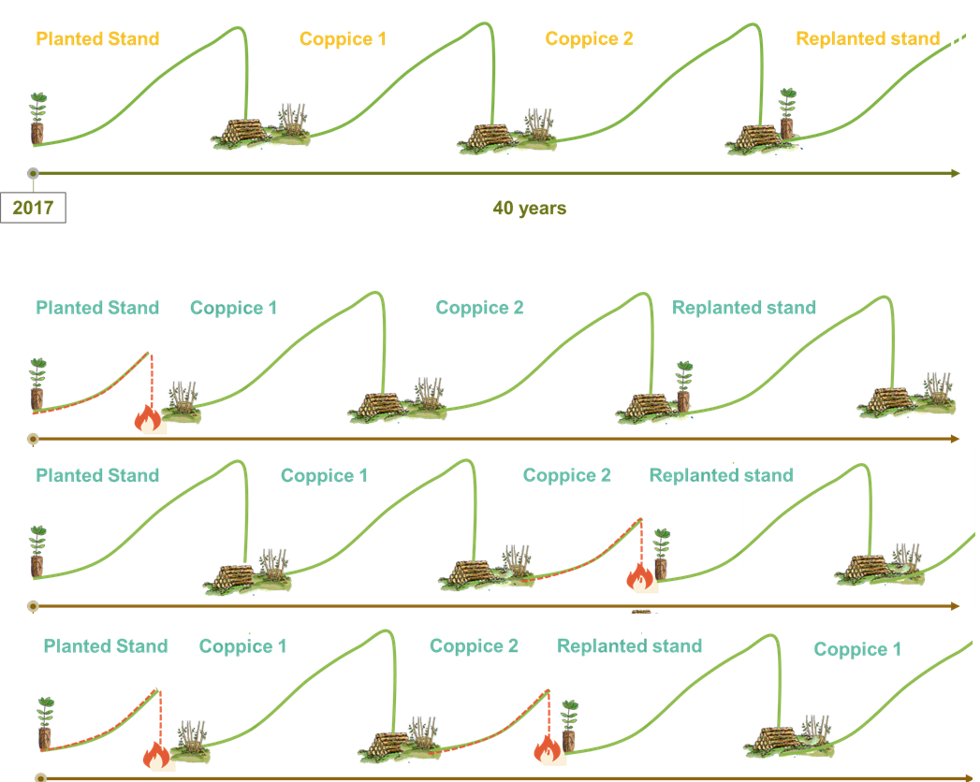
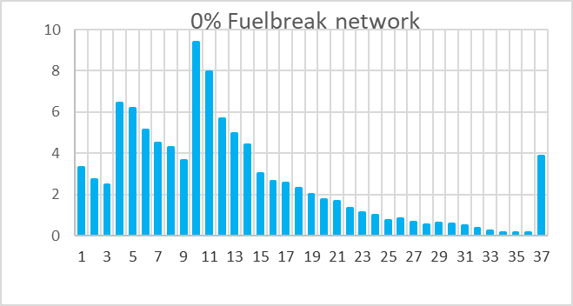
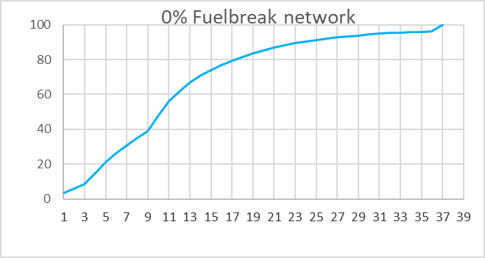
Example 6 – Simulate management prescriptions taking fire occurrence into account
Distributions of “time-since –last-fire” were generated by running fire spread models for the case study area
Pseudo-random numbers were drawn to determine when and how often fires would occur during the planning horizon
Sets od fire-sensitive management prescriptions were generated and StandsSIm.md forest simulator run to assess the impact of fire on volume harvested
A sample size of 400 was used (sample size option 2 used see slide 22) : 400 run and Vharv averaged

Slide 74
- Additional details on theoretical distributions
Theoretical distributions – Probability distributions:
Normal
Poisson
Exponential
Weibull
often used in natural and social sciences to represent real-valued random variables whose distributions are not known
Number of events that occur in an interval of time
Time taken between 2 events occurring
Commonly used for generating diameter distributions in forest plots,

Slide 75
Theoretical distributions – Probability distributions:
Normal
Poisson
Exponential
Weibull
often used in natural and social sciences to represent real-valued random variables whose distributions are not known
Number of events that occur in an interval of time
Time taken between 2 events occurring
Commonly used for generating diameter distributions in forest plots,

Slide 76
Theoretical distributions – Probability distributions:
Normal
2 Normal distributions of the heights of male humans: at birth and as adults
Normal distributions are always centered in the average value
often used in natural and social sciences to represent real-valued random variables whose distributions are not known
Average baby height 50 cm
Average adult height 170 cm
50
100
150
170
190
Height
(cm)

Slide 77
Theoretical distributions – Probability distributions:
Normal
2 Normal distributions of the heights of male humans: at birth and as adults
More likely
Looking at the graph there is a high probability that a newborn is between 49 – 51 cm
often used in natural and social sciences to represent real-valued random variables whose distributions are not known
Less likely
50
100
150
170
190
Height
(cm)

Slide 78
Theoretical distributions – Probability distributions:
Normal
2 Normal distributions of the heights of male humans: at birth and as adults
More likely
While adults are between 150 – 190 cm
often used in natural and social sciences to represent real-valued random variables whose distributions are not known
Less likely
50
100
150
170
190
Height
(cm)

Slide 79
Theoretical distributions – Probability distributions:
Normal
2 Normal distributions of the heights of male humans: at birth and as adults
More likely
The curve for babies is much taller than for adults => there are many more possibilities for adults’ height than for babies
often used in natural and social sciences to represent real-valued random variables whose distributions are not known
Thus the more possibilities there are for height, the less likely one specific measurement will be one of them!
Less likely
50
100
150
170
190
Height
(cm)

Slide 80
Theoretical distributions – Probability distributions:
Normal
2 Normal distributions of the heights of male humans: at birth and as adults
More likely
The width of the curve is defined by the standard deviation
So, babies have a smaller standard deviation compared to adults
often used in natural and social sciences to represent real-valued random variables whose distributions are not known
Less likely
50
100
150
170
190
Height
(cm)

Slide 81
Theoretical distributions – Probability distributions:
Normal
2 Normal distributions of the heights of male humans: at birth and as adults
More likely
Knowing the standard deviation is useful because Normal curves are drawn so that 95% of its values fall between +/- 2standard deviations
often used in natural and social sciences to represent real-valued random variables whose distributions are not known
Less likely
50
100
150
170
190
Height
(cm)

Slide 82
Theoretical distributions – Probability distributions:
Normal
To draw a Normal distribution you need to know:
The average measurement (tells you where the curve is centered)
The standard deviation of the measurements (tells you how wide the curve will be)
More likely
The width of the curve determines how tall it should be
often used in natural and social sciences to represent real-valued random variables whose distributions are not known
Less likely
50
100
150
170
190
Height
(cm)

Slide 83
Theoretical distributions – Probability distributions:
Normal
Are found a lot in Nature and there is a reason for that that make it quite useful: CENTRAL LIMIT THEOREM
More likely
As n increases, the distribution of the sample mean or sum approaches a normal distribution
often used in natural and social sciences to represent real-valued random variables whose distributions are not known
Less likely
50
100
150
170
190
Many other variables!

Slide 84
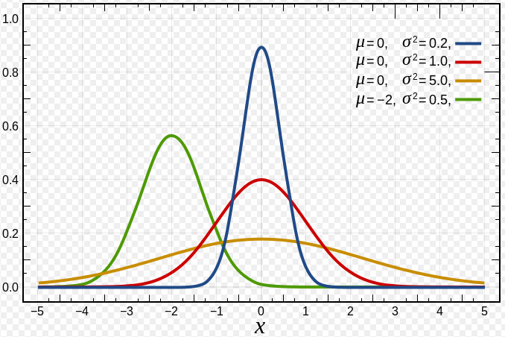
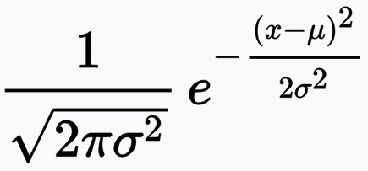
Theoretical distributions – Probability distributions
Normal - real-valued random variables whose distributions are not known
The mean
The standard deviation
f(x) =

Slide 85
Theoretical distributions – Probability distributions
Normal - real-valued random variables whose distributions are not known
The mean
The standard deviation
Probabilities are AREAS, so if I take the mean value (165), the proportion to the left of the mean will be 50%
f(x) =
Probability density
Cumulative probability
0.05
1
0.04
By the time we get to the 165, we have acumulated half of the distribution
0.75
0.03
0.5
0.5
0.02
0.01
0.25
0
0
140
165
190
140
165
190

Slide 86
Theoretical distributions – Probability distributions
Normal - real-valued random variables whose distributions are not known
The mean
The standard deviation
so if we had chosen a values left to 165, let’s say the one that represents 25% of the region (assume it is 158)
f(x) =
Probability density
Cumulative probability
0.05
1
0.04
The values in yy tell us how much of a distribution is to the left of a given xx value
0.75
0.03
0.25
0.5
0.02
0.01
0.25
0
0
158
158
140
165
190
140
165
190

Slide 87
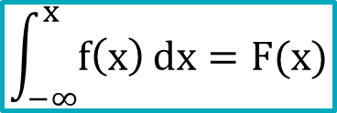
Theoretical distributions – Probability distributions
Normal - real-valued random variables whose distributions are not known
The mean
The standard deviation
If probabilities are AREAS to move from the probability density to the cumulative probability, we need to…
f(x) =
Probability density
Cumulative probability
0.05
1
0.04
0.75
0.03
F(x)
$$\int_{−∞}^{x}{f\left(x\right)}dx=F(x)$$
0.5
0.02
0.01
0.25
Tedious and time consuming
0
0
x
x
140
165
190
140
165
190

Slide 88
Theoretical distributions – Probability distributions
Normal - real-valued random variables whose distributions are not known
The mean
The standard deviation
Standard Normal distribution
There is a 50% probability that a given selection from this distribution being less than zero
Probability density
Probability density
σ = 1
σ = 1
0.5
?
?
But what’s the probability of being less than -1?
or greater than 1.645?
µ = 0
-1
µ = 0
1.645

Slide 89
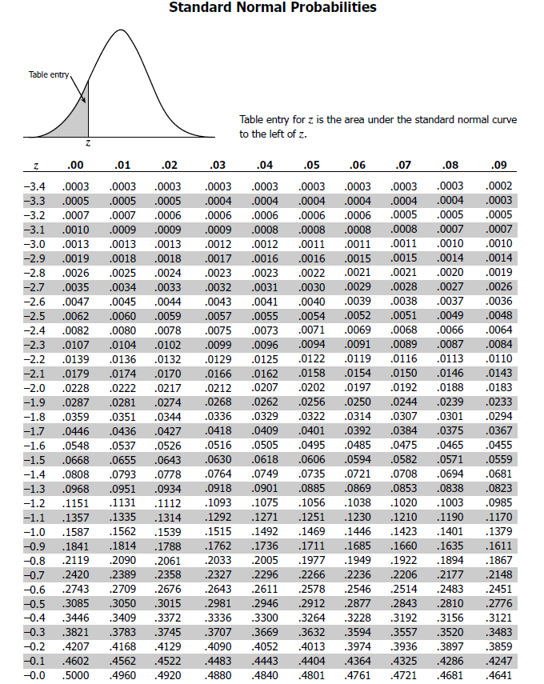
Theoretical distributions – Probability distributions
Normal - real-valued random variables whose distributions are not known
The mean
The standard deviation
Standard Normal distribution
has been tabulated
Probability density
σ = 1
?
?
-1
µ = 0
1.645

Slide 90
Theoretical distributions – Probability distributions
Normal - real-valued random variables whose distributions are not known
The mean
The standard deviation
Probability density
σ = 1
?
?
-1
µ = 0
1.645

Slide 91
Theoretical distributions – Probability distributions
Normal - real-valued random variables whose distributions are not known
The mean
The standard deviation
Probability density
σ = 1
0.1587
?
-1
µ = 0
1.645

Slide 92
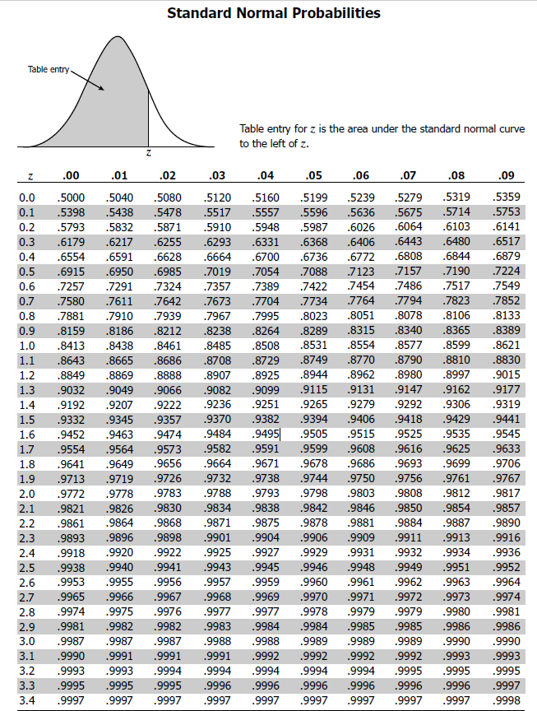
Theoretical distributions – Probability distributions
Normal - real-valued random variables whose distributions are not known
The mean
The standard deviation
Probability density
σ = 1
0.1587
?
-1
µ = 0
1.645

Slide 93
Theoretical distributions – Probability distributions
Normal - real-valued random variables whose distributions are not known
The mean
The standard deviation
Probability density
σ = 1
0.1587
1-0.9495 = 0.0505
1-0.9505 = 0.0495
-1
µ = 0
1.645

Slide 94
Theoretical distributions – Probability distributions
Normal - real-valued random variables whose distributions are not known
The mean
The standard deviation
Probability density
σ = 1
0.1587
0.05
-1
µ = 0
1.645

Slide 95
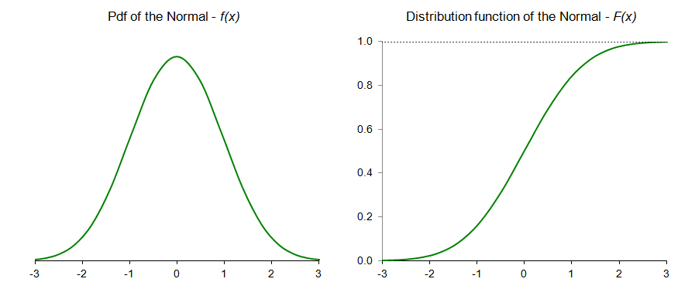
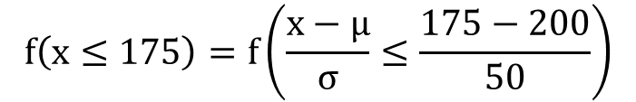
Theoretical distributions – Probability distributions
Standard Normal distribution
- Programmed (e.g. EXCEL: cpdf = Normsdist ( (upperLimit-mean)/std) )
$$f\left(x≤175\right)=f\left(\frac{x−μ}{σ}≤\frac{175−200}{50}\right)$$
$$f\left(x≤175\right)=f\left(z≤−0.5\right)$$
x | Upper limit | z=(xup-200)/50
50 | 75 | -2.5
100 | 125 | -1.5
150 | 175 | -0.5
200 | 225 | 0.5
250 | 275 | 1.5
300 | 325 | 2.5
350 | 375 | 3.5
400
x
75
125
175
225
275
325
375
∞
200
∞
z
-2.5
-1.5
-0.5
0.5
1.5
2.5
3.5

Slide 96
Theoretical distributions – Probability distributions
Standard Normal distribution
- Programmed (e.g. EXCEL: cpdf = Normsdist ( (upperLimit-mean)/std) )
$$f\left(x≤175\right)=f\left(\frac{x−μ}{σ}≤\frac{175−200}{50}\right)$$
$$f\left(x≤175\right)=f\left(z≤−0.5\right)$$
x | Upper limit | z=(xup-200)/50 | cpdf
50 | 75 | -2.5 | 0.00621
100 | 125 | -1.5 | 0.06681
150 | 175 | -0.5 | 0.30854
200 | 225 | 0.5 | 0.69146
250 | 275 | 1.5 | 0.93319
300 | 325 | 2.5 | 0.99379
350 | 375 | 3.5 | 0.99977
400 |  |  | 1
0.30854
200
x
75
125
175
225
275
325
375
∞
∞
∞
∞
z
-2.5
-1.5
-0.5
0.5
1.5
2.5
3.5

Slide 97
Theoretical distributions – Probability distributions
Standard Normal distribution
- Programmed (e.g. EXCEL: cpdf = Normsdist ( (upperLimit-mean)/std) )
Draw random number (0-1) = 0.58
1
x | Upper limit | z=(xup-200)/50 | cpdf
50 | 75 | -2.5 | 0.00621
100 | 125 | -1.5 | 0.06681
150 | 175 | -0.5 | 0.30854
200 | 225 | 0.5 | 0.69146
250 | 275 | 1.5 | 0.93319
300 | 325 | 2.5 | 0.99379
350 | 375 | 3.5 | 0.99977
400 |  |  | 1
0.69146
0.58
0.30854
0.06681
200
x
75
125
175
225
275
325
375
200
∞
∞
z
-2.5
-1.5
-0.5
0.5
1.5
2.5
3.5

Slide 98
Theoretical distributions – Probability distributions:
shape parameter (indicates the average number of events in the given time interval)
Poisson
Only has one parameter λ
Bounded between 0 and infinity
Assumptions:
Rate at which events occur is CONSTANT
Events are independent, i.e. one event does not affect the subsequent
In some cases it may be applied even if the rate is not constant (e.g. nr of visits o a website during a day, not likely to have it happening at 3 in the morning…)
Number of events that occur in an interval of time

Slide 99
Theoretical distributions – Probability distributions:
Poisson
Suppose: λ = 3
= poisson.dist ( x , λ , false)
= poisson.dist ( x , λ , true)

Slide 100
Theoretical distributions – Probability distributions:
Poisson
Suppose: λ = 3
What is the probability of 5 events occurring
P (x=5) = poisson.dist ( 5, 3, false)
= poisson.dist ( x , λ , false)
= poisson.dist ( x , λ , true)

Slide 101
Theoretical distributions – Probability distributions:
Poisson
Suppose: λ = 3
What is the probability of exactly 5 events taking place:
P (x = 5) = poisson.dist ( 5, 3, false)
What is the probability of 5 or less events taking place:
P ( x ≤ 5) = poisson.dist ( 5, 3, true)
= poisson.dist ( x , λ , false)
= poisson.dist ( x , λ , true)

Slide 102
Theoretical distributions – Probability distributions:
Poisson
Suppose: λ = 3
What is the probability of exactly 5 events taking place:
P (x = 5) = poisson.dist ( 5, 3, false)
What is the probability of 5 or less events taking place: P ( x ≤ 5) = poisson.dist ( 5, 3, true)
What is the probability of at least 5 events taking place: P ( x ≥ 5) = 1- poisson.dist ( 4, 3, true)
= poisson.dist ( x , λ , false)
= poisson.dist ( x , λ , true)

Slide 103
Theoretical distributions – Probability distributions:
Exponential
Time taken between 2 events occurring

Slide 104
Theoretical distributions – Probability distributions:
Exponential - Time taken between 2 events occurring
Average nr of events occurring in one time unit (min., days, weeks…)
P (x) = λ e^{−λx}
P (X <= x) = 1- e^{−λx}
P (X <= 0.5)
Probabilities are AREAS
Probability density function

Slide 105
Theoretical distributions – Probability distributions
Exponential - Time taken between 2 events occurring
Average nr of events occurring in one time unit (min., days, weeks…)
P (x) = λ e^{−λx}
P (X <= x) = 1- e^{−λx}
Probabilities are AREAS
Cumulative distribution function
Probability density function

Slide 106
Theoretical distributions – Probability distributions:
Weibull
Extremely flexible fitting different kinds of data
3 parameters Weibull
scale (b), shape (c) and location (a)
2 parameters Weibull
scale (b) and shape (c)
Reliability and survival (the chance of survival from from t=0 till time t)
Commonly used for generating diameter distributions in forest plots

Slide 107
Theoretical distributions:
3-Weibull
is a 3-parameter pdf, used in diameter distribution modelling
    a – location parameter (related to the d_{min})
    b – scale parameter (>0)
    c – shape parameter (>0)
    a+b is close to percentile 63% (P₆₃) of the distribution
Cumulative distribution
Excel only has the 2- Weibull
= Weibull.dist ( upperlim, c, b, true)

Slide 108
Theoretical distributions:
3-Weibull
c – shape parameter
Exponential
Rayleigh
Normal

Slide 109
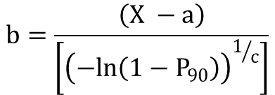
Theoretical distributions:
3-Weibull
b – scale parameter
$$b=\frac{\left(X −a\right)}{\left[{\left(−ln\left(1−P_{90}\right)\right)}^{1/c}\right]}$$
Determines the number of classes with observations

Slide 110
Theoretical distributions:
3-Weibull
a – location parameter
a = 0.9 d_{min}
plot minimum diameter
So as stands grow older (and trees grow thicker) a value must increase

Slide 111
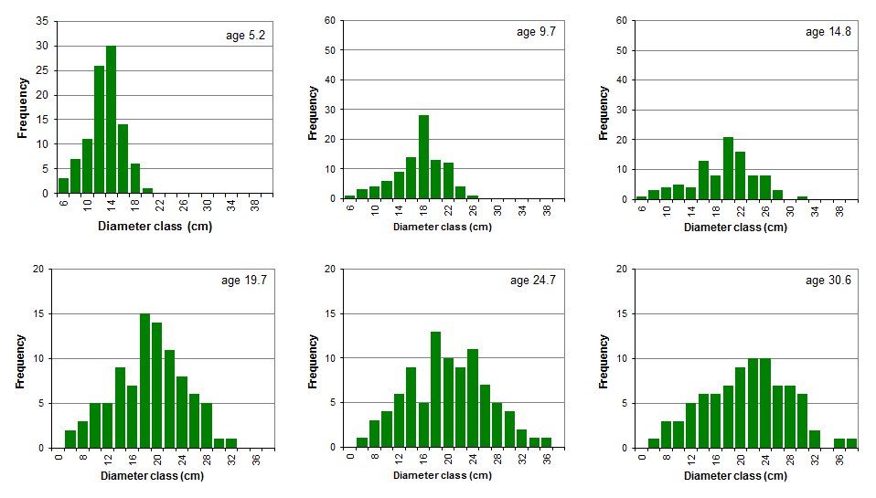
Diameter distribution for the same permanent plot over time

Slide 112
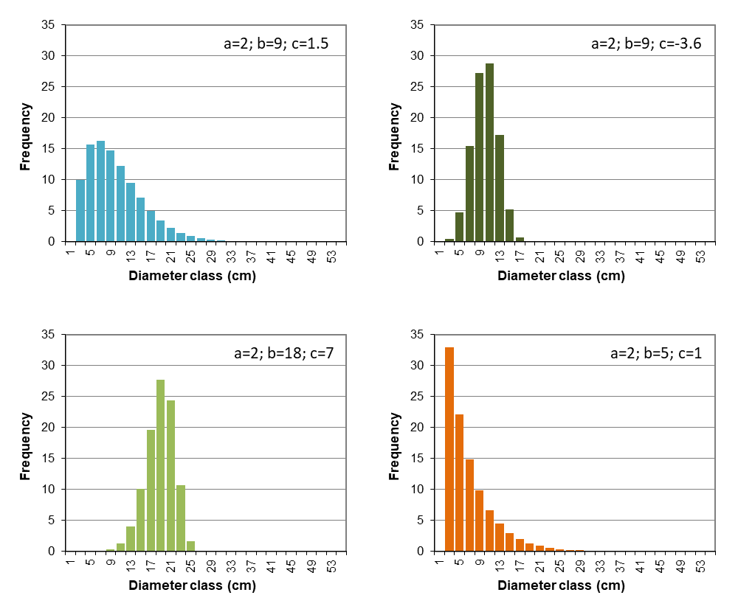
Inverted J shape (uneven-aged stands)

Slide 113
1
What is Monte Carlo? Basic Principles
2
Distributions
3
Random Numbers
4
Sample Sizes
5
Monte Carlo Simulation Examples
6
Monte Carlo Simulation Exercises

Slide 114
Example 1 – Simulating with a distribution provided (empirical)
Example 2 – Setting a distribution based on know distributions of other variables (independent variables)
Example 3 – Simulating using dependent variables
Example 4 – Simulating using theoretical distributions

