Slide 1
Linear Programming
Graphical Sensitivity Analysis
Applied Operations Research 2024-2025
Susana Barreiro
6 & 11 March 2025

Slide 2
Keeping the River Clean Problem
Formulation of a linear programming model that (unlike the poet’s problem) involves:
  (1) minimizing an objective function not related to profit
  (2) >= constraints that express management objectives

Slide 3
The problem
A pulp mill makes mechanical and chemical pulp and during the production process it pollutes the river in which it spills its spent waters. The owners would like to:
minimize pollution (measured by the biological oxygen demand – BOD)
keeping at least 300 people employed at the mill
generating at least 40000€ of revenue per day
both chemical and mechanical pulp require the labor of one worker for about 1 day, or 1 workday (wd), per ton produced
Chemical pulp sells at 200€/ton, mechanical at 100€/ton
The maximum capacity of the mill to make mechanical pulp is 300 tons/d and 200 tons/d for chemical pulp (the mechanical pulp line cannot be used to make chemical pulp, and vice-versa)
1 ton of mechanical pulp produces 1 unit of BOD, 1 ton of chemical pulp produces 1.5 units

Slide 4
The problem
A pulp mill makes mechanical and chemical pulp and during the production process it pollutes the river in which it spills its spent waters. The owners would like to:
minimize pollution (measured by the biological oxygen demand – BOD)
keeping at least 300 people employed at the mill
generating at least 40000€ of revenue per day
both chemical and mechanical pulp require the labor of one worker for about 1 day, or 1 workday (wd), per ton produced
Chemical pulp sells at 200€/ton, mechanical at 100€/ton
The maximum capacity of the mill to make mechanical pulp is 300 tons/d and 200 tons/d for chemical pulp (the mechanical pulp line cannot be used to make chemical pulp, and vice-versa)
1 ton of mechanical pulp produces 1 unit of BOD, 1 ton of chemical pulp produces 1.5 units
pollution
employment
revenue
employment
revenue
pollution

Slide 5
The problem (decision variables and formulation)
  x1 - Amount of mechanical pulp produced (in tons/day, or t/d)
  x2 - Amount of chemical pulp produced (t/d)
Objective: minimize pollution (measured by the biological oxygen demand – BOD)
1 ton of mechanical pulp produces 1 unit of BOD, 1 ton of chemical pulp produces 1.5 units
Employment: keeping at least 300 people employed at the mill
Employment: both chemical and mechanical pulp require the labor of one worker for about 1 day, or 1 workday (wd), per ton produced
Revenues: generating at least 40000€ of revenue per day
Revenues: Chemical pulp sells at 200€/ton, mechanical at 100€/ton
Max capacity mech pulp: is 300 tons/d
Max capacity chem pulp: is 200 tons/d for chemical pulp
the mechanical pulp line cannot be used to make chemical pulp, and vice-versa

Slide 6
The problem (decision variables and formulation)
  x1 - Amount of mechanical pulp produced (in tons/day, or t/d)
  x2 - Amount of chemical pulp produced (t/d)
min Z = x1 + 1.5 x2 units of BOD / d
Objective: minimize pollution (measured by the biological oxygen demand – BOD)
1 ton of mechanical pulp produces 1 unit of BOD, 1 ton of chemical pulp produces 1.5 units
Employment: keeping at least 300 people employed at the mill
Employment: both chemical and mechanical pulp require the labor of one worker for about 1 day, or 1 workday (wd), per ton produced
Revenues: generating at least 40000€ of revenue per day
Revenues: Chemical pulp sells at 200€/ton, mechanical at 100€/ton
Max capacity mech pulp: is 300 tons/d
Max capacity chem pulp: is 200 tons/d for chemical pulp
the mechanical pulp line cannot be used to make chemical pulp, and vice-versa

Slide 7
The problem (decision variables and formulation)
  x1 - Amount of mechanical pulp produced (in tons/day, or t/d)
  x2 - Amount of chemical pulp produced (t/d)
min Z = x1 + 1.5 x2 units of BOD / d
subject to
  x1 + x2 ≥ 300 workers employed
Objective: minimize pollution (measured by the biological oxygen demand – BOD)
1 ton of mechanical pulp produces 1 unit of BOD, 1 ton of chemical pulp produces 1.5 units
Employment: keeping at least 300 people employed at the mill
Employment: both chemical and mechanical pulp require the labor of one worker for about 1 day, or 1 workday (wd), per ton produced
Revenues: generating at least 40000€ of revenue per day
Revenues: Chemical pulp sells at 200€/ton, mechanical at 100€/ton
Max capacity mech pulp: is 300 tons/d
Max capacity chem pulp: is 200 tons/d for chemical pulp
the mechanical pulp line cannot be used to make chemical pulp, and vice-versa

Slide 8
The problem (decision variables and formulation)
  x1 - Amount of mechanical pulp produced (in tons/day, or t/d)
  x2 - Amount of chemical pulp produced (t/d)
min Z = x1 + 1.5 x2 units of BOD / d
subject to
  x1 + x2 ≥ 300 workers employed
  100x1 + 200x2 ≥ 40000 revenue € / d
Objective: minimize pollution (measured by the biological oxygen demand – BOD)
1 ton of mechanical pulp produces 1 unit of BOD, 1 ton of chemical pulp produces 1.5 units
Employment: keeping at least 300 people employed at the mill
Employment: both chemical and mechanical pulp require the labor of one worker for about 1 day, or 1 workday (wd), per ton produced
Revenues: generating at least 40000€ of revenue per day
Revenues: Chemical pulp sells at 200€/ton, mechanical at 100€/ton
Max capacity mech pulp: is 300 tons/d
Max capacity chem pulp: is 200 tons/d for chemical pulp
the mechanical pulp line cannot be used to make chemical pulp, and vice-versa

Slide 9
The problem (decision variables and formulation)
  x1 - Amount of mechanical pulp produced (in tons/day, or t/d)
  x2 - Amount of chemical pulp produced (t/d)
min Z = x1 + 1.5 x2 units of BOD / d
subject to
  x1 + x2 ≥ 300 workers employed
  100x1 + 200x2 ≥ 40000 revenue € / d
  x1 ≤ 300 mech pulping capacity t /d
Objective: minimize pollution (measured by the biological oxygen demand – BOD)
1 ton of mechanical pulp produces 1 unit of BOD, 1 ton of chemical pulp produces 1.5 units
Employment: keeping at least 300 people employed at the mill
Employment: both chemical and mechanical pulp require the labor of one worker for about 1 day, or 1 workday (wd), per ton produced
Revenues: generating at least 40000€ of revenue per day
Revenues: Chemical pulp sells at 200€/ton, mechanical at 100€/ton
Max capacity mech pulp: is 300 tons/d
Max capacity chem pulp: is 200 tons/d for chemical pulp
the mechanical pulp line cannot be used to make chemical pulp, and vice-versa

Slide 10
The problem (decision variables and formulation)
  x1 - Amount of mechanical pulp produced (in tons/day, or t/d)
  x2 - Amount of chemical pulp produced (t/d)
min Z = x1 + 1.5 x2 units of BOD / d
subject to
  x1 + x2 ≥ 300 workers employed
  100x1 + 200x2 ≥ 40000 revenue € / d
  x1 ≤ 300 mech pulping capacity t /d
  x2 ≤ 200 chem pulping capacity t /d
  x1; x2 ≥ 0

Slide 11
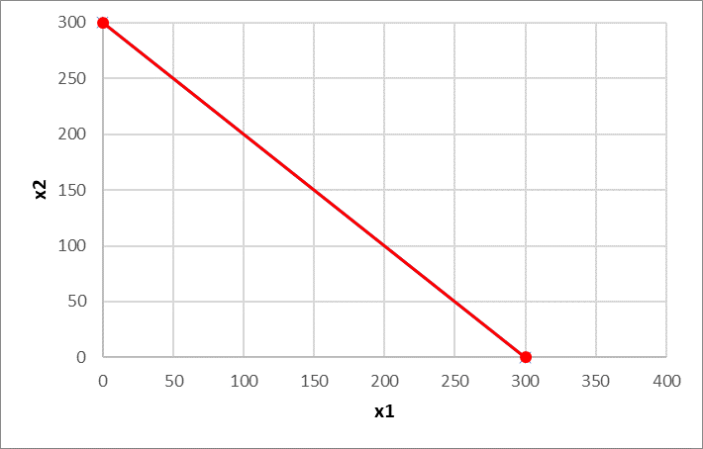
The problem (the feasible region)

Slide 12
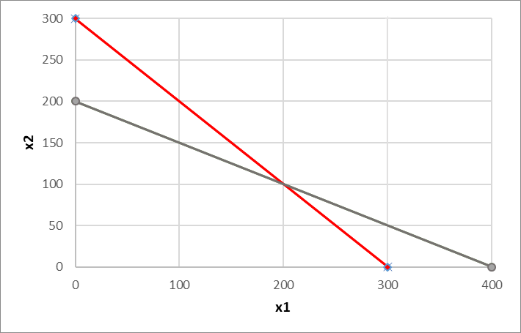
The problem (the feasible region)

Slide 13
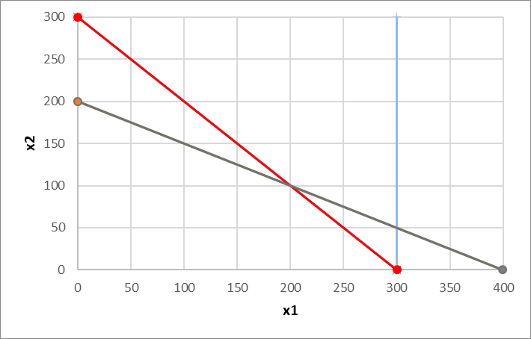
The problem (the feasible region)

Slide 14
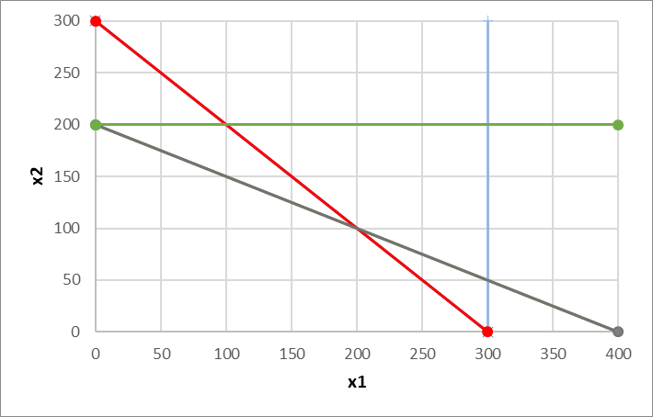
The problem (the feasible region)
x1; x2 ≥ 0

Slide 15
The problem (the feasible region)
How do you figure out your feasible region?
Make (x1, x2) = (0, 0) for each constraint
  0 ≥ 300 False Above the red line
  0 ≥ 40000 False Above the grey line
  0 ≤ 300 True Below the blue line
  0 ≤ 200 True Below the blue line
x1; x2 ≥ 0

Slide 16
The problem (the vertices of the feasible region)
To find the vertices, we solve the systems of equations:
x1 + x2 = 300
100x1 + 200x2 = 40000
x1 = 200
x2 = 100
A =
B
C
x1 + x2 = 300
x2 = 200
A
B =
x1 = 100
x2 = 200
D
C =
x2 = 200
x1 = 300
If a Linear Programming problem has one solution it is located in one of the vertices
(but it can have multiple solutions)
D =
x1 = 300
100x1 + 200x2 = 40000
x1 = 300
x2 = 50

Slide 17
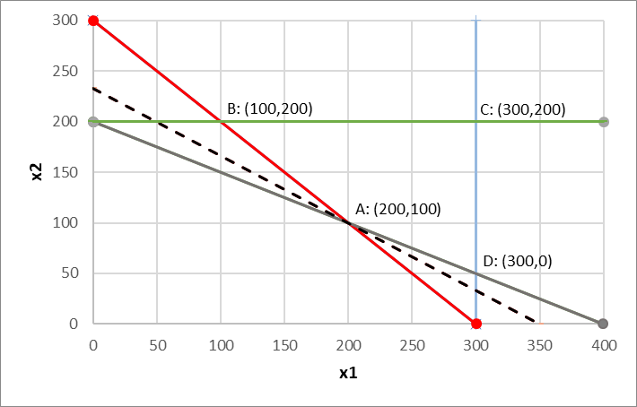
The problem (the vertices of the feasible region)
To find the vertices, we solve the systems of equations:
x1 + x2 = 300
100x1 + 200x2 = 40000
x1 = 200
x2 = 100
A =
B
C
x1 + x2 = 300
x2 = 200
A
B =
x1 = 100
x2 = 200
D
C =
x2 = 200
x1 = 300
If a Linear Programming problem has one solution it is located in one of the vertices
(but it can have multiple solutions)
D =
x1 = 300
100x1 + 200x2 = 40000
x1 = 300
x2 = 50

Slide 18
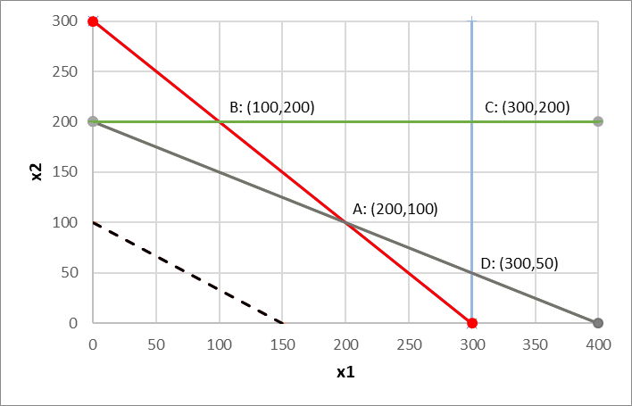
The problem (the feasible region and isolines)
But, where is my optimal solution?
Min
Z = x1 + 1.5 x2
I’ll assign random values to Z to draw the isolines
(lines with the same slope of the objective function)
Z x1 x2
ISO_150

Slide 19
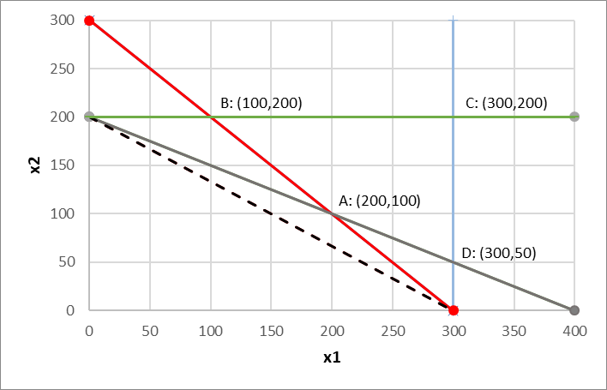
The problem (the feasible region and isolines)
But, where is my optimal solution?
Min
Z = x1 + 1.5 x2
I’ll assign random values to Z to draw the isolines
(lines with the same slope of the objective function)
ISO_300
Z x1 x2

Slide 20
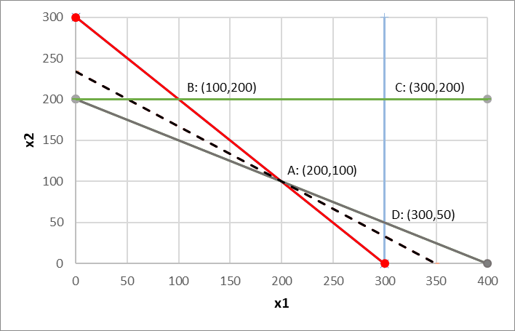
The problem (the feasible region and isolines)
But, where is my optimal solution?
Min
Z = x1 + 1.5 x2
I’ll assign random values to Z to draw the isolines
(lines with the same slope of the objective function)
ISO_300
Z x1 x2
ISO_350

Slide 21
The problem (the feasible region and isolines)
But, where is my optimal solution?
Min
Z = x1 + 1.5 x2
I’ll assign random values to Z to draw the isolines
(lines with the same slope of the objective function)
ISO_300

Slide 22
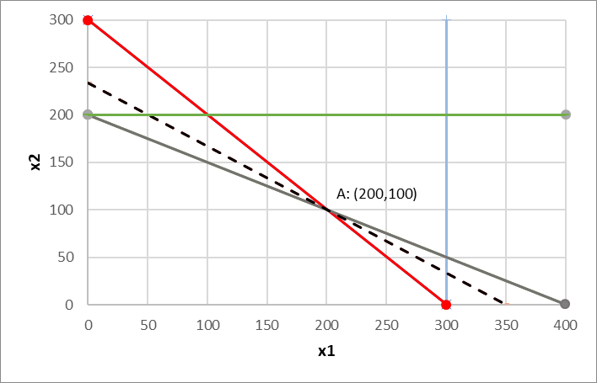
The problem (the feasible region and isolines)
But, where is my optimal solution?
A: (200,100)
Z=350
Min
Z = x1 + 1.5 x2
I’ll assign random values to Z to draw the isolines
(lines with the same slope of the objective function)
A: (200,100)
ISO_300

Slide 23
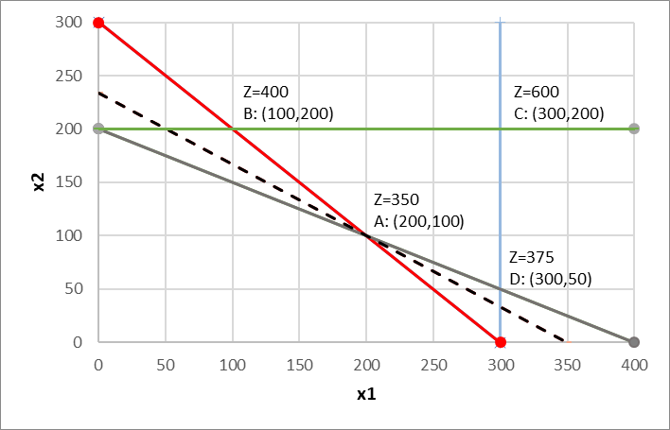
The problem (the feasible region and isolines)
But, where is my optimal solution?
Min
Z = x1 + 1.5 x2
I’ll assign random values to Z to draw the isolines
(lines with the same slope of the objective function)
A: (200,100) Let’s confirm A is the vertice that leads to the minimum Z in the feasible region

Slide 24
Feasible regions and solutions
Bounded feasible region & one optimal solution
Bounded feasible region & multiple optimal solutions
Unbounded feasible region & one optimal solution
Unbounded feasible region & multiple optimal solutions
Unbounded feasible region & unbounded solutions
Unfeasible problem

Slide 25
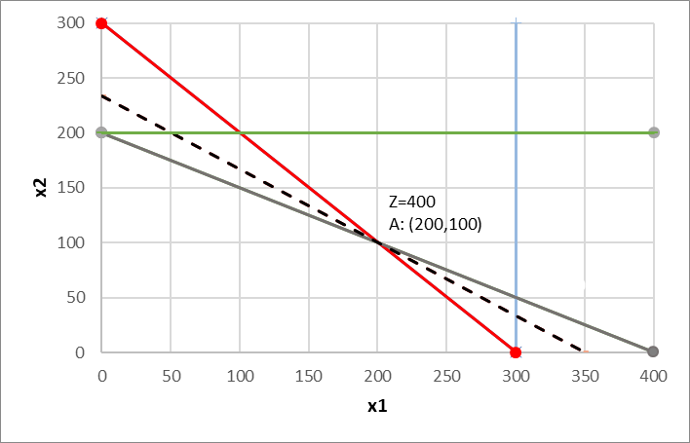
Feasible regions and solutions
Bounded feasible region &
one optimal solution
min Z = x1 + 1.5 x2
subject to
x1 + x2 ≥ 300
100x1 + 200x2 ≥ 40000
x1 ≤ 300
x2 ≤ 200
x1; x2 ≥ 0

Slide 26
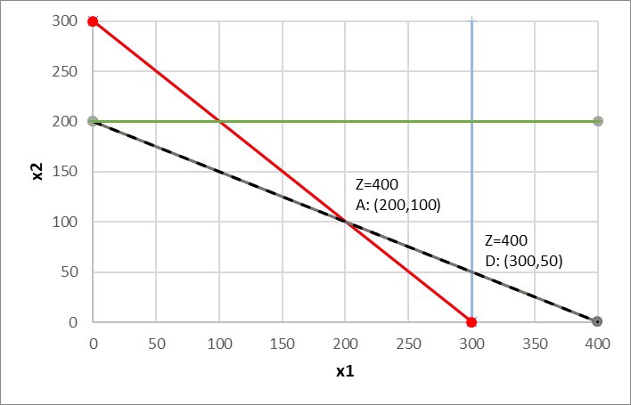
Feasible regions and solutions
Bounded feasible
region &
multiple optimal solutions
min Z = x1 + 1.5 x2
min Z = x1 + 2 x2
subject to
x1 + x2 ≥ 300
100x1 + 200x2 ≥ 40000
x1 ≤ 300
x2 ≤ 200
x1; x2 ≥ 0
The objective function and the grey constraint have the same slope (-1/2)
Z=400
E: (250,75)

Slide 27
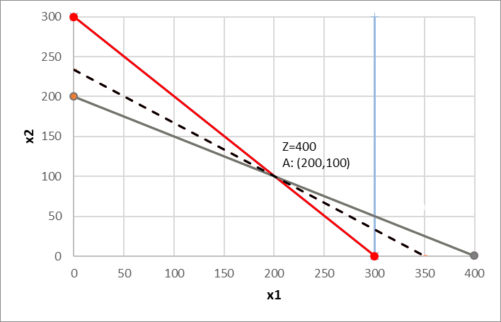
Feasible regions and solutions
Unbounded feasible
region &
one optimal solution
min Z = x1 + 1.5 x2
subject to
x1 + x2 ≥ 300
100x1 + 200x2 ≥ 40000
x1 ≤ 300
x1; x2 ≥ 0

Slide 28
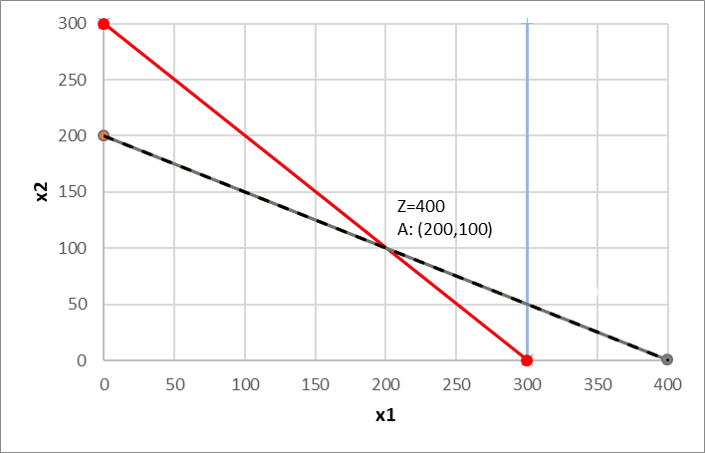

Feasible regions and solutions
Unbounded feasible
region &
multiple optimal solutions
min Z = x1 + 2 x2
subject to
x1 + x2 ≥ 300
100x1 + 200x2 ≥ 40000
x1 ≤ 300
x1; x2 ≥ 0

Slide 29
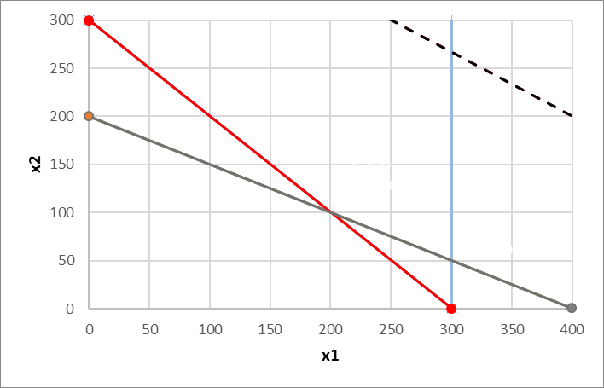
Feasible regions and solutions
Unbounded feasible
region &
unbounded solutions
min Z = x1 + 1.5 x2
max Z = x1 + 1.5 x2
subject to
x1 + x2 ≥ 300
100x1 + 200x2 ≥ 40000
x1 ≤ 300
x1; x2 ≥ 0

Slide 30
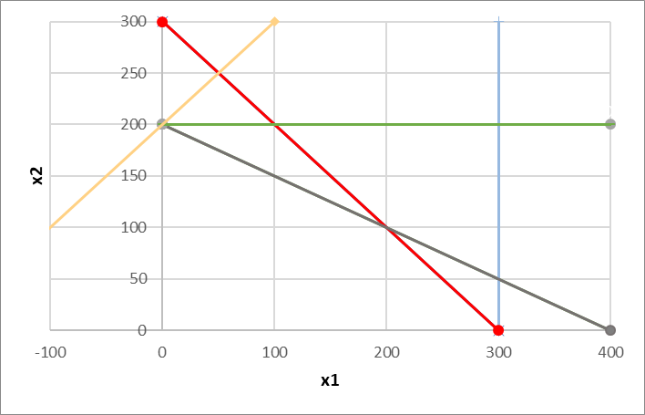
Feasible regions and solutions
Unfeasible
problem
max Z = x1 + 1.5 x2
subject to
x1 + x2 ≥ 300
100x1 + 200x2 ≥ 40000
x1 ≤ 300
x2 ≤ 200
-100x1 + 100x2 ≥ 20000
x1; x2 ≥ 0
The feasible region must result of the interception of the regions derived from all constraints (the orange doesn’t intercept the remaining

Slide 31
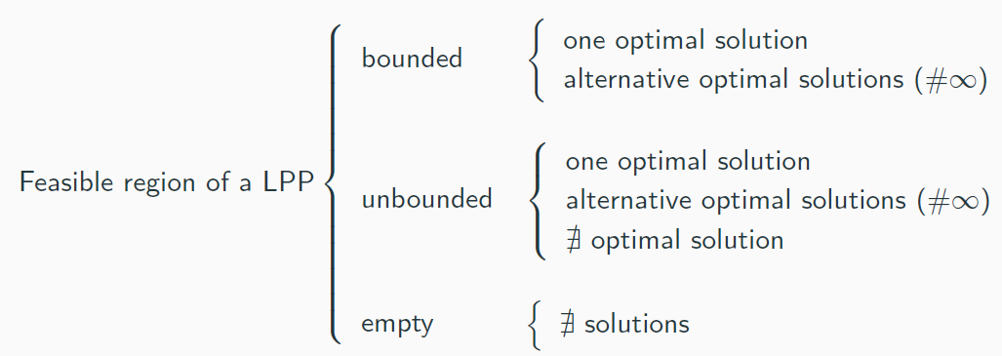
Feasible regions and solutions
Summary

Slide 32
Why alternative solutions are always infinite
The feasible region of a LPP is a closed convex set.
Definitions:
A set is convex if the straight line segment that joins every pair of points in the set is also in the set.
A set is closed if contains its boundary.
Non-convex sets:
The objective function of a LPP is linear.
closed convex set
open convex set
closed convex set

Slide 33
Graphical Sensitivity Analysis
Range of optimality for the objective function coefficients
Right-hand-side (RHS) values
Range of feasibility for the RHS concerning the shadow price

Slide 34
Sensitivity Analysis
When defining a LP problem the values used as model parameters are usually estimates.
The main purpose of sensitivity analysis is to identify the sensitive parameters (i.e. the ones that cannot be changed without changing the optimal solution) that require being closely monitored as the study is implemented.
If we discover a true value of a sensitive parameter differs from the estimated value, this immediately signals the need to change the solution.

Slide 35
Sensitivity Analysis
Sensitivity analysis (or post-optimality analysis) is used to determine how the optimal solution is affected by changes, within specified ranges in:
      The objective function coefficients
      On the right-hand side values of the constraints
Sensitivity analysis is important to managers that operate in dynamic environments having to deal with imprecise estimates of the coefficients because it allows them to ask what-if-questions about the problem

Slide 36
Graphical Sensitivity Analysis
Range of optimality for the objective function coefficients
Right-hand-side (RHS) values
Range of feasibility for the RHS concerning the shadow price

Slide 37
Graphical Sensitivity Analysis
Range of optimality for the objective function coefficients
Right-hand-side (RHS) values
Range of feasibility for the RHS concerning the shadow price

Slide 38
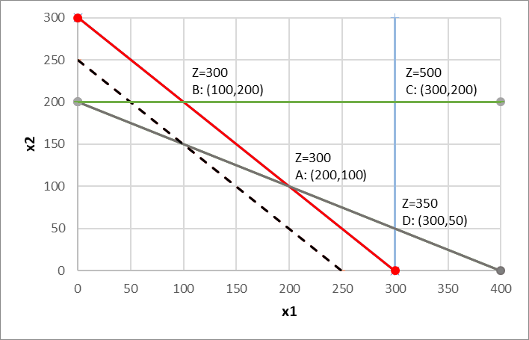
Graphical Sensitivity Analysis
Range of optimality for the objective function coefficients
Question: What range of values can the objective function coefficients take without changing the optimal solution (200,100)?
Focus on c₂:
ISO_300
min Z = x₁ + 1.5 x₂
Z = c₁ x₁ + c₂ x₂
c₂ = 0
c₂ = 1
c₂ = 1.5
c₂ = 2
c₂ = 3
min Z = x₁ + 1 x₂
subject to
  x₁ + x₂ ≥ 300
  100x₁ + 200x₂ ≥ 40000
  x₁ ≤ 300
  x₂ ≤ 200
  x₁; x₂ ≥ 0
ISO_250
Optimal solution: A
Optimal solution: A - B Z changes

Slide 39
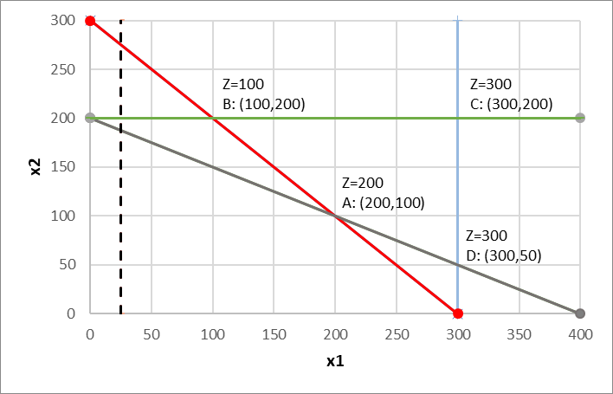
Graphical Sensitivity Analysis
Range of optimality for the objective function coefficients
Question: What range of values can the objective function coefficients take without changing the optimal solution (200,100)?
Focus on c₂:
ISO_25
ISO_50
ISO_100
Z = x₁ + c₂ x₂
c₂ = 0
c₂ = 1
c₂ = 1.5
c₂ = 2
c₂ = 3
min Z = x₁ + 0 x₂
subject to
  x₁ + x₂ ≥ 300
  100x₁ + 200x₂ ≥ 40000
  x₁ ≤ 300
  x₂ ≤ 200
  x₁; x₂ ≥ 0
Optimal solution CHANGES: B, Z changes

Slide 40
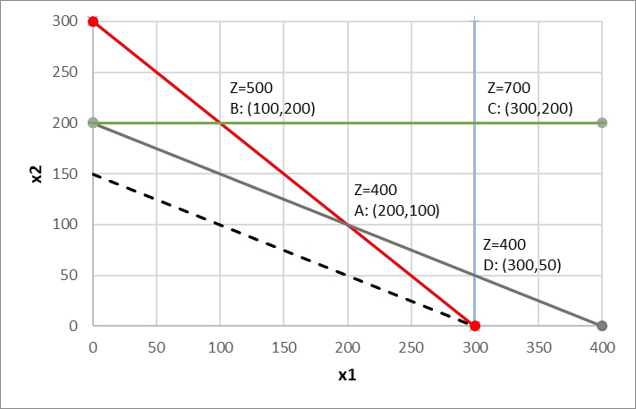
Graphical Sensitivity Analysis
Range of optimality for the objective function coefficients
Question: What range of values can the objective function coefficients take without changing the optimal solution (200,100)?
Focus on c₂:
Z = x₁ + c₂ x₂
c₂ = 0
c₂ = 1
c₂ = 1.5
c₂ = 2
c₂ = 3
min Z = x₁ + 2 x₂
subject to
  x₁ + x₂ ≥ 300
  100x₁ + 200x₂ ≥ 40000
  x₁ ≤ 300
  x₂ ≤ 200
  x₁; x₂ ≥ 0
ISO_300
ISO_400
Optimal solution: A; Z changes

Slide 41
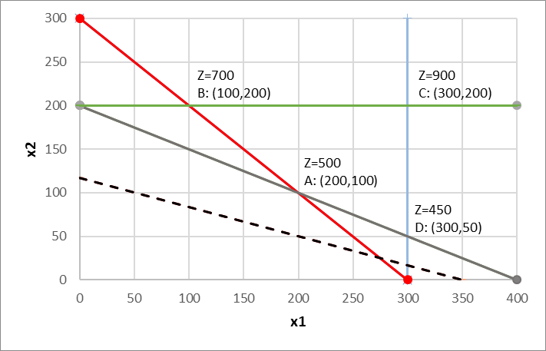
Graphical Sensitivity Analysis
Range of optimality for the objective function coefficients
Question: What range of values can the objective function coefficients take without changing the optimal solution (200,100)?
Focus on c₂:
Z = x₁ + c₂ x₂
c₂ = 0
c₂ = 1
c₂ = 1.5
c₂ = 2
c₂ = 3
min Z = x₁ + 3 x₂
subject to
  x₁ + x₂ ≥ 300
  100x₁ + 200x₂ ≥ 40000
  x₁ ≤ 300
  x₂ ≤ 200
  x₁; x₂ ≥ 0
ISO_450
ISO_350
Optimal solution CHANGES: D, Z changes

Slide 42
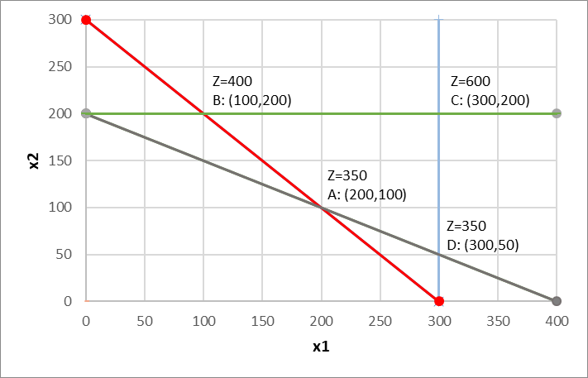
Graphical Sensitivity Analysis
Range of optimality for the objective function coefficients
Question: What range of values can the objective function coefficients take without changing the optimal solution (200,100)?
Focus on c₂:
Z = x₁ + c₂ x₂
c₂ = 0
c₂ = 1
c₂ = 1.5
c₂ = 2
c₂ = 3
min Z = x₁ + 1.5 x₂
subject to
  x₁ + x₂ ≥ 300
  100x₁ + 200x₂ ≥ 40000
  x₁ ≤ 300
  x₂ ≤ 200
  x₁; x₂ ≥ 0
A is the optimal solution as long as the ISOline is between these constraints:
  x₁ + x₂ ≥ 300
  100x₁ + 200x₂ ≥ 40000

Slide 43
Graphical Sensitivity Analysis
min Z = x1 + 1.5 x2
Range of optimality for the objective function coefficients
Question: What range of values can the objective function coefficients take without changing the optimal solution (200,100)?
Focus on c₂: look at the slopes (- c₁/c₂)
Question: What range of values can the objective function coefficients take without changing the optimal solution (200,100)?
Focus on c₁: look at the slopes (- c₁/c₂)
  x₁ + x₂ = 300 slope: -1
  100x₁ + 200x₂ = 40000 slope: -1/2
  Z = 1 x₁ + c₂ x₂ slope: -1/ c₂
  The objective function will be between these 2 constraints :
  -1 ≤ -1/ c₂ ≤ -1/2 ⬄ 1 ≤ c₂ ≤ 2
  x₁ + x₂ = 300 slope: -1
  100x₁ + 200x₂ = 40000 slope: -1/2
  Z = c₁ x₁ + 1.5 x₂ slope: - c₁ /1.5
  The objective function will be between these 2 constraints :
  -1 ≤ c₁ /1.5 ≤ -1/2 ⬄ 1.5 ≥ c₁ ≥ 0.75
(assuming C₁=1)
(assuming C₂=1.5)

Slide 44
Graphical Sensitivity Analysis
Range of optimality for the objective function coefficients
Question: What range of values can the objective function coeff. take without changing the optimal solution (200,100)?
i.e. assume better estimates of the emission of pollutants (c1, c2) associated to the production of mechanical and chemical pulp (x1, X2) could be obtained
How much could (c1, c2) be changed to guarantee the mill is still able to provide 200 tons/day of mechanical pulp and 100 tons/day of chemical pulp
  x1 - Amount of mechanical pulp produced (tons/day)
  x2 - Amount of chemical pulp produced (tons/day)
  1 ton of mechanical pulp produces 1 unit of BOD
  1 ton of chemical pulp produces 1.5 units of BOD
  Maintaining all constraints unchanged
≤ c₂ ≤ 2, assuming C1=1
min Z = 1 x1 + 1 x2; Z=300
min Z = 1 x1 + 2 x2; Z=400
Optimal solution
(x1 = 200, x2 = 100)
min Z = c1x1 + c2 x2
min Z = 1 x1 + 1.5 x2
Optimal solution
(x1 = 200, x2 = 100)
Z = 350
0.75 ≤ c₁ ≤ 1.5, assuming C2=1.5
min Z = 1.5 x1 + 1.5 x2; Z=450
min Z = 0.75 x1 + 1.5 x2; Z=300

Slide 45
A few remarks
P
The Keep the River Clean problem:
Q
min Z = x₁ + 1.5 x₂ units of BOD / d
subject to x1 + x2 ≥ 300 workers employed
100x1 + 200x2 ≥ 40000 revenue € / d
x1 ≤ 300 mech pulping capacity t /d
x2 ≤ 200 chem pulping capacity t /d
x1; x2 ≥ 0
B= (100, 200) Feasible solution, but not optimal
100+200 = 300 ≥ 300 (all planned workers hired)
100*100+200*200 = 50000 ≥ 40000 (extra 10000 €/d generated)
100 ≤ 300 (200 t/d unused)
200 ≤ 200 (all used)
P= (250, 150) Feasible solution, but not optimal
250+150 = 400 ≥ 300 (extra 100 workers hired)
100*250+200*150 = 55000 ≥ 40000 (extra 15000 €/d generated)
250 ≤ 300 (50 t/d unused)
150 ≤ 200 (50 t/d unused)
A= ( 200, 100) Optimal solution
200+100 = 300 ≥ 300 (all used LHS = RHS)
100*200+200*100=40000 ≥ 40000 (all used LHS = RHS)
200 ≤ 300 (100 t/d unused)
100 ≤ 200 (100 t/d unused)
Q= (200, 50) unfeasible solution, 2 constraints violated!
200+50 = 250 ≥ 300 (nr workers not met by 50)
100*200+200*50 = 30000 ≥ 40000 (less 10000 €/d generated)
200 ≤ 300 (100 t/d unused)
50 ≤ 200 (150 t/d unused)

Slide 46
A few remarks
B’: (50,200)
P
A’:( 100,150)
The Keep the River Clean problem:
Q
Q
min Z = x1 + 1.5 x2 units of BOD / d
subject to x1 + x2 ≥ 300 workers employed
100x1 + 200x2 ≥ 40000 revenue € / d
x1 ≤ 300 mech pulping capacity t /d
x2 ≤ 200 chem pulping capacity t /d
x1; x2 ≥ 0
The binding constrains (those capable of affecting the pollution levels) are the number of workers employed and the revenue
The pulping capacity is not reached in either of the lines, so there is no point increasing the production capacity in either of them
In order to reduce pollution we would have to let go some workers:
e.g. x1 + x2 ≥ 250
would change the optimal solution to point A’ (100,150) => Z=325
B’ ( 50,200) => Z=350 (the same as for point A)
A= ( 200, 100) Optimal solution
200+100 = 300 ≥ 300 (all used LHS = RHS)
100*200+200*100=40000 ≥ 40000 (all used LHS = RHS)
200 ≤ 300 (100 t/d unused)
100 ≤ 200 (100 t/d unused)

Slide 47
A few remarks
P
The Keep the River Clean problem:
Q
min Z = x1 + 1.5 x2 units of BOD / d
subject to x1 + x2 ≥ 300 workers employed
100x1 + 200x2 ≥ 40000 revenue € / d
x1 ≤ 300 mech pulping capacity t /d
x2 ≤ 200 chem pulping capacity t /d
x1; x2 ≥ 0
A’:( 250,50)
D’: (300,25)
The binding constrains are the number of workers employed and the revenue (those capable of affecting the pollution levels)
The pulping capacity is not reached in either of the lines (blue and green), so there is no point increasing the production capacity in either of them
In order to reduce pollution we would have to let go some workers:
e.g. x1 + x2 ≥ 250
e.g. 100x1 + 200x2 ≥ 35000
would change the optimal solution to point A’ (100,150) => Z=325
B’ ( 50,200) => Z=350 (the same as for point B)
A= ( 200, 100) Optimal solution
200+100 = 300 ≥ 300 (all used)
100*200+200*100=40000 ≥ 40000 (all used)
200 ≤ 300 (100 t/d unused)
100 ≤ 200 (100 t/d unused)
would change the optimal solution to
A’ (250,50) => Z=325
D’ (300,25) => Z=337.5

Slide 48
Graphical Sensitivity Analysis
Range of optimality for the objective function coefficients
Right-hand-side (RHS) values
Range of feasibility for the RHS concerning the shadow price

Slide 49
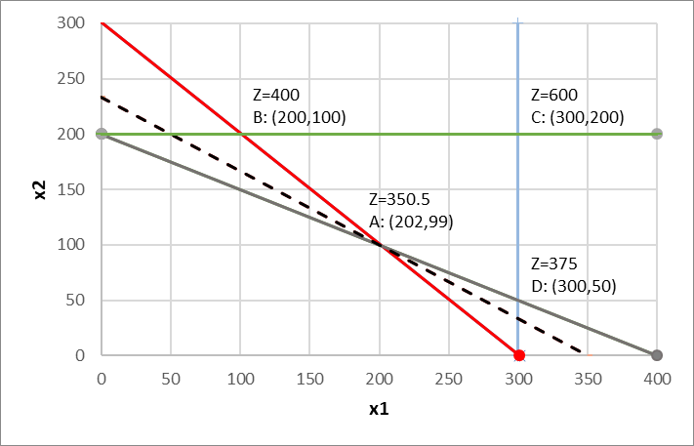
Graphical Sensitivity Analysis
Right-hand-side (RHS) values
Question: How does the objective function change with slight changes of the RHS?
The change on the RHS did not affect the slope of the constraint, just the feasible area
For example: keeping at least 301 workers employed instead of 300?
min Z = x₁ + 1.5 x₂
subject to
  x₁ + x₂ ≥ 301
  100x₁ + 200x₂ ≥ 40000
  x₁ ≤ 300
  x₂ ≤ 200
  x₁; x₂ ≥ 0
Z=401
B: (101,200)
The shadow price of a constraint measures the impact on the optimal objective value of a (slight) increase of the RHS.

Slide 50
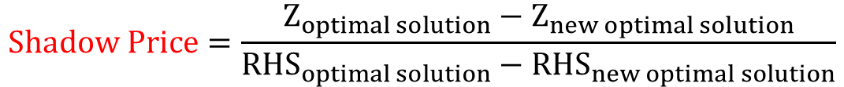

Graphical Sensitivity Analysis
Right-hand-side (RHS) values
Question: How does the objective function change with slight changes of the RHS?
$$Shadow Price=\frac{Z_{optimal solution}−Z_{new optimal solution}}{{RHS}_{optimal solution}−{RHS}_{new optimal solution}}$$
min Z = x₁ + 1.5 x₂
subject to
  x₁ + x₂ ≥ 300
  100x₁ + 200x₂ ≥ 40000
  x₁ ≤ 300
  x₂ ≤ 200
  x₁; x₂ ≥ 0
min Z = x₁ + 1.5 x₂
subject to
  x₁ + x₂ ≥ 301
  100x₁ + 200x₂ ≥ 40000
  x₁ ≤ 300
  x₂ ≤ 200
  x₁; x₂ ≥ 0
Z = 350
Z* = 350.5
$Shadow Price=\frac{350−350.5}{300−301}$ = 0.5
The shadow price of the red constraint is 0.5 units of BOD/day/worker
The pollution would increase by 0.5 =(350.5 – 350) units of BOD per day if a new worker were to be employed
for the same levels of revenue, max capacity for mechanical pulping and max capacity for chemical pulping
The shadow price of a constraint measures the impact on the optimal objective value of a (slight) increase of the RHS.

Slide 51

Graphical Sensitivity Analysis
Right-hand-side (RHS) values
Question: How does the objective function change with slight changes of the RHS?
min Z = x₁ + 1.5 x₂
subject to
  x₁ + x₂ ≥ 300
  x₁ + x₂ ≥ 301
  x₁ + x₂ ≥ 302
  …
  x₁ + x₂ ≥ 320
  100x₁ + 200x₂ ≥ 40000
  x₁ ≤ 300
  x₂ ≤ 200
  x₁; x₂ ≥ 0
$Shadow Price=\frac{350−350.5}{300−301}$ = 0.5
Z = 350
Z* = 350.5 350 + 1*0.5 = 350.5
Z* = 351 350 + 2*0.5 = 351
Z* = Z + (nr workers * shadow price)
Z* = 360 350 + 20*0.5 = 360

Slide 52
Graphical Sensitivity Analysis
Right-hand-side (RHS) values
Question: How does the objective function change with slight changes of the RHS?
The shadow price of a constraint measures the impact on the optimal objective value of a slight increase of the RHS
Question: does this hold true for any range of change in RHS?
No!
Let us see…
LPP deal with the allocation of resources and when constraints are in the ≤ form, the RHS represents the amount of resources available.
Consequently, it would be useful to know the contribution of each resource to the performance of Z

Slide 53
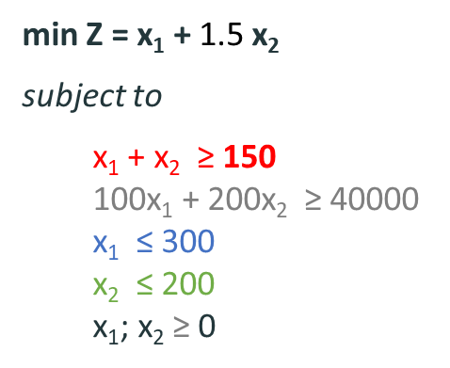


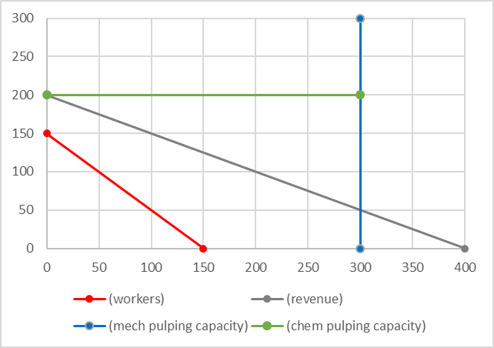
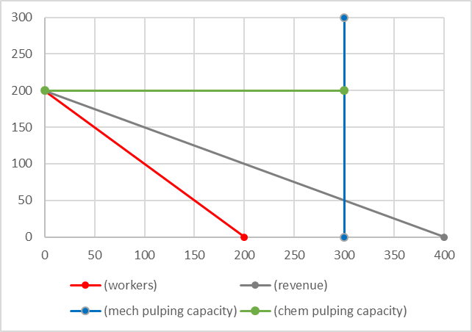
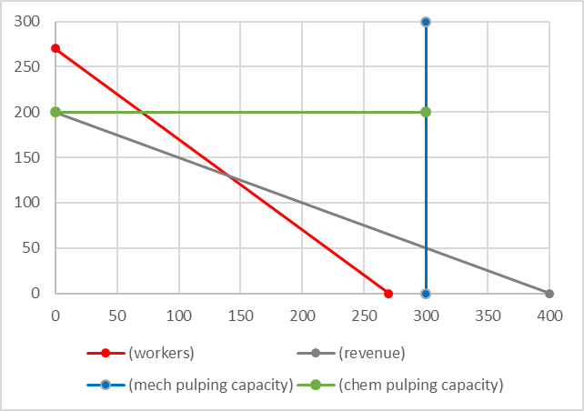
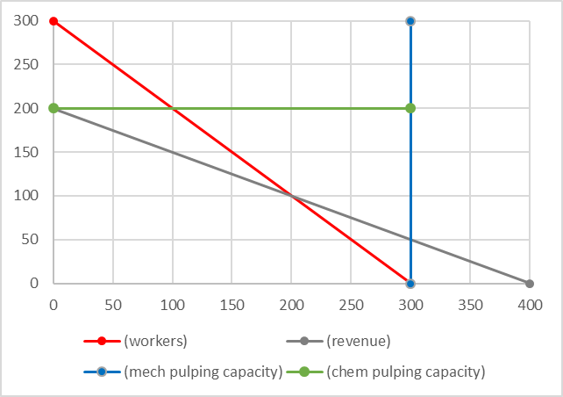

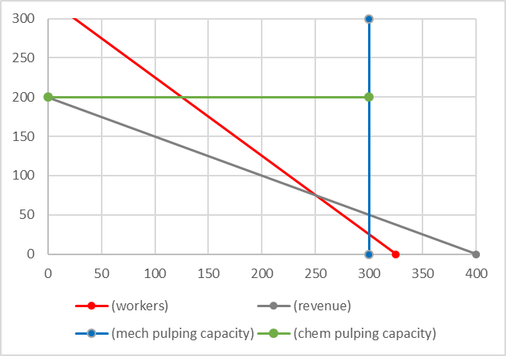
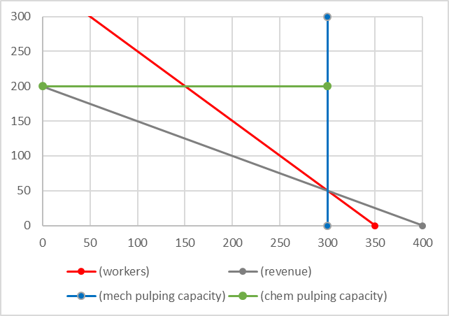
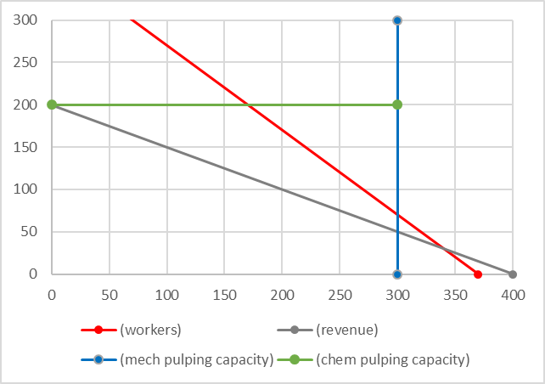



200
The 2 binding constraints still intercept within the feasible region
The 2 original binding constraints intercept outside the feasible region
  Violation of constraint
  x₁ ≥ 0
  Violation of the blue constraint
  x₁ ≤ 300
How to determine the range od feasibility?

Slide 54
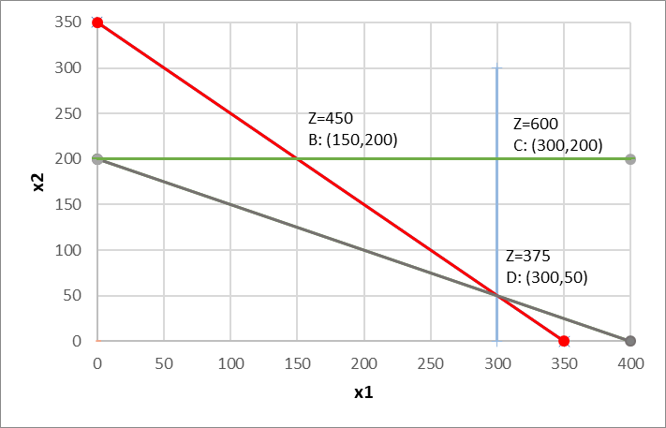
Graphical Sensitivity Analysis
Range of feasibility for the RHS concerning the shadow price
min Z = x₁ + 1.5 x₂
subject to
  x₁ + x₂ ≥ 300 + h
  100x₁ + 200x₂ ≥ 40000
  x₁ ≤ 300
  x₂ ≤ 200
  x₁; x₂ ≥ 0
We want to find the range of change of h that allows the shadow price to hold

Slide 55
Graphical Sensitivity Analysis
Range of feasibility for the RHS concerning the shadow price
min Z = x₁ + 1.5 x₂
subject to
  x₁ + x₂ ≥ 300 + h
  100x₁ + 200x₂ ≥ 40000
  x₁ ≤ 300
  x₂ ≤ 200
  x₁; x₂ ≥ 0
x1 + x2 = 300 +h
100x1 + 200x2 = 40000
x1 = 200+2h
x2 = 100-h
i =
ii =
x1 = 200 +2h
x1 = 300
h = 50
iii =
x2 = 100-h
x2 = 200
h = -100
We want to find the range of change of h that allows the shadow price to hold
-100 ≤ h ≤ 50
The number of workers can range from
300+50 = 350
300-100 =200

Slide 56
Graphical Sensitivity Analysis
Range of feasibility for the RHS concerning the shadow price
The shadow price of the red constraint is valid with an increase up to 350 workers.
min Z = x₁ + 1.5 x₂
subject to
  x₁ + x₂ ≥ 350
  100x₁ + 200x₂ ≥ 40000
  x₁ ≤ 300
  x₂ ≤ 200
  x₁; x₂ ≥ 0

Slide 57

Graphical Sensitivity Analysis
Range of feasibility for the RHS concerning the shadow price
The shadow price of the red constraint is valid with an increase up to 350 workers.
Shadow price = 0.5 => pollution increase of 50 x 0.5 = 25
Z _{optimal solution} = 350 + 25 = 375
Z= 350
A: (200,100)
Z _{optimal solution} = 350 RHS _{optimal solution} = 300
Z _{new optimal solution} = 375 RHS _{new optimal solution} = 350
$Shadow Price=\frac{350−375}{300−350}$ = $\frac{− 25}{− 50}$ = 0.5

Slide 58
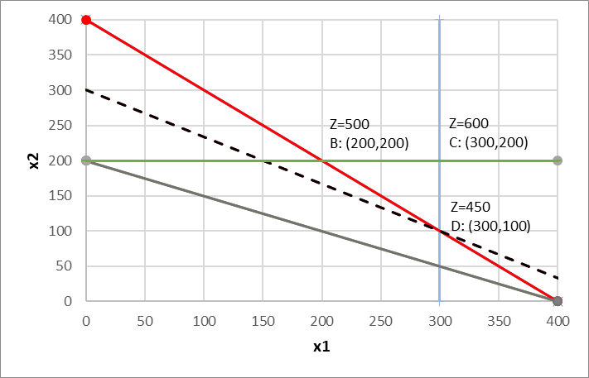
Graphical Sensitivity Analysis
Range of feasibility for the RHS concerning the shadow price
The shadow price of the red constraint is valid with an increase up to 350 workers.
min Z = x₁ + 1.5 x₂
subject to
  x₁ + x₂ ≥ 400
  100x₁ + 200x₂ ≥ 40000
  x₁ ≤ 300
  x₂ ≤ 200
  x₁; x₂ ≥ 0
Z= 350
A: (200,100)

Slide 59

Graphical Sensitivity Analysis
Range of feasibility for the RHS concerning the shadow price
The shadow price of the red constraint is valid with an increase up to 350 workers.
Shadow price = 0.5 => pollution increase of 100 x 0.5 = 50?
Z _{optimal solution} = 350 + 50 = 400
Z= 350
A: (200,100)
Z _{optimal solution} = 350 RHS _{optimal solution} = 300
Z _{new optimal solution} = 450 RHS _{new optimal solution} = 400
$Shadow Price=\frac{350−450}{300−400}$ = $\frac{− 100}{− 100}$ = 1 ≠ 0.5 !!!
For an increase of 100 workers (300 -> 400) the shadow price = 1

Slide 60
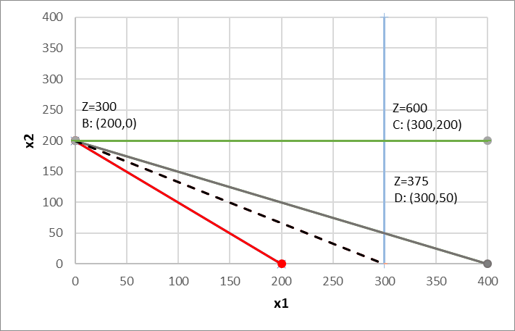
Graphical Sensitivity Analysis
Range of feasibility for the RHS concerning the shadow price
The shadow price of the red constraint is valid with a decrease down to 200 workers.
min Z = x₁ + 1.5 x₂
subject to
  x₁ + x₂ ≥ 200
  100x₁ + 200x₂ ≥ 40000
  x₁ ≤ 300
  x₂ ≤ 200
  x₁; x₂ ≥ 0

Slide 61

Graphical Sensitivity Analysis
Range of feasibility for the RHS concerning the shadow price
The shadow price of the red constraint is valid with a decrease down to 200 workers.
Shadow price = 0.5 => pollution decrease of 100 x 0.5 = 50
Z _{optimal solution} = 350 - 50 = 300
Z _{optimal solution} = 350 RHS _{optimal solution} = 300
Z _{new optimal solution} = 300 RHS _{new optimal solution} = 200
$Shadow Price=\frac{350−300}{300−200}$ = $\frac{ 50}{100}$ = 0.5

Slide 62
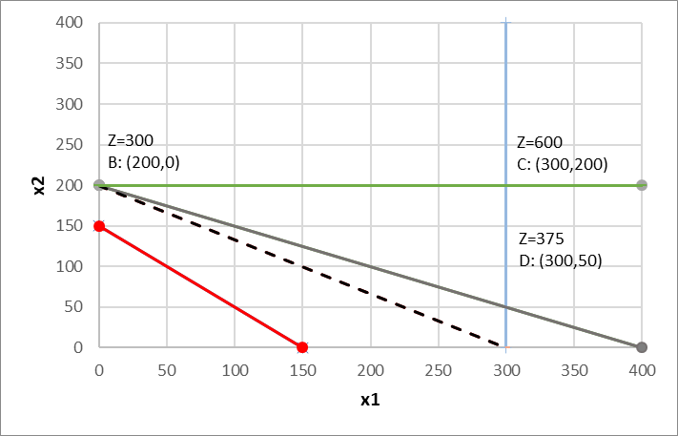
Graphical Sensitivity Analysis
Range of feasibility for the RHS concerning the shadow price
The shadow price of the red constraint is valid with a decrease down to 200 workers.
min Z = x₁ + 1.5 x₂
subject to
  x₁ + x₂ ≥ 150
  100x₁ + 200x₂ ≥ 40000
  x₁ ≤ 300
  x₂ ≤ 200
  x₁; x₂ ≥ 0

Slide 63

Graphical Sensitivity Analysis
Range of feasibility for the RHS concerning the shadow price
The shadow price of the red constraint is valid with a decrease down to 200 workers.
Shadow price = 0.5 => pollution decrease of 150 x 0.5 = 75
Z _{optimal solution} = 350 - 75 = 275
Z _{optimal solution} = 350 RHS _{optimal solution} = 300
Z _{new optimal solution} = 300 RHS _{new optimal solution} = 150
$Shadow Price=\frac{350−300}{300−150}$ = $\frac{ 50}{150}$ = 0.333 ≠ 0.5 !!!
For a decrease of 150 workers (300 -> 150) the shadow price = 0.333

Slide 64
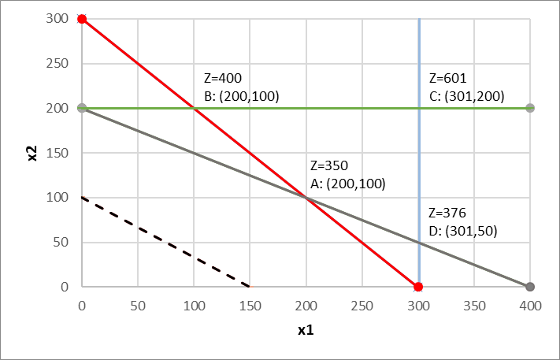
Graphical Sensitivity Analysis
Range of feasibility for the RHS concerning the shadow price
Let us look at a different constraint
For example: increasing the maximum capacity of mech pulping to 301 instead of 300?
min Z = x₁ + 1.5 x₂
subject to
  x₁ + x₂ ≥ 300
  100x₁ + 200x₂ ≥ 40000
  x₁ ≤ 300
  x₂ ≤ 200
  x₁; x₂ ≥ 0
min Z = x₁ + 1.5 x₂
subject to
  x₁ + x₂ ≥ 300
  100x₁ + 200x₂ ≥ 40000
  x₁ ≤ 301
  x₂ ≤ 200
  x₁; x₂ ≥ 0

Slide 65

Graphical Sensitivity Analysis
Range of feasibility for the RHS concerning the shadow price
Let us look at a different constraint
For example: increasing the maximum capacity of mech pulping to 301 instead of 300?
Z _{optimal solution} = 350 RHS _{optimal solution} = 300
Z _{new optimal solution} = 350 RHS _{new optimal solution} = 301
$Shadow Price=\frac{350−350}{300−301}$ = $\frac{ 0}{1}$ = 0
Increasing the maximum capacity of mech pulping in 1 unit does not affect pollution
shadow price = 0

Slide 66
Graphical Sensitivity Analysis
Range of feasibility for the RHS concerning the shadow price
Revisiting the concept
Binding and non-binding constraints
Z=375.25
D: (301,49.5)
Z _{optimal solution} = 350 RHS _{optimal solution} = 300
Z _{new optimal solution} = 350 RHS _{new optimal solution} = 301
$Shadow Price=\frac{350−350}{300−301}$ = $\frac{ 0}{1}$ = 0
Increasing the maximum capacity of mech pulping in 1 unit does not affect pollution
shadow price = 0

Slide 67
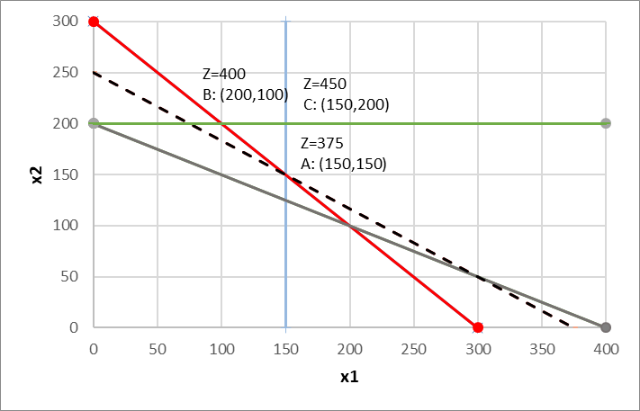

Graphical Sensitivity Analysis
Range of feasibility for the RHS concerning the shadow price
Let us look at a different constraint
For example: decreasing the maximum capacity of mech pulping to 150 instead of 300?
Z _{optimal solution} = 350 RHS _{optimal solution} = 300
Z _{new optimal solution} = 375 RHS _{new optimal solution} = 150
$Shadow Price=\frac{350−375}{300−150}$ = $\frac{ 25}{150}$ = 0.167
decreasing the maximum capacity of mech pulping in 150 units affects pollution
shadow price = 0.167

Slide 68
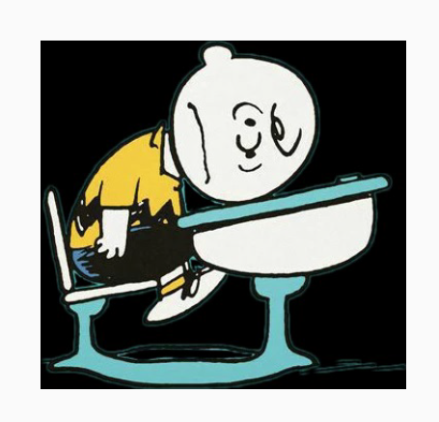

Slide 69
Graphical Sensitivity Analysis
Solve graphically and determine the range of optimality for the objective function coefficients (c1, c2) and for the RHS values of all constraints
max P = 4 x + 3 y
subject to
  5 x + 3 y ≤ 30 constraint 1
  2 x + 3 y ≤ 21 constraint 2
  x ≤ 4 constraint 3
  x ; y ≥ 0

Slide 70
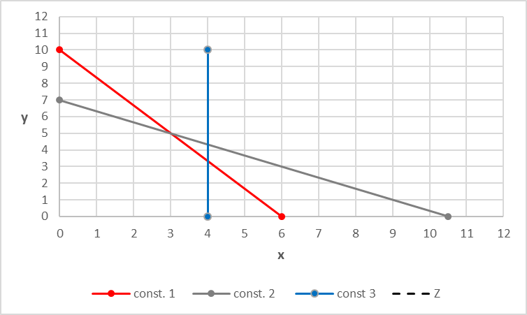
max Z = 4 x + 3 y
subject to:
  5 x + 3 y ≤ 30 constraint 1
  2 x + 3 y ≤ 21 constraint 2
  x ≤ 4 constraint 3
  x ; y ≥ 0
1) Graph the constraints
Determine the feasible region (FR):
  (x,y) = (0,0) 0 ≤ 30 , thus (0,0) in FR
  0 ≤ 21 , thus (0,0) in FR
  0 ≤ 4 , thus (0,0) in FR

Slide 71
max Z = 4 x + 3 y
subject to:
  5 x + 3 y ≤ 30 constraint 1
  2 x + 3 y ≤ 21 constraint 2
  x ≤ 4 constraint 3
  x ; y ≥ 0
A: (0,7)
B: (3,5)
C: (4,3.33)
E: (0,0)
D: (4,0)
1) Graph the constraints
Determine the feasible region (FR)
Find the corner points
Corner points A, D and E are easily to determine just by looking at the graph but let’s check B and C
5 x + 3 y = 30
2 x + 3 y = 21
x = (30 - 3 y)/5
2 (30 - 3 y)/5 + 3 y = 21
-
12 – 6/5 y + 15/5 y = 21
B:
-
9/5 y = 9
x = (30 - 15)/5
y = 5
x = 3
y = 5
B: (3, 5)
5 x + 3 y = 30
X = 4
20 + 3 y = 30
-
Y =10/3 ~ 3.33
X = 4
C:
C: (4, 3.33)

Slide 72
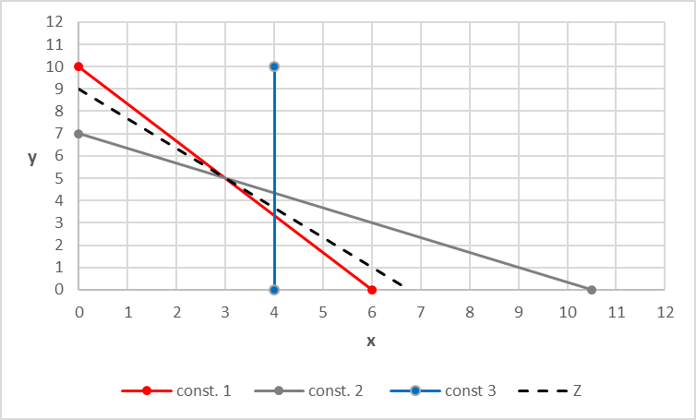
max Z = 4 x + 3 y
subject to:
  5 x + 3 y ≤ 30 constraint 1
  2 x + 3 y ≤ 21 constraint 2
  x ≤ 4 constraint 3
  x ; y ≥ 0
A: (0,7)
B: (3,5)
C: (4,3.33)
E: (0,0)
D: (4,0)
1) Graph the constraints
Determine the feasible region (FR)
Find the corner points
Find the optimal solution
Assign values to the objective function to draw the isolines in the graph (Z_10,…Z_27) until it touches the last corner point in the feasible region (because we are maximizing)
5) Confirm point B is the optimal solution

Slide 73
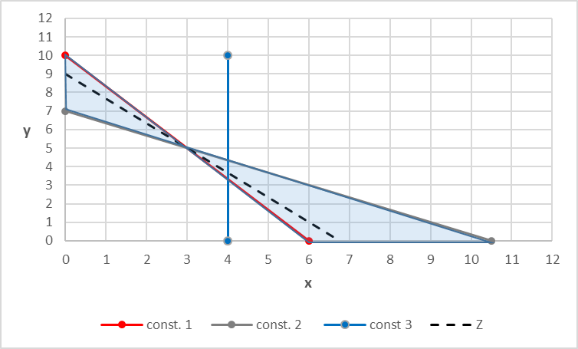
6) Find the range of variation of the objective function coefficients
A change in any of the objective function’s coefficients implies a change in its slope (-C1/C2)
However if this change lies within certain limits the optimal solution B (3,5) will not change (despite Z will), the limits are set by the 2 biding constraints (red and grey). If the slope of Z is maintained between the slopes of these constraints, the optimal solution will not change.
B: (3,5)
max Z = C1 x + C2 y slope: -C1/C2
max Z = 4 x + 3 y slope: -4/3
s.t.:
  5 x + 3 y ≤ 30 slope: -5/3
  2 x + 3 y ≤ 21 slope: -2/3
  Sort slopes ascendingly:
  -5/3 < -4/3 < -2/3
6.1) Range of variation of C1 (assuming C2 is maintained)
6.2) Range of variation of C2 (assuming C1 is maintained)
-5/3 ≤ -C1/3 ≤ -2/3
  (*-3): 5 ≥ C1 ≥2
  2 ≤ C1 ≤ 5
-5/3 ≤ -4/C2 ≤ -2/3
~2.4 ≤ C2 ≤ 6
  5/3 ≤ -4/C2
  C2 ≥ 12/5 ~ 2.4
  -4/C2 ≤ -2/3
  12/2 ≥ C2
  C2 ≤ 6

Slide 74
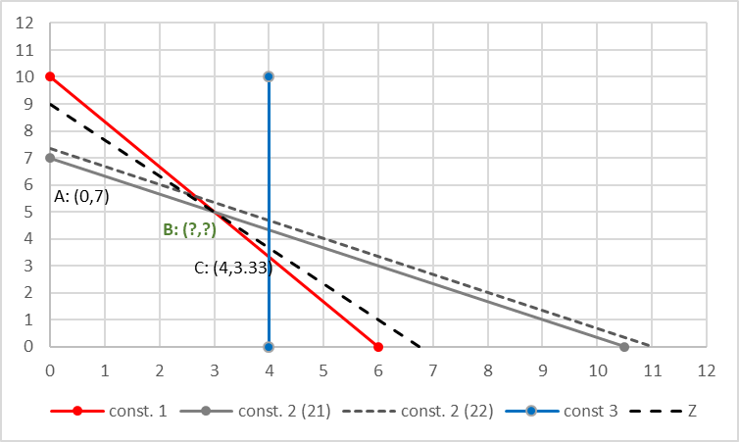
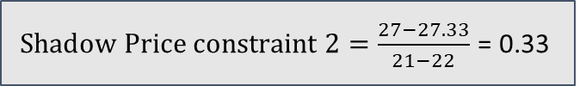
7) Find the shadow price of constraint 2 and its range of change
max Z = 4 x + 3 y
subject to:
  5 x + 3 y ≤ 30
  2 x + 3 y ≤ 21
  x ≤ 4
  x ; y ≥ 0
max Z = 4 x + 3 y
subject to:
  5 x + 3 y ≤ 30
  2 x + 3 y ≤ 22
  x ≤ 4
  x ; y ≥ 0
7.1) Find the shadow price for constraint 2
Z=27
5 x + 3 y = 30
2 x + 3 y = 22
x = (30 - 3 y)/5
2 (30 - 3 y)/5 + 3 y = 22
-
12 – 6/5 y + 15/5 y = 22
-
9/5 y = 10
x = (30 – 50/3)/5
y = 50/9
x = ((90 – 50)/3)/5
y = 50/9
B:
x ~ 2.66
y ~ 5.55
$Shadow Price constraint 2=\frac{27−27.33}{21−22}$ = 0.33

Slide 75
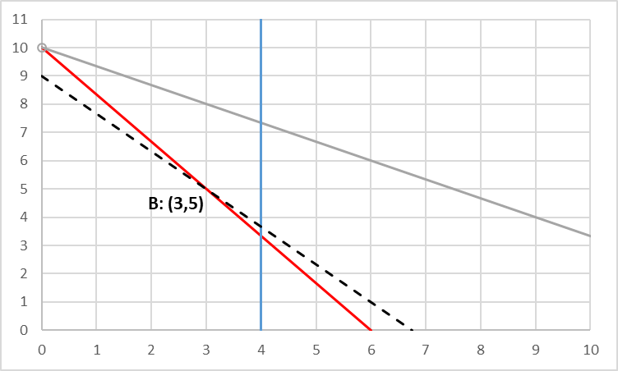
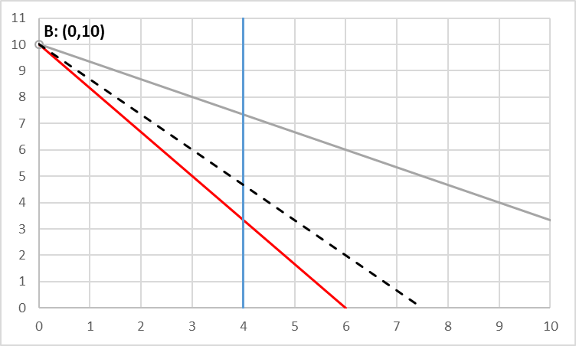
7.2) Find the range of change of constraint 2
max Z = 4 x + 3 y
subject to:
  5 x + 3 y ≤ 30
  2 x + 3 y ≤ 21+ h
  x ≤ 4
  x ; y ≥ 0
How much can I move (up and down) the grey constraint so that the optimal solution is still found in the interception of the grey and red constraint?
If I move up, where is the new corner point found?
In the interception of lines grey red and the non negativity constraint x>=0 !
Solve the system of equations:
5 x + 3 y = 30
2 x + 3 y = 21+h
x=0
B:

Slide 76
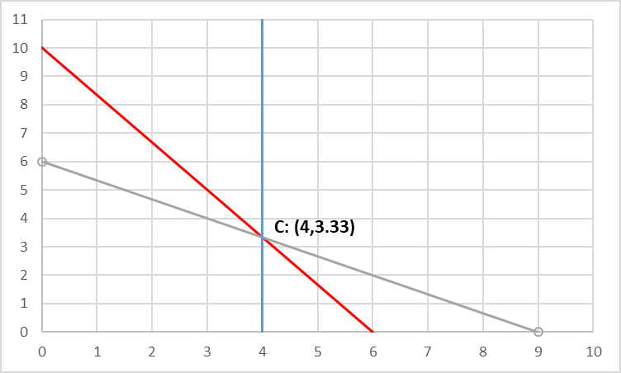
7.2) Find the range of change of constraint 2
max Z = 4 x + 3 y
subject to:
  5 x + 3 y ≤ 30
  2 x + 3 y ≤ 21+ h
  x ≤ 4
  x ; y ≥ 0
How much can I move (up and down) the grey constraint so that the optimal solution is still found in the interception of the grey and red constraint?
If I move down, where is the new corner point found?
In the interception of lines grey red and blue x<=4 !
Solve the system of equations:
5 x + 3 y = 30
2 x + 3 y = 21+h
x=4
B:

Slide 77
7.2) Find the range of change of constraint 2
max Z = 4 x + 3 y
subject to:
  5 x + 3 y ≤ 30
  2 x + 3 y ≤ 21+h
  x ≤ 4
  x ; y ≥ 0
Z=27
5 x + 3 y = 30
2 x + 3 y = 21+h
x=0
3 y = 30
3 y = 21+h
30 = 21+h
h = 9
allowable increase is 9
5 x + 3 y = 30
2 x + 3 y = 21+h
x = 4
20+3y = 30
8+3y= 21+h
3y = 30-20
3y= 21-8 +h
10 =30-20
3y= 13 +h
10= 13 +h
h= -3
allowable decrease is 3
9 ≤ h ≤ 3
For changes on the RHS of constraint 2 between 12 (21+9) and 18 (21-3), the impacts on Z can be calculated by multiplying the change (h) by the shadow price = 0.33
For h=-2 (RHS=19): Z* = 27 - 2*0.33 = 26.33
For h= 3 (RHS=24): Z* = 27 + 3*0.33 = 27.99

Slide 78
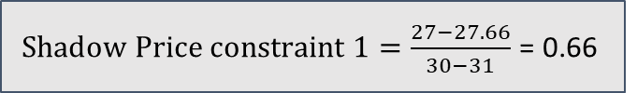
8) Find the shadow price of constraint 1 and its range of change
max Z = 4 x + 3 y
subject to:
  5 x + 3 y ≤ 30
  2 x + 3 y ≤ 21
  x ≤ 4
  x ; y ≥ 0
max Z = 4 x + 3 y
subject to:
  5 x + 3 y ≤ 31
  2 x + 3 y ≤ 21
  x ≤ 4
  x ; y ≥ 0
8.1) Find the shadow price for constraint 1
Z=27
5 x + 3 y = 31
2 x + 3 y = 21
x = (31 - 3 y)/5
2 (31 - 3 y)/5 + 3 y = 21
-
62/5 – 6/5 y + 15/5 y = 21
-
62/5+9/5 y = 21
-
9y = 105-62
x = 3.33
y = 4.77
B:
Z*=27.66
$Shadow Price constraint 1=\frac{27−27.66}{30−31}$ = 0.66

Slide 79
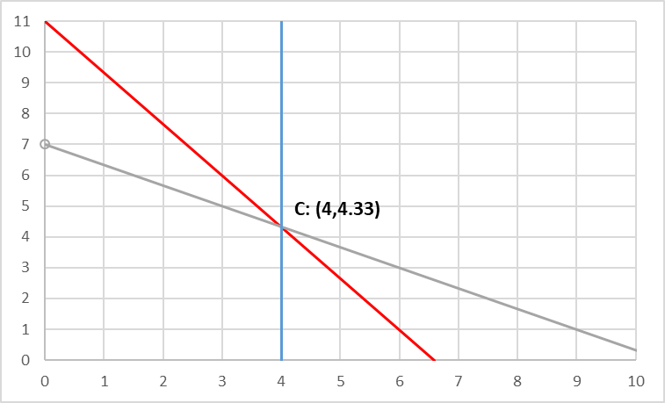
8.2) Find the range of change of constraint 1
max Z = 4 x + 3 y
subject to:
  5 x + 3 y ≤ 30 +h
  2 x + 3 y ≤ 21
  x ≤ 4
  x ; y ≥ 0
How much can I move (up and down) the red constraint so that the optimal solution is still found in the interception of the grey and red constraint?
If I move up, where is the new corner point found?
In the interception of lines grey red and x<=4 !
Solve the system of equations:
5 x + 3 y = 30 +h
2 x + 3 y = 21
x=4
h=3
allowable increase is 3
B:
(…)

Slide 80
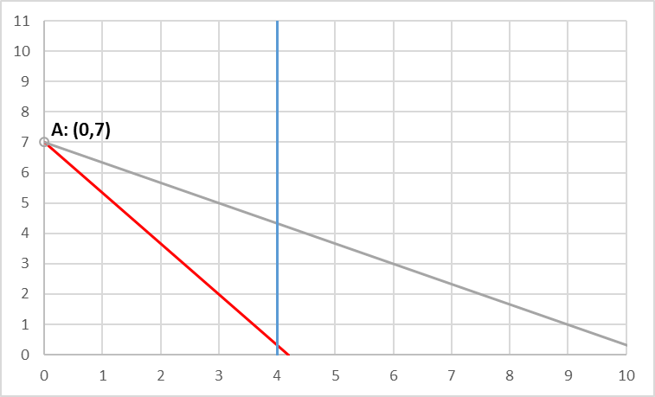
8.2) Find the range of change of constraint 1
max Z = 4 x + 3 y
subject to:
  5 x + 3 y ≤ 30 + h
  2 x + 3 y ≤ 21
  x ≤ 4
  x ; y ≥ 0
How much can I move (up and down) the red constraint so that the optimal solution is still found in the interception of the grey and red constraint?
If I move down, where is the new corner point found?
In the interception of lines grey red and red x>=0 !
Solve the system of equations:
allowable decrease is 9
5 x + 3 y = 30 +h
2 x + 3 y = 21
x=0
h=-9
B:
(…)

Slide 81

9) Find the shadow price of constraint 3 and its range of change
max Z = 4 x + 3 y
subject to:
  5 x + 3 y ≤ 30
  2 x + 3 y ≤ 21
  x ≤ 4
  x ; y ≥ 0
max Z = 4 x + 3 y
subject to:
  5 x + 3 y ≤ 30
  2 x + 3 y ≤ 21
  x ≤ 5
  x ; y ≥ 0
9.1) Find the shadow price for constraint 3
Z=27
B:
5 x + 3 y = 31
2 x + 3 y = 21
x=5
Z*=27
$Shadow Price constraint 3=\frac{27−27}{4−5}$ = 0

Slide 82

9.2) Find the range of change of constraint 3
max Z = 4 x + 3 y
subject to:
  5 x + 3 y ≤ 30
  2 x + 3 y ≤ 21
  x ≤ 4 + h
  x ; y ≥ 0
How much can I move (left and right) the blue constraint so that the optimal solution is still found in the interception of the grey and red constraint?
If I move right, where is the new corner point found?
In the exact same place!
I can move it indefinitely to the right and my optimal solution will still be corner point B (3,5)
allowable increase is +infinity

Slide 83

9.2) Find the range of change of constraint 3
max Z = 4 x + 3 y
subject to:
  5 x + 3 y ≤ 30
  2 x + 3 y ≤ 21
  x ≤ 4 + h
  x ; y ≥ 0
How much can I move (left and right) the blue constraint so that the optimal solution is still found in the interception of the grey and red constraint?
If I move left, where is the new corner point found?
In the exact same place!
I can move it indefinitely to the right and my optimal solution will still be corner point B (3,5)
allowable decrease is 1
5 x + 3 y = 30
2 x + 3 y = 21
x=4+ h
5 (4+h) + 3 y = 30
2 (4+h) + 3 y = 21
(…)
h=1
B:

Slide 85

A few remarks
B
C
P
D
The Poet’s problem:
A
E
max Z = 90 x1 + 120 x2 revenues (€/ year)
subject to 2x1 + 3x2 ≤ 180 time to manage (days/yr)
  x1 ≤ 40 area of pine (ha)
  x2 ≤ 50 area of hardwoods (ha)
  x1; x2 ≥ 0
C = ( 15, 50) Feasible solution, but not optimal
2*15+3*50 = 180 ≤ 180 (all used)
15 ≤ 40 (25 ha pine unused)
50 ≤ 50 (all used)
P= (15,20) Feasible solution, but not optimal
2*15+3*20 = 90 ≤ 180 (90 days unused)
15 ≤ 40 (25 ha pine unused)
20 ≤ 50 (30 ha hardwoods unused)
D= ( 40, 33.33) Optimal solution
2*40+3*33.33 = 179.99 ≤ 180 (all used)
40 ≤ 40 (all used)
33.33 ≤ 50 (16.67 ha hardwoods unused)
Q= (40,50) unfeasible solution
2*40+3*50 = 230 ≤ 180 (FALSE, Constraint violated! )
40 ≤ 40 (all used)
50 ≤ 50 (all used)

Slide 86
A few remarks
B’
B
C
D’
D’’
P
D
The Poet’s problem:
A
E
max Z = 90 x1 + 120 x2 revenues (€/ year)
subject to 2x1 + 3x2 ≤ 180 time to manage (days/yr)
  x1 ≤ 40 area of pine (ha)
  x2 ≤ 50 area of hardwoods (ha)
  x1; x2 ≥ 0
The constrains that intercept to originate the optimal solution represent the limiting resources (binding constraints)
These constraints represent the resources that we should try to change if we want to impact on the objective function
Would increasing the number of hectares available to plant hardwoods increase the revenue?
e.g. x2 ≤ 60
e.g. x1 ≤ 45
e.g. x1 ≤ 60
would change point B to B’ (0,60) => Z=5400, optimal solution holds at D (40,33.33) Z=7600
D= ( 40, 33.33) Optimal solution
2*40+3*33.33 = 179.99 ≤ 180 (all used)
40 ≤ 40 (all used)
33.33 ≤ 50 (16.67 ha hardwoods unused)
would change point D to D’ (45,30) => Z=7650
would change point D to D’’ (20,60) => Z=7800

