Slide 1
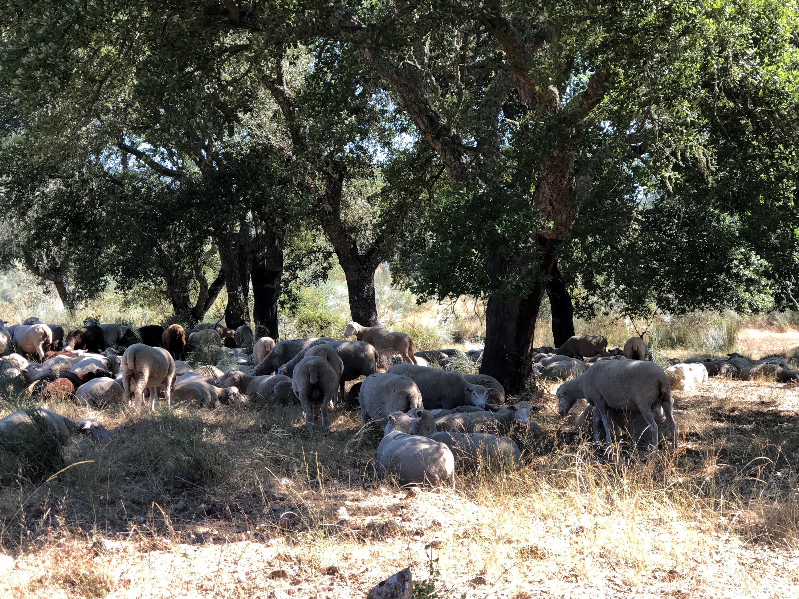
Diameter distribution models for even-aged stands
Margarida Tomé, Susana Barreiro
Instituto Superior de Agronomia
Universidade de Lisboa

Slide 2
Summary
Diameter distribution models for even-aged stands
  Typology of different models: whole-stand, diameter-distribution and individual tree models
  Introduction to diameter distributions
  Modelling diameter distributions
  PDF functions (Weibull and Johnson’s SB)
  The PBRAVO Model

Slide 3
MoDisPinaster summary
Author: Teresa Fonseca, professor UTAD
Model type: empirical growth and yield diameter distribution model
Data for model development: Data_Pinaster - large database on maritime pine that gathers data from temporary and permanent plots collected in northern Portugal, more precisely in stands located in the Tâmega Valley
Modules: growth, diameter distribution, wind risk and management (thinning and final harvest)
Maximum rotation: 65 years
Time-step: 5 years
Simulator: model “available” in CAPSIS platform

Slide 4
MoDisPinaster structure
Calculus module
Calculus module
S (eq.2)
Ga (eq.11)
h_tree
v_tree
w_tree
Diameter distribution module
d- dist (eq.9)
Nja (eq.10)
Growth module
hdom (eq.1)
G2 (eq.3)
PI (eq.4)
Poc (eq.5)
P (eq.6)
N2 (eq.7)
N2aj (eq.8)
S, Ga , hi_tree, vi_tree, Wi_tree
Growth module
Stand
t
Thin?
No
hdom, G2, N2, N2aj, PI, Poc, P
Diameter distribution model
yes
d- dist, Nja
t+i
Thinning module
Fw, SDI, …

Slide 5
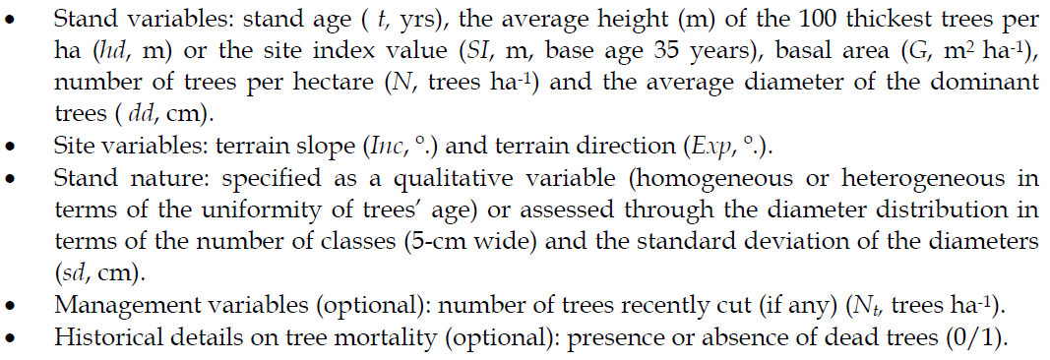
MoDisPinaster variables
Variables:
Other optional variables include: the median (d0.50, cm), the average ( d , cm) and the minimum value of the diameter distribution (dmin, cm).

Slide 6
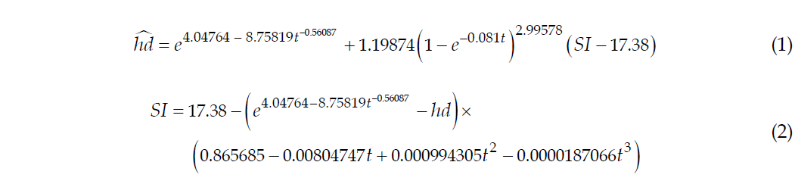
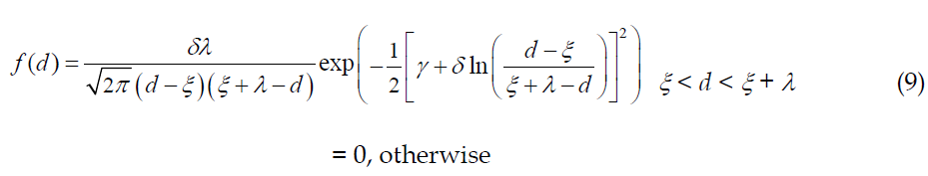
MoDisPinaster equations
Calculus module
Variable Qhdc and the dummies BF1 and BF2 are related to the stability of the stand;
variable RSb refers to the relative spacing before thinning with BRS being a dummy that makes a distinction of the average space conditions between the trees for the current stand;
dgMAX is the maximum values of tree diameter allowed according to the self-thinning line for the species
BAMPD is a dummy used to differentiate the stands according to the proximity to the self-thinning line
BMA is related to the occurrence of recent mortality
BSExp intrinsic risk of damage occurrence due to aspect
Diameter distribution module
h-diameter, tree volume, tree biomass equations to be applied to the average tree in the diameter class

Slide 7
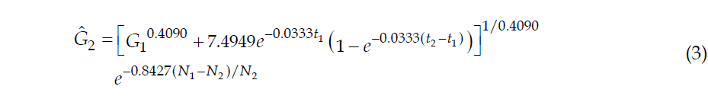
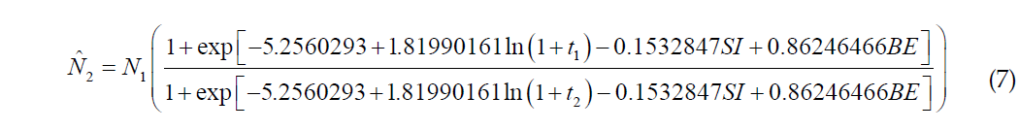
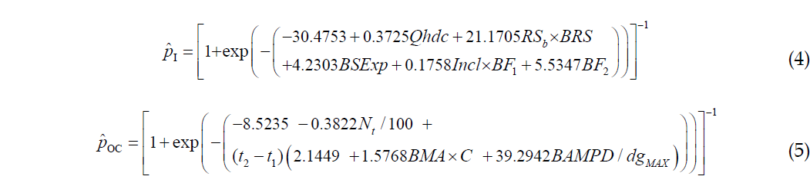
Growth module
MoDisPinaster equations
Variable Qhdc and the dummies BF1 and BF2 are related to the stability of the stand;
variable RSb refers to the relative spacing before thinning with BRS being a dummy that makes a distinction of the average space conditions between the trees for the current stand;
dgMAX is the maximum values of tree diameter allowed according to the self-thinning line for the species
BAMPD is a dummy used to differentiate the stands according to the proximity to the self-thinning line
BMA is related to the occurrence of recent mortality
BSExp intrinsic risk of damage occurrence due to aspect
Qhdc = 100 x (hd –1.30m)/dd
BF1 = 1 if Qhdc > 48; BF1 = 0, otherwise.
BF2 = 1 if 100 x hd/dd ≤ 54; BF2= 0, otherwise.
RS = 100 /( √N x hd)
RSb = 100 /(√ b N x hd
BRS = 1 if RS ≤ 0.20; BRS = 0, otherwise.
C = 1 for recent thinning; C = 0, otherwise.
dgMAX = 25 (1859/N)1/1.897
BAMPD = 1 if (dgMAX – dg) ≤ 17.5cm; BAMPD = 0, otherwise.
BMA = 1 for recent mortality; BMA = 0, otherwise.
BSExp = 1 if direction (º) belongs to ]60, 120]  ]180, 240]  ]300, 360]; BSExp = 0,

Slide 8
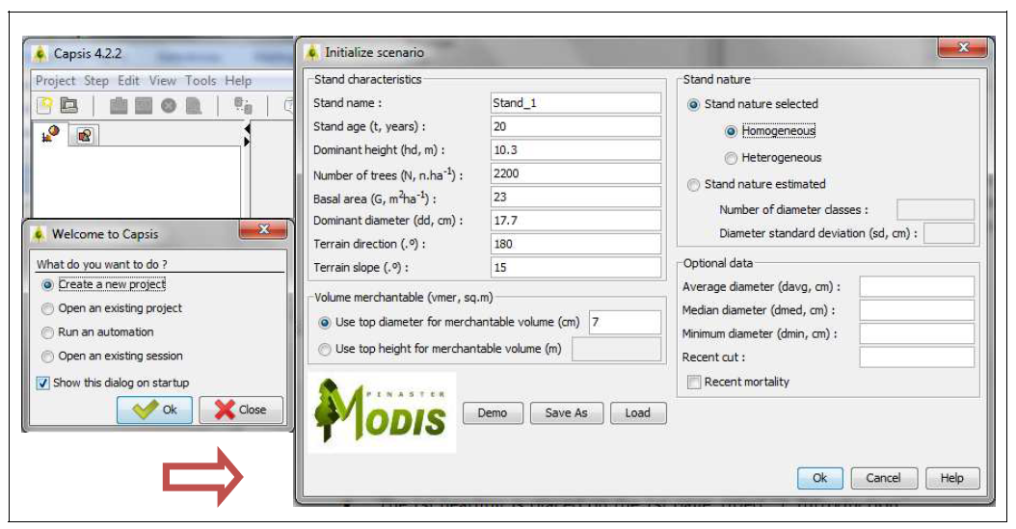
MoDisPinaster interface
The variables that characterize the stand for the base year of simulation: age (t, yrs), dominant height (hdom, m), number of trees (N, trees ha-1), and basal area (G, m2 ha-1), are updated on an annual basis until the end of the growth period, using the set of equations 1-8.). Site variables are also provided terrain slope (Inc, º.) and terrain direction (Exp, º.).
By default, the stand is assumed to be of homogeneous structure (even-aged).
Other optional variables include: the median (d0.50, cm), the average ( d , cm) and the minimum value of the diameter distribution (dmin, cm).
A merchantability limit of a top diameter of 7 cm is specified for volume estimates.

Slide 9
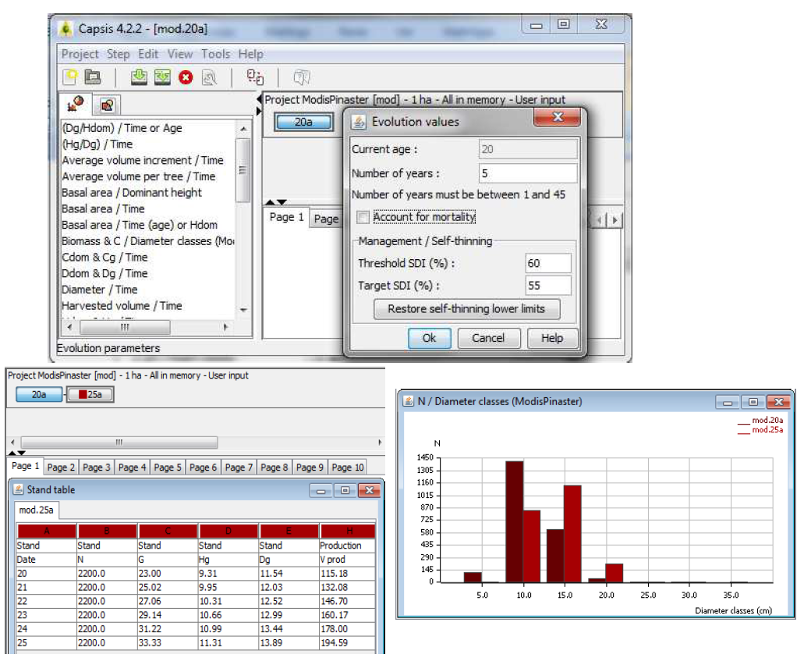
MoDisPinaster interface
An automatic management procedure, based on the self-thinning theory is available in the Management/Self-thinning dialog. By default, the limits specified for the Stand Density Index (SDI, Reineke, are with respect to a stand that grows under high values of density.
The occurrence of mortality by competition is expected whenever SDI reaches the threshold of 60%. The limits can be modified by the user, according to pre-determined management guidelines.
Outputs refer to a stand table for the 5-year evolution period and to the number of trees by diameter class, at the initial stand age (20 yrs) and at the end of the simulation (25 yrs). The diameter distribution is presented for each simulation year

Slide 10
MoDisPinaster interface
Thinnings
The majority of the maritime pine stands in Portugal are even-aged and are managed according to a thinning regime.
Density regulation is usually based on the Wilson factor. A typical value of Fw = 0.23 has been assumed in the maritime pine stands of the Tâmega Valley Region.
The rotation age is defined by the age at which occurs the
maximum annual increment of tree stem volume. Depending on site quality, stands attain their absolute explorability term for the volume variable when the stand reaches 35 (high quality) years to 45 (low quality).
In the area studied it is usual to set the lowest limit of stand age to harvest to 40-45 years.

Slide 11
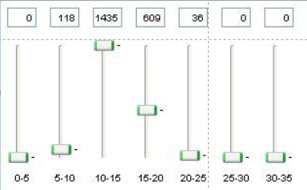
MoDisPinaster interface
Thinnings
There are 4 options for thinning simulation:
  Wilson factor
  Number of trees
  Stand density Index (SDI)
  Thinning diagram (Cut trees by action on an interactive diameter distribution histogram)
In each of these cases, the selection of the trees to remove from the stand is made according to the algorithm of Alder, which assures a probability of a tree to survive to cut being proportional to the tree´s size.
Alternatively, the user can perform a selective thinning using the Capsis interactive diagram. With this option, the trees are cut by action on an interactive diameter distribution diagram.

