Slide 1
Multiple Objective Linear Programming
Decision Analysis and Optimization
Susana Barreiro
6 -15 May 2025

Slide 2
Content
Single- versus multi-objective problems
Decision making and multiple objectives
Multi-objective linear programming
  Goal programming
  Classical methods - conversion to single objective problems
    - Preemptive optimization
    - Weighted sums
  True multi-objective linear programming
    - The optimality and the Pareto frontier concepts
    - Weighted sums
    - Evolutionary Multi-objective Optimization (EMO) Algorithms

Slide 3
Single- versus multi-objective problems

Slide 4
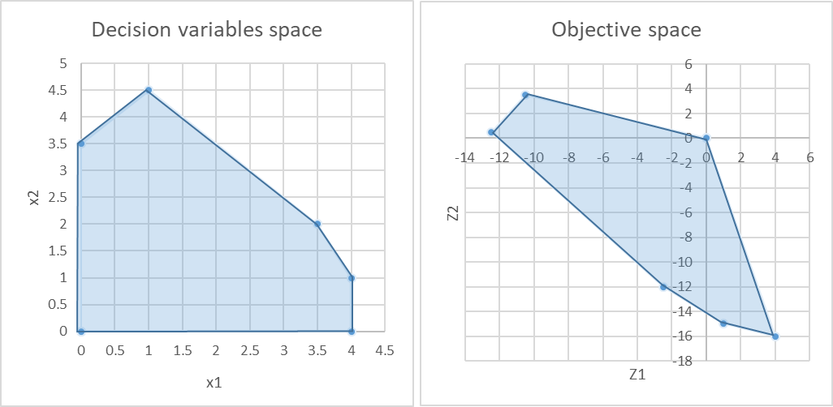
Multi-objective Linear problems
Single-objective problems
The goal is to find the (single) feasible solution that optimizes the objective function ( max Z₁ = x₁ – 3x₂ )
Even when alternative solutions exist, these provide the same objective function value
C
B
D
E
A
F

Slide 5
Multi-objective Linear problems
Multi-objective problems
Can we maximize these two objectives at the same time?
max Z₁ = x₁ – 3x₂ & max Z₂ = -4x₁ + x₂
we have a set of solutions reflecting different amounts of satisfaction of two different objectives (Z₁ and Z₂)
Brings us to the discussion of decision making
C
B
D
E
A
F

Slide 6
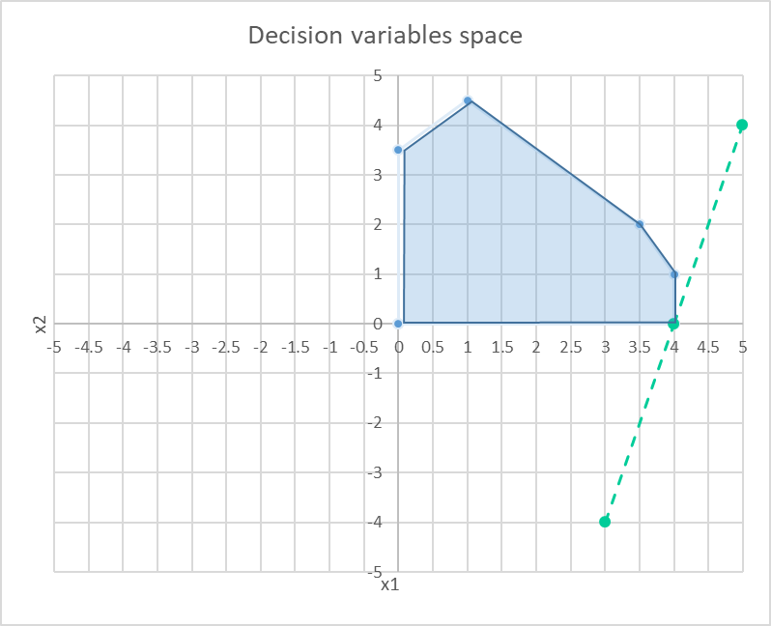
MOLP – a few notes
Can we maximize these two objectives at the same time?
max Z₁ = x₁ – 3x₂ & max Z₂ = -4x₁ + x₂
we have a set of solutions reflecting different amounts of satisfaction of two different objectives (Z₁ and Z₂)
In which direction does the line have to move to increase Z₂?
Smaller X₁ values and higher X₂ values increase Z₂
Z₂ minimum
What is the last point of the feasible region to be touched?

Slide 7
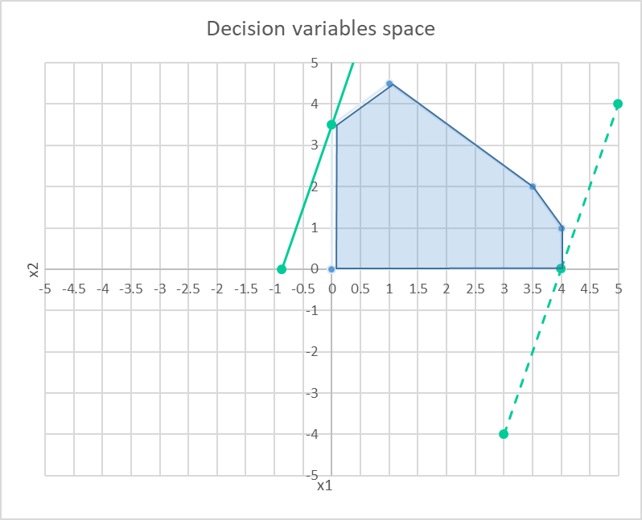
MOLP – a few notes
Can we maximize these two objectives at the same time?
max Z₁ = x₁ – 3x₂ & max Z₂ = -4x₁ + x₂
we have a set of solutions reflecting different amounts of satisfaction of two different objectives (Z₁ and Z₂)
In which direction does the line have to move to increase Z2?
Smaller X₁ values and higher X₂ values increase Z₂
Z₂ maximum
What is the last point of the feasible region to be touched?
B = (0 , 3.5)

Slide 8
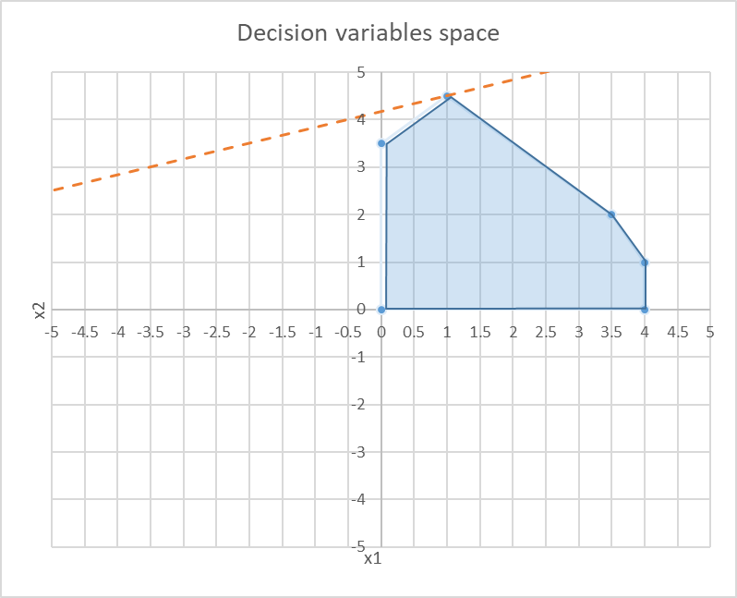
MOLP – a few notes
Can we maximize these two objectives at the same time?
max Z₁ = x₁ – 3x₂ & max Z₂ = -4x₁ + x₂
we have a set of solutions reflecting different amounts of satisfaction of two different objectives (Z₁ and Z₂)
In which direction does the line have to move to increase Z₁?
Higher X₁ values and smaller X₂ values increase Z₁
Z₁ minimum
What is the last point of the feasible region to be touched?

Slide 9
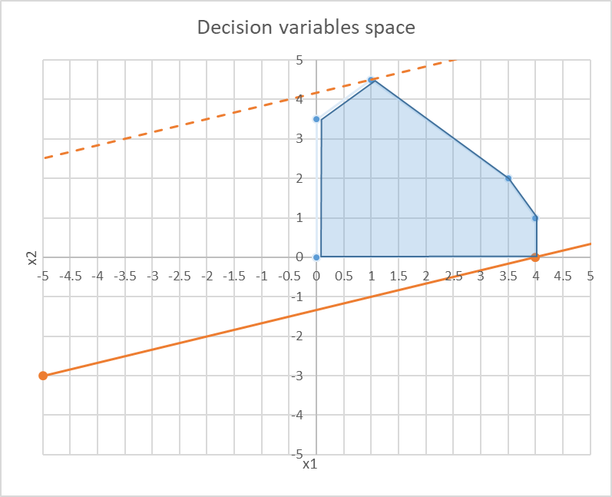
MOLP – a few notes
Can we maximize these two objectives at the same time?
max Z₁ = x₁ – 3x₂ & max Z₂ = -4x₁ + x₂
we have a set of solutions reflecting different amounts of satisfaction of two different objectives (Z₁ and Z₂)
In which direction does the line have to move to increase Z₁?
Higher X₁ values and smaller X₂ values increase Z₁
Z₁ maximum
What is the last point of the feasible region to be touched?
F = ( 4, 0)

Slide 10
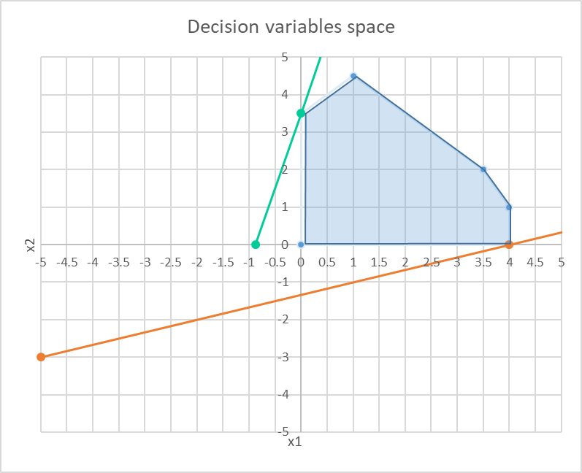
Multi-objective Linear problems
Can we maximize these two objectives at the same time?
max Z₁ = x₁ – 3x₂ & max Z₂ = -4x₁ + x₂
we have a set of solutions reflecting different amounts of satisfaction of two different objectives (Z₁ and Z₂)
Brings us to the discussion of decision making

Slide 11
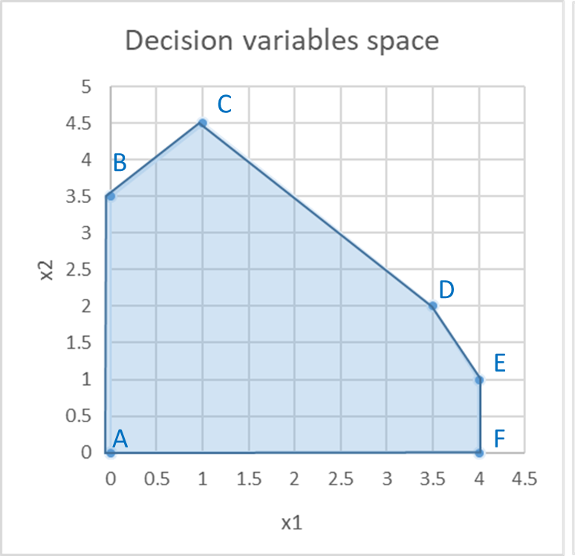
Multi-objective Linear problems
Multi-objective problems
Can we maximize these two objectives at the same time?
max Z₁ = x₁ – 3x₂ & max Z₂ = -4x₁ + x₂
we have a set of solutions reflecting different amounts of satisfaction of two different objectives (Z₁ and Z₂)
Brings us to the discussion of decision making
B
C
A
D
E
F

Slide 12
Multi-objective Linear problems
In many situations more than one objective is generally important
Multi-objective programming deals with:
  optimization problems with 2 or more objectives
  problem formulation differs in the expression of the objective function(s)
  the evaluation of solutions is significantly different: instead of seeking an optimal or best overall solution, the goal is to quantify the degree of conflict (trade-off)
Several optimization techniques have been developed to capture explicitly the trade-offs that may exist between conflicting, and possibly noncommensurate, objectives

Slide 13
Multi-objective Linear problems
For conflicting objectives the optimality concept may be inappropriate
So, what does optimal mean in this case?
A new concept that can measure solutions against multiple, conflicting and even noncommensurate objectives is required: the non-inferiority concept
Dominance (mathematical programmers), Efficiency (statisticians and economists)
Pareto optimality (welfare economists)
A solution is non-inferior if there exists no other feasible solution with better performance with respect to any objective without having worse performance for at least one other objective

Slide 14
Multi-objective Linear problems
Multi-objective problems
we seek to find the set of solutions for which we can demonstrate that no better solution exists ( max Z₁ ; max Z₂ )
This set of solutions is referred to as non-inferior or non-dominated solutions

Slide 15
Multi-objective Linear problems
Multi-objective problems
we seek to find the set of solutions for which we can demonstrate that no better solution exists
This set of solutions is referred to as non-inferior or non-dominated solutions
Efficient frontier or Pareto Front
B
( max Z₁ ; max Z₂ )
C
A
D
E
F

Slide 16
Multi-objective Linear problems
Multi-objective problems
Efficient frontier or Pareto Front
Classical approaches for generating the Pareto Front
  Convert to single objective problem, which delivers one efficient point in the Pareto front (one optimal solution)
  run it several times
B
C
A
D
E
F

Slide 17
Decision making and multiple objectives

Slide 18

Multiple Objective Decision Analysis
Decision Making
Takes place under multiple criteria. All the rest is: analysis, measurement and search.
Measurement and search is sufficient for finding the heaviest apple.
This is not a problem of decision making or optimization, but merely a technical challenge.
No value judgments, no trade-offs and no decisions go into single-criterion problems
Consider a basket of apples, and that weight is our single criterion. How do we proceed to find (identify, choose, select) the heaviest apple?
    We measure all apples, then we search the one with the highest weight

Slide 19


Multiple Objective Decision Analysis
Decision Making
Takes place under multiple criteria. All the rest is: analysis, measurement and search.
But this time, the function of measurement and search is not sufficient.
We have two different apples and our criteria are ‘conflicting’
Which apple do we choose?
Now, we must go beyond measurement and search and decide
Consider the same basket of apples, but now we wish to find the heaviest and the sweetest apple. Our criteria are now: weight and sweetness.
We use the same procedures of measurement and search and identify the heaviest (as before) and then the sweetest apple.

Slide 20
Multiple Objective Decision Analysis
Decision Making
Takes place under multiple criteria. But are all multiple criteria decision problems?
This particular apple would be preferred by all decision makers aiming to maximize both criteria.
Measurement and search would safely identify such an apple making it sufficient even under multiple criteria
Suppose we could look outside the basket and add an additional apple
And that this is both the heaviest and the sweetest in the basket.

Slide 21
Multiple Objective Decision Analysis
Decision Making
Thinking “outside the basket” is the key to effective Decision Making.
Decision making: is a function beyond measurement and search, aimed at managing, resolving or dissolving the conflict of trade-offs.
In this basket there are no trade-offs
we have an “ideal” apple dominating the entire basket - an obvious choice of every rational decision maker

Slide 22
Multiple Objective Decision Analysis
Decision Making Challenges
Existence of multiple conflicting objectives (e.g. car: comfort vs price; house: square footage vs price)
Difficulty in identifying good alternatives (e.g. firing one-third of your employees, reducing everyone’s pay)
Existence of intangibles ie, difficult-to-measure (e.g. consumer satisfaction, employee morale, recreation value)
Existence Long time horizons where the consequences of decisions that must be made today, will not be known for years/decades (e.g forest management and planning)
Interdisciplinary substance of decisions and/or having multiple decision makers require information from several “areas of expertise”, (e.g. forest owners, forest managers, public laws, funding schemes)
Uncertainty and risk: not being able to precisely predict the future, raises questions (one can try to use historical data, expert judgments, simulations to deal with uncertainty and risk)
Being able to quantify trade-offs: expressing the value trade-offs among the multiple objectives

Slide 23
Multiple Objective Decision Analysis
Multiple Objective Decision Analysis (MODA) is an operations research technique for evaluating a decision under multiple, sometimes competing and conflicting objectives or criteria.
Multi-objective optimization leads to a set of optimal solutions (known as Pareto-optimal solutions) since no solution can be considered better than any other regarding all the objectives
MODA provides a process that systematically identifies alternatives and the decision maker’s objectives that serves as the measuring device for selecting the preferred alternative given the decision space.
Decision makers try to balance multiple objectives (e.g., cost, performance, reliability) none of which is obviously the best

Slide 24
Multiple Objective Decision Analysis
Decision Making
Its quality depends on:
  the quality of the underlying process (but not the inverse)
  the problem formulation
  the quality and nature of available decision alternatives (it is the configuration of the feasible set of available alternatives
Decision maker must choose from a set of alternative solutions
Analyst
must describe as accurate as possible the range of choices and the trade-offs among objectives

Slide 25
Multi-objective linear programming
  Goal programming
  Classical methods - conversion to single objective problems
  True multi-objective linear programming

Slide 26
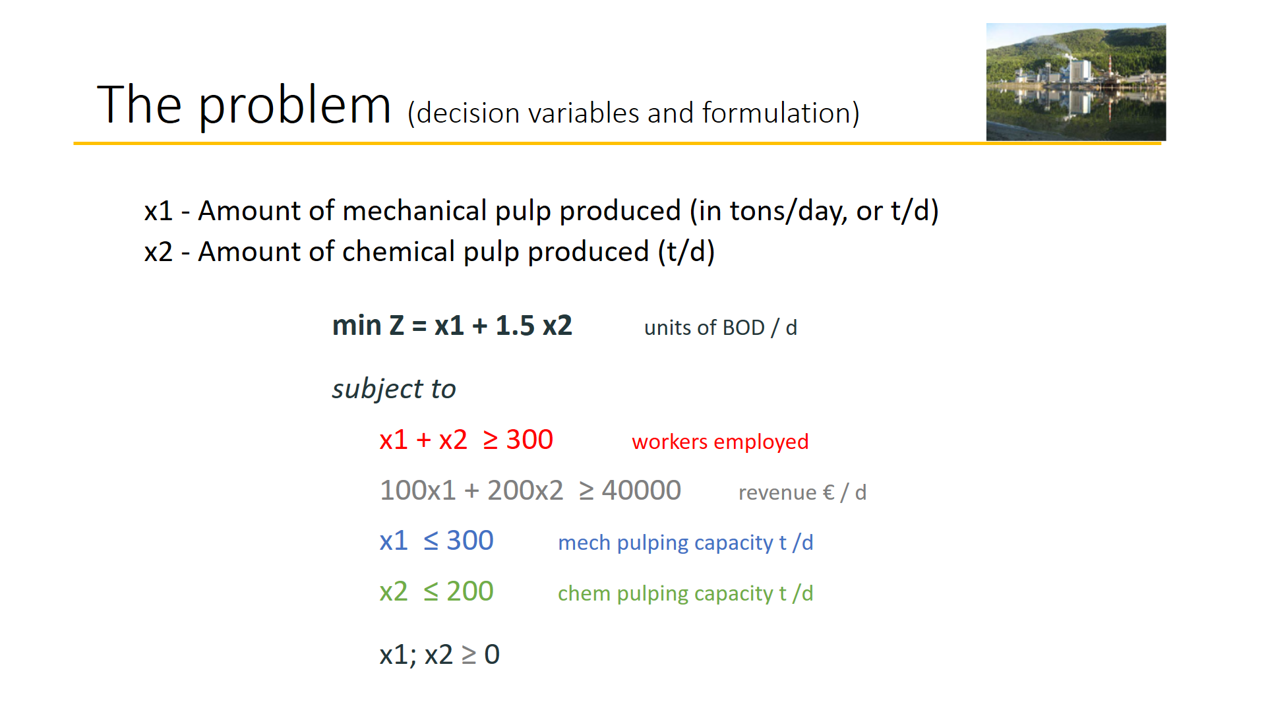
Multi-objective linear problems
A constraint that imposes strict thresholds can be unrealistic and may also lead to infeasible solutions
a slight relaxation might
allow for a feasible solution
Representing goals by standard linear programming
constraints is somewhat rigid
Goals

Slide 27
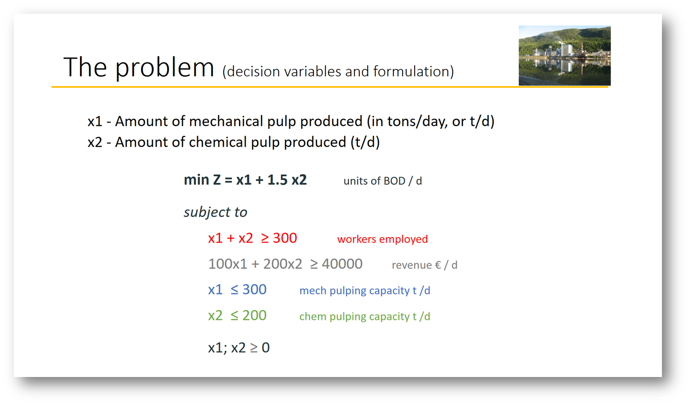
Multi-objective linear problems
Goal programming
Corrects these limitations and allows treating several objectives simultaneously treating them in the same way (eventually giving them different weights)
Objective function: Min Sum deviations from goals

Slide 28
Multi-objective linear problems
Goal programming
Example:
Define target levels of each objective rather than max or min the objective functions
  Suppose the goal for obj i is gi:
  obj₁ > g₁ ; obj₂ > g_{2 ; …;} obj_{n} > g_{n}
  These goals are treated as soft constraints (ie these can be violated)
  Obj = min (w₁ |obj₁ - g₁|+ w₂ |obj₂ - g₂|+ … + w_{n} |obj_{n} - g_{n}|
  Maybe we can’t satisfy all goals, but we want to capture how much we can satisfy (find the deviations). The optimal solution to this problem is not necessarily an efficient point in the original model
max Z₁ = x₁
max Z₂ = -4x₁ + x₂
x₁ > g₁
-4x₁ + x₂ < g₂
To find the deviations, which can be + or -, we use:
  y₁ = y₁⁺ - y₁⁻
  y₂ = y₂⁺ - y₂⁻
  where y_{i}⁺ ≥ 0, y_{i}⁻ ≥ 0
Y₁ = x₁ - g₁
Y₂ = -4x₁ + x₂ - g₂
x₁ - (y₁⁺ - y₁⁻) = g₁
-4x₁ + x₂ - (y₂⁺ - y₂⁻) = g₂
Set penalty weights for missing the goals. Assume 5 for falling under g₁ and 2 for falling above g₂
min Z₃ = 5 y₁⁻ + 2 y₂⁺
Obj = min (w₁ |obj₁ - g₁|+ w₂ |obj₂ - g₂|+ … + w_{n} |obj_{n} - g_{n}|

Slide 29
Multi-objective linear problems
Multi-objective optimization problems with a number of equality and inequality constraints can be formulated as:
Minimize / Maximize f_{i} (x) i = 1,…, N_{obj} – number of objective functions
Subject to:
a set of constraints
To simplify the solution process, in optimization problems with a number of objective functions, additional objective functions are usually handled as constraints
HOWEVER, the final solutions can be satisfying those constraints they cannot be called optimal with respect to all the objective functions.

Slide 30
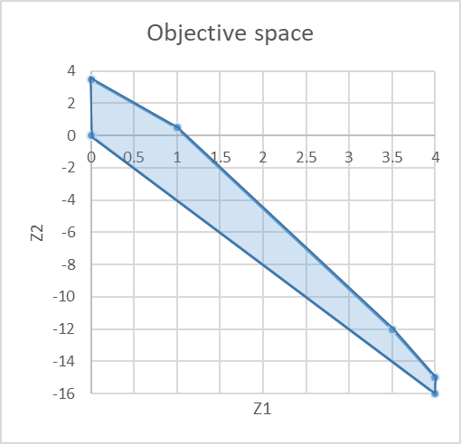
Multi-objective linear problems
Classical methods - Preemptive Optimization
Example:
Perform optimization by considering one objective at a time, based on priorities:
STAGE1:
  optimize the 1st objective (most important)
  obtain an optimal solution
  transform this objective into a constraint
STAGE2:
  optimize the 2nd objective (2nd most important)
  obtain an optimal solution
  …continue until all objectives have been considered
If an optimal solution is obtained at each stage => the final solution is an efficient point of the original multi-objective model
max Z₁ = x₁
max Z₂ = -4x₁ + x₂
B
C
A
D
E
F

Slide 31
Multi-objective linear problems
Classical methods - Preemptive Optimization
Example:
Perform optimization by considering one objective at a time, based on priorities:
STAGE1:
  Assume Z₁ is 1st priority
  obtain an optimal solution (all points along the segment)
  transform this objective into a constraint
STAGE2:
  optimize Z₂ (2nd priority)
  Add x₁ = 4 as constraint
  obtain an optimal solution: (4, -15)
  …continue until all objectives have been considered
If an optimal solution is obtained at each stage => the final solution is an efficient point of the original multi-objective model
max Z₁ = x₁
max Z₂ = -4x₁ + x₂
B
C
A
C
B
D
D
E
E
A
F
F

Slide 32
Multi-objective linear problems
Classical methods - Weighted Sum
Example:
Convert multiple objectives into one single objective using weights and summation:
  Determine the importance of each objective function assigning it a weight (w)
  Add up all functions:
  min Z = ( w₁ z₁ + w₂ z₂ +…+ w_{n} z_{n} )
An optimal solution to this problem is the final solution is an efficient point of the original multi-objective model
max Z₁ = x₁
max Z₂ = -4x₁ + x₂
B
C
A
D
E
F

Slide 33
Multi-objective linear problems
Classical methods - Weighted Sum
Example:
Convert multiple objectives into one single objective using weights and summation:
  Assume z₁ is 3 times as important as z₂ (W₁ = 3, W₂ = 1)
  Add up all functions:
  max Z₃ = ( 3x₁ - 4x₁ + x₂ )
  = ( -x₁ + x₂ )
  Optimal solution for the weighted sum 3 Z₁ + Z₂ are the points along the segment BC
max Z₁ = x₁
max Z₂ = -4x₁ + x₂
B
C
A
C
B
D
D
E
E
A
F
F

Slide 34
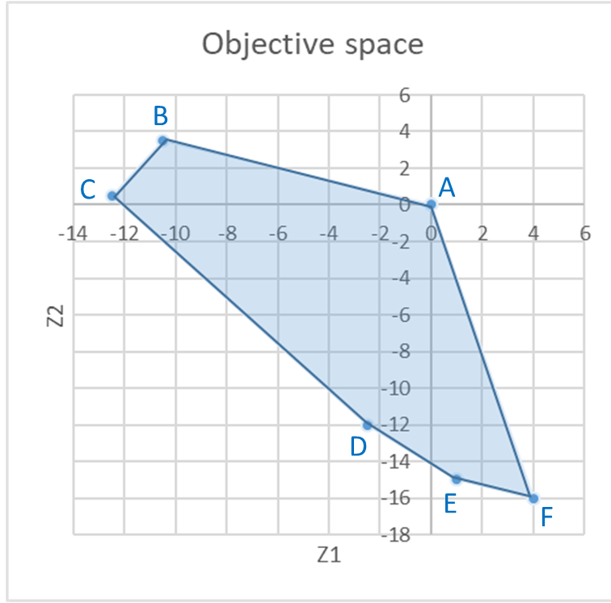
Multi-objective linear problems
Classical approaches (most common is weighted sum)
Estimate relative importance vector
w₁, w₂, …, w_{n}
Single objective optimization problem
Min Z = w₁ f₁ + w₂ f₂ + …+ w_{n} f_{n}
s.t.: constraints
Multi-objective
min f₁, f₂, …, f_{n}
s.t.: constraints
High Level info
Decision making phase
Single objective optimizer
(Simplex, solver, etc)
Optimization phase
For a 2 objectives problem Min Z = w₁ f₁ + w₂ f₂ the slope of this line (-w₁/w₂) (parameterized approach W_{i} as the parameters)
By varying the weights we can move along the objective space from one optimization to the next (generating different points along the Pareto front)
However,
    1) doesn't return an optimal solution
    2) requires the weights
    3)may lead to non-uniform Pareto optimal solutions

Slide 35
Multi-objective Linear problems
Difficulties with the most classical approaches
Need to run single optimization many times to build the Pareto front
Expect a lot of problem knowledge (convex or not)
  - Can’t guarantee that we’ll get all the points in the convex region
  - How to assign weights? What weights to assign?
Aggravated for complex problems (many objective functions and several variables)

Slide 36
Multi-objective linear problems
Ideal approach
Multi-objective
min f₁, f₂, …, f_{n}
s.t.: constraints
Ideal multi- objective optimizer
Multiple tradeoff solutions found
High Level info
Optimization phase
Decision making phase
STEP1:
  find a set of Pareto optimal solutions
STEP2:
  choose 1 from the set of optimal solution (unlike classical methods where we first decide unaware of the solutions)
Choose 1 solution

Slide 37
Multi-objective linear problems
Evolutionary Multi-objective Methodologies
These are no single approaches, but POPULATION APPROACHES, allowing finding several solutions simultaneously and permitting a faster search
Non-Pareto techniques
  Approaches that do not incorporate directly the concept of Pareto-optimum
  Unable to reproduce certain portions of the Pareto front
  Efficient and easy to implement, but appropriate to handle only a few objectives
Pareto techniques
  Use of non-dominanted ranking and selection to move the population towards the Pareto front
  Require a ranking procedure and a technique to maintain diversity in the population

Slide 38
Multi-objective linear programming
  Goal programming

Slide 39
MOLP - Goal Programming
We have assumed so far that linear programming encompasses a single overriding objective (e.g. maximizing total profit / minimizing total cost).
Most times this is not realistic since we frequently focus on a variety of objectives, e.g. forest management:
    to maintain stable profit,
    increase wood production,
    diversify ecosystem services,
    restrain the impact of pests /diseases,
    minimize erosion,
    …
Goal programming provides a way of achieving several objectives simultaneously.
representing some goals by constraints in effect gives them
priority over the goal reflected in the objective function, because the objective function is optimized within the feasible region defined by the constraints

Slide 40
MOLP - Goal Programming
Representing some goals by constraints in effect gives them priority over the goal reflected in the objective function, because the objective function is optimized within the feasible region defined by the constraints
Deciding which goal should be selected as the objective function and which ones should be reflected by constraints is often arbitrary and difficult
Goal programming attempts to overcome these limitations while using linear programming, striving toward selected objectives simultaneously, treating all objectives in the same manner, although perhaps giving them different weights.

Slide 41
MOLP - Goal Programming
We have assumed so far that linear programming encompasses a single overriding objective (e.g. maximizing total profit / minimizing total cost).
Most times this is not realistic since we frequently focus on a variety of objectives, e.g. forest management:
    to maintain stable profit,
    increase wood production,
    diversify ecosystem services,
    restrain the impact of pests /diseases,
    minimize erosion,
    …
Goal programming provides a way of achieving several objectives simultaneously.

Slide 42
MOLP - Goal Programming
Capacity limits we cannot change (e.g. number of seats on a flight) or we do not want to change
Linear programming
  Most LP problems have hard constraints that cannot be violated:
Goal programming
  GP problems have soft constraints that represent goals or targets we want to achieve
  Constraints are very important because they refer to the amount of resources / capacity limits we face
  First, we look at our limitations;
  Then, we think of an optimization model
Max: Z = 90 x₁ + 120 x₂
Subject to:
x₁ ≤ 40
x₂ ≤ 50
2x₁ + 3x₂ ≤ 180
and x₁ ≥ 0; x₂ ≥ 0
(ha of pine)
(ha of eucalypt)
(days of work)

Slide 43
MOLP - Goal Programming
Linear programming
  Most LP problems have hard constraints that cannot be violated:
Goal programming
  GP problems have soft constraints that represent goals or targets we want to achieve
  Suppose we look back to the Poets problem again and he says that he reconsidered and would be:
  “… willing to give an extra 250 days of work if needed… preferred having 40 and 50 ha of pine and eucalypt but he would be flexible ”
  The “days of work” would no longer be a hard constraint
Max: Z = 90 x₁ + 120 x₂
Subject to:
x₁ ≤ 40
x₂ ≤ 50
2x₁ + 3x₂ ≤ 180
and x₁ ≥ 0; x₂ ≥ 0
(ha of pine)
(ha of eucalypt)
(days of work)

Slide 44
MOLP - Goal Programming
The basic approach of goal programming is to:
  establish a specific numeric goal for each of the objectives
  formulate an objective function for each objective
  seek a solution that minimizes the (weighted) sum of deviations of these objective functions from their respective goals

Slide 45
MOLP - Goal Programming
There are three possible types of goals:
  A lower, one-sided goal sets a lower limit that we do not want to fall under (but exceeding the limit is fine).
  An upper, one-sided goal sets an upper limit that we do not want to exceed (but falling under the limit is fine).
  A two-sided goal sets a specific target that we do not want to miss on either side.

Slide 46
MOLP - Goal Programming
Goal programming problems can be categorized according to the type of mathematical programming model that it fits except for having multiple goals instead of a single objective:
  linear programming,
  integer programming,
  nonlinear programming,
  etc
In class, we ill only consider linear goal programming—those goal programming problems that fit linear programming, but I’ll refer to it just as goal programming

Slide 47
MOLP - Goal Programming
Goal programming problems can also be categorized according to how the goals compare in importance:
  nonpreemptive goal programming – if all the goals are of roughly comparable in importance
  preemptive goal programming – if there is a hierarchy of priority levels for the goals, so that the goals of primary importance receive first priority attention, those of secondary importance receive second-priority attention, and so forth (if there are more than two priority levels).

Slide 48
MOLP - Goal Programming
The OR department of the DEWRIGHT COMPANY has been assigned the task of determining which mix of products should be produced.
Management wants primary consideration given to the following three goals:
  (1) achieving a long-run profit (NPV) of at least $125 million from these products
  (2) maintaining the current employment level of 4,000 employees,
  (3) holding the capital investment to less than $55 million.

Slide 49
MOLP - Goal Programming
However, it probably will not be possible to attain all these goals simultaneously, priorities have been discussed leading to setting a penalty weight:
  5 for missing the profit goal (per $1 million under),
  2 for going over the employment goal (per 100 employees) and 4 for going under this same goal
  3 for exceeding the capital investment goal (per $1 million over)
Each new product’s contribution to profit, employment level, and capital investment level is proportional to the rate of production.

Slide 50
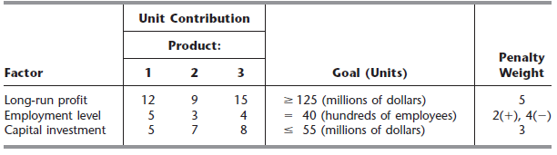
MOLP - Goal Programming
These contributions per unit rate of production are shown in the table along with the goals and penalty weights.

Slide 51
MOLP - Goal Programming
Goal Programming Formulation: The Dewright Company problem includes all three possible types of goals:
  profit goal is a lower one-sided goal: 12x₁ + 9x₂ + 15x₃ ≥ 125
  employment goal is a two-sided goal: 5x₁ + 3x₂ + 4x₃ = 40
  investment goal is an upper one-sided goal: 5x₁ + 7x₂ + 8x₃ ≤ 55
Where x₁, x₂, x₃ are the decision variables representing the production rates of products 1, 2, and 3, respectively and x₁, x₂, x₃ ≥ 0

Slide 52
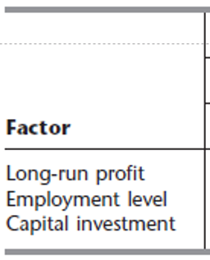
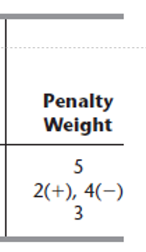
MOLP - Goal Programming
Linear Programming Formulation: Transform goals into constraints
Subject to:
  12x₁ + 9x₂ + 15x₃ ≥ 125
  5x₁ + 3x₂ + 4x₃ = 40
  5x₁ + 7x₂ + 8x₃ ≤ 55
Objective function:
The objective then is to choose the values of x₁, x₂, and x₃ that minimize
  Z = 5 (amount under the long-run profit goal)
  + 2 (amount over the employment level goal)
  + 4 (amount under the employment level goal)
  + 3 (amount over the capital investment goal)
Maybe we can’t satisfy all goals, but we want to capture how much we can satisfy (find the deviations)
where no penalties are incurred for being over the long-run profit goal or for being under the capital investment goal

Slide 53
MOLP - Goal Programming
Linear Programming Formulation:
To express this mathematically, we introduce some auxiliary variables y₁, y₂, and y₃, to represent the deviations defined as follows:
  y₁ = 12x₁ + 9x₂ + 15x₃ - 125 (long-run profit minus the target)
  y₂ = 5x₁ + 3x₂ + 4x₃ - 40 (employment level minus the target)
  y₃ = 5x₁ + 7x₂ + 8x₃ - 55 (capital investment minus the target)
Since each y_{i} can be either positive or negative, and replace each one by the difference of two nonnegative variables:
  y₁ = y₁⁺ - y₁⁻, where y₁⁺ ≥ 0, y₁⁻ ≥ 0
  y₂ = y₂⁺ - y₂⁻, where y₂⁺ ≥ 0, y₂⁻ ≥ 0
  y₃ = y₃⁺ - y₃⁻, where y₃⁺ ≥ 0, y₃⁻ ≥ 0
y_{i}⁺ represents the positive part of y_{i} variable (positive deviation)
y_{i}⁻ represents the negative part of y_{i} variable (negative deviation)

Slide 54
MOLP - Goal Programming
Linear Programming Formulation:
Subject to:
  12x₁ + 9x₂ + 15x₃ ≥ 125
  5x₁ + 3x₂ + 4x₃ = 40
  5x₁ + 7x₂ + 8x₃ ≤ 55
Let us build the objective function:
  Min Z = 5y₁⁻ + 2 y₂⁺ + 4 y₂⁻ + 3 y₃⁺
Because there is no penalty for exceeding the profit goal of 125 or being under the investment goal of 55, neither y₁⁺ nor y₃⁻ should appear in this objective function representing the total penalty for deviations from the goals.
If we’re above 125, we have a positive deviation y₁⁺, but it’s according to the goal, so there is no problem. However, we don’t want to have a negative deviation, so we penalize y₁⁻
125
y₁⁺
y₁⁻

Slide 55
MOLP - Goal Programming
Linear Programming Formulation:
Subject to:
  12x₁ + 9x₂ + 15x₃ ≥ 125
  5x₁ + 3x₂ + 4x₃ = 40
  5x₁ + 7x₂ + 8x₃ ≤ 55
Let us build the objective function:
  Min Z = 5y₁⁻ + 2 y₂⁺ + 4 y₂⁻ + 3 y₃⁺
Because there is no penalty for exceeding the profit goal of 125 or being under the investment goal of 55, neither y₁⁺ nor y₃⁻ should appear in this objective function representing the total penalty for deviations from the goals.
We don’t care if we meet exactly the goal of 40 (=40), but we don’t want to be above or below 40 (having positive or negative deviations, respectively), thus we penalize y₂⁺ both y₂⁻
40
y₂⁺
y₂⁻

Slide 56
MOLP - Goal Programming
Linear Programming Formulation:
Subject to:
  12x₁ + 9x₂ + 15x₃ ≥ 125
  5x₁ + 3x₂ + 4x₃ = 40
  5x₁ + 7x₂ + 8x₃ ≤ 55
Let us build the objective function:
  Min Z = 5y₁⁻ + 2 y₂⁺ + 4 y₂⁻ + 3 y₃⁺
Because there is no penalty for exceeding the profit goal of 125 or being under the investment goal of 55, neither y₁⁺ nor y₃⁻ should appear in this objective function representing the total penalty for deviations from the goals.
We don’t care if we’re below 55, but we don’t want to be above (having positive deviation), thus we penalize y₃⁺
55
y₃⁺
y₃⁻

Slide 57
MOLP - Goal Programming
Linear Programming Formulation:
Finally, we must incorporate the above definitions of the y_{i}⁺ and y_{i}⁻ directly into the model, because the simplex method considers only the objective function and constraints that constitute the model.
Since y₁⁺ - y₁⁻ = y₁, the expression for y₁ is
12x₁ + 9x₂ + 15x₃ - 125 = y₁⁺ - y₁⁻
12x₁ + 9x₂ + 15x₃ - (y₁⁺ - y₁⁻) = 125
Now we have an equality constraint for the linear programming model.

Slide 58
MOLP - Goal Programming
Linear Programming Formulation:
Proceeding in the same way for y₂⁺ - y₂⁻ and y₃⁺ - y₃⁻, we obtain the following formulation for this goal programming problem
Objective function:
Min Z = 5y₁⁻ + 2 y₂⁺ + 4 y₂⁻ + 3 y₃⁺
Subject to:
  12x₁ + 9x₂ + 15x₃ - (y₁⁺ - y₁⁻) = 125
  5x₁ + 3x₂ + 4x₃ - (y₂⁺ - y₂⁻) = 40
  5x₁ + 7x₂ + 8x₃ -(y₃⁺ - y₃⁻) = 55
  x₁ , x₂ , x₃ , y₁⁺, y₁⁻, y₂⁺, y₂⁻ , y₃⁺ , y₃⁻ ≥ 0

Slide 59
MOLP - Goal Programming
Excel Solver:
Applying the simplex method to this formulation yields an optimal solution with:
x₁ = 23/5 , x₂ = 0, x₃ = 5/3
y₁⁺= 0 , y₁⁻= 0, y₂⁺= 23/5, y₂⁻= 0, y₃⁺= 0, y₃⁻ = 0
Therefore, y₁ = 0, y₂ = 23/5 , and y₃ = 0, so the first and third goals are fully satisfied, but the employment level goal of 40 is exceeded by 8 1/3 (833 employees). The resulting penalty for deviating from the goals is Z = 16 2/3.

Slide 60
MOLP - Goal Programming
Excel Solver:

Slide 61
MOLP - Goal Programming
Deviations below the goal
Excel Solver:

Slide 62
MOLP - Goal Programming
Deviations above the goal
Excel Solver:

Slide 63
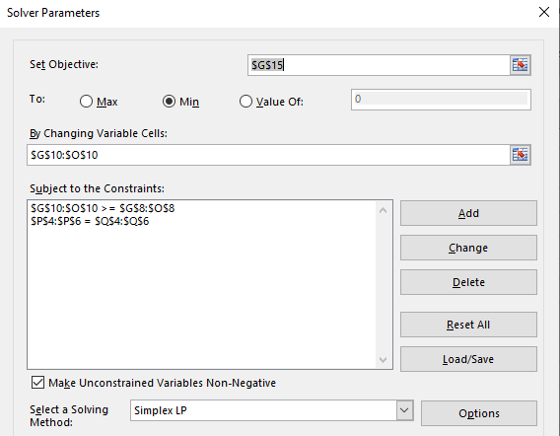
MOLP - Goal Programming
Excel Solver:

Slide 64
MOLP - Goal Programming
Excel Solver:

Slide 65
MOLP - Goal Programming
Excel Solver:

Slide 66
MOLP - Goal Programming
Excel Solver:

Slide 67
MOLP - Goal Programming
Excel Solver:

Slide 68
MOLP - Goal Programming
Excel Solver:
This means we’re 8.33 above the employment goal of 40 hundred (833 employees)

Slide 69
MOLP - Goal Programming
Excel Solver:
This means the best way to achieve the goals given these penalties is not producing product X₂

Slide 70
MOLP - Goal Programming
Exercise 1:
A project manager wants to find the quantities of 3 products. Producing 1 unit of:
  product 1 requires 40 employees, 2 tons of raw material and will bring the company a profit of 5 hundred €
  product 2 requires 30 employees, 4 tons of raw material and will bring the company a profit of 8 hundred €
  product 3 requires 20 employees, 3 tons of raw material and will bring the company a profit of 4 hundred €
The manager has 3 goals:
  The maximum number of employees that can be allocated to producing these 3 products is 100 employees
  There are 10 tons of raw material in the warehouse and he wants to consume no more no less than that
  The total profit is expected to be at least 30 hundred €
The manager suspects he might not be able to meet these 3 goals simultaneously therefore he sets some penalty weights to each of the goals:
  Each extra employee is associated to a penalty of 5
  Each ton below the goal is associated to a penalty of 8 (-) whereas each ton above the goal of 10 is associated to a penalty of 12 (+)
  If profit is less than 30 hundred €, each hundred € is associated to a penalty of 15
Formulate the problem as a linear programming problem and use excel solver (LP simplex) to find the combination of the 3 products that minimizes the penalties.

Slide 71
MOLP - Goal Programming
Exercise 2:
Reconsider the original version of the Dewright Co. After further reflection about the solution obtained by the simplex method, management now is asking some what-if questions.
(a) Management wonders what would happen if the penalty weights in the rightmost column of Table 7.5 were to be changed to 7, 4, 1, and 3, respectively. Would you expect the optimal solution to change? Why?
(b) Management is wondering what would happen if the total profit goal were to be increased to wanting at least $140 million (without any change in the original penalty weights). Solve the revised model with this change.
(c) Solve the revised model if both changes are made.

Slide 72
MOLP - Goal Programming
Exercise 2:
New penalty weights of: 7, 4, 1, and 3, respectively.
profit goal were to be increased to wanting at least $140 million

Slide 73
MOLP - Goal Programming additional remarks

Slide 74
MOLP - Goal Programming
Weighting the goals:
In most situations, goal variables are in completely different units, thus it is generally unsatisfactory to minimize the ordinary sum of all deviations, which in our example
Objective function:
Min Z = y₁⁺ + y₁⁻ + y₂⁺ + y₂⁻ + y₃⁺ + y₃⁻
  With the units of the DEWRIGHT COMPANY problem being (y₁⁺ , y₁⁻ , y₃⁺ , y₃⁻) millions of dollars and (y₂⁺ , y₂⁻) hundreds of employees
  With the units of the Keep the River Clean problem being (y₁⁺ , y₁⁻ ) workers, (y₂⁺ , y₂⁻) €/day and (y₃⁺ , y₃⁻) BOD/day

Slide 75
MOLP - Goal Programming
Weighting the goals:
In most situations, goal variables are in completely different units, thus it is generally unsatisfactory to minimize the ordinary sum of all deviations. Instead, a weighted sum of the deviations should be minimized.
Objective function:
Min Z = (w₁⁺ y₁⁺) + (w₁⁻ y₁⁻) + (w₂⁺ y₂⁺) + (w₂⁻ y₂⁻ ) + (w₃⁺ y₃⁺) + (w₃⁻ y₃⁻)
  These weights have two purposes:
    to make all weighted deviations commensurate
    to express the relative importance of each goal

Slide 76
MOLP - Goal Programming
Weighting the goals/ Simplifying the weights:
1st reduce the objective function to the simplest expression consistent with the problem at hand
make all weighted deviations commensurate - work with relative deviations (divide the weight by the target value of the goal)
Min Z = (w₁⁺ y₁⁺)/ g₁ + (w₁⁻ y₁⁻)/ g₁ + (w₂⁺ y₂⁺)/ g₂ + (w₂⁻ y₂⁻ )/ g₂ + (w₃⁺ y₃⁺)/ g₃ + (w₃⁻ y₃⁻)/ g₃
express the relative importance of each goal – if all goals have the same importance w_{i} = 1/g_{i}
The coefficients may be very small which can lead to round-off problems when solving the problem. To avoid this, multiply all coefficients by a large number.

Slide 77
MOLP - Goal Programming
Weighting the goals:
In most situations, goal variables are in completely different units, thus it is generally unsatisfactory to minimize the ordinary sum of all deviations. Instead, a weighted sum of the deviations should be minimized.
Objective function:
Min Z = (w₁⁺ y₁⁺) + (w₁⁻ y₁⁻) + (w₂⁺ y₂⁺) + (w₂⁻ y₂⁻ ) + (w₃⁺ y₃⁺) + (w₃⁻ y₃⁻)
  These weights have two purposes:
    to make all weighted deviations commensurate
    to express the relative importance of each goal

Slide 78
MOLP - Goal Programming
Final remarks on GP:
Different GP solutions should not be compared only on the basis of their objective function values (because from one iteration to the next weights are changed and these measure different things) -> look at solutions as a whole (not only to Z value)
Sometimes, one or more goals might be considered infinitely more important than other: in such case assign arbitrarily large weights to the deviations from these goals to ensure undesirable deviations from them never occur (Preemptive GP) Note that if these goals can be achieved the use of these large weights transforms them into hard constraints never to be violated

Slide 79
MOLP - Goal Programming
Summary of the steps involved in goal programming:
  Identify the decision variables
  Define the hard constraints (if any)
  Define the goals of the problem and their target values
  Define the goals and corresponding target values as soft constraints
  Include deviational variables in the soft constraints
  Determine which deviational variables represent undesirable deviations from the target
  Formulate an objective function that Min the weighted sum of undesirable deviations (or the % weighted sum of undesirable deviations)
  Identify appropriate weights for the objective function
  Solve the problem, analyze the result and if the solution is unacceptable, go back to step 8

Slide 81
LP vs MOLP
Linear, Goal Programming & multi-objective optimization
Linear programming
Goal programming
Multi-objective optim.
Manager knows his only priority (wants to minimize/maximize) a certain objective under certain constraints
Manager wants to meet certain goals and defines some reference values (thresholds) that can be met, exceeded or less than
Manager wants to optimize several objectives simultaneously but no reference values (thresholds) are defined à priori
An MOLP problem is an LP problem with more than one objective function
In some methods, MOLP problems can be viewed as special types of GP problems where we must also determine target values for each goal or objective

Slide 82
Multi-objective linear programming
  Classical methods - conversion to single objective problems

Slide 83
MOLP - Classical methods
Classically, multiobjective optimization problems are often solved using scalarization techniques.
In brief, scalarization means that the objective functions are aggregated (or reformulated as constraints), and then a constrained single-objective problem is solved.
By using different parameters of the constraints and aggregation function, it is possible to obtain different points on the Pareto front. However, when using such techniques, certain caveats have to be considered. In fact, one should always ask the following two questions:
1. Does the optimization of scalarized problems result in efficient points?
2. Can we obtain all efficient points or vectors on the Pareto front by changing the parameters of the scalarization function or constraints?

Slide 84
Max Z₁ (x), Z₂ (x), … , Z_{k} (x)
s.t.
C_{i} (x) ≤ a
x ≥ 0
MOLP - Classical methods
We will provide four representative examples of scalarization approaches and comment on whether they have these properties.
1. Global criterion method (MiniMax method, Min % deviations weighted sum)
2. The Absolute Priority Method (Lexicographic method, Preemptive method)
3. Weighting method (Weighting sum method)

Slide 85
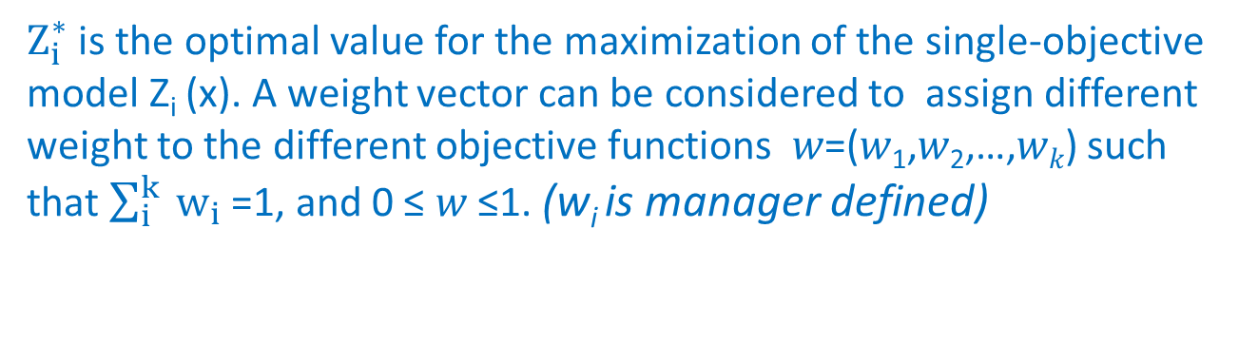

Max Z₁ (x), Z₂ (x), … , Z_{k} (x)
s.t.
C_{i} (x) ≤ a
x ≥ 0
MOLP - Classical methods
We will provide four representative examples of scalarization approaches and comment on whether they have these properties.
1. Global criterion method (MiniMax method)
2. The Absolute Priority Method (Lexicographic method, Preemptive method)
3. Weighting method (Weighting sum method)
Min $\sum_{i}^{k}{{ w}_{i}}\frac{Z_{i}^{∗} −Z_{i} \text{(}\text{x}\text{)}}{Z_{i}^{∗}}$
s.t.
C_{i} (x) ≤ a
x ≥ 0
$Z_{i}^{∗}$ is the optimal value for the maximization of the single-objective model Z_{i} (x). A weight vector can be considered to assign different weight to the different objective functions 𝑤=(𝑤₁,𝑤₂,…,𝑤_{𝑘}) such that $\sum_{i}^{k}{{ w}_{i}}$=1, and 0 ≤ 𝑤 ≤1. (w_{i} is manager defined)
the optimal solution of this model will be a non-dominated solution

Slide 86

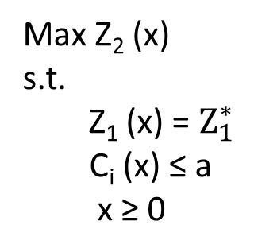
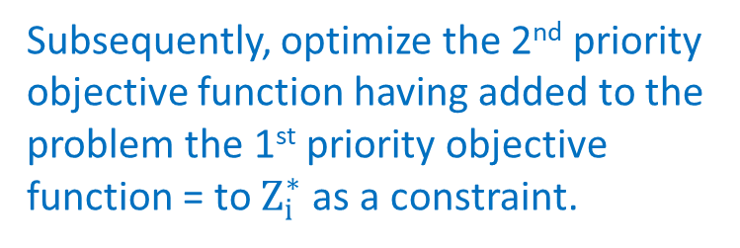
Max Z₁ (x), Z₂ (x), … , Z_{k} (x)
s.t.
C_{i} (x) ≤ a
x ≥ 0
MOLP - Classical methods
We will provide four representative examples of scalarization approaches and comment on whether they have these properties.
1. Global criterion method
2. The Absolute Priority Method (APM)
3. Weighting method (Weighting sum method)
Optimize the single Z_{i} (x) present in the model following a pre-determined priority (manager defined).
Max Z₁ (x)
s.t.
C_{i} (x) ≤ a
x ≥ 0
Max Z₂ (x)
s.t.
Z₁ (x) = $Z_{1}^{∗}$
C_{i} (x) ≤ a
x ≥ 0
Max Z_{k} (x)
s.t.
Z₁ (x) = $Z_{1}^{∗}$
Z₂ (x) = $Z_{2}^{∗}$
…
Z_{k-1} (x) = $Z_{k−1}^{∗}$
C_{i} (x) ≤ a
x ≥ 0
The problem is solely solved for the 1st priority.
Subsequently, optimize the 2nd priority objective function having added to the problem the 1st priority objective function = to $Z_{i}^{∗}$ as a constraint.
the optimal solution of this model will be a non-dominated solution
Continue until the entire number of objective functions is optimized

Slide 87
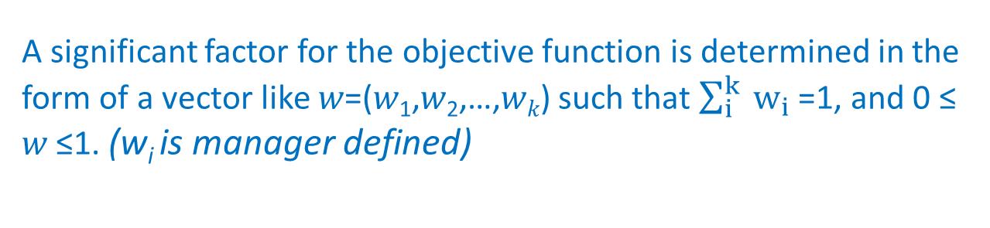
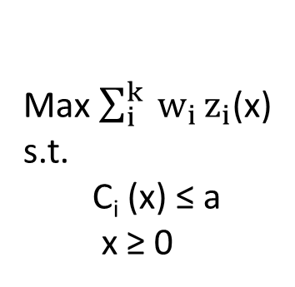
Max Z₁ (x), Z₂ (x), … , Z_{k} (x)
s.t.
C_{i} (x) ≤ a
x ≥ 0
MOLP - Classical methods
We will provide four representative examples of scalarization approaches and comment on whether they have these properties.
1. Global criterion method (MiniMax method, Min % deviations weighted sum)
2. The Absolute Priority Method (Lexicographic method, Preemptive method)
3. Weighting method
Max $\sum_{i}^{k}{{ w}_{i}}z_{i}$(x)
s.t.
C_{i} (x) ≤ a
x ≥ 0
A significant factor for the objective function is determined in the form of a vector like 𝑤=(𝑤₁,𝑤₂,…,𝑤_{𝑘}) such that $\sum_{i}^{k}{{ w}_{i}}$=1, and 0 ≤ 𝑤 ≤1. (w_{i} is manager defined)
the optimal solution of this model will be a non-dominated solution

Slide 88
MOLP - Classical methods - Global criterion method exercise
Solve applying the Global criterion method
  Blackstone Mining Company operates 2 coal mines Wythe and Giles. The manager is anticipating a demand increase for coal in the coming year and he wants to schedule extra shifts of workers to the mines. Each extra shift has an extra cost of 40000/month at Wythe and 32000/month at Giles.
  The extraction methods lead to the production of toxic water. Running an extra shift at Wythe leads to the production of 800 gallons and 1250 gallons at Giles.
  Despite safety guidelines are followed 0.2 life threatening accidents are expected at Wythe and 0.45
Coal production a month by a shift of workers (ton)
Increase in demand
48
28
100
Determine the number of extra shifts at each of the mines that minimizes costs, toxic waste production and life threatening accidents
Wythe
Giles

Slide 89
MOLP - Classical methods - Global criterion method exercise
EXAMPLE: Blackstone Mining runs 2 coal mines in Southwest Virginia. Monthly production by a shift of workers at each mine is summarized as follows:
Blackstone coal production/month (tons) needs to increase 48 more tons of high-grade, 28 more tons of medium-grade, and 100 more tons of low-grade coal.
Determine the number of extra shifts at each of the mines that minimizes costs, toxic waste production and life threatening accidents
Type of Coal Wythe Mine Giles Mine
High-grade 12 tons 4 tons
Medium-grade 4 tons 4 tons
Low-grade 10 tons 20 tons
Cost per month $40,000 $32,000
Gallons of toxic water produced 800 1,250
Life-threatening accidents 0.20 0.45

Slide 90
MOLP - Classical methods - Global criterion method exercise
Decision variables:
  X₁ = number of months to schedule an extra shift at the Wythe county mine
  X₂ = number of months to schedule an extra shift at the Giles county mine
The objectives:
  Min Z₁ = 40 X₁ + 32 X₂ (Production costs)
  Min Z₂ = 800 X₁ + 1250 X₂ (Toxic water)
  Min Z₃ = 0.20 X₁ + 0.45 X₂ (Accidents)
The Constraints:
  12 X₁ + 4 X₂ ≥ 48 (High-grade coal required)
4 X₁ + 4 X₂ ≥ 28 (Medium-grade coal required)
  10 X₁ + 20 X₂ ≥ 100 (Low-grade coal required)
  X₁, X₂ ≥ 0 (Non-negativity constraints)

Slide 91
MOLP - Classical methods - Global criterion method exercise
If the objectives had target values we could treat them like goals:
  Goal 1: The total production cost should be approximately t₁
  Goal 2: The amount of toxic water produced should be approximately t₂
  Goal 3: The number of life-threatening accidents should be approximately t₃
We can solve 3 separate LP problems, independently optimizing each objective, to find values for t₁, t₂ and t₃. (where t is the target value of each goal)
  Min Z₁ = 40 X₁ + 32 X₂
  Min Z₂ = 800 X₁ + 1250 X₂
  Min Z₃ = 0.2 X₁ + 0.45 X₂
  12 X₁ + 4 X₂ ≥ 48
  4 X₁ + 4 X₂ ≥ 28
  10 X₁ + 20 X₂ ≥ 100
  X₁, X₂ ≥ 0
  12 X₁ + 4 X₂ ≥ 48
  4 X₁ + 4 X₂ ≥ 28
  10 X₁ + 20 X₂ ≥ 100
  X₁, X₂ ≥ 0
  12 X₁ + 4 X₂ ≥ 48
  4 X₁ + 4 X₂ ≥ 28
  10 X₁ + 20 X₂ ≥ 100
  X₁, X₂ ≥ 0

Slide 92
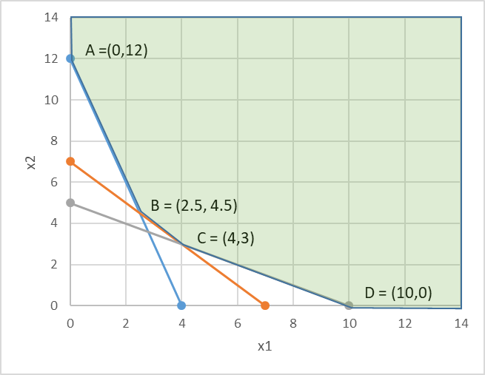
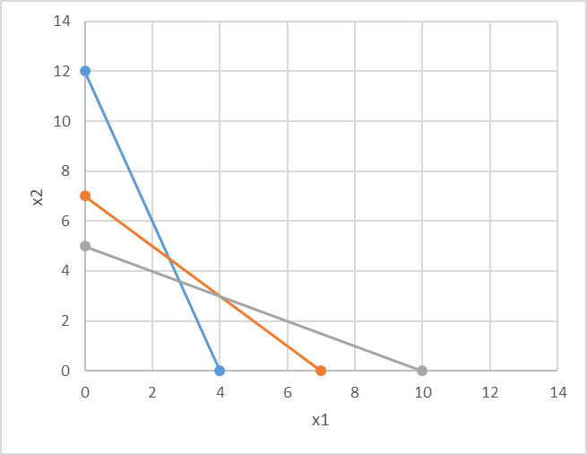
MOLP - Classical methods - Global criterion method exercise
First let us find our feasible region:
  12 X₁ + 4 X₂ ≥ 48
  4 X₁ + 4 X₂ ≥ 28
  10 X₁ + 20 X₂ ≥ 100
  X₁, X₂ ≥ 0
  Min Z₁ = 40 X₁ + 32 X₂
  Min Z₂ = 800 X₁ + 1250 X₂
  Min Z₃ = 0.2 X₁ + 0.45 X₂

Slide 93
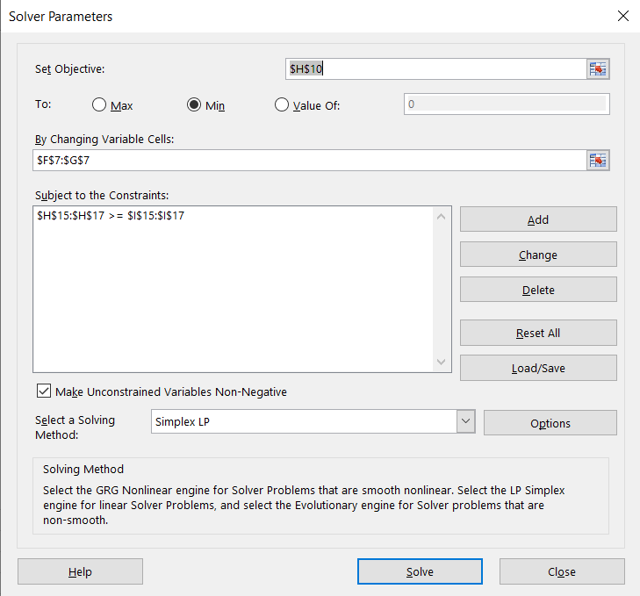
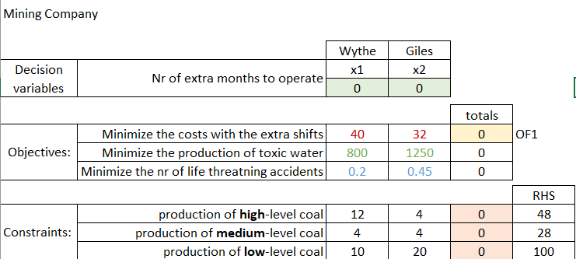
MOLP - Classical methods - Global criterion method exercise
If the objectives had target values we could treat them like goals:
  Goal 1: The total cost of productions cost should be approximately t₁
Solving Z₁ independently to find t₁
  Min Z₁ = 40 X₁ + 32 X₂
  12 X₁ + 4 X₂ ≥ 48
  4 X₁ + 4 X₂ ≥ 28
  10 X₁ + 20 X₂ ≥ 100
  X₁, X₂ ≥ 0

Slide 94
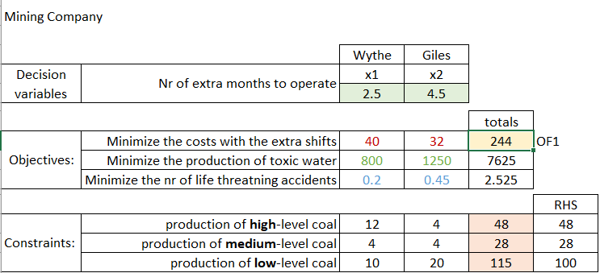
MOLP - Classical methods - Global criterion method exercise
If the objectives had target values we could treat them like goals:
  Goal 1: The total cost of productions cost should be approximately t₁
Solving Z₁ independently to find t₁
  Min Z₁ = 40 X₁ + 32 X₂
  12 X₁ + 4 X₂ ≥ 48
  4 X₁ + 4 X₂ ≥ 28
  10 X₁ + 20 X₂ ≥ 100
  X₁, X₂ ≥ 0
  (x₁,x₂) = (2.5,4.5)
  t₁ = 244

Slide 95
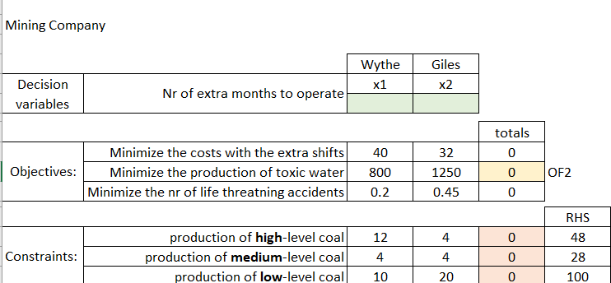
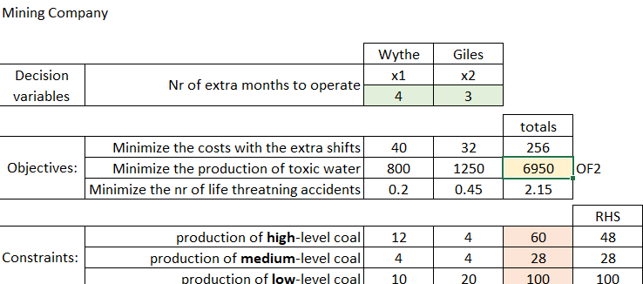
MOLP - Classical methods - Global criterion method exercise
If the objectives had target values we could treat them like goals:
  Goal 2: The total cost of productions cost should be approximately t₂
Solving Z₂ independently to find t₂
  Min Z₂ = 800 X₁ + 1250 X₂
  12 X₁ + 4 X₂ ≥ 48
  4 X₁ + 4 X₂ ≥ 28
  10 X₁ + 20 X₂ ≥ 100
  X₁, X₂ ≥ 0
  (x₁,x₂) = (4,3)
  t₂ = 6950

Slide 96
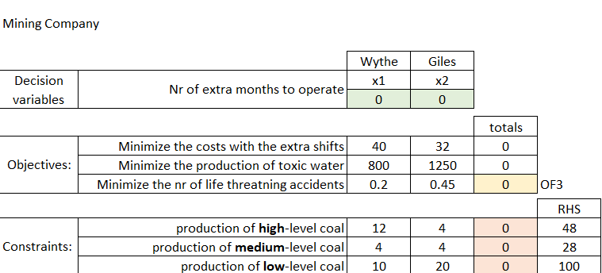
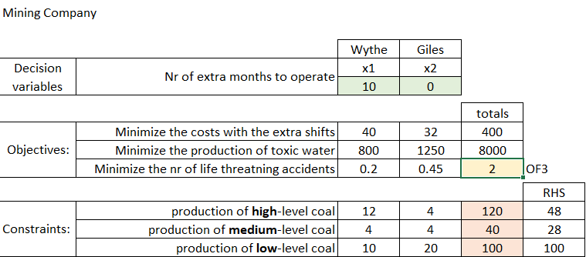
MOLP - Classical methods - Global criterion method exercise
If the objectives had target values we could treat them like goals:
  Goal 3: The total cost of productions cost should be approximately t₃
Solving Z₃ independently to find t₃
  Min Z₃ = 0.2 X₁ + 0.45 X₂
  12 X₁ + 4 X₂ ≥ 48
  4 X₁ + 4 X₂ ≥ 28
  10 X₁ + 20 X₂ ≥ 100
  X₁, X₂ ≥ 0
  (x₁,x₂) = (10,0)
  t₃ = 2

Slide 97

MOLP - Classical methods - Global criterion method exercise
Feasible region:
Solutions:
  12 X₁ + 4 X₂ ≥ 48
  4 X₁ + 4 X₂ ≥ 28
  10 X₁ + 20 X₂ ≥ 100
  X₁, X₂ ≥ 0
Sol. 1: min prod cost
Sol. 2: min toxic water
Sol. 3: min accidents
  Min Z₁ = 40 X₁ + 32 X₂
  (x₁,x₂) = (2.5,4.5) t₁ = 244
 | x₁ | x₂ | Z₁ | Z₂ | Z₃
A | 0 | 12 | 384 | 15000 | 5.4
B | 2.5 | 4.5 | 244 | 7625 | 2.525
C | 4 | 3 | 256 | 6950 | 2.15
D | 10 | 0 | 400 | 8000 | 2
  Min Z₂ = 800 X₁ + 1250 X₂
  (x₁,x₂) = (4,3) t₂ = 6950
  Min Z₃ = 0.2 X₁ + 0.45 X₂
  (x₁,x₂) = (10,0) t₃ = 2

Slide 98

MOLP - Classical methods - Global criterion method exercise
Finding the optimal values for individual objective functions:
  Total production costs should be
  Gallons of toxic water produced should be
  Nr of life-threatening accidents should be
Building the composite objective function (ie Minimize the sum of % deviations):
  Z₁ = 40 X₁ + 32 X₂ ~ t₁ = 244 $Z_{1}^{∗}$
  Z₂ = 800 X₁ + 1250 X₂ ~ t₂ = 6950 ${ Z}_{2}^{∗}$
  Z₃ = 0.2 X₁ + 0.45 X₂ ~ t₃ = 2 $Z_{3}^{∗}$

Slide 99
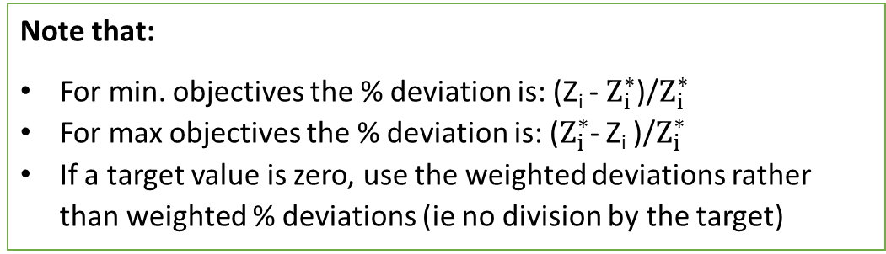
MOLP - Classical methods - Global criterion method exercise
Solve the problem using Excel Solver considering:
    (w₁, w₂, w₃) = (1, 1, 1)
    (w₁, w₂, w₃) = (10, 1, 1)
    (w₁, w₂, w₃) = (1, 10, 1)
    (w₁, w₂, w₃) = (1, 1, 10)
to conclude that:
  All solutions are corner points of the feasible region (no matter what weights are used)
  WHY? Because this is just a linear combination of the decision variables
Note that:
For min. objectives the % deviation is: (Z_{i} - $Z_{i}^{∗}$)/$Z_{i}^{∗}$
For max objectives the % deviation is: ($Z_{i}^{∗}$- Z_{i} )/$Z_{i}^{∗}$
If a target value is zero, use the weighted deviations rather than weighted % deviations (ie no division by the target)

Slide 100
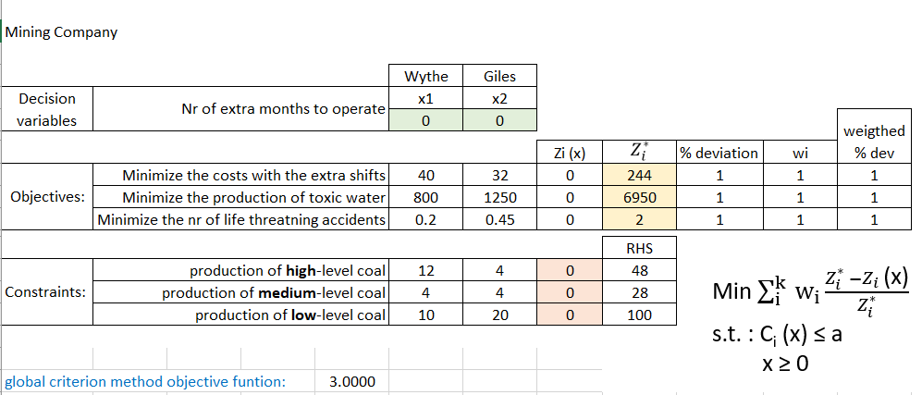
MOLP - Classical methods - Global criterion method exercise
Solve the problem using Excel Solver considering: (w₁, w₂, w₃) = (1, 1, 1)
Zi (x)
=SUMPRODUCT($F$7:$G$7,F10:G10)

Slide 101
MOLP - Classical methods - Global criterion method exercise
Solve the problem using Excel Solver considering: (w₁, w₂, w₃) = (1, 1, 1)
% deviation
=ABS(H10-I10)/I10

Slide 102
MOLP - Classical methods - Global criterion method exercise
Solve the problem using Excel Solver considering: (w₁, w₂, w₃) = (1, 1, 1)
Weighted % dev
=J10*K10

Slide 103
MOLP - Classical methods - Global criterion method exercise
Solve the problem using Excel Solver considering: (w₁, w₂, w₃) = (1, 1, 1)
=SUMPRODUCT($F$7:$G$7,F15:G15)
=SUMPRODUCT($F$7:$G$7,F15:G15)
LHS

Slide 104
MOLP - Classical methods - Global criterion method exercise
Solve the problem using Excel Solver considering: (w₁, w₂, w₃) = (1, 1, 1)
Solver
=K10*abs(H10-I10)/I10 + K11*abs(H11-I11)/I11 + K12*abs(H12-I12)/I12)

Slide 105
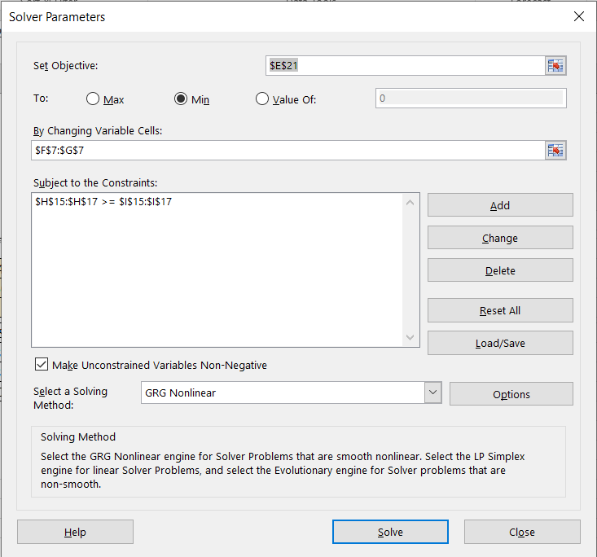
MOLP - Classical methods - Global criterion method exercise
Solve the problem using Excel Solver considering: (w₁, w₂, w₃) = (1, 1, 1)

Slide 107
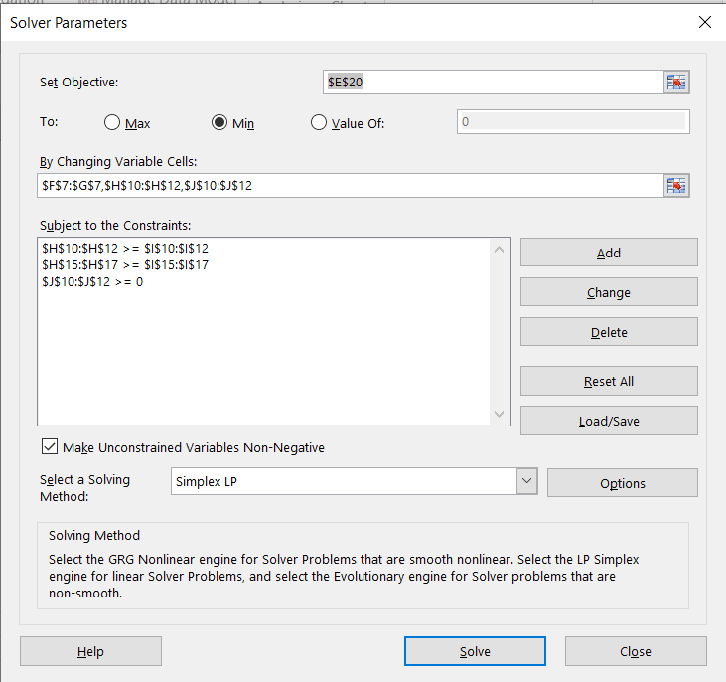
MOLP - Classical methods - Global criterion method exercise
Solve the problem using Excel Solver considering: (w₁, w₂, w₃) = (1, 1, 1)

Slide 108
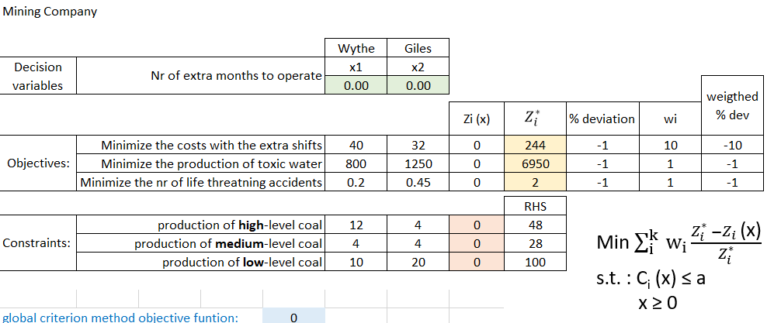
MOLP - Classical methods - Global criterion method exercise
Solve the problem using Excel Solver considering: (w₁, w₂, w₃) = (10, 1, 1)

Slide 109
MOLP - Classical methods - Global criterion method exercise
Solve the problem using Excel Solver considering: (w₁, w₂, w₃) = (1, 10, 1)

Slide 110
MOLP - Classical methods - Global criterion method exercise
Solve the problem using Excel Solver considering: (w₁, w₂, w₃) = (1, 1, 10)

Slide 111
MOLP - Classical methods - The Absolute Priority Method
Solve applying the Absolute Priority method (Preemptive)
  Blackstone Mining Company operates 2 coal mines Wythe and Giles. The manager is anticipating a demand increase for coal in the coming year and he wants to schedule extra shifts of workers to the mines. Each extra shift has an extra cost of 40000/month at Wythe and 32000/month at Giles.
  The extraction methods lead to the production of toxic water. Running an extra shift at Wythe leads to the production of 800 gallons and 1250 gallons at Giles.
  Despite safety guidelines are followed 0.2 life threatening accidents are expected at Wythe and 0.45
Consider the following priorities: 1st productions costs; 2nd toxic water; 3rd nr accidents
Coal production a month by a shift of workers (ton)
Increase in demand
48
28
100
Determine the number of extra shifts at each of the mines that minimizes costs, toxic waste production and life threatening accidents
Wythe
Giles

Slide 112
MOLP - Classical methods - The Absolute Priority Method
Solve applying the Absolute Priority method 1st costs; 2nd pollution; 3rd safety
Same result as obtained using Global criterion method and a weight of (10,1,1)

Slide 113
MOLP - Classical methods - The Absolute Priority Method
Solve applying the Absolute Priority method 2nd pollution; 1st costs; 3rd safety
Same result as obtained using Global criterion method and a weight of (1,10,1)

Slide 114
MOLP - Classical methods - The Absolute Priority Method
Solve applying the Absolute Priority method 3rd safety ; 1st costs; 2nd pollution
Same result as obtained using Global criterion method and a weight of (1,1,10)

Slide 115
MOLP - Classical methods - sum of % deviations
Summary of the steps involved in MOLP (Minimize the sum of % deviations) :
  Identify the decision variables
  Identify the objectives in the problem and formulate them as usual
  Identify the constraints in the problem and formulate them as usual
  Solve the problem once for each of the objectives identified in step 2 to determine the optimal value of each objective
  Transform the objectives to goals using the optimal objective values identified in step 4 as the target values
  For each goal, create a deviation function that measures the amount by which any given solution fails to meet the goal (as an absolute value or a %)
  Assign a weight to each of the functions in step 6
  Solve the problem, analyze the result and if the solution is unacceptable, go back to step 7

Slide 116
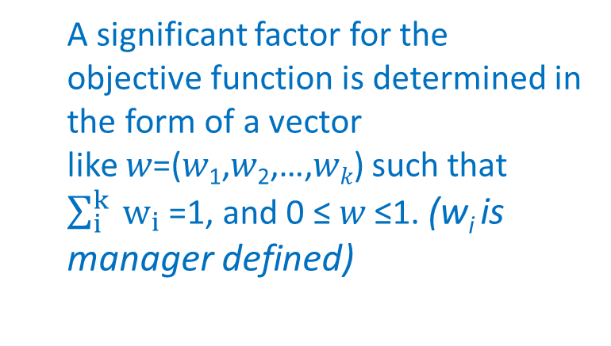
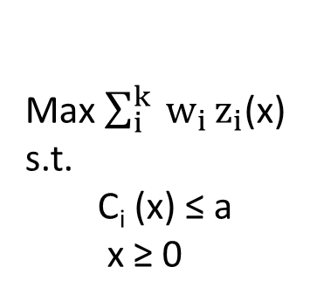
MOLP - Classical methods - sum of % deviations
Max $\sum_{i}^{k}{{ w}_{i}}z_{i}$(x)
s.t.
C_{i} (x) ≤ a
x ≥ 0
A significant factor for the objective function is determined in the form of a vector like 𝑤=(𝑤₁,𝑤₂,…,𝑤_{𝑘}) such that $\sum_{i}^{k}{{ w}_{i}}$=1, and 0 ≤ 𝑤 ≤1. (w_{i} is manager defined)
the optimal solution of this model will be a non-dominated solution

Slide 117
MOLP – Solving using weighted sum
DISADVANTAGES:
The combined weighted sum transforms the optimization problem into a single objective, which is not necessarily equivalent to the original multi-objective problem because the extra weighting coefficients could be arbitrary, whereas the final solutions still depend on these coefficients
Another important issue is that of how to choose the weighting coefficients, since the solutions depend on these coefficients
Usually difficult to generate a good set of points that are uniformly distributed on the Pareto front
Scaling or normalization of the objectives are often needed so that the ranges/values of each objective can be comparable; otherwise, the weight coefficients are not well distributed and thus lead to biased sampling on the Pareto front
Different combinations of weight coefficients can lead to the same point or points very close to each other, and consequently the points are not uniformly distributed on the Pareto front. Only works for problems with convex Pareto fronts
the subjective setting of weights and the nonnormalization of the objectives can introduce some wrong solutions to the final optimum.

Slide 119
Multi-objective linear programming
  MOLP – weighted sums (based on the Pareto front)

Slide 120
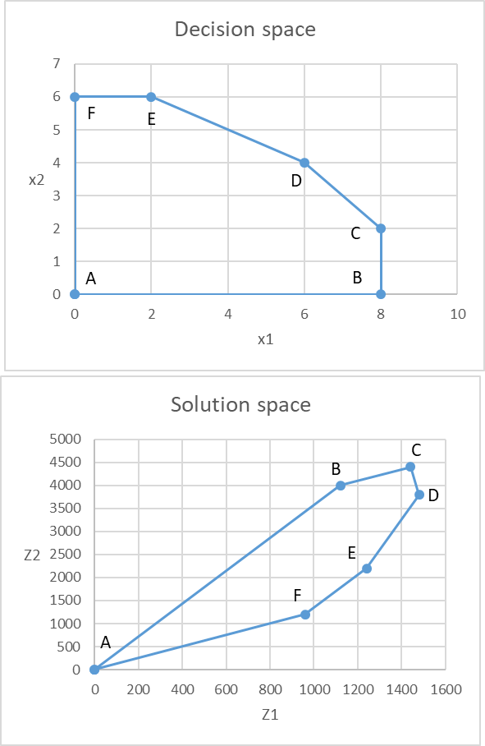
MOLP - weighted sums Pareto front based
Nondominated concept (Pareto front)
 | x1 | x2 | Max Z1 | Min Z2
A | 0 | 0 | 0 | 0
B | 8 | 0 | 1120 | 4000
C | 8 | 2 | 1440 | 4400
D | 6 | 4 | 1480 | 3800
E | 2 | 6 | 1240 | 2200
F | 0 | 6 | 960 | 1200
D is optimal for Z1
A is optimal for Z2
the optimal solution to each individual function is nondominated
- Is there any alternative that would always be preferred to B?
Yes! Both alternatives D and E perform better than B with respect to both objectives

Slide 121
MOLP - weighted sums Pareto front based
Nondominated concept (Pareto front)
 | x1 | x2 | Max Z1 | Min Z2
A | 0 | 0 | 0 | 0
B | 8 | 0 | 1120 | 4000
C | 8 | 2 | 1440 | 4400
D | 6 | 4 | 1480 | 3800
E | 2 | 6 | 1240 | 2200
F | 0 | 6 | 960 | 1200
D is optimal for Z1
A is optimal for Z2
the optimal solution to each individual function is nondominated
- Is there any alternative that would always be preferred to B?
Yes! Both alternatives D and E perform better than B with respect to both objectives
- Is there any alternative that would always be preferred to C?
Yes! Alternative D performs better than C with respect to both objectives

Slide 122
MOLP - weighted sums Pareto front based
Nondominated concept (Pareto front)
 | x1 | x2 | Max Z1 | Min Z2
A | 0 | 0 | 0 | 0
B | 8 | 0 | 1120 | 4000
C | 8 | 2 | 1440 | 4400
D | 6 | 4 | 1480 | 3800
E | 2 | 6 | 1240 | 2200
F | 0 | 6 | 960 | 1200
D is optimal for Z1
A is optimal for Z2
the optimal solution to each individual function is nondominated
- Is there any alternative that would always be preferred to B?
Yes! Both alternatives D and E perform better than B with respect to both objectives
- Is there any alternative that would always be preferred to C?
Yes! Alternative D performs better than C with respect to both objectives

Slide 123
MOLP - weighted sums Pareto front based
Nondominated concept (Pareto front)
 | x1 | x2 | Max Z1 | Min Z2
A | 0 | 0 | 0 | 0
B | 8 | 0 | 1120 | 4000
C | 8 | 2 | 1440 | 4400
D | 6 | 4 | 1480 | 3800
E | 2 | 6 | 1240 | 2200
F | 0 | 6 | 960 | 1200
B and C are dominated solutions
A, D E and F are nondominated
(Pareto front)
- Is there any alternative that would always be preferred to B?
Yes! Both alternatives D and E perform better than B with respect to both objectives
- Is there any alternative that would always be preferred to C?
Yes! Alternative D performs better than C with respect to both objectives

Slide 124
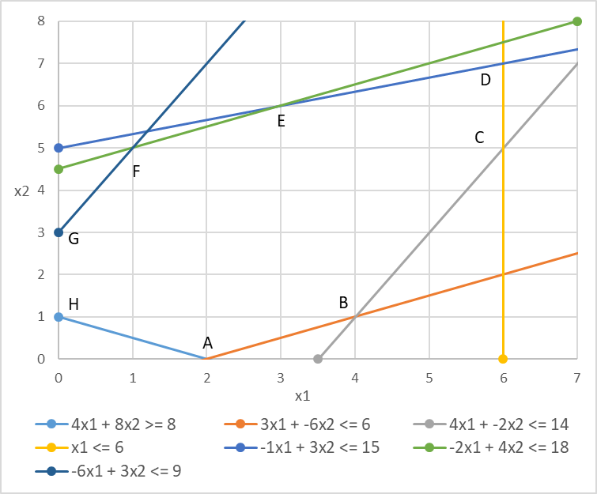
MOLP - weighted sums Pareto front based
Example
Take the following MOLP problem:
  Max Z₁ = 3 x₁ - 2 x₂
  Max Z₂ = - x₁ + 2 x₂
Subject to the following constraints:
  4 x₁ + 8 x₂ ≥ 8
  3 x₁ – 6 x₂ ≤ 6
  4 x₁ - 2 x₂ ≤ 14
  1 x₁ ≤ 6
  -1 x₁ + 3 x₂ ≤ 15
  -2 x₁ + 4 x₂ ≤ 18
  -6 x₁ + 3 x₂ ≤ 9
  x₁ , x₂ ≥ 0
Decision Space:

Slide 125
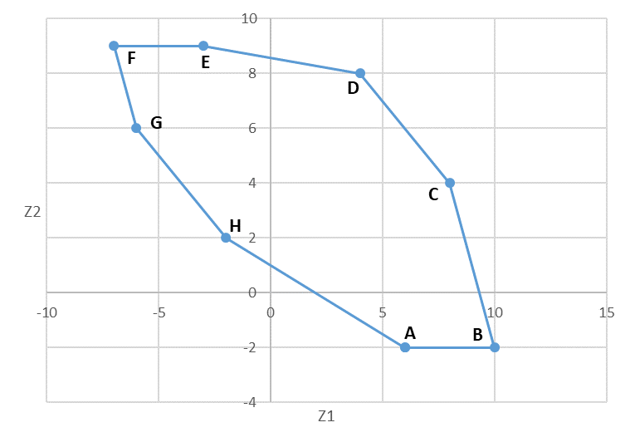
MOLP - weighted sums Pareto front based
In which direction do I max both Z1 and Z2?
Example Determining the nondominated set graphically
There is a correspondence between the decision space (x1,x2) and the solutions space (Z1, Z2)
 | x1 | x2 | z1 | z2
A | 2 | 0 | 6 | -2
B | 4 | 1 | 10 | -2
C | 6 | 5 | 8 | 4
D | 6 | 7 | 4 | 8
E | 3 | 6 | -3 | 9
F | 1 | 5 | -7 | 9
G | 0 | 3 | -6 | 6
H | 0 | 1 | -2 | 2
Objective Space:

Slide 126
MOLP - weighted sums Pareto front based
Nondominated solutions (Pareto front)
Example Determining the nondominated set graphically
There is a correspondence between the decision space (x1,x2) and the solutions space (Z1, Z2)
 | x1 | x2 | z1 | z2
A | 2 | 0 | 6 | -2
B | 4 | 1 | 10 | -2
C | 6 | 5 | 8 | 4
D | 6 | 7 | 4 | 8
E | 3 | 6 | -3 | 9
F | 1 | 5 | -7 | 9
G | 0 | 3 | -6 | 6
H | 0 | 1 | -2 | 2
Objective Space:

Slide 127
MOLP - weighted sums Pareto front based
In which direction would I min both Z1 and Z2?
Example Determining the nondominated set graphically
There is a correspondence between the decision space (x1,x2) and the solutions space (Z1, Z2)
 | x1 | x2 | z1 | z2
A | 2 | 0 | 6 | -2
B | 4 | 1 | 10 | -2
C | 6 | 5 | 8 | 4
D | 6 | 7 | 4 | 8
E | 3 | 6 | -3 | 9
F | 1 | 5 | -7 | 9
G | 0 | 3 | -6 | 6
H | 0 | 1 | -2 | 2
Objective Space:
For minimization objectives, one can multiply that objective function by —1 to change its sense to a maximization

Slide 128
MOLP - weighted sums Pareto front based
In which direction would I min Z1 and max Z2?
Example Determining the nondominated set graphically
There is a correspondence between the decision space (x1,x2) and the solutions space (Z1, Z2)
 | x1 | x2 | z1 | z2
A | 2 | 0 | 6 | -2
B | 4 | 1 | 10 | -2
C | 6 | 5 | 8 | 4
D | 6 | 7 | 4 | 8
E | 3 | 6 | -3 | 9
F | 1 | 5 | -7 | 9
G | 0 | 3 | -6 | 6
H | 0 | 1 | -2 | 2
Objective Space:

Slide 129
MOLP – Weighting method for generating the non-dominated set
Example
Back to the previous example:
  Max Z₁ = 3 x₁ - 2 x₂
  Max Z₂ = - x₁ + 2 x₂
Solve it for Z₁ and for Z₂ independently. This is equivalent to solving:
  Max Z_{g} = w₁ Z₁ + w₂ Z₂ with w₂ = 0
  Max Z_{g} = w₁ Z₁ + w₂ Z₂ with w₁ = 0, respectively
The relative weights of these objective functions are what is important, not their specific values
It is not necessary that weights sum 1, but is common practice
The number of weights combinations increases with the increase in the number of objective functions
Several generating techniques have been developed:
  - Weighting method
  - Constraint method
Both rely on the repeated solution of p LP
Combine all objective functions into a single objective function by multiplying each by a weight and adding them
  Max (Z₁ , Z₂ ,…, Z_{p})
  Max Z_{g} = w₁ Z₁ + w₂ Z₂ + … + w_{n} Z_{n}
Solve Z_{g} while systematically vary the weights covering the widest range of variation possible
(oldest & most used)

Slide 130
MOLP – Weighting method for generating the non-dominated set
Example
Set up a solver and apply it to each of the Z_{g}_1 ,…, Z_{g}_11
Back to the previous example:
  Max Z₁ = 3 x₁ - 2 x₂
  Max Z₂ = - x₁ + 2 x₂
  Max Z_{g} = w₁ Z₁ + w₂ Z₂ + … + w_{n} Z_{n}
For a step of 0.1:
Record the solution (x₁, x₂) for each of the Z_{g}_i
Find the corresponding corner point
The list of corner points will correspond to the non-dominated set
 |  | W1 | W2 | Zg
 | Zg_1 | 1 | 0 | 3x₁- 2x₂
 | Zg_2 | 0.9 | 0.1 | 2.6x₁- 1.6x₂
 | Zg_3 | 0.8 | 0.2 | 2.2x₁- 1.2x₂
 | Zg_4 | 0.7 | 0.3 | 1.8x₁- 0.8x₂
 | Zg_5 | 0.6 | 0.4 | 1.4x₁- 0.4x₂
 | Zg_6 | 0.5 | 0.5 | 1x₁
 | Zg_7 | 0.4 | 0.6 | 0.6x₁+ 0.4x₂
 | Zg_8 | 0.3 | 0.7 | 0.2x₁ +0.8x₂
 | Zg_9 | 0.2 | 0.8 | -0.2x₁+1.2x₂
 | Zg_10 | 0.1 | 0.9 | -0.6x₁+1.6x₂
 | Zg_11 | 0 | 1 | - x₁ + 2 x₂

