Slide 1
Specificity of the cork oak system in PORTUGAL

Slide 2
Specificity of the cork oak system
Cork oak stands are a very peculiar forestry system:
  the stands have a relatively small number of trees per ha (sparse forest)

Slide 3
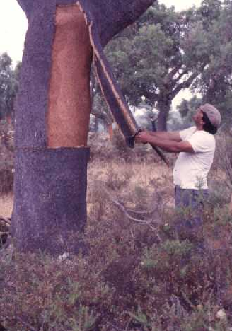
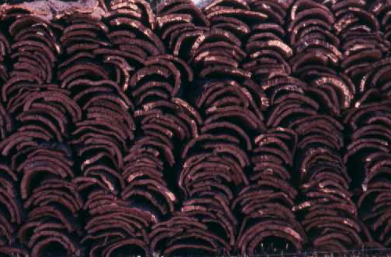
Specificity of the cork oak system
Cork oak stands are a very peculiar forestry system:
  the main product is not the wood but the cork (bark)

Slide 4
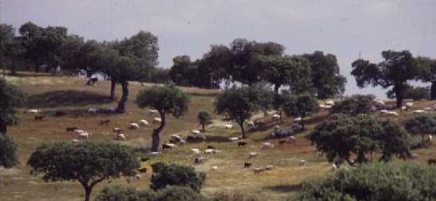
Specificity of the cork oak system
Cork oak stands are a very peculiar forestry system:
  it is an usual practice to grow agricultural crops or grass and herbage for cattle in association with the trees

Slide 5
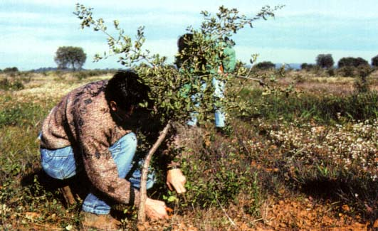
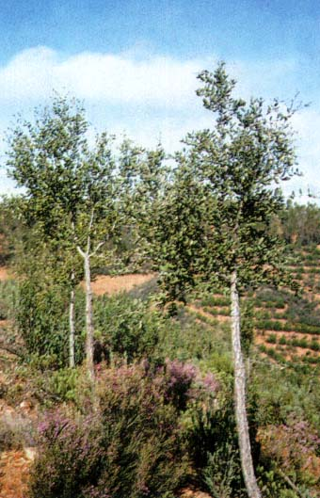
Specificity of the cork oak system
Cork oak stands are a very peculiar forestry system:
  conducting pruning is practised in order to improve tree shape for cork stripping

Slide 6
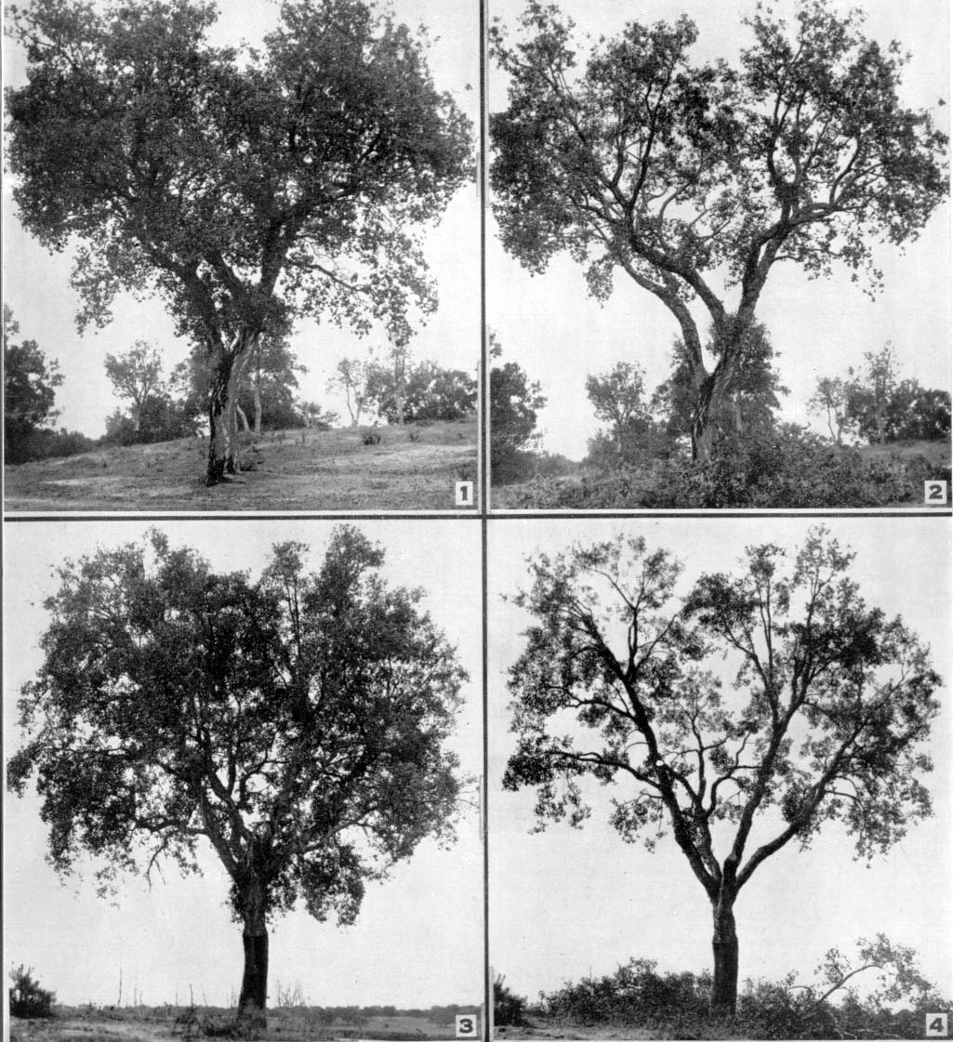
Specificity of the cork oak system
Cork oak stands are a very peculiar forestry system:
  pruning for fruit production used to be a common practice

Slide 7
Specificity of the cork oak system
Cork oak stands are a very peculiar forestry system:
  afforestation through plantation or artificial sowing, with initial densities higher than in the traditional stands, is relatively recent

Slide 8
Some information about cork
Cork is a thick and continuous layer of suberised cells, produced by the meristematic cork cambium (phellogen), which makes up the external envelope of stem and branches
Usually the first cork layer is removed when the tree attains an over bark perimeter at breast height of 70 cm (between 20-40 years of age) – “virgin cork”
At that time the maximum legal height for debarking is 2 times the perimeter at breast height (debarking coefficient = 2)

Slide 9
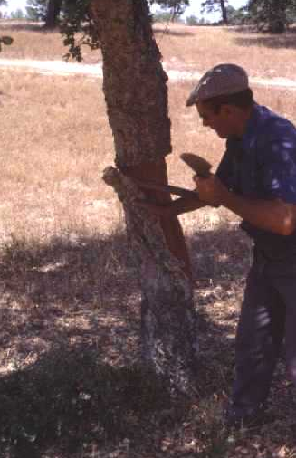
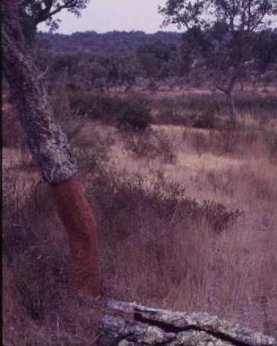

Slide 10
Some information about cork
The cork cambium is destroyed during the cork stripping process but the sustainability of production is ensured because the species has the ability of regenerating a new cambium in the inner part of the bark
cork back
phellogen
cork
bark
wood

Slide 11
Some information about cork
After the first debarking the new phellogen starts producing new layers of cork cells, originating the “second cork”, being cork cells production higher in the years immediately after debarking
In most regions, 9 years of cork growth allow to obtain a thickness suitable for the production of cork wine stoppers
The maximum legal height for second cork debarking is 2.5 times the perimeter at breast height (debarking coefficient = 2.5)

Slide 12
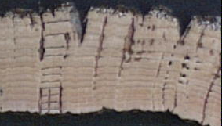
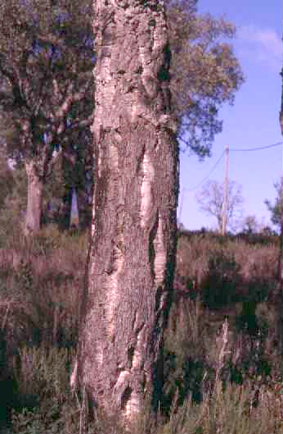
Virgin cork
Second cork

Slide 13
Some information about cork
After the extraction of the second cork, a new phellogen is again regenerated, cork properties stabilise in the following extractions – “mature cork”
Maximum legal height for mature cork debarking is 3 times the perimeter at breast height (debarking coefficient = 3)
Mature cork is extracted periodically (9 years is the most common rotation period) and the process can be sustained until the tree is quite old, sometimes 150-200 years

Slide 14
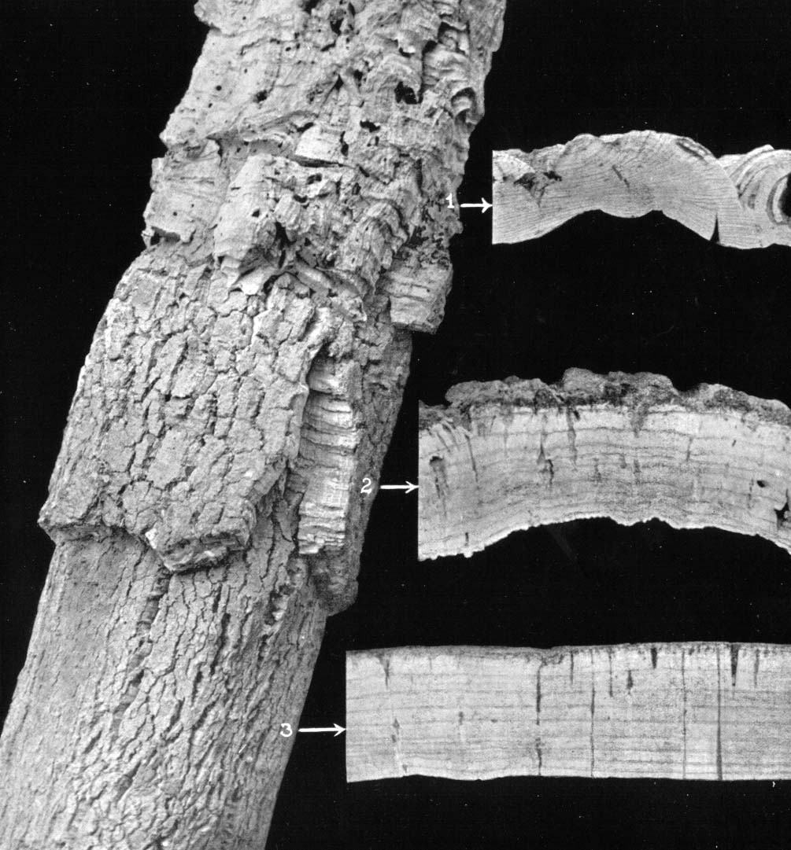
Virgin cork
Second cork
Mature cork

Slide 15
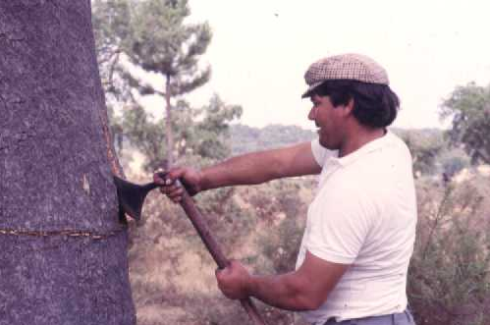
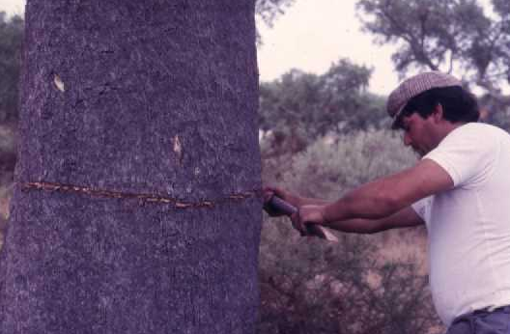
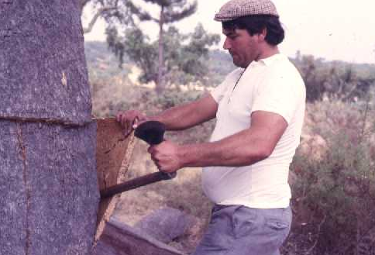
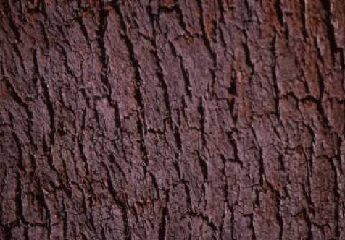

Slide 16
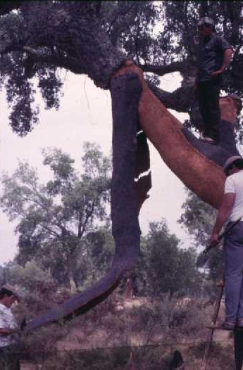
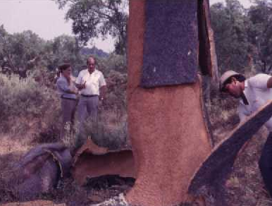
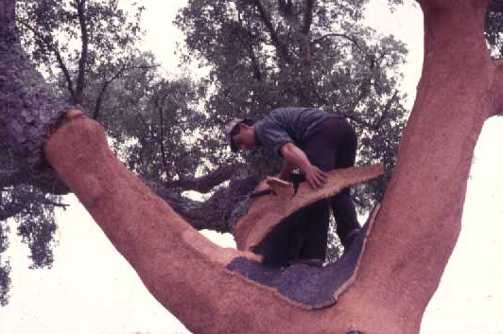
Range of tree production per harvest
7 - 11 kg / m² debarked area
Up to 150 kg per tree in one harvest

Slide 17
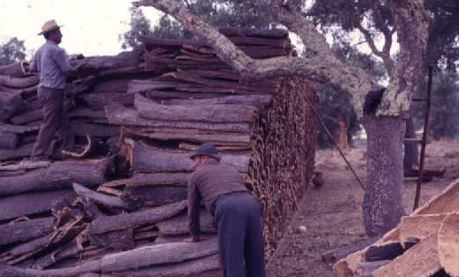
After extraction, the cork is usually stored in the farm in large stacks
14

Slide 18
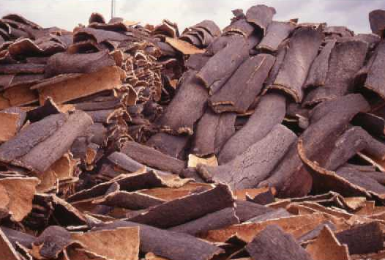
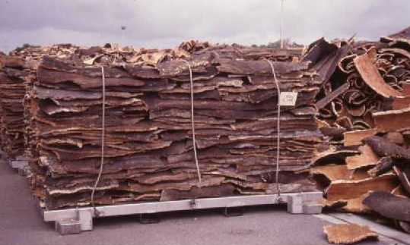
The raw cork is then transported to the mill where it will be processed
Time between harvest and processing is about 6-8 months
Before processing cork is treated with boiling water in autoclaves at ambient pressure during 1 hour

Slide 19
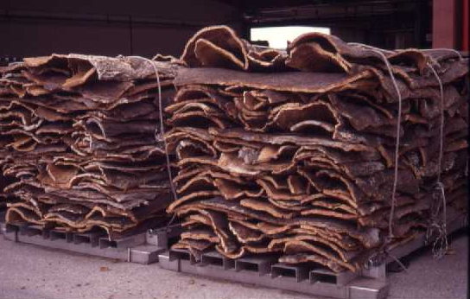
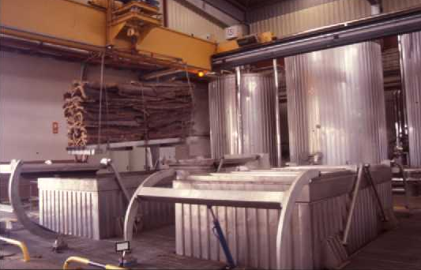
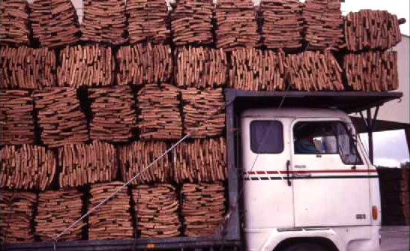
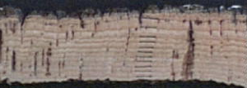
Dimension expansion with boiling: radial – 10-15% tangencial and axial – 5%

