Slide 1
SUBER model
The new version of the SUBER model – predicting multi products from the cork oak ecosystem

Slide 2
SUBER model – modules
Estimation of site productivity
Model initialization
  in which the model simulates the variables that are not available from forest inventory
Simulation of the growth of each tree (individual tree model)
Simulation of cork parameters
  cork growth, evolution of cork thickness, cork weight prediction, cork quality
Simulation of silvicultural practices
  Thinning (uniform system, selection system)
  Regeneration
Non-cork products and services

Slide 3
Structure of the model
Inicialization
Simulate data not available from the forest inventory
Growth
Set of functions to predict tree and cork growth
Stand at
age t
t=t+1
Stand at age t+1
After thinning
Stand at age t+1
N
N
Apply thinning
Thin
?
Debark
?
Y
Y
Stand at age t+1
After debarking
Predict
mortality
Debarking
Predict cork weight

Slide 4
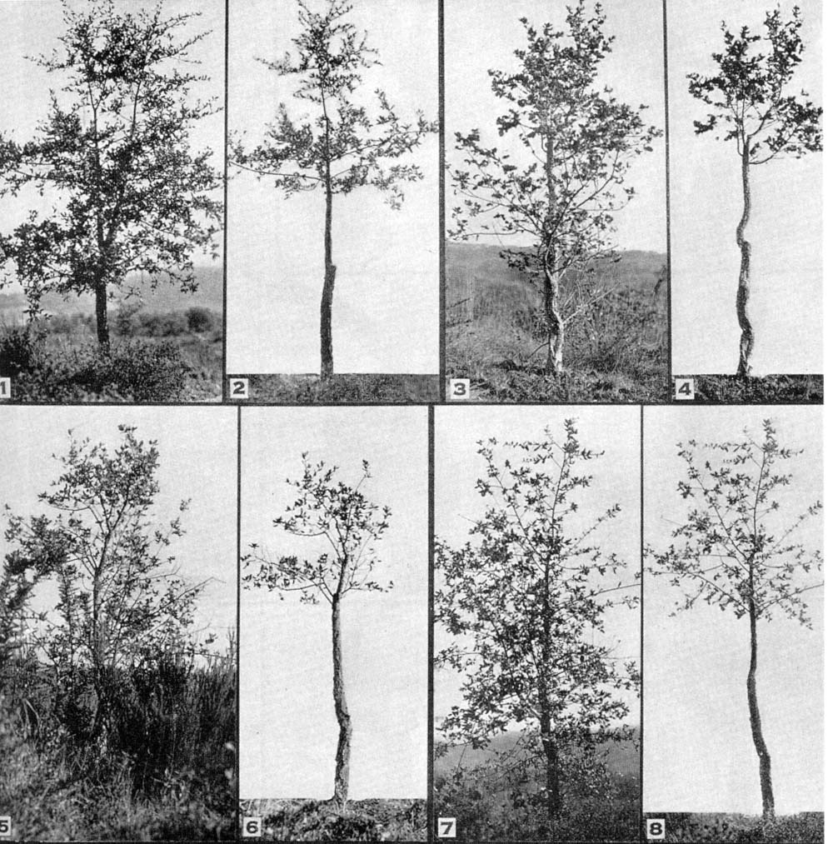
Stages of tree development
h=3.00 m
Regeneration
Juvenile
Intermediate
Mature

Slide 5
SUBER model – modules
Modules:
  Prediction of site productivity

Slide 6
Prediction of site productivity
The development of this module was based on several plots established in juvenile stands (age known) representative of the cork oak stands in Portugal (contrasting climate and soil)
Each site was object of a detailed characterization of the soil, including the study of the whole profile
Climate was characterized by the nearest weather station (IM) and by available soil digital information
The site index curves for cork oak developed for Spain – Mariola Gonzaléz – were used to estimate site index (S) for each plot
The relationship between S and climate and soil characteristics was then modeled (reduced model and full model)

Slide 7
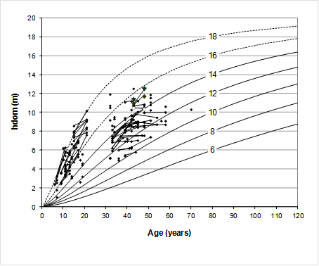
Prediction of site productivity

Slide 8
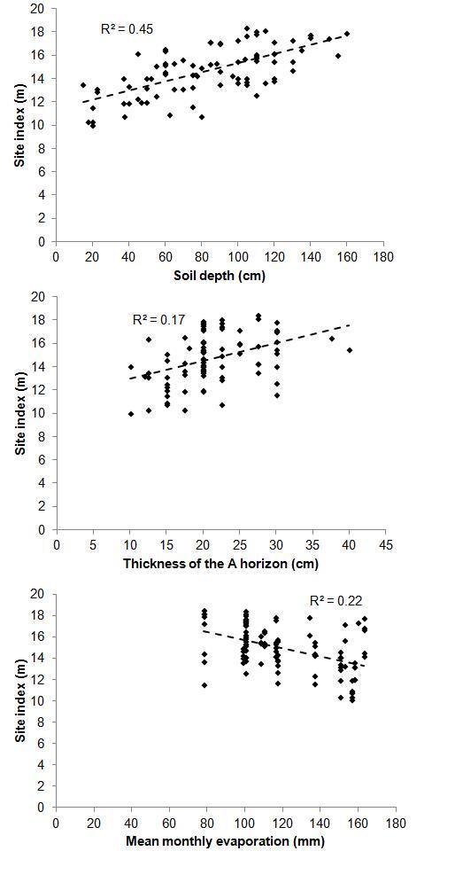
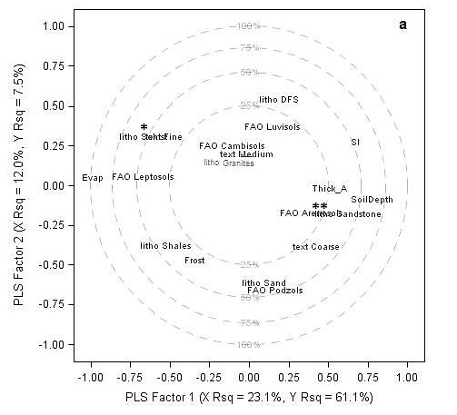
Estimation of site productivity

Slide 9
Prediction of site productivity
Presently working on the prediction and mapping of cork growth index distribution

Slide 10
SUBER model – modules
Modules:
  Methodology to estimate site productivity
  Growth model for trees in the regeneration stage

Slide 11
Growth of trees in the regeneration stage
The growth model for trees in the regeneration stage was based on data from provenance and regeneration trails (M. H. Almeida)
  Dominant height growth is modeled with the Spanish site index curves
  Mean and minimum tree heights are predicted from dominant height
  Height distribution is modeled from those variables
  Each tree is given a height according to the height distribution

Slide 12
SUBER model – modules
Modules:
  Methodology to estimate site productivity
  Growth model for trees in the juvenile stage
  Transition between the regeneration and juvenile stages
  Growth model for the juvenile stage

Slide 13
Transition regeneration → juvenile
The transition of a tree from the regeneration to the juvenile stage was modelled with data from a large set of plots established in juvenile stands
  When a tree attains a height = 3 m, it comes to the juvenile stage and its diameter is predicted (with some random effect added):
  From then on tree dbh growth is modeled with an equation specifically developed for this stage:
  Tree height and crown diameter are predicted with the same functions used for the adult stage, using du estimated from
    du=-1.5276+0.8321 d

Slide 14
SUBER model – modules
Modules:
  Methodology to estimate site productivity
  Module to simulate growth of trees in the juvenile stage
  Transition between the regeneration and juvenile stages
  Growth model for trees in the juvenile stage
  Transition between the juvenile and adult stages

Slide 15
Transition juvenile → adult
The transition of a tree from the juvenile to the adult stage includes three sub-models:
  Decision about debarking (for even-aged stands, when p% of the trees have a d>22.28 cm)
  Prediction of diameter under cork
  Simulation of height of branching
  Simulation of the number of branches that will be debarked
    Monte-Carlo simulation using observed distributions by NUTII or a user defined distribution

Slide 16
SUBER model – modules
Modules:
  Methodology to estimate site productivity
  Module to simulate growth of trees in the juvenile stage
  Transition between the regeneration and juvenile stages
  Growth model for trees in the juvenile stage
  Transition between the juvenile and adult stages
  Growth model for trees in the adult stage

Slide 17
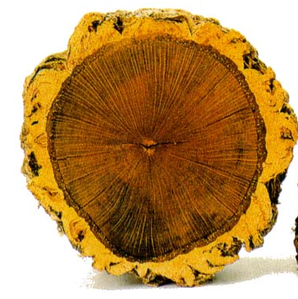
SUBER - tree growth at dbh
data from stem analysis

Slide 18
Growth of trees in the adult stage
Diameter under cork growth model for dominant trees was developed using the Richards function formulated as an age-independent difference equation
k parameter
  If stand age is known, S can be directly estimated, if not it can be predicted from soil and climate characteristics
  Genetic variability is simulated through the k parameter
  Tree height and crown diameter are also predicted with prediction functions common to juvenile and mature stages

Slide 19
SUBER model – modules
Modules:
  Methodology to estimate site productivity
  Module to simulate growth of trees in the juvenile stage
  Transition between the regeneration and juvenile stages
  Growth model for trees in the juvenile stage
  Transition between the juvenile and adult stages
  Growth model for trees in the adult stage
  Prediction of cork weight as a function of cork age

Slide 20
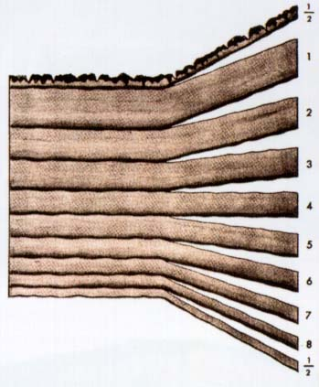
Modelling options - cork growth
Example with a cork with 9 years
1st half year
total cork thickness
8 complete years
(cork growth index)
last half year

Slide 21
Modelling options - cork growth
Cork growth sub-models:
  juvenile stage
    1st cork thickness distribution
  intermediate and mature stages
    cork growth prediction (complete years)
    total cork thickness prediction
        (as a function of the thickness of complete years)
    evolution of cork growth index through successive cork extractions
    modification of cork growth index as a consequence of cork extraction intensity??? -> next topic!

Slide 22
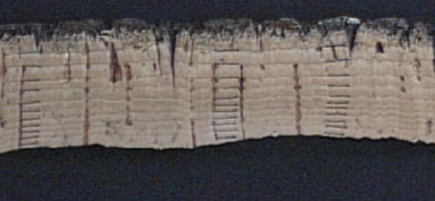
SUBER - cork growth
Data from cork ring measurements in cork samples with ages ranging from 7 to 16 years

Slide 23
SUBER - cork growth
Data from cork ring measurements in cork samples with ages ranging from 7 to 16 years
Data on the relationship between total cork thickness and thickness of complete rings

Slide 24
Modelling options - cork growth
Predict cork caliber with 9 years from a measurement at 4 years
Start with cork calibre with 4 years (measured in the field)
Discount the cork back and the 2 half years to obtain cork thickness in 3 complete years
(eq. 3)
Predict cork thickness in 8 complete years
(eq. 1)
Predict cork calibre with 9 years
(eq. 2)

Slide 25
Evolution of cgi in sucessive debarkings
cgi
Successive debarkings

Slide 26

Prediction of cork weight using cork age
Equation to predict cork weight for corks with 9 years
Equation to predict % cork back weight at 9 years of age (cbp₉)
Estimate the biomass of cork tissue free from the cork back
Estimate the cork biomass for t years of growth

Slide 27
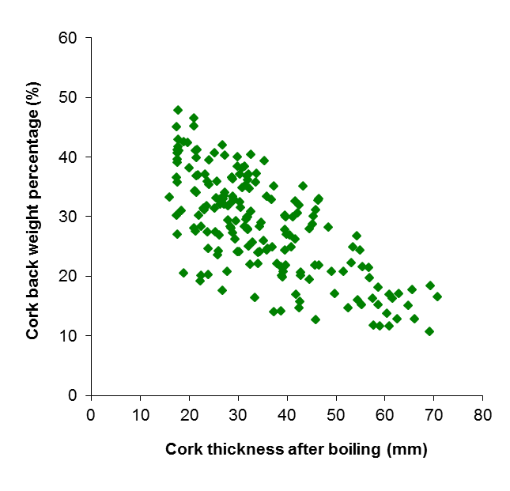
Percentage of cork back (in weight)

Slide 28
SUBER model – modules
Modules:
  Methodology to estimate site productivity
  Module to simulate growth of trees in the juvenile stage
  Transition between the regeneration and juvenile stages
  Growth model for trees in the juvenile stage
  Transition between the juvenile and adult stages
  Growth model for trees in the adult stage
  Prediction of cork weight as a function of cork age
  Simulation of thinnings without using competition indices

Slide 29
Simulation of thinnings without CI
The SUBER 3 model was used to simulate the development of several plots with alternative thinning strategies
These simulated data were used to develop a model that predicts the probability of a tree being thinned (logistic regression):
Trees are “thinned” with Monte-Carlo simulation
  Uniform system: all trees at the same time
  Selection system: by diameter class, towards a target distribution

Slide 30
SUBER model – modules
Modules:
  Methodology to estimate site productivity
  Module to simulate growth of trees in the juvenile stage
  Transition between the regeneration and juvenile stages
  Growth model for trees in the juvenile stage
  Transition between the juvenile and adult stages
  Growth model for trees in the adult stage
  Prediction of cork weight as a function of cork age
  Simulation of thinnings without using competition indices
  Non-cork products and services

Slide 31
Non-cork products and services
Products considered:
  Wood from thinnings and harvests (under implementation)
  Total biomass by tree components
  Carbon (total and by tree components)

Slide 32
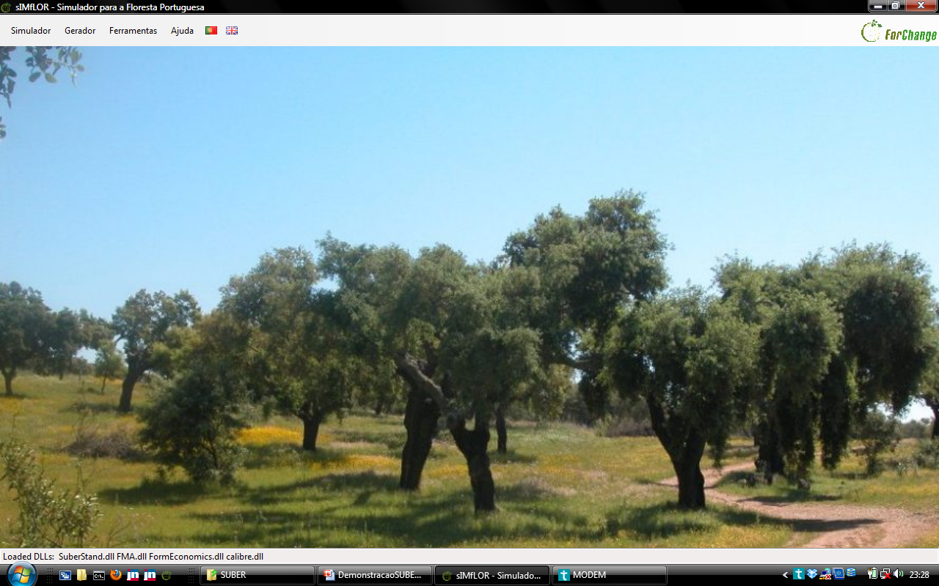
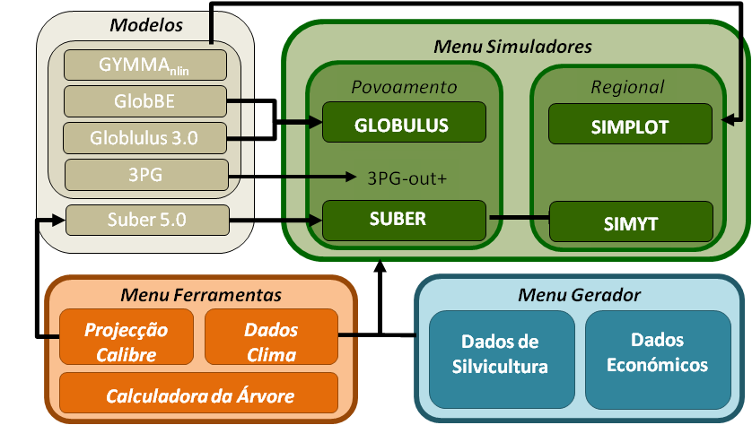
Just a few words on…
sIMfLOR forest simulators platform
  www.isa.ulisboa.pt/cef/forchange/fctools

Slide 33
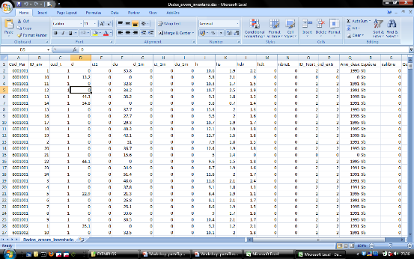
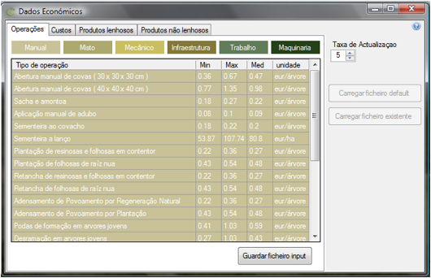
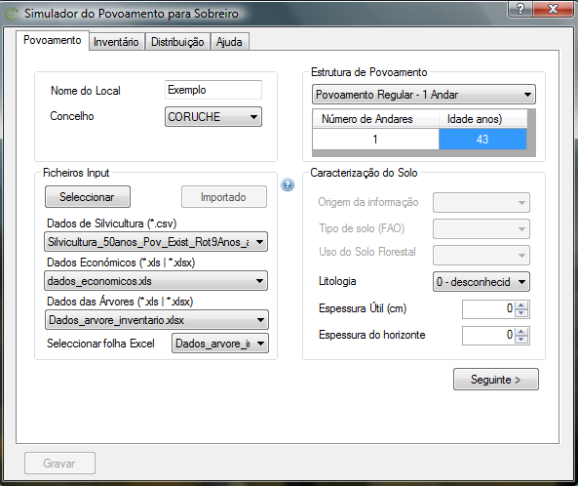
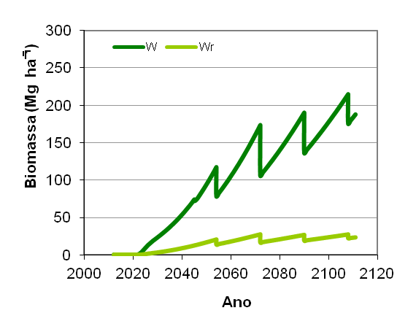
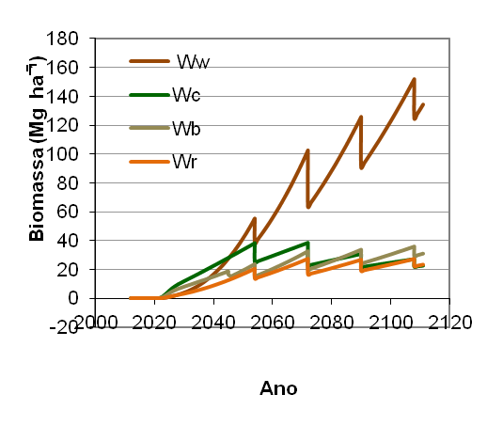
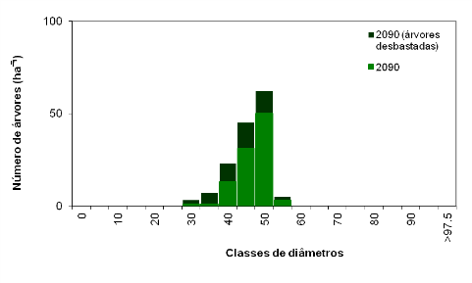
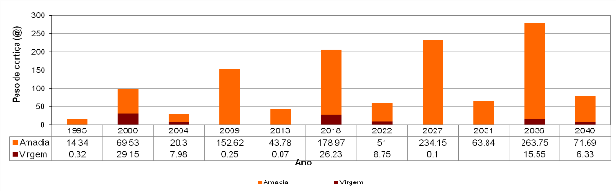
Just a few words on…
sIMfLOR forest simulators platform
  www.isa.ulisboa.pt/cef/forchange/fctools

Slide 34
SUBER model – application
THE PROBLEM
During the last decades cork oak stands have been used as a silvopastoral system with sheep grazing underneath the trees
Some landowners think that grazing is no more profitable, so they are considering several alternatives:
  Increase stand density at least for 50% crown cover (OPTION 1)
  Maintain a lower stand density (40%) and move to a selection system (OPTION 2)
  Maintain a lower stand density (40%) combined with read deer to increase the income (OPTION 3)

Slide 35
SUBER model – application
AN EXAMPLE
  Application to a stand with 252 ha
  Stand density: 136 ha⁻¹
  Basal area: 7.76 m² ha⁻¹ (under bark)
  Quadratic mean dbh: 28 cm
  Crown cover: 40%
It is a relatively young stand, “more or less” even-aged
Cork rotation is 9 years, with two extractions in a 9 years period (two cork ages)

Slide 36
Present status of the stand
Net present value ha⁻¹ 13975.1
OPTION 1
Net present value ha⁻¹=16238
OPTION 2
Net present value ha⁻¹=13539
OPTION 3
Net present value ha⁻¹=14174

Slide 37
SUBER model – application
CONSEQUENCES
After this first application the landowners put other questions:
  Is 9 years the best cork extraction rotation?
  Is it wise to concentrate cork extraction on every i^{th} year?
  Should cork extraction intensity be increased from now or from the next debarking?
Again, the SUBER model was used to give answer to these questions

Slide 39
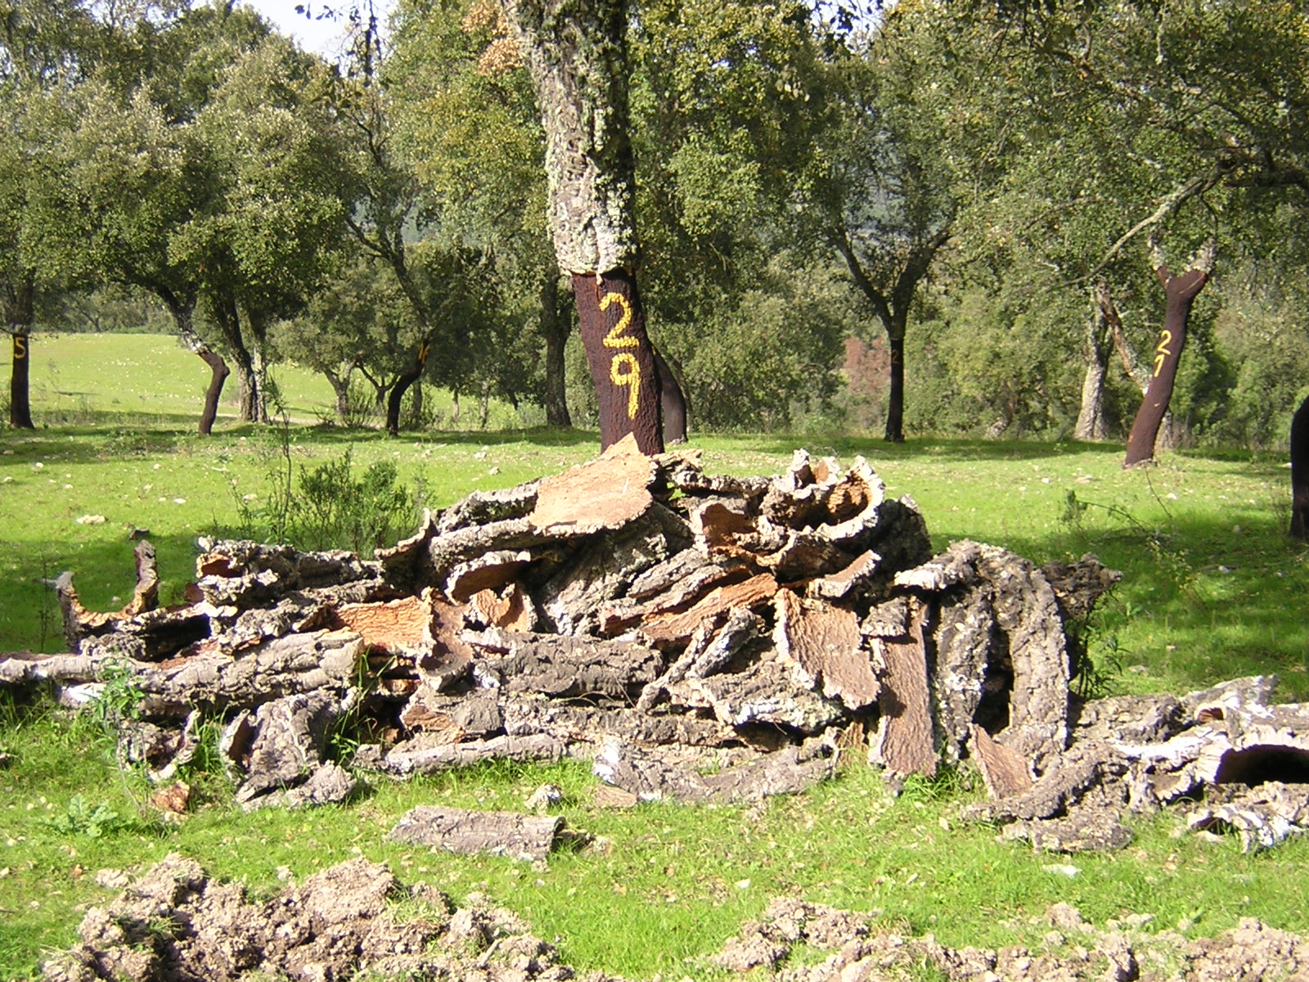
The END

