Slide 1
Tree and stand variables biomass

Slide 2
Outline
Definition of biomass
Total biomass and biomass per tree component
Direct evaluation of biomass?
Indirect evaluation of biomass
  Stem biomass (wood and bark)
  Crown biomass (branches and leaves)
  Root biomass
Biomass estimation with allometric equations
The special case of cork biomass

Slide 3
Total biomass and biomass per tree component
Biomass is defined as “dry weight” (after drying in a stove till constant weight is achieved)
It is important to take into account the biomass of the different tree components:
  Stem, separated into wood and bark
  Crown, separated into branches, leaves, flowers and fruits
  Roots, separated in main root, thick roots and fine roots
Tree total biomass is the sum of all the tree components
  For some purposes some components are not taken into account (e.g. flowers and fruits for the Kyoto protocol)
Tree total aboveground biomass does not include the roots

Slide 4
Why is biomass estimation it so important?
Biomass estimation is the basis for the evaluation of carbon stocks, carbon sequestration and nutrients balance
Forest products (wood and non-wood) are many times marketed on a weight basis:
  Wood for energy (or even for other purposes)
  Cork, one of the most important forest products in Mediterranean regios, is marketed on a weight basis

Slide 5
Biomass – direct evaluation?
The evaluation of tree biomass implies the harvest of the tree, including the up-rooting, and the separation of all the tree components
Ecen though, in the field just the fresh weight can be obtained – therefore direct evaluation is not possible…
Tree biomass estimation depends on the tree component:
  Determination of water content in a sample (by drying the sample in a stove)
  Wood and bark biomass may be obtained from volume estimation and wood or bark density
  Among other possible methods …

Slide 6
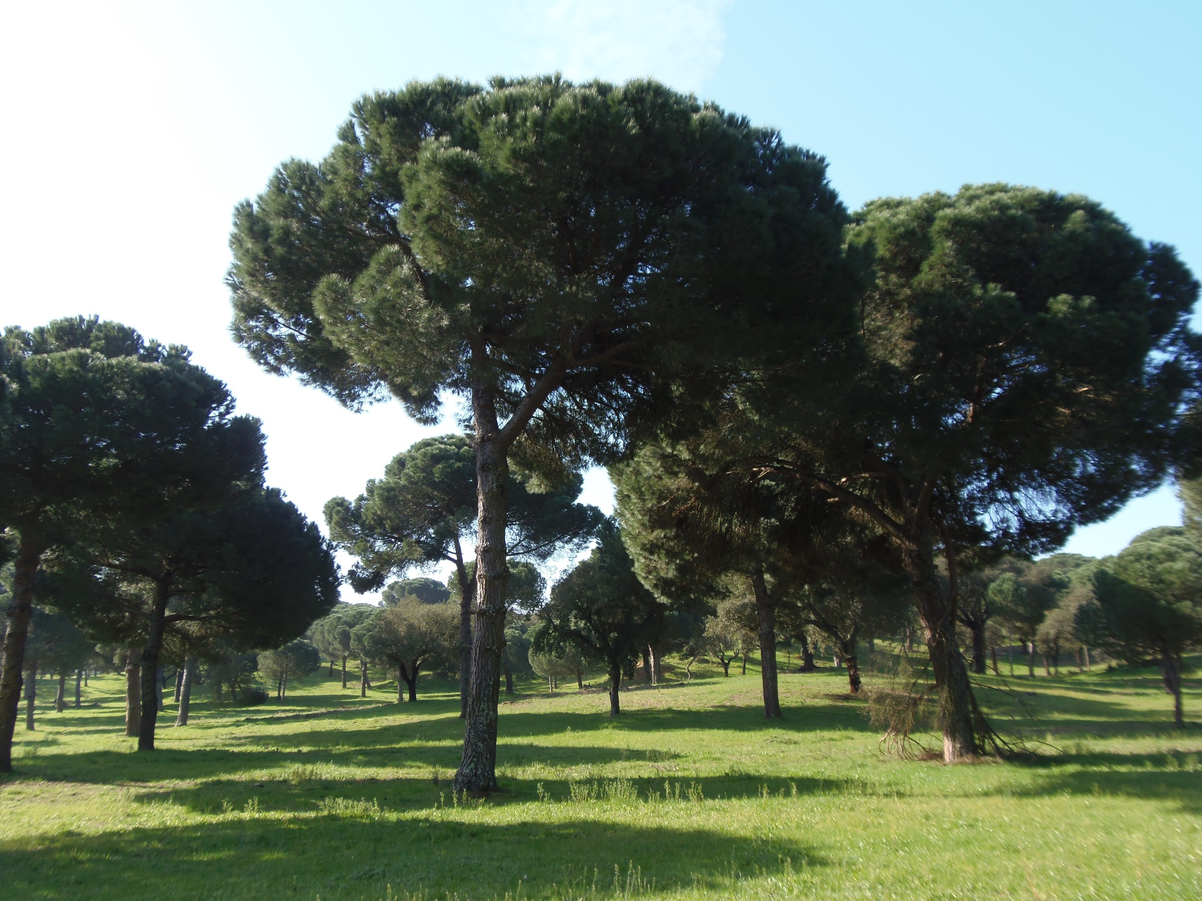

Slide 7
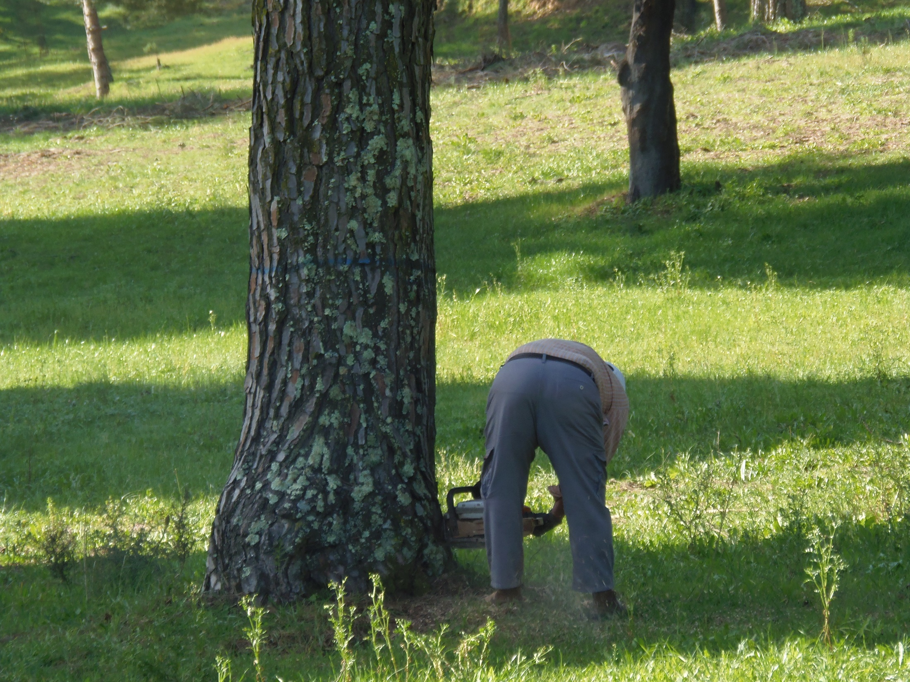

Slide 8
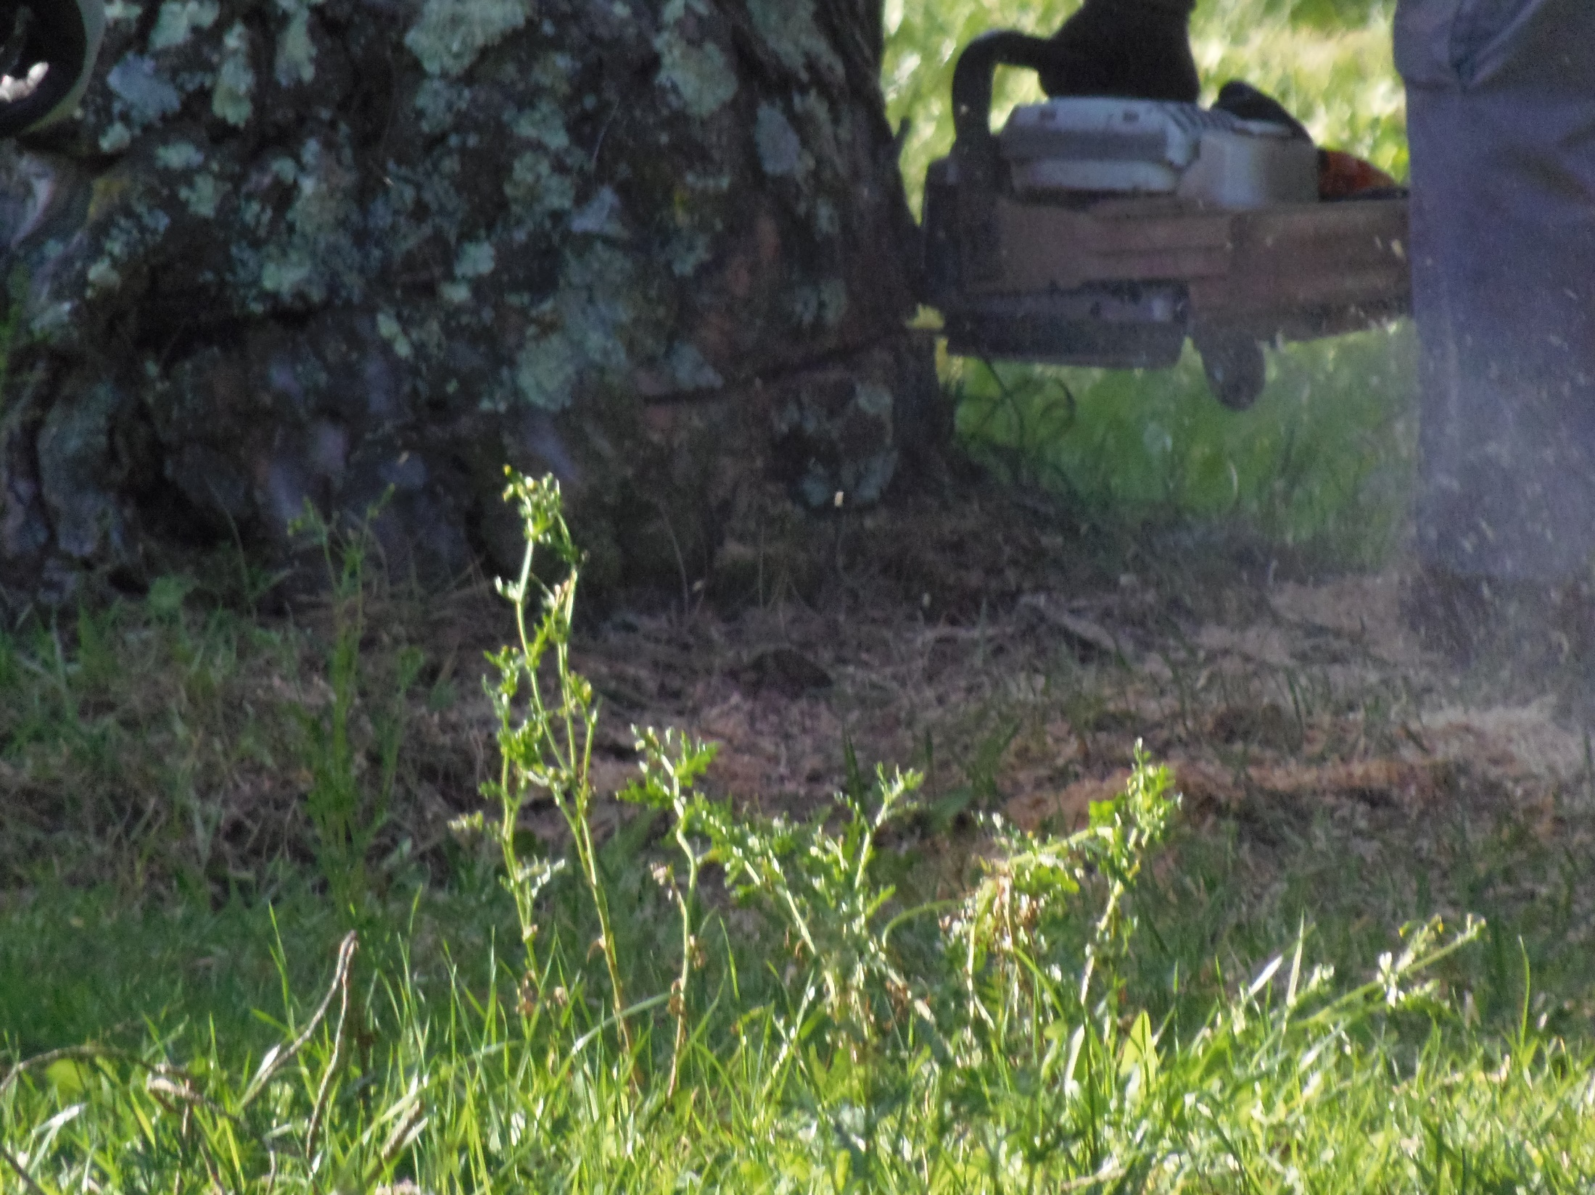

Slide 9
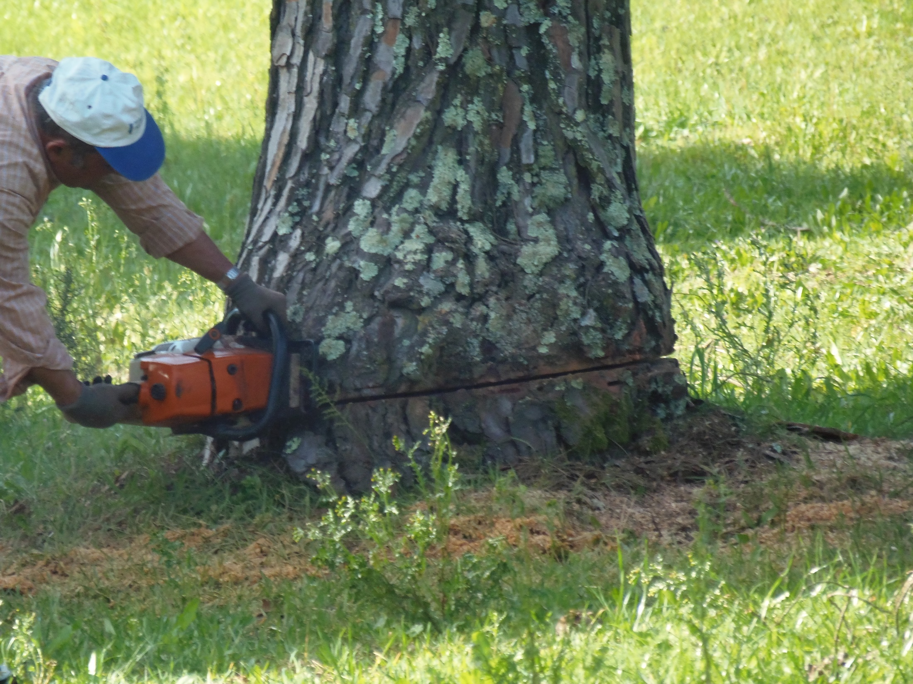

Slide 10
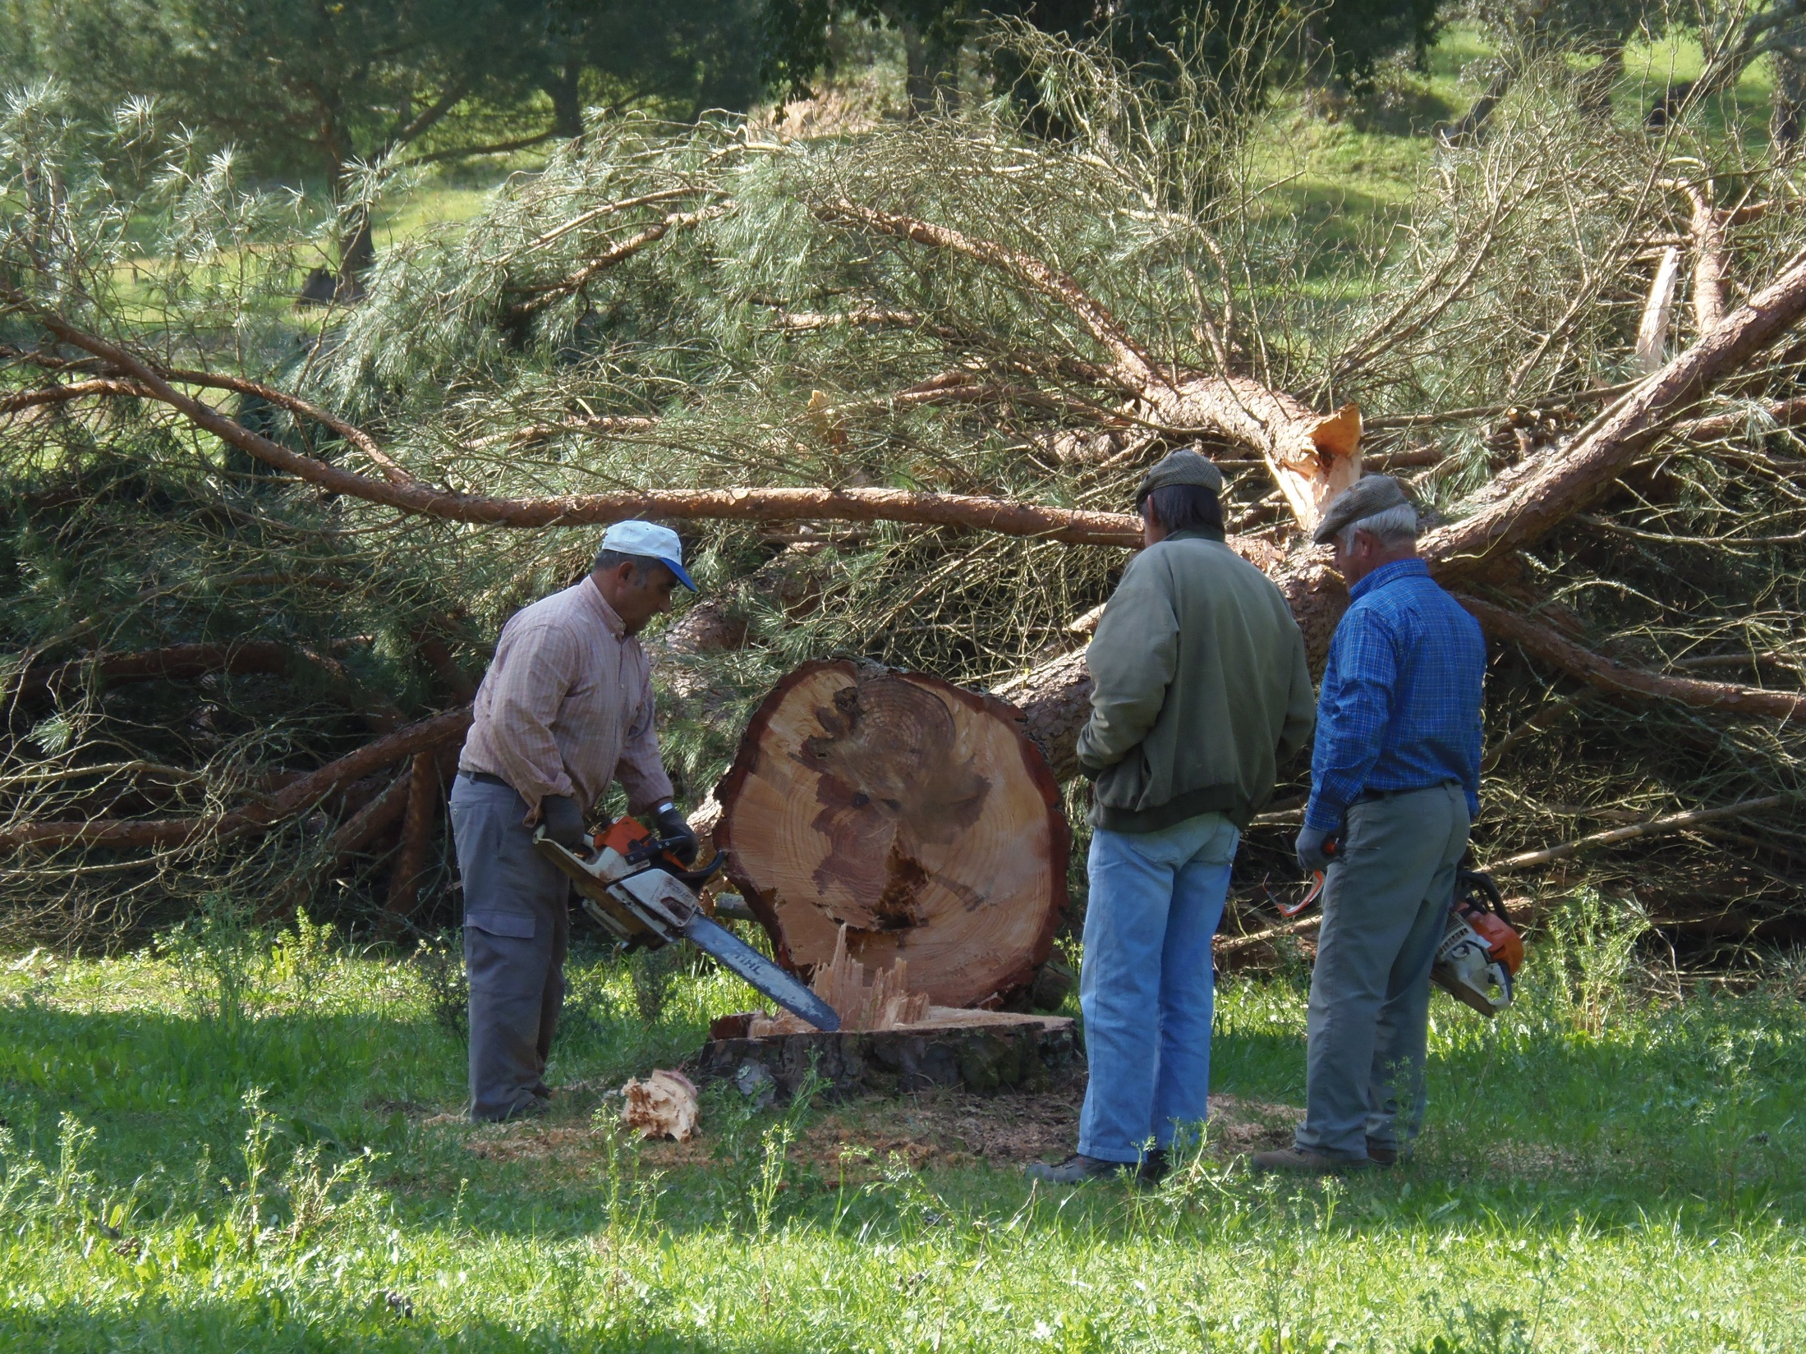

Slide 11
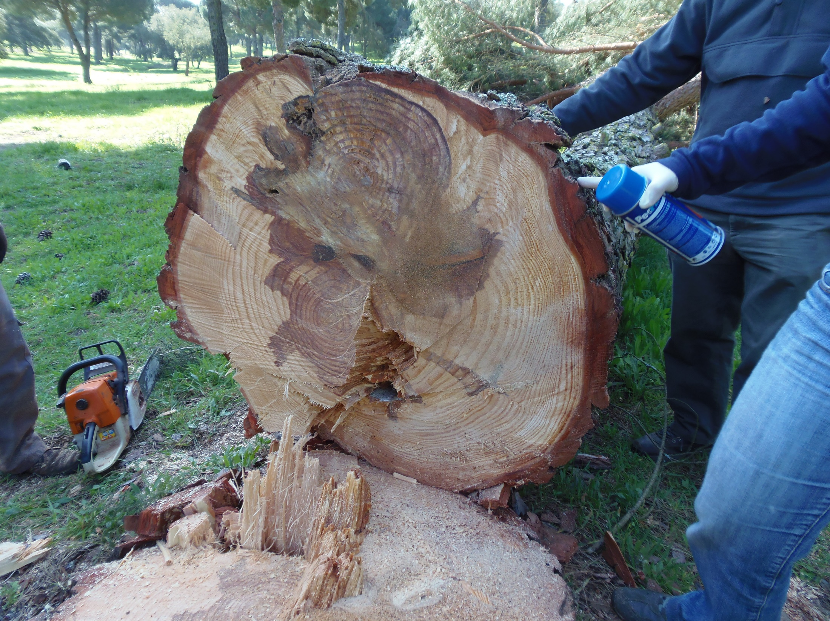

Slide 12
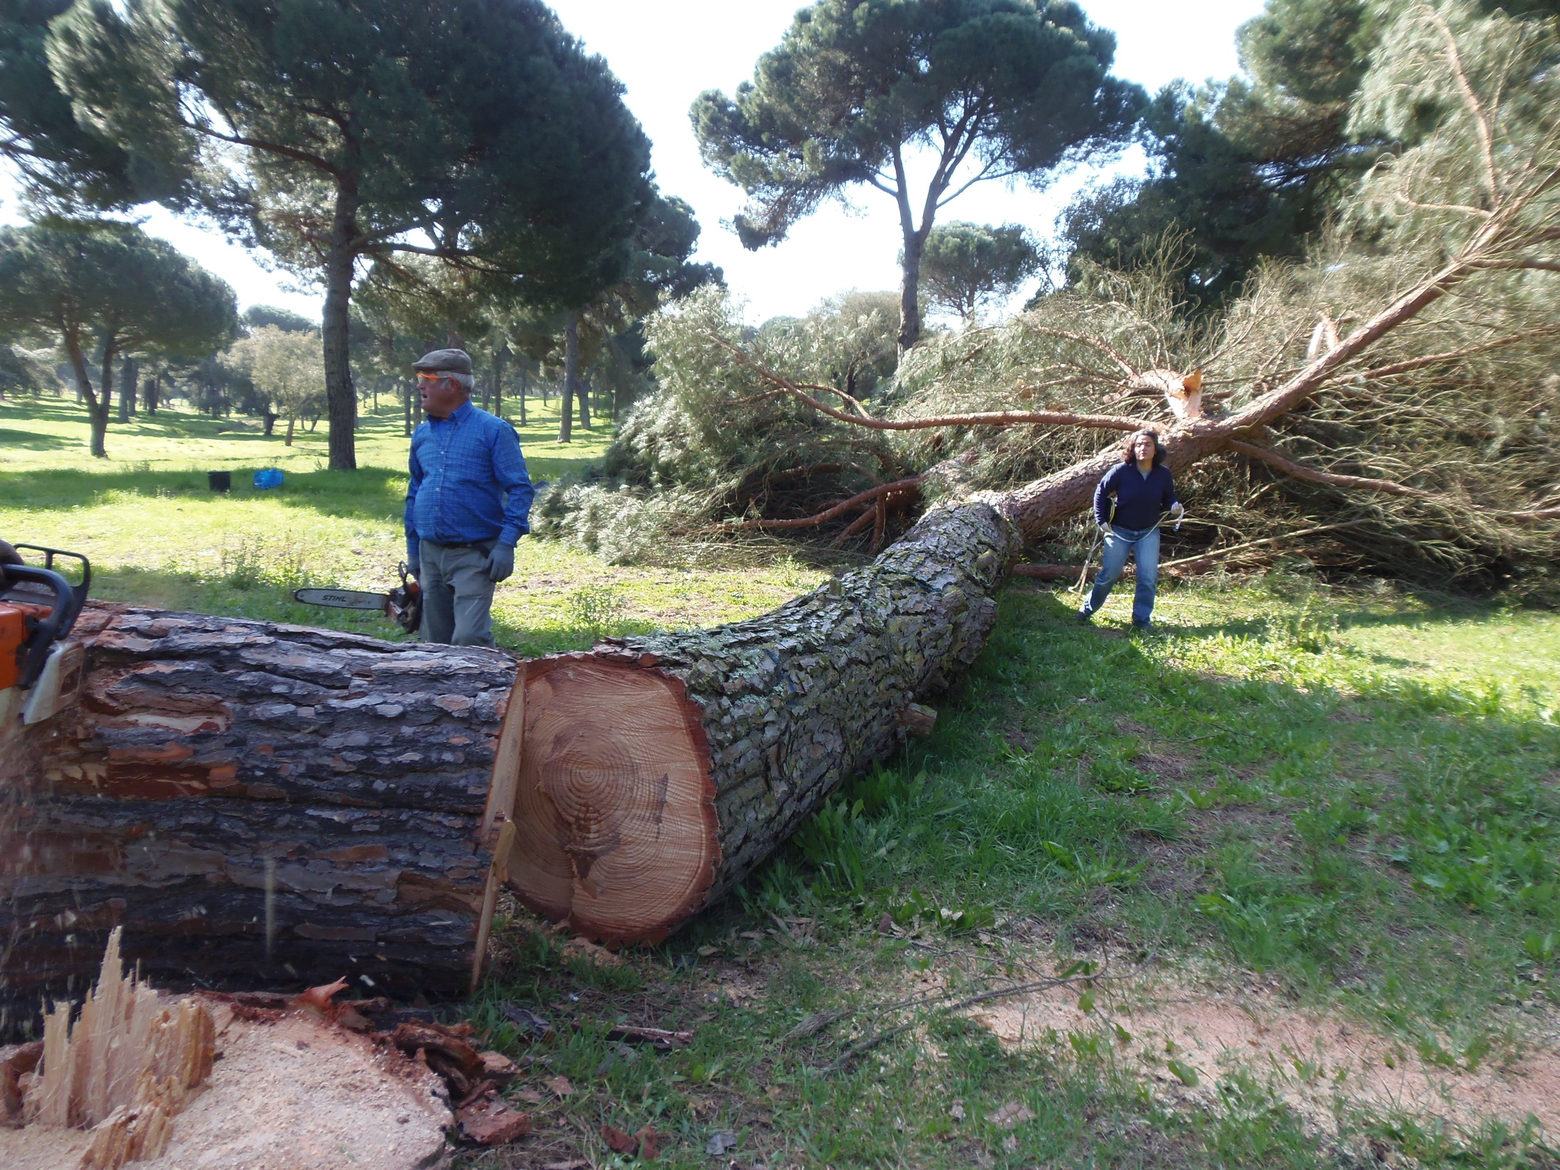

Slide 13
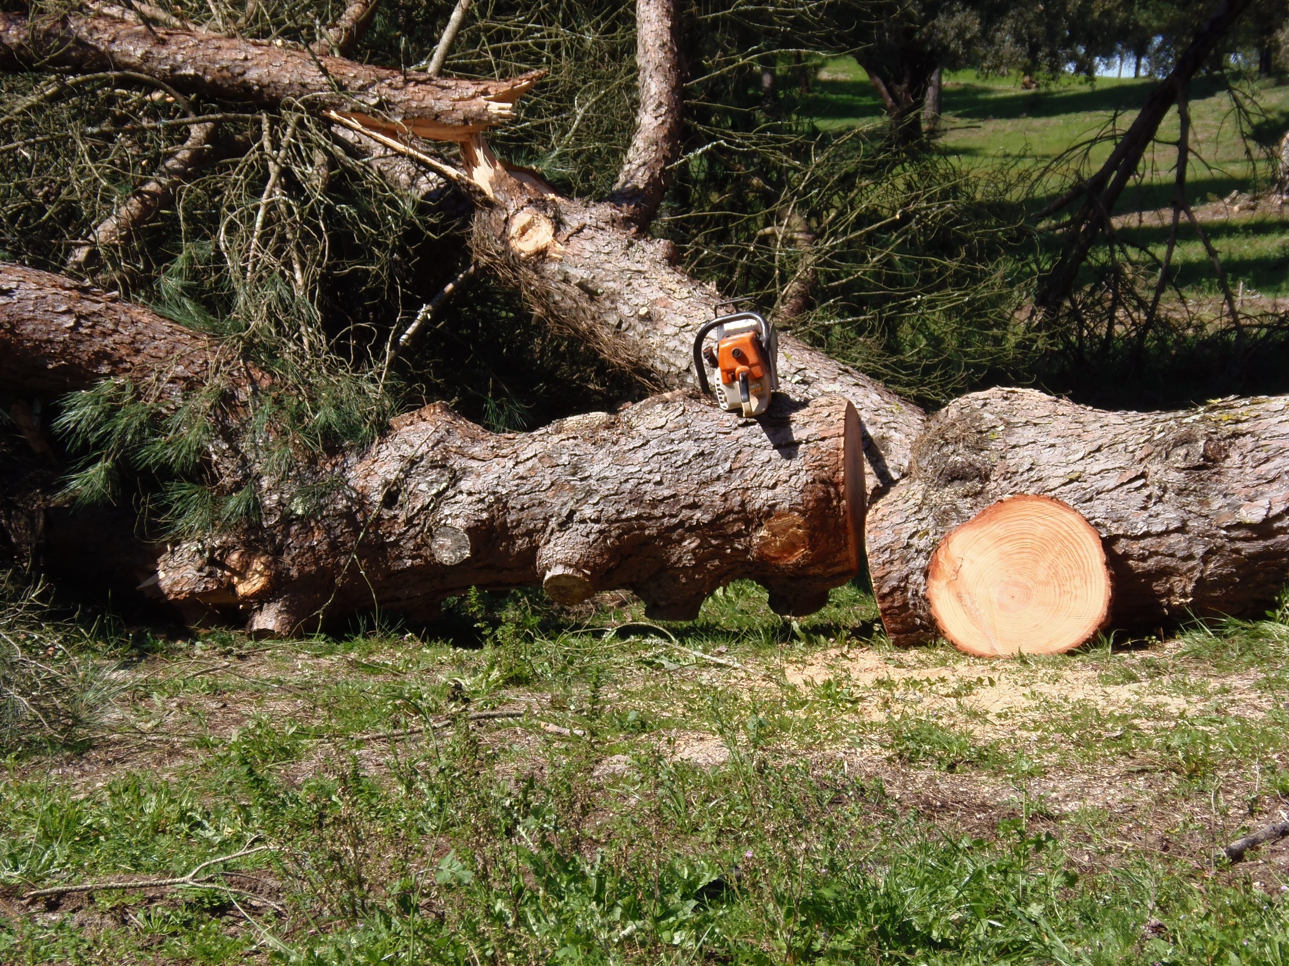

Slide 14
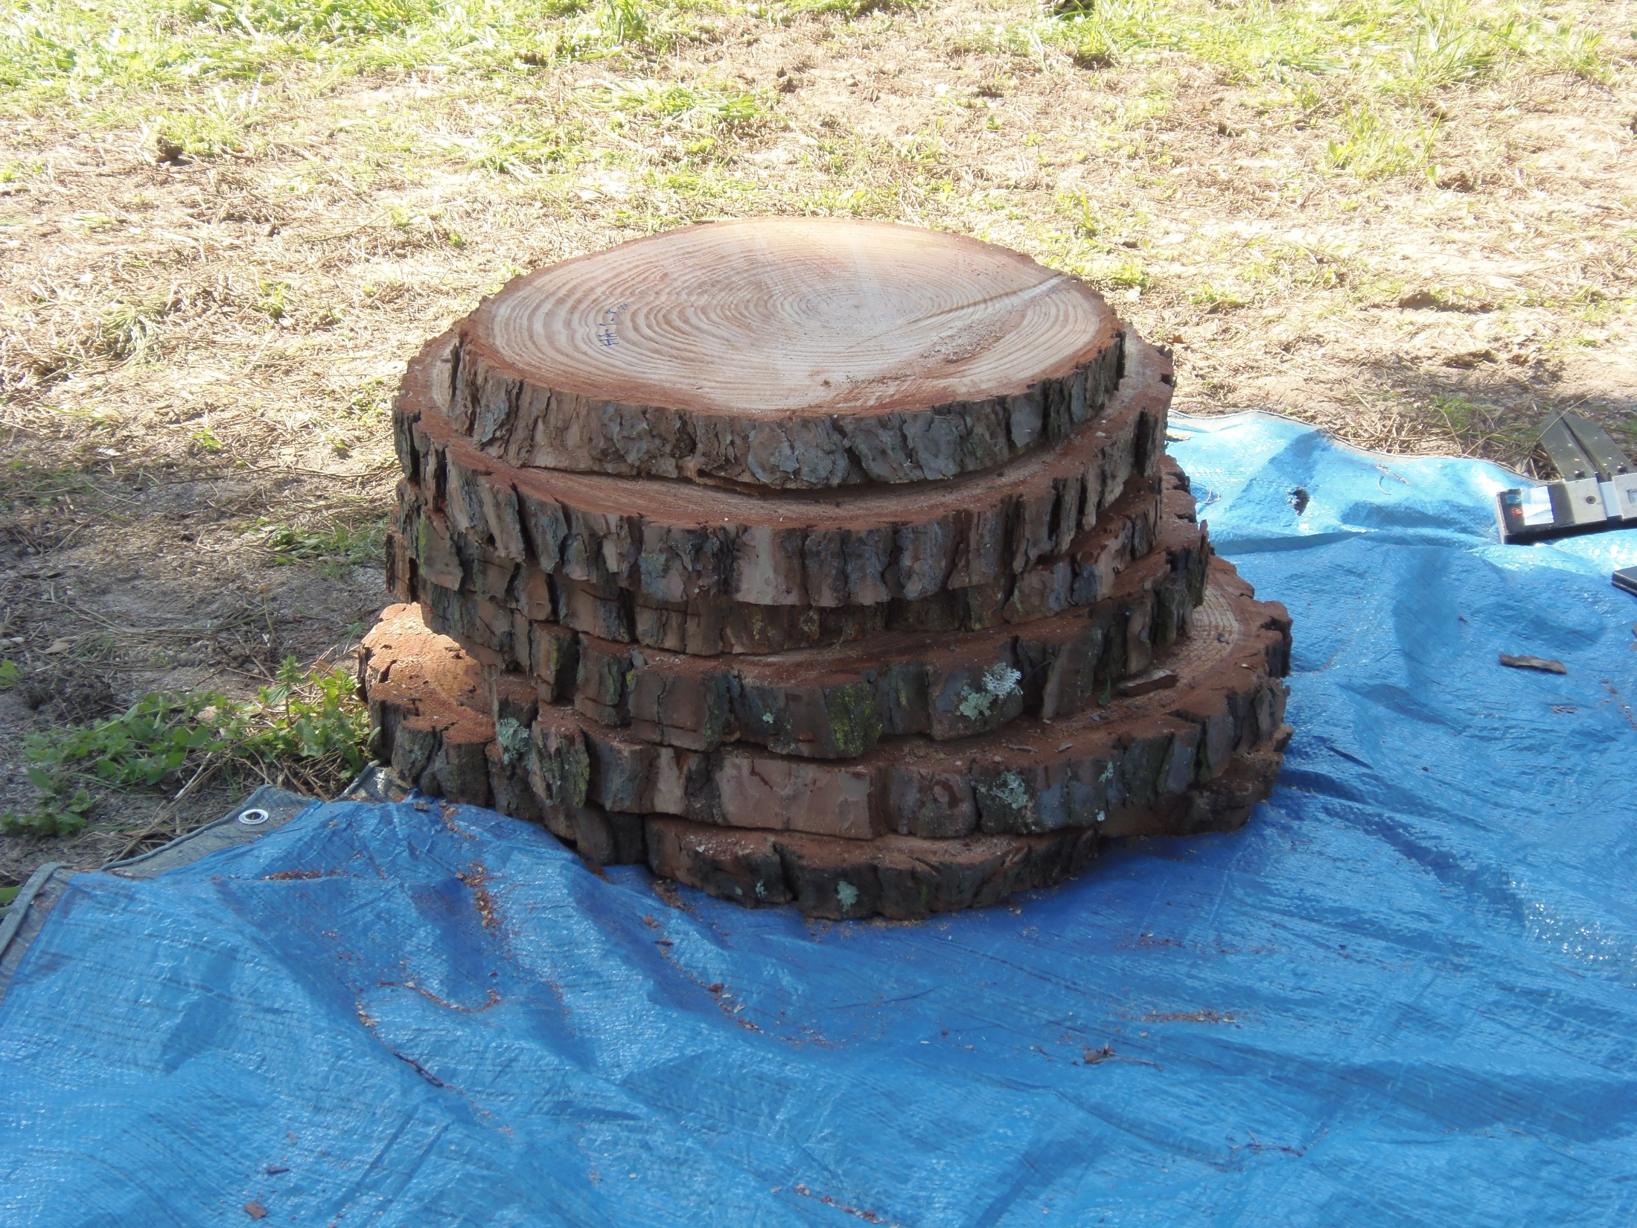

Slide 15
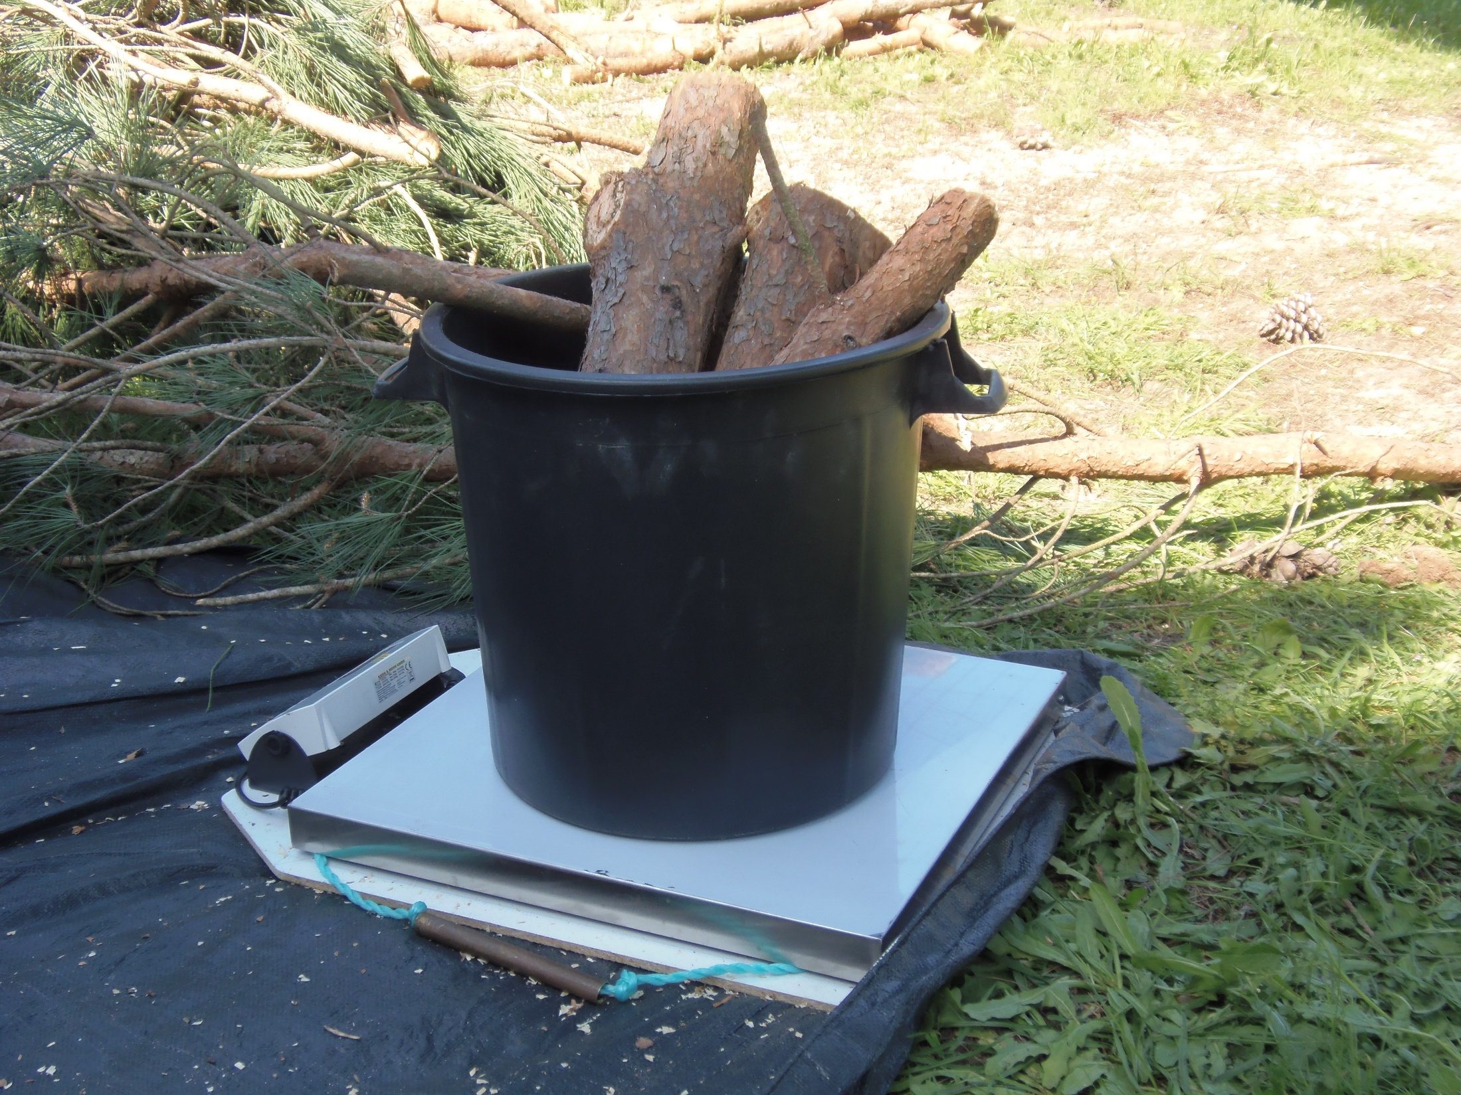

Slide 16
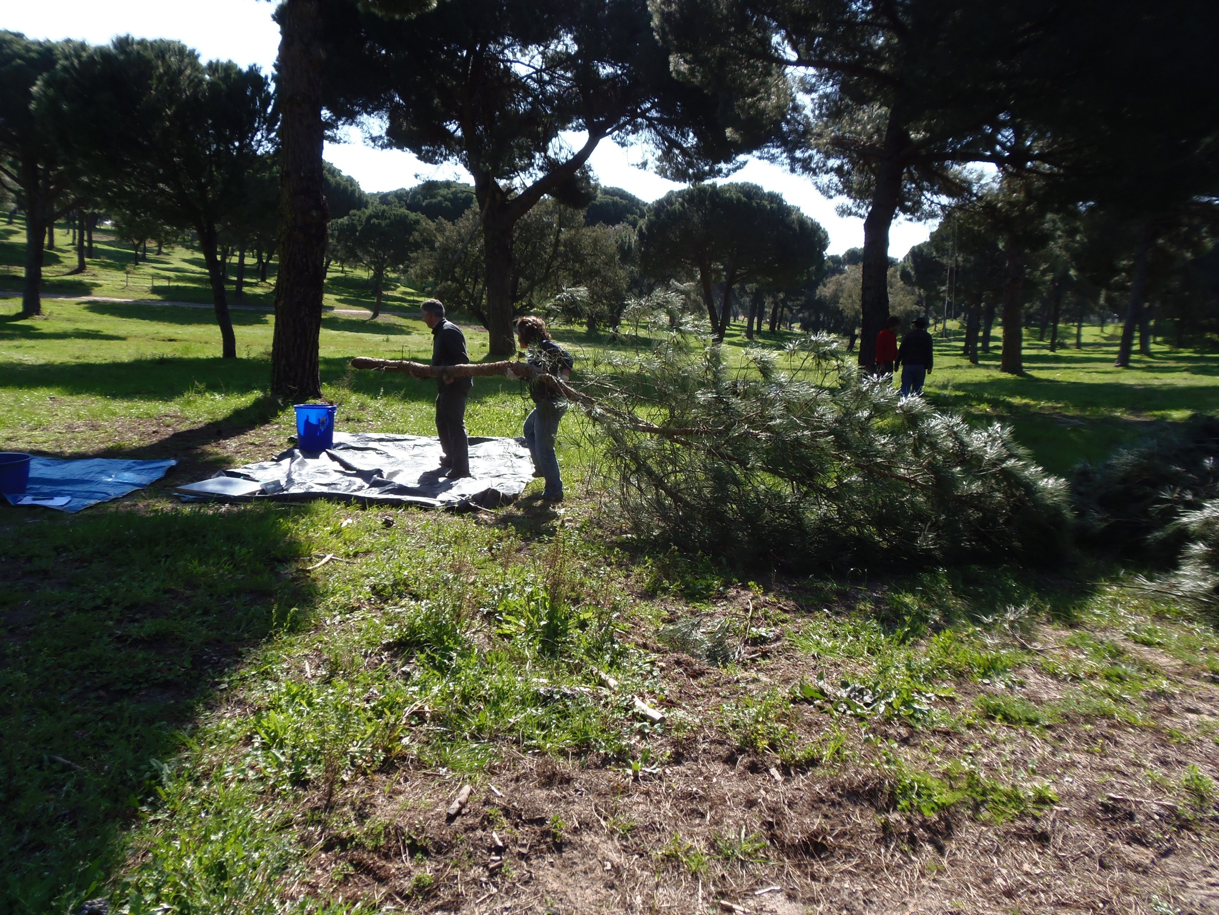

Slide 17
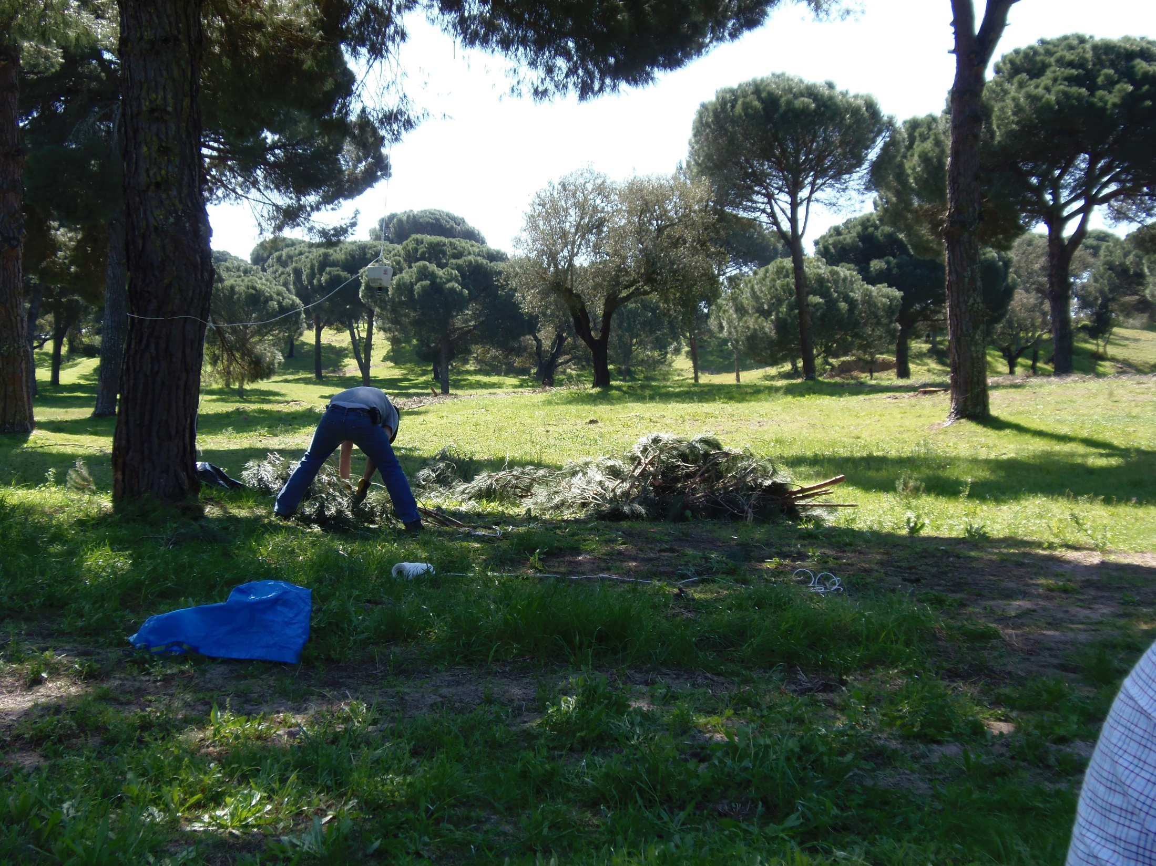

Slide 18
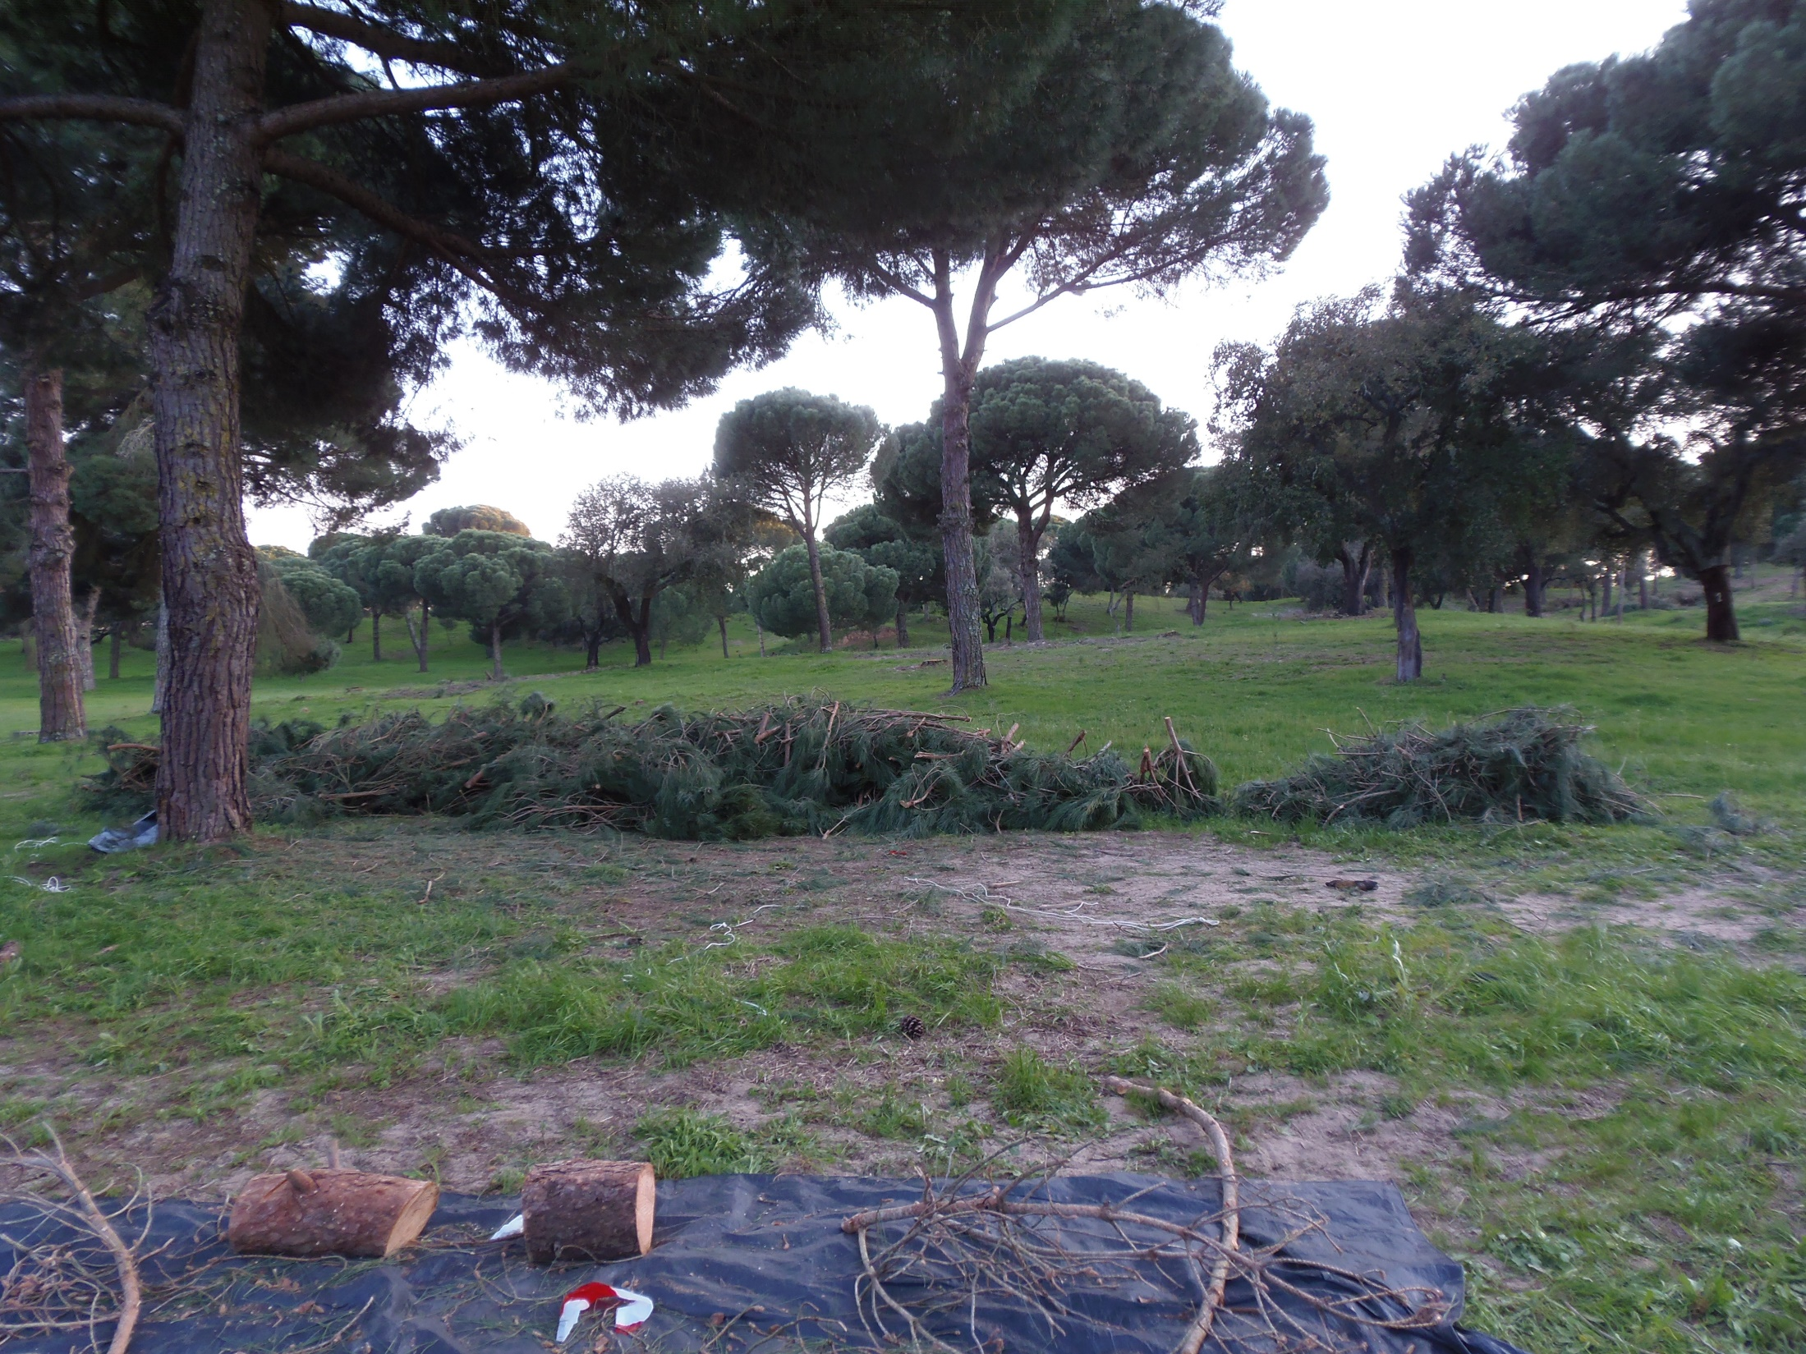

Slide 19
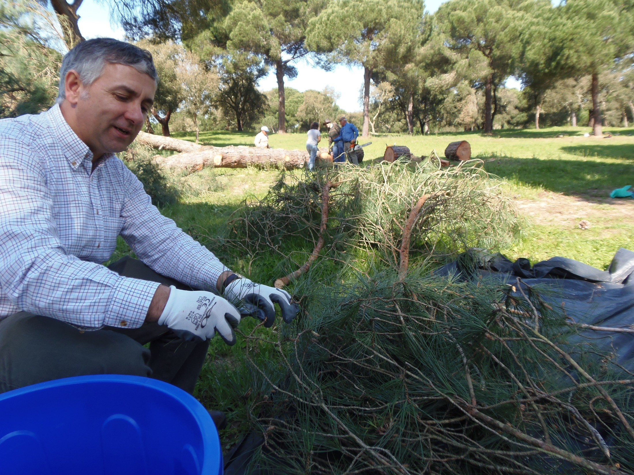

Slide 20
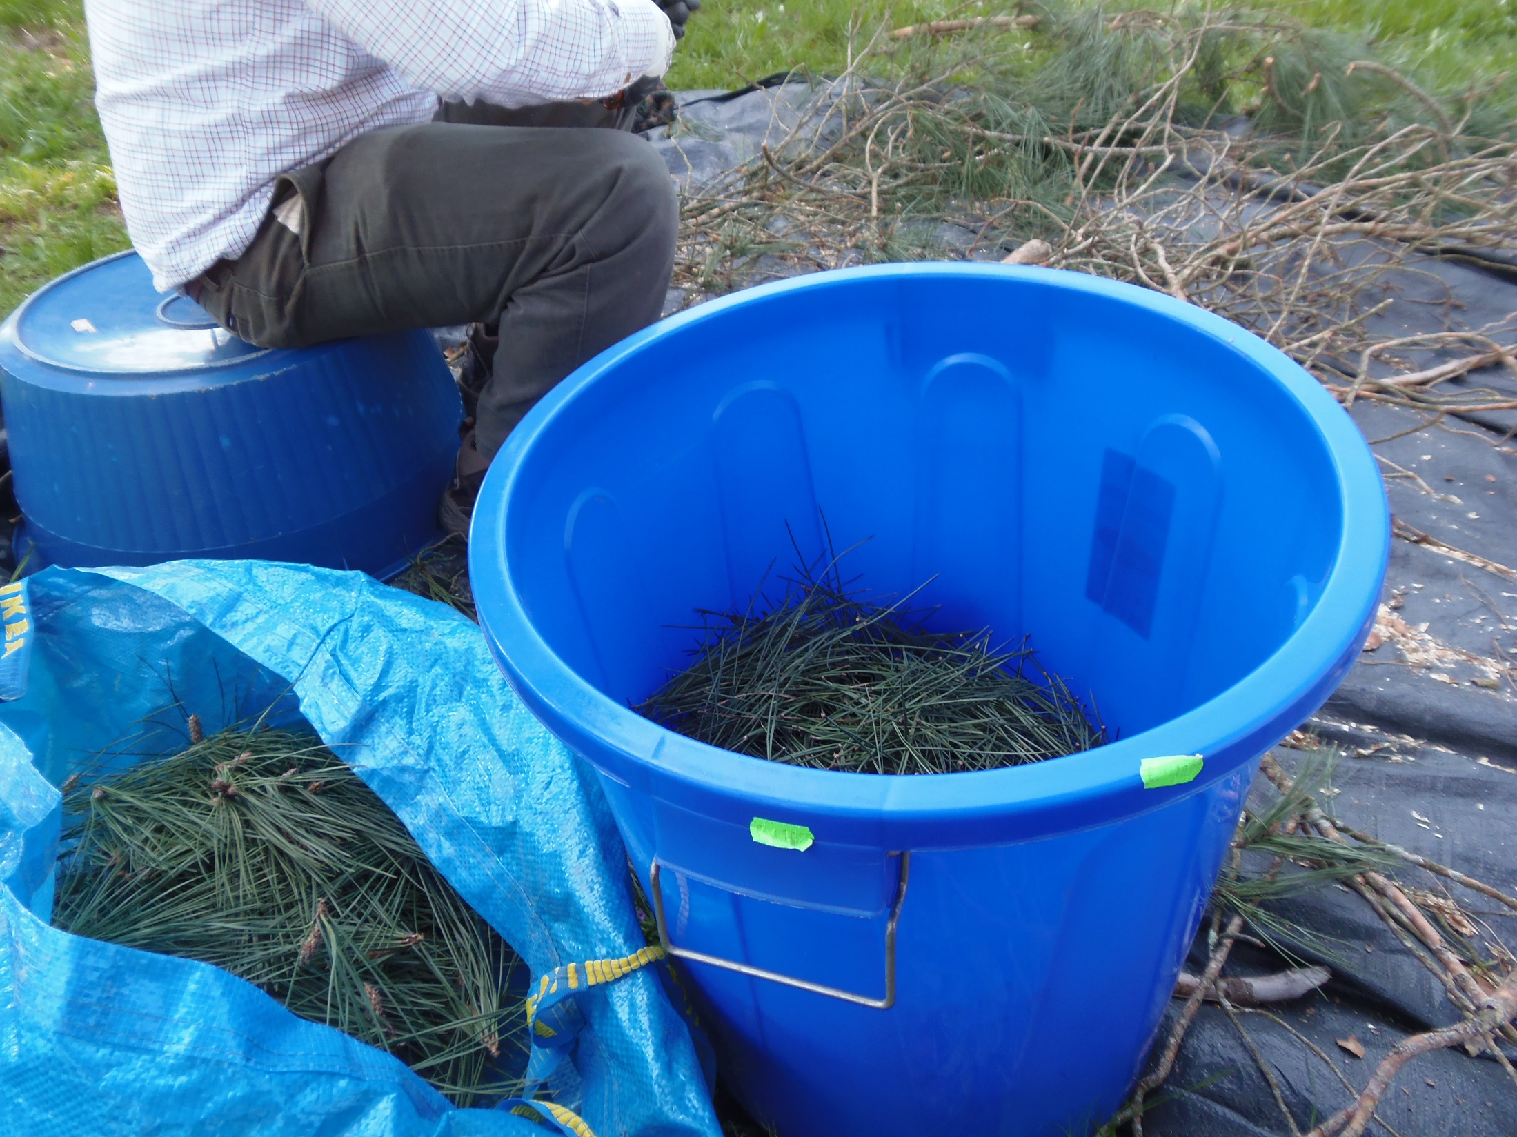

Slide 21
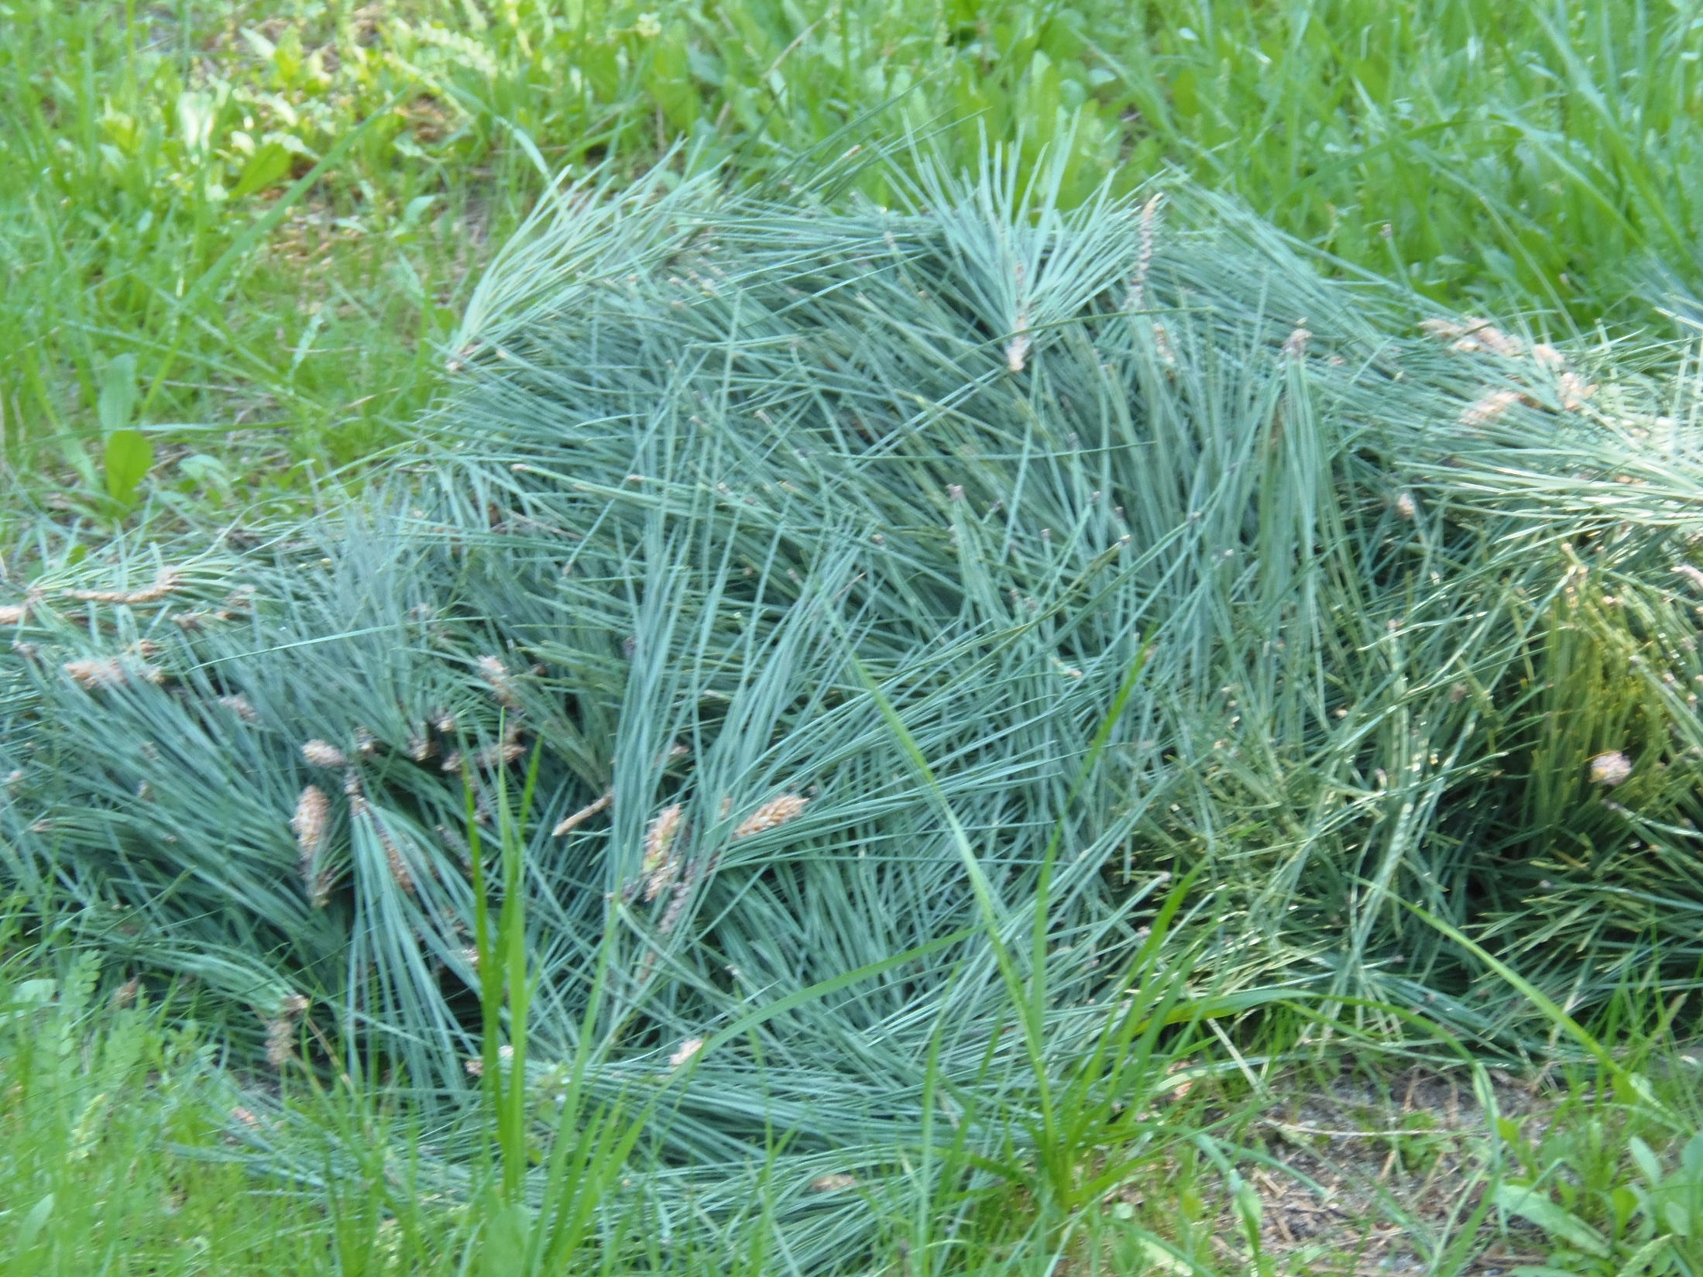

Slide 22
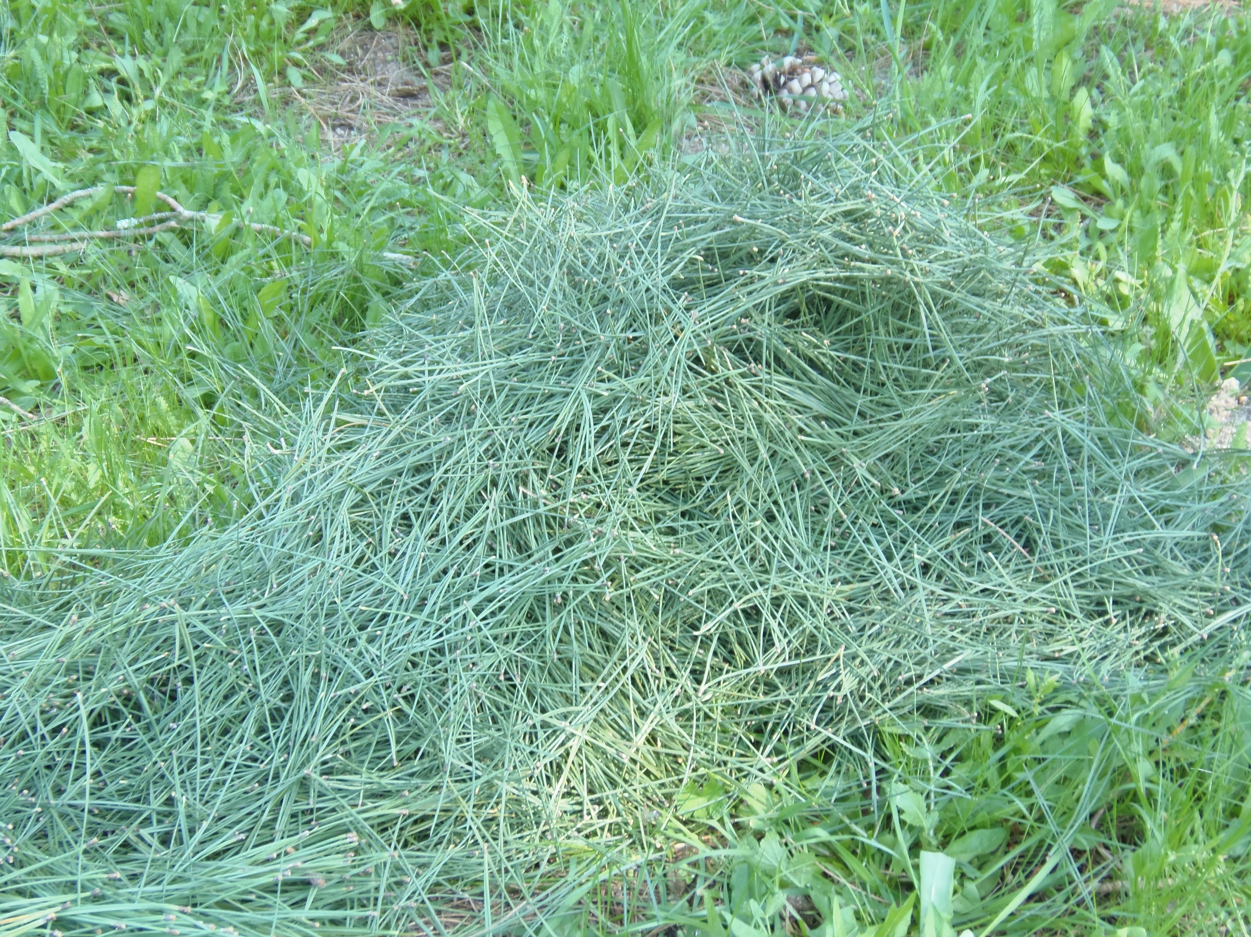

Slide 23
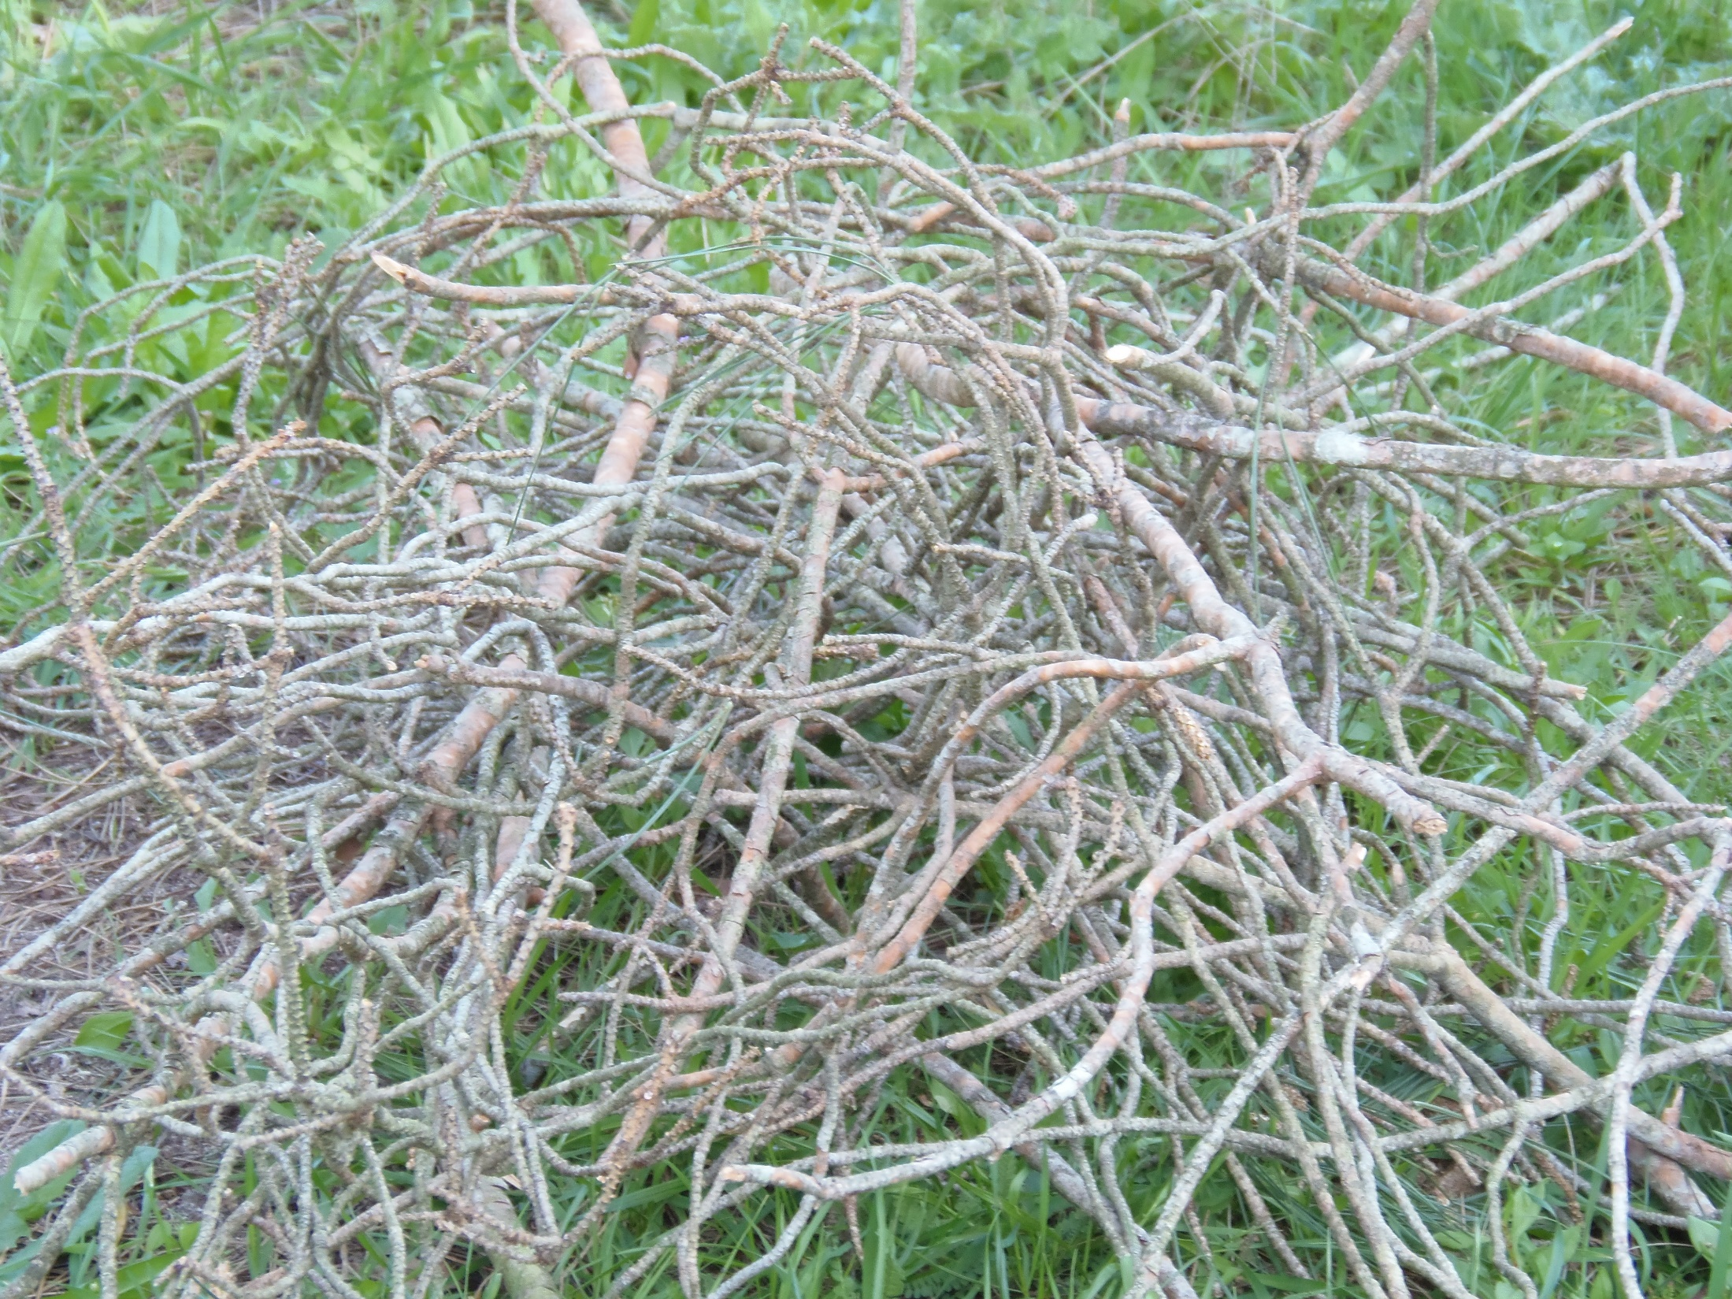

Slide 24
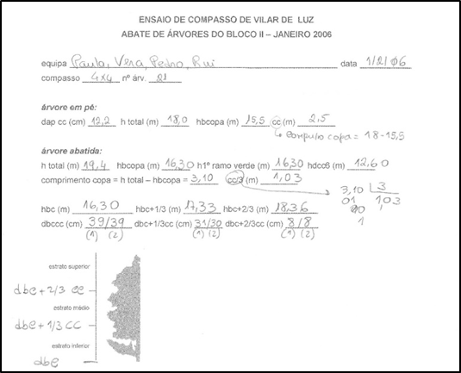
Example of data for tree biomass determination
These data refere to an eucalyptus tree harvested in a plot with spacing 4X4 m

Slide 25
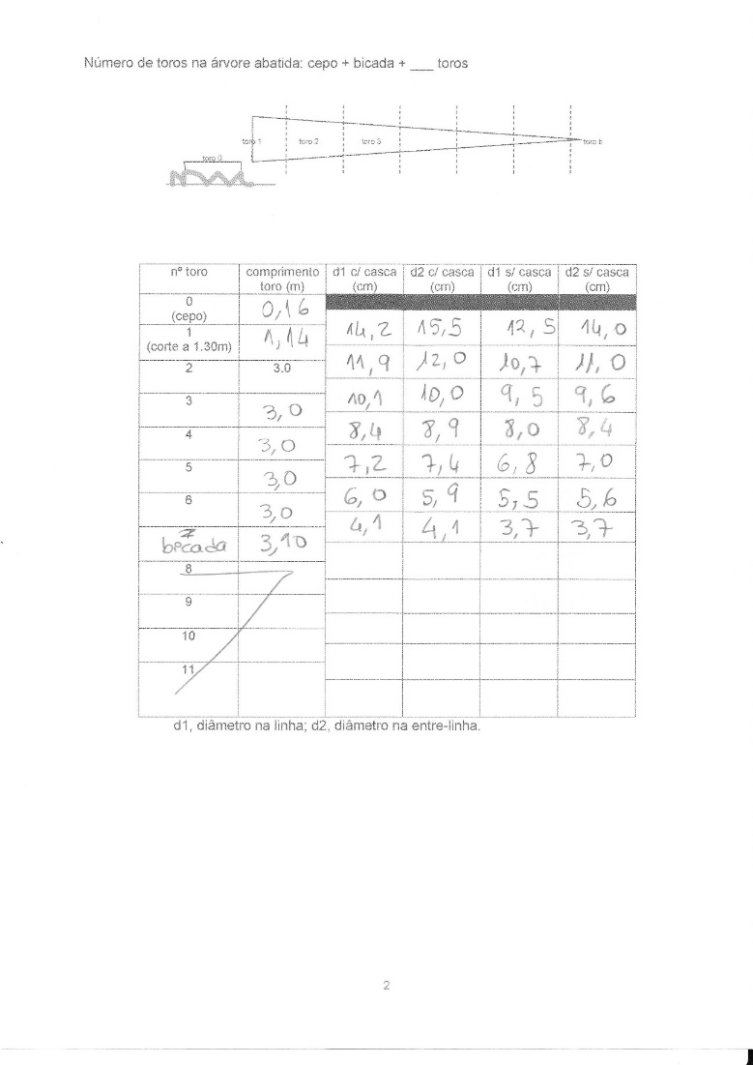
Example of data for tree biomass determination

Slide 26
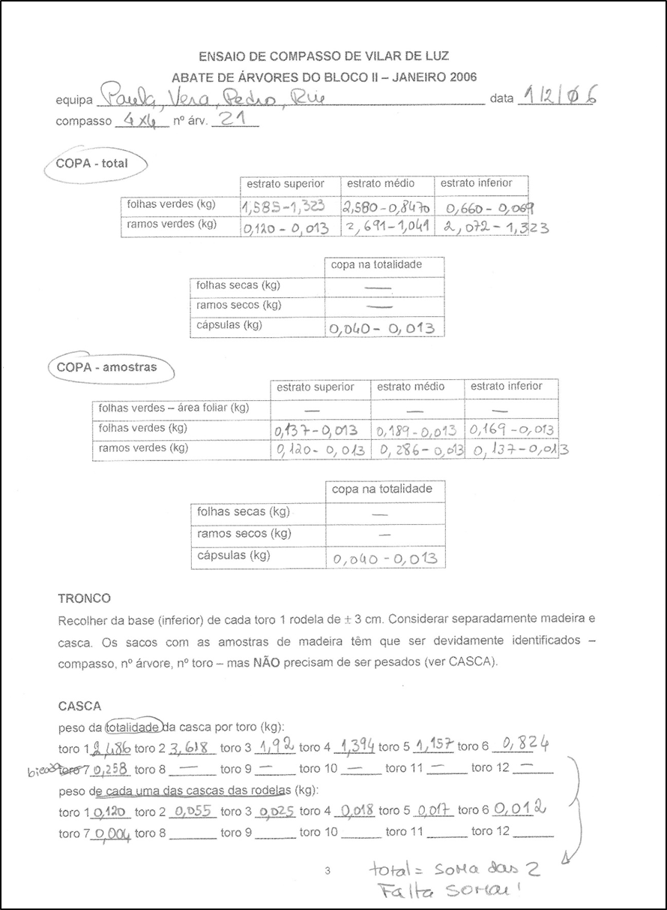
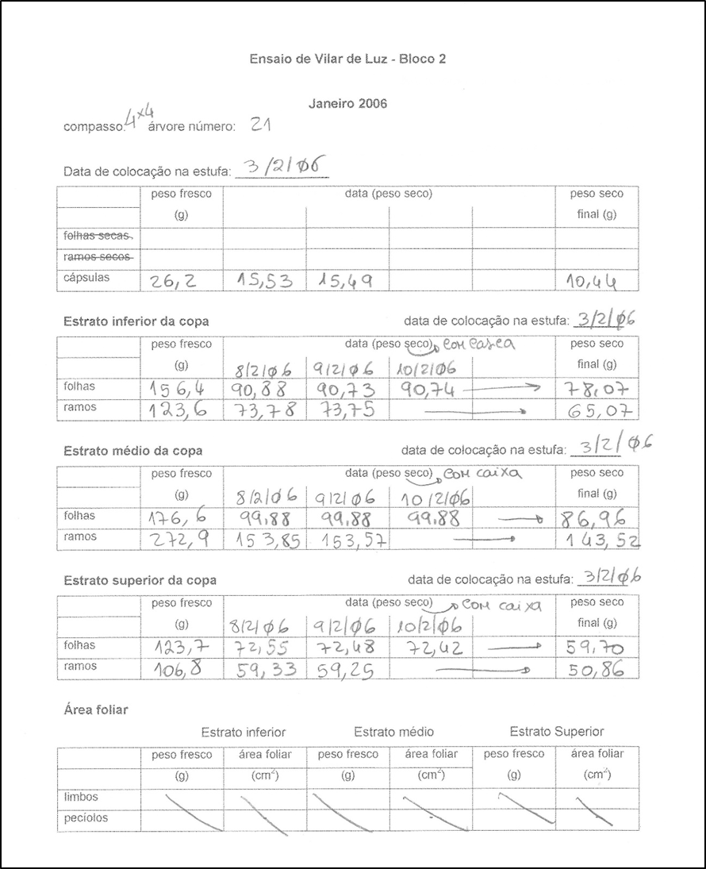

Slide 27
Estimating biomass with allometric equations
The difficulty envolved in the direct evaluation of tree biomass implies the use of equations to estimate tree biomass from dbh and height/height of the live crown
Let’s see na example

Slide 28
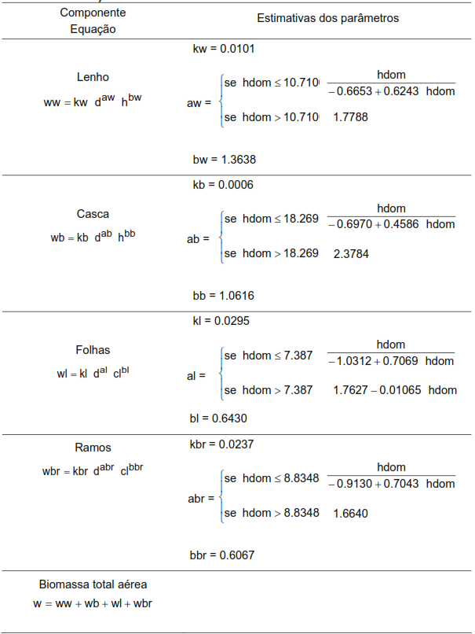
Tree component
Parameter estimations
Wood
Equations to estimate total biomass and biomass per tree component for eucalyptus in Portugal (António et al., 2007)
Bark
Leaves
Branches
Total aboveground biomass

Slide 29
The special case of cork
Equations to predict tree cork weight started to appear in the 50’s and from then several new equations have been developed (Natividade, 1950; Ferreira et al., 1986; Montero, 1988; Ferreira e Oliveira, 1991; Costa, 1992; Sousa, 1997)
All the equations published till the year 2000 refered to fresh weight and not to air dried or dry weight
The available models can be very simple, using just d or c as regressor variable or more complex requiring a much larger number of variables
All the models predict cork weight for 9 years old cork, except the model developed by Vázquez and Pereira (2005) that includes a dummy variable for 10 years old cork

Slide 30
The special case of cork

Slide 31
The special case of cork

Slide 32
The special case of cork

Slide 33
The special case of cork
Paulo and Tomé (2010) proposed a method for the prediction or cork dry weight with t years of age from a cork measurement undertaken at any cork age
The method is based on the follwoing:
  Estimation of the proportion of cork back weight
  Homogeneity of cork density if cork back is excluded
  Use of a cork growth model to predict cork thickness at t years of age

Slide 34
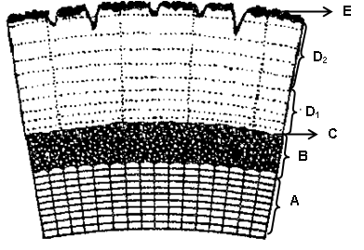
The special case of cork
Structure of a 9 years old cork: A – wood; B – phelogen; C – cork belly; D1 e D2 – cork annual rings; E – cork back (adapted from Natividade, 1950)

Slide 35
The special case of cork
Relationship between cork back weight and cork thickness after boiling
% of cork back weight
% do peso da costa
Espessura da cortiça cozida (mm)
Cork thickness after boiling (mm)

Slide 36
The special case of cork
The application of the method consists in:
  Estimate 9 years cork weight (wcm₉)
  Estimarte the % of cork back weight in a 9 years old cork (cb%)
  Estimate 9 years cork weight without the cork back (wcm_{9_b}):
  Estimate the t years cork weight:
  cc_{tc} is cork thickness after boiling of a tc years cork and cc₉ is the respective thickness with 9 years of age

Slide 37
The special case of cork
Model to estimate the % of cork back weight (Paulo and Tomé, 2010):
  cb% = exp(-(cc_{tc}/19.4629)^{0.4744})
  cb% – percentage of cork back weight; cc_{t} – cork thickness after boiling for a tc years cork (mm)

Slide 38
The special case of cork
Models to estimate 9 years cork weight (Paulo and Tomé, 2010):
  wc=0.0203 du ^{1.9843}
  wc=0.0372 nbrd₁^{0.2811}du ^{1.7825}
  wc=0.1036 du ^{1.3395} hdv ^{0.6709+0.1466 ln(nbrd1)}
  wc=0.0303 [ln(cc₉)]^{1.0667} du ^{1.3178} hdv ^{0.6703+0.1570 ln(nbrd1)}
  wc – cork dry weight (kg); du – underbark diameter (cm); nbrd₁ – number of debarked 1st order branches; hdv – vertical debarking height (m); cc₉ – cork thickness after boiling at 9 years of age (mm)

Slide 39
The special case of cork
Estimate the thickness of cork with 9 years using a cork growth model (Almeida and Tomé, 2010):
  Estimate the thickness of the complete cork rings (ct_{tc}; cc_{tc} is the caliber of boiled cork):
  Estimate the cgi (cork growth index or thickness of the first compelte 8 rings)
  ct_{tc} is the thickness of complete rings in a cork with tc years; cc_{tc} is the respective caliber

Slide 40
The special case of cork
  Estimate the caliber of a cork with 9 years:
Estimate the tickness of a cork with tc years using the cork growth model (Almeida and Tomé, 2010):
  Estimate ct_{tc}:
  Estimate cc_{tc}:

Slide 41
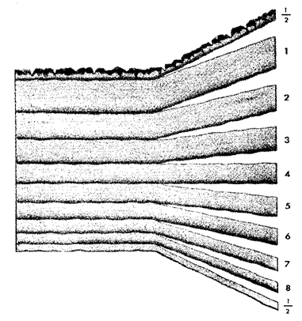
The special case of cork
  Schematicrepresentation of a sample of a 9 years old cork, showing the 8 complete rings and the 2 half rings (adapted from Natividade, 1940)
1st half ring
8 complete rings
Cork caliber
Last half ring

Slide 42
The special case of cork
As an example, let’s calculate the weight of a 11 years old cork from a tree with du=80 cm in which the cork caliber at 7 years was measured as 20 mm
  Weight of the 9 years old cork (tree growth not considered)
  wc₉=0.0203(80) ^{1.9843}=121.2823 kg
  Caliber of the 9 years old cork (cc₉)
    ct₇=(cc₇-4.572)/1.058=14.58 mm
    cgi=ct₉=ct₇(1+19.5(7-1)^{-1.088})/(1+19.5(9-1)^{-1.088})=18.17 mm
    cc₉=4.572+1.058 ct₉=4.572+1.058(18.17)=23.80 mm
  % of cork back weight in a 9 years old cork (cb%9)
    cb%9=exp(-(cc₉/19.4629)^{0.4744})=0.33

Slide 43
The special case of cork
  Weight of a 9 years old cork without the back weight
  wc_{9_b}=wc₉(1-0.33)=121.2823–121.2823(0.33)=
  =121.2823-40.0232=81.2592 kg
  Caliber of the 11 years old cork (cc₁₁)
    ct₁₁=ct₇(1+19.5(7-1)^{-1.088})/(1+19.5(11-1)^{-1.088})=21.24 mm
    cc₁₁=4.572+1.058 ct₁₁=4.572+1.058(21.24)=27.04 mm
  Weight of the 11 years old cork (wc₁₁)
    wc₁₁=wc_{9_b}(cc₁₁/cc₉)+wc₉(0.33)=
    =81.2592(27.04/23.80)+40.0232=132.3445 kg

