Slide 1
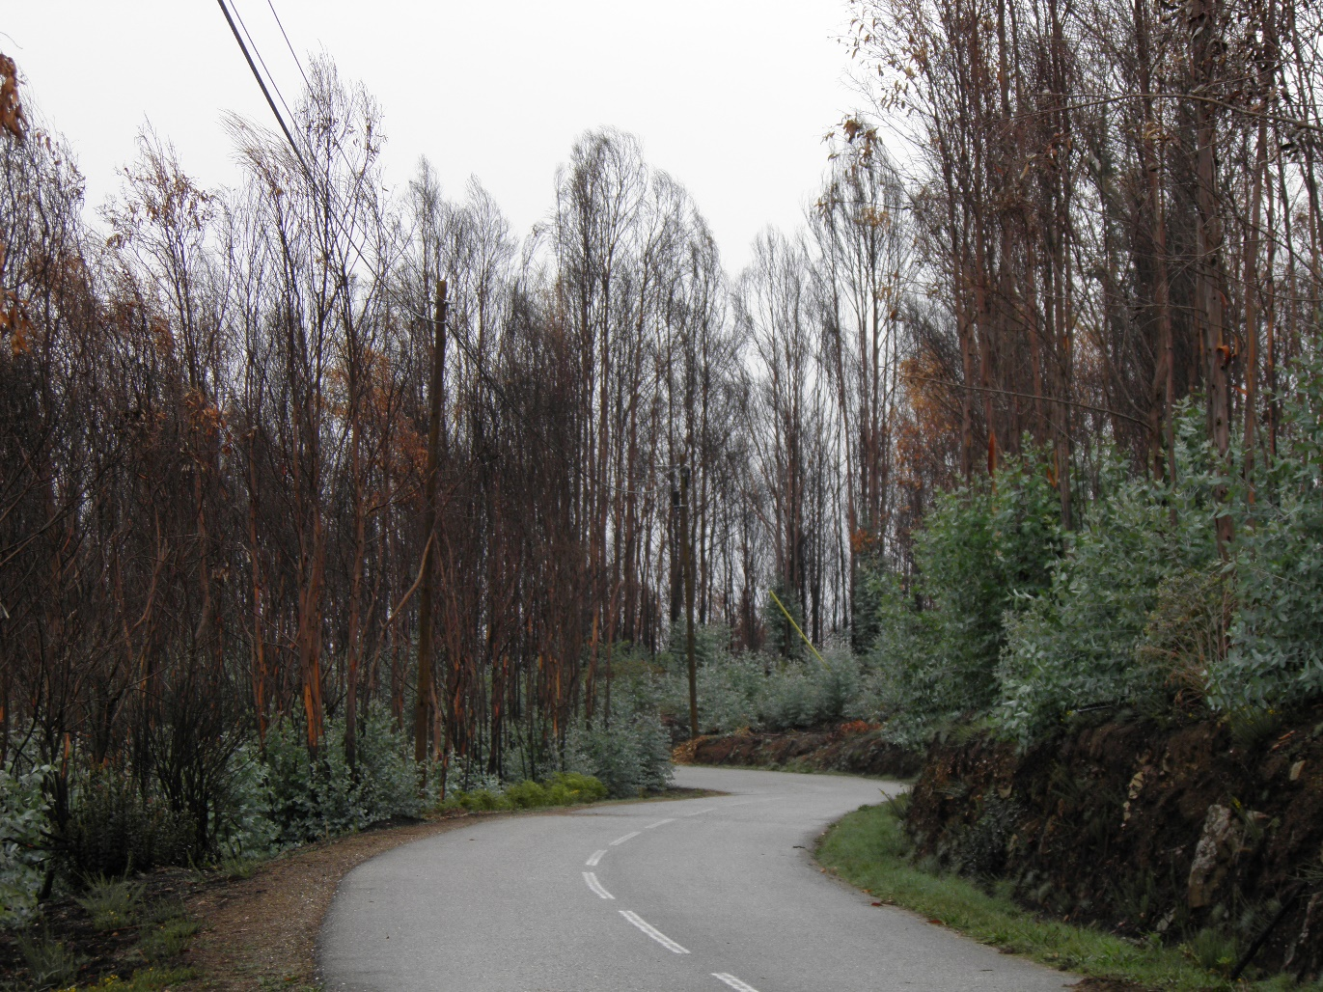



Bringing forest Simulations to life
using a management driven simulator to improve forest management in portugal
S. Barreiro^{1,2}, J. Rua¹, A. Benali¹ and M. Tomé¹
¹ Forest Research Centre, School of Agriculture, University of Lisbon, Portugal smb@isa.ulisboa.pt
² Forest Ecology and Forest Management Group, Wageningen University and Research, Netherlands
New Frontiers in Forecasting Forests
25-28 September 2018
Stellenbosch, South Africa

Slide 2
Presentation roadmap
Approach
Background
Material & Methods
  Study area
  Approach - StandsSIM.md
  Forest Owners / Forest Management Approaches (FMAs) - Prescriptions
  Scenarios
Results & Discussion
Next Steps

Slide 3
Presentation roadmap
Approach
Background
Material & Methods
  Study area
  Approach - StandsSIM.md
  Forest Owners / Forest Management Approaches (FMAs) - Prescriptions
  Scenarios
Results & Discussion
Next Steps

Slide 4
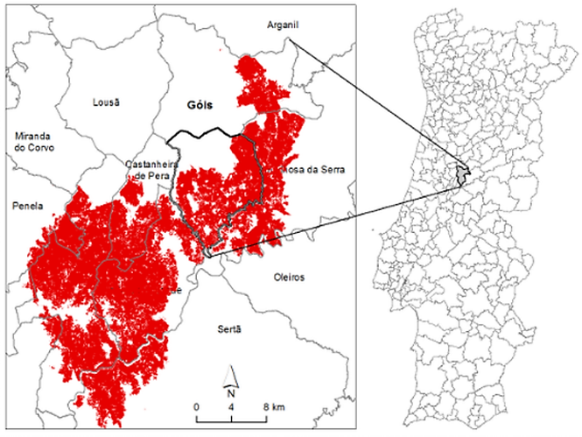
Background
Approach
In 2017, 10000ha parish, ALVARES, in the centre of Portugal suffered a severe wildfire in which 67% of the parish was burnt
A consortium was set up gathering experts from different fields
Help ALVARES parish to become:
- more fire resilient
- more economically attractive
- safer
How?
- improving management
- reducing forest area (fuel-breaks)

Slide 5
Presentation roadmap
Approach
Background
Material & Methods
  Study area
  Approach - StandsSIM.md
  Forest Owners / Forest Management Approaches (FMAs) - Prescriptions
  Scenarios
Results & Discussion
Next Steps

Slide 6
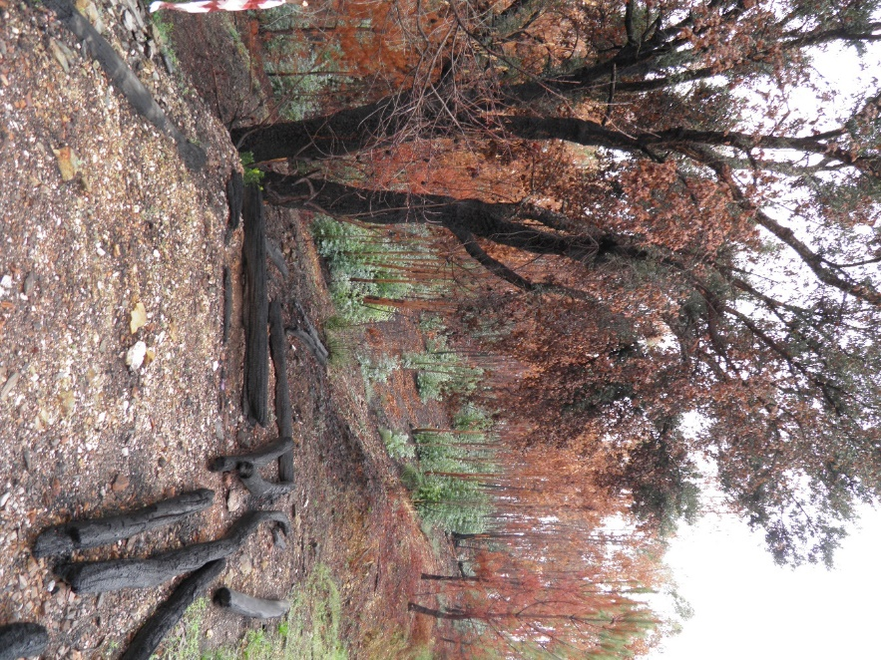
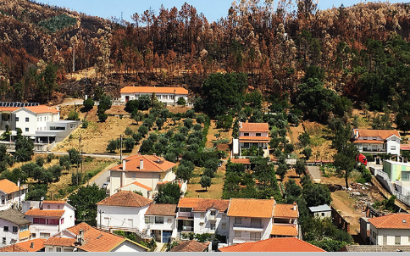
Material & Methods
Study Area
ALVARES population
  >60% over 65 years
  36% has completed primary school
  17% of illiterate inhabitants
Present forest ownership
  >3000 forest owners (incl. pulp companies)
  Average property size: 0.54 ha
In 1940, ALVARES 4500 inhabitants, in 2011 ~800
  depopulation => land abandonment

Slide 7
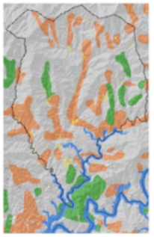
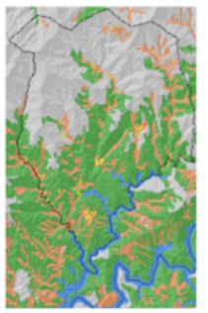
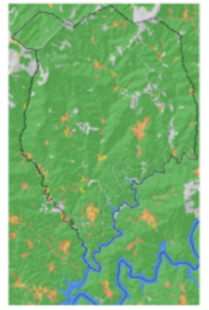

Material & Methods
Study Area
ALVARES population
  >60% over 65 years
  36% has completed primary school
  17% of illiterate inhabitants
Present forest ownership
  >3000 forest owners (incl. pulp companies)
  Average property size: 0.54 ha
In 1940, ALVARES 4500 inhabitants, in 2011 ~800
  depopulation => land abandonment
  Increase in forest area
Land Use over time (forest area)
1905: 7%
1955: 35%
2010: 90%
Forest
Agriculture
Shrubs

Slide 8
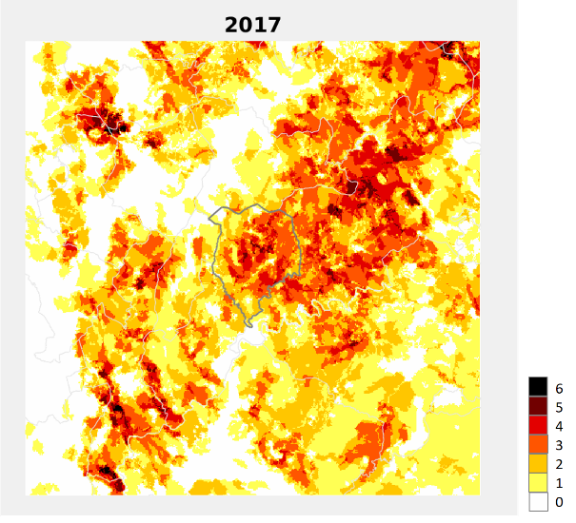
Material & Methods
Study Area
ALVARES population
  >60% over 65 years
  36% has completed primary school
  17% of illiterate inhabitants
Present forest ownership
  >3000 forest owners (incl. pulp companies)
  Average property size: 0.54 ha
In 1940, ALVARES 4500 inhabitants, in 2011 ~800
  depopulation => land abandonment
  Increase in forest area
2017 was not an isolated event:
Since 1975, some areas were burnt up to 6 times

Slide 9
Presentation roadmap
Approach
Background
Material & Methods
  Study area
  Approach - StandsSIM.md
  Forest Owners / Forest Management Approaches (FMAs) - Prescriptions
  Scenarios
Results & Discussion
Next Steps

Slide 10
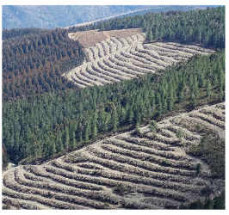
Material & Methods
Approach
OBJECTIVE:
- Show forest owners that improving forest management compensates
HOW:
- Characterizing different forest owners/forest management type
  - Simulating fire with FARSITE to generatate “time-since-last-fire” distrib.
- Simulating forest growth for alternative scenarios over a 36 years using StandsSIM.md simulator
LIMITATIONS:
- Reduced funding
- Short time span to present results
- Limited input data to run simulations (expert guesses)
EXPECTATIONS:
- High!!!

Slide 11

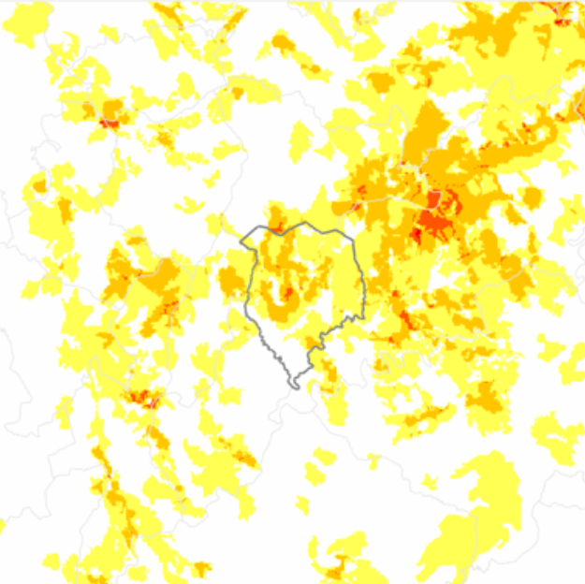

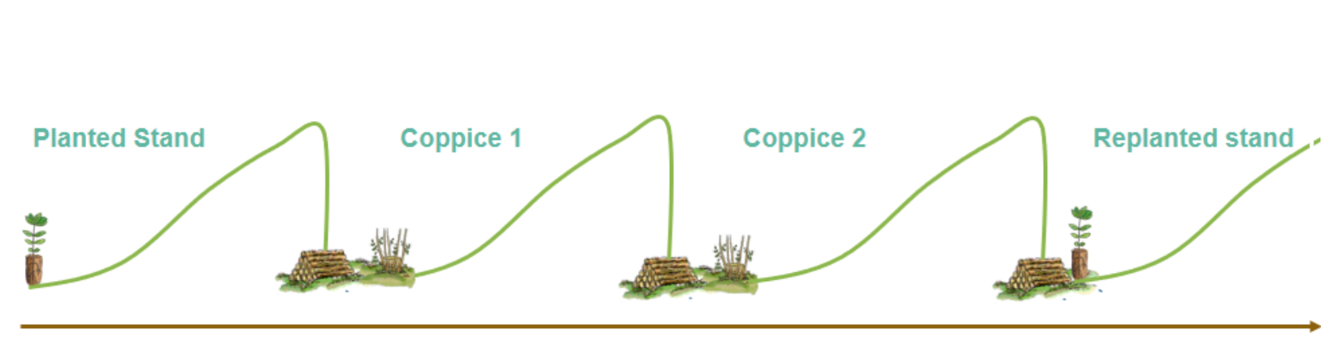
Material & Methods
Approach
X
Growth Simulations
Fire Simulation
Fire Modellers
StandsSIM.md
Growth over time
FARSITE
Fire over space
Growth Modellers
Stakeholders
Situation
Situation
fuel models / fuel loads
Forest Manag. Approaches (FMA)

Slide 12
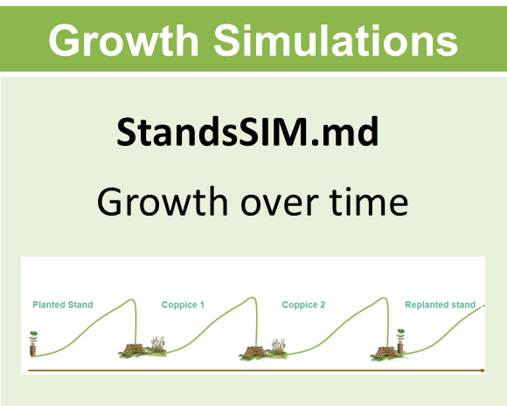

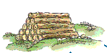
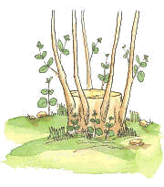
Material & Methods
Approach - Forest Owners / Forest Management Approaches (FMAs) - Presc
1 Planning horizon: 36 years
2 One plantation followed by 2 coppices
Planted Stand
Coppice 1
Coppice 2
Replanted stand
2017
36 years

Slide 13
Material & Methods
Approach - Forest Owners / Forest Management Approaches (FMAs) - Presc
1 Planning horizon: 36 years
2 One plantation followed by 2 coppices
3 Harvest age: 12 or 10
4 All stands were harvested after 2017 fire
Planted Stand
Coppice 1
Coppice 2
Replanted stand
2017
36 years

Slide 14
Material & Methods
Approach - Forest Owners / Forest Management Approaches (FMAs) - Presc
1 Planning horizon: 36 years
2 One plantation followed by 2 coppices
3 Harvest age: 12 or 10
4 All stands were harvested after 2017 fire
Coppice 1
Coppice 2
Replanted stand
Coppice 1
2017
36 years

Slide 15
Material & Methods
Approach
Thinking of management, what happens when a fire takes place?
Growth Simulations
Fire Simulation
Fire Modellers
StandsSIM.md
Growth over time
FARSITE
Fire over space
Growth Modellers
Stakeholders
Situation
Situation
fuel models / fuel loads
Forest Manag. Approaches (FMA)

Slide 16
Material & Methods
Forest Owners / Forest Management Approaches (FMAs) - Prescriptions
1 Planning horizon: 36 years
2 One plantation followed by 2 coppices
3 Stands are harvested after a FIRE
Planted Stand
Coppice 1
Coppice 2
Replanted stand
2017
36 years

Slide 17
Material & Methods
Forest Owners / Forest Management Approaches (FMAs) - Prescriptions
1 Planning horizon: 36 years
2 One plantation followed by 2 coppices
3 Stands are harvested after a FIRE
Planted Stand
Coppice 1
Coppice 2
Replanted stand
2017
36 years

Slide 18
Material & Methods
Forest Owners / Forest Management Approaches (FMAs) - Prescriptions
1 Planning horizon: 36 years
2 One plantation followed by 2 coppices
3 Stands are harvested after a FIRE
Planted Stand
Coppice 1
Coppice 2
Replanted stand
Coppice 1
2017
36 years

Slide 19
Material & Methods
Approach
How can I determine when a fire will take place and anticipate my harvest age?
If I knew the distribution of the number of years since the last fire occurred… maybe I could use
Growth Simulations
Fire Simulation
Fire Modellers
StandsSIM.md
Growth over time
FARSITE
Fire over space
Growth Modellers
Stakeholders
Situation
Situation
fuel models / fuel loads
Forest Manag. Approaches (FMA)

Slide 20
Material & Methods
Approach
Monte Carlo Simulation!!!!
Growth Simulations
Fire Simulation
Fire Modellers
Assess the impact of management & fire on
industrial volume harvested
+
Net Present Value (NPV)
“Time-since-last-fire” distributions
based on fire spread models
Growth Modellers
Stakeholders
Situation
Situation
fuel models / fuel loads
Forest Manag. Approaches (FMA)

Slide 21
Material & Methods
Approach
Fire Modellers
Growth Modellers
Stakeholders
Situation
Situation
fuel models / fuel loads
Forest Manag. Approaches (FMA)

Slide 22
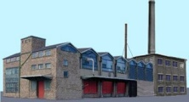
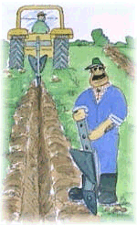
Material & Methods
Approach - Forest Owners / Forest Management Approaches (FMAs)
Industrial
1
1
Intensive sustainable management - proper site establishment
Genetically improved material
Fertilize, and perform intensive fuel and pest control operations
Active
2
Try to mimic the management practiced by the industry, but managing slightly less intensively
More limited access to genetically improved material
Extremely high operation costs

Slide 23

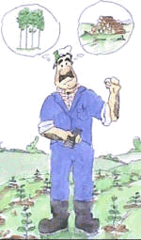
Material & Methods
Approach - Forest Owners / Forest Management Approaches (FMAs)
Semi-Active
3
Mainly focus on site establishment operations
No genetically improved material
Perform less to no fertilizations / fuel control operations
Extremely high operation costs
Close-to-absent
4
Simply focus on final harvest (usually anticipated)
Benefit from eucalypt re-sprouting ability for site establishment
Extremely high operation costs

Slide 24
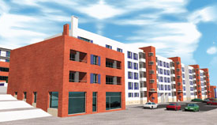
Material & Methods
Approach - Forest Owners / Forest Management Approaches (FMAs)
Absent
5
unmanaged shrubby-forests

Slide 25
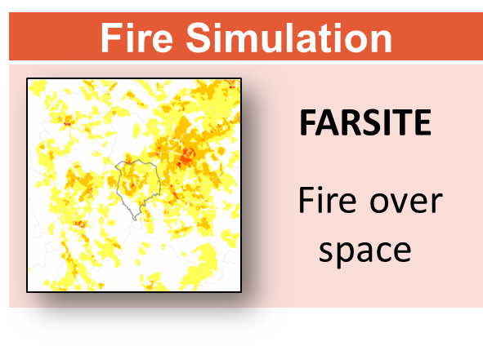

Material & Methods
Approach - Forest Owners / Forest Management Approaches (FMAs)
4 Owner Types
Only these will have growth simulations
Industrial
S₁₀ = 19
Active
S₁₀ = 16
Semi-Active
S₁₀ = 13
Close-to-absent
S₁₀ = 9

Slide 26
Material & Methods
Approach
Fire Simulation
“Time-since-last-fire” distributions
based on fire spread models
Fire Modellers
Growth Modellers
Stakeholders
Situation
Situation
fuel models / fuel loads
Forest Manag. Approaches (FMA)

Slide 27
Material & Methods
Approach – FARSITE fire spread model
FARSITE was used to simulate thousands of individual hypothetical fires after being calibrated using historic data on burnt areas (only fires over 1000 ha were considered). Simulations were carried out for a 55 x 55km window centered in the parish under diverse conditions in terms of:
  Meteorology - meteorological conditions of the days when the biggest fires took place were reproduced, and appropriate tools for generating whather conditions and computing spatially varying wind fields in complex terrain were used
  Ignitions - Using ICNF historic data on ignitions of fires that resulted in over 1000 burnt ha, a fire ignition probability surface was generated
  Fuel loads - The Land Use Occupation cartography (COS1990 and COS2015) representative of the historic period (1975 a 2017)

Slide 28
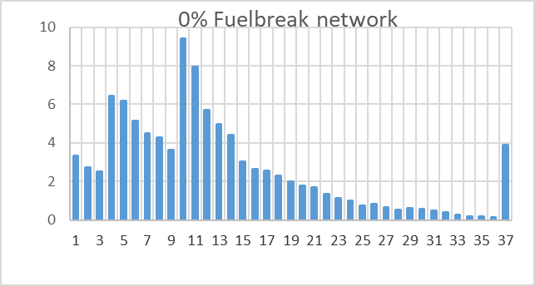
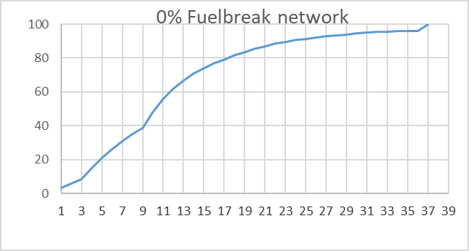
Material & Methods
Approach – FARSITE fire spread model
FARSITE was used to simulate thousands of individual hypothetical fires after being calibrated using historic data on burnt areas (only fires over 1000 ha were considered). Simulations were carried out for a 55 x 55km window centered in the parish under diverse conditions in terms of:

Slide 29
Material & Methods
Approach
Monte Carlo Simulation!!!!
Growth Simulations
Fire Simulation
Fire Modellers
Assess the impact of management & fire on
industrial volume harvested
+
Net Present Value (NPV)
“Time-since-last-fire” distributions
based on fire spread models
Growth Modellers
Stakeholders
Situation
Situation
fuel models / fuel loads
Forest Manag. Approaches (FMA)

Slide 30
Material & Methods
Forest Owners / Forest Management Approaches (FMAs) - Prescriptions
1 Planning horizon: 36 years
2 One plantation followed by 2 coppices
Prescriptions Generator:
MONTE CARLO simulation:
“Time-since-last-fire” distributions
Random numbers drawn ⬄ when next fire happens during the 36 yrs
400 repetitions
3 Stands are harvested after a FIRE
Planted Stand
Coppice 1
Coppice 2
Replanted stand
2017
36 years

Slide 31
Material & Methods
Forest Owners / Forest Management Approaches (FMAs) - Prescriptions
1 Planning horizon: 36 years
2 One plantation followed by 2 coppices
Prescriptions Generator:
MONTE CARLO simulation:
“Time-since-last-fire” distributions
Random numbers drawn ⬄ when next fire happens during the 36 yrs
400 repetitions
3 Stands are harvested after a FIRE
Planted Stand
Coppice 1
Coppice 2
Replanted stand
2017
36 years

Slide 32
Material & Methods
Forest Owners / Forest Management Approaches (FMAs) - Prescriptions
1 Planning horizon: 36 years
2 One plantation followed by 2 coppices
Prescriptions Generator:
MONTE CARLO simulation:
“Time-since-last-fire” distributions
Random numbers drawn ⬄ when next fire happens during the 36 yrs
400 repetitions
3 Stands are harvested after a FIRE
Planted Stand
Coppice 1
Coppice 2
Replanted stand
Coppice 1
2017
36 years

Slide 33
Material & Methods
Forest Owners / Forest Management Approaches (FMAs) - Prescriptions
1 Planning horizon: 36 years
2 One plantation followed by 2 coppices
Prescriptions Generator:
MONTE CARLO simulation:
“Time-since-last-fire” distributions
Random numbers drawn ⬄ when next fire happens during the 36 yrs
400 repetitions
3 Stands are harvested after a FIRE
Fire consequences:
Stand age < 4 => Fire does not affect stand
Stand age = harvest age => stands are harvested after the fire
Salvage wood increases with stand age and stand productivity
Burnt wood logging costs decrease with stand age and stand productivity

Slide 34
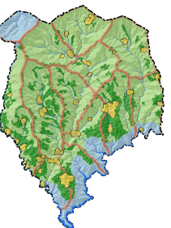
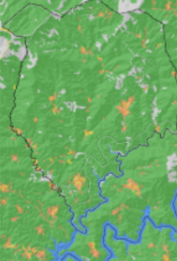

Material & Methods
Defining management and planning scenarios
Eucalypt Forest Area
(%)
100%
95%
Improved management
+
1/3 firebreaks implemented
Improved management
No fire
000Cur
000Mod
000High
033Cur
033Mod
033High
1 Industrial
2 Active
3 Semi-active
4 Close-to-absent
5 Absent

Slide 35
Material & Methods
Defining management and planning scenarios
Eucalypt Forest Area
(%)
100%
95%
Improved management
+
1/3 firebreaks implemented
Improved management
No fire
000Cur
000Mod
000High
033Cur
033Mod
033High
1 Industrial
2 Active
3 Semi-active
4 Close-to-absent
5 Absent

Slide 36
Material & Methods
Defining management and planning scenarios
Eucalypt Forest Area
(%)
100%
95%
Improved management
+
1/3 firebreaks implemented
Improved management
No fire
000Cur
000Mod
000High
033Cur
033Mod
033High
1 Industrial
2 Active
3 Semi-active
4 Close-to-absent
5 Absent

Slide 37
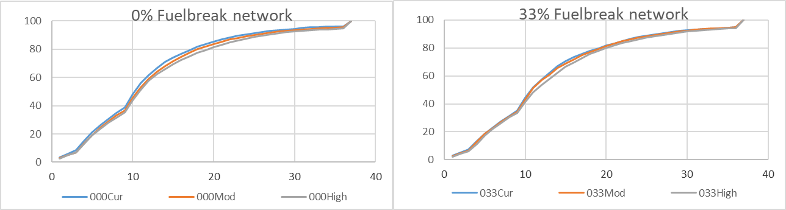
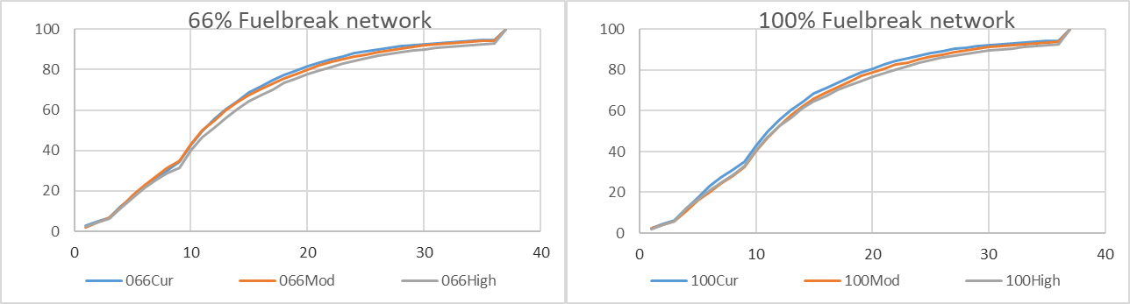
Material & Methods
Defining management and planning scenarios
  The fuel loads for the future fire simulations under the different scenarios were additionally defined based on discussions among stakeholders and fire experts (e.g. Prof. Paulo Fernandes).

Slide 38
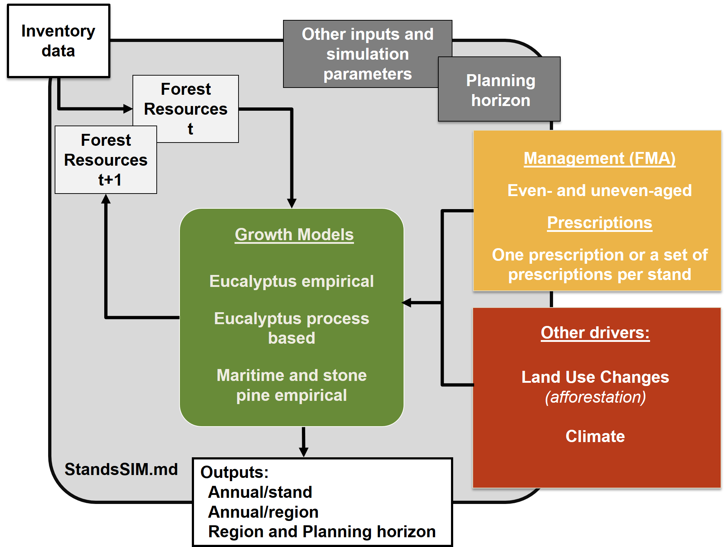
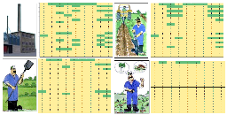
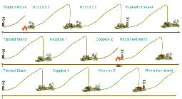
Material & Methods
Approach - StandsSIM.md simulator input requirements
FMAs
Prescriptions
http://www.isa.ulisboa.pt/cef/forchange/fctools/en/home

Slide 39

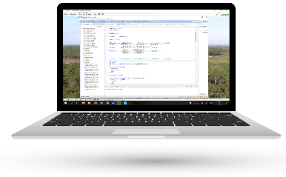
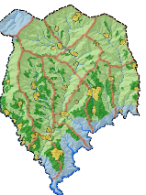
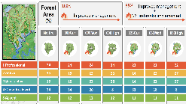
Industrial Volume Harvested
(m³ ha⁻¹)
Material & Methods
StandsSIM.md simulator runs
Net Present Value (€ ha⁻¹)
Stands
FMAs
StandsSIM.md
Prescriptions
Up-scaled for the parish
Scenarios

Slide 40
Presentation roadmap
Approach
Background
Material & Methods
  Study area
  Approach - StandsSIM.md
  Forest Owners / Forest Management Approaches (FMAs) - Prescriptions
  Scenarios
Results & Discussion
Next Steps

Slide 41
Presentation roadmap
Approach
Background
Material & Methods
  Study area
  Approach - StandsSIM.md
  Forest Owners / Forest Management Approaches (FMAs) - Prescriptions
  Scenarios
Results & Discussion
Next Steps

Slide 42
Presentation roadmap
Approach
Background
Material & Methods
  Study area
  Approach - StandsSIM.md
  Forest Owners / Forest Management Approaches (FMAs) - Prescriptions
  Scenarios
Results & Discussion
Next Steps

Slide 43
Preliminary results & Discussion
Volume harvested with industrial use
Industrialvolume harvested (10³m³)
100%
95%
Improved management
+
1/3 firebreaks implemented
Improved management
No fire
000Cur
000Mod
000High
1 Industrial
033Cur
033Mod
033High
area maintained
Benefit from improved management practiced by private forest owners
Increases reflect the decreasing fire risk as management is improved in the parish
1 Industial
2 Active
3 Semi-active
4 Close-to-absent
Parish
1322
1069
1258
1396
1049
1206
1367

Slide 44
Preliminary results & Discussion
Volume harvested with industrial use
Industrialvolume harvested (10³m³)
100%
95%
Improved management
+
1/3 firebreaks implemented
Improved management
2 & 3 Active and Semi-active
No fire
000Cur
000Mod
000High
033Cur
033Mod
033High
area increased
Benefit from improved management and area increase at the expense of the close-to-absent
1 Industial
4 Close-to-absent
2 Active
area decreased
Very low productivity combined with the small area
3 Semi-active
4 Close-to-absent
Parish
1322
1069
1258
1396
1049
1206
1367

Slide 45
Preliminary results & Discussion
Volume harvested with industrial use
Industrialvolume harvested (10³m³)
100%
95%
Improved management
+
1/3 firebreaks implemented
Improved management
No fire
000Cur
000Mod
000High
033Cur
033Mod
033High
1 Industial
2 Active
3 Semi-active
4 Close-to-absent
Parish
1322
1069
1258
1396
1049
1206
1367

Slide 46
Preliminary results & Discussion
Volume harvested with industrial use
Industrialvolume harvested (10³m³)
100%
95%
Improved management
+
1/3 firebreaks implemented
Improved management
No fire
000Cur
000Mod
000High
033Cur
033Mod
033High
1 Industial
2 Active
3 Semi-active
4 Close-to-absent
Parish
1322
1069
1258
1396
1049
1206
1367

Slide 47
Preliminary results & Discussion
Net Present Value
NPV
M€
100%
95%
Improved management
+
1/3 firebreaks implemented
Improved management
No fire
000Cur
000Mod
000High
033Cur
033Mod
033High
1 Industial
2 Active
3 Semi-active
4 Close-to-absent
Parish
5259
497
1590
2030
1276
1701
2452

Slide 48
Presentation roadmap
Approach
Background
Material & Methods
  Study area
  Approach - StandsSIM.md
  Forest Owners / Forest Management Approaches (FMAs) - Prescriptions
  Scenarios
Results & Discussion
Next Steps

Slide 49
Next Steps
S1.3 Net Present Value
Review of the “Time- since-last-fire” distributions
Improving the stand inputs
Redefining the methodology for assigning a SI to each forest management approach / forest owner
  Use the 3PG model to assess the impact of: - Fertilization
  - Fuel control operations
  - Pest attack
  …

Slide 50
Thank you!
Questions?
S1.3 Net Present Value

Slide 51
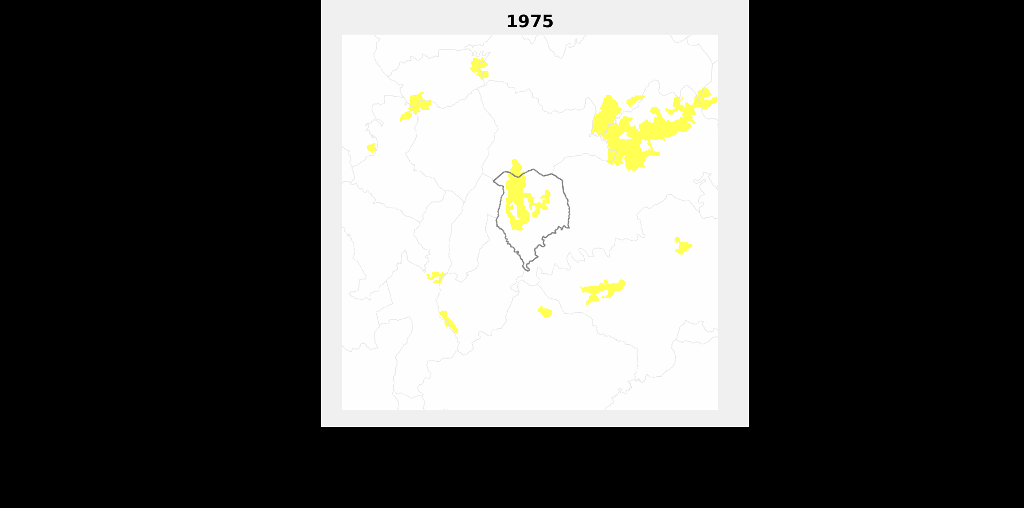
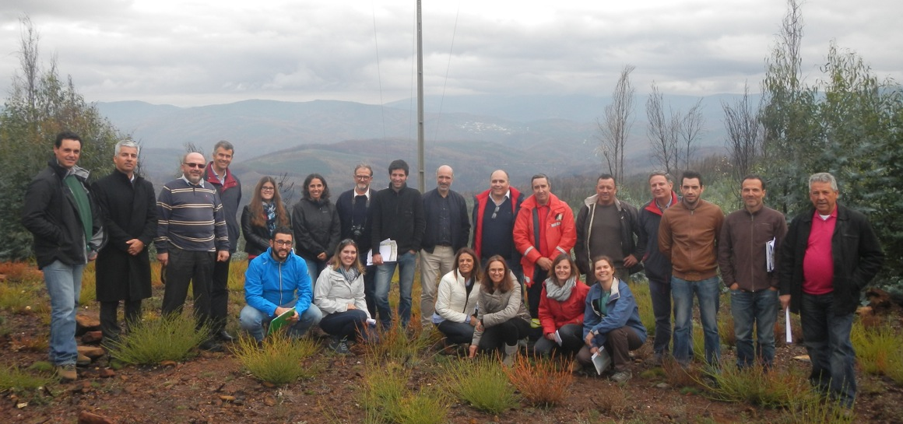
Acknowledgements
S1.3 Net Present Value
Team: Susana Barreiro, João Rua, Akli Benali, Margarida Tomé, Ana Sá, Yannik Le Page, José Miguel Cardoso Pereira, João Pinho, Paulo Fernandes, Maria João Canadas, Ana Novais, Ana Martins, José Lima Santos, Sandra Oliveira, Ana Gonçalves, José Luis Zêzere, Carlos da Camara, Ricardo Trigo, Sílvia Nunes, Miguel Pinto, Jornal O Observador, Núcleo Fundador da ZIF da Ribeira de Sinhel, Associação Florestal de Góis, The Navigator Company, ALTRI Florestal, Henrique Pereira dos Santos, Francisco Cordovil, CM Góis
smb@isa.ulisboa.pt
6
5
4
3
2
1
0

