Slide 1
Diameter distribution models

Slide 2
Diameter distribution models
The idea behind diameter distribution models is:
  To start by simulating the growth of some stand variables (principal variables):
    dominant height (hdom)
    number of trees per ha (N)
    stand basal area (G)
    some variables localizing the diameter distribution such as the minimum diameter (dmin), some percentile of the diameter distribution (Pp) or the variance of diameters (depending on the pdf used for diameter distribution)

Slide 3
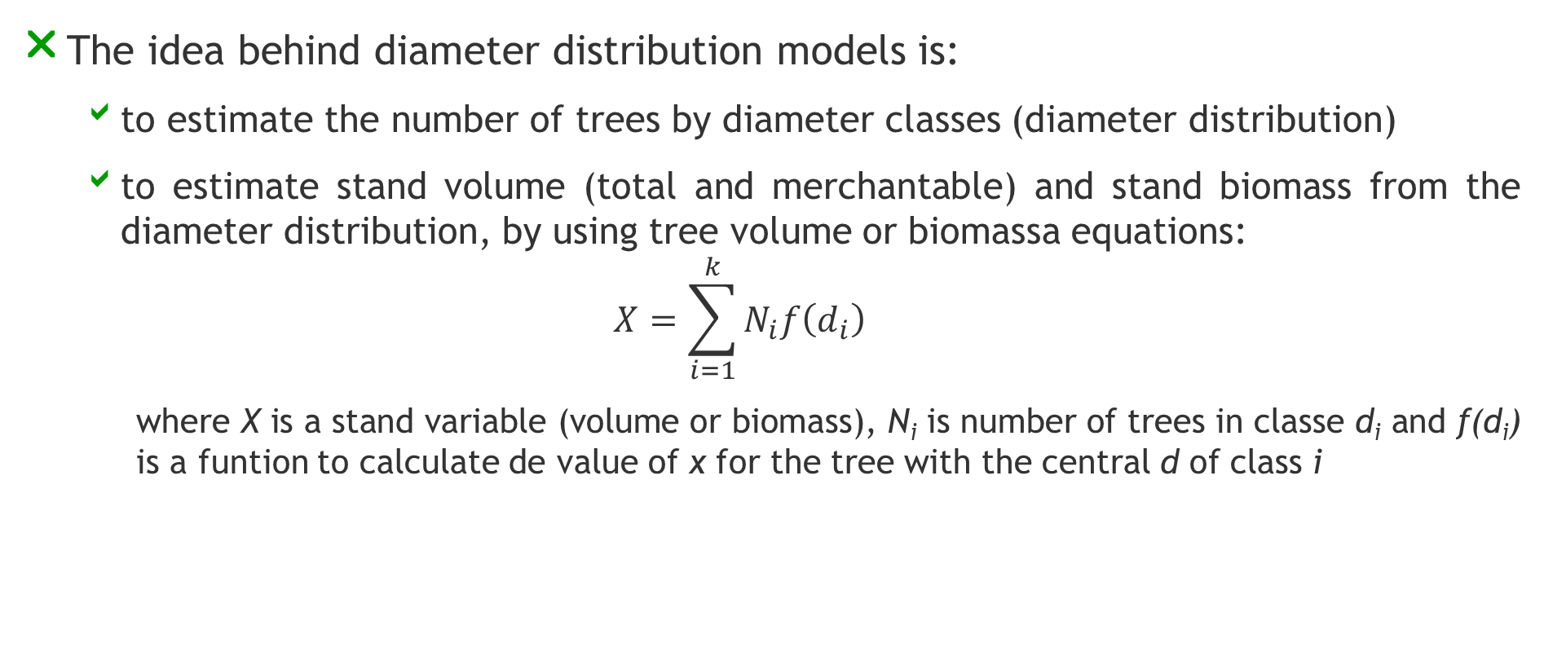
Diameter distribution models
The idea behind diameter distribution models is:
  to estimate the number of trees by diameter classes (diameter distribution)
  to estimate stand volume (total and merchantable) and stand biomass from the diameter distribution, by using tree volume or biomassa equations:
  $$X=\sum_{i=1}^{k}{N_{i}f\left(d_{i}\right)}$$
    where X is a stand variable (volume or biomass), N_{i} is number of trees in classe d_{i} and f(d_{i}) is a funtion to calculate de value of x for the tree with the central d of class i

Slide 4
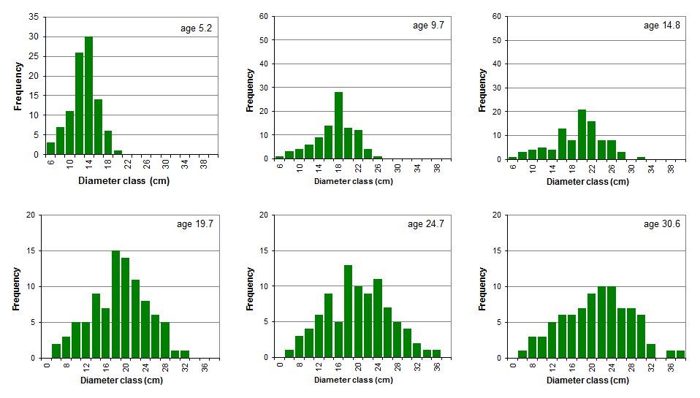
Diameter distributions of an eucalypt permanent plot over time

Slide 5
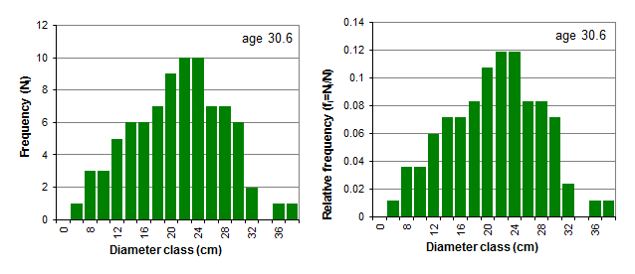
Diameter distribution in relative frequencies
The diameter distributions may be expressed in terms of relative frequencies by expressing the frequency each diameter class (N_{i}) relative to the total number of trees per ha (N)
Σf_{i}=1

Slide 6
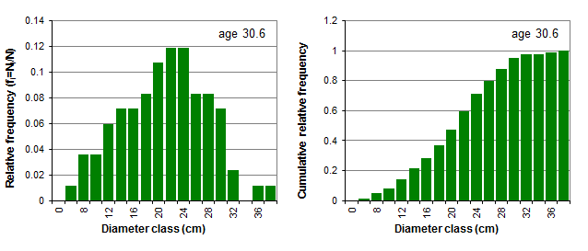
Diameter distribution in cumulative relative frequencies
The cumulative relative frequency of a diameter distribution leads to the empirical distribution function

Slide 7
Modeling diameter distributions

Slide 8
Modelling diameter distributions
Diameter distributions can be modelled by a variety of mathematical functions from the probability density functions (pdfs) type
Probability density functions express the relative likelihood for a random variable to take on a given value
The probability density function is non-negative everywhere, and its integral over the entire space is equal to one (like the accumulated relative frequencies)
The probability that the random variable takes a value<x is equal to the integral of the pdf from the start to x

Slide 9
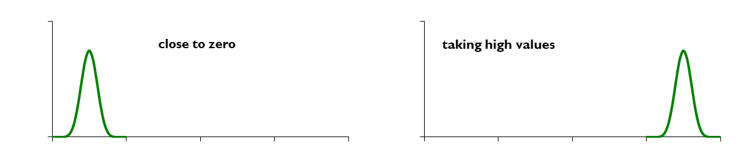
Modelling diameter distributions
A pdf is characterized by parameters:
  Location – where, in the X axis, the distribution is located

Slide 11
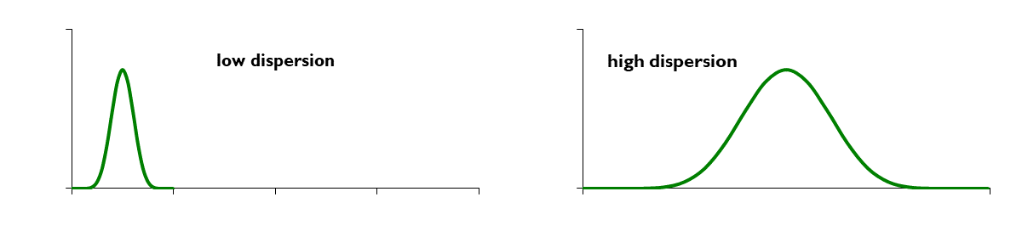
Modelling diameter distributions
A pdf is characterized by parameters:
  Location – where, in the X axis, the distribution is located
  Dispersion – how large is the range of values that the variable can take

Slide 13
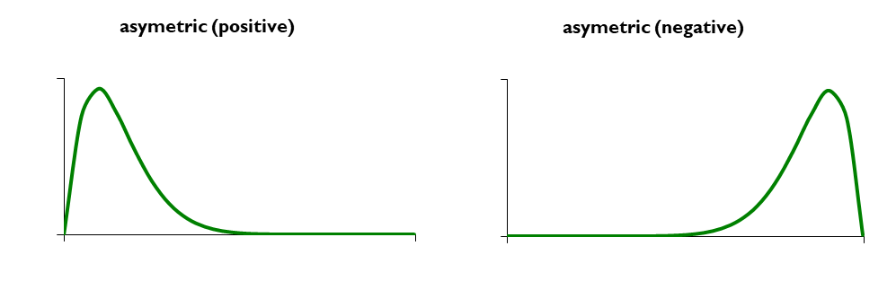
Modelling diameter distributions
A pdf is characterized by parameters:
  Location – where, in the X axis, the distribution is located
  Dispersion – how large is the range of values that the variable can take
  Shape – is the function symmetric or assymetric? Is it pointed or flat?

Slide 14
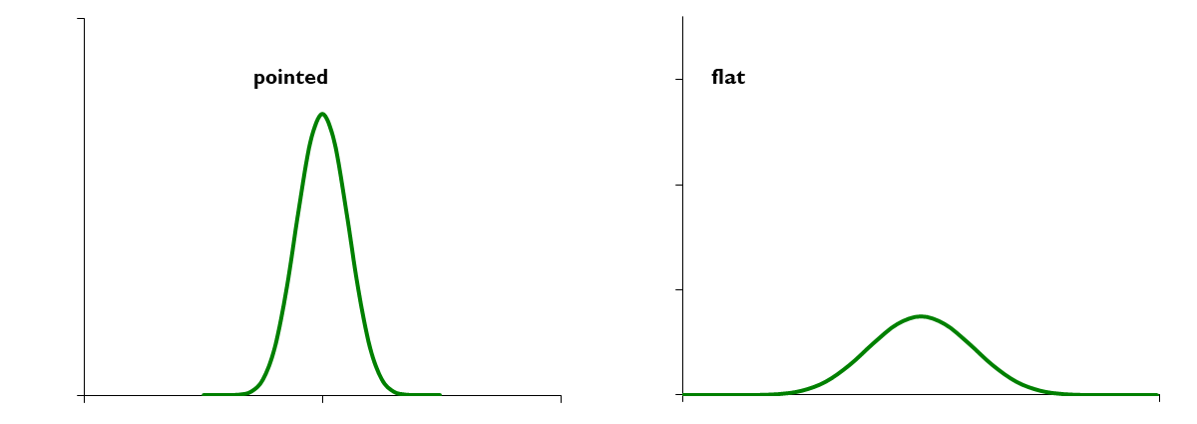
Modelling diameter distributions
A pdf is characterized by parameters:
  Location – where, in the X axis, the distribution is located
  Dispersion – how large is the range of values that the variable can take
  Shape – is the function symmetric or assymetric? Is it pointed or flat?

Slide 16
Probability density functions (pdfs)
For instance, a normal distribution, the most well know pdf, has the following expression
  that includes two parameters, the mean (μ) and the standard deviation (σ), and is designated by N(μ,σ)

Slide 17
Probability density functions (pdfs)
Integrating the pdf produces the cumulative distribution function that, for the normal distribution is
The Normal distribution is not appropriate to model diameter distributions because of its symmetry, diameter distributions are usually skewed

Slide 18
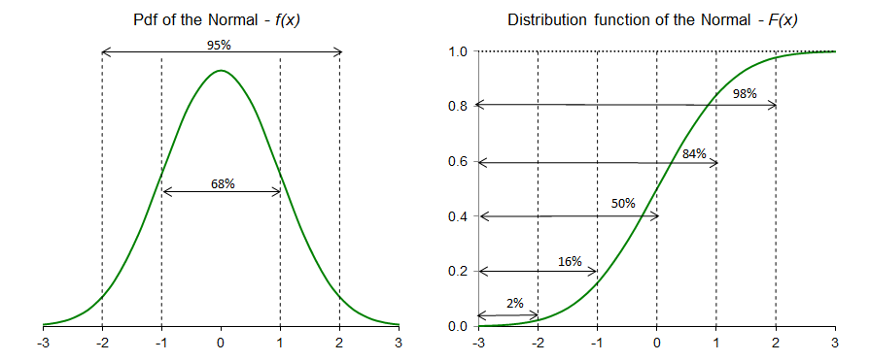
Probability density functions (pdfs)
The normal distribution is symmetric around the mean (μ); it has zero skew and kurtosis of 3

Slide 19
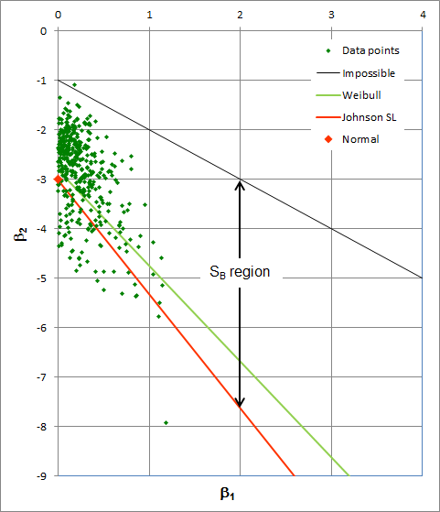
Probability density functions (pdfs) can take different values for the pair (β₁,β₂)
(β₁,β₂) values for the pdfs most used for diameter distribution modeling and for a set of eucalyptus permanent plots
Estimators for β₁ and β₂:
kurtosiss
skewness

Slide 20
Weibull pdf
The Weibull, one of the most used pdfs in diameter distribution modeling, is a three-parameter pdf
    a – location parameter (related to the d_{min})
    b – scale parameter (>0)
    c – shape parameter (>0; if c<=1 implies a inverse J shape; if c=3.6 is close to Normal; c<3.6 is right skewed; if c>3.6 is left skewed)
    a+b is close to percentile 63% (P₆₃) of the distribution

Slide 21
Weibull pdf
Integrating the pdf produces the cumulative distribution function for the Weibull distribution
The Weibull distribution has the advantage of having a closed integral form which makes it very tractable
Once the a, b and c parameters are known, the Weibull distribution can be used to obtain the diameter distribution

Slide 22
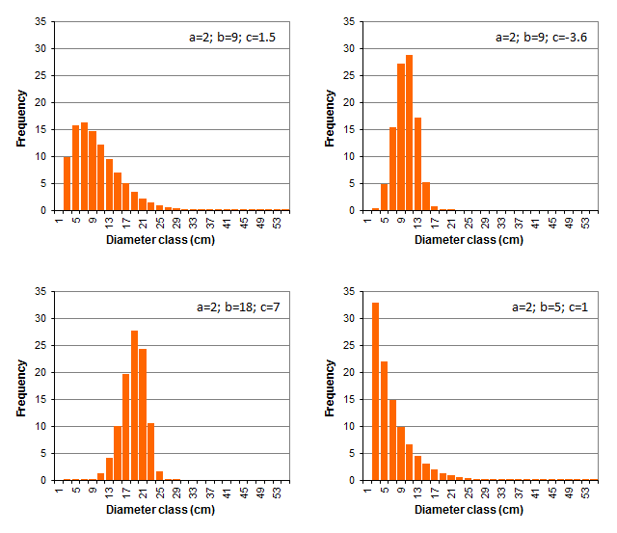
Weibull distribution - examples

Slide 23
The Johnson’s SB system of pdfs
The system of random variables generated by
is called the Johnson’s SB system of distributions
It is very flexible and can take several shapes

Slide 24
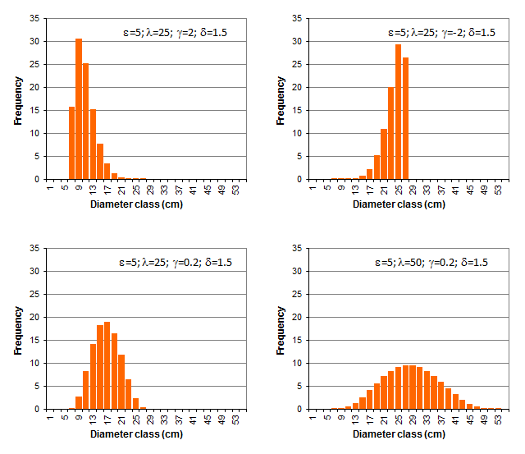
Johnson’s SB system - examples

Slide 25
The PBRAVO model

Slide 26
PBRAVO model – equations in the growth module

Slide 27
PBRAVO model – equations in the initialization module
Applicable to young unthinned stands

Slide 28
PBRAVO model –tree equations in the calculus module

Slide 29
PBRAVO model – equations to estimate residual variables
1st thinning

Slide 30
PBRAVO model – equations to estimate residual variables
2nd thinning

Slide 31
PBRAVO model – diameter distribution
The simulation of the diameter distribution is based on the Weibull distribution
  Parameters a e b are estimated with the following equations:

Slide 32
PBRAVO model – diameter distribution
  After a and b being estimated, the c parameter is estimated by resolution, using numerical methods, of the following non-linear equation

Slide 33
PBRAVO model – stand volume prediction
Stand volume is estimated from the diameter distribution using the estimated values of N and of the Weibull parameters a, b and c
  Let’s see an example for N=868, a=2.6, b=9.0 e c=3.2
  Start by using the Weibull function to estimate the accumulated frequency of trees per dbh class

Slide 34
PBRAVO model – stand volume estimation
Estimate accumulated probabilities of trees to occur below each dbh class

Slide 35
PBRAVO model – stand volume estimation
Number of trees per class and basal area
  Multiplying the accumulated probabilities by N and making the differences between consecutive d classes one obtains the diameter distribution and the respective G

Slide 36
PBRAVO model – stand volume estimation
Stand volume estimation
  Predicting the height and volume of the average tree of each d class, it is possible to estimate volume per d class by multiplying tree volume by the number of trees per ha. Stand volume is estimated by summing up these values

Slide 37
The PBRAVO simulator

Slide 38
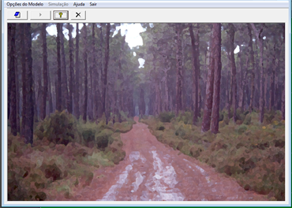
PBRAVO model – stand simulator
The PBRAVO model is implemented in an interactive user-friend stand simulator

Slide 39
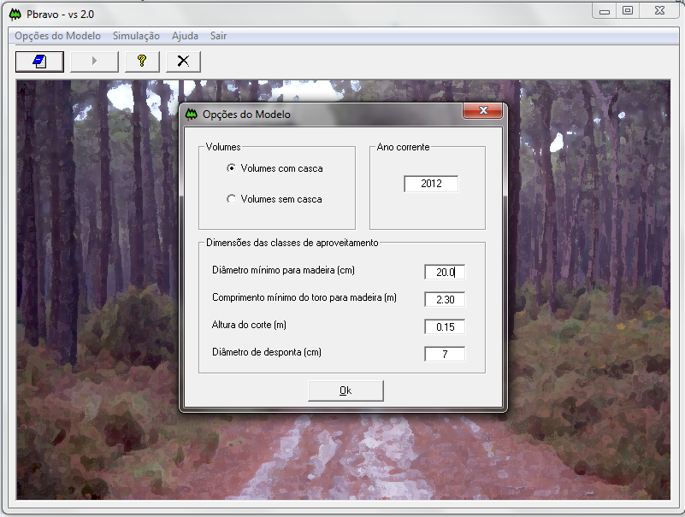
Model Options
Volumes
Current year
Volume overbark
Volume underbark
Assortment Dimensions
Minimum diameter - wood (cm)
Log minimum length - wood (m)
Stump height (m)
Top diameter(cm)

Slide 40
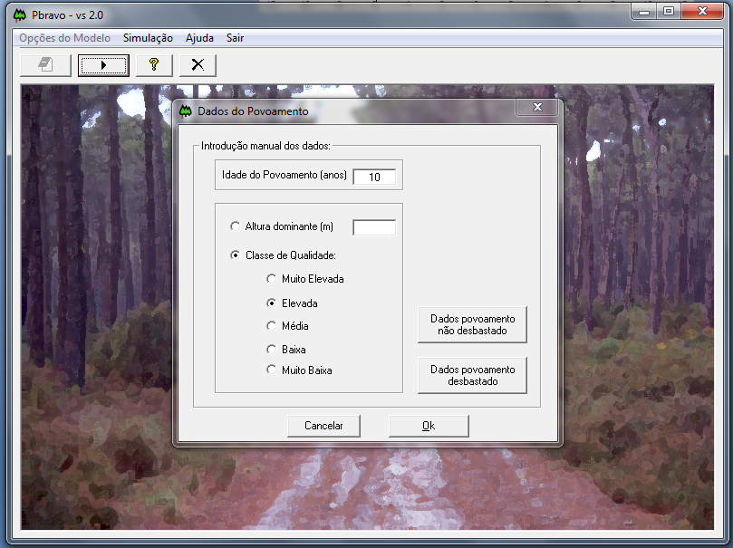
Stand Inputs
Filling in the data:
Stand age (years):
Dominant height (m)
Site Index Classes
Very high (23)
High (19)
Medium (15)
Inputs for Unthinned stands
Low (11)
Very Low (7)
Inputs for Thinned stands
Cancel

Slide 41
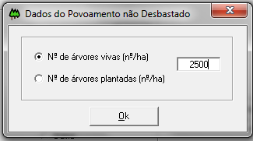
Stand Inputs
Filling in the data:
Stand age (years):
Inputs for Unthinned Stands
Dominant height (m)
Site Index Classes
Number living trees (trees/ha)
Very high (23)
Number of trees at planting (trees/ha)
High (19)
Medium (15)
Inputs for Unthinned stands
Low (11)
Very Low (7)
Inputs for Thinned stands
Cancel

Slide 42
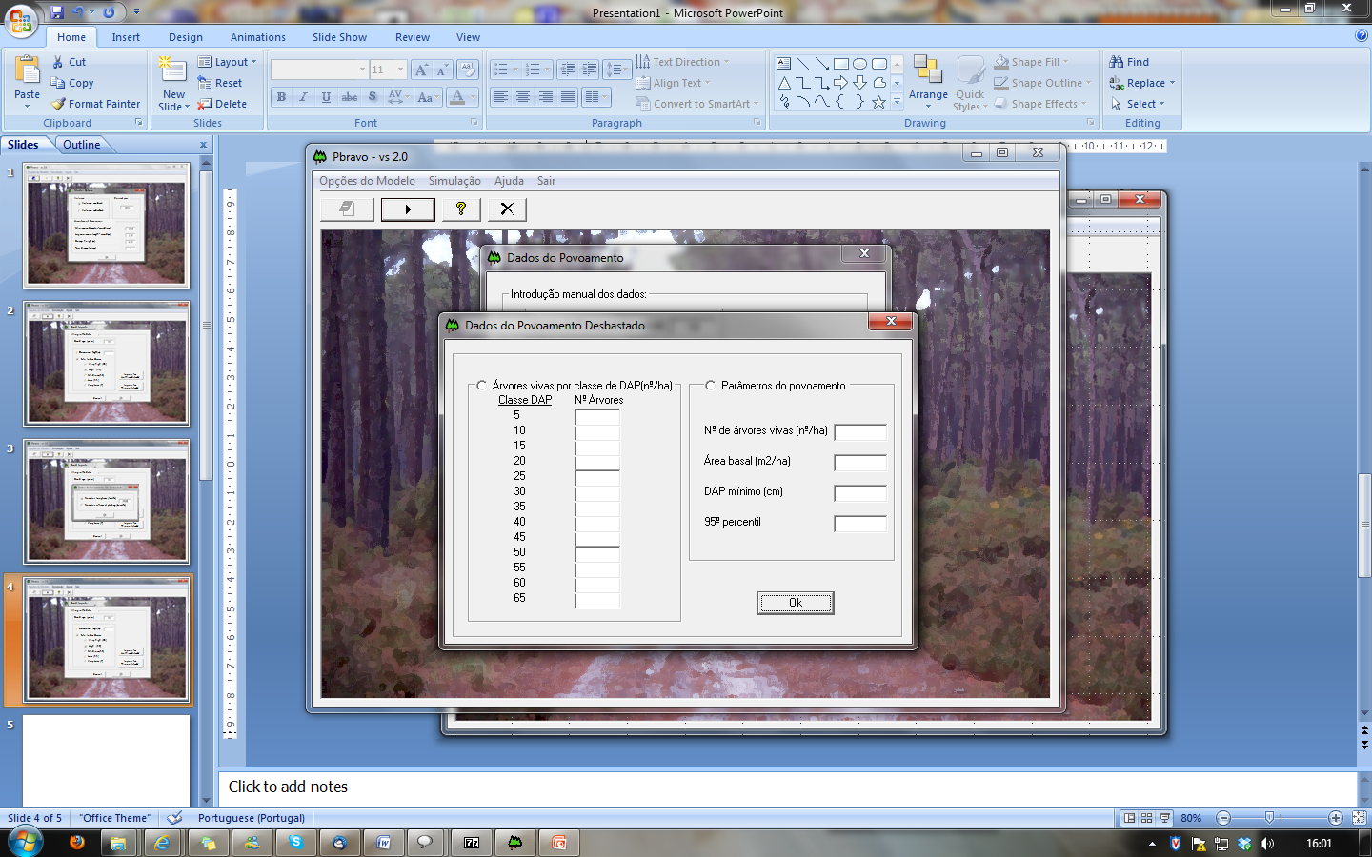
Stand Inputs
Filling in the data:
Inputs for Thinned Stands
Stand age (years):
Living trees by dbh class (trees/ha)
Stand varaibles:
dbh class Number of trees
Dominant height (m)
Site Index Classes
Number of trees (ha⁻¹)
Very high (23)
Basal area(m² ha⁻¹)
High (19)
Minimum dbh (cm)
Medium (15)
Inputs for Unthinned stands’
95 Percentile
Low (11)
Very Low (7)
Inputs for Thinned stands’
Cancel

Slide 43
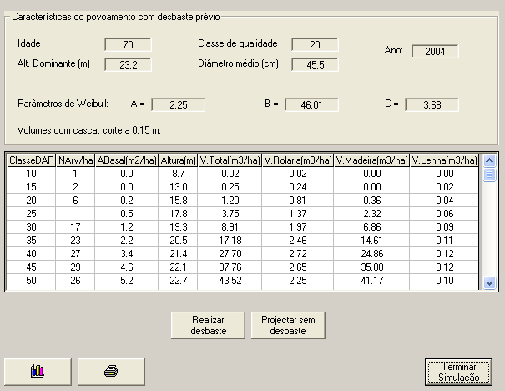
Inputs for Thinned Stands
Stand characteristics for a previously thinned stand
Stand age (years)
Site Index
Year
Dominant height (m)
Average diameter (cm)
Weibull Parameters:
Volume overback without stump:
Dbh Class
N (cm)
G (m² ha⁻¹)
H (m)
V_{total} (m³ ha⁻¹)
V_{roundwood} (m³ ha⁻¹)
V_{sawnwood} (m³ ha⁻¹)
V_{firewood} (m³ ha⁻¹)
Project a thinning
Project without thinning
End
Simulation

Slide 44
Inputs for Thinned Stands
Stand characteristics for a previously thinned stand
Stand age (years)
Site Index
Year
Dominant height (m)
Average diameter (cm)
Weibull Parameters:
Volume overback without stump:
Dbh Class
N (cm)
G (m² ha⁻¹)
H (m)
V_{total} (m³ ha⁻¹)
V_{roundwood} (m³ ha⁻¹)
V_{sawnwood} (m³ ha⁻¹)
V_{firewood} (m³ ha⁻¹)
Project a thinning
Project without thinning
End
Simulation

Slide 45
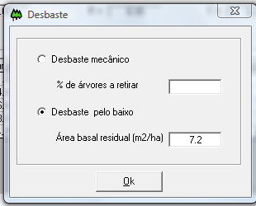
Inputs for Thinned Stands
Stand characteristics for a previously thinned stand
Stand age (years)
Site Index
Year
Dominant height (m)
Average diameter (cm)
Thinning
Weibull Parameters:
Volume overback without stump:
Mechanical thinning
% of trees to remove
Dbh Class
N (cm)
G (m² ha⁻¹)
H (m)
V_{total} (m³ ha⁻¹)
V_{roundwood} (m³ ha⁻¹)
V_{sawnwood} (m³ ha⁻¹)
V_{firewood} (m³ ha⁻¹)
Thinning from below
Residual Basal Area (m² ha⁻¹)
Project a thinning
Project without thinning
End
Simulation

Slide 46
Inputs for Thinned Stands
Stand characteristics for a previously thinned stand
Stand age (years)
Site Index
Year
Dominant height (m)
Average diameter (cm)
Weibull Parameters:
Volume overback without stump:
Dbh Class
N (cm)
G (m² ha⁻¹)
H (m)
V_{total} (m³ ha⁻¹)
V_{roundwood} (m³ ha⁻¹)
V_{sawnwood} (m³ ha⁻¹)
V_{firewood} (m³ ha⁻¹)
Do you want to thin again?
Project without thinning
End
Simulation

Slide 47
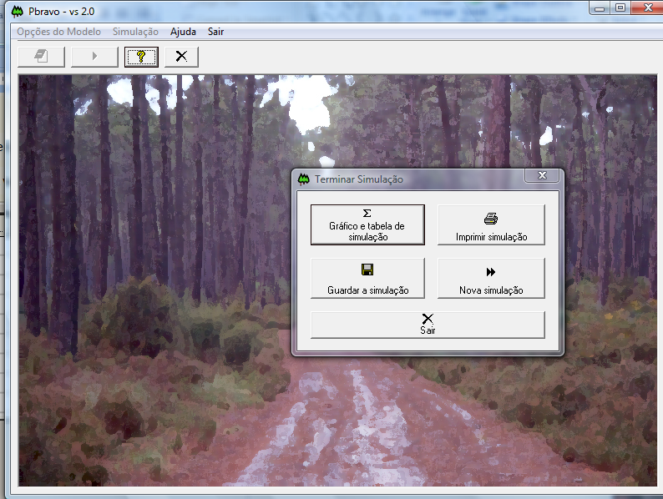
Graphics and Table
Print Simulation
Save Simulation
Simulate Simulation
Simulate again

Slide 48
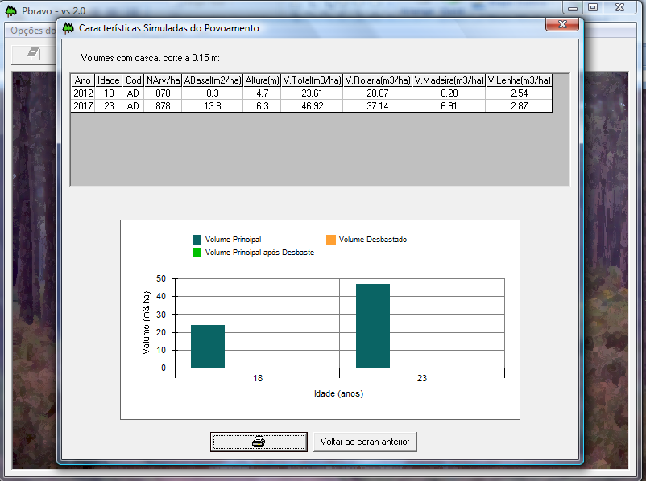
Characteristics Simulated Stand:
Volume overback without stump:
Standing volume
Thinned volume
Standing volume after thinning
Volume (m³ ha⁻¹)
Age (years)
Back

Slide 49
Finally we got to the end!!!

