Slide 1
Individual tree models The PINASTER model as an example

Slide 2
The PINASTER model
The PINASTER model is a distance-independent individual tree model developed for Portugal
Can be used for even and uneven-aged stands
Uses several equations developed in a PhD thesis (Nunes, 2011) that was complemented with
An initialization module
several thinning algorithms
It is implemented within the standsSIM simulator

Slide 3
PINASTER – growth module

Slide 4

Dominant height growth – site index curves
$${hdom}_{2}=e^{x}{\left(1−e^{−t_{2}^{0.294358}}\right)}^{65.08759−13.5194 x}$$
$$x=\frac{log\left({hdom}_{1}\right)−65.08759 log\left(1−e^{−t_{2}^{0.294358}}\right)}{1−13.5194 log\left(1−e^{−t_{1}^{0.294358}}\right)}$$

Slide 5
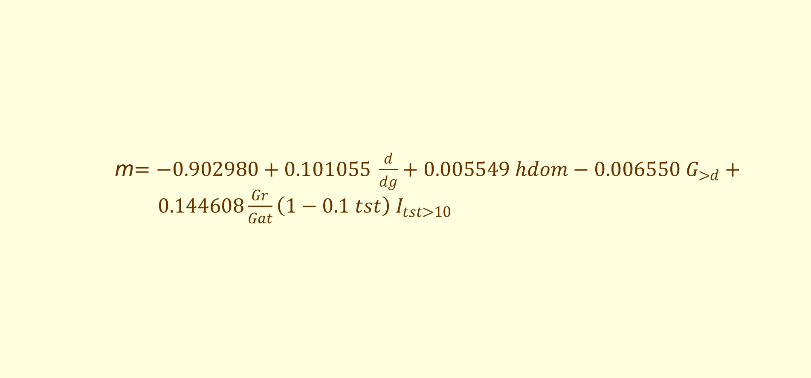
Annual diameter growth
m$=−0.902980+0.101055 \frac{d}{dg}+0.005549 hdom−0.006550 G_{>d}+ 0.144608\frac{Gr}{Gat}\left(1−0.1 tst\right) I_{tst>10}$
$$i_{d}=e^{1.296149+0.203967 log\left(d\right)+m log\left(t\right)}$$

Slide 6
Change of tree status
Ocasional mortality
$P\left(status=0\right)={\left(1+e^{−9.267380−0.204070 d+0.065599 G+0.076903 G_{>d}}\right)}^{−1}$
The probability of each tree to survive is compared with a random number in order to find out if it dies or stay alive:
$if P\left(status=o\right)$ > random number tree stays alive (status=0)
otherwise tree dies (status=1)

Slide 7
Change of tree status
Mortality due to self-thinning
If the number of trees per ha is higher than the number estimated with the self-thinning line (N_{st}), trees are iteratively “killed” in order to achieve the number indicated by the self-thinning line

Slide 8
Change of tree status – self-thinning
Maritime pine data - PORTUGAL
N
N_{st}

Slide 9
Change of tree status
Mortality due to self-thinning
If the number of trees per ha is higher than the number estimated with the self-thinning line (N_{st}), trees are iteratively “killed” in order to achieve the number indicated by the self-thinning line
The probability of a tree to stay is alive is estimated with the probability function used for ocasional mortality
Note that after each tree is “killed” the dg changes and this is the reason why the method is iterative: 1) decide the first tree to be “killed”; 2) recalculate dg and N_{st}; 3) if still needed come back to 1); 4) Stop the process when N<= N_{st}

Slide 10
PINASTER – calculus module
The PINASTER calculus module includes:
A height-diameter curve
A set of equations to estimate tree volume (total and merchantable)
A set of equations to estimate tree biomass per tree component

Slide 11
PINASTER – thinning module (1/2)
The PINASTER thinning module considers the tree list divided into a certain number of groups (usually 3)
The trees are sorted according to size and assigned to one of the groups
The user provides for each group a % that defines the maximum number of trees that can be removed from that group
The simulador computes, for each tree, a thinning index that defines the probability of a tree to be thinned and that usually depends on tree size and competition (in other models tree form can be taken into account)

Slide 12
PINASTER – thinning module (2/2)
The following process is repeated until the thinning criteria is achieved
The probability of a tree to be thinned is compared to a random number to decide if it will be thinned, takin also into account the % of removal fixed for the group to which the tree belongs
If the tree is thinned the competition indices around this tree and the thinning index are re-calculated
The process is repeated untill the thinning criteria is achieved

Slide 13
PINASTER – initialization module
The PINASTER initialization module is still preliminary and needs to be improved:
The trees are given a diameter dimension when hdom=5 m
Tree diameters follow a diameter distribution that was observed in some spacing trials followed since the establishment (not many) and are assigned using Monte Carlo simulation
Information of stand variables before the age when the stand achieves hdom=5 m is estimated on the basis of the stand variables at that point

Slide 14
The End!!

