Slide 1
Management oriented process based models
The 3PG model as an example
Improving the Calculus Module

Slide 2
Summary
Problems with the original calculus module
Improving the calculus module
“My templates” for 3PGpjs2.7.xls
Exercises

Slide 3
Improving the calculus module “information for managers”

Slide 4
The Calculus Module of the original 3PG has some problems
The volume estimation assumes that:
  Percentage of branches and bark can be easily estimated
  Wood density is a good “converter” of stemwood biomass into volume

Slide 5
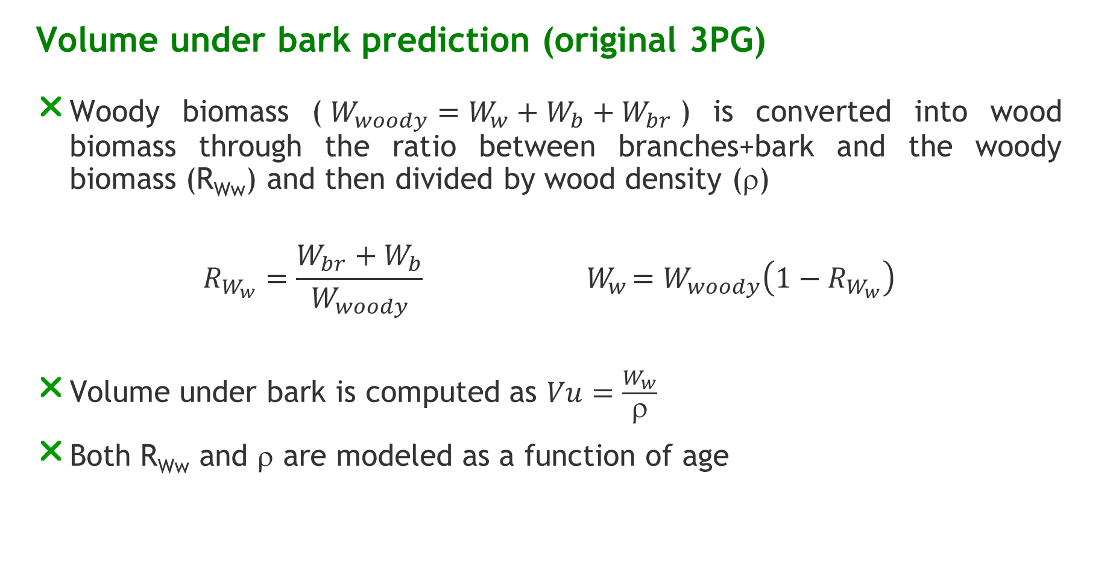
Volume under bark prediction (original 3PG)
Woody biomass ($W_{woody}=W_{w}+W_{b}+W_{br}$) is converted into wood biomass through the ratio between branches+bark and the woody biomass (R_{Ww}) and then divided by wood density (ρ)
$$R_{W_{w}}=\frac{W_{br}+W_{b}}{W_{woody}}{ W}_{w}=W_{woody}\left(1−R_{W_{w}}\right)$$
Volume under bark is computed as $Vu=\frac{W_{w}}{ρ}$
Both R_{Ww} and ρ are modeled as a function of age

Slide 6
The Calculus Module of the original 3PG has some problems
Volume estimation assumes that:
  Percentage of branches and bark can be easily estimated
  Wood density is a good “converter” of stemwood biomass into volume
Basal area estimation uses:
  the basal area of the average tree and an allometric relationship between tree diameter and wood biomass to estimate the diameter of the average tree

Slide 7
Basal area prediction
Woody biomass of the mean tree is first predicted through division by stand density (N)
Quadratic mean diameter (dg) is then predicted through the inversion of the allometric equation for tree woody biomass prediction
Finally G is predicted by multiplying the basal area of the mean tree by stand density
X

Slide 8
Objective of the “new” calculus module
In Portugal there is a large database from permanent plots
The objective was to use the existing data to develop allometric equation to
  Improve basal area (G) estimation
  Improve the underbark volume (Vu) estimation
  To obtain an estimation of dominant height (hdom) , a stand variable usually required by forest managers

Slide 9
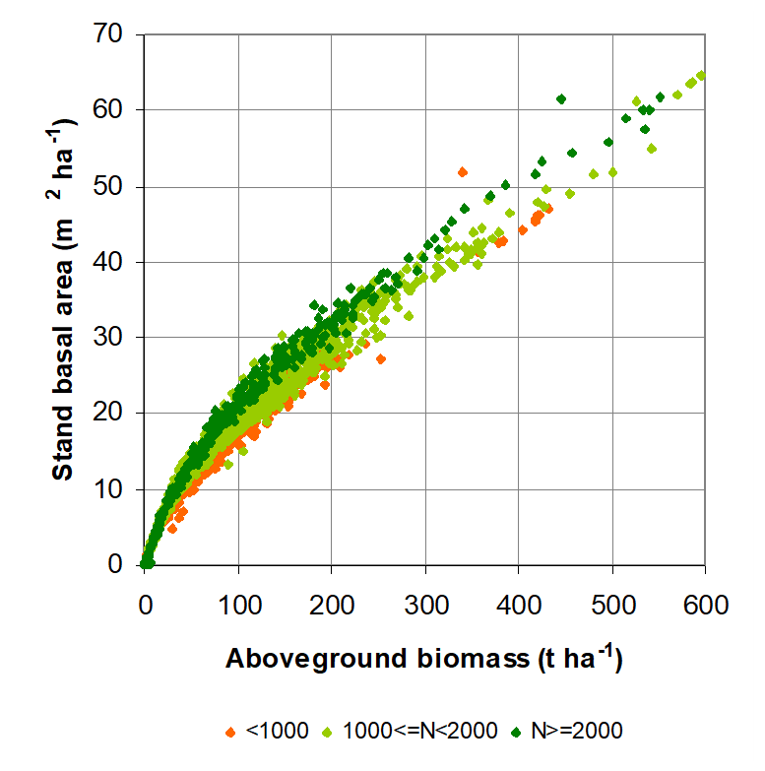

Allometric relationship for G
  $G=k {Wa}^{a1+a2\frac{N}{10000}}$
  $G_{t2}=G_{t1}\left(\frac{{Wa}_{t2}^{a1+a2\frac{N_{t2}}{10000}}}{{Wa}_{t1}^{a1+a2\frac{N_{t1}}{10000}}}\right)$
    k, a1, a2 are parameters

Slide 10
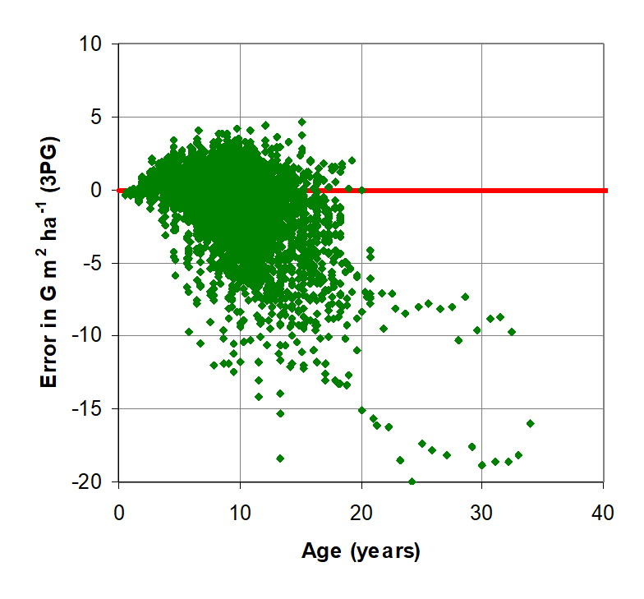
Error in G estimation (3PG)

Slide 11
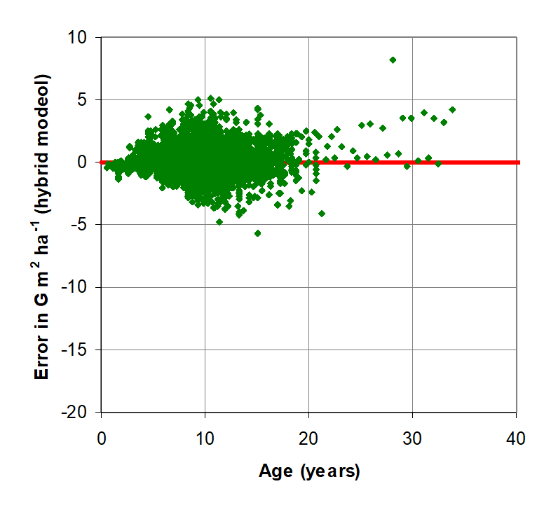
Error in G estimation (with the allometric equation)

Slide 12
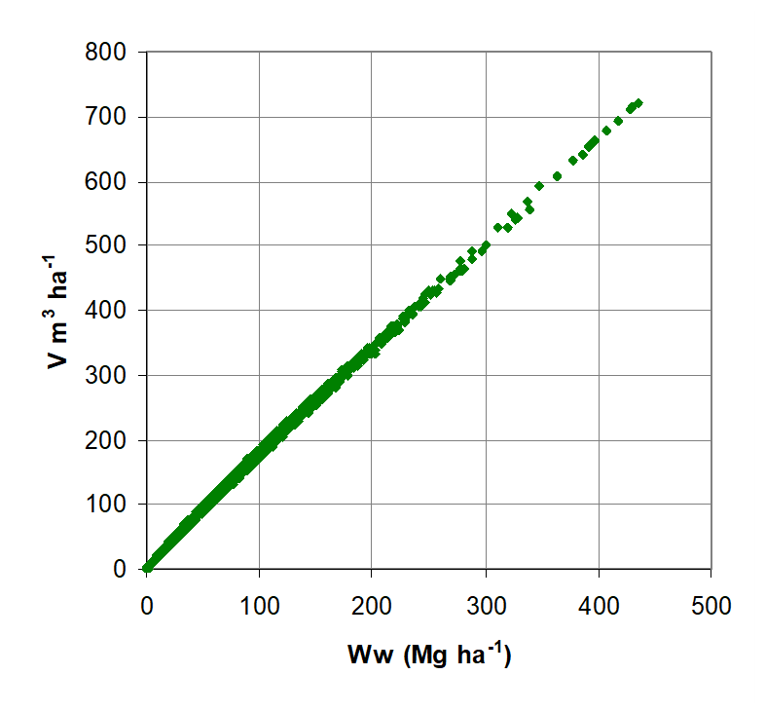

Allometric relationship for Vu
  $Vu=k {Wwy}^{a1+a2\frac{N}{10000}}$
  ${Vu}_{t2}={Vu}_{t1}\left(\frac{{Wwya}_{t2}^{a1+a2\frac{N_{t2}}{10000}}}{{Wwy}_{t1}^{a1+a2\frac{N_{t1}}{10000}}}\right)$
    k, a1, a2 are parameters

Slide 13
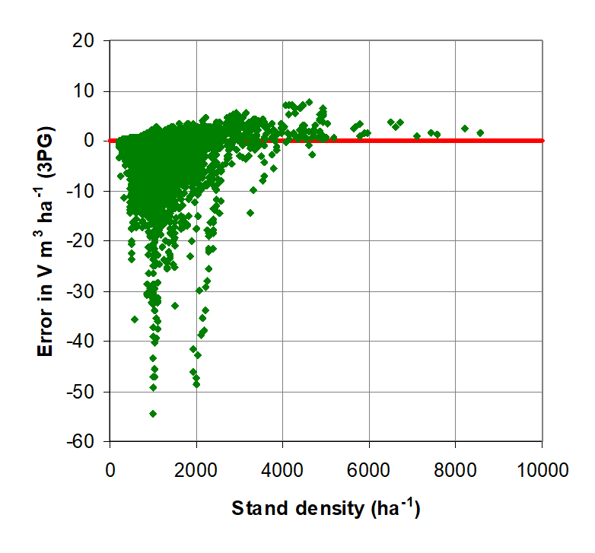
Error in Vu prediction ( with 3PG)

Slide 14
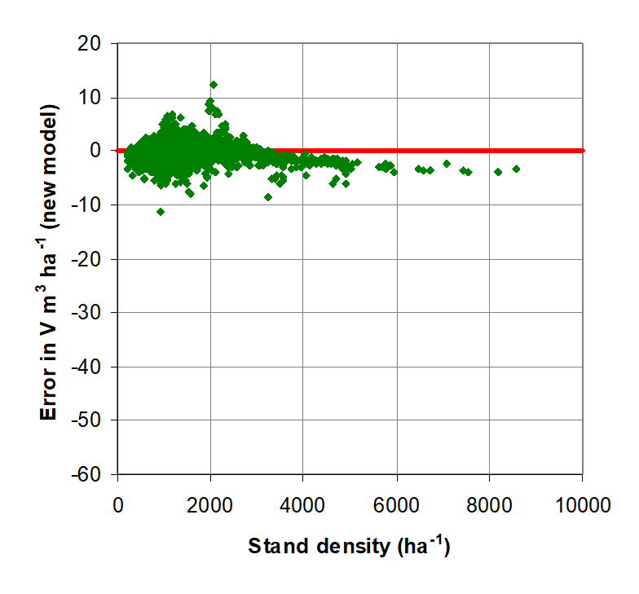
Error in Vu estimation (with the allometric equation

Slide 15
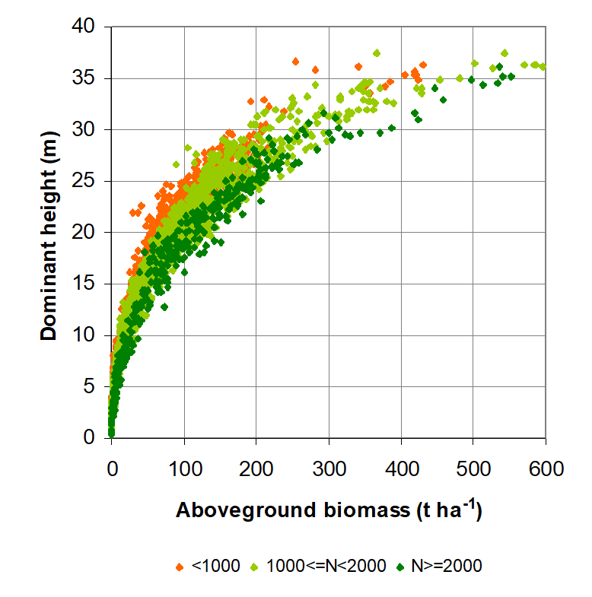

Allometric relationship for hdom
  $hdom=k {Wwy}^{a1+a2\frac{N}{10000}}$
  ${hdom}_{t2}={hdom}_{t1}\left(\frac{{Wwya}_{t2}^{a1+a2\frac{N_{t2}}{10000}}}{{Wwy}_{t1}^{a1+a2\frac{N_{t1}}{10000}}}\right)$
    k, a1, a2 are parameters

Slide 16
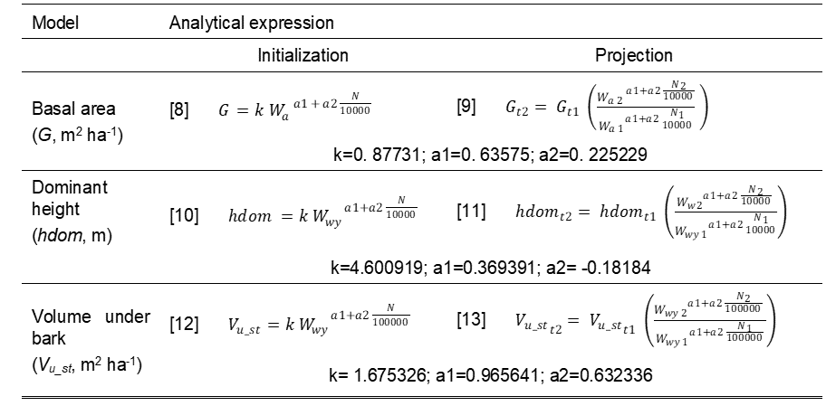
The equations of the “new” Calculus Module

Slide 17
The end!!!
The end!!!

