Slide 1
Thinnings

Slide 2
Thinning: “Low”
The thinnest trees are removed in even-aged stands
Thinnings

Slide 3
Thinning: “Low”
The thinnest trees are removed in even-aged stands
Thinnings

Slide 4
Thinning: “Selective”
Trees are removed to guarantee a similar basal area in each diameter class – uneven-aged stands (requires natural regeneration or planting to guarantee ingrowth)
Thinnings

Slide 5
Thinning: “Mechanical”
Trees are removed in stripes regardless of their size (less common)
Thinnings

Slide 6
Thinning: “Alegria”
Alegria, C. visited stands that had been marked for thinning and measured the dbh of all trees and which had been marked for thinning, developed a Logistic model that determines the probability of a given tree to be thinned as a function of the tree diameter
Tries to reproduce the thinning practiced in the reagion
Thinnings

Slide 7
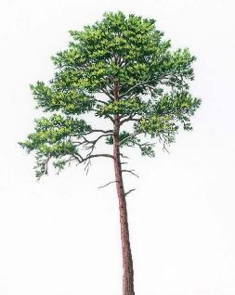
8.1 PINASTER. Simulating a new plantation
Simulate the growth of the following maritime pine stand:
Location: São Pedro de Moel municipality
Altitude: 31 m (if you don’t know the altitude you can use the webGLOBULUS stand simulator to obtain it)
Site index: 18 m (50 years)
Plantation spacing: 2 x 2 (the interface requires the number of trees per hectare)
a) Define a suitable forest management approach (FMA) considering thinning from below to take place every 10 years based on a Wilson Factor of 0.25 and final harvest at 50 years. Consider a planning horizon of 50 years.
Thinning
FW=0.25
Thinning
FW=0.25
Thinning
FW=0.25
Final harvest 50 yrs

Slide 8
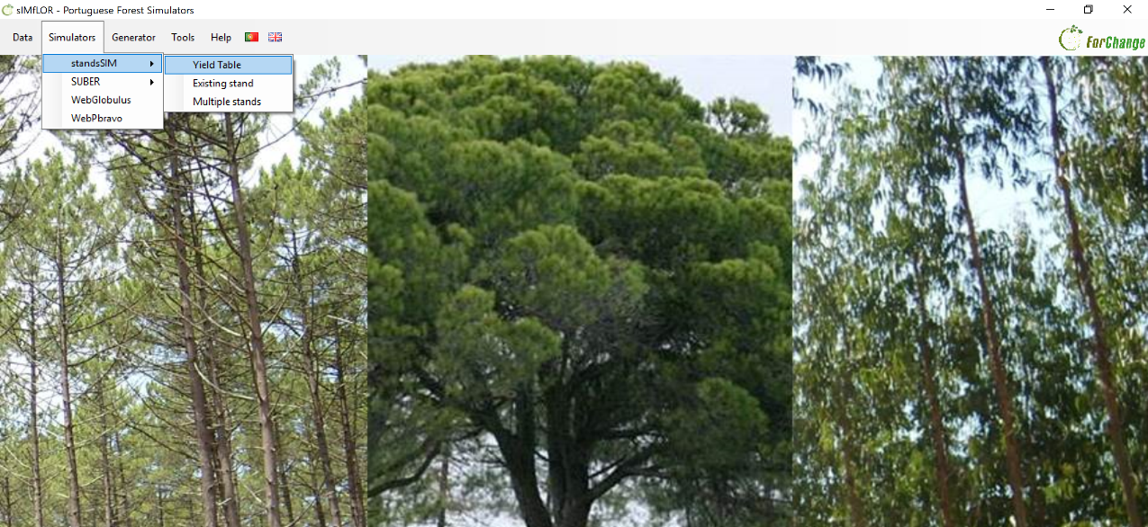
8.1 PINASTER. Simulating a new plantation

Slide 9
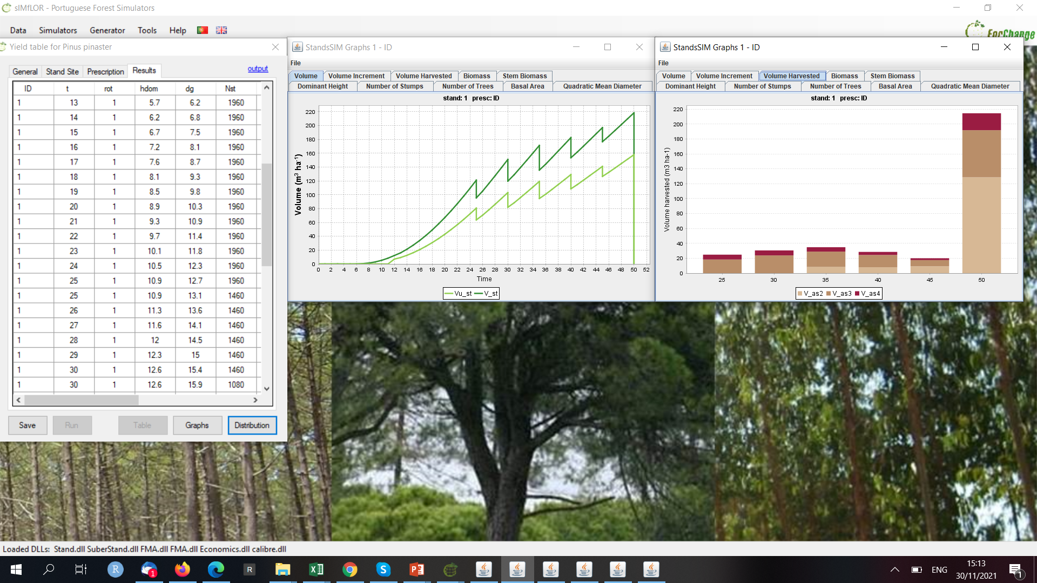
8.1 PINASTER. Simulating a new plantation

Slide 10
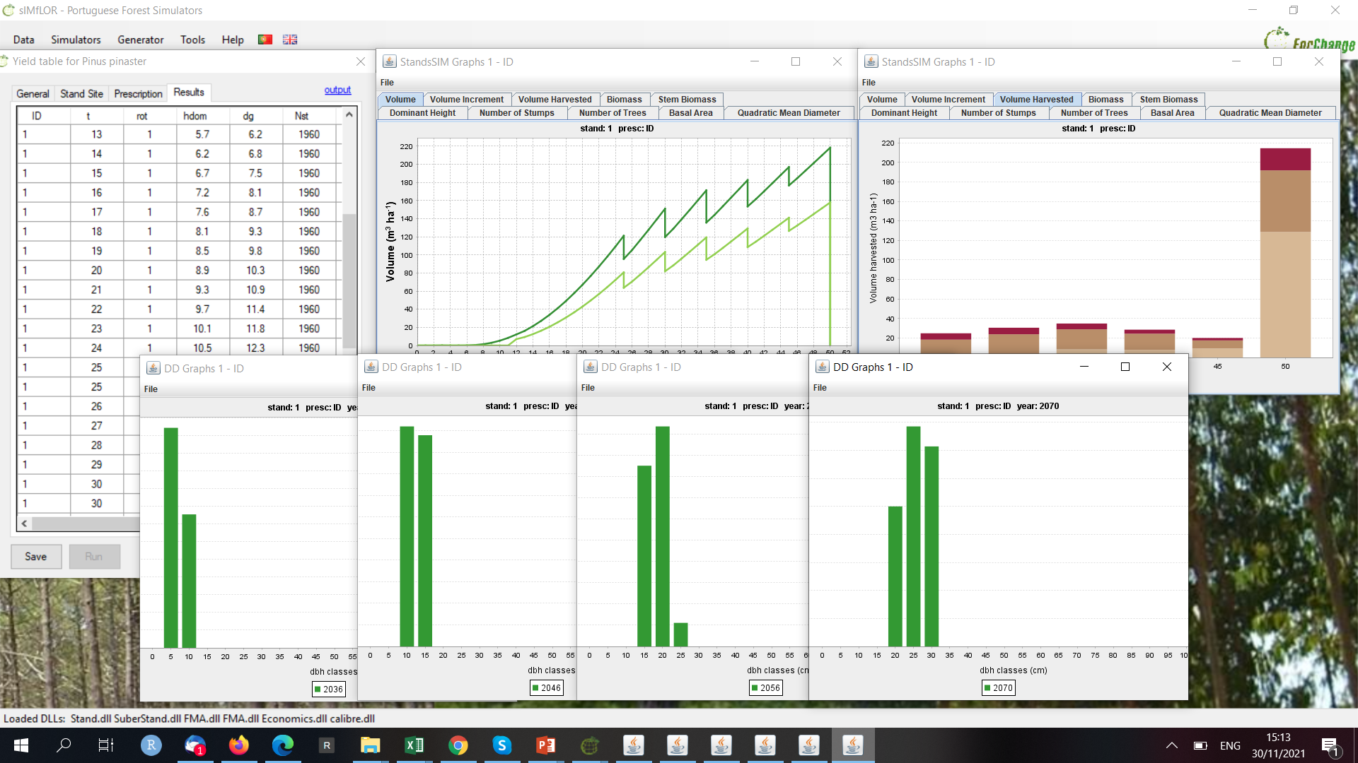
8.1 PINASTER. Simulating a new plantation
Thinning from below
FW=0.25

Slide 11
8.1 PINASTER. Simulating a new plantation
Simulate the growth of the following maritime pine stand:
Location: São Pedro de Moel municipality
Altitude: 31 m (if you don’t know the altitude you can use the webGLOBULUS stand simulator to obtain it)
Site index: 18 m (50 years)
Plantation spacing: 2 x 2 (the interface requires the number of trees per hectare)
b) Define a suitable forest management approach (FMA) considering thinning from below to take place every 10 years based on a residual basal area of 25 m² ha⁻¹ and final harvest at 50 years. Consider a planning horizon of 50 years.
Thinning
Gres=25
Thinning
Gres=25
Thinning
Gres=25
Final harvest 50 yrs

Slide 12
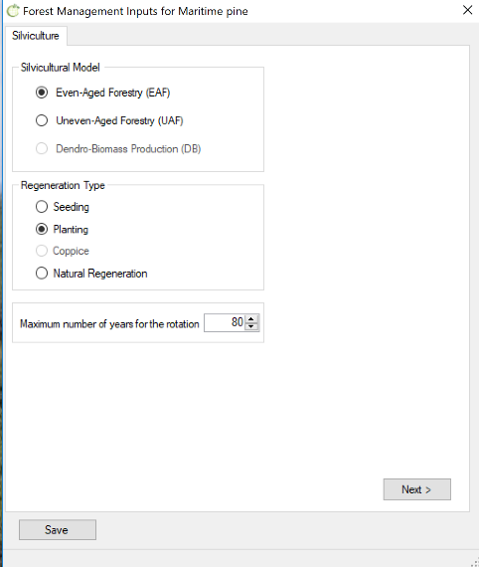
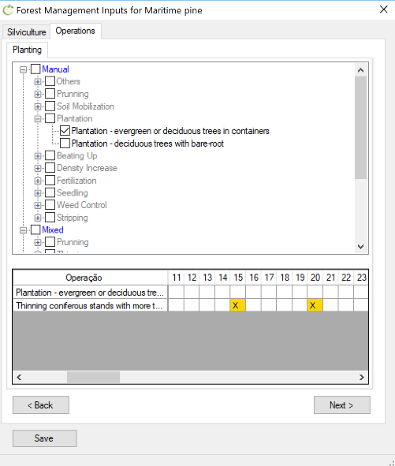
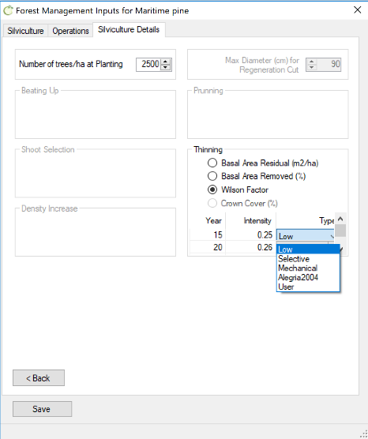
8.1 PINASTER. Simulating a new plantation

Slide 13
8.1 PINASTER. Simulating a new plantation

Slide 14
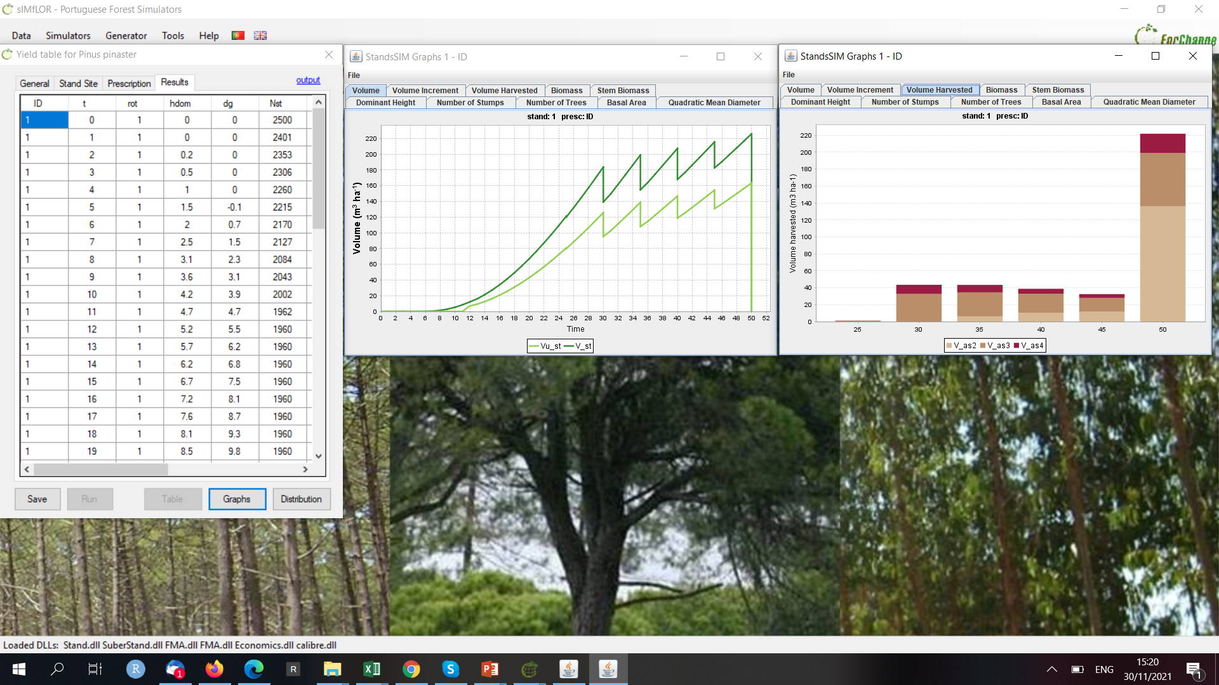
8.1 PINASTER. Simulating a new plantation

Slide 15
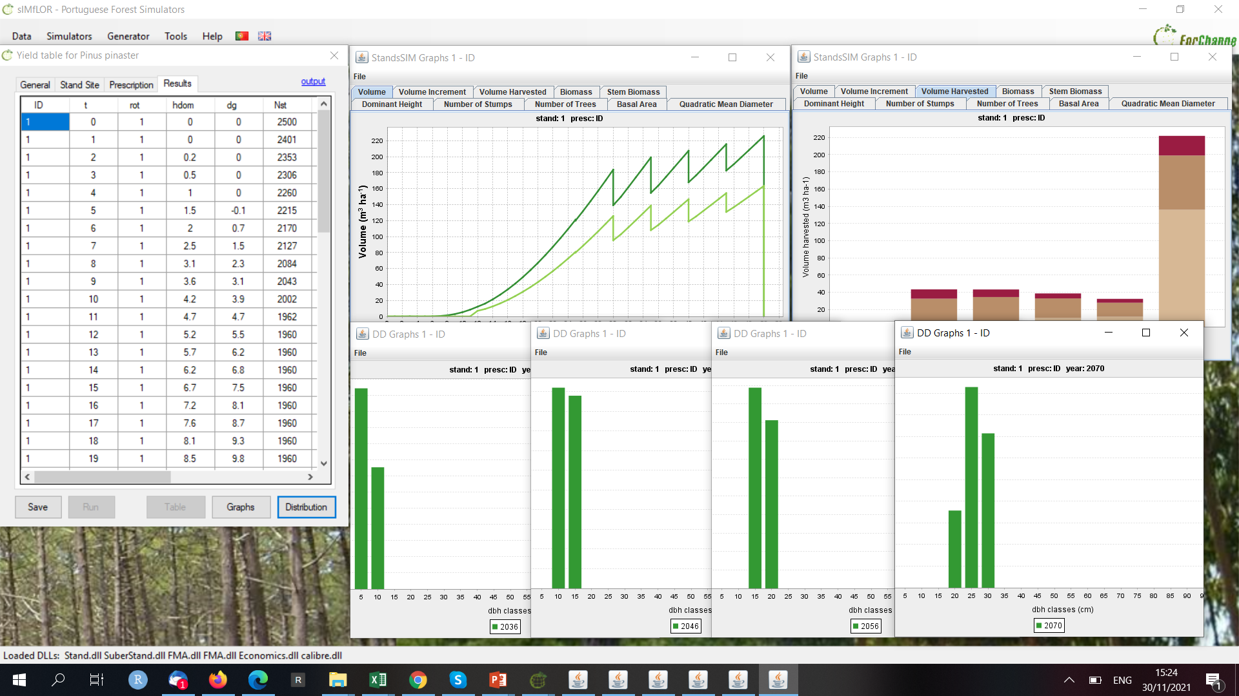
8.1 PINASTER. Simulating a new plantation
Thinning from below
Gres=25 m²ha⁻¹

Slide 16
8.2 PINASTER. Simulating a new plantation
Delay the final harvest age up to 80 years
Simulate the growth of the following maritime pine stand:
Location: São Pedro de Moel municipality
Altitude: 31 m (if you don’t know the altitude you can use the webGLOBULUS stand simulator to obtain it)
Site index: 18 m (50 years)
Plantation spacing: 2 x 2 (the interface requires the number of trees per hectare)
Delay the final harvest age up to 80 years and not carrying out any thinning (the stand will reach self-thinning).
cycle 1
Even-aged management for 80 years with final harvest in the end of the cycle FMA41_Pb_SelfThin_REGular.csv
Final harvest 80 yrs

Slide 17
8.2 PINASTER. Simulating a new plantation

Slide 18
8.2 PINASTER. Simulating a new plantation

Slide 19
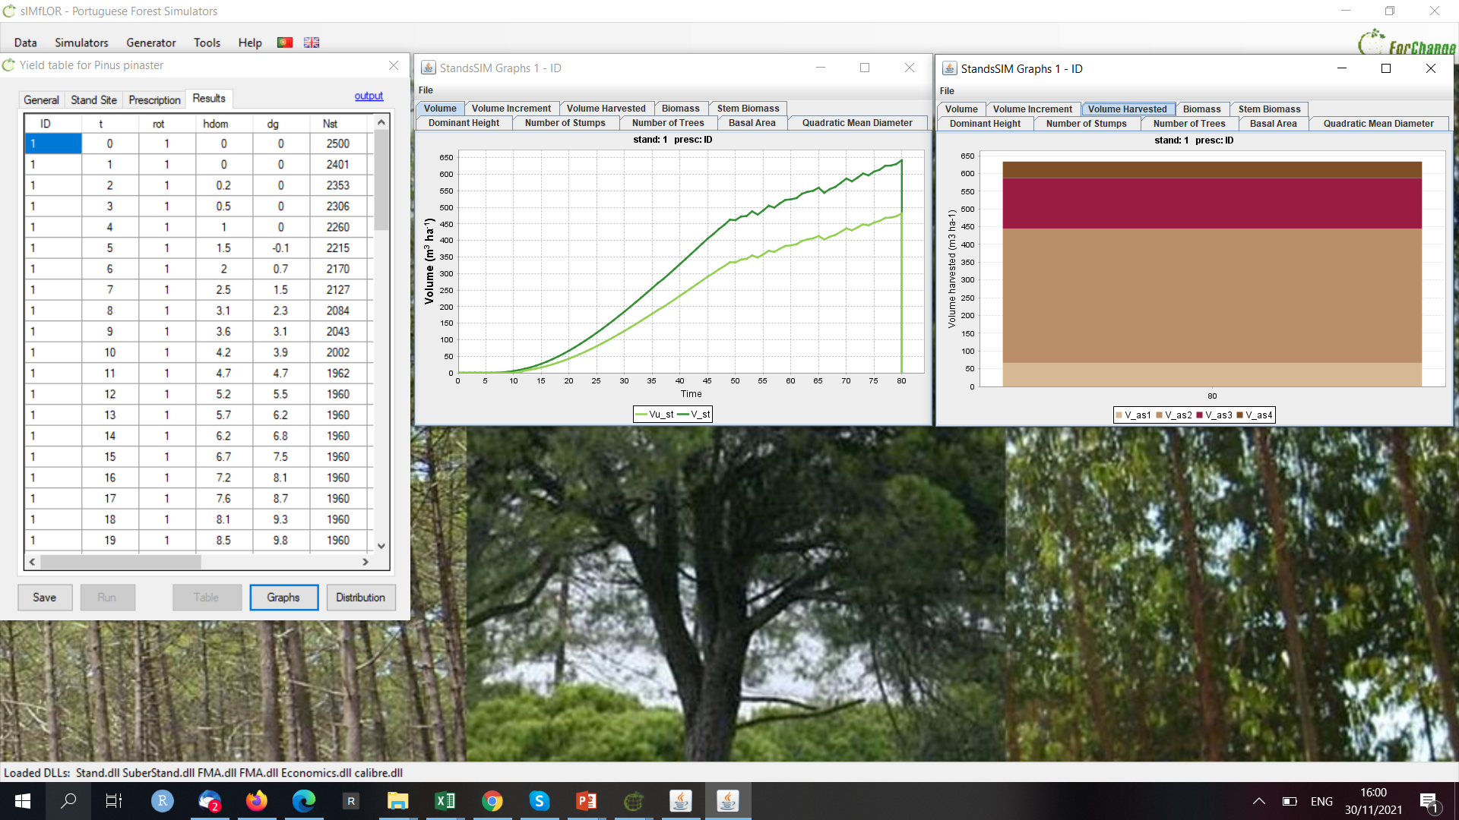
8.2 PINASTER. Simulating a new plantation

Slide 20
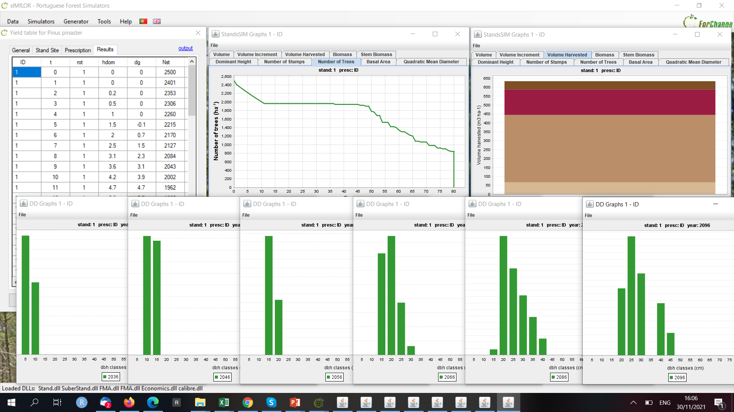
8.2 PINASTER. Simulating a new plantation
Self-thinning

Slide 21
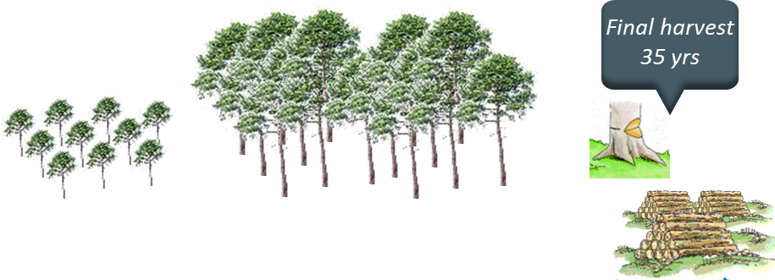
8.3 PINASTER. Simulating an existing even-aged stand
Simulate the growth of the following maritime pine stand:
Location: São Pedro de Moel municipality
Stand structure: even-aged, Stand Age: 15 years, Dominant height =12 m
Number of trees in the plot: 49 trees, Plot area: 500 m²
Altitude: 100 m (if you don’t know the altitude you can use the webGLOBULUS stand simulator to obtain it)
Tree data file: FMA41_Pb_025_REGular.csv
Build a prescription for a planning horizon of 80 years assuming the final harvest age is 35 yrs
cycle 1
Even-aged management of a 15 yrs old stand until age 35
cycle 2
Even-aged management of a plantation until age 35
cycle 3
Even-aged management of a plantation until age 35
Final harvest 35 yrs
Final harvest 35 yrs

Slide 22
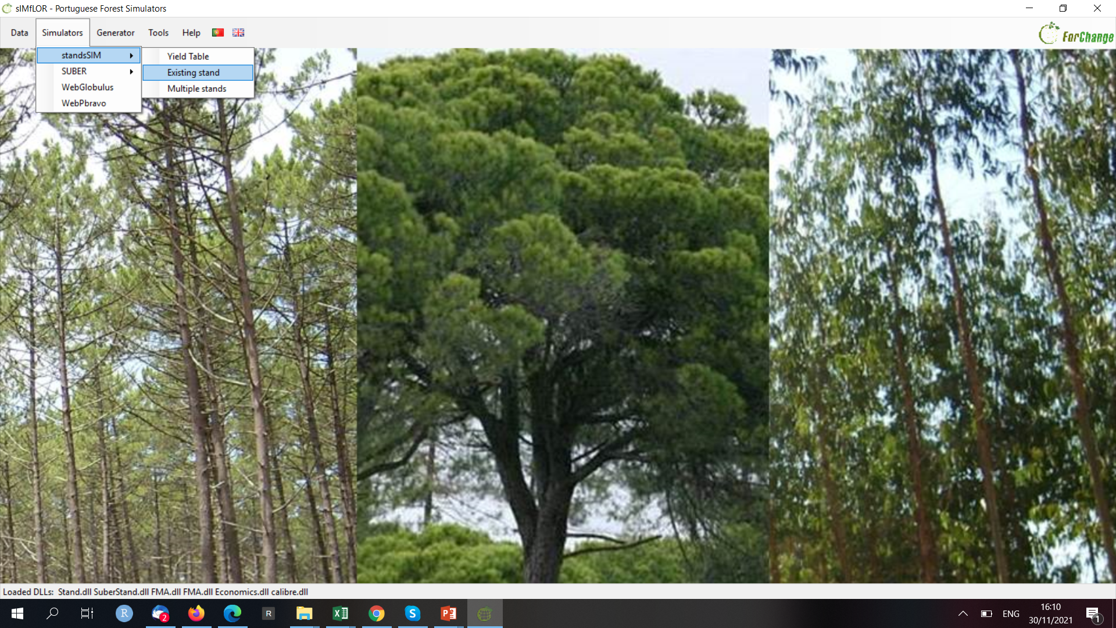
8.3 PINASTER. Simulating an existing even-aged stand

Slide 23
8.3 PINASTER. Simulating an existing even-aged stand

Slide 24
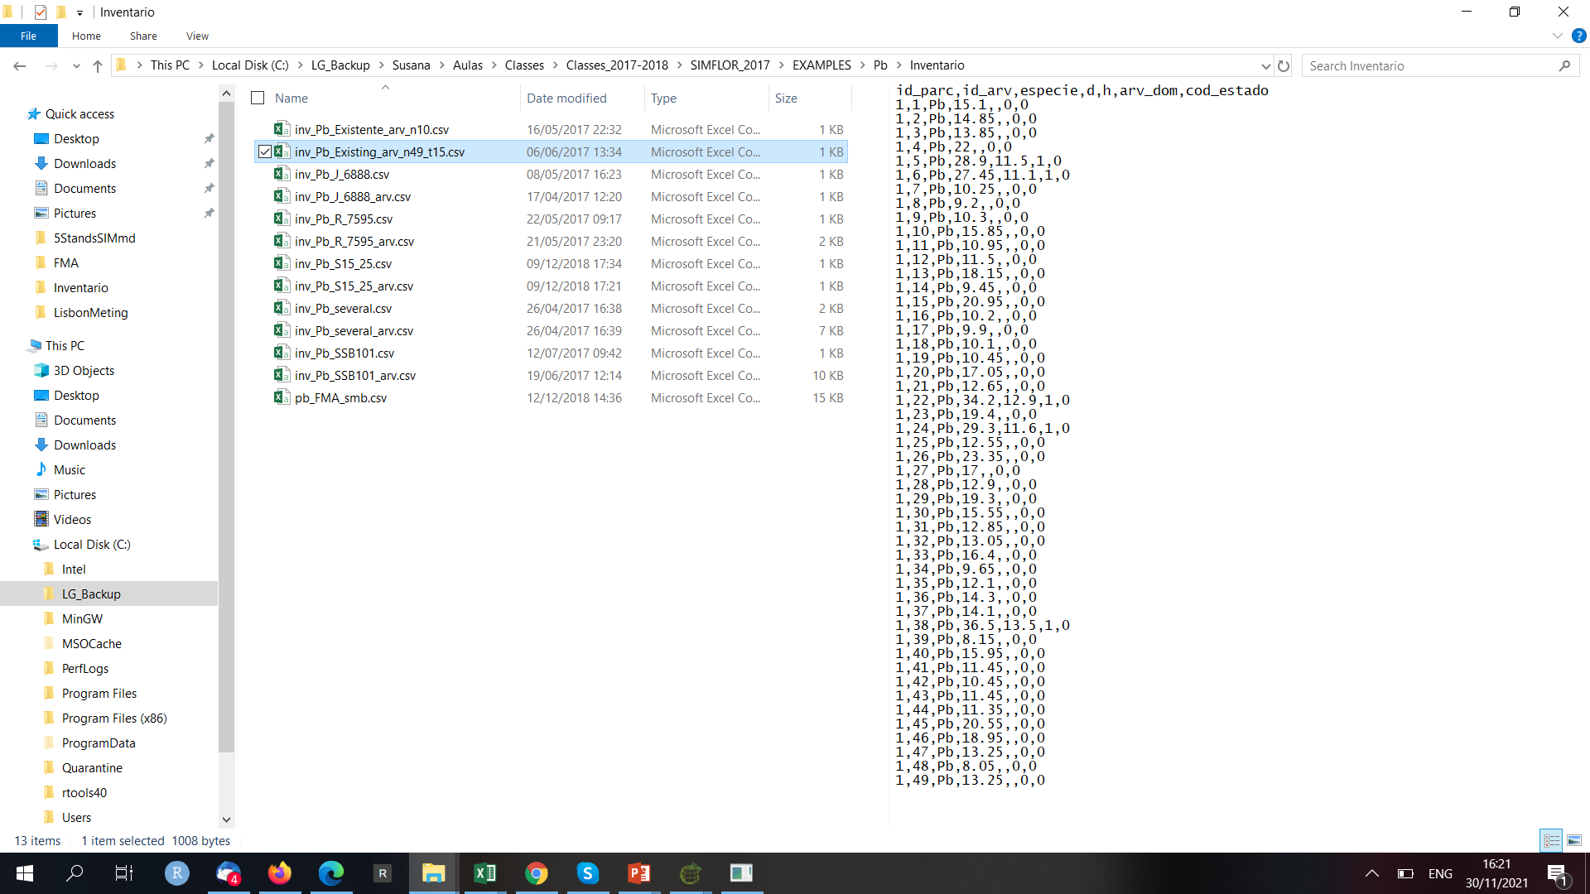
8.3 PINASTER. Simulating an existing even-aged stand

Slide 25
8.3 PINASTER. Simulating an existing even-aged stand

Slide 26
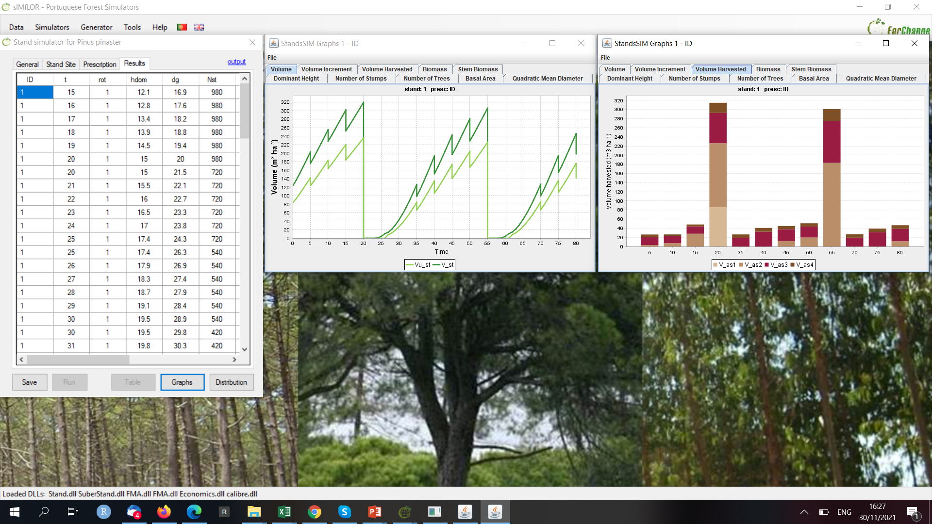
8.3 PINASTER. Simulating an existing even-aged stand

Slide 27
8.4 PINASTER. Simulating an existing uneven-aged stand transition to even-aged
Simulate the growth of the following maritime pine stand:
Location: Alcácer do Sal municipality
Stand structure: uneven-aged
Number of trees in the plot: 10 trees
Plot area: 500 m²
Altitude: 100 m (if you don’t know the altitude you can use the webGLOBULUS stand simulator to obtain it)
Tree data file: inv_Pb_J_6888_arv.csv
Build a prescription with 2 cycles as described below:
A planning horizon of 70 years
cycle 1
Uneven-aged management for 35 years with final harvest in the end of the cycle FMA31_Pb_Gres_Irreg.csv
cycle 2
Planting and final harvest at 35 years FMA41_Pb_025_REGular.csv
Final harvest 35 yrs
Final harvest 35 yrs

Slide 28
8.4 PINASTER. Simulating an existing uneven-aged stand transition to even-aged

Slide 29
8.4 PINASTER. Simulating an existing uneven-aged stand transition to even-aged
$$N=$$
$$Fw=\frac{100}{hdom\sqrt{N}}$$
If you have a predefined FW = 0.25 you have to find out the number of trees it corresponds to (N_{FW}):
If your stand density (N) > (N_{FW}) the number of trees to be thinned (N_thin) are:
N_{Thin} = N - N_{FW}
$$N_{FW}=\frac{{100}^{2}}{{hdom}^{2}{FW}^{2}}$$

Slide 30
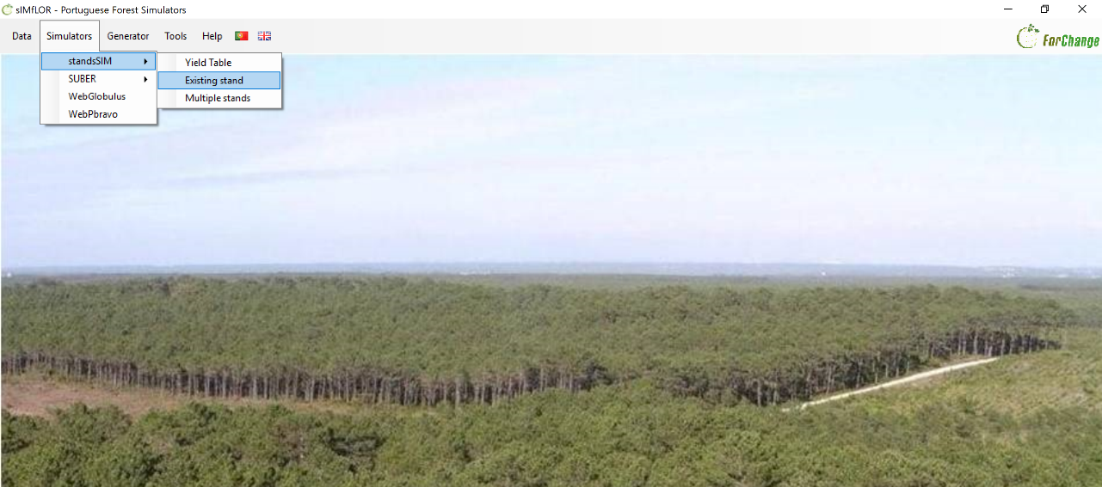
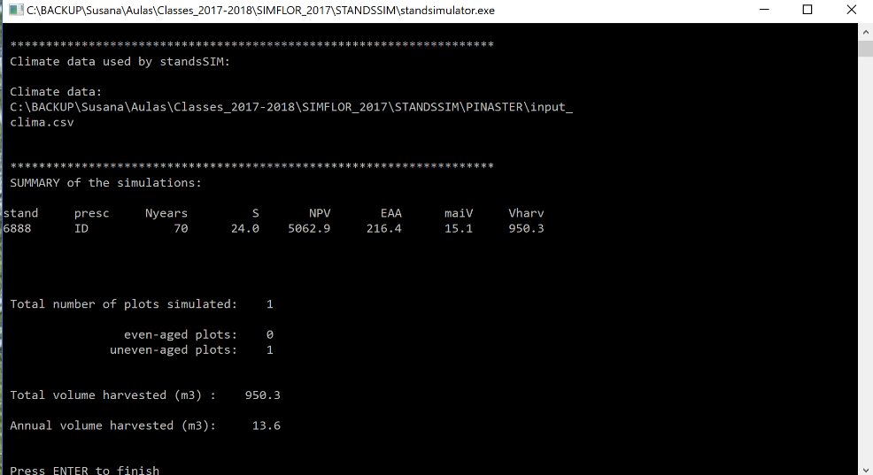
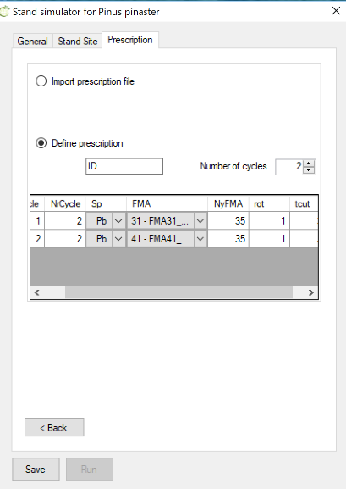
8.4 PINASTER. Simulating an existing uneven-aged stand transition to even-aged

Slide 31
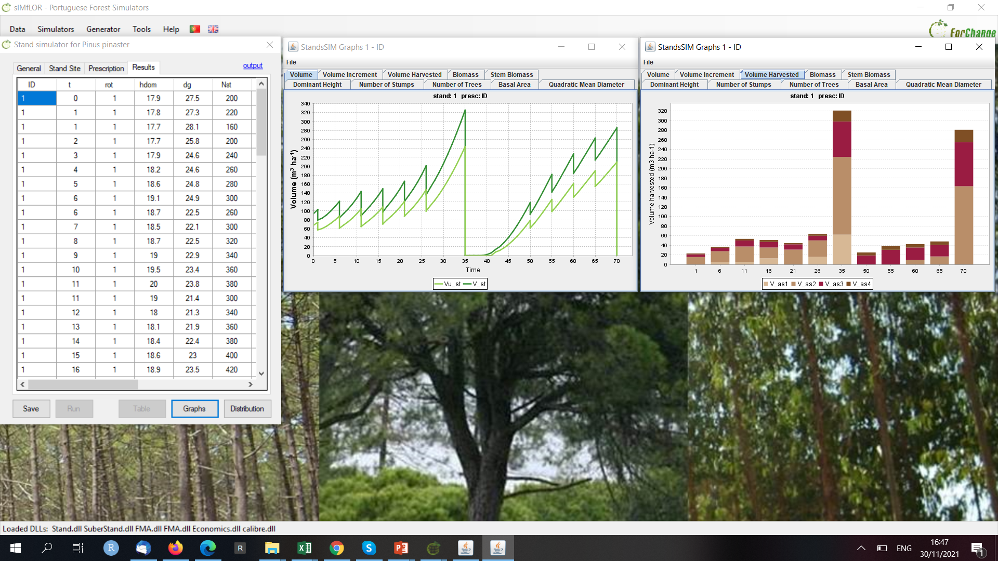
8.4 PINASTER. Simulating an existing uneven-aged stand transition to even-aged

Slide 32
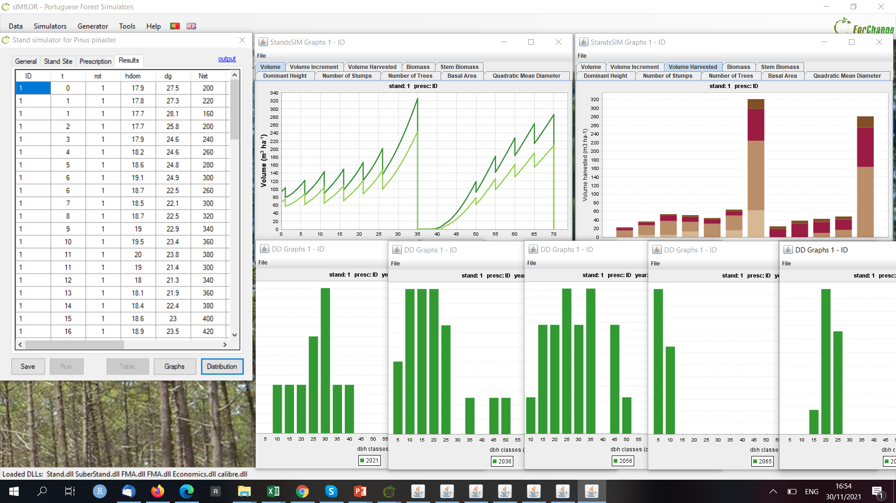
8.4 PINASTER. Simulating an existing uneven-aged stand transition to even-aged

Slide 33
8.5 PINASTER. Simulating an existing even-aged stand transition to uneven-aged
Simulate the growth of the following maritime pine stand:
Location: São Pedro de Moel municipality
Stand structure: even-aged, Stand Age: 15 years, Dominant height =12 m
Number of trees in the plot: 49 trees, Plot area: 500 m²
Altitude: 100 m (if you don’t know the altitude you can use the webGLOBULUS stand simulator to obtain it)
Tree data file: Pb_inv_t15_arv.csv
Build a prescription for a planning horizon of 70 yrs with 2 cycles: suggestion adapt the recommended FMAs below to include a heavy thinning in the end of the 1st cycle and density increases along the 2nd cycle
cycle 2
uneven-aged management for 35 years (suggestion: FMA31_Pb_Gres_Irreg.csv)
cycle 1
even-aged management for 35 years (suggestion: FMA41_Pb_025_REGular.csv)
Thinning
FW=0.29
Thinning
Gres=25
Thinning
Gres=25
Thinning
Gres=25

Slide 34
Homework
8.5 PINASTER. Simulating an existing even-aged stand transition to uneven-aged
8.6 PINASTER. Building a series of yield tables for a range of site indices

