Slide 1
The Simplex Method
Susana Barreiro
16-17 March 2022

Slide 2
The Simplex Method
The Simplex Method
  The Simplex Method - formulation (standard form)
  The Simplex Method - procedure
  The Simplex Method - particular cases
    Tie for the Entering BV
    Tie for the Leaving BV - degenerate
    No leaving BV – Unbounded Z
    Multiple optimal solutions
  The Simplex Method - other cases
    Minimization of the objective function
    Negative Right Hand Sides
    Eliminating negative variables
    Functional constraints in ≥ and = form
    Eliminating unconstrained variables
  Sensitivity analysis using the tableau
  The Simplex Method – Exercises

Slide 3
Simplex Method
The graphical approach can be used for two-variable LP problems
Unfortunately, most real-life LPs problems require a method to find optimal solutions capable of dealing with several variables: the simplex algorithm
In the classes we will focus on the manual application of the simplex algorithm (using EXCEL), although computer packages to apply the simplex algorithm have been developed (LINDO and LINGO)

Slide 4
Simplex Method
The Simplex method is an approach to solving linear programming problems by hand using slack variables, tableaus, and pivot variables as a means to finding the optimal solution of an optimization problem
To solve a LP problems using the Simplex method the following steps are necessary:
  Standard form
  Introducing slack variables
  Creating the tableau
  Finding the Pivot variables
  Creating a new tableau
  Checking for optimality
  Identify optimal values

Slide 5
Simplex Method
Formulation

Slide 6
Simplex Method - Formulation
In LP problem, the decision maker usually wants to:
maximize (usually revenue or profit) mminimize (usually costs)
the objective function (Z) is expressed by a set of decision variables
Certain limitations are often imposed to these decision variables (expressed in the form of ≤, = or ≥).
These restrictions are called constraints
Standard form is the baseline format for all linear programs before solving for the optimal solution and has three requirements:
  must be a maximization problem,
  all linear constraints must be in a less-than-or-equal-to inequality,
  all variables are non-negative.
Standard form is the ideal starting point for solving the Simplex method

Slide 7
Simplex Method - Formulation
Standard form is the baseline format for all linear programs before solving for the optimal solution and has three requirements:
  must be a maximization problem,
  all linear constraints must be in a less-than-or-equal-to inequality,
  all variables are non-negative.
Standard form is the ideal starting point for solving the Simplex method
Poets’ Problem
Max: Z = 90 x₁ + 120 x₂
Subject to:
x₁ ≤ 40
x₂ ≤ 50
2x₁ + 3x₂ ≤ 180
and x₁ ≥ 0; x₂ ≥ 0
(€/yr)
(ha of pine)
(ha of eucalypt)
(days of work)

Slide 8
Simplex Method - Formulation
The Simplex algorithm is an algebraic procedure to solve LP problems based on geometric concepts that requires LP problems to be presented in the standard form:
Poets’ Problem
Max: Z = 90 x₁ + 120 x₂
Subject to:
x₁ ≤ 40
x₂ ≤ 50
2x₁ + 3x₂ ≤ 180
and x₁ ≥ 0; x₂ ≥ 0
(€/yr)
1) Objective function is maximized
2) Constraints in the form of ≤ inequalities
3) All values on the right handside are ≥
4) All variables are nonnegative (≥)
(ha of pine)
(ha of eucalypt)
(days of work)

Slide 9
Simplex Method - Formulation
The Simplex algorithm is an algebraic procedure to solve LP problems based on geometric concepts that must be translated into algebraic language to allow solving systems of equations.
  1st - transform all inequalities into equalities by introducing one additional variable to each constraint (the slack variables: S₁, S₂, S₃).
Original form:
Standard or augmented form:
Max: Z = 90 x₁ + 120 x₂
Subject to:
x₁ + S₁ ≤ 40
x₂ + S₂ ≤ 50
2x₁ + 3x₂ + S₃ ≤ 180
and x₁ x₂ S₁ S₂ S₃ ≥ 0
Max: Z = 90 x₁ + 120 x₂
Subject to:
x₁ + S₁ = 40
x₂ + S₂ = 50
2x₁ + 3x₂ + S₃ = 180
and x₁ x₂ S₁ S₂ S₃ ≥ 0

Slide 10
Simplex Method - Formulation
The Simplex algorithm is an algebraic procedure to solve LP problems based on geometric concepts that must be translated into algebraic language to allow solving systems of equations.
  1st - transform all inequalities into equalities by introducing one additional variable to each constraint (the slack variables: S₁, S₂, S₃).
  2nd - transform the objective function into an additional constraint
Max: Z = 90 x₁ + 120 x₂
Subject to:
x₁ + S₁ = 40
x₂ + S₂ = 50
2x₁ + 3x₂ + S₃ = 180
and x_{1 ,} x_{2 ,} S_{1 ,} S_{2 ,} S₃ ≥ 0
Z - 90 x₁ - 120 x₂ = 0
x₁ + S₁ = 40
x₂ + S₂ = 50
2x₁ + 3x₂ + S₃ = 180

Slide 11
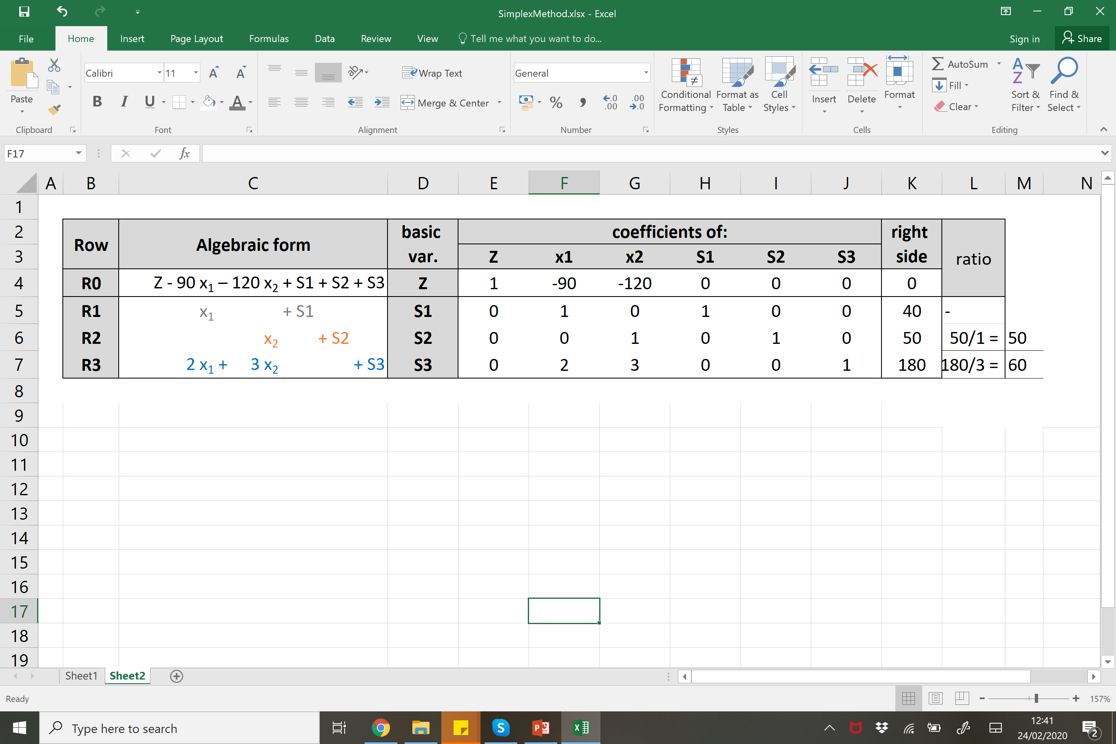
Simplex Method - Formulation
The Simplex algorithm is an algebraic procedure to solve LP problems based on geometric concepts that must be translated into algebraic language to allow solving systems of equations.
  1st - transform all inequalities into equalities by introducing one additional variable to each constraint (the slack variables: S₁, S₂, S₃).
  2nd - transform the objective function into an additional constraint
  3rd - build the Simplex tabular form where only the essential information is recorded
Z - 90 x₁ - 120 x₂ = 0
x₁ + S₁ = 40
x₂ + S₂ = 50
2x₁ + 3x₂ + S₃ = 180

Slide 12
Simplex Method - Formulation
The Simplex algorithm is an algebraic procedure to solve LP problems based on geometric concepts that must be translated into algebraic language to allow solving systems of equations.
  1st - transform all inequalities into equalities by introducing one additional variable to each constraint (the slack variables: S₁, S₂, S₃).
  2nd - transform the objective function into an additional constraint
  3rd - build the Simplex tabular form where only the essential information is recorded
Each basic feasible solution has basic or non-basic variables
- non-basic variables are set to ZERO
- basic variables are directly obtained from the table
Non-basic variables
Basic variables
initialize the procedure setting x₁ = x₂ = 0
(X₁, X₂, S₁, S₂, S₃ ) =( 0, 0, 40, 50, 180)

Slide 13
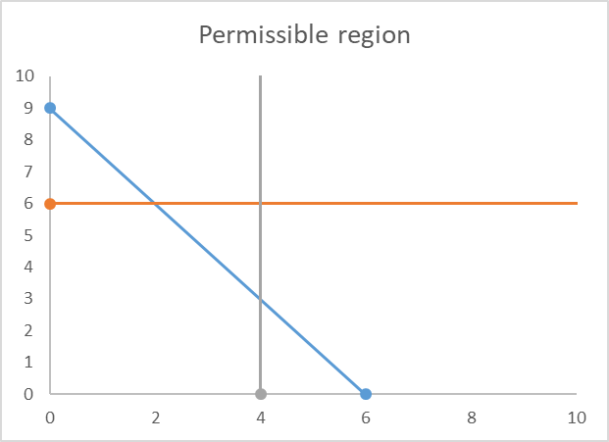
Simplex Method - Graphical analysis
The Simplex algorithm is a search procedure that:
  shifts through the set of basic feasible solutions, one at a time, until the optimal basic feasible solution (whenever it exists) is identified.
  - the method is an efficient implementation the Corner Points Procedure.
  Corner point feasible solutions – vertices of the feasible region
  Optimal solution(s) – vertice(s) of the feasible region that maximize Z, ie solution that gives the best favorable value to the objective function
B= (0,50)
C= (15,50)
D= (40,33)
A= (0,0)
E= (40,0)

Slide 14
Simplex Method - Graphical analysis
The Simplex algorithm is a search procedure that:
  shifts through the set of basic feasible solutions, one at a time, until the optimal basic feasible solution (whenever it exists) is identified.
  - the method is an efficient implementation the Corner Points Procedure.
Replacing X₁ and X₂ by the values of A, B, C, D and E in the objective function:
  Z_{A}= 0
  Z_{B}= 6000
  Z_{C}= 7350
  Z_{D}= 7600
  Z_{E} = 3600
B= (0,50)
C= (15,50)
D= (40,33)
Z = 90 x₁ + 120 x₂
A= (0,0)
E= (40,0)

Slide 15
Simplex Method - Graphical analysis
The Simplex algorithm is a search procedure that:
  shifts through the set of basic feasible solutions, one at a time, until the optimal basic feasible solution (whenever it exists) is identified.
  - the method is an efficient implementation the Corner Points Procedure.
  Feasible solutions – within or on the border of the feasible region ie solutions for which the constraints are satisfied
  Infeasible solution – outside the feasible region, ie solution for which at least one constraint is violated
B= (0,50)
C= (15,50)
D= (40,33)
A= (0,0)
E= (40,0)

Slide 16
Simplex Method - Formulation
Bring the LP problem to the standard form -> obtain a BFS ie set A= (x1, x2) = (0, 0)
Optimality check
No
Find another feasible solution
Find in which direction to move towards the algebraic equivalent of an extreme point ie a Basic Feasible Solution with a single different basic variable
Swap the non-basic variable with one of the basic variables
Apply Gaussian elimination to transform the new basic variable to (0,1) while solving for Z
B= (0,50)
C= (15,50)
A = (X₁, X₂, S₁, S₂, S₃ )
= ( 0, 0, 40, 50, 180)
B = (X₁, X₂, S₁, S₂, S₃ )
= ( 0, 50, 40, 0, 30)
C = (X₁, X₂, S₁, S₂, S₃ )
= (15, 50, 0, 25, 0 )
A is adjacent to B but not to C
B is adjacent to both A and C
D= (40,33)
 | A | B | C
basic | S₁, S₂, S₃ | S₁, X₂, S₃ | X₁, X₂, S₂
non-basic | X₁, X₂ | X₁, S₂ | S₁, S₃
A= (0,0)
E= (40,0)

Slide 17
Simplex Method
Procedure

Slide 18
Simplex Method - Procedure
Bring the LP problem to the standard form -> obtain a BFS ie set (x1, x2) = (0, 0)
Optimality check:
The current BFS is optimal (in a max LP) if every coefficient in Row 0 is ≥ 0.
No
Find another feasible solution
Entering variable: Choose the entering variable (in a max problem) to be the NBV with the most negative coefficient in Row 0. Ties may be broken in an arbitrary fashion.
Leaving BV: apply minimum ratio test - identify the row with the smallest ratio RHS /aij (the most restrictive Row); the BV for this row is the leaving BV (it becomes nonbasic).
Apply Gauss-Jordan elimination procedure to solve the system of linear equations.
Yes
Optimal feasible solution found – STOP SIMPLEX

Slide 19
Simplex Method - Procedure
-120 -> 0
3 -> 0

Slide 20
Simplex Method - Procedure
-120 -> 0
3 -> 0

Slide 21
Simplex Method - Procedure
-120 -> 0
3 -> 0

Slide 22
Simplex Method - Procedure
-120 -> 0
3 -> 0

Slide 23
Simplex Method - Procedure
-120 -> 0
3 -> 0

Slide 24
Simplex Method - Procedure
-120 -> 0
3 -> 0

Slide 25
Simplex Method - Procedure
-120 -> 0
3 -> 0

Slide 26
Simplex Method - Procedure
-120 -> 0
3 -> 0

Slide 27
Simplex Method - Procedure
-120 -> 0
3 -> 0

Slide 28
Simplex Method - Procedure
-120 -> 0
3 -> 0

Slide 29
Simplex Method - Procedure
-120 -> 0
3 -> 0

Slide 30
Simplex Method - Procedure
-120 -> 0
3 -> 0

Slide 31
Simplex Method - Procedure
-120 -> 0
3 -> 0

Slide 32
Simplex Method - Procedure
-120 -> 0
3 -> 0

Slide 33
Simplex Method - Procedure
-120 -> 0
3 -> 0

Slide 34
Simplex Method - Procedure

Slide 35
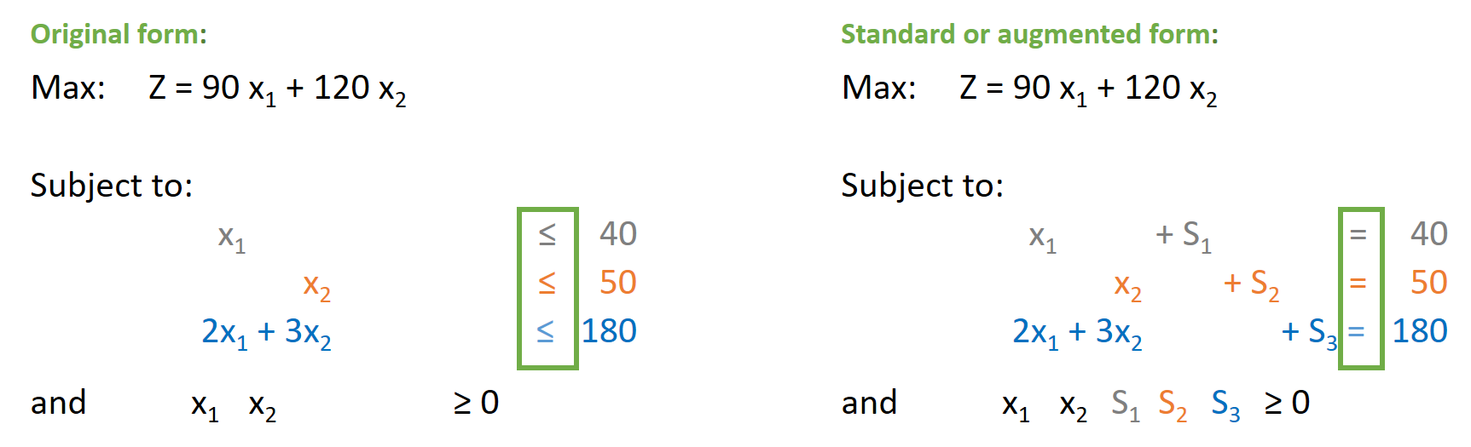
Simplex Method - Procedure
Z = 6000
S1 = 40
X2 = 50
S3 = 30
X1 = 0
S2 = 0
(x1, x2) = (0,50)
(x1, x2, S1, S2, S3) = (0, 50, 40, 0, 30)
X1 = 0 ⬄ Plant 0 ha of pine
X2 = 50 ⬄ Plant 50 ha of eucalypt
S1 = 40 ⬄ 40 ha of area available for pine plant.
S2 = 0 ⬄ no ha of area available for eucalypt plant.
S3 = 30 ⬄ 30 working hours still available

Slide 36
Simplex Method - Procedure
(x1, x2) = (0,0)
(x1, x2, S1, S2, S3) = (0, 0, 40, 50, 180)
Z = 6000
S1 = 40
X2 = 50
S3 = 30
X1 = 0
S2 = 0
(x1, x2) = (0,50)
(x1, x2, S1, S2, S3) = (0, 50, 40, 0, 30)
The basic variables in these solutions differ in one single variable (S1 and S3 are maintained as basic variables)
These are adjacent solutions

Slide 37
Simplex Method - Procedure
(x1, x2) = (0,0)
(x1, x2, S1, S2, S3) = (0, 0, 40, 50, 180)
Z = 6000
S1 = 40
X2 = 50
S3 = 30
X1 = 0
S2 = 0
(x1, x2) = (0,50)
(x1, x2, S1, S2, S3) = (0, 50, 40, 0, 30)
B= (0,50)
C= (15,50)
D= (40,33)
A= (0,0)
E= (40,0)

Slide 38
Simplex Method - Procedure
Optimality check:
The current BFS is optimal (in a max LP) if every coefficient in Row 0 is ≥ 0.
X1 will become basic
S3 will become non-basic variable
(X1 column will have to take the shape of S3: (0, 0, 0, 1)

Slide 39
Simplex Method - Procedure

Slide 40
Simplex Method - Procedure
-90 -> 0
1 -> 0

Slide 41
Simplex Method - Procedure
Z = 7350
S1 = 25
X2 = 50
x1 = 15
S2 = 0
S3 = 0
(x1, x2) = (0,0)
(x1, x2, S1, S2, S3) = (0, 0, 40, 50, 180) z=0 (A)
(x1, x2) = (0,50)
(x1, x2, S1, S2, S3) = (0, 50, 40, 0, 30) z=6000 (B)
(x1, x2) = (15,50)
(x1, x2, S1, S2, S3) = (15, 50, 25, 0, 0) z=7350 (C)
B= (0,50)
C= (15,50)
X1 = 15 ⬄ Planted 15 ha of pine
X2 = 50 ⬄ Planted 50 ha of eucalypt
S1 = 25 ⬄ 25 ha of area available for pine plant.
S2 = 0 ⬄ no ha of area available for eucalypt plant.
S3 = 0 ⬄ no working hours available
D= (40,33)
A= (0,0)
E= (40,0)

Slide 42
Simplex Method - Procedure
Optimality check:
The current BFS is optimal (in a max LP) if every coefficient in Row 0 is ≥ 0.
S2 will become basic
S1 will become non-basic variable
(S2 column will have to take the shape of S1: (0, 1, 0, 0)
Entering variable: the most negative coefficient in Row 0
Leaving BV: the smallest positive ratio RHS /aij

Slide 43
Simplex Method - Procedure
Optimality check:
The current BFS is optimal (in a max LP) if every coefficient in Row 0 is ≥ 0.
S2 will become basic
S1 will become non-basic variable
(S2 column will have to take the shape of S1: (0, 1, 0, 0)

Slide 44
Simplex Method - Procedure
Optimality check:
The current BFS is optimal (in a max LP) if every coefficient in Row 0 is ≥ 0.
OPTIMAL SOLUTION!
Z = 7600
S2 = 16.67
X2 = 33.33
x1 = 40
S1 = 0
S3 = 0
(x1, x2) = (0,0)
(x1, x2, S1, S2, S3) = (0, 0, 40, 50, 180) z=0 (A)
(x1, x2) = (0,50)
(x1, x2, S1, S2, S3) = (0, 50, 40, 0, 30) z=6000 (B)
(x1, x2) = (15,50)
(x1, x2, S1, S2, S3) = (15, 50, 25, 0, 30) z=7350 (C)
(x1, x2) = (40,33.33)
(x1, x2, S1, S2, S3) = (40, 33.33, 0, 16.67, 0) z=7600 (D)
B= (0,50)
C= (15,50)
X1 = 40 ⬄ Planted 40 ha of pine
X2 = 33.33 ⬄ Planted 33.33 ha of eucalypt
S1 = 0 ⬄ 0 ha of area available for pine plant.
S2 = 16.67 ⬄ 16.67 ha of area available for eucalypt plant.
S3 = 0 ⬄ no working hours available
D= (40,33.33)
A= (0,0)
E= (40,0)

Slide 45
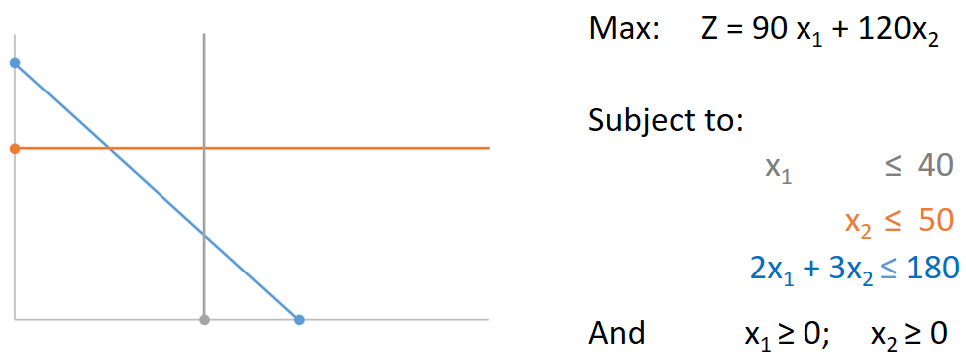
Simplex Method – Graphical approach
Graphical Method
Simplex Method
Replace each inequality by an equality
Find the set of points satisfying the equality (allows to draw a line that cuts the plane into 2 half-planes)
Find which half-plane satisfies the inequality
Intercept all the half-plane areas to find the feasible region (FR) – feasible solutions = (x1, x2) corners
Draw iso-lines for the objective function to find the optimal solution: (x1, x2) corner point of the FR

Slide 46
Simplex Method – Graphical approach
Graphical Method
Simplex Method
Replace each inequality by an equality adding a slack variable
Transform the objective function into an equality
Build a table for the constraints only specifying the coefficients
Set x1 and x2 to ZERO =>x1=0; x2=0; S1=40; S2=50; S3=180
Test different combinations of basic variables
  Select the non-basic var. that results in a bigger increase in Z (the smallest coefficient in R0)
  Select the basic var. that guarantees the biggest increase in Z without leaving the feasible region and that all basic variables are nonnegative (smallest positive ratio)
  Gaussian elimination so that the new basic var. only has: 0,1
  Test optimality: all coeff. in R0 >=0? If not, test new combination
Replace each inequality by an equality
Find the set of points satisfying the equality (allows to draw a line that cuts the plane into 2 half-planes)
Find which half-plane satisfies the inequality
Intercept all the half-plane areas to find the feasible region (FR) – feasible solutions = (x1, x2) corners
Draw iso-lines for the objective function to find the optimal solution: (x1, x2) corner point of the FR
Non-basic variables
Basic variables

Slide 47
Simplex Method
Particular cases

Slide 48
Simplex Method – Particular cases
Tie for the Entering BV:
  – Entering variable: Choose the entering variable (in a max problem) to be the NBV with the most negative coefficient in Row 0.
  – What to do when there is a tie for the entering basic variable ?
  Selection made arbitrarily.

Slide 49
Simplex Method – Particular cases
Tie for the Leaving BV - Degenerate:
  – Leaving BV: apply minimum ratio test - identify the row with the smallest positive ratio bi /aij (the most restrictive Row); the BV for this row is the leaving BV (it becomes nonbasic).
- Choose the leaving variable arbitrary
- continue the Simplex procedure until optimality is reached

Slide 50
Simplex Method – Particular cases
Tie for the Leaving BV - Degenerate:
  – Leaving BV: apply minimum ratio test - identify the row with the smallest positive ratio bi /aij (the most restrictive Row); the BV for this row is the leaving BV (it becomes nonbasic).
- Choose the leaving variable arbitrary
- continue the Simplex procedure until optimality is reached
- basic variables with a value of zero are called degenerate

Slide 51
Simplex Method – Particular cases
No leaving BV – Unbounded Z:
Occurs if all the coefficients in the pivot column (where the entering basic variable is) are either negative or zero (excluding row 0)
No solution – when the constraints do not prevent improving the objective function indefinitely

Slide 52
Simplex Method – Particular cases
Multiple optimal solutions:
When a NBV has a zero coefficient in row 0, then we perform one more iteration to identify the other optimal BF solution.

Slide 53
Simplex Method
Other cases
To be continued

Slide 54
Simplex Method
Exercises

Slide 55
Simplex Method
Other cases
Minimization of the objective function
Negative Right Hand Sides
Eliminating negative variables
Functional constraints in ≥ and = form
Eliminating unconstrained variables

Slide 56
Simplex Method - Other cases
LPP in standard form:
What happens if:
1) Objective function is maximized
2) All values on the right handside are ≥
3) All variables are nonnegative (≥)
4) Constraints in the form of ≤ inequalities
5) All variables are bounded
Min z = 0.4 x₁ + 0.5 x₂
2) 2x₁ + 3x₂ ≥ -180
3) x₁ ≥ 0 ; x₂ ≤ 0
4) 2x₁ + 3x₂ = 180 or x₁ - 2 x₂ ≥ 6
5) x₁, x₂ ≥ 0, x₃ unbounded

Slide 57
Simplex Method - Other cases
When the LP problem is presented in other forms it requires some adjustments to bring it to standard form.
  1) Minimization of the objective function
Two alternative ways for minimizing Z with the simplex method is:
  A) reversing the rules for the optimality check and entering variable (no changes for the min. ratio test):
    The entering variable chosen is the one with the biggest positive value (instead of the biggest negative value as for maximization problems)
    Optimality is reached when all coefficients in R0 are negative or equal to zero
  B) converting any minimization problem to an equivalent maximization problem:
min z = max (-z) Min z = 0.4 x₁ + 0.5 x₂
Max - z = - 0.4 x₁ - 0.5 x₂

Slide 58
Simplex Method - Other cases
When the PL problem is presented in other forms it requires some adjustments to bring it to standard form.
  2) Negative Right Hand Sides
  When the right hand side is negative, multiply the constraint by (-1), this inverts the signs of the coefficients as well as the inequality sign
Max: Z = 90 x₁ + 120 x₂
Subject to:
x₁ + S₁ ≤ 40
x₂ + S₂ ≤ 50
2x₁ + 3x₂ + S₃ ≥ -180
and x₁ x₂ S₁ S₂ S₃ ≥ 0
Max: Z = 90 x₁ + 120 x₂
Subject to:
x₁ + S₁ ≤ 40
x₂ + S₂ ≤ 50
- 2x₁ - 3x₂ + S₃ ≤ 180
and x₁ x₂ S₁ S₂ S₃ ≥ 0
(*-1)

Slide 59
Simplex Method - Other cases
When the PL problem is presented in other forms it requires some adjustments to bring it to standard form.
  3) Eliminating negative variables
  To eliminate a negative variable make a substitution by a variable ≥ 0,
  remember the results in the final table will be for the replacement variable x₂*
Max: Z = 90 x₁ + 120 x₂
Subject to:
x₁ + S₁ ≤ 40
x₂ + S₂ ≤ 50
2x₁ + 3x₂ + S₃ ≤ 180
and x₁ ≥ 0 x₂ ≤ 0
Max: Z = 90 x₁ - 120 x₂*
Subject to:
x₁ + S₁ ≤ 40
- x₂* + S₂≤ 50
2x₁ - 3 x₂* ≤ 180
and x₁ ≥ 0 x₂* ≥ 0 x₂* = - x₂

Slide 60
Simplex Method - Other cases
When the PL problem is presented in other forms it requires some adjustments to bring it to standard form.
  4) Functional constraints in ≥ or = forms
  Require the use the artificial-variable technique, introducing dummy or artificial variables into each constraint that needs one. This new variable is introduced just for the purpose of being the initial BV for that equation
  Non-negativity constraints are placed on these variables
  The objective function is also modified to impose an exorbitant penalty (M) to the artificial variables to prevent any of these from becoming part of an optimal solution to the original problem.
  This penalty is created by choosing a positive constant M so large that the artificial variable is forced to be 0 in any final optimal solution of the original problem. This is achieved by assigning a very large penalty in the objective function (-M for maximization and + M for minimization, if the signs were different these variables would be selected as basic variables!).
  Then the iterations of the simplex method will automatically force the artificial variables to disappear (become zero), one at a time, until they are all gone and the real problem is solved

Slide 61
Simplex Method - Other cases
When the PL problem is presented in other forms it requires some adjustments to bring it to standard form.
  4) Functional constraints in = form
  The simplex requires a starting BFS, we solve this by introducing an artificial variable in the constraint and also in the objective function.
  We have a problem because the coefficient of one of the BV (an artificial variable) is a non-zero (M), an this must be eliminated from equation (0) before the simplex method can either apply the optimality test or find the Entering BV.
Max: Z = 90 x₁ + 120 x₂
Subject to:
x₁ + S₁ ≤ 40
x₂ + S₂ ≤ 50
2x₁ + 3x₂ + S₃ = 180
and x₁ x₂ S₁ S₂ S₃ ≥ 0
Max: Z = 90 x₁ + 120 x₂
Subject to:
x₁ + S₁ = 40
x₂ + S₂ = 50
2x₁ + 3x₂ + S₃ = 180
and x₁ x₂ S₁ S₂ ≥ 0
Max: Z = 90 x₁ + 120 x₂ - M a1
Subject to:
x₁ + S₁ = 40
x₂ + S₂ = 50
2x₁ + 3x₂ +a1 = 180
and x₁ x₂ S₁ S₂ a1 ≥ 0

Slide 62
Simplex Method - Other cases
When the PL problem is presented in other forms it requires some adjustments to bring it to standard form.
  4) Functional constraints in ≥ form
  Let’s see two exemples:
M = exorbitant penalty
In ≥ constraints we have to introduce both:
  a surplus variable (S*) - sign
  an artificial variable (a*)
Max: Z = x₁ + 2 x₂
Subject to: x₁ + x₂ ≤ 10
x₁ - 2 x₂ ≥ 6
x₁, x₂ ≥ 0
Artificial problem:
Max: Z = x₁ + 2 x₂ - M a₂
Subject to: x₁ + x₂ + S₁ = 10
x₁ - 2 x₂ - S₂ + a₂ = 6
x₁, x₂, S₁, S₂, a₂ ≥ 0
Min: Z = 4 x₁ + 2 x₂
Subject to: 2 x₁ - x₂ ≥ 4
x₁ + x₂ ≥ 5
x₁, x₂ ≥ 0
Artificial problem:
Min: Z = 4 x₁ + 2 x₂ + M a₁ + M a₂
Subject to: 2 x₁ - x₂ - S₁ + a₁ = 4
x₁ + x₂ - S₂ + a₂ = 5
x₁, x₂, S₁, S₂, a₁, a₂ ≥ 0

Slide 63
Simplex Method - Other cases
When the PL problem is presented in other forms it requires some adjustments to bring it to standard form.
  4) Functional constraints in ≥ form
Artificial problem:
Min: Z = 4 x₁ + 2 x₂ + M a₁ + M a₂
Subject to: 2 x₁ - x₂ - S₁ + a₁ = 4
x₁ + x₂ - S₂ + a₂ = 5
x₁, x₂, S₁, S₂, a₁, a₂ ≥ 0
Where a₁ = 4 - 2 x₁ + x₂ + S₁ and a₂ = 5 - x₁ - x₂ + S₂
Replacing in the OF:
Min Z = 4 x₁ + 2 x₂ + M (4 - 2 x₁ + x₂ + S₁ ) + M (a₂ = 5 - x₁ - x₂ + S₂)
Min Z = 4 x₁ + 2 x₂ + 4M - 2Mx₁ + Mx₂ + MS₁ + 5M - Mx₁ - Mx₂ + MS₂
Min Z = 4 x₁ - 2Mx₁ - Mx₁ + 2 x₂ + Mx₂ - Mx₂ + MS₁+ MS₂ + 4M + 5M
Min Z = 4 x₁ - 3Mx₁ + 2 x₂ + MS₁+ MS₂ + 9M
Min Z = (4 - 3M) x₁ + 2 x₂ + MS₁+ MS₂ + 9M
Artificial problem:
Max: Z = x₁ + 2 x₂ - M a₂
Subject to: x₁ + x₂ + S₁ = 10
x₁ - 2 x₂ - S₂ + a₂ = 6
x₁, x₂, S₁, S₂, a₂ ≥ 0
Where a₂ = 6 - x₁ + 2 x₂ + S₂
Replacing in the OF:
Max Z = x₁ + 2 x₂ - M (6 - x₁ + 2 x₂ + S₂)
Max Z = x₁ + 2 x₂ - 6M + Mx₁ - 2Mx₂ - MS₂
Max Z = x₁ + Mx₁ + 2 x₂- 2Mx₂ - MS₂ - 6M
Max Z = (1 + M) x₁ + (2 - 2M) x₂ - MS₂ - 6M

Slide 64
Simplex Method - Other cases
When the PL problem is presented in other forms it requires some adjustments to bring it to standard form.
  4) Functional constraints in ≥ form
Tabular form:
Min Z = (4 - 3M) x₁ + 2 x₂ + MS₁+ MS₂ + 9M
Z - (4 - 3M) x₁ - 2 x₂ - MS₁- MS₂ = 9M
Tabular form:
Max Z = (1 + M) x₁ + (2 - 2M) x₂ - MS₂ - 6M
Z - (1 + M) x₁ - (2 - 2M) x₂ + MS₂ + 6M
-

Slide 65
Simplex Method - Other cases
When the PL problem is presented in other forms it requires some adjustments to bring it to standard form.
  Functional constraints in = form
  The simplex requires a starting BFS, we solve this by introducing an artificial variable in the constraint and also in the objective function.
  We have a problem because the coefficient of one of the BV (an artificial variable) is a non-zero (M), an this must be eliminated from equation (0) before the simplex method can either apply the optimality test or find the Entering BV.
M = exorbitant penalty
In = constraints we only introduce an artificial variable (a*)
Artificial problem:
Max: Z = 3 x₁ + 5 x₂ - M a₃
Subject to: x₁ + S₁ = 4
2 x₂ + S₂ = 12
3 x₁ + x₂ + a₃ = 18
x₁, x₂, S₁, S₂, a₃ ≥ 0
Original problem:
Max: Z = 3 x₁ + 5 x₂
Subject to: x₁ ≤ 4
2 x₂ ≤ 12
3 x₁ + x₂ = 18
x₁, x₂ ≥ 0

Slide 66
Simplex Method - Other cases
When the PL problem is presented in other forms it requires some adjustments to bring it to standard form.
  Functional constraints in = form
Artificial problem:
Max: Z = 3 x₁ + 5 x₂ - M a₃
Subject to: x₁ + S₁ = 4
2 x₂ + S₂ = 12
3 x₁ + 2 x₂ + a₃ = 18
x₁, x₂, S₁, S₂, a₃ ≥ 0
Where a₃ = 18 – 3 x₁ -2x₂
Replacing in the OF:
Max Z = 3 x₁ + 5 x₂ - M (18 – 3 x₁ -2x₂)
Max Z = 3 x₁ + 5 x₂ - 18M + 3Mx₁ + 2Mx₂
Max Z = 3 x₁ + 3Mx₁ + 5 x₂ + 2Mx₂ - 18M
Max Z = (3 + 3M) x₁ + (5 + 2M) x₂ - 18M
Tabular form:
Max Z = (3 + 3M) x₁ + (5 + 2M) x₂ - 18M
Z - (3 + 3M) x₁ - (5 - 2M) x₂ = -18M

Slide 67
Simplex Method - Other cases
When the PL problem is presented in other forms it requires some adjustments to bring it to standard form.
  5) Eliminating unconstrained variables
  When variables with unrestricted signs exist in a LP problem, there is the need to first convert the problem into one where all variables are nonnegative .
  The idea is to rewrite such a variable as the difference between two nonnegative variables. That is, we can introduce two nonnegative variables, say x₃⁺ and x₃⁻ , and let x₃ ~ x₃⁺ − x₃ ⁻.
  Let’s consider the particular numerical examples:
    if x₃ = 5 -> its positive part (x₃⁺) = 5 and its negative part (x₃⁻ ) = 0 x₃ ~ x₃⁺ − x₃⁻ ⬄ x₃ ~ 5 – 0 = 5
    if x₃ = -5 -> its positive part (x₃⁺) = 0 and its negative part (x₃⁻ ) = 5 x₃ ~ x₃⁺ − x₃⁻ ⬄ x₃ ~ 0 – 5 = -5
x₃⁻ = −min[x₃, 0]
x₃⁺ = max[0, x₃]

Slide 68
Simplex Method - Other cases
When the PL problem is presented in other forms it requires some adjustments to bring it to standard form.
  5) Eliminating unconstrained variables
x₃⁻ = −min[x₃, 0]
x₃⁺ = max[0, x₃]
Original problem:
Max: Z = 2x₁ + 3x₂ - x₃
Subject to:
x₁ - x₂ + 2x₃ ≤ 10
-3x₁ - 2x₂ - 4x₃ ≤ 6
x₁ + 9x₂ ≤ 7
x₁, x₂ ≥ 0, x₃ unbounded
x₃ = x₃⁺ − x₃⁻
Modified problem:
Max: Z = 2x₁ + 3x₂ - x₃⁺ + x₃⁻
Subject to:
x₁ - x₂ + 2 (x₃⁺ - x₃⁻ ) ≤ 10
-3x₁ - 2x₂ - 4 (x₃⁺ + x₃⁻) ≤ 6
x₁ + 9x₂ ≤ 7
x₁, x_{2,} x₃⁺, x₃⁻ ≥ 0

Slide 69
Simplex Method - Other cases
When the PL problem is presented in other forms it requires some adjustments to bring it to standard form.
  5) Eliminating unconstrained variables
x₃⁻ = −min[x₃, 0]
x₃⁺ = max[0, x₃]
Modified problem:
Max: Z = 2x₁ + 3x₂ - x₃⁺ + x₃⁻
Subject to:
x₁ - x₂ + 2 (x₃⁺ - x₃⁻ ) ≤ 10
-3x₁ - 2x₂ - 4 (x₃⁺ + x₃⁻ ) ≤ 6
x₁ + 9x₂ ≤ 7
x₁, x_{2,} x₃⁺, x₃⁻ ≥ 0
The new problem has 4 nonnegative variables
x₃⁺ - x₃⁻ always appear in the form of a pair with opposite signs.
If x₃⁺ is basic, then x₃⁻ must be nonbasic and vice versa
Both variables can be nonbasic at the same time, but can not be basic at the same time
Suppose we have the feasible solution to this modified problem (x₁, x_{2,} x₃⁺, x₃⁻) = (5, 2, 1, 0), since x₃ = x₃⁺ - x₃⁻ the solution for the original problem will be (x₁, x₂, x₃) = (5, 2, 1).

Slide 70
Simplex Method
Sensitivity analysis in the tableau

Slide 71
Simplex Method
Exercises

Slide 72
Simplex Method - exercises
1) A company produces 3 different products: A, B and C. Each product has to go under 3 processes consuming different amounts of time along the way. The time available for each process is described in the table below.
Assuming the selling profits for products A, B and C are 2, 3 and 4€ per unit. Determine how many units of each product should be produced to maximize the profit.
Was there any time left?
Process | Total number of hours available | Number of hours needed to produce each product
 |  | A | B | C
I | 12000 | 5 | 2 | 4
II | 24000 | 4 | 5 | 6
III | 18000 | 3 | 5 | 4

Slide 73
Simplex Method - exercises
2) A company produces 3 diferente bookshelves: a luxury, a regular and na exportation model. Consider the maximum demand for each model to be 500, 750 and 400 respectively. The working hours at the carpentry and finishing sections have the working time limitations below:
Assuming the selling profit for the luxury, regular and exportation models is 1500, 1300 2500 respectively, formulate the LP problema in order to maximize the profit.
Interpret the results detailling the optimal number of bookshelves of each type produced discussing the total amount of hours used in each section. How far from meeting the maximum demands were we?
Section | Total number of hours (thousands) | Number of hours needed to produce each model
 |  | luxury | regular | exportation
carpentry | 1.4 | 0.5 | 0.5 | 1.0
finishing | 1.2 | 0.5 | 0.5 | 2.0

Slide 74
Simplex Method - exercises
3)
Max: Z = x₁ + 2 x₂
Subject to:
2x₁ + 4x₂ ≤ 20
x₁ + x₂ ≤ 8
and x₁ x₂ ≥ 0
4)
Max: Z = x₁ + x₂
Subject to:
x₁ + x₂ ≤ 4
2 x₁ + x₂ ≤ 6
x₁ + 2 x₂ ≤ 6
and x₁ x₂ ≥ 0
Solution A: (x1, x2, s1, s2) = (0, 5, 0, 3) and Z= 10
Solution B: (x1, x2, s1, s2) = (2, 6, 0, 0) and Z= 10
degenerate solution
Max: Z = x₁ + x₂
Subject to:
x₁ + x₂ ≤ 10
2 x₁ - 3 x₂ ≤ 15
x₁ - 2 x₂ ≤ 20
and x₁ x₂ ≥ 0
5)
Apply the Simplex to find the optimal solution
Multiple, unbound and degenerate solutions
unlimited solution - unbound problem

Slide 75
Simplex Method - exercises
6)
7)
Min: Z = 2 x₁ - 3 x₂ – 4 x₃
Subject to:
x₁ + 5 x₂ - 3 x₃ ≤ 15
x₁ + x₂ + x₃ ≤ 11
5 x₁ – 6 x₂ + x₃ ≤ 4
and x₁ x₂ x₃ ≥ 0
Max: Z = 10 x₁ + 30 x₂
Subject to:
x₁ ≤ 15
x₁ - x₂ ≤ 20
-3 x₁ + x₂ ≥ -30
and x₁ ≥ 0 x₂ ≤ 0
Optimal solution: (x1, x2, x3, S1, S2, S3) = (0, 1, 10, 40, 0, 0) and Z = -43
Solution to the real problem (x1, x2, S1, S2, S3) = (10, 0, 5, 10, 0) and Z = 100
8)
Max: Z = - x₂
Subject to:
x₁ + x₂ + x₃ ≤ 100
x₁ - 5 x₂ ≤ 40
x₃ ≥ -10
and x₁ ≥ 0 x₂ ≤ 0 x₃ unbounded
Bring the following PL problems to standard form and apply the Simplex to find the optimal solution
Minimization, negative RHS, negative and unbounded variables
Solution to the real problem: (x1, x2, X3,S1, S2, S3) = (0, -8, 0, 108, 0, 10) and Z = 8

Slide 76
Simplex Method - exercises
9)
10)
Min: Z = 4 x₁ + 2 x₂
Subject to: 2 x₁ - x₂ ≥ 4
x₁ + x₂ ≥ 5
x₁, x₂ ≥ 0
Max: Z = x₁ + 2 x₂
Subject to: x₁ + x₂ ≤ 10
x₁ - 2 x₂ ≥ 6
x₁, x₂ ≥ 0
Solution to the real problem: (x1, x2, S1, S2) = (3, 2, 0, 0) and Z = 16
Bring the following PL problems to standard form introducing artificial variables apply the big M method using Simplex to find the optimal solutions

Slide 77
Simplex Method - exercises
11)
12)
Max: Z = 3x₁ + 2 x₂
Subject to: 2x₁ + x₂ ≤ 9
x₁ + 2 x₂ ≤ 9
x₁, ≥ 0 ; x₂ unbounded
Max: Z = 3x₁ + 4 x₂
Subject to: x₁ + x₂ ≤ 10
5 x₁ + 12 x₂ ≤ 60
x₁ + 3 x₂ ≤ 15
x₂ ≤ 5
x₁, x₂≥ 0
Solution to the real problem: (x1, x2, S1, S2) = (3,3, 0, 0) and Z = 15
Solution to the real problem: (x1, x2, S1, S2, S3, S4) = (8.6, 1.4, 0, 0, 2.1, 3.6) and Z = 31.43

Slide 78
