Slide 1
Linear Programming
Graphical Sensitivity Analysis
Applied Operations Research 2021-2022
Susana Barreiro
16 February 2023

Slide 2
Outline
Formulation of a linear programming model that (unlike the poet’s problem) involves:
  (1) minimizing an objective function not related to profit
  (2) >= constraints that express management objectives
Solving it graphically (using Excel)
  Graph the problem
  Find the corners and define feasible region
  Test the corners to find the optimal solution
Sensitivity analysis to find the range of change of the

Slide 3
Keeping the River Clean Problem
Formulation of a linear programming model that (unlike the poet’s problem) involves:
  (1) minimizing an objective function not related to profit
  (2) >= constraints that express management objectives

Slide 4
The problem
A pulp mill makes mechanical and chemical pulp and during the production process it pollutes the river in which it spills its spent waters. The owners would like to:
minimize pollution (measured by the biological oxygen demand – BOD)
keeping at least 300 people employed at the mill
generating at least 40000€ of revenue per day
both chemical and mechanical pulp require the labor of one worker for about 1 day, or 1 workday (wd), per ton produced
Chemical pulp sells at 200€/ton, mechanical at 100€/ton
The maximum capacity of the mill to make mechanical pulp is 300 tons/d and 200 tons/d for chemical pulp (the mechanical pulp line cannot be used to make chemical pulp, and vice-versa)
1 ton of mechanical pulp produces 1 unit of BOD, 1 ton of chemical pulp produces 1.5 units

Slide 5
The problem
A pulp mill makes mechanical and chemical pulp and during the production process it pollutes the river in which it spills its spent waters. The owners would like to:
minimize pollution (measured by the biological oxygen demand – BOD)
keeping at least 300 people employed at the mill
generating at least 40000€ of revenue per day
both chemical and mechanical pulp require the labor of one worker for about 1 day, or 1 workday (wd), per ton produced
Chemical pulp sells at 200€/ton, mechanical at 100€/ton
The maximum capacity of the mill to make mechanical pulp is 300 tons/d and 200 tons/d for chemical pulp (the mechanical pulp line cannot be used to make chemical pulp, and vice-versa)
1 ton of mechanical pulp produces 1 unit of BOD, 1 ton of chemical pulp produces 1.5 units
pollution
employment
revenue
employment
revenue
Prod capacity
pollution

Slide 6
The problem (decision variables and formulation)
  x1 - Amount of mechanical pulp produced (in tons/day, or t/d)
  x2 - Amount of chemical pulp produced (t/d)
Objective: minimize pollution (measured by the biological oxygen demand – BOD)
1 ton of mechanical pulp produces 1 unit of BOD, 1 ton of chemical pulp produces 1.5 units
Employment: keeping at least 300 people employed at the mill
Employment: both chemical and mechanical pulp require the labor of one worker for about 1 day, or 1 workday (wd), per ton produced
Revenues: generating at least 40000€ of revenue per day
Revenues: Chemical pulp sells at 200€/ton, mechanical at 100€/ton
Max capacity mech pulp: is 300 tons/d
Max capacity chem pulp: is 200 tons/d for chemical pulp
the mechanical pulp line cannot be used to make chemical pulp, and vice-versa

Slide 7
The problem (decision variables and formulation)
  x1 - Amount of mechanical pulp produced (in tons/day, or t/d)
  x2 - Amount of chemical pulp produced (t/d)
min Z = x1 + 1.5 x2 units of BOD / d
Objective: minimize pollution (measured by the biological oxygen demand – BOD)
1 ton of mechanical pulp produces 1 unit of BOD, 1 ton of chemical pulp produces 1.5 units
Employment: keeping at least 300 people employed at the mill
Employment: both chemical and mechanical pulp require the labor of one worker for about 1 day, or 1 workday (wd), per ton produced
Revenues: generating at least 40000€ of revenue per day
Revenues: Chemical pulp sells at 200€/ton, mechanical at 100€/ton
Max capacity mech pulp: is 300 tons/d
Max capacity chem pulp: is 200 tons/d for chemical pulp
the mechanical pulp line cannot be used to make chemical pulp, and vice-versa

Slide 8
The problem (decision variables and formulation)
  x1 - Amount of mechanical pulp produced (in tons/day, or t/d)
  x2 - Amount of chemical pulp produced (t/d)
min Z = x1 + 1.5 x2 units of BOD / d
subject to
  x1 + x2 ≥ 300 workers employed
Objective: minimize pollution (measured by the biological oxygen demand – BOD)
1 ton of mechanical pulp produces 1 unit of BOD, 1 ton of chemical pulp produces 1.5 units
Employment: keeping at least 300 people employed at the mill
Employment: both chemical and mechanical pulp require the labor of one worker for about 1 day, or 1 workday (wd), per ton produced
Revenues: generating at least 40000€ of revenue per day
Revenues: Chemical pulp sells at 200€/ton, mechanical at 100€/ton
Max capacity mech pulp: is 300 tons/d
Max capacity chem pulp: is 200 tons/d for chemical pulp
the mechanical pulp line cannot be used to make chemical pulp, and vice-versa

Slide 9
The problem (decision variables and formulation)
  x1 - Amount of mechanical pulp produced (in tons/day, or t/d)
  x2 - Amount of chemical pulp produced (t/d)
min Z = x1 + 1.5 x2 units of BOD / d
subject to
  x1 + x2 ≥ 300 workers employed
  100x1 + 200x2 ≥ 40000 revenue € / d
Objective: minimize pollution (measured by the biological oxygen demand – BOD)
1 ton of mechanical pulp produces 1 unit of BOD, 1 ton of chemical pulp produces 1.5 units
Employment: keeping at least 300 people employed at the mill
Employment: both chemical and mechanical pulp require the labor of one worker for about 1 day, or 1 workday (wd), per ton produced
Revenues: generating at least 40000€ of revenue per day
Revenues: Chemical pulp sells at 200€/ton, mechanical at 100€/ton
Max capacity mech pulp: is 300 tons/d
Max capacity chem pulp: is 200 tons/d for chemical pulp
the mechanical pulp line cannot be used to make chemical pulp, and vice-versa

Slide 10
The problem (decision variables and formulation)
  x1 - Amount of mechanical pulp produced (in tons/day, or t/d)
  x2 - Amount of chemical pulp produced (t/d)
min Z = x1 + 1.5 x2 units of BOD / d
subject to
  x1 + x2 ≥ 300 workers employed
  100x1 + 200x2 ≥ 40000 revenue € / d
  x1 ≤ 300 mech pulping capacity t /d
Objective: minimize pollution (measured by the biological oxygen demand – BOD)
1 ton of mechanical pulp produces 1 unit of BOD, 1 ton of chemical pulp produces 1.5 units
Employment: keeping at least 300 people employed at the mill
Employment: both chemical and mechanical pulp require the labor of one worker for about 1 day, or 1 workday (wd), per ton produced
Revenues: generating at least 40000€ of revenue per day
Revenues: Chemical pulp sells at 200€/ton, mechanical at 100€/ton
Max capacity mech pulp: is 300 tons/d
Max capacity chem pulp: is 200 tons/d for chemical pulp
the mechanical pulp line cannot be used to make chemical pulp, and vice-versa

Slide 11
The problem (decision variables and formulation)
  x1 - Amount of mechanical pulp produced (in tons/day, or t/d)
  x2 - Amount of chemical pulp produced (t/d)
min Z = x1 + 1.5 x2 units of BOD / d
subject to
  x1 + x2 ≥ 300 workers employed
  100x1 + 200x2 ≥ 40000 revenue € / d
  x1 ≤ 300 mech pulping capacity t /d
  x2 ≤ 200 chem pulping capacity t /d
  x1; x2 ≥ 0

Slide 12
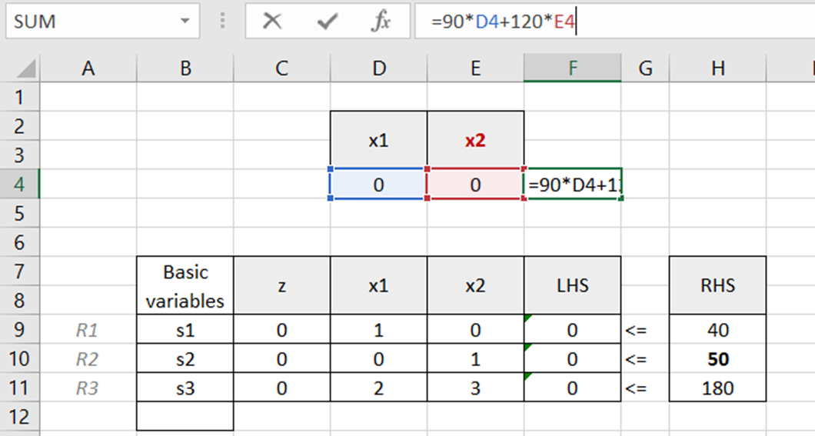
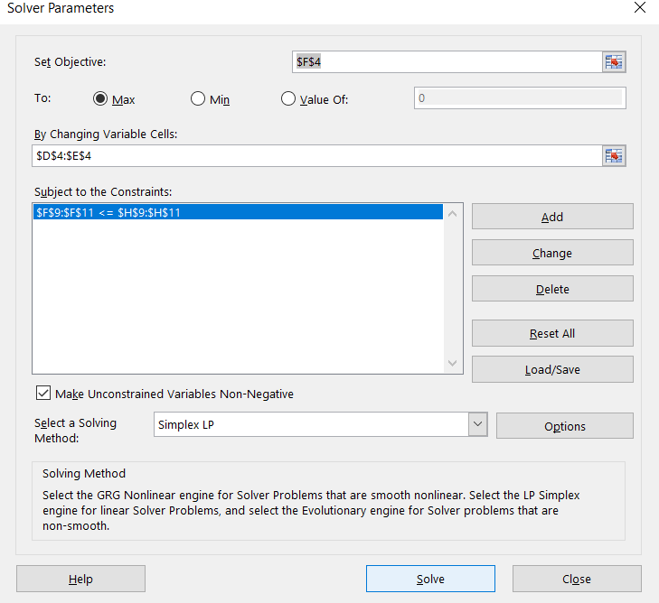
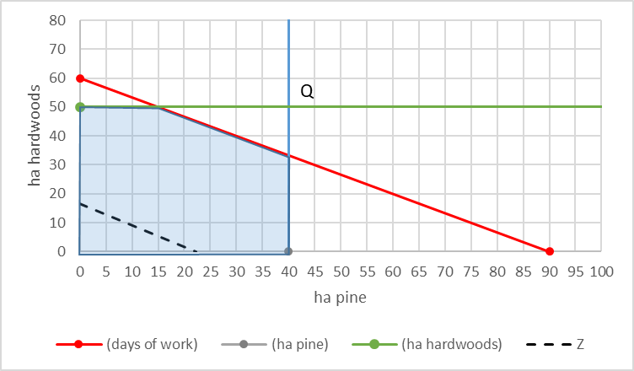
Solving LP problems
Graphical
Excel solver
Only applicable simple problems with 2 variables
Simplex

Slide 13
Keeping the River Clean Problem
Solving it graphically (using Excel)
  Graph the problem
  Find the corners and define feasible region
  Test the corners to find the optimal solution
Sensitivity analysis to find the range of change of the

Slide 14
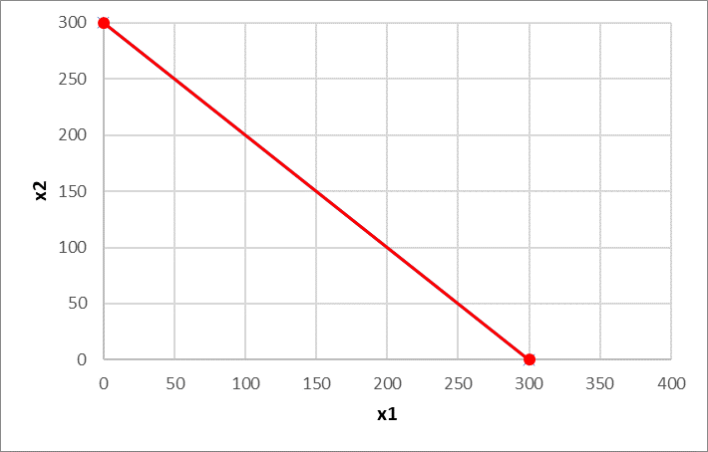
The problem (the feasible region)

Slide 15
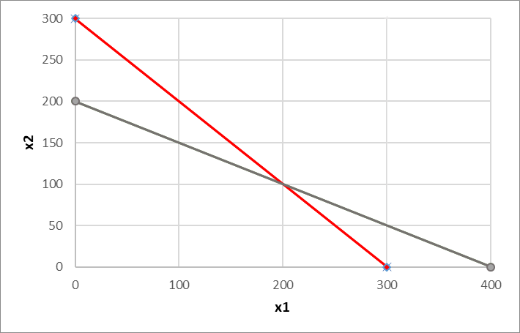
The problem (the feasible region)

Slide 16
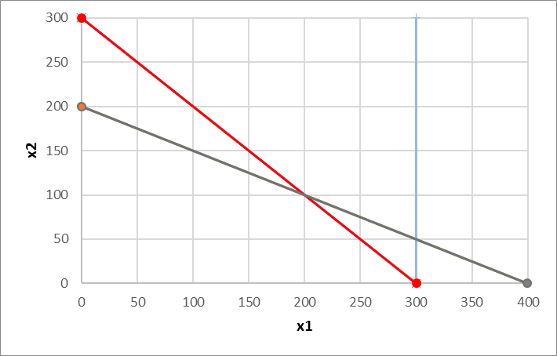
The problem (the feasible region)

Slide 17
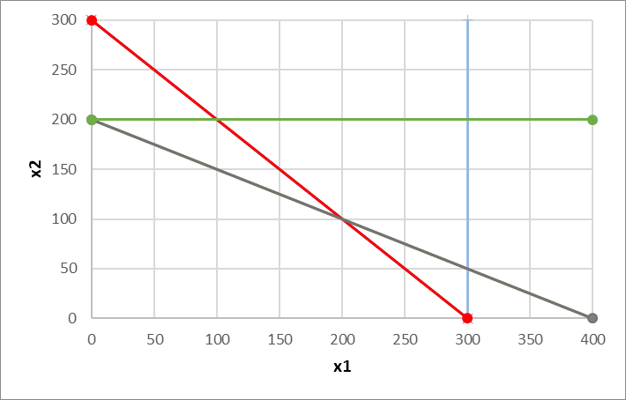
The problem (the feasible region)
x1; x2 ≥ 0

Slide 18
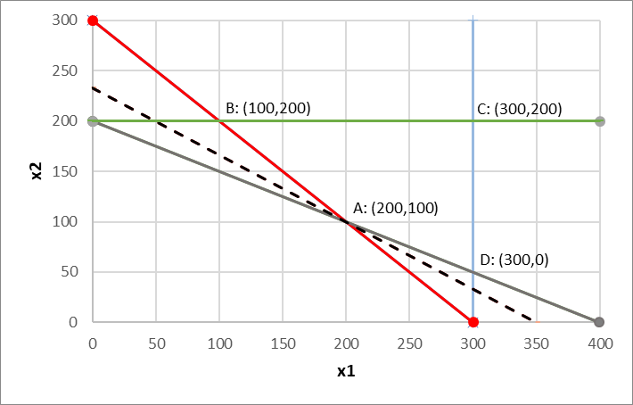
The problem (the vertices of the feasible region)
To find the vertices, we solve the systems of equations:
x1 + x2 = 300
100x1 + 200x2 = 40000
x1 = 200
x2 = 100
A =
B
C
x1 + x2 = 300
x2 = 200
A
B =
x1 = 100
x2 = 200
D
C =
x2 = 200
x1 = 300
If a Linear Programming problem has one solution it is located in one of the vertices
(but it can have multiple solutions)
D =
x1 = 300
100x1 + 200x2 = 40000
x1 = 300
x2 = 50

Slide 19
The problem (the feasible region)
How do you figure out your feasible region?
Make (x1, x2) = (0, 0) for each constraint and see if (0,0) satisfies each inequality. If (you can do this for any other (x1, x2) !)
  0 ≥ 300 False Above the red line
  0 ≥ 40000 False Above the grey line
  0 ≤ 300 True Below the blue line
  0 ≤ 200 True Below the blue line
x1; x2 ≥ 0

Slide 20
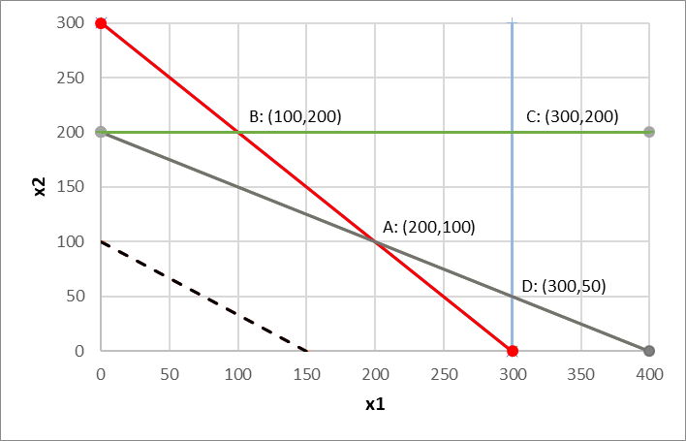
The problem (the feasible region and isolines)
But, where is my optimal solution?
Min
Z = x1 + 1.5 x2
I’ll assign random values to Z to draw the isolines
(lines with the same slope of the objective function)
Z x1 x2
ISO_150

Slide 21
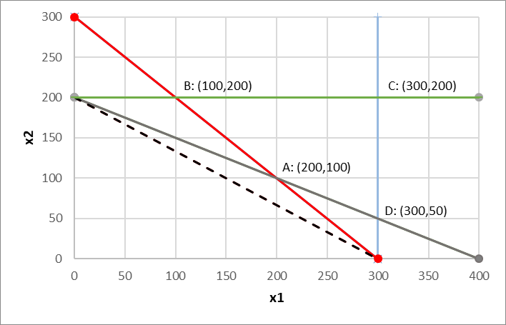
The problem (the feasible region and isolines)
But, where is my optimal solution?
Min
Z = x1 + 1.5 x2
I’ll assign random values to Z to draw the isolines
(lines with the same slope of the objective function)
ISO_300
Z x1 x2

Slide 22
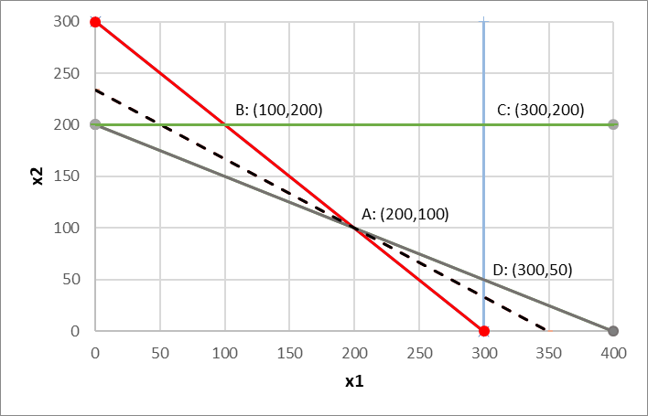
The problem (the feasible region and isolines)
But, where is my optimal solution?
Min
Z = x1 + 1.5 x2
I’ll assign random values to Z to draw the isolines
(lines with the same slope of the objective function)
ISO_300
Z x1 x2
ISO_350

Slide 23
The problem (the feasible region and isolines)
But, where is my optimal solution?
Min
Z = x1 + 1.5 x2
I’ll assign random values to Z to draw the isolines
(lines with the same slope of the objective function)
ISO_300

Slide 24
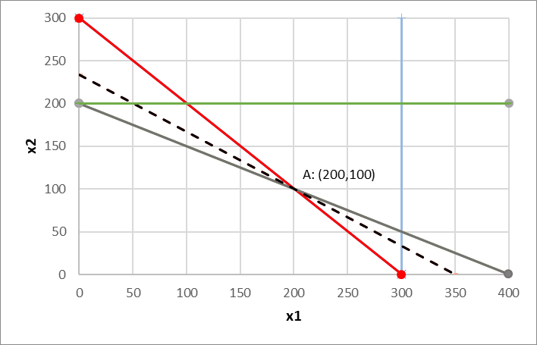
The problem (the feasible region and isolines)
But, where is my optimal solution?
A: (200,100)
Z=350
Min
Z = x1 + 1.5 x2
I’ll assign random values to Z to draw the isolines
(lines with the same slope of the objective function)
A: (200,100)
ISO_300

Slide 25
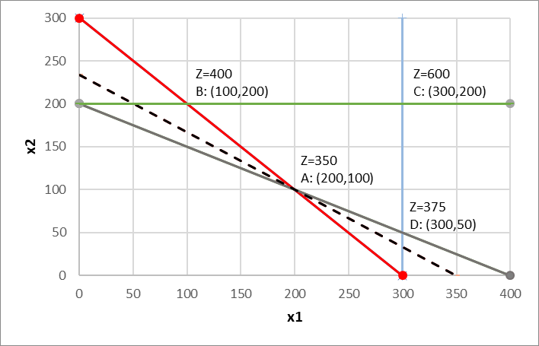
The problem (the feasible region and isolines)
But, where is my optimal solution?
Min
Z = x1 + 1.5 x2
I’ll assign random values to Z to draw the isolines
(lines with the same slope of the objective function)
A: (200,100) Let’s confirm A is the vertice that leads to the minimum Z in the feasible region

Slide 26
Feasible regions and solutions
Bounded feasible region & one optimal solution
Bounded feasible region & multiple optimal solutions
Unbounded feasible region & one optimal solution
Unbounded feasible region & multiple optimal solutions
Unbounded feasible region & unbounded solutions
Unfeasible problem

Slide 27
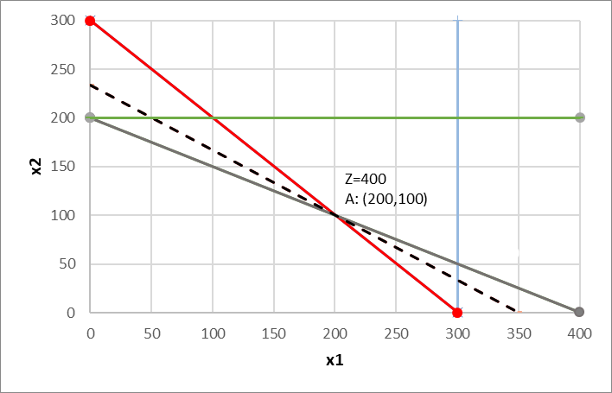
Feasible regions and solutions
Bounded feasible region &
one optimal solution
min Z = x1 + 1.5 x2
subject to
x1 + x2 ≥ 300
100x1 + 200x2 ≥ 40000
x1 ≤ 300
x2 ≤ 200
x1; x2 ≥ 0

Slide 28
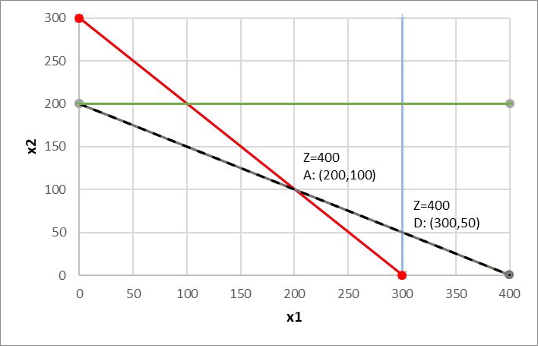
Feasible regions and solutions
Bounded feasible
region &
multiple optimal solutions
min Z = x1 + 1.5 x2
min Z = x1 + 2 x2
subject to
x1 + x2 ≥ 300
100x1 + 200x2 ≥ 40000
x1 ≤ 300
x2 ≤ 200
x1; x2 ≥ 0
Different obj. function
Now with the same slope as the grey constraint (-1/2)

Slide 29
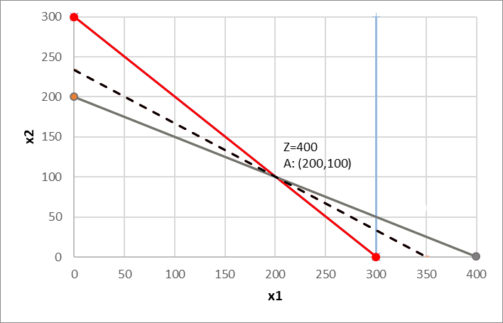
Feasible regions and solutions
Unbounded feasible
region &
one optimal solution
min Z = x1 + 1.5 x2
subject to
x1 + x2 ≥ 300
100x1 + 200x2 ≥ 40000
x1 ≤ 300
x1; x2 ≥ 0
Same obj. function
One less constraint

Slide 30
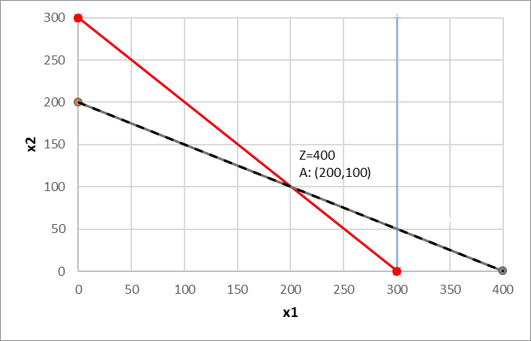

Feasible regions and solutions
Unbounded feasible
region &
multiple optimal solutions
min Z = x1 + 2 x2
subject to
x1 + x2 ≥ 300
100x1 + 200x2 ≥ 40000
x1 ≤ 300
x1; x2 ≥ 0
Different obj. function
Now with the same slope as the grey constraint (-1/2)
One less constraint

Slide 31
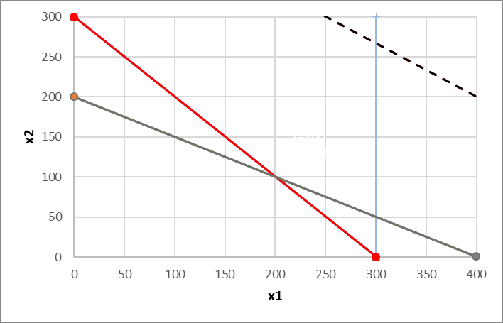
Feasible regions and solutions
Unbounded feasible
region &
unbounded solutions
min Z = x1 + 1.5 x2
max Z = x1 + 1.5 x2
subject to
x1 + x2 ≥ 300
100x1 + 200x2 ≥ 40000
x1 ≤ 300
x1; x2 ≥ 0
Maximizing the obj. function
One less constraint

Slide 32
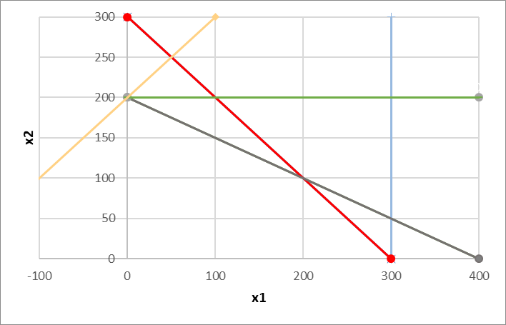
Feasible regions and solutions
Unfeasible
problem
Same obj. function
One more constraint
The feasible region must result of the interception of the regions derived from all constraints (the orange doesn’t intercept the remaining
max Z = x1 + 1.5 x2
subject to
x1 + x2 ≥ 300
100x1 + 200x2 ≥ 40000
x1 ≤ 300
x2 ≤ 200
-100x1 + 100x2 ≥ 20000
x1; x2 ≥ 0

Slide 33
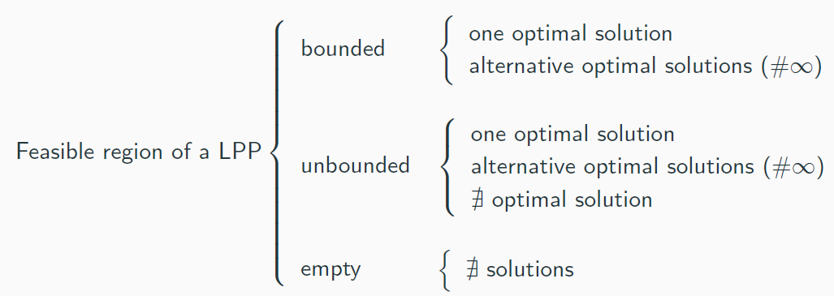
Feasible regions and solutions
Summary

Slide 34
Why alternative solutions are always infinite
The feasible region of a LPP is a closed convex set.
Definitions:
A set is convex if the straight line segment that joins every pair of points in the set is also in the set.
A set is closed if contains its boundary.
Non-convex sets:
The objective function of a LPP is linear.
closed convex set
open convex set
closed convex set

Slide 35
Graphical Sensitivity Analysis
Range of optimality for the objective function coefficients
Right-hand-side (RHS) values
Range of feasibility for the RHS concerning the shadow price

Slide 36
Sensitivity Analysis
When defining a LP problem the values used as model parameters are usually estimates.
The main purpose of sensitivity analysis is to identify the sensitive parameters (i.e. the ones that cannot be changed without changing the optimal solution) that require being closely monitored as the study is implemented.
If we discover a true value of a sensitive parameter differs from the estimated value, this could mean the optimal solution might change.

Slide 37
Sensitivity Analysis
Sensitivity analysis (or post-optimality analysis) is used to determine how the optimal solution is affected by changes, within specified ranges in:
      The objective function coefficients
      On the right-hand side values
Sensitivity analysis is important to managers that operate in dynamic environments having to deal with imprecise estimates of the coefficients because it allows them to ask what-if-questions about the problem

Slide 38
Graphical Sensitivity Analysis
Range of optimality for the objective function coefficients
Right-hand-side (RHS) values
Range of feasibility for the RHS concerning the shadow price

Slide 39
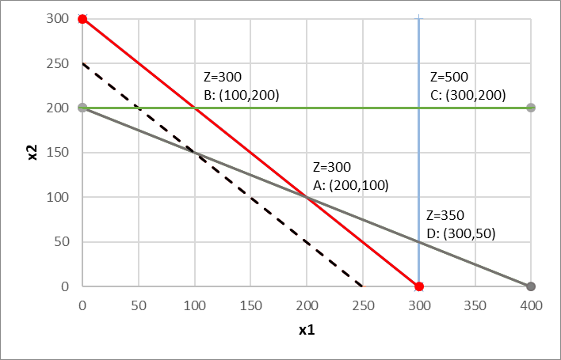
Graphical Sensitivity Analysis
Range of optimality for the objective function coefficients
Question: What range of values can the objective function coefficients take without changing the optimal solution (200,100)?
Focus on c₂:
ISO_300
Z = x₁ + c₂ x₂
c₂ = 0
c₂ = 1
c₂ = 1.5
c₂ = 2
c₂ = 3
min Z = x₁ + 1 x₂
subject to
  x₁ + x₂ ≥ 300
  100x₁ + 200x₂ ≥ 40000
  x₁ ≤ 300
  x₂ ≤ 200
  x₁; x₂ ≥ 0
ISO_250
Optimal solution: A; Z changes

Slide 40
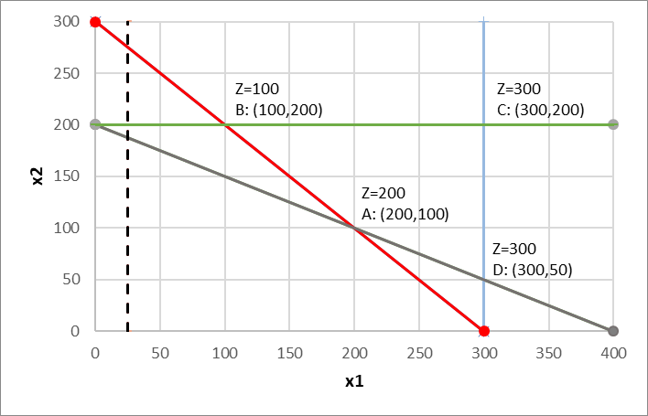
Graphical Sensitivity Analysis
Range of optimality for the objective function coefficients
Question: What range of values can the objective function coefficients take without changing the optimal solution (200,100)?
Focus on c₂:
ISO_25
ISO_50
ISO_100
Z = x₁ + c₂ x₂
c₂ = 0
c₂ = 1
c₂ = 1.5
c₂ = 2
c₂ = 3
min Z = x₁ + 0 x₂
subject to
  x₁ + x₂ ≥ 300
  100x₁ + 200x₂ ≥ 40000
  x₁ ≤ 300
  x₂ ≤ 200
  x₁; x₂ ≥ 0
Optimal solution CHANGES: B, Z changes

Slide 41
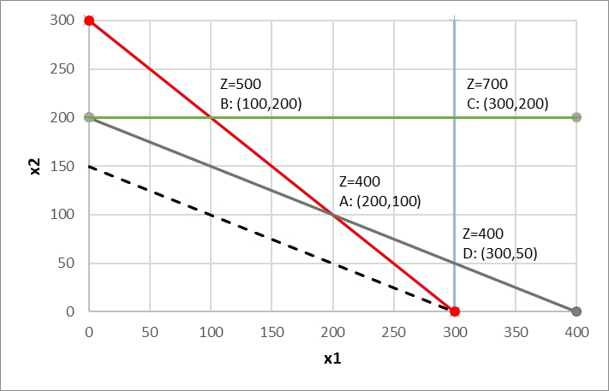
Graphical Sensitivity Analysis
Range of optimality for the objective function coefficients
Question: What range of values can the objective function coefficients take without changing the optimal solution (200,100)?
Focus on c₂:
Z = x₁ + c₂ x₂
c₂ = 0
c₂ = 1
c₂ = 1.5
c₂ = 2
c₂ = 3
min Z = x₁ + 2 x₂
subject to
  x₁ + x₂ ≥ 300
  100x₁ + 200x₂ ≥ 40000
  x₁ ≤ 300
  x₂ ≤ 200
  x₁; x₂ ≥ 0
ISO_300
ISO_400
Optimal solution: A; Z changes

Slide 42
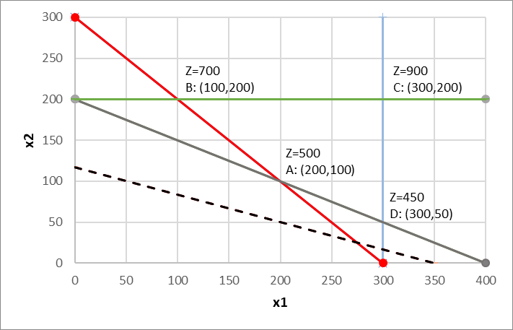
Graphical Sensitivity Analysis
Range of optimality for the objective function coefficients
Question: What range of values can the objective function coefficients take without changing the optimal solution (200,100)?
Focus on c₂:
Z = x₁ + c₂ x₂
c₂ = 0
c₂ = 1
c₂ = 1.5
c₂ = 2
c₂ = 3
min Z = x₁ + 3 x₂
subject to
  x₁ + x₂ ≥ 300
  100x₁ + 200x₂ ≥ 40000
  x₁ ≤ 300
  x₂ ≤ 200
  x₁; x₂ ≥ 0
ISO_450
ISO_350
Optimal solution CHANGES: D, Z changes

Slide 43
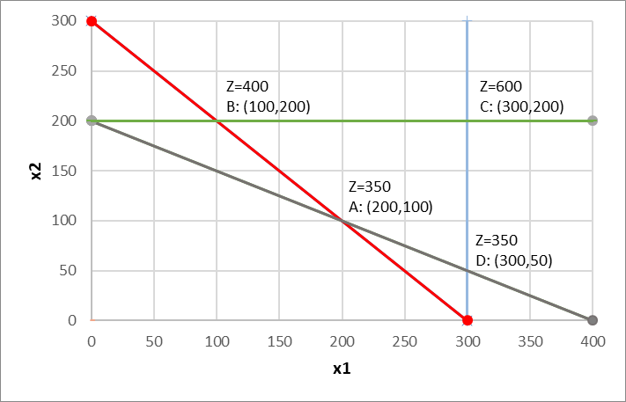
Graphical Sensitivity Analysis
Range of optimality for the objective function coefficients
Question: What range of values can the objective function coefficients take without changing the optimal solution (200,100)?
Focus on c₂:
Z = x₁ + c₂ x₂
c₂ = 0
c₂ = 1
c₂ = 1.5
c₂ = 2
c₂ = 3
min Z = x₁ + 1.5 x₂
subject to
  x₁ + x₂ ≥ 300
  100x₁ + 200x₂ ≥ 40000
  x₁ ≤ 300
  x₂ ≤ 200
  x₁; x₂ ≥ 0
A is the optimal solution as long as the ISOline is between these constraints:
  x₁ + x₂ ≥ 300
  100x₁ + 200x₂ ≥ 40000

Slide 44
Graphical Sensitivity Analysis
min Z = x1 + 1.5 x2
Range of optimality for the objective function coefficients
Question: What range of values can the objective function coefficients take without changing the optimal solution (200,100)?
Focus on c₂: look at the slopes (- c₁/c₂)
Question: What range of values can the objective function coefficients take without changing the optimal solution (200,100)?
Focus on c₁: look at the slopes (- c₁/c₂)
  x₁ + x₂ = 300 slope: -1
  100x₁ + 200x₂ = 40000 slope: -1/2
  Z = 1 x₁ + c₂ x₂ slope: -1/ c₂
  The objective function will be between these 2 constraints :
  -1 ≤ -1/ c₂ ≤ -1/2 ⬄ 1 ≤ c₂ ≤ 2
  x₁ + x₂ = 300 slope: -1
  100x₁ + 200x₂ = 40000 slope: -1/2
  Z = c₁ x₁ + 1.5 x₂ slope: - c₁ /1.5
  The objective function will be between these 2 constraints :
  -1 ≤ c₁ /1.5 ≤ -1/2 ⬄ 1.5 ≥ c₁ ≥ 0.75
(assuming C₁=1)
(assuming C₂=1.5)

Slide 45
Graphical Sensitivity Analysis
Range of optimality for the objective function coefficients
Question: What range of values can the objective function coeff. take without changing the optimal solution (200,100)?
i.e. assume better estimates of the emission of pollutants (c1, c2) associated to the production of mechanical and chemical pulp (x1, X2) could be obtained
How much could (c1, c2) be changed to guarantee the mill is still able to provide 200 tons/day of mechanical pulp and 100 tons/day of chemical pulp
  x1 - Amount of mechanical pulp produced (tons/day)
  x2 - Amount of chemical pulp produced (tons/day)
  1 ton of mechanical pulp produces 1 unit of BOD
  1 ton of chemical pulp produces 1.5 units of BOD
  Maintaining all constraints unchanged
≤ c₂ ≤ 2, assuming C1=1
min Z = 1 x1 + 1 x2; Z=300
min Z = 1 x1 + 2 x2; Z=400
Optimal solution
(x1 = 200, x2 = 100)
Optimal solution
(x1 = 200, x2 = 100)
min Z = c1x1 + c2 x2
min Z = 1 x1 + 1.5 x2 ; Z = 350
1.5 ≥ c₁ ≥ 0.75, assuming C2=1.5
min Z = 1.5 x1 + 1.5 x2; Z=450
min Z = 0.75 x1 + 1.5 x2; Z=300

Slide 46
Graphical Sensitivity Analysis
Solve graphically and determine the range of optimality for the objective function coefficients (c1, c2)
max P = 4 x + 3 y
subject to
  5 x + 3 y ≤ 30 constraint 1
  2 x + 3 y ≤ 21 constraint 2
  x ≤ 4 constraint 3
  x ; y ≥ 0
max Z = 3 x + 2 y
subject to
  x + 2 y ≤ 4 constraint 1
  x - y ≤ 1 constraint 2
  x ; y ≥ 0

