Slide 1
Shadow Price & Sensitivity Analysis
Interpreting Solver outputs
Susana Barreiro
2 March 2023

Slide 2
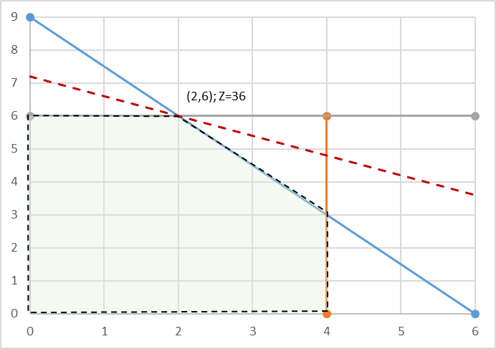
Shadow prices
Max Z = 3x₁ + 5x₂
Subject to:
x₁ ≤ 4
2x₂ ≤ 12
3x₁ + 2x₂ ≤ 18
And x₁ ≥ 0; x₂ ≥ 0
The Excel Formulation
X1 number of window batch; X2 number of glass doors batch
Profit of windows batch = 3 profit of doors batch = 5 (K€)
Plant 1- produces the aluminum frames (prod. time available = 4 h/week)
Plant 2- produces the wood frames (prod. time available = 12)
Plant 3- produces the glass and assembles the product (prod. time available = 18)
Resources - the production capacity of each Plant made available (R1, R2, R3), where bi (RHS) represents the hours of production time per week

Slide 3
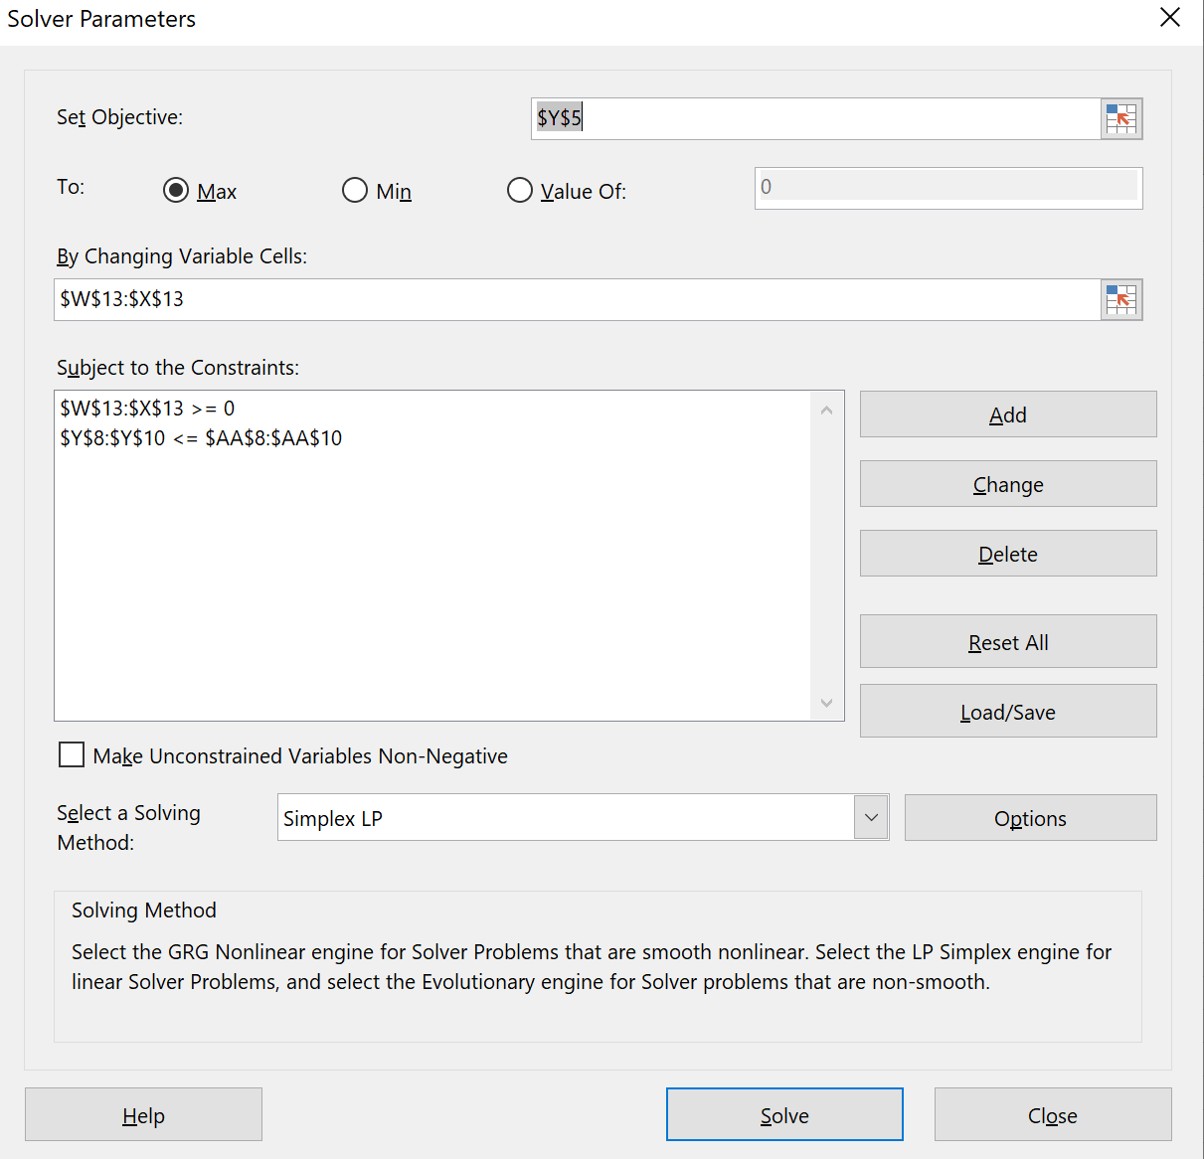
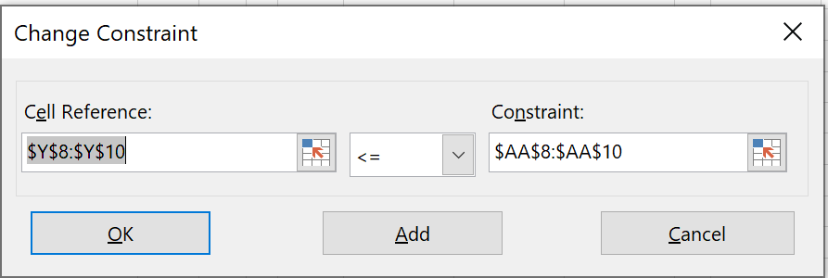
Shadow prices
Max Z = 3x₁ + 5x₂
Subject to:
x₁ ≤ 4
2x₂ ≤ 12
3x₁ + 2x₂ ≤ 18
And x₁ ≥ 0; x₂ ≥ 0
An example of how to solve this LP problem in Excel
The initial tableau
The Excel Formulation
Because all the constraint signs are the same, constraint coeff. and their respective RHS can be selected in one step
When each of the constraints has different signs, these must be added one by one.

Slide 4
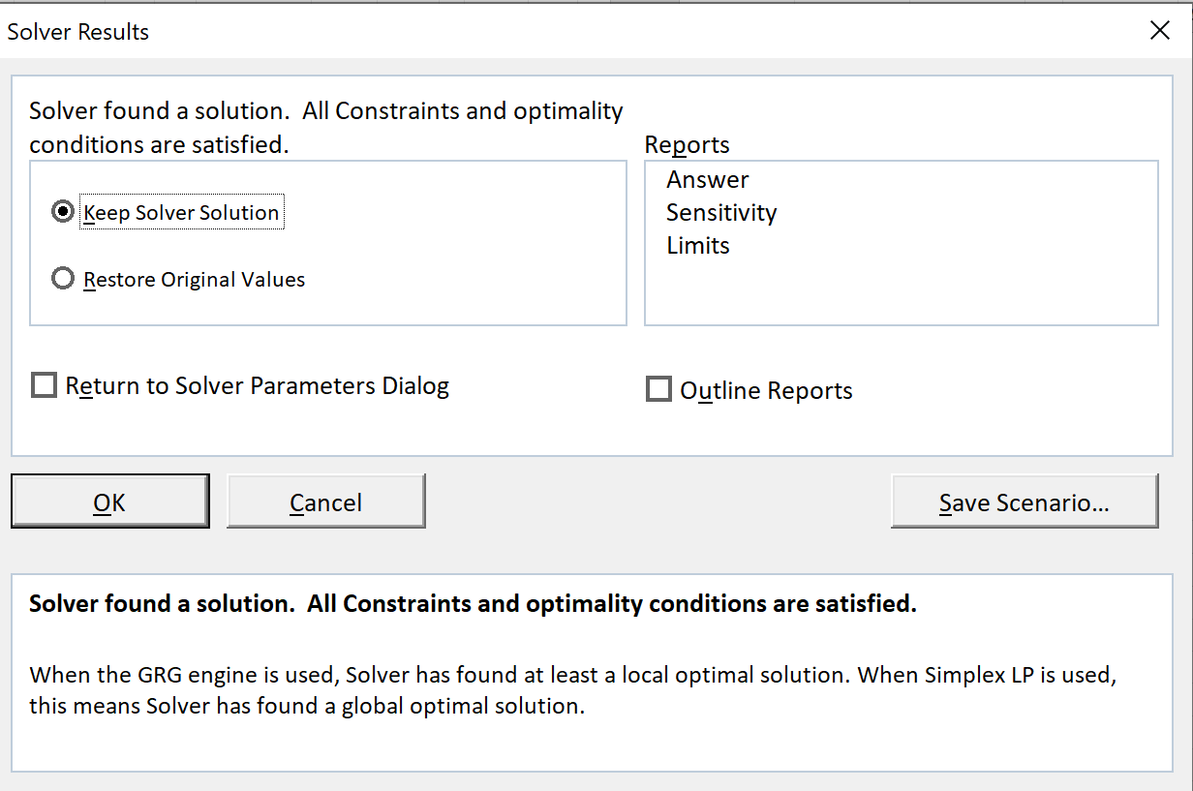
Shadow prices
Max Z = 3x₁ + 5x₂
Subject to:
x₁ ≤ 4
2x₂ ≤ 12
3x₁ + 2x₂ ≤ 18
And x₁ ≥ 0; x₂ ≥ 0
There is information we can obtain from the optimal tableau that we don’t get directly in the Excel spreadsheet, but further details can be obtained by clicking on the option Answer under Reports.

Slide 5
Shadow prices
The Analysis Report indicates:
The Objective Cell table tells us the starting value of the objective function (Z) when Solver was applied and the optimal value after Solver
The Variables Cells shows the values of the decision variables (x1, x2) for the initial solution and the optimal solution
The Constraints table provides information regarding the restrictions applied to each of the decision variables and resources (Formula), providing indication on which are the limiting resources (the binding constraints that will have a positive shadow price, but not the shadow price value)
The initial and optimal solutions (x1, x2, S1, S2) can be read across tables

Slide 6
Shadow prices
The Analysis Report indicates:
The Objective Cell table tells us the starting value of the objective function (Z) when Solver was applied and the optimal value after Solver
The Variables Cells shows the values of the decision variables (x1, x2) for the initial solution and the optimal solution
The Constraints table provides information regarding the restrictions applied to each of the decision variables and resources (Formula), providing indication on which are the limiting resources (the binding constraints that will have a positive shadow price, but not the shadow price value)
The initial and optimal solutions (x1, x2, S1, S2) can be read across tables

Slide 7
Shadow prices
The Analysis Report indicates:
The Objective Cell table tells us the starting value of the objective function (Z) when Solver was applied and the optimal value after Solver
The Variables Cells shows the values of the decision variables (x1, x2) for the initial solution and the optimal solution
The Constraints table provides information regarding the restrictions applied to each of the decision variables and resources (Formula), providing indication on which are the limiting resources (the binding constraints that will have a positive shadow price, but not the shadow price value)
The initial and optimal solutions (x1, x2, S1, S2) can be read across tables

Slide 8
Shadow prices
The Analysis Report indicates:
The Objective Cell table tells us the starting value of the objective function (Z) when Solver was applied and the optimal value after Solver
The Variables Cells shows the values of the decision variables (x1, x2) for the initial solution and the optimal solution
The Constraints table provides information regarding the restrictions applied to each of the decision variables and resources (Formula), providing indication on which are the limiting resources (the binding constraints that will have a positive shadow price, but not the shadow price value)
The initial and optimal solutions (x1, x2, S1, S2) can be read across tables

Slide 9
Shadow prices
The Analysis Report indicates:
The Objective Cell table tells us the starting value of the objective function (Z) when Solver was applied and the optimal value after Solver
The Variables Cells shows the values of the decision variables (x1, x2) for the initial solution and the optimal solution
The Constraints table provides information regarding the restrictions applied to each of the decision variables and resources (Formula), providing indication on which are the limiting resources (the binding constraints that will have a positive shadow price, but not the shadow price value)
The initial and optimal solutions (x1, x2, S1, S2) can be read across tables
For more detailed information e.g (the shadow prices) a different option of the Reports should be selected: Sensitivity Analysis

Slide 10
Sensitivity Analysis
The basic idea of Sensitivity Analysis is to be able to give answers to questions such as:
  1. If the objective function changes, how does the solution change?
  2. If resources available change, how does the solution change?
  3. If a constraint is added to the problem, how does the solution change?

Slide 11
Sensitivity Analysis
The basic idea of Sensitivity Analysis is to be able to give answers to questions such as:
  1. If the objective function changes, how does the solution change?
  2. If resources available change, how does the solution change?
  3. If a constraint is added to the problem, how does the solution change?
  (We will just focus on the first 2)

Slide 12
Sensitivity Analysis
The basic idea of Sensitivity Analysis is to be able to give answers to questions such as:
  1. If the objective function changes, how does the solution change?
  2. If resources available change, how does the solution change?
  3. If a constraint is added to the problem, how does the solution change?
  (We will just focus on the first 2)

Slide 13
Sensitivity Analysis
Interpreting the Solver Sensitivity Report:
Max Z = 3x₁ + 5x₂
Subject to:
x₁ ≤ 4
2x₂ ≤ 12
3x₁ + 2x₂ ≤ 18
x_{1,} x₂ ≥ 0

Slide 14
Sensitivity Analysis
Interpreting the Solver Sensitivity Report:
Max Z = 3x₁ + 5x₂
Subject to:
x₁ ≤ 4
2x₂ ≤ 12
3x₁ + 2x₂ ≤ 18
x_{1,} x₂ ≥ 0
  First, let us analyze the Variable Cells part of the table:
  - The Final Value = Optimal Solution, thus replacing the optimal (x1, X2) in the objective function leads to Z = 3*2 + 5*6 = 36

Slide 15
Sensitivity Analysis
Interpreting the Solver Sensitivity Report:
Max Z = 3x₁ + 5x₂
Subject to:
x₁ ≤ 4
2x₂ ≤ 12
3x₁ + 2x₂ ≤ 18
x_{1,} x₂ ≥ 0
  First, let us analyze the Variable Cells part of the table:
  - The Final Value = Optimal Solution, thus replacing the optimal (x1, X2) in the objective function leads to Z = 3*2 + 5*6 = 36
  - The allowable increase and decrease show how much the coeff. of the objective function can change before the optimal solution has to be altered

Slide 16
Sensitivity Analysis
Interpreting the Solver Sensitivity Report:
Max Z = 3x₁ + 5x₂
Subject to:
x₁ ≤ 4
2x₂ ≤ 12
3x₁ + 2x₂ ≤ 18
x_{1,} x₂ ≥ 0
Upper Limit
Lower Limit
+ 7.5 0
  First, let us analyze the Variable Cells part of the table:
  - The Final Value = Optimal Solution, thus replacing the optimal (x1, X2) in the objective function leads to Z = 3*2 + 5*6 = 36
Since the Allowable Increase for X1 is 4.5 this means that if we increase the objective function coeff. for x1 up to an Upper Limit of 7.5 the optimal solution will not change (2, 6)

Slide 17
Sensitivity Analysis
Interpreting the Solver Sensitivity Report:
Max Z = 3x₁ + 5x₂
Subject to:
x₁ ≤ 4
2x₂ ≤ 12
3x₁ + 2x₂ ≤ 18
x_{1,} x₂ ≥ 0
Upper Limit
Lower Limit
7.5 0
+ ∞ 2
  First, let us analyze the Variable Cells part of the table:
  - The Final Value = Optimal Solution, thus replacing the optimal (x1, X2) in the objective function leads to Z = 3*2 + 5*6 = 36
Since the Allowable Increase for X1 is 4.5 this means that if we increase the objective function coeff. for x1 up to an Upper Limit of 7.5 the optimal solution will not change (2, 6)
Excel usually represents very big numbers by 1E+30 which can be seen as infinity

Slide 18
Sensitivity Analysis
X1
0
3
7.5
Interpreting the Solver Sensitivity Report:
X2
Max Z = 3x₁ + 5x₂
Subject to:
x₁ ≤ 4
2x₂ ≤ 12
3x₁ + 2x₂ ≤ 18
x_{1,} x₂ ≥ 0
2
5
+ ∞
Upper Limit
Lower Limit
7.5 0
+ ∞ 2
  First, let us analyze the Variable Cells part of the table:
  - The Final Value = Optimal Solution, thus replacing the optimal (x1, X2) in the objective function leads to Z = 3*2 + 5*6 = 36
So, what will happen if the coeff. of X1 increases to 10 ?
- It will fall outside the allowable interval, thus the optimal solution will change (Final Values)

Slide 19
Sensitivity Analysis
X1
0
3
7.5
Interpreting the Solver Sensitivity Report:
X2
Max Z = 3x₁ + 5x₂
Subject to:
x₁ ≤ 4
2x₂ ≤ 12
3x₁ + 2x₂ ≤ 18
x_{1,} x₂ ≥ 0
2
5
+ ∞
Upper Limit
Lower Limit
7.5 0
+ ∞ 2
  First, let us analyze the Variable Cells part of the table:
  - The Final Value = Optimal Solution, thus replacing the optimal (x1, X2) in the objective function leads to Z = 3*2 + 5*6 = 36
So, what will happen if the coeff. of X1 increases to 10 ?
- It will fall outside the allowable interval, thus the optimal solution will change (Final Values)
And what will happen if the coeff. of X1 increases to 6 ?
- The optimal solution will remain optimal but Z = 6*2 + 5*6 = 42

Slide 20
Sensitivity Analysis
X1
0
3
7.5
Interpreting the Solver Sensitivity Report:
X2
Max Z = 3x₁ + 5x₂
Subject to:
x₁ ≤ 4
2x₂ ≤ 12
3x₁ + 2x₂ ≤ 18
x_{1,} x₂ ≥ 0
2
5
+ ∞
Upper Limit
Lower Limit
4 - = 1
7.5 0
- 4 =1
+ ∞ 2
  First, let us analyze the Variable Cells part of the table:
  - The Final Value = Optimal Solution, thus replacing the optimal (x1, X2) in the objective function leads to Z = 3*2 + 5*6 = 36
And what will happen if both coeff. X1 and X2 change to 4 (simultaneous changes)?
- This optimality report only applies to individual changes and to answer the question we will have to calculate 100% Rule:
  X1 increases in 1 unit, so: 1 / 4.5 (allowable increase) = 0.22
  X2 decreases in 1 unit, so: 1 / 3 (allowable decrease) = 0.33
0.22 + 0.33 = 0.55 % <100%
Solution remains optimal
Z = 4*2 + 4*6 = 32

Slide 21
Sensitivity Analysis
Interpreting the Solver Sensitivity Report:
Max Z = 3x₁ + 5x₂
Subject to:
x₁ ≤ 4
2x₂ ≤ 12
3x₁ + 2x₂ ≤ 18
x_{1,} x₂ ≥ 0
4 - = 1
- 4 =1
  First, let us analyze the Variable Cells part of the table:
  - The Final Value = Optimal Solution, thus replacing the optimal (x1, X2) in the objective function leads to Z = 3*2 + 5*6 = 36
Reduced Cost column is set to zero for both variables because both products are being produced (2 units of X1 and 6 units of X2).
However, there might be situations for which not producing one of the products is more profitable (Final Value = 0). In such situations, the Reduced Cost = certain negative amount (for a maximization problem), which represent the reduction in profit that would be obtained if we insisted in producing one unit of that product

Slide 22
Sensitivity Analysis
Interpreting the Solver Sensitivity Report:
Max Z = 3x₁ + 5x₂
Subject to:
x₁ ≤ 4
2x₂ ≤ 12
3x₁ + 2x₂ ≤ 18
x_{1,} x₂ ≥ 0
  Now, let us analyze the Constraints part of the table:
  - The bottom table addresses the range of feasibility ie the range for the RHS of the constraints that allows the Shadow Price to remain unchanged
Upper Limit
Lower Limit
7.5 0
+ ∞ 2

Slide 23
Sensitivity Analysis
Interpreting the Solver Sensitivity Report:
Max Z = 3x₁ + 5x₂
Subject to:
x₁ ≤ 4
2x₂ ≤ 12
3x₁ + 2x₂ ≤ 18
x_{1,} x₂ ≥ 0
  Now, let us analyze the Constraints part of the table:
  - The bottom table addresses the range of feasibility ie the range for the RHS of the constraints that allows the Shadow Price to remain unchanged
Upper Limit
Lower Limit
+ ∞ 2
18 6
18 12
Increase in Z resulting of an Unit increase in the RHS of a constraint

Slide 24
Sensitivity Analysis
Optimal sol.: (x1, x2) =(0, 6)
Z = 36
Interpreting the Solver Sensitivity Report:
Max Z = 3x₁ + 5x₂
Subject to:
x₁ ≤ 4
2x₂ ≤ 12
3x₁ + 2x₂ ≤ 18
x_{1,} x₂ ≥ 0
  Now, let us analyze the Constraints part of the table:
  - The bottom table addresses the range of feasibility ie the range for the RHS of the constraints that allows the Shadow Price to remain unchanged
Upper Limit
Lower Limit
+ ∞ 2
18 6
18 12
This table allows us to say how much would profit increase (Z) without having to apply Simplex again as long as the change in the RHS of a constraint remains between its Upper and Lower Limits, because this means the Shadow Price will hold.
Increase in Z resulting of an Unit increase in the RHS of a constraint

Slide 25
Sensitivity Analysis
Optimal sol.: (x1, x2) =(0, 6)
Z = 36
Interpreting the Solver Sensitivity Report:
Max Z = 3x₁ + 5x₂
Subject to:
x₁ ≤ 4
2x₂ ≤ 12
3x₁ + 2x₂ ≤ 18
x_{1,} x₂ ≥ 0
  Now, let us analyze the Constraints part of the table:
  - The bottom table addresses the range of feasibility ie the range for the RHS of the constraints that allows the Shadow Price to remain unchanged
Upper Limit
Lower Limit
+ ∞ 2
+ 5 = 17
18 6
18 12
This table allows us to say how much would profit increase (Z) without having to apply Simplex again as long as the change in the RHS of a constraint remains between its Upper and Lower Limits, because this means the Shadow Price will hold.
Suppose we increase the RHS of constraint 2 by 5 (from 12 to 17):
5 * 1.5 = 7.5 , thus Z = 36 + 7.5 = 43.5
Increase in Z resulting of an Unit increase in the RHS of a constraint

Slide 26
Sensitivity Analysis
Optimal sol.: (x1, x2) =(0, 6)
Z = 36
Interpreting the Solver Sensitivity Report:
Max Z = 3x₁ + 5x₂
Subject to:
x₁ ≤ 4
2x₂ ≤ 12
3x₁ + 2x₂ ≤ 18
x_{1,} x₂ ≥ 0
  Now, let us analyze the Constraints part of the table:
  - The bottom table addresses the range of feasibility ie the range for the RHS of the constraints that allows the Shadow Price to remain unchanged
Upper Limit
Lower Limit
+ ∞ 2
- 5 = 7
18 6
18 12
This table allows us to say how much would profit increase (Z) without having to apply Simplex again as long as the change in the RHS of a constraint remains between its Upper and Lower Limits, because this means the Shadow Price will hold.
Suppose we decrease the RHS of constraint 2 by 5 (from 12 to 17):
- 5 * 1.5 = 7.5 , thus Z = 36 - 7.5 = 28.5
Increase in Z resulting of an Unit increase in the RHS of a constraint

Slide 27
Sensitivity Analysis
Optimal sol.: (x1, x2) =(0, 6)
Z = 36
Interpreting the Solver Sensitivity Report:
Max Z = 3x₁ + 5x₂
Subject to:
x₁ ≤ 4
2x₂ ≤ 12
3x₁ + 2x₂ ≤ 18
x_{1,} x₂ ≥ 0
  Now, let us analyze the Constraints part of the table:
  - The bottom table addresses the range of feasibility ie the range for the RHS of the constraints that allows the Shadow Price to remain unchanged
Upper Limit
Lower Limit
+ ∞ 2
18 6
+ 7 = 11
18 12
This table allows us to say how much would profit increase (Z) without having to apply Simplex again as long as the change in the RHS of a constraint remains between its Upper and Lower Limits, because this means the Shadow Price will hold.
Suppose we decrease the RHS of constraint 3 by 7, from 18 to 11, please note that the Allowable Decrease is 6 making the RHS new value fall outside the Lower Limit. Therefore the Shadow Price is no longer valid and for that reason we can not tell what would happen to profit.
Increase in Z resulting of an Unit increase in the RHS of a constraint

