Slide 1
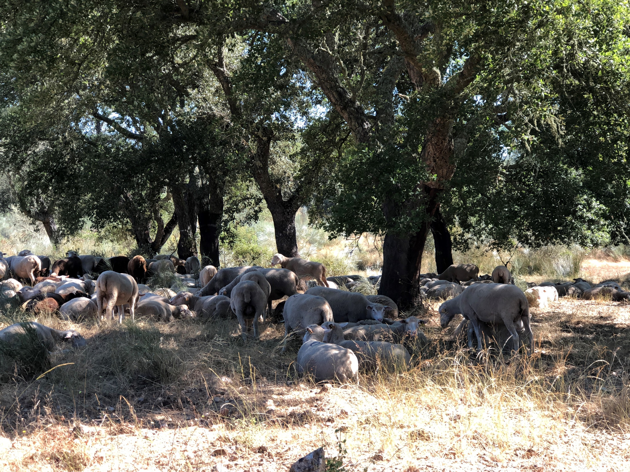
R – Tratamento de dados de Inventário Florestal

Slide 2
Instalar o R e o RStudio

Slide 3
Instalar o R
Se já tem o software R instalado no seu computador, salte para o slide “instalar o R studio” ou para o slide “começar a trabalhar com o R”
Caso contrário, vá ao site do R www.r-project.org e faça o download do software no link mirrors do CRAN (Comprehensive R Archive Network)

Slide 4
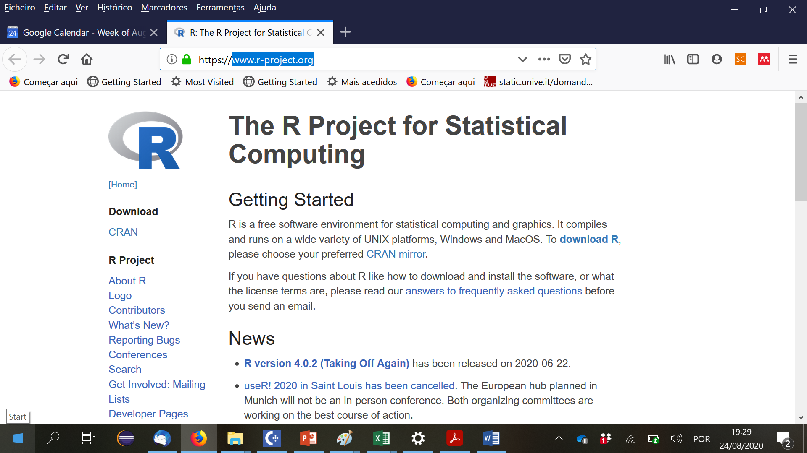

Slide 5
Instalar o R
Se já tem o software R instalado no seu computador, salte para o slide “instalar o R studio” ou para o slide “começar a trabalhar com o R”
Caso contrário, vá ao site do R www.r-project.org e faça o download do software no link mirrors do CRAN (Comprehensive R Archive Network)
Ao clicar no link CRAN, será exibida uma lista de servidores de rede em todo o planeta. Basta selecionar um e seguir as instruções de instalação
Observe que encontra vários materiais de suporte no site do R, basta explorar quando necessário

Slide 6
Instalar o RStudio
O RStudio é um ambiente de desenvolvimento integrado (IDE – integrated development environment ) para o R
Inclui uma consola, um editor com realce de sintaxe que suporta a execução direta de código, bem como ferramentas para gráficos, histórico, depuração e gestão do espaço de trabalho (workspace)
Faça o download do Rstudio no link am baixo e instale-o
https://www.rstudio.com/products/rstudio/download/
Scroll até encontrar o botão “Installers for Supported Platforms”
Click link para download que corresponda ao Sistema operative do seu computador

Slide 7
Começar a trabalhar com o R
Icons R versus RStudio
R: não abra este link
RStudo: abra este link

Slide 8
Instalar Rtools
Faça o download do instalador no CRAN:
On Windows 64-bit: rtools40v2-x86_64.exe (i386 and x64 compilers)
On Windows 32-bit: rtools40-i686.exe (i386 compilers only)
(verificar se está a usar uma versão recente do Rstudio, pelo menos 1.2.5042)
Após a conclusão da instalação, precisa de colocar a localização dos utilitários Rtools make no PATH. A maneira mais fácil de fazer isso é dar a seguinte instrução R na consola:
writeLines('PATH="${RTOOLS40_HOME}\\usr\\bin;${PATH}"', con = "~/.Renviron")
Inicie agora o R e em princípio vai trabalhar
(mais em: https://cran.r-project.org/bin/windows/Rtools/)

Slide 9
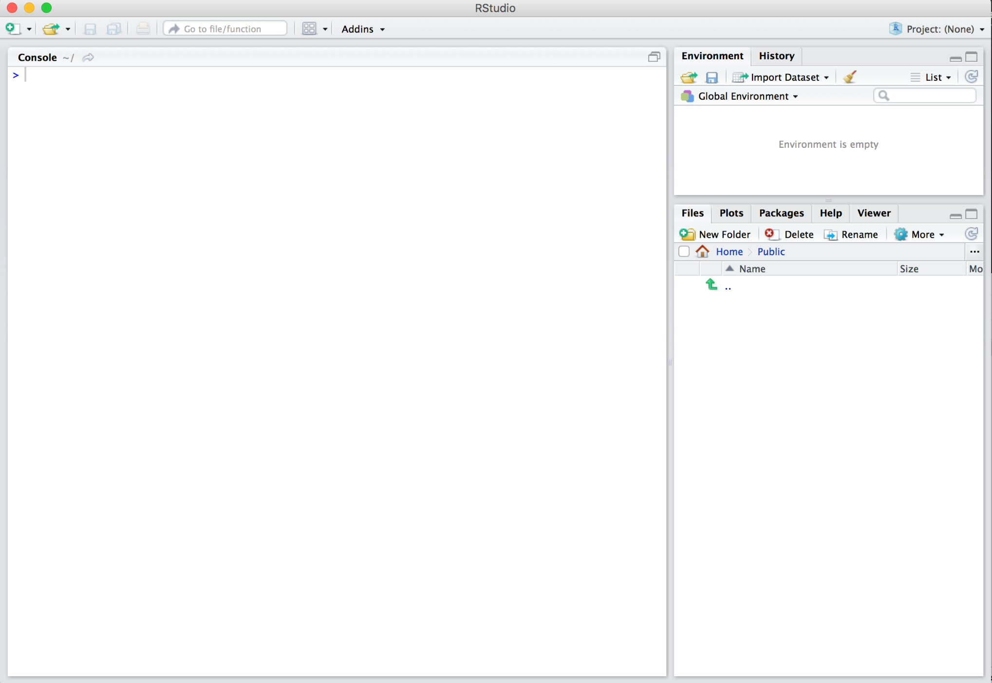
Interface do Rstudio com o R – tem o seguinte aspeto
“Environment”
Consola
Ficheiros & mais

Slide 10
O ambiente do RStudio

Slide 11
Usar o R
O R pode ser usado ​​de duas maneiras:
digitando as instruções na consola, uma após a outra, no comando R (após >)
escrevendo uma lista de comandos num ficheiro que pode ser usado sempre que necessário (um script); é assim que vamos usar o R
A melhor forma de aprender R é começar a resolver “problemas” com a ajuda de alguém que já esteja familiarizado com o R
Na interface do Rstudio, podemos usar a Ajuda (Help) que é muito poderosa

Slide 12
Interface do Rstudio com o R – tem o seguinte aspeto
“Environment”
Consola
Ficheiros & mais

Slide 13
R workspace
O workspace é o ambiente de trabalho do R onde os ficheiros de dados e os objetos R definidos pelo utilizador (vetores, matrizes, tabelas, listas, funções) estão localizados
Funções relacionadas com o workspace
getwd() # mostra o workspace corrente
setwd() # muda o workspace para outra pasta
setwd ("G:\\Shared drives\\Ensino\\InventarioFlorestal\\MaterialDeEstudo")
(note o \\ em vez de \; também é possível usar / em vez de \\)

Slide 14
Comandos para modificar o workspace
list.files() – comando que lista todos os objetos que estão no workspace
rm(list=…) – função que apaga do workspace todos os objectos indicados na lista
ls() – commando que lista todos os objectos que estão no workspace
rm(list=ls()) – apaga todos os objetos que estão no workspace

Slide 15
Relative paths no Rstudio
Todos os paths (caminhos) em R podem ser definidos de forma relativa em relação ao workspace (working directory)
setwd() define o workspace
o ponto . indica o workspace
.. indica ‘a pasta acima do workspace’
Suponha que damos a instrução
setwd("G:/Shared drives/Ensino/InventarioFlorestal/MaterialDeEstudo“)
setwd(..) seguido de getwd() origina
[1] "G:/Shared drives/Ensino/InventarioFlorestal"

Slide 16
Why relative paths are preferable?
If we share files, other users won’t have the same directory structure, so they will need to recreate the file paths
If we alter our directory structure, we need to rewrite the paths
An absolute file path will likely be longer than a relative path, more of the backslashes will need to be edited, so there is more scope for error

Slide 17
R packages

Slide 18
R packages
As R packages são conjuntos de funções e de conjuntos de dados desenvolvidos/criados pela comunidade
Uma R package geralmente contem um conjunto de funções de R reutilizáveis, a documentação que a descreve e dados como exemplo
As packages aumentam a capacidade do R por melhorarem as funcionalidade existentes no R base
No curso vamos usar várias R packages
LINK interessante: https://r-pkgs.org/

Slide 19
Utilizando R packages
Como é que podemos trabalhar com uma R package?
Primeiro temos que a instalar com o comando install.packages("x") ou através do RStudio
Para utilizar uma package num R script usamos o commando library("x")
Uma package apenas necessita de ser instalada uma vez, mas para a utilizar temos que a “carregar” com o comando library(“x”) em cada utilização
Pode obter ajuda com package?, com help(package = "x") ou ainda na janela de help do RStudio
É útil criar um script “InstallPackages.R” com alista de todas as packages que já instalou (mais tarde se precisar de reinstalar o R, basta corer esse script e repõe todas as packages que tinha instaladas…)

Slide 20
Estruturas de dados em R

Slide 21
Estruturas de dados em R
É importante ter uma ideia das estruturas de dados que existem no R:
vectores
listas
matrizes
data frame (e tibble)
factores
Para tal, pode explorer vários web sites, por exemplo:
https://swcarpentry.github.io/r-novice-inflammation/13-supp-data-structures/

Slide 22
Símbolos especiais
Os objetos R podem conter símbolos especiais:
NA (missing value)
NaN (Not a Number)
NULL (undefined value)
Inf and –Inf (infinito)

Slide 23
Importar, exportar e guardar ficheiros

Slide 24
Reading EXCEL data files with R
To read an entire data frame (set of vectors with the same length) directly, the external file will normally have a special format:
The first line of the file should have a name for each variable in the data frame
The first item (column) is usually a row label, followed by the values for each variable (one variable per column)
Each sheet in the Forest Models data files is already in the format required to be read as a data.frame
Data in EXCEL can be read using the R function read.xlxs() which requires the instalation of the “xlsx” package

Slide 25
Reading EXCEL data files with R
Start by installing the package “xlsx” – just need to do it once
Each time you need to read data in Excel files, you need to load the “xlsx” package and use the read.xlsx function:
library “xlsx”
To learn more about the read.xlsx command use the help tab in the R studio or search in the web

Slide 26
Reading EXCEL data files with R – alternative 1
Excel data can be read with na alternative library (RODBC) that allows for the read of larger data sets
Example
library(RODBC) #loads the RODBC package
library(ImportExport) #loads the ImportExport package
file = odbcConnectExcel2007("d)_IFN5_Tree_Pb.xlsx")
Pbtree =sqlFetch(file,"Tree_Pb")

Slide 27
Reading ACCESS tables with R
To read an ACCESS table into a data frame you need to use the “RODBC” package. After loading it, use function sqlFetch() to read an ACCESS table into a dataframe
For instance to read the table called 'TM_Biomassa' in the database BD_Pb_data.accdb located in C:/Users/magatome/BasesDeDados:
setwd ("C:/Users/magatome/BasesDeDados")
Pb_data <- odbcConnectAccess2007("BD_PB_data.accdb")
TM_biomassa <- sqlFetch(Pb_data, "TM_Biomassa")

Slide 28
Write R data files into EXCEL
Use package “xlsx”
write.xlsx (X, filename, sheetName=“Name”,
col.names=TRUE, row.names=TRUE,
append=FALSE)
where X is the R data file
It does not work for very large files

Slide 29
Write R data files into EXCEL – alternative 1
Use the "writexl" package
write_xlsx(X,"AllPossible.xlsx")
where X is the R data file

Slide 30
Saving and loading R data files
We may want to save a (or more than one) R datafile that “took a long time to prepare”:
save(data1,data2,file=“data.Rdata”)
Later on, in another script, you can load these data:
load(“data.Rdata”) - we will have direct access to the data structures data1 and data2
To know which files are in “your” working space:
list.files()

Slide 31
ifelse, if else and loops in R

Slide 32
ifelse and if…else
R allow the use of two conditional expressions:
used as one instruction:
ifelse (condition, expression if TRUE, expression if FALSE)
if…else statement
if (condition) {
statements if condition is TRUE
} else {
statements if condition is FALSE
}

Slide 33
Functions in R

Slide 34
“Looking” at R data files
Several functions can be used to “see” data inside a R data file
View(Data) opens the R file Data
nrows(filename)
lenght (filename) provides the number of variables
lenght (filename$var) provides the number of lines
lenght (unique(filename$var1, filename$var2) provides the number of lines with different values of filename$var1 x filename$var1

Slide 35
“Looking” at R data files
Several functions can be used to “see” data inside a R data file (cont.)
str(filename) describes the structure of the R data file
summary(filename) shows a summary for each variable in the R data file
head(filename) shows the first 6 lines of the R data file
head(filename) shows the first 6 lines of the R data file
head(filename, n=k) shows the first k lines of the R data file

Slide 36
Subseting R datasets by columns (package “dplyr”)
The select() function allows to select just some columns out of a data.frame
Examples (the “” can be omitted or ‘’ can be used instead):
Pb <- select (Pb,c(“hdom”,”t”)) just hdom and t columns
Ec <- select (Ec,-c(“Ww”,”Wb”)) all columns except Ww and Wb
Pb <- select (Pb,c(5:8)) selects columns 5 to 8
Ec <- select (Ec,c(“Id_plot”:”Wa”) seelcts all columns between variables Id_plot and Wa
Pay attention to the fact that the package “MASS” can not be loaded at the same time

Slide 37
Subseting R datasets by rows (package “dplyr”)
The filter() function allows to select just some rows out of a data.frame
filter(X, ..., .by = NULL, .preserve = FALSE)
Examples:
Pb <- filter (d <

Slide 38
Sorting a data.frame with order() – 1/2
order(X, decreasing= TRUE or FALSE, NA.last = TRUE or FALSE, …
sorts X by the order of the index value
if we want to really sort according to the values, we have to take the value of the X order
Example
d <- c(12.5, 4.5, 18.9, 34.2)
order(d, decreasing=FALSE) provides 2,1,3,4 (the index of the smaller number is 2, the index of the second smaller is 1, etc)
d[order(d)] provides 4.5, 12.5, 18.9, 34.2

Slide 39
Sorting a data.frame with order() – 2/2
Add now another column and create a data.frame plot to be sorted by decreasing value of d
h <- c(10.5, 5.0, 12.9, 15.4)
plot <- data.frame(d,h)
plot[order(d,decreasing = TRUE),] will provide:
d | h
34.2 | 15.4
18.9 | 12.9
12.5 | 10.5
4.5 | 5.0

Slide 40
Functions of the apply family
Functions of the apply family come with the R basic package
These functions allow us to manipulate data frames, arrays, matrices, vectors.
They can be seen as a substitute to the loop
https://www.guru99.com/r-apply-sapply-tapply.html#1
https://www.analyticssteps.com/blogs/apply-family-functions-r

Slide 41
Functions of the apply family – apply()
The apply() function helps us to apply a function on rows or columns of a matrix or of a data frame
apply (X, MARGIN, FUN, …)
x: an array, matrix, data frame
MARGIN=1: the manipulation is performed on rows
MARGIN=2: the manipulation is performed on columns
MARGIN=c(1,2): the manipulation is performed on rows and columns
FUN: tells which function to apply. Built functions like mean, median, sum, min, max and even user-defined functions can be applied

Slide 42
Functions of the apply family – lapply()
The lapply() takes a list as an argument and applies a function to each element of the list by looping
lapply(X, FUN, …)
x: Specifies a list on which functions should be replicated
FUN: is a function that needs to be looped on each element of the list

Slide 43
Functions of the apply family – sapply()
The sapply() is a more generalized version of lapply(). It works the same as lapply(), the only difference is in output generalization. Where lapply() returns a list as an output every time, sapply has certain algorithms while returning the output.
If the result is a list with each element of length unity, a vector will be returned.
If the result is a list with more than one element, but each vector of the same length, a matrix will be returned.
If none of the above algorithms is applicable, a list will be returned

Slide 44
Functions of the apply family – sapply()
sapply(X, FUN, …, simplify=TRUE, USE.NAMES=TRUE)
x: Specifies a list on which functions should be replicated
FUN: is a function that needs to be looped on each element of the list
simplify - argument that specifies if we want to simplify the results or not
USE.NAME - specifies the argument names to be used or not.

Slide 45
Functions of the apply family – tapply()
The tapply() function can be applied on a subset of a vector where the vector is divided into different levels that are also known as factors
tapply(X, INDEX, FUN)
x: an object, usually a vector
INDEX: a list containing factor
FUN: tells which function to apply. Built functions like mean, median, sum, min, max and even user-defined functions can be applied
the function FUN provides values for each value of the factor

Slide 46
Functions related to objects
List all objects that are active
ls()
Eliminate objects that won’t be needed anymore
rm(object1,object2)
Describe an object
str(object)

Slide 47
The %>% operator
You can use the %>% operator with standard R functions — and even with your own functions
The rules are simple: the object on the left hand side is passed as the first argument to the function on the right hand side
euca <- euca_all %>%
select(c("ID_plot","ID_rot","t","hdom","N","G"))
is equivalent to
euca <- select(euca_all, c("ID_plot","ID_rot","t","hdom","N","G"))

Slide 48
Several R functions for vectors
mean(X) → average of the values of vector X
sum(X) → sum values of vector X
prod(X) → makes the product of values in vector X
round(X, digits=k) → round numbers in vector X
floor(X) → rounds to the integer immediately before
ceiling(X) → rounds to the integer immediately after
trunc(X) → gives the integer obtained by truncating X
sample(X) → shuffles the values of vector X in a random order
sample(X,size=k,replace=FALSE) → random sample k

Slide 49
R functions to generate numbers from a fdp (distribution)
These functions require the library(“stats”)
set.seed(1) # provides a seed to start the series of numbers
rnorm(n= , mean=, sd=) normal distribution
rpoison(n=, lambda=) Poison
runif(n=,min=, max=) uniform distribution

Slide 50
t-Student
pt(x,df) - returns the value of the cdf of the Student t distribution for a value x and degrees of freedom df. If you’re interested in the area to the right of a given value x, you can simply add the argument lower.tail = FALSE
qt(x,df) - returns the value of x for a certain value of the cdf and degrees of freedom df
dt(x,df) - returns the value of the Student t distribution (pdf) for a value x and degrees of freedom df
rt(n,df) - generates a vector of random variables that follow a Student t distribution given a vector length n and degrees of freedom df
https://www.statology.org/working-with-the-student-t-distribution-in-r-dt-qt-pt-rt/

Slide 51
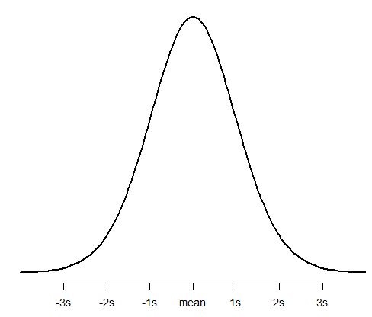
t-student
x <- seq(-4, 4, length=100)
y <- dt(x = x, df = 20)
plot(x,y, type = "l", lwd = 2, axes = FALSE, xlab = "", ylab = "")
axis(1, at = -3:3, labels = c("-3s", "-2s", "-1s", "mean", "1s", "2s", "3s"))
https://www.statology.org/working-with-the-student-t-distribution-in-r-dt-qt-pt-rt/

Slide 52
Write your own functions

Slide 53
How to write your own functions in R
First select a name for your function (the name can not the same as an existing R function)
FunctionName <- function (arguments) {
code for the function
return (function output, usually a list)
}
Let see some examples
Notes:
Explicado

Slide 54
Graphs in R

Slide 55
Functions related to graphics
par(mar, mgp, las)
par(mar=c(5.1, 4.1, 4.1, 2.1), mgp=c(3, 1, 0), las=0)
mar – A numeric vector of length 4, which sets the margin sizes in the following order: bottom, left, top, and right. The default is c(5.1, 4.1, 4.1, 2.1)
mgp – A numeric vector of length 3, which sets the axis label locations relative to the edge of the inner plot window. The first value represents the location the labels (i.e. xlab and ylab in plot), the second the tick-mark labels, and third the tick marks. The default is c(3, 1, 0)
las – A numeric value indicating the orientation of the tick mark labels and any other text added to a plot after its initialization. The options are as follows: always parallel to the axis (the default, 0), always horizontal (1), always perpendicular to the axis (2), and always vertical (3)
par (“mar”), par(“mgp”), par(“las”) show the current value of the parameters

Slide 56
Functions related to graphics
par(mfrow= par(mfrow=c(2,2))
creates a 2x2 plotting matrix
par(mfrow= par(mfrow=c(1,1))
come back to the original
Notes:
Explicado

Slide 57
The ggplot2 package (e.g. https://ggplot2.tidyverse.org/)
ggplot2 is a system for declaratively creating graphics, based on The Grammar of Graphics. You provide the data, tell ggplot2 how to map variables to aesthetics, what graphical primitives to use, and it takes care of the details
In most cases, you start with ggplot(), supply the aesthetic with aes() and then add layers (like the type of graphics, the colours, etc)

Slide 58
Printing results in the console
See the links:
https://www.gastonsanchez.com/r4strings/formatting.html

Slide 59
Interesting links
problems with attach() and detach() functions
https://www.r-bloggers.com/2011/05/to-attach-or-not-attach-that-is-the-question/
merging data sets by columns with diferent names
https://www.r-bloggers.com/2012/12/joining-2-r-data-sets-with-different-column-names/
R for Data Science (a lot of topics presented in a nice way):
https://r4ds.had.co.nz/workflow-scripts.html

Slide 60
Commenting multiple lines in scripts
There are two ways to add multiple single-line comments in R Studio:
Select the multiple lines which you want to comment using the cursor and then use the key combination “control + shift + C” to comment or uncomment the selected lines.
The other way is to use the GUI, select the lines which you want to comment by using the cursor and click on “Code” in menu, a pop-up window pops out in which we need to select “Comment/Uncomment Lines” which appropriately comments or uncomment the lines which you have selected.
(https://www.geeksforgeeks.org/comments-in-r/)

Slide 61
Let´s now test how R works by following the “try and see” scripts “PlayWith_Pb_GrowthData” “Pbtrees_NFIData_LargeDataset” “PlayWith_Ec_GrowthData”

