Slide 1
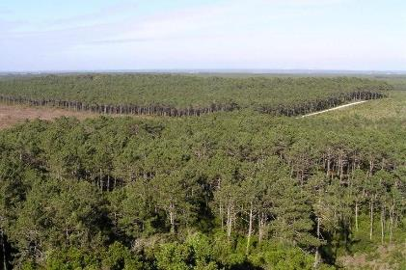
YIELD TABLES
Barreiro S & Tomé M
Modelling Ecosystem Services Course April 2025

Slide 2
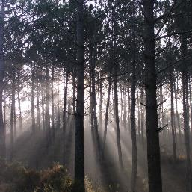
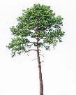
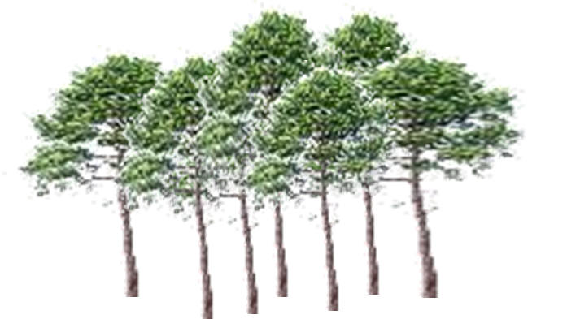
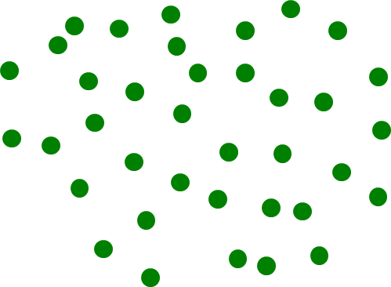
Outline
Yield table concept and limitations
How to create yield tables: different methods
Classical methods
Methods driven by the prediction of total volume
Methods driven by the prediction of thinned volume
Using Growth models /Forest simulators
?

Slide 3
What is a yield table?
Originally developed for pure even-aged plantations YT can be seen as the first models developed to assist forest management
What is a yield table? It is a table that predicts the evolution of a stand for a certain forest management approach ie table indicating the volume of wood per unit area of forest to be expected at different ages of the trees for a given site index, Fw, stand density,…
Over the past decades, YT have become less effective for their:
limited applicability to more complex stands (e.g. mixed species stands);
requiring a high number of tables to cover all situations;
representation of forest growth under environmental conditions that have changed in the meantime, (data used to develop them were different and collected under more stable conditions)

Slide 4
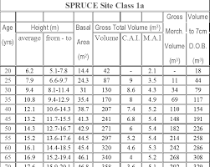
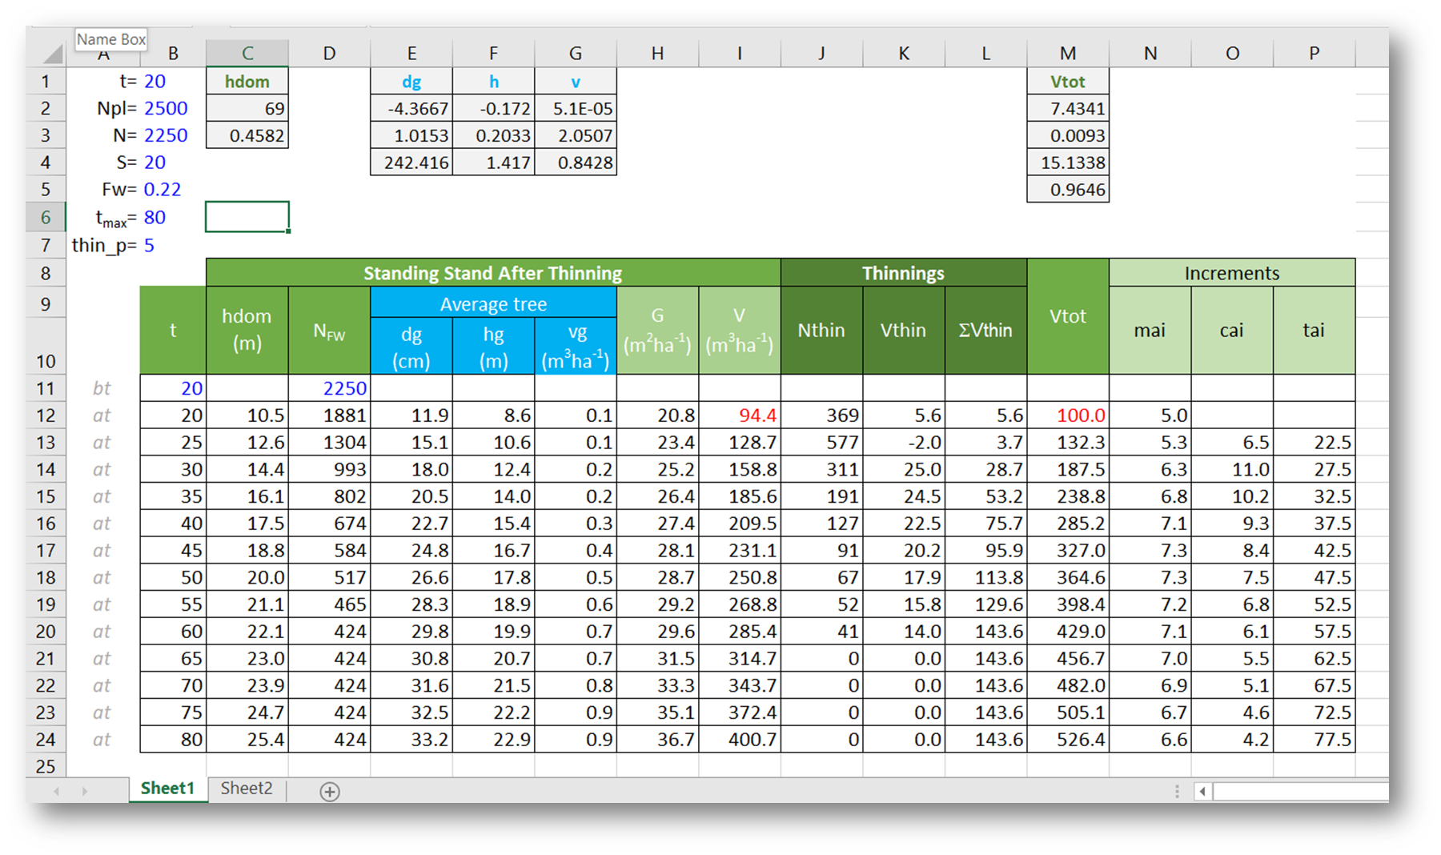
What is a yield table?
A yield table may be obtained through:
Classical methods
Growth and yield model, much more flexible, therefore used nowadays
Building and yield table using the classical methods is an important contribution to understand the impact of management on stand growth and yield

Slide 5
What is a yield table?
Classical methods – relationships between stand variables based on simple, but well established in forest growth and yield theory
Driven by the prediction of total stand volume
Total stand volume at age t is the standing volume at age t plus the accumulated volume lost as a consequence of mortality and thinning
Driven by the prediction of thinned volume
Wilson Factor (FW) – relative space index that represents the average space trees have to grow related to their dominant height
hdom – height of the 100 thickest trees/ha
N – number of trees/ha
$$Fw=\frac{100}{hdom\sqrt{N}}$$
$$N_{FW}=\frac{{100}^{2}}{{hdom}^{2}{FW}^{2}}$$

Slide 6
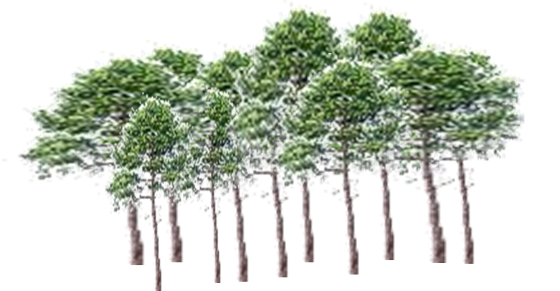
What is a yield table?
Classical methods – relationships between stand variables based on simple, but well established in forest growth and yield theory,
Driven by the prediction of total stand volume
Total stand volume at age t is the standing volume at age t plus the accumulated volume lost as a consequence of mortality and thinning
Driven by the prediction of thinned volume
$$N_{FW}=\frac{{100}^{2}}{{hdom}^{2}{FW}^{2}}$$
N
$$N_{Fw}$$
If one wishes to manage for a FW = 0.25, the number of standing trees after thinning is given by N_{FW}
?
${thus the N}_{thin}$ = N - $N_{Fw}$

Slide 7
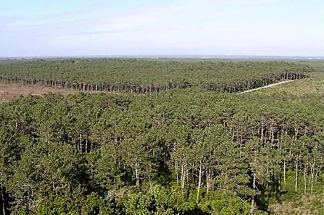
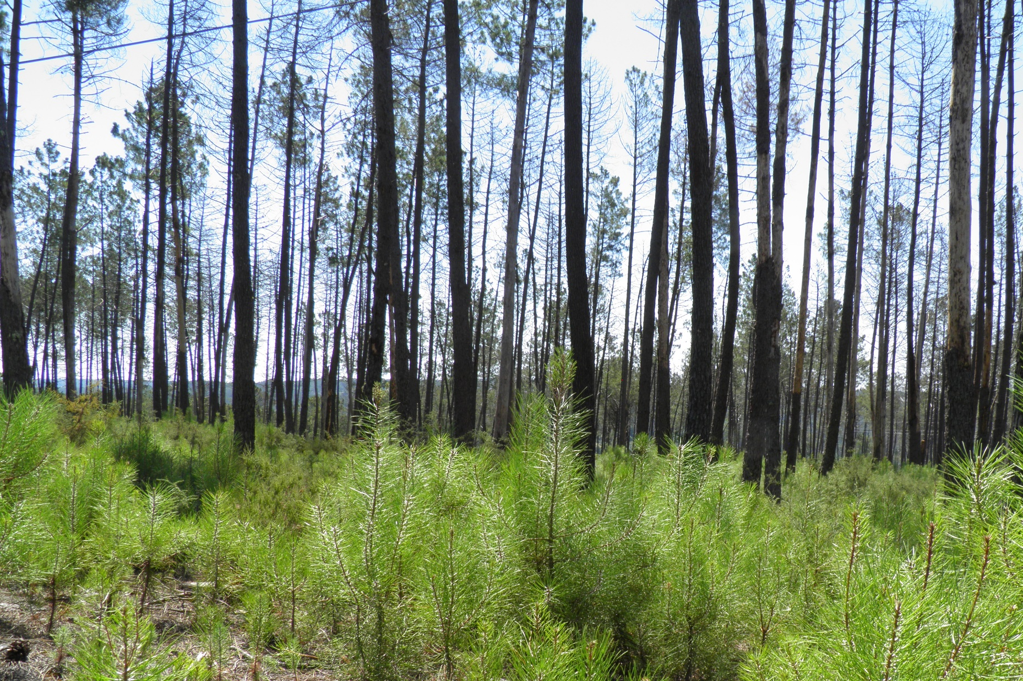
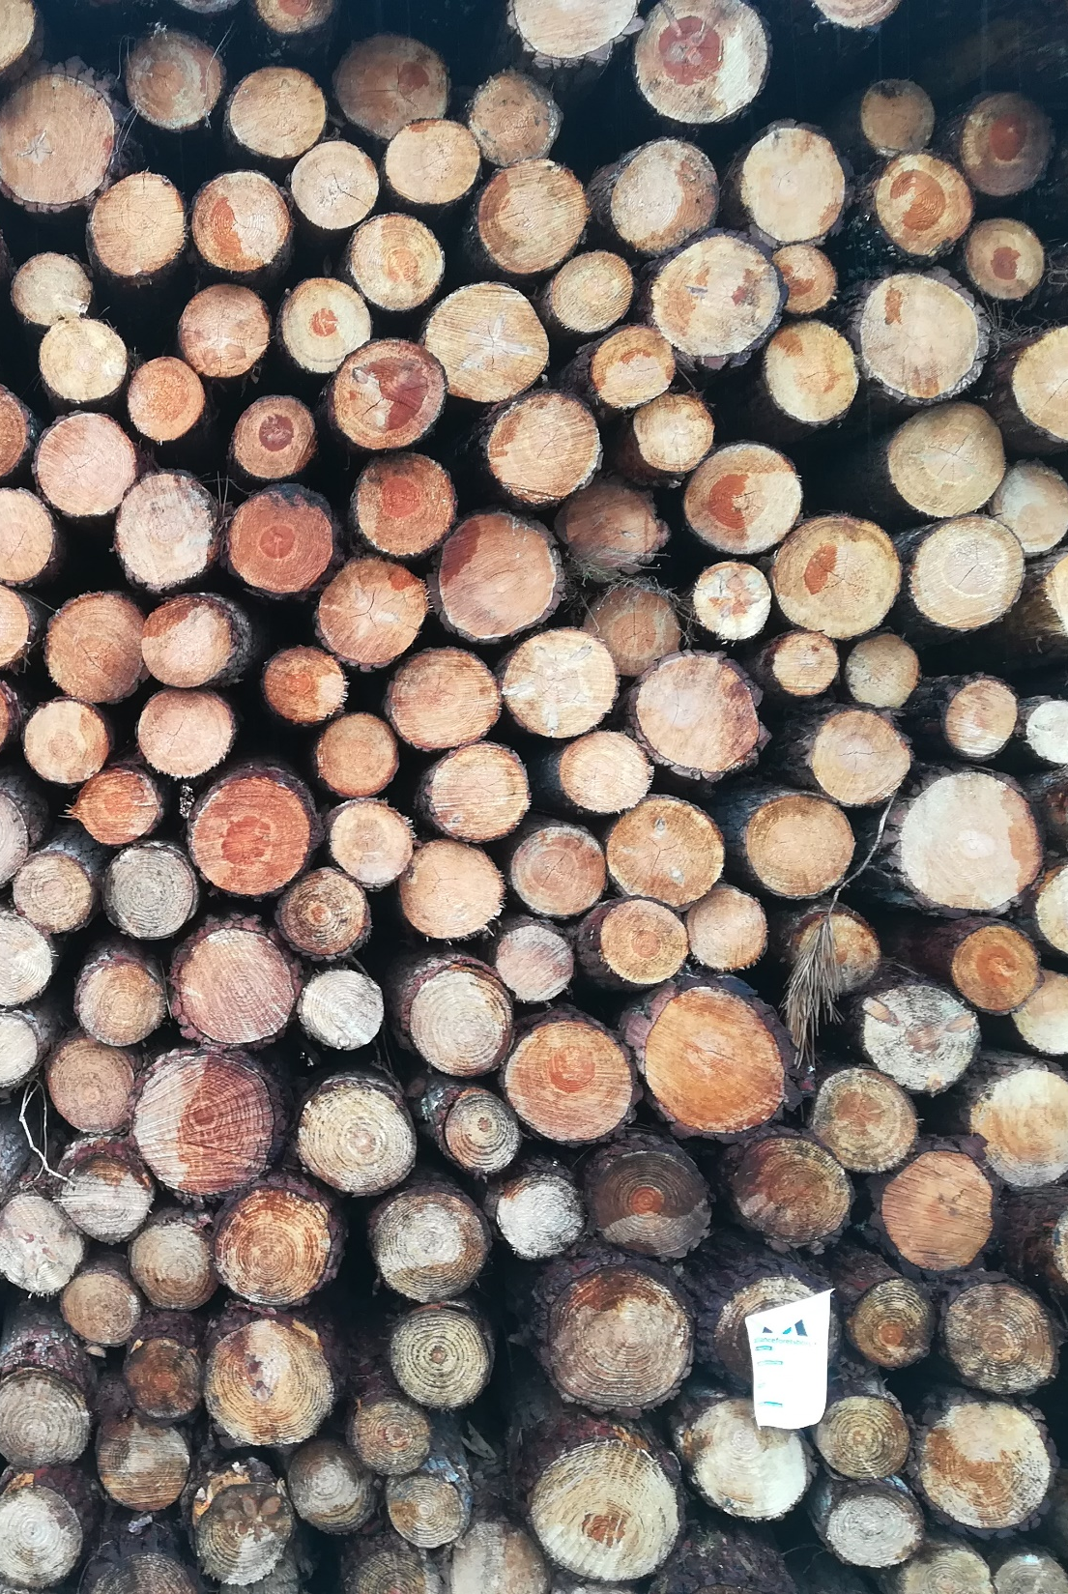
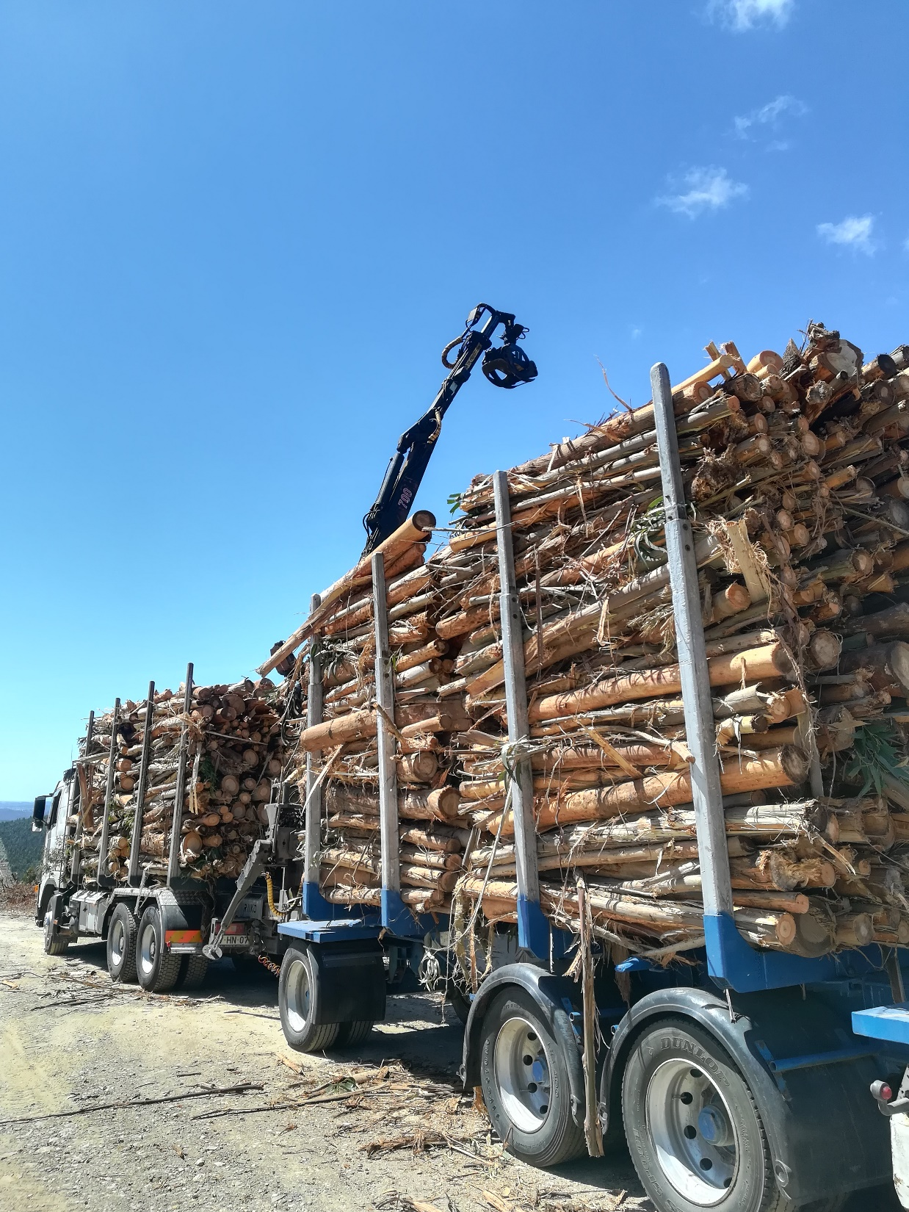
YIELD TABLES’ DEVELOPMENT
Classical methods
driven by the prediction of total volume

Slide 8
Classical methods total volume example
Predict the evolution of dominant height
hdom = f(S,t)
Prediction of the evolution of total volume
Vtotal=f(hdom,S)
Selection of a thinning regime (periodicity, criteria and intensity) and its traduction in terms of the evolution of the number of trees per ha of the standing volume
The relative spacing, namely the Wilson Factor is an option

Slide 9
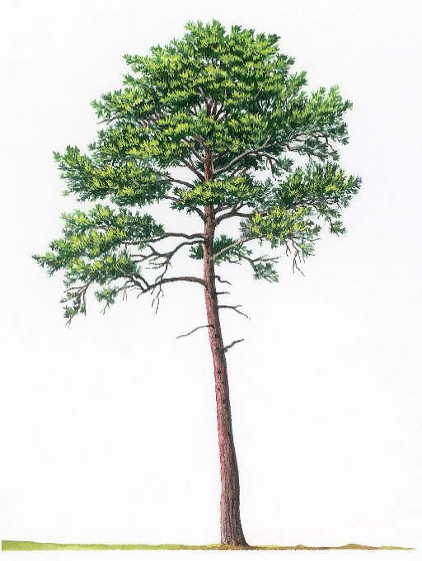
Classical methods total volume example
Prediction of quadratic mean dbh for the standing stand after thinning
Prediction of the volume of the standing stand after thinning
at – after thinning
Diameter, height and volume of the average tree after thinning
Multiplied by the number of trees after thinning
Prediction of the thinned volume
Thinned volume = Total volume – Standing volume after thining -Σ (thinned volume)
Standing volume after thinning

Slide 10
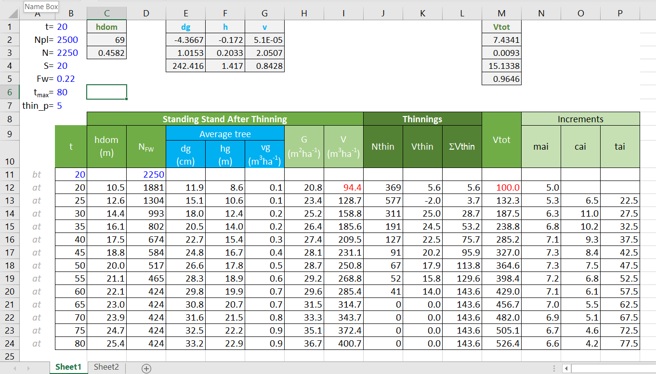
Classical methods total volume example
Site index curves (hdom, m)
Stand density (N, trees ha⁻¹)
Quadratic mean dbh after thinning (dg, cm; hdom, m)
$$N_{FW}=\frac{{100}^{2}}{{hdom}^{2}{FW}^{2}}$$

Slide 11
Classical methods total volume example
Height-diameter curve (h, m; d, cm; hdom, m)
Tree volume equation (v, m³; d, cm; h, m)
Standing volume (V, m³ha⁻¹)

Slide 12
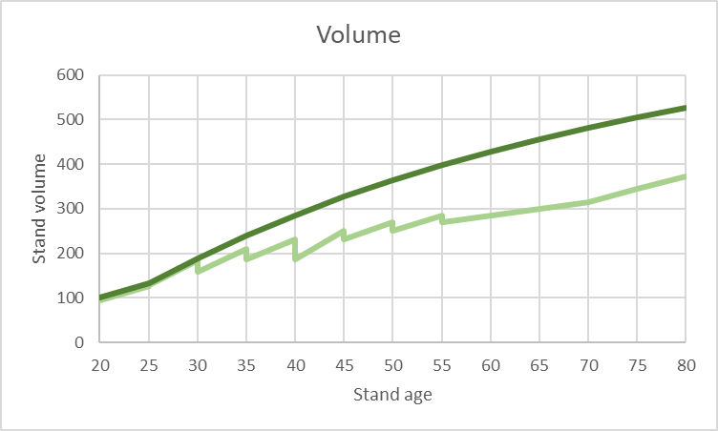
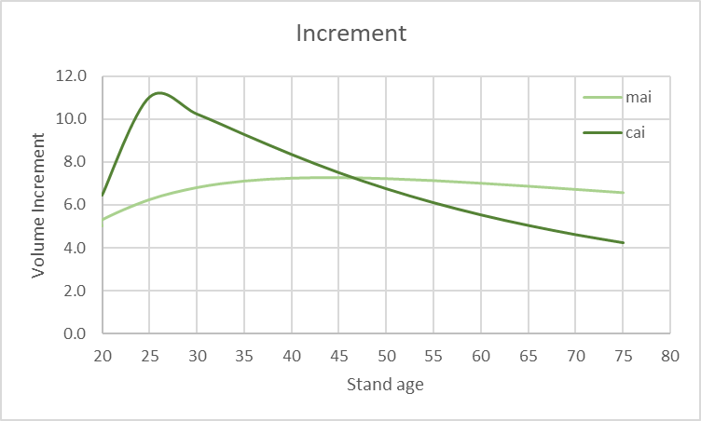
Classical methods total volume example
Total volume (Vtot, m³ha⁻¹; hdom, m)

Slide 13
YIELD TABLES’ DEVELOPMENT
Classical methods
driven by the prediction of thinned volume

Slide 14
Classical methods thinned volume example
Predict the evolution of dominant height
hdom = f (S, t)
Selection of a thinning regime (periodicity, criteria and intensity) and its traduction in terms of the evolution of the number of trees per ha of the standing volume
The relative spacing, namely the Wilson factors is an option
$$N_{FW}=\frac{{100}^{2}}{{hdom}^{2}{FW}^{2}}$$
Prediction of quadratic mean dbh of the standing stand before thinning

Slide 15
Classical methods thinned volume example
Predicting volume of the standing stand before thinning
Vp_{bt} = f (G, hdom)
Prediction of the quadratic mean dbh of the thinned stand
dg_{at} = f(dg, N_{thin}, N_{bt})
Predicting volume of the thinned stand
V_{thin}= f ( N_{thin}, d_{thin}, Vp_{bt}, dg_{at}, N_{bt} )

Slide 16
Classical methods – thinned volume
Predicting the volume of the standing volume after thinning
Predicting total volume

Slide 17
YIELD TABLES’ DEVELOPMENT
Using Growth Models / Simulators

Slide 22
