Slide 1
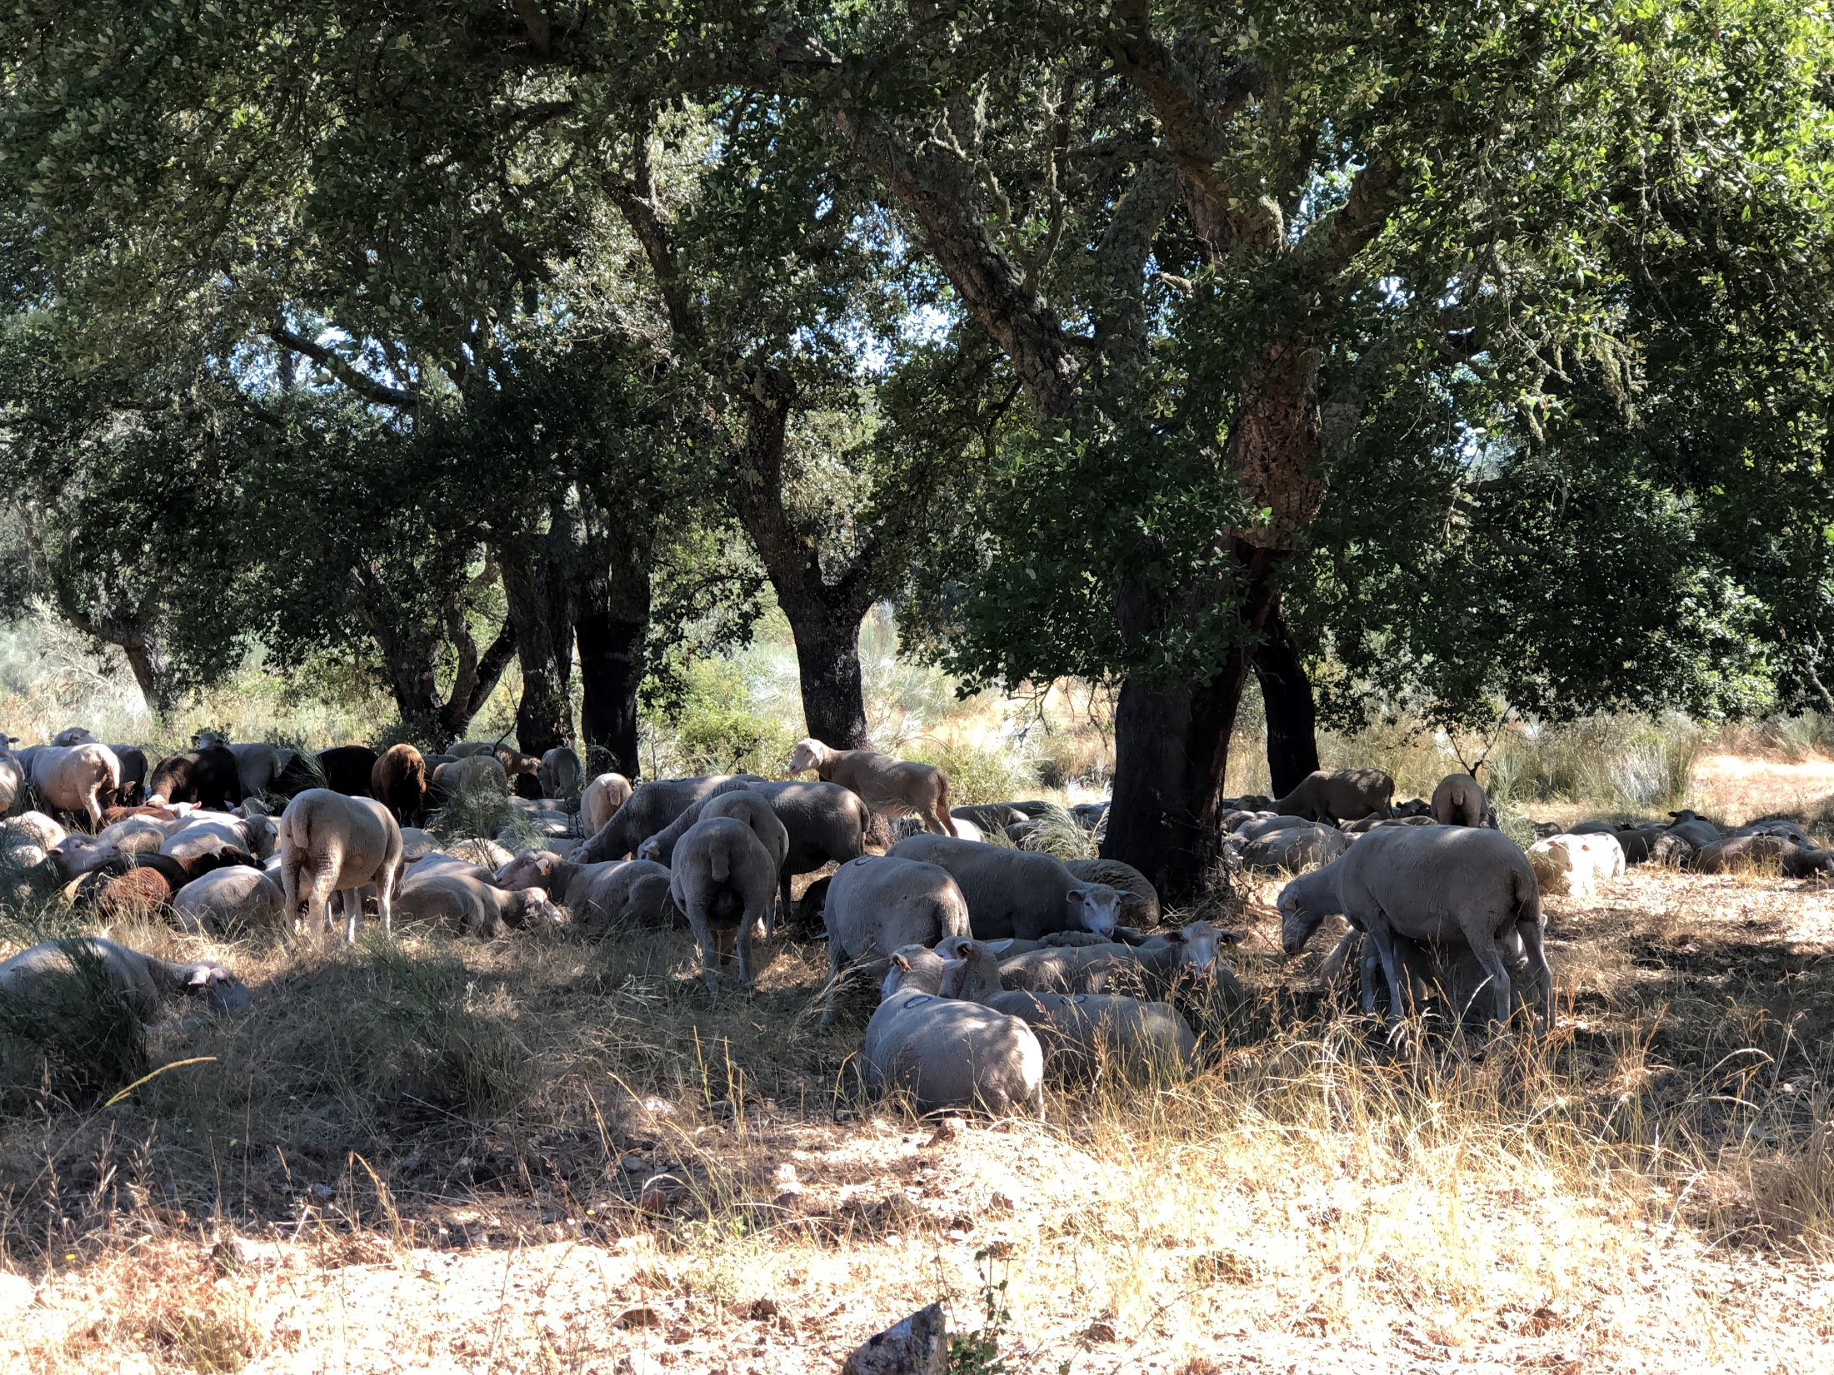
Diameter distribution models for even-aged stands
Margarida Tomé, Susana Barreiro
Instituto Superior de Agronomia
Universidade de Lisboa

Slide 2
Summary
Diameter distribution models for even-aged stands
  Typology of different models: whole-stand, diameter-distribution and individual tree models
  Introduction to diameter distributions
  Modelling diameter distributions
  PDF functions (Weibull and Johnson’s SB)
  The PBRAVO Model

Slide 3
Whole stand models (WSM)
Empirical models
The first were yield tables – static density (average or normal densities)
WSM developed for more flexibility – stand density dynamic part of the prediction
State variables are all defined at stand level
 | WSM | WSM-dd | WSM-sc | ITM
Dominant height | stand | stand | stand | stand
Trees ha⁻¹ | stand | stand | stand | mortality of trees
Basal area | stand | stand | stand | dbh of trees
Volume | stand | average tree/by diamclass | average tree | volume of trees
Biomass | stand | average tree | average tree | biomass of trees
Variables for the diameter distribution | NA | yes | no | NA

Slide 4
Diameter distribution models (DDM)
Empirical models
Forest management and planning require information about the distribution of volume by size and product classes
The nr trees/diam. class obtained using probability density function
Some state variables are defined at stand level
 | WSM | DDM | WSM-sc | ITM
Dominant height | stand | stand | stand | stand
Trees ha⁻¹ | stand | stand | stand | mortality of trees
Basal area | stand | stand | stand | dbh of trees
Volumes | stand | average tree/by diamclass | average tree | volume of trees
Biomasses | stand | average tree/by diamclass | average tree | biomass of trees
Variables for the diameter distribution | NA | yes | no | NA

Slide 5
Individual tree models (ITM)
Empirical models
Simulate individual-tree dynamics allowing information of stand structure and development as well as distribution of stand volume by size classes
Majority of state variables defined at tree level (even-aged)
 | WSM | DDM | ITM
Dominant height | stand | stand | stand
Trees ha⁻¹ | stand | stand | mortality of trees
Basal area | stand | stand | dbh of trees
Volumes | stand | average tree/by diamclass | volume of trees
Biomasses | stand | average tree/by diamclass | biomass of trees
Variables for the diameter distribution | NA | yes | NA (all d are known)

Slide 6
Models with diameter distributions

Slide 7
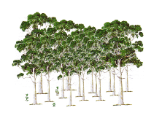
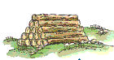
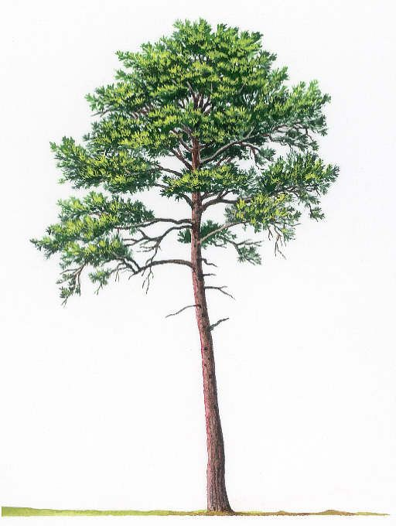
Stand volume may be enough for some purposes, but often the distribution of volume by size and product classes is often required also it is important for planning thinning or final harvest
Stand tables (nr of trees by diameter class) and stock tables (volume by diameter class) complemented the information from Yield Tables
                Attention was given to modelling diameter distributions
WSM
Whole Stand Models
Diameter Distribution Models
Sample Text
Typically, the total nr of trees per hectare (N, trees ha⁻¹)
is distributed among diameter classes
using
probability density functions (pdf)
Sample Text
Individual Tree Models

Slide 8
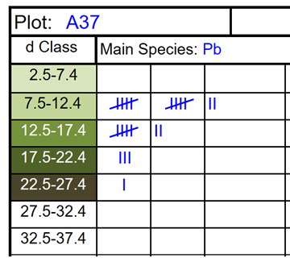
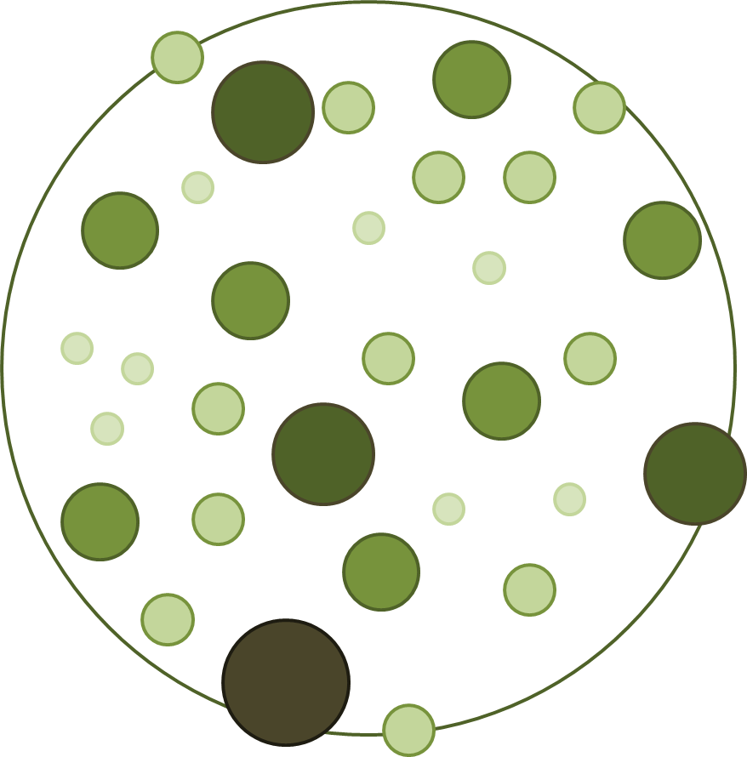
Diameter distributions
  In forest inventory, the mensuration of tree diameters for all trees in one plot (total enumeration of diameters) allows distributing them by different diameter classes
WSM
Sample Text
  This allows characterizing the plot/stand at time t
  However, if WSM are applied to predict the evolution of a stand for t+1, N (trees ha⁻¹) is all we know
Sample Text

Slide 9
Diameter distributions
  In modelling, WSM provide information on N (trees ha⁻¹) over time that combined with a probability density function (pdf), enable the distribution of N by d-classes and volume to be estimated by d-class (vi)
  d central (diameter midpoint) represents the d of the average tree in the d-class;
  combined with a h-d curve, an estimate of the height of the average tree (h) can be obtained;
  knowing d and h, the volume of the average tree is estimated that multiplied by Ni gives the volume in the d-class (vi)
WSM
Sample Text
  with i representing the d Class
240
140
60
Sample Text
20

Slide 10
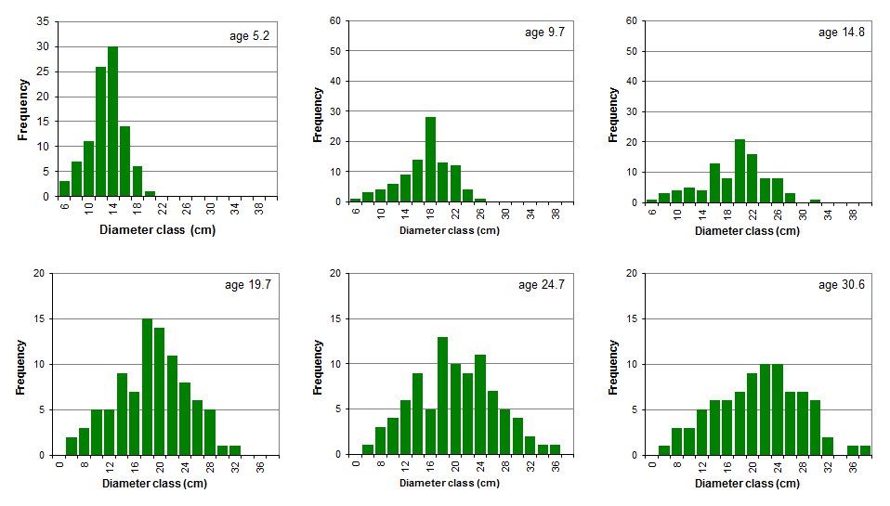
What do diameter distributions look like?
Diameter distributions of a permanent plot over time
WSM
Sample Text
Sample Text

Slide 11
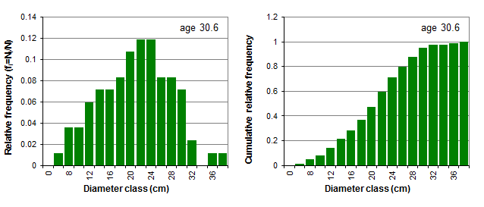
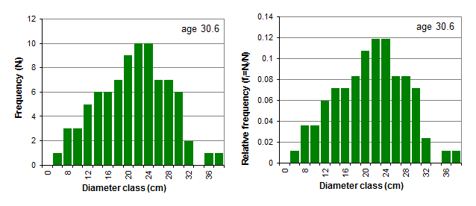
How can they be expressed?
Diameter distribution in relative frequencies
  The diameter distributions may be expressed in terms of relative frequencies by expressing the frequency each diameter class (N_{i}) relative to the total number of trees per ha (N)
Diameter distribution in cumulative relative frequencies
  The cumulative relative frequency of a diameter distribution leads to the empirical distribution function
WSM
Sample Text
Σf_{i}=1
Sample Text

Slide 12
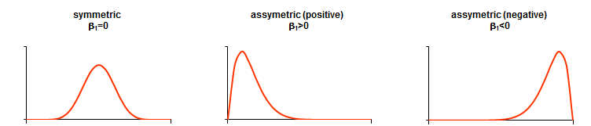
Modelling diameter distributions:
  A typical diameter distribution for pure, even-aged stands is unimodal and slightly skewed
  Skewness coefficient (β₁) is used to measure the symmetry of a distribution
WSM
Sample Text
Sample Text

Slide 13
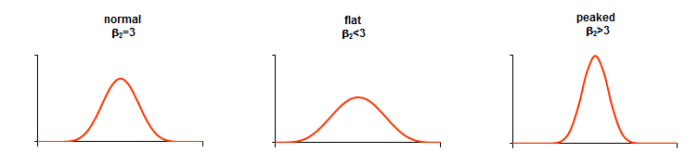
Modelling diameter distributions:
  Diameter distributions for pure, even-aged stands can also be more or less flat
  Kurtosis coefficient (β₂) is used to measure the peakdness or flatness of a distribution
WSM
Sample Text
Sample Text

Slide 14
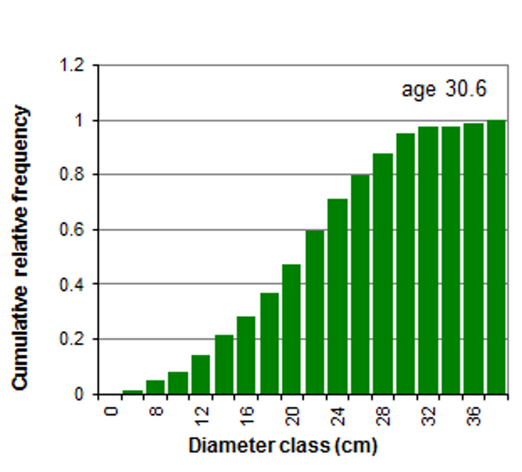
Modelling diameter distributions:
  Diameter distributions can be modelled by a variety of mathematical functions from the probability density functions (pdfs) type:
    express the relative likelihood for a random variable to take on a given value
    are non-negative everywhere, and its integral over the entire space is equal to one
    The probability that the random variable takes a value<x is equal to the integral of the pdf from the start to x
The probability of a tree to have a d ≤ 22cm = 0.6
0.6
22

Slide 15
Modelling diameter distributions:
Probability density functions (pdfs)
  A pdf is described by a mathematical expression that contains parameters
  The values of the parameters give a different shape to the pdf (including the location one)
  For instance, a Normal distribution, the most well know pdf, has the following expression
    that includes two parameters, the mean (μ) and the standard deviation (σ), and is designated by N(μ,σ)

Slide 16
Modelling diameter distributions:
Probability density functions (pdfs)
  Integrating the pdf produces the cumulative distribution function that, for the Normal distribution is
  The Normal distribution is not appropriate to model diameter distributions because of its symmetry

Slide 17
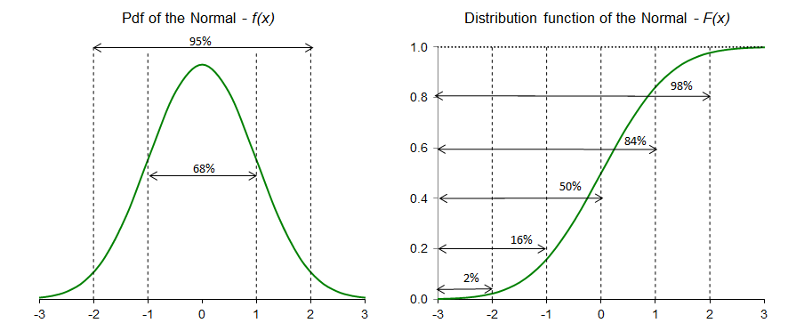
Modelling diameter distributions:
Probability density functions (pdfs)
  Integrating the pdf produces the cumulative distribution function that, for the Normal distribution is
  The Normal distribution is not appropriate to model diameter distributions because of its symmetry: it is symmetric around the mean (μ)

Slide 18
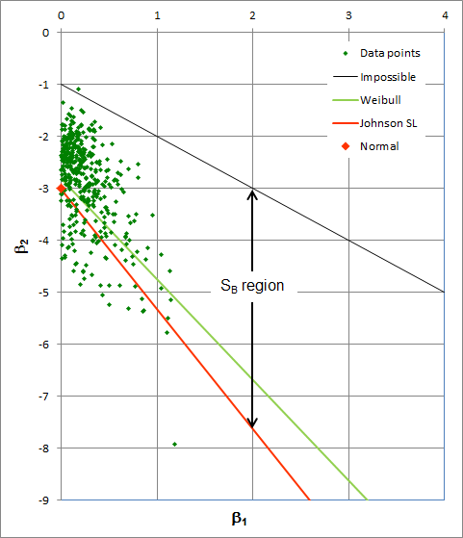
Modelling diameter distributions:
Probability density functions (pdfs)
  Other pdfs, that can take different values for the pair ( β₁, β₂ ) = ( Skewness coefficient, Kurtosis coefficient), have been used for diameter distribution modelling
  (β₁,β₂) values for the pdfs most used for diameter distribution modelling and for a set of eucalyptus permanent plots
  Estimators for β₁ and β₂:

Slide 19
Modelling diameter distributions:
Selecting a distribution function
  Easiness of parameter estimation
  Flexibility to describe a wide range of shapes
  Simplicity of integration methods for estimating proportions in different size classes
  Accuracy in fitting
Region representing combinations of β1 and β2 that are mathematically impossible (for the distribution)

Slide 20
Modelling diameter distributions
Selecting a distribution function
  Easiness of parameter estimation
  Flexibility to describe a wide range of shapes
  Simplicity of integration methods for estimating proportions in different size classes
  Accuracy in fitting
Distributions represented by a single point in the graph (Normal) have one single shape

Slide 21
Modelling diameter distributions:
Selecting a distribution function
  Easiness of parameter estimation
  Flexibility to describe a wide range of shapes
  Simplicity of integration methods for estimating proportions in different size classes
  Accuracy in fitting
Distributions represented by a line in the graph (eg Weibull) can take various combinations of β1 and β2 showing their flexibility in terms of shape

Slide 22
Modelling diameter distributions:
Selecting a distribution function
  Easiness of parameter estimation
  Flexibility to describe a wide range of shapes
  Simplicity of integration methods for estimating proportions in different size classes
  Accuracy in fitting
The Johnson S_{B} is a system of distributions and is represented by an area in the graph showing their flexibility in terms of shape

Slide 23
Modelling diameter distributions:
Selecting a distribution function
  - The Weibull probability density function, one of the most used pdfs in diameter distribution modelling, is a three-parameter pdf
    a – location parameter (related to the d_{min})
    b – scale parameter (>0)
    c – shape parameter (>0; if c>1 implies a inverse J shape;
      if c=3.6 is close to Normal;
      If c<3.6 is right skewed;
      if c>3.6 is left skewed)
    a+b is close to percentile 63% (P₆₃) of the distribution

Slide 24
Modelling diameter distributions:
Selecting a distribution function
  Integrating the pdf produces the cumulative distribution function for the Weibull distribution
  The Weibull distribution has the advantage of having a closed integral form which makes it very tractable

Slide 25
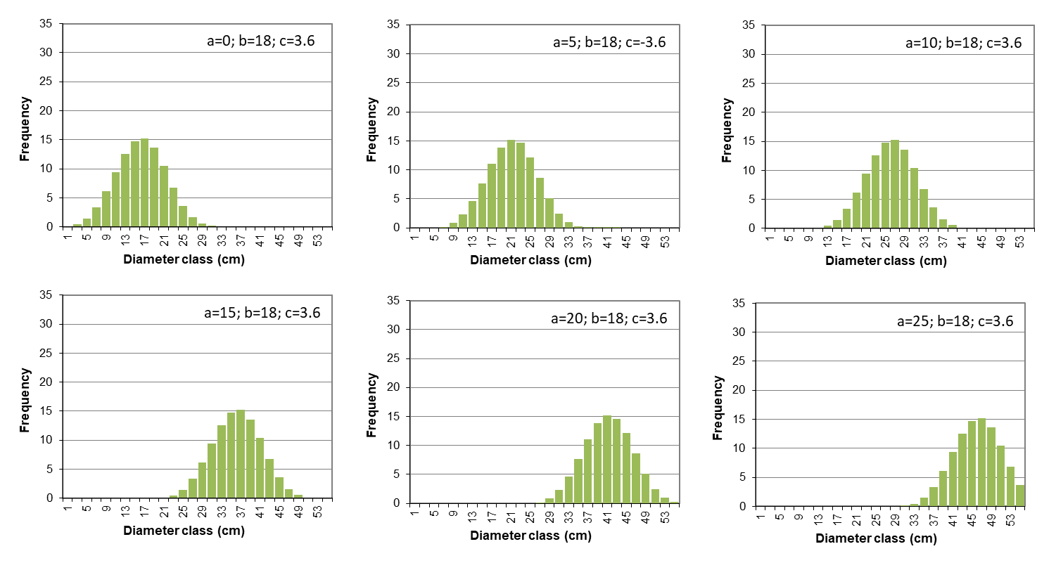
Modelling diameter distributions:
Selecting a distribution function
  - Examples of the Weibull probability density function
    a – location parameter (related to the d_{min})
    b – scale parameter (>0) 18
    c – shape parameter (>0; if c>1 implies a inverse J shape; 3.6
      if c=3.6 is close to Normal;
      If c<3.6 is right skewed;
      if c>3.6 is left skewed)
    a+b is close to percentile 63% (P₆₃) of the distribution
a = 0
a = 5
a = 10
a = 15
a = 20
a = 25

Slide 26
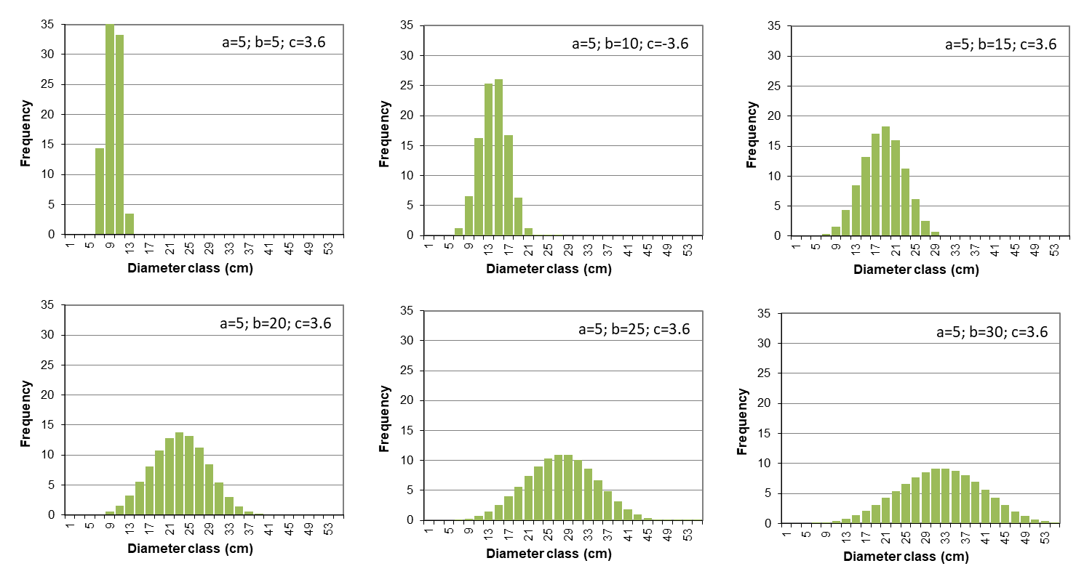
Modelling diameter distributions:
Selecting a distribution function
  - Examples of the Weibull probability density function
    a – location parameter (related to the d_{min}) 5
    b – scale parameter (>0)
    c – shape parameter (>0; if c>1 implies a inverse J shape; 3.6
      if c=3.6 is close to Normal;
      If c<3.6 is right skewed;
      if c>3.6 is left skewed)
    a+b is close to percentile 63% (P₆₃) of the distribution
b = 5
b = 10
b= 15
b = 20
b = 25
b = 30

Slide 27
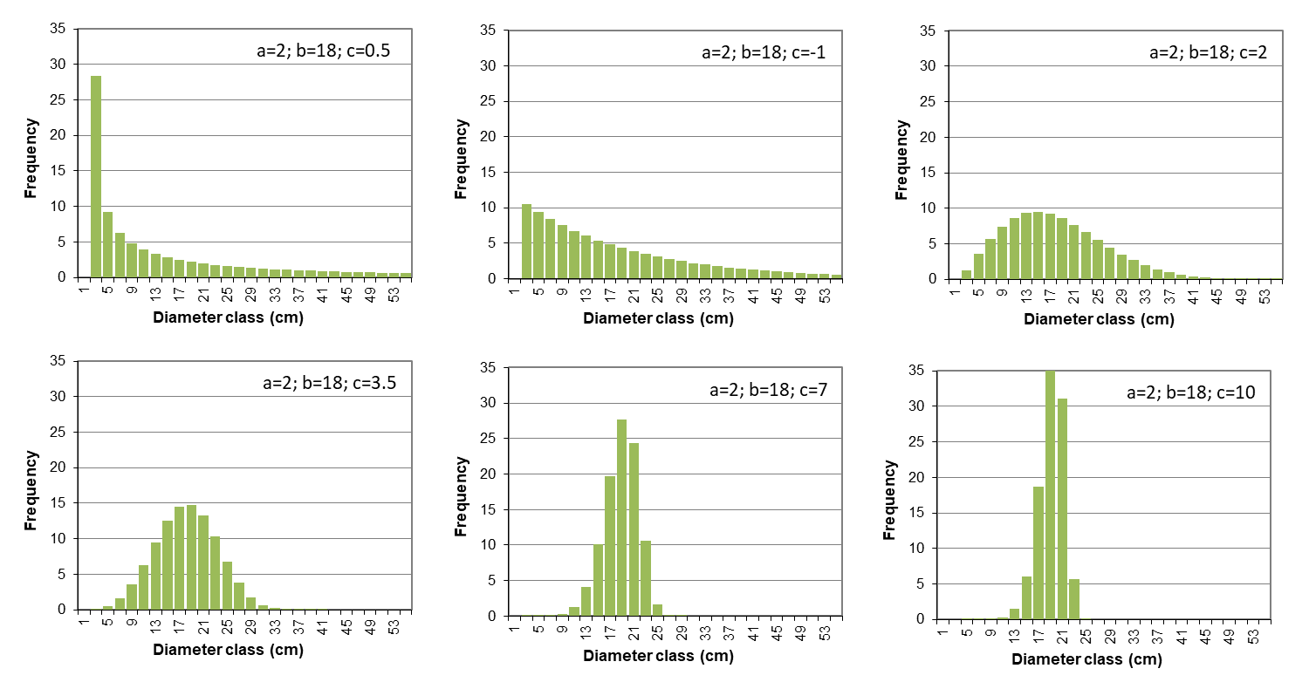
Modelling diameter distributions:
Selecting a distribution function
  - Examples of the Weibull probability density function
    a – location parameter (related to the d_{min}) 2
    b – scale parameter (>0) 18
    c – shape parameter (>0; if c>1 implies a inverse J shape;
      if c=3.6 is close to Normal;
      If c<3.6 is right skewed;
      if c>3.6 is left skewed)
    a+b is close to percentile 63% (P₆₃) of the distribution
c = 0.5
c= 1
exponential
c= 2
Rayleigh
c = 3.5
Normal
c = 7
c = 10

Slide 28
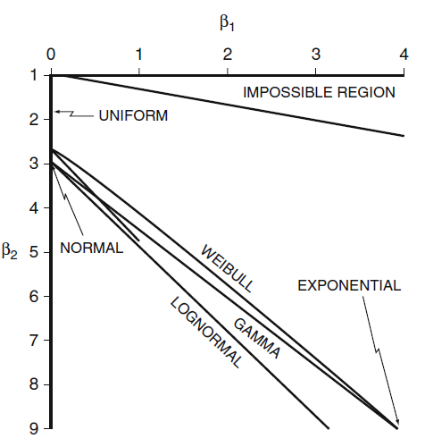
Modelling diameter distributions:
Selecting a distribution function
  - The Johnson’s S_{B} is a system of distributions based on transformations of a standard normal. This system consists of three distributions S_{B}, S_{L} and S_{U}
    S_{L} distribution – three parameter lognormal distribution with one parameter being the lower limit
    S_{B} distribution – covers the region above the line defined by the S_{L}
    S_{U} distribution – covers the region below the line defined by the S_{L}
    It is very flexible and can take several shapes

Slide 29
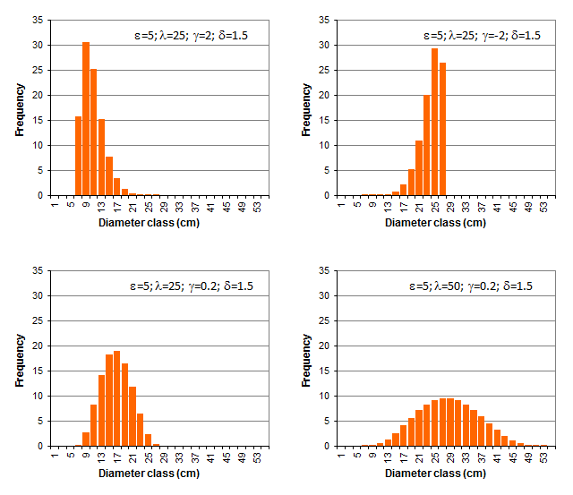
Modelling diameter distributions
Selecting a distribution function
  The Johnson’s S_{B} is a system of distributions based on transformations of a standard normal. This system consists of three distributions S_{B}, S_{L} and S_{U}
  Examples of the Johnson’s S_{B} distribution

Slide 30
Diameter-distribution models
Modelling diameter distributions:
  Methods for estimating the parameters of diameter distributions:
    When developing a diameter-distribution based yield model sample plot data for selected sample trees are required: age, total number of trees per ha, site index (or, equivalently, average dominant stand height, etc
    Parameter Prediction
      Data are then used to develop regression equations to predict the parameters, for example for 3-parameter Weibull
              a = f₁ (t, N, S) ; b = f₂ (t, N, S) ; c = f₃ (t, N, S)
        a = usually represents the minimum diameter of the stand
        b = usually represents an upper percentile (P₆₃, P₉₃)
        c = usually calculated after a and b are estimated

Slide 31
Diameter-distribution models
Modelling diameter distributions:
  Summarizing the idea behind diameter distribution models is:
    to estimate the distribution of trees by diameter classes (diameter distribution)
    Usually the simulation of diameter distribution implies the need to predict other variables, namely minimum diameter and some percentile in the upper part of the distribution
    to estimate stand volume (total and merchantable) from the diameter distribution, by using tree volume equations

Slide 32
Diameter-distribution models
Modelling diameter distributions:
  To start by simulating the growth of some variables (principal variables):
    dominant height
    number of trees per ha
    stand basal area
    some variables characterizing the diameter distribution such as:
      the minimum diameter,
      some percentile of the diameter distribution or the variance of diameters (depending on the pdf used for diameter distribution)

Slide 33
Diameter-distribution models
Exercise:
Implement the 3-parameters Weibull distribution in EXCEL in order to distribute a total of 100 trees ha-1 according to the following parameter combinations:
Consider the following diameter intervals:
a | b | c
2 | 9 | 1.5
2 | 9 | 3.6
2 | 18 | 7
2 | 5 | 1

