Slide 1
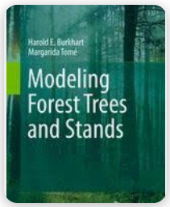
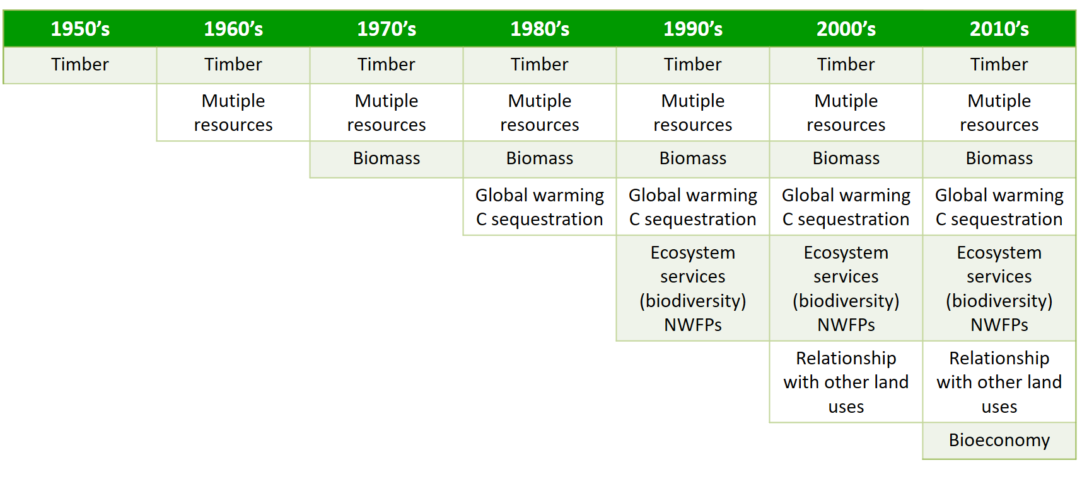
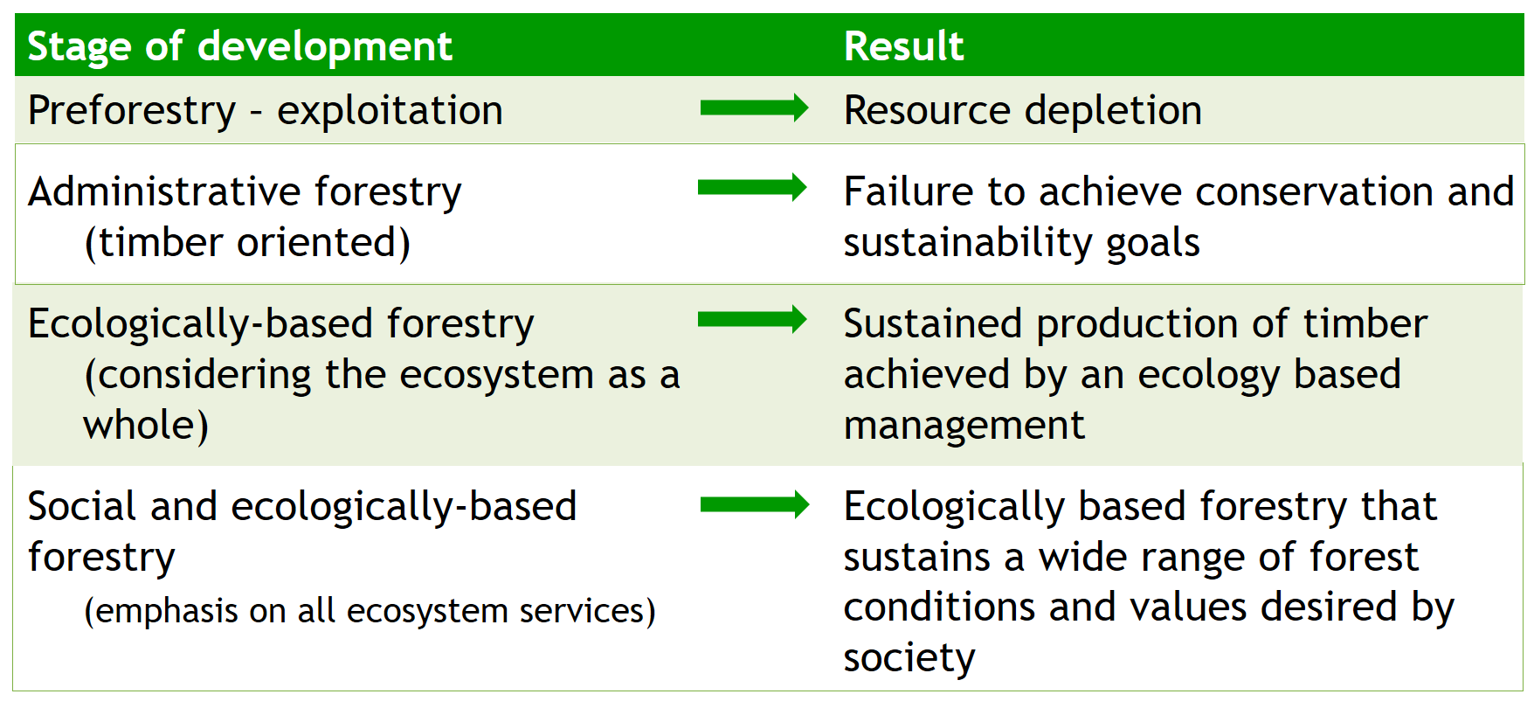
Estimating tree volumes and stand yields has a long history in forestry, starting with tabulations and progressing to use of advanced statistical analyses and electronic computers for implementation
Evolution of management goals
Evolution of Forestry

Slide 2
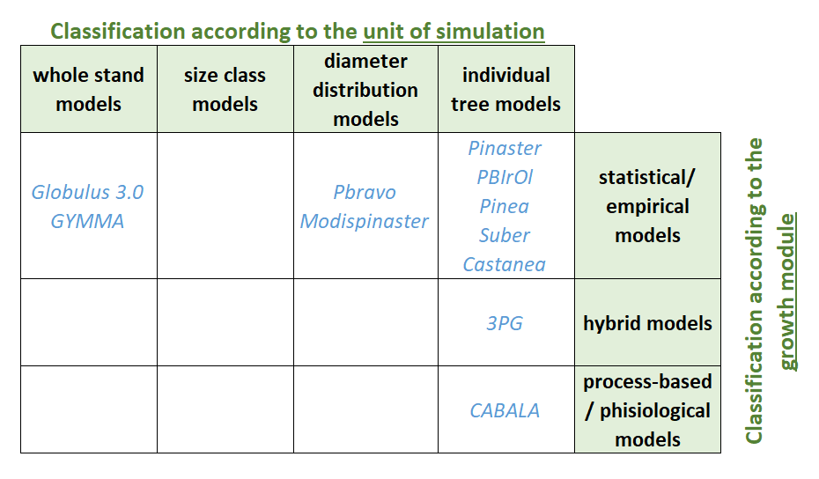
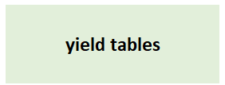
Estimating tree volumes and stand yields has a long history in forestry, starting with tabulations and progressing to use of advanced statistical analyses and electronic computers for implementation

Slide 3
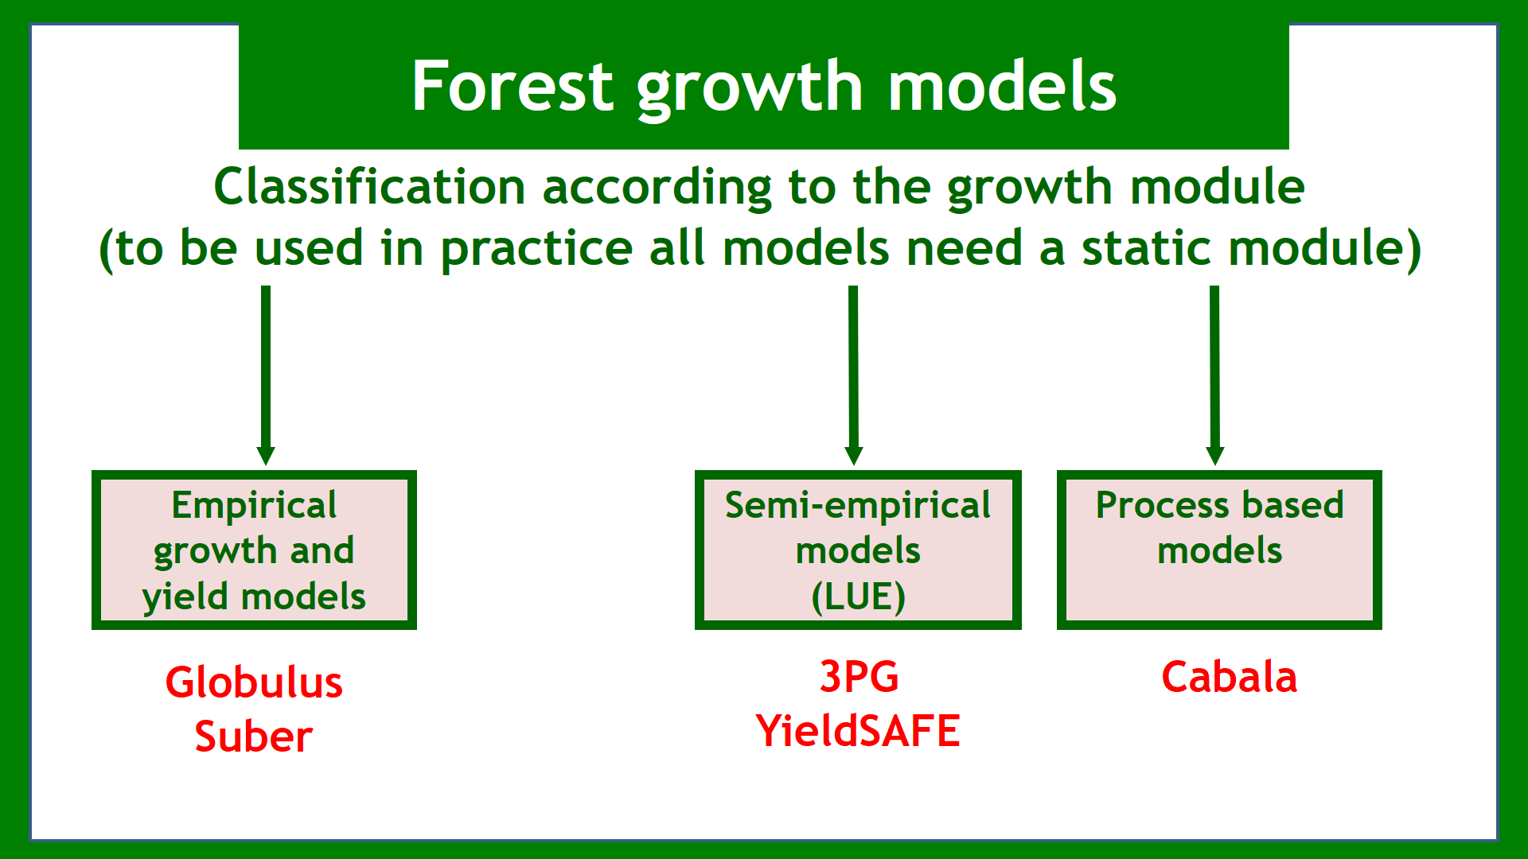
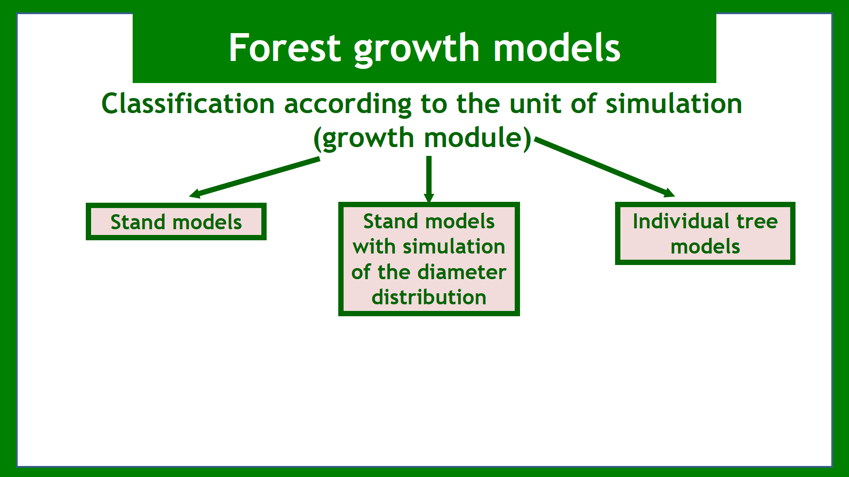
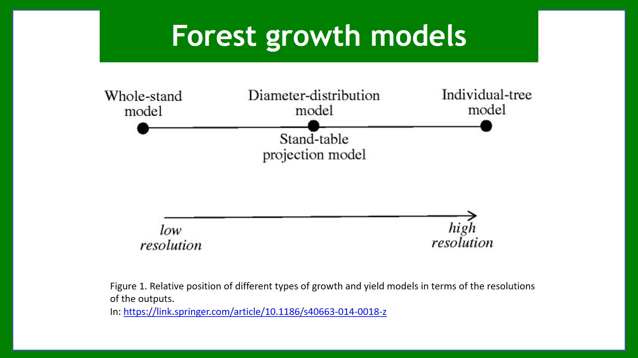
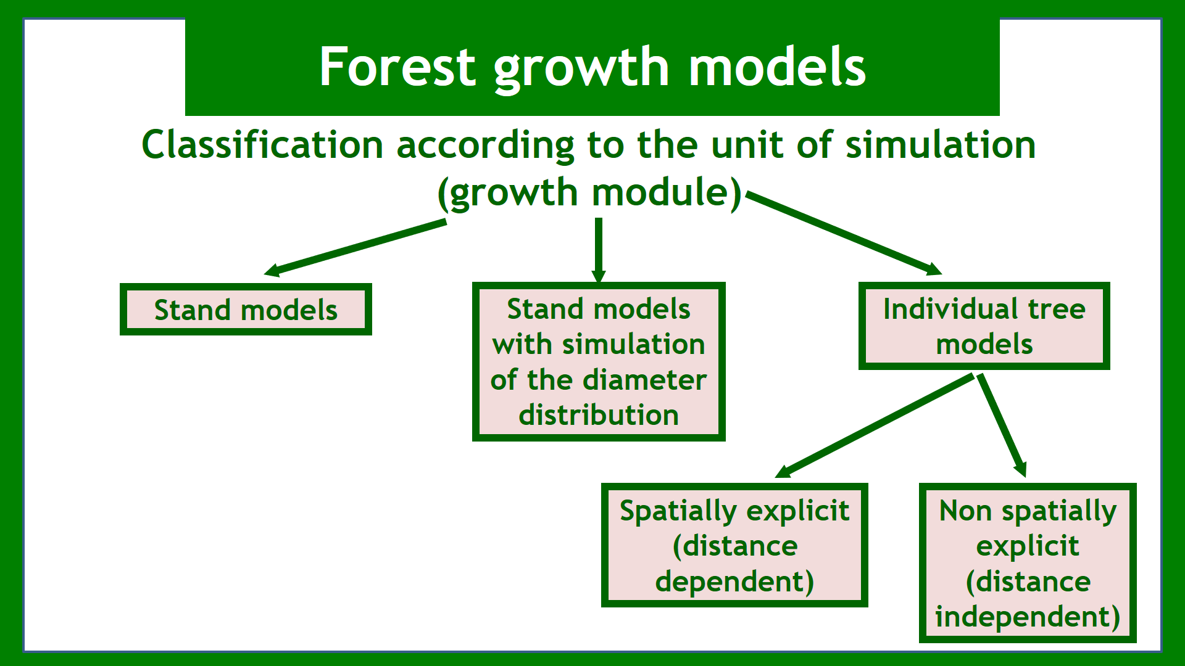

Slide 4

Estimating tree volumes and stand yields has a long history in forestry, starting with tabulations and progressing to use of advanced statistical analyses and electronic computers for implementation
The majority of the models /projection systems have been developed for even-aged stands

Slide 5
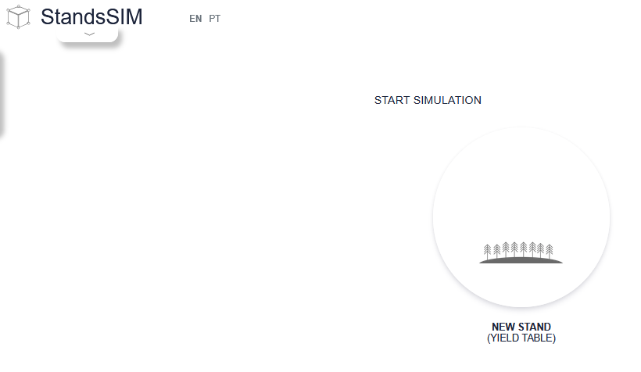
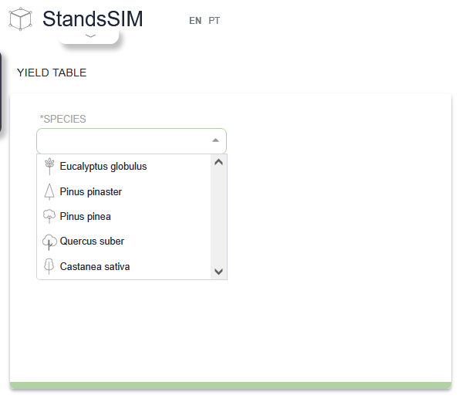
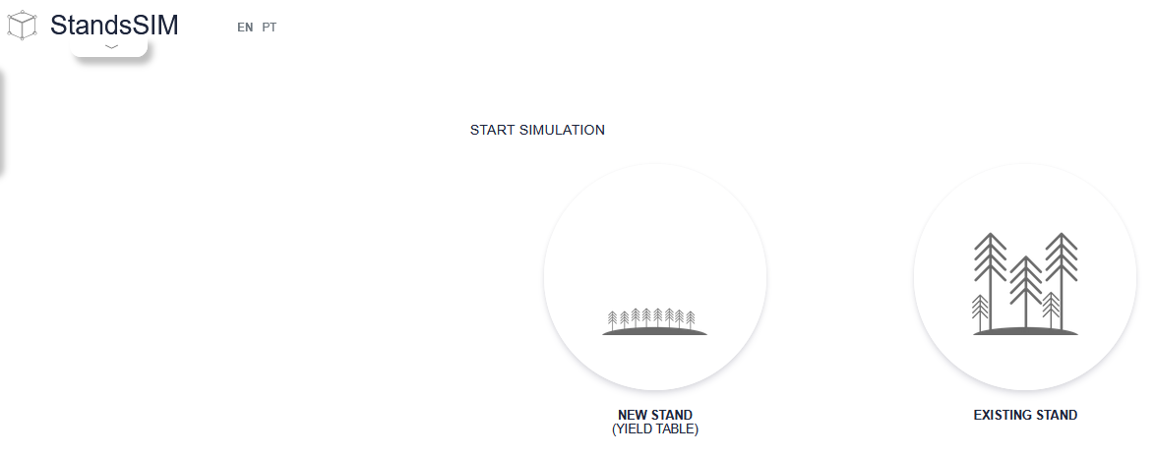
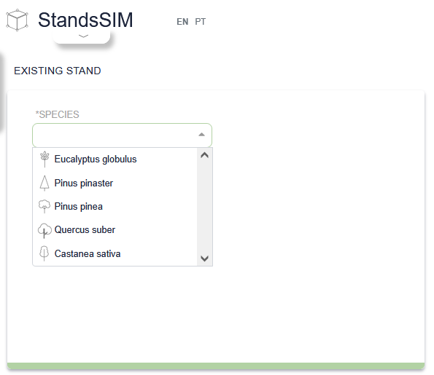
Estimating tree volumes and stand yields has a long history in forestry, starting with tabulations and progressing to use of advanced statistical analyses and electronic computers for implementation

Slide 6
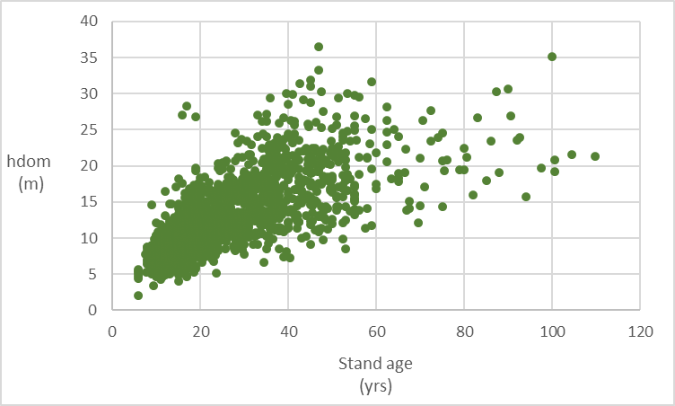
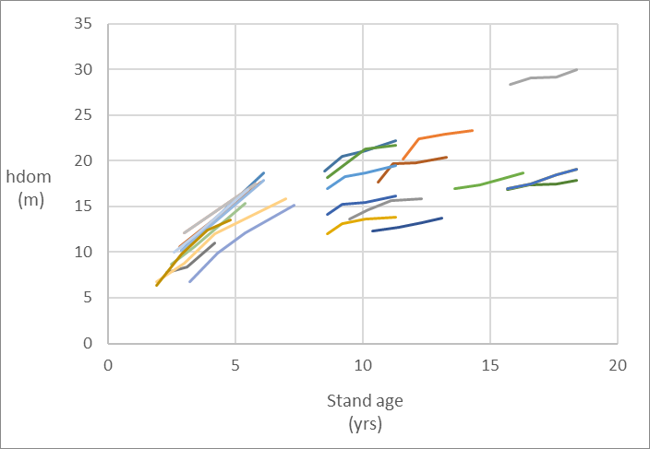
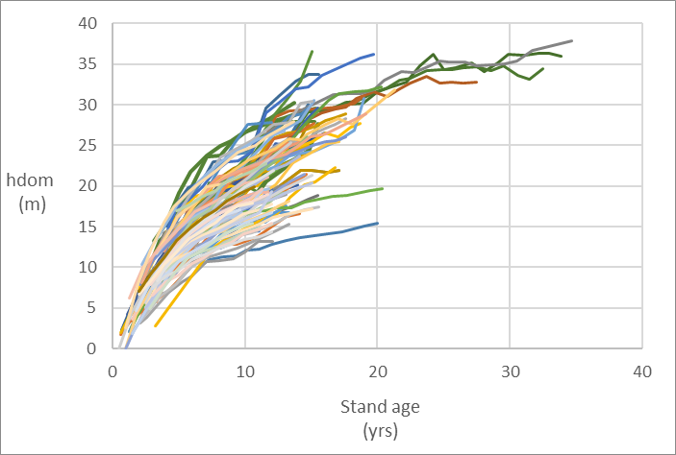
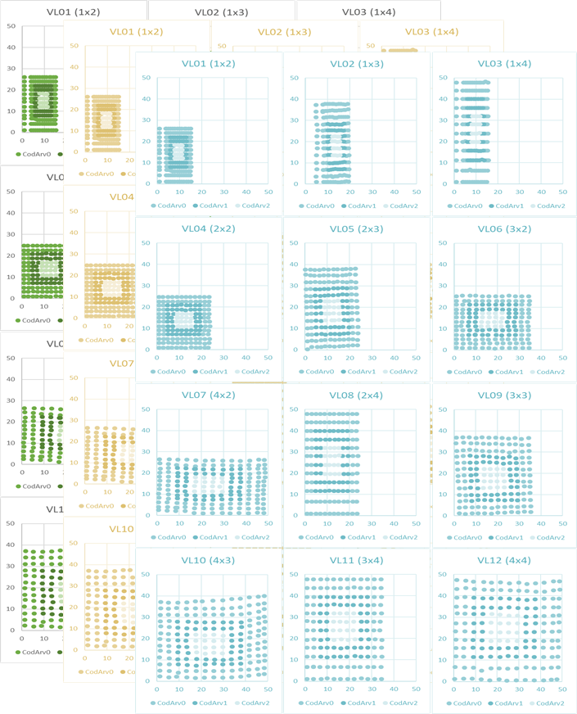
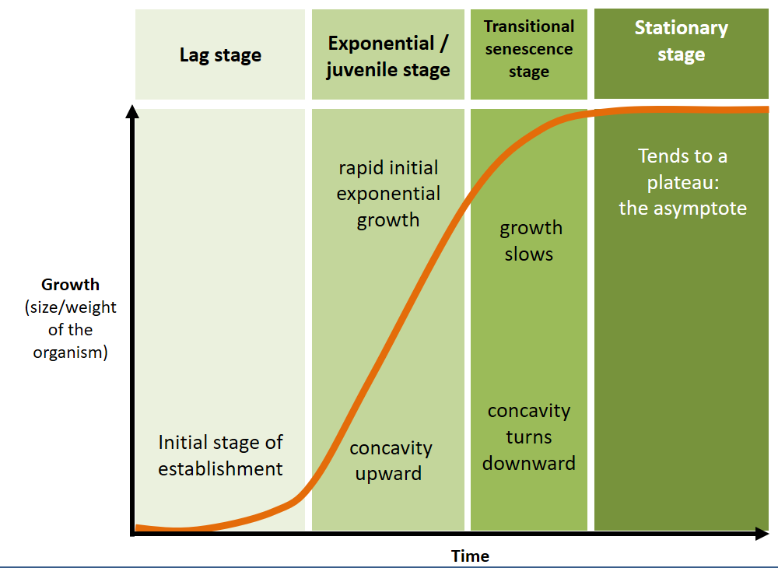
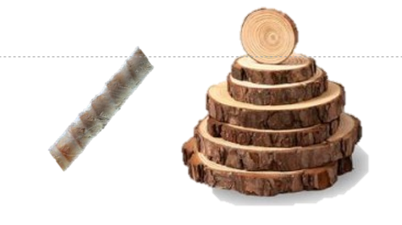
Sigmoid curve
Stem analysis
total/partial
Temporary plots
Interval plots
Permanent plots
Experimental trials
TEMPORARY PLOT DATA was used to:
develop normal yield tables for even-aged stands:
1st - identification and selection of fully stocked or “normal” density plots for varying ages representing various site qualities;
2nd - plots were grouped in site-quality classes and volume per unit area values were plotted over age resulting in a volume-age curve using graphical techniques (which only allowed considering 2 variables and holding density constant at fully stocked or “normal” levels);
3rd - volumes were read from the curve for a given selected site-quality and age to compile a normal yield table (such tables may also other variables G, N and diameter distributions);
develop empirical yield tables (similar to the previous, but with a different 1st step):
1st - selection of average stocked plots (avoids having to find fully stocked plots, but can only be applied to average densities at most thinned and unthinned stands can be distinguished);
develop variable-density yield tables include density as a dynamic part of the stand projection system (equations that use whole-stand values as the basic modeling unit)

