Slide 1
Forest production and site productivity management
Examples with eucalyptus

Slide 2
Summary
Potential and Actual productivity of a site
Limiting factors – altering productivity
  Climate
  Soil
  Genetics
  Management
Examples management of forest productivity
  Alto do Vilão Trial – spacing
  Optimization Trial – fertilization and irrigation
  Agolada Trial – spacing and genetic material

Slide 3
Site productivity
Site productivity may be defined as:
  the potential net primary production (NPP) of biomass
  the accumulation of biomass/unit area/unit time
It includes accumulation of tree biomass as well as all other plant and animal life in the site
The potential production is achieved when the stand attains the maximum leaf area
Complex systems
NPP is distributed among the different species present in the system
Simple systems
NPP can focus on the desired species as well as in the desired product

Slide 4
Site productivity – potential productivity
Soil and climate determine the limits to the potential productivity of a site (PPS)
Genetic potential (species and genetic material) determine the biological limits of PPS
Management (spacing, weed control) determine to which point is the PPS attained. Management may also, obviously, change PPS (e.g. fertilization and/or irrigation, species choices)
A site’s maximum leaf area capacity may take more or less time to be achieved as a consequence of management and genetic potential

Slide 5
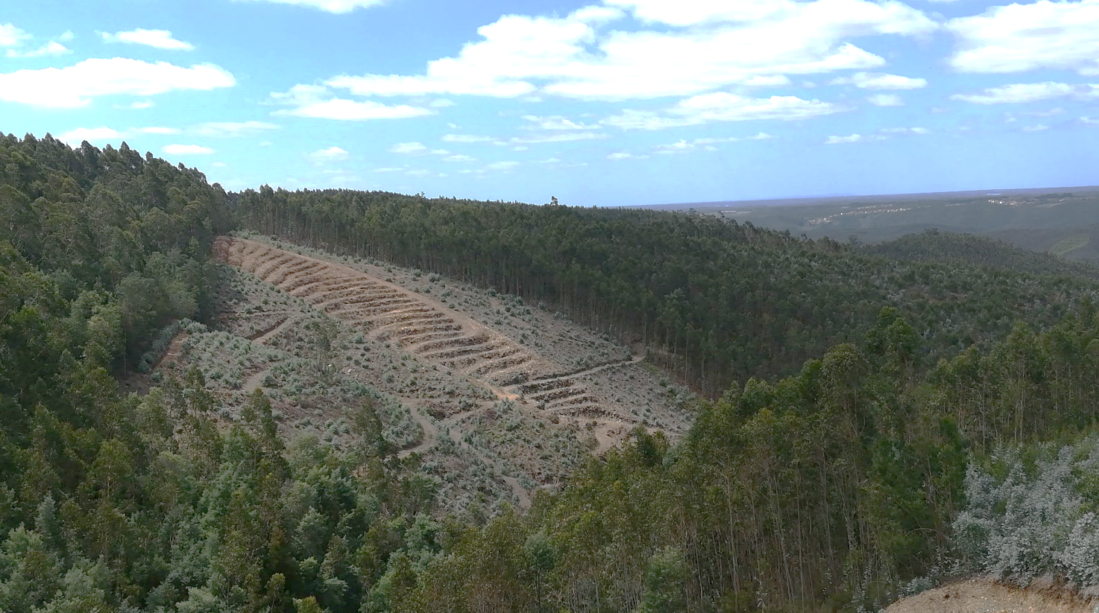
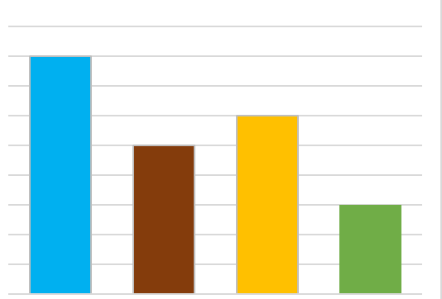
Site productivity actual and potential productivity
Site productivity is affected by:
- Climate
- Soil
- Genetics
Potential
climate
soil
genetics
Adapted from Powers, 1999

Slide 6
Site productivity actual and potential productivity
Site productivity limited by stocking
(potential is never reached)
Potential
Actual
climate
soil
genetics
stocking
Adapted from Powers, 1999

Slide 7
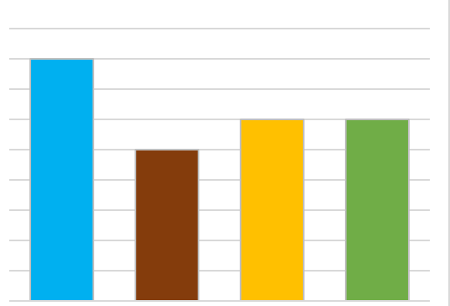
Site productivity actual and potential productivity
Improving stocking, productivity is increased up to the level constrained by the soil
(potential is reached)
Potential
= Actual
climate
soil
genetics
stocking
Adapted from Powers, 1999

Slide 8
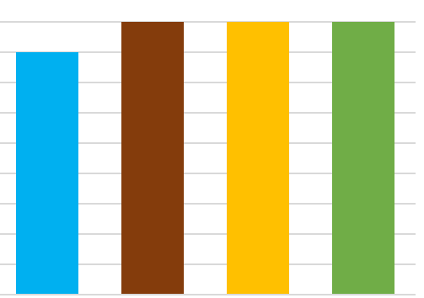
Site productivity actual and potential productivity
Soil amelioration (fertilization), genetics and stocking improved, productivity raises to a new potential (limited by climate)
Potential
= Actual
climate
soil
genetics
stocking
Adapted from Powers, 1999

Slide 9
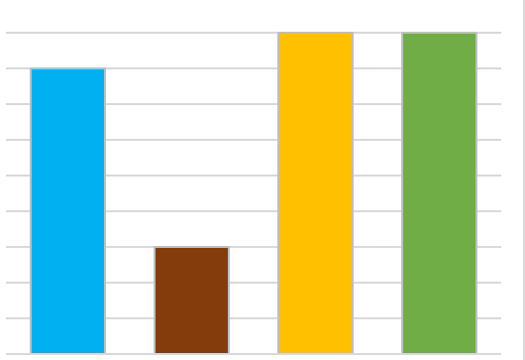
Site productivity actual and potential productivity
If soil is degraded, productivity drops
(new potential is set by the soil)
climate
soil
Potential
= Actual
genetics
stocking
Adapted from Powers, 1999

Slide 10
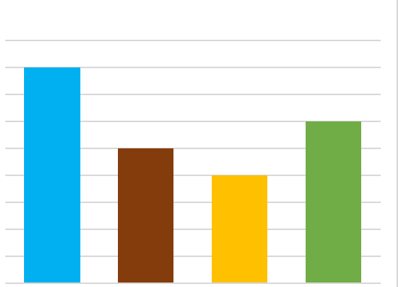
Site productivity actual and potential productivity
Unless genetics can substantially change leaf area or improve photosynthetic efficiency, genetic improvement merely gets the plantation to the site limit faster
(potential limited by soil)
Potential
Actual
climate
soil
genetics
stocking
Adapted from Powers, 1999

Slide 11
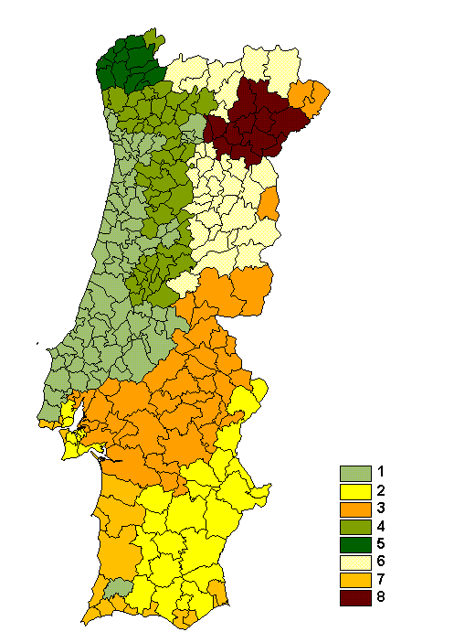
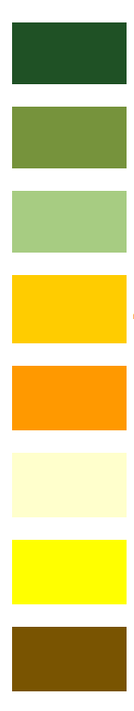
Site productivity - Portugal influence of climate in E. globulus plantations
Climatic classification of Portugal - 8 regions
1 North Litoral
2 North/Centre Litoral
3 Centre Litoral
4 South Litoral
5 Tagus Valley
6 North Interior
7 South Interior
8 Douro valley

Slide 12
Site productivity - Portugal influence of climate in E. globulus plantations
Climatic classification of Portugal - 8 regions

Slide 13
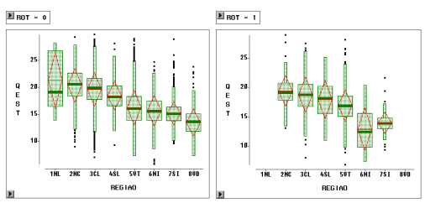
Site productivity - Portugal influence of climate in E. globulus plantations
Yield (site index, base age 10) in the 8 regions
1st rotation
1st rotation
Coppiced stands
coppice
40 m³ha⁻¹yr⁻¹
3 m³ha⁻¹yr⁻¹

Slide 14
Site productivity - Portugal influence of microsite in E. globulus plantations
Yield for plots located in the same farm
Npl 1200

Slide 15
Management of forest productivity and stand production
EXAMPLES

Slide 16
Management of site productivity and stand production
Foresters can manipulate tree growth by modifying the growing environment in order to optimize the quantity and quality of the desired product
Modifications may include
  management of site potential productivity
  use of appropriate genetic material (e.g. choice of tree species)
  appropriate silvicultural practices
The success of such manipulation depends of course of a thorough knowledge of the processes that drive tree growth

Slide 17
ALTO DO VILÃO trial spacing

Slide 18
Research team
(CELBI, ISA)
Margarida Tomé, Paula Soares (ISA)
Luís Leal, João P. Pina, C. Araújo (CELBI)

Slide 19
Alto do Vilão trial
Main objective
  Evaluate the impact of initial spacing on Eucalyptus globulus production
through
  The installation of a trial with different spacings
  Annual monitorization of the trial to measure plant growth
Plantation date
  March 1975
Location
  Near to Óbidos, centre of Portugal, 10 km from Atlantic Ocean, elevation of 30 m
Climate
  Mean annual temperature: 15.2 ºC
  Mean annual precipitation: 607 mm
  Frost occurrence: not frequent
  Dry season: June to September
  Fog during summer, attenuating the effect of drought

Slide 20
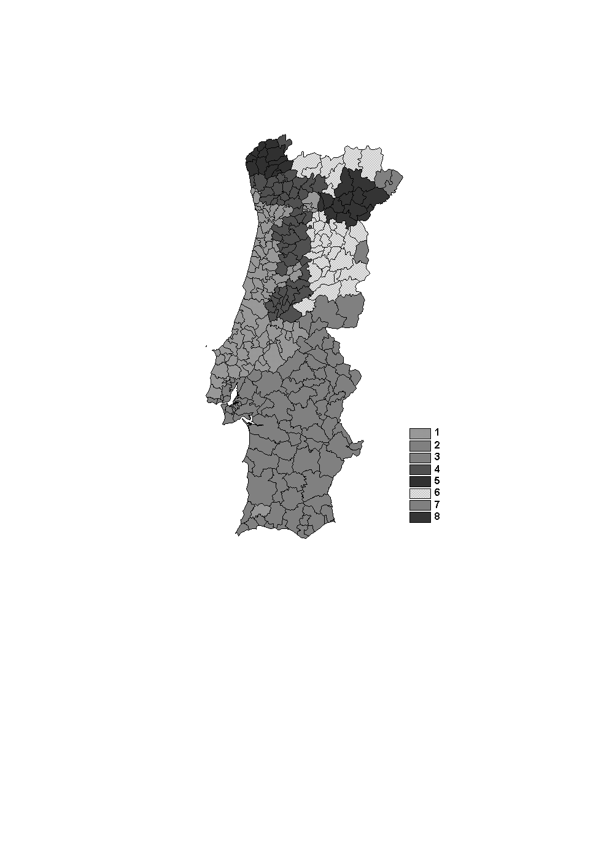
Alto do Vilão trial
Genetic material
  Seedlings
Fertilization at planting
  Commercial fertilizer
Productivity
  According to the climate classification of Portugal of Ribeiro and Tomé (2000) it belongs to the “Centro Litoral” (CL) region
  Site index (base age 10) is between 21 and 24, close to the 99% percentile for the region

Slide 21
Alto do Vilão trial
Site index “location” within the CL region

Slide 22
Alto do Vilão trial
Plot number spacing N
AV09 5x4 21
Experimental design
map of the trial
AV07 4x4 21
AV02 3x2 21
AV05 4x3 22
AV04 3x3 22
productivity
spacing
spacing
AV06 4x3 23
productivity
AV03 3x3 22
AV08 4x4 22
AV01 3x2 22
Block 1
AV10 5x4 24
Block 2

Slide 23
Alto do Vilão trial dominant height in the trial “over” permanent plots 3x3 (x)
Some results

Slide 24
Alto do Vilão trial quadratic mean diameter in the trail “over” permanent plots 3x3 (x)
Some results

Slide 25
Alto do Vilão trial basal area in the trial “over” permanent plots 3x3 (x)
Some results

Slide 26
Alto do Vilão trial volume in the trial “over” permanent plots 3x3 (x)
Some results
Notes:
We have EPEs 3x3 with higher volumes than in our 3x3 trial, thus the trial site has its productivity constrained by soil and or climate

Slide 27
Alto do Vilão trial mai in volume in the trial “over” permanent plots 3x3 (x)
Some results

Slide 28
Optimization of site productivity (and consequently stand production) fertilization and irrigation

Slide 29
Research team
(CELBI, Univ. Uppsala, ISA)
Coordination:
João S.Pereira, Sune Linder (physiology)
M. Madeira, A. Fabião, T. Ericsson (soils)
Margarida Tomé, Clara Araújo (biometry)

Slide 30
Manipulation of site productivity/stand production
Main objective
  Evaluate the effect of optimum availability of water and nutrients in Eucalyptus globulus productivity to establish the limits of biomass production in the Atlantic areas with Mediterranean influence
Through
  The establishment of a trial with different treatments of irrigation and fertilization
  Intensive monitorization of the trials, including climate, plant growth, physiological parameters, nutrients in the soil and in the plant, etc
Location
  Close to Óbidos, centre of Portugal, 10 km from the Atlantic Ocean, elevation of 30 m
Climate
  Mean annual temperature: 15.2 ºC
  Mean annual precipitation: 607 mm
  Frost occurrence: not frequent
  Dry season: June to September
  Fog during summer, attenuating the effect of drought
Plantation date
  March 1986

Slide 31
Manipulation of site productivity/stand production
Soil
  Spodosols (FAO/UNESCO, 1994)
  Sandy texture with a low amount of clay to 170 cm of depth, except in a small part of the trial where slightly higher clay content could be observed from 90 cm
  Low organic matter content (0.4 a 0.5 %) at planting
Site preparation
  ploughing till 80 cm of depth
Spacing at planting
  Spacing of 3x3 m in the main plot (no harvest of trees) and of 1.5x1.5 m in the plot for destructive sampling, thinned at the age of 2 years to 3x3 m
Genetic material
  Seedlings (genetically improved)
Fertilization at planting
  Commercial fertilizer (31 kg ha⁻¹ N, 42 kg ha⁻¹ K, 26 kg ha⁻¹ P) + 1.5 t ha⁻¹ of dolomitic calcarium (66.5% de Ca CO₃, 32.5% de Ng CO₃)
Productivity
  According to the climatic classification of Portugal by Ribeiro e Tomé (2000) the trial is located in the “Centro Litoral” (CL) region
  Site index in the control plots is 23.2 and 24.6, respectively in blocks 1 and 2, close to the 99% percentile for the region

Slide 32
Manipulation of site productivity/stand production
Site index of the trial within the CL region

Slide 33
Manipulation of site productivity/stand production
Experimental design - treatments
  Control:
    No irrigation and just the “normal” fertilization at planting
  Solid fertilization:
    (N, P, K, Ca, Mg) applied in March and October of each year, with the amount estimated using the Ingestad’s theory
  Irrigation
    Drip irrigation between April and October in order to maintain water content at least at 80% of field capacity
  Irrigation + fertilization:
    Irrigation as in the irrigation treatment + weekly application of liquid fertilizer jointly with the irrigation
Experimental design - design
  Complete randomized blocks with 2 replicates
  Each main plot includes 121 (11x11) trees, plus a border line (area: 1089 m²)
  Contiguous to each plot a smaller plot was established for destructive samplings, initially with a 1.5x1.5 m spacing, later reduced to a 3x3 m spacing and receiving the same treatment
  The total area of the trial was approximately 1 ha

Slide 34
Optimization of productivity trial dominant height in the trial “over” permanent plots 3x3 (x)
Manipulation of site productivity/stand production
Some results
Permanent plots
Irrig + fertiliz
Irrig
Fertiliz
Control

Slide 35
Manipulation of productivity trial quadratic mean diameter in the trial “over” permanent plots 3x3 (x)
Manipulation of site productivity/stand production
Some results
Permanent plots
Irrig + fertiliz
Irrig
Fertiliz
Control

Slide 36
Optimization of productivity trial basal area in the trial “over” permanent plots 3x3 (x)
Manipulation of site productivity/stand production
Some results
Permanent plots
Irrig + fertiliz
Irrig
Fertiliz
Control

Slide 37
Optimization of productivity trial volume in the trial “over” permanent plots 3x3 (x)
Manipulation of site productivity/stand production
Some results
Permanent plots
Irrig + fertiliz
Irrig
Fertiliz
Control

Slide 38
Optimization of productivity trial mai in volume in the trial “over” permanent plots 3x3 (x)
Manipulation of site productivity/stand production
Some results
Permanent plots
Irrig + fertiliz
Irrig
Fertiliz
Control

Slide 39
Optimization of productivity trial biomass in the trial “over” permanent plots 3x3 (x)
Manipulation of site productivity/stand production
Some results
Permanent plots
Irrig + fertiliz
Irrig
Fertiliz
Control

Slide 40
AGOLADA trial spacing and genetic material

Slide 41
Research team
Coordination:
Carlos Arruda Pacheco (soil)
José A. Tomé (physiology)
Margarida Tomé (biometry)

Slide 42
Agolada trial
Manipulation of site productivity/stand production
Main objective
  Contribute to the understanding of water and nutrients use by Eucalyptus globulus and its relationship with biomass growth and yield
through
  The establishment of trials with variability in terms of water and nutrients availability and stand density
  Intensive monitoring of these trials including climate, plant growth, physiological parameters, available soil water, nutrients content in the soil and the plant, etc
Location
  5 km from Coruche, within an eucalyptus management area with ≅ 600 ha
Climate
  Mean annual temperature: 21.5 ºC
  Mean annual precipitation: 737 mm
  Dry season: May to October
  Low relative humidity in summer, corresponding to high levels of evapotranspiration (annual average is 79%, 90% in winter and 70% during the dry period)
  High insolation values, achieving 2900 horas per year, 67% of light hours

Slide 43
Agolada trial
Manipulation of site productivity/stand production
Soil
  Ludvic Arenosols (FAO/UNESCO, 1994)
  Sandy layers in combination with layers with some clay and loam, with a high % of quartz gross elements
  These layers cover compact sandstone rock sometimes strongly cemented by iron oxides, with ca. 3% of clay, 30% of elements with diameter > 2 mm and ≅ 65% of coarse sand
Previous soil use
  Eucalyptus plantation in a 6th (?) cutting cycle
Site preparation
  Similar to the one selected by PORTUCEL for the stand in which the trial is included
  Harvest and extraction of the previous stand, extraction, gathering and burning of the stumps
  Ripping till 0.8 to 0.9 m (distance between tooth ripper of 0.7 m), followed by harrowing
Date of planting
  November 1994
Other silvicultural operations in the trial
  Weed control by the end of summer 1995 and 1996 (if needed)

Slide 44
Agolada trial
Manipulation of site productivity/stand production
Genetic material
  Three clones selected by PORTUCEL, Espirra, corresponding to different productions, coded as Cl1, Cl2 and Cl3
Fertilization at planting
  30 g of Osmocote 11+22+9+6 MgO per seedling
Productivity
  According to the climatic classification of Portugal by Ribeiro e Tomé (2000) the trial locates in the “Vale do Tejo” (VT) region

Slide 45
Agolada trial
Manipulation of site productivity/stand production
Site index of the trial within the VT region

Slide 46
Agolada trial
Manipulation of site productivity/stand production
Experimental design – treatments
  fertilization:
    Just at planting
    Additional fertilization with NPK (100:150:150) by the end of 1995
  Spacing at planting
  clones Cl1, Cl2 and Cl3
Experimental design – design
  split-split-plot with two replicates
  main treatment - fertilization
  treatment in the sub-plots – spacing at planting
  treatment in the sub-sub-plots - clone
  Each sub-sub-plot includes 35 (7x5) plants, just 15 (5x3) considered for intensive measurement (other are border trees)
  The area of the sub-sub-plots depends on the spacing at planting from 15 to 240 m²
  Total area of the trial is 2 ha
spacing
Trees ha⁻¹

Slide 47
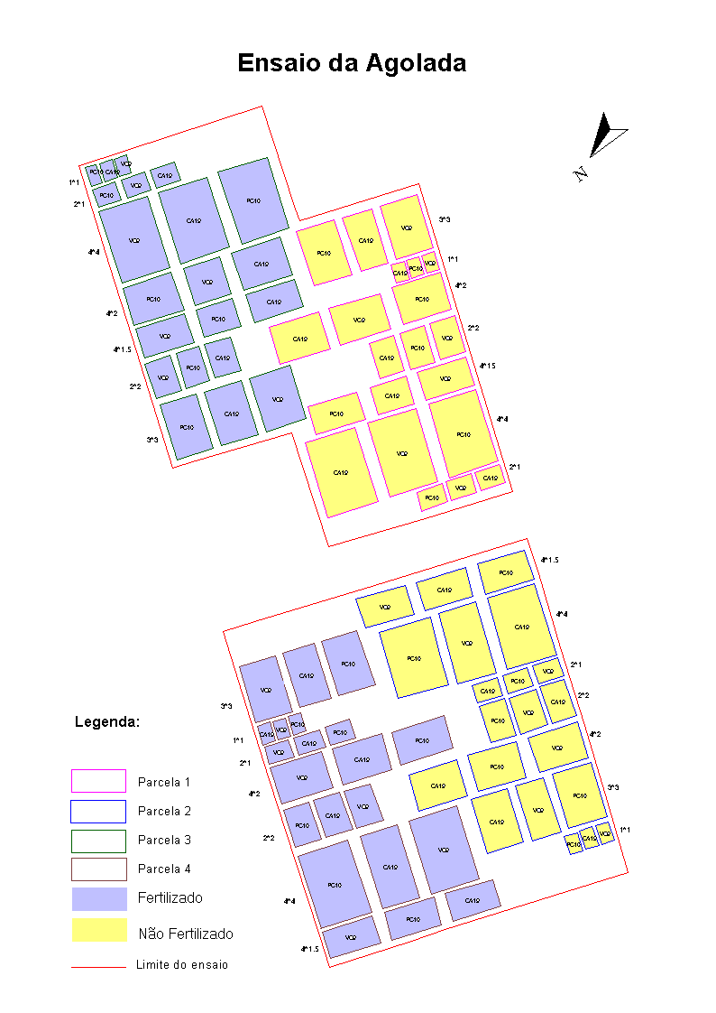
Agolada trial
Experimental design
map of the trial
Plot 1
Plot 3
Fertilization
No fertilization
Limite of the trial
Block 1

Slide 48
Agolada trial
Experimental design
map of the trial
Plot 1
Plot 3
Fertilization
No fertilization
Limite of the trial
Block 2

Slide 49
Agolada trial
Experimental design
detail of one plot

Slide 50
Agolada trial
Some results

Slide 51
Agolada trial quadratic mean diameter
Block 1 / plot 4
Clone 1
Clone 2
Clone 3

Slide 52
Agolada trial basal area
Block 1 / plot 4
Clone 1
Clone 2
Clone 3

Slide 53
Agolada trial volume
Block 1 / plot 4
Clone 1
Clone 2
Clone 3

Slide 54
Agolada trial biomass
Block 1 / plot 4
Clone 1
Clone 2
Clone 3
Clone 1
Clone 2
Clone 3

Slide 55
Some final comments
Productivity of eucalypt in Portugal may achieve very high values by optimizing all the factors that control PPS:
  Water and nutrients availability
  Genetic material
  Density at planting
  Weed control
Are we doing a good job?
Or is there still a “world” to explore?
Is it possible to produce more in the same area?

Slide 56
The end!!

