Slide 1
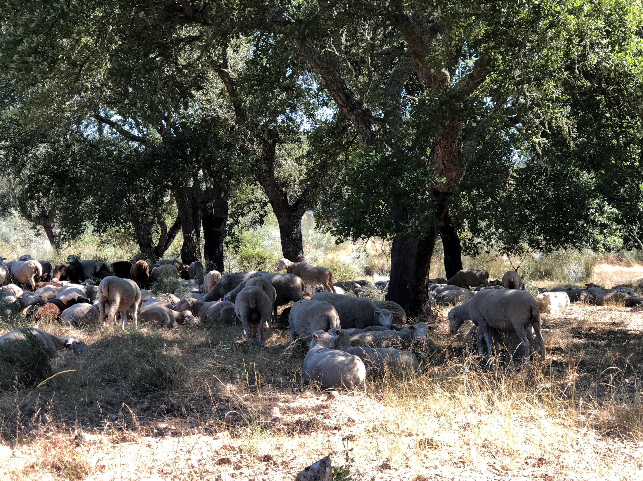
Whole stand models for even-aged stands
Margarida Tomé, Susana Barreiro
Instituto Superior de Agronomia
Universidade de Lisboa

Slide 2
Summary
Whole stand models for even-aged stands
State variables
Control variables
Stand density and stocking
Stand density measures:
Stand density index (SDI)
Crown competition factor (CCF)
Relative spacing (Wilson factor)
Spacing factor (Sf)
Crown cover (CC)
Growth and calculus modules
Site productivity
Silvicultural treatments and thinning

Slide 3
Whole stand models for even-aged stands

Slide 4
Whole stand models – state variables
In whole stand models the state variables are all defined at stand level:
Dominant height (hdom)
Number of trees per ha (N)
Basal area (G)
Volume (V) and merchantable volumes (Vdi or Vhi)
Biomass (W) and biomass per tree component (Wr, Ww, Wb, Wbr, Wl)
hdom, N and G are almost always principal variables, volume may be derived or not
Principal variables
Derived variables

Slide 5
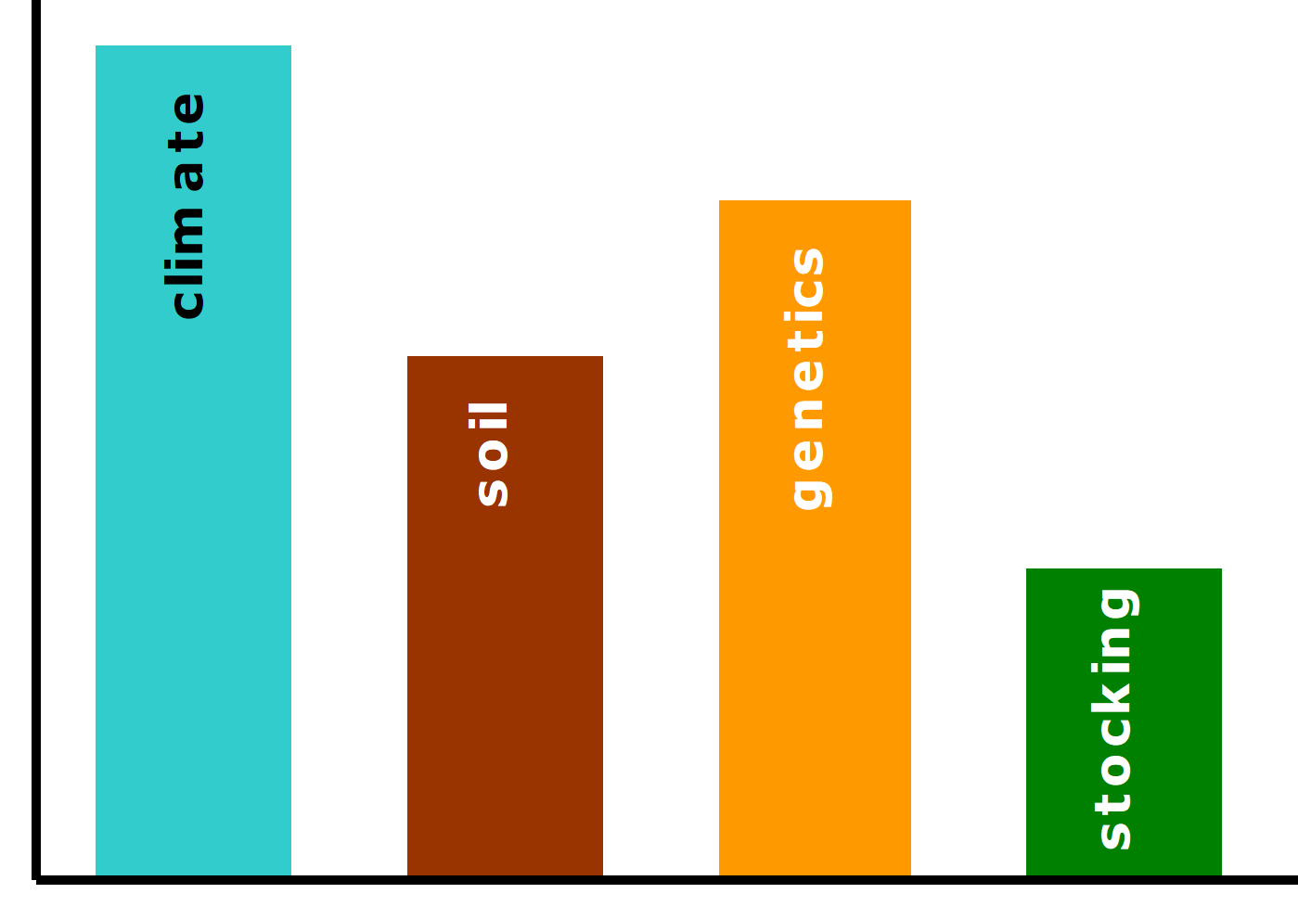
Whole stand models – control variables
The most important control variables are:
Site productivity (climate and soil), very often expressed as site index
Genetics
Application of fertilizers
Stocking control, either initial stand density and thinnings
Other silvicultural techniques (weeding, pruning, irrigation, etc)
Selection of quantitative measures of stand density is therefore an important step in forest models development and/or application

Slide 6
Stocking and stand density
Although stocking and stand density are terms that are often applied interchangeably in forestry use, the two terms are not synonymous
Stand density denotes a quantitative measurement of the stand (number of trees per hectare)
Stocking:
Stocking refers to the adequacy of a given stand density to meet some management objective (Bickford et al. 1957)
Stands may be referred to as “understocked”, “fully-stocked”, or overstocked
A stand that is “overstocked” for one management objective could be “understocked” for another

Slide 7
Quantifying stand density
Stand density is a quantitative term describing the degree of stem crowding within a stocked area and it can be expressed in:
Absolute measures of density are determined directly from a given stand without reference to any other stand:
Relative density is based on a selected standard density, usually the “fully-stocked” stand or the open-grown trees (the extremes):
Other stand density measures:
Relative spacing (FW)
Spacing factor (SF)
Percent crown cover (CC)
Basal area per ha
Number of trees per ha
Stand density index (SDI)
Crown competition factor (CCF)

Slide 8
Quantifying stand density
Stand density index (SDI) - Relative stand density measures
SDI evaluates stand density by comparing it with the maximum density for a stand with the same quadratic mean dbh (dg) – limiting situation or self-thinning line
For any given dg there is a limit to the number of trees per unit that can be carried
Reineke (1933) noted that for a variety of species the slope of the limiting line was approximately -1.6 on the log-log scale
Maritime pine data - PORTUGAL

Slide 9
Quantifying stand density
Stand density index (SDI) - Relative stand density measures
SDI is based on the evaluation of the difference between the number of trees in the stand and the maximum number of trees it could sustain according to the self-thinning line
SDI assumes that an understocked stand is located in a logN-logdg line parallel to the self-thinning line but with a smaller intercept
Maritime pine data - PORTUGAL

Slide 10
Quantifying stand density
Stand density index (SDI) - Relative stand density measures
The intercept for a stand can be obtained as
The index is “normalized” by using the dg=25 as a basis for comparison
ln
ln

Slide 11

Quantifying stand density
Stand density index (SDI) - Relative stand density measures
The expression for SDI in a particular stand is then obtained:
ln
ln
&

Slide 12
Quantifying stand density
Crown competition factor (CCF) - Relative stand density measures
CCF reflects the relationship between the area available for the average tree of the stand and the maximum area that the tree could use if it was growing in open space (open-grown tree)
The computation of CCF requires the study of the relationship between crown width of an open-grown tree (cw_{og}) and its dbh (d_{og}), usually linear:
The crown of an open-grown tree ocupies the area ca_{og}:
CCF is then computed as the sum of the ca_{og} values for all the trees in the stand, expressed as a percentage of the plot area:

Slide 13
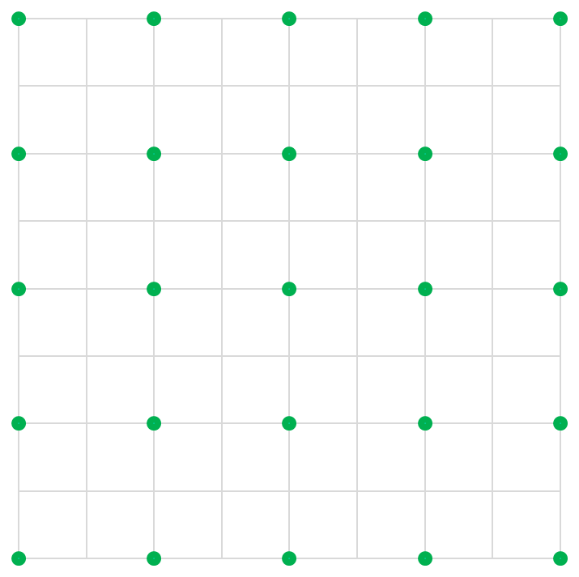
Quantifying stand density
Relative spacing (Rs)
RS is a stand density measure that relates the average distance between trees with the dominant height
It is based on the assumption that the stand density must decrease as the stand develops (the dominant height increases)
Assuming that the trees are regularly spaced, the area available per tree is:

Slide 14
Quantifying stand density
Relative spacing (Rs), Wilson factor (Fw)
Assuming that the trees are regularly spaced, the area available per tree is:
The relative spacing can be written in the form usually known as wilson factor

Slide 15
Quantifying stand density
Spacing factor (Sf)
Sf is a stand density measure that relates the average distance between trees to the crown width of the average tree:
If a regularly spaced stand is assumed, Sf comes as:

Slide 16
Quantifying stand density
Crown cover(Cc)
Crown cover (Cc) is a stand density measure that computes the percentage of area covered with crowns :

Slide 17
Whole stand models for even-aged stands (WSM-eas)
Site productivity
A system of site index curves is the most common way to express site productivity in WSM-eas
In species in which age is difficult to determine:
Site index may be assessed with a site prediction equation
Site productivity may be included in the several sub-models through climatic and soil variables

Slide 18
Whole stand models for even-aged stands (GLOBULUS 3.0)
Model Structure
Initialization Module
Control variables
Initialization
functions
Calculus Module
Growth Module
Initial values
for the state
variables at ti
Forest
Inventory
data
Other variables Calculus
Prediction
equations
i=i+1
Values of
the derived
variables at ti+1
N
Values of
the state
variables at ti+1
Y
end?
STOP

Slide 19
Whole stand models for even-aged stands (WSM-eas)
Growth modules
Growth modules refer to principal variables, the ones whose growth is predicted from one instante in time to the next by the model:
Direct prediction of growth
i_{X1-2} = f(S, t₁, t₂, SD₁)
X₂ = X₁+i_{X1-2}
Direct prediction of future value
SD2 = f(S, t₁, t₂, SD₁)
X₂ = f(S, t₁, t₂, X₁, SD₁, SD_{2,} other stand variables)
Notation
S = site index or site variables (climate and soil)
t_{i} = stand age at time t_{i}
X_{i} = principal stand variable X at time t_{i}
SD_{i} = stand density measure at time t_{i}
i_{X1-2} = growth of variable X in the period between t₁ and t₂
Y_{i} = derived stand variable Y at time t_{i}

Slide 20
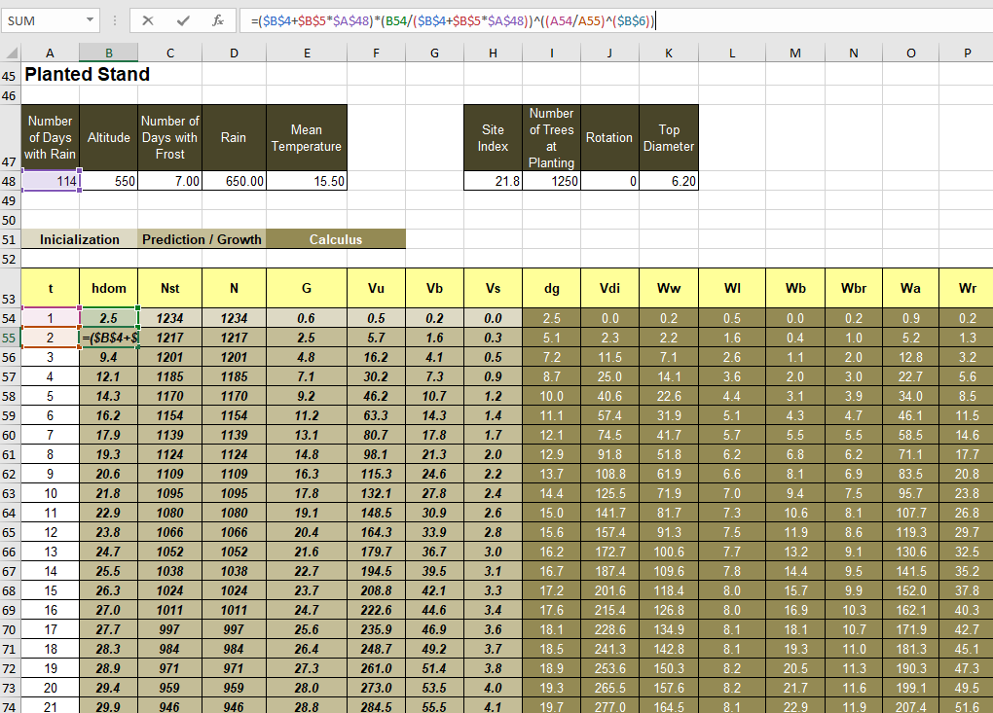
Whole stand models for even-aged stands (GLOBULUS 3.0)
Module Growth: hdom₂ = f (t₁, t₂, hdom₁, Rain)

Slide 21
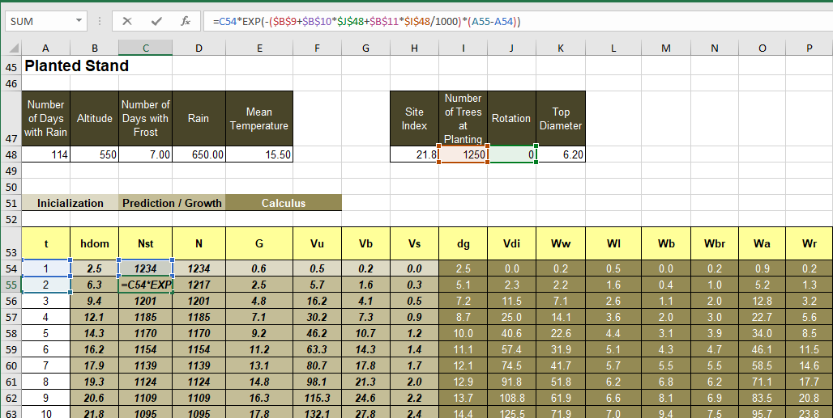
Whole stand models for even-aged stands (GLOBULUS 3.0)
Module Growth: Nst₂ = f (t₁, t₂, Nst₁, NPL, rotation)

Slide 22
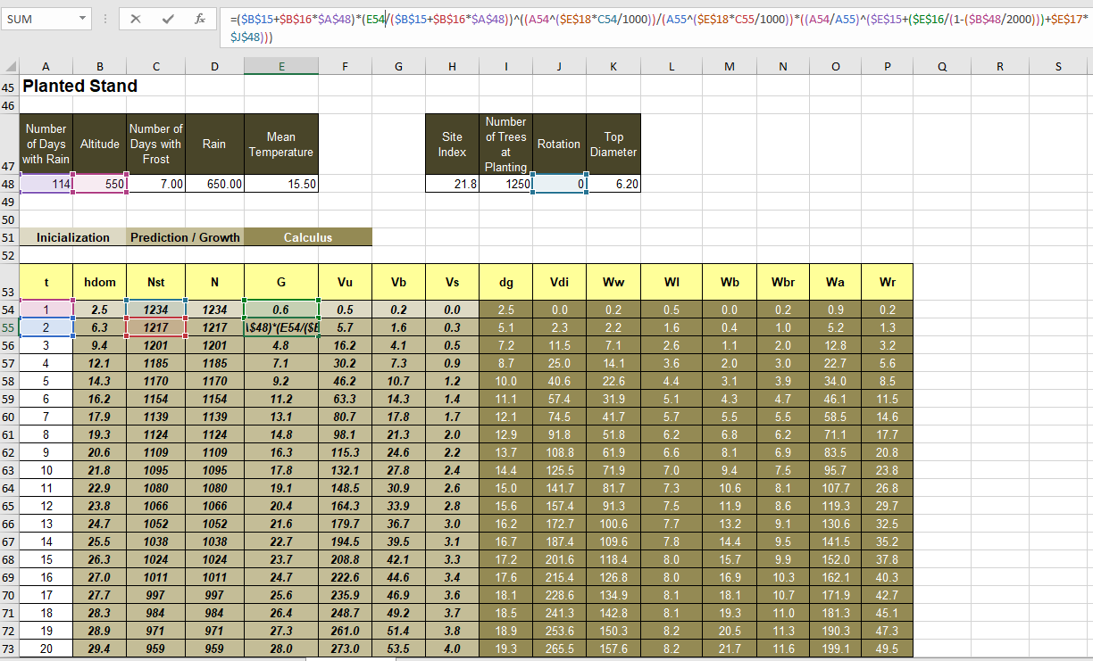
Whole stand models for even-aged stands (GLOBULUS 3.0)
Module Growth: G₂ = f (t₁, t₂, Nst₁, Nst₂, G₁, rotation, Rain, altitude)

Slide 23
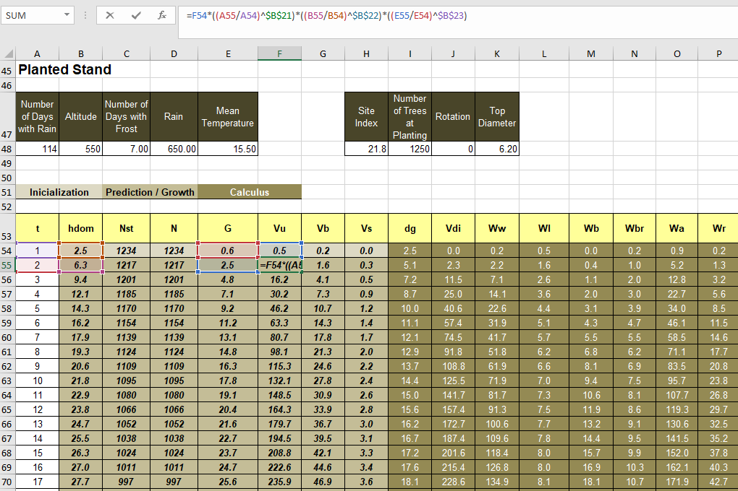
Whole stand models for even-aged stands (GLOBULUS 3.0)
Module Growth: Vu₂ = f (t₁, t₂, hdom₁, hdom₂, G_{1,} G₂, Vu₁)

Slide 24
Whole stand models for even-aged stands (WSM-eas)
Calculus module
Calculus modules refer to derived variables, the ones that are computed from other variables at the same point in time:
Computed variable:
Y₂ = f(S, t₂, SD_{2,} other stand variables)
Notation
S = site index or site variables (climate and soil)
t_{i} = stand age at time t_{i}
X_{i} = principal stand variable X at time t_{i}
SD_{i} = stand density measure at time t_{i}
i_{X1-2} = growth of variable X in the period between t₁ and t₂
Y_{i} = derived stand variable Y at time t_{i}

Slide 25
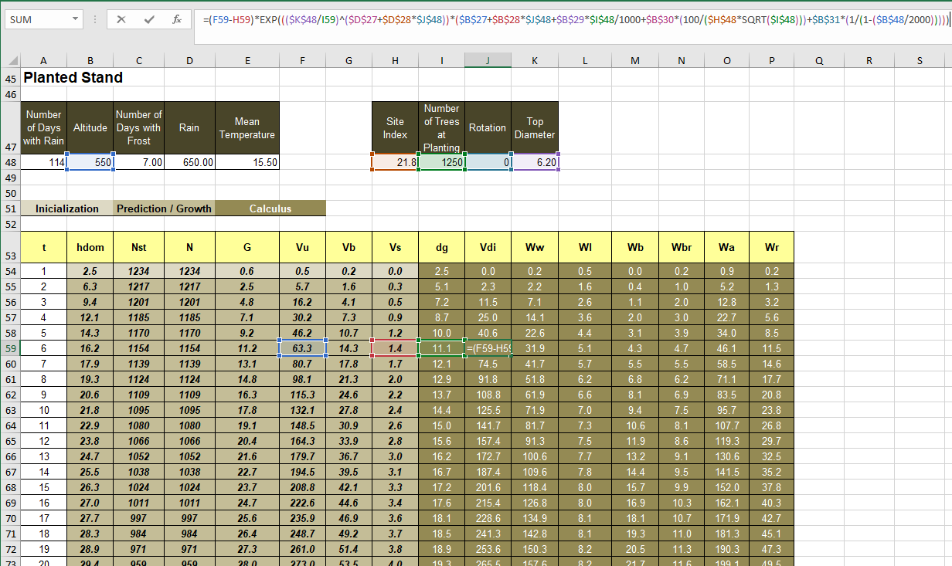
Whole stand models for even-aged stands (GLOBULUS 3.0)
Module calculus: Vdi = (Vu, Vs, dg, Altitude, S, NPL, top_diameter)
, G₂

Slide 26
Whole stand models for even-aged stands (GLOBULUS 3.0)
Module calculus: Vdi = (Vu, Vs, dg, Altitude, S, NPL, top_diameter)
, G₂

Slide 27
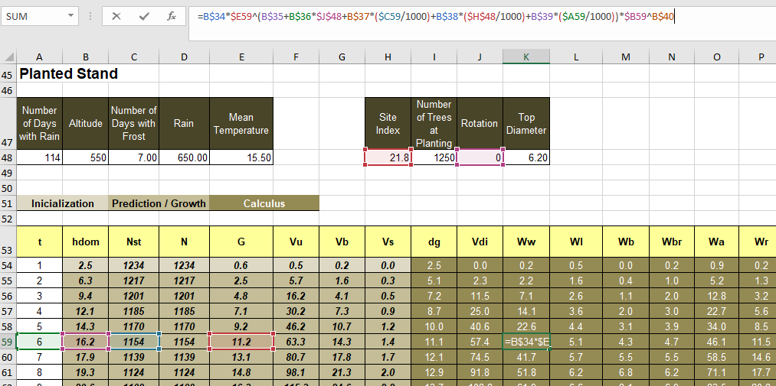
Whole stand models for even-aged stands (GLOBULUS 3.0)
Module calculus: Ww = (t, hdom, G, Nst, S, rotation)
, G₂

Slide 28
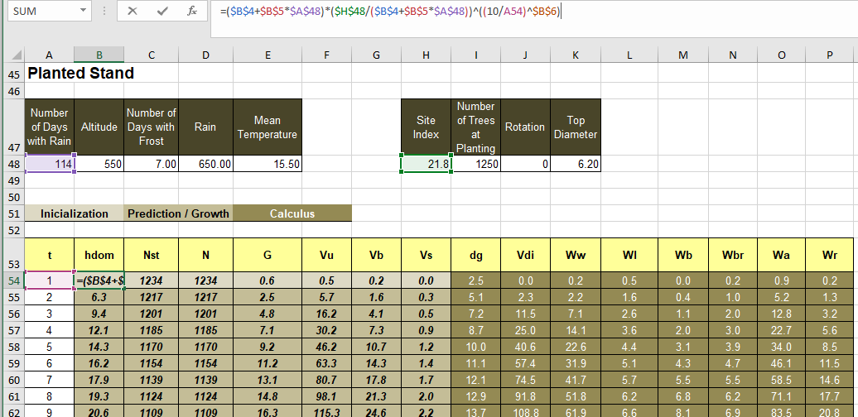
Whole stand models for even-aged stands (GLOBULUS 3.0)
Module inicialization: hdom = f( t, Rain, S)

Slide 29
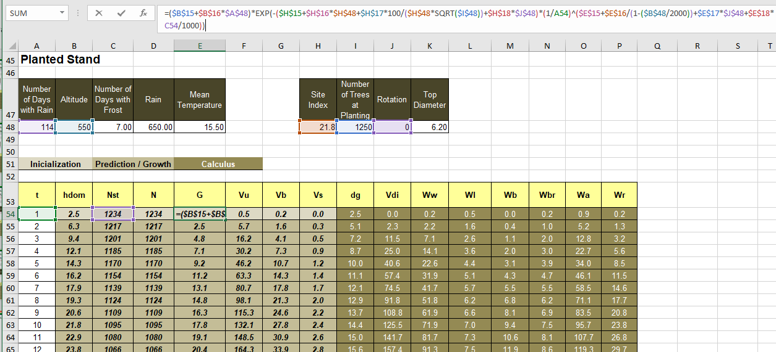
Whole stand models for even-aged stands (GLOBULUS 3.0)
Module initialization: G = f( t, Nst, Rain, Altitude, S, NPL, rotation)

Slide 30
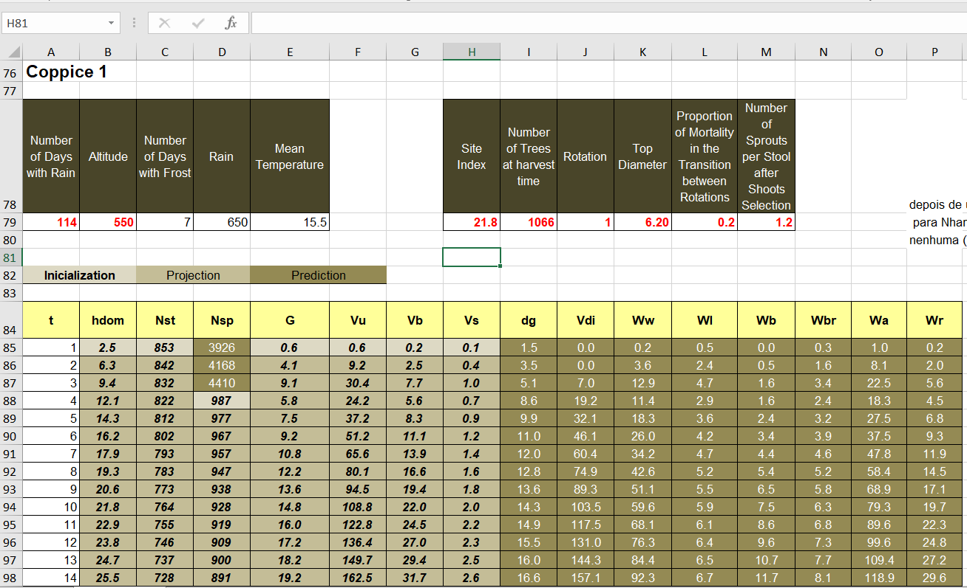
Whole stand models for even-aged stands (GLOBULUS 3.0)
Coppice – 2nd cycle

Slide 31
Whole stand models for even-aged stands (WSM-eas)
Stand response to silvicultural treatments
Including stand response to silvicultural treatments into forest models is crucial for the selection of the most efficient management
In spite of this importance, there is no established theory and the study of such models is usually made through examples
Some examples from Burkhart and Tomé (2012) are presented here as an illustration

Slide 32
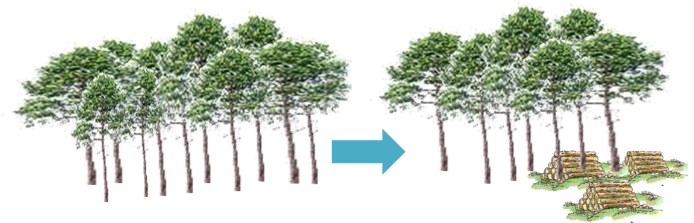
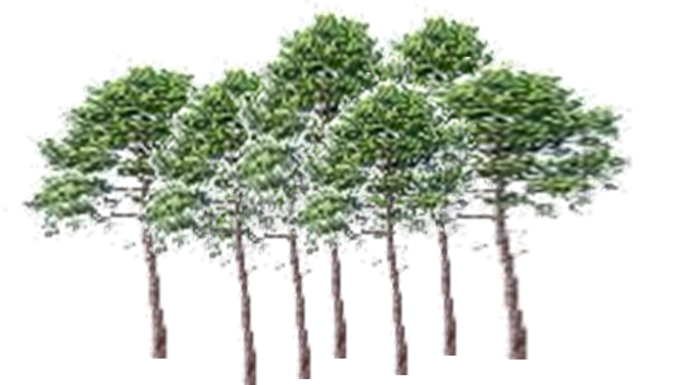
Whole stand models for even-aged stands (WSM-eas)
N_{at}
Stand response to thinning
Pienaar and Shiver (1986)
N_{t}
hdom, N, G
t_{t}
t
(present)
t_{t} = plantation age at last thinning
N = present number of trees per unit area
N_{t} = number of trees removed in last thinning
N_{at} = number of trees remaining after last thinning
G = basal area per unit area
t = plantation age
hdom = dominant height

Slide 33
Whole stand models for even-aged stands (WSM-eas)
Stand response to thinning
Pienaar and Shiver (1986)
The term (N_{t}t_{t}/N_{at}t) modifies the basal area of unthinned plantations of given age, stems per unit area, and average dominant height to predict the basal area for comparable thinned plantations
In the non-logarithmic form of the prediction equation, it is a multiplicative modifier theoretically between 0 and 1
For any given age, t, the earlier a thinning of given intensity (N_{t}/N_{at}) occurs, the larger (closer to 1) the modifier will be
If thinnings of different intensities occur the same time ago, so that (t_{t}/t) and N_{at} are the same, then the modifier will be larger for the less intensive thinning.

Slide 34
Whole stand models for even-aged stands (WSM-eas)
Stand response to thinning
Pienaar and Shiver (1986)
A basal area growth equation was derived from the previous equation

Slide 35
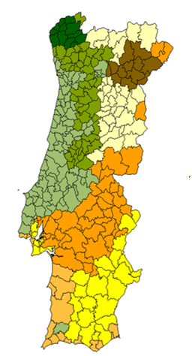


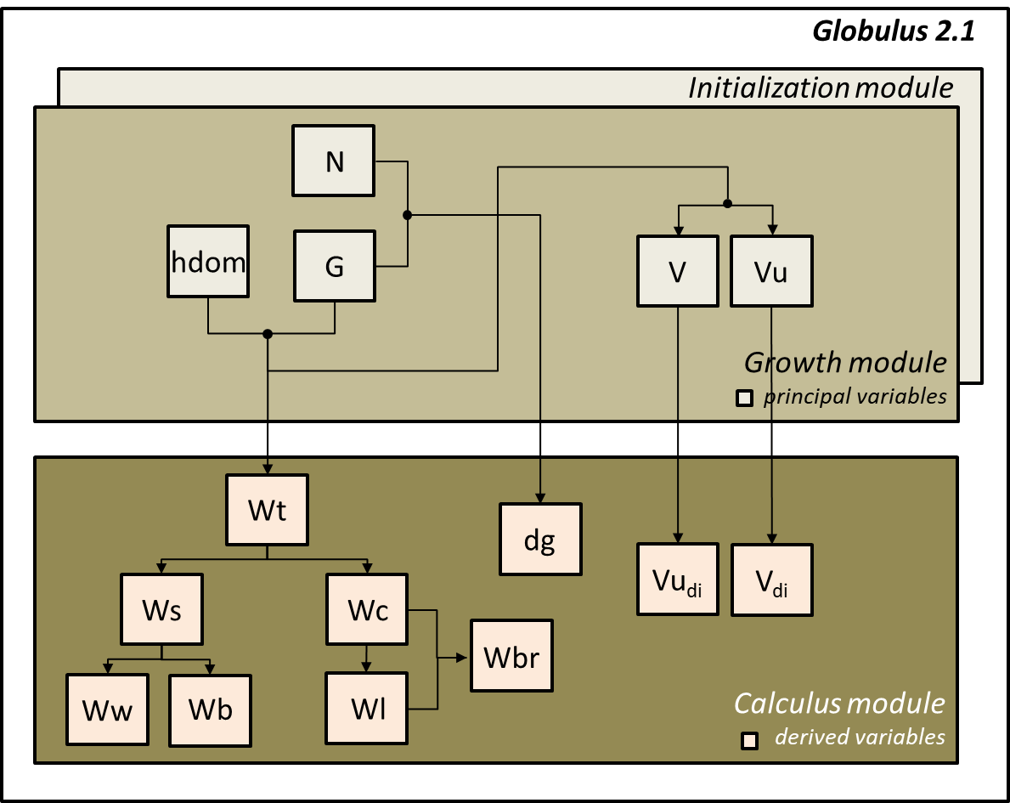
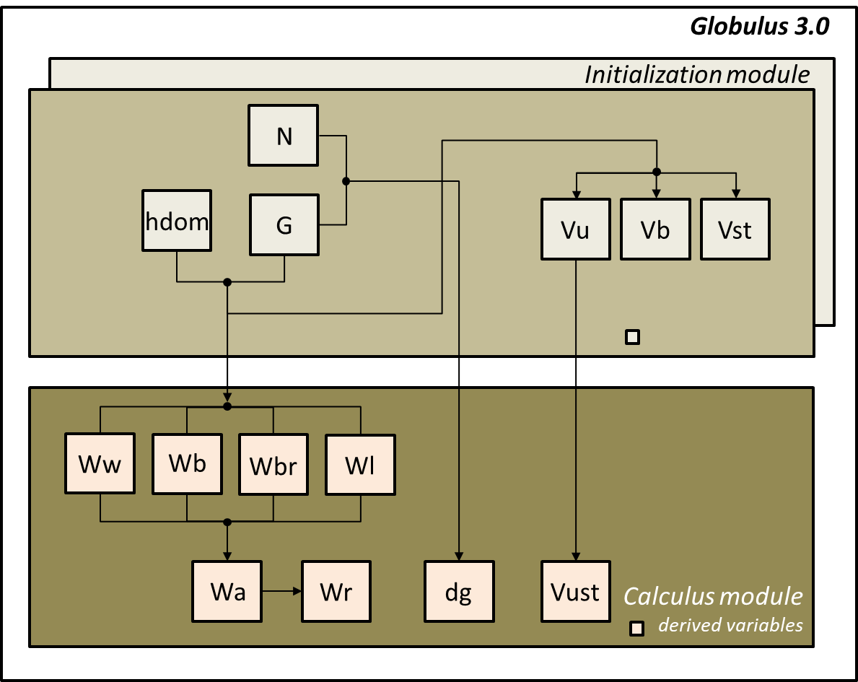
Whole stand models for even-aged stands
Climatic topographic variables
Globulus 2.1 & GLOBULUS 3.0
Climatic regions
The Initialization module contains equations for the variables present in the growth module but estimates values based on control variables and/or variables previously initialized

Slide 36
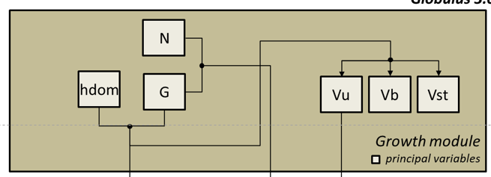
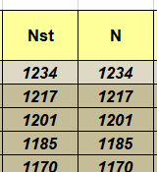
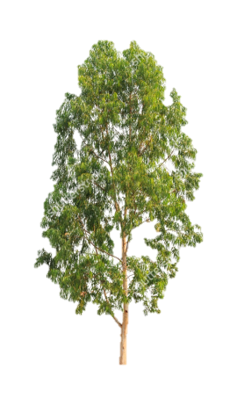
Whole stand models for even-aged stands
GLOBULUS 3.0 – initialization vs growth
Plantation
Initialization functions
Growth functions
No difference between stool and sprout/tree

Slide 37
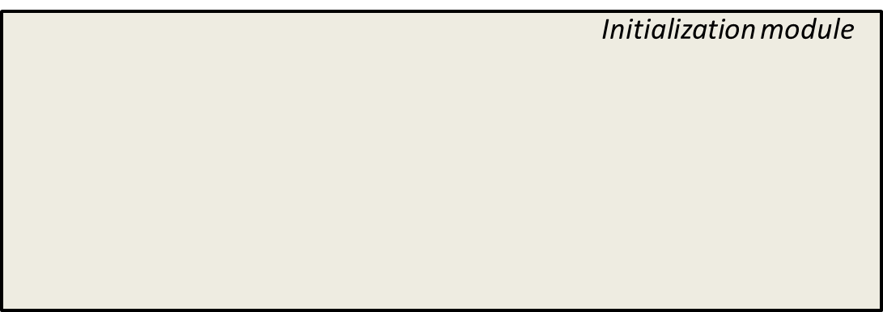
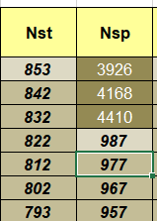
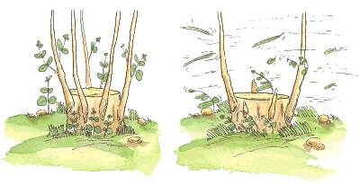
Whole stand models for even-aged stands
GLOBULUS 3.0 – initialization vs growth
Coppice
Initialization functions
Growth functions
Stools may have more than 1 sprout/tree
If the manager does not know how many sprouts per stool to keep, he can estimate it.
However, if he does, he just has the multiply that number by the number of living stools at the age of shoots selection

Slide 38
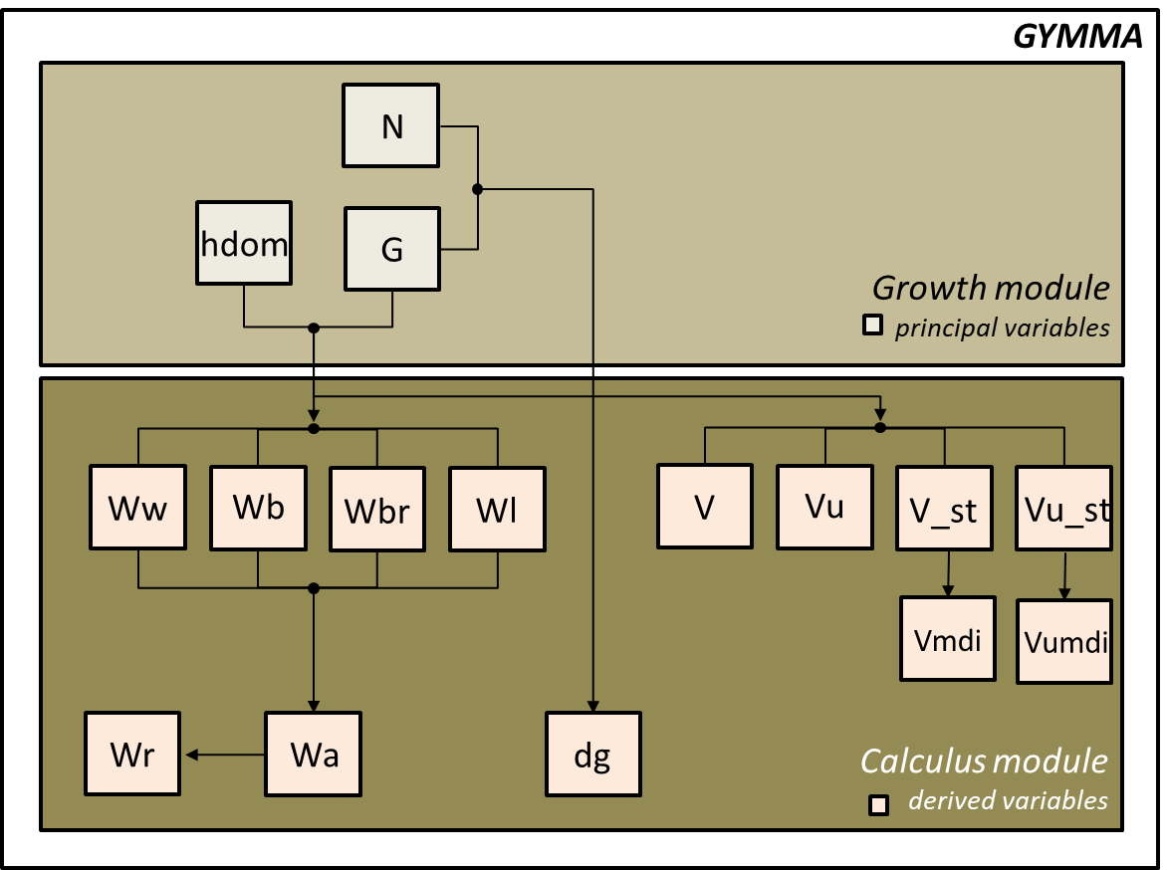
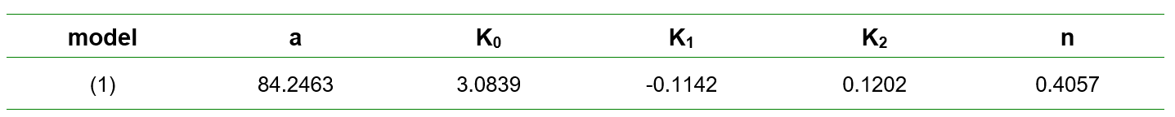
Whole stand models for (un)even-aged stands
GYMMA
GYMMA and Globulus 2.1 were compared for dominant height, basal area and volume(s) and graphical analyses showed GYMMA performed reasonably well.
However, GYMMA will neither allow to determine the exploitable age nor to estimate a site index value for a given stand

Slide 39
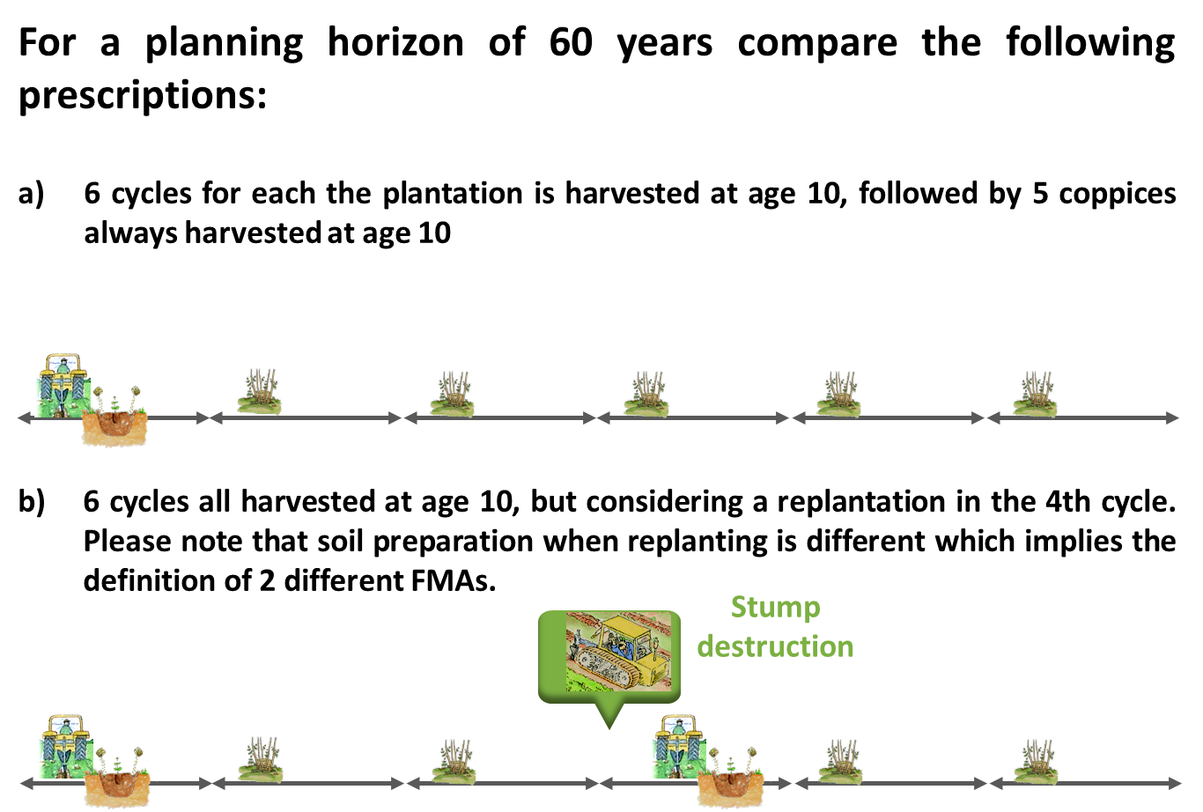
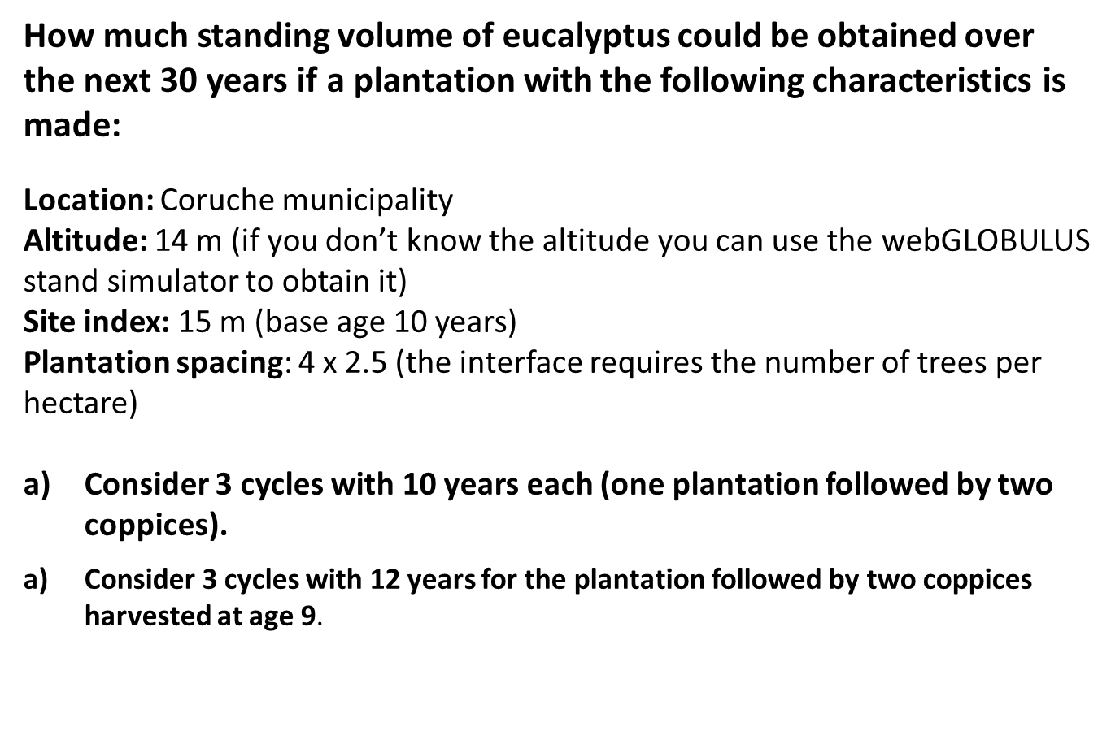
Whole stand models for even-aged stands
Usability
Suppose you want to simulate the growth for a period of 60 yrs testing different management schedules. How would you do it in EXCEL?
Discuss how to do it in EXCEL and solve it using with simflor.online / StandsSIM.md.

Slide 40
The end!!

