Slide 1
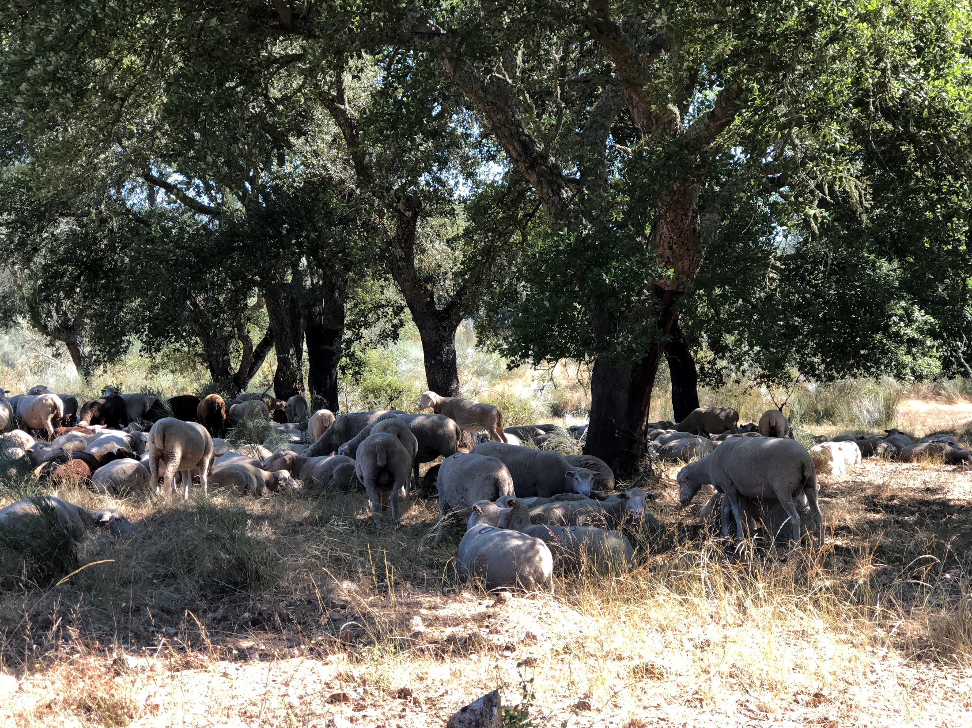
Methods to study the evolution of tree and stand variables over time
Margarida Tomé, Susana Barreiro
Instituto Superior de Agronomia
Universidade de Lisboa

Slide 2
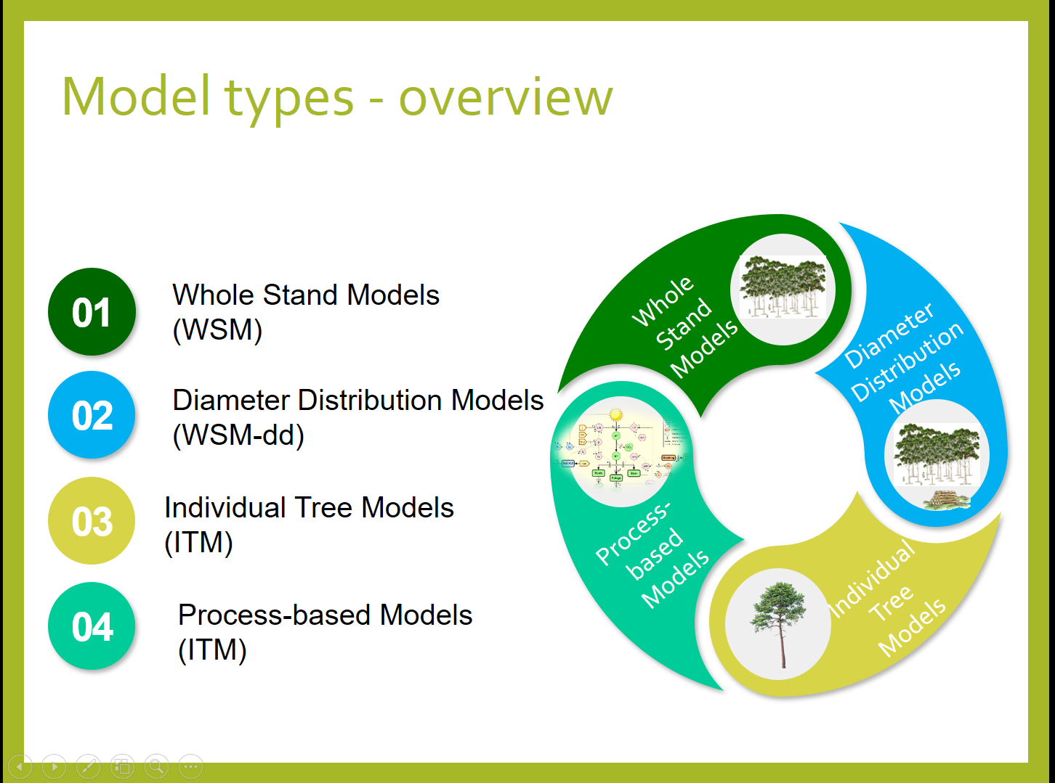
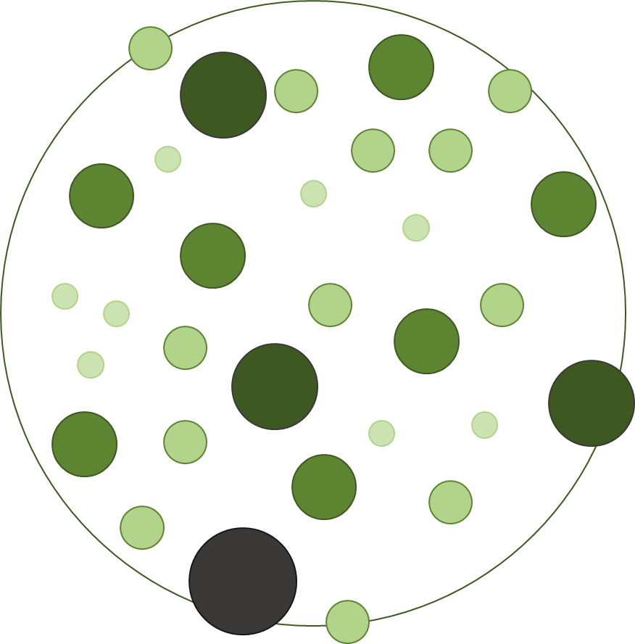
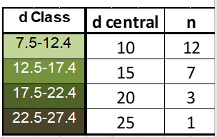
Methods to study the evolution of tree and stand variables over time
Size class Models
diameter
Size-class models for even-aged stands typically generate future diameter distributions (stand tables)
based on an initial measured diameter distribution
The stand projection requires to estimate:
- d growth by diameter class
- mortality by diameter class

Slide 3
Methods to study the evolution of tree and stand variables over time
Size class Models
diameter
Present and future stand tables can be converted to stock tables (volumes by size classes) and growth can be estimated.

Slide 4
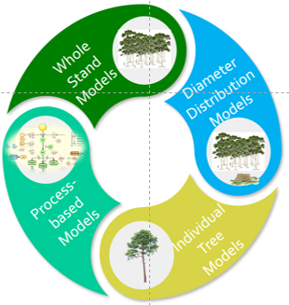
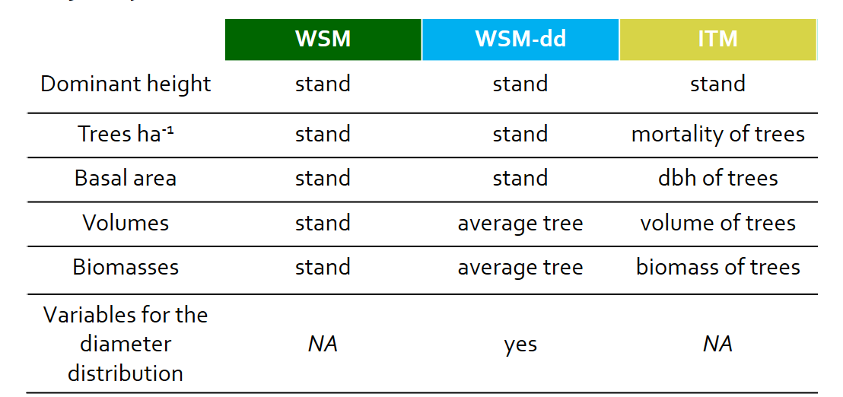
Methods to study the evolution of tree and stand variables over time
The STP procedure can be summarized as follows:
A present stand table showing numbers of trees in each dbh class is developed from a conventional inventory.
Past periodic growth, by dbh classes, is determined from increment borings or from remeasurements of permanent sample plots.
Past diameter growth rates are applied to the present stand table to derive a future stand table (adjustments for mortality must be made).
Both present and future stand tables are converted to stock tables and periodic stand growth is obtained as the difference between the volume of the present stand and that of the future stand.
Stand-Table projection
Size class Models
Forest inventory for diameter distribution and partial stem analysis

Slide 5
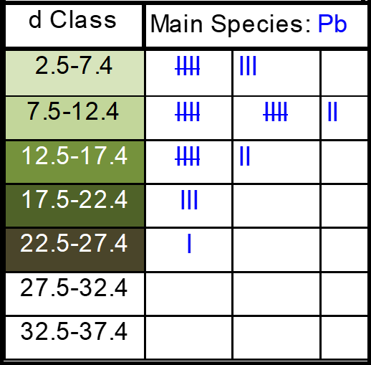
Methods to study the evolution of tree and stand variables over time
Stand-Table Projection
Forest inventory / diameter distribution

Slide 6
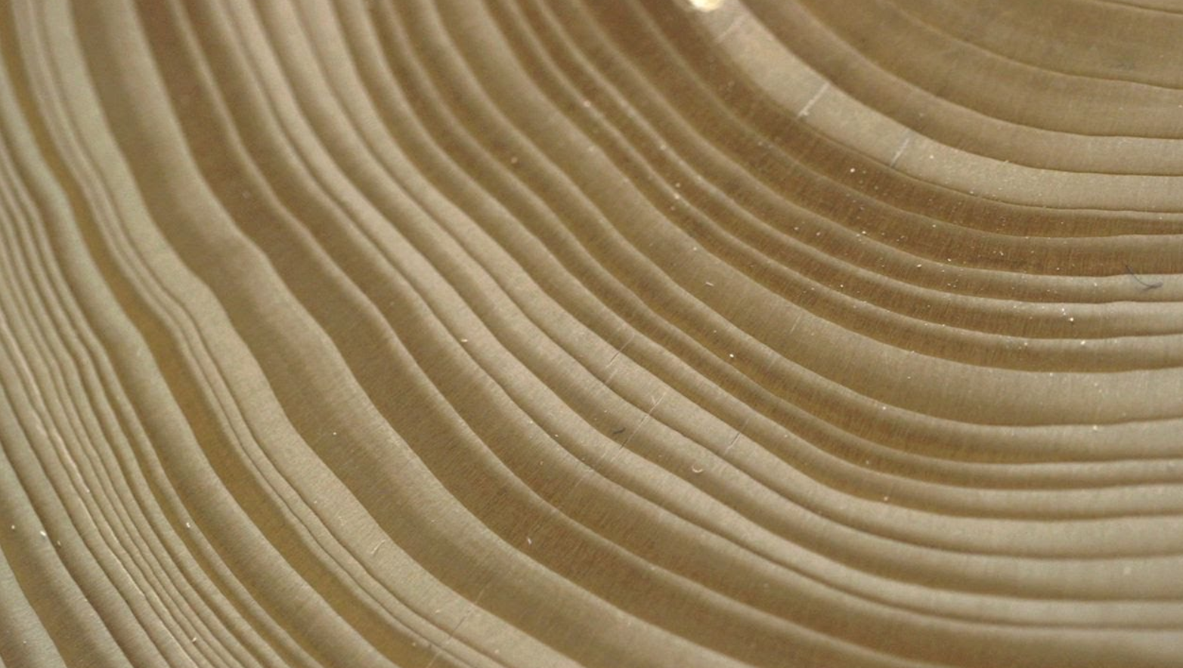
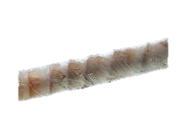
Methods to study the evolution of tree and stand variables over time
Stand-Table Projection
From stem analysis
Trees growing In temperate forests add a new layer of wood (from ground level to the tip and all around the stem) pushing the bark outwards creating a new layer every year.
Looking at the cross-cut, these layers appear as rings.
Each year:
a light ring (early wood) of new growth is created in the trunk during the spring and early summer,
a dark thinner ring (late wood) is created in the fall, when growth is slower.
Stem analysis is the study of tree growth from the analysis and measurement of the growth rings;
Partial stem analysis focus on the analysis of increment cores at dbh level

Slide 7
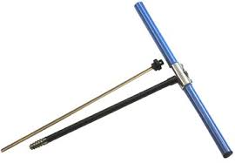
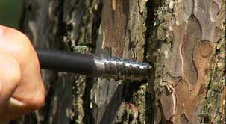
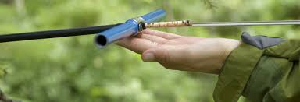
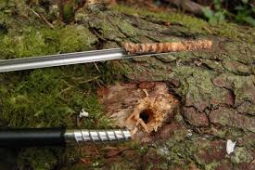

Methods to study the evolution of tree and stand variables over time
Stand-Table Projection
It is usually used for short-term predictions of forest inventory data:
During the forest inventory an increment core is taken in some “sample” trees
Diameter growth of wood in the last k years (usually 5 years) is measured in the increment core from each tree and converted to diameter growth
The diameter growth (idj) of the average tree of each diameter class (j) is estimated
(Hagloff images)

Slide 8

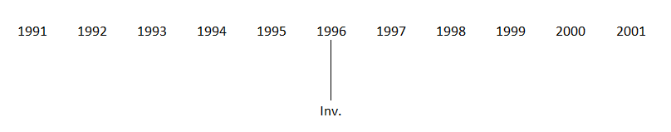

Methods to study the evolution of tree and stand variables over time
Stand-Table Projection
It is usually used for short-term predictions of forest inventory data:
During the forest inventory an increment core is taken in some “sample” trees
Diameter growth of wood in the last k years (usually 5 years) is measured in the increment core from each tree and converted to diameter growth
The diameter growth (idj) of the average tree of each diameter class (j) is estimated
12.5
17.5
15
Treej stays in same d_class
dj~lower_lim
+
Idj
Treej moves 1 d_class (the next)
Treej moves 2 d_class

Slide 9
Methods to study the evolution of tree and stand variables over time
Stand-Table Projection
It is usually used for short-term predictions of forest inventory data:
During the forest inventory an increment core is taken in some “sample” trees
Diameter growth of wood in the last k years (usually 5 years) is measured in the increment core from each tree and converted to diameter growth
The diameter growth (idj) of the average tree of each diameter class (j) is estimated
12.5
17.5
15
Treej stays in same d_class
dj~upper_lim
+
Idj
Treej moves 1 d_class (the next)
Treej moves 2 d_class

Slide 10
Methods to study the evolution of tree and stand variables over time
Stand-Table Projection
It includes several steps (and assumes you have just completed your forest inventory):
Start by computing the stand table (number of trees by diameter class) from forest inventory data
Take a core from the tree that is closest to the central diameter in each diameter class
Measure the width of the rings over the past k yrs to determine the increment in each class (id_{j})

Slide 11
Methods to study the evolution of tree and stand variables over time
Stand-Table Projection
It includes several steps (and assumes you have just completed your forest inventory):
Start by computing the stand table (number of trees by diameter class) from forest inventory data
Estimate mortality in each diameter class and compute the future number of trees
Compute the growth index ie the ratio between id_{j} and the width of the class – this index allows the computation of the number of trees that stay in the class and the ones that move 1 or 2 classes

Slide 12
Methods to study the evolution of tree and stand variables over time
Stand-Table Projection
It includes several steps (and assumes you have just completed your forest inventory):
Start by computing the stand table (number of trees by diameter class) from forest inventory data
Estimate mortality in each diameter class and compute the future number of trees
Compute the growth index ie the ratio between id_{j} and the width of the class – this index allows the computation of the number of trees that stay in the class and the ones that move 1 or 2 classes
A GI=0.76 means that 76% of the trees move 1 class and none move 2 classes
A GI=1.10 means that 90% of the trees move 1 class and 10% move 2 classes

Slide 13
Methods to study the evolution of tree and stand variables over time
Stand-Table Projection
Computation of growth index:
Assumes that trees inside a dbh class have a uniform distribution
Estimate the diameter increment in k years of each dbh class (i_{d})
All trees inside a dbh class [d₁; d₂[ with d>d₂+i_{d}, after k years will be in the next class
12.5
17.5
15

Slide 14
Methods to study the evolution of tree and stand variables over time
Stand-Table Projection
=102*(0.76)
=102-24.48
=102*(1-0.76)
=100+4
Increment in diameter for the period
number of trees alive in each class
= 3.80 / 5cm => 76% of the trees move to the next class
= 3.80 / 5cm =>
= 3.85 / 5cm =>
…
= 3.90 / 5cm => 78% of the trees move to the next class

Slide 15
Methods to study the evolution of tree and stand variables over time
Stand-Table Projection
We should also take into account the ingrowth
trees that achieve the lower limit of the first diameter class and must be added to the stand

Slide 16
Methods to study the evolution of tree and stand variables over time
Stand-Table Projection
=24+100

Slide 17
Methods to study the evolution of tree and stand variables over time
Stand-Table Projection
To estimate volume (or biomass) increment:
Estimate the height of the average tree in each dimater class using a height-diameter curve
Estimate the respective volume with a volume equation (v_avgtree)
Estimate the volume in each point in time using the stand tables (N_class * v_avgtree)
Obtain the volume (biomass) growth by difference

Slide 18
Methods to study the evolution of tree and stand variables over time
Stand-Table Projection
=0.0070*124

Slide 19
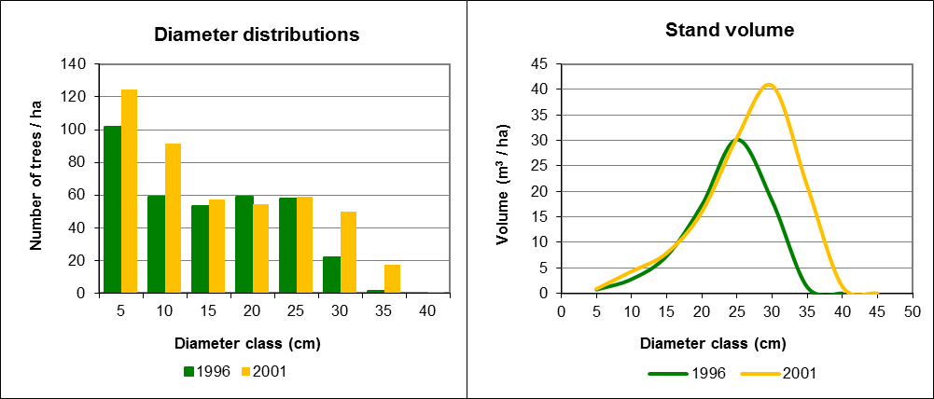
Methods to study the evolution of tree and stand variables over time
Stand-Table Projection
i_{V}=45m³/ha

Slide 20
Methods to study the evolution of tree and stand variables over time
Stand-Table Projection
Tree movement:
Note that now the trees are not equally distributed but this assumption will hold for the next period projection
I_{d1}= 3/4 interval
I_{d2}= 2/4 interval
I_{d3}= 1/4 interval
Class d1 = 4 trees
Class d2 = 8 trees
Class d3 = 4 trees
Moves to Class d2:
3/4 interval * 4 trees
3 trees move to d2
Moves to Class d3:
I_{d2}= 2/4 interval * 8 trees
4 trees move to d3
Moves to Class d4:
I_{d2}= 1/4 interval * 4 trees
1 tree moves to d4
i_{d1}
i_{d2}
i_{d3}
Period 1
 | class d1 |  |  |  | class d2 |  |  |  | class d3
Period 2
 | class d1 |  |  |  | class d2 |  |  |  | class d3

Slide 21
Methods to study the evolution of tree and stand variables over time
Stand-Table Projection
Tree movement:
Note that now the trees are not equally distributed but this assumption will hold for the next period projection
I_{d1}= 3/4 interval
I_{d2}= 2/4 interval
I_{d3}= 1/4 interval
Class d1 = 4 trees
Class d2 = 8 trees
Class d3 = 4 trees
Moves to Class d2:
P1₁= 3/4 interval * 4 trees
3 trees move to d2
Moves to Class d3:
P1₂= 2/4 interval * 8 trees
4 trees move to d3
Moves to Class d4:
P1₃= 1/4 interval * 4 trees
1 tree moves to d4
i_{d1}
i_{d2}
i_{d3}
Period 1
 | class d1 |  |  |  | class d2 |  |  |  | class d3
Period 2
 | class d1 |  |  |  | class d2 |  |  |  | class d3

Slide 23
Revision on data for growth studies
Where do we get the data for growth studies?
Permanent and Interval plots
Temporary plots
Experimental trials
Continuous forest inventory data
Stem analysis
Total – analysis of several tree discs along the stem
Partial – analysis of increment cores at dbh level

Slide 24
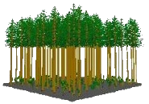
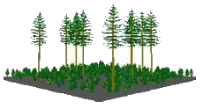
1950’s | 1960’s | 1970’s | 1980’s | 1990’s | 2000’s | 2010’s
Timber | Timber | Timber | Timber | Timber | Timber | Timber
 | Mutiple resources | Mutiple resources | Mutiple resources | Mutiple resources | Mutiple resources | Mutiple resources
 |  | Biomass | Biomass | Biomass | Biomass | Biomass
 |  |  | Global warming C sequestration | Global warming C sequestration | Global warming C sequestration | Global warming C sequestration
 |  |  |  | Ecosystem services (biodiversity) NWFPs | Ecosystem services (biodiversity) NWFPs | Ecosystem services (biodiversity) NWFPs
 |  |  |  |  | Relationship with other land uses | Relationship with other land uses
 |  |  |  |  |  | Bioeconomy
Production forestry often involved:
the establishment of pure even-aged stands
substantial investments for intensive management
Several approaches from empirical to process-based have been used
Stands are composed of trees and models of tree attributes:
stem taper,
tree volume
tree biomass
crown characteristics
central components in comprehensive growth & yield prediction systems
Trees and stands respond to silvicultural treatments & environment
branchiness
crown size

Slide 25
1950’s | 1960’s | 1970’s | 1980’s | 1990’s | 2000’s | 2010’s
Timber | Timber | Timber | Timber | Timber | Timber | Timber
 | Mutiple resources | Mutiple resources | Mutiple resources | Mutiple resources | Mutiple resources | Mutiple resources
 |  | Biomass | Biomass | Biomass | Biomass | Biomass
 |  |  | Global warming C sequestration | Global warming C sequestration | Global warming C sequestration | Global warming C sequestration
 |  |  |  | Ecosystem services (biodiversity) NWFPs | Ecosystem services (biodiversity) NWFPs | Ecosystem services (biodiversity) NWFPs
 |  |  |  |  | Relationship with other land uses | Relationship with other land uses
 |  |  |  |  |  | Bioeconomy
Production forestry often involved:
the establishment of pure even-aged stands
substantial investments for intensive management
Based on the description of observed data at tree or stand level
Several approaches from empirical to process-based have been used
Stands are composed of trees and models of tree attributes:
stem taper,
tree volume
tree biomass
crown characteristics
central components in comprehensive growth & yield prediction systems
Based on the description of processes that lead to the production of dry matter its distribution among plant parts
Trees and stands respond to silvicultural treatments & environment
branchiness
crown size

Slide 26
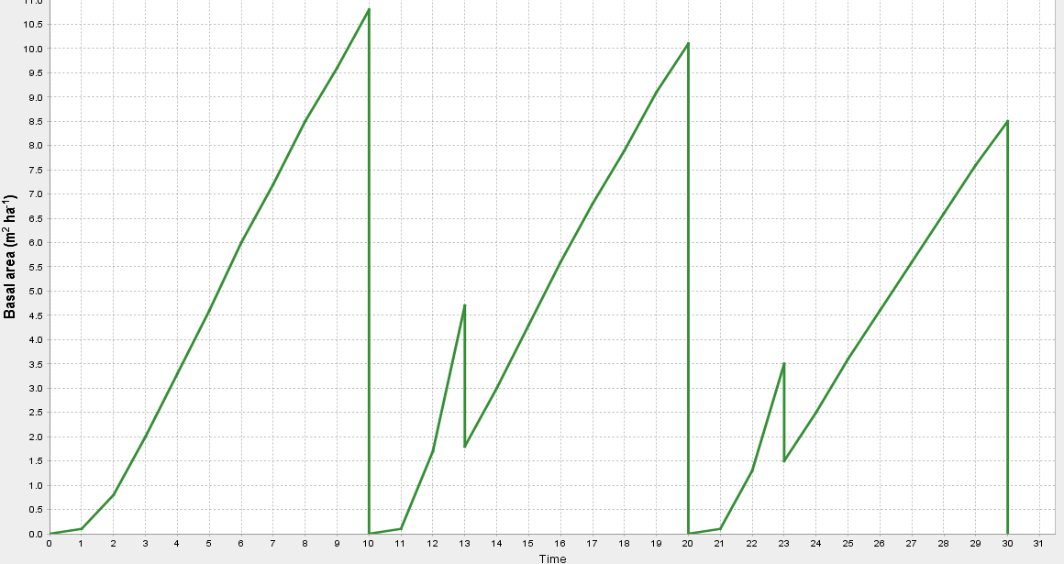
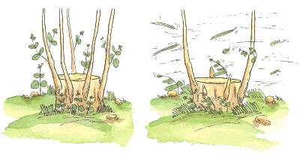
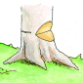
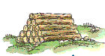
Plantation
Coppice
1st rotation
2nd rotation
3rd rotation
Terminology !
Shoots selection operation
Seedlings are planted
Stools resprout
Final harvest or clear cut
Trees are harvested
originating many shoots

Slide 27
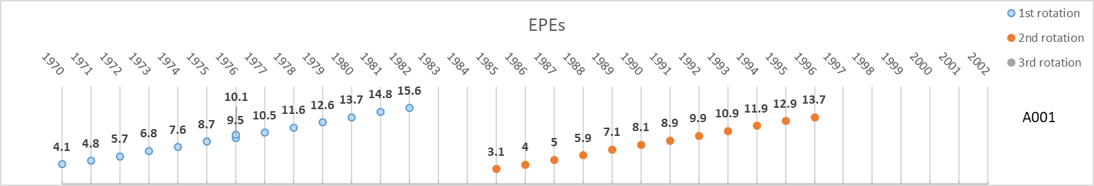
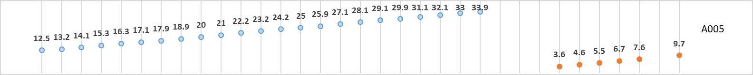
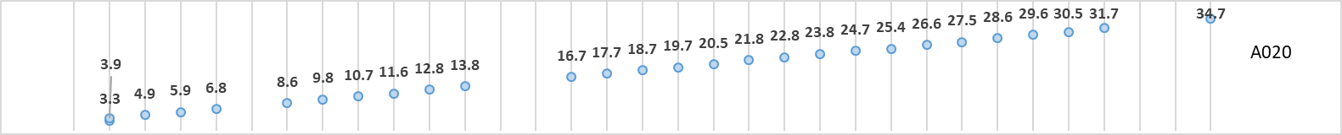

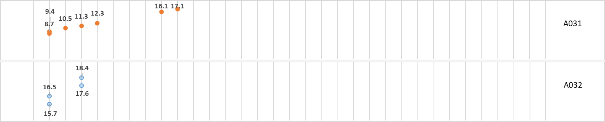
Stand age at each measurement
This is not stand height evolution!
Permanent plots
Interval plots

Slide 28
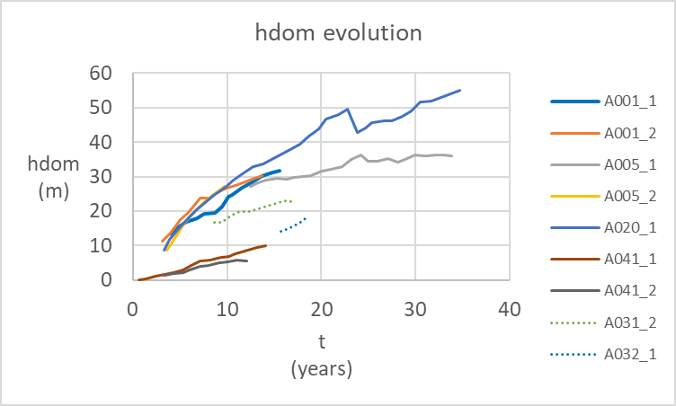
This is stand height evolution!
Permanent plots
Interval plots

Slide 29
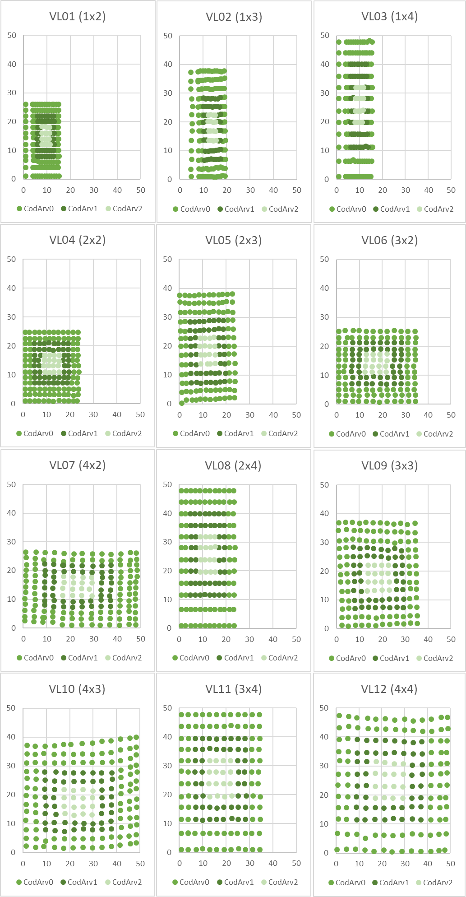
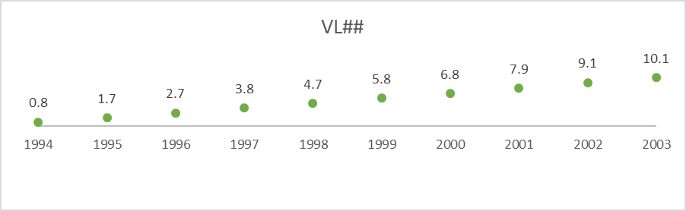
Experimental trials
Trials are set to study one specific silvicultural practice or a combination of two (even if in practice several treatments are applied simultaneously)
Trials usually present a design with repetitions of the given treatment
E.g. Spacing trial: (1x2, 1x3, 1x4, 2x2, 2x3, 3x2, 4x2, 2x4, 3x3, 4x3, 3x4, 4x4) * 3Blocks
Measurements over time covering the entire 1st rotation

Slide 30
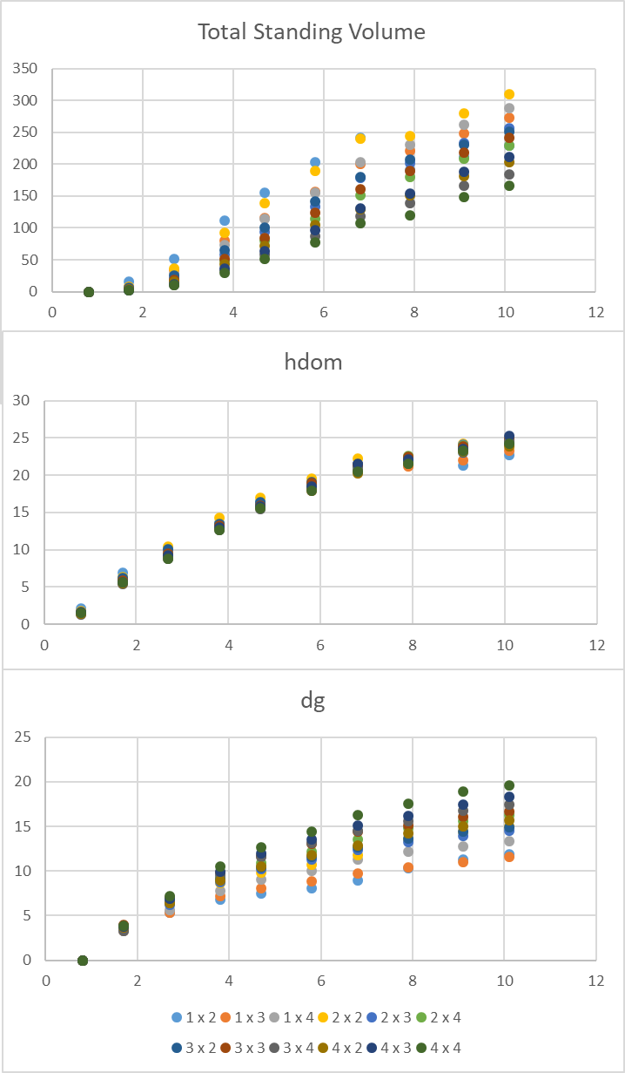
Experimental trials
Trials are set to study one specific silvicultural practice or a combination of two (even if in practice several treatments are applied simultaneously)
Trials usually present a design with repetitions of the given treatment
E.g. Spacing trial: (1x2, 1x3, 1x4, 2x2, 2x3, 3x2, 4x2, 2x4, 3x3, 4x3, 3x4, 4x4) * 3Blocks
Measurements over time covering the entire 1st rotation

Slide 31
Experimental trials
Trials are set to study one specific silvicultural practice or a combination of two (even if in practice several treatments are applied simultaneously)
Trials usually present a design with repetitions of the given treatment
E.g. Spacing trial: (1x2, 1x3, 1x4, 2x2, 2x3, 3x2, 4x2, 2x4, 3x3, 4x3, 3x4, 4x4) * 3Blocks
Comparison of some stand variables at age 10.1:
Spacing that maximizes volume

Slide 32
Experimental trials
Trials are set to study one specific silvicultural practice or a combination of two (even if in practice several treatments are applied simultaneously)
Trials usually present a design with repetitions of the given treatment
E.g. Spacing trial: (1x2, 1x3, 1x4, 2x2, 2x3, 3x2, 4x2, 2x4, 3x3, 4x3, 3x4, 4x4) * 3Blocks
Comparison of some stand variables at age 10.1:
Spacing that maximizes diameter

Slide 33
ANALYSIS OF MEASURED RESULTS
PERMANENT PLOTS
FIELD TRIALS
Data for construction and validation
Better understanding of physiological processes
Indication for the need to obtain new data
Ideas for new experiments
ANALYSIS OF SIMULATED RESULTS using FOREST GROWTH MODELS
Better understanding of physiological processes
EXPERIMENTS UNDERTAKEN IN LABORATORY

