Slide 1
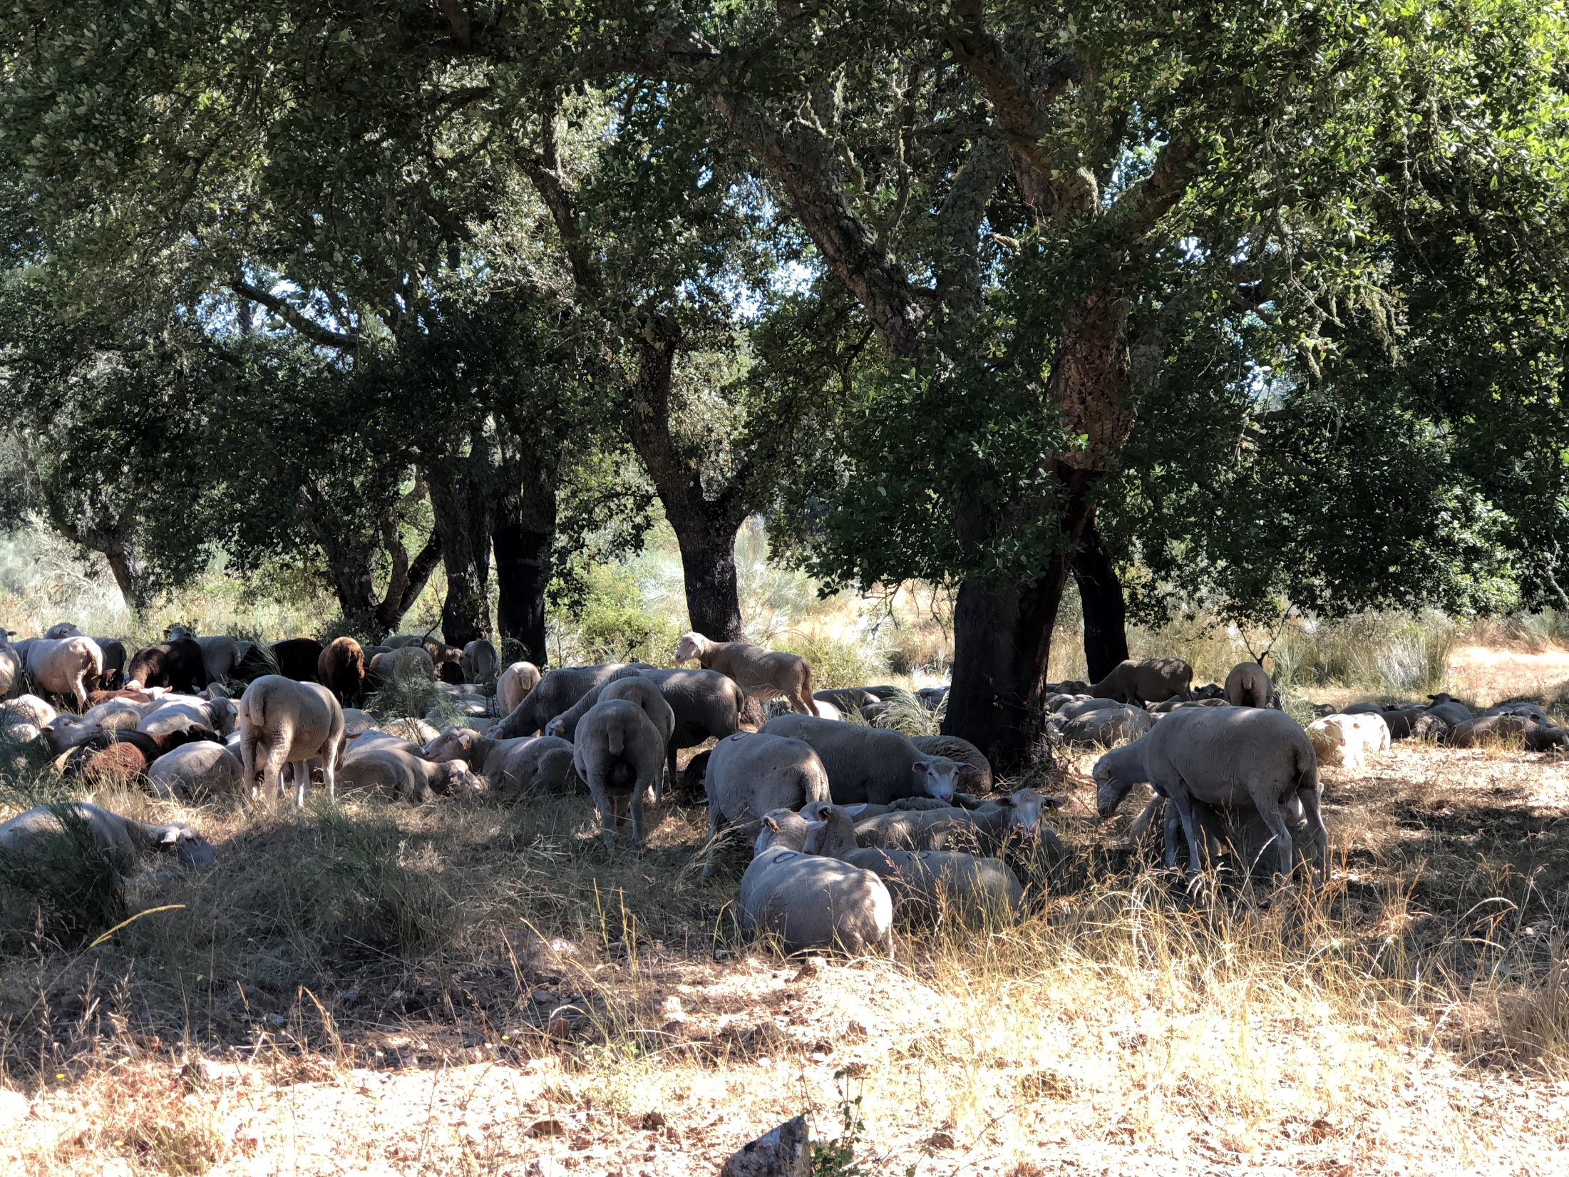
Diameter distribution models for even-aged stands
Margarida Tomé, Susana Barreiro
Instituto Superior de Agronomia
Universidade de Lisboa

Slide 2
Summary
Diameter distribution models for even-aged stands
“Definition”
Diameter distribution
What do diameter distributions look like?
How can diameter distributions be expressed
Modelling diameter distributions
PDF functions (Weibull and Johnson’s SB)
The PBRAVO Model (Weibull)
The ModisPinaster Model (Johnson’s SB)

Slide 3
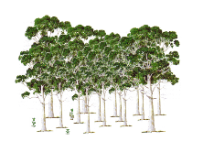
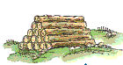
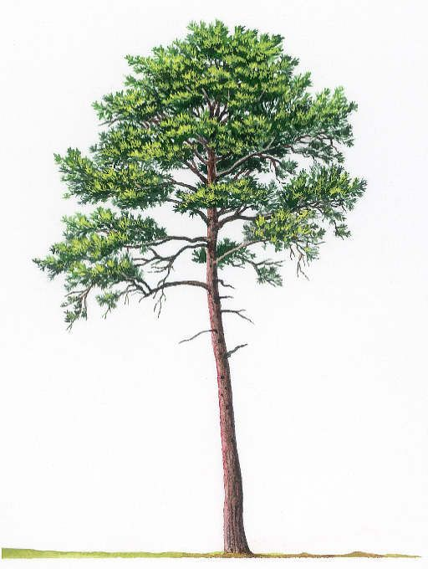
Whole-stand models with diameter distribution (WSM-dd)
Diameter distribution models (DDM)
Stand volume may be enough for some purposes, but often the distribution of volume by size and product classes is often required also it is important for planning thinning or final harvest
Stand tables (nr of trees by diameter class) and stock tables (volume by diameter class) complemented the information from Yield Tables
Attention was given to modelling diameter distributions
WSM
Whole Stand Models
Diameter Distribution Models
Sample Text
Typically, the total nr of trees per hectare (N, trees ha⁻¹)
is distributed among diameter classes
using
probability density functions (pdf)
Sample Text
Individual Tree Models

Slide 4
Whole-stand models with diameter distribution (WSM-dd)
Diameter distribution models (DDM)
Empirical models
Forest management and planning require information about the distribution of volume by size and product classes
The nr trees by diameter class is obtained using a probability density function
Some state variables are defined at stand level
 | WSM | DDM | WSM-sc | ITM
Dominant height | stand | stand | stand | stand
Trees ha⁻¹ | stand | stand | stand | mortality of trees
Basal area | stand | stand | stand | dbh of trees
Volumes | stand | average tree/by diamclass | average tree | volume of trees
Biomasses | stand | average tree/by diamclass | average tree | biomass of trees
Variables for the diameter distribution | NA | yes | no | NA

Slide 5
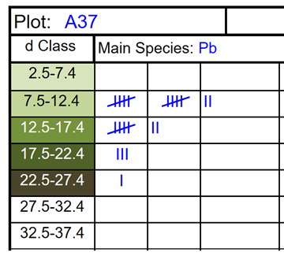
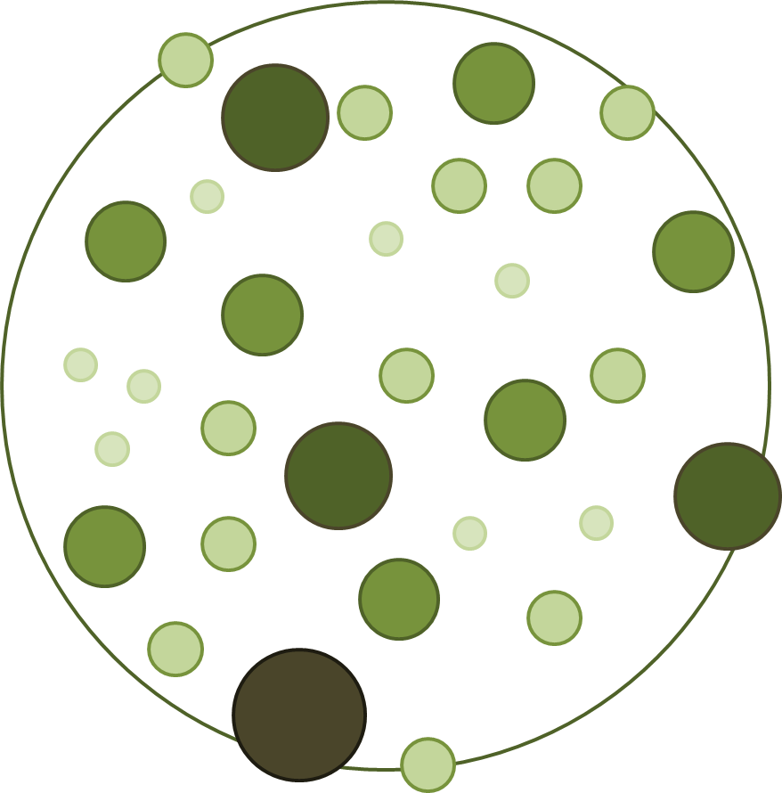
Whole-stand models with diameter distribution (WSM-dd)
Diameter distribution models (DDM)
Diameter distributions
In forest inventory, the mensuration of tree diameters for all trees in one plot (total enumeration of diameters) allows distributing them by different diameter classes
WSM
Sample Text
This allows characterizing the plot/stand at time t
However, if WSM are applied to predict the evolution of a stand for t+1, N (trees ha⁻¹) is all we know
Sample Text

Slide 6
Whole-stand models with diameter distribution (WSM-dd)
Diameter distribution models (DDM)
Diameter distributions
In modelling, WSM provide information on N (trees ha⁻¹) over time that combined with a probability density function (pdf), enable the distribution of N by d-classes and volume to be estimated by d-class (vi)
d central (diameter midpoint) represents the d of the average tree in the d-class;
combined with a h-d curve, an estimate of the height of the average tree (h) can be obtained;
knowing d and h, the volume of the average tree is estimated that multiplied by Ni gives the volume in the d-class (vi)
WSM
Sample Text
with i representing the d Class
240
140
60
Sample Text
20

Slide 7
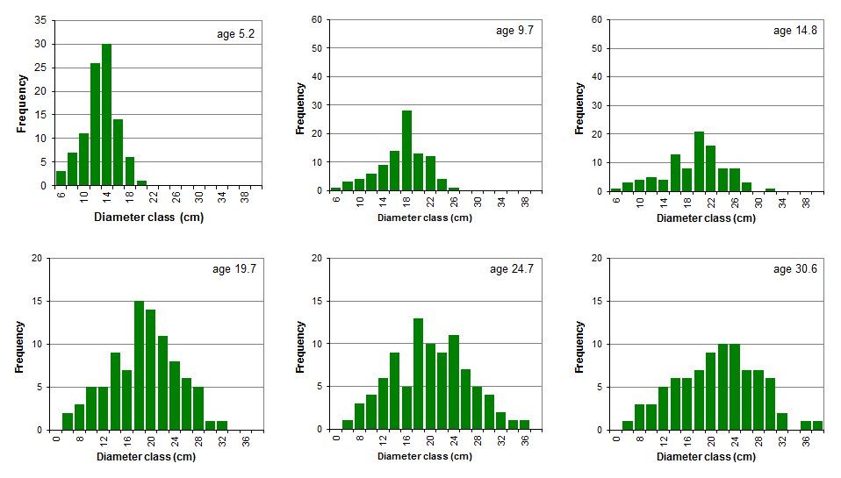
Whole-stand models with diameter distribution (WSM-dd)
Diameter distribution models (DDM)
What do diameter distributions look like?
Diameter distributions of a permanent plot over time

Slide 8
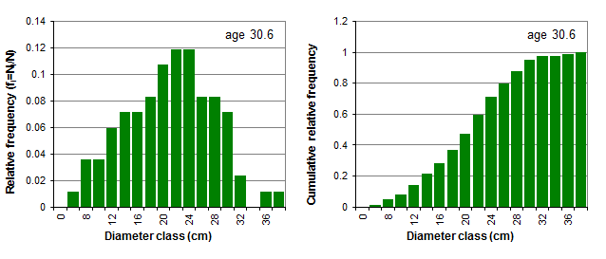
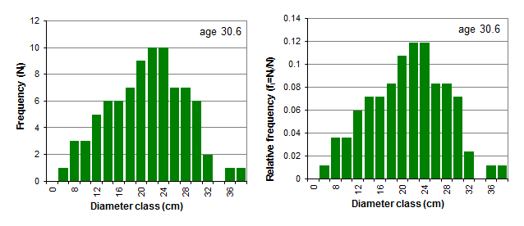
Whole-stand models with diameter distribution (WSM-dd)
Diameter distribution models (DDM)
How can they be expressed?
Diameter distribution in relative frequencies
expressing the frequency each diameter class (N_{i}) relative to the total number of trees per ha (N)
Diameter distribution in cumulative relative frequencies
The cumulative relative frequency of a diameter distribution leads to the empirical distribution function
WSM
Sample Text
Σf_{i}=1
Sample Text

Slide 9
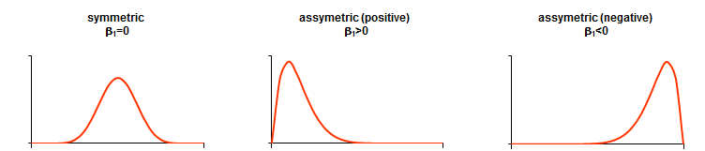
Whole-stand models with diameter distribution (WSM-dd)
Diameter distribution models (DDM)
Modelling diameter distributions:
A typical diameter distribution for pure, even-aged stands is unimodal and slightly skewed
Skewness coefficient (β₁) is used to measure the symmetry of a distribution
(coeficiente de assimetria)
WSM
Sample Text

Slide 10
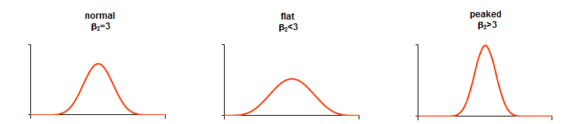
Whole-stand models with diameter distribution (WSM-dd)
Diameter distribution models (DDM)
Modelling diameter distributions:
Diameter distributions for pure, even-aged stands can also be more or less flat
Kurtosis coefficient (β₂) is used to measure the peakdness or flatness of a distribution
distribuição é mesocúrtica – coeficiente de achatamento igual a 3, platicúrtica ou achatada – coeficiente de achatamento menor que 3 – ou leptocúrtica ou abicada – coeficiente de achatamento maior do que 3
WSM
Sample Text
Sample Text

Slide 11
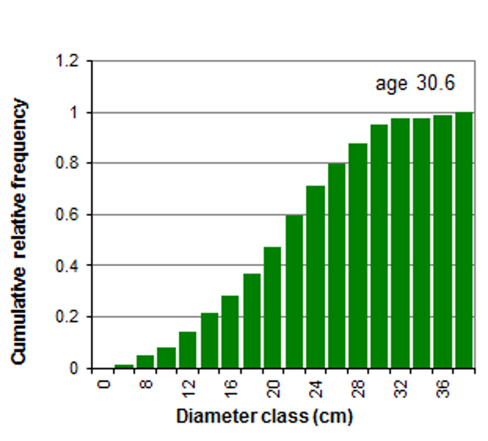
Whole-stand models with diameter distribution (WSM-dd)
Diameter distribution models (DDM)
Modelling diameter distributions:
Diameter distributions can be modelled by a variety of mathematical functions from the probability density functions (pdfs) type:
express the relative likelihood for a random variable to take on a given value
are non-negative everywhere, and its integral over the entire space is equal to one
The probability that the random variable takes a value<x is equal to the integral of the pdf from the start to x
The probability of a tree to have a d ≤ 22cm = 0.6
0.6
22

Slide 12
Whole-stand models with diameter distribution (WSM-dd)
Diameter distribution models (DDM)
Modelling diameter distributions:
Probability density functions (pdfs)
A pdf is described by a mathematical expression that contains parameters
The values of the parameters give a different shape to the pdf (including the location one)
For instance, a Normal distribution, the most well know pdf, has the following expression
that includes two parameters, the mean (μ) and the standard deviation (σ), and is designated by N(μ,σ)

Slide 13
Whole-stand models with diameter distribution (WSM-dd)
Diameter distribution models (DDM)
Modelling diameter distributions:
Probability density functions (pdfs)
Integrating the pdf produces the cumulative distribution function that, for the Normal distribution is
The Normal distribution is not appropriate to model diameter distributions because of its symmetry

Slide 14
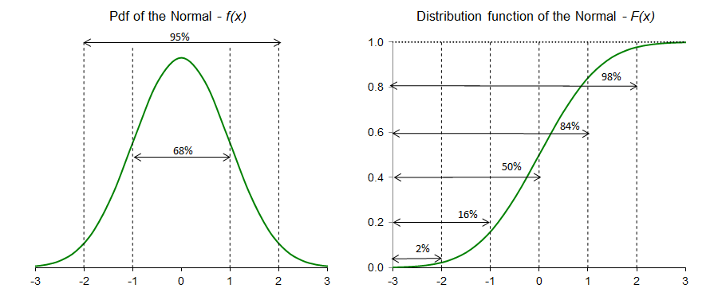
Whole-stand models with diameter distribution (WSM-dd)
Diameter distribution models (DDM)
Modelling diameter distributions:
Probability density functions (pdfs)
Integrating the pdf produces the cumulative distribution function that, for the Normal distribution is
The Normal distribution is not appropriate to model diameter distributions because of its symmetry: it is symmetric around the mean (μ)

Slide 15
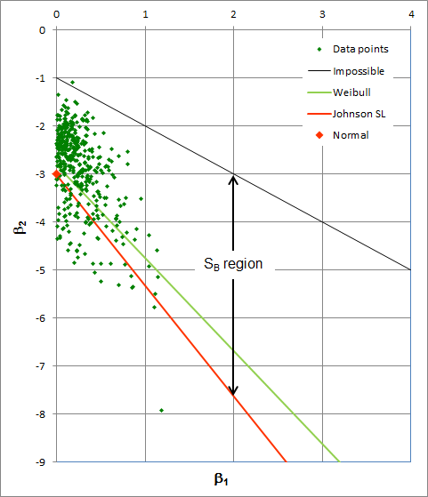
Whole-stand models with diameter distribution (WSM-dd)
Diameter distribution models (DDM)
Modelling diameter distributions:
Probability density functions (pdfs)
Other pdfs, that can take different values for the pair ( β₁, β₂ ) = ( Skewness coefficient, Kurtosis coefficient), have been used for diameter distribution modelling
(β₁,β₂) values for the pdfs most used for diameter distribution modelling and for a set of eucalyptus permanent plots
Estimators for β₁ and β₂:

Slide 16
Whole-stand models with diameter distribution (WSM-dd)
Diameter distribution models (DDM)
Modelling diameter distributions:
Selecting a distribution function
Easiness of parameter estimation
Flexibility to describe a wide range of shapes
Simplicity of integration methods for estimating proportions in different size classes
Accuracy in fitting
Region representing combinations of β1 and β2 that are mathematically impossible (for the distribution)

Slide 17
Whole-stand models with diameter distribution (WSM-dd)
Diameter distribution models (DDM)
Modelling diameter distributions:
Selecting a distribution function
Easiness of parameter estimation
Flexibility to describe a wide range of shapes
Simplicity of integration methods for estimating proportions in different size classes
Accuracy in fitting
Distributions represented by a single point in the graph (Normal) have one single shape

Slide 18
Whole-stand models with diameter distribution (WSM-dd)
Diameter distribution models (DDM)
Modelling diameter distributions:
Selecting a distribution function
Easiness of parameter estimation
Flexibility to describe a wide range of shapes
Simplicity of integration methods for estimating proportions in different size classes
Accuracy in fitting
Distributions represented by a line in the graph (eg Weibull) can take various combinations of β1 and β2 showing their flexibility in terms of shape

Slide 19
Whole-stand models with diameter distribution (WSM-dd)
Diameter distribution models (DDM)
Modelling diameter distributions:
Selecting a distribution function
Easiness of parameter estimation
Flexibility to describe a wide range of shapes
Simplicity of integration methods for estimating proportions in different size classes
Accuracy in fitting
The Johnson S_{B} is a system of distributions and is represented by an area in the graph showing their flexibility in terms of shape

Slide 20
Whole-stand models with diameter distribution (WSM-dd)
Diameter distribution models (DDM)
Modelling diameter distributions:
Selecting a distribution function
- The Weibull probability density function, one of the most used pdfs in diameter distribution modelling, is a three-parameter pdf
a – location parameter (related to the d_{min})
b – scale parameter (>0)
c – shape parameter (>0; if c>1 implies a inverse J shape;
if c=3.6 is close to Normal;
If c<3.6 is right skewed;
if c>3.6 is left skewed)
a+b is close to percentile 63% (P₆₃) of the distribution

Slide 21
Whole-stand models with diameter distribution (WSM-dd)
Diameter distribution models (DDM)
Modelling diameter distributions:
Selecting a distribution function
Integrating the pdf produces the cumulative distribution function for the Weibull distribution
The Weibull distribution has the advantage of having a closed integral form which makes it very tractable

Slide 22
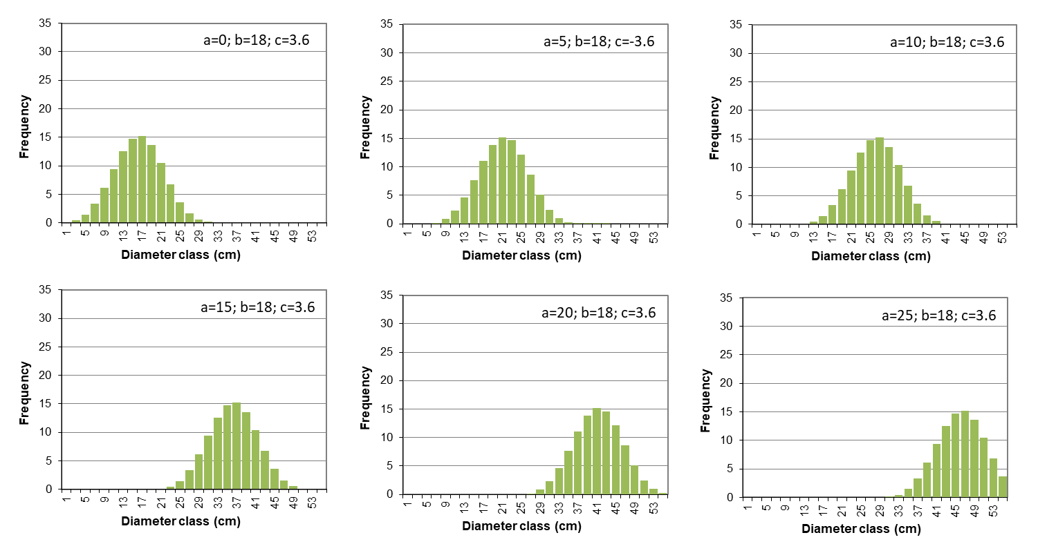
Whole-stand models with diameter distribution (WSM-dd)
Diameter distribution models (DDM)
Modelling diameter distributions:
Selecting a distribution function
- Examples of the Weibull probability density function
a – location parameter (related to the d_{min})
b – scale parameter (>0) 18
c – shape parameter (>0; if c>1 implies a inverse J shape; 3.6
if c=3.6 is close to Normal;
If c<3.6 is right skewed;
if c>3.6 is left skewed)
a+b is close to percentile 63% (P₆₃) of the distribution
a = 0
a = 5
a = 10
a = 15
a = 20
a = 25

Slide 23
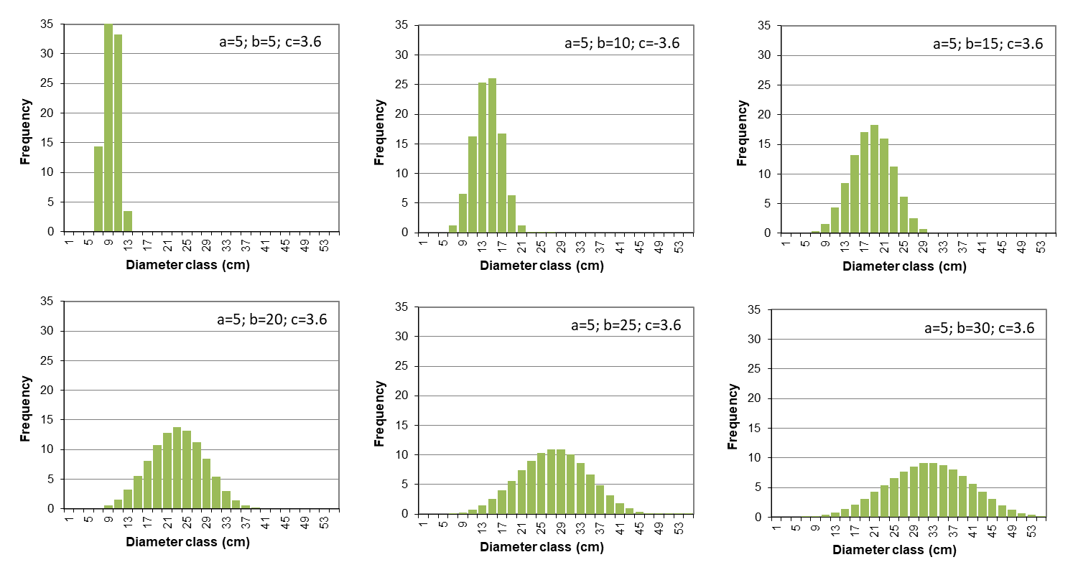
Whole-stand models with diameter distribution (WSM-dd)
Diameter distribution models (DDM)
Modelling diameter distributions:
Selecting a distribution function
- Examples of the Weibull probability density function
a – location parameter (related to the d_{min}) 5
b – scale parameter (>0)
c – shape parameter (>0; if c>1 implies a inverse J shape; 3.6
if c=3.6 is close to Normal;
If c<3.6 is right skewed;
if c>3.6 is left skewed)
a+b is close to percentile 63% (P₆₃) of the distribution
b = 5
b = 10
b= 15
b = 20
b = 25
b = 30

Slide 24
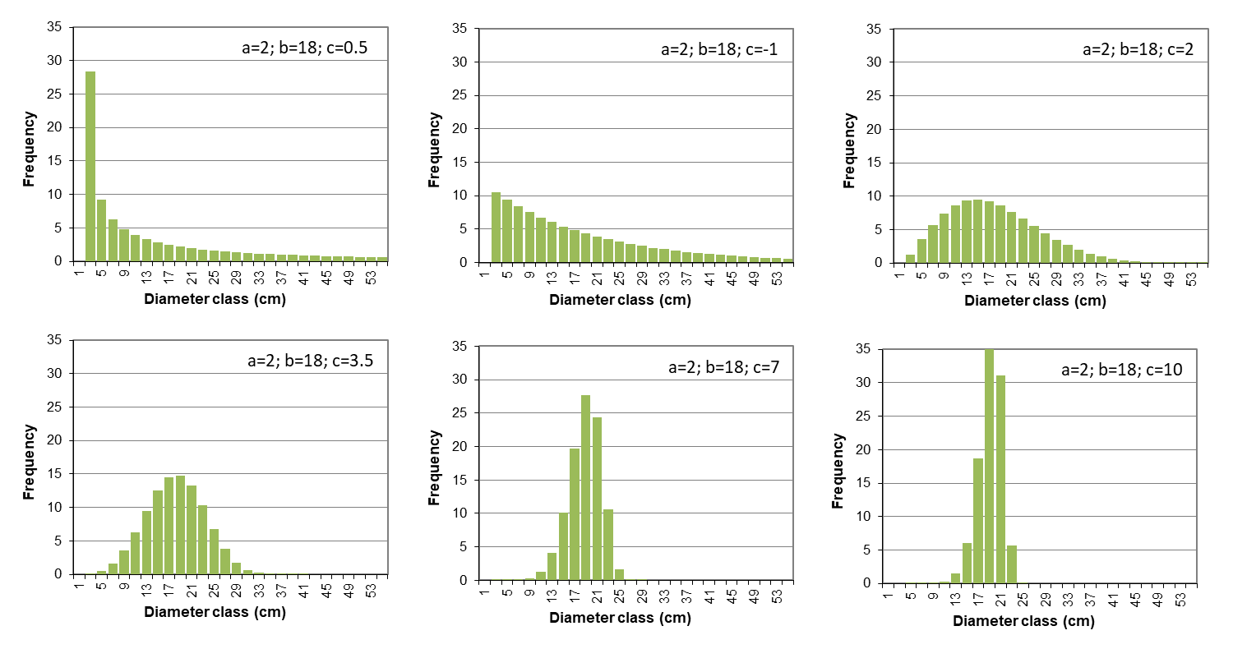
Whole-stand models with diameter distribution (WSM-dd)
Diameter distribution models (DDM)
Modelling diameter distributions:
Selecting a distribution function
- Examples of the Weibull probability density function
a – location parameter (related to the d_{min}) 2
b – scale parameter (>0) 18
c – shape parameter (>0; if c>1 implies a inverse J shape;
if c=3.6 is close to Normal;
If c<3.6 is right skewed;
if c>3.6 is left skewed)
a+b is close to percentile 63% (P₆₃) of the distribution
c = 0.5
c= 1
exponential
c= 2
Rayleigh
c = 3.5
Normal
c = 7
c = 10

Slide 25
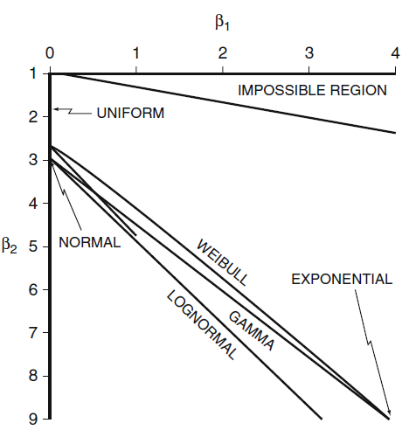
Whole-stand models with diameter distribution (WSM-dd)
Diameter distribution models (DDM)
Modelling diameter distributions:
Selecting a distribution function
- The Johnson’s S_{B} is a system of distributions based on transformations of a standard normal. This system consists of three distributions S_{B}, S_{L} and S_{U}
S_{L} distribution – three parameter lognormal distribution with one parameter being the lower limit
S_{B} distribution – covers the region above the line defined by the S_{L}
S_{U} distribution – covers the region below the line defined by the S_{L}
It is very flexible and can take several shapes

Slide 26
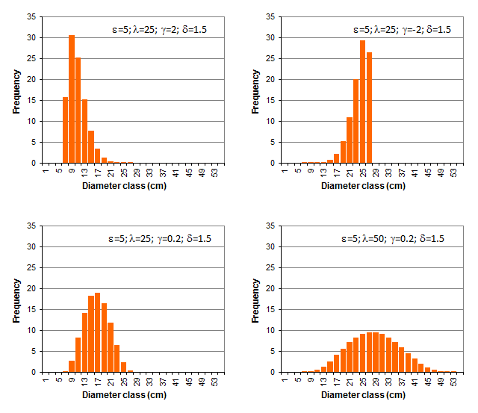
Whole-stand models with diameter distribution (WSM-dd)
Diameter distribution models (DDM)
Modelling diameter distributions:
Selecting a distribution function
The Johnson’s S_{B} is a system of distributions based on transformations of a standard normal. This system consists of three distributions S_{B}, S_{L} and S_{U}
Examples of the Johnson’s S_{B} distribution

Slide 27
Whole-stand models with diameter distribution (WSM-dd)
Diameter distribution models (DDM)
Modelling diameter distributions:
Methods for estimating the parameters of diameter distributions:
When developing a diameter-distribution based yield model sample plot data for selected sample trees are required: age, total number of trees per ha, site index (or, equivalently, average dominant stand height, etc
Parameter Prediction
Data are then used to develop regression equations to predict the parameters, for example for 3-parameter Weibull
a = f₁ (t, N, S) ; b = f₂ (t, N, S) ; c = f₃ (t, N, S)
a = usually represents the minimum diameter of the stand
b = usually represents an upper percentile (P₆₃, P₉₅)
c = usually calculated after a and b are estimated

Slide 28

Whole-stand models with diameter distribution (WSM-dd)
Diameter distribution models (DDM)
Summarizing the idea behind diameter distribution models:
predict growth of the principal variables (hdom, G, N)
(usually the simulation of diameter distribution implies the need to) predict other principal variables, namely minimum diameter and some percentile in the upper part of the distribution
estimate the distribution of trees by diameter classes (diameter distribution using a pdf)
estimate stand volume (total and merchantable) and biomass from the diameter distribution,
by using h-d curves and tree volume equations / tree biomass equations applied to the average tree
calculating volume and biomass per hectare multiplying the number of tree in each class by the average tree values
Summing up the values by class
$$X=\sum_{i=1}^{k}{N_{i}f\left(d_{i}\right)}$$
where k is the number of diameter classes, f(di) corresponds to the calculation of the variable x for the midpoint of diameter class i, and Ni is the number of trees per hectare in that same class

Slide 29
Whole-stand models with diameter distribution (WSM-dd)
Diameter distribution models (DDM)
PBRAVO summary:
Author: Fernando Páscoa, professor IPC
Model type: empirical growth and yield diameter distribution model
Data for model development: MNL continuous forest inventory
Modules: initialization, growth, calculus + diameter distribution, wind risk and management (thinning and final harvest)
Maximum rotation: 80 years
Time-step: 5 years
Simulator: PBRAVO

Slide 30
Whole-stand models with diameter distribution (WSM-dd)
Diameter distribution models (DDM)
The PBRAVO model (Weibull cdf):
The simulation of the diameter distribution is based on the Weibull distribution
Parameters a e b are estimated with the following equations:

Slide 31
Whole-stand models with diameter distribution (WSM-dd)
Diameter distribution models (DDM)
The PBRAVO model (Weibull cdf):
Estimate accumulated probabilities of trees to occur below each dbh class using the Weibull parameters a=2.6, b=9.0, c=3.2 and the stand density of 878
Weibull function to estimates the accumulated frequency of trees per dbh class

Slide 32
Whole-stand models with diameter distribution (WSM-dd)
Diameter distribution models (DDM)
The PBRAVO model (Weibull cdf):
Multiplying the accumulated probabilities by N and making the differences between consecutive d classes one obtains the diameter distribution and the respective G
Stand

Slide 33
Whole-stand models with diameter distribution (WSM-dd)
Diameter distribution models (DDM)
The PBRAVO model (Weibull cdf):
Predicting the height and volume of the average tree of each d class, we estimate volume per d class by multiplying tree volume by the number of trees per ha.
Stand volume is estimated by summing up these values

Slide 34
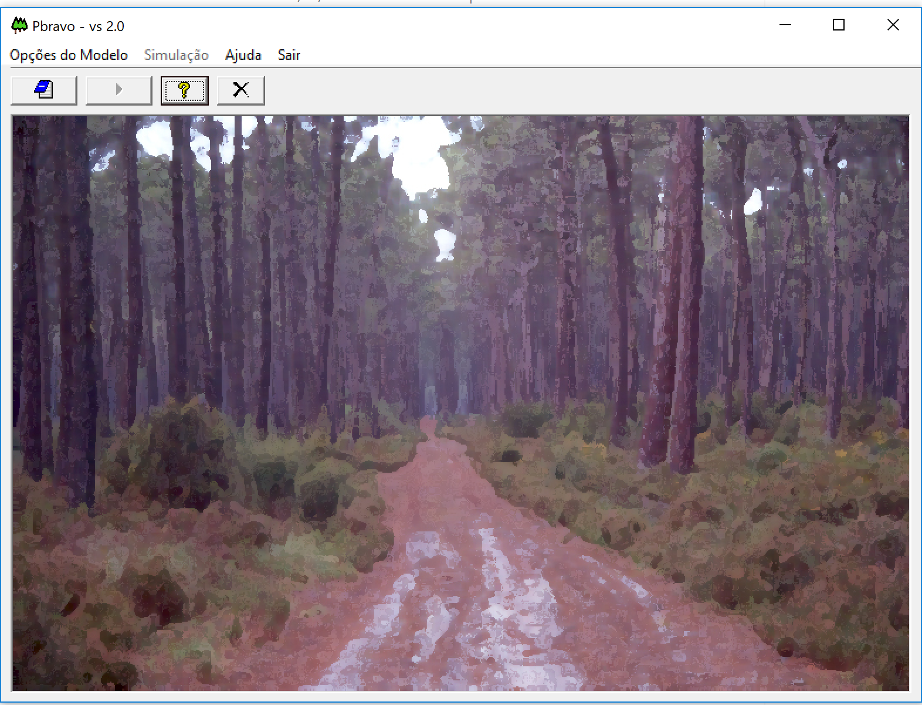
Whole-stand models with diameter distribution (WSM-dd)
Diameter distribution models (DDM)
The PBRAVO model (Weibull cdf):
PBRAVO Model

Slide 35
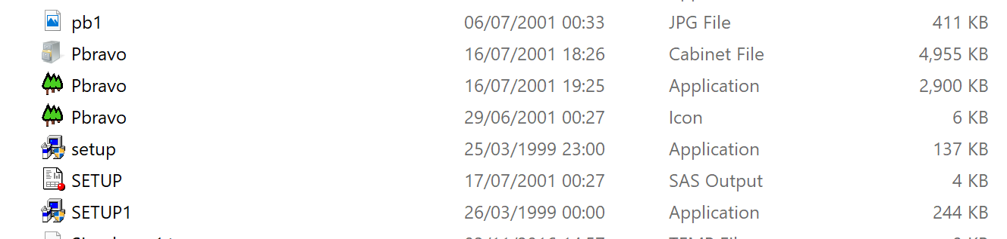
Whole-stand models with diameter distribution (WSM-dd)
Diameter distribution models (DDM)
The PBRAVO model (Weibull cdf):
1) Copy the folder PBRAVO from the memory stick
2) Go to PBRAVO\PBRAVO-FPFP
3) Click on the setup (NOT on the SETUP1)
4) After installing the setup, click on the
Pbravo application
Read the PBRAVO_Model.pdf
Class Materials \ PowerPoints
PBRAVO Model

Slide 36
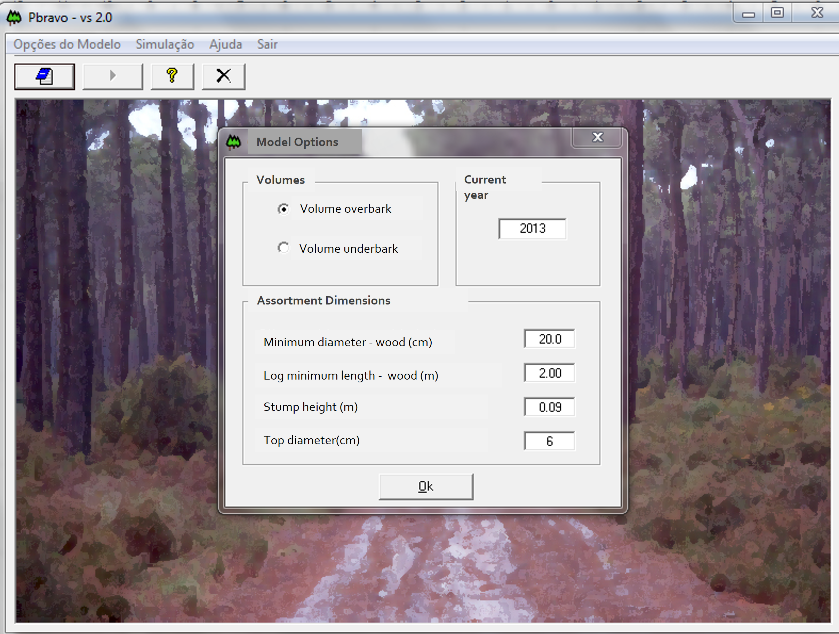
Whole-stand models with diameter distribution (WSM-dd)
Diameter distribution models (DDM)
The PBRAVO model (Weibull cdf):
The current year defined should be consistent with stand age
For maritime pine trees bark represents 20-30% of stem volume
The assortment dimensions:
1.21
2.0
2.0
0.09
2.0
Wood
Pulp
Firewood
madeira
20.00
rolaria
6
lenha

Slide 37
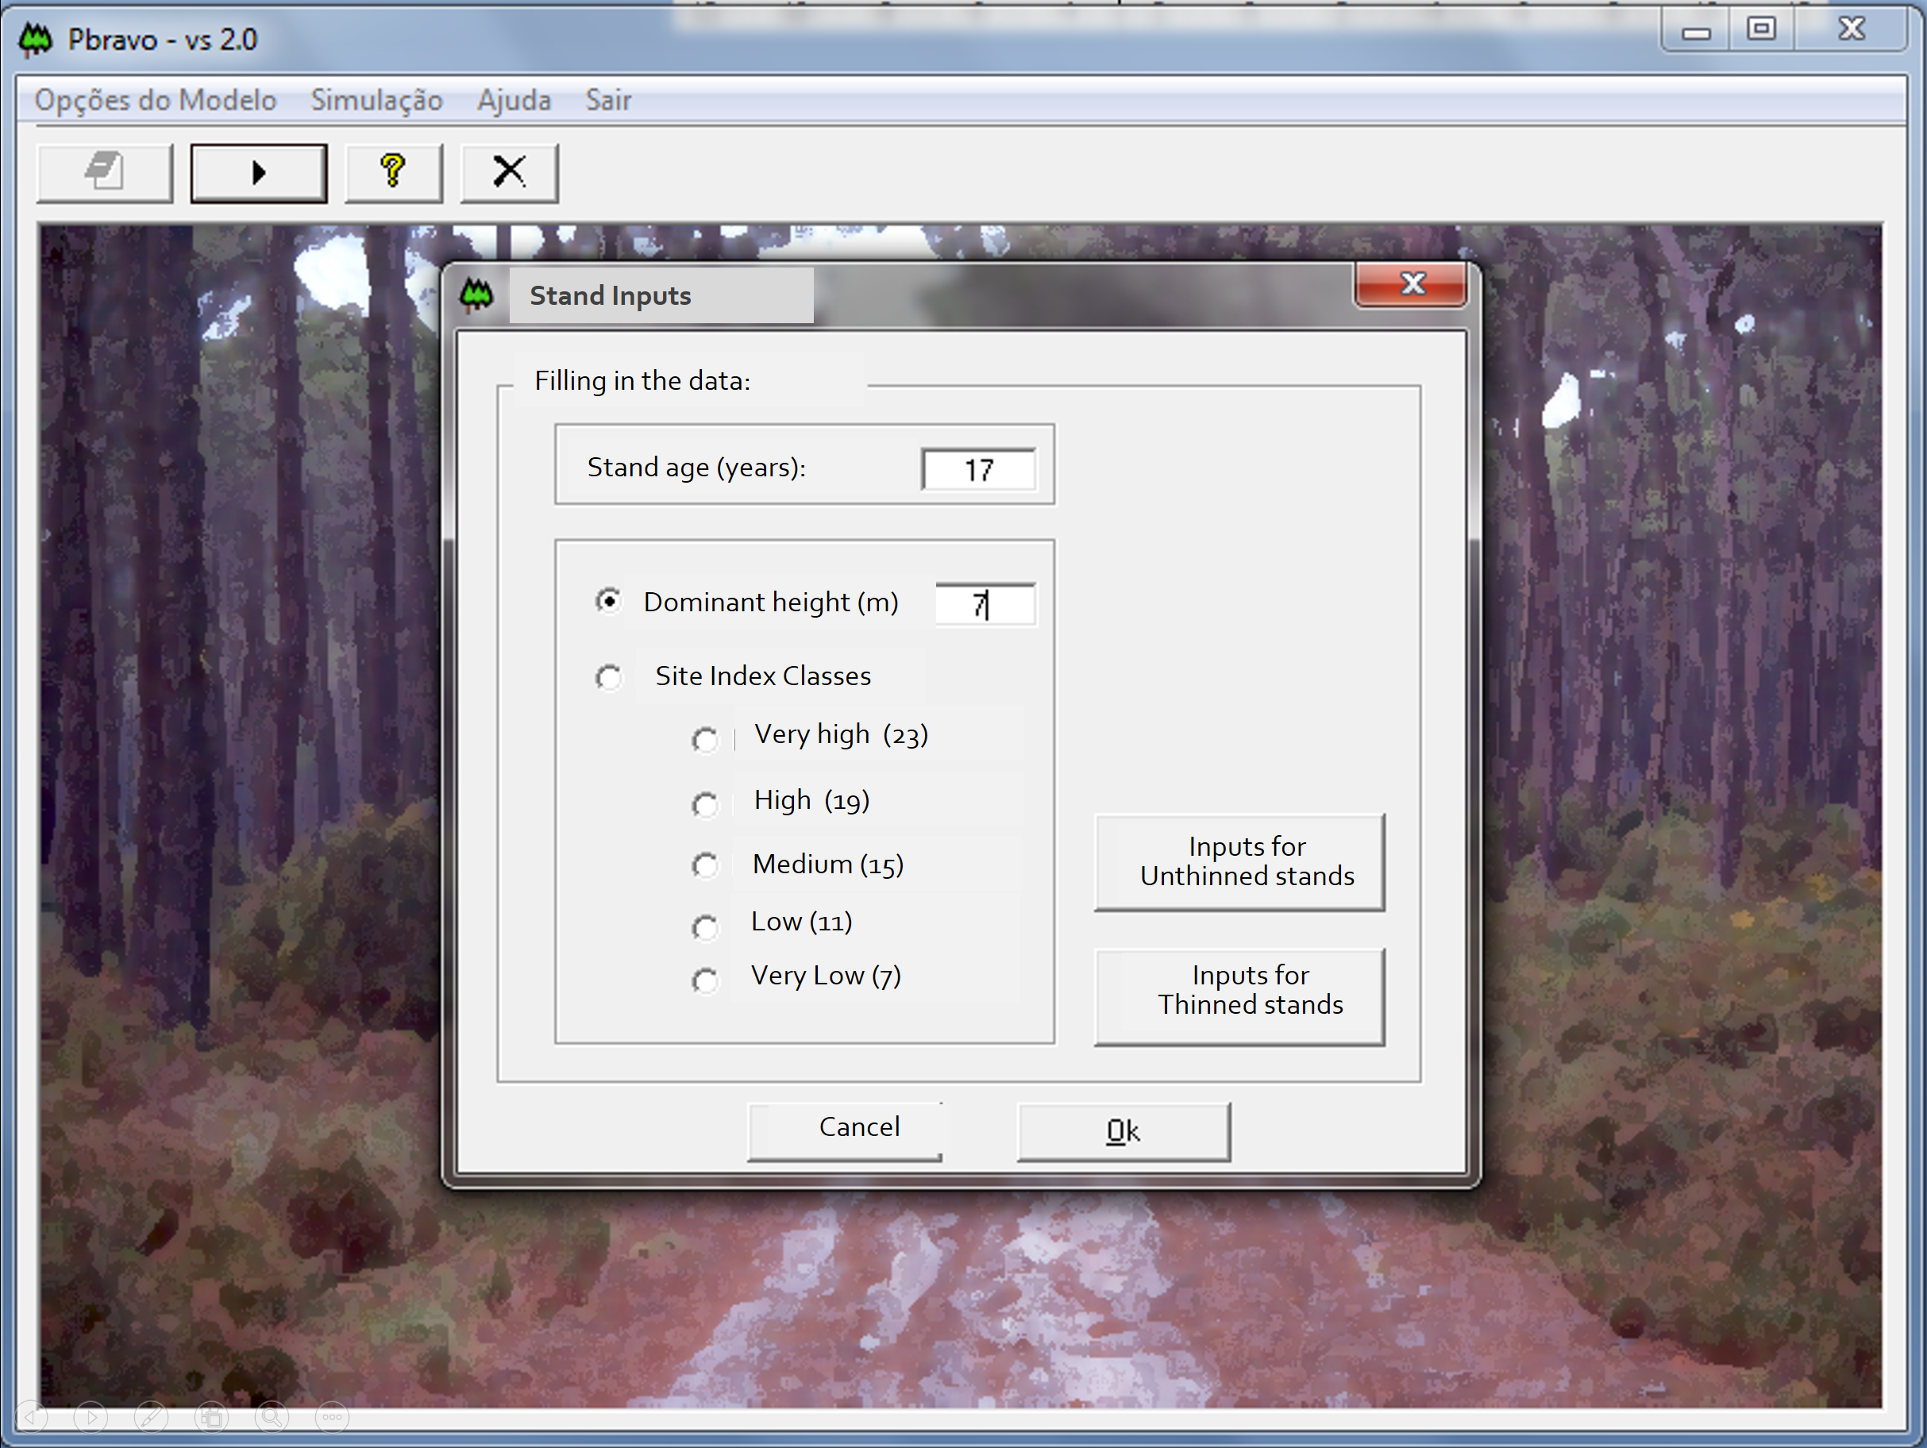
Whole-stand models with diameter distribution (WSM-dd)
Diameter distribution models (DDM)
The PBRAVO model (Weibull cdf):
The model can run for stands that :
- have hdom measured-> fill hdom value
- Have no hdom measured -> fill site index class
- unthinned stands - young stands (projections are not so good for unthinned old stands)
For young stands, the user has to provide either the number of standing trees (ha⁻¹) or the number of trees planted (ha⁻¹). In the latest case a mortality model is applied to express the death of trees due to competition in early stages of stand development
The model runs in 5-year time-steps, stopping at each step allowing to (re-)define the management for the next 5-years period

Slide 38
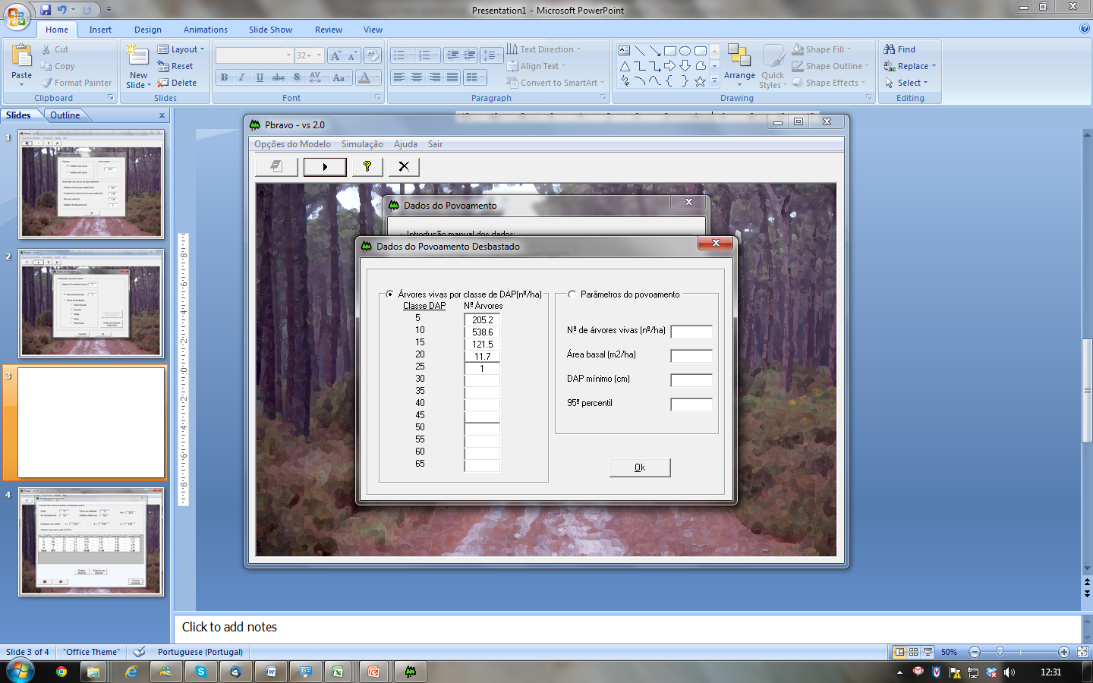
Whole-stand models with diameter distribution (WSM-dd)
Diameter distribution models (DDM)
The number of trees by diameter class
The PBRAVO model (Weibull cdf):
For older stands (already thinned), the user has to provide:
OR
The stand variables to calculate the Weibull parameters (a, b, c)
The dbh class value represents the midpoint of the diameter class
If the stand has trees with dbh greater than 67.5 cm these should be grouped under the 65 class
Class 5 includes not only the trees with dbh [2.5, 7.5[ but also those with dbh < 2.5 cm

Slide 39
Whole-stand models with diameter distribution (WSM-dd)
Diameter distribution models (DDM)
MoDisPinaster summary:
Author: Teresa Fonseca, professor UTAD
Model type: empirical growth and yield diameter distribution model
Data for model development: Data_Pinaster - large database on maritime pine that gathers data from temporary and permanent plots collected in northern Portugal, more precisely in stands located in the Tâmega Valley
Modules: growth, diameter distribution, wind risk and management (thinning and final harvest)
Maximum rotation: 65 years
Time-step: 5 years
Simulator: model “available” in CAPSIS platform

Slide 40
Whole-stand models with diameter distribution (WSM-dd)
Diameter distribution models (DDM)
MoDisPinaster structure
Calculus module
Calculus module
S (eq.2)
Ga (eq.11)
h_tree
v_tree
w_tree
Diameter distribution module
d- dist (eq.9)
Nja (eq.10)
Growth module
hdom (eq.1)
G2 (eq.3)
PI (eq.4)
Poc (eq.5)
P (eq.6)
N2 (eq.7)
N2aj (eq.8)
S, Ga , hi_tree, vi_tree, Wi_tree
Growth module
Stand
t
Thin?
No
hdom, G2, N2, N2aj, PI, Poc, P
Diameter distribution model
yes
d- dist, Nja
t+i
Thinning module
Fw, SDI, …

Slide 41
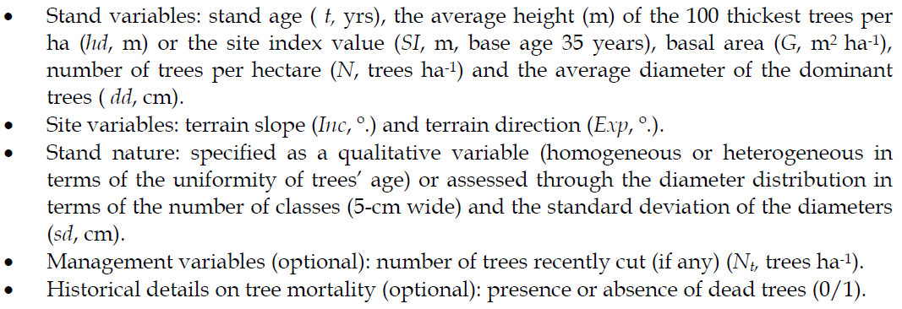
Whole-stand models with diameter distribution (WSM-dd)
Diameter distribution models (DDM)
MoDisPinaster variables
Other optional variables include: the median (d0.50, cm), the average ( d , cm) and the minimum value of the diameter distribution (dmin, cm).

Slide 42
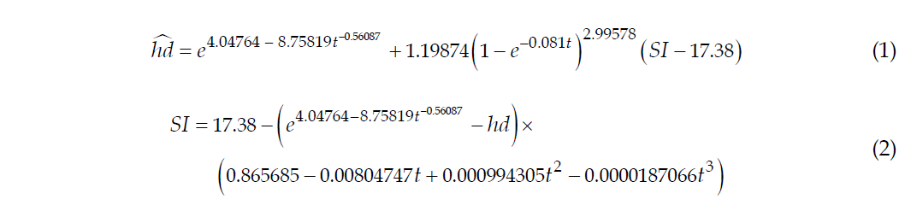
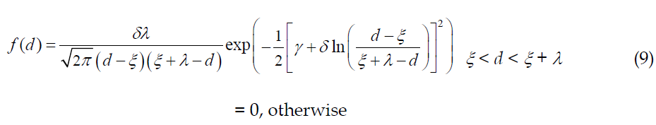
Whole-stand models with diameter distribution (WSM-dd)
Diameter distribution models (DDM)
Calculus module
MoDisPinaster equations
Variable Qhdc and the dummies BF1 and BF2 are related to the stability of the stand;
variable RSb refers to the relative spacing before thinning with BRS being a dummy that makes a distinction of the average space conditions between the trees for the current stand;
dgMAX is the maximum values of tree diameter allowed according to the self-thinning line for the species
BAMPD is a dummy used to differentiate the stands according to the proximity to the self-thinning line
BMA is related to the occurrence of recent mortality
BSExp intrinsic risk of damage occurrence due to aspect
- Diameter distribution
h-diameter, tree volume, tree biomass equations to be applied to the average tree in the diameter class

Slide 43
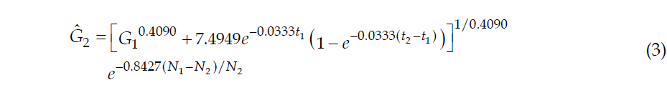
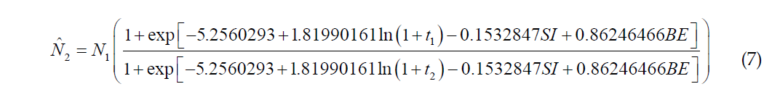
Whole-stand models with diameter distribution (WSM-dd)
Diameter distribution models (DDM)
MoDisPinaster equations
Growth module
Variable Qhdc and the dummies BF1 and BF2 are related to the stability of the stand;
variable RSb refers to the relative spacing before thinning with BRS being a dummy that makes a distinction of the average space conditions between the trees for the current stand;
dgMAX is the maximum values of tree diameter allowed according to the self-thinning line for the species
BAMPD is a dummy used to differentiate the stands according to the proximity to the self-thinning line
BMA is related to the occurrence of recent mortality
BSExp intrinsic risk of damage occurrence due to aspect

Slide 44
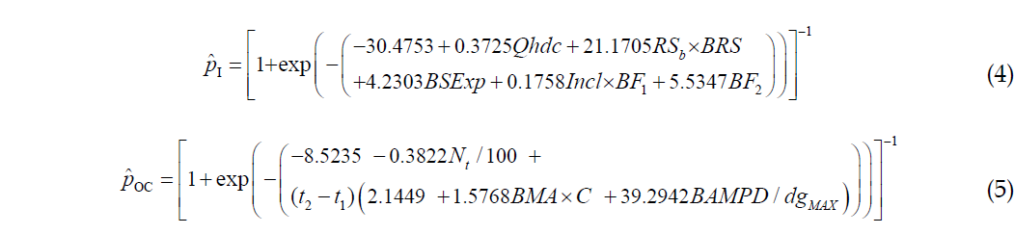
Whole-stand models with diameter distribution (WSM-dd)
Diameter distribution models (DDM)
MoDisPinaster equations
Growth module
Variable Qhdc and the dummies BF1 and BF2 are related to the stability of the stand;
variable RSb refers to the relative spacing before thinning with BRS being a dummy that makes a distinction of the average space conditions between the trees for the current stand;
dgMAX is the maximum values of tree diameter allowed according to the self-thinning line for the species
BAMPD is a dummy used to differentiate the stands according to the proximity to the self-thinning line
BMA is related to the occurrence of recent mortality
BSExp intrinsic risk of damage occurrence due to aspect

Slide 45
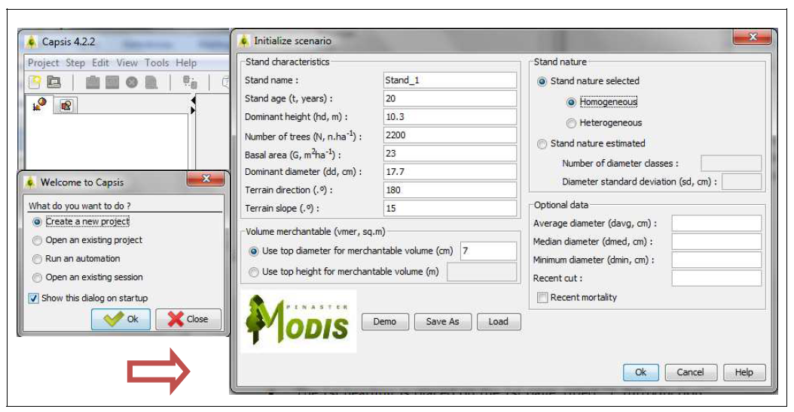
MoDisPinaster interface
The variables that characterize the stand for the base year of simulation: age (t, yrs), dominant height (hdom, m), number of trees (N, trees ha-1), and basal area (G, m2 ha-1), are updated on an annual basis until the end of the growth period, using the set of equations 1-8.). Site variables are also provided terrain slope (Inc, º.) and terrain direction (Exp, º.).
By default, the stand is assumed to be of homogeneous structure (even-aged).
Other optional variables include: the median (d0.50, cm), the average ( d , cm) and the minimum value of the diameter distribution (dmin, cm).
A merchantability limit of a top diameter of 7 cm is specified for volume estimates.

Slide 46
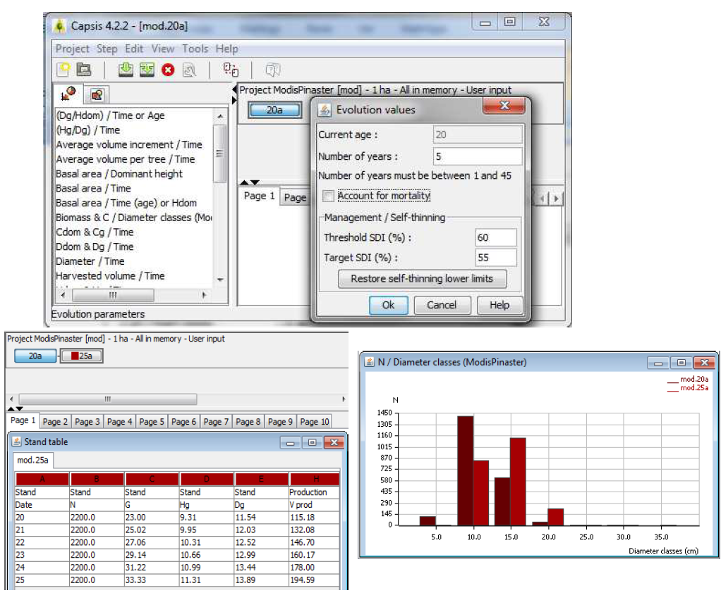
MoDisPinaster interface
An automatic management procedure, based on the self-thinning theory is available in the Management/Self-thinning dialog. By default, the limits specified for the Stand Density Index (SDI, Reineke, are with respect to a stand that grows under high values of density.
The occurrence of mortality by competition is expected whenever SDI reaches the threshold of 60%. The limits can be modified by the user, according to pre-determined management guidelines.
Outputs refer to a stand table for the 5-year evolution period and to the number of trees by diameter class, at the initial stand age (20 yrs) and at the end of the simulation (25 yrs). The diameter distribution is presented for each simulation year

Slide 47
MoDisPinaster interface
Thinnings
The majority of the maritime pine stands in Portugal are even-aged and are managed according to a thinning regime.
Density regulation is usually based on the Wilson factor. A typical value of Fw = 0.23 has been assumed in the maritime pine stands of the Tâmega Valley Region.
The rotation age is defined by the age at which occurs the
maximum annual increment of tree stem volume. Depending on site quality, stands attain their absolute explorability term for the volume variable when the stand reaches 35 (high quality) years to 45 (low quality).
In the area studied it is usual to set the lowest limit of stand age to harvest to 40-45 years.

Slide 48
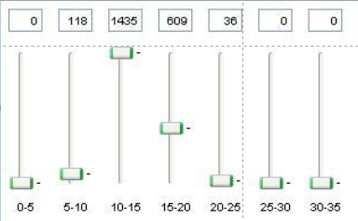
MoDisPinaster interface
Thinnings
There are 4 options for thinning simulation:
Wilson factor
Number of trees
Stand density Index (SDI)
Thinning diagram (Cut trees by action on an interactive diameter distribution histogram)
In each of these cases, the selection of the trees to remove from the stand is made according to the algorithm of Alder, which assures a probability of a tree to survive to cut being proportional to the tree´s size.
Alternatively, the user can perform a selective thinning using the Capsis interactive diagram. With this option, the trees are cut by action on an interactive diameter distribution diagram.

