Slide 1
Susana Barreiro & Margarida Tomé, 2025
PINASTER
Individual Tree Model

Slide 2
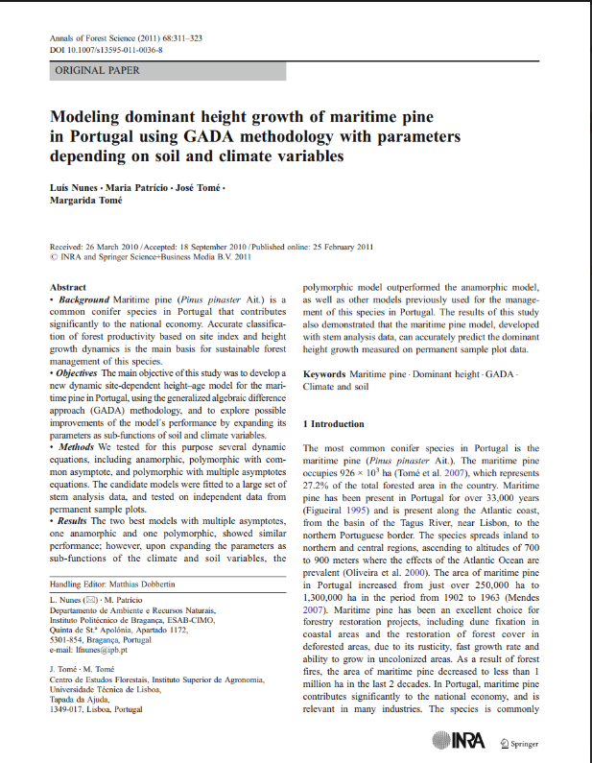
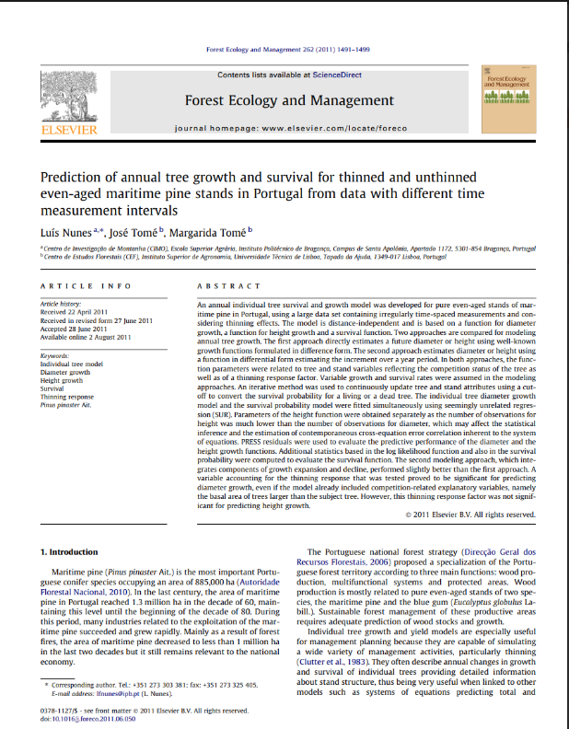
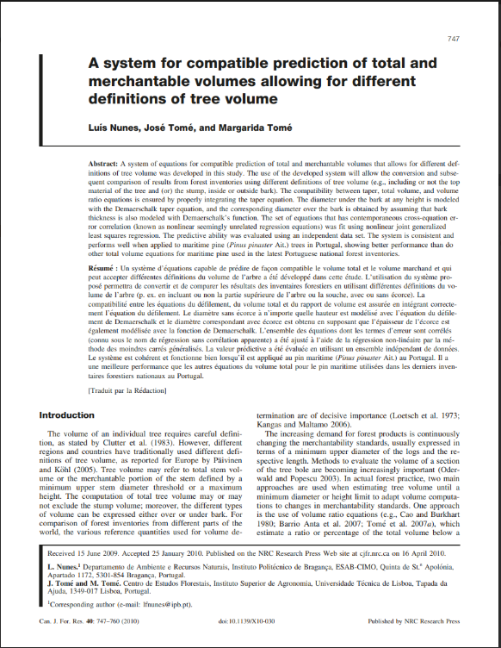
PINASTER individual tree model
´most of the model components were developed by a colleague from Instituto Politécnico de Bragança, North of Portugal, under his PhD and published in 3 separate papers
But not all his equations were integrated in StandsSIM.md simulator

Slide 3
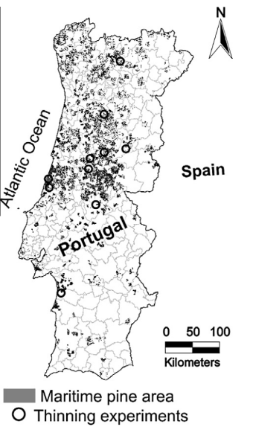
PINASTER individual tree model
Growth module (principal variables)
Thinning experiments in a total of 145 permanent sample plots covering different treatments concerning from low to heavy thinning, including no thinning, and also situations of increasing and decreasing thinning intensity. All thinnings were from below.
The diameter growth model includes:
A variable accounting for the thinning response;
competition-related variable = the basal area of trees larger than the subject tree.
Thinning response was not significant for predicting height growth.
The individual tree diameter growth model and the survival probability model were fitted simultaneously using seemingly unrelated regression (SUR). Parameters of the height function were obtained separately as the number of observations for height was much lower than the number of observations for diameter

Slide 4
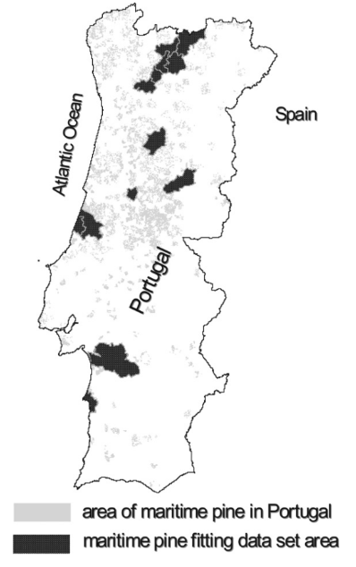
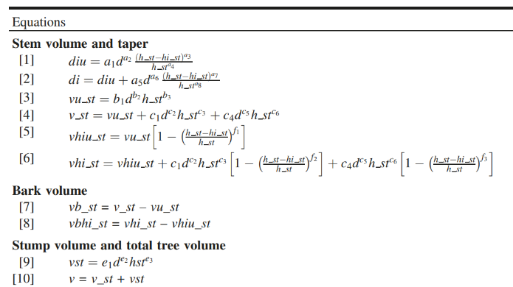
PINASTER individual tree model
Calculus module (derived variables)
Merchantability standards are usually expressed in terms of a min. upper diameter of the logs and its respective length
estimate a ratio or percentage of the total volume below a limiting top diameter or height
Total tree volume is partitioned:
- stump volume
- above-stump volume
stem volume underbark
stem volume overbark
Equations fit using nonlinear joint generalized

Slide 5
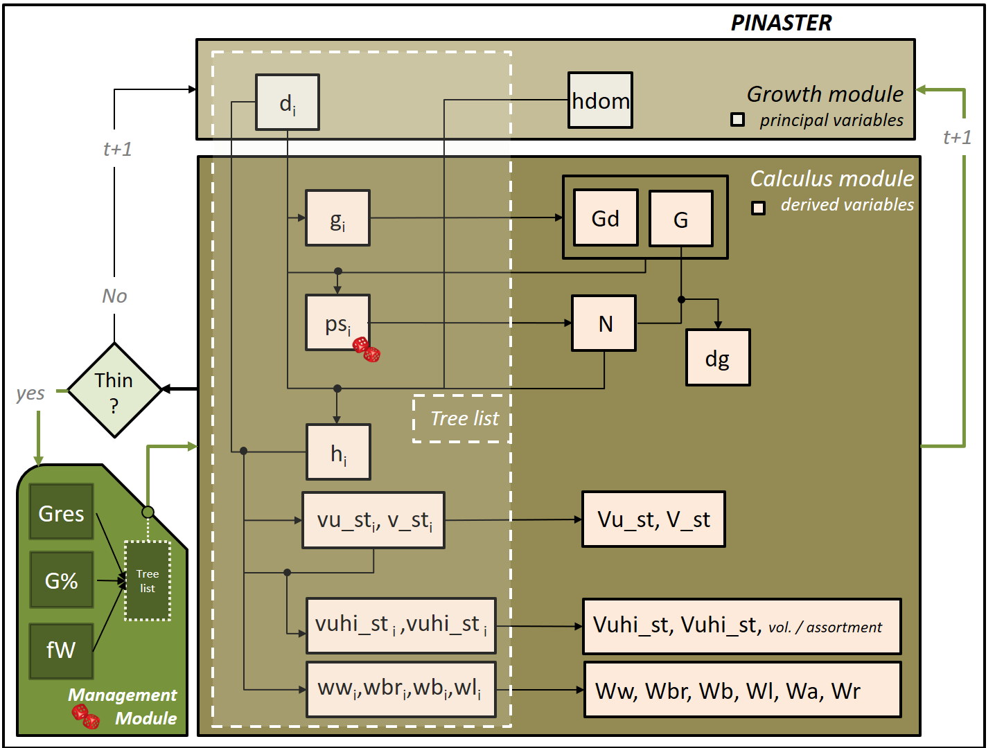
PINASTER individual tree model
Implementation of the model in StandsSIM.md
Growth Module:
Site index curves (Tomé et al. 2001)
Diameter growth (Nunes et al. 2011) Calculus module:
Tree survival (Nunes et al. 2011)
Height-diameter curves (Tomé et al. 2007)
Self-thinning (Tomé 2001)
System of equations for total standing - volumes and volume by assortments (Nunes et al. 2010)
Total biomass and biomass by tree components (Faias 2009)

Slide 6
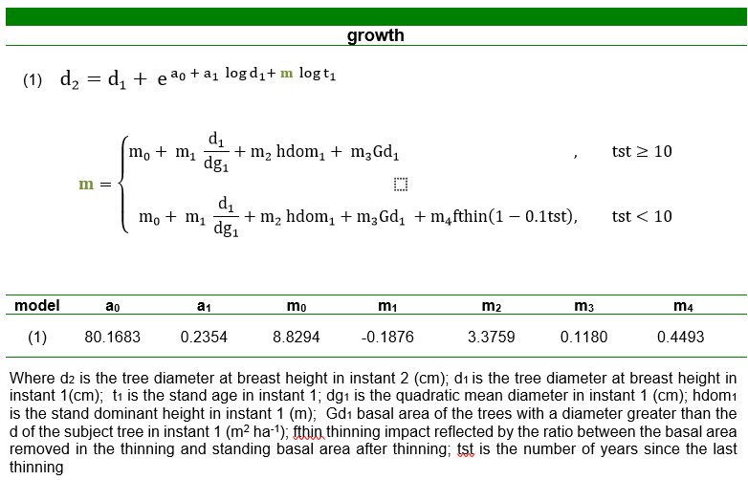
PINASTER individual tree model
Growth module (principal variables)
The diameter growth model includes:
A variable accounting for the thinning response;
competition-related variable = the basal area of trees larger than the subject tree.

Slide 7
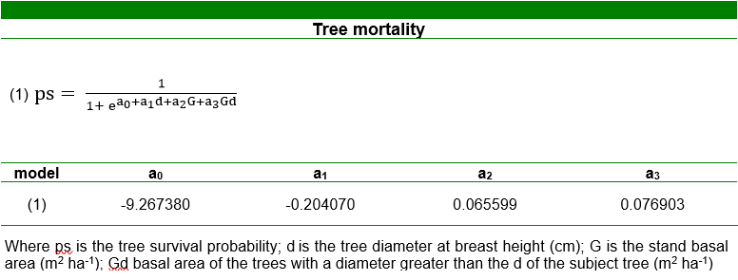
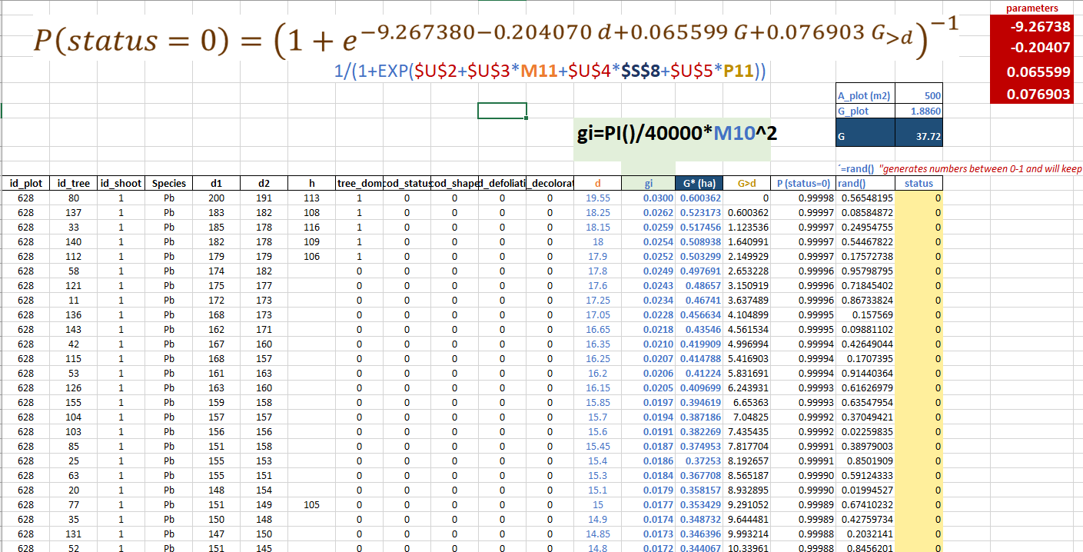
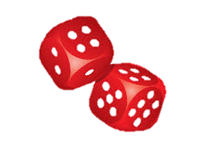
PINASTER individual tree model
Calculus module (derived variables)
The survival probability and the diameter growth equations were simultaneously fitted

Slide 8
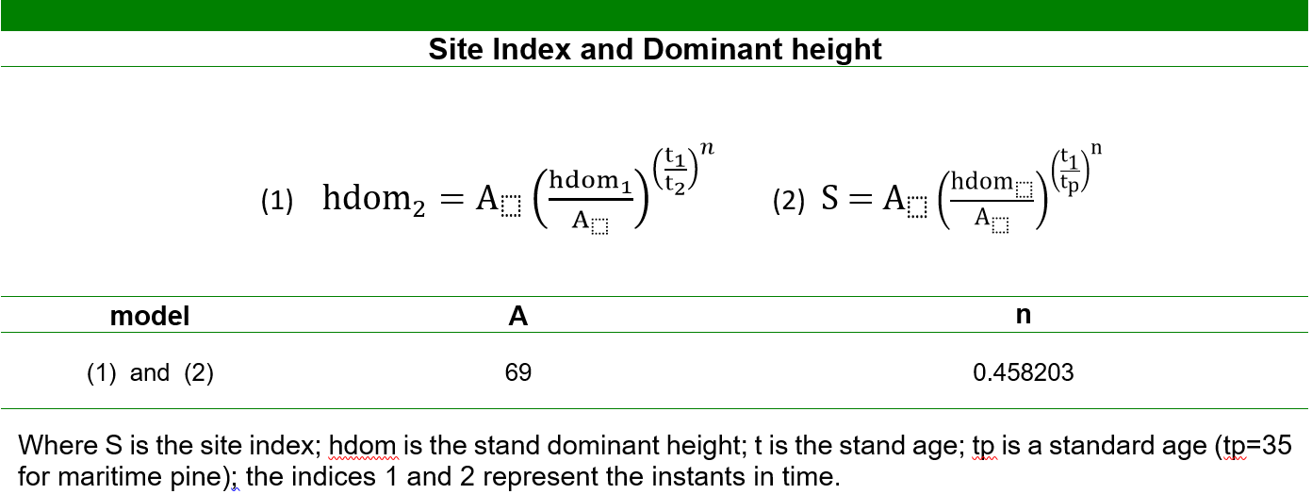
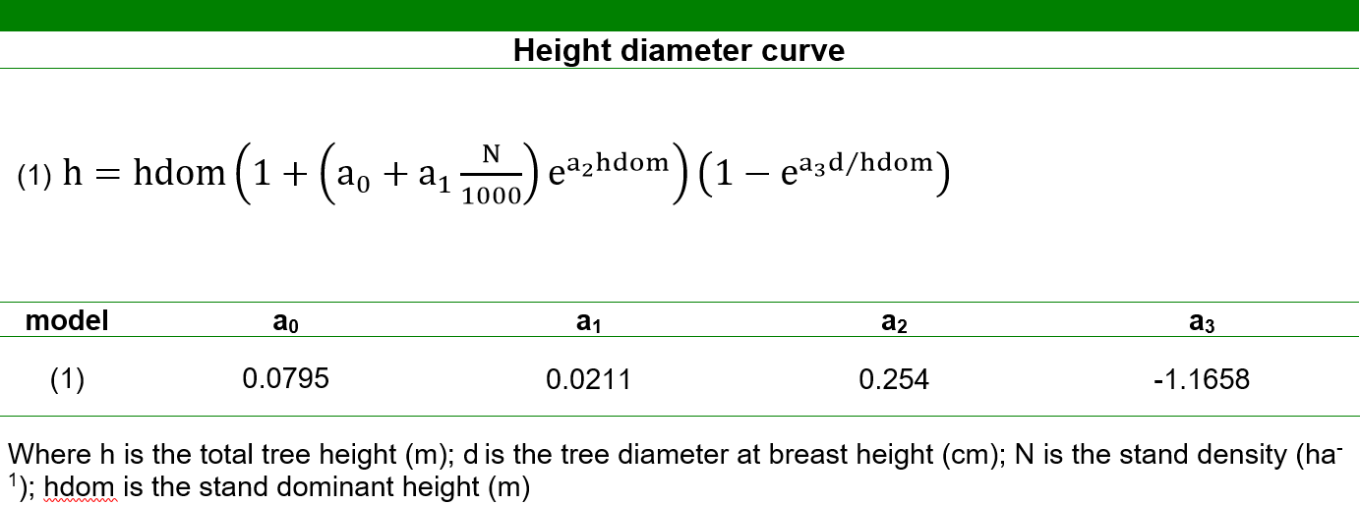
PINASTER individual tree model
Growth and Calculus modules
The dominant height growth and the tree height growth models were not compatible
CONSEQUENCE: if implemented in the simulator applying one or the other could originate different height values for the same instant in time; SOLUTION: using an alternative set of equations Tomé et al. 2001, Tomé et al. 2007 avoiding using both the height growth and hdom growth at the same time

Slide 9
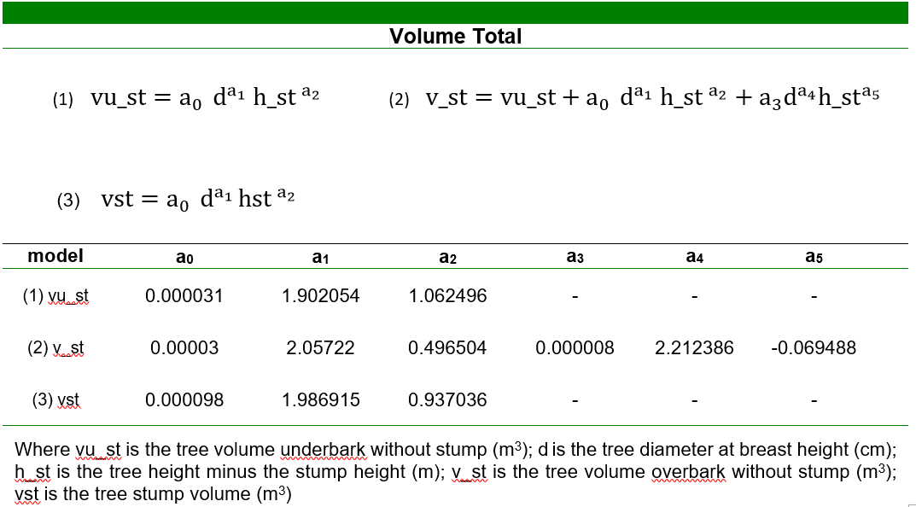
PINASTER individual tree model
Calculus module (derived variables)
Total tree volume is partitioned into above-stump volume and stump
volume. The above-stump volume is subdivided into stem volume (under and over bark) and bark volume, which is obtained by the difference of the two stem volumes.
vb
v_st -vu_st
vu_st
v_st
vst

Slide 10
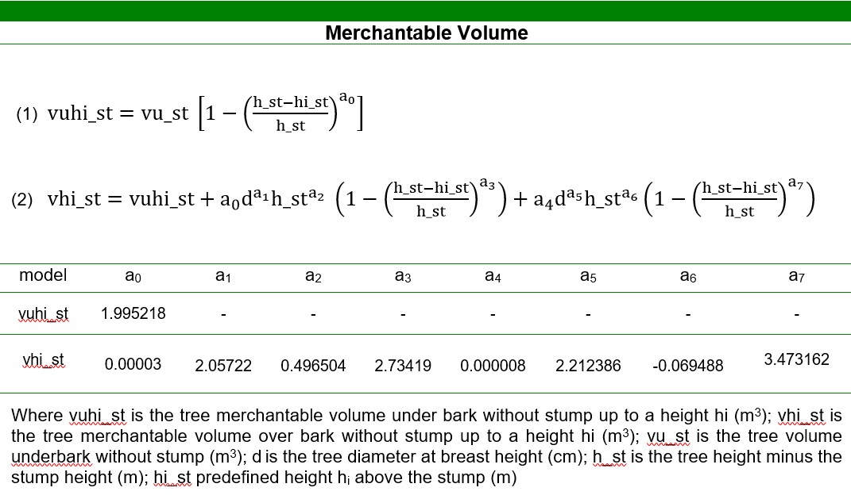
PINASTER individual tree model
Calculus module (derived variables)
Merchantable tree volume: compatible total volume equations (vu_st and v_st) and volume ratio equations (vuhi_st and vhi_st) were obtained using total or partial tree height above stump

Slide 11
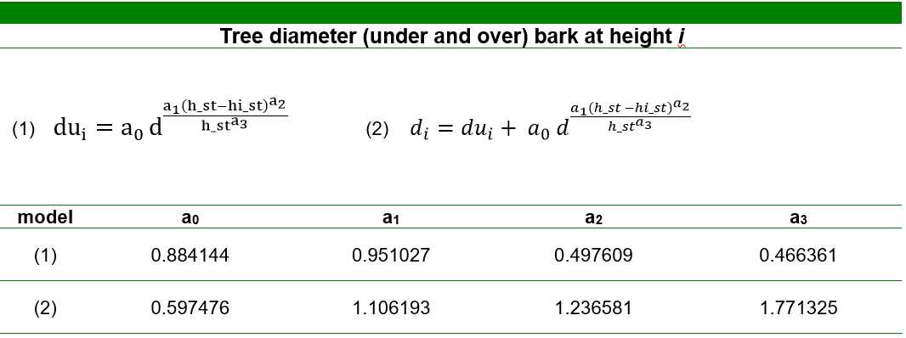
PINASTER individual tree model
Calculus module (derived variables)
Tree volume by assortment: compatible equations to estimate diameter under and over bark at a given height

Slide 12
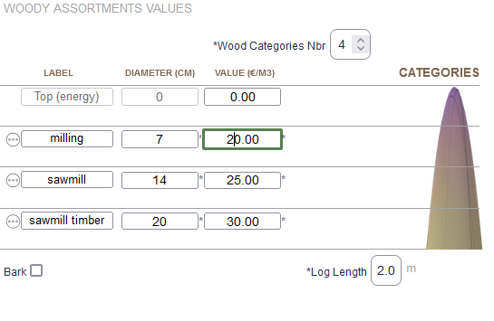
PINASTER individual tree model
Calculus module (derived variables)
Merchantable tree volume: compatible total volume equations (vu_st and v_st) and volume ratio equations (vhiu_st and vhi_st) were obtained using total or partial tree height above stump

Slide 13
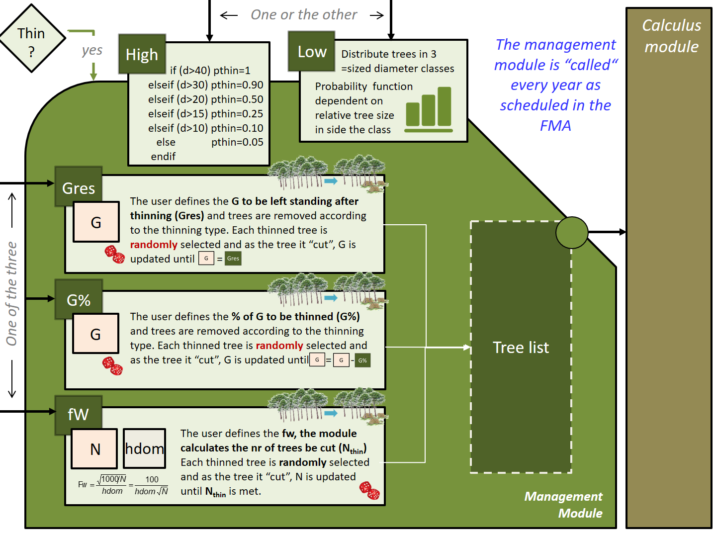
PINASTER individual tree model
The management module
Growth Module:
Site index curves (Tomé et al. 2001)
Diameter growth (Nunes et al. 2011) Calculus module:
Tree survival (Nunes et al. 2011)
Height-diameter curves (Tomé et al. 2007)
Self-thinning (Tomé 2001)
System of equations for total standing - volumes and volume by assortments (Nunes et al. 2010)
Total biomass and biomass by tree components (Faias 2009)

Slide 14
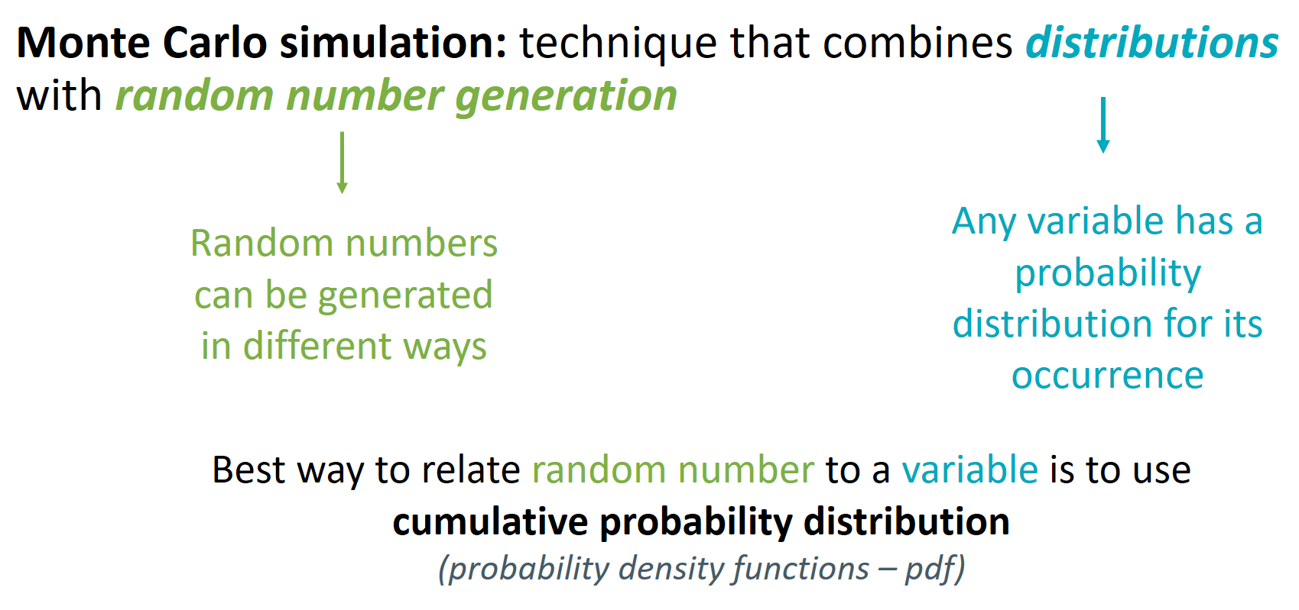
PINASTER individual tree model
The management module
Random numbers & Monte Carlo Simulation
Monte Carlo simulation is a computerized mathematical technique that allows to model the probability of different outcomes in a process that cannot be easily predicted due to the intervention of random variables
Monte Carlo simulation depends on a sequence of random numbers which is generated during the simulation

Slide 15
PINASTER individual tree model
The management module
Random numbers & Monte Carlo Simulation
Random numbers are used to obtain random observations from a probability distribution. How are they generated?
Manually – laborious and not practical
Random Tables – random physical process but difficult to implement in a computer
Computers – generate pseudo random numbers (pseudo because they’re obtained with a deterministic mathematical process EXCEL RAND(), RANDBETWEEN(min, max)
– generate true random numbers use nature related processes that are truly unpredictable (usually the easiest is using the day and time
Usually used with a seed so that the same result can be reproduced under similar conditions (deterministic simulation)

Slide 16
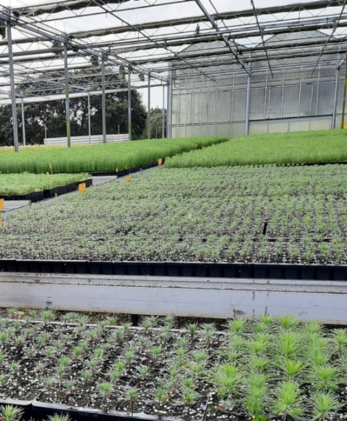
PINASTER individual tree model
The management module
Random numbers & Monte Carlo Simulation
The daily demand for clone packs (80 seedlings/pack) during Spring months was studied (200 weeks) and the probabilities are the following:
Relative frequencies (probability)
If the distribution is known , WHY do we use random numbers to simulate it?
Nr packs ordered | probability
0 | 0.05
1 | 0.1
2 | 0.15
3 | 0.3
4 | 0.25
5 | 0.15
BECAUSE, although the probability is known (the relative frequency of each demand level), the order of occurrence is not
It is the order of occurrence (which is assumed random) which we want to simulate

Slide 17
PINASTER individual tree model
The management module
Random numbers & Monte Carlo Simulation
Using a empirical distribution
The daily demand for clone packs (80 seedlings/pack) during Spring months was studied (200 weeks). Assume that the demand/week is given by the distribution and simulate the demand for 10 weeks. Draw random numbers to determine the nr of packs ordered.
Nr packs ordered | Absolute frequency | Probability (relative frequency) | cumulative
0 | 10 | 0.05 | 0.05
1 | 20 | 0.1 | 0.15
2 | 30 | 0.15 | 0.35
3 | 60 | 0.3 | 0.65
4 | 50 | 0.25 | 0.85
5 | 30 | 0.15 | 1
Eg.: Rand nr=0.4 means 3 packs ordered that week
200

Slide 18
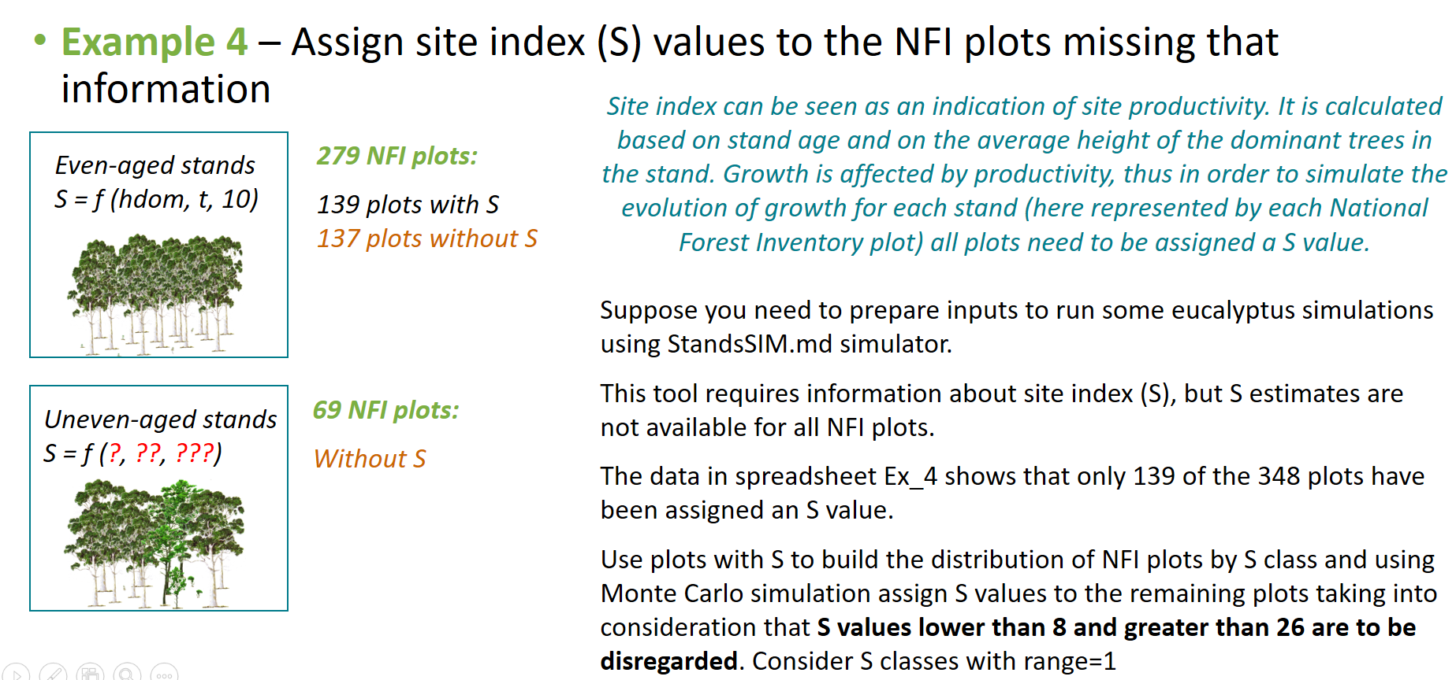
PINASTER individual tree model
The management module
Random numbers & Monte Carlo Simulation
Using a empirical distribution

Slide 19
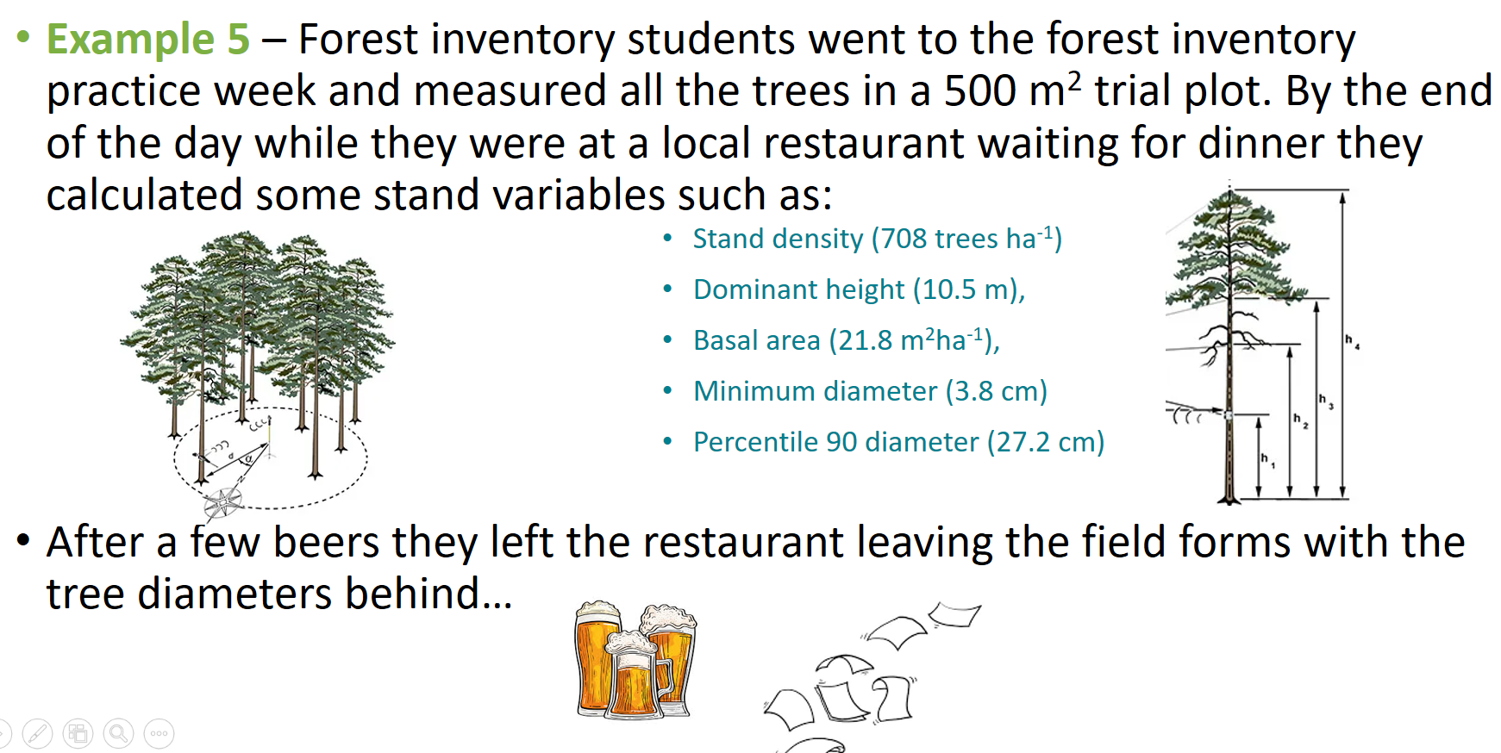
PINASTER individual tree model
The management module
Random numbers & Monte Carlo Simulation
Using a theoretical distribution

Slide 20
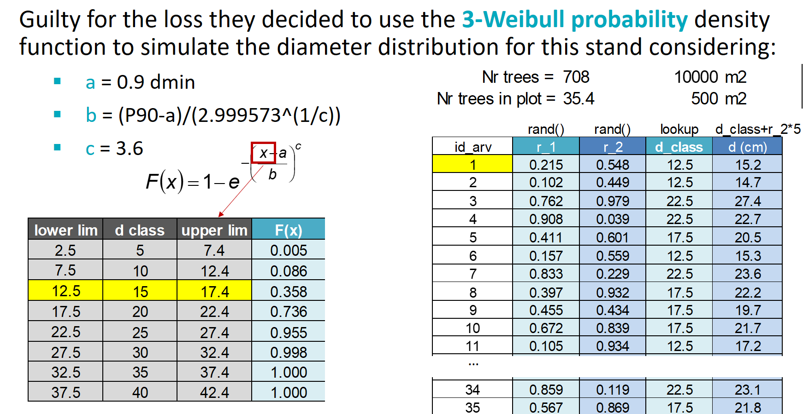
PINASTER individual tree model
The management module
Random numbers & Monte Carlo Simulation
Using a theoretical distribution

Slide 21
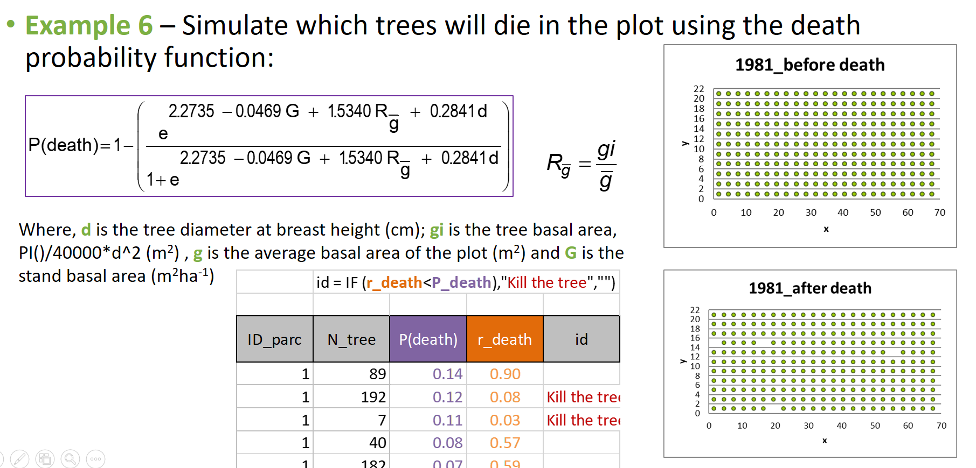
PINASTER individual tree model
The management module
Random numbers & Monte Carlo Simulation
Using a probability function

Slide 22
The End!!

