Slide 1
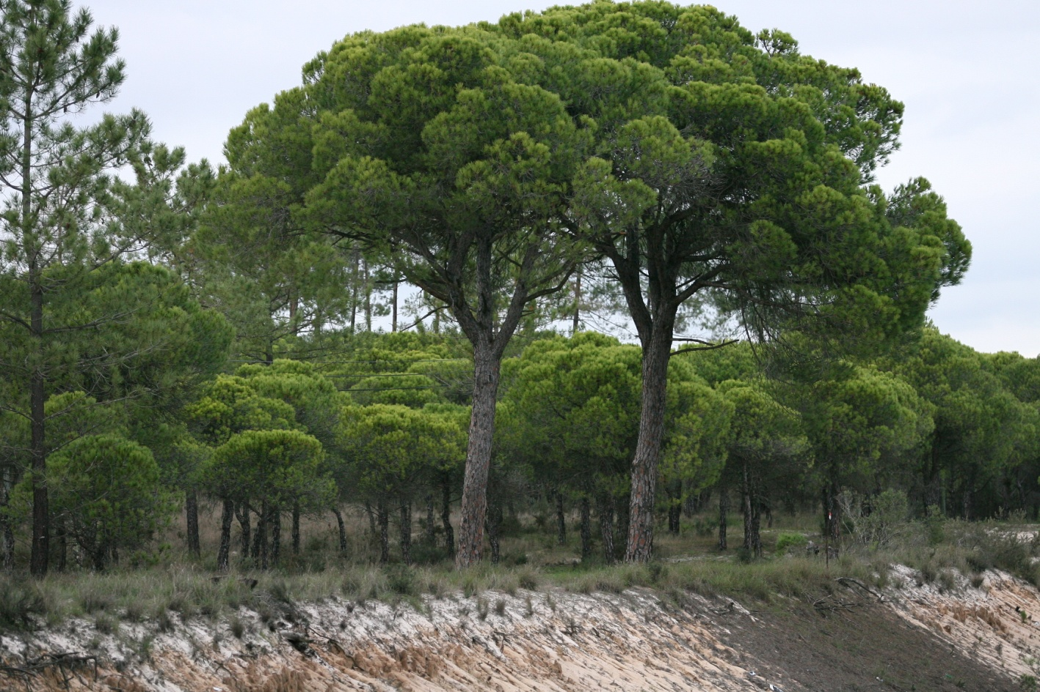
Susana Barreiro & Margarida Tomé, 2026
PINEA
Individual Tree Model

Slide 2
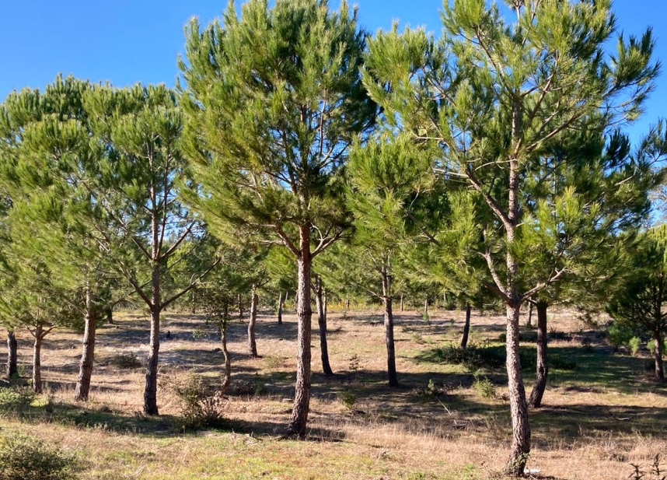
PINEA individual tree model

Slide 3
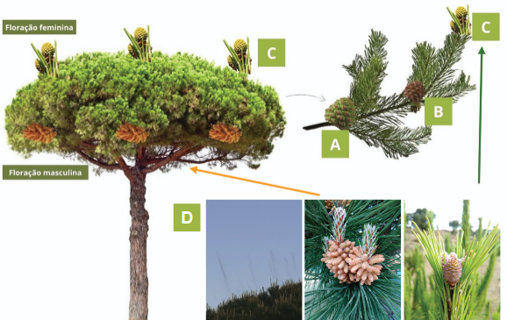
PINEA individual tree model
Pine cones formation / production
Pine cone to be harvested in the current year (n);
(B) Pine cone to be harvested next year (n+1);
(C) Pine cone to be harvested in 2 years time (n+2);
(D) Polen cloud
(E) Male flowering (lower part of the crown)
(F) Female flowering (upper part of the crown)
2004-2005
2006-2007
2007-2008
E
F

Slide 4
PINEA individual tree model
Pine cones formation / production
Pine cone to be harvested in the current year (n);
(B) Pine cone to be harvested next year (n+1);
(C) Pine cone to be harvested in 2 years time (n+2);
(D) Polen cloud
(E) Male flowering (lower part of the crown)
(F) Female flowering (upper part of the crown)
2004-2005
2006-2007
2007-2008
E
F

Slide 5
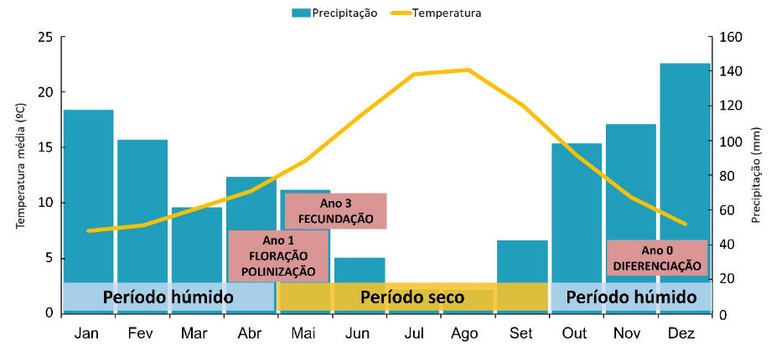
PINEA individual tree model
Pine cones formation / production
Long reproductive cycle: from differentiation of floral structures to their full maturity (up to 4 years) with several phenological phases occurring simultaneously throughout the same year:
flowering,
fecundation,
cone development
vegetative growth
Reproductive cycle influenced by seasonal climate patterns: water availability 4 years

Slide 6
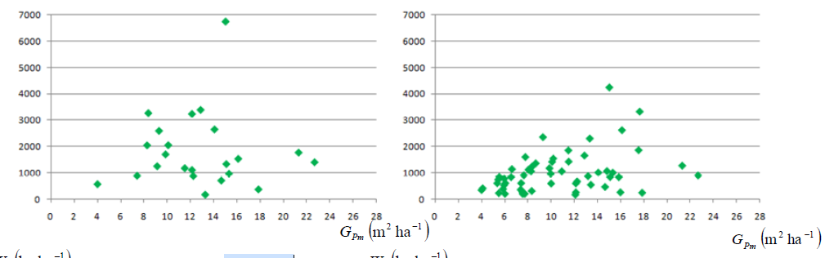

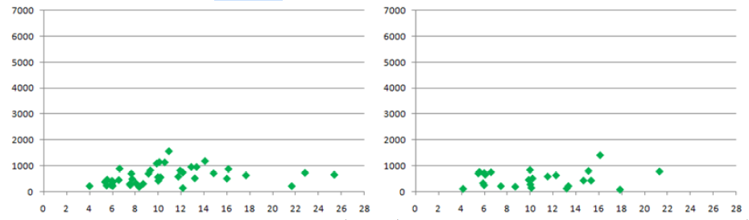

PINEA individual tree model
Pine cones formation / production
2004-2005
2005-2006
There is considerable variation in pine cone production:
between different stands
within the same stand,
between different growing seasons.
This may be due to:
the age of the trees,
competition
weather conditions during the formation and ripening of the pine cones
Pine cone formation is a complex process
2006-2007
2007-2008

Slide 7
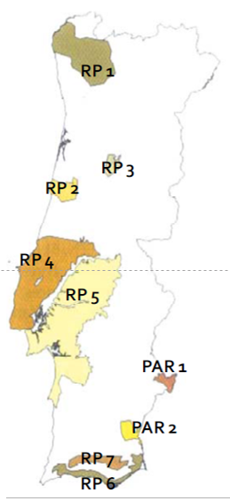
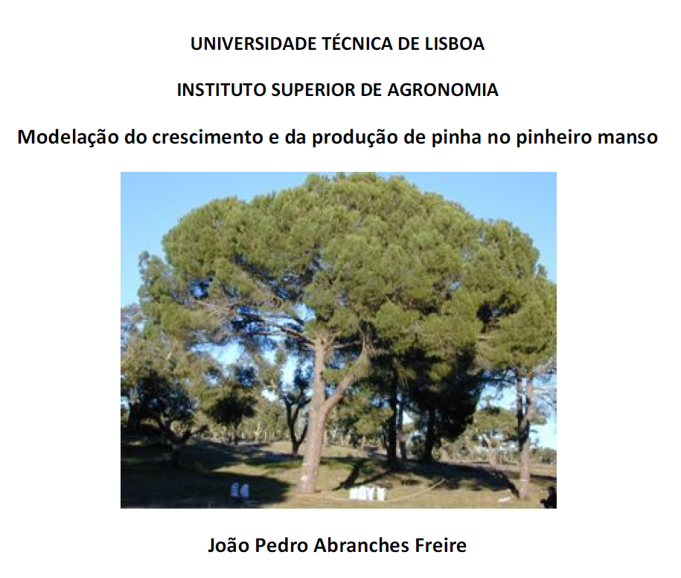
PINEA individual tree model
Pine cones formation / production
Stone pine is a Mediterranean tree species well adapted to central and Southern Portugal.
Pine cones are the main source of income
Its socio-economic importance is reflected through the increasing area of plantations and has justified the development of a growth model to support forest management.

Slide 8
PINEA individual tree model
Most of the model components were developed by a colleague under his PhD
Canopy variables are of extreme importance:
Diameter growth
h-d curve for even-aged stands
h-d curve for uneven-aged stands
Crown diameter
Crown length
Cone production
cone existence x cone weight

Slide 9
PINEA individual tree model
Most of the model components were developed by a colleague under his PhD, BUT not all his equations were integrated in StandsSIM.md simulator
The model integrates the following modules :
Prediction Module: . Site index curves (Calama et al. 2013) . Growth diameter (Freire 2010)
Calculus Module: . Cone weight prediction (accounting for masting (Freire 2010)
Crown diameter prediction (Freire 2010) . Height-diameter curves (Freire 2010) . Self-thinning (Tomé 2001) . System of equations for total standing volumes and volume by assortments (Nunes et al. 2010) . Total biomass and biomass by tree components (Correia et al. 2010)
Management Module: Thinning

Slide 10
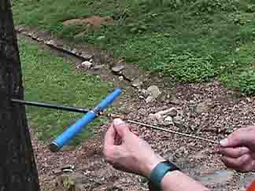
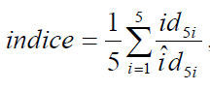
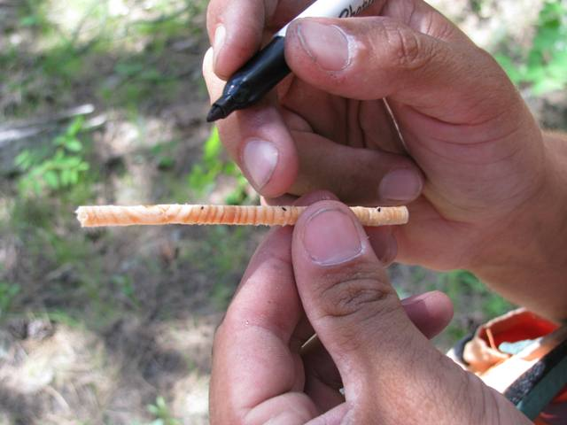

PINEA individual tree model
The growth index (indice) and its integration in StandsSIM.md simulator
measurement of underbark diameter (cm) over the past 5 years in tree cores in 5 trees the closest to percentiles 5, 25 50, 75 e 95% of mean crown diameter
average underbark diameter growth (cm) prediction for 5 years in tree i:
$\hat{id_{5i} }= a_{0}$ + $a_{1}G_{Pm}$ + $a_{2}\frac{g_{i}}{G_{T}}$ + $a_{3 }$ $dgdom$
Where G_{Pm} is the basal area of stone pine, gi is the sectional area of tree i, G_{T} is the total basal area of the plot and dgdom is the quadratic mean diameter of the dominant trees.

Slide 11
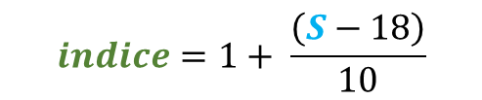
PINEA individual tree model
The growth index (indice) and its integration in StandsSIM.md simulator
measurement of underbark diameter (cm) over the past 5 years in tree cores in 5 trees the closest to percentiles 5, 25 50, 75 e 95% of mean crown diameter
Indice values:
above 1 - indicate an above the average site;
close to 1- indicate an average site,
lower 1 - indicate a poor site
The simulator, for easiness of use and compatibility reasons requires a S value between 10 and 30 that need to be converted to the indice as follows:
average underbark diameter growth (cm) prediction for 5 years in tree i:
$\hat{id_{5i} }= a_{0}$ + $a_{1}G_{Pm}$ + $a_{2}\frac{g_{i}}{G_{T}}$ + $a_{3 }$ $dgdom$
$$indice=1+ \frac{\left(S−18\right)}{10}$$
Where G_{Pm} is the basal area of stone pine, gi is the sectional area of tree i, G_{T} is the total basal area of the plot and dgdom is the quadratic mean diameter of the dominant trees.

Slide 12


PINEA individual tree model
Most of the stands were naturally regenerated with trees of different ages which prevents the use of site index curves
Site quality has a major influence on tree growth.
In order to integrate site quality into the model, a growth index (indice) was defined.
The index expresses the relationship between growth in a given plot - assessed on the basis of ring-count measurements - and the average expected growth for trees of the same size.
In order to estimate this index, underbark diameter growth was estimated over a 5-year period, fitting a regression of the current underbark diameter (du) against the underbark diameter five years earlier (du-5) using data from the trees from which growth rings were collected, and taking into account the equations in the table

Slide 13
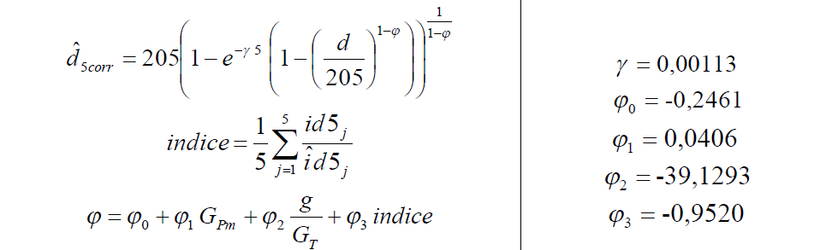
PINEA individual tree model
PINEA individual tree model
Growth module (principal variables)
Symbol | Description | Unit
H1 | Dominant height t=1 | m
H2 | Dominant height t=t+1 | m
T1 | Age t=1 | yrs
T2 | Age t=t+1 | yrs
d | Diameter at breast height | Cm
d-5 | Diameter at breast height 5 years ago | Cm
du | Diameter at breast height underbark | Cm
du-5 | Diameter at breast height underbark 5 years ago | Cm
g | Tree sectional area | m²
id5 | Diameter increment (5 years core measurement) | cm
îd5 | Mean diameter increment in 5 years period | cm
h | Tree height | m
h_st | Tree height above stump level | m
hst | Stump height
cw | Crown diameter | m
wc | Cone weight (green in a campaign) | kg
NT | Total number of trees | haֿ¹
dgPm | Stone pine quadratic mean diameter | cm
dgdom | quadratic mean diameter of dominant trees | cm
Gd | Dead trees basal area | m² haֿ¹
Gres | Residual basal area | m² haֿ¹
GPm | Residual basal area of stone pine | m² haֿ¹
GT | Total basal area | m² haֿ¹
GiPm | Basal area of stone pines with a basal area ≥ basal area of stone pine i | m² haֿ¹
GiT | Basal area of all trees with a basal area ≥ basal area of stone pine i | m² haֿ¹
P4 | Acumulated precipitations from January until May (inclusive) before polination (3 years before cone harvest) | mm
Pcg | Acumulated precipitations between March and July in the year of corne harvest | mm
v | Total volume | m³
vu_st | Volume without stump and bark | m³
v_st | Volume without stump | m³
vb_st | Bark volume (without stump bark) | m³
vst | Stump volume | m³
c | Perimiter at breast height | cm
wl | Needles biomass | Kg
wbr | Branch biomass | Kg
wb | Bark biomass of the stem | Kg
ws | Stem biomass | Kg
wa | Above ground biomass | kg
Diameter growth
2006-2007
2007-2008

Slide 14
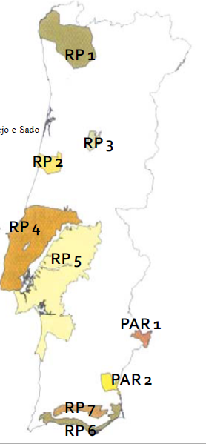

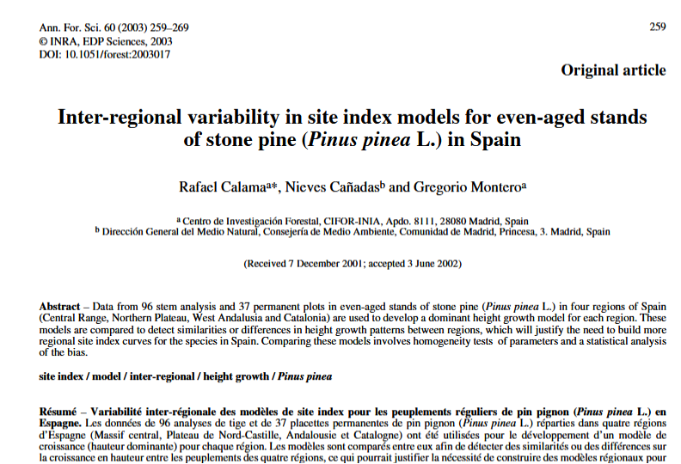
PINEA individual tree model
PINEA individual tree model
Pine cone formation is a complex process
Growth module (principal variables)
Symbol | Description | Unit
H1 | Dominant height t=1 | m
H2 | Dominant height t=t+1 | m
T1 | Age t=1 | yrs
T2 | Age t=t+1 | yrs
d | Diameter at breast height | Cm
d-5 | Diameter at breast height 5 years ago | Cm
du | Diameter at breast height underbark | Cm
du-5 | Diameter at breast height underbark 5 years ago | Cm
g | Tree sectional area | m²
id5 | Diameter increment (5 years core measurement) | cm
îd5 | Mean diameter increment in 5 years period | cm
h | Tree height | m
h_st | Tree height above stump level | m
hst | Stump height
cw | Crown diameter | m
wc | Cone weight (green in a campaign) | kg
NT | Total number of trees | haֿ¹
dgPm | Stone pine quadratic mean diameter | cm
dgdom | quadratic mean diameter of dominant trees | cm
Gd | Dead trees basal area | m² haֿ¹
Gres | Residual basal area | m² haֿ¹
GPm | Residual basal area of stone pine | m² haֿ¹
GT | Total basal area | m² haֿ¹
GiPm | Basal area of stone pines with a basal area ≥ basal area of stone pine i | m² haֿ¹
GiT | Basal area of all trees with a basal area ≥ basal area of stone pine i | m² haֿ¹
P4 | Acumulated precipitations from January until May (inclusive) before polination (3 years before cone harvest) | mm
Pcg | Acumulated precipitations between March and July in the year of corne harvest | mm
v | Total volume | m³
vu_st | Volume without stump and bark | m³
v_st | Volume without stump | m³
vb_st | Bark volume (without stump bark) | m³
vst | Stump volume | m³
c | Perimiter at breast height | cm
wl | Needles biomass | Kg
wbr | Branch biomass | Kg
wb | Bark biomass of the stem | Kg
ws | Stem biomass | Kg
wa | Above ground biomass | kg
Dominant height growth (adapted from Spain)
2004-2005
2005-2006
2006-2007
2007-2008

Slide 15
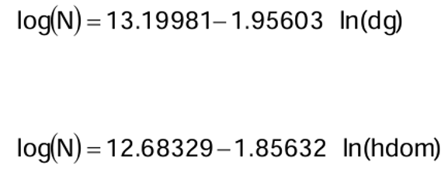
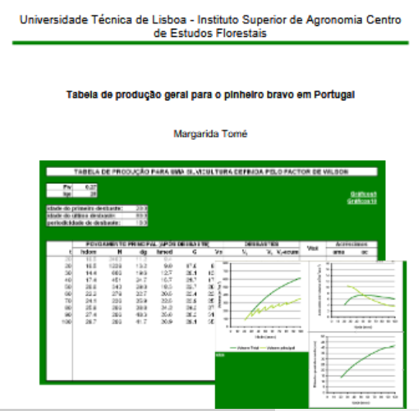
PINEA individual tree model
PINEA individual tree model
Pine cone formation is a complex process
Calculus module (derived variables)
Symbol | Description | Unit
H1 | Dominant height t=1 | m
H2 | Dominant height t=t+1 | m
T1 | Age t=1 | yrs
T2 | Age t=t+1 | yrs
d | Diameter at breast height | Cm
d-5 | Diameter at breast height 5 years ago | Cm
du | Diameter at breast height underbark | Cm
du-5 | Diameter at breast height underbark 5 years ago | Cm
g | Tree sectional area | m²
id5 | Diameter increment (5 years core measurement) | cm
îd5 | Mean diameter increment in 5 years period | cm
h | Tree height | m
h_st | Tree height above stump level | m
hst | Stump height
cw | Crown diameter | m
wc | Cone weight (green in a campaign) | kg
NT | Total number of trees | haֿ¹
dgPm | Stone pine quadratic mean diameter | cm
dgdom | quadratic mean diameter of dominant trees | cm
Gd | Dead trees basal area | m² haֿ¹
Gres | Residual basal area | m² haֿ¹
GPm | Residual basal area of stone pine | m² haֿ¹
GT | Total basal area | m² haֿ¹
GiPm | Basal area of stone pines with a basal area ≥ basal area of stone pine i | m² haֿ¹
GiT | Basal area of all trees with a basal area ≥ basal area of stone pine i | m² haֿ¹
P4 | Acumulated precipitations from January until May (inclusive) before polination (3 years before cone harvest) | mm
Pcg | Acumulated precipitations between March and July in the year of corne harvest | mm
v | Total volume | m³
vu_st | Volume without stump and bark | m³
v_st | Volume without stump | m³
vb_st | Bark volume (without stump bark) | m³
vst | Stump volume | m³
c | Perimiter at breast height | cm
wl | Needles biomass | Kg
wbr | Branch biomass | Kg
wb | Bark biomass of the stem | Kg
ws | Stem biomass | Kg
wa | Above ground biomass | kg
Self-thinning line (adapted from maritime pine)
2004-2005
2005-2006
2006-2007
2007-2008

Slide 16
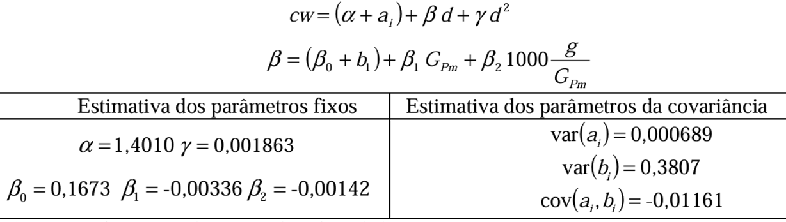
PINEA individual tree model
PINEA individual tree model
Pine cone formation is a complex process
Calculus module (derived variables)
Symbol | Description | Unit
H1 | Dominant height t=1 | m
H2 | Dominant height t=t+1 | m
T1 | Age t=1 | yrs
T2 | Age t=t+1 | yrs
d | Diameter at breast height | Cm
d-5 | Diameter at breast height 5 years ago | Cm
du | Diameter at breast height underbark | Cm
du-5 | Diameter at breast height underbark 5 years ago | Cm
g | Tree sectional area | m²
id5 | Diameter increment (5 years core measurement) | cm
îd5 | Mean diameter increment in 5 years period | cm
h | Tree height | m
h_st | Tree height above stump level | m
hst | Stump height
cw | Crown diameter | m
wc | Cone weight (green in a campaign) | kg
NT | Total number of trees | haֿ¹
dgPm | Stone pine quadratic mean diameter | cm
dgdom | quadratic mean diameter of dominant trees | cm
Gd | Dead trees basal area | m² haֿ¹
Gres | Residual basal area | m² haֿ¹
GPm | Residual basal area of stone pine | m² haֿ¹
GT | Total basal area | m² haֿ¹
GiPm | Basal area of stone pines with a basal area ≥ basal area of stone pine i | m² haֿ¹
GiT | Basal area of all trees with a basal area ≥ basal area of stone pine i | m² haֿ¹
P4 | Acumulated precipitations from January until May (inclusive) before polination (3 years before cone harvest) | mm
Pcg | Acumulated precipitations between March and July in the year of corne harvest | mm
v | Total volume | m³
vu_st | Volume without stump and bark | m³
v_st | Volume without stump | m³
vb_st | Bark volume (without stump bark) | m³
vst | Stump volume | m³
c | Perimiter at breast height | cm
wl | Needles biomass | Kg
wbr | Branch biomass | Kg
wb | Bark biomass of the stem | Kg
ws | Stem biomass | Kg
wa | Above ground biomass | kg
Crown width
2004-2005
2005-2006
2006-2007
2007-2008
Crown width

Slide 17
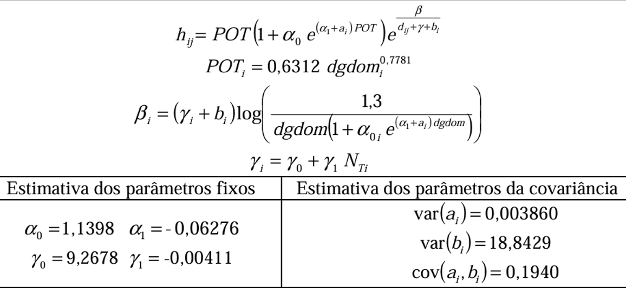
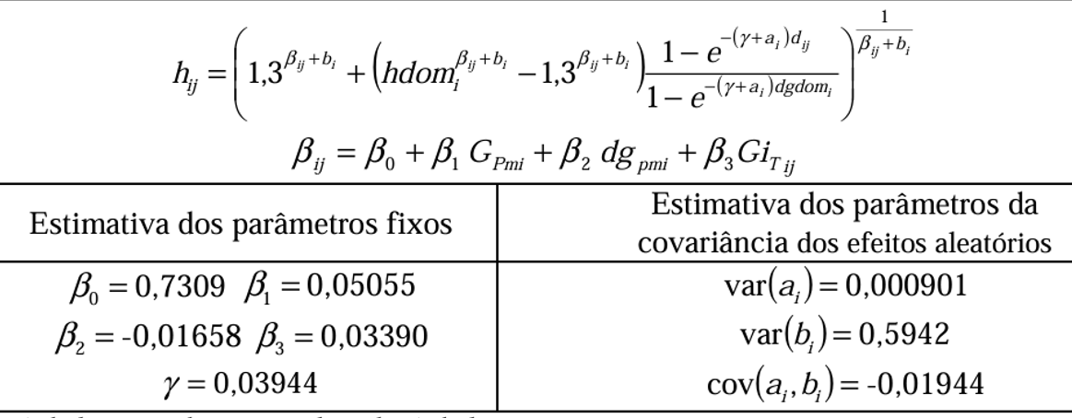
PINEA individual tree model
PINEA individual tree model
Pine cone formation is a complex process
Calculus module (derived variables)
Symbol | Description | Unit
H1 | Dominant height t=1 | m
H2 | Dominant height t=t+1 | m
T1 | Age t=1 | yrs
T2 | Age t=t+1 | yrs
d | Diameter at breast height | Cm
d-5 | Diameter at breast height 5 years ago | Cm
du | Diameter at breast height underbark | Cm
du-5 | Diameter at breast height underbark 5 years ago | Cm
g | Tree sectional area | m²
id5 | Diameter increment (5 years core measurement) | cm
îd5 | Mean diameter increment in 5 years period | cm
h | Tree height | m
h_st | Tree height above stump level | m
hst | Stump height
cw | Crown diameter | m
wc | Cone weight (green in a campaign) | kg
NT | Total number of trees | haֿ¹
dgPm | Stone pine quadratic mean diameter | cm
dgdom | quadratic mean diameter of dominant trees | cm
Gd | Dead trees basal area | m² haֿ¹
Gres | Residual basal area | m² haֿ¹
GPm | Residual basal area of stone pine | m² haֿ¹
GT | Total basal area | m² haֿ¹
GiPm | Basal area of stone pines with a basal area ≥ basal area of stone pine i | m² haֿ¹
GiT | Basal area of all trees with a basal area ≥ basal area of stone pine i | m² haֿ¹
P4 | Acumulated precipitations from January until May (inclusive) before polination (3 years before cone harvest) | mm
Pcg | Acumulated precipitations between March and July in the year of corne harvest | mm
v | Total volume | m³
vu_st | Volume without stump and bark | m³
v_st | Volume without stump | m³
vb_st | Bark volume (without stump bark) | m³
vst | Stump volume | m³
c | Perimiter at breast height | cm
wl | Needles biomass | Kg
wbr | Branch biomass | Kg
wb | Bark biomass of the stem | Kg
ws | Stem biomass | Kg
wa | Above ground biomass | kg
h-d curves ((un)even-aged)
uneven-aged h-d curve
2004-2005
2005-2006
2006-2007
2007-2008
even-aged h-d curve

Slide 18
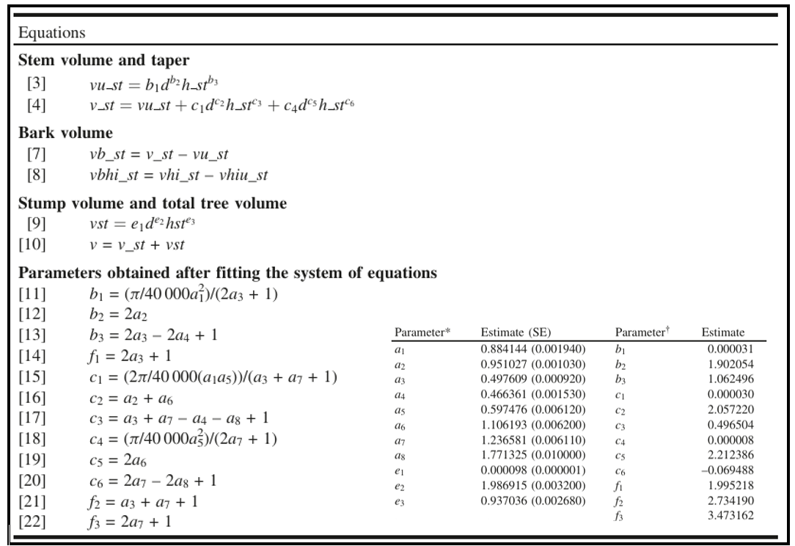
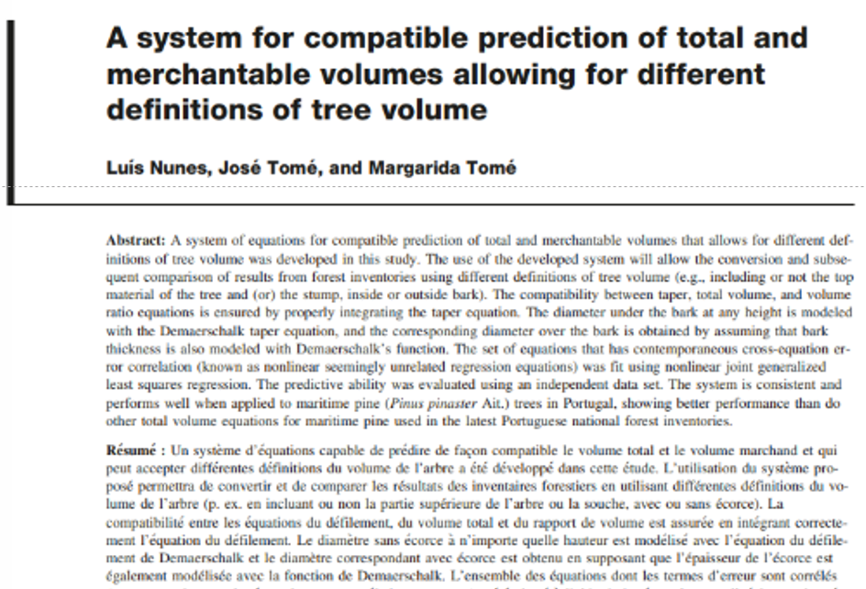
PINEA individual tree model
PINEA individual tree model
Pine cone formation is a complex process
Calculus module (derived variables)
Symbol | Description | Unit
H1 | Dominant height t=1 | m
H2 | Dominant height t=t+1 | m
T1 | Age t=1 | yrs
T2 | Age t=t+1 | yrs
d | Diameter at breast height | Cm
d-5 | Diameter at breast height 5 years ago | Cm
du | Diameter at breast height underbark | Cm
du-5 | Diameter at breast height underbark 5 years ago | Cm
g | Tree sectional area | m²
id5 | Diameter increment (5 years core measurement) | cm
îd5 | Mean diameter increment in 5 years period | cm
h | Tree height | m
h_st | Tree height above stump level | m
hst | Stump height
cw | Crown diameter | m
wc | Cone weight (green in a campaign) | kg
NT | Total number of trees | haֿ¹
dgPm | Stone pine quadratic mean diameter | cm
dgdom | quadratic mean diameter of dominant trees | cm
Gd | Dead trees basal area | m² haֿ¹
Gres | Residual basal area | m² haֿ¹
GPm | Residual basal area of stone pine | m² haֿ¹
GT | Total basal area | m² haֿ¹
GiPm | Basal area of stone pines with a basal area ≥ basal area of stone pine i | m² haֿ¹
GiT | Basal area of all trees with a basal area ≥ basal area of stone pine i | m² haֿ¹
P4 | Acumulated precipitations from January until May (inclusive) before polination (3 years before cone harvest) | mm
Pcg | Acumulated precipitations between March and July in the year of corne harvest | mm
v | Total volume | m³
vu_st | Volume without stump and bark | m³
v_st | Volume without stump | m³
vb_st | Bark volume (without stump bark) | m³
vst | Stump volume | m³
c | Perimiter at breast height | cm
wl | Needles biomass | Kg
wbr | Branch biomass | Kg
wb | Bark biomass of the stem | Kg
ws | Stem biomass | Kg
wa | Above ground biomass | kg
Volume equations adapted from maritime pine)
2004-2005
2005-2006
2006-2007
2007-2008

Slide 19
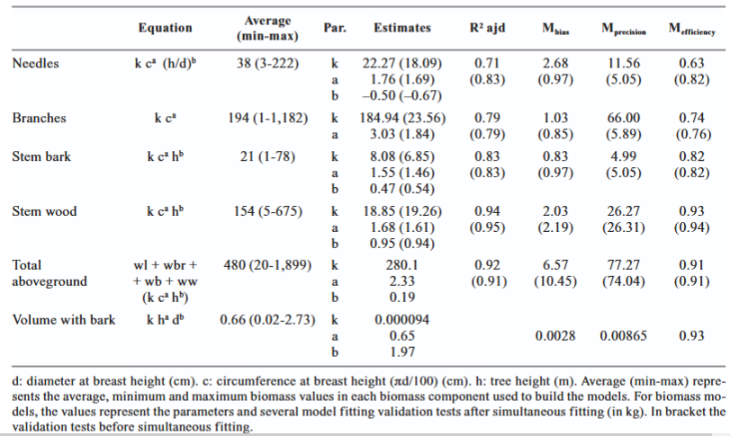
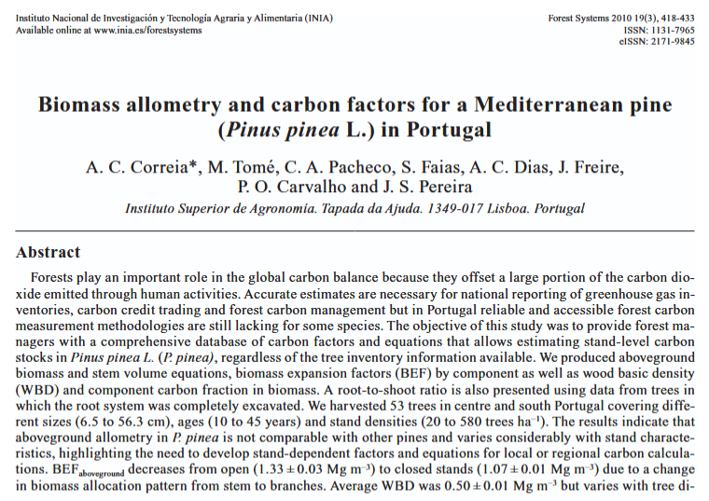
PINEA individual tree model
PINEA individual tree model
Pine cone formation is a complex process
Calculus module (derived variables)
Symbol | Description | Unit
H1 | Dominant height t=1 | m
H2 | Dominant height t=t+1 | m
T1 | Age t=1 | yrs
T2 | Age t=t+1 | yrs
d | Diameter at breast height | Cm
d-5 | Diameter at breast height 5 years ago | Cm
du | Diameter at breast height underbark | Cm
du-5 | Diameter at breast height underbark 5 years ago | Cm
g | Tree sectional area | m²
id5 | Diameter increment (5 years core measurement) | cm
îd5 | Mean diameter increment in 5 years period | cm
h | Tree height | m
h_st | Tree height above stump level | m
hst | Stump height
cw | Crown diameter | m
wc | Cone weight (green in a campaign) | kg
NT | Total number of trees | haֿ¹
dgPm | Stone pine quadratic mean diameter | cm
dgdom | quadratic mean diameter of dominant trees | cm
Gd | Dead trees basal area | m² haֿ¹
Gres | Residual basal area | m² haֿ¹
GPm | Residual basal area of stone pine | m² haֿ¹
GT | Total basal area | m² haֿ¹
GiPm | Basal area of stone pines with a basal area ≥ basal area of stone pine i | m² haֿ¹
GiT | Basal area of all trees with a basal area ≥ basal area of stone pine i | m² haֿ¹
P4 | Acumulated precipitations from January until May (inclusive) before polination (3 years before cone harvest) | mm
Pcg | Acumulated precipitations between March and July in the year of corne harvest | mm
v | Total volume | m³
vu_st | Volume without stump and bark | m³
v_st | Volume without stump | m³
vb_st | Bark volume (without stump bark) | m³
vst | Stump volume | m³
c | Perimiter at breast height | cm
wl | Needles biomass | Kg
wbr | Branch biomass | Kg
wb | Bark biomass of the stem | Kg
ws | Stem biomass | Kg
wa | Above ground biomass | kg
Biomass equations
2004-2005
2005-2006
2006-2007
2007-2008

Slide 20
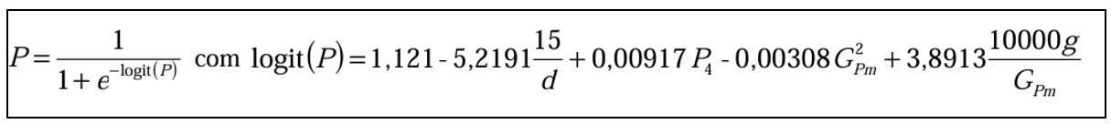
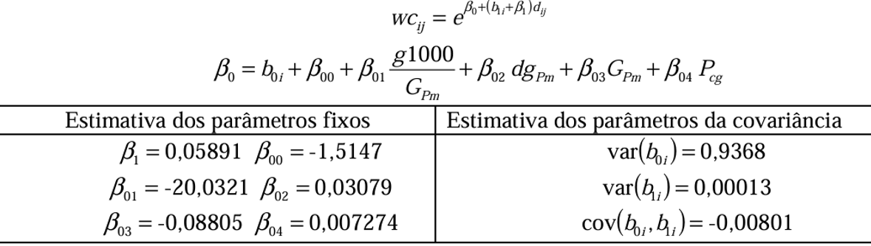
PINEA individual tree model
PINEA individual tree model
Pine cone formation is a complex process
Calculus module (derived variables)
Symbol | Description | Unit
H1 | Dominant height t=1 | m
H2 | Dominant height t=t+1 | m
T1 | Age t=1 | yrs
T2 | Age t=t+1 | yrs
d | Diameter at breast height | Cm
d-5 | Diameter at breast height 5 years ago | Cm
du | Diameter at breast height underbark | Cm
du-5 | Diameter at breast height underbark 5 years ago | Cm
g | Tree sectional area | m²
id5 | Diameter increment (5 years core measurement) | cm
îd5 | Mean diameter increment in 5 years period | cm
h | Tree height | m
h_st | Tree height above stump level | m
hst | Stump height
cw | Crown diameter | m
wc | Cone weight (green in a campaign) | kg
NT | Total number of trees | haֿ¹
dgPm | Stone pine quadratic mean diameter | cm
dgdom | quadratic mean diameter of dominant trees | cm
Gd | Dead trees basal area | m² haֿ¹
Gres | Residual basal area | m² haֿ¹
GPm | Residual basal area of stone pine | m² haֿ¹
GT | Total basal area | m² haֿ¹
GiPm | Basal area of stone pines with a basal area ≥ basal area of stone pine i | m² haֿ¹
GiT | Basal area of all trees with a basal area ≥ basal area of stone pine i | m² haֿ¹
P4 | Acumulated precipitations from January until May (inclusive) before polination (3 years before cone harvest) | mm
Pcg | Acumulated precipitations between March and July in the year of corne harvest | mm
v | Total volume | m³
vu_st | Volume without stump and bark | m³
v_st | Volume without stump | m³
vb_st | Bark volume (without stump bark) | m³
vst | Stump volume | m³
c | Perimiter at breast height | cm
wl | Needles biomass | Kg
wbr | Branch biomass | Kg
wb | Bark biomass of the stem | Kg
ws | Stem biomass | Kg
wa | Above ground biomass | kg
Biomass equations / Cone production x weight
Pine cone formation is a complex process , thus it was required to model the probability of occurrence of cones (P) and the cone weight (Wc)
IF P ≥ 0.6 THEN P=1 ELSE P = 0
2004-2005
2005-2006
2006-2007
2007-2008

Slide 21
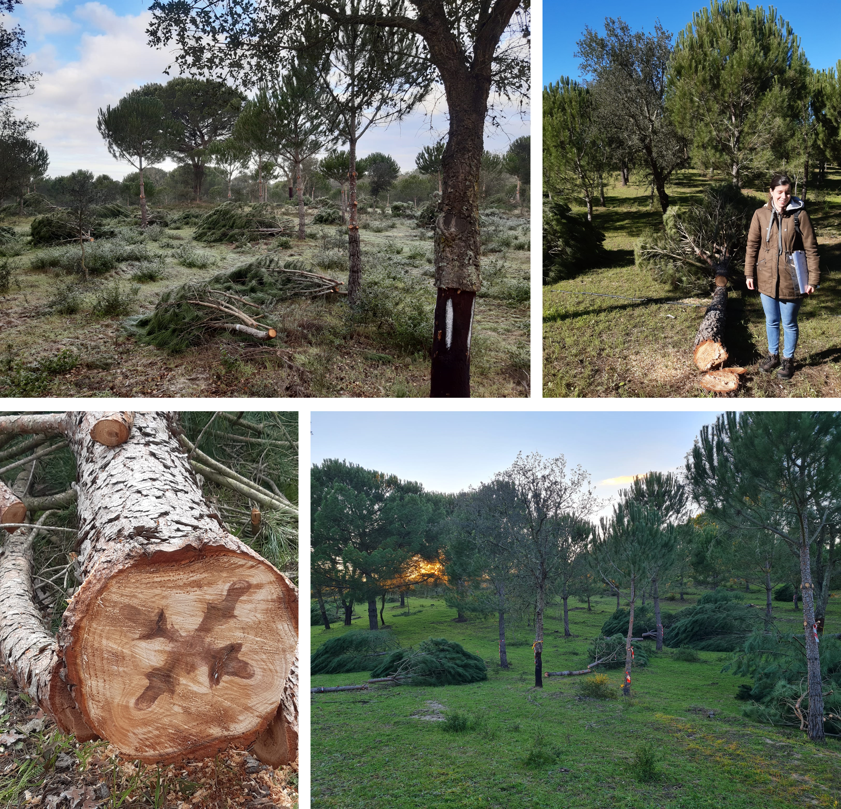
PINEA individual tree model
PINEA individual tree model
Pine cone formation is a complex process
Management module (derived variables)
Thinning
Type of thinning : thinning from below
Thinning criteria : Gres
Interval between successive thinnings : 5 yrs; 10yrs
Severity/ intensity / weight of thinning :
Wood production : Gres ~25 m² ha⁻¹
Cone production : Gres ~15 m² ha⁻¹
Stand density:
Wood and fruit production : 625 < N <1100
Cone production : 200 < N < 300
2004-2005
2005-2006
2006-2007
2007-2008
Stand regeneration

Slide 22
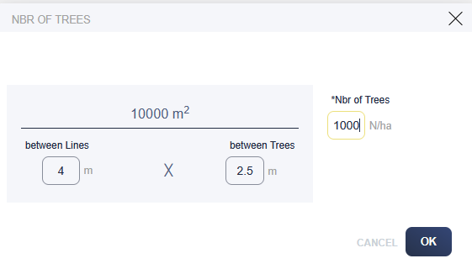
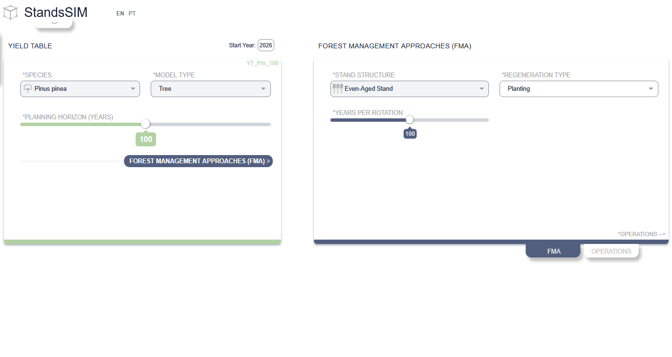
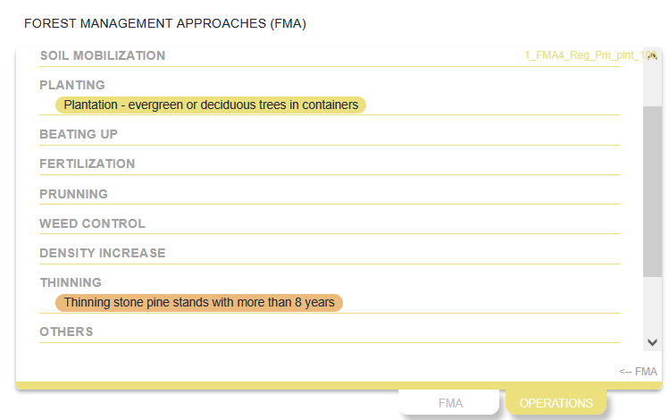
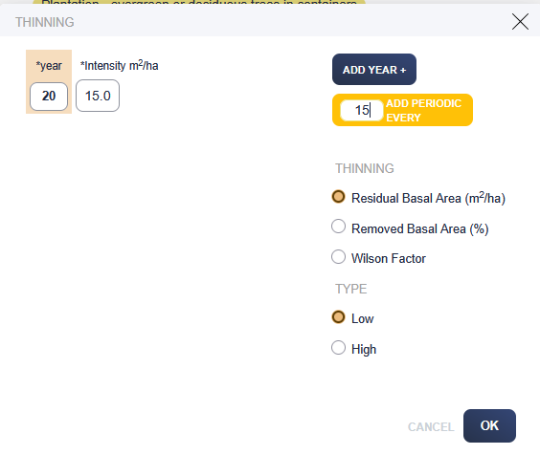
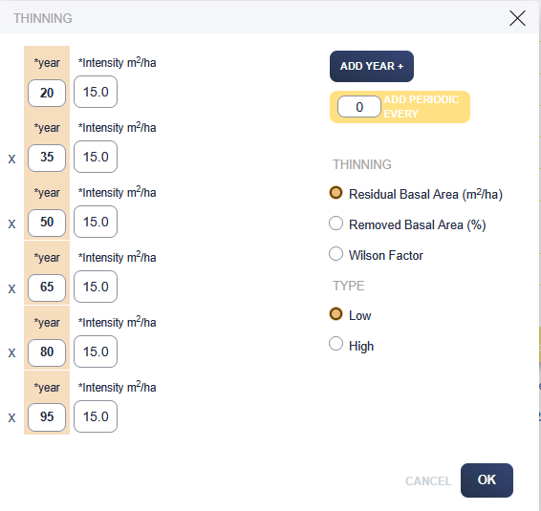
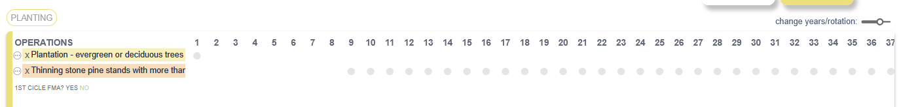
PINEA individual tree model
PINEA individual tree model
Pine cone formation is a complex process
Management module (derived variables)
2004-2005
2005-2006
2006-2007
2007-2008

Slide 23
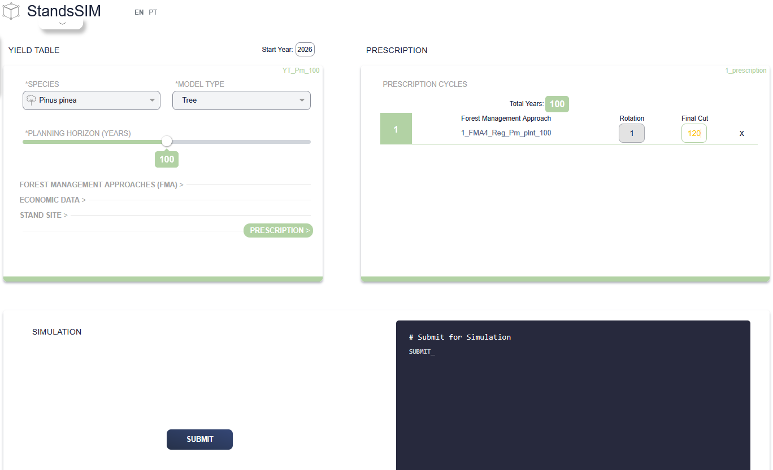
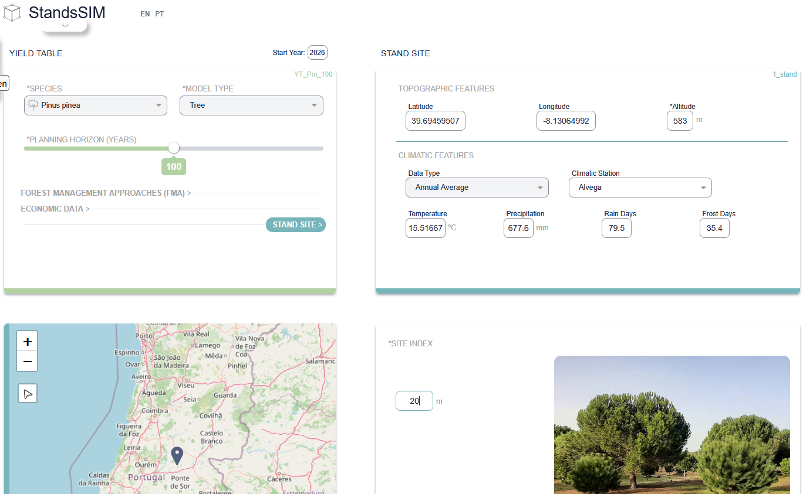
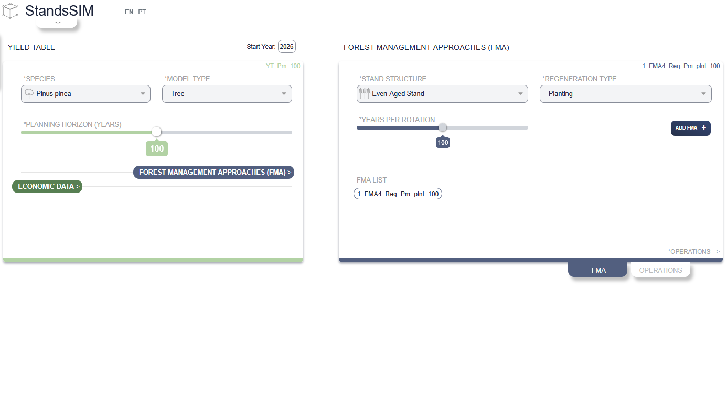
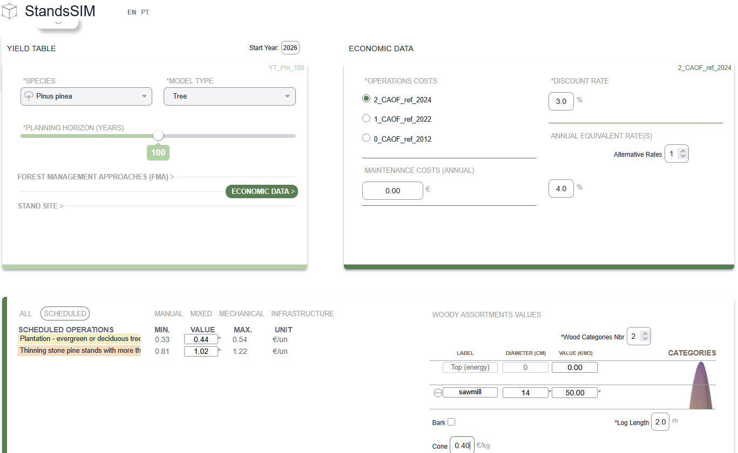
PINEA individual tree model
PINEA individual tree model
Pine cone formation is a complex process
Management module (derived variables)
2004-2005
2005-2006

Slide 24
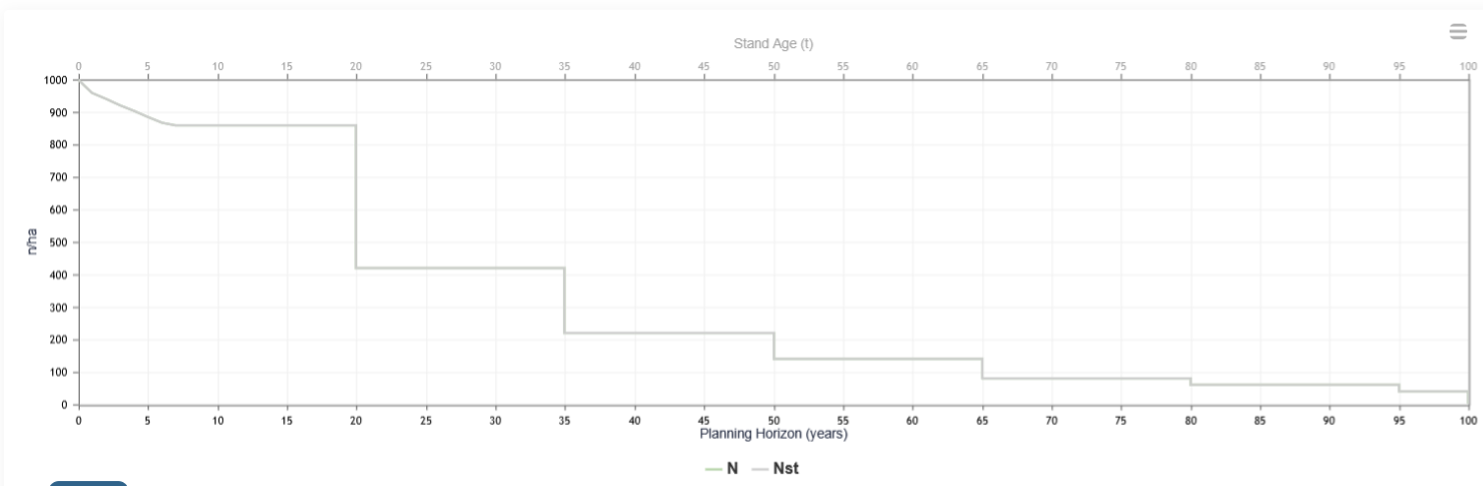
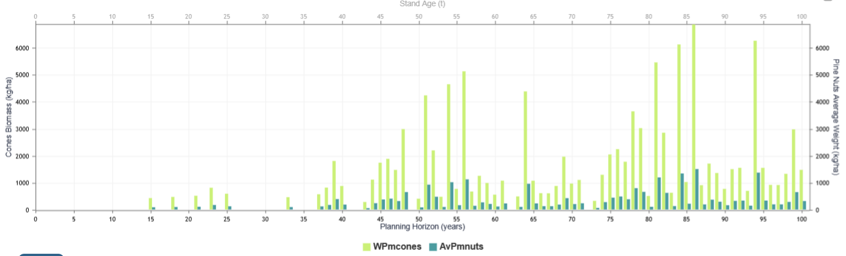
PINEA individual tree model
PINEA individual tree model
Pine cone formation is a complex process
Management module (derived variables)
2004-2005

Slide 25
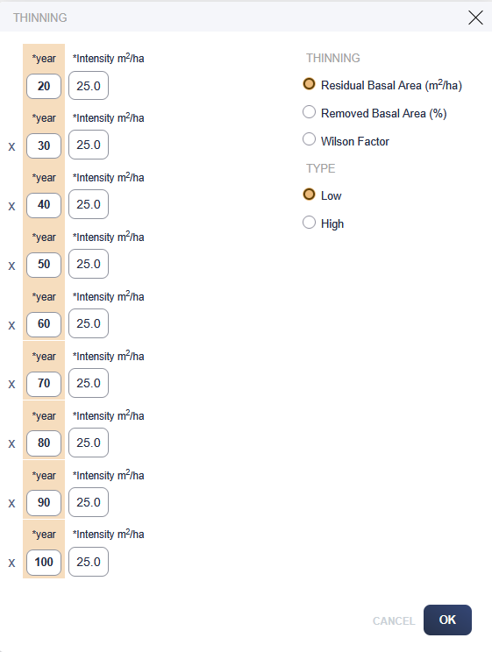
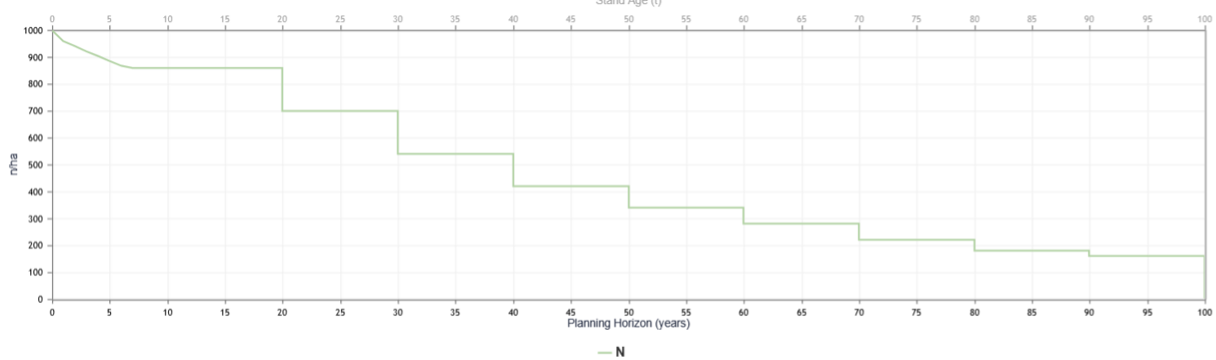
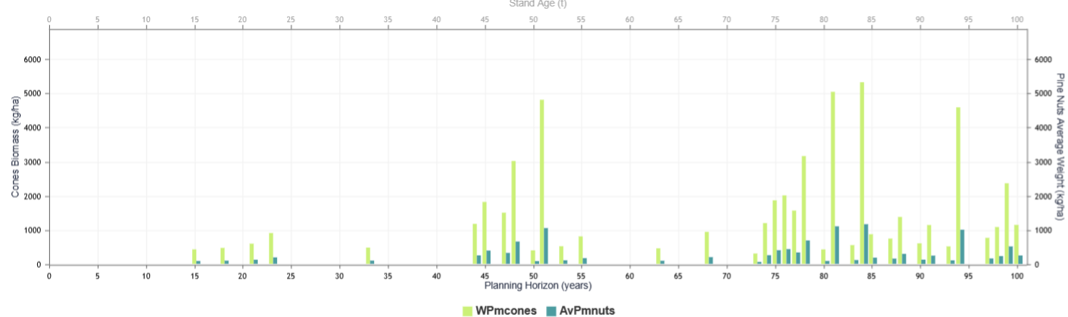
PINEA individual tree model
PINEA individual tree model
Pine cone formation is a complex process
Management module (derived variables)
2004-2005

Slide 26
